Slide 1



Update on impact of field quality
R. De Maria, M. Giovannozzi, F. Van der Veken¹, CERN, Geneva, Switzerland
¹ University of Malta, Msida, Malta
Acknowledgements: G. Arduini, Y. Cai, A. Mereghetti, Y. Nosochkov, E. Todesco
9th HL-LHC Collaboration Meeting, Fermilab, USA - 14-16 October 2019

Slide 2
Outline
Main results about FQ steering using V1.0
Implementation of tools for V1.4
First results of studies using V1.4
Outlook
We greatly acknowledge all BOINC volunteers who supported LHC@Home project, giving for free their CPU time and allowing these results to be produced

Slide 3
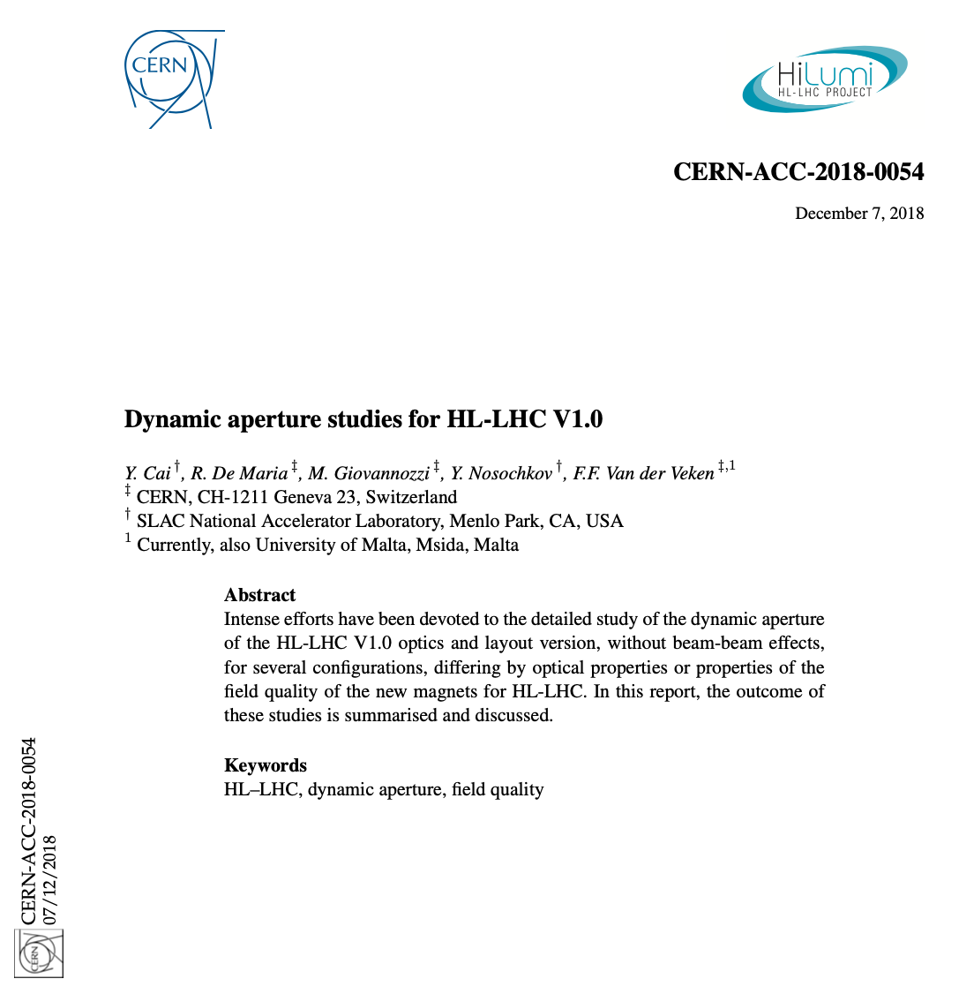
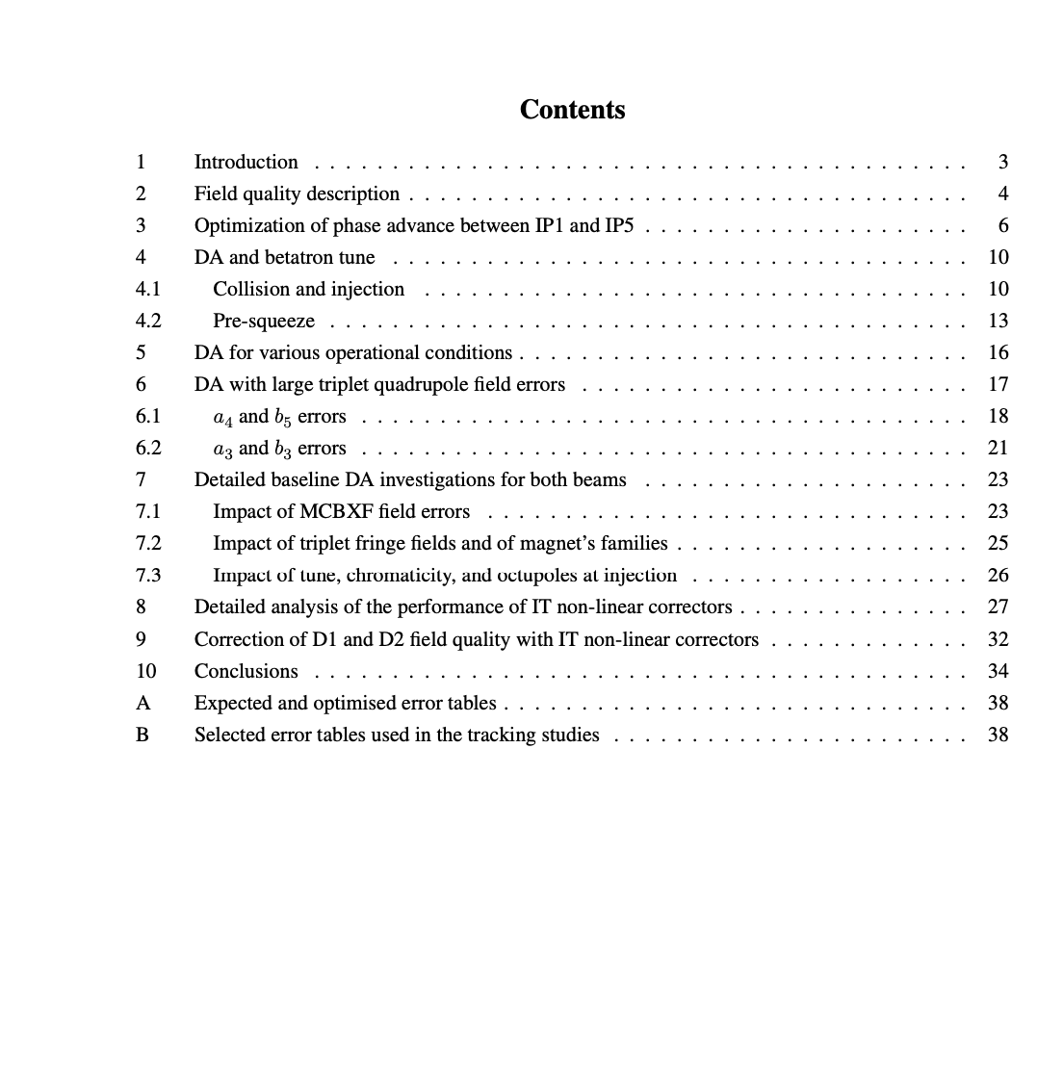
Main results of FQ studies using V1.0

Slide 4
MQXF, MCBRD, and MCBXF FQ and V1.0
Analysis of the impact of some large multipoles (a3, b3, a4, b5, b6), resulting in the decision to increase the strength of the non-linear correctors in the corrector package.
Involved situation for the analysis of the impact of the FQ of orbit correctors.
Stronger impact of FQ of MCBXFs with respect to that of MCBRDs.
Very strong impact of the assumed signs for the field errors of the MCBXF. This indicates that there are strong compensation effects between the FQ of the various magnets in the IR.

Slide 5
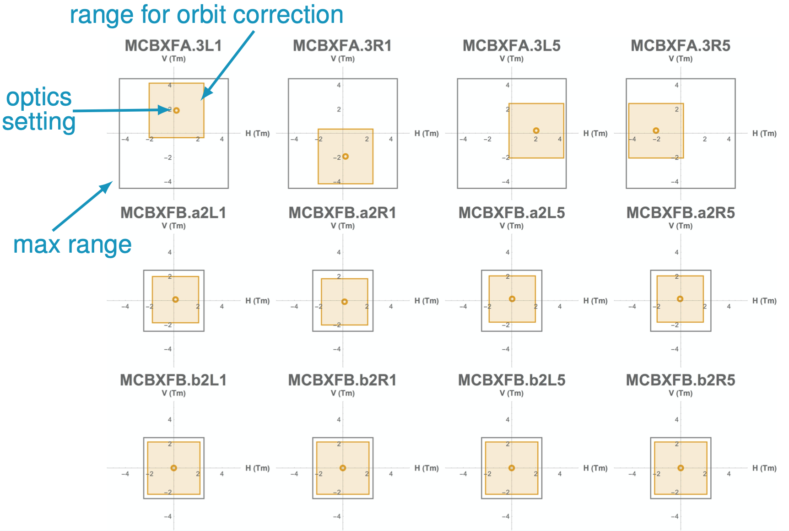
MQXF, MCBRD, and MCBXF FQ and V1.0
Example for the MCBXF orbit correctors
The strength budget is divided into
  Separation/crossing bumps (fully known)
  Orbit correction (estimate available)
  Triplets misalignments (not fully known)
A Monte Carlo over all possible configurations should be performed: we do not know a priori what is the configuration producing the worst DA.
All this is outside of our simulations capabilities!

Slide 6
Implementation of tools for V1.4
Strong efforts to review the error routines used in our simulations.
The conventions for the signs of the multipoles depend on the connection side of the magnet.
The connection side might have changed with the layout version.
New routines have been written for the layout V1.4
Some features of the old routines have been fixed…

Slide 7
MQXF magnets
Single-aperture magnets
Fringe fields implemented (as multipolar kicks)
Inverted magnets are
  Q1b.R, Q2a.R, Q3b.R
  Q1a.L, Q2b.L, Q3a.L
Previous routine implemented layout as
  IP (=Q1=) (=Q2=) (=Q3=)

Slide 8
MCBXF magnets
Single-aperture magnets
Inverted magnets are
  MCBXFA.L, MCBXFBa.L, and MCBXFBb.R

Slide 9
MBXF magnets
Single-aperture magnets
No fringe fields implemented (it should be done in the future)
Inverted magnets are
  D1.R
Previous routine implemented layout as
  IP … (D1=)

Slide 10
MBRD magnets
Double-aperture magnets
No fringe fields implemented (it should be done in the future)
Inverted magnets are
  D2.L
Apertures are
  V1 → Beam 1
Previous routine implemented layout as
  IP … (D2=)

Slide 11
MCBRD magnets
Layout V1.0
Layout V1.4
Layout V1.5

Slide 12
MCBRD magnets
Double-aperture magnets
Inverted magnets are
  MCBRDV.L.B1 and MCBRDV.R.B1
  MCBRDH.L.B2 and MCBRDH.R.B2
Apertures are
  MCBRDH.L.V2, MCBRDV.L.V1, MCBRDH.R.V1, MCBRDV.R.V2 → Beam 1
  MCBRDV.L.V1, MCBRDH.L.V2, MCBRDV.R.V2, MCBRDH.R.V1 → Beam 2

Slide 13
MQY magnets
Double-aperture magnets
Inverted magnets are
  Q4.R
Apertures are
  V2 → Beam 1
  V1 → Beam 2
As of v1.4 no new Q4 installed, but LHC MQY reused. However, they switch places
  Q4.L1 ↔ Q4.R5
  Q4.L5 ↔ Q4.R1

Slide 14
MBH magnets
Double-aperture magnets to replace main dipoles
Some fixes in the error routines implemented

Slide 15
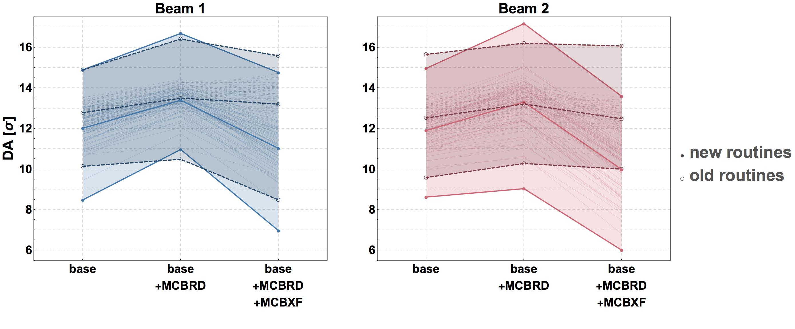
Comparison of old and new routines
Collision, round optics
octupoles = 0 A
Q’= 3
Qx = 62.31 Qy = 60.32
xing = 250 μrad
Observations
New routines introduce a DA reduction with respect to old ones.
New routines reduce DA difference between Beam 1 and 2.
Increased sensitivity to MCBXF FQ
All this should be carefully scrutinised!

Slide 16
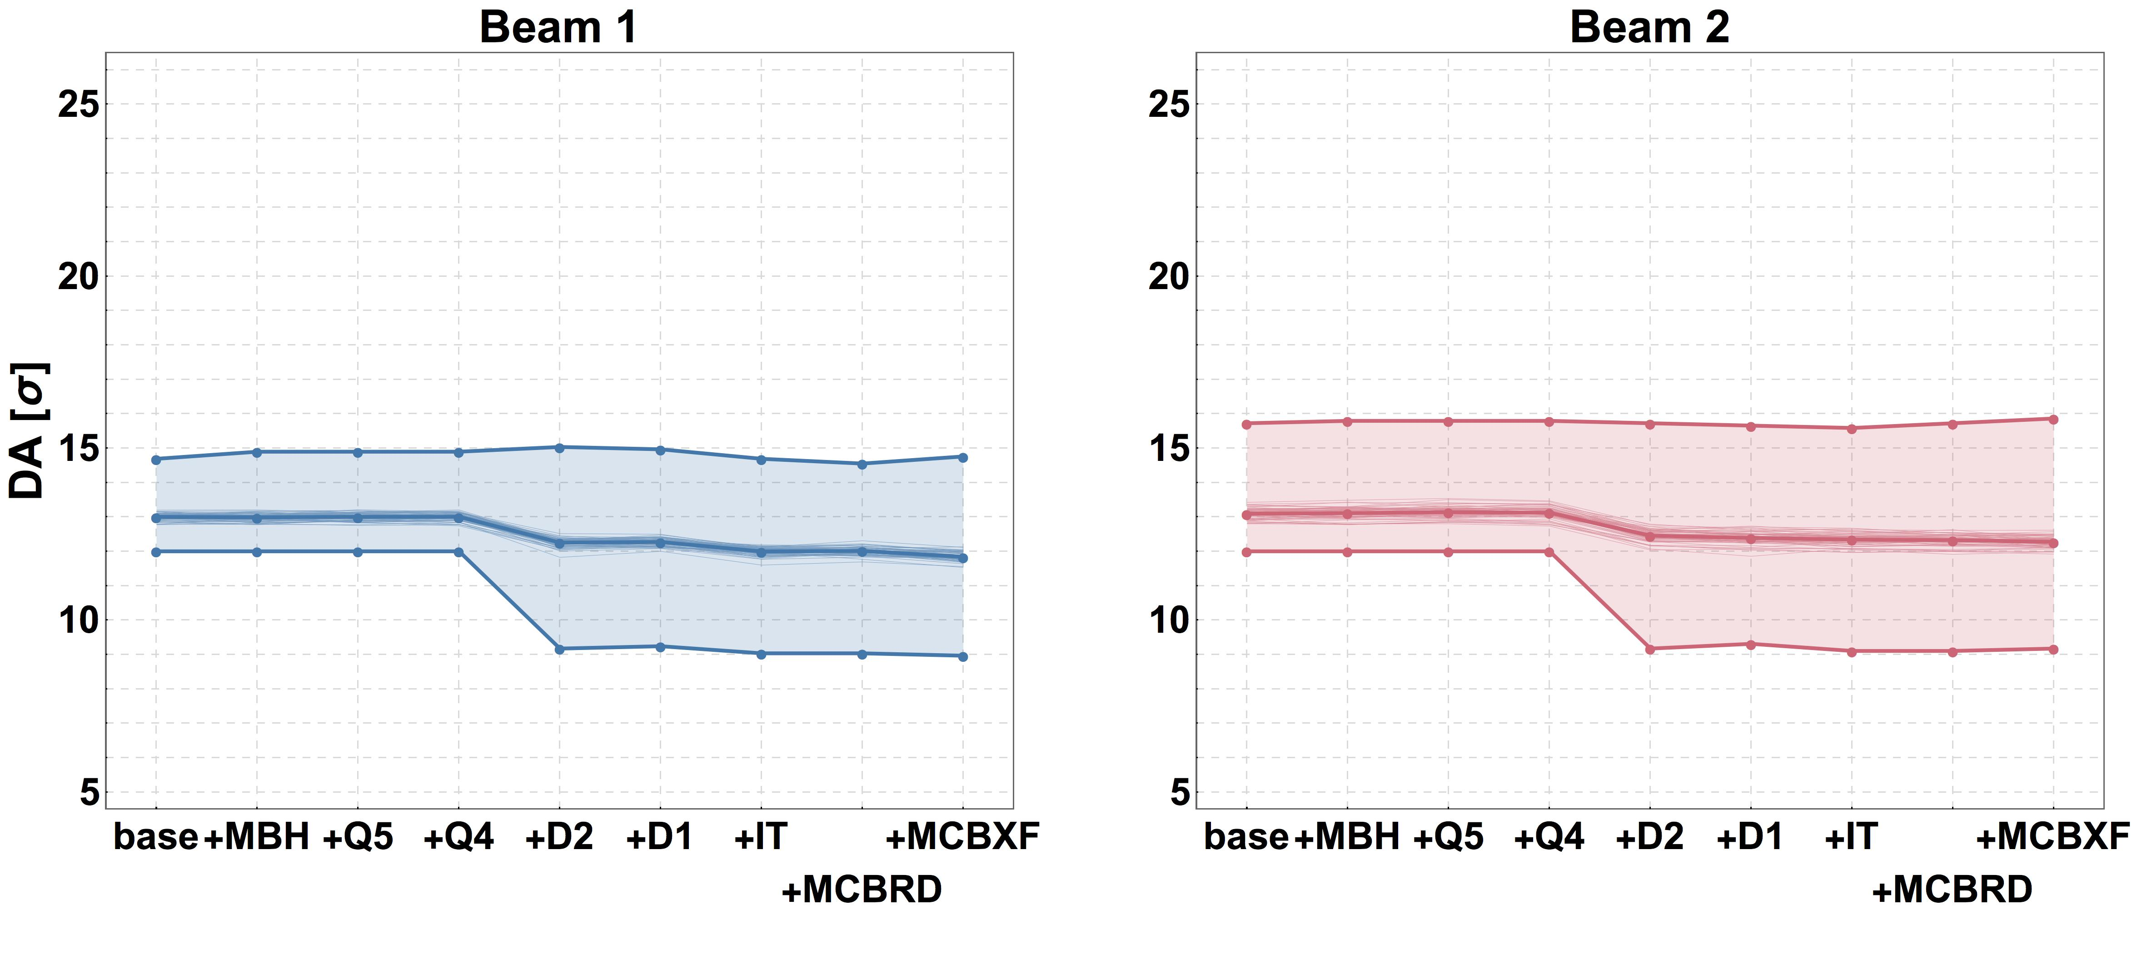
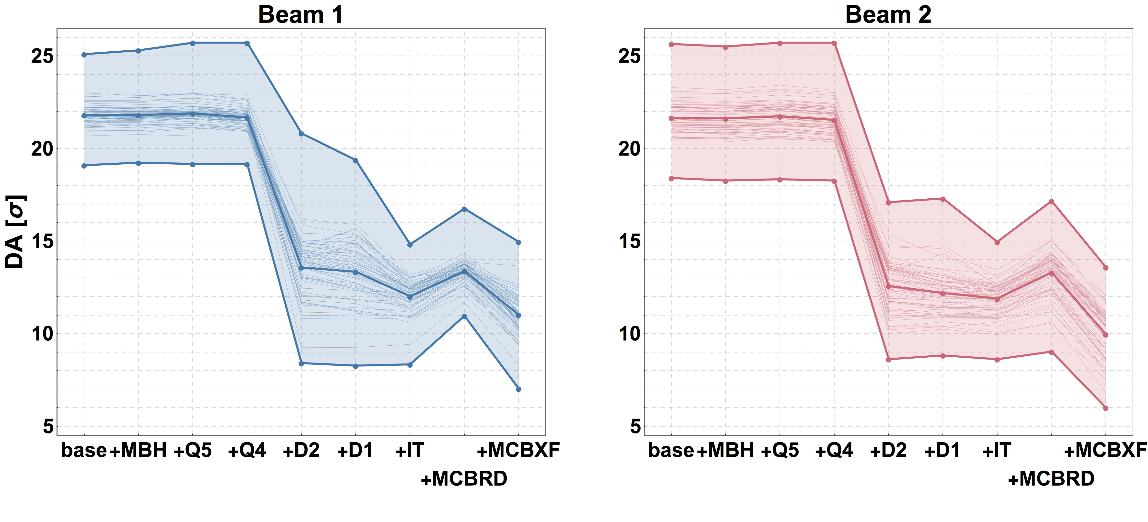
Impact of various magnets families
Injection
octupoles = 0 A
Q’= 3
Qx = 62.27 Qy = 60.295
xing = 250 μrad
FQ is not an issue. It is possible to increase the xing up to 295 μrad
Collision, round optics
octupoles = 0 A
Q’= 3
Qx = 62.31 Qy = 60.32
xing = 250 μrad
IR magnets are dominating the DA. Strong impact of MCBXF

Slide 17
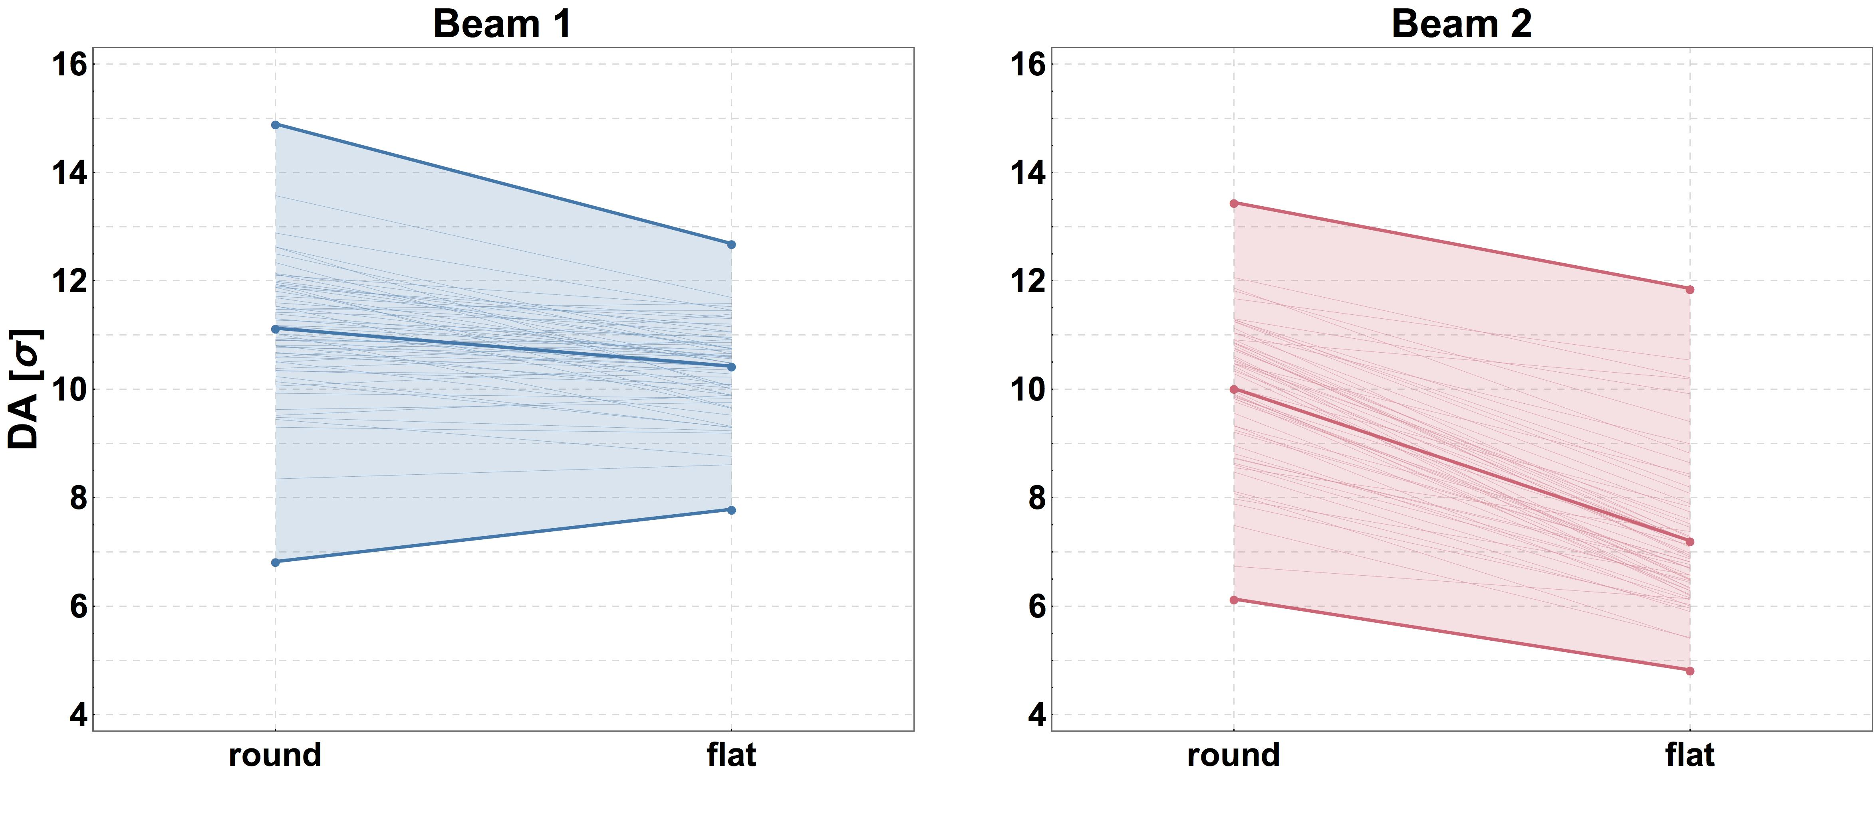
Comparison of round and flat optics
Collision, round and flat optics
octupoles = 0 A
Q’= 3
Qx = 62.31 Qy = 60.32
xing = 250 μrad
Observations
DA improves for flat optics for Beam 1
DA worsen for flat optics for Beam 2
All this should be carefully scrutinised!

Slide 18
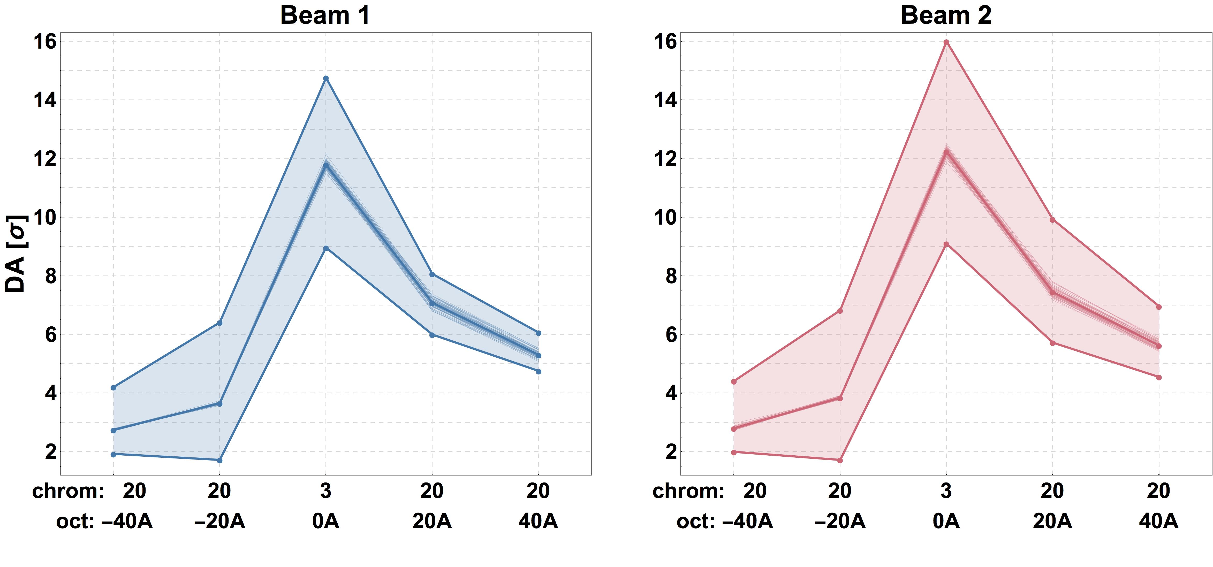
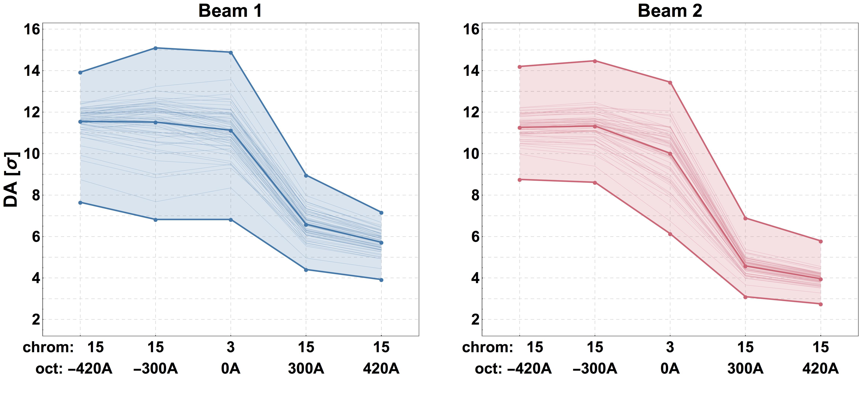
Impact of octupoles
Injection
octupoles = 0 A
Q’= 3 or 20
Qx = 62.27 Qy = 60.295
xing = 295 μrad
Octupoles strongly dominate DA
Collision, round optics
octupoles = 0 A
Q’= 3 or 15
Qx = 62.31 Qy = 60.32
xing = 250 μrad
Octupoles strongly dominate DA

Slide 19
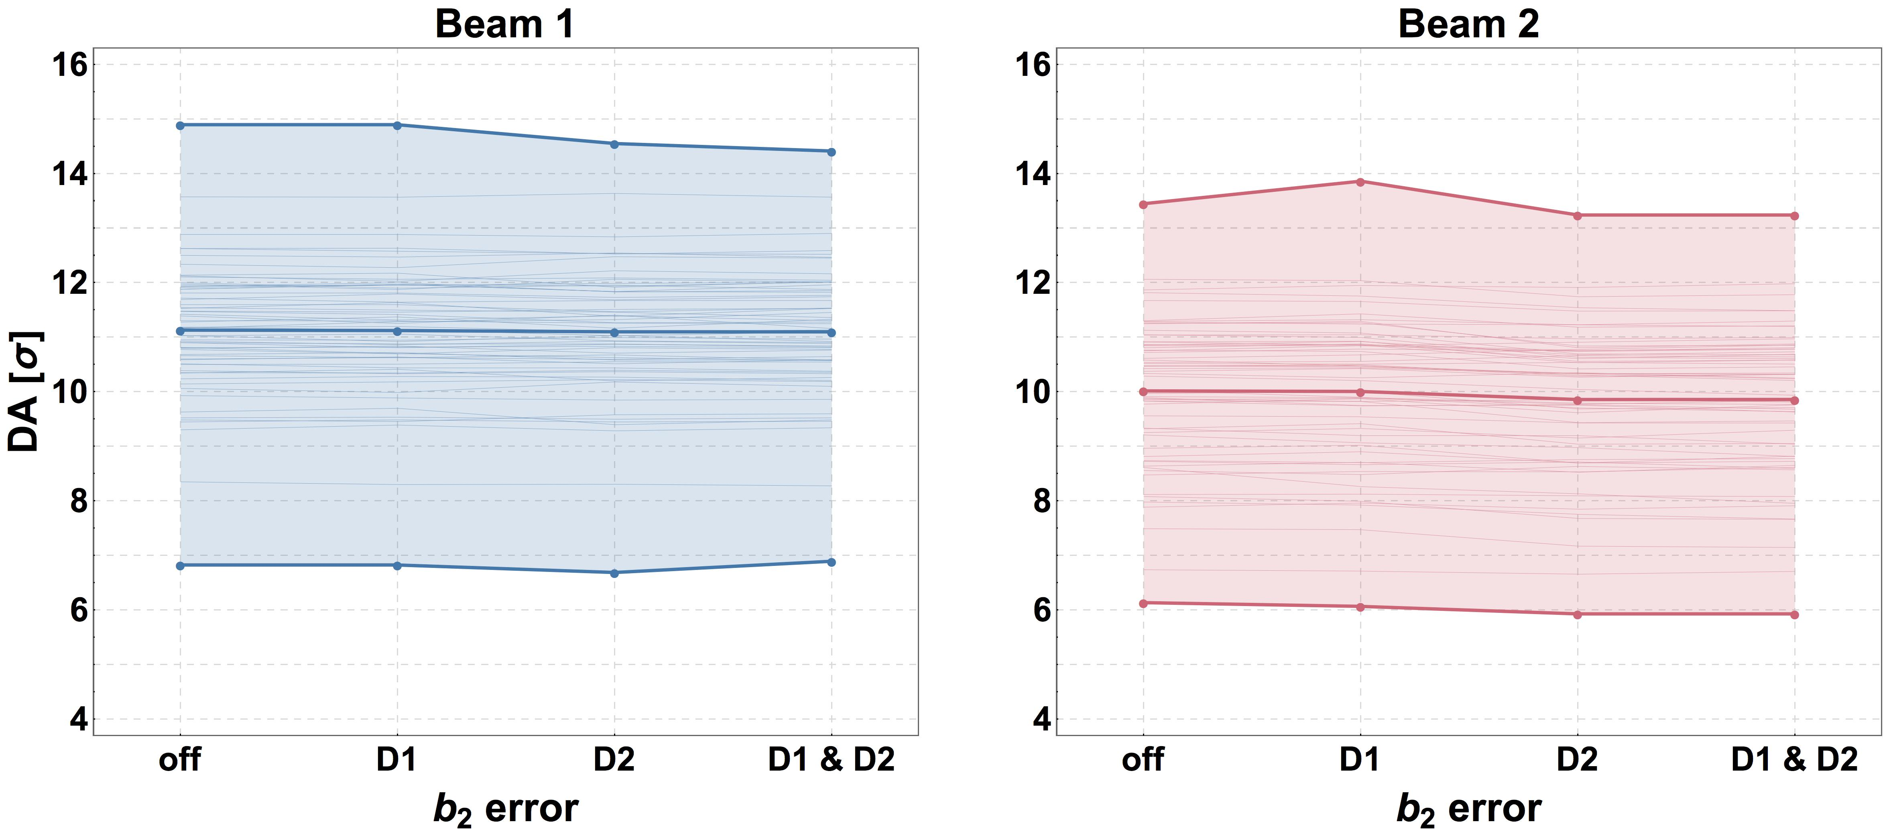
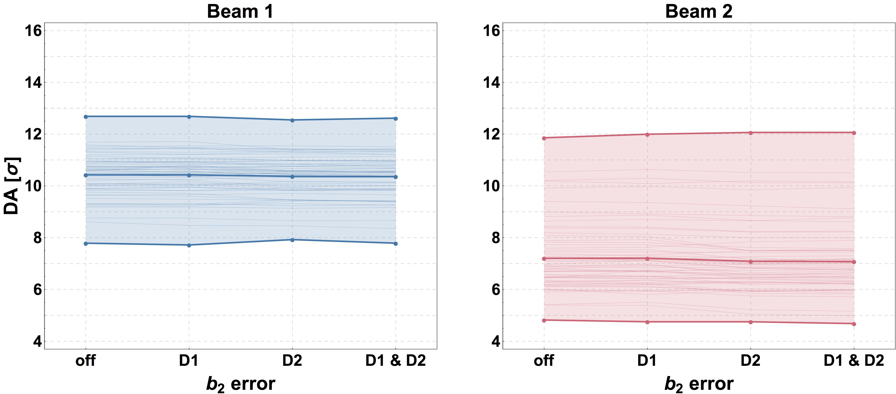
Impact of b2 errors
Collision, round optics
octupoles = 0 A
Q’= 3
Qx = 62.31 Qy = 60.32
xing = 250 μrad
No impact of b2 on DA
Impact of b2 errors on optics to be assessed, but local correctors exist
Collision, flat optics
octupoles = 0 A
Q’= 3
Qx = 62.31 Qy = 60.32
xing = 250 μrad
No impact of b2 on DA

Slide 20
Outlook
Tracking activities for V1.4 are in fully swing
Some hot topics under study
  Study whether phase advance can be used to increase DA (already successfully done for V1.0)
  Provide FQ acceptance criteria for MCBXFs
  Disentangle direct effects of b3 and of its feed down to b2, e.g. for MCBXF
Establish a firm link between DA and beam lifetime (already in good shape for individual studies, but not used at the design level, yet).

Slide 21
Thank you for your attention!

