Slide 1


Gas jet diagnostics for hollow electron lens
Carsten Welsch & Hao Zhang
for the
BGC Collaboration
9th HL-LHC Collaboration meeting, Fermilab, USA, 15th October 2019
Notes:
Good afternoon, Everyone. My name is Hao Zhang from University of Liverpool and Cockcroft Institute. I will talk about the Beam gas curtain experimental programme.

Slide 2
Outline
Motivation
Principle of the supersonic gas jet beam profile monitor in beam induced fluorescence (BIF) mode.
Experimental program in CI with prototype setup
Ongoing v3 setup for HEL test stand
HL-LHC-UK phase II proposal and plans
Notes:
The motivation for this project is to develop a non-invasive beam profile monitor for hollow Electron lens and HLLHC. Although it is covered before, we will briefly talk about the principle of this supersonic gas jet beam profile monitor based on beam induced fluorescence mode.
Then we will discuss the progress of a prototype monitor we have built last recently as well as the experimental program.

Slide 3
Motivation
Problem: HLLHC aims to increase the luminosity by 10 times than current LHC condition. There is no mature diagnostics for continuous, non-invasive 2D profile monitoring for such condition.
Hollow e-lens (HEL) requires a diagnostic for on-line monitoring of the overlap between proton and electron beams in high magnetic field region.
A solution was developed during HL-LHC-UK phase I where it was successfully demonstrated through a prototype setup at the Cockcroft Institute that a supersonic gas jet in fluorescence mode can measure the 2D transverse beam profile online with sufficiently short integration times.
Notes:
Need to edit

Slide 4
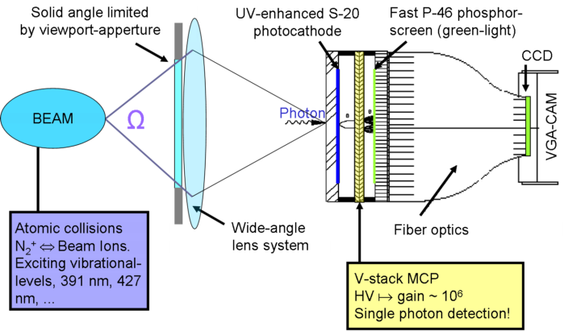

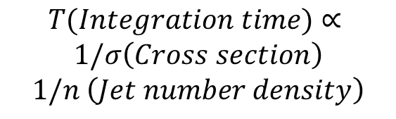
Beam induced fluorescence using gas jet
Particle Beam propagate to the jet curtain perpendicularly
Supersonic gas jet curtain with 45 degree tilted
PROS:
  Very simple source: incoherent, isotropic, monochromatic.
  Detection is simple: imaging
CONS:
  Low light yield, noise sources (SR, losses).
*Credit: GSI, http://www-bd.gsi.de/dokuwiki/doku.php
$$T(Integration time)∝$$
$$1/σ\left(Cross section\right)$$
$$1/n \left(Jet number density\right)$$
Key: Increase gas jet density
test working gases
Notes:
First of all, we will mention a technique been used in GSI and many other places called beam induced fluorescence profile monitor. As shown in the picture, particle beams, here the ion beam, pass through a vacuum pipe, the particles will interact with the residual gas molecules, cause the molecule to either ionized or into excite mode, or both. When the excited molecules or excited ions returned to the ground level, they will emit fluorescent light, where the wavelength of the fluorescence will depend on the energy difference between the excited state and ground state. The cross section for the fluorescence is usually very low, and a fracture of light collecting angle can be used. To make this method practical, gases will be introduced into the system to make a local pressure bump to increase the fluorescence rate. However, the drawback is the beam loss and unwanted high vacuum pressure. Two independent camera system will be installed if a two dimensional profile is required.
Here, in our design, instead of pouring gas into the whole chamber, we use a supersonic curtain gas jet with transverse dimension about 5*0.5 mm². The benefit of it will be the directionality of the jet, which means it could be easily pumped away. The curtain could be tilted 45 degree, which means a 2D measurement at the same time. The interaction length depends on the thickness of the gas jet, which could be optimized, which means a minimum invasive method.
The photon detection system is similar to one of the BIF monitor.

Slide 5
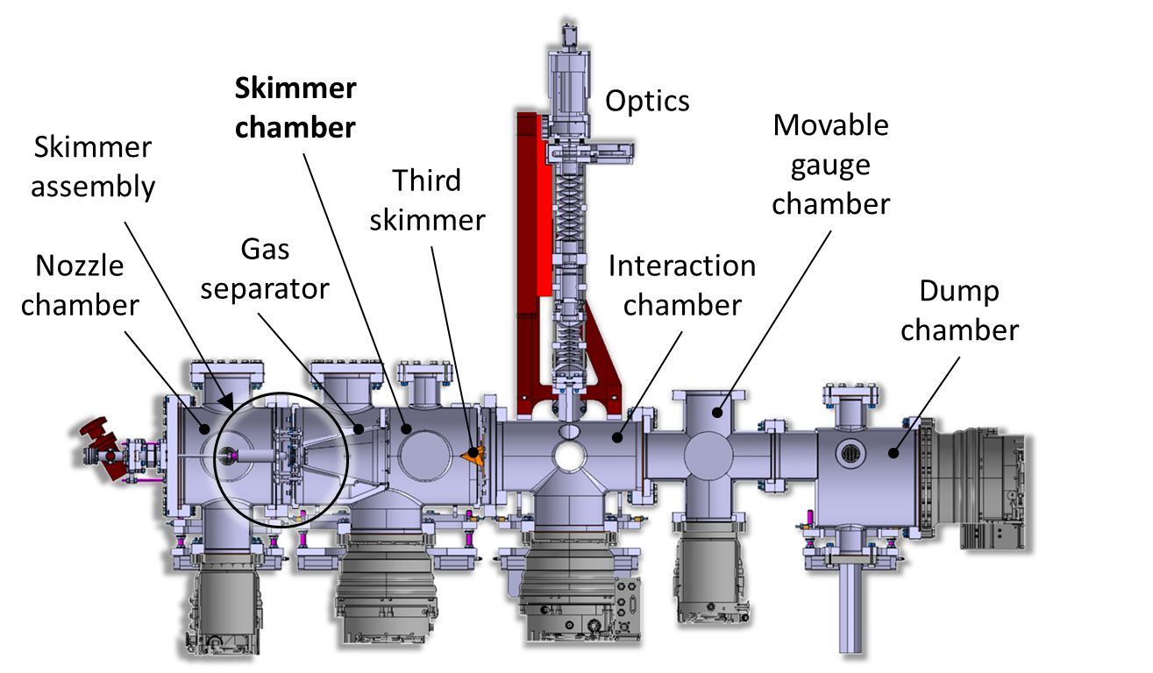
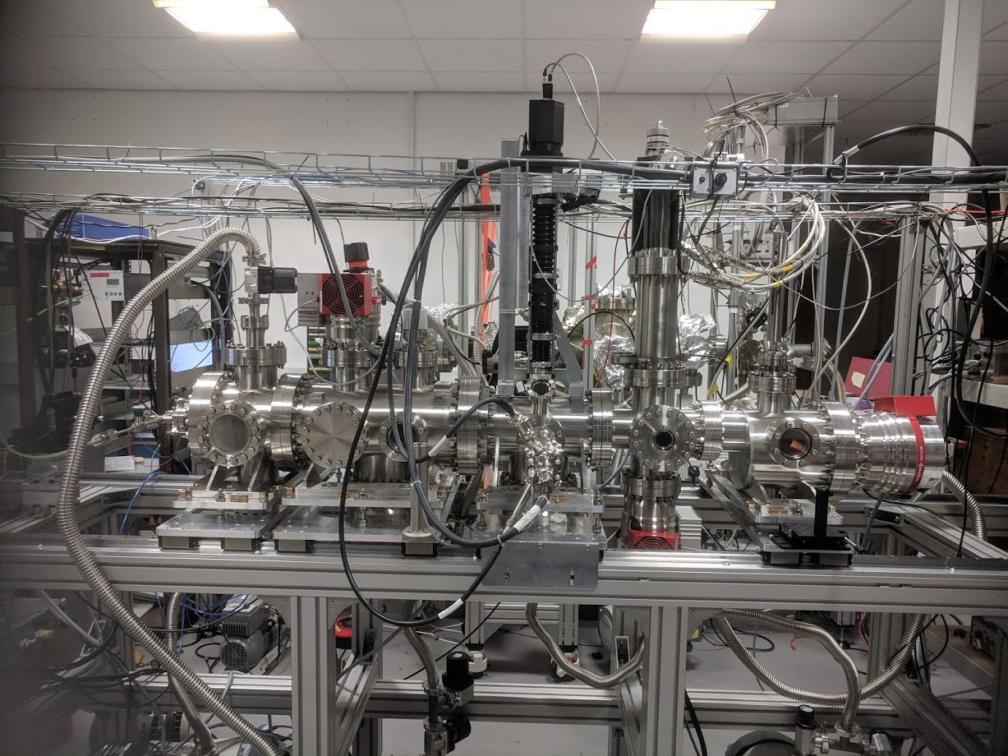
Prototype (v2) at the Cockcroft Institute
Imaging System
Skimmer Chamber
Skimmer Assembly
Moveable Gauge Chamber
Third Skimmer
Gas Separator
Interaction Chamber
Nozzle Chamber
Dump Chamber
Imaging System
Gas jet
1.6 m
Nozzle Chamber
Skimmer Chamber
Interaction Chamber
Moveable Gauge Chamber
Dump Chamber
HIPACE 300L/S
Turbo-molecular pump
HIPACE 700L/S
Turbo-molecular pump

Slide 6

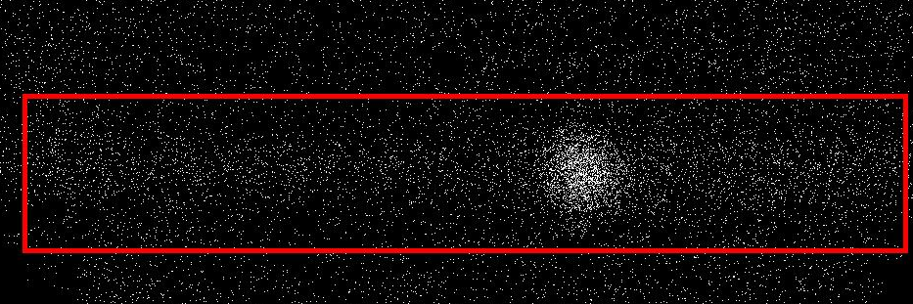
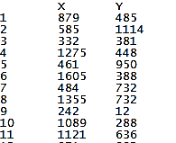
Photon counting method
Exposure time: 1 s, e-beam: 5 keV, 0.65 mA
Inlet pressure: 5 bar
30 μm nozzle
3.8 mm nozzle to skimmer distance (optimum)
Identify location of each dot. Each dot is a photon (either signal or noise)
Repeat this for all frames
Integrate all frames to form a photon count matrix. The total integration time will be exposure time * frame number.
1
3
Gas jet
2
Electron beam
y
x

Slide 7
Working gas test: Nitrogen gas jet
Integration time: 400 s
Integration time : 400 s
Gas jet
Electron beam
FWHM = 1.8 mm
y
x
FWHM = 1.5 mm
Integration time : 4 s
FWHM = 1.5 mm
Filter used for Nitrogen: 391 nm with 10 nm bandwidth Number of photons per second from the jet: ~ 17
Electron beam signal is visible in just 4 s via binning.
Notes:
Redo the plot

Slide 8
Neon and Argon gas-jet
Integration time: 4,000 s (+ 4,000 s for background);
Good agreement between normalised profiles of neon and nitrogen;
Filter used for Neon: 585 nm with 10 nm bandwidth
Number of photons per second from jet: 1.6 per second
Integration time: 4,000 s (+ 4,000 s for background);
Filter used for Neon: 476 nm with 10 nm bandwidth
The background was subtracted from the gas jet image
Number of photons per second from jet: 1.3 per second.
FWHM = 1.5 mm
FWHM = 1.5 mm
Notes:
Redo plot

Slide 9

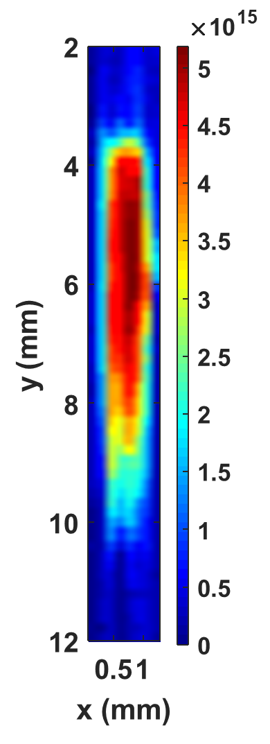
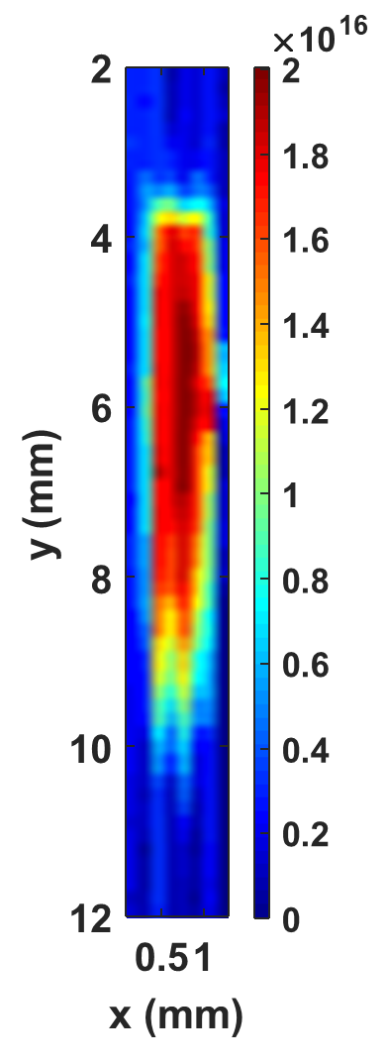
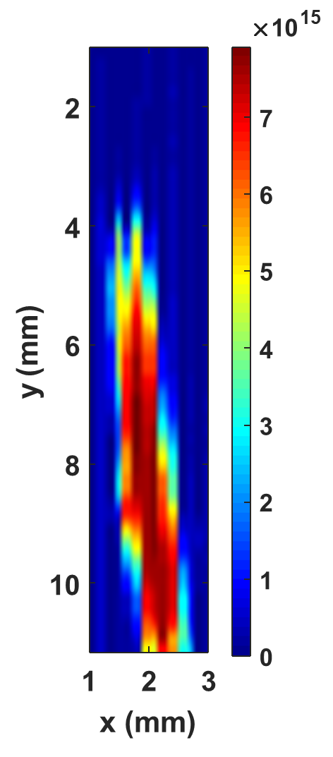
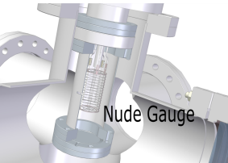
Density measurements with pin-hole gauge
A scan was taken using the pin-hole opening for nitrogen, neon and argon under similar experimental conditions. (30 μm nozzle at optimum nozzle-skimmer distance and third skimmer set vertically).
Density measured by :
6.3 mm
Third skimmer
0.7 mm
Nitrogen
0
Neon
0
Argon
D: 40 mm

Slide 10
Summary: working gases in lab condition
 | Experimental Photon Number/s | Advantages | Disadvantages
N₂ N₂⁺ emitter 391.4 nm | 17 | Higher photon rate, shorter integration time. lower dark counts rate for the photocathode Higher quantum efficiency of photocathode | Ion emitter with 60 ns lifetime, potential distortion due to space charge and external EM field on the N₂⁺ Need further vacuum approval
Neon Ne emitter 585.4 nm | 1.6 | Fluorescence due to neutral Ne (yellow line), not affect by space charge of the primary beam and external EM field LHC vacuum compatible | Lower photon rate, longer integration time Higher dark counts rate for the photocathode Lower quantum efficiency of photocathode Background light from lab e-gun
Argon Ar⁺ emitter 476.5 nm | 1.3 | Short decay time, less affected by space charge or external EM field Higher quantum efficiency of photocathode | Lower photon rate, longer integration time Background light from lab e-gun
Argon Ar⁺ emitter 420±75 nm | 4

Slide 11
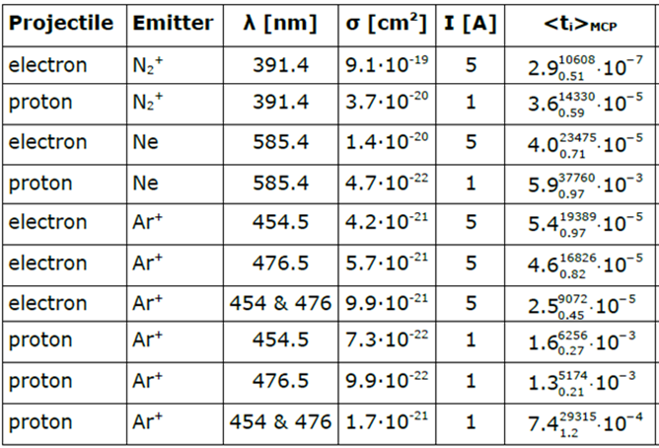
Estimation for HEL condition
Based on a gas jet with N=2.5e10 cm⁻³, d=0.5 mm.
Cross section data for 7 TeV proton beam is extrapolated from references. Tests are required for LHC condition.
<t_{i}>_{mcp} is the expected time to detect one photon. A few hundred photons are required for the proton beam and 10⁴ for the HEL electron beam.
Expected integration time
  Electron: sub second
  Proton: few or few tens of seconds

Slide 12
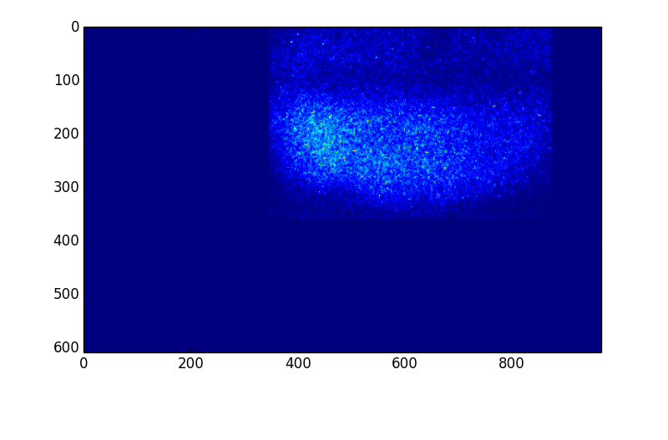
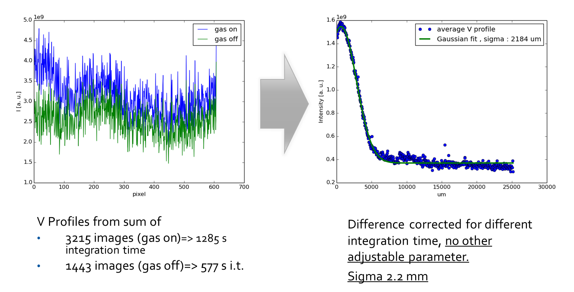
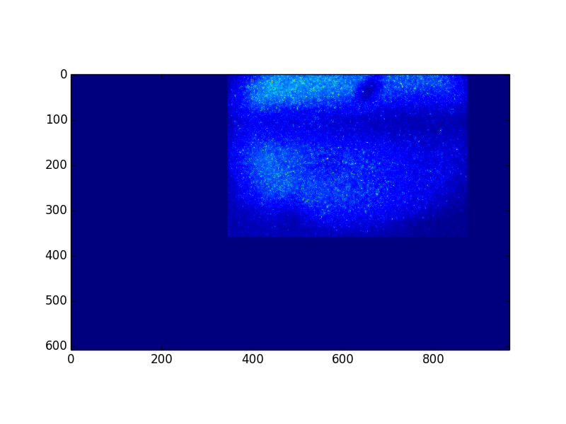
BIF test during Run 2
Pb⁺ at injection
Proton test => Noises from SR
585 nm, gas OFF, beam ON
“photon counting” over 210.8 s
(527 frames, 400 ms exp time)
585 nm, gas ON, beam ON
“photon counting” over 1286.4 s
(3216 frames, 400 ms exp time)

Slide 13
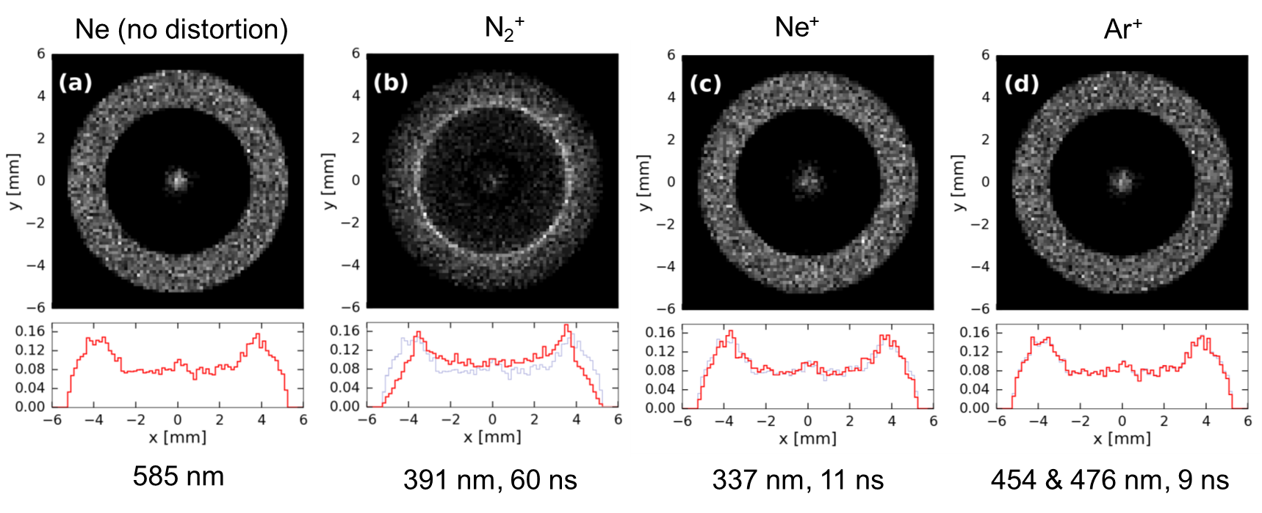
Challenge of BGC for HEL
Gas choice (distortion due to space charge)
Light pollution (SR, stray light) => Black coating, filtering
  NEG on Cu (R = 44.3%) vs. Polyteknik black coating (R = 0.12 % @ 585 nm)
Shorten the integration time => Increase jet density.
Notes:
Multilayer sputttering

Slide 14
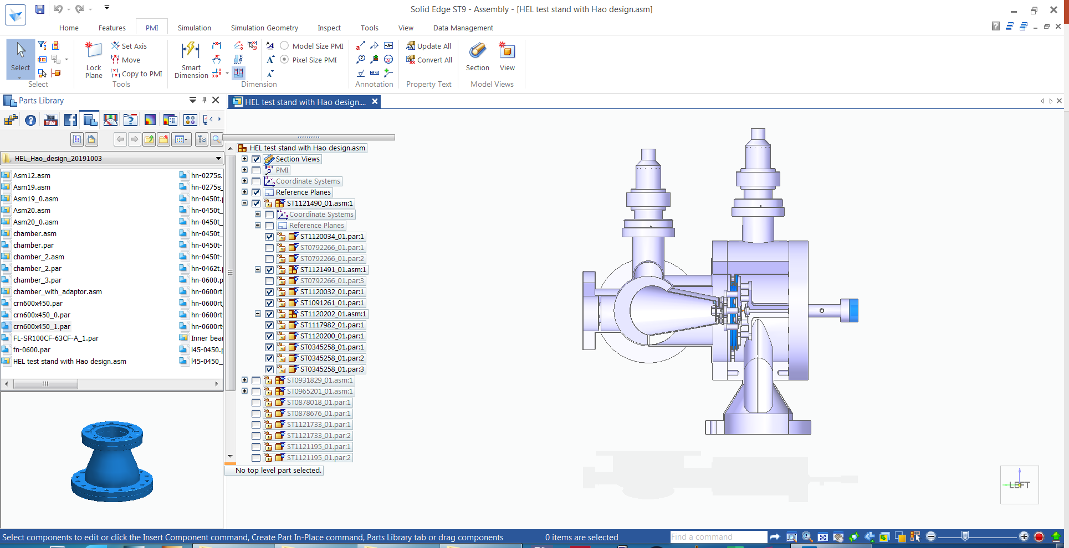
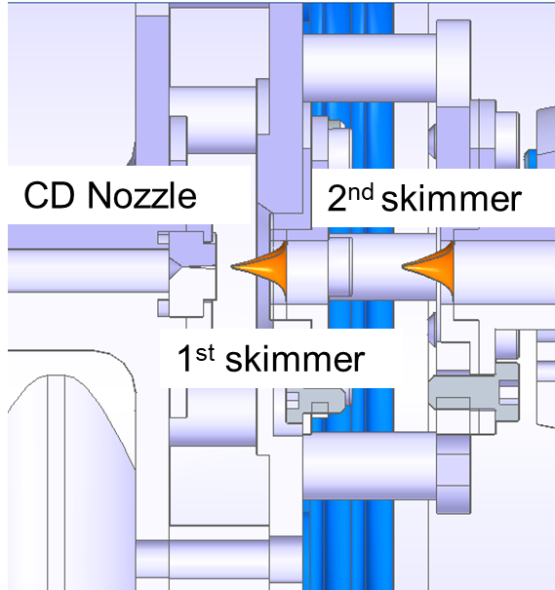
Compact design for gas jet generation
Versatile for space limitation
Increase gas jet density at the interaction chamber.
3rd skimmer
400 mm

Slide 15
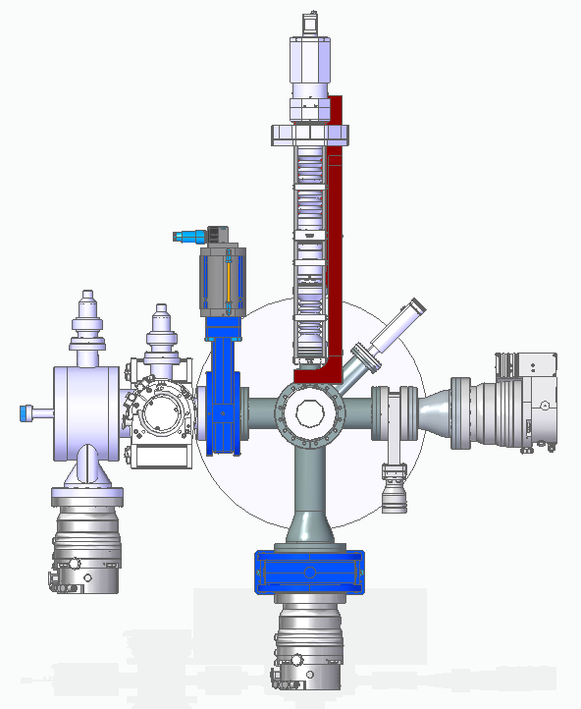
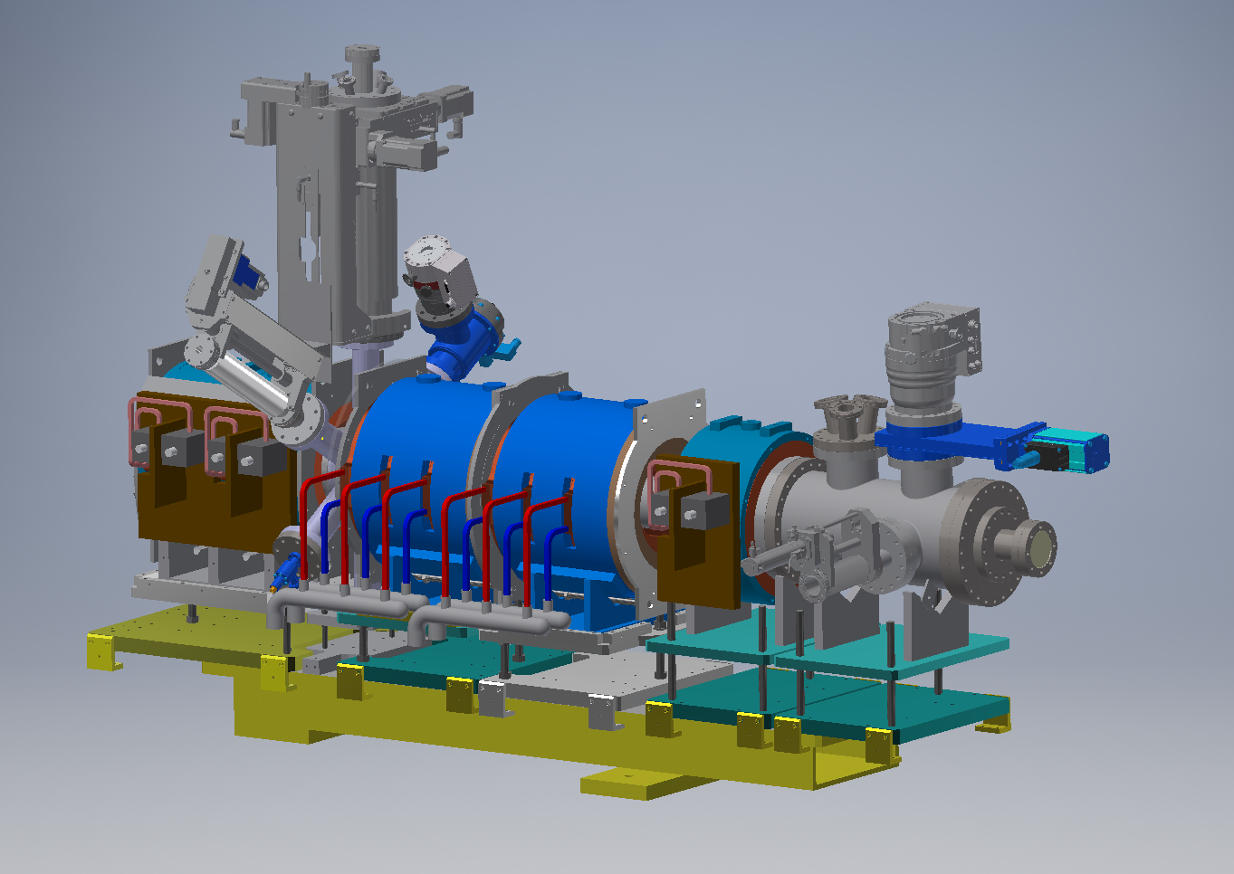
V3 gas jet setup for HEL test stand
Imaging system
Room for beam diagnostics (BGC)
Gate valve
Nozzle Chamber
Dump Chamber
Skimmer Chamber
Gate valve
Gate valve
Second drift solenoid + correctors
Collector solenoid
Interaction Chamber

Slide 16
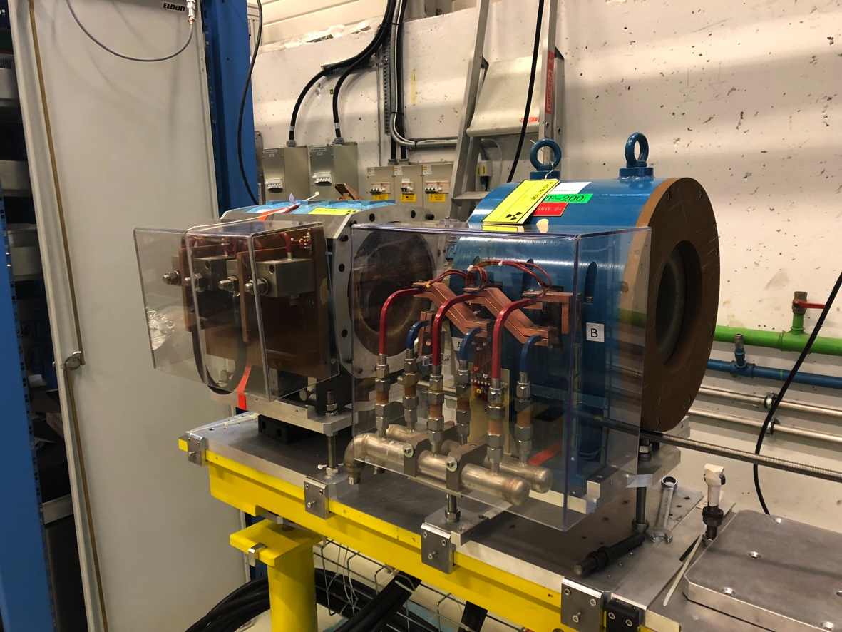
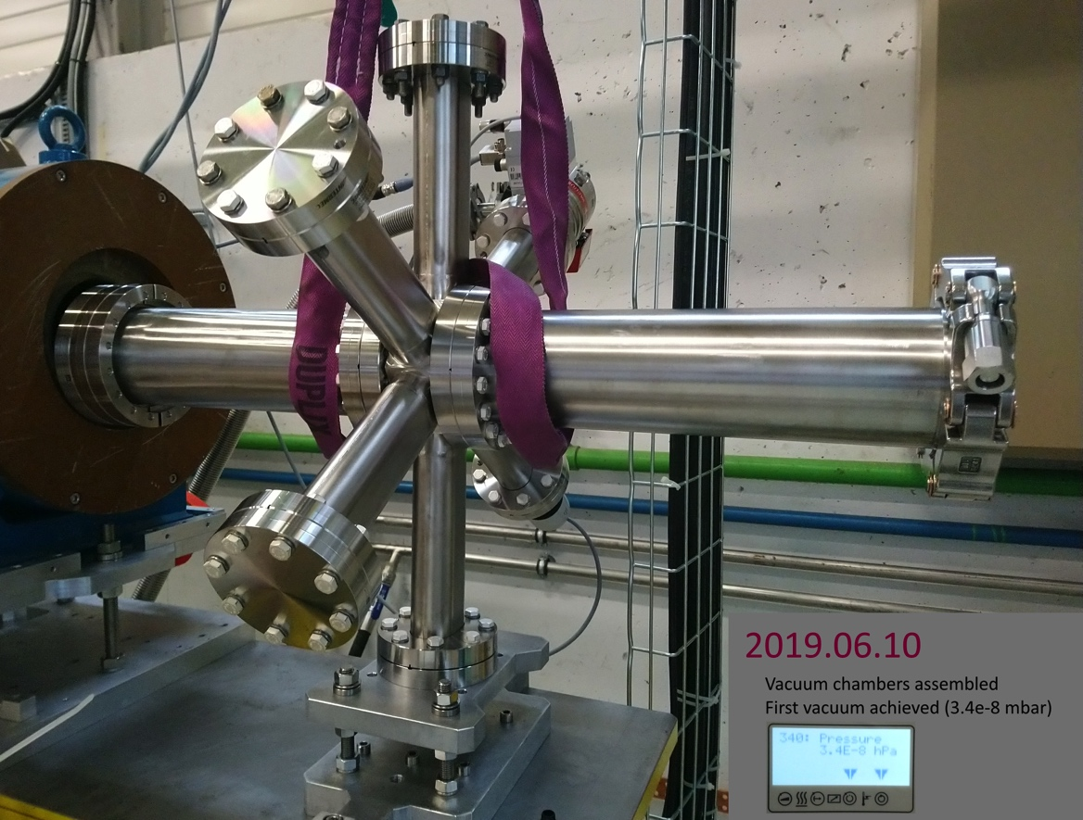
Plans for v3 gas jet for HEL test stand
Procurement ongoing
By end of March 2020: v3 gas jet system delivered and commissioned at CI;
Connected to June 2020 milestone: ARIES e-gun and modulator measurements
Solenoid

Slide 17
HL-LHC-UK Phase II
Gas jet beam profile monitor (BGC) is strongly supported by CERN for LHC as a general non-invasive profile measurement diagnostic and the baseline instrument for on-line monitoring of the overlap between proton and electron beams for HEL;
We will carry out R&D into minimum-invasive transverse profile monitoring and deliver two supersonic gas jet-based monitors based on beam-induced fluorescence
The specific objectives are
  Build and commission two gas jet monitors; deliver the instruments to CERN for integration in HL-LHC and contribute to commissioning and operation;
  Optimize optical imaging and acquisition system through simulation and experiments;
  Fully characterize different jet formation schemes and their impact on density at interaction point;
  Study options for gas jet wire scanner and achievable resolution.

Slide 18
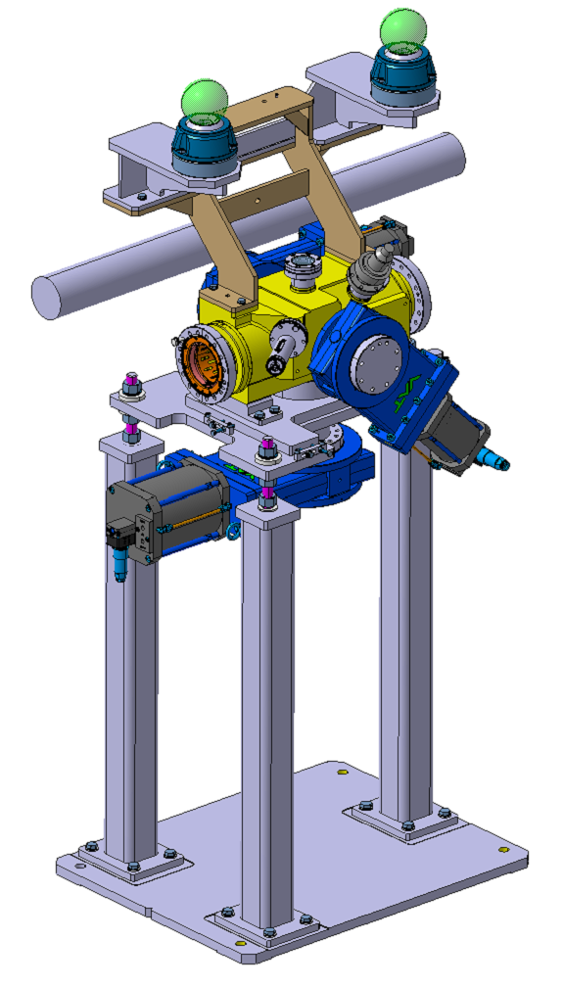
HL-LHC-UK Phase II
Interaction chamber
This work is a direct continuation of our previous studies in HLLHCUK – phase I.
Large parts of the monitors will be manufactured by UK industry through established contacts from phase I. Opportunities for further commercialization of the monitor will be exploited with the help of experts from D-Beam, STFC-CERN BIC alumni.
Phase II work will make this profile monitor a versatile solution for essentially any high energy, high intensity accelerator.
Research and installation plan
  Stage 1
    Install interaction chamber assembly in LHC include blackened chamber, gate valves, supports, optical calibration target during LS2. 01/04/20-24/12/20
  Stage 2
    M3.2.1: Commission and optimize gas-jet design based on Phase I final deliverable both at CI and at HEL test stand. 01/04/20-31/11/21
    Carry out investigations into the adaptation of the current scheme to a gas jet wire scanner. 01/01/21-31/11/21
    D3.2.1: Get-jet monitor engineering design: show that proposed design meets all specifications. 31/12/21
Image Courtesy: J. Glutting

Slide 19
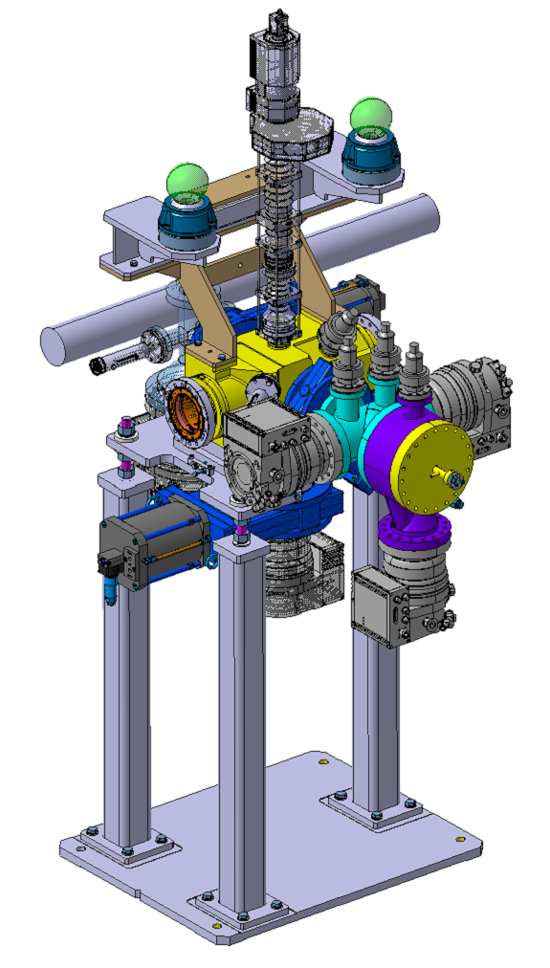
HL-LHC-UK Phase II
Research and installation plan - continued
  Stage 3
    Prototype monitor installed during LHC technical stop 01/12/22-28/02/22
    M3.2.2: Finalize design and production drawings. 01/03/22-30/06/22
    Review of gas-jet drawings to launch production completed 01/03/22-30/06/22
    Prototype monitor commissioning and study of 7 TeV proton fluorescence 01/03/22-31/08/22
    D3.2.2: Final design: report with final drawings, integration and commissioning plan 01/09/22-31/10/22
  Stage 4
    Manufacture interaction chambers and delivery to CERN for HEL setup 30/06/22-28/03/23
    D3.2.3: Delivery of interaction chambers for integration in HEL 31/03/23
    M3.2.3: Orders placed for major gas-jet unit 1 components:
      Manufacture and delivery of gas jet monitor unit 1 28/03/23-26/03/24
      Manufacture and delivery of gas jet monitor unit 2 26/03/24-17/12/24
    D3.2.4: Delivery of gas-jet monitor unit 1, pre-tested at CI, for integration in HEL. Participation in commissioning 28/03/23-31/03/2024
    D3.2.5: Delivery of gas-jet monitor unit 2 for integration at CERN, pre-tested at CI 31/12/2024
    M3.2.4: Production of gas-jets completed and shipped to CERN 02/01/25
Preliminary image of BGC integrated with LHC.
Image Courtesy: J. Glutting

Slide 20
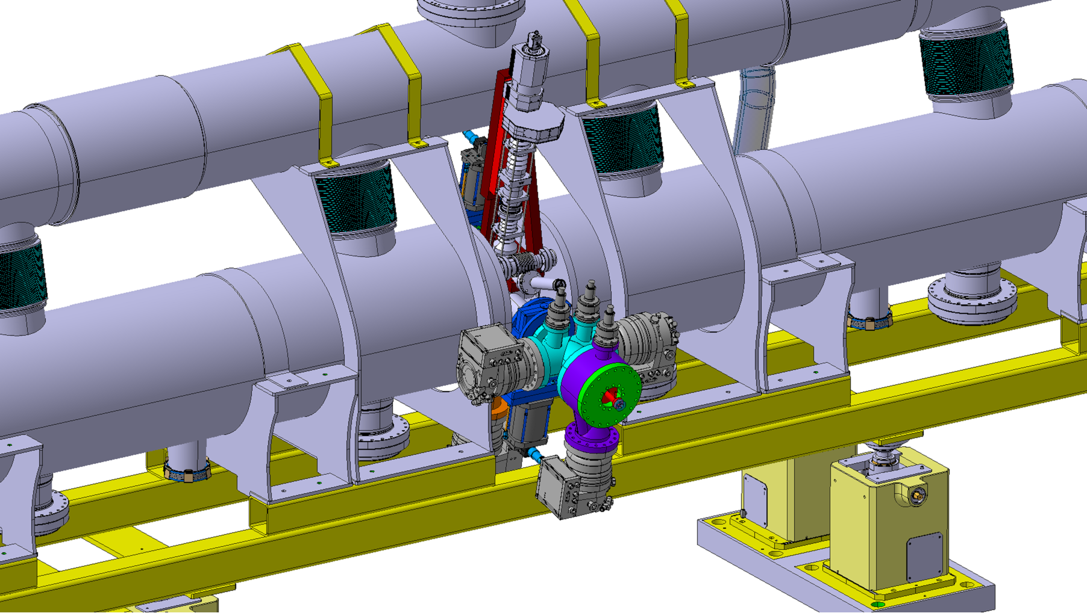
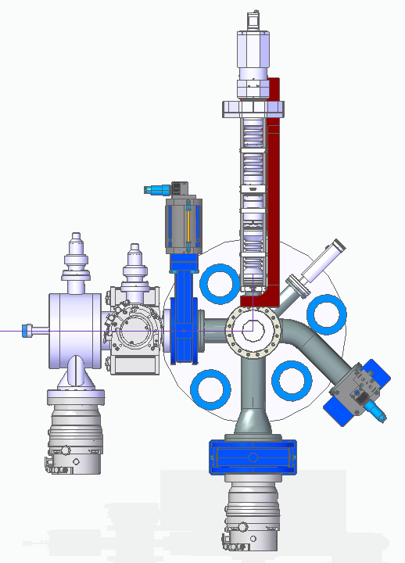
HEL integration with gas jet monitor
Space for BGC
GAP for mounting
~ 200 mm
Main solenoid
Main solenoid
Gas jet monitor

Slide 21
Summary
In HL-LHC-UK phase I, we successfully demonstrated 2D minimum invasive transverse profile monitor based on beam-induced fluorescence, using supersonic gas jet;
Various options of gases were studied in terms of achievable gas jet density and integration time;
Key technologies required to produce a working instrument in the LHC have been identified and development is well under-way
V3 monitor is being progressed and will be tested in HEL test stand;
For HL-LHC-UK phase II, primary goal will be delivery of two working monitors, but R&D into gas jet wire, BGV and monitor simplification will continue.

Slide 22

Thanks for your attention!
Work presented on behalf of the BGC collaboration:
J. Resta Lopez, N. Kumar, A. Salehilashkajani,
C.P. Welsch, H. Zhang (U Liverpool / Cockcroft Institute)
P. Forck, S. Udrea (GSI)
M. Ady, N. Chritin, T. Doddington, J. Glutting, R. Jones, R. Kersevan, S. Mazzoni,
A. Rossi, G. Schneider, R. Veness, (CERN BE-BI, TE-VSC, EN-MME)
9th HL-LHC Collaboration meeting, 15th October 2019

