Slide 1


Status of the electron cloud simulations for HL-LHC: build-up and instabilities
G. Iadarola, L. Mether, L. Sabato, G. Skripka
Many thanks to:
G. Arduini, B. Bradu, E. Métral, V. Petit, A. Romano, G. Rumolo, M. Taborelli, L. Tavian, E. Wulff
INFN-CNAF HPC team
CERN HPC team
8th HL-LHC Collaboration Meeting, Fermilab, 14-16 October 2019

Slide 2
Outline
e-cloud buildup studies:
  Heat loads on the arc beam screens
    Scaling with bunch intensity
  Hybrid schemes
  Studies for other devices
e-cloud instabilities:
  Single-bunch instabilities
    Dependence on RF settings
    Dependence on bunch intensity
    Effect of transverse feedback, chromaticity, octupoles
  Coupled-bunch instabilities
    Effect of the bunch intensity
    Effect of transverse feedback

Slide 3

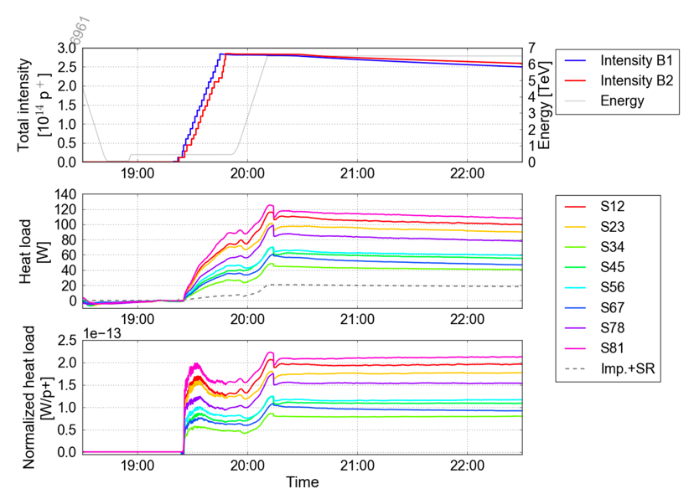
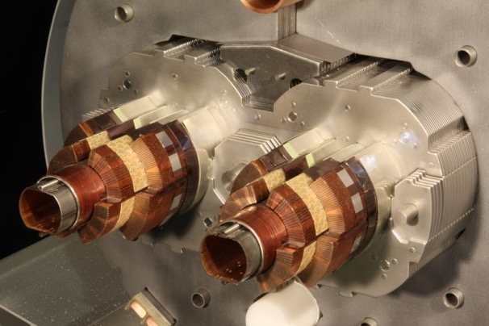
Heat loads on the arc beam-screens
Beam induced heat loads on the arc beam screens have been a challenge for LHC operation with 25 ns in Run 2: dominating total load on the cryo-plants
Much larger than expected from impedance and synchrotron radiation
Large differences observed between sectors and between consecutive cells in the same sector
A degradation is observed between Run 1 and Run 2
Being followed-up by dedicated Task Force
  Section of a main dipole
    Beam screen cooling circuit (helium)
    Supercond. coils (1.9 K)
    Beam screen
    (5 – 20 K)

Slide 4
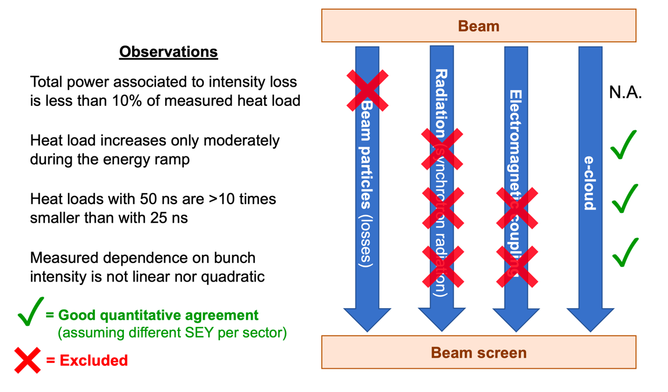
Underlying mechanism
Beam observations during Run 2 indicated that:
The additional heat load comes from electron cloud effects
It is compatible with alterations in the beam-screen surface properties leading to a higher Secondary Electron Yield (SEY)

Slide 5
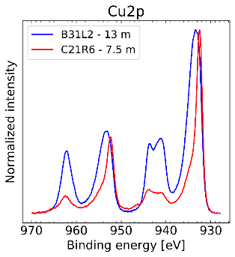
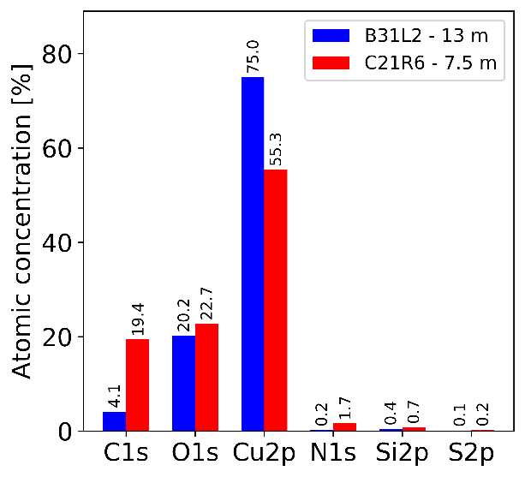
Underlying mechanism
Beam observations during Run 2 indicated that:
The additional heat load comes from electron cloud effects
It is compatible with alterations in the beam-screen surface properties leading to a higher Secondary Electron Yield (SEY)
Laboratory analysis of beam screens extracted from high-load magnets identified:
Presence of cupric oxide (CuO) instead of the native cuprous oxide (Cu₂O)
Extremely low concentration of Carbon
Work ongoing to identify exact mechanisms leading to these alterations
High-Load
Low-Load
XPS analysis:
For more info: M. Taborelli, presentation at the LMC meeting, 2 Oct 2019

Slide 6
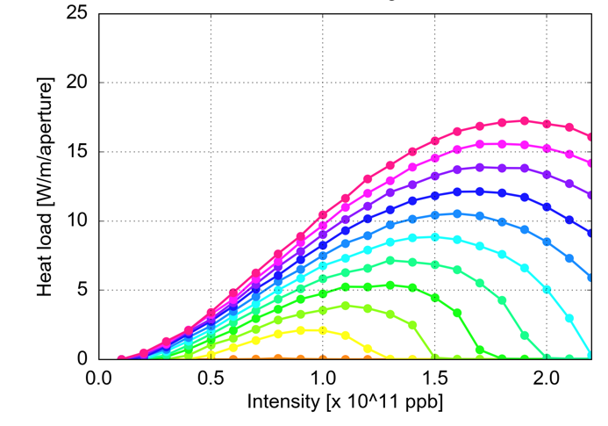
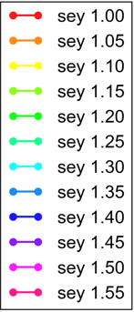

Arc heat loads - scaling with bunch intensity
  With the available model, simulations foresee a relatively mild increase of the heat load from e-cloud when increasing the bunch intensity to HL-LHC values
  Arc quadrupoles
  Arc dipoles
G. Skripka and G. Iadarola, Beam-induced heat loads on the beam screens of the HL-LHC arcs, CERN-ACC-NOTE-2019-0041

Slide 7
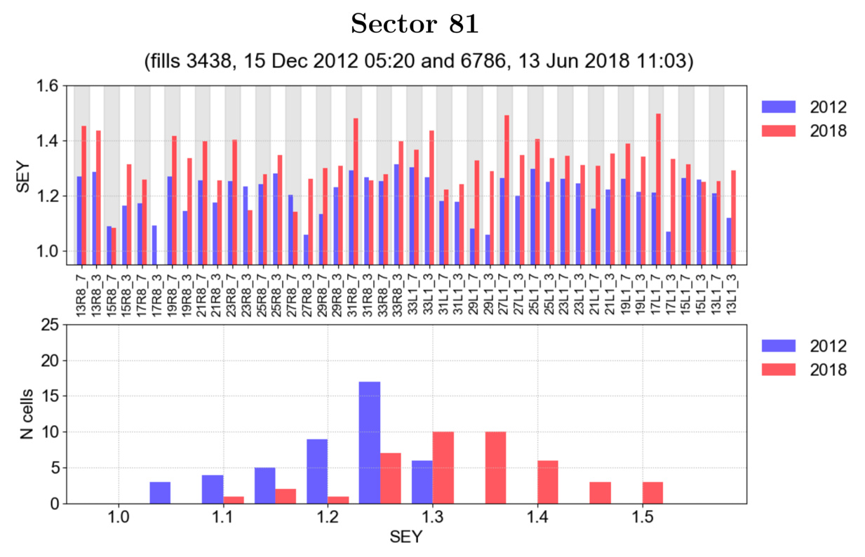
Arc heat loads - scaling with bunch intensity
  To make predictions for HL-LHC, the SEY for the different cells has been inferred from the measured heat loads
    The degradation between Run 1 and Run 2 is clearly visible
G. Skripka

Slide 8
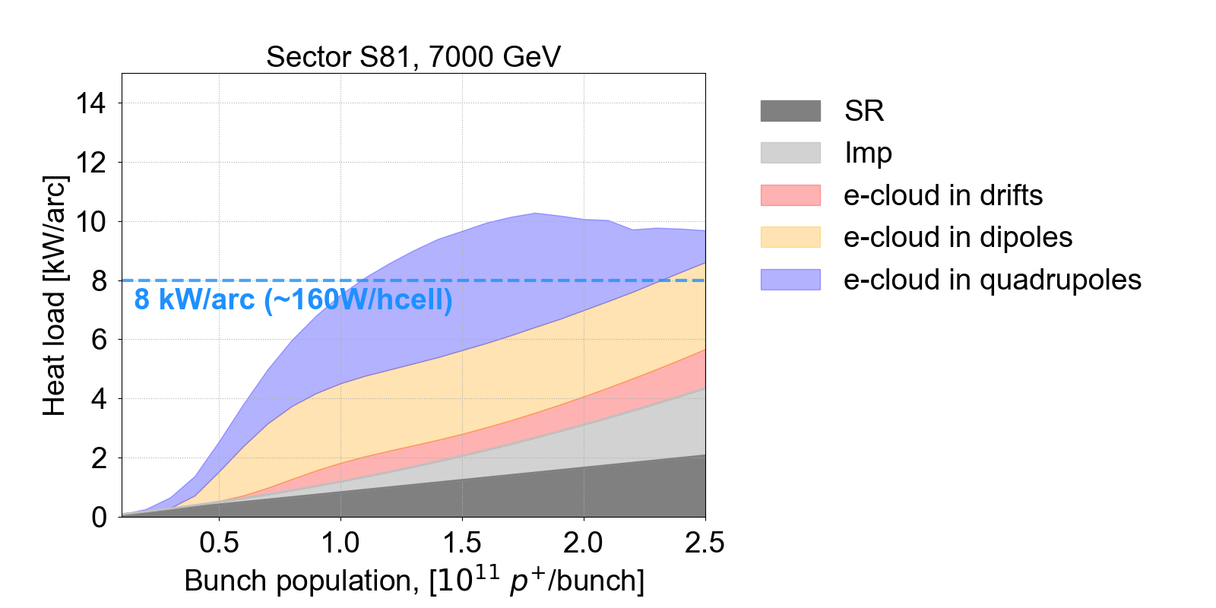
Arc heat loads - scaling with bunch intensity
  For the most critical sector a heat load of ~10 kW/arc is expected
    This is incompatible with the nominal cooling capacity of 8 kW/arc
  An optimized configuration of the cryogenic system (using one cold-compressor unit for two arcs) has been devised and routinely used in Run 2
    This increases the cooling capacity to ~10 kW/arc, which is compatible with the expected heat load (assuming that we avoid further deterioration!)
Optimized configuration
More info: G. Skripka, Scaling of e-cloud effects with bunch population, HL-LHC WP2 meeting 26 Feb 2019
K. Brodzinski, Maximum cooling capacity for cryogenics in Run 4, HL-LHC WP2 meeting 24 Sep 2019

Slide 9
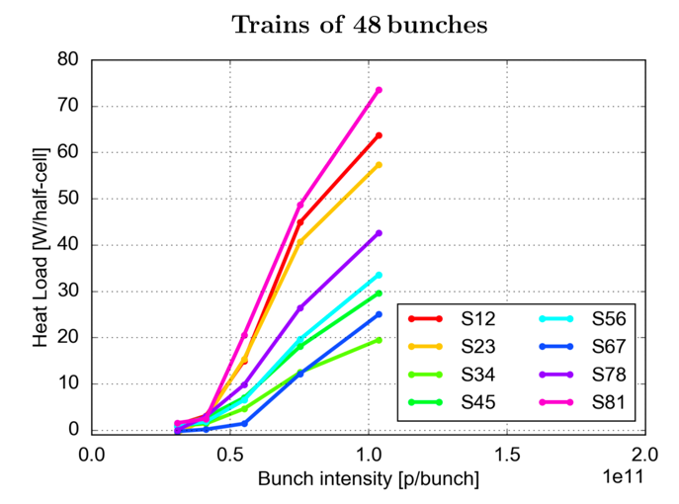
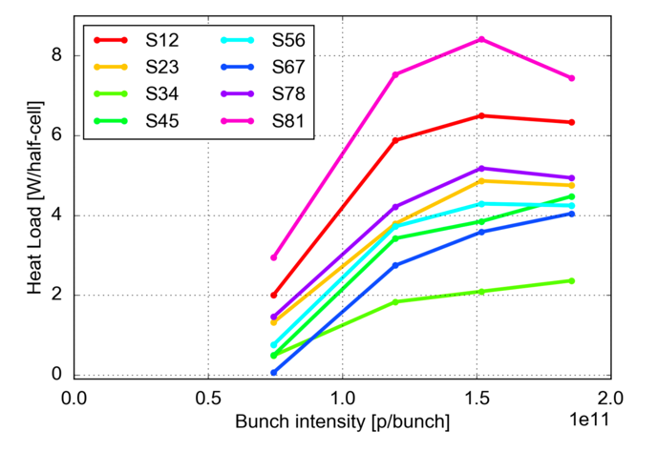
Arc heat loads - scaling with bunch intensity
  Trains of 48 bunches, 450 GeV
  A crucial element in the predictions presented so far is the expected dependence of the e-cloud heat load on the bunch intensity
  Significant MD time in 2018 devoted to collect systematic measurements
  With long bunch trains it is not possible to reach more than 1.2 p/bunch (technical limitations in the injectors)
  Measurements with higher bunch intensity could be collected at the end of 2018 using trains of 12 bunches and the 8b+4e scheme
    Expected non-monotonic behaviour observed experimentally for the first time
Inaccessible during Run 2
  Trains of 12 bunches, 450 GeV

Slide 10
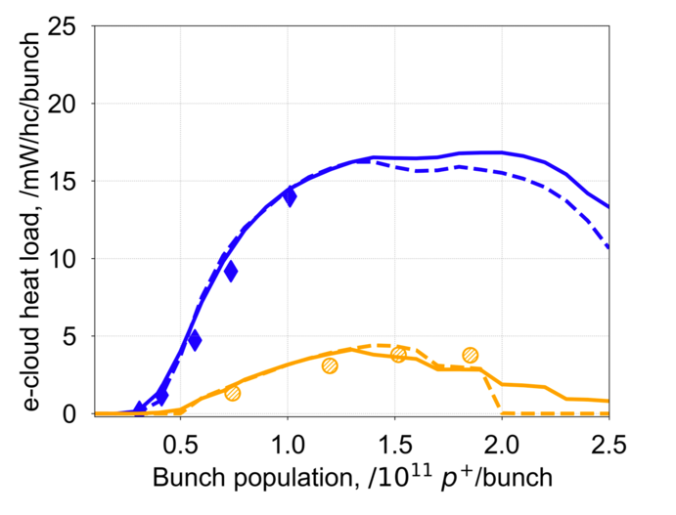
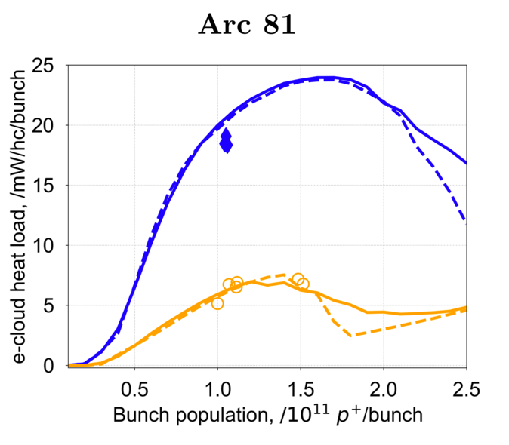
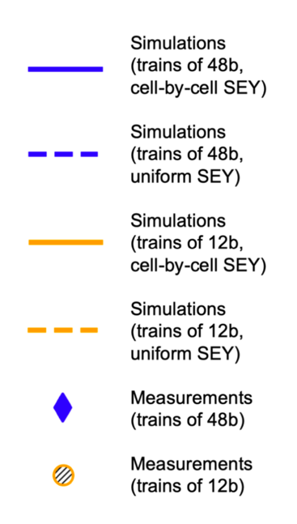
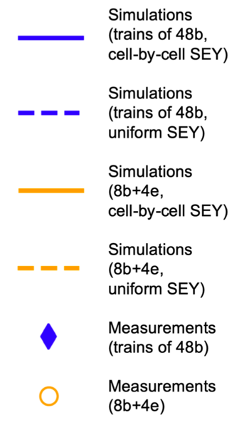

Arc heat loads - scaling with bunch intensity
  The collected measurements have been compared against the simulation model
    The agreement is very good, in all tested beam configurations
Sector 81, 450 GeV
Sector 81, 6.5 TeV
Heat load [W/h-cell/bunch]
Used to infer SEY
Heat load [W/h-cell/bunch]
Bunch population [10¹¹ p/bunch]
G. Skripka
Bunch population [10¹¹ p/bunch]

Slide 11
Outline
e-cloud buildup studies:
  Heat loads on the arc beam screens
    Scaling with bunch intensity
  Hybrid schemes
  Studies for other devices
e-cloud instabilities:
  Single-bunch instabilities
    Dependence on RF settings
    Dependence on bunch intensity
    Effect of transverse feedback, chromaticity, octupoles
  Coupled-bunch instabilities
    Effect of the bunch intensity
    Effect of transverse feedback

Slide 12
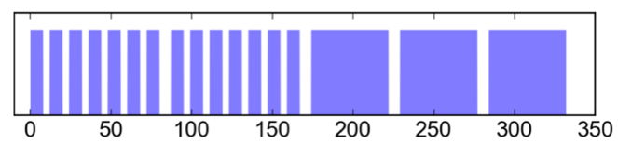
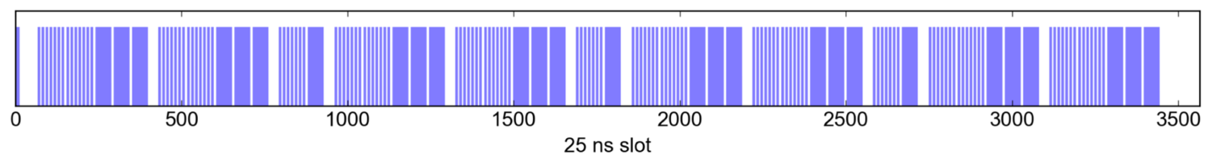
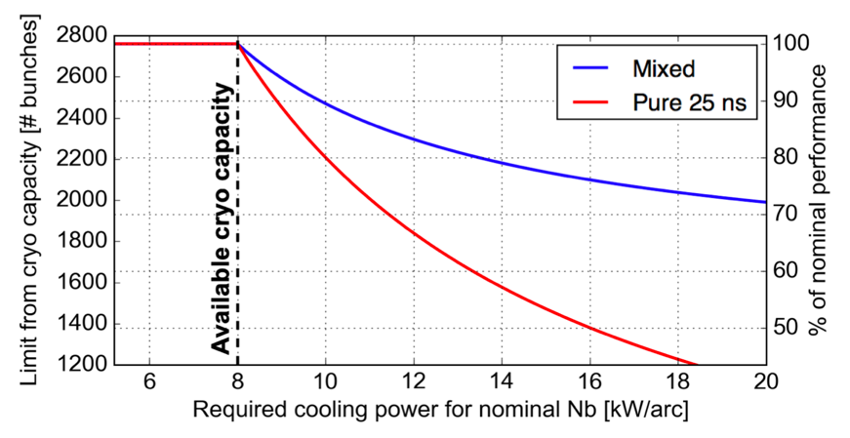
Arc heat loads – mixed scheme
  A backup beam configuration has been prepared in case limitations from e-cloud are stronger than expected:
    Hybrid schemes combining 25 ns bunch trains and 8b+4e trains
The fraction of 8b+4e beam can be optimized to match the available cooling capacity
G. Skripka and G. Iadarola, Beam-induced heat loads on the beam screens of the HL-LHC arcs, CERN-ACC-NOTE-2019-0041

Slide 13
Outline
e-cloud buildup studies:
  Heat loads on the arc beam screens
    Scaling with bunch intensity
  Hybrid schemes
  Studies for other devices
e-cloud instabilities:
  Single-bunch instabilities
    Dependence on RF settings
    Dependence on bunch intensity
    Effect of transverse feedback, chromaticity, octupoles
  Coupled-bunch instabilities
    Effect of the bunch intensity
    Effect of transverse feedback

Slide 14
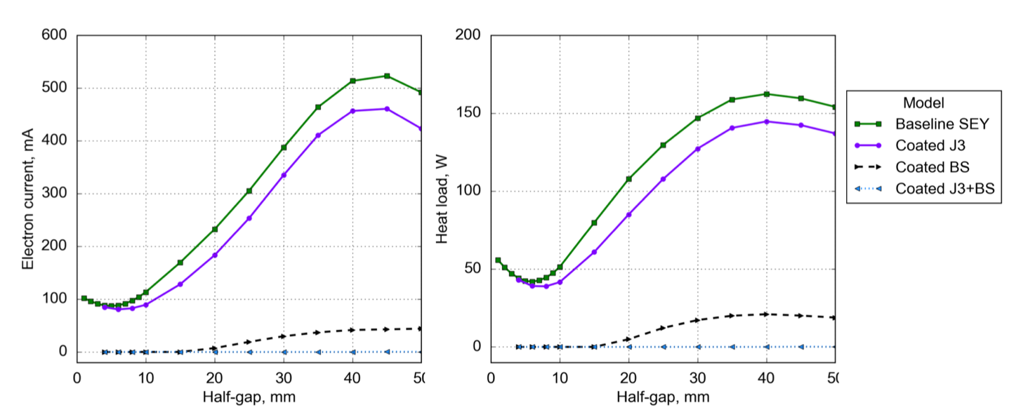
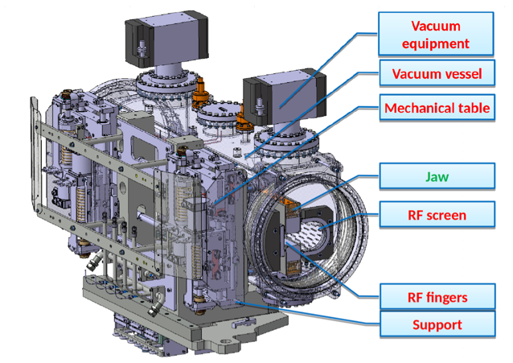
Buildup studies for other devices
  TDIS injection absorber (to be installed during LS2): simulation study performed to evaluated different low-SEY coating options
    Coating of the RF screen provides a strong suppression of the e-cloud
  Build-up study performed for new collimators:
    e-cloud formation is not expected for operational values of the collimator gaps
G. Skripka and G. Iadarola, Electron cloud studies for the LHC TDI and HL-LHC TDIS, CERN-ACC-NOTE-2018-0060
G. Iadarola and E. Wulff, Update on e-cloud validation of new materials, ColUSM meeting 18 Jan 2019

Slide 15
Outline
e-cloud buildup studies:
  Heat loads on the arc beam screens
    Scaling with bunch intensity
  Hybrid schemes
  Studies for other devices
e-cloud instabilities:
  Single-bunch instabilities
    Dependence on RF settings
    Dependence on bunch intensity
    Effect of transverse feedback, chromaticity, octupoles
  Coupled-bunch instabilities
    Effect of the bunch intensity
    Effect of transverse feedback

Slide 16
Instabilities driven by e-cloud
Instabilities driven by e-cloud arise from the coupling via electromagnetic forces between the motion of the electrons and the dynamics of the proton beam
Wake-field effects
Electron cloud effects
Boundary conditions
e⁻ production mechanisms
Beam charge distribution
Maxwell’s equations
E.M.
forces
e⁻ equations of motion
Maxwell’s equations
E.M.
forces
Beam equations of motion
Forces from
magnets, RF, etc..
Due to the non-linear nature of the electron dynamics it is difficult to study these instabilities using analytical treatments
Modeling and understanding strongly relies on numerical simulations
  PyECLOUD-PyHEADTAIL suite, developed and maintained at CERN
Simulations can be very heavy → relying on HPC clusters at CERN and at INFN-CNAF (Bologna)

Slide 17
Outline
e-cloud buildup studies:
  Heat loads on the arc beam screens
    Scaling with bunch intensity
  Hybrid schemes
  Studies for other devices
e-cloud instabilities:
  Single-bunch instabilities
    Dependence on RF settings
    Dependence on bunch intensity
    Effect of transverse feedback, chromaticity, octupoles
  Coupled-bunch instabilities
    Effect of the bunch intensity
    Effect of transverse feedback

Slide 18
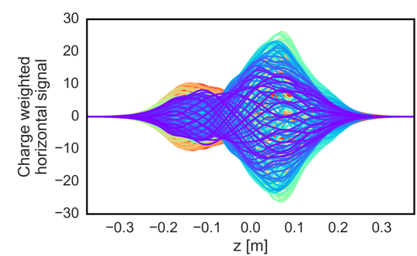
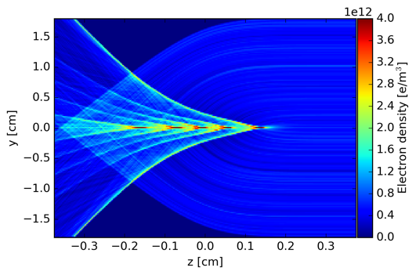
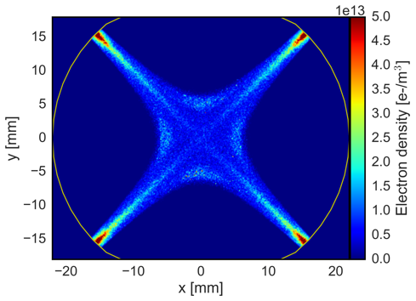
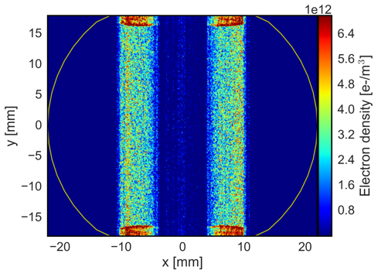
Intra-bunch instabilities at injection energy
The electron motion is fast enough to act as a coupling mechanism between the head and the tail of the bunch (dominated by electrons at the beam location)
  Stronger at injection energy due to lower beam rigidity
Proton bunch
oscillations
Electron dynamics
Tail
Head
Electrons in the arc quadrupoles are expected to be the strongest contributor (quadrupolar field concentrates a large electron density at the beam location)
  Instabilities driven by e-cloud in the quadrupoles will be considered in the following

Slide 19
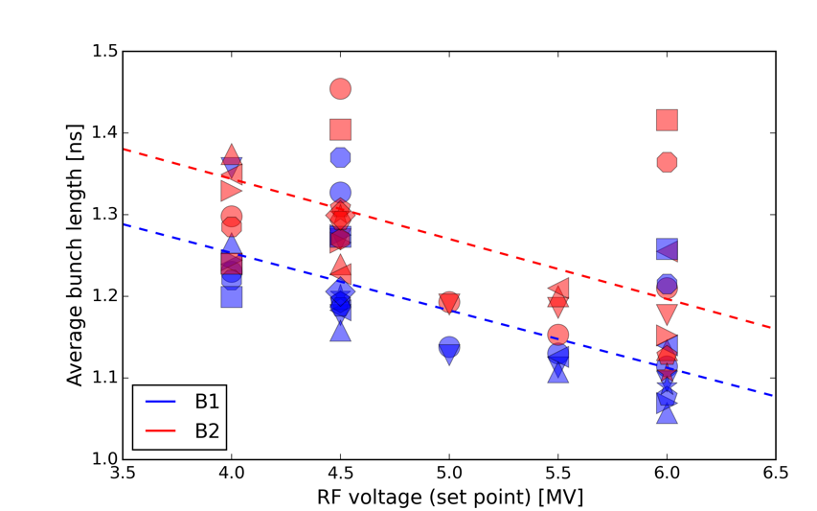
Dependence on RF settings
The possibility of lowering the RF voltage at injection is being considered to cope with RF power limitations
  An extensive simulation study has been conducted to address the impact on e-cloud driven instabilities
In the simulations the bunch length has been adapted to the RF voltage following the dependence measured at the LHC
  In all simulations the longitudinal distribution is matched to the bucket
LHC measurements
H. Timko, presentation at LMC meeting, 5 Sep 2018
Simulated

Slide 20
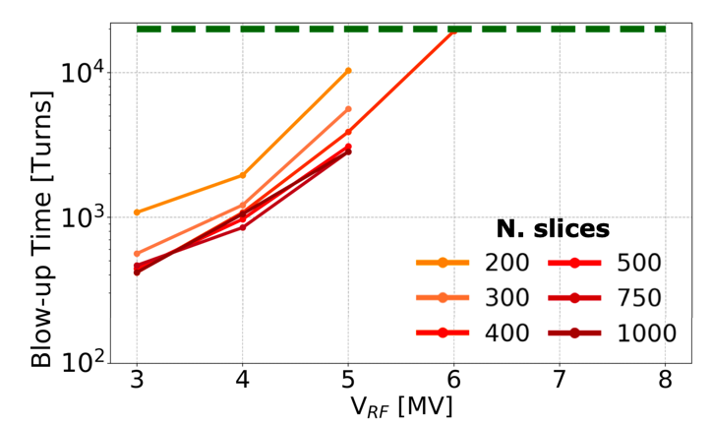
Intra-bunch instabilities at injection energy
Thorough parameter scans were performed to identify appropriate numerical settings
Numerical parameter | Chosen value
Slices/bucket | 500
p⁺ MPs | 1.25 x 10⁶
N_{kicks} | 8
e⁻ MPs | 5e5
Transverse grids (dual) | External: 0.8 mm Internal: 0.15 mm (0.2 σ_{beam})
Parameters defined as a result of the convergence study
(all parameters in the table have been scanned):
1.2 x 10¹¹ p/bunch
Example of convergence test
Instability detected [turns]

Slide 21
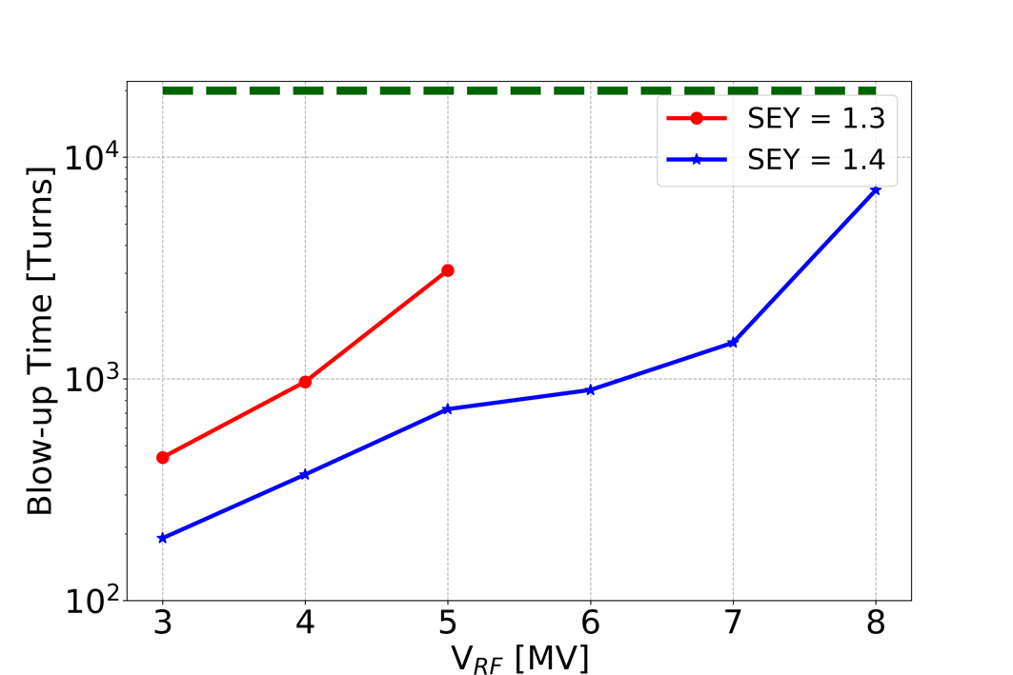
Effect of RF voltage
Longitudinal settings were scanned together with the SEY parameter
For LHC bunch intensity (1.2 x 10¹¹ p/bunch):
  The instability develops faster for lower RF voltage
  Additional tests showed that this effect is driven mainly by the lower synchrotron tune
1.2 x 10¹¹ p/bunch
No instability observed over 20k turns for: V_{RF} > 5 MV,
SEY = 1.3
Instability detected [turns]
L. Sabato

Slide 22
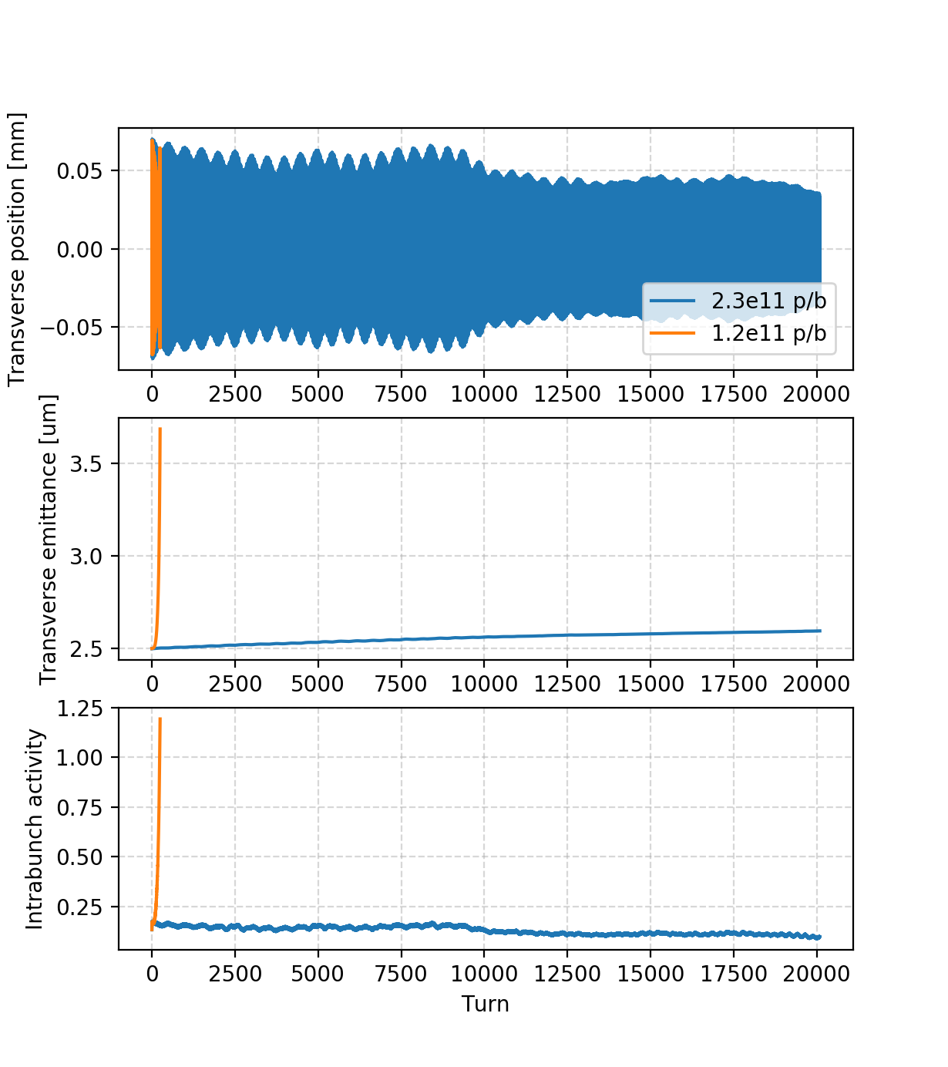
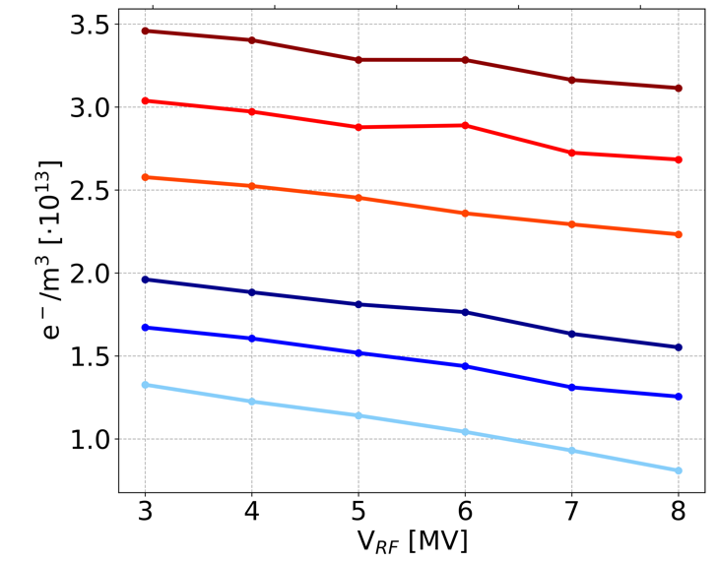
Effect of bunch intensity
The same parameter range (SEY: 1.3 - 1.4, V_{RF}: 3 – 8 MV) has been explored for HL-LHC intensity (2.3 x 10¹¹ p/bunch):
  No instability detected even for the most unfavorable cases!
  The reason is that for higher bunch intensity there are less electrons in the chamber
SEY=1.4, V_{RF} = 4 MV
Average electron density at the beam location during the bunch passage
1.2 x 10¹¹ p/b, SEY=1.5
1.2 x 10¹¹ p/b, SEY=1.4
1.2 x 10¹¹ p/b, SEY=1.3
2,3 x 10¹¹ p/b, SEY=1.5
2.3 x 10¹¹ p/b, SEY=1.4
2.3 x 10¹¹ p/b, SEY=1.3
L. Sabato

Slide 23
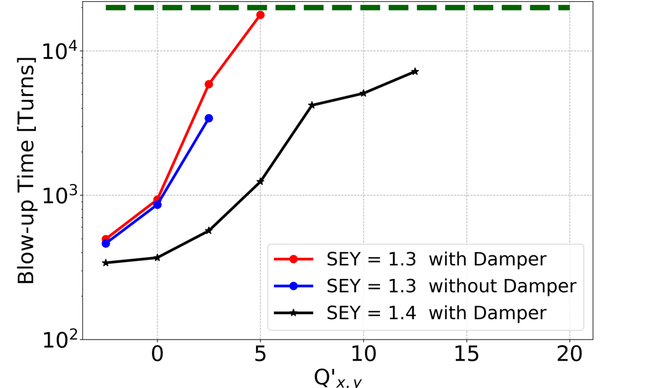
Effect of transverse feedback and chromaticity
For the case of LHC intensity (which an instability could be observed) the effectiveness of different mitigation measures has been investigated:
  The instability is strongly mitigated by increasing the chromaticity settings
  The transverse feedback (bunch-by-bunch, dumping time of 10 turns) is mostly ineffective
No instability observed over 20k turns for Q’ > 12.5!
Instability detected [turns]
L. Sabato

Slide 24
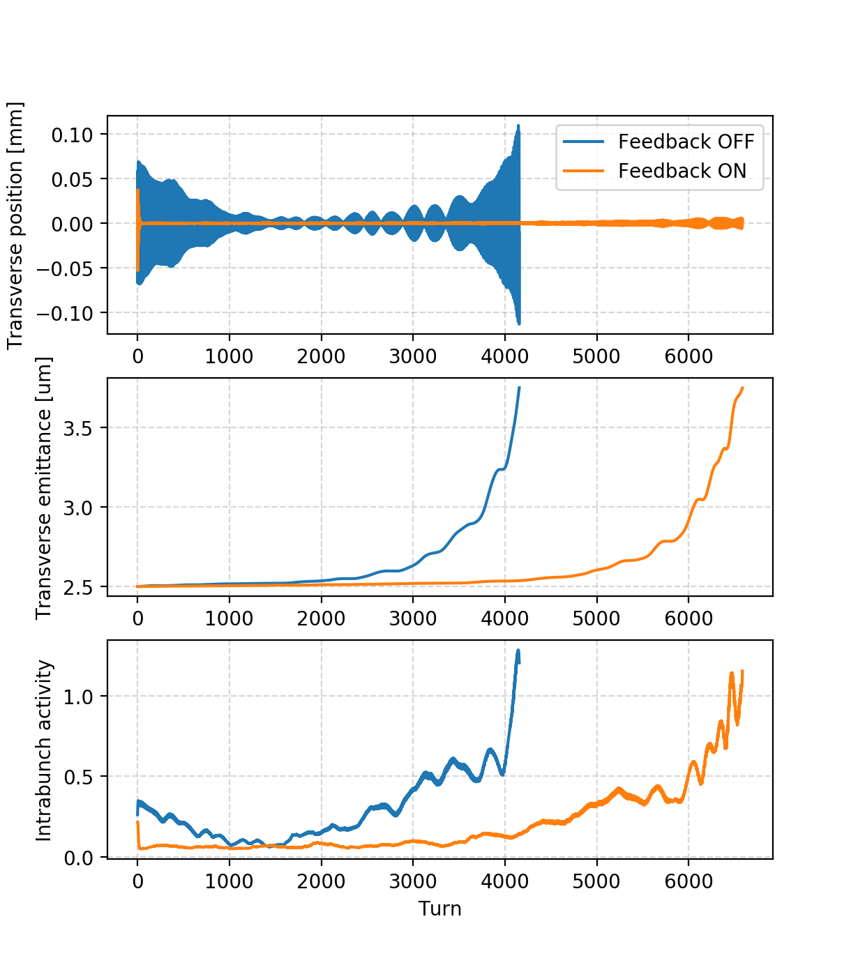
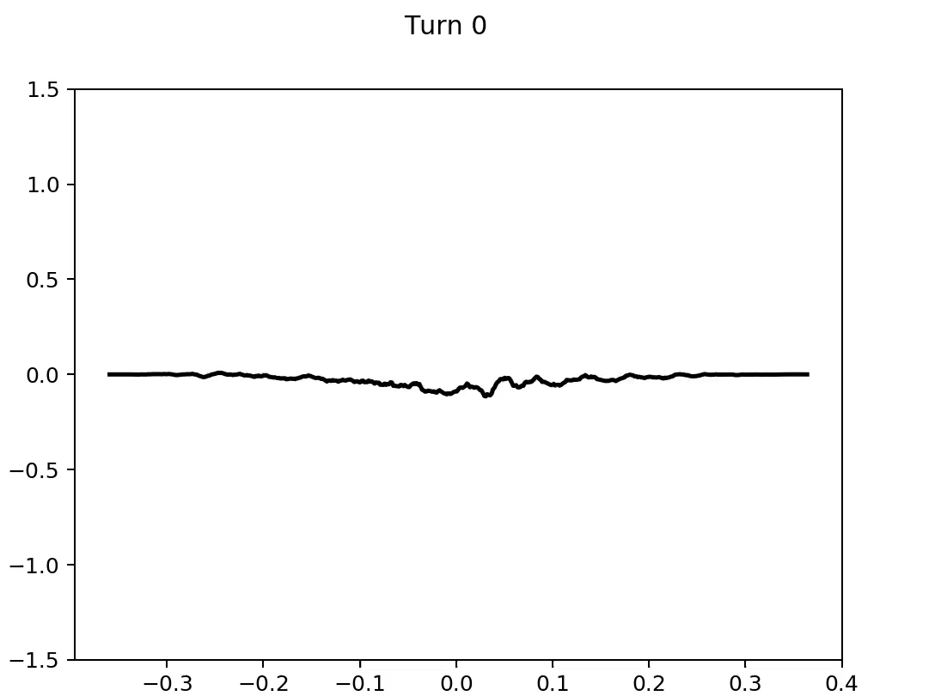
Effect of transverse feedback and chromaticity
For the case of LHC intensity (which an instability could be observed) the effectiveness of different mitigation measures has been investigated:
  The instability is strongly mitigated by increasing the chromaticity settings
  The transverse feedback (bunch-by-bunch, dumping time of 10 turns) is mostly ineffective → cannot damp intra-bunch motion
SEY=1.3, Q’=2.5, V_{RF}=4MV
Example: SEY=1.4, V_{RF}=4MV
Feedback ON
Pickup Δ-signal
z [m]

Slide 25
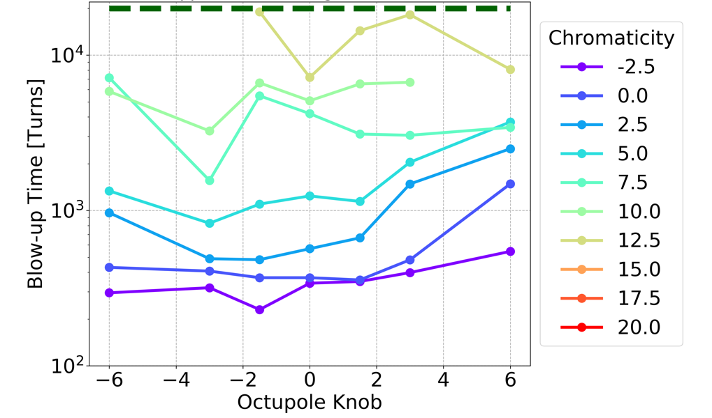
Octupole scan
For the case of LHC intensity the octupole current has also been scanned
  → Much less effective compared to chromaticity
SEY=1.4, Feedback ON, 1.2 x 10¹¹ p/bunch
L. Sabato
I_{LOF} = 78 A
I_{LOF} = -78 A

Slide 26
Outline
e-cloud buildup studies:
  Heat loads on the arc beam screens
    Scaling with bunch intensity
  Hybrid schemes
  Studies for other devices
e-cloud instabilities:
  Single-bunch instabilities
    Dependence on RF settings
    Dependence on bunch intensity
    Effect of transverse feedback, chromaticity, octupoles
  Coupled-bunch instabilities
    Effect of the bunch intensity
    Effect of transverse feedback

Slide 27
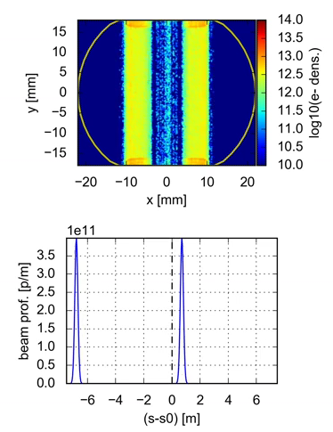
Coupled-bunch instabilities
The electrons in the two vertical stripes typical of the e-cloud distribution in dipole magnets contribute very little to single-bunch instabilities but can couple the motion of consecutive bunches
Simulation of these phenomena is extremely heavy
  Requires the simulation of the full e-cloud buildup process coupled with the beam dynamics at each turn
  The PyECLOUD-PyHEADTAIL suite and its PyPARIS parallelization layer have been recently been extended to exploit HPC clusters to perform these simulations
For more info: G. Iadarola, New tools for the simulation of coupled bunch instabilities driven by electron cloud, e-cloud meeting 14 Feb 2018

Slide 28
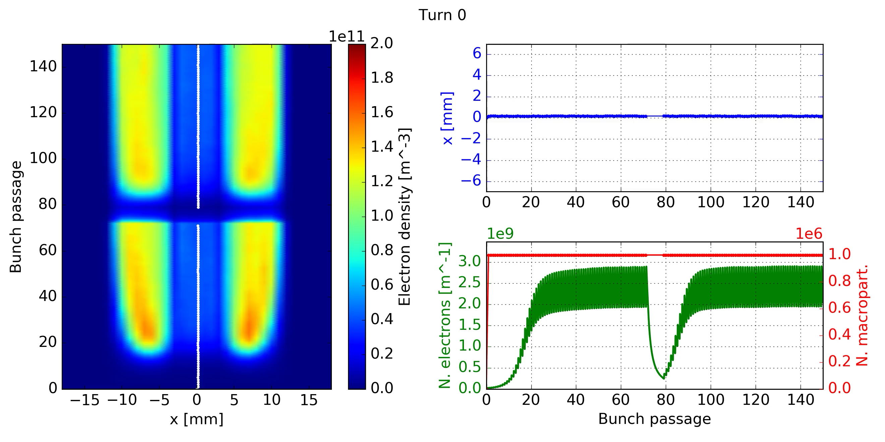
Coupled-bunch instabilities
Example of simulation for LHC bunch intensity (1.2 x 10¹¹ p/bunch)
A train of 144 bunches is simulated
The simulation requires a total 144 x 10⁶ proton MPs for the bunches and 160 x 10⁶ electron MPs
It is performed on 800 CPU-cores on the CERN HPC cluster
Coupling between the motion of the bunches and the electron distribution is visible
Simulated SEY=1.8, to observe the instability with an affordable simulation time
L. Mether

Slide 29
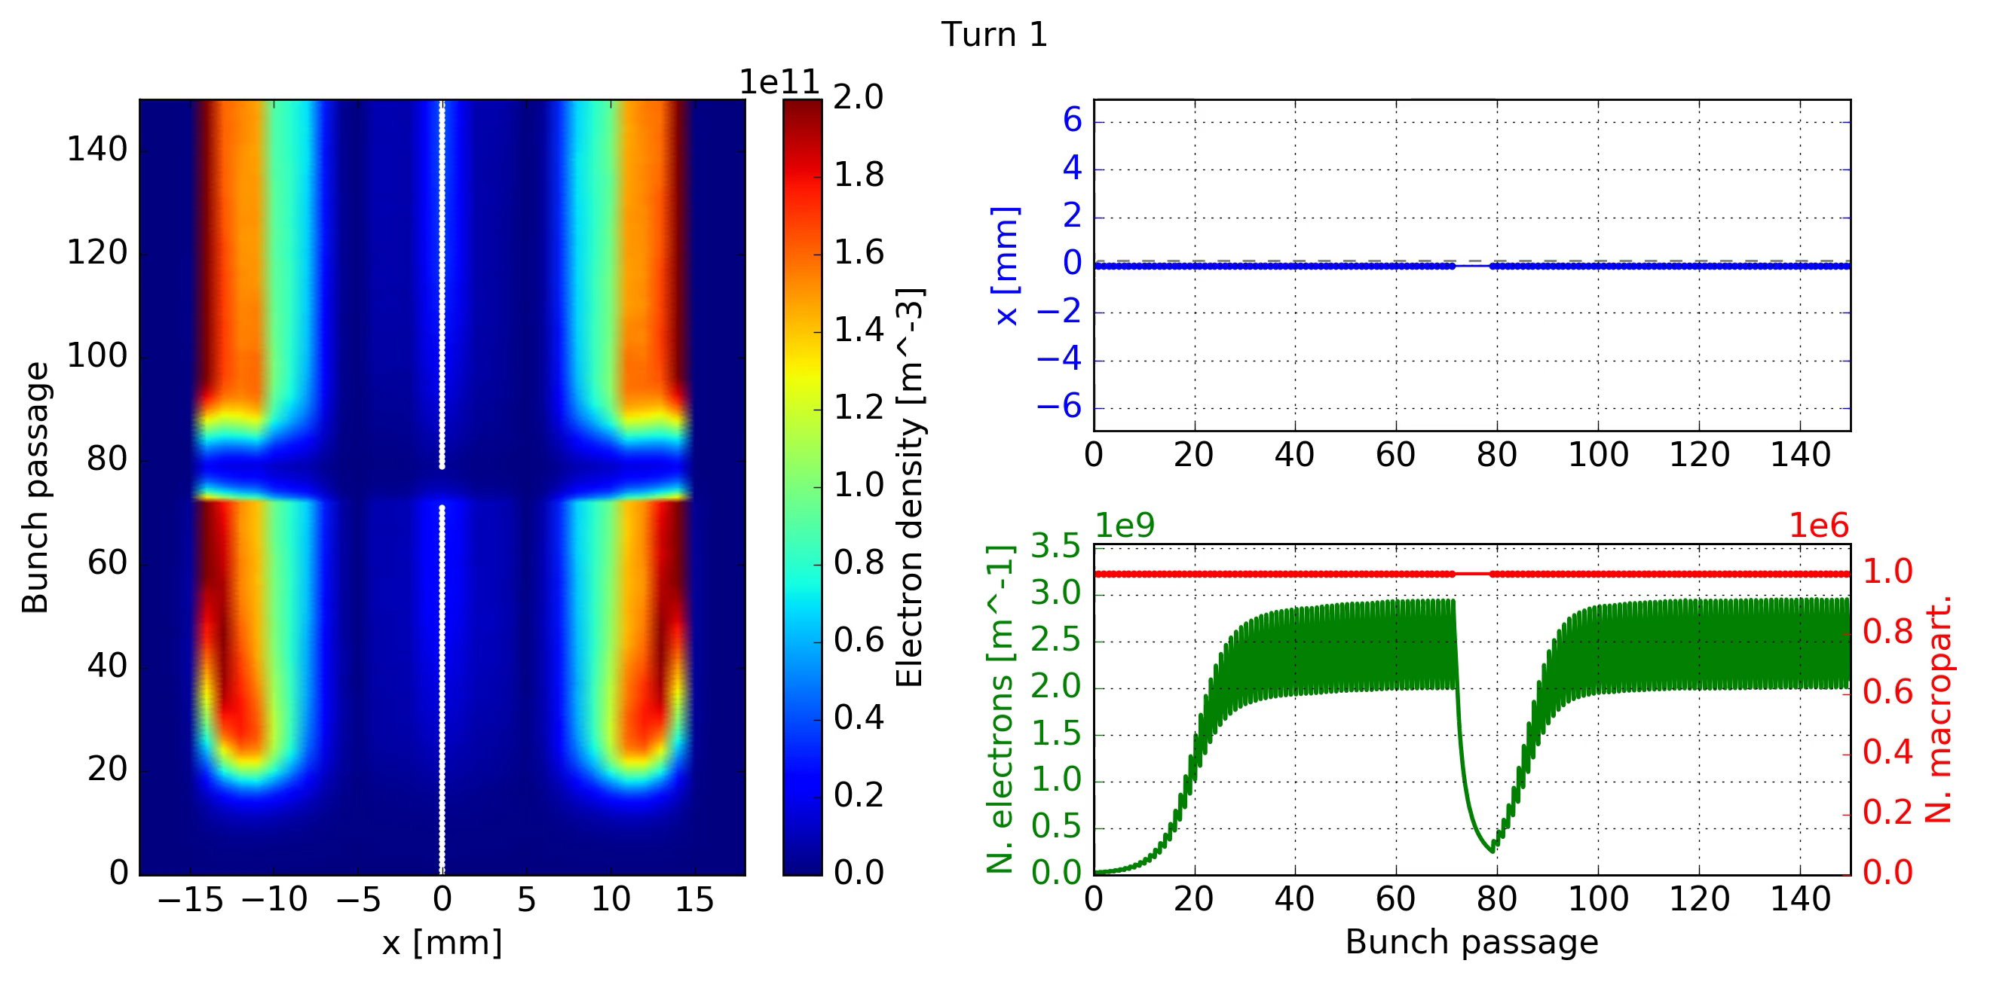
Coupled-bunch instabilities
The same simulation is performed for HL-LHC bunch intensity (2.3 x 10¹¹ p/bunch)
As a result of the larger bunch intensity, the electron stripes are further away from the beam
The instability pattern along the bunch train is different
  Most unstable bunches are in the middle of the first train
Simulated SEY=1.8, to observe the instability with an affordable simulation time
L. Mether

Slide 30
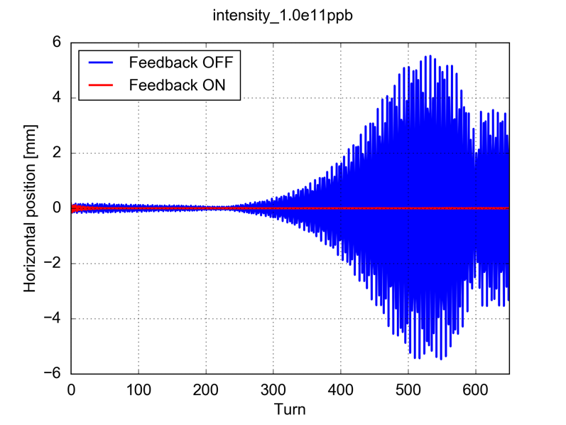
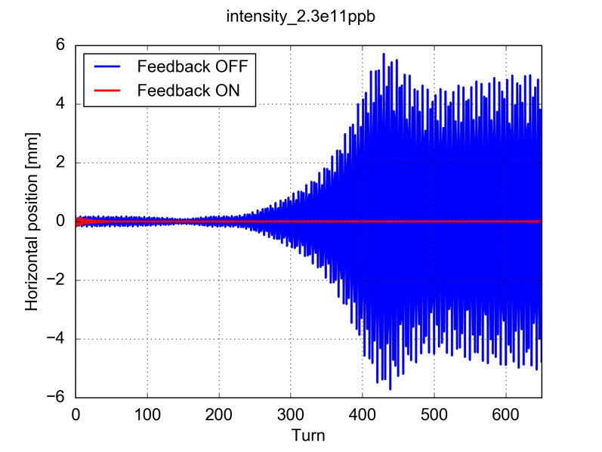
Coupled-bunch instabilities
For the two values of the bunch intensity the rise-time of the instability is similar
The simulations have been repeated with the transverse feedback active (20 turns dumping time)
  In both cases the feedback fully suppresses the instability (over the simulated timespan)
1.0 x 10¹¹ p/bunch
2.3 x 10¹¹ p/bunch
L. Mether

Slide 31
Summary and conclusions
The heat loads expected in the arc-beam screens have been simulated using SEY estimated from heat load measurements (at a cell-by-cell level)
  For the most critical sectors a heat load of ~10 kW/arc is expected
  Optimized cryogenics configuration deployed in Run 2 allows for ~sufficient cooling capacity (with no margin)
  Important to avoid further degradation of the SEY
Dependence of heat loads on bunch intensity probed experimentally at the LHC during 2018 using short bunch trains→ found to be consistent with simulation model
Transverse instabilities due to electron cloud are being studied using HPC computing resources:
  Single bunch instabilities driven by e-cloud in the main quadrupoles at 450 GeV:
    Found a significant dependence of the instability risetime on RF settings
    High chromaticity is found to be the most effective mitigation
    The beam is more stable for HL-LHC bunch intensity (e-cloud density is lower)
    Effect of dipoles and drifts will be investigated in the near future
  First studies on coupled-bunch instabilities conducted on CERN HPC cluster
    Bunch-by-bunch feedback fully suppresses the instability in simulation
    Next step is to move to more realistic scenarios: octupoles, Q’ etc.

Slide 32
Thanks for your attention

Slide 33
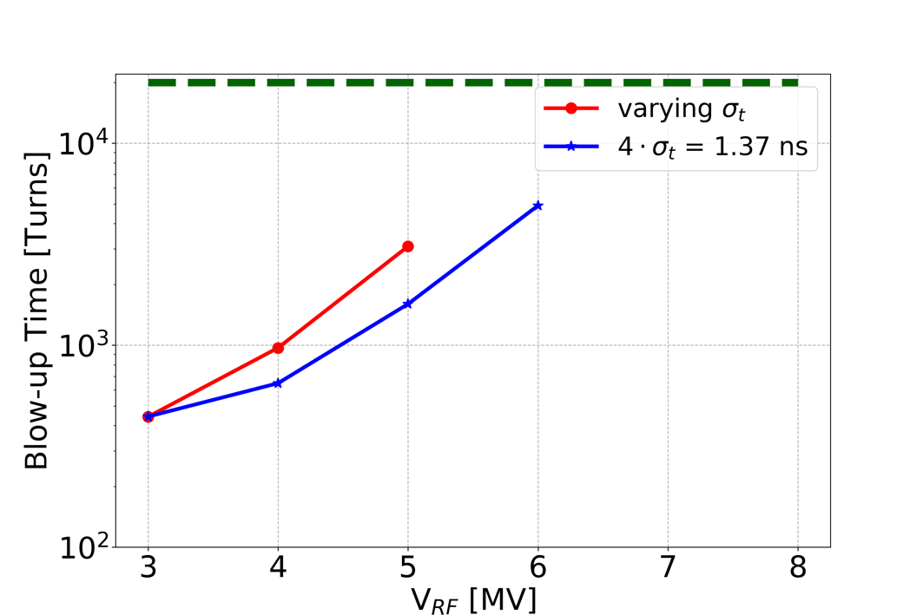
Bunch Length and RF Voltage Amplitude
SEY = 1.3
Fixed bunch length (same electron pinch)
Changing V_{RF} (matched bunch, changing Qs, long. emittance)
The dominant element is the change of V_{RF} and not the change in bunch length

