Slide 1


Qualification Status of US-AUP
RFD Prototype Cavities Fabrication at E. Zanon
Manuele Narduzzi - FNAL
9th Collaboration Meeting, Fermilab, USA - October 14th-16th 2019

Slide 2
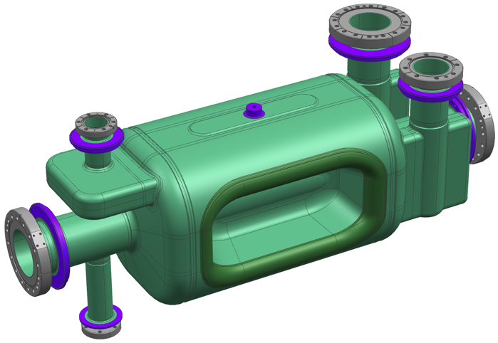
RFD Prototype Cavities Fabrication at Zanon: Outline
Design for fabrication
  AUP RFD Prototypes Cut-Out
  Assembly Strategy
  Drawing Status (back-up)
Fabrication Status
  Forming, Machining & EBW Tools
  Manufacturing Results Summary
  Waveguide Boxes Example
  V-HOM Extrusion
  Beam Axis extrusion test
  Deep Drawing
  Insert Machining Test
  Next steps & Pics
QA documentation
  Actual Status
  MTF Status
Summary

Slide 3
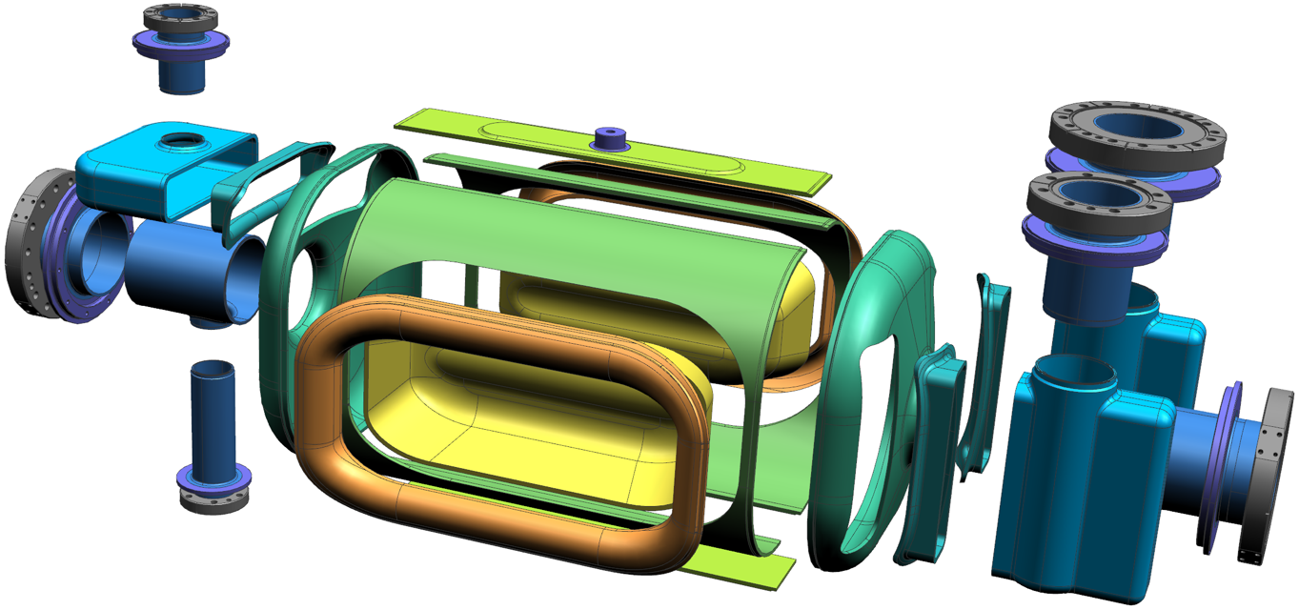
Design For Fabrication: AUP RFD Prototypes Cut-Out
Transition
V-HOM
Racetrack
V-HOM
Waveguide
Transition
H-HOM
H-HOM
Waveguide
Beam Axis Extr.
Antenna
Extr.
Corner
Pole
FPC
Waveguide
Half Main Body
End Cap
Transition
FPC
Rationale behind AUP RFD cut-out:
  Adopted CERN LHCACFCA0002vAE design also for protos
  Cut-out close to CERN prototype (baseline: favor EBW) but:
    Extremities machined from thick Nb pipe (no rolled tube)
    Adopted same transition insert between End Cap & Waveguides (different EBW strategy)

Slide 4






























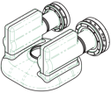
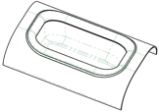

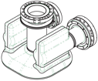
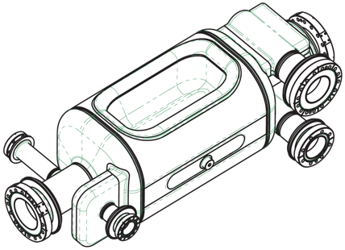

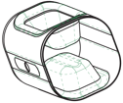
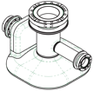


























Design For Fabrication: Assembly Strategy
FPC Waveguide
End Cap
H-HOM Waveguide
Beam Axis
Pole
Corner
Half Main Body
Racetrack
& Tuning Pin
Pick Up
Beam Axis
V-HOM Waveguide

Slide 5
RFD Prototype Cavities Fabrication at Zanon: Outline
Design for fabrication
  AUP RFD Prototypes Cut-Out
  Assembly Strategy
  Drawing Status (back-up)
Fabrication Status
  Forming, Machining & EBW Tools
  Manufacturing Results Summary
  Waveguide Boxes Example
  V-HOM Extrusion
  Beam Axis extrusion test
  Deep Drawing
  Insert Machining Test
  Next steps & Pics
QA documentation
  Actual Status
  MTF Status
Summary

Slide 6
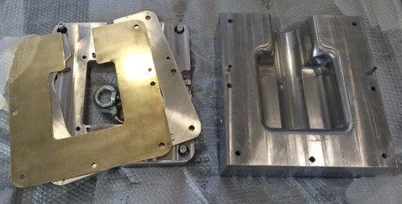
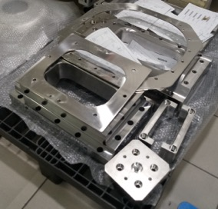
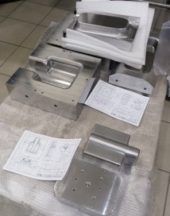
Fabrication Status: Forming, Machining & EBW Tools
Components | Description | Drawing Status (E. Zanon)
RFD Bare Cavity | EBW Tool
Corner | Forming Tool
 | Machining Tool
Pole | Deep Drawing Tool
 | Machining Tool
Pole + Corner | Machining & EBW Tool
Half Main Body | Forming Tool
 | Machining Tool
Tuning Band | Machining & EBW Tool
Main Body | Machining & EBW Tool
End Caps | Forming Tools
 | Machining & EBW
Beam Axis Extremities | EBW Tools
H-HOM | Boxes Forming Tools
 | Machining & EBW Tools
H-HOM Extremities | EBW Tools
V-HOM | Boxes Forming Tools
 | Machining & EBW Tools
V-HOM Extremities | EBW Tools
FPC | Boxes Forming Tools
 | Machining & EBW Tools
FPC Extremities | EBW Tools
Tool validated after Niobium tests
Manufacturing ongoing
Not Machined
NOTA: Forming Tools based on CERN RFD prototype experience.

Slide 7

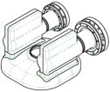


Fabrication Status: Manufacturing Results Summary
FPC Waveguide
End Cap
H-HOM Waveguide
Beam Axis
Pole
Corner
Half Main Body
Racetrack
& Tuning Pin
Pick Up
Beam Axis
V-HOM Waveguide

Slide 8
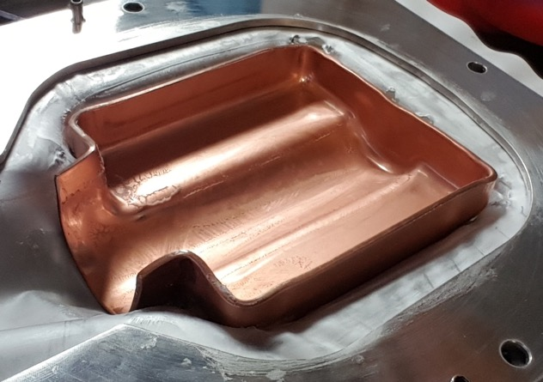
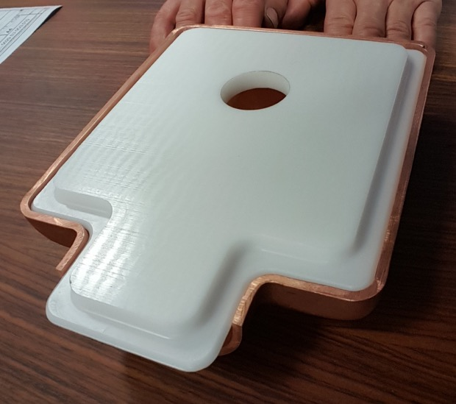
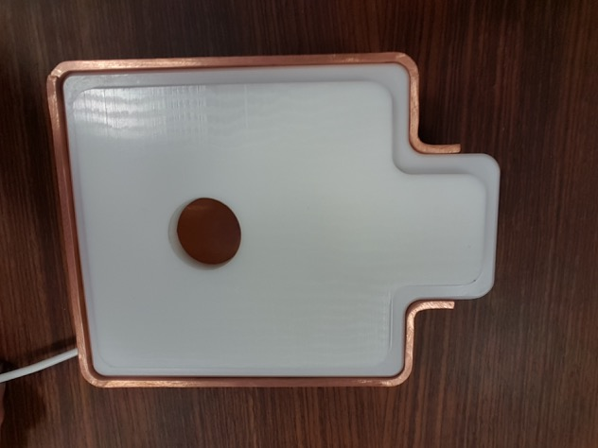
Fabrication Results: Waveguide Boxes Example
Copper H-HOM Box Shaping
  Upgrade forming procedure
    Increase deep drawing pressure (>100 Ton)
    Trimming (+3mm on theoretical shape)
    3 x Stamping at 300bar (120 Ton)
  Use POM template for calibration
NOTA:
Reshaping not enough in highlighted areas.
Local Thickness 3.85mm.

Slide 9
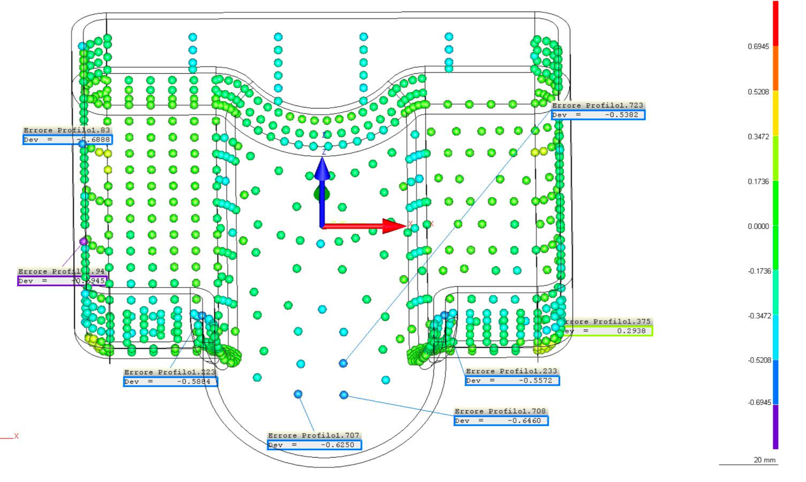
Fabrication Results: Waveguide Boxes Example
Copper H-HOM Box Metrology Results
  Shape accuracy after reshaping 300bar:
    Flat surfaces: encouraging <0.7mm (±0.35mm) shape accuracy
    Tube interface area to be improve by calibration ~1.3mm (±0.65mm) shape accuracy
  Minimum thickness: 3.85mm (only local area)

Slide 10
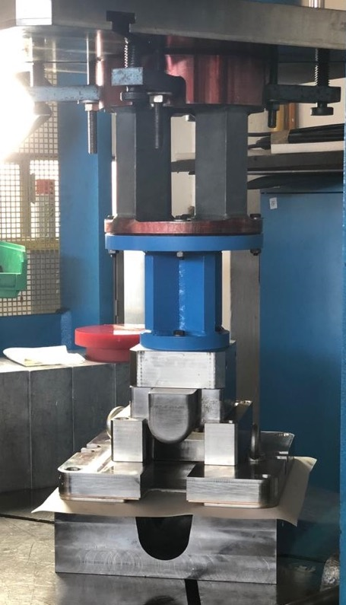
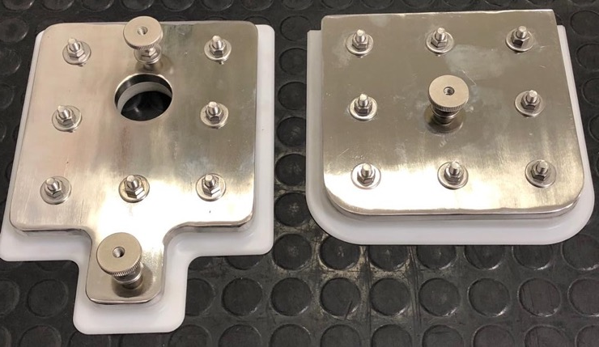
Fabrication Results: Waveguide Boxes Example
Niobium Waveguides Box Shaping (lessons learnt after Cu trials)
  Upgrade forming procedure
    Using Br intermediate plate (less friction)
    Increase deep drawing pressure up to 350bar (>120 Tons)
    Trimming (+3mm on theoretical shape)
    3 x Stamping at 375bar (>130 Tons)
  Use stiffer POM+SS template for comparison
  Calibration utmost importance

Slide 11
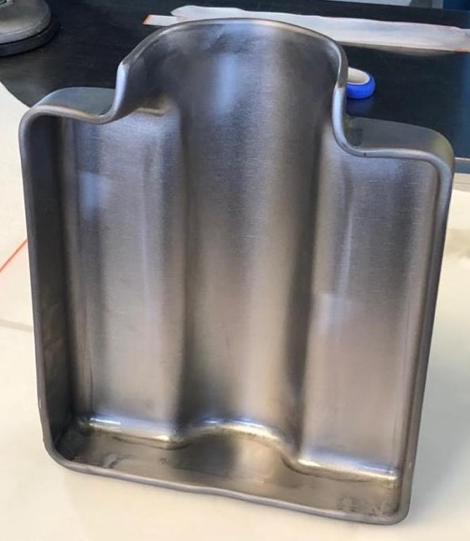
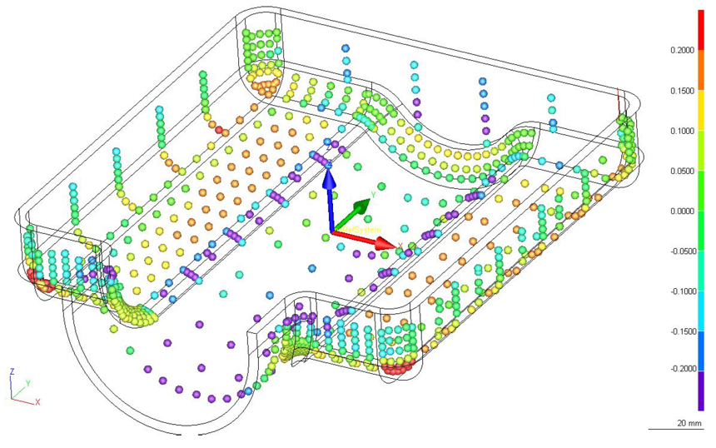
Fabrication Results: Waveguide Boxes Example
Niobium H-HOM Box: First Metrology Results
  Shape accuracy after forming at 350bar
    No reshaping
    Shape accuracy on “flat surfaces” better than 0.4mm (±0.2mm)
    Calibration of extremity tube interface required
    Refine process and/or mold in Corners area
  Thickness:
    Some friction scratch in blue area (no RF side)
    Minimum thickness in line with Cu trials
Refine process and/or mold
To be improved by manual calibration

Slide 12
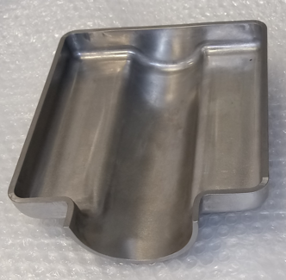
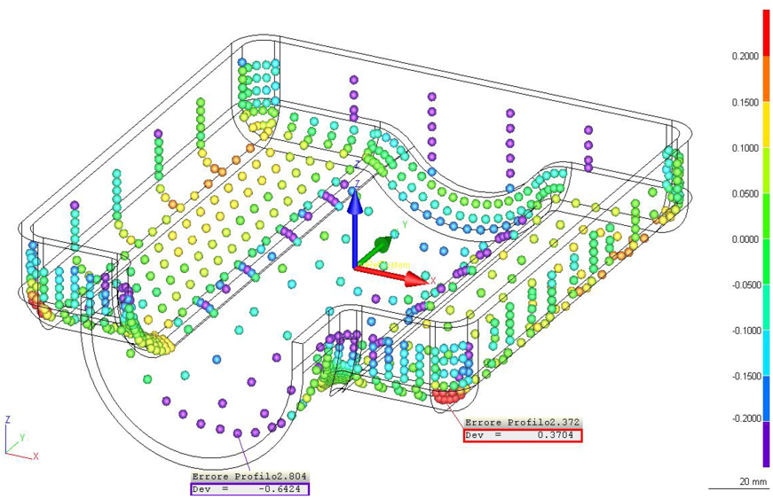
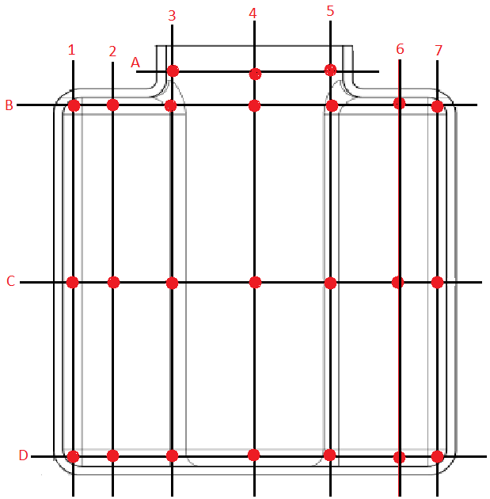
Fabrication Results: Waveguide Boxes Example
Niobium H-HOM Box 1-4: Metrology Results
  Shape accuracy after trimming & reshaping
    Improved surfaces accuracy <0.3mm (±0.15mm)
    Calibration of extremity tube interface still required
    Refine process and/or mold in Corners area confirmed
  Thickness:
    Minimum thickness > 3.5mm (on worst sample)
    NOTA: Only in local corners area!
Thickness report
 | 1 | 2 | 3 | 4 | 5 | 6 | 7
A |  |  | 4.10 | 4.10 | 4.40
B | 3.50 | 4.20 | 4.50 | 4.20 | 4.40 | 4.30 | 3.50
C | 4.10 | 4.10 | 4.00 | 4.10 | 4.00 | 4.10 | 4.00
D | 3.70 | 4.10 | 4.10 | 3.75 | 4.00 | 4.15 | 3.65
Tool optimization
Calibration work

Slide 13
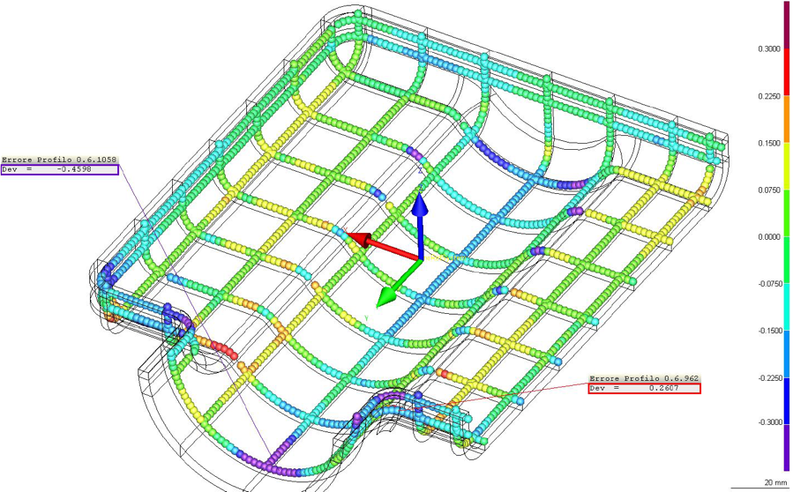
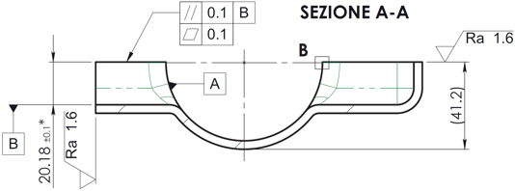
Fabrication Results: Waveguide Boxes Example
H-HOM Box 2-3: Final Metrology
  Shape accuracy boxes ready to weld
    Good overall shape accuracy achieved
    Effective calibration of extremity tube interface
    Effective forming even in Corners area
  NOTA: Improve machining fixture!
Improved geometry
Note on AUP/ Zanon fabrication strategy:
The worst manufactured components → Used for RFD proto #1
Leave room for improvement on second RFD Cavity #2

Slide 14
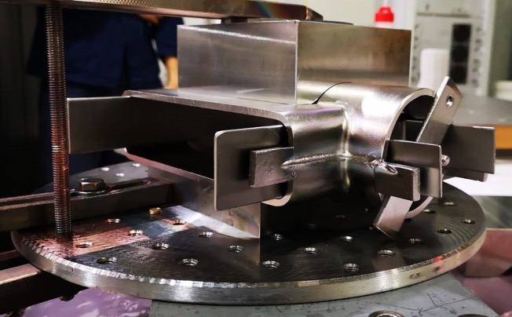
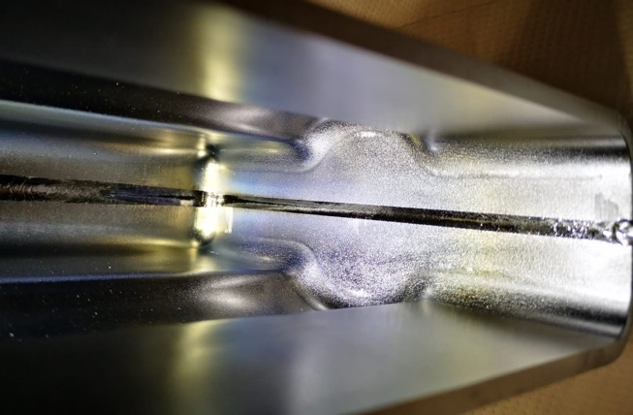
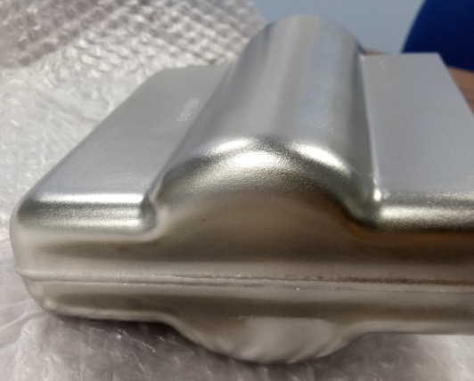
Fabrication Results: Waveguide Boxes Example
H-HOM Boxes: EBW highlight
  No official fixture used
    Tight schedule & lack of funding = Creativity!
  Metrology of welded boxes ongoing
  RX test ongoing
  Consideration about results
    External weld bead is homogeneous and clean
    RF side: smooth and constant welding width
    No undercut
    No excessive penetration
    No misalignments
    No sagging

Slide 15
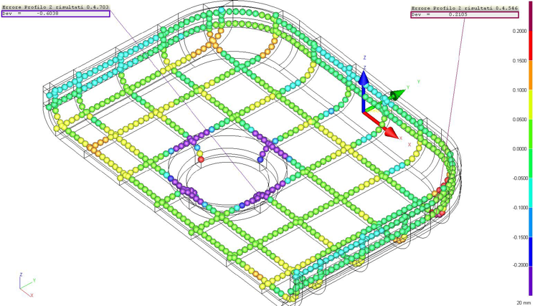
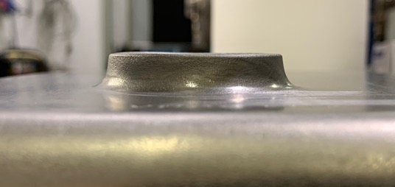
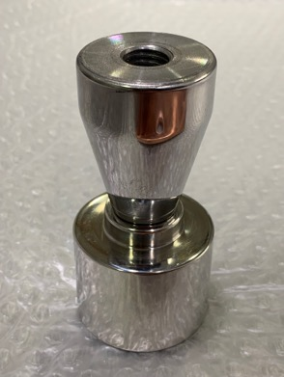
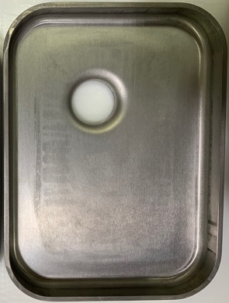
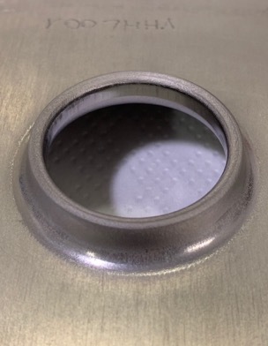
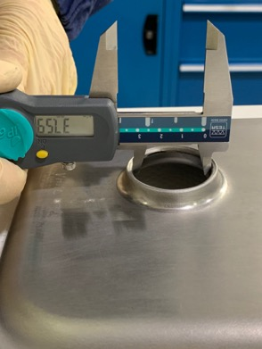
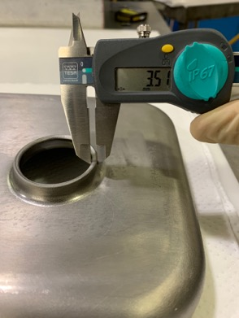
Fabrication Results: V-HOM Extrusion
Niobium V-HOM Box: extrusion
  First test: shape tolerance ±0.17mm
  Extrusion: very good results
  Improve machining for EBW (// 0.25mm)
Calibration before EBW
Very flat extrusion even w/o trimming!
From Left: Extrusion Tool. V-HOM Results. Results: nominal Ø37.63mm, nominal thickness 2.2mm!

Slide 16
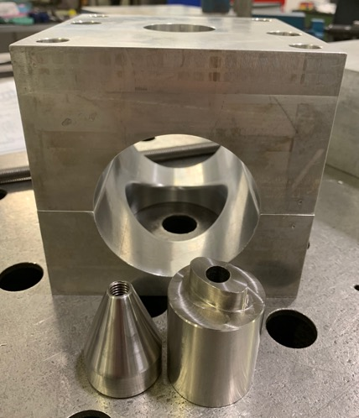
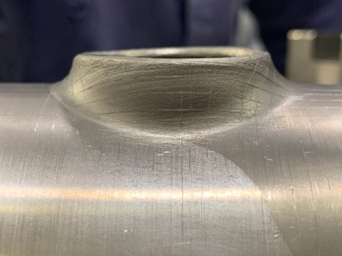
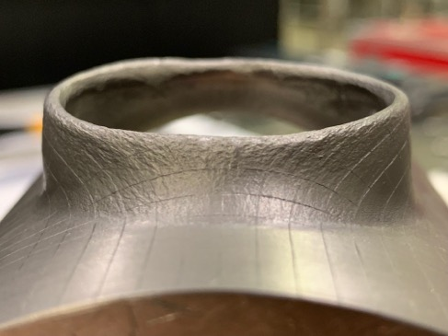
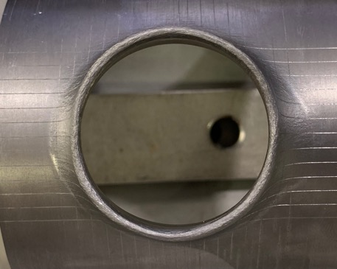
Fabrication Results: Beam Axis extrusion test
Niobium Beam Tube Extrusion Test
  First extrusion test: from a high thickness pre-machined tube
  Some issue due to inaccurate machining of extrusion tool
    Excessive clearance between coupling elements
      Uneven extrusion
      Not constant thickness
      Low circularity
    Internal radius not well machined
      Different external radius on extruded component
  Ongoing test with new extrusion tool
Uneven extrusion w/o trimming & different external radius. Not constant and low thickness. Low circularity.

Slide 17
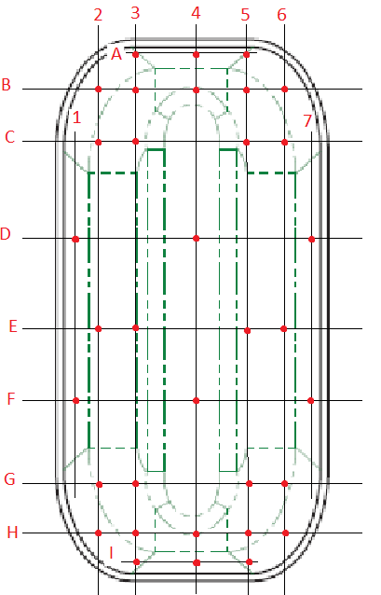
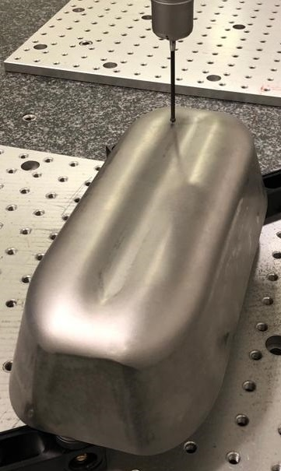
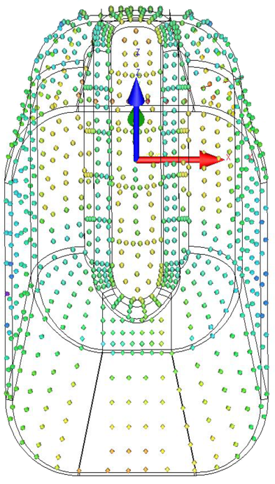
Fabrication Results: Deep Drawing
Niobium Pole 1-4: Metrology Results
  Shape accuracy after reshaping 400bar: ~0.6mm
    NOTA: shape defects due to initial sheet thicker than requirements (>4.15mm)
  Minimum thickness: >3.6mm (only local area)
Thickness report
 | 1 | 2 | 3 | 4 | 5 | 6 | 7
A |  |  | 4.25 | 4.20 | 4.27
B |  | 3.81 | 3.61 | 3.88 | 3.6 | 3.92
C |  | 4.02 | 3.96 |  | 3.98 | 4.12
D | 4.19 |  |  | 4.09 |  |  | 4.15
E |  | 4.22 | 4.07 |  | 4.1 | 4.25
F | 4.22 |  |  | 4.1 |  |  | 4.21
G |  | 4.07 | 4.05 |  | 4.08 | 4.13
H |  | 3.92 | 3.71 | 3.89 | 3.65 | 3.89
I |  |  | 4.25 | 4.15 | 4.25
Pole n. 2: Metrology after trimming

Slide 18
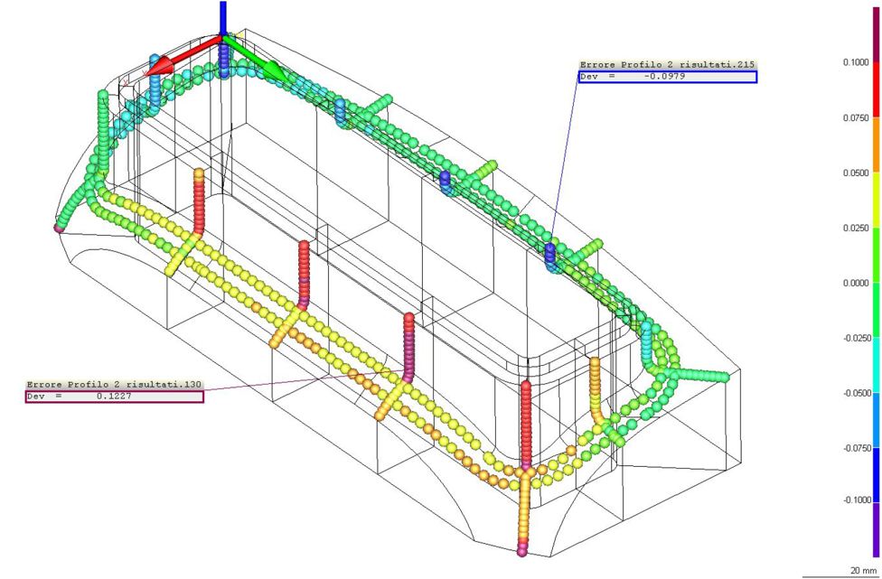
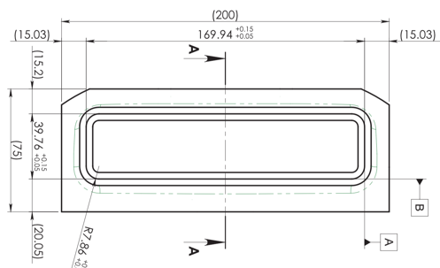
Fabrication Results: Insert Machining Test
Copper Waveguides/ End Cap transition insert
  Good overall results
  Satisfying quality of machined welding edges (shape accuracy <0.2mm)
  Need better fixture for machining centering (see rectangles)

Slide 19
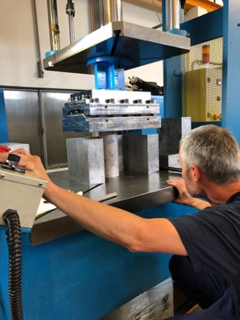
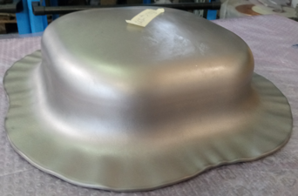
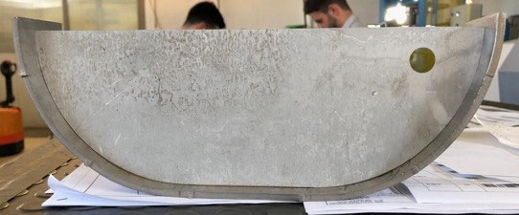
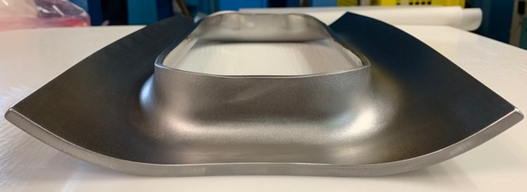
Fabrication Status: Next steps & Pics
Imminent activities:
Forming of Half Main Body (full scale)
EBW test between copper Pole & Corner
RX EBW of waveguides (MTF upload)
Metrology check of Nb transition insert
Machining of Nb End Caps
Machining of Nb extremities
Finalization of Machining & EBW Tools
…
End Cap
Half Main Body “short Test”
Corner

Slide 20
RFD Prototype Cavities Fabrication at Zanon: Outline
Design for fabrication
  AUP RFD Prototypes Cut-Out
  Assembly Strategy
  Drawing Status
Fabrication Status
  Forming, Machining & EBW Tools
  Manufacturing Results Summary
  Waveguide Boxes Example
  V-HOM Extrusion
  Beam Axis extrusion test
  Deep Drawing
  Insert Machining Test
  Next steps & Pics
QA documentation
  Actual Status
  MTF Status
Summary

Slide 21
QA Documentation: Actual Status
Description Procedure | Procedure N. | Revision | Status
RFD Crab Cavity Drawing Package | 3326.1.000.000 | 0 | Check ongoing (FNAL)
Manufacturing Drawing Tooling | Not Available | 0 | Update ongoing (Zanon)
Welding Book – section 1 Welding Map | 3326.W.001 | 0 | Update ongoing (Zanon)
Welding Book - section 3 Test Coupon (WPQR) | 3326.W.001 | 0 | Update ongoing (Zanon)
Welding Book - section 2 (WPS) | 3326.W.001 | 0 | Update ongoing (Zanon)
Welding Book - section 4 Welding Operators (WOPQ) | 3326.W.001 | 0 | Update ongoing (Zanon)
Welding Book – section 1-4 | 3326.W.001 | 0 | Update ongoing (Zanon)
Quality Control Plan – RFD Prototypes (MIP) | 3326.F.001 | 2 | Update ongoing (Zanon)
Quality Control Plan – Deep Drawing of Cu Test | 3326.F.002 | 0 | Approved (for Prototype)
Cleaning & Chemical Etching | 3326.S.004 | 1 | Approved
Identification, Marking, Traceability | 3326.S.001 | 1 | Approved
Radiographic Examination (RT) | 3326.S.005 | 1 | Approved
Radiographic Test Extent | Radiographic Tests Extent | 1 | Update ongoing (Zanon)
Manufacturing Sequence | 3326.S.008 | 0 | Update ongoing (Zanon)
Helium Leak (LT) | 3326.S.006 | 0 | Waiting for comments (CERN)
Dimensional Control | 3326.S.002 | 0 | Waiting for comments (CERN)
Visual Inspection | 3326.S.003 | 1 | Approved
Packing Procedure | 3326.P.001 | 0 | Ongoing (Zanon)
QA documents provides by Zanon are available on EDMS
NOTA: The Eng. Spec. (EDMS 1389669) requires CERN approval for all procedures concerning Pre-series and Series production

Slide 22
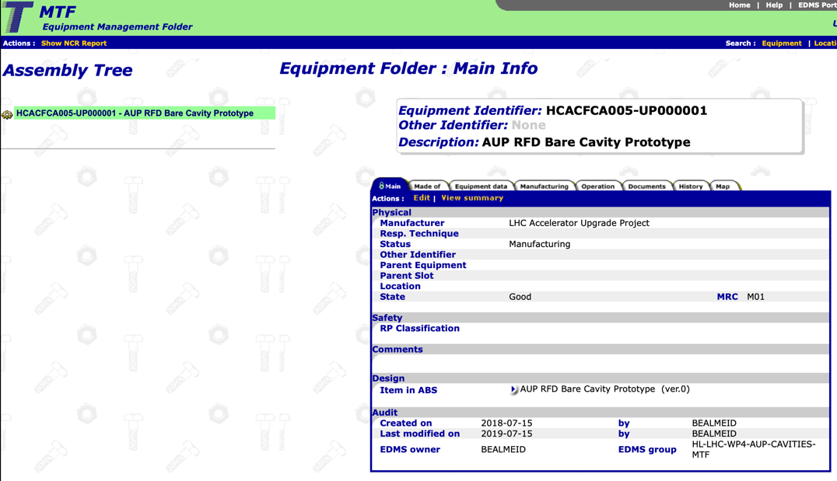
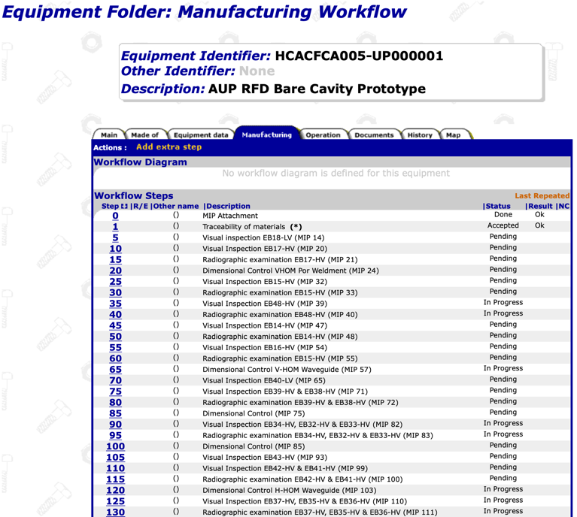
QA Documentation: MTF Status
Workflow Steps based on Zanon QCP rev.1
QA docs available on MTF/ EDMS
  EDMS CERN-0000197563
Note: A lot of document will be uploaded in the next weeks

Slide 23
RFD Prototype Cavities Fabrication at Zanon: Outline
Design for fabrication
  AUP RFD Prototypes Cut-Out
  Assembly Strategy
  Drawing Status (back-up)
Fabrication Status
  Forming, Machining & EBW Tools
  Manufacturing Results Summary
  Waveguide Boxes Example
  V-HOM Extrusion
  Beam Axis extrusion test
  Deep Drawing
  Insert Machining Test
  Next steps & Pics
QA documentation
  Actual Status
  MTF Status
Summary

Slide 24

Summary
Fabrication drawings
  Fixing minor details to achieve ISO GPS standard requirements
Fabrication Tools:
  Forming Tools almost validated
  Machining and EBW manufacturing ongoing
Subcomponents Manufacturing:
  4x Pole: ready for EBW
  2x H-HOM: boxes welded (RX ongoing)
  2x V-HOM: boxes welded (RX ongoing)
  2x FPC: boxes welded (RX ongoing)
  2 x End Cap: formed
Machining agenda for next weeks
  Half Main Body: first forming on Niobium ongoing
  End Cap: preparation for EBW ongoing
  Waveguides bulk transition insert: machining ongoing
  Pole & Corner preparation for EBW: machining ongoing
  Copper Pole & Corner EBW test ongoing
  Extremities machining ongoing
Updating QA documents according to CERN/FNAL feedbacks
Tight schedule for prototype!

Slide 25
Thank for the attention!

