Slide 1


D1 Update
Results of Model Development and
Status of Prototype and Series
Tatsushi NAKAMOTO, KEK
On behalf of CERN-KEK Collaboration for D1 Construction for HL-LHC
9th HL-LHC Collaboration Meeting, Fermilab, USA, 15 October 2019

Slide 2
Acknowledgement
KEK (in particular)
M. Sugano, N. Kimura, K. Suzuki, Y. Arimoto, R. Ueki, Y. Ikemoto, H. Kawamata, N. Okada, R. Okada, H. Ohhata, A. Terashima, H. Ikeda, K. Tanaka, N. Ohuchi, T. Ogitsu.
CERN (in particular)
E. Todesco, A. Musso, H. Prin, D. Duarte Ramos, C. Scheuerlein, A. Foussat, B. Almeida Ferreira.
Hitachi
A. Horikoshi, T. Chiba.
Fusac Technologies
T. Ichihara.

Slide 3
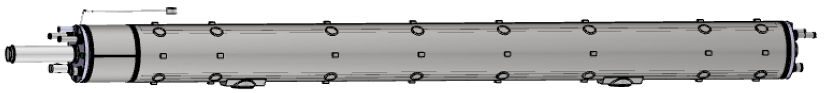
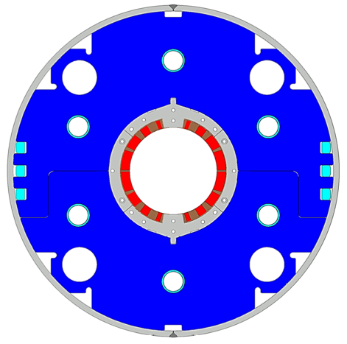
Japanese Contribution to HL-LHC: D1 magnets
Beam separation dipole (D1) by KEK
  Design study of D1 for HL-LHC within the framework of the CERN-KEK collaboration since 2011.
  150 mm single aperture, 35 Tm (5.6 T x 6.3 m), Nb-Ti technology.
  Development 2-m long model magnets (3 units) at KEK
Deliverables for HL-LHC
  1 full-scale prototype cold mass (LMBXFP)
  6 series cold masses (LMBXF1-6)
7 units x 7-m long cold masses

Slide 4
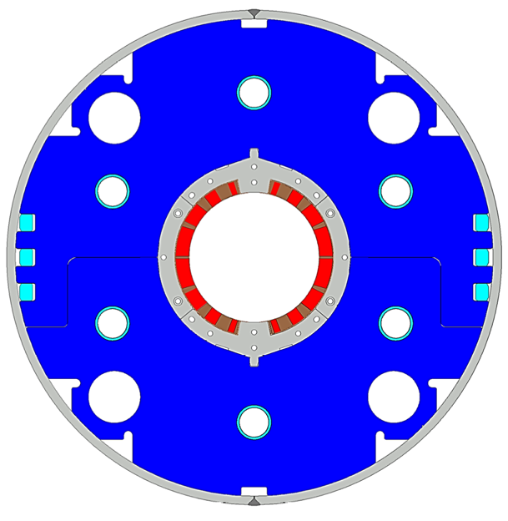
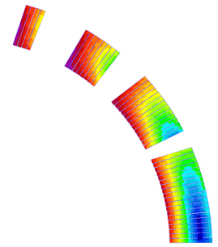
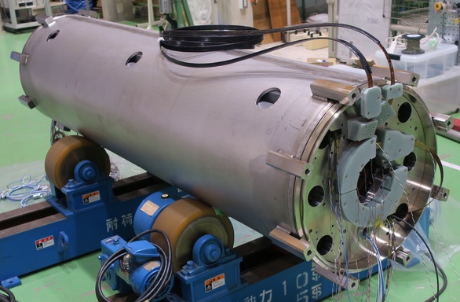
Design parameters
Collar
Nb-Ti/Cu coil
GFRP
wedge
 | A series production (7m) | MBXFS3 (2 m)
Coil aperture | 150 mm
Field integral | 35 T m | 9.5 T m
Field (3D) | Nominal: 5.60 T, Ultimate: 6.04 T
Peak field (3D) | Nominal: 6.58 T, Ultimate: 7.14 T
Current | Nominal : 12.05 kA, Ultimate 13.14 kA
Operating temperature | 1.9 K
Field quality | <10⁻⁴ w.r.t B₁ (R_{ref}=50 mm)
Load line ratio (3D) | Nominal: 76.5%, Ultimate: 83.1% at 1.9 K
Differential inductance | Nominal: 4.0 mH/m
Conductor | Nb-Ti: LHC-MB outer cable
Stored energy | Nominal: 340 kJ/m
Magnetic length | 6.26 m | 1.67 m
Coil mech. length | 6.58 m | 2.00 m
Magnet mech. length | 6.73 m | 2.15 m
Heat load | 135 W (Magnet total) 2 mW/cm³ (Coil peak) > 25 MGy
Radiation dose
Shell
Yoke
QPH
Insulation
Brass shoe
4
8
13
4 blocks
44 turns
19
Large-aperture single layer coil → Mechanical support of a coil is challenging
Production magnet: 7 m-long
Three 2 m model magnets have been developed at KEK

Slide 5
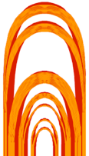
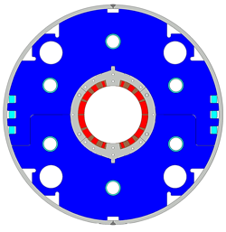
Model magnet development in KEK
MBXFS1 cold test at Apr. 2016
Insufficient training performance due to lack of azimuthal pre-stress
Field quality could not be evaluated at nominal current due to low quench current
MBXFS1b cold test at Feb. 2017
Improvement of training performance due to enhanced coil pre-stress
Field quality could not be quantitatively discussed due to shim insertion
MBXFS2 cold test at Nov. 2018
Significant change in yoke design → Magnetic and mechanical design update
Wet-winding at coil end for coil end support
Successful validation of QPH with meandering heater strips
Large b₃ offset of ~20 unit from calculation
MBXFS3 cold test at Sep. 2019
Basically same design as MBXFS2 → Reproducibility check
Identical wedge as MBXFS2 → a systematic large b₃ offset is expected
Further enhancement of mechanical support at coil end.

Slide 6
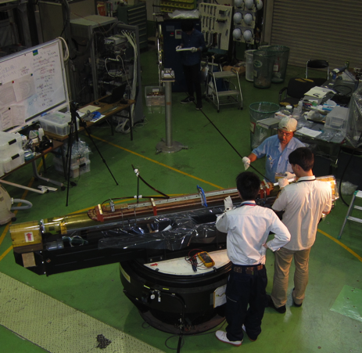
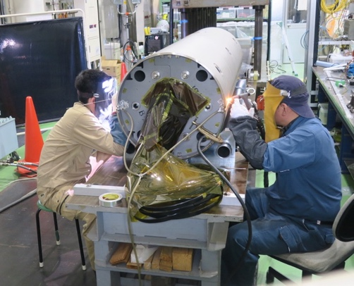
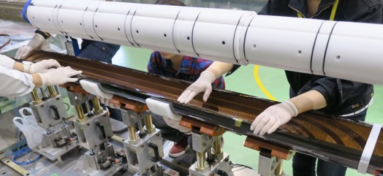
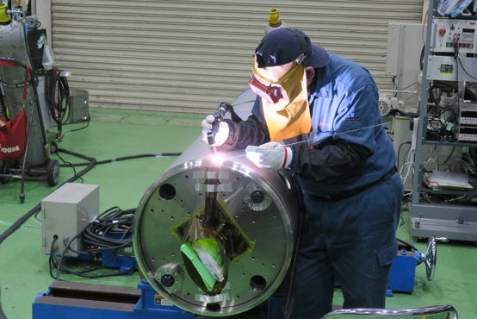
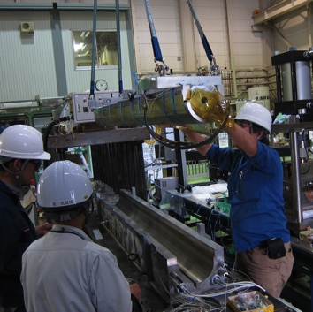
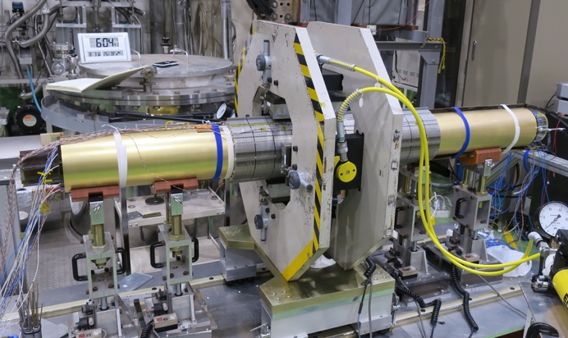
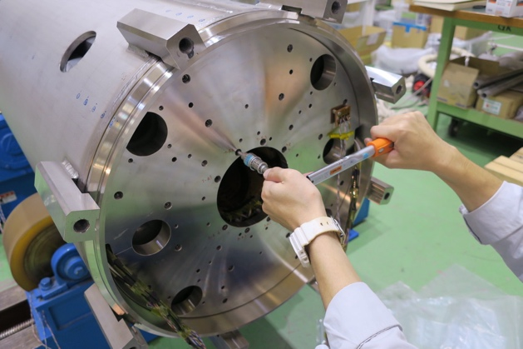
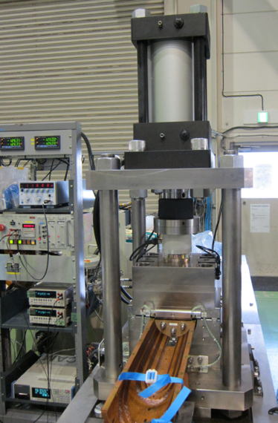
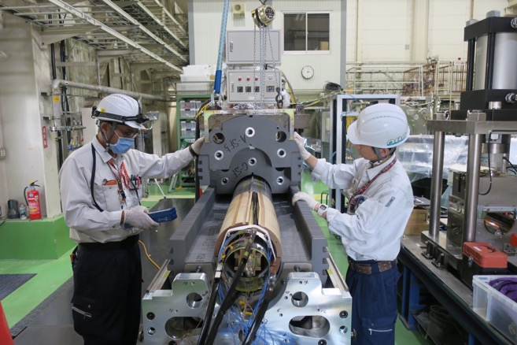
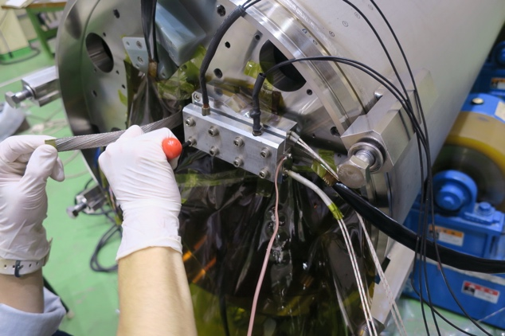
Fabrication steps
1. Coil winding
4. QPH, insulation
wrapping
7. Shell, end-ring
welding
2. Curing
5. Collaring
8. Axial pre-loading
3. Coil size meas.
6 .Yoking
9. Splicing

Slide 7
Mechanical design of MBXFS3

Slide 8
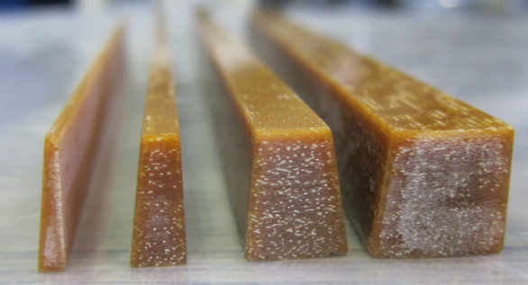
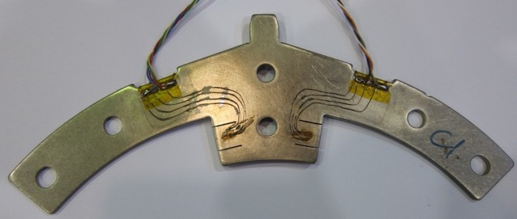
Mechanical support in the SS in MBXFS3
Pole shim and wedges
GFRP wedge
Oversizing
Strain gauges on collar pole
GFRP oversize and coil pre-stress
 | MBXFS1 | MBXFS1b | MBXFS2 | MBXFS3
Total GFRP arc length w.r.t MBXFS1 (mm) | – | 0.8 | 1.14 | 1.14
Target azimuthal pre-stress (MPa) | 80 | 110 | 115 | 115
Measured pre-stress after yoking (MPa) | 65 | 100 | 111 | 114
Wedge design same as MBXFS2, Similar measured pre-stress

Slide 9
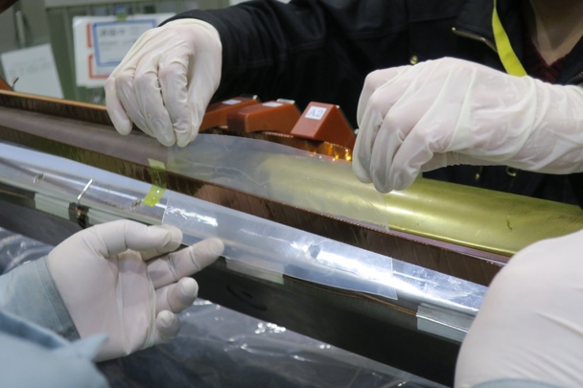
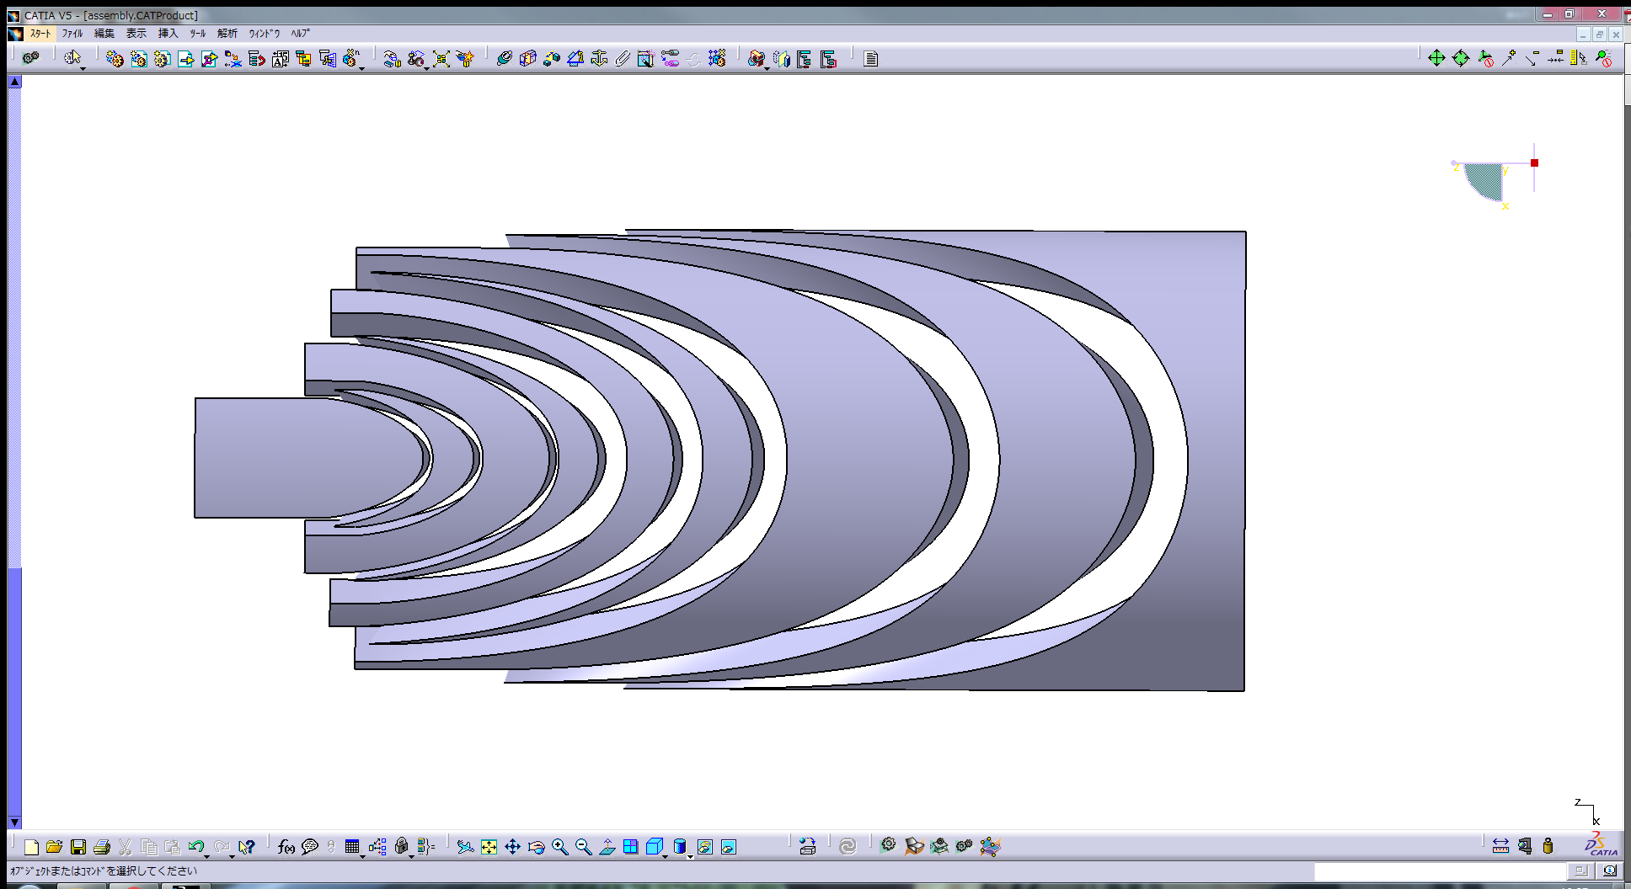
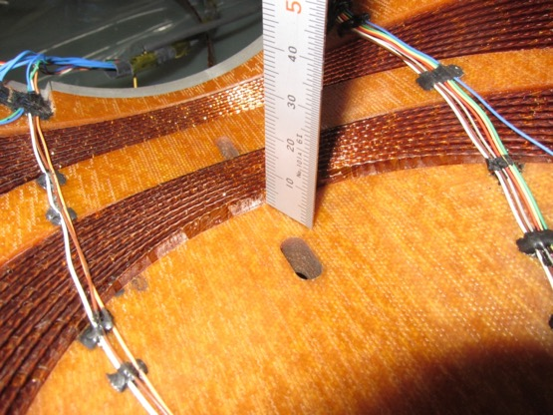
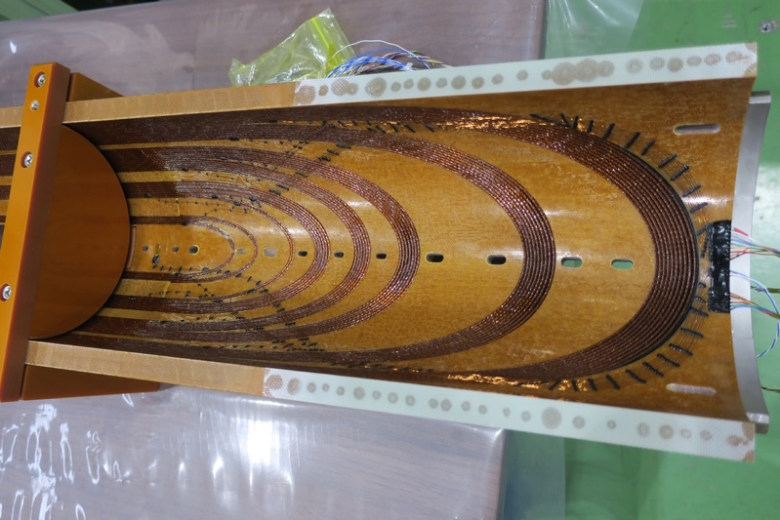
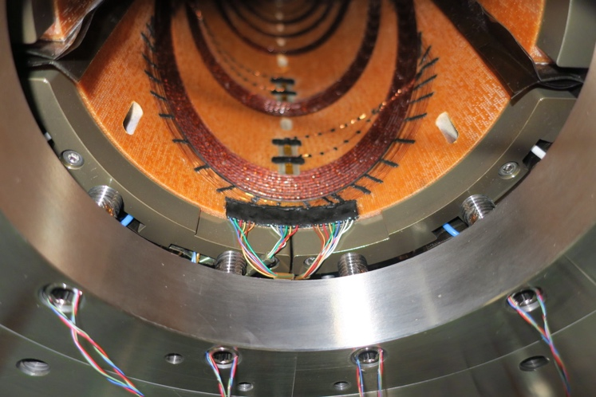
Mechanical support at coil end
Oversize
Wet-winding
Cable deformation
MBXFS1
RE6
RE4
RE2
RE9
RE8
RE7
RE5
RE3
RE1
Max displacement
3.4 mm in MBXFS1
→ ~1 mm in MBXFS2
Axial pre-load
Taper shim
Gap filling
 | MBXFS1 | MBXFS1b | MBXFS2 | MBXFS3
Oversize of end spacers wrt MBXFS1 (mm) | – | 0.9 | 1.14 | 1.14
Wet-winding | No | No | Yes | Yes
Tightening torque of bullets (Nm) | 14 | 14 | 20 | 24
Axial pre-load per coil end (kN) | – | – | 30 – 43 | 25 – 40
Additional shim on end saddle | – | – | – | t0.7 mm at max
Gap filing with epoxy resin | No | No | No | Yes

Slide 10
Mechanical support at coil end
Oversize
Wet-winding
Cable deformation
MBXFS1
RE6
RE4
RE2
RE9
RE8
RE7
RE5
RE3
RE1
Max displacement
3.4 mm in MBXFS1
→ ~1 mm in MBXFS2
Axial pre-load
Taper shim
Gap filling
 | MBXFS1 | MBXFS1b | MBXFS2 | MBXFS3
Oversize of end spacers wrt MBXFS1 (mm) | – | 0.9 | 1.14 | 1.14
Wet-winding | No | No | Yes | Yes
Tightening torque of bullets (Nm) | 14 | 14 | 20 | 24
Axial pre-load per coil end (kN) | – | – | 30 – 43 | 25 – 40
Additional shim on end saddle | – | – | – | t0.7 mm at max
Gap filing with epoxy resin | No | No | No | Yes

Slide 11
Test result of MBXFS3

Slide 12
Training history
1st cycle of MBXFS3
Number of quenches to nominal (12.05 kA):8 in MBXFS2 → 2 in MBXFS3
Significant improvement in training up to nominal current in MBXFS3
The ultimate current (13.14 kA) was achieved at the 16th quench.
Current holding: 12.3 kA for 1hour, 13.3 kA for 35 min
4.4 K training: I_{q,4.4K}=12.3 kA up to short sample limit
→ Quench current at 1.9 K is limited by mechanical support

Slide 13
Training history
1st cycle of MBXFS3
Number of quenches to nominal (12.05 kA):8 in MBXFS2 → 2 in MBXFS3
Significant improvement in training up to nominal current in MBXFS3
The ultimate current (13.14 kA) was achieved at the 16th quench.
Current holding: 12.3 kA for 1hour, 13.3 kA for 35 min
4.4 K training: I_{q,4.4K}=12.3 kA up to short sample limit
→ Quench current at 1.9 K is limited by mechanical support

Slide 14
Training history
First quench in the 2nd cycle
I_{q}=13.21 kA
MFM, QPH
2nd cycle of MBXFS3
The first quench current after full thermal cycle exceeded the ultimate current. (I_{q}=13.21 kA beyond the ultimate of 13.14 kA)
Very good training memory

Slide 15

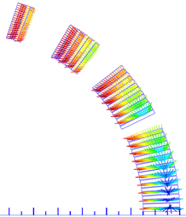

Coil stress in the straight section
Pole
Azimuthal
coil
pre-stess
Lorentz
force
Strain gauges
on collar pole
Mid-plane
I_{nom}
I_{ult}
I_{nom}
I_{ult}
MBXFS2
MBXFS3
Pre-stress
=111 MPa
Pre-stress
=114 MPa
Variation of coil stress
at collar pole (MPa)
Variation of coil stress
at collar pole (MPa)
Sufficient azimuthal coil pre-stress in MBXFS3 same as MBXFS2

Slide 16
MFM: Transfer function
(*) Average of ramp-up / down
 | MBXFS2 |  | MBXFS3
 | Data* | Calc. | Data* | Calc.
TF (T/kA) @ 12 kA | 0.4698 | 0.4684 | 0.4667 | 0.4681
TFs of MBXFS2 and 3 agree within 0.7 % at nominal operating current

Slide 17
MFM: at the magnet center (I=3kA, 12.05kA)
(*) Average of ramp-up / down
 | MBXFS2 |  | MBXFS3
 | 3 kA* | 12.047 kA* | 3 kA* | 12.047 kA*
b₃ (units) | 20.84 | 35.94 | 24.05 | 37.28
b₅ (units) | -1.98 | 1.61 | -1.82 | 2.01
b₇ (units) | -0.16 | -0.83 | 0.03 | -0.58
b₉ (units) | 0.05 | 0.40 | 0.08 | 0.50
b₁₁ (units) | 0.20 | 0.21 | 0.21 | 0.23
b₁₃ (units) | -0.50 | -0.53 | -0.51 | -0.52
b₁₅ (units) | -0.96 | -1.02 | -1.01 | -1.10
#2-#3 comparison:
Good agreement in the higher allowed multipole (n≥5)
~3 unit difference observed in the geometrical b3, and reduced to ~1 unit at I_{nominal}

Slide 18
Cause of Large b3
MBXFS2 ROXIE2D model w/ LHC cryostat for I=3kA (geometrical check)
 | Original Model (wrong) | Based on actual wedge dimensions suggested by Ezio | Measurement (average up/down)
b3 | 2.12 | 20.69 | 20.89
b5 | -3.18 | -2.86 | -1.95
b7 | 0.4 | -0.04 | -0.15
b9 | -0.27 | -0.07 | 0.08
Comparison of two ROXIE models with measurement.
  Original ROXIE model with azimuthal insulation thickness of 0.130 mm. No consideration of additional oversizing of 0.82 mm which was needed to achieve σ_{coil} of 115 MPa.

Slide 19
Cause of Large b3
MBXFS2 ROXIE2D model w/ LHC cryostat for I=3kA (geometrical check)
 | Original Model (wrong) | Based on actual wedge dimensions (suggested by Ezio) | Measurement (average up/down)
b3 | 2.12 | 20.69 | 20.89
b5 | -3.18 | -2.86 | -1.95
b7 | 0.4 | -0.04 | -0.15
b9 | -0.27 | -0.07 | 0.08
Comparison of two ROXIE models with measurement.
  Original ROXIE model with azimuthal insulation thickness of 0.130 mm. No consideration of additional oversizing of 0.82 mm which was needed to achieve σ_{coil} of 115 MPa.
  ROXIE model based on the actual wedge dimensions including additional oversizing of 0.82 mm.
We concluded that inadequate design of wedge oversizing for coil prestress enhancement was the cause of a large b3.

Slide 20
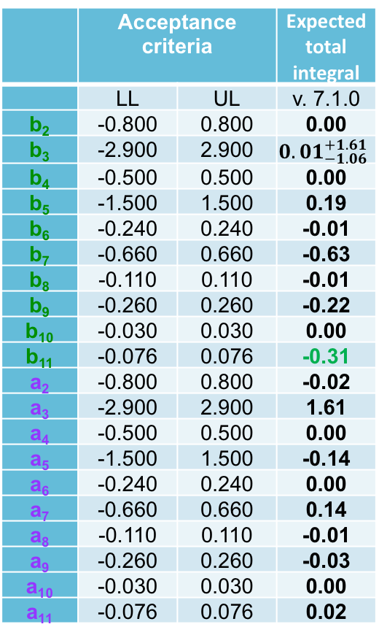
Design for MBXFP1
For 7m long full-scale prototype, the ROXIE model with appropriate azimuthal insulation thickness of 0.122 mm including the prestress enhancement is used for the design.
  In addition, the effects of oval structural deformation, coil deformation due to Lorenz force and unpredictable iron saturation effect in 3D model at 12 kA are taken into account for the 7m long full-scale prototype.
 | Acceptance criteria |  | Expected total integral
 | LL | UL | v. 7.1.0
b₂ | -0.800 | 0.800 | 0.00
b₃ | -2.900 | 2.900 | $${0.01}_{−1.06}^{+1.61}$$
b₄ | -0.500 | 0.500 | 0.00
b₅ | -1.500 | 1.500 | 0.19
b₆ | -0.240 | 0.240 | -0.01
b₇ | -0.660 | 0.660 | -0.63
b₈ | -0.110 | 0.110 | -0.01
b₉ | -0.260 | 0.260 | -0.22
b₁₀ | -0.030 | 0.030 | 0.00
b₁₁ | -0.076 | 0.076 | -0.31
a₂ | -0.800 | 0.800 | -0.02
a₃ | -2.900 | 2.900 | 1.61
a₄ | -0.500 | 0.500 | 0.00
a₅ | -1.500 | 1.500 | -0.14
a₆ | -0.240 | 0.240 | 0.00
a₇ | -0.660 | 0.660 | 0.14
a₈ | -0.110 | 0.110 | -0.01
a₉ | -0.260 | 0.260 | -0.03
a₁₀ | -0.030 | 0.030 | 0.00
a₁₁ | -0.076 | 0.076 | 0.02
 | MBXFS2 and 3 | MBXFP1 v7.1.0
Target b3 at 3kA | 0 | -5
φ1 | 1.1346 | 1.2962
φ2 | 27.8721 | 27.9747
φ3 | 50.2969 | 50.4743
φ4 | 70.6992 | 70.841
α2 | 26.0000 | 27.4005
α3 | 52.4212 | 52.34
α4 | 68.0015 | 68.9141
Azimuthal insulation thickness (mm) | 0.130 | 0.122
B1=5.578 T @ 12070A

Slide 21
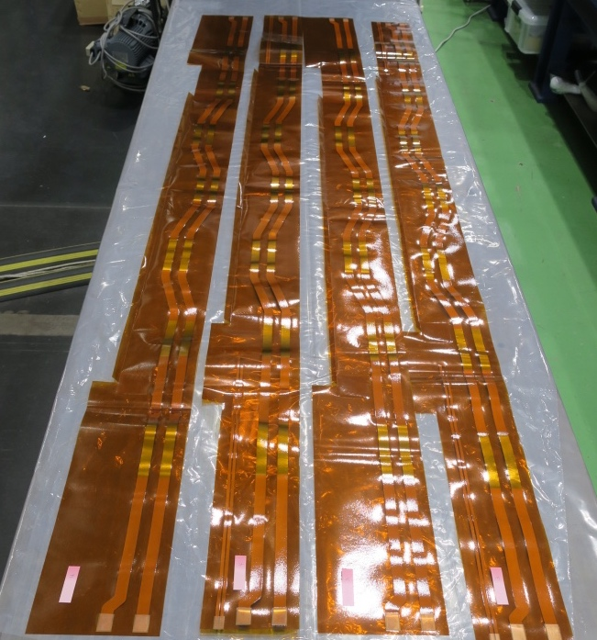
New QPH Design and Experimental Validation
Single strip heaters for MBXFS01 was not good enough…
A longitudinal length of SUS patch is >100 mm to cover a cable twist pitch.
A zigzag pattern is adopted to increase heater coverage
A total resistance of the heater (RQH) is adjusted by copper regions to keep a sufficient peak power density.
Tests at MBXFS02 and MBXFS03.

Slide 22
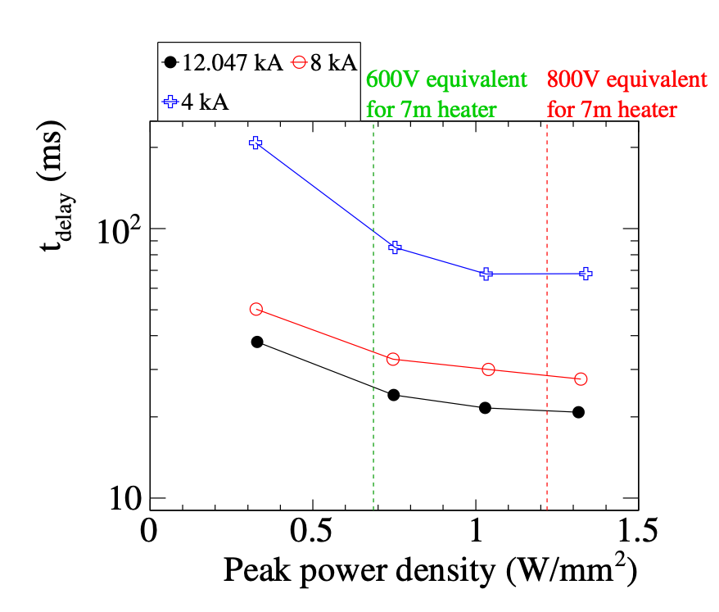
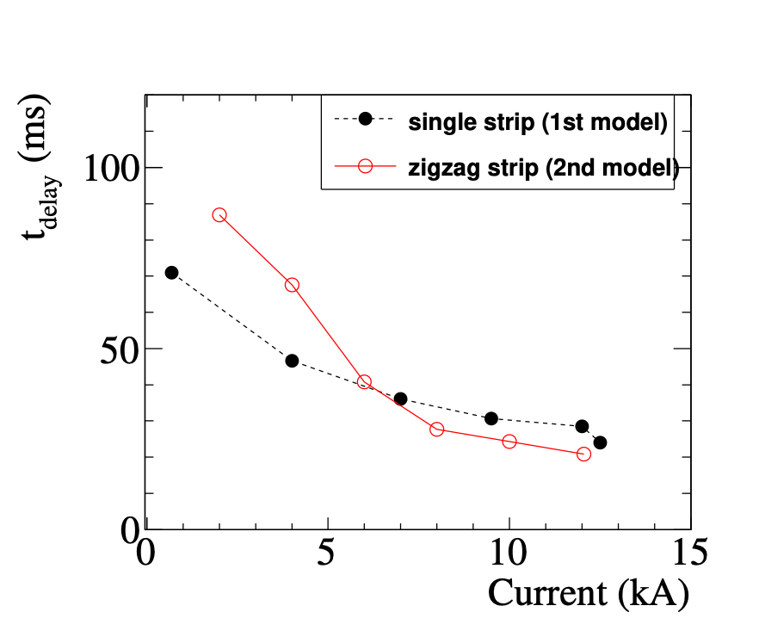
Delay time
P_{peak}=1.3 W/mm²
T_{delay} vs. I_{mag}
T_{delay} vs. P_{peak}
Shorter tdelay was confirmed at the higher current (> 7kA) for new QPH.
tdelay curve (Right) is almost flat in the region > 1 W/mm²
Full-scale QH (800V full charge) is expected to give a similar heater delay of ~20ms at I_{nom}.

Slide 23
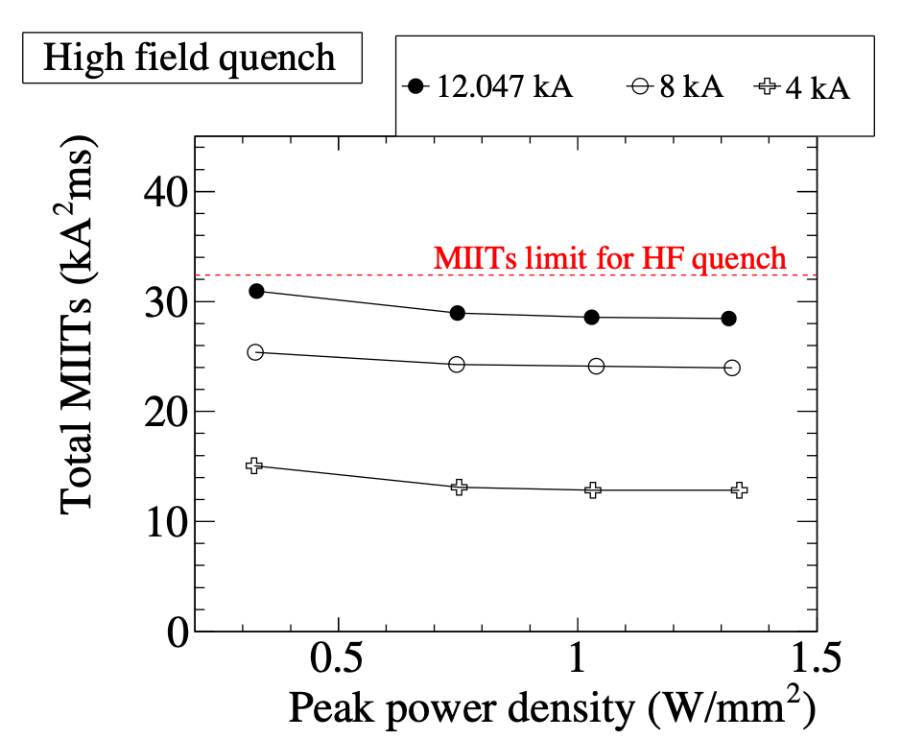
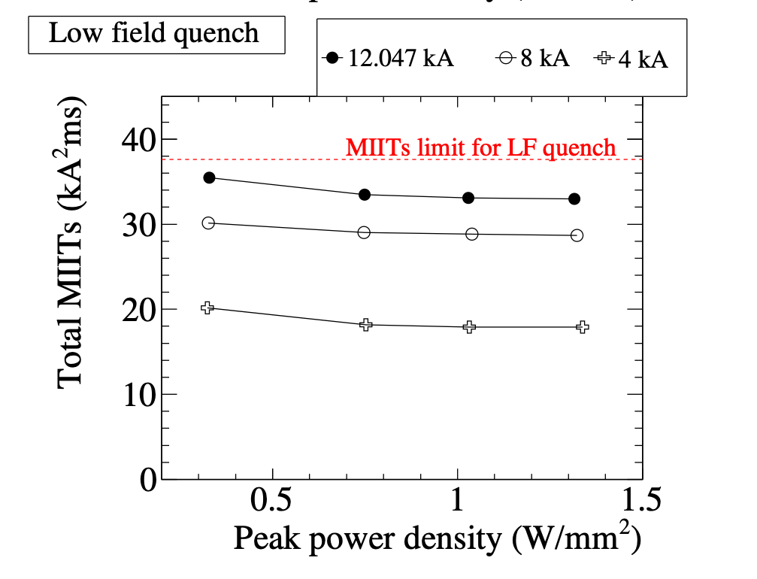
MIITs evaluation in full energy dump test
Measured total MIITs (incl. detection time, tdet) for high field (left) and low field (right) quenches.
Overall MIITs are well below the limit (T=300 K) even the charge voltage of PS is half (400 V)

Slide 24
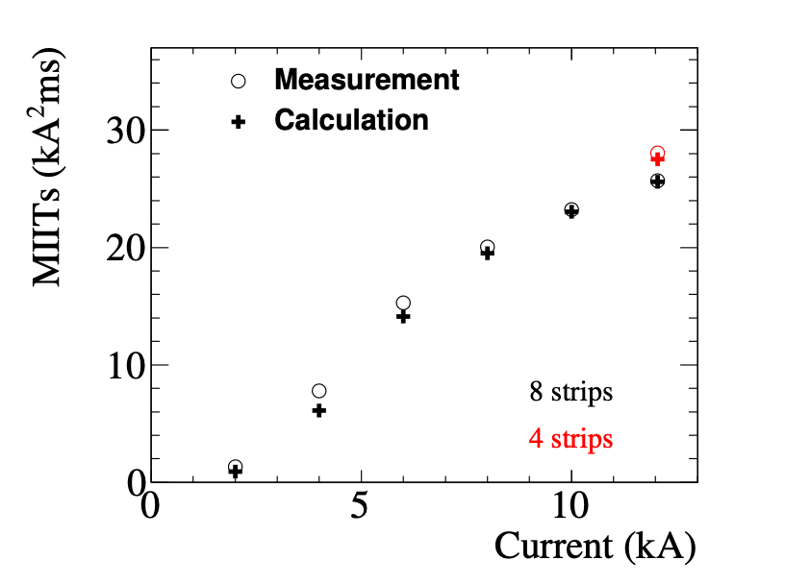
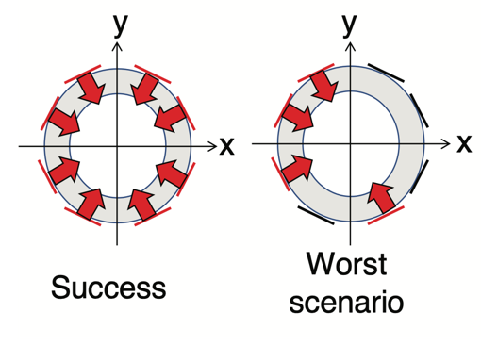
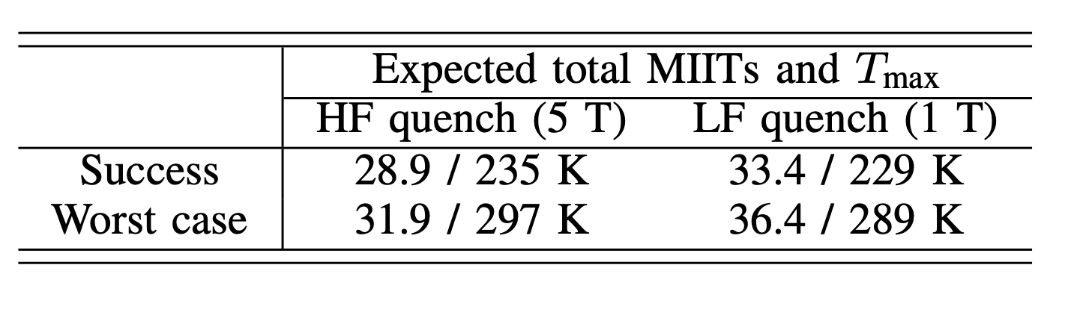
Full-Scale QPH Performance
Validation of simulation by full energy dump of MBXFS02
Good agreement of simulation confirmed in 2m model.
Failure (misfire) Case
Predicted MIITs and T_{max} at I_{nom}
Discrepancy (small) between the simulation and the measurement is taken into account to estimate a full-scale QPH performance.
Simulation results predict;
  T_{max} will be well below 300 K in no-failure mode.
  the magnet can be protected even in case of 2 P/S failures (2 out of 4).

Slide 25
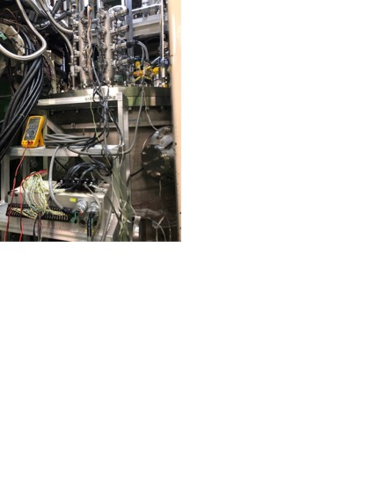
HiPot Test at NOC*
EIQA criteria
Test name |  | Value (V)
Test voltage at NOC* | Coil to ground | 1300
 | Heater to coil | 2300
 | b/w heater strips | 2300
Maximum leakage current (µA) |  | 10
Test voltage duration (s) |  | 30
(*)Nominal Operation Condition=1.9K
Good!
Coil to ground (1.3 kV)
  Coil (HV+): <0.1 µA for 30 s
Heater to coil (2.3 kV)
  QPH1-4 (HV+), Coil (HV- = GND) : Breakdown at 1.90 kV
  QPH1-4 (HV+), Coil (HV-) : GND fault at 1.95 kV
Heater strips (2.3 kV)
  QPH1 (HV+), QPH2-4 (HV- = GND) : <0.1 µA for 30 s
  QPH2 (HV+), QPH1,3-4 (HV- = GND) : <0.1 µA for 30 s
  QPH3 (HV+), QPH1-2,4 (HV- = GND) : < 0.1 µA for 30 s
  QPH4 (HV+), QPH1-3 (HV- = GND) : Breakdown at 1.82 kV
  QPH4 (HV+), QPH3 (HV-) : GND fault at 1.54 kV
Good!
Good!
There might be weakness in the cable line of QPH4
Good!

Slide 26
Status of Prototype

Slide 27
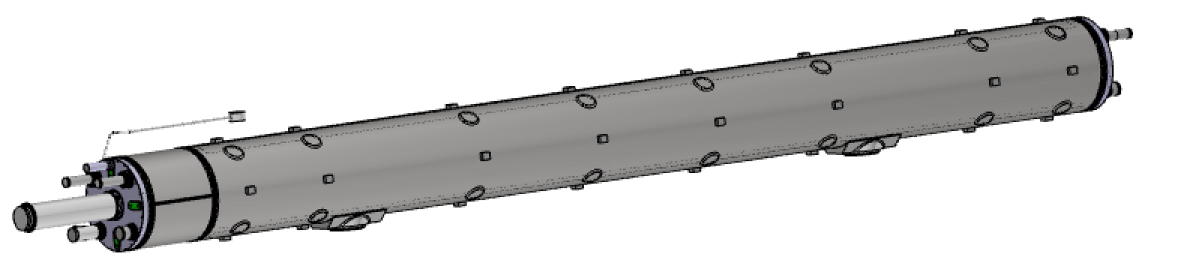
D1 Magnet Cold Mass
RE side
IP side
LE side
NIP side
MN
X2
X1
L2
L1
Design Parameters
Nominal current and field, field integral: 12070 A, 5.58T, 35 Tm
Design pressure and operating temperature: 2.0 MPa, 1.9 K
Pressure test at 2.5 MPa
He leak rate below 1 x 10⁻¹⁰ Pa m³/s
Cold mass length and distance between saddles: 7370 mm and 3900 mm
Outer diameter: < 630 mm Shell OD: 570 mm + markers
The detail of extremities given by CERN
  Two HeII HX pipes in line with MQXF (X1, X2)
  Two HeII conduction lines (L1, L2)
  Bus bars interconnection line (MN)

Slide 28
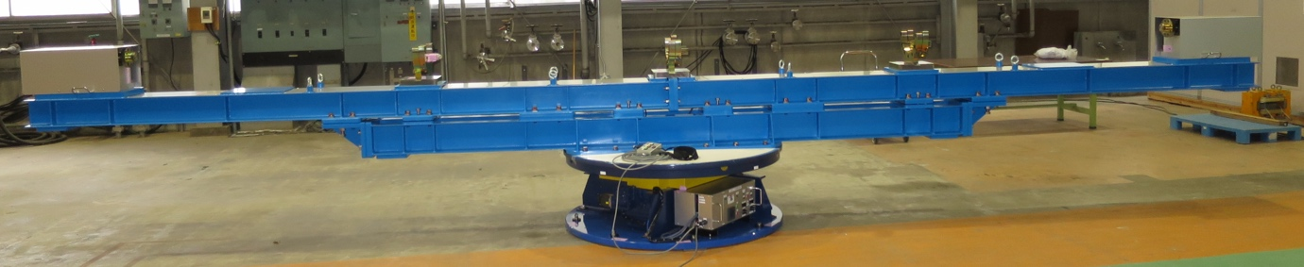
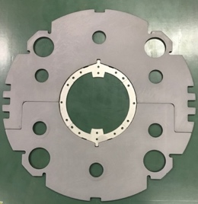
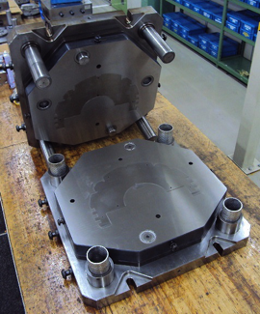
Overview of Production of D1 Prototype and Series
In-house development of 2-m model magnets so far.
  Design, drawings, fabrication processes are available for 7-m long magnets.
    Change of coil cross section will be applied to the prototype.
  Asset for 7-m magnets:
    7m long coil winding machine NEW!
    2 x 3.6m long hydraulic press
    Fine-blanking dies for collar and yoke
    50% of stainless steel (NSSC130S) for the whole project.

Slide 29
Overview of Production of D1 Prototype and Series
Production of 7-m cold masses (prototype and series) by a manufacturer.
  Involvement of Japanese firms already in model magnet development:
  >> smooth technical transfer, accurate (lower) cost estimate.
  A Multi-year contract given to Hitachi (May 2019)
    Covering construction of 1 prototype & 4 series cold masses
    Another contract for 2 remaining cold masses will be made in JFY 2021 and 2022.
    To be fitted to the delivery schedule.
Raw materials procured by KEK: timely provision to the manufacturer.
  Due to some reasons: budget limitation, PED, cobalt content.
    Low cobalt iron and stainless steel, radiation resistant GFRP, etc.
Supplies from CERN:
  insulated SC cables,
  base laminates of QPH
  HX tubes
  insulated beam tubes
  end-covers
  Extremity parts such as flare flanges (under discussion).
  Agreement of money transfer using Mixed Flow Budget Code in preparation.

Slide 30
Manufacturing in Hitachi

Slide 31
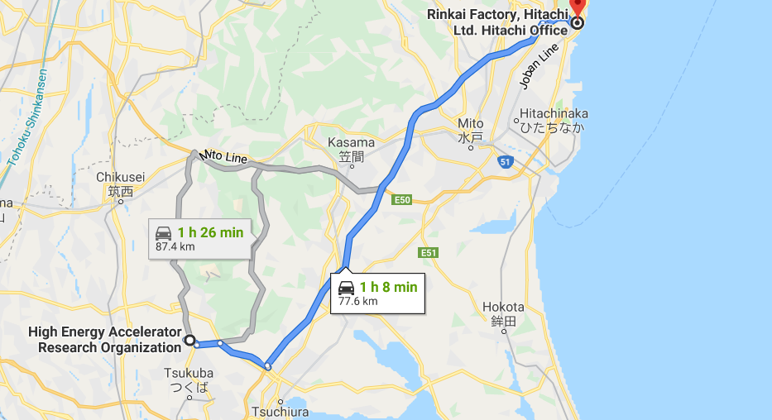
Hitachi Workshop and KEK Tsukuba
Rinkai Factory (Hitachi, Ltd.)
～80 km
Pacific Ocean
KEK Tsukuba
Tokyo

Slide 32
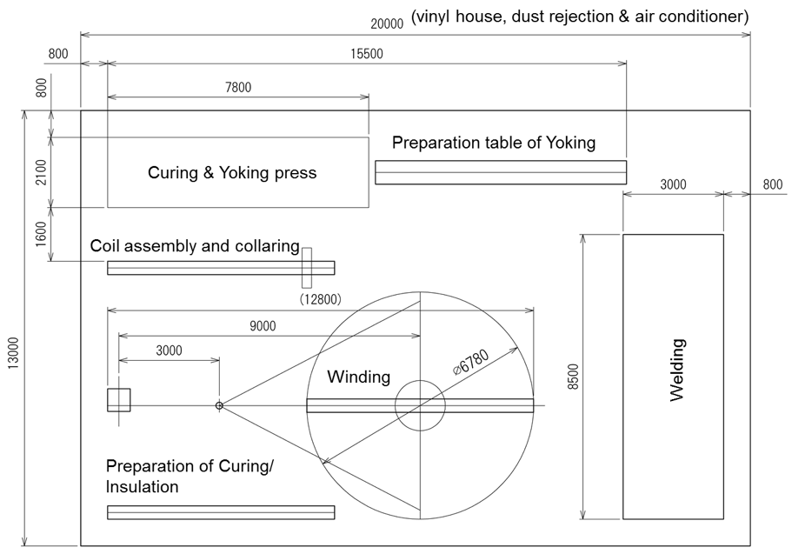
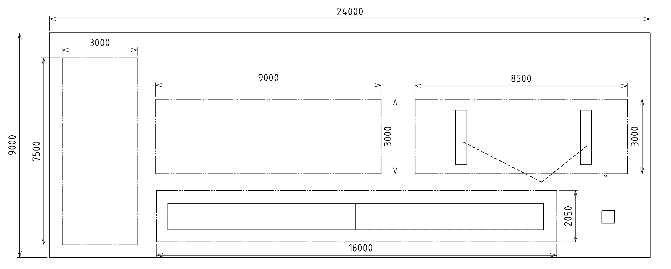
Manufacturing Layout in Hitachi
Two manufacturing spaces for series production.
Space 1: 20m×13m
> Winding
> Curing
> Insulation
> Collaring
Note: Space 1 is only available for the prototype.
Vinyl house, dust rejection & air conditioner
Space 2: 24m×9m
> Parts storage
> Welding
> Yoking
> Pressurization test

Slide 33
Flow of D1 Cold Mass Production
PV: Pressure Vessel
5 installation of tubes (BT, HXT)
final splice, instrumentation
end-cover & extremities welding
alignment & support welding
1 coil winding
D1 Yoked Magnet
2 insulation, collaring
HITACHI
3 yoking
inspection incl. pressure test (@ 2.5 MPa)
HITACHI
4 shell & end-ring welding, end-plate, splice
Alignment target welding,
cap welding, alignment meas.
KEK
SSW
Rotating coil
warm MFM
SSW
Rotating coil
warm MFM
KEK
CERN
shipping to CERN
CERN HP
vertical cold test
Cryostating
Horizontal cold test

Slide 34
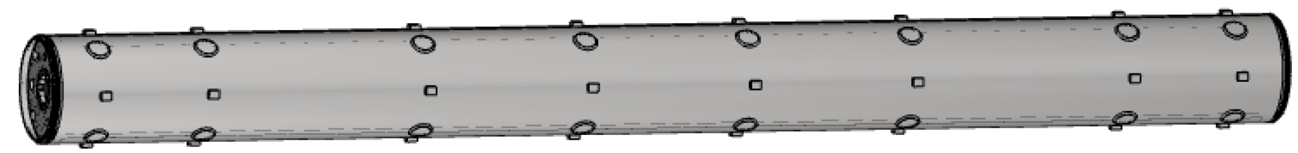
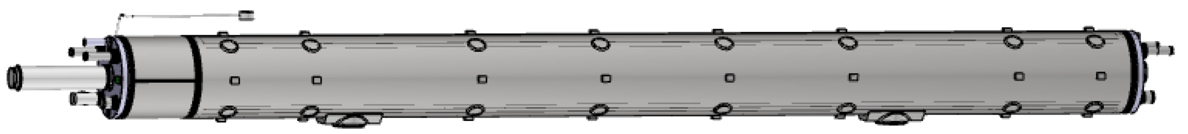
Flow of D1 Cold Mass Production
PV: Pressure Vessel
5 installation of tubes (BT, HXT)
final splice, instrumentation
end-cover & extremities welding
alignment & support welding
D1 magnet after process ”4” for vertical cold test at KEK
=Yoked magnet w/ shell, end-ring, cap
1 coil winding
D1 Yoked Magnet
2 insulation, collaring
HITACHI
3 yoking
inspection incl. pressure test (@ 2.5 MPa)
HITACHI
4 shell & end-ring welding, end-plate, splice
Alignment target welding,
cap welding, alignment meas.
D1 cold mass after process ”5” as a deliverable to CERN
KEK
SSW
Rotating coil
warm MFM
SSW
Rotating coil
warm MFM
KEK
CERN
shipping to CERN
CERN HP
vertical cold test
Cryostating
Horizontal cold test

Slide 35
Organization: KEK, CERN, HITACHI
Project Manager
T. Nakamoto
WP3
WPL: E. Todesco (CERN)
WPE: A. Musso (CERN)
Head of Cryogenics Science Center
T. Ogitsu
Design Team
M. Sugano
Quality Control Team
T. Nakamoto
Contract Section
Test Team
K. Suzuki
Technical supervision
Manufacturer (HITACHI)
A. Horikoshi (PM)
T. Chiba (GL)
Outside supplier

Slide 36
Preparatory Work

Slide 37
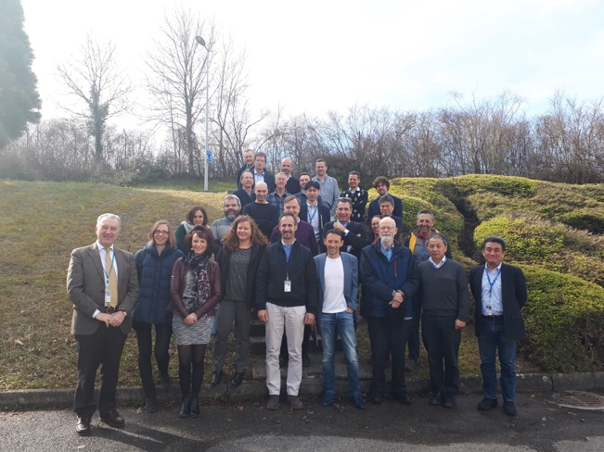
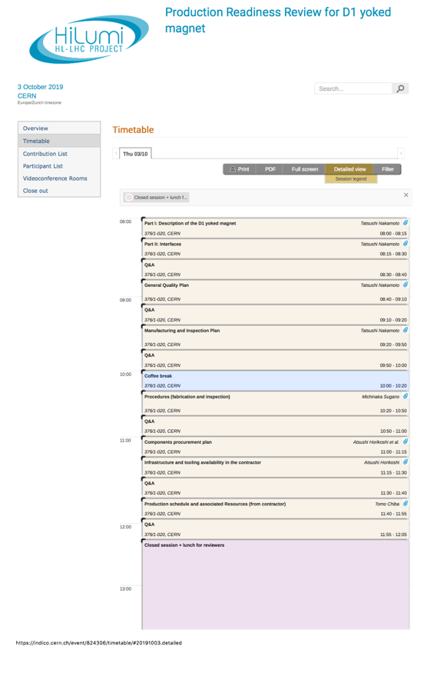
Reviews for Prototype
International review on D1 and D2 superconducting magnets for HL-LHC (11-13 March 2019)
  https://indico.cern.ch/event/790845/
  Recommendations:
    Understanding of b3 problem
    Reoptimizing the start of series production to solve the b3 problem.
      Note: the cause of b3 was not fully understood at that time.
Production Readiness Review for D1 yoked magnet (3 and 9 October 2019)
  https://indico.cern.ch/event/824306/
  “The production can start providing that a few actions listed below are taken.”
    Approve and upload all the drawings before starting the manufacturing.
    Define an appropriate production and delivery schedule.

Slide 38
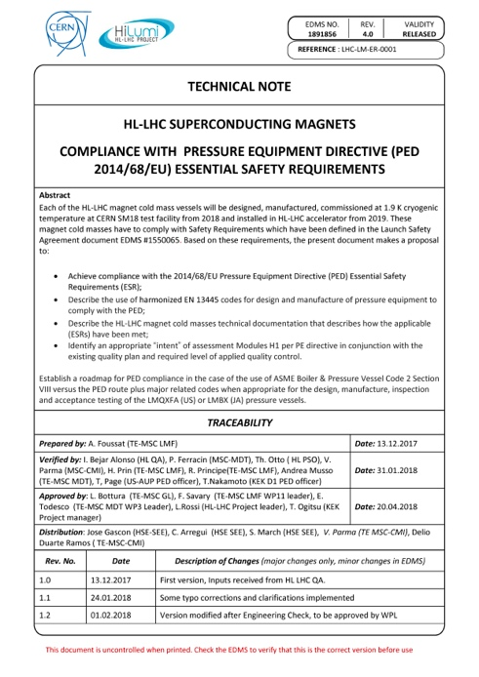
Compliance with PED Safety Requirement
CERN Baseline: 2014/68/EU Pressure Equipment Directive (PED) Essential Safety Requirements (ESR) and harmonized EN 13445 codes.
  The HL-LHC Superconducting Magnets Compliance with Pressure Equipment Directive Essential Safety Requirements [EDMS 1891856]
Alternative: “ASME Boiler and Pressure Vessel Code Section VIII Division 2” in compliance with PED << KEK’s baseline
  The CERN-KEK Agreement for Compliance with CERN Safety Requirements for Pressure Vessels [EDMS 2052040].
Report of structural analysis of D1 cold mass [to be uploaded to EDMS 2045901]
  1st version covering up to the shell structure w/o extremity is being checked by CERN-HSE.
  Final version for a full D1 cold mass structure will be prepared ASAP with provision of design analysis of extremity by CERN.

Slide 39
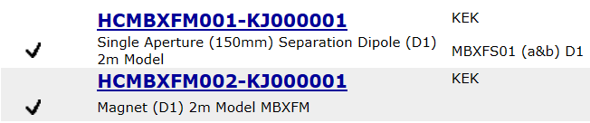
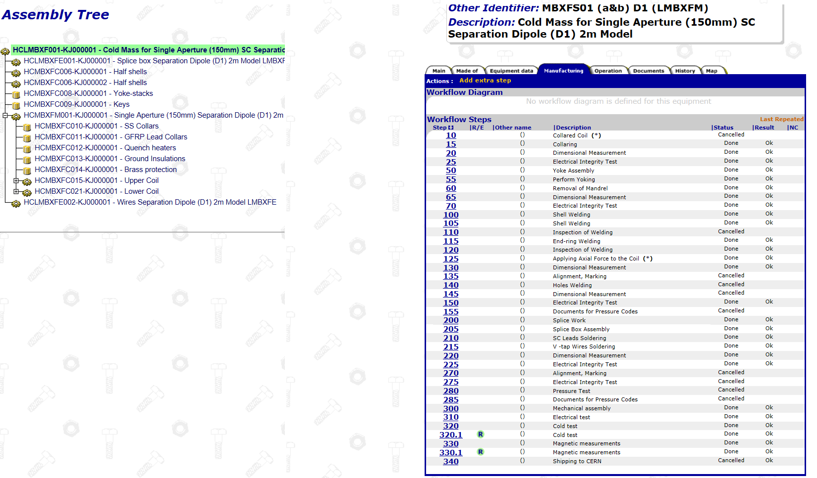
Quality Plan, Documentation
KEK-QP: EDMS 2102114, KCDS-000101. (Sep. 2019),
Hitachi Quality Manual + D1 dedicated QP: EDMS 2143585
KEK QP is basically consistent with HL-LHC QP.
  Minor deviation due to the international collaboration framework and the manufacturer outside of KEK.
In particular, all the necessary documents will be transferred to EDMS, MTF, CDD as same as the other deliverables in the HL-LHC project.
Manufacturing documents and drawings of 2-m model magnets were already uploaded to MTF and CDD.

Slide 40
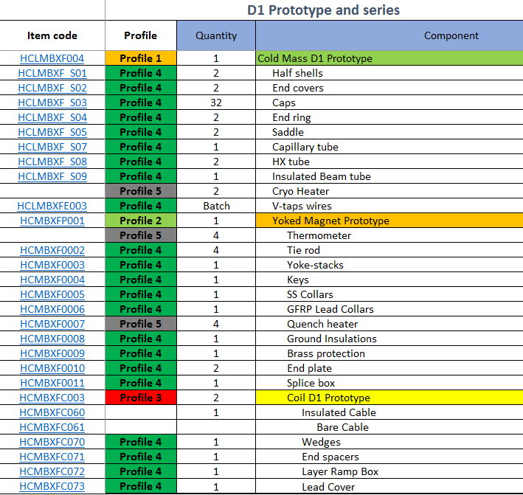

Status of D1 document: full-scale cold mass
1st meeting for MIP and documentation with CERN, KEK and HITACHI on the 2nd of Sep. 2019 at HITACHI premise.
BOM was created for the full-scale cold mass with help of CERN. MTF structure is being prepared..
Original drawings were provided by KEK and drawings for the prototype and series are now prepared by HITACHI. They will be uploaded to CDD after approval by KEK.
BOM for LMBXF

Slide 41




Structure of MIP for LMBXF
Up to yoked magnet
KEK premise
Including PED safety requirement
MIP-K1
Materials, Cold Mass
Procurement, Magnet Test
KEK
KEK premise
PV
MIP-0
Magnet
HITACHI
MIP-5
Magnet Insertion
to Vert. Cryo.
HITACHI
MIP-6
Cold Mass Assembly
HITACHI
PV
MIP-W4
WPQT: End-cover
Welding
HITACHI
MIP-1
Material Acceptance
HITACHI
MIP-2
Coil Fabrication
HITACHI
MIP-3
Magnet Assembly 1
HITACHI
MIP-4
Magnet Assembly 2
HITACHI
MIP-W5
WPQT: Extremities
Welding
HITACHI
MIP-W1
WPQT: Shell/
End-dome Welding
HITACHI
MIP-W6
WPQT: Support
Saddle Welding
HITACHI
MIP-W2
WPQT: End-ring
Welding
HITACHI
Drafts of MIPs up to yoked magnet are ready, but need a final confirmation.
MIP-W3
WPQT: Shell-cap
Welding
HITACHI

Slide 42
Test Facility

Slide 43


SSW, MFM and Optical Survey for D1
Area (15m x 5m) for MFM and survey for D1
SSW system of QCS magnet for SuperKEKB
Nikko-exp. hall for SuperKEKB
Magnetic axis and field angle with respect to fiducials will be determined by MFM with SSW (Single Stretched Wire) and rotating coil in horizontal position.
The measurement system was already developed for SuperKEKB QCS magnet and is now available for the D1.
  The dedicated team joined the HL-LHC D1 project.
  Preparation of measurement for the 7m long prototype cold mass is underway in Nikko-Exp. Hall at KEK.
Laser-tracker will be used for the survey of the D1 cold mass.

Slide 44

Readiness of Vertical Cold Test Stand
V-cryostat manufactured by Toshiba (2000)
  19 LHC-MQXA (7m) & 32 J-PARC SCFM (4m) tested.
Operating Temp.: 4.4K to 1.9K
Capacity
  whole bath: 9020 mm deep.
  1.9 K bath: 7524 mm deep, 700 mm in a diameter.
He Cryogenic Plants with HeII sub-cooler
  Dedicated liquefier at 160 L/h (+ 350 L/h)
  ΔT=30 mK at 80 W, 1.9 K. 4 parallel pump lines.
15 kA, 15 V Power Converter (1993)
  Thyristor switch for prompt shutoff.
  Dump resistor: 0, 12.5, 25, 50, 75 and 100 mΩ.
  Quench detectors
    2 x V_balance + 2 x V_total
  External 15 kA DCCT
New header for the D1 (MBXF)
  Manufactured in 2014
  Anti-cryostat for field measurement: O.D. 141.3 mm
  Quench antennas: 11 arrays for 7 m long magnet
  Feedthrough: 48 poles x 10
  HVWL: Improved up to 2.3kV
  15 kA Current Leads
  Already operated for the cold tests of the 2m models
MFM system and DAQ are mostly ready.
Some improvement needs for Quench Antenna signals.
New rotating coils for 7m long magnet will be developed.

Slide 45
Schedule, Summary

Slide 46



Schedule
Contract with Hitachi in May 2019.
Some initial delay for start-up at Hitachi was observed.
  KEK and CERN expressed big concerns about the schedule delay.
  Hitachi has been pursuing the schedule recovery plan underway.
Prototype
  The fabrication will start in Feb. 2020 and the vertical cold test is planned in August.
  Need a revision of cold mass assembly schedule in Oct. 2020.
1st series
  Fabrication will only start after the vertical cold test of the prototype.

Slide 47
Summary
KEK has developed three 2 m-long model magnets (MBXFS1, 2 and 3) with one variant (MBXFS1b) of the beam separation dipole D1 for the HL-LHC upgrade.
The latest 3rd model with an improvement of mechanical support showed a good training performance
  1st cycle;
    Reaching the nominal current after the first quench.
    Achievement of current hold (10 min.) w/o quench at the ultimate current.
  2nd cycle
    the first quench beyond the ultimate. Excellent training memory.
It was concluded that a large b₃ around 20 unit consistently observed in MBXFS2 and 3 was caused by the inadequate design of coil wedges.
New coil cross section with minimal b₃ has been designed and be implemented in the prototype.
Contract of D1 cold mass production was given to Hitachi. The coil fabrication will be started in Fen. 2020.
  Documentation, drawings, procurement are underway at KEK and Hitachi.
Renovation of test facility at KEK is on-going.
Need to finalize the defining documents together with CERN: acceptance criteria, structural analysis, delivery schedule, …

