Slide 1
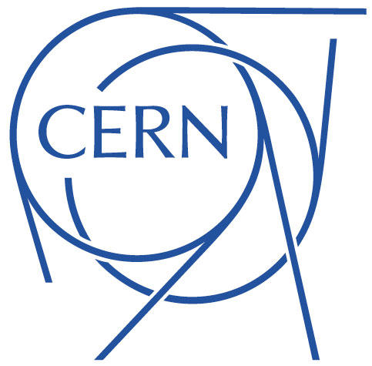
Conclusion on Machine Protection tests with Crab Cavities in the SPS
J. Uythoven, D. Wollmann
With input from:
H. Bartosik, T. Bohl, A. Butterworth, R. Calaga L.R. Carver, V. Kain, T.E. Levens, B. Lindstrom, G. Papotti, R. Secondo, M. Valette, G. Vandoni, J. Wenninger and M. Zerlauth
9th HL-LHC Collaboration Meeting, Fermilab, USA, 14 - 16 October 2019

Slide 2
Outline
Introduction: crab cavities and machine protection
Crab cavities in SPS in 2018
Observed slow and fast losses
Implementation and validation of HW phase interlock in the SPS
SPS interlock requirements for the future tests
Interlock requirements for HL-LHC
Conclusions

Slide 3
Introduction: crab cavities and machine protection
Crab cavities can cause fast transverse kicks on the circulating beam leading to critical beam losses in the aperture within tens of microseconds in case of failures
Criticality of failures estimated for HL-LHC by studying ‘corner cases’ (see A. Santamaria Garcia’s PhD thesis):
  Voltage drop: sudden drop of crab cavity voltage
  Phase jump: sudden change of crab cavity phase
  Detuning: continuous change of crab cavity phase
Criticality of combined failures has been studied (see IPAC18 paper by B. Lindstrom et al.), adding Beam-Beam kick.
Criticality of crab cavity failures has also been studied for the SPS
First machine protection tests with crab cavities and circulating hadron beam were performed in 2018 in the SPS

Slide 4
Crab cavity in SPS 2018 - Overview
Two double quarter wave cavities in one cryo-module
  Max 3.4 MV but only used up to ~1 MV in 2018
  Operated mainly in single cavity mode
  Maximum vertical kick:
    @26 GeV: 1.12 σ/MV // 3.12 mm/MV
    @270 GeV: 0.35 σ/MV // 0.3 mm/MV
  SPS vert. aperture limited to 20.4 mm:
    7.3 σ @ 26 GeV,
    23.6 σ @ 270 GeV
  CC frequency cannot follow change of SPS accelerating RF frequency during ramp (delta f = 130 kHz from 26 GeV to 270 GeV within 6 s)
Interlock matrix to interlock table position, vacuum, RF (via PLC - slow) etc. well established and tested
CC failures:
  Voltage drop → not critical in SPS due to available aperture
  Phase jump → not critical in SPS due to available aperture
  Detuning → critical with high intensity beam, can lead to resonant excitation

Slide 5
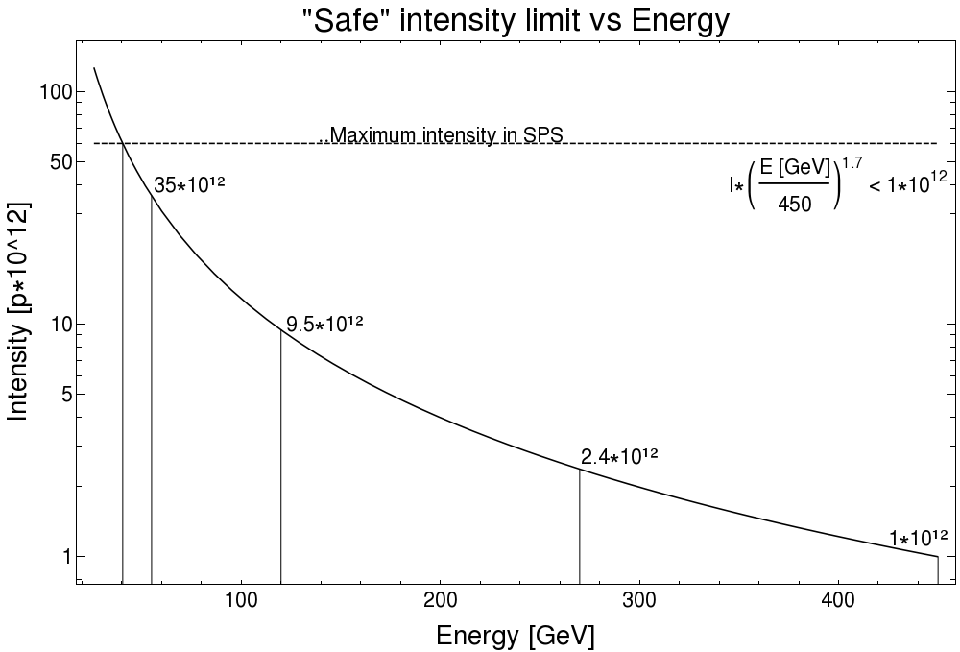
Safe intensity limits for Crab Cavity MDs in SPS
Reaction time of SPS ring beam loss monitors too slow
(20 ms) to interlock on fast critical beam losses
Allowed intensity limits for crab cavity MDs without additional fast interlock (including factor 10 safety margin) :
  @ 26 GeV: < 6 x 10¹² protons
  @ 270 GeV: < 2.4 x 10¹¹ protons

Slide 6
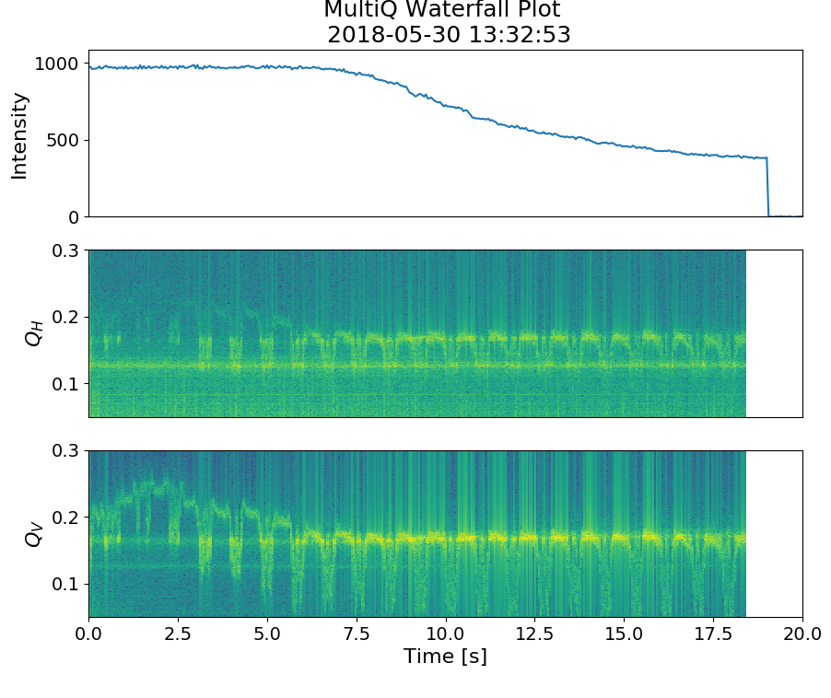
Observed slow losses
Loss of significant parts of the beam within 0.5 to 19 sec
Caused by issues with the tuner loop
  < 10 kV applied on beam with varying frequencies
  Crossing of vertical betatron tune
Not critical for test setup as SPS BLMs can provide sufficient protection

Slide 7
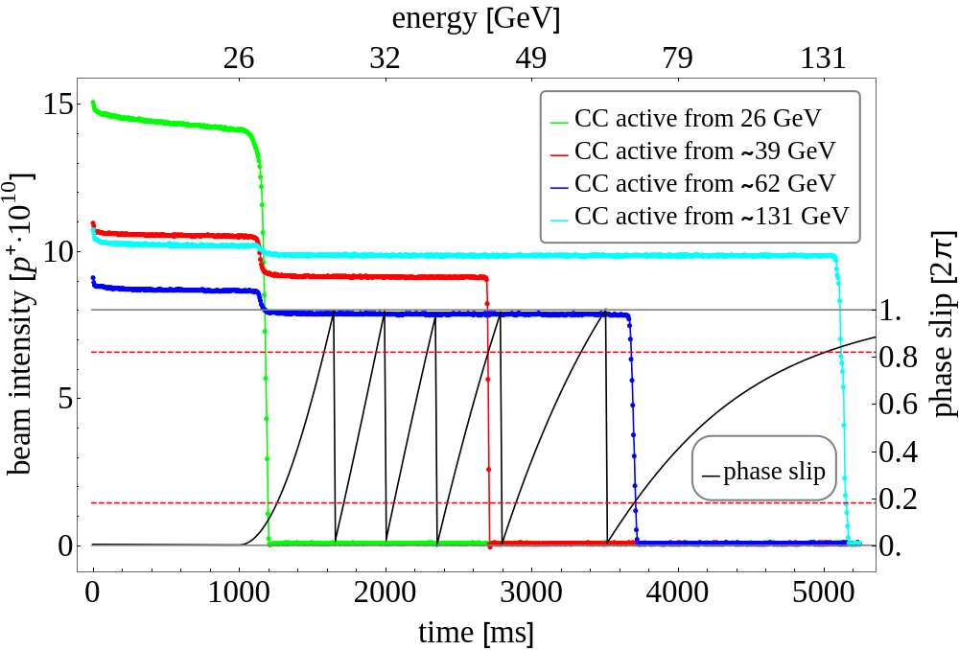
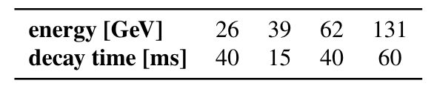
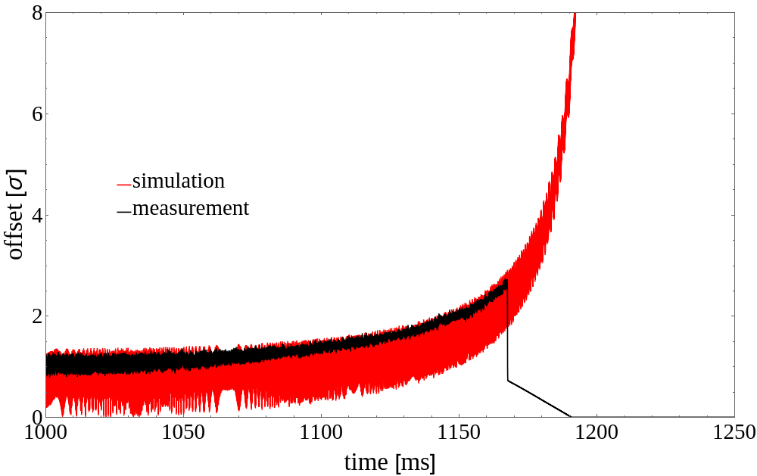
Observed fast losses
90 % of beam lost within 15 – 60 ms, due to resonant excitation of the beam by CC frequency crossing the betatron tune during ramp of main SPS RF
Loss behaviour reproduced by simulations
Loss speed affected by
    Beam energy: slower losses at higher beam energies
    Space charge induced tune depression: faster losses with reduced tune depression at higher beam energies; beneficial effect stronger when tune approached from below
Could cause critical losses in case of unsafe beam → fast HW interlock of frequency / phase required

Slide 8
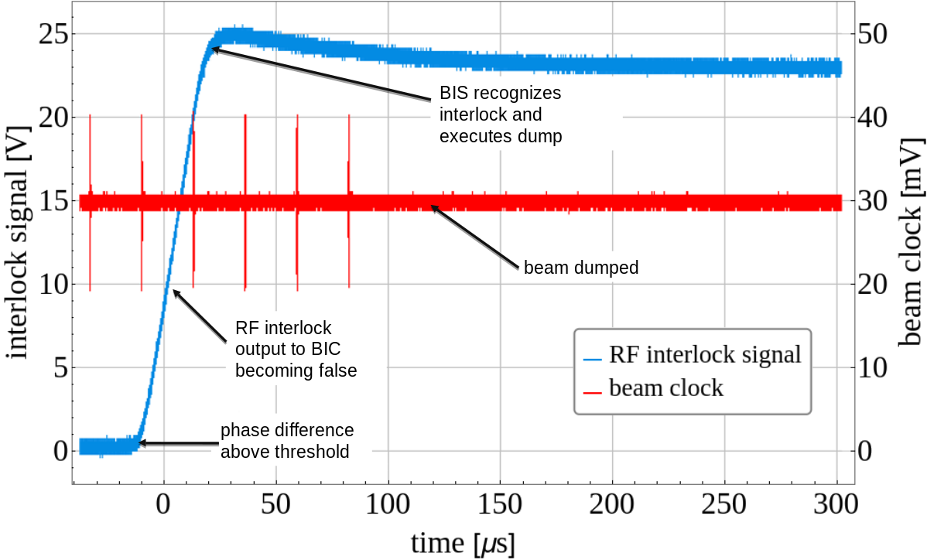
Fast phase interlock
Hardware interlock of phase between SPS main RF and crab cavity RF was implemented and successfully tested in the SPS
Beam was dumped five turns (< 120 us) after phase difference reached interlock threshold

Slide 9
Outlook to future SPS test, 2021 and beyond
Crab cavity tests (setup of HW, RF controls etc.) with safe intensity can be performed without additional interlocks besides the existing interlock matrix
Operation with high intensity beams requires:
  Validated fast HW interlock of phase between main SPS RF and CC RF
    Interlocking phase changes > +- 15 degree (for Q_{h}=0.13 and Q_{v}=0.18)
  Ensuring that CC voltage < 50 kV before matching between main SPS RF and CC RF frequency:
    Via HW interlock (strongly preferred) OR
    Procedure/automatic sequence, which has been validated with low intensity: note that any change to the validated sequences requires a new validation

Slide 10
Requirements for HL-LHC
Based on simulation results crab cavities can cause critical losses within less than ten LHC turns (< 1 ms)
Dedicated hardware interlocks are required to interlock on
  Phase drifts in one or multiple crab cavities (like tested in the SPS 2018)
    This covers the interlocking against any frequency change
  Sudden changes of voltage in one or multiple crab cavities (requested for SPS 2021)
    Also needed for switching on cavities
Correlated failures of multiple crab cavities need to be avoided, as they can lead to critical losses before a beam dump can be issued
  Have independent cc systems, avoiding common hardware failures as much as possible

Slide 11
Conclusion
For the first time machine protection experiments have been performed with crab cavities and low intensity proton beams
Slow and fast losses were observed – loss scenarios seem to be understood
Observed failures require HW interlock of crab cavity phase for the use with unsafe beam intensities in the SPS, also for 2021
Voltage interlock is recommended for future SPS tests and to validate for future HL-LHC
HL-LHC requires dedicated interlocks of voltage and phase.
Common mode failures of multiple crab cavities need to be avoided by separating systems

Slide 12
References
B. Lindstrom et al., ”Machine protection experience from beam tests with crab cavity prototypes in the CERN PS", Institute of Physics Journal of Physics: IPAC19
A. Santamaria Garcia ”Experiment and Machine Protection from Fast Losses caused by Crab Cavities in the High Luminosity LHC", CERN thesis 2018
B. Lindstrom et al., "Crab Cavity Failures combined with a Loss of the Beam-Beam Kick in the HL-LHC", Proceedings IPAC 2018.

