Slide 1


MQXFAP1b Alignment and Field Quality
J. DiMarco, D. Cheng, B. Ghiorso, C. Hernikl, C. Myers, H. Pan, G. L. Sabbi, H. Song, P. Wanderer, X. Wang, H. Zhu
HiLumi Collaboration Meeting, Fermilab, October 16, 2019

Slide 2
Magnetic Measurements during Assembly
MQXFAP1b Magnet geometry and fabrication:
Shorter magnetic length (4 m)
Three previously used first-generation coils
One new coil made with shorter length but incorporating many new features
  See coil P06 review information at https://indico.fnal.gov/event/19381/
  Mid-plane/pole shim for b6 correction still not implemented
Magnetic measurement system and plan
Measurements performed for coil pack and after complete assembly
  MQXFAP2: drive system was not complete for coil pack measurement, and splice box was not completed for “final” measurement
New power supply (more stable, better controls, capability to switch polarity)
Field harmonics as a function of longitudinal position
  Including a detailed scan of the ends
Magnetic axis vs. longitudinal position relative to external fiducials
Relative change in the field orientation vs. longitudinal position
  Including a scan step allowing to overlap the positions of the two probes mounted on the PCB

Slide 3
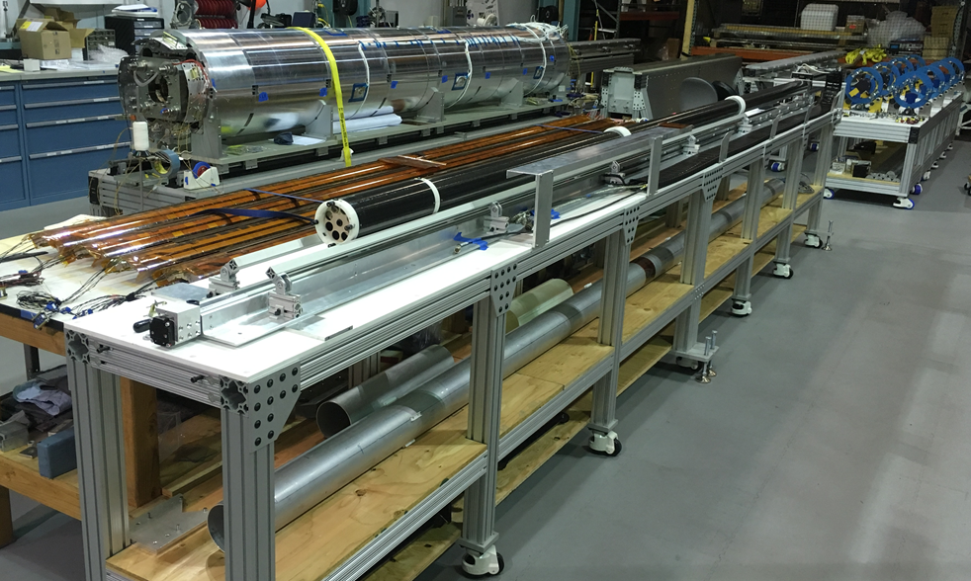
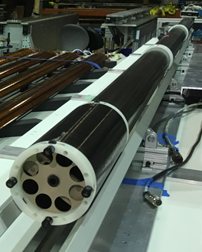

Magnetic Measurement System at LBNL
Probe is inserted from lead end
MQXFAP2
Return end
Fiducial
locations
Drive
system
Rotating
probe
Probe support tube
(inside magnet)
PCB
X. Wang, J. DiMarco, D. Cheng, J. Herrera, S. Myers, B. Ghiorso, A. Pekedis et al.
Retroreflectors
Rotating probe includes two identical PCBs from FNAL with 108.74 mm effective length and 59.5 mm radius

Slide 4
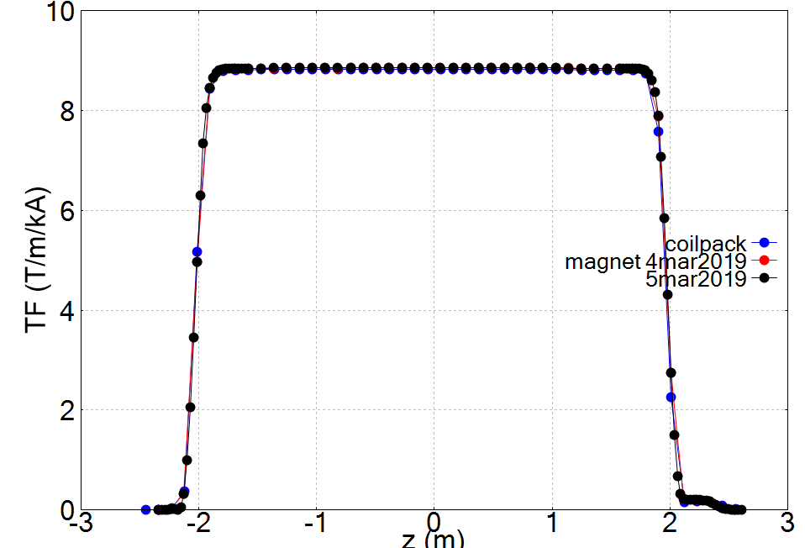
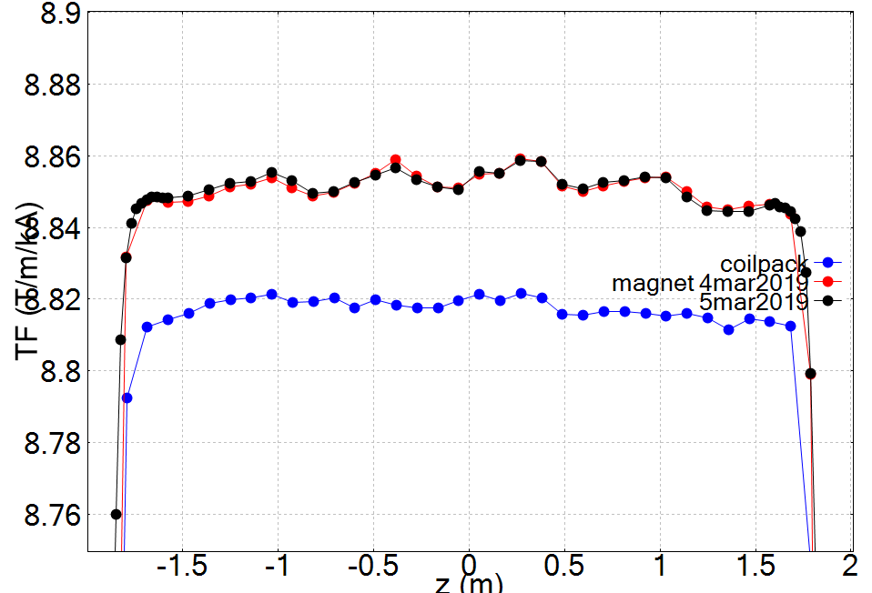
Longitudinal scan: Transfer Function
TF increases by 0.4% from coil pack to final assembly
  Effect of loading (iron pads are already present in coil pack measurement)
Scan length is sufficient to cover both ends – however this is a shorter magnet, may need some improvement for full length magnet

Slide 5
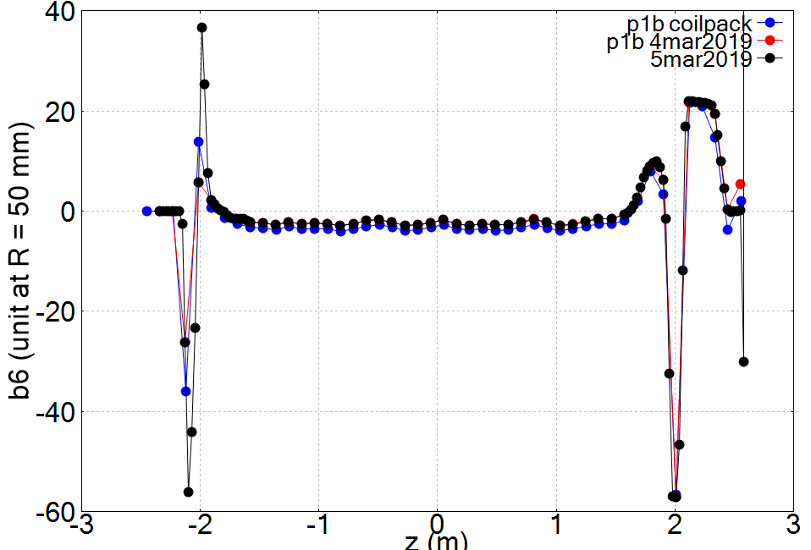
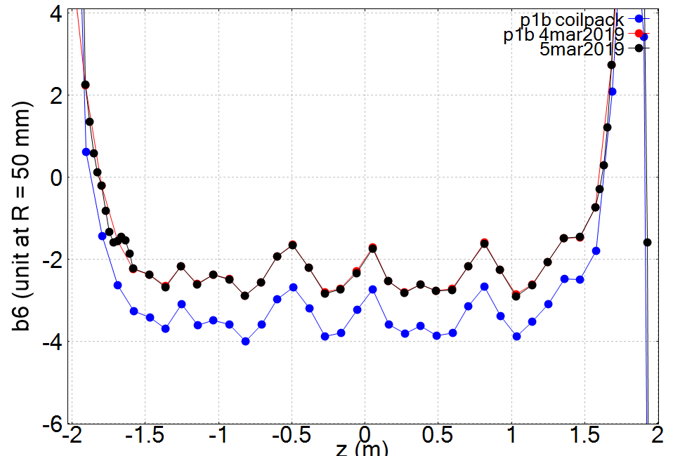
Longitudinal Scan: b6
b6 is around -2 units in the straight section (about 5 units smaller than AP2)
Also much more stable along the length (about +/- 1 unit)
Change of about 1 unit (-3 to -2) from coil pack to final.
Fine (1/4) scan of magnet ends allows to accurately capture the peaks
Useful to compare with models and for longitudinal reference
Will be repeated in vertical test

Slide 6
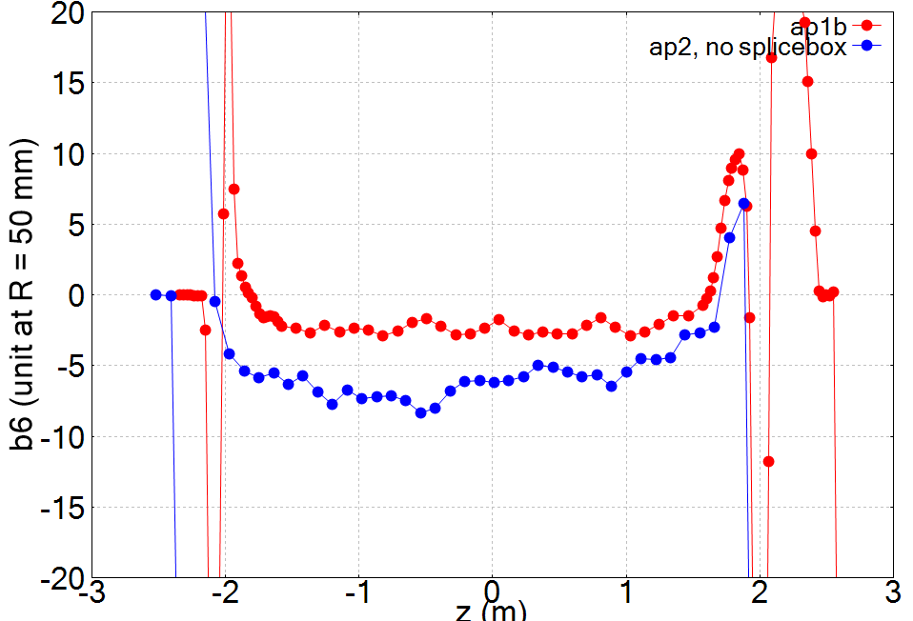
Comparison of MQXFAP1b and MQXFAP2
b6 is smaller and more stable along the length
Zoom in

Slide 7
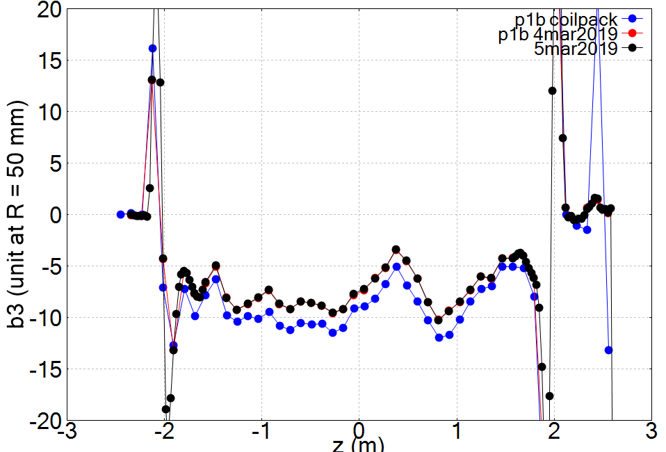
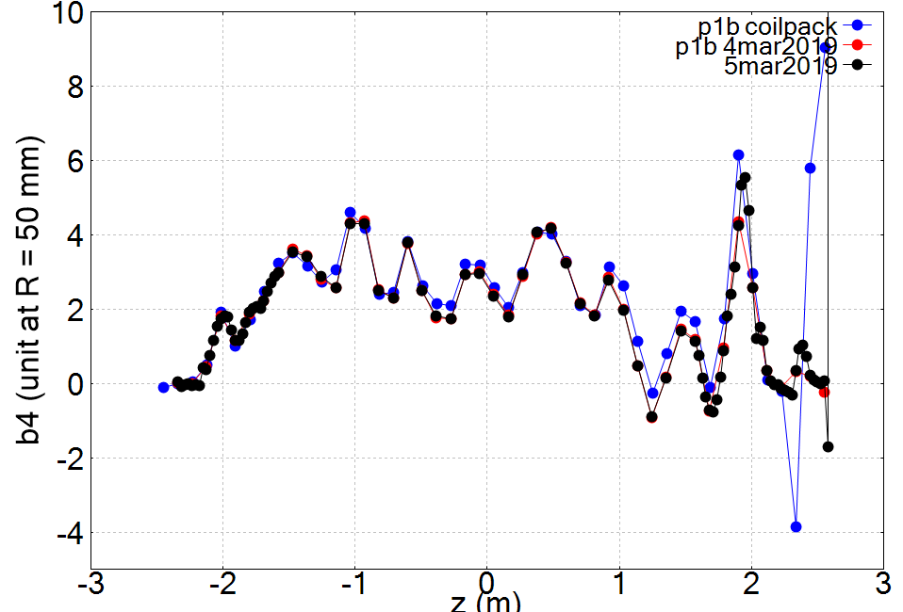
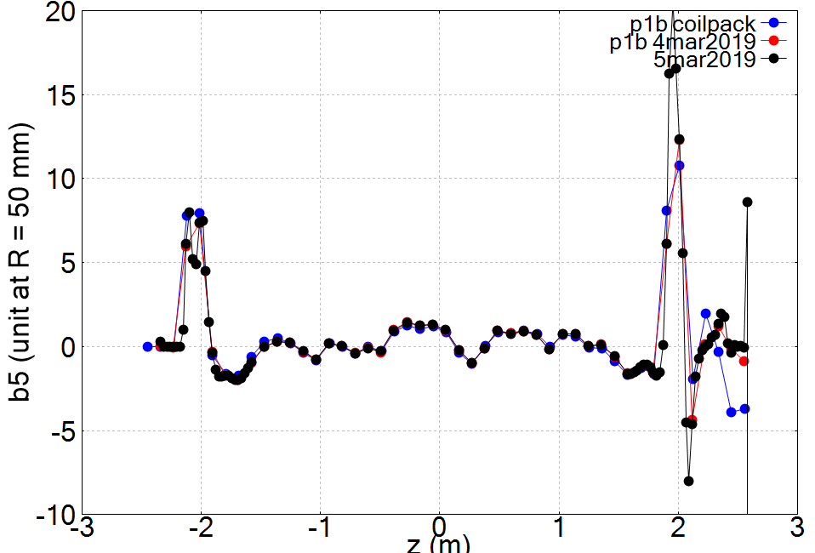
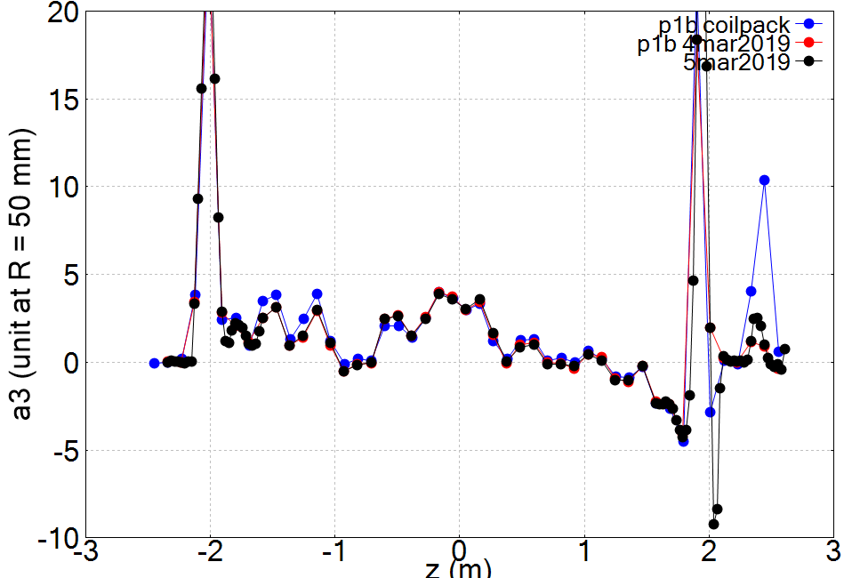
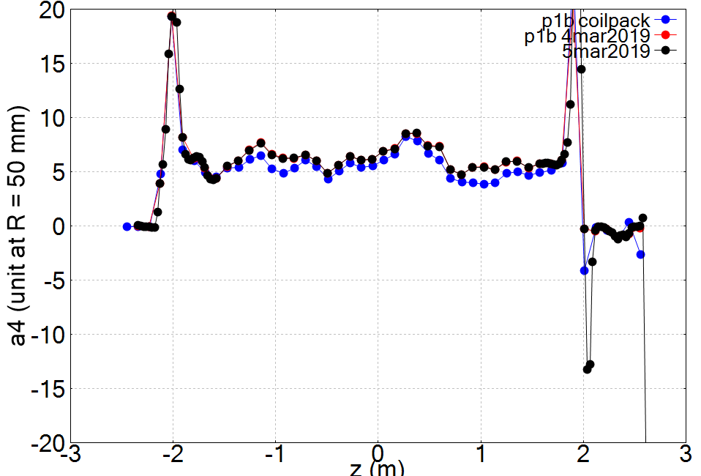
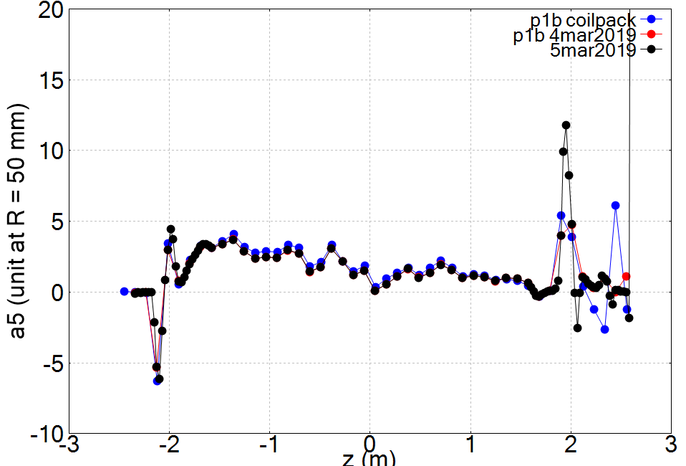
Longitudinal scan – other harmonics
Change of 2 units of b3 from coil pack to final. All other harmonics do not change significantly
Comparatively large a5

Slide 8
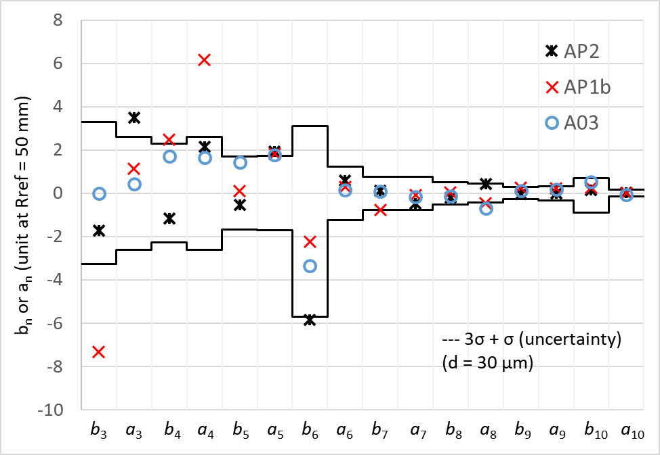
Comparison of harmonics after assembly

Slide 9
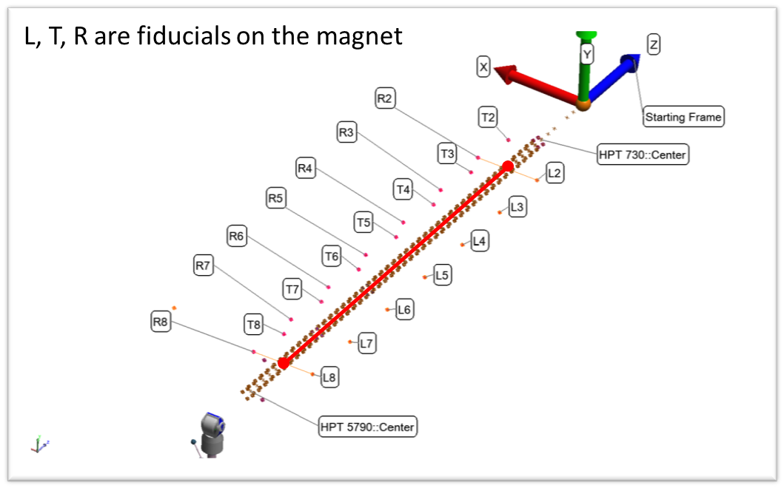
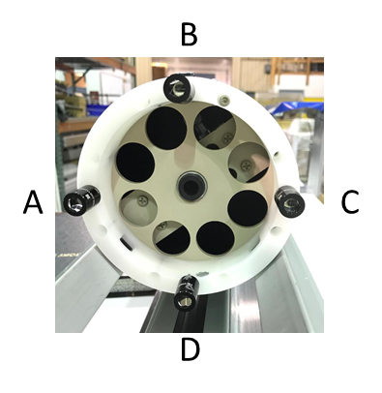
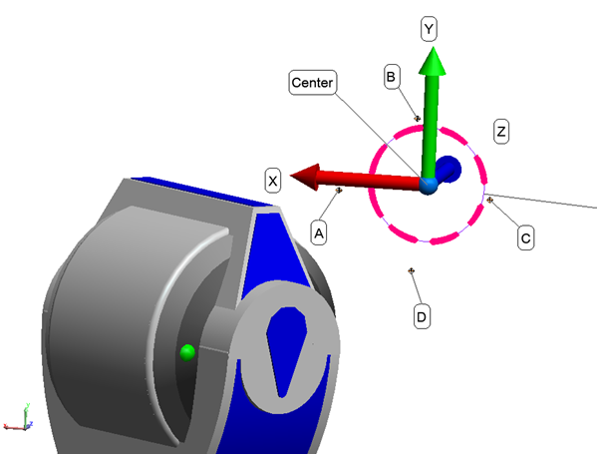
Reference axis and probe position survey
Survey performed by Chris Hernikl, Hongyan Zhu, Dan Ellis, and Federico Carrara (Survey & Alignment Group, Engineering Division)

Slide 10
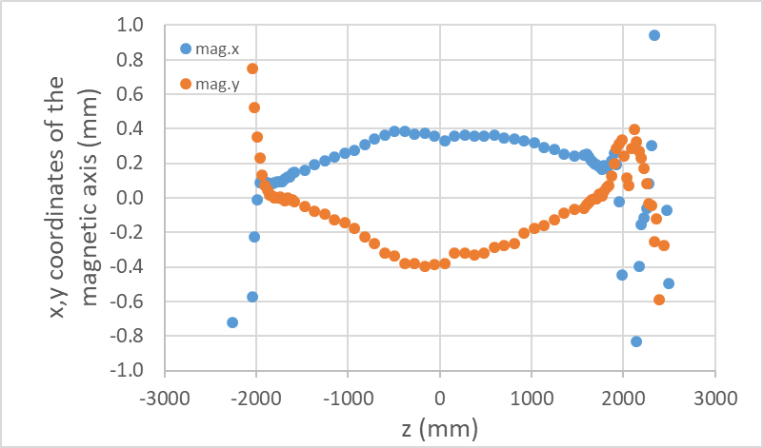
Magnetic Axis
Magnetic center relative to reference axis
The magnetic axis will be defined as the best fit, independently for x and y
Variations of magnetic center relative to best fit are within +/- 0.2 mm (straight section)
Requirement is +/- 0.5 mm
Additional benefit from integration length (0.5 m)

Slide 11
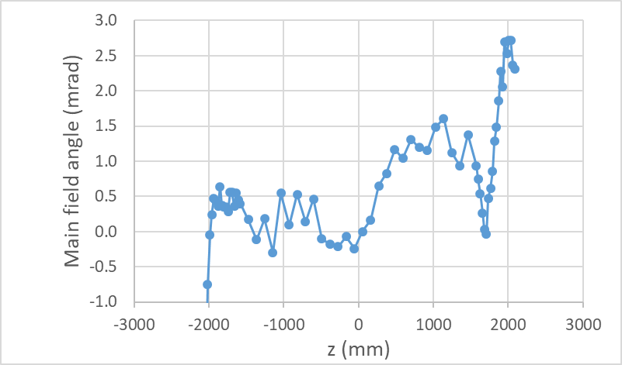
Magnetic Field Angle
Magnetic field angle along the magnet length
Magnet angle can be adjusted for best fit
Variations of magnetic field angle relative to best fit are within +/- 1 mrad
Requirement is +/- 2 mrad
Ends are excluded
Additional benefit from integration length (0.5 m)

Slide 12
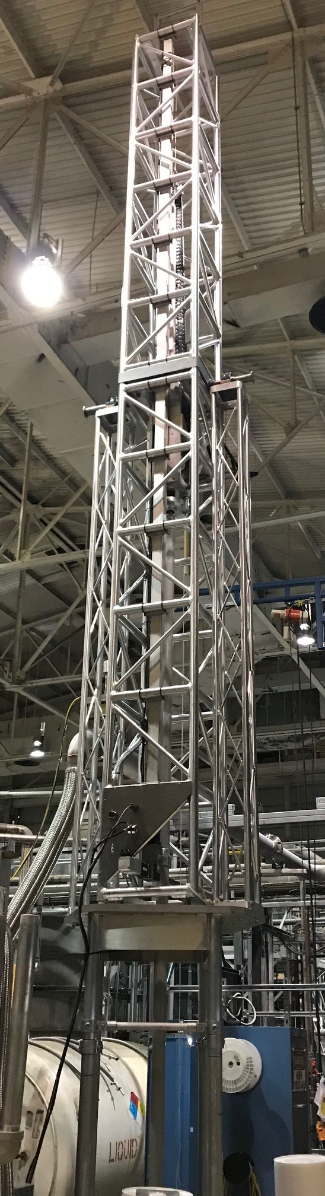
Magnetic Measurements System at BNL

Slide 13
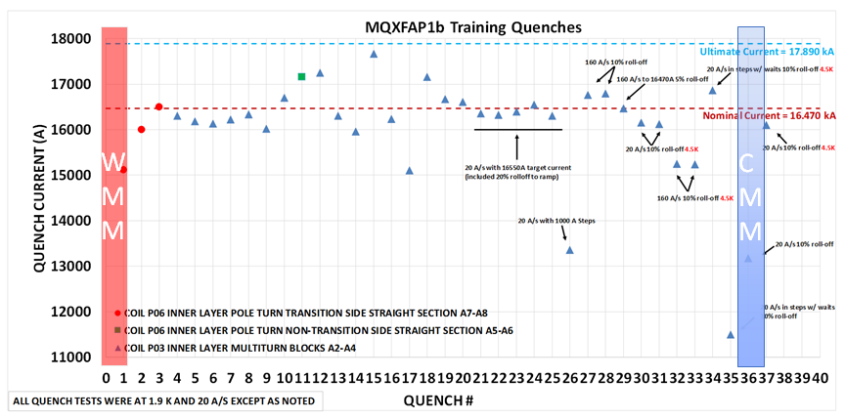
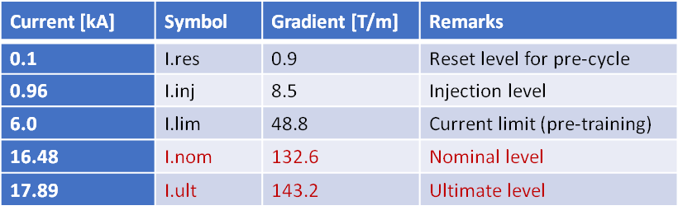
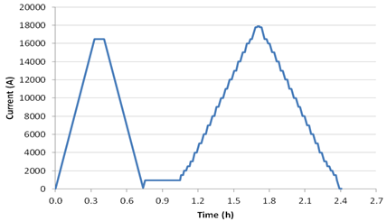
Magnetic Measurements during Vertical Test
MQXFAP1b quench history, warm and cold magnetic field measurement time
Stair-step measurement

Slide 14
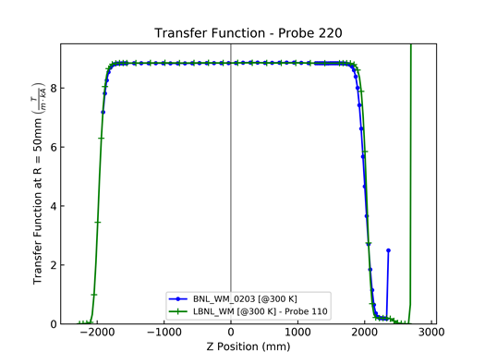
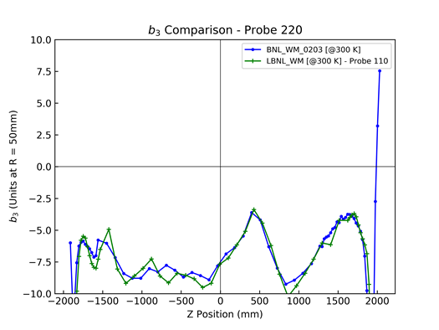
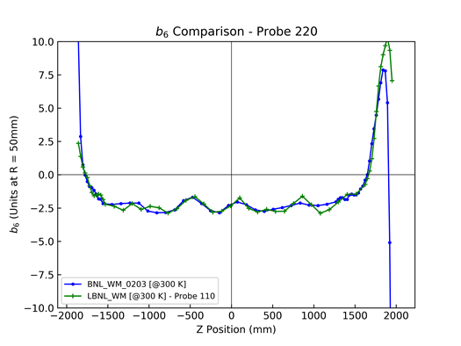
Warm Measurements during Vertical Test
Comparison between warm measurements during assembly at LBNL and prior to vertical test at BNL are generally in good agreement
No indications of changes during shipping, small differences are mainly due to different probe length
New identical 440 mm probes from FNAL are under fabrication for future tests

Slide 15
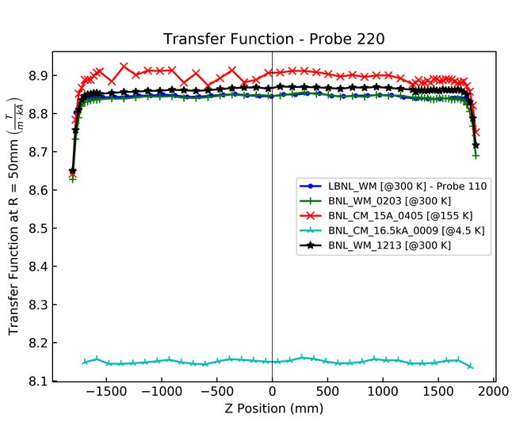
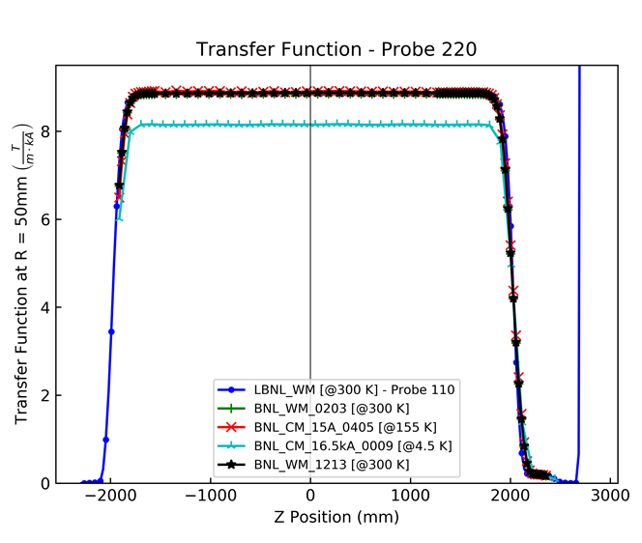
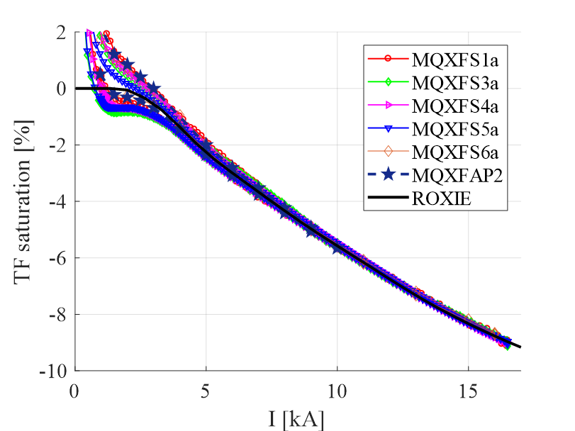
Cold Measurements during Vertical Test
Transfer function
Decrease on the transfer function from injection to nominal by ~ 9 % due to iron saturation, consistent with calculations and results from other model magnets and prototypes

Slide 16
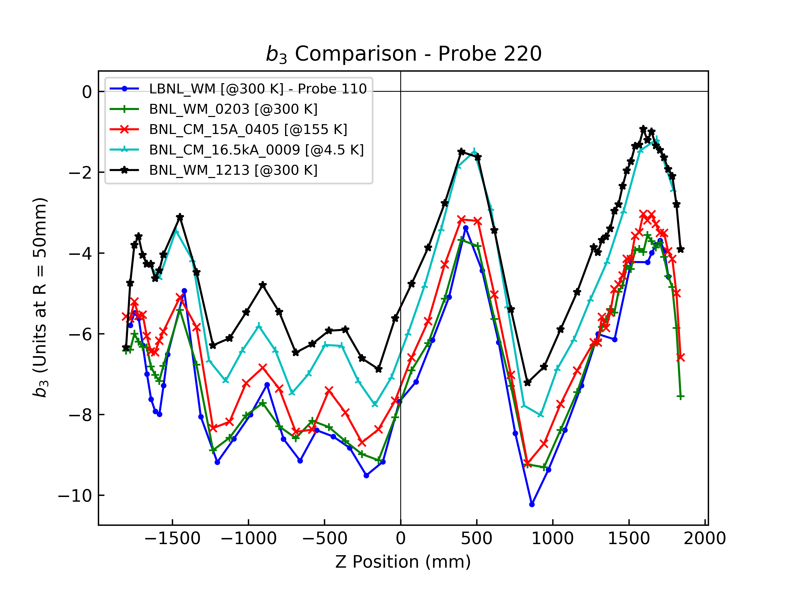
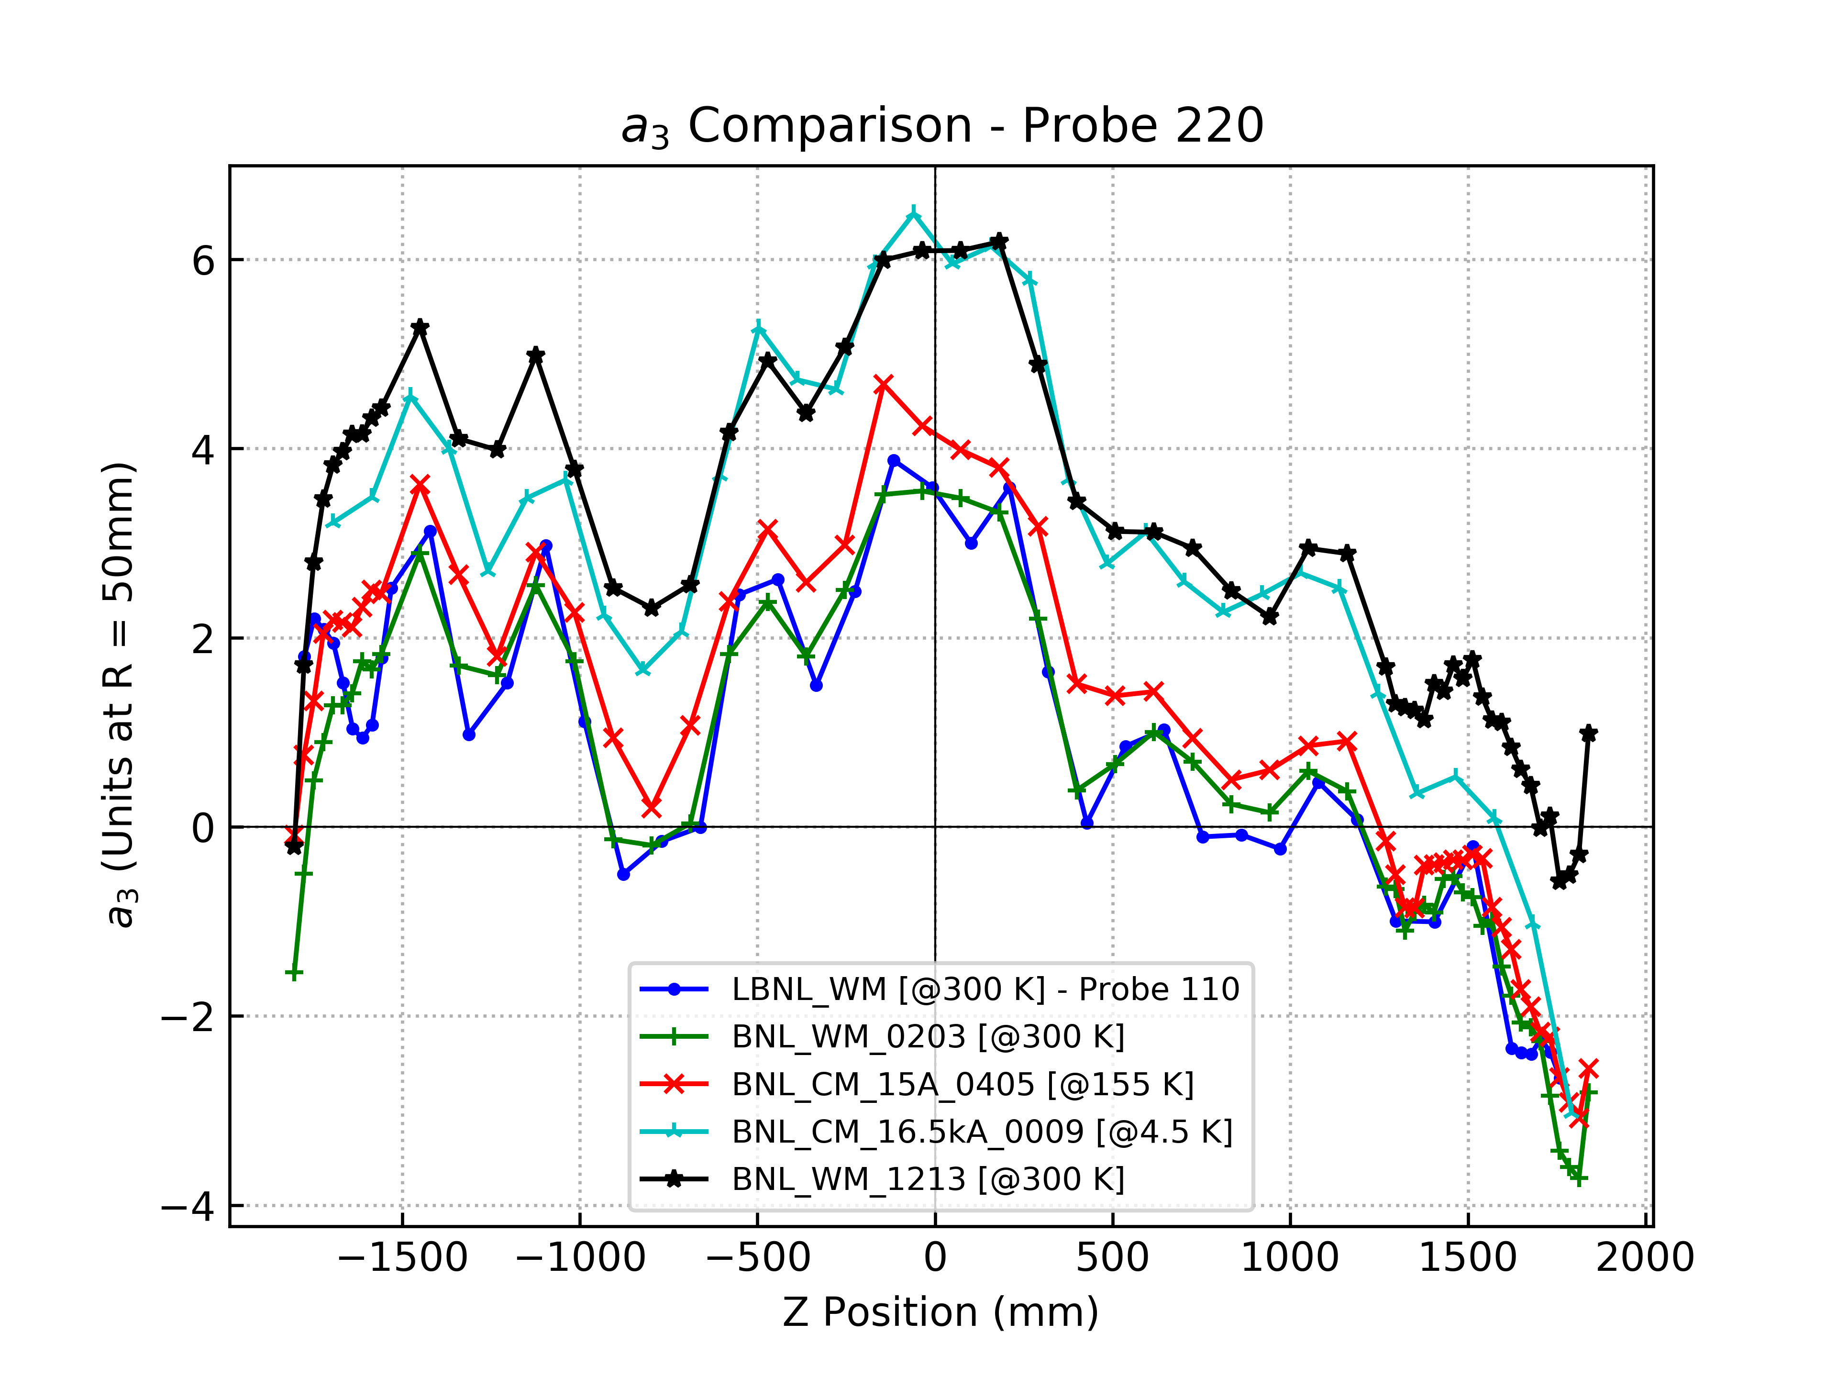
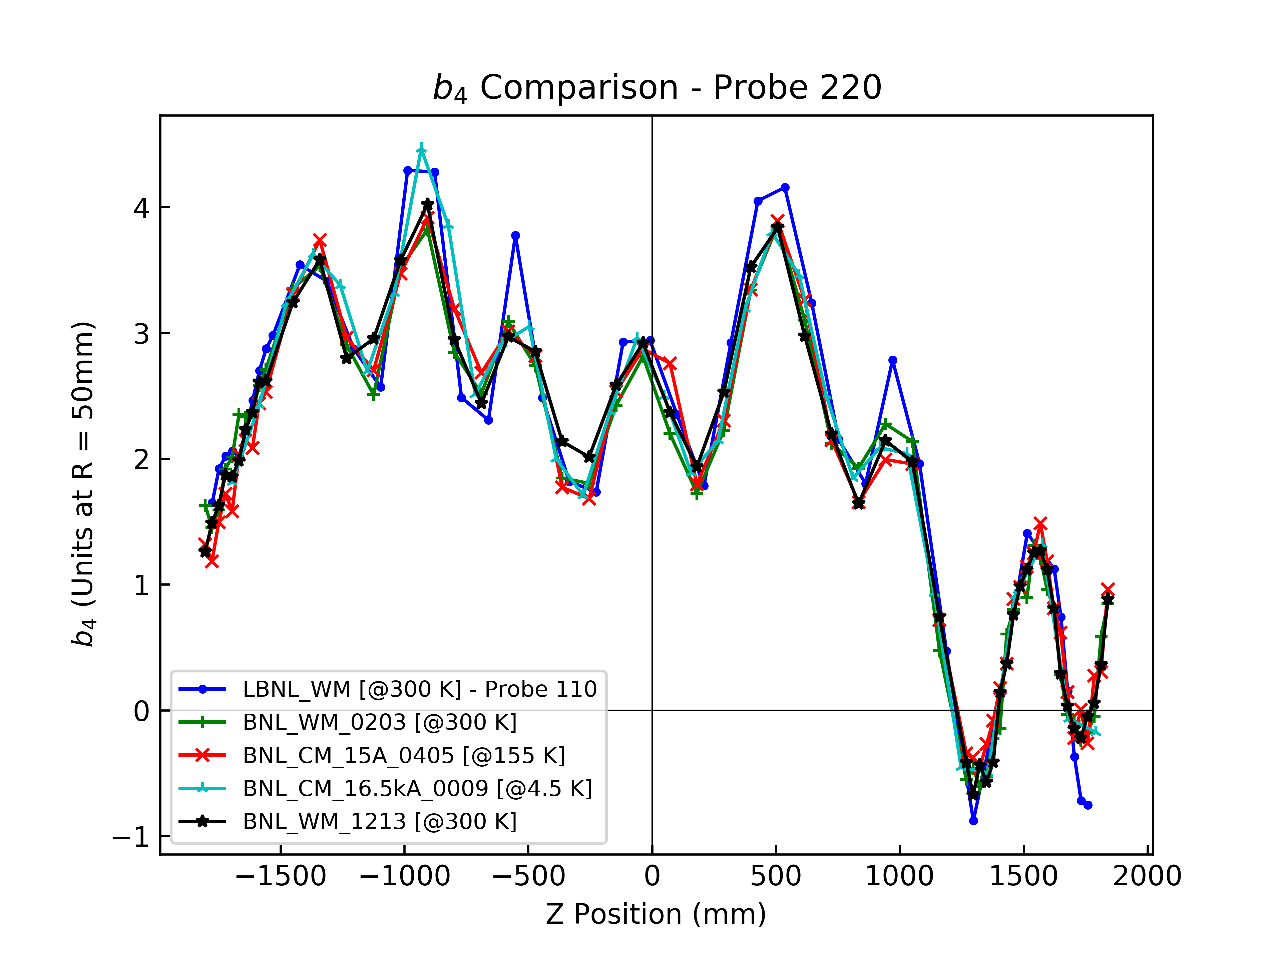
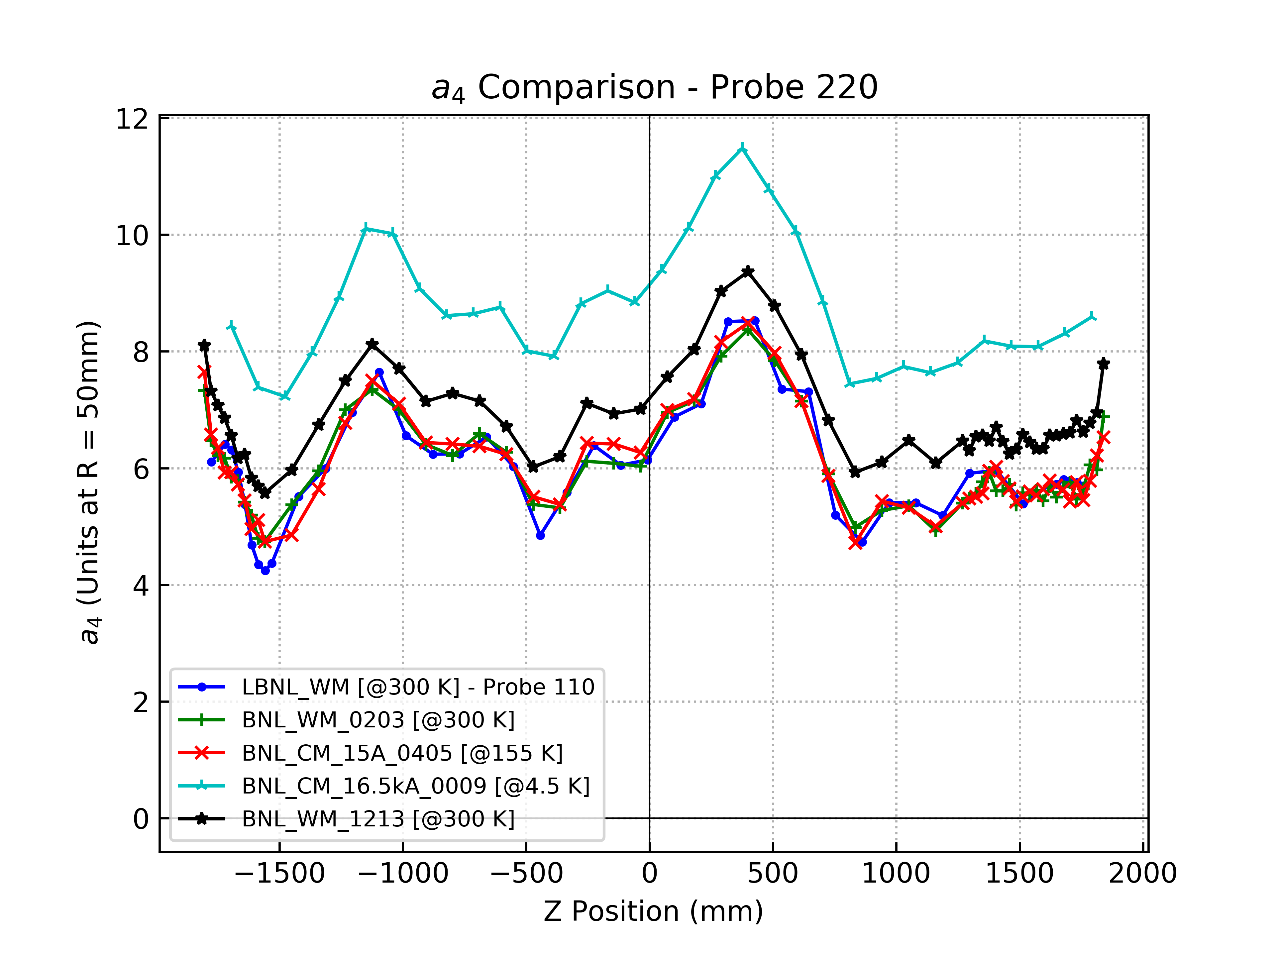
Cold Measurements during Vertical Test
Similar longitudinal variations at different temperature/current, with some offset (0-2 units)

Slide 17
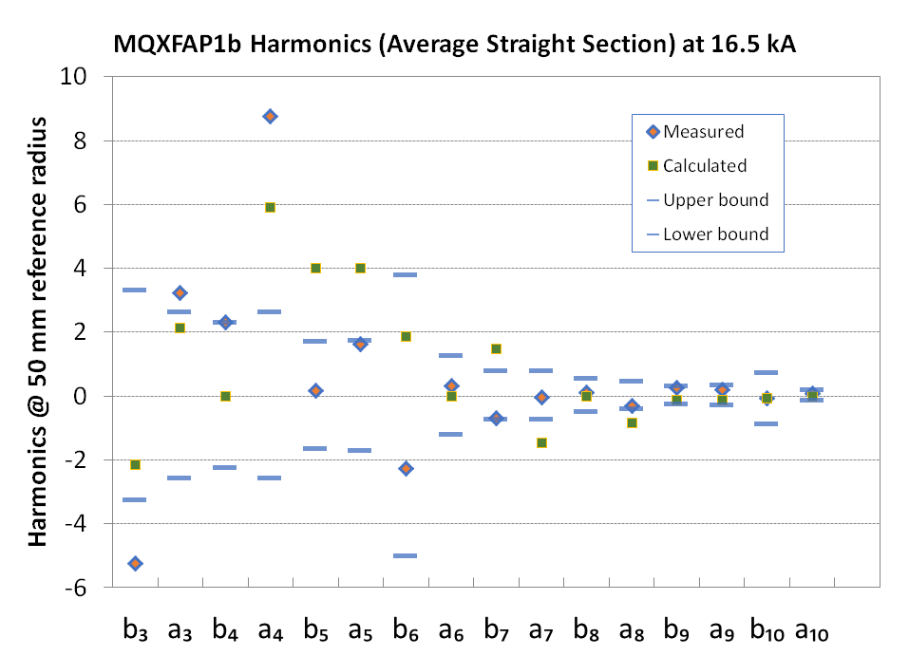
Cold Measurements during Vertical Test
Upper bound: s + u + 3σ
Lower bound: s - u - 3σ

Slide 18
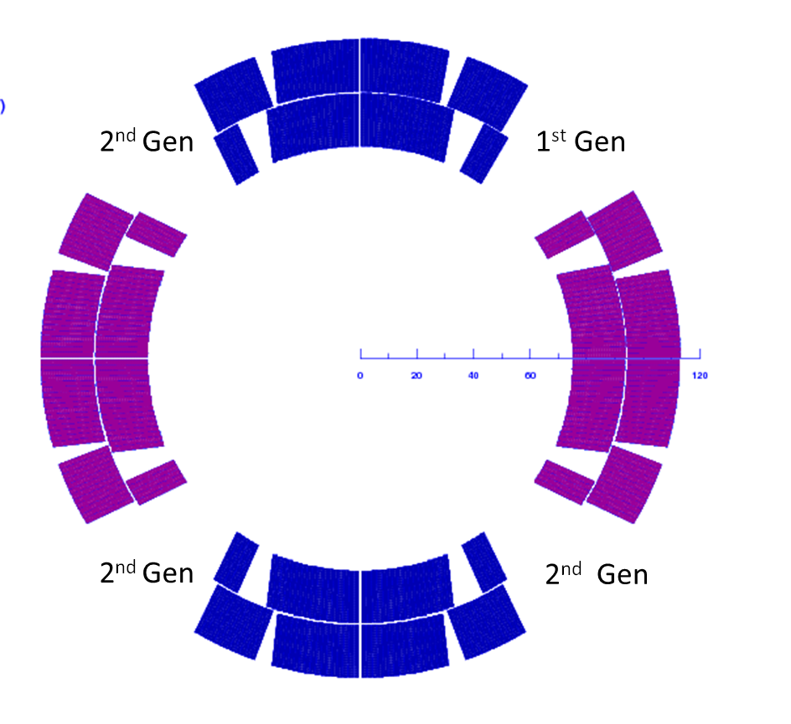
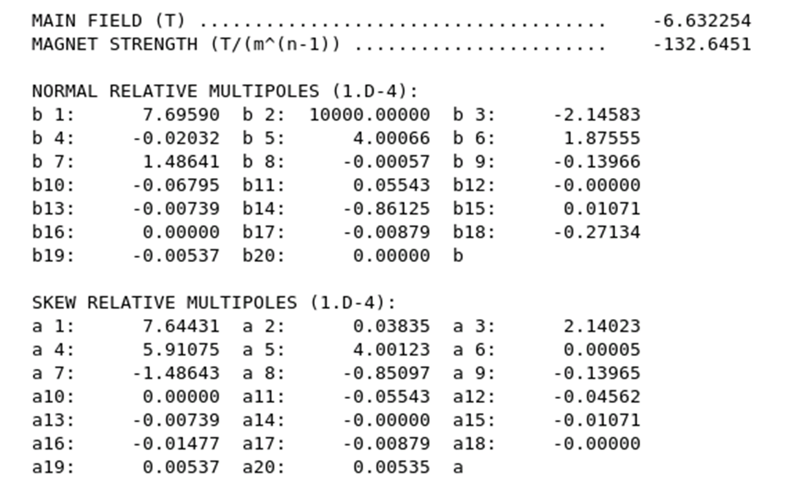
MQXFAP1b Calculated Harmonics
MQXFAP1 and MQXFAP1b included both 1st and 2nd generation coils
One coil first generation (Quadrant 1 for the computations)
Three coils second generation
Calculated field errors at nominal current (16.47 kA):

Slide 19
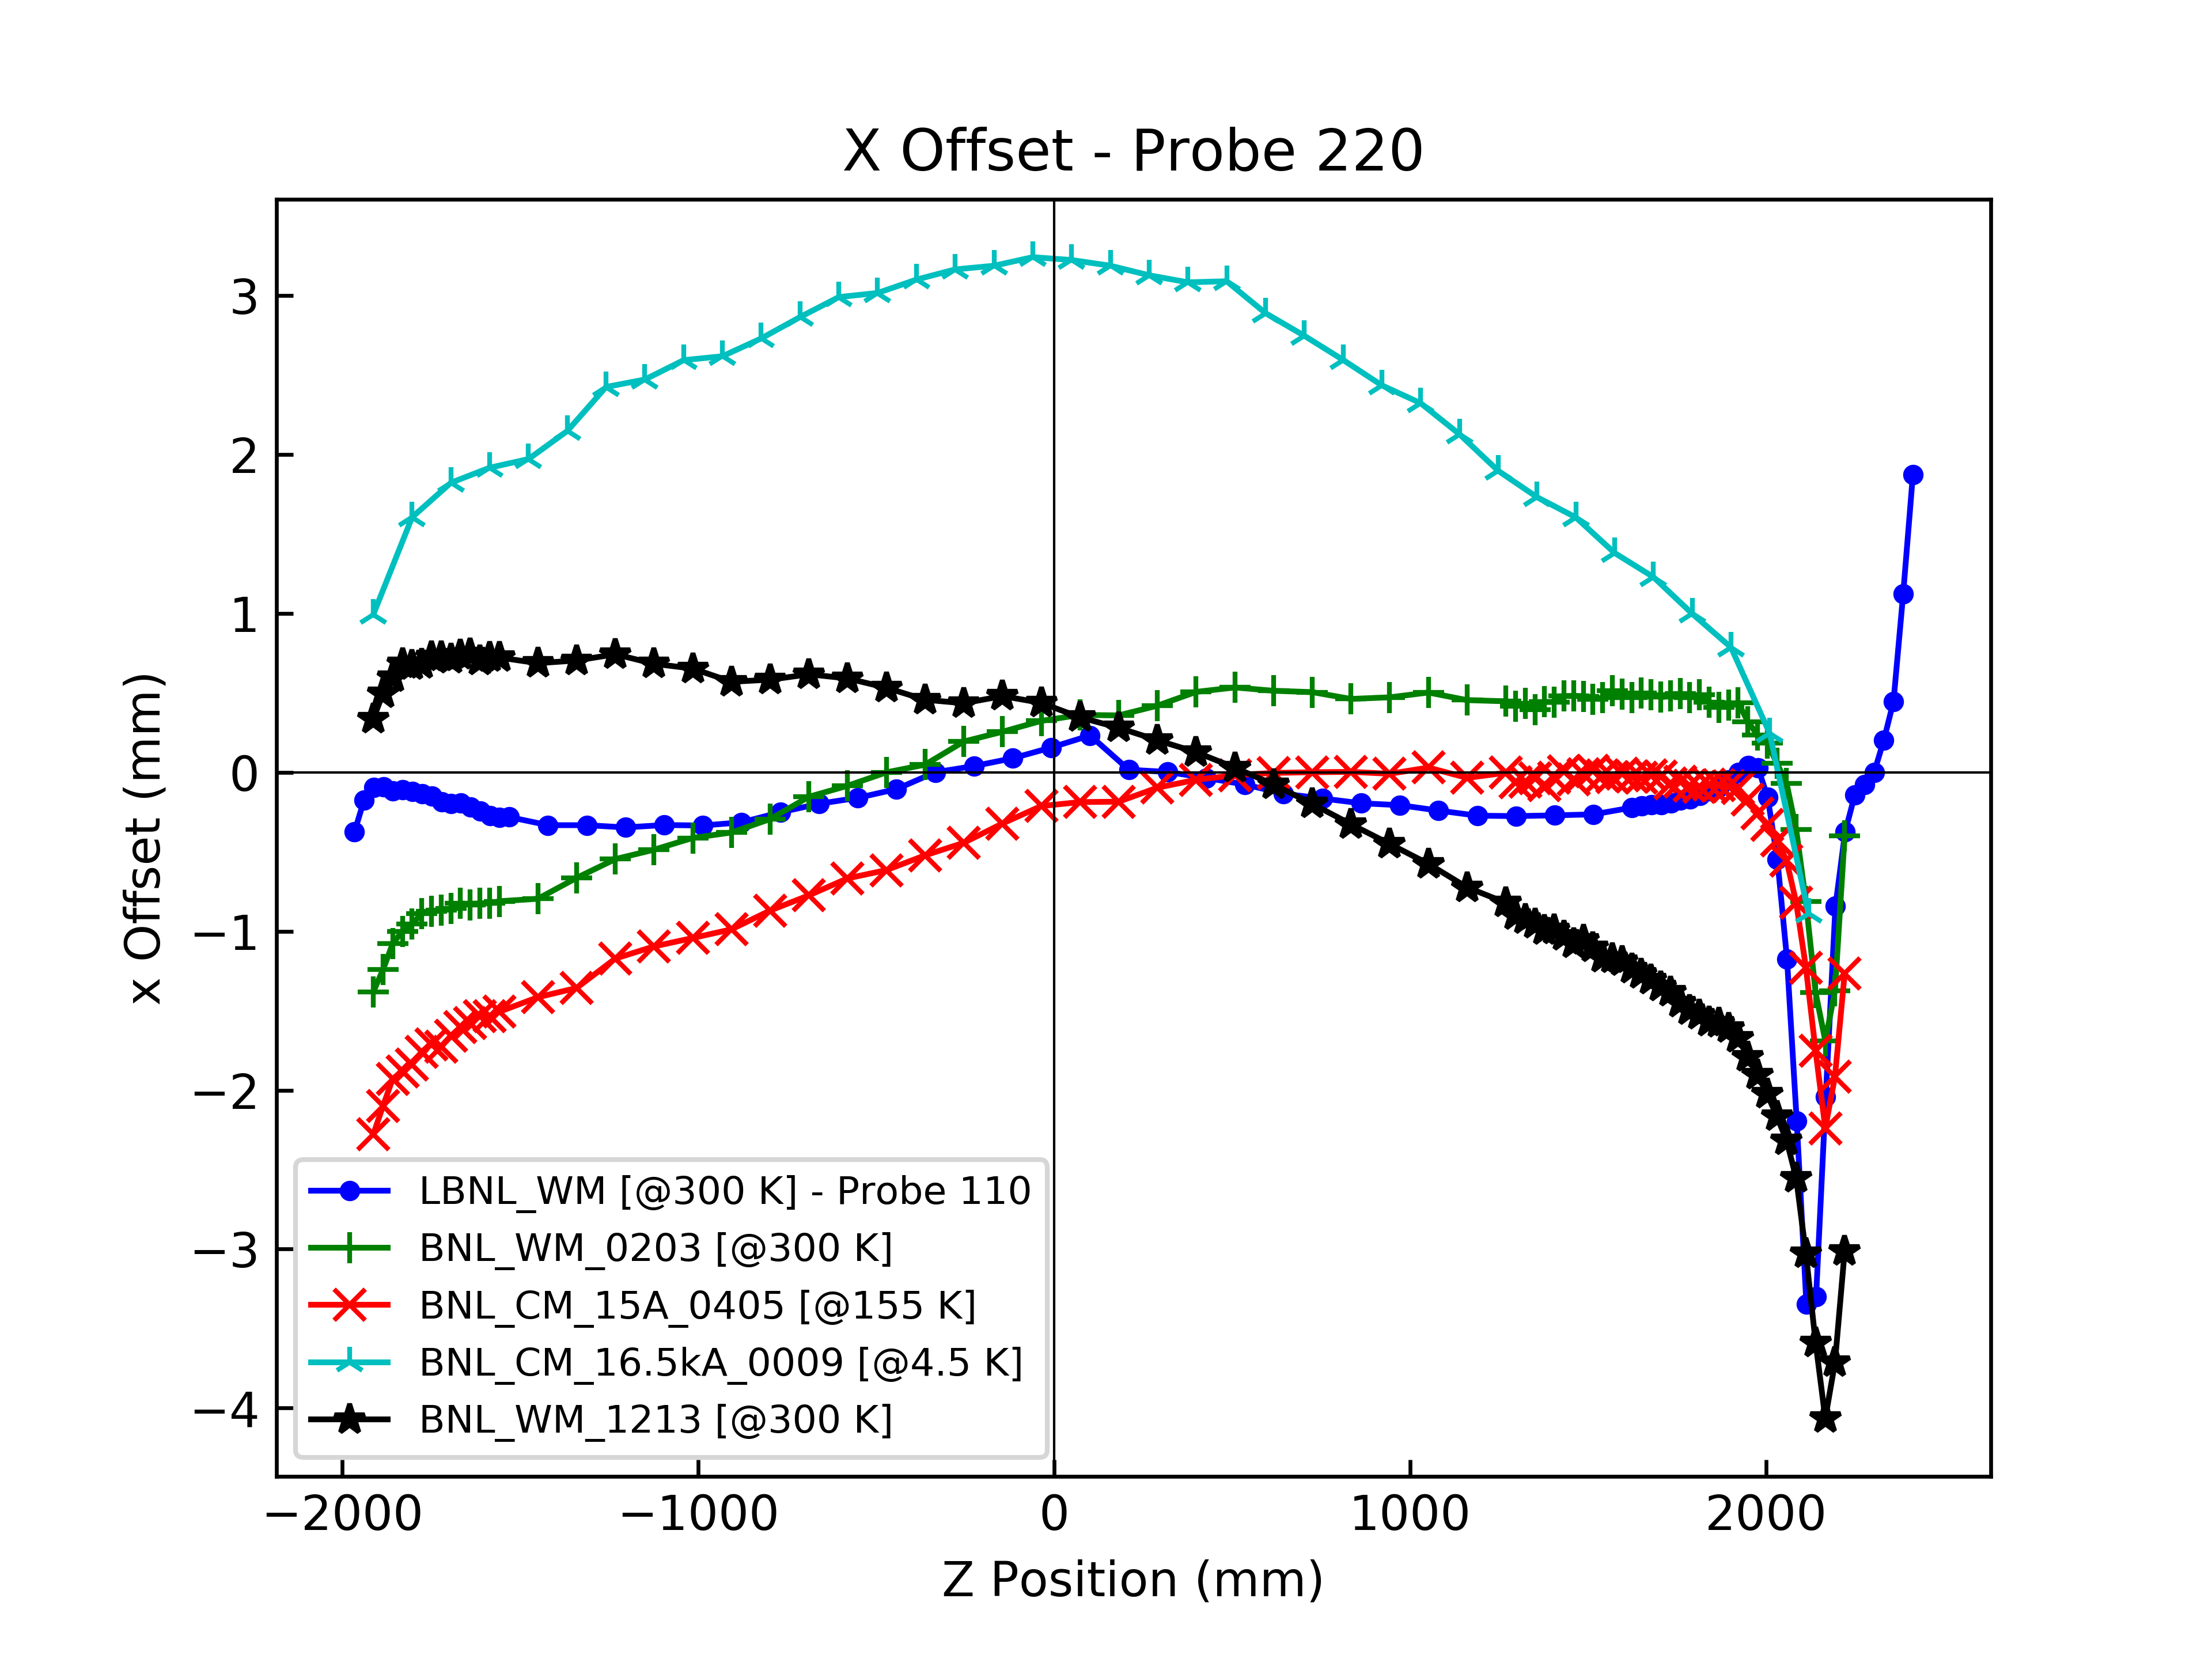
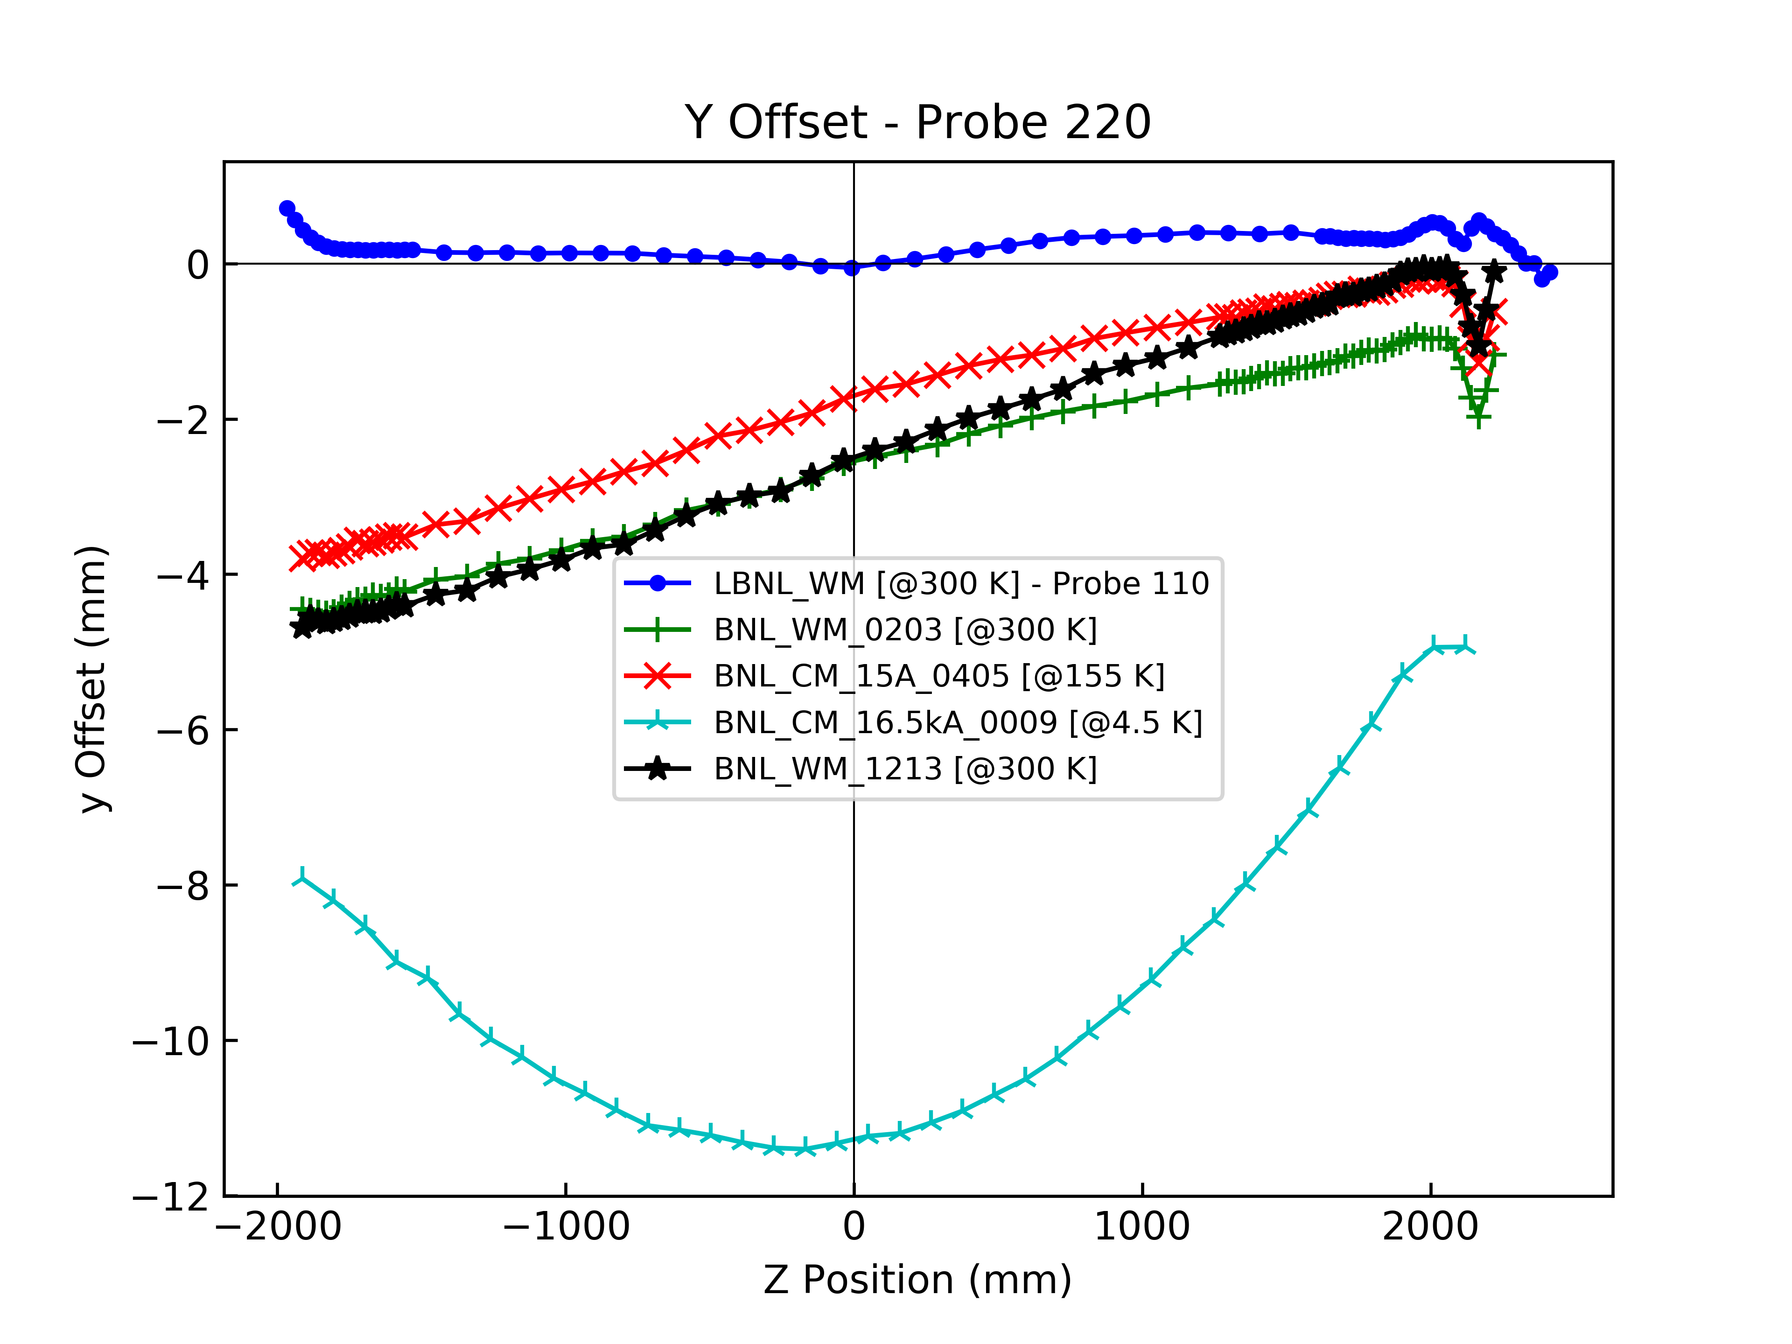
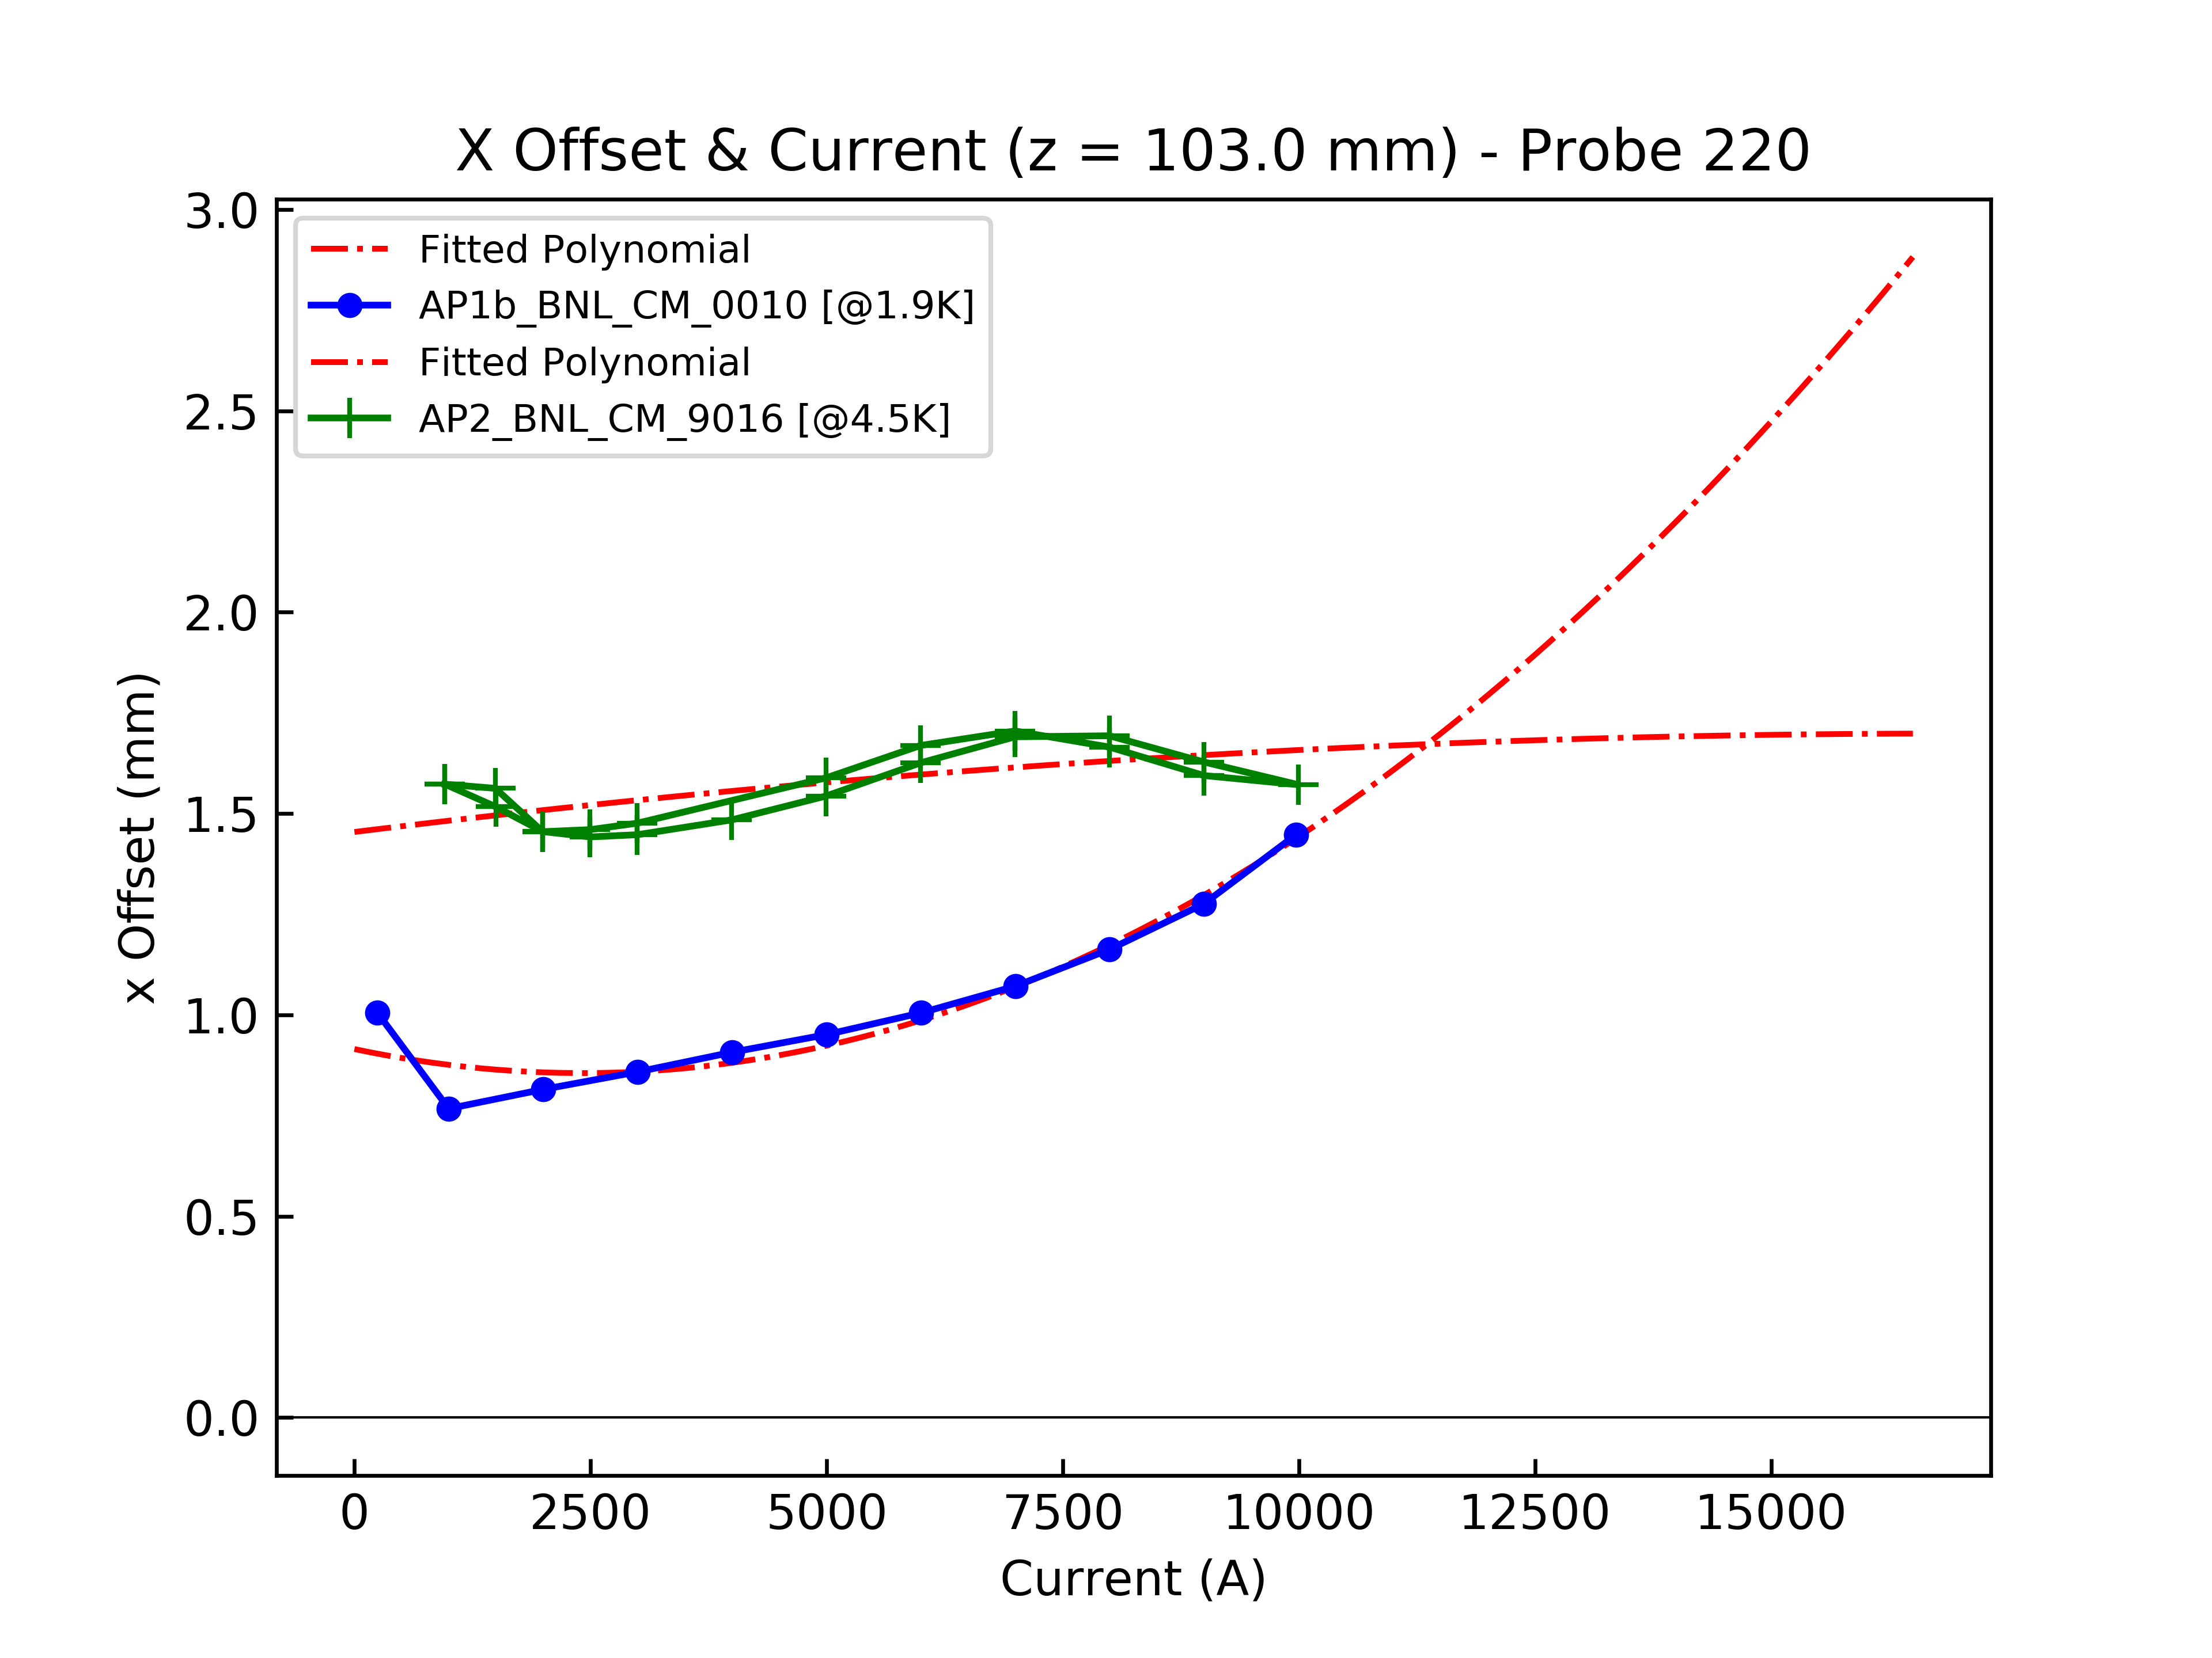
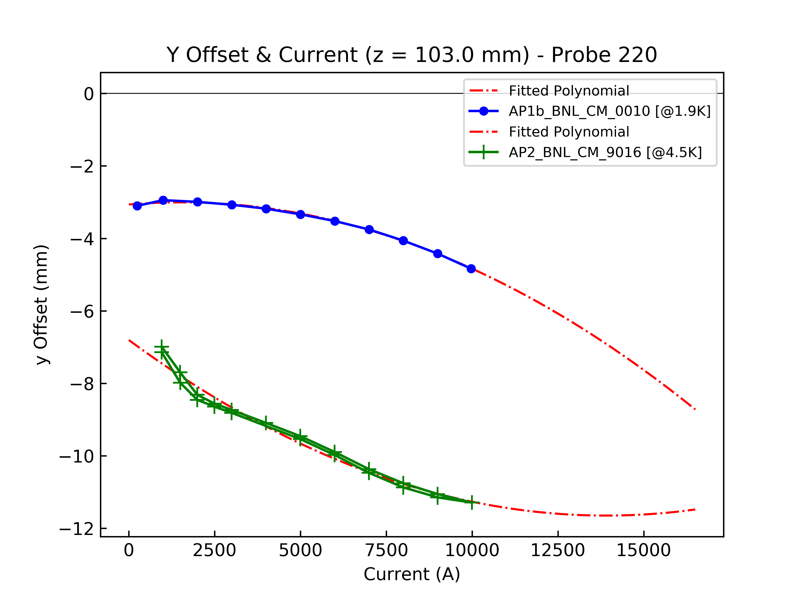
Cold Measurements during Vertical Test
Relative shift of magnetic vs probe axis up to ~12 mm was observed
Calculated - assuming measured dipole stems from probe offset in pure quad field
Significant changes in value and pattern from warm to cold measurements
About a factor of two change from low to high current
Addressed with additional alignment features for the warm bore between AP2 and AP1b
X
Y
Cold AP1b
Z
Cold AP1b
Cold AP1b
I
Cold AP1b

Slide 20
Additional slides

Slide 21
Field Quality Reference Table

Slide 22
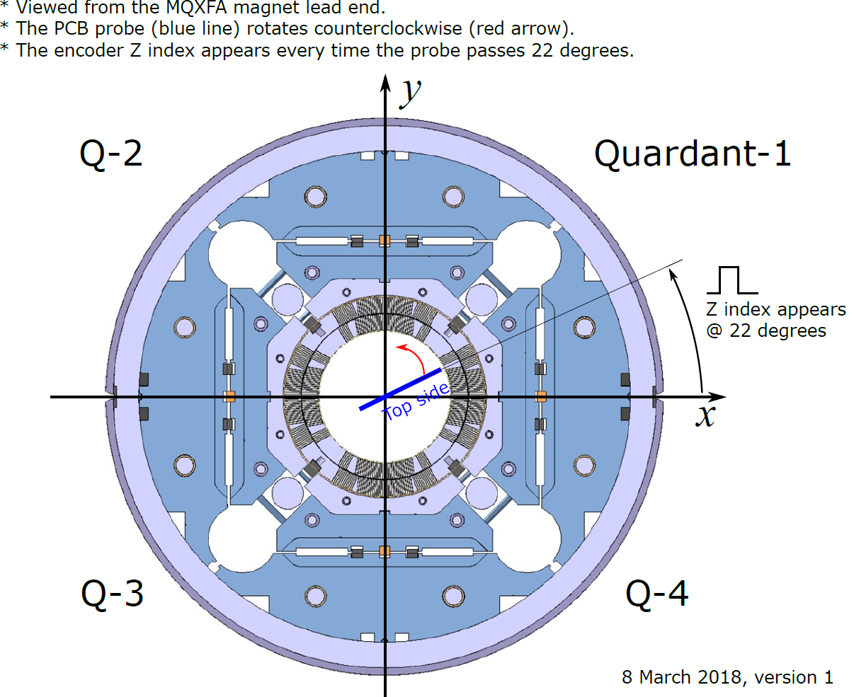
Reference Frame for Magnetic Measurements
Longitudinal axis points from the return to the lead end
z = 0 is defined as the magnetic center based on the integrated quadrupole strength
Consider defining z=0 based on a specific geometric location/drawing
Also need to introduce in the quadrant/coil diagram a geometric feature (e.g. main leads) to clarify angular reference
C104
C102
C105
C106

Slide 23
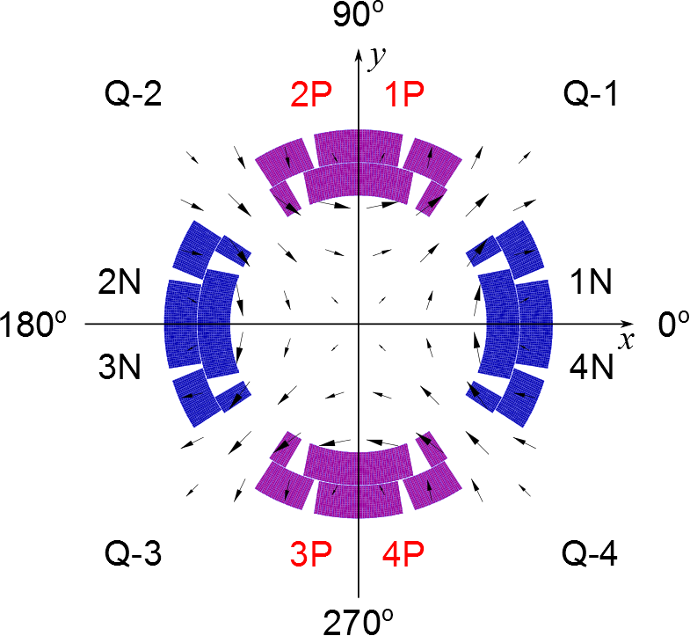
Quadrupole reference frame and powering
Positive or negative quadrupole depending on powering
Positive or negative depending on rotation (switches every 90 degrees)
Positive or negative quadrupole depending on direction of travel
Two magnets will be oriented opposite to each other in the cold mass
Next steps:
Confirm quadrupole sign for given powering orientation at LBNL and BNL
Some issue at LBNL comparing AP2 with AP1b:opposite quadrupole sign for nominally same powering
But, AP2 measurement was performed with no splice box (coils connected manually)

Slide 24
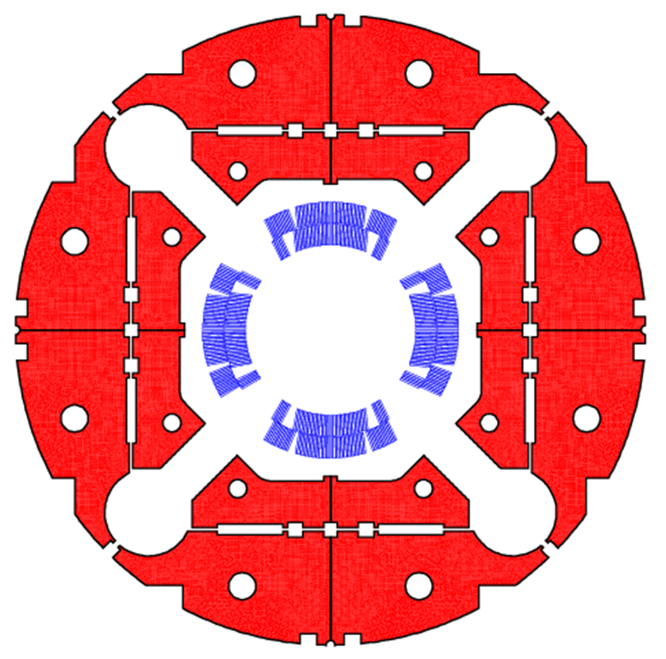
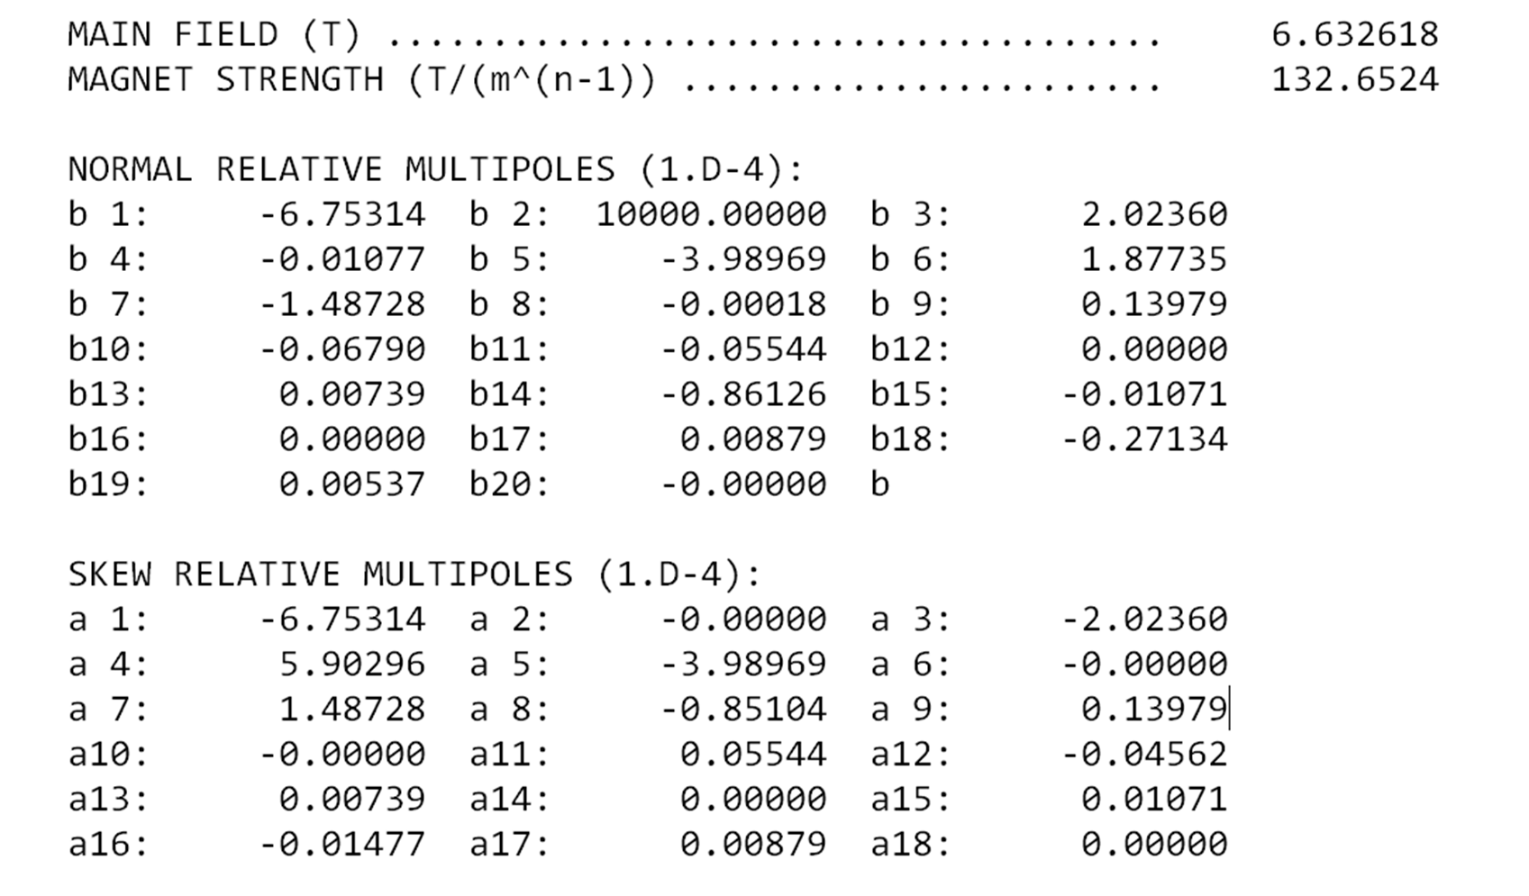
MQXFAP1b Calculated Harmonics
MQXFAP1 and MQXFAP1b included both 1st and 2nd generation coils
One coil first generation in Quadrant 3
Three coils second generation
Calculated field errors at nominal current (16.47 kA):
2G
2G
1G
2G

Slide 25
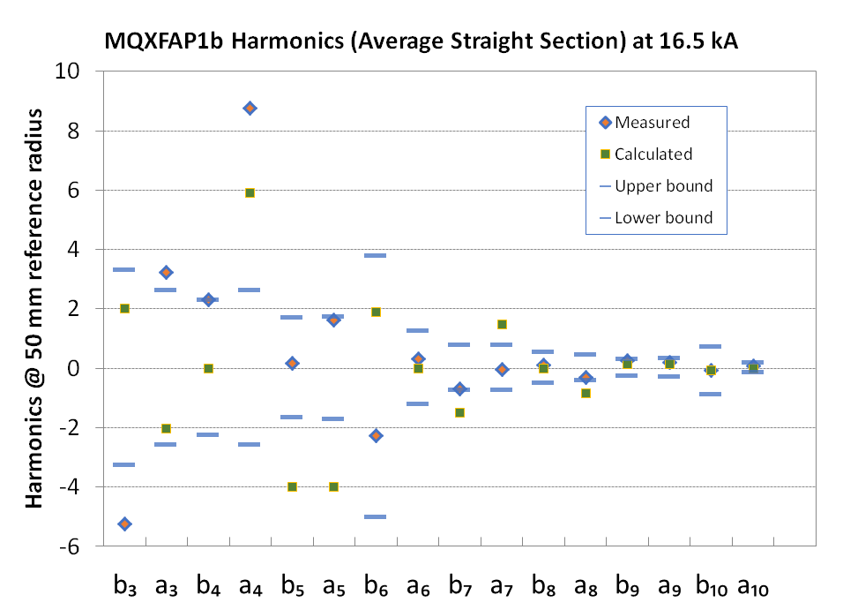
Cold Measurements during Vertical Test
Upper bound: s + u + 3σ
Lower bound: s - u - 3σ

