Slide 1

Short overview of previous
WP5 failure studies
R. Bruce on behalf of WP5
Annual HL-LHC collaboration meeting, Fermilab, 2019.10.15

Slide 2
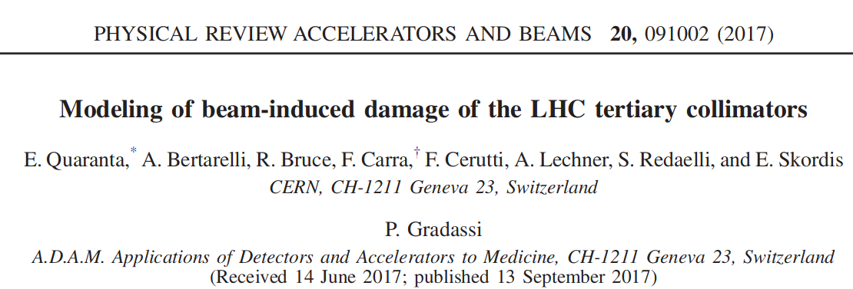
Studies of TCT damage limit for asynch. dump
3-step simulation of asynch dump in HL-LHC v 1.0: tracking + energy depostion + thermo-mechanical simulation

Slide 3
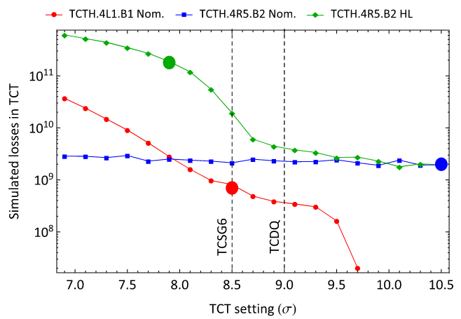
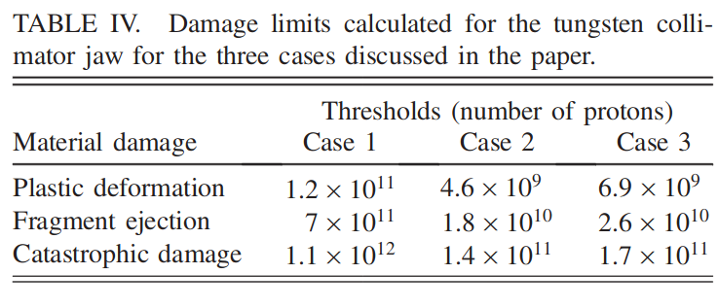
Studies of TCT damage limit for asynch. dump
Found potentially very high losses on TCTs – still old optics with “bad” phase advance
Calculated limits used as input to all following studies on asynch dump

Slide 4
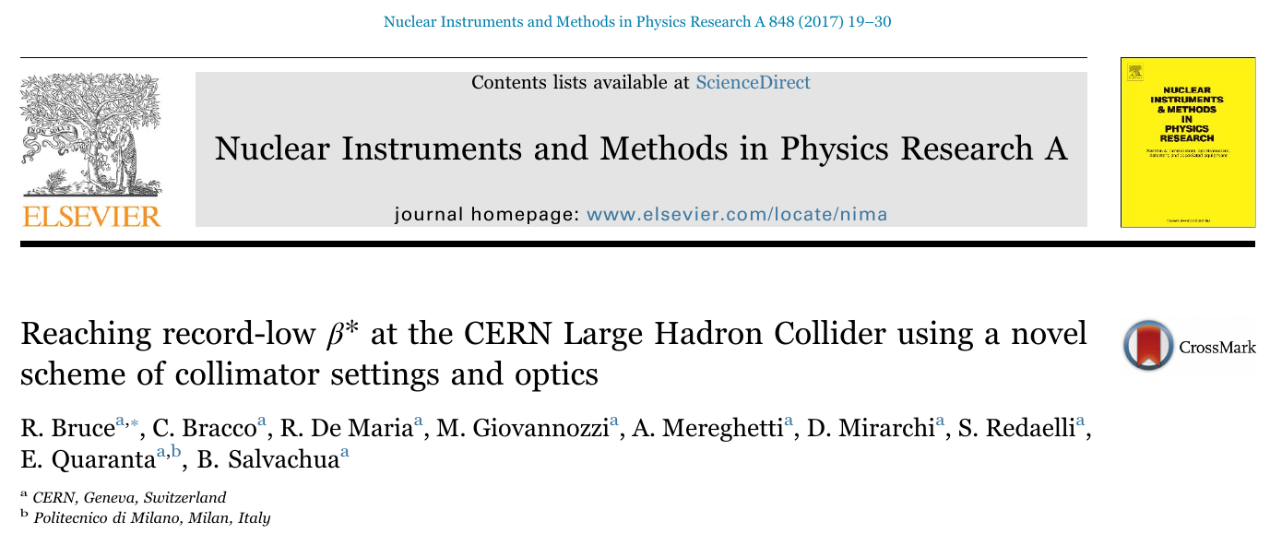
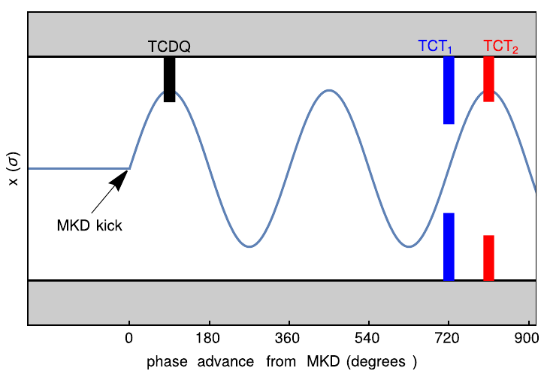
Studies on MKD-TCT phase advance
Studies for the 2016 LHC run: elimination of primary TCT impacts during asynch dump by use of MKD-TCT phase advance

Slide 5
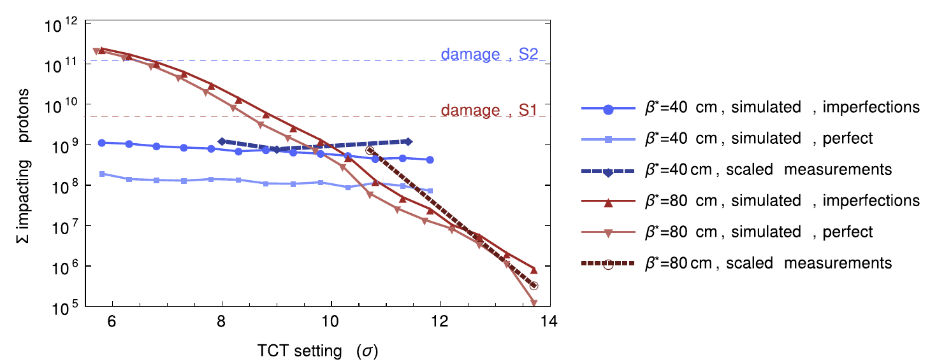
Studies on MKD-TCT phase advance
“safe” situation, not limited by asynch. Dump, for MKD-TCT phase < 30 deg
Successfully implemented strategy in 2016 and allowed to reach β*=40 cm
Successfully benchmarked simulation with measurements

Slide 6
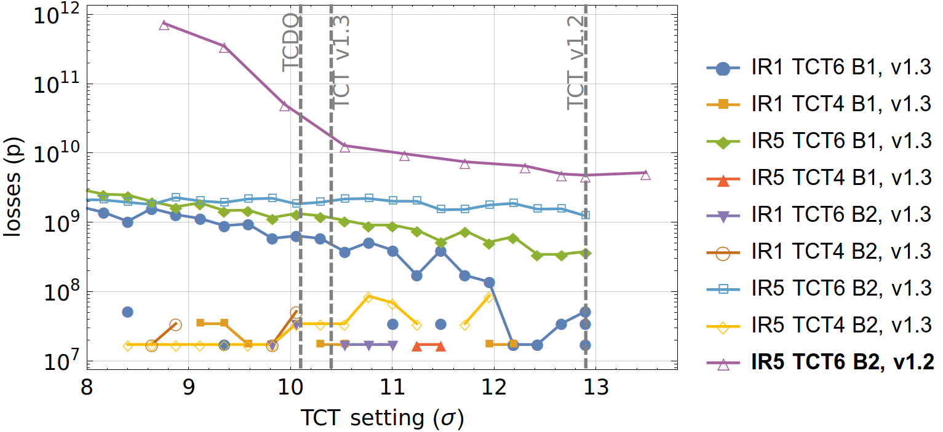
Failure studies including MKD-TCT phase for HL-LHC v1.3
Included LHC experience in HL-LHC design, with requirements on MKD-TCT phase advance
Presented at the 2017 annual HL-LHC meeting (indico links: 1,2)
Conclusion: tungsten TCTs well below damage limit for secondary impacts
Allowed tighter TCT setting at 10.4 σ → pre-requisite to reach 15 cm after rebaselining
Damage, spread-out impacts

Slide 7
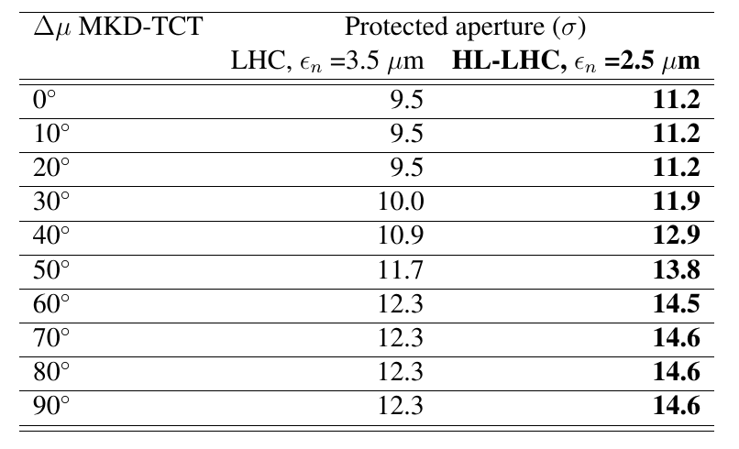
Calculation of allowed settings vs phase
Achieved phase advance in HL v1.3 and later allows tighter TCTs and aperture
Calculation of protected aperture for different MKD-TCT phase advance
    CERN-ACC-2017-0051
    CERN-ACC-2017-0051

Slide 8
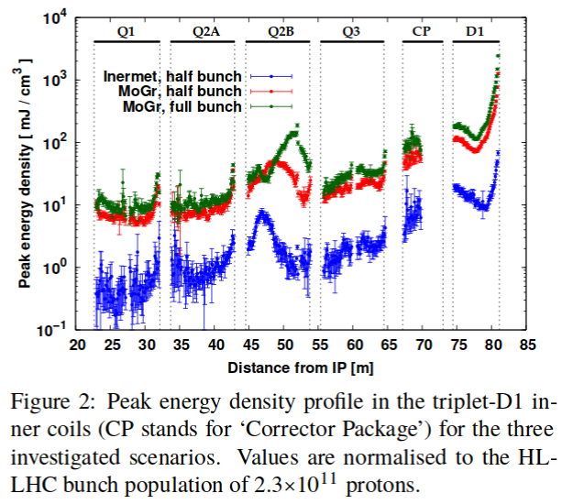
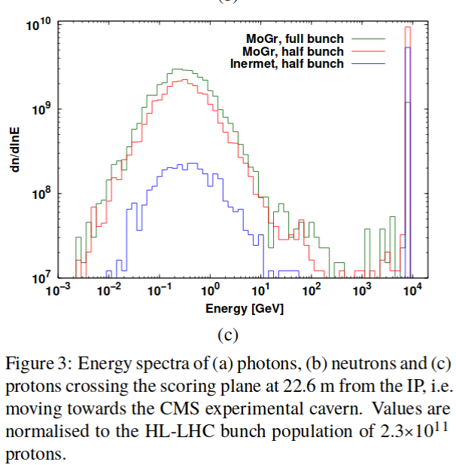
FLUKA studies of TCT shower during failure
Studies of energy deposition on downstream elements for asynch dump: input from previous tracking studies
Simulated cases with both “bad” and “good” MKD-TCT phase advance
See A. Tsinganis et al. at HL-LHC meeting 2017 and at IPAC

Slide 9
Input to energy deposition
Particles entering the detector used as input to FLUKA study of ATLAS detector by A. Sbrizzi et al.
Even with MoGr TCTs (unrealistically light) we are at least a factor 300 below ATLAS damage limit
A. Sbrizzi, ATLAS non-collisional background meeting 9/4/2018
IBL damage threshold: dN_{MIPs}/dS = 10¹³/cm² (measured @ HiRadMat)
  dE_{thr}/dV = (dN_{MIPs}/dS) (dE_{MIP}/dx) = 3.87*10¹³ MeV/cm³
  dE_{dep}/dV = (dE_{dep}/dVdN_{p}) N_{p}
TCT4 material | Impact scenario | N_{p}/10¹¹ | dE_{dep}/dE_{thr} [%]
 |  |  | TAS ∅ 60 mm | TAS ∅ 34 mm
W alloy | Half-bunch | 1.167 | 0.0048 | 0.0016
Mo graphite | Half-bunch | 1.167 | 0.17 | 0.038
Mo graphite | Full-bunch | 2.184 | 0.30 | 0.078

Slide 10
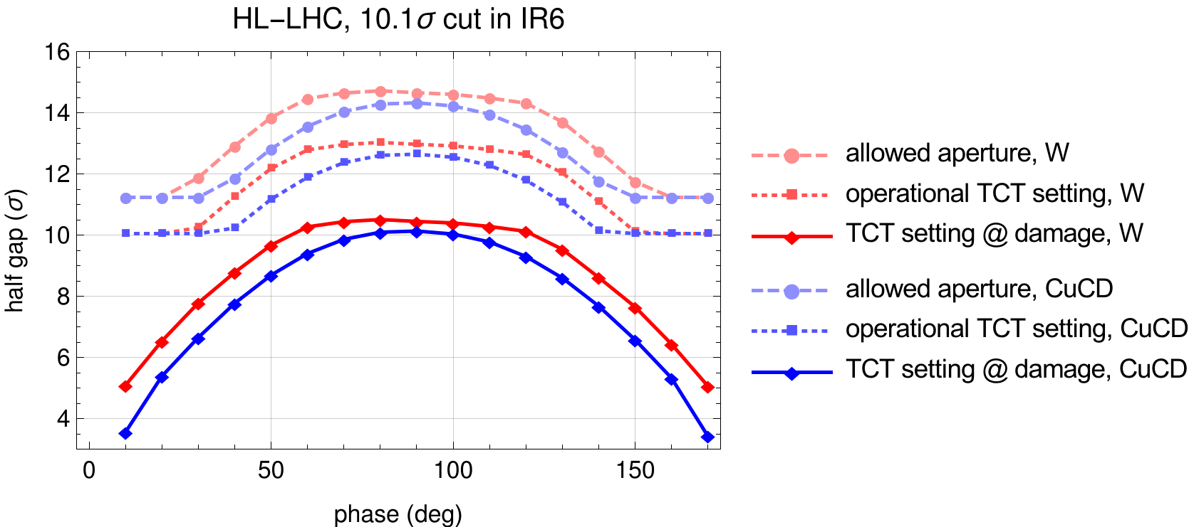
TCT impacts with new material: CuCD
With CuCD, improvement in robustness. TCT can take more protons before being damaged
  Possibility for tighter TCTs and tighter protected aperture
See ColUSM 115
Best case: aperture=11.2 σ below 20 deg for W
and below 30 deg for CuCD
Note: 2.5 um emittance

Slide 11
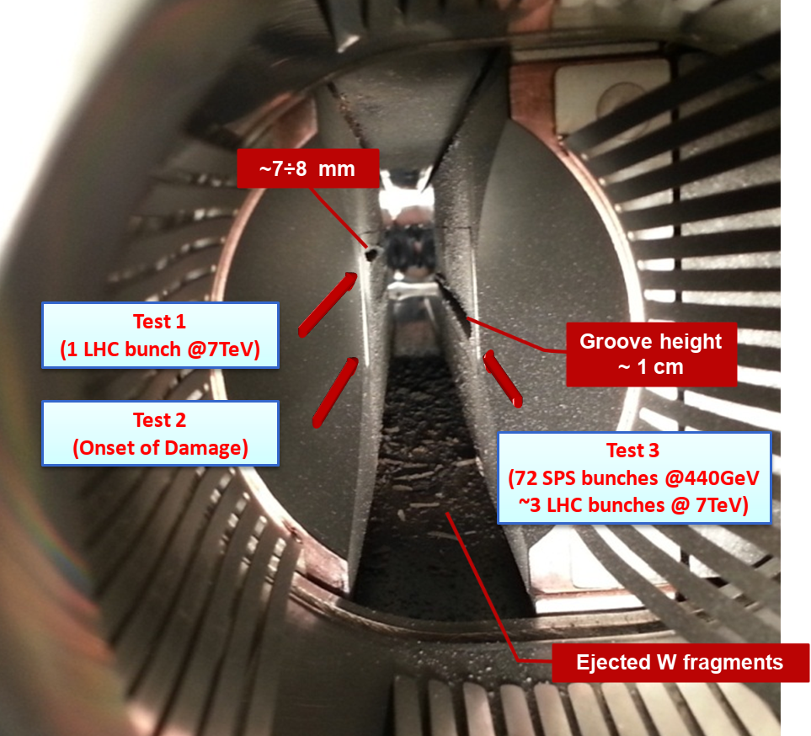
HiRadMat tests
Experimental validation of robustness of material samples as well as full collimator jaws
Assessing impacts of
async. dump and
injection failure
Some references:
  Overview of
  Multimat (HRMT 36)
  Paper on HRMT 23,
  comparison of
  W and CuCD
  Overview of earlier
  HiRadMAt studies
A. Bertarelli, F. Carra et al.

