Slide 1


HiLumi Cryogenics,
Progress highlights and perspectives
Serge Claudet,
On behalf of the Cryogenic project team
October 14th 2019

Slide 2
Table of contents
Introduction
P1/P5, interfaces revisited (IT, D2, DF’s, CC)
P1/P5, QXL cryoline integrated
P1/P5, process studies – controls architecture
P4 upgrade
Summary

Slide 3
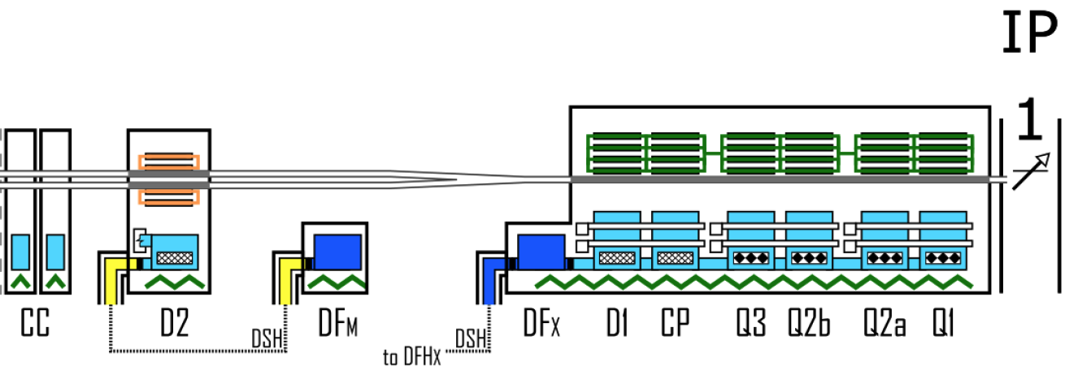
HL-LHC cryogenic upgrade
P1-P5: 2 new cryoplants (~15 kW @ 4.5 K incl. ~3 kW @ 1.8 K ) and 2 x 750m cryo-distribution for high-luminosity insertions
P4: upgrade (+2 kW @ 4.5 K) of an existing LHC 18 kW @ 4.5K cryoplant
SPS-BA6: SRF test facility with beam primarily for Crab-Cavities
+
SPS-BA6
P1/P5: Provide adequate cooling for this
Other test facilities related activities not reported here
14Oct'19

Slide 4
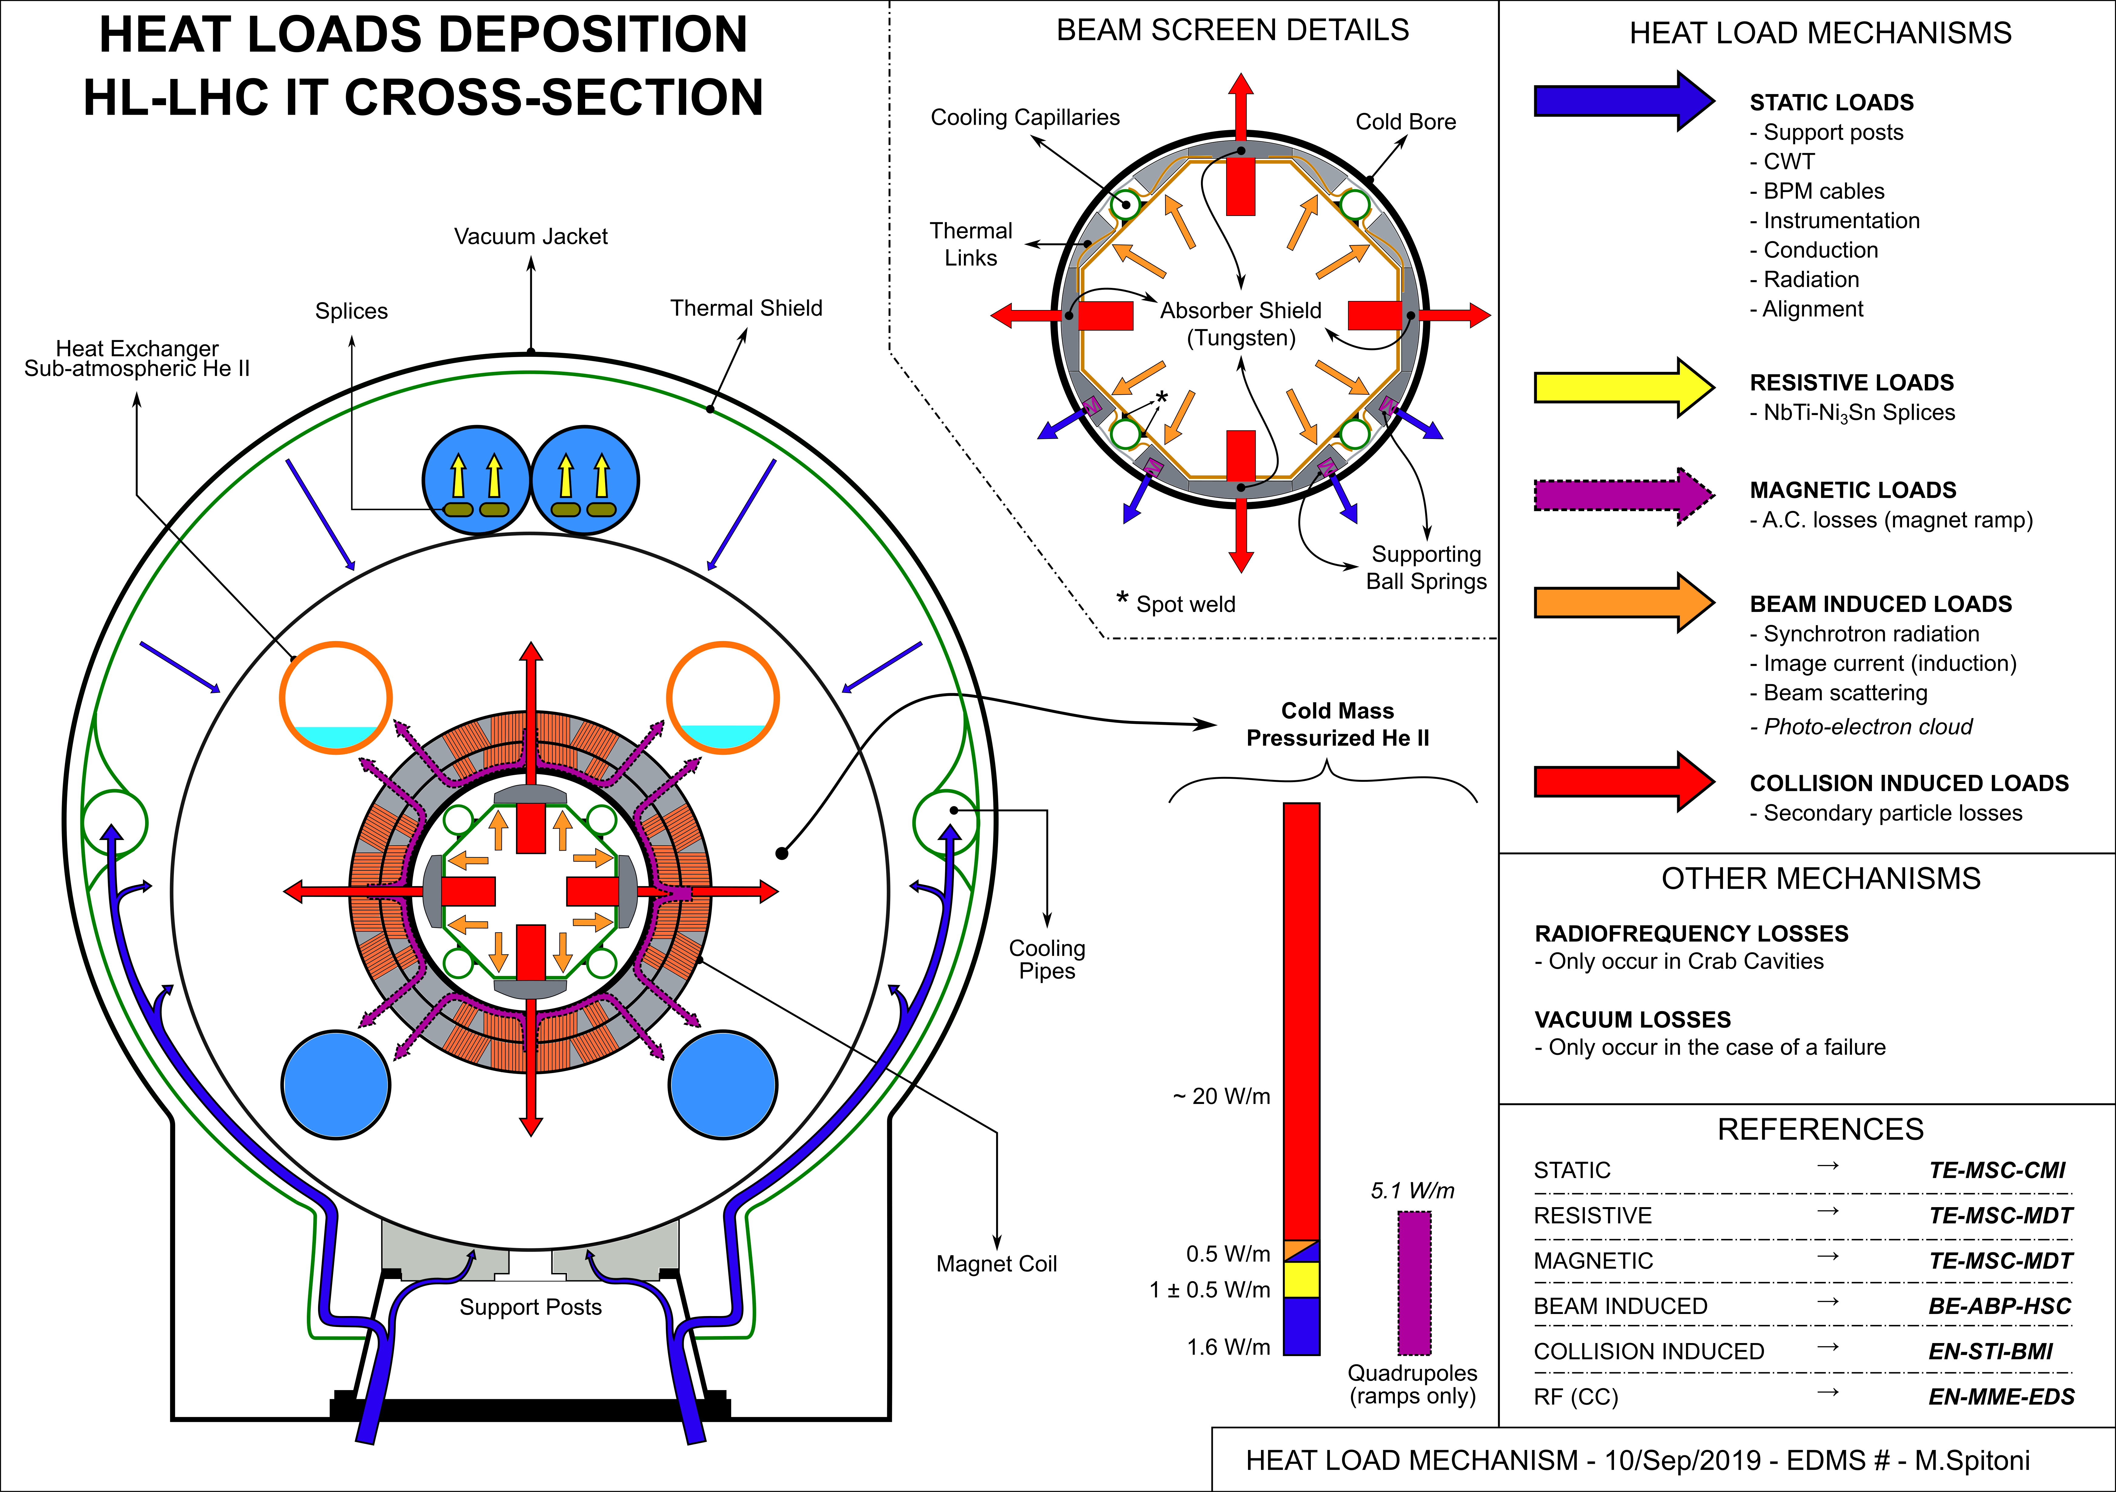
Heat loads mechanisms - Cross Section
14Oct'19

Slide 5
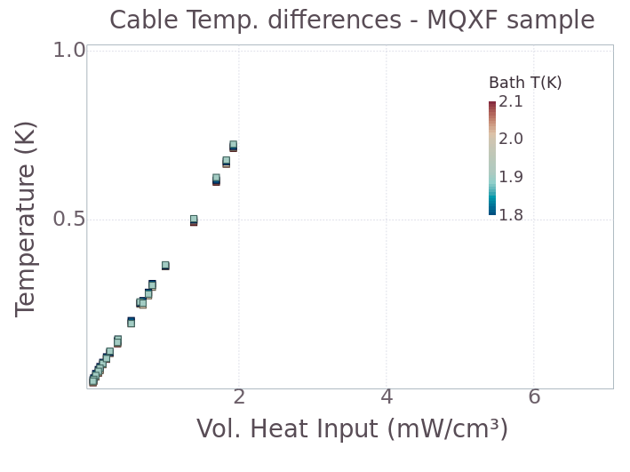
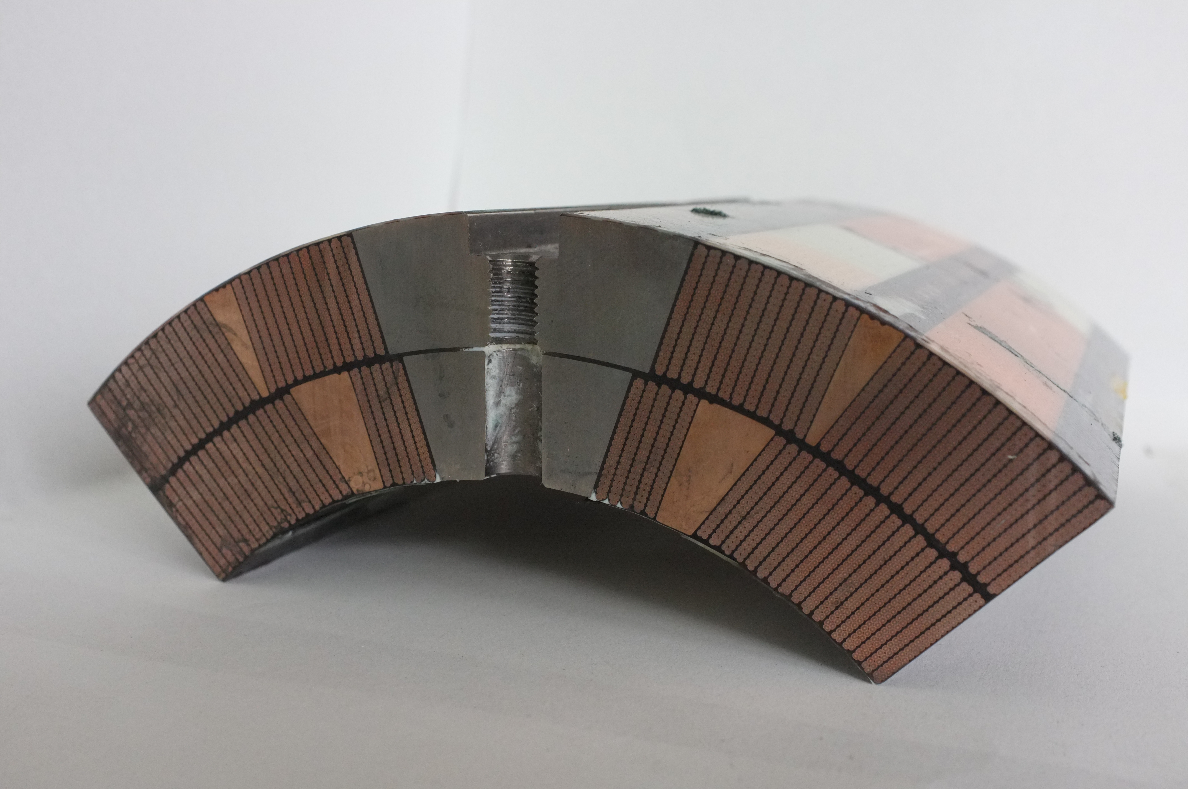
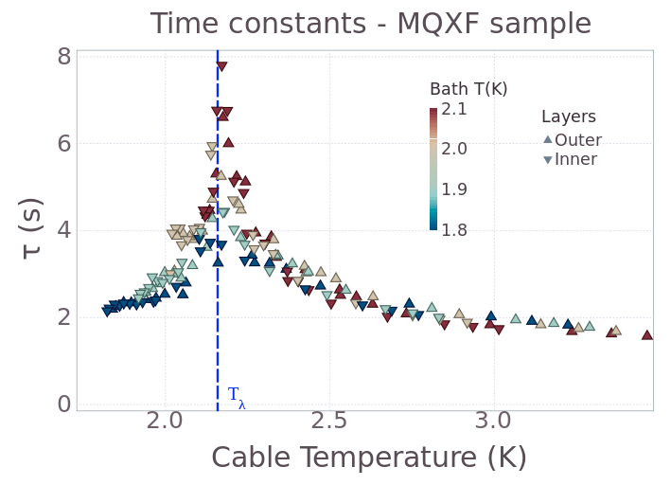
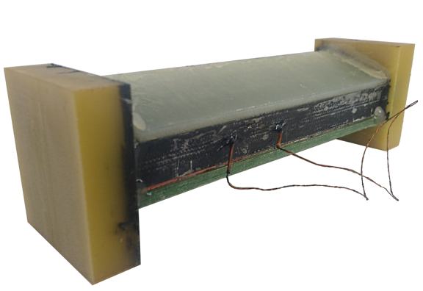
Heat transfer measurements in Nb3Sn stacks
Inter layer DT
Characterisation of material properties
Porosity to He
14Oct'19

Slide 6
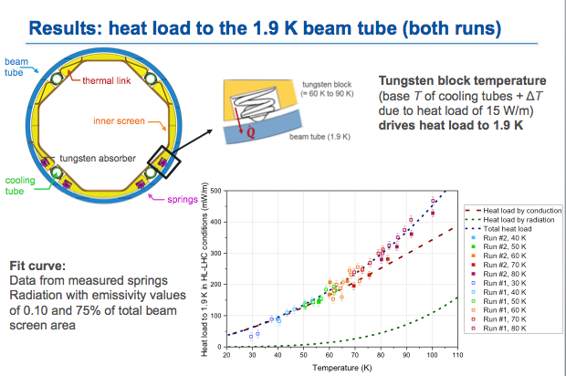
Beam-Screen thermal behaviour
2+ years of elementary and complete tests done at cryolab, now completed
14Oct'19

Slide 7
Revised Process & Flow diagram
Splitting valves
Lower radiation region
Reasons
1) The electrical heater could be moved to a lower radiation area → main reason
2) Separate supplies allow separate CV at inlet for better flow control → positive effect
14Oct'19

Slide 8
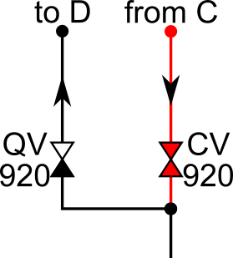
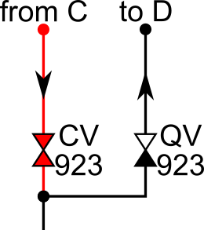
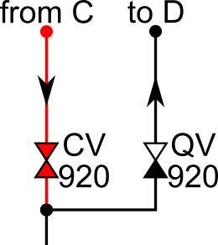
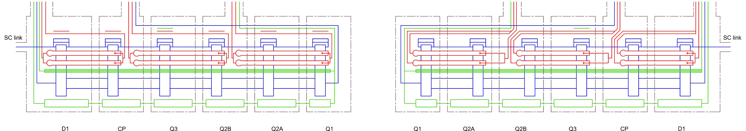

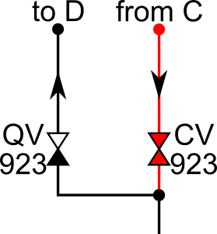
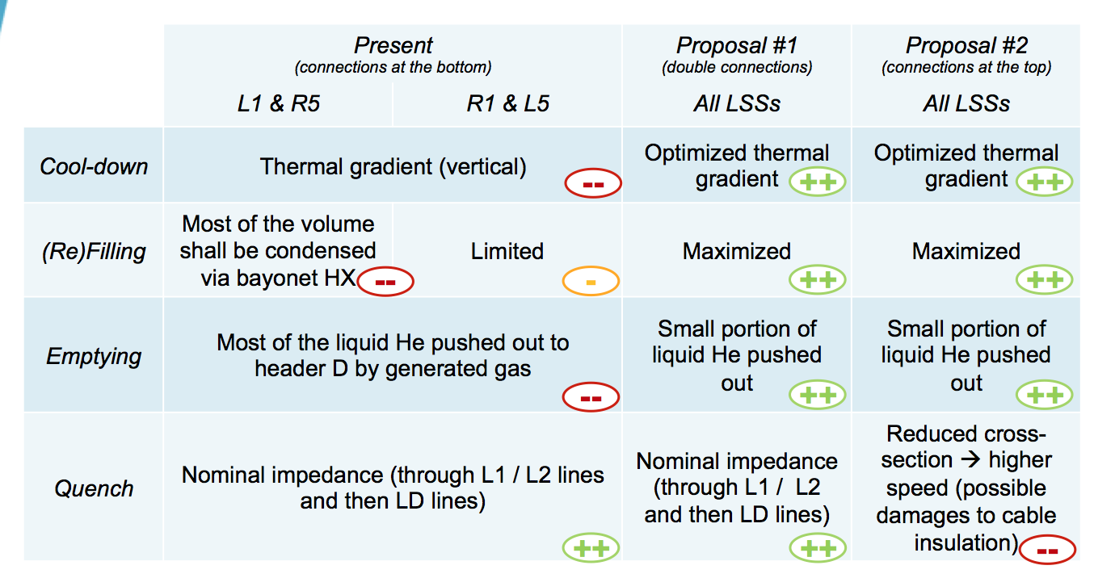
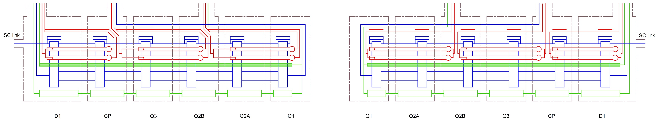

IT+D1: LD’ lines for transients
Cool-down
(Re)Filling
Cool-down
(Re)Filling
Emptying
Quench
Emptying
Quench
P1
OUTLET
OUTLET
Horizontal reference
Emptying
Quench
Cool-down
(Re)Filling
Emptying
Quench
P5
Cool-down
(Re)Filling
OUTLET
OUTLET
Horizontal reference
14Oct'19

Slide 9
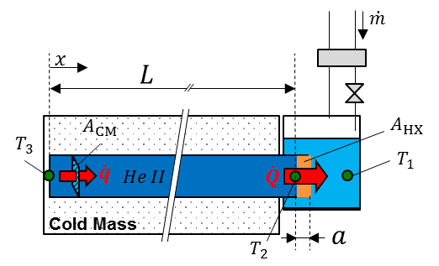
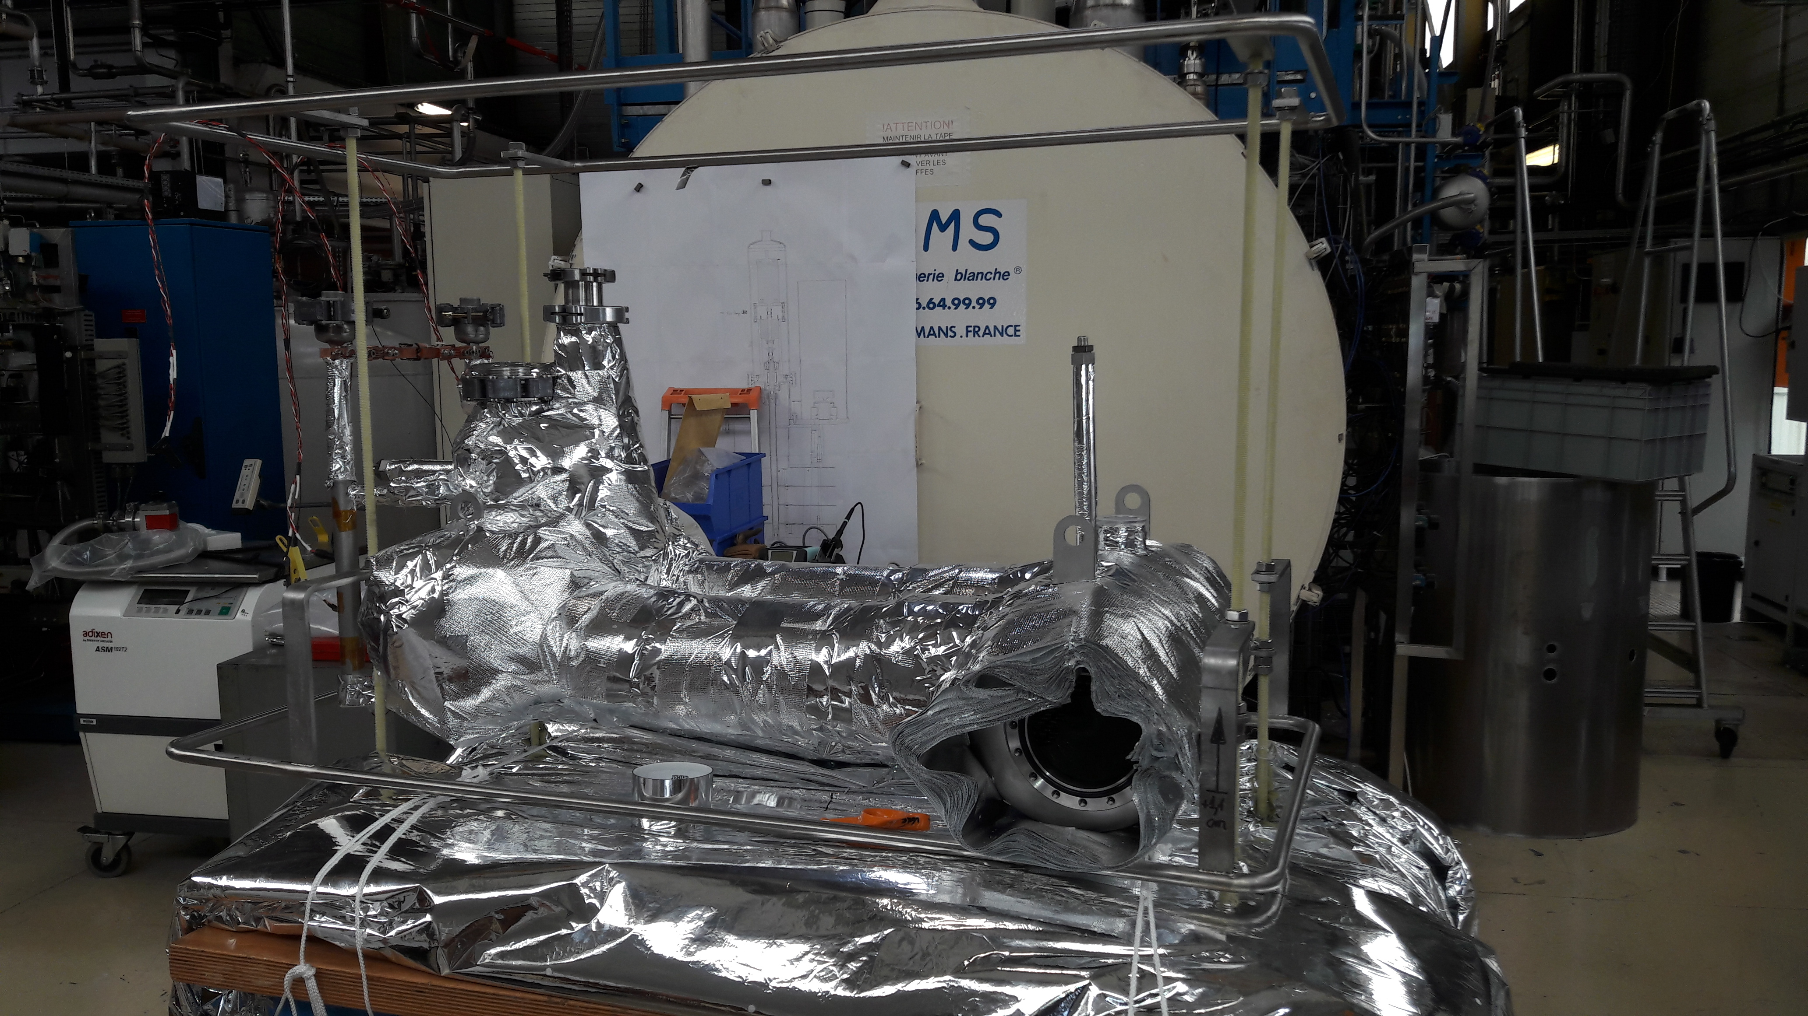


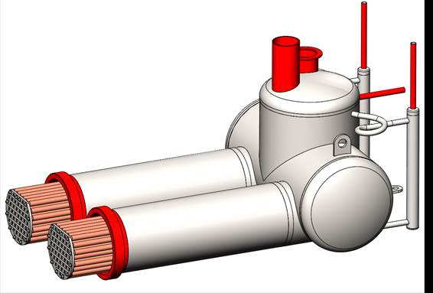
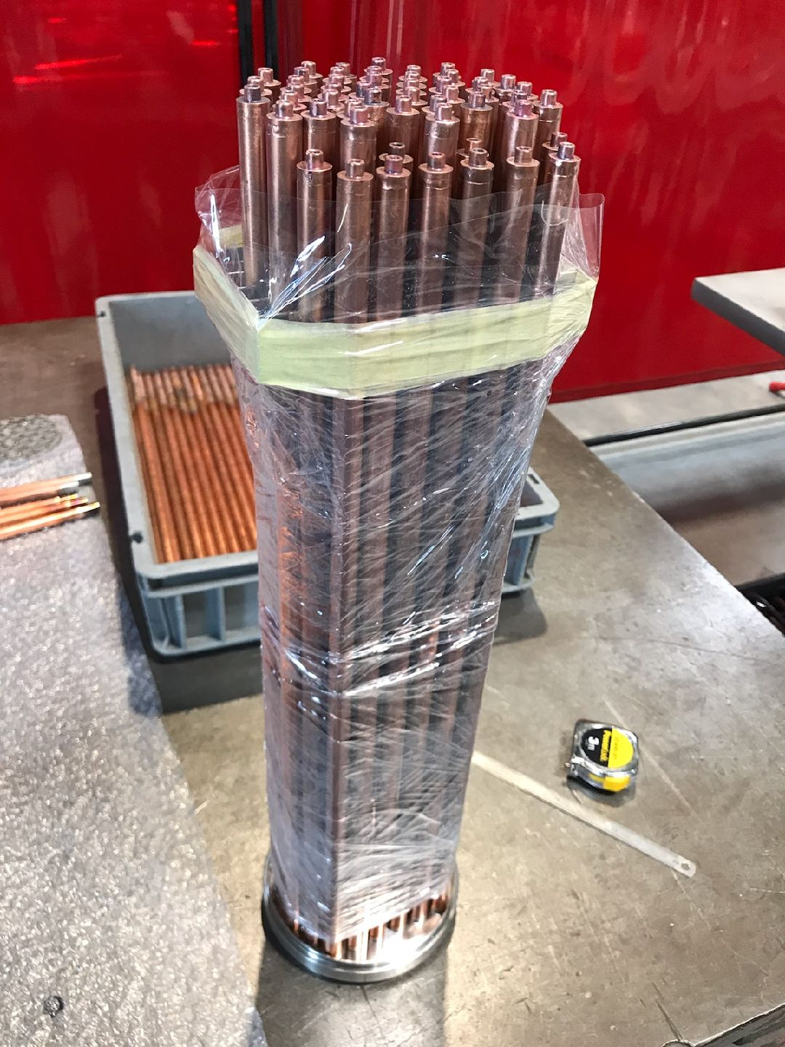
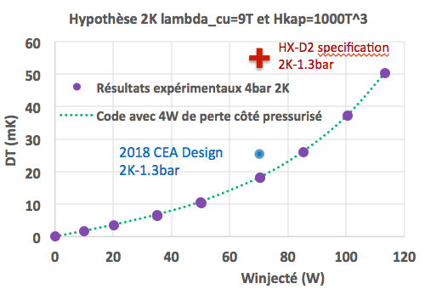
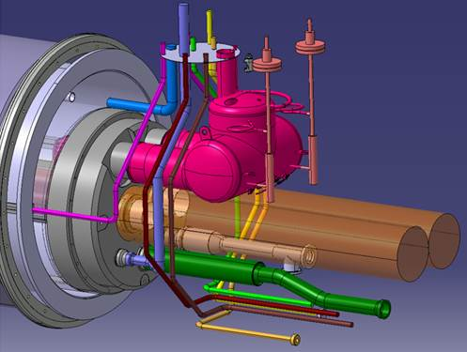
D2 heat exchanger
Studies, procurement and validations tests under collaboration with CEA-SBT Grenoble
13.5m
Not sensitive to slope, adapted for stand-alone magnets, up to 70W@2K ?
Performance validated @CEA Sept’19
14Oct'19

Slide 10
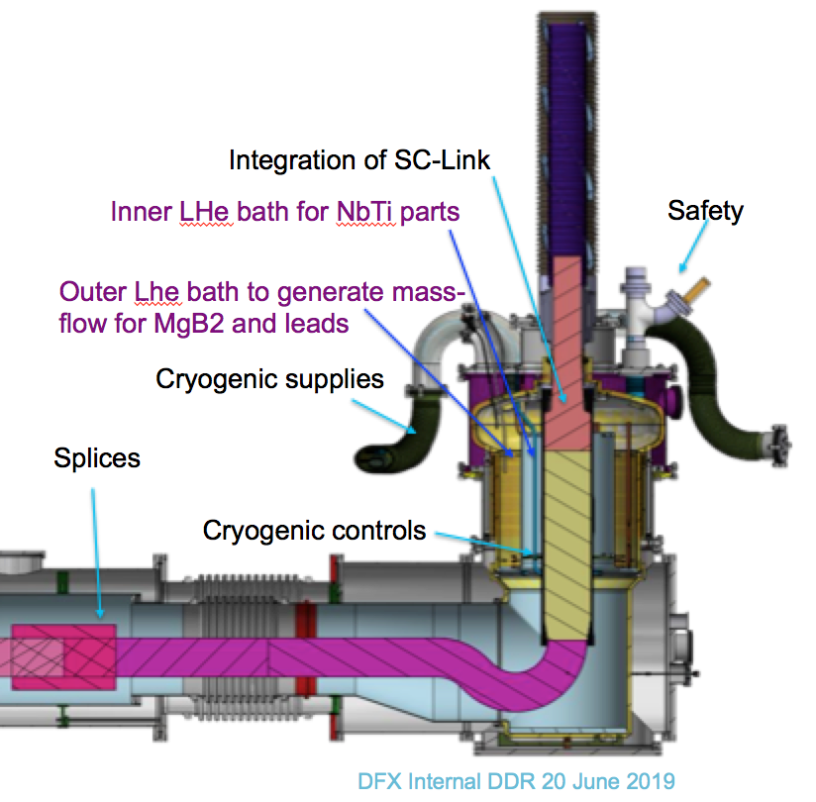
Cold powering, cryogenic aspects
Defined with a baseline for cold extremity,
Being studied and defined for warm extremity with leads
14Oct'19

Slide 11
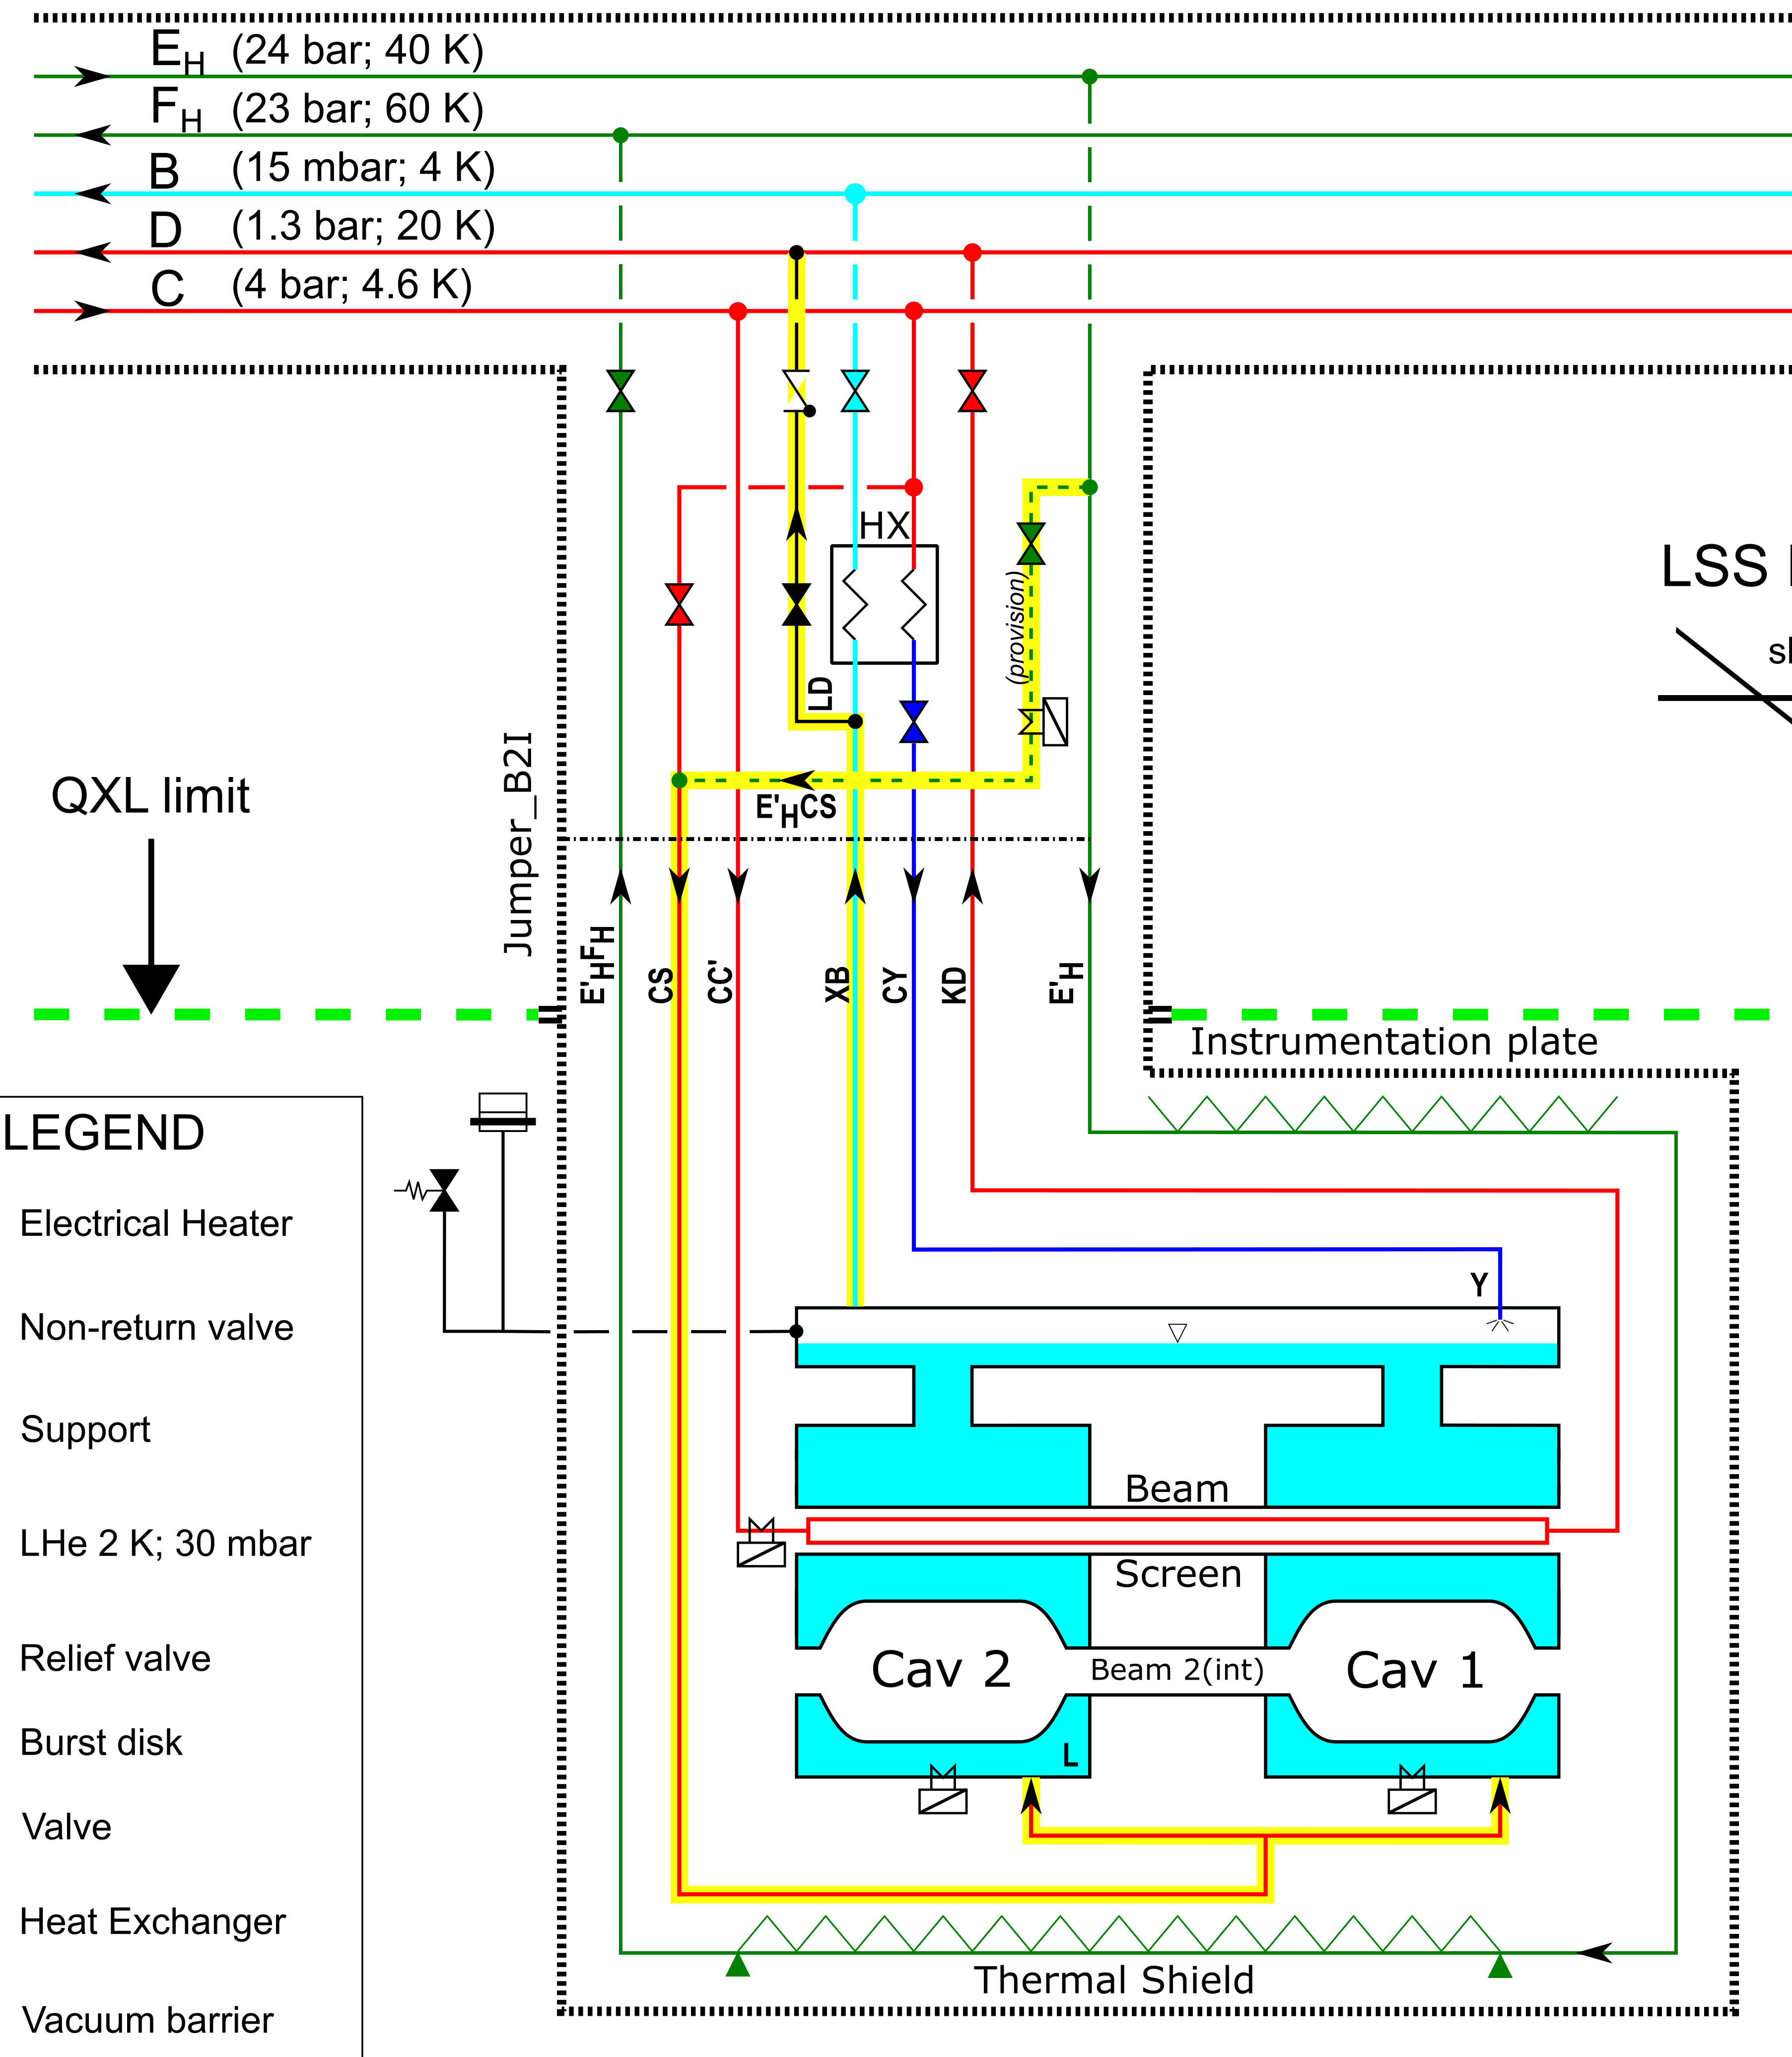
New CC warm-up proposal
The objective is to warm-up the CC using warm helium from thermal shield at 60 K
New simplified arrangement for independent warm-up now ready for decision
The circuit to this purpose would be
Eh → E’h → CS → CC → XB → LD → D
The Warm-up control valve will regulate the flow in order to perform the warm-up in a controled way
The proposed warm-up configuration must cope with the existing safety scheme
Control valve
To Header D
Warm-up
Control valve
Burst disk
Valve type | CV to Header D | SV to atmosphere | BD to atmosphere
Opening [bar a] | 1.5 | 1.7 | 2.1
Kv [m3/h] | t.b.d. | - | -
Aperture [mm] | - | < 20 | 100
Tolerance [%] | +0% -10% | +10% -10% | +10% -0%
Remarks | Helium recovery | First protection | Extreme protection
Safety valve
14Oct'19

Slide 12
Table of contents
Introduction
P1/P5, interfaces revisited (IT, D2, DF’s, CC)
P1/P5, QXL cryoline integrated
P1/P5, process studies – controls architecture
P4 upgrade
Summary
14Oct'19

Slide 13
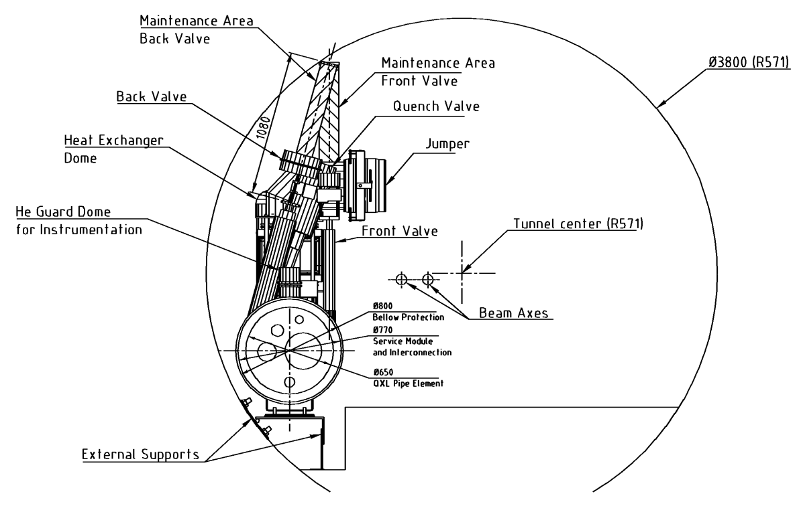
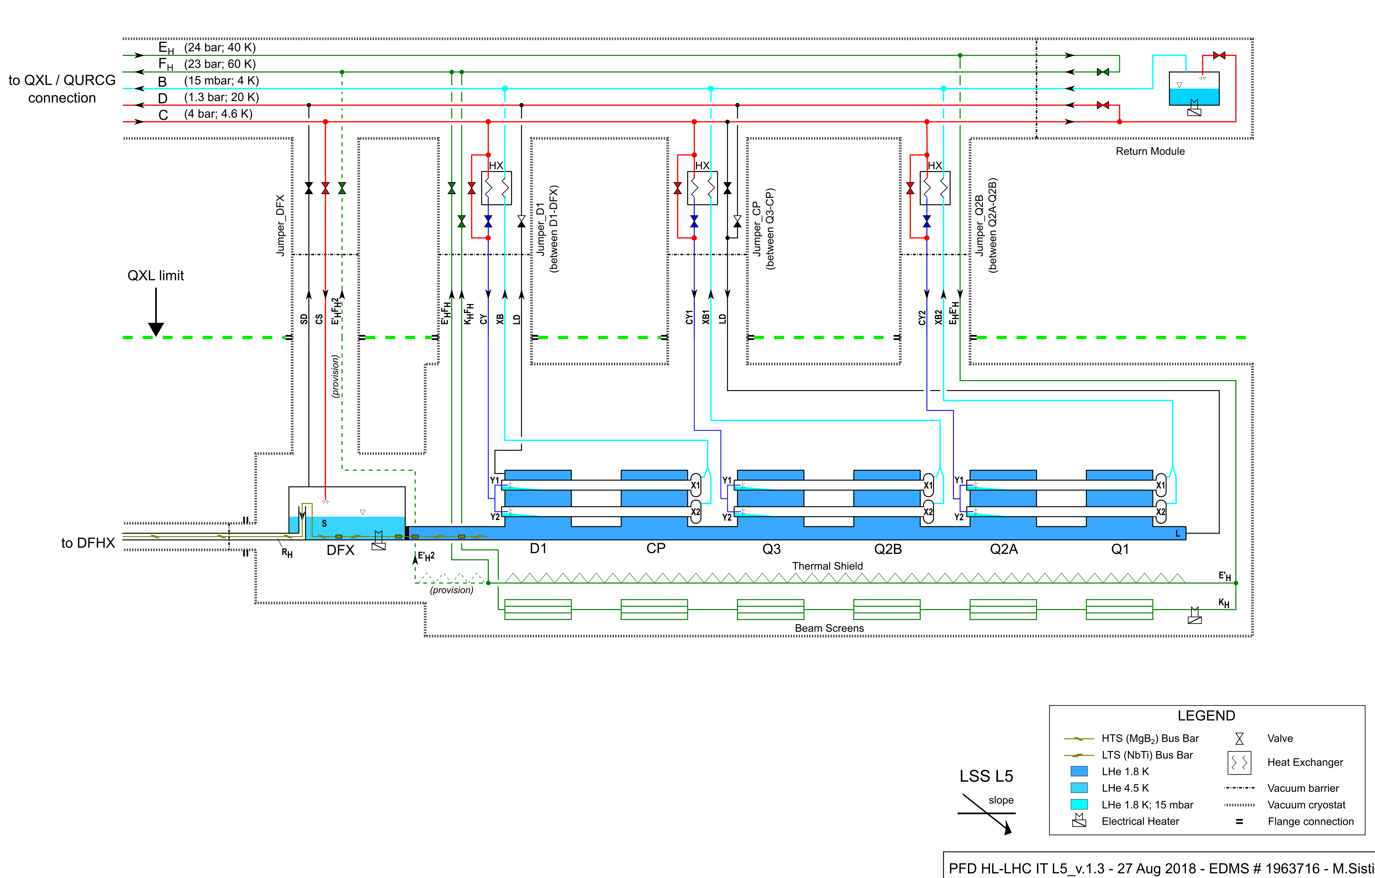
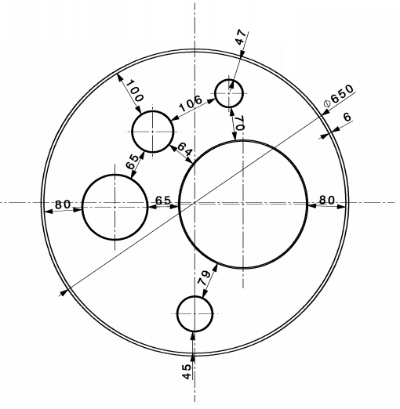
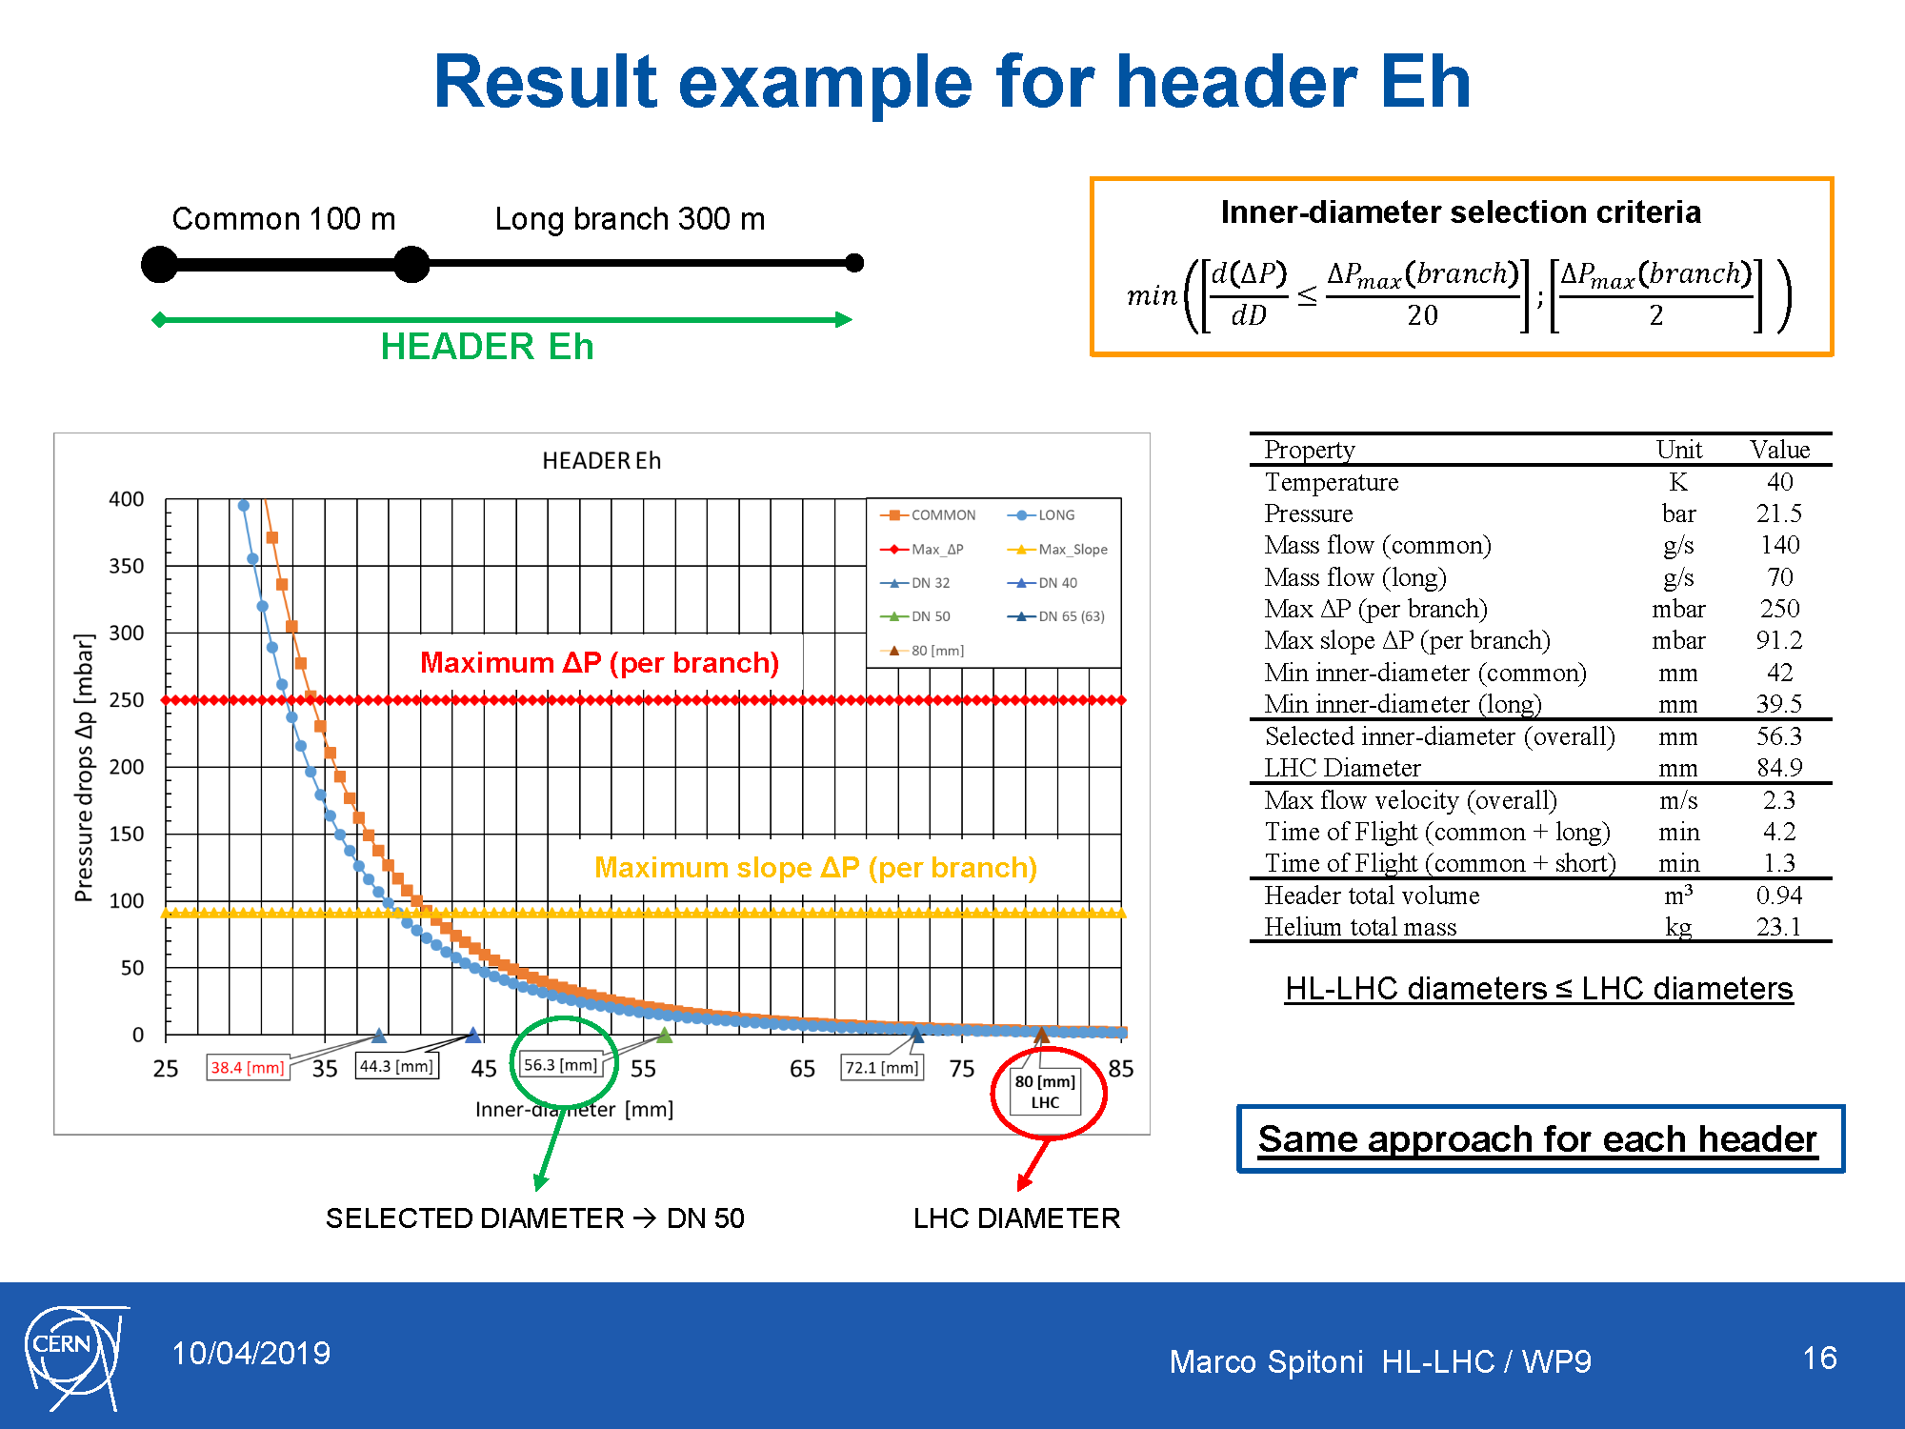
QXL cryoline headers
Typical Tunnel cross section
Inner Triplet flow scheme
QXL
Typical QXL cross section
Users
Eh
C
Header Eh → Supply of thermal shield and beam screen (IT only)
Header Fh → Return of header Eh
Header C → Supply of supercritical He
Header B → Return of superfluid He (very low pressure)
Header D → Return from DFX-DFM, beam screen (D2, CC, SAMs)
Various modes:
- Nominal
- Reduced capacity
- Cool-down
- Quench
- Other transients
D
B
Fh
Marco Spitoni HL-LHC / WP9
13

Slide 14
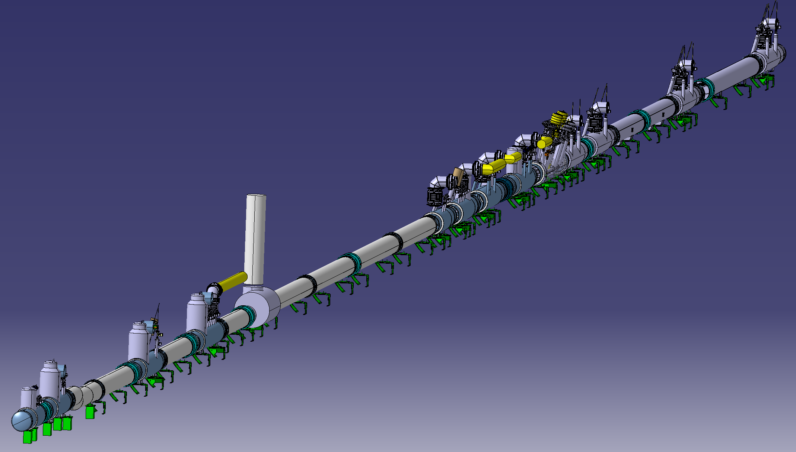
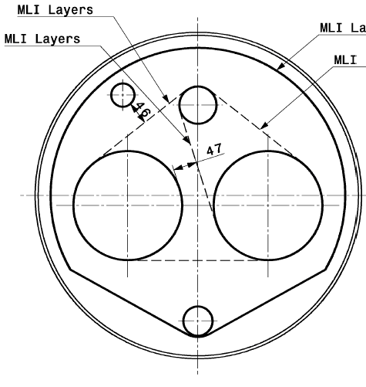
QXL Cryoline sizing, and 3D model integrated !
Typical Tunnel cross section
Typical QXL - Service Galleries
Constant outer diameter as boundary limit so far
Eh
C
Large “B” to match pressure drop criteria
D
B
Fh
Increased “D” to provide cold quench buffer for triplets
Typical QXL – LHC Tunnel
Reduced “B” as not impacting pressure drop
C
Eh
Verifying jumper/piping interfaces with all users while progressing now in service galleries
D
B
Fh
14Oct'19
Marco Spitoni HL-LHC / WP9
14

Slide 15
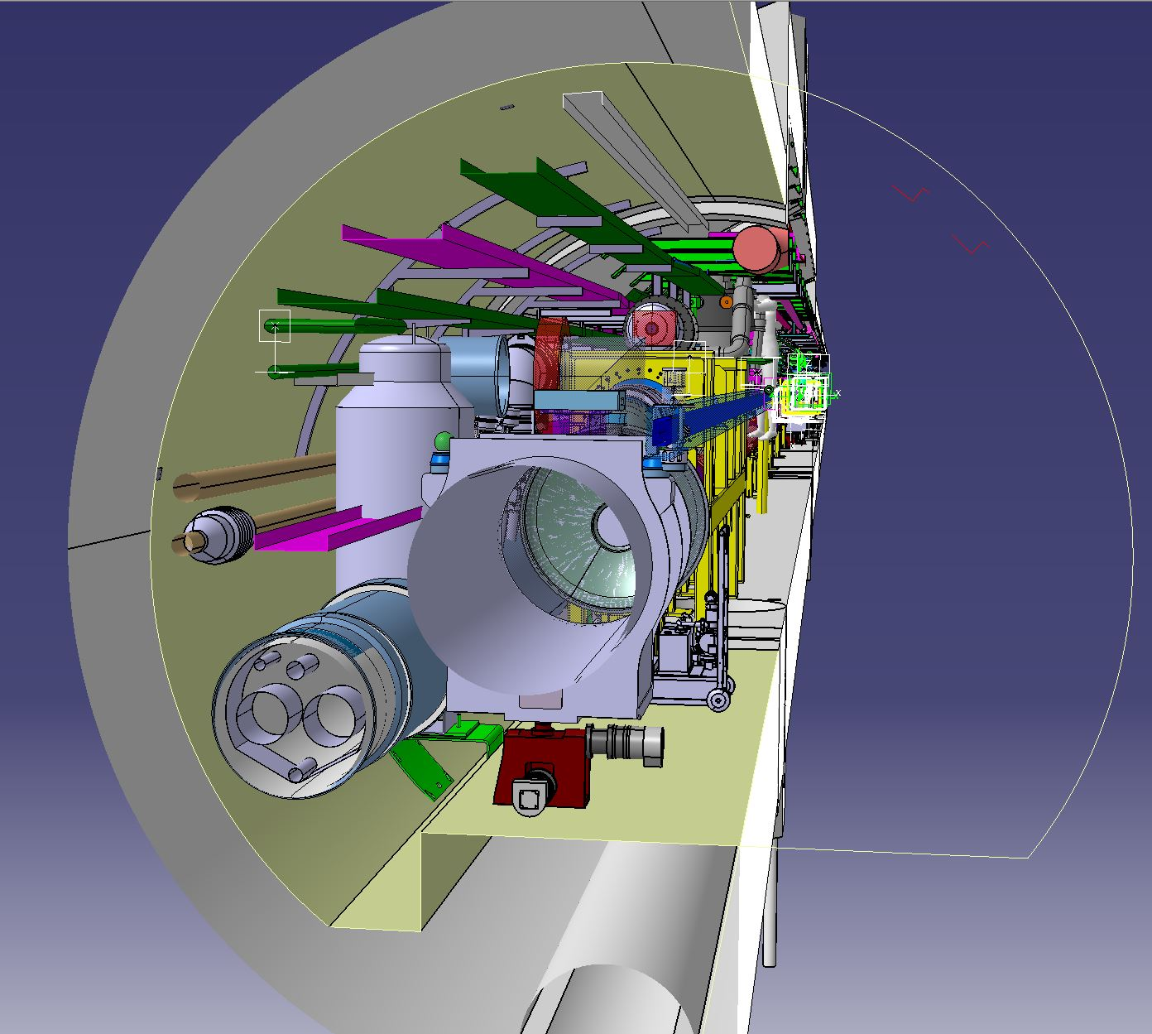
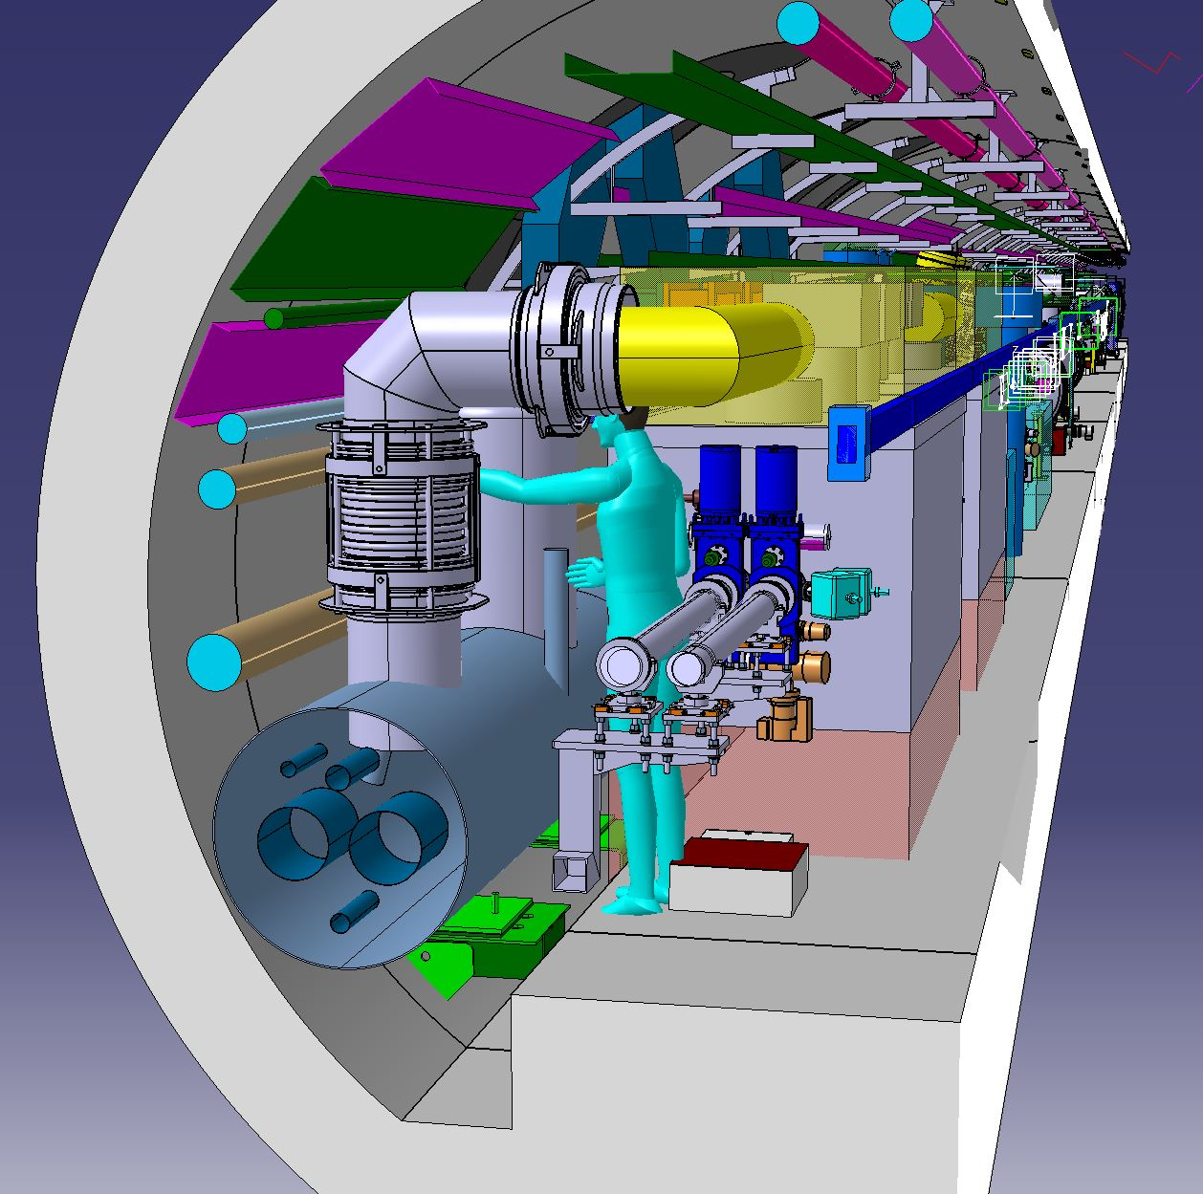
QXL cryoline, 3D models and integration
14Oct'19

Slide 16
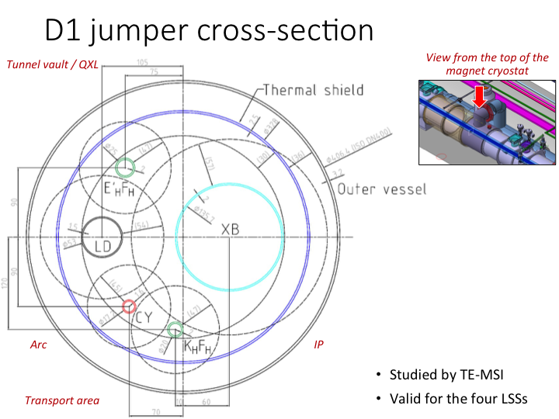
An example, done for all jumper interfaces
14Oct'19

Slide 17
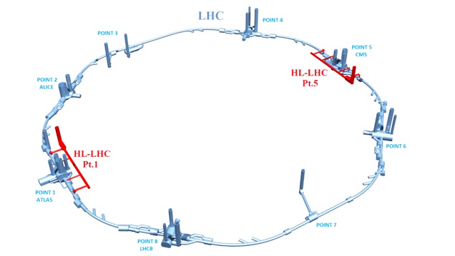
P1/P5 Cryogenic architecture
15 kW equivalent at 4.5 K, including 3 kW at 1.8 K
Warm compressor station
SHE
QSVB
GHe storage tanks
Surface piping
SHM
QSCG
QSAG
Dryer
QSP
Surface cold box
SLN
SD
SLN
Liquid Nitrogen tank(s)
Quench tank
QSDQ
QSRG
QSDN
Surface
QPP
QPLG
Vertical transfer line
Shaft
Underground
US
Cold compressors box
QURCG
DFHX
DFHM
(existing)
DFBL
UR
UL
QUIG
DSHX
DSHM
LHC tunnel
Interconnection box
DFX
DFM
DSL
Q1
Q2a
Q2b
Q3
CP
D1
D2
CC
CC
CC
CC
Q4
Q5
Q6
QRP
QXL
HRL
14Oct'19

Slide 18
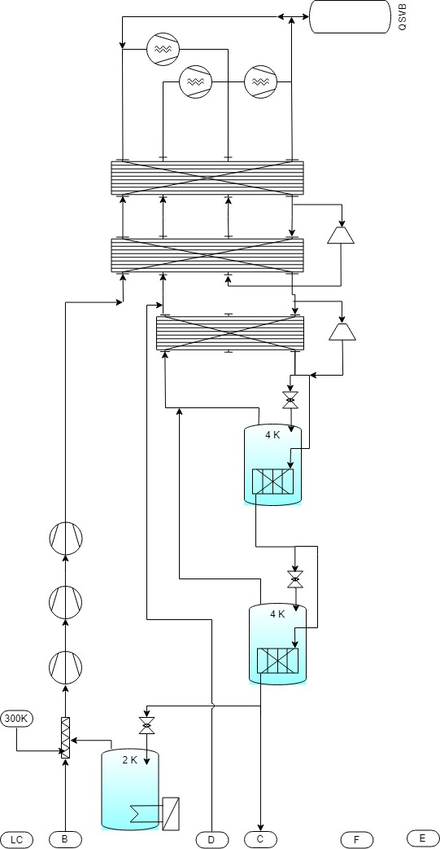
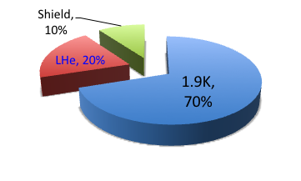
From cooling requirements to Refrigeration capacity and process
300 K
LC
Load @
4.5-300K
QSCG
C
4,5 K
20 K
D
Load @
4.5-20K
QSRG
4 K
B
HX
Load @
1.9-2K
QPLG
E
40 K
60 K
F
Load @
40-60K
QURCG
Obvious need for 15mbar header (1.8K cold source), no special need for 4.5K loads
Process options now under study
14Oct'19

Slide 19
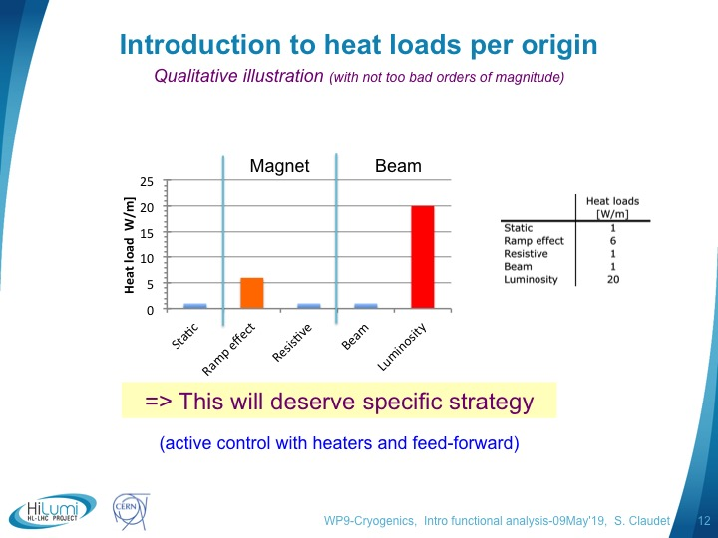
Managing dynamic loads
Refrigerator
HEX
Z max
#3: Lumi ramp
Beam off
Beam on
Z min
Heater
J to He_{sub}
J to He_{press}
J to He_{press}
C
Cold Compressor
B
m’ = CC driven
#1: Acceleration
#2: Pre-load + active controls
Cryo-distribution
Magnet Cryostat
14Oct'19

Slide 20
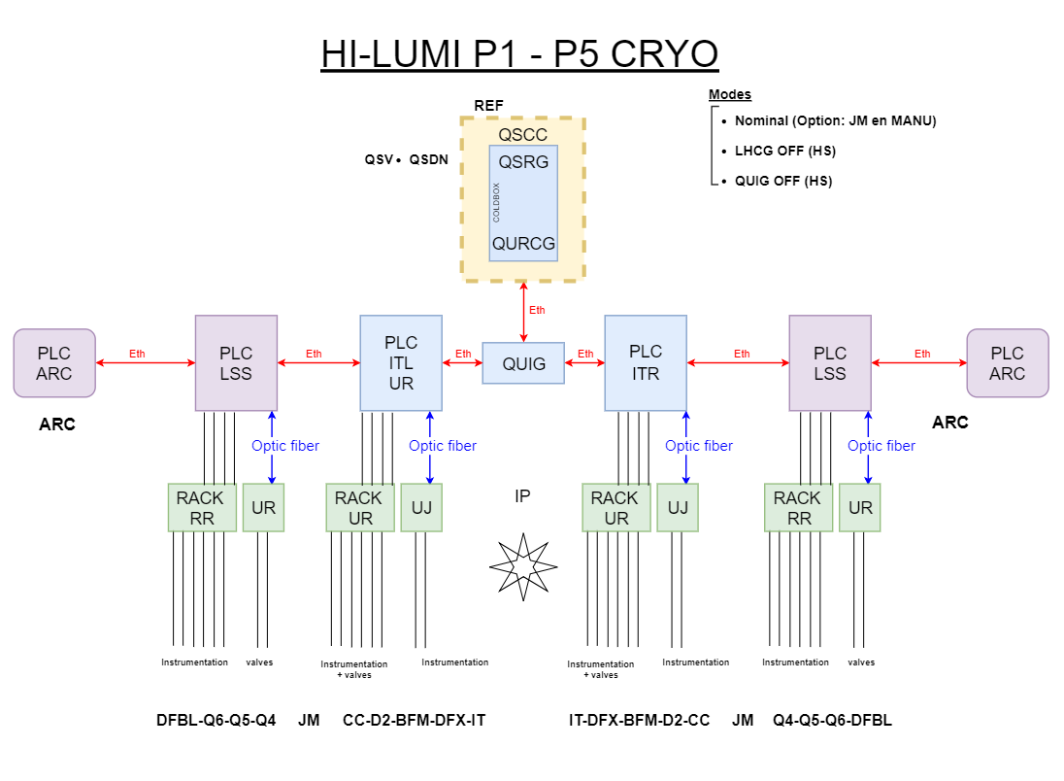
HL-LHC cryogenic “control” principles
Instrumentation
=> Racks-Electronics
=> Controls

Slide 21
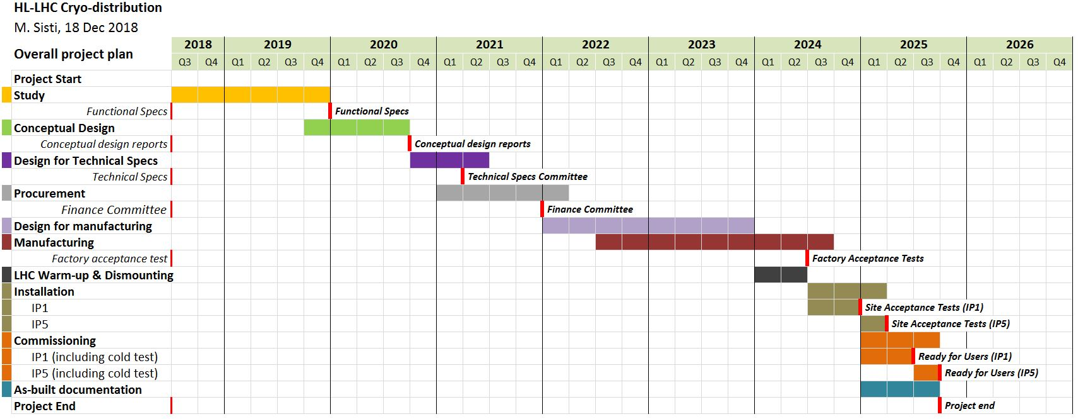
Project plans Refrigeration-Distribution
LS3
UR’s available
+
UL’s available
-
Today
Interfaces to be frozen by end 2020
Used now to discuss for LS3 (ready to install, P1 w.r.t P5)
14Oct'19

Slide 22
Table of contents
Introduction
P1/P5, interfaces revisited (IT, D2, DF’s, CC)
P1/P5, QXL cryoline integrated
P1/P5, process studies – controls architecture
P4 upgrade
Summary
14Oct'19

Slide 23
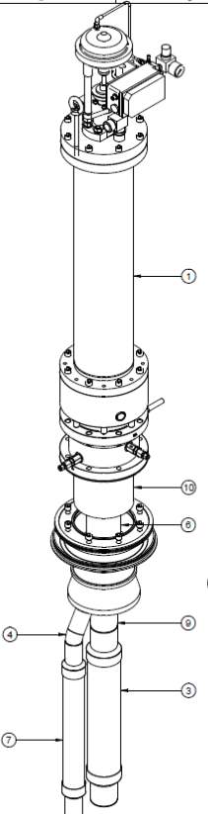
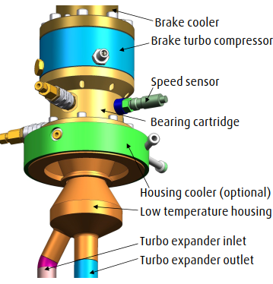
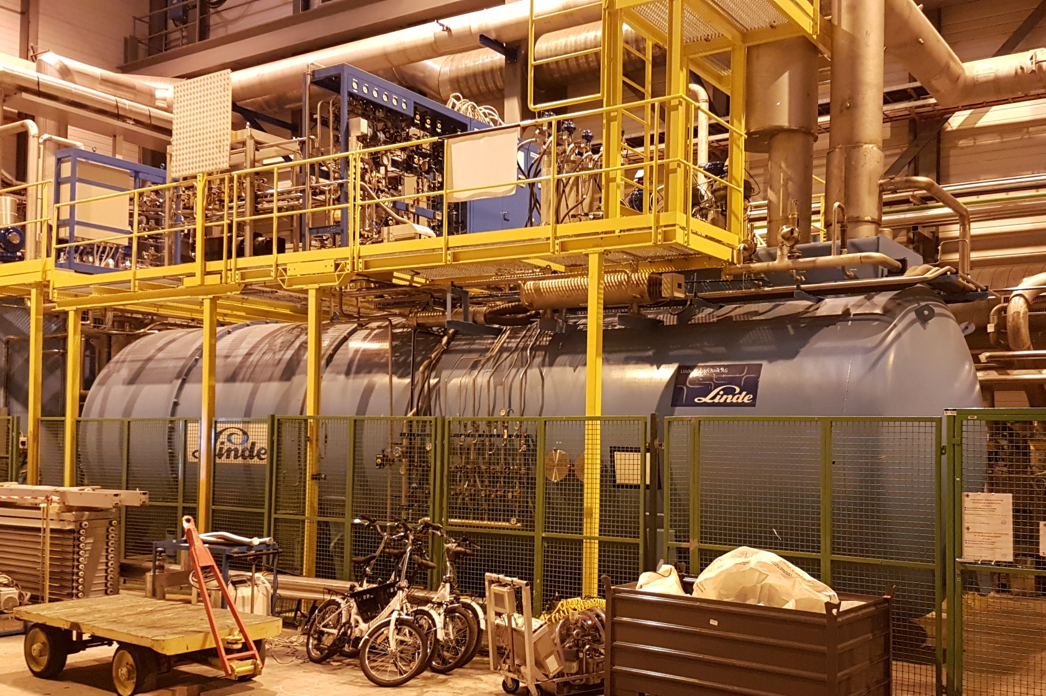
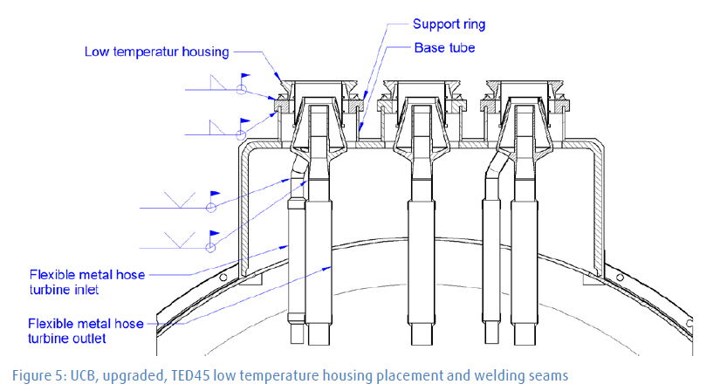
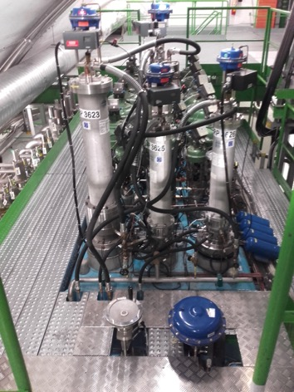
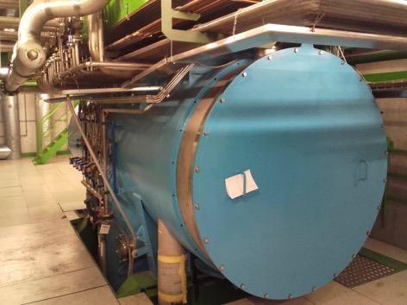
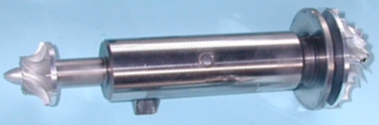
Upgrade of Helium Refrigerator at LHC Point 4 for HL-LHC – Upper and Lower Cold Boxes
Principle of the capacity upgrade: to replace 8 turbines by new type (more efficient)
This requires exchange of turbine housings & instrumentation
(FC Dec’18)
Site works: Q4-2019
Commissioning: Q2-2020
New turbine housings and instrumentation
Upper CB: 4 TU’s
Surface
Shaft
Cavern
Cut view of existing cold box
Spares and repairs: to ensure availability as for all helium refrigerators
Lower CB: 4 TU’s
14Oct'19

Slide 24
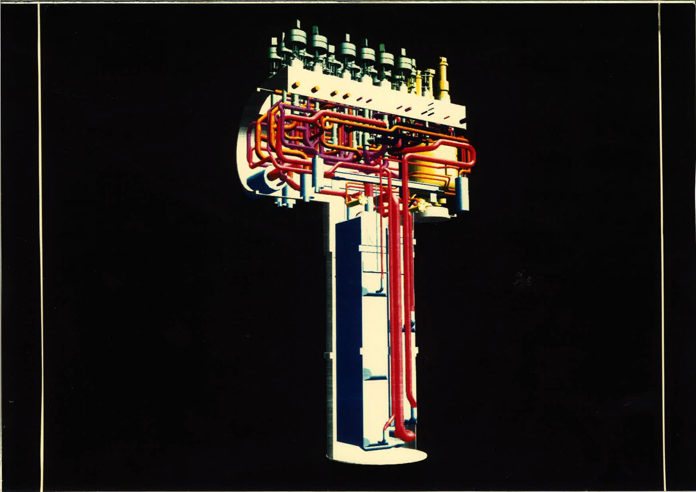
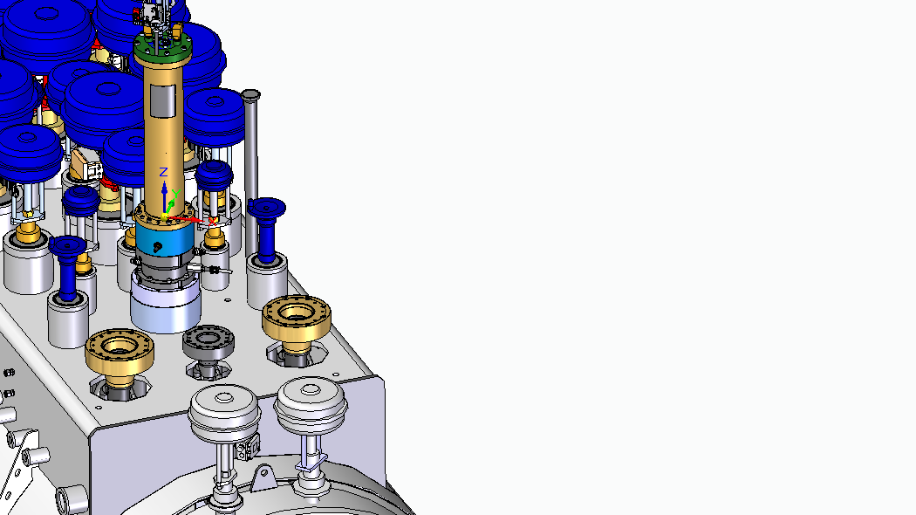
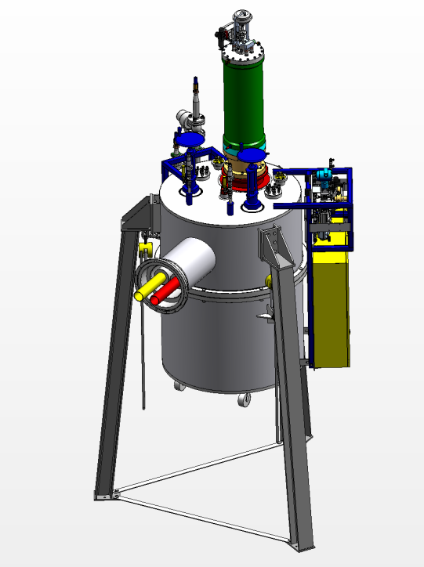
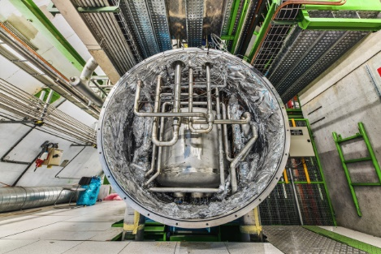
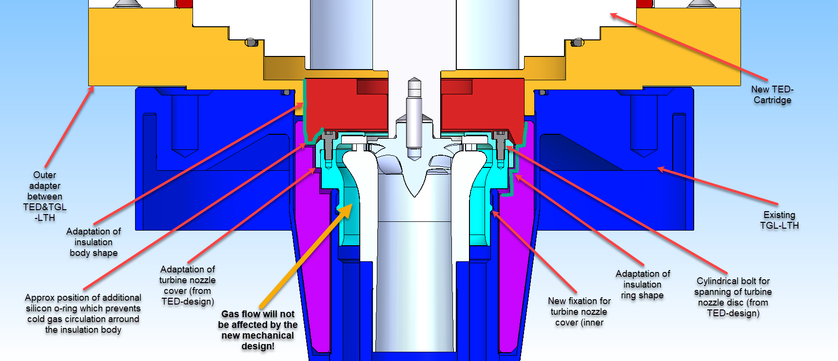
P4 lower cold box, from inner piping to new turbine interface
Linde 12-18kW Lower Cold-Box
3D model of internal piping
(picture 25 yrs ago)
Valve actuators
Turbines
LHe phase separator
Cryolines interfaces
Heat exchangers
Towards modified new inner parts into “old” housing
Next: work on-site to start end oct’19
14Oct'19

Slide 25
Summary
P1/P5 in 2019:
  Final definition of interfaces with superconducting sub-systems
  The HiLumi cryoline (QXL) has been sized and integrated
  Process studies have started, together with management of dynamic heat loads
  Instrumentation racks and controls architecture being studied
2020: Global review of heat loads foreseen to allow freezing requirements and proceed with procurement
P4 upgrade is well advanced, on track for tests in Q2-2020
14Oct'19

Slide 26
WP9 organisation and roles
Re-inforced 2019
Coordination: Serge Claudet, Rob Van Weelderen
Quality, documentation, project management: Antonio Perin + Sigrid Knoops*
Magnet cooling requirements: Rob Van Weelderen + K. Puthran
Crab cavities cooling requirements: Krzysztof Brodzinski
Heat Load management: Antonio Perin + M. Spitoni
General process overview: Udo Wagner + Vanessa Gahier + Benjamin Bradu
3D models and integration: Jos Metselaar (+ designers)
Instrumentation & controls: so far CRG/CE-CI experts
P4-RF and P1-P5
  Refrigeration: Emmanuel Monneret (Sep’17)
  Cryodistribution: Michele Sisti (Jun’17)
  Cryogenic infrastructure: Gérard Ferlin (Jul’19)
SPS-BA6:
  Refrigeration: Laurent Delprat
  Cryodistribution: Krzysztof Brodzinski + Hendrie Derking
  Infrastructure: Jos Metselaar + O. Pirotte
Part time contributors during LS2, but valuable help expected from experienced colleagues
Consolidations: S. Claudet + Jos Metselaar
Done!
14Oct'19

