Slide 1


Mechanics & Cooling Challenges for the ATLAS ITk Upgrade for HL-LHC
Diego Alvarez Feito
CERN EP-DT
On Behalf of the ATLAS Collaboration
28th International Workshop on Vertex Detectors
Lopud Island, Croatia 17th October 2019

Slide 2
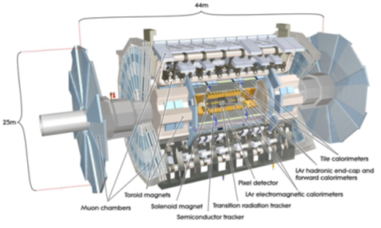
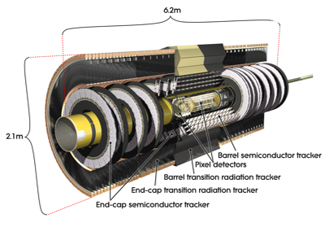

ATLAS Phase II Tracker Upgrade: ITk
New ATLAS Inner Tracker (ITk)
  Finer segmentation
  Faster readout and more storage
  Increased radiation hardness
  All silicon
Current ID

Slide 3
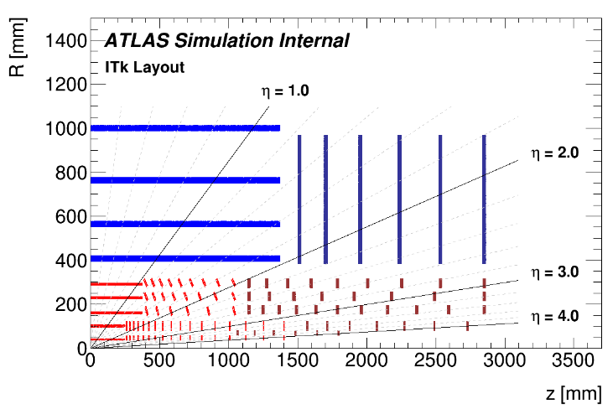
ATLAS ITk: Layout
ATLAS ITk
Strip Detector
  4 active layers
  |η|~2.8 coverage
  ~18000 strip modules (~165m²)
Strip
TDR: http://cds.cern.ch/record/2257755?ln=en
Pixel Detector
  5 active layers
  |η|~4 coverage
  ~10000 pixel modules (~13m²)
Pixel
TDR: http://cds.cern.ch/record/2285585?ln=en

Slide 4
ATLAS ITk: Layout
ATLAS ITk
Strip Endcap
Strip Barrel
Pixel Outer Barrel
Pixel Endcap
Replaceable layers
(2000 fb⁻¹)
Pixel Inner System

Slide 5
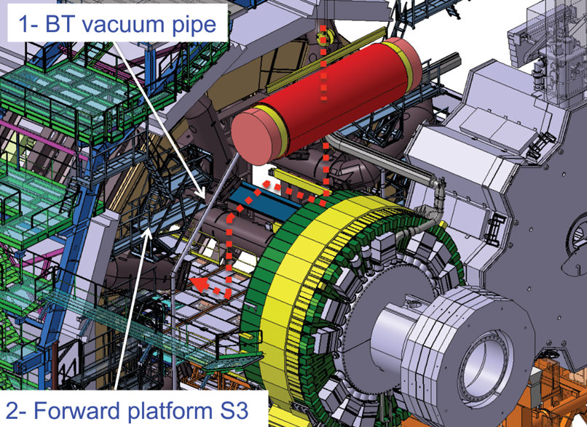
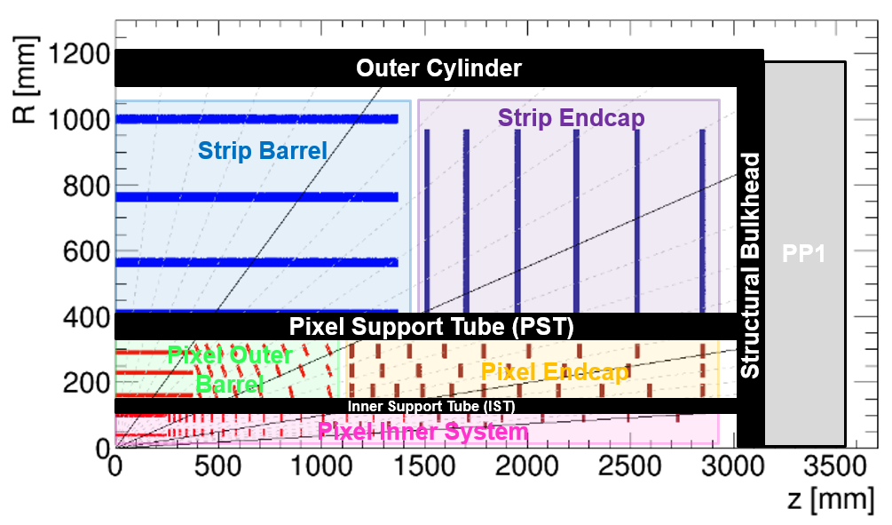
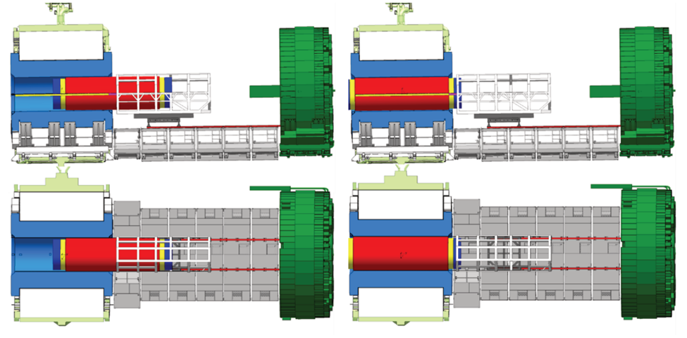
ATLAS ITk: Overall Concept
ITk to be assembled on surface inside an Outer Cylinder (OC) closed at each end by a Structural Bulkhead (SB)
  OC & SBs form ITK humidity barrier and are part of Faraday cage
  Strip/Pixel detectors separated by Pixel Support Tube (PST)
  Fully tested ITk to be installed in inner bore of LAr cryostat (IWV) via rails/rollers
  Design to allow for fast connections in the pit → Activated environment
  Very tight installation and lowering clearances

Slide 6
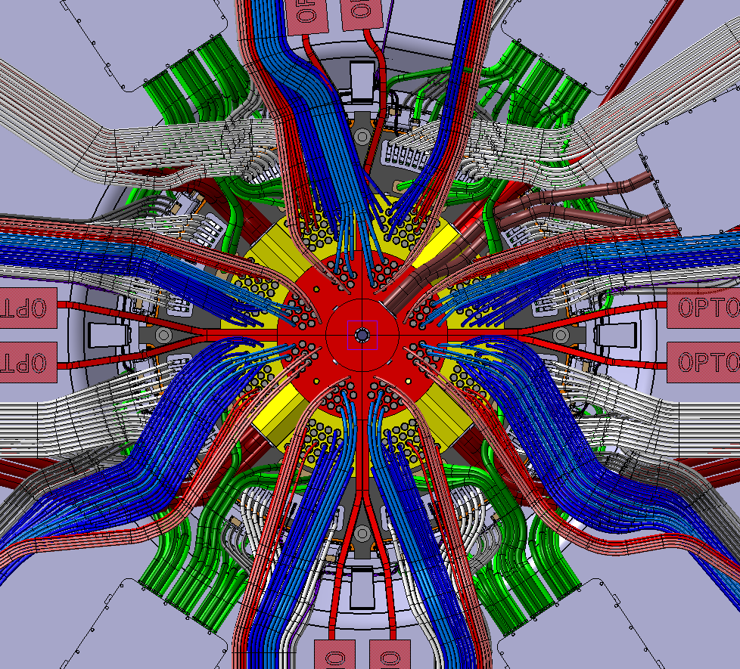
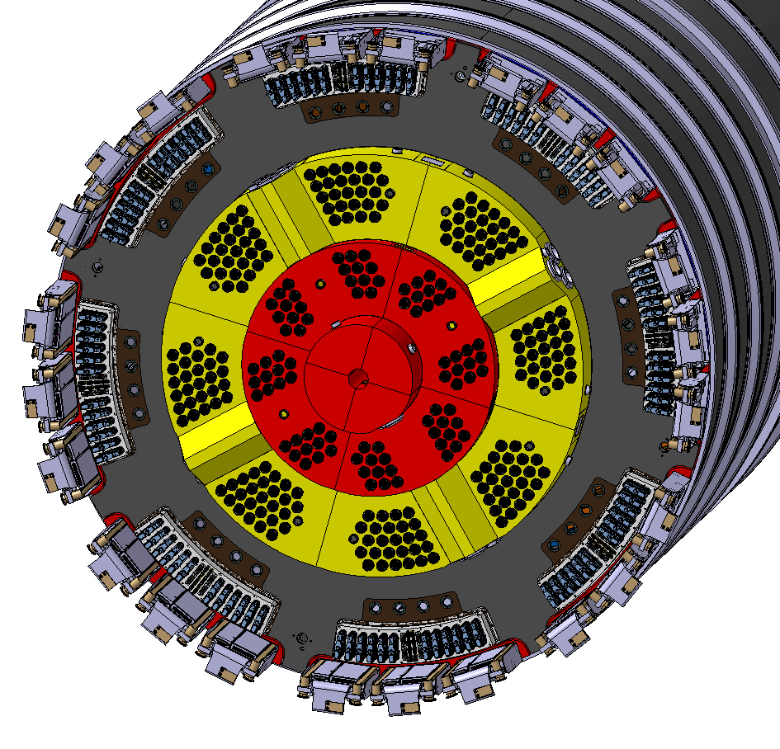
ATLAS ITk: Global Structures
Outer Cylinder (3 sections)
Hat Stiffener
Joining Flange
PP1 Strip Detector
Pixel Support Tube
(3 sections)
PP1 Pixel Detector
Structural Bulkhead
Structural Bulkhead

Slide 7
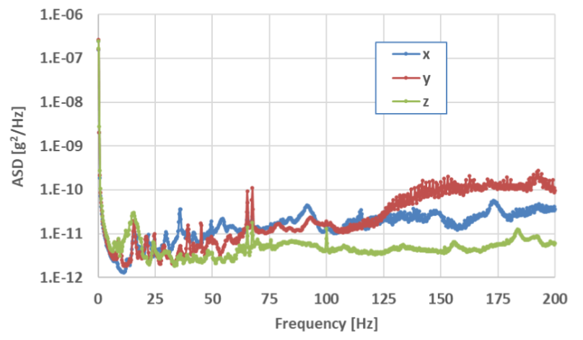
ITk Environment & Stability Requirements
Detector Subsystem | Integrated Luminosity [fb⁻¹] | Max Dose [Mrad] | 1 MeV neutron equivalent Fluence [10¹⁴ neq/cm²]
Pixel Inner System L0 | 2000 | 900 | 130
Pixel Inner System L1 |  | 400 | 40
Pixel Outer Barrel | 4000 | 300 | 20
Pixel Outer Endcap |  | 450 | 30
Strip Barrel | 4000 | 45 | 10
Strip Endcap |  | 70 | 16
Four separate volumes with controlled humidity
  OSV: dew point -30°C
  Strips: dew point -60°C
  Outer Pixels: dew point -60°C
  Inner Pixels: dew point -60°C
OC with bonded heaters
PST
IST
Equivalent ASD to that measured in the current detector
Stability requirements
Timescale |  | Module Stability, RMS [µm]
Short | ~ 1 day | 2
Medium | ~ 1 day | 5
Long | ~ 1 year | Equivalent to placement accuracy

Slide 8
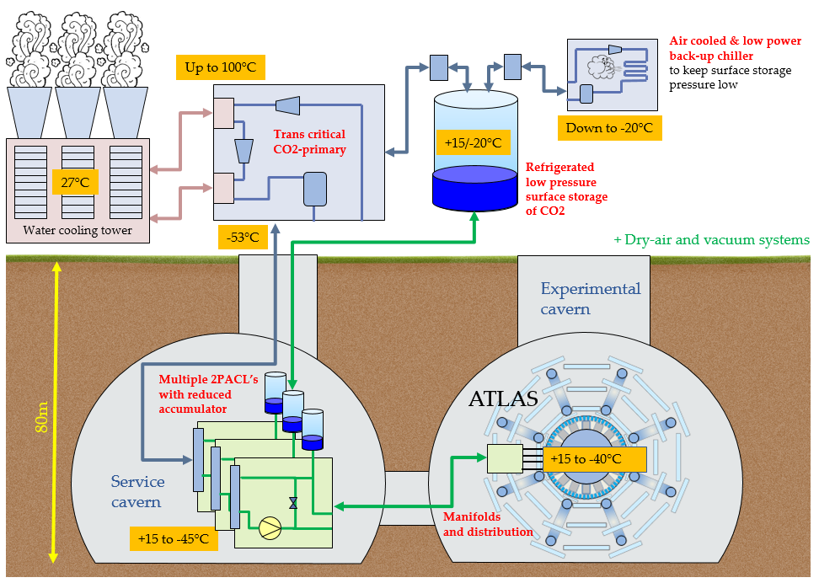
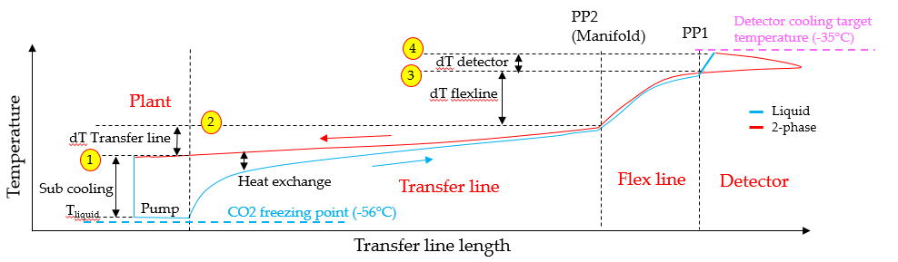
ITk: CO₂ Cooling
System conceived to minimise temperature @ evaporator exit (as low as -40°C at PP1)
ITk Heat removal requirements ~ 270kW (Strip~124kW; Pixel~146kW)
Temperature drop budget:
  Plant saturation: -45°C (proven with BabyDemo)
  Hottest temperature evaporators: -35°C
1
4
Design temperatures are on the limit!
B.VERLAAT
L. ZWALINSKI

Slide 9
Strip Detector

Slide 10
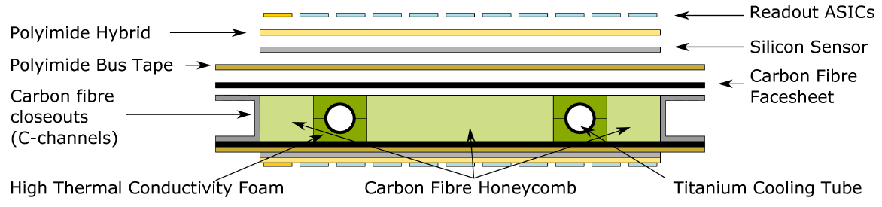
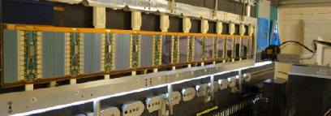
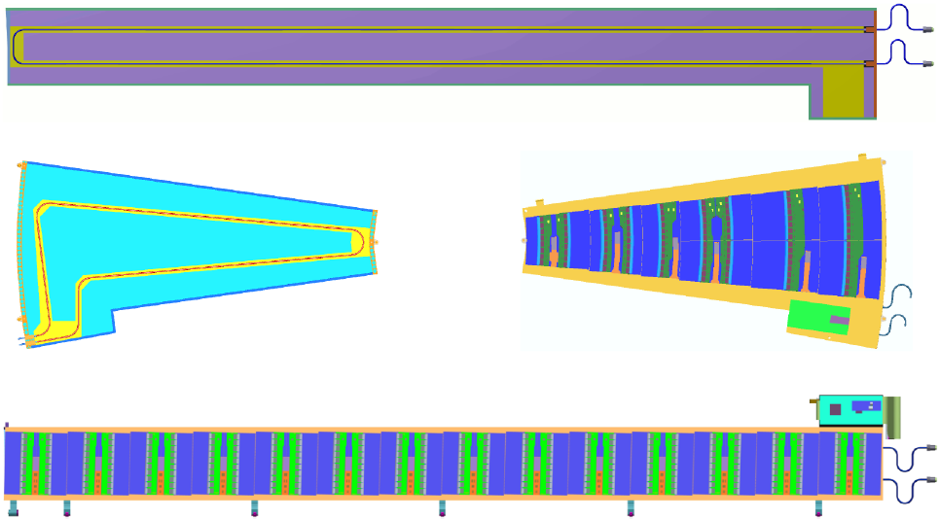
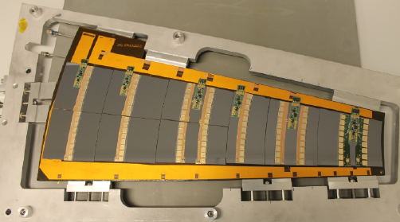
Strip Local Supports
Sandwich structures with CFRP skins, CFRP honeycomb
Ti pipes embedded in carbon foam for cooling
Strip modules bonded on both skins (double sided local supports)
  Equivalent concept for Endcap and Barrel
Endcap Petal
Barrel Stave

Slide 11
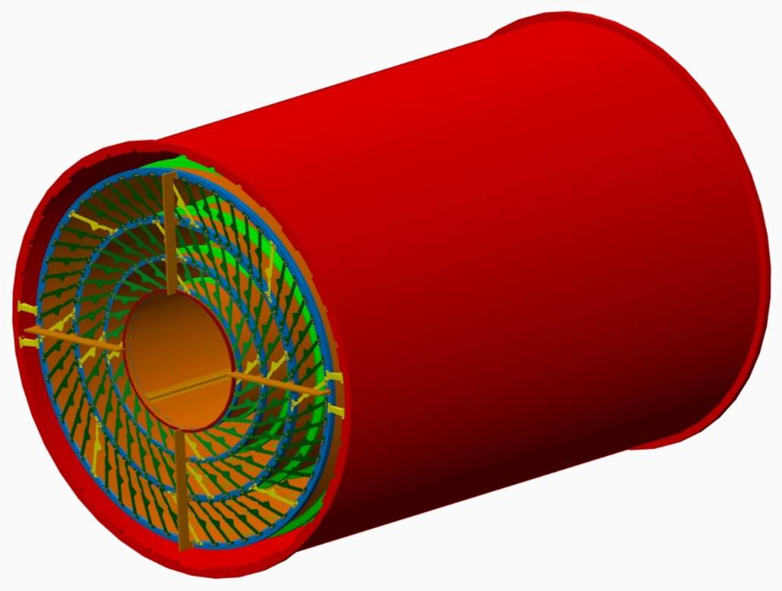
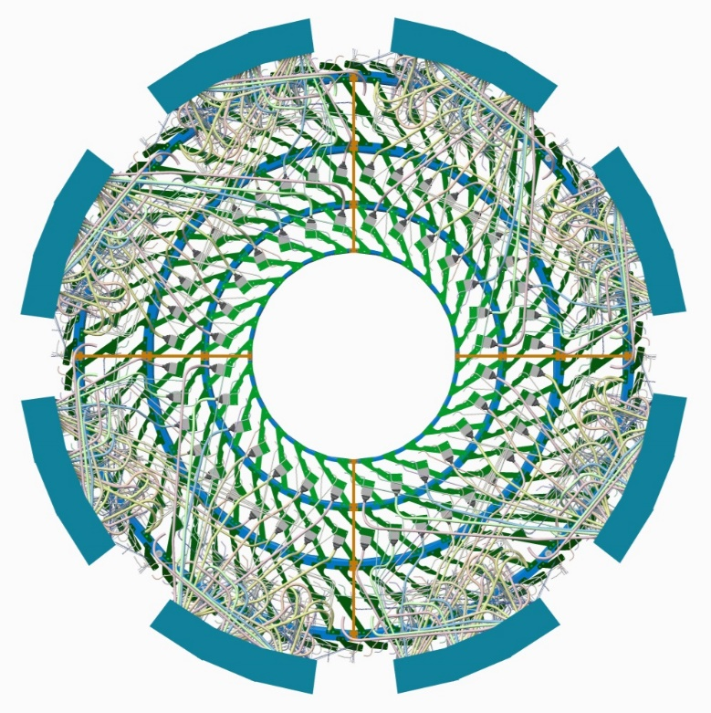
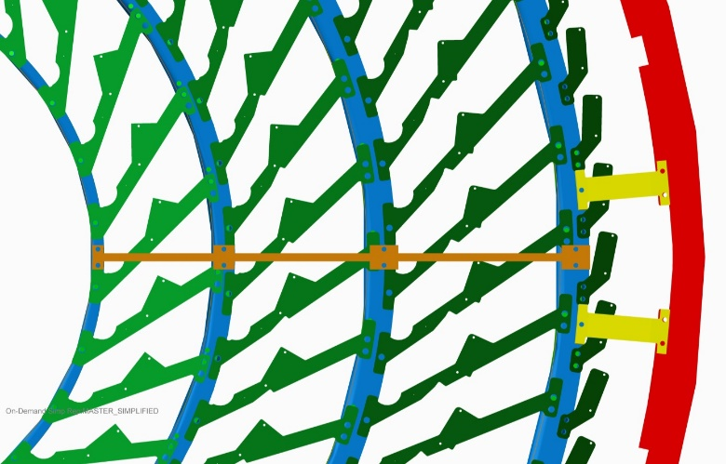
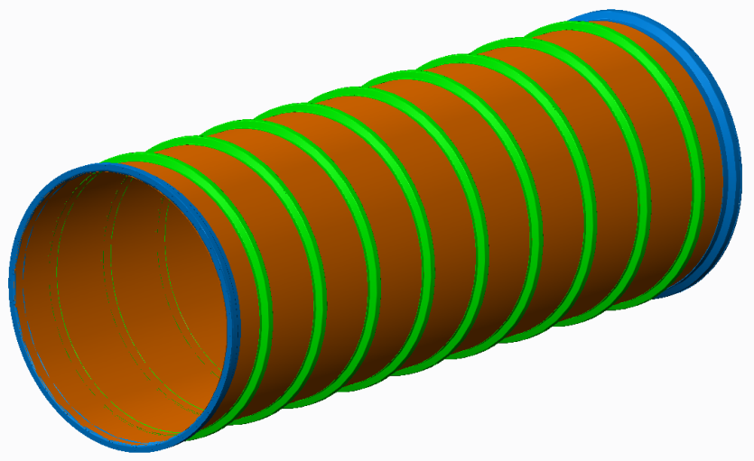
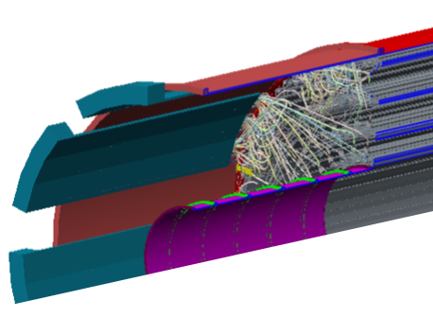
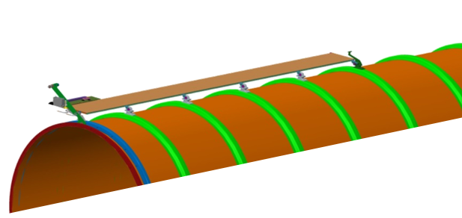
Strip Barrel
OC
Interlink
Z-braces
OC-brackets
Barrel Shell
Stiffening Ring
Stave services
Flange
Cylinder Shell
Stave locking bracket
Service module

Slide 12
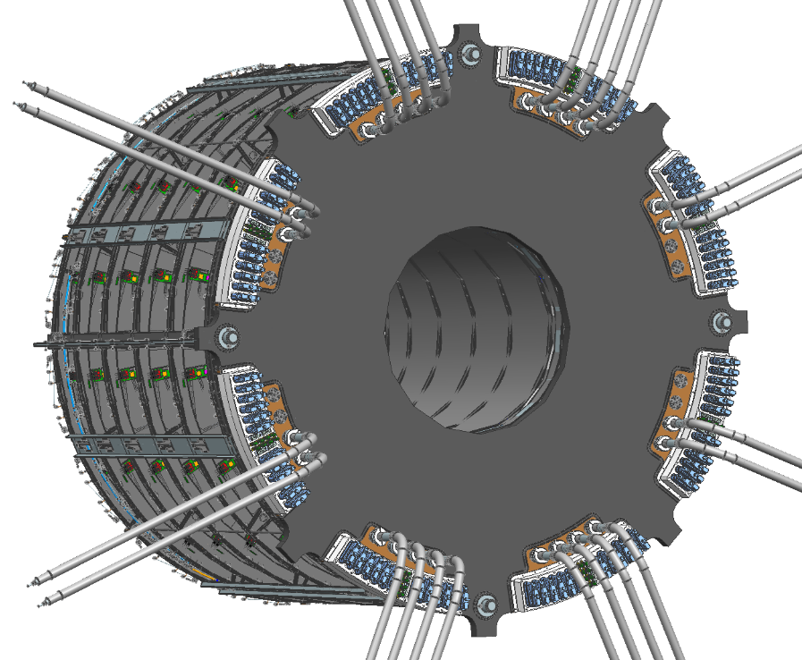
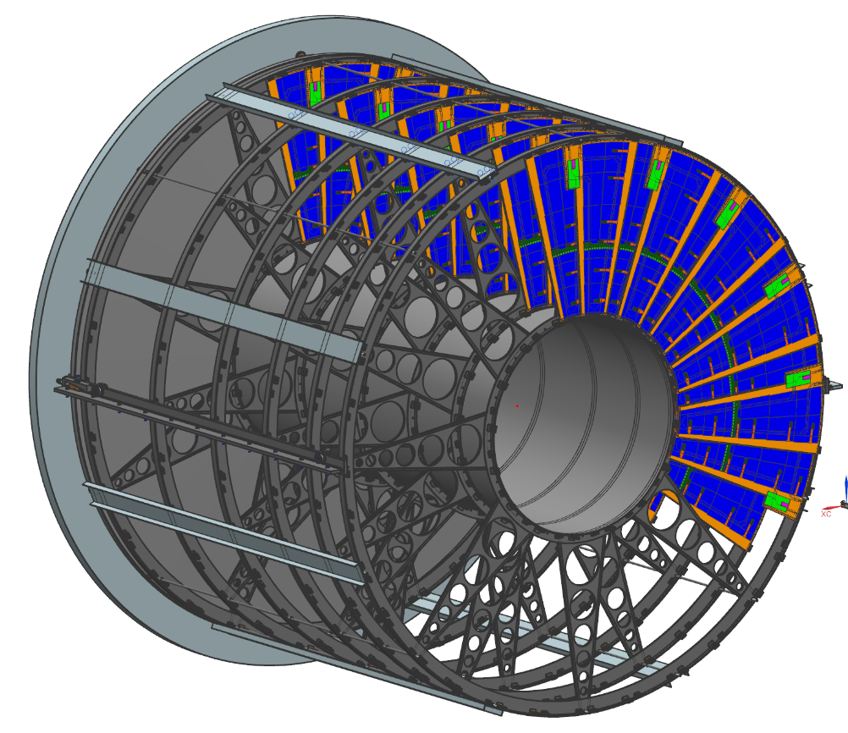
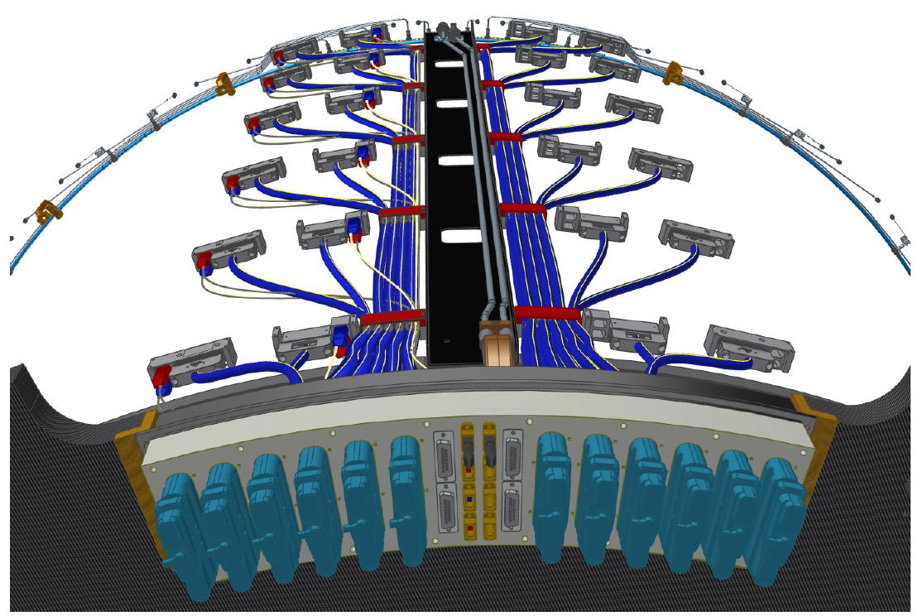
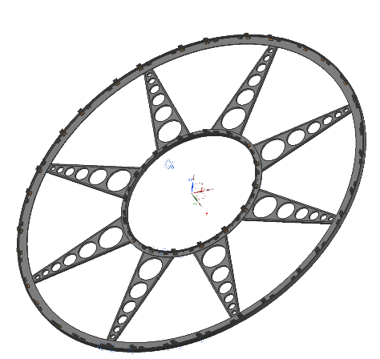
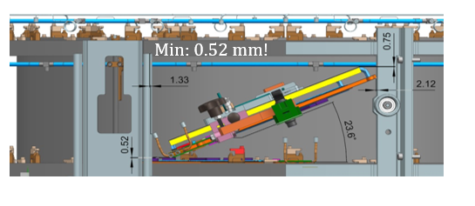
Strip Endcap
Structural Bulkhead
Petal
Electrical patch panel
(45° phi sector)
Stiffening Disk
Rails
SB supports the cooling & electrical patch panels @ PP1
Inner Tube
Service Trays
Wheels (rings + blades)
Very tight clearances for petal insertion
(complex tooling for controlled kinematics)
Strip Endcaps assembled outside CERN (challenging transport)

Slide 13
Pixel Detector

Slide 14
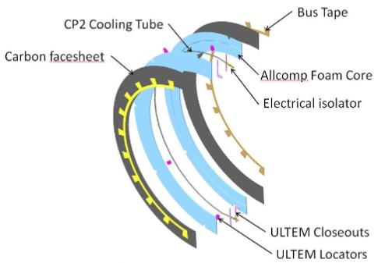
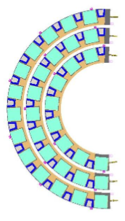
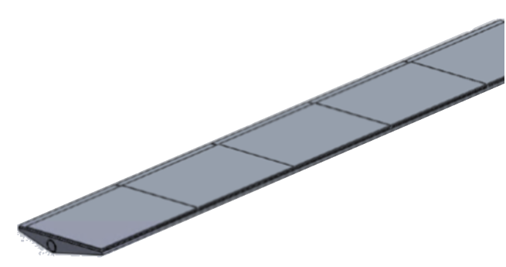
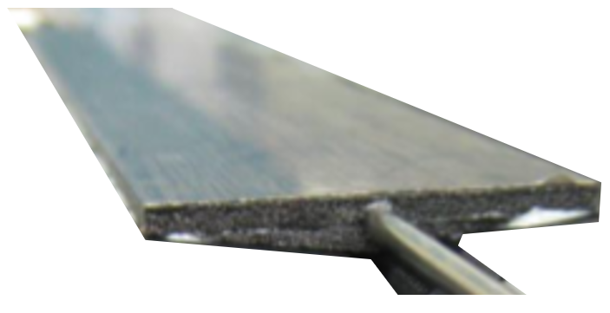
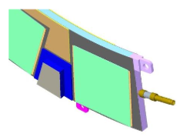
Pixel Local Supports: Endcap & Inner System
Sandwich structures with CFRP skins & carbon foam
Ti pipes embedded in carbon foam for cooling
Pixel modules bonded on one (staves) or two (rings) sides
  Equivalent concept for EC and Inner System
Bus Tape
Ti-Tube
CFRP Skin
Carbon Foam
E-break
L0/1 Coupled Ring
L1 Ring
L0.5 Ring
Closeouts
R2
R3
R4
Endcap Rings
L1 Stave
L0 Stave

Slide 15
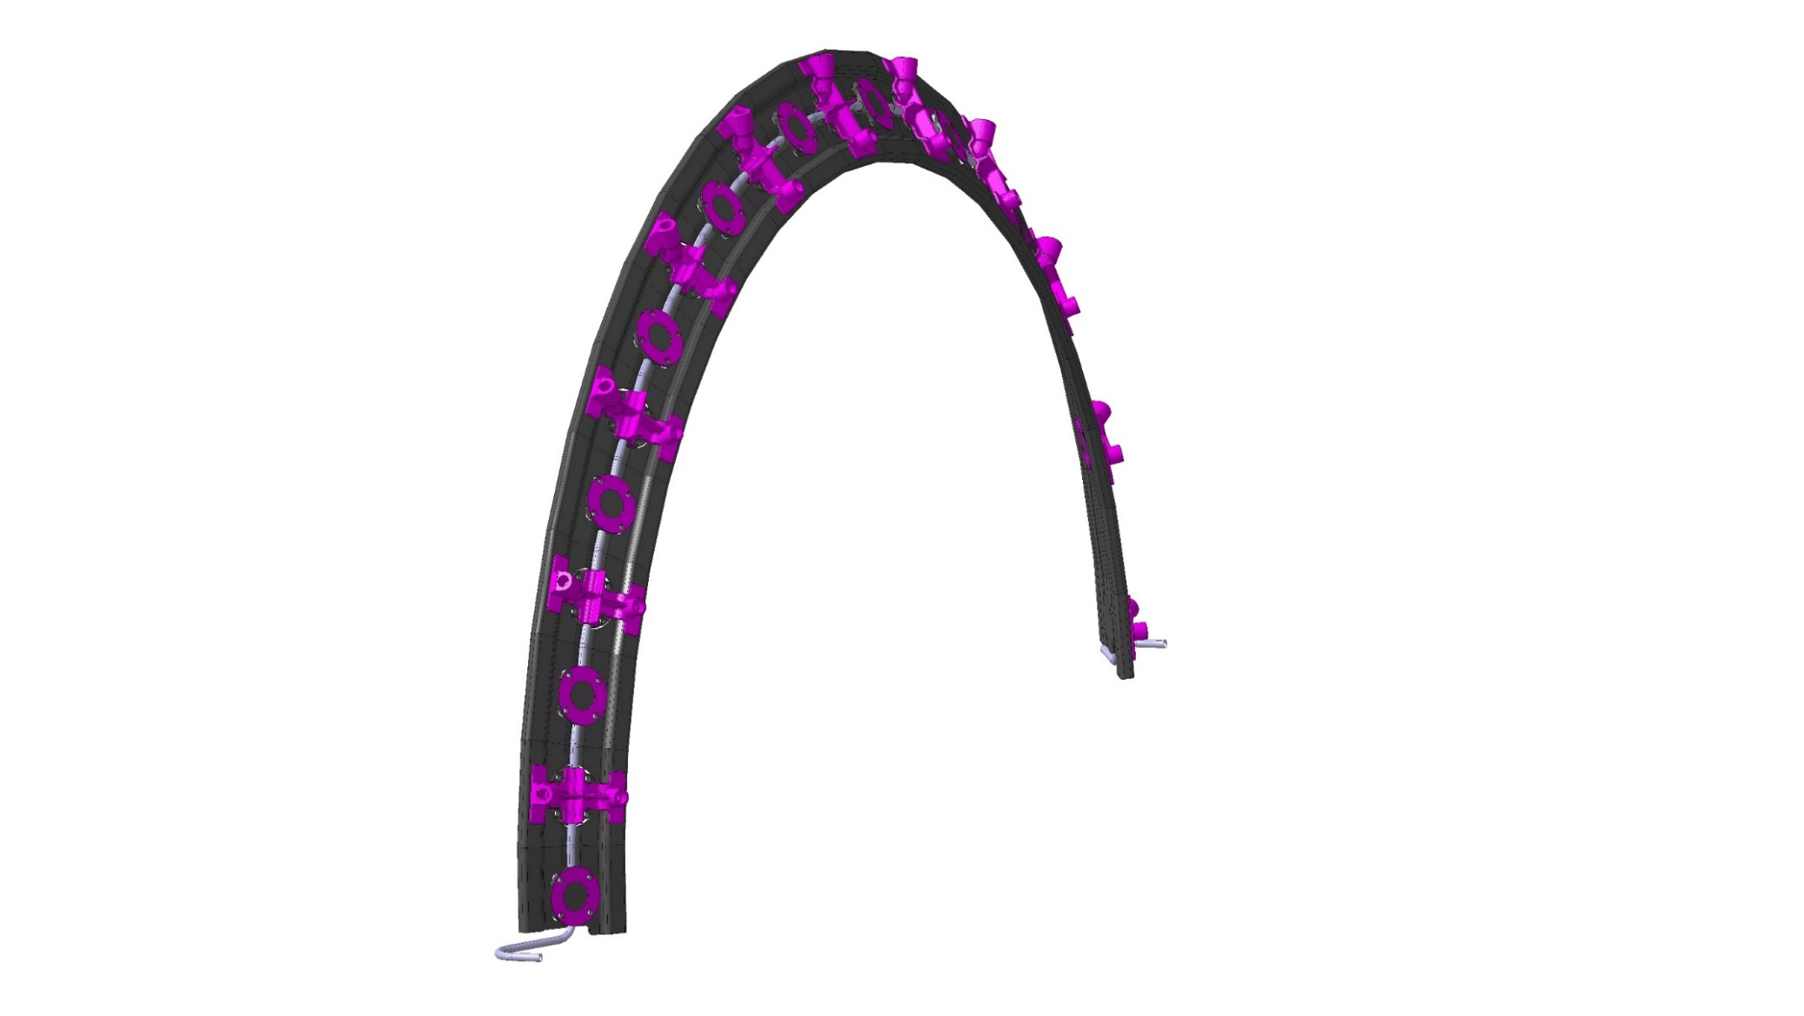
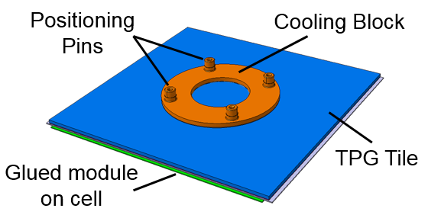
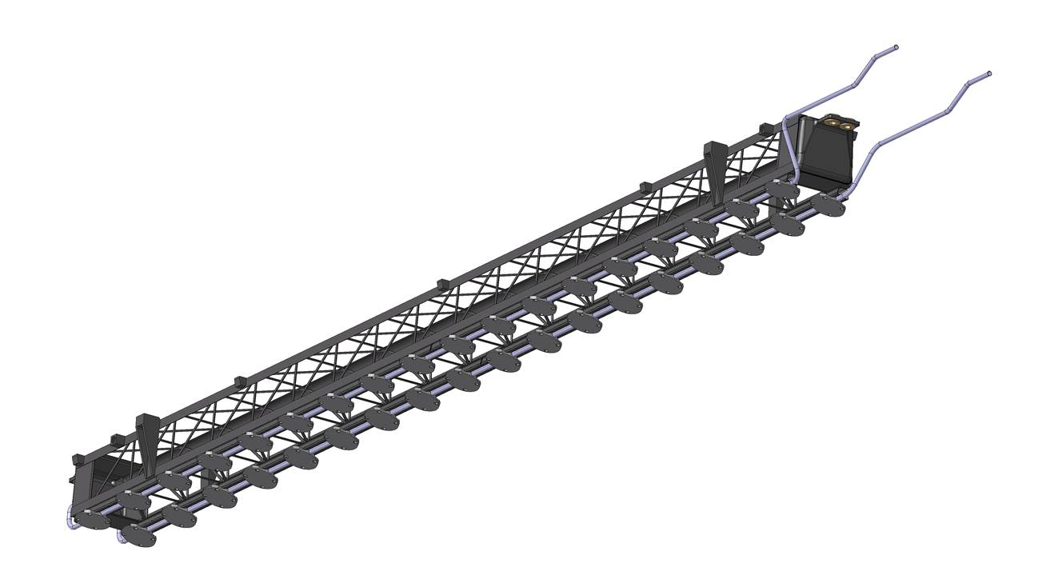
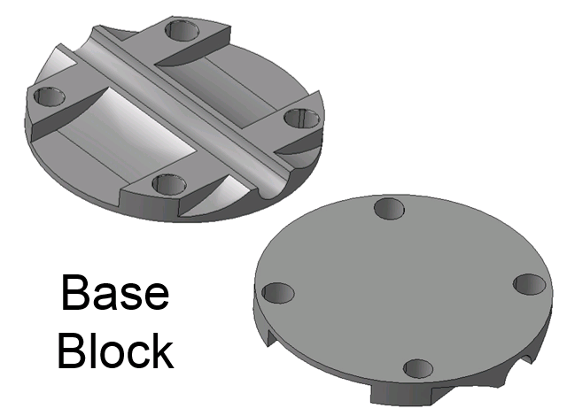
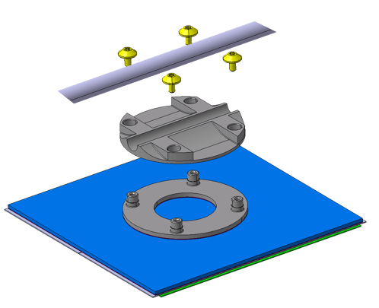
Pixel Local Supports: Outer Barrel
Module Cells (module bonded to TPG)
Functional Inclined Half-Ring
CFRP Ring
Ti Pipe
Gusset
Ti cooling pipes
Base blocks
CFRP Support Structure
Soldered
(Ni-coating)
Bonded
CFRP Truss
Functional Longeron
Ti Pipe
Cells screwed to FLS with TIM between blocks (re-workability!)

Slide 16
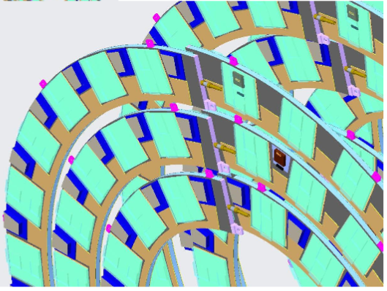
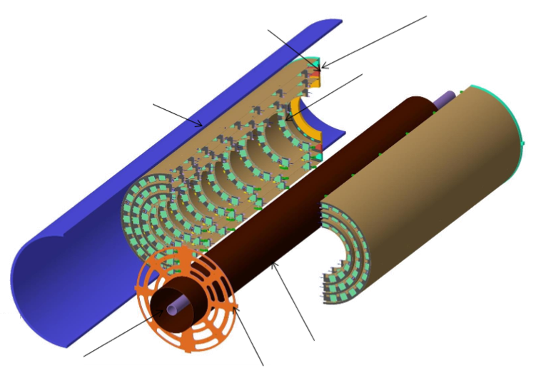
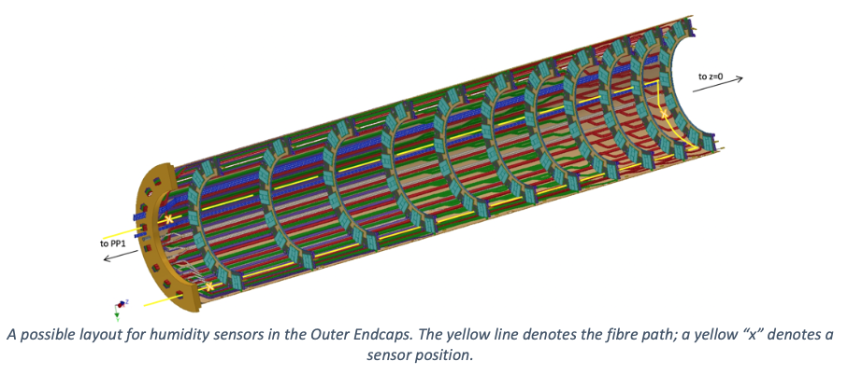
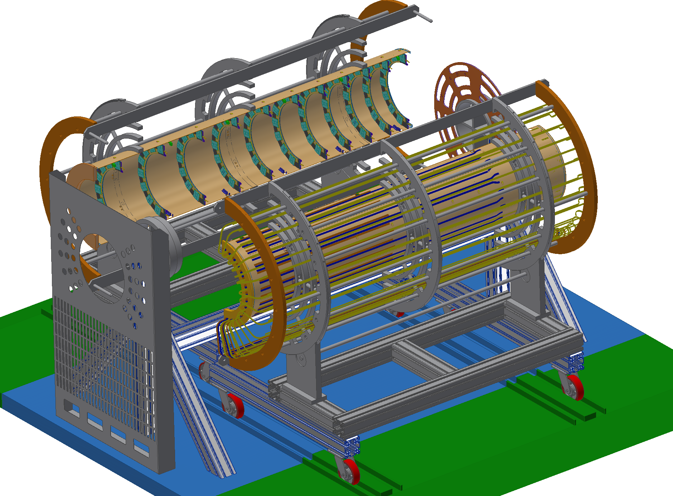
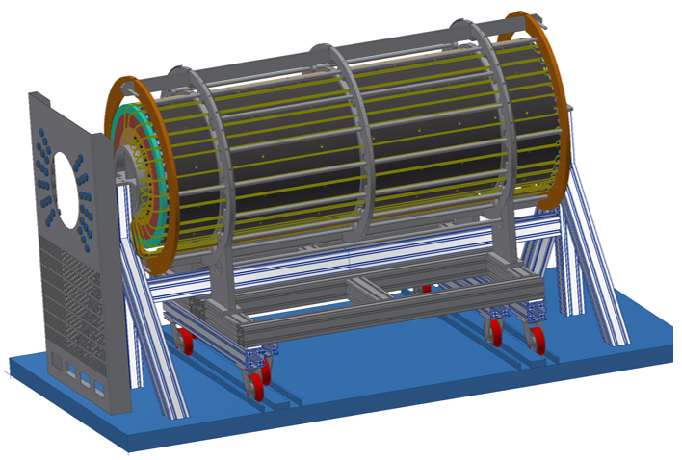
Pixel Endcap
Challenging service management in very limited space
Half-rings overlap
Flange
Half Rings
PST
Half Shell
Integration in half layers
IST
Beam Pipe
Flange

Slide 17
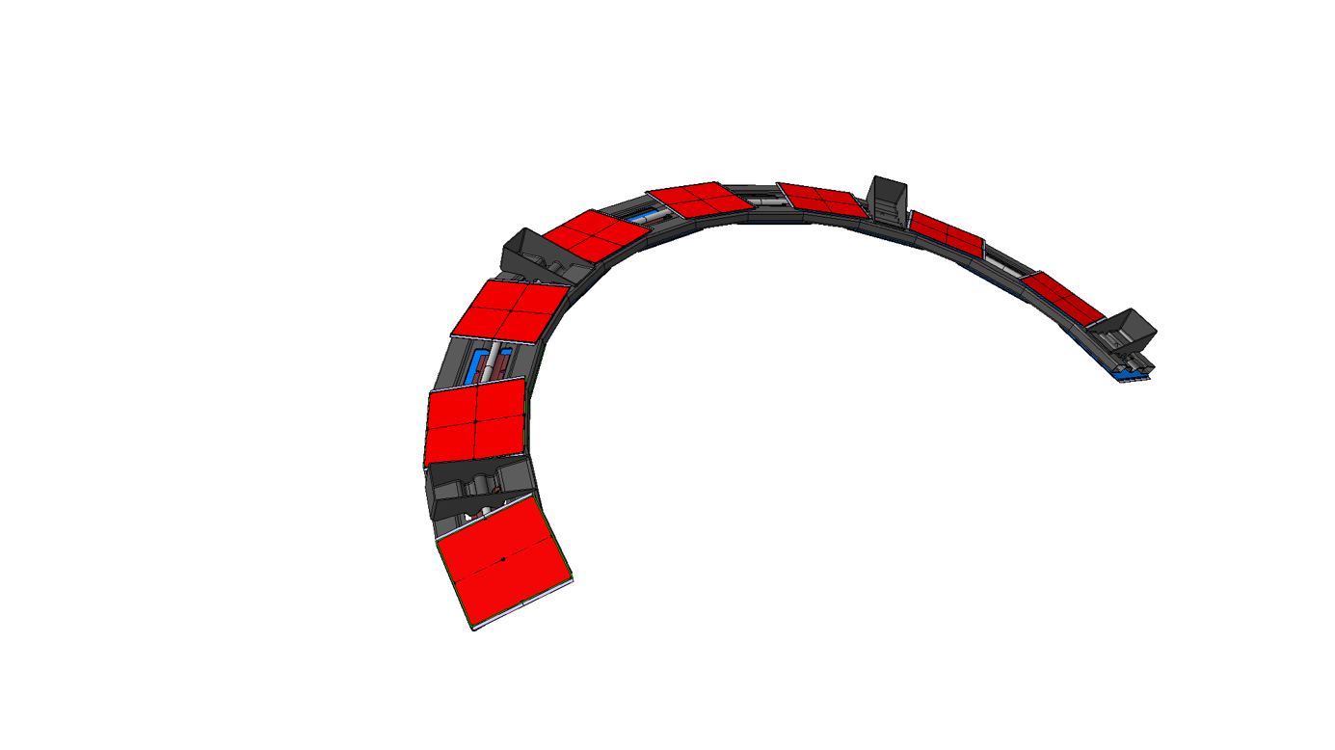
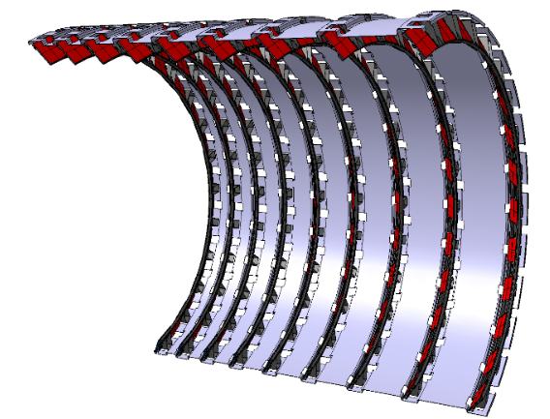

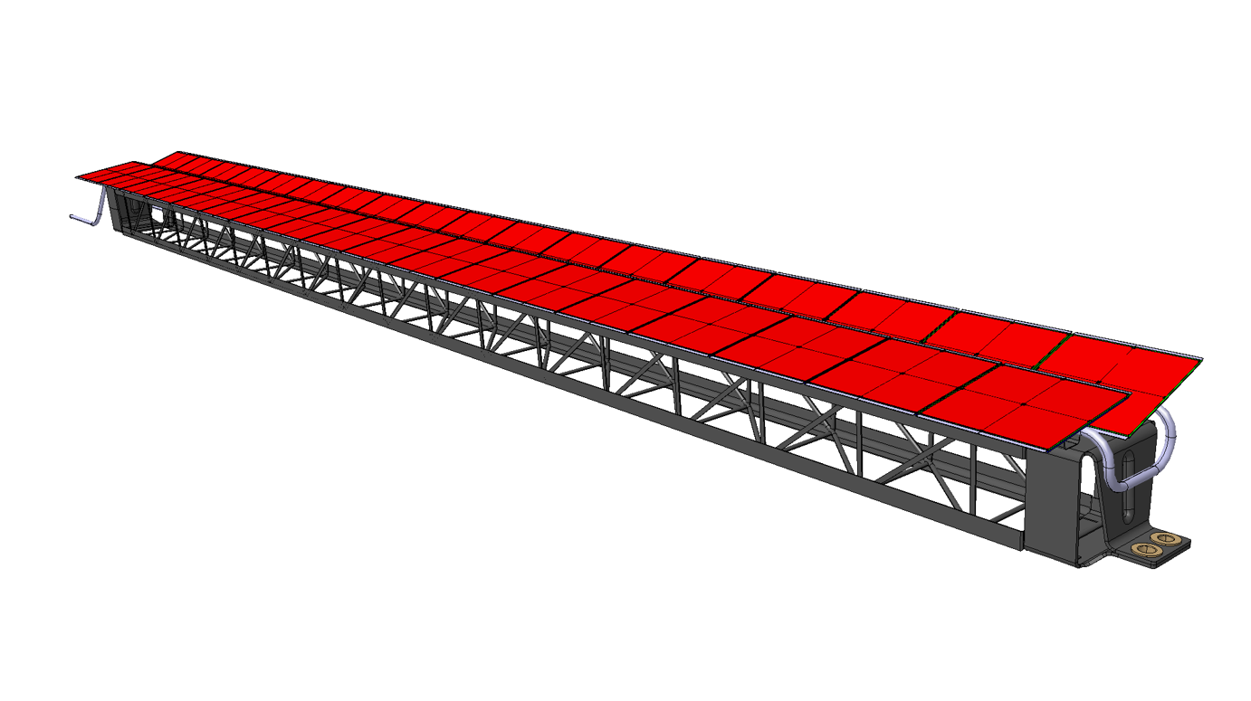
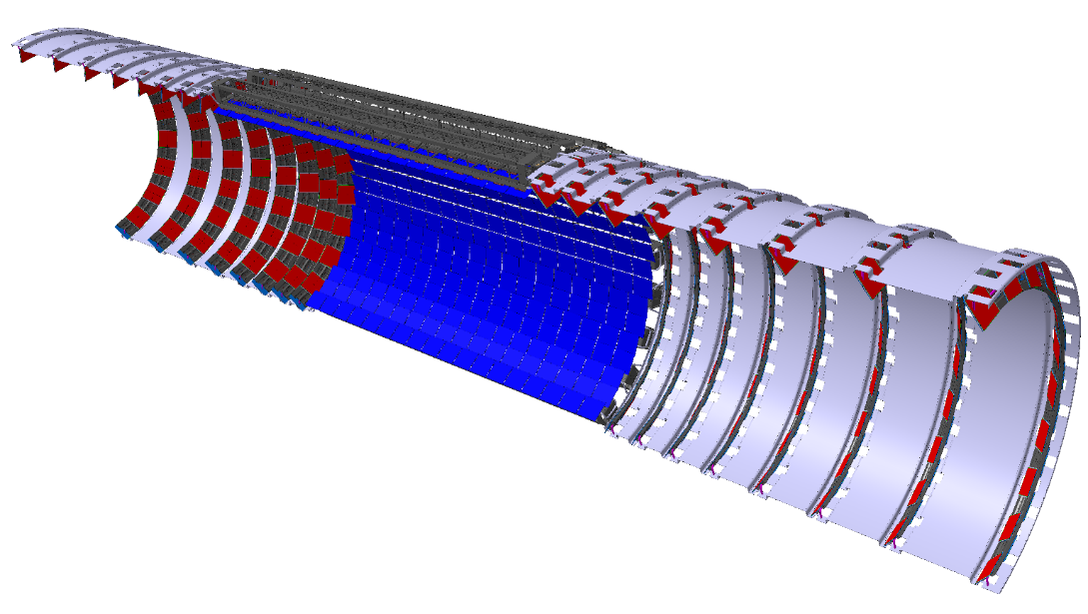
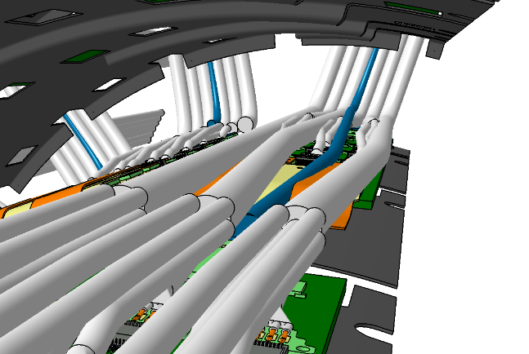



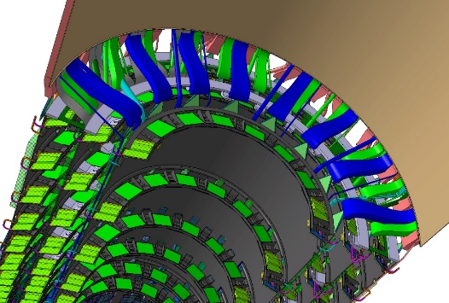
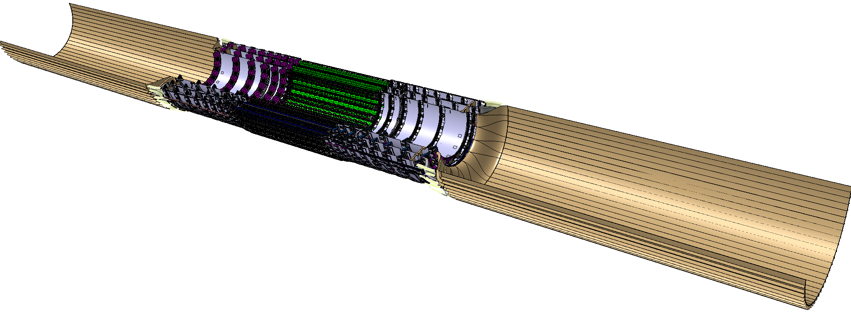
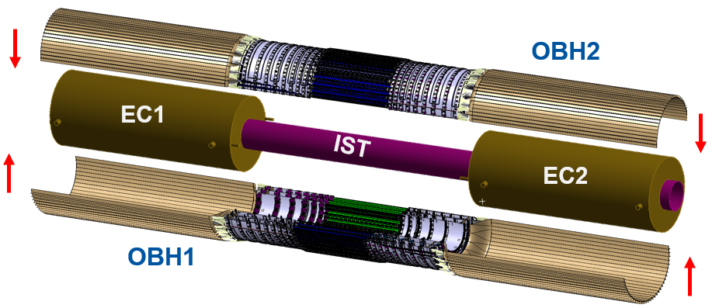

Pixel Outer Barrel
Extremely challenging service management due to very limited space
Inclined Half Ring
Longerons
Half Layer
Half layer Type-1 Services
Half-layer shell
Inclined Unit
Service support shell
Outer Barrel Half (3xHalf Layers)
Outer System integration: OB halves closed around the ECs and the IST

Slide 18
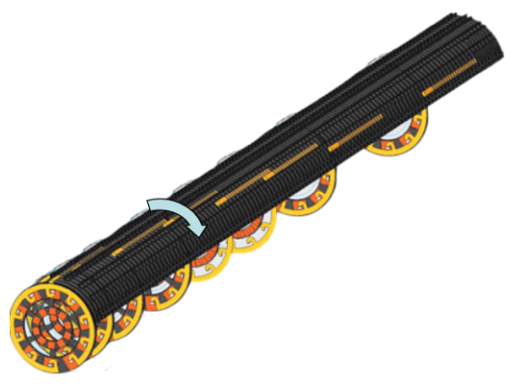







Pixel Inner System
  Cooling & electrical services arranged in trays atop the quarter shells
  Inner System built around “quarter shells”
  Inner Endcap Quarter
Quarter Shell
Coupled ring
Support rings
L1 Stave
Quarter shell
L0 Stave
IST
IPT
(beam pipe support)
  Inner Barrel Quarter
PP0 Board
Inner System rails
  Inner System designed to be replaceable in the pit (separated from Outer System by Inner Support Tube – IST)

Slide 19






Local Supports: Thermal Performance
Challenging heat-management requirements for local supports
Thermal-electrical FEA to estimate runaway and sensor behaviour at the end of life
Full thermal prototypes under testing for validation
  Strip Module (Barrel Stave)
  Pixel Module (OB Longeron Cell)
  G.BECK

Slide 20

Material Qualification
Challenging material selection due to expected radiation doses, particularly in the inner Pixel region
Ongoing characterisation studies to qualify raw materials (e.g. adhesives, TIMs, potting compounds) and components (e.g. connectors)
https://maxrad.web.cern.ch/maxrad/www/home.php
Thermal Tests
Mechanical Tests
  N. PACIFICO

Slide 21
Concluding Remarks
New Inner Tracker (ITk) will replace the current ATLAS ID in LS3.
Future all-silicon ITk will feature Strip and Pixel detectors (coverage up to |η|~4).
ITK subsystems to be assembled and commissioned on surface inside a CFRP cylinder, which will them be installed at the centre of ATLAS.
Mechanical designs of the Global Structures, the Strip and Pixel detectors are conceived to overcome the challenges imposed by HL-LHC.
Substantial prototyping effort to qualify all design elements underway.
Limited space for service routing remains a critical issue, particularly in the Pixel detector.

Slide 22
Questions?

