Slide 1

3D integration of readout chip for the SOI pixel sensors
15 October 2019
T. Tsuboyama (KEK)
Y. Arai(KEK), K.Hara (University of Tsukuba) I.Kurachi (KEK), M. Motoyoshi (Tohoku Microtec) S. Ono (KEK)) M. Yamada (TMCIT) K. Yanagimura (Tohoku Microtec)
and for the SOIPIX collaboration

Slide 2
Outline
Excellent summaries of 3D integration was performed in Vertex 2017 by Ron Lipton and Vertex 2018 by Valerio Re.
Motivation for the 3D integration in pixel sensors.
3D integration technologies
Efforts in the SOI pixel sensor: SOFIST
Summary

Slide 3
Overview of 3D stacking
  In the present and future high luminosity collider experiments, high signal rate and background environment is anticipated
  Detection efficiency of sensors should not be degraded.
  Occupancy reduction is essential for the design of the pixel vertex detector.
ATLAS ILD Belle2

Slide 4
Selecting signal from background
To reduce hit occupancy, the fast and complex frontend circuit enable us to select signal from backgrounds and different events.
Increase the time resolution
  Solution 1: Smaller feature CMOS circuit
0.18 μm CMOS is standard in the current pixel sensors.
If we can use 0.9 um feature CMOS. Four times circuit can be integrated.
This is a firm solution, however, expensive.
0.18 μm Chrono pixel

Slide 5
Solution 2: 3D stacking
For the commercial image sensors, the first trial is to move the peripheral circuits to the second chip and stacked by using TSV, through silicon via.
This is not an answer for HEP. We have to increase the performance of circuit in each pixel. Pixel-by-pixel connection is necessary.
  Parallel data processing.
  Low power operation thanks to minimum parasitic capacitance.
Pixel
Memory
Pixel
Memory
Logic
Logic

Slide 6
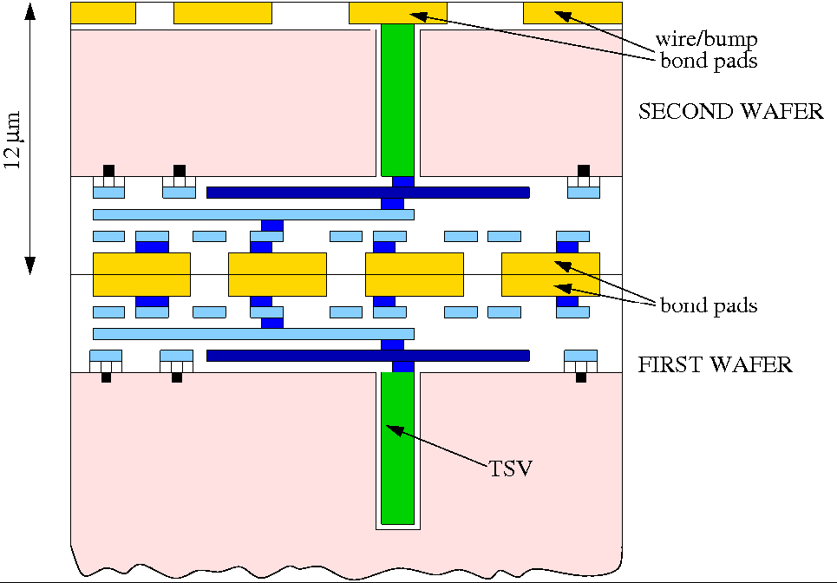
3D stacking methods (I) Direct Bonding Interconnect
Two wafers are prepared.
The bonding surface is flattened and cleaned.
Aligned and attached. Apply suitable pressure and heat for the diffusion bonding of pads.
SiO2 surfaces is also fused, resulting in the stable structure.
Widely used for the mass production of high-end image sensors.
From the slide of Valerio Re, Vertex2018

Slide 7
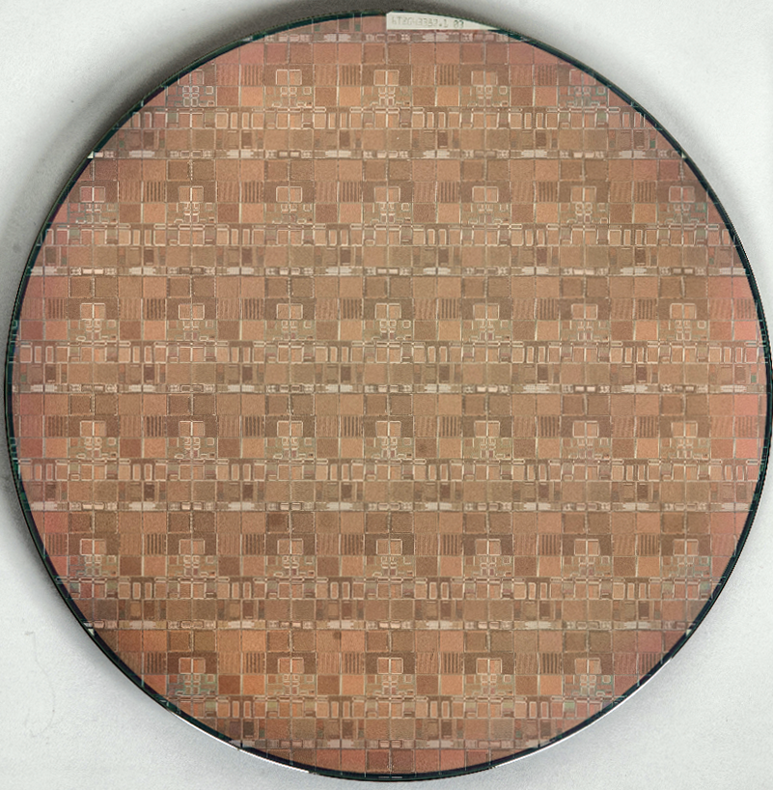
Progress of 3D bonding in FNAL
Slide from R. Lipton Vertex2017
Fermilab led a consortium to demonstrate 3 dimensional electronics – a 4+ year effort.
A working 3D process was demonstrated using 2-tier 3D Global Foundries 0.13 μm TSV wafers. FNAL chips for ILC(VIP), CMS(VICTR) and X-ray imaging (VIPIC) in collaboration with Tezzaron and Ziptronix.
This took about 18 months longer than anticipated – Tezzaron copper bonding issues finally solved by using Ziptronix DBI process
LEFT (bottom)
chips
Right (top)
chips

Slide 8
Progress of 3D bonding in FNAL
Slide from R. Lipton
After the initial 3D run with Tezzaron/Ziptonix follow-up work was started with Novati/Nhanced for x-ray imaging sensors and 3D integrated trigger chips using hybrid (oxide) bonding.
Changes:
Through Silicon Vias (TSV) no longer available from the CMOS foundry – these were inserted early in the CMOS process
R&D to implement “via-last” TSV insertion on standard wafers
  Original design assume 1 micron x 10 micron vias – this is difficult in via-last
  Significant R&D to achieve this amid commercial changes at the foundry
Expect delivery this calendar year
Fermilab and BNL have moved to collaboration with MIT-LL which has licensed the process
Hybrid bonding used in our 3D work is now well-developed and widely licensed
Courtesy
Nhanced
Semiconductor

Slide 9
3D stacking methods (II) Bump bonding
Metal bumps are formed on the bump pads.
Two chips are aligned and pushed to establish electric connection.
The procedure is close to that of hybrid pixel sensors, however, by using SOI chip, an advanced 3D stacking is enabled.
Si
High R-Si

Slide 10
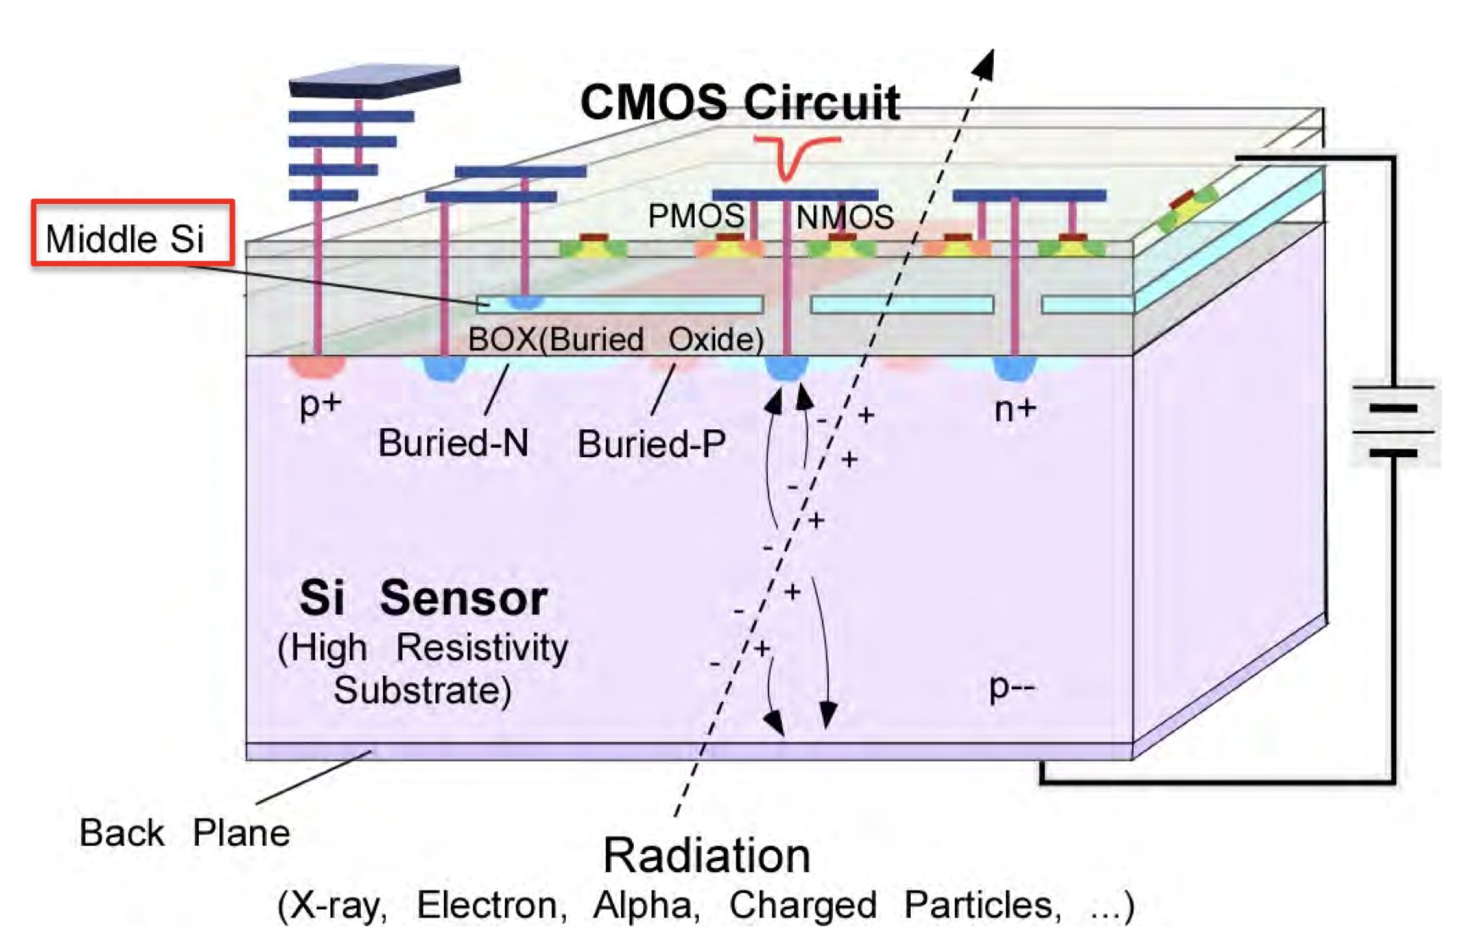
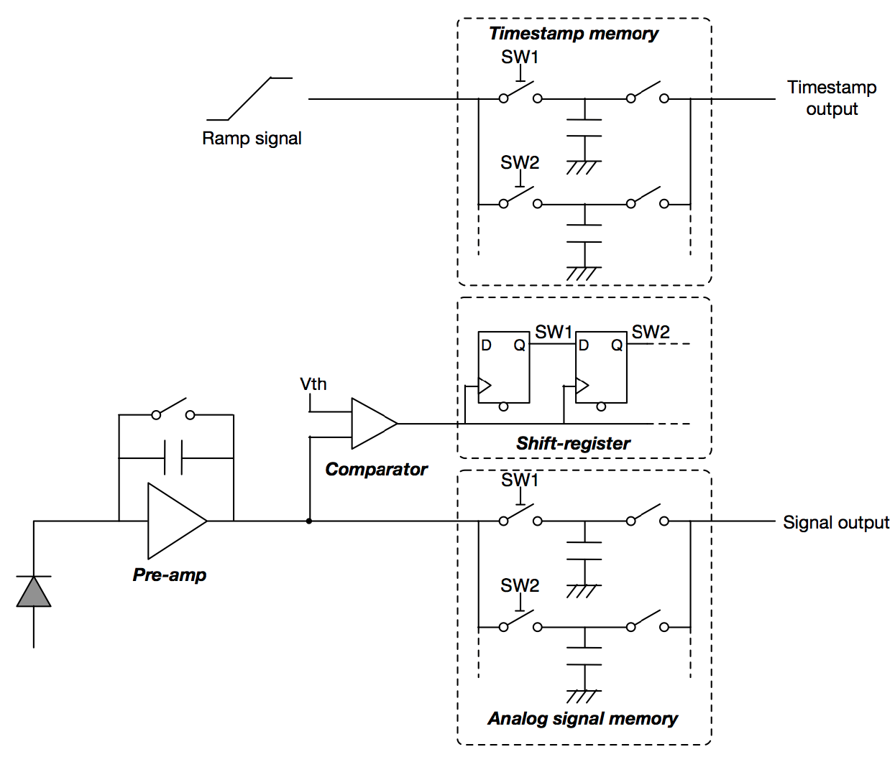
SOFIST: A SOI pixel sensor designed for ILC
Preamplifier, comparator, hit charge memories and time-stamp memories are integrated.
For the ~1 ms long bunch train, multiple hits data are stored in each pixel.
The data is read out in the 200 ms interval of ILC beam collision structure.
SOIPIX is already a 3D integrated pixel sensor.

Slide 11
SOFIST development
 | Ver. 1 | Ver. 2 | Ver. 3 | Ver. 4
Produced /Tested | 2016/2017 | 2017/2018 | 2018/2019 | 2018/2020
Wafer | SOI | DSOI | DSOI | DSOI
Pixel size (μm x μm) | 20x20 | 25x25 | 30x30 | 20x20
Charge memory | 2 | 0 | 3 | 3
Time stamp memory | 0 | 2 | 3 | 3
Chip size (mm x mm) | 3x3 | 4.5x4.5 | 6x6 | 3x3
Notes | Global shutter |  |  | 3D integration
Results of SOFIST Ver.1 and Ver.2 have been reported already.

Slide 12
SOISFT Ver. 3 Beam test data @FNAL
Multiple hits in one sample can be separated with hit-time information in the time-stamp memory.
Chip 1 Chip2
c
b
a

Slide 13
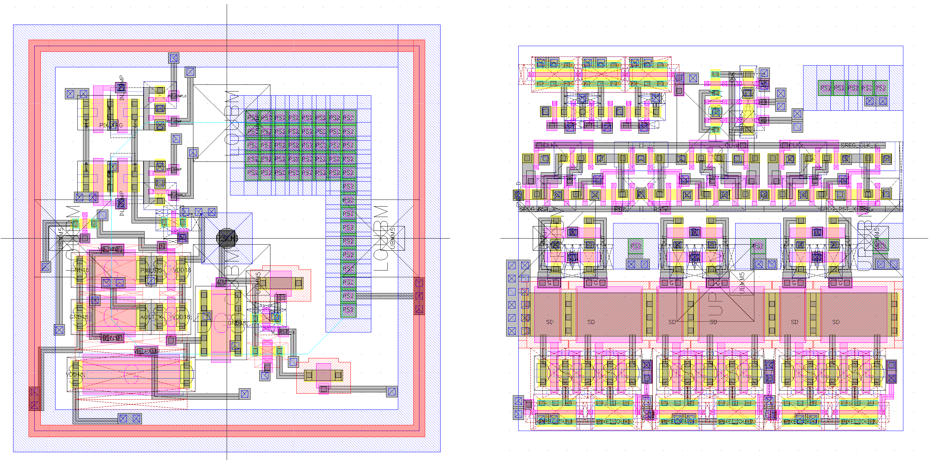
SOFIST4: First SOIPIX sensor with 3D stacking
SOFIST Ver. 3
SOFIST Ver. 4
Lower chip Upper chip
Comp
Comp
20 μm
AGnd
AVdd
AGnd
AVdd
Signal
Signal

Slide 14
3D stacking procedure of SOI pixel chip
Lower Chip
Upper Chip
Step 1
Step 2
Prepare upper and lower chip
High R-Si
Si
Bump Metal deposition & patterning
High R-Si
Si
Au cylinder Bump formation
High R-Si
Si

Slide 15
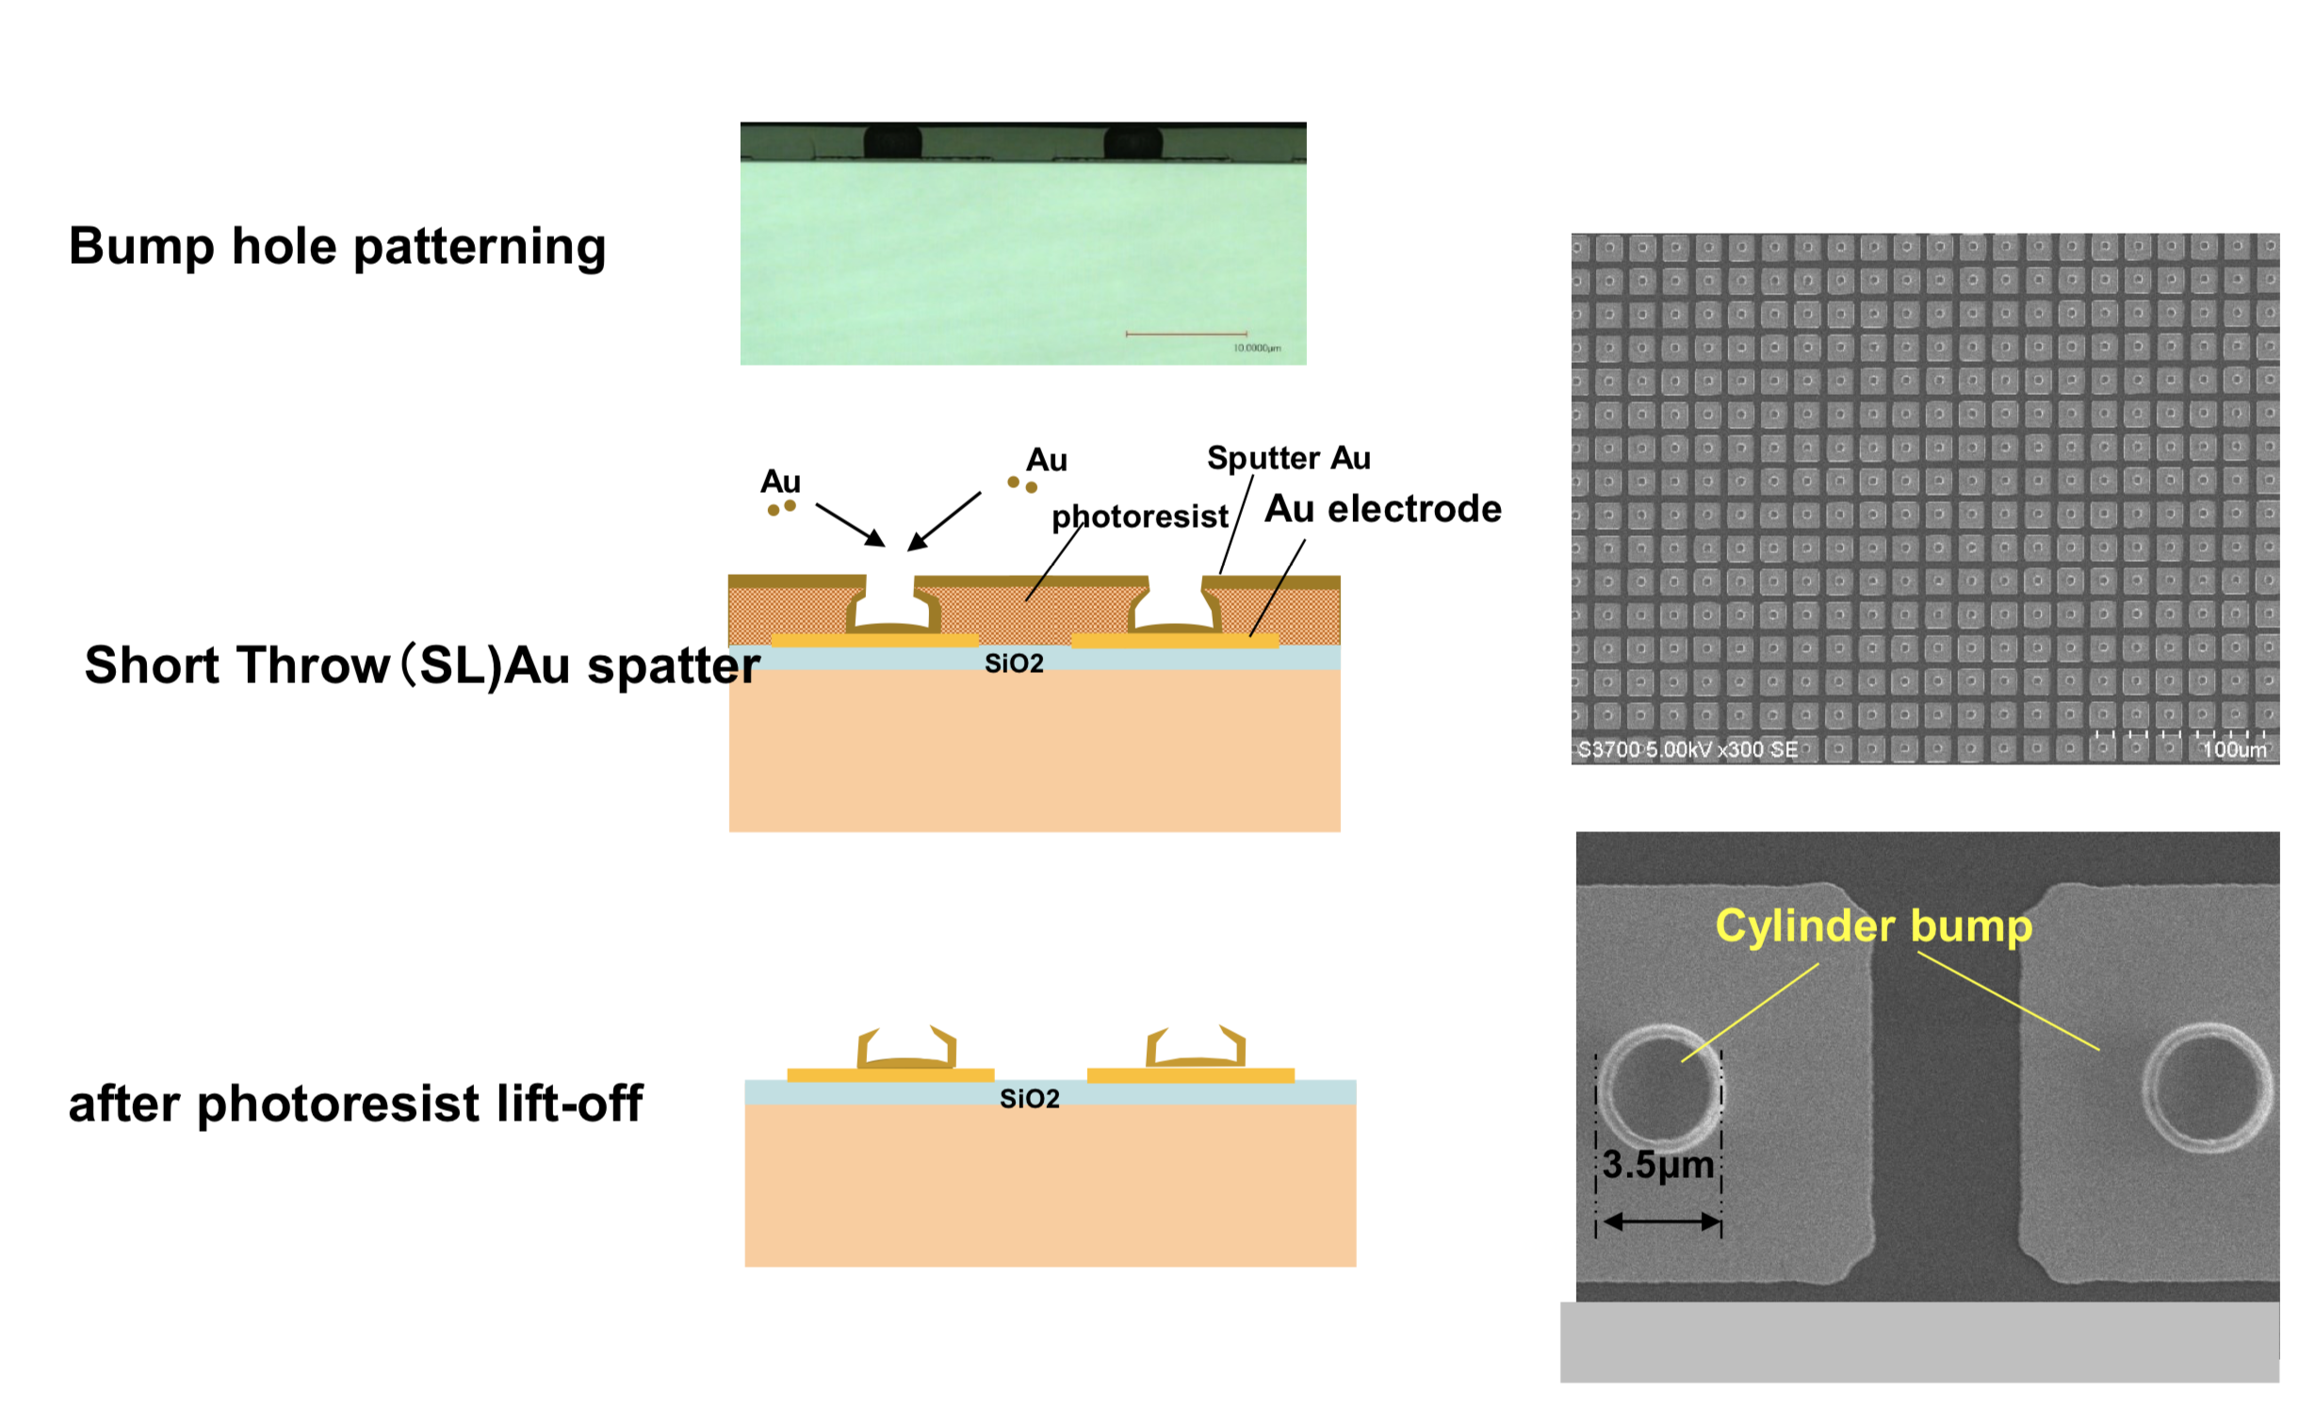
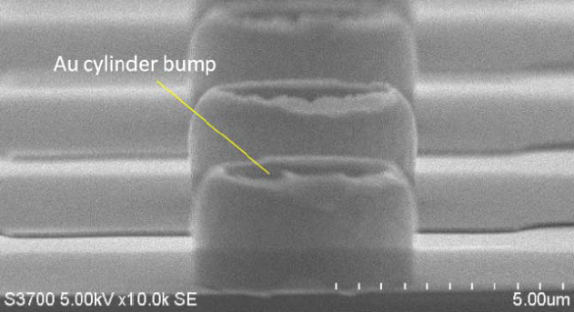
Formation of micro gold cylinders
Gold cylinders after combined
We collaborate with Tohoku Microtec

Slide 16
Step 3
Step 4
Step5
Lower & Upper Chip alignment
Si
High R-Si
Press and heat for Bonding
Adhesion Glue injection
Si
High R-Si

Slide 17
Step 6
Step 7
Upper Si removal (expose through BOX via)
High R-Si
Upper Metal (Bonding pad & backside gate) deposition & pattering
Passivation deposition & patterning
High R-Si

Slide 18
The stacking can be repeated in the same procedure
Step 8
High R-Si

Slide 19
3D design tool
Virtuoso with Special rule files.
Virtual layers are automatically generated between upper and lower chips that unify the chips geometrically and logically.
The DRC (design rule check) and LVS (layout versus schematic) can be applied for the whole pixel system.
Upper chip
Lower chip
MET5 (upper)
Special VIA Gen.
Upper-tier
port
PV (upper)： VIA
Layout
LayoutZ
ZC1 (upper)： Bump
LVS1
(Virtual connect)
ZC5 (upper)： Bump ID
DRC, LVS
DRC, LVS
ZC6 (lower)：Bump ID
Lower-tier
port
ZC1 (lower)： Bump
Stacking
Special
DRC/LVS rule
Stacking
PV (lower)： VIA
MET5 (lower)
Unified
DRC＆LVS2
Dummy Gen.

Slide 20
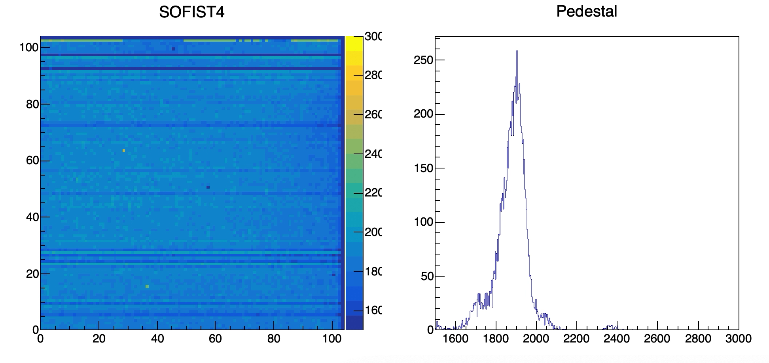
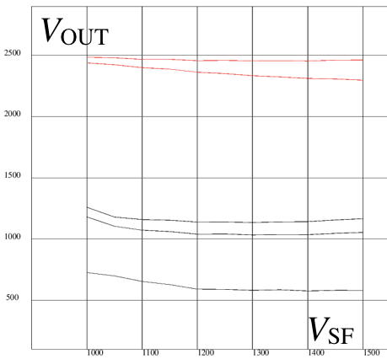
Performance of SOFIST Ver. 4
Response to ⁹⁰Sr β source
Analog output voltage versus bias voltage of the preamplifier. Extracted pixels whose gain is less than the design.
3 out of 102x102 pixels do not show response.
Connection yield = 99.97 %
Preliminary
Problem in the preamplifier
Bump bonding failure
(Preliminary)

Slide 21
Radiation hardness of the 3D glue
70 MeV Proton irradiation to NIEL 5x10¹⁴ n-eq/cm² and TID 0.4 MGy, similar to the environment of LHC pixel detector.
Visual inspection was done. No clacks, bubbles, color changes observed: The glue is enough rad-hard.
Quantitative test is not done.
Before irradiation Two month after irradiation
3mm

Slide 22
Advantages of the SOI micro-bump bonding:
Requirement to surface flatness is determined by the height of the cylinders: a few μm tolerance.
The soft cylindrical gold bumps results in high-connection yield.
TSV is not necessary: The through BOX via (TVB) for the back side are produced at the SOI CMOS circuit processes.
The circuit chip has SiO2 layer on both sides: The stacking process can be repeated.
Upper chip: Only CMOS circuit in SiO₂ remains.
  The thickness is about 10 μm.

Slide 23
Summary
In order to meet the high event rate and background of the present and future high energy collider experiment, the 3D stacking is a reasonable solution.
The direct connection method and bump bonding method are briefly explained.
SOFIST Ver.4, the SOI PIX sensor with micro cylindrical bump showed a high bonding connection yield of 99.97 %. Note that the size of SOFIST Ver.4 is 3 mm x 3 mm.
The glue used for the stacking is radiation hard to NIEL 5x10¹⁴ n-eq/cm² and TID 0.4 MGy.
We are preparing a beam test of the SOFIST Ver.4 chip in this winter.

Slide 24
Thank you for your attention.

