Slide 1


Recent progress in CVD diamond detector R&D
Rainer Wallny
on behalf of
the RD42 collaboration
The help of my RD42 colleagues is gratefully acknowledged.
Vertex 2019, Lafodia Sea Resort, Croatia

Slide 2
RD42 Collaboration (2019)
114 participants
30 institutes

Slide 3
Outline
Diamond as a radiation detector
Summary of RD42 radiation tolerance results
3D pixel detectors
  Concept and motivation
  Results
Results on 3D mapping of charge transport
with two photon absorption edge TCT
Conclusions and outlook
J. Phys. D: Appl. Phys. 52 465103 (2019) NEW
Nucl. Instrum. Meth. A, 786, 97-104, (2015)
Appl. Phys. Lett. 114,
203504 (2019) NEW
http://rd42.web.cern.ch/rd42/publications/publications.html

Slide 4
Diamond as a radiation detector
Diamond detectors are operated as ionization chambers
            1 electron-hole pair generated per 13 eV ionizing energy loss
            36 electron-hole pairs per µm per MIP
            Large (5.47 eV) bandgap ensures no thermal carrier generation
Poly-crystalline material comes in large wafers
            The wafers are grown to several times the specified thickness, parts are then cut out with a laser and thinned from
            the substrate side to the desired thickness
            ~300 µm collection distance can be achieved on finished parts
            Single crystal sensors still confined to 7 mm x 7 mm size
Devices can be made in any configuration
            Pad, Strip, Pixel, 3D
Working principle
15 cm diameter pCVD diamond wafer
3D diamond sensor with pixel readout

Slide 5
Summary of RD42 Results on Radiation Tolerance

Slide 6
Radiation tolerance of diamonds
Irradiate diamond samples with various particle species and energies
            Re-metalize after each irradiation step to fabricate a strip detector
            Readout with low (~80 electrons) noise VA2 chip
Characterize irradiated devices in beam tests
            Using hit prediction from telescope, collect charge in region of interest of up to 10 strips
            Tracking precision at detector under test: ∼ 2–3 μm
Diamond strip detector wire-
bonded to a VA2 readout chip
Schematic of the test assembly in CERN SPS H6A beamline

Slide 7
Radiation tolerance of diamonds
Measure pulse height as a function of irradiation
            Measure under both positive and negative bias
            Convert mean pulse height to mean drift length before immobilization by deep trapping – “Schubweg” ( ∽μ τ E)
Fit data with an empirical damage equation
            n- number of traps, λ – Schubweg, k – damage constant, φ - fluence
            The data for each sample are fit individually
            Poly has a shorter initial Schubweg due to a higher initial trap concentration
q^{signal} (e)
⧲ -
⧳ +
800 MeV p irradiation
pCVD
(Sample 1-3)
scCVD (Sample 4)
ɸ (p/cm² )

Slide 8
Summary of RD42 radiation tolerance results
In RD42 we use the damage constant for 24 GeV protons as a reference
The new analysis re-confirms the damage constant for 24 GeV protons
            ~ (6.2±0.7x10⁻¹⁷) μm⁻¹cm⁻²
            ~ 10% uncertainty on relative k
Particle | Energy | Relative k
proton | 24 GeV | 1
 | 800 MeV | 1.67+/-0.09
 | 70 MeV | 2.48+/-0.25
 | 25 MeV | 4.2
fast reactor neutrons |  | 4.5+/-0.4

Slide 9
3D Pixel
Diamond Detectors

Slide 10
Principle of 3D detector
Parker et al., NIM A395 (1997)
After large radiation fluence all detectors become trap limited
3D = bias and readout electrode are inside detector material
Same thickness D → same amount of induced charge → shorter drift distance L
Increased collected charge in detectors with limited mean drift path
However, low field regions are introduced

Slide 11
Principle of 3D detector
Simulation with 30 V bias voltage and periodic boundary conditions
Electric field ∼1 V/μm over a large area in the cell
Low field region in between the electrodes

Slide 12
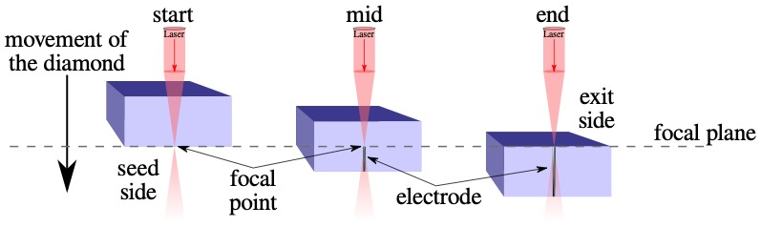
Laser drilling
“Drilling” columns using 800 nm fs-LASER (Oxford University)
            Converts diamond into resistive mixture of carbon phases (i.a. DLC, graphite, ...)
Usage of Spatial Light Modulator (SLM) to correct for spherical aberration
            Initial column yield ∼90 % → now ≳ 99.8 %
            Initial column diameter 6 ∼ 10 μm → now 2.6 μm

Slide 13
3D pixel detectors
CMS setup
ATLAS setup
Two prototypes are built:
            ~ 8000 2.6 µm columns laser drilled from both sides
            ~4000 50 µm x 50 µm 3D cells
            Bump bonding:
              CMS chip at Princeton (Indium without reflow)
              ATLAS at IFAE (Sn-Ag solder balls)
            Both readout and bias columns have a small gap (∼15 μm) to the surface

Slide 14
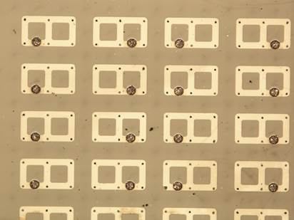
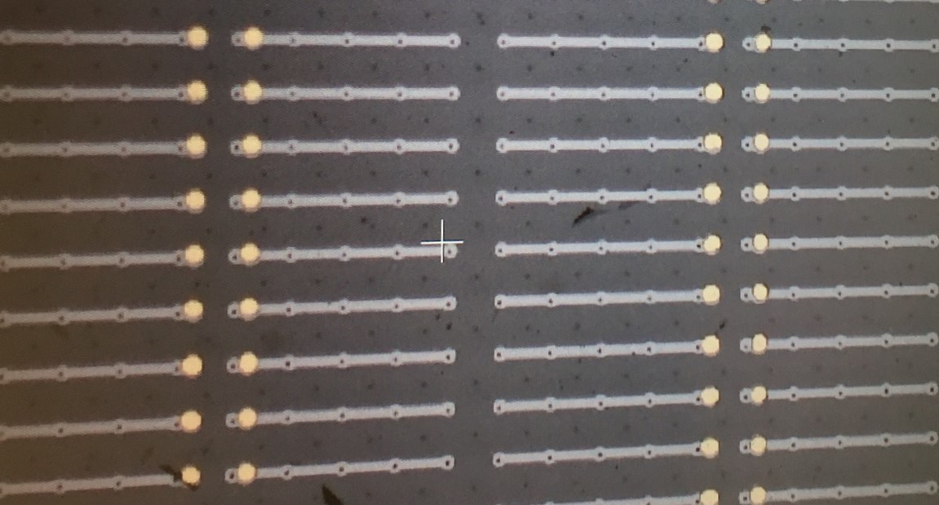
3D pixel detectors
Bias columns
Bias columns
3D cell
3D cell
Readout columns
CMS setup
Bump bonds
Readout columns
ATLAS setup
Bump bonds
Connection to bias and readout columns with surface metallization
Ganging of cells to match pixel pitch of readout-chip (ROC)
            3x2 ganged cells tested in Aug 2017 at PSI; Sept, Oct 2018 at CERN
            5x1 ganged cells tested in Sept, Oct 2018 at CERN

Slide 15
3D pixel detector prototypes
CMS setup
ATLAS setup
Connection to bias and readout columns with surface metallization
Ganging of cells to match pixel pitch of readout-chip (ROC)
            3x2 ganged cells tested in Aug 2017 at PSI; Sept, Oct 2018 at CERN
            5x1 ganged cells tested in Sept, Oct 2018 at CERN

Slide 16
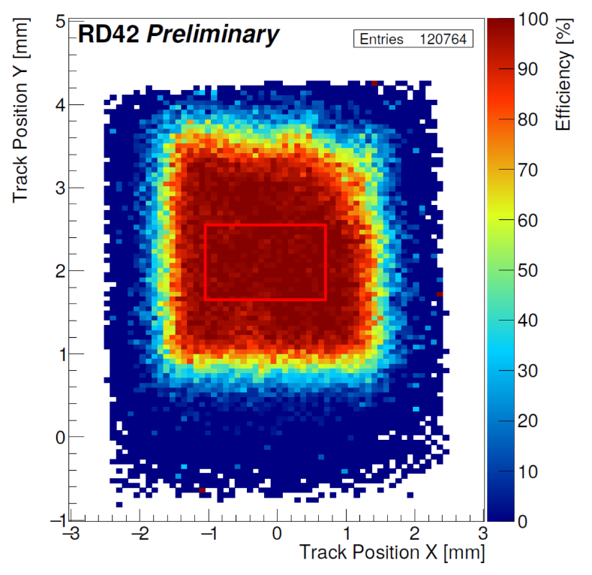
3D pixel detector prototype: CMS
Preliminary Results (50μm x 50μm cells)
Readout with PSI46dig v2.1-respin CMS chip
Testing at PSI (using 260 MeV π⁺ beam)
6 cells (3x2) readout with 1 channel
Preliminary efficiency >99.2%
Collect >85% of charge (in fid. region)
applied voltage -55V
threshold 1500 electrons
hit efficiency >99.2%

Slide 17
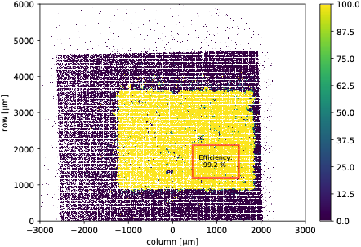
3D pixel detector prototype: CMS
Preliminary Results (50μm x 50μm cells)
Readout with PSI46dig v2.1-respin CMS chip
Testing at CERN with 120 GeV proton beam
6 cells (3x2) readout with 1 channel
Preliminary efficiency >99.2%
Collect >85% of charge (in fid. region)
preliminary

Slide 18
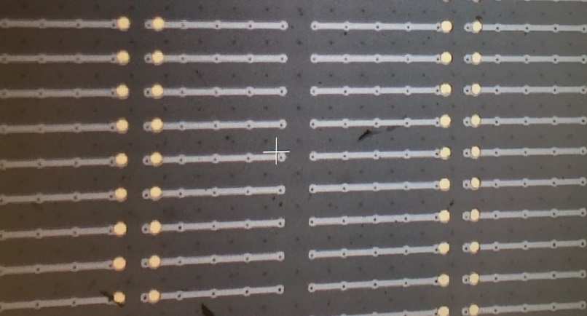
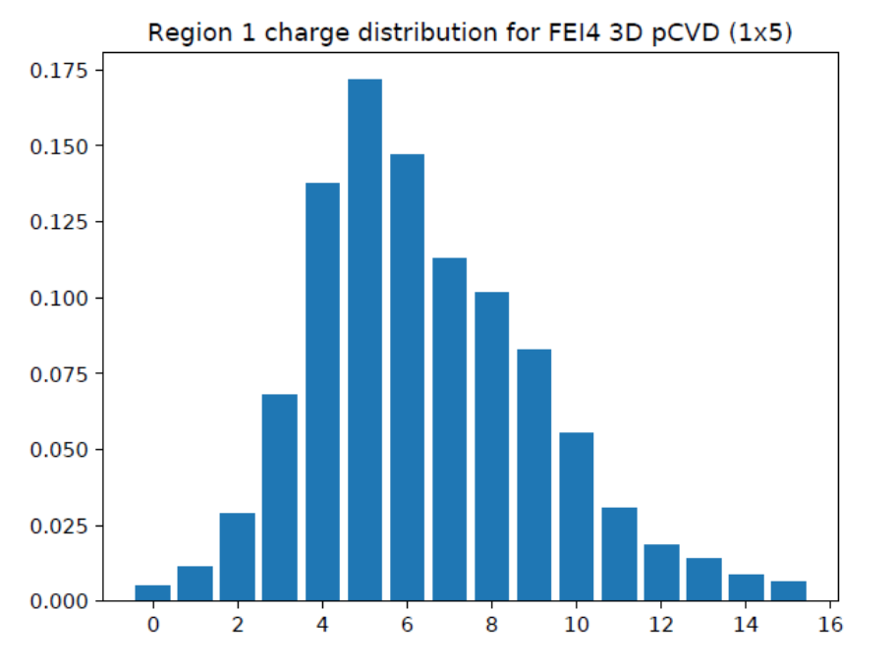
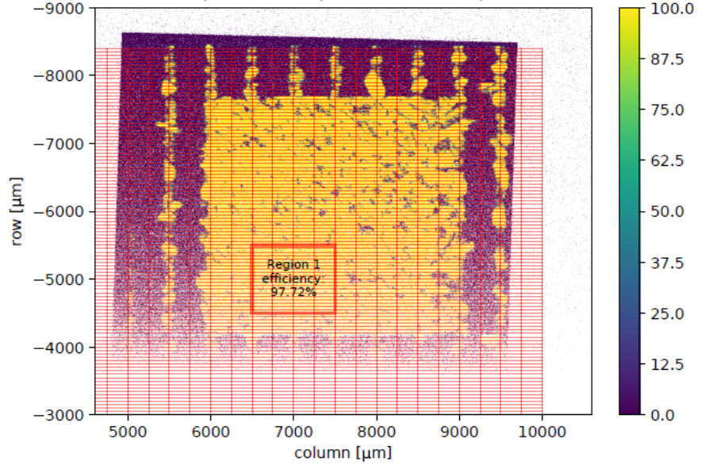
3D pixel detector prototype: ATLAS
Preliminary Results (50μm x 50μm cells)
Readout with FE-I4 ATLAS pixel chip
Testing at CERN with 120 GeV proton beam
5 cells (1x5) readout with 1 channel
Preliminary efficiency >97.7%
5ToT=11,000e; Mean ToT=6.73=14,800e
Collect >80% of deposited charge
high voltage -30V
threshold 1100 e
mean ToT 6.73

Slide 19
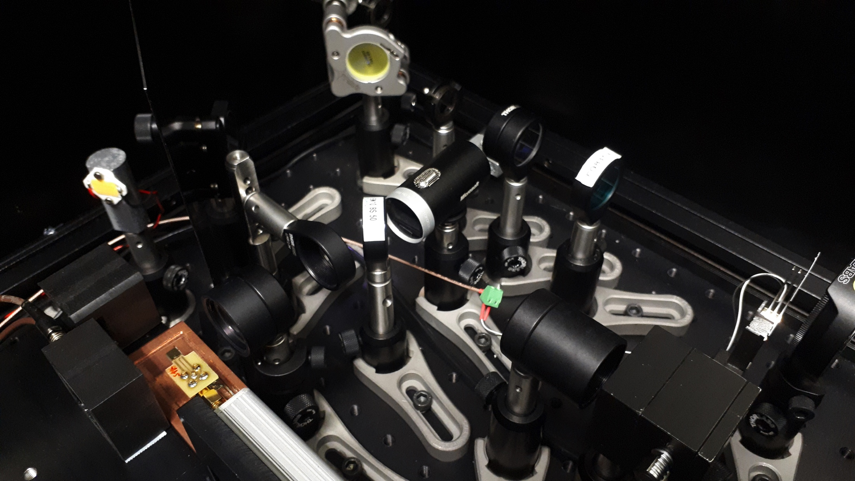
Edge TCT charge mapping of diamond
Select as featured article in APL

Slide 20
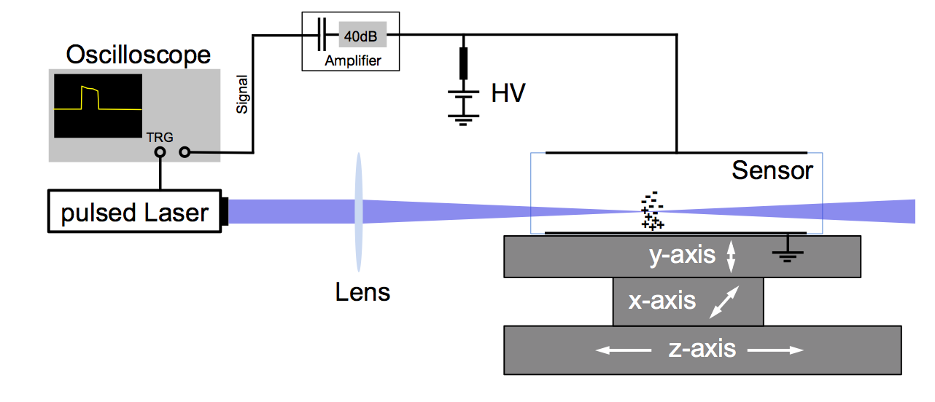
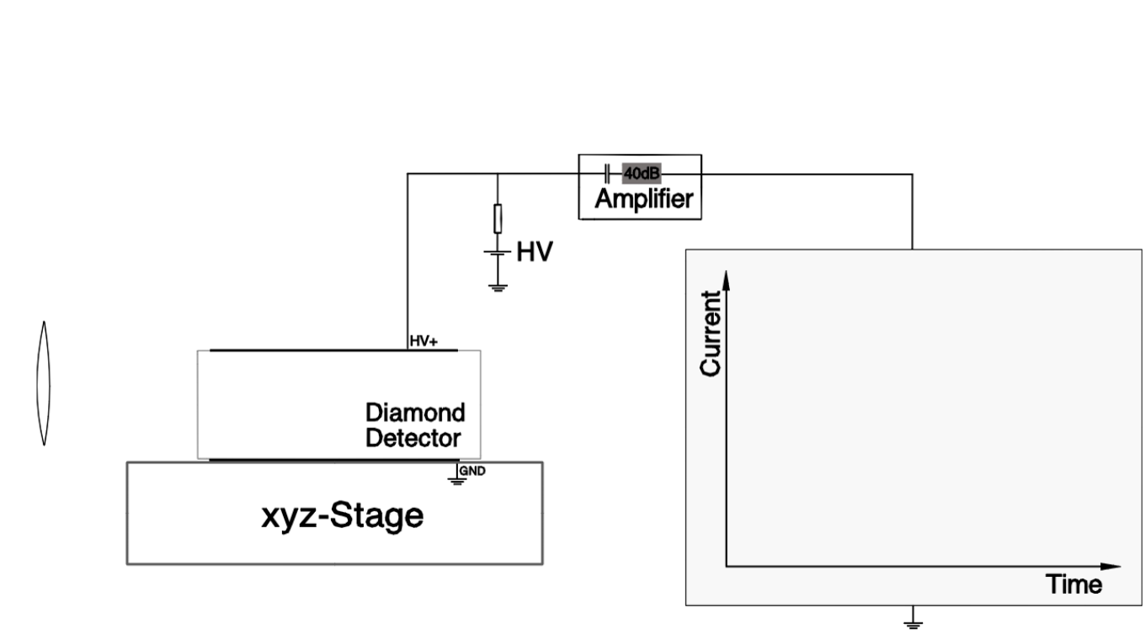
  Edge-TCT Principle
  Charge Generation through 2-Photon Absorption
The setup allows to measure:
the mobilities of electrons and holes
the charge collection efficiency in the bulk
the electric field in the bulk
15 October 2019
Recent progress in CVD diamond detector R&D

Slide 21
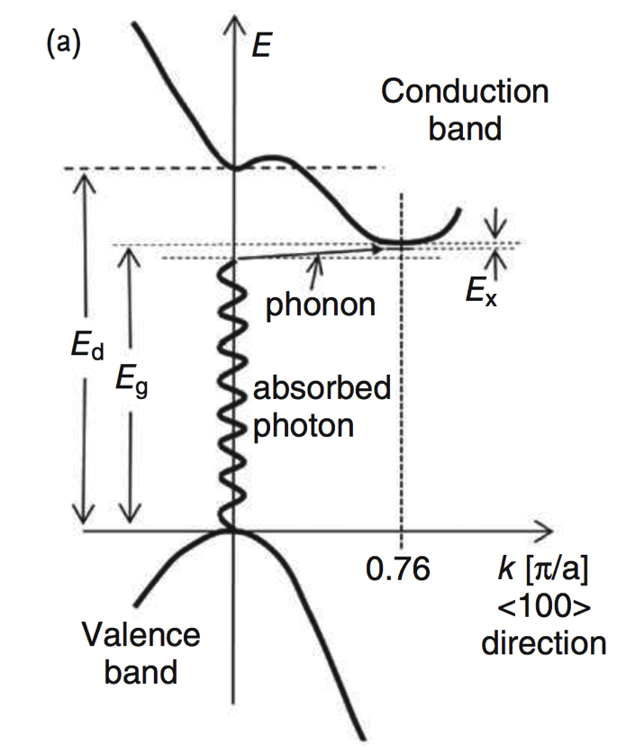
  Theory of 2- and 3-Photon Absorption in Diamond
Direct Bandgap
required energy = 7.3 eV / 170 nm
1-photon absorption
2-photon absorption: E_{γ} = 3.65 eV / 340 nm
3-photon absorption: E_{γ} = 2.43 eV / 510 nm
Indirect Bandgap
required energy ≈ 5.47 eV / 226 nm
(minus phonon contribution and exciton energy)
1-photon absorption
2-photon absorption: E_{γ} ≈ 2.74 eV / 453 nm
Excitation Laser Beam
photon energy 3.1 eV (400 nm)
pulse length ~100 fs
0.1-5 nJ pulse energy eq. to 2*10⁸ – 10¹⁰ photons/pulse
2 Hz - 1 kHz repetition rate
15 October 2019
Recent progress in CVD diamond detector R&D

Slide 22
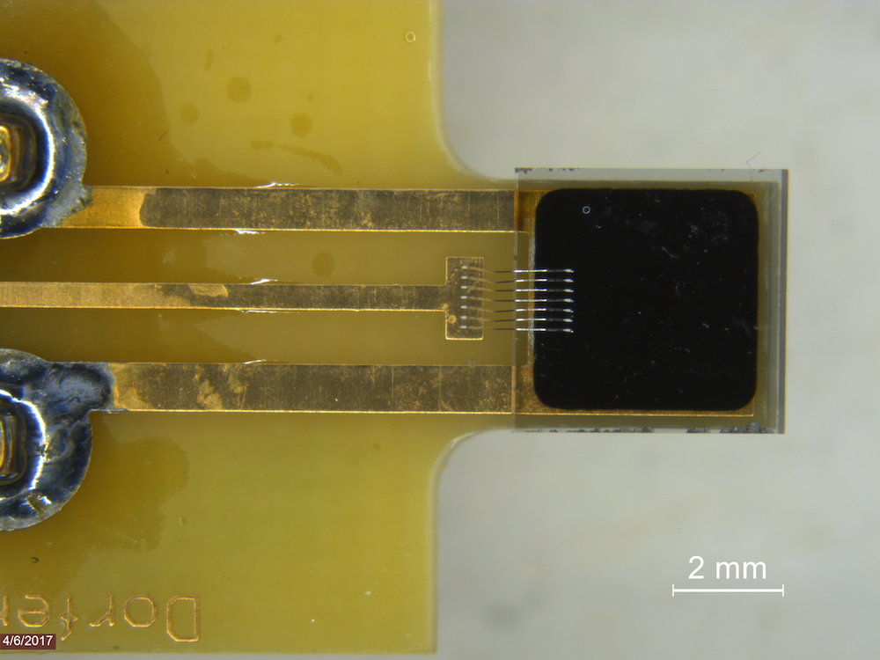
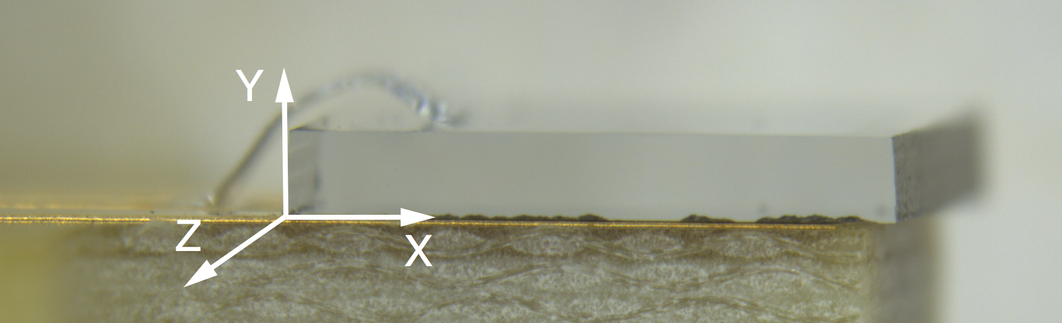
  Sample Signals
laser entry positions
-1400V
540 μm
GND
X
Z
Laser System
15 October 2019
Recent progress in CVD diamond detector R&D

Slide 23
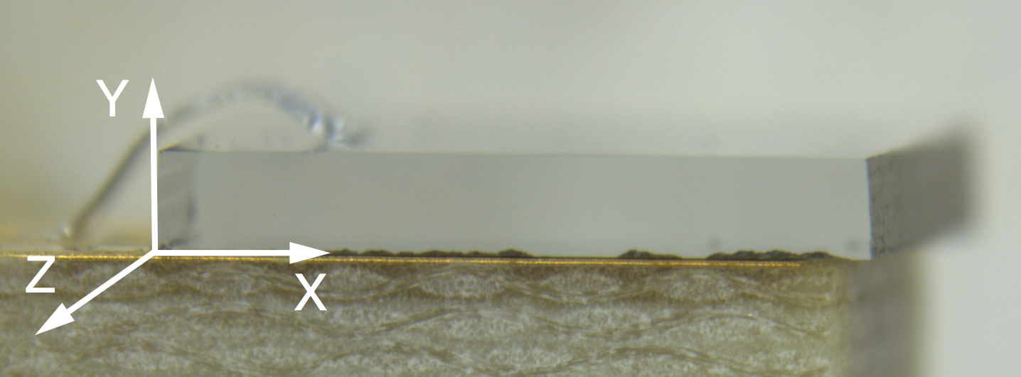
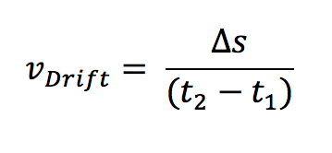
  Mobility and drift velocity of charge carriers
440 μm
15 October 2019
Recent progress in CVD diamond detector R&D

Slide 24
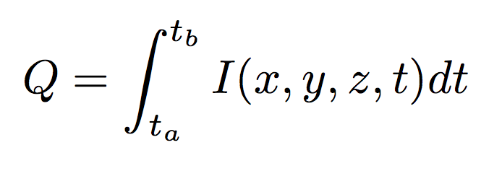
  Collected Charge Map
The collected charge at every scan point can be calculated as
where t_{a} and t_{b} denote the integration times (0 – 200 ns in this case).
15 October 2019
Recent progress in CVD diamond detector R&D

Slide 25
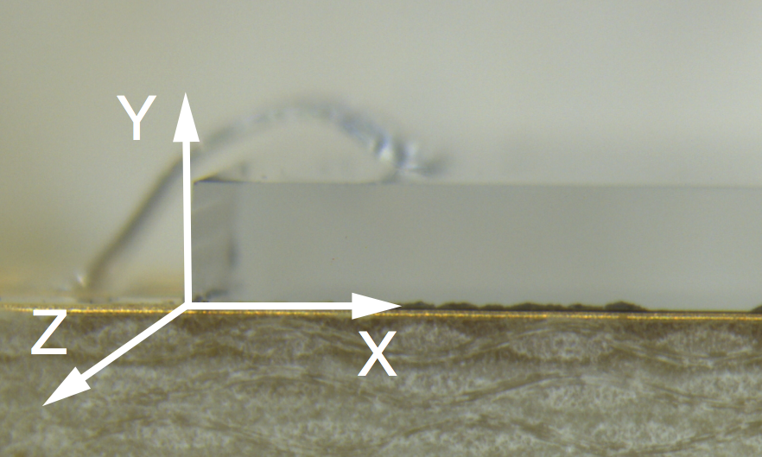
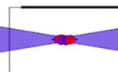
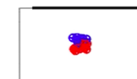
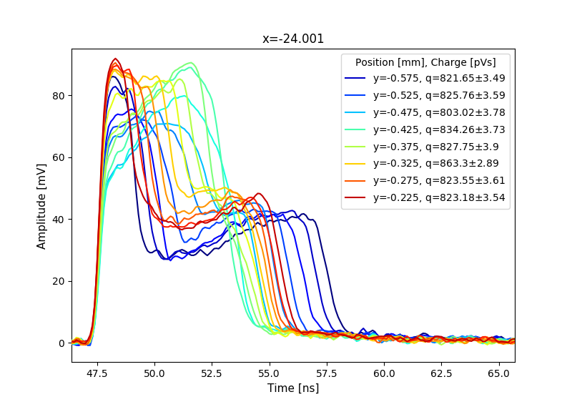
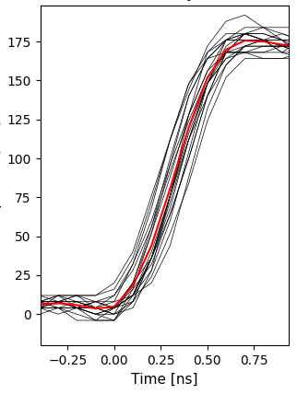
  Electric Field Measurement
hit positions
→
Drift distance only 20 – 40μm during rising time.
Assumption: No carrier trapping at defects etc.
I_{prompt}(y, t≈0) = c·[μ_{e}(E) + μ_{h}(E)]·E(y)
Assuming constant mobilities the current at t≈0 is proportional to the electric field
relative measurement
to get an absolute measurement the above equation needs to be solved numerically with a mobility model
15 October 2019
Recent progress in CVD diamond detector R&D

Slide 26
  Electric Field vs. Defect Density in the Diamond
Left: Comparison of the prompt current result (black) to the defect density seen by X-ray topography (red).
Z = 1500 um
15 October 2019
Recent progress in CVD diamond detector R&D

Slide 27
Conclusions
Updated radiation hardness of diamond results for 800 MeV and 24 GeV proton up to fluences 2x10¹⁶ protons/cm²
              Published in Journal of Physics D: Applied Physics, Volume 52, Number 46 [DOI: 10.1088/1361-6463/ab37c6]
Two 3D pixel detectors with 4000 50-µm x 50-µm cells fabricated
              3x2 cell ganging with CMS chip readout
              5x1 cell ganging with ATLAS chip readout
              Laser drilling of ~2.6μm diameter columns with ~99.7% efficiency
              Hit detection efficiency >99% achieved even for high (3700 electrons) thresholds
            2-photon edge-TCT is proving to be a useful to further the understanding of charge carrier transport in diamond

Slide 28
Future Plans
Irradiate and assess performance of 3D detectors after fluences 10¹⁵ and 10¹⁶ particles/cm²
Fabricate 25 μm x 25 μm 3D cells
Scale up 3D column production using lasers
Develop column etch process compatible with semiconductor industry
Edge-TCT of irradiated diamonds

Slide 29
Backup

Slide 30
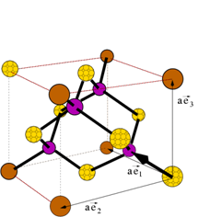
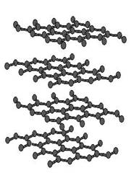
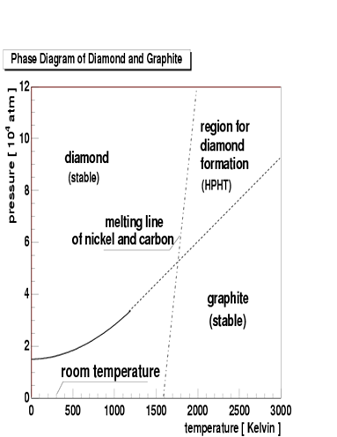
CVD: Chemical Vapor Deposition
High Pressure High Temperature
(HPHT) Process causes high impurity
concentration
C=1s²2s²2p²
C=1s²2s¹2p³
HPHT
At 298 K and 1 atm pressure graphite
configuration is stable and diamond
configuration is meta-stable:
need 0.03 eV/atom but large
activation energy barrier
CVD: C-H bond less tight than H-H bond.
atomic hydrogen and radicals edge away
C-H layer on surface: exothermic process.
sp³-bonds are more energetically favorable
than sp²-bonds.
=> Vacant surface site will prefer diamond
lattice over graphite lattice
CVD

Slide 31
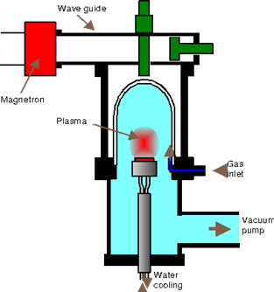
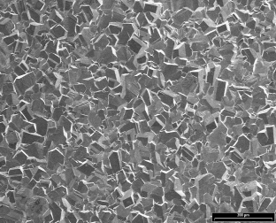
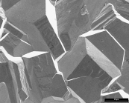
CVD Diamond Production
Grain size: ~100-150μm
growth
substrate
columnar structure of polycrystalline CVD diamond (SEM picture M.Bruzzi)
H
H
H
H
H
H
H
H
H
- Columnar growth of diamond crystal
- Si or diamond substrate
- Growth speed ~ few μm/hour
Grains grow wider from substrate side
recently: single crystal diamond
H
H
H
H
H
H
C
C
C
H
H
H
H
C
H
H
H
C
H
H
C
C
C
C
C
C
C
C
H
H
C
C
C
C
C
C
C
C
C
C
C
C
C

