Slide 1
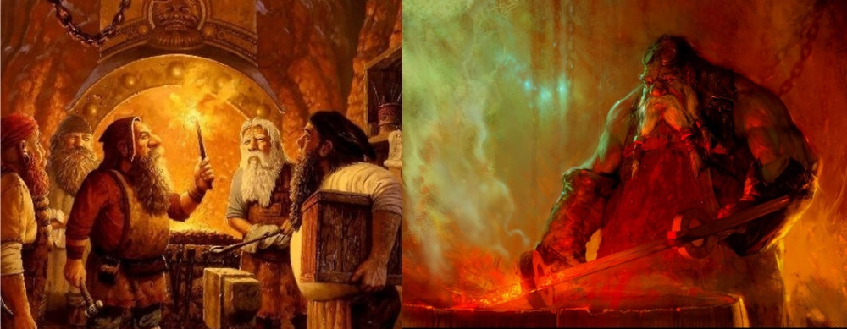
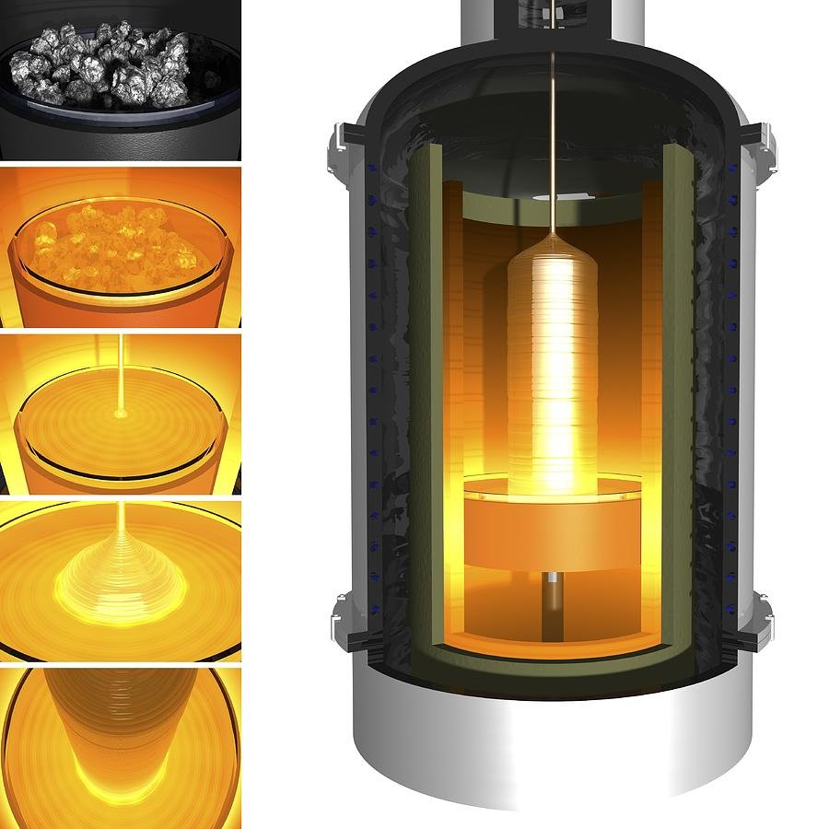


A story about enabling technology:
Entering Mordor, Silicon forging and the dwarf blacksmith
Vertex 2019 ,Lopud, Croatia October 18th, 2019
Iván Vila Álvarez
Instituto de Física de Cantabria (CSIC-UC)

Slide 2
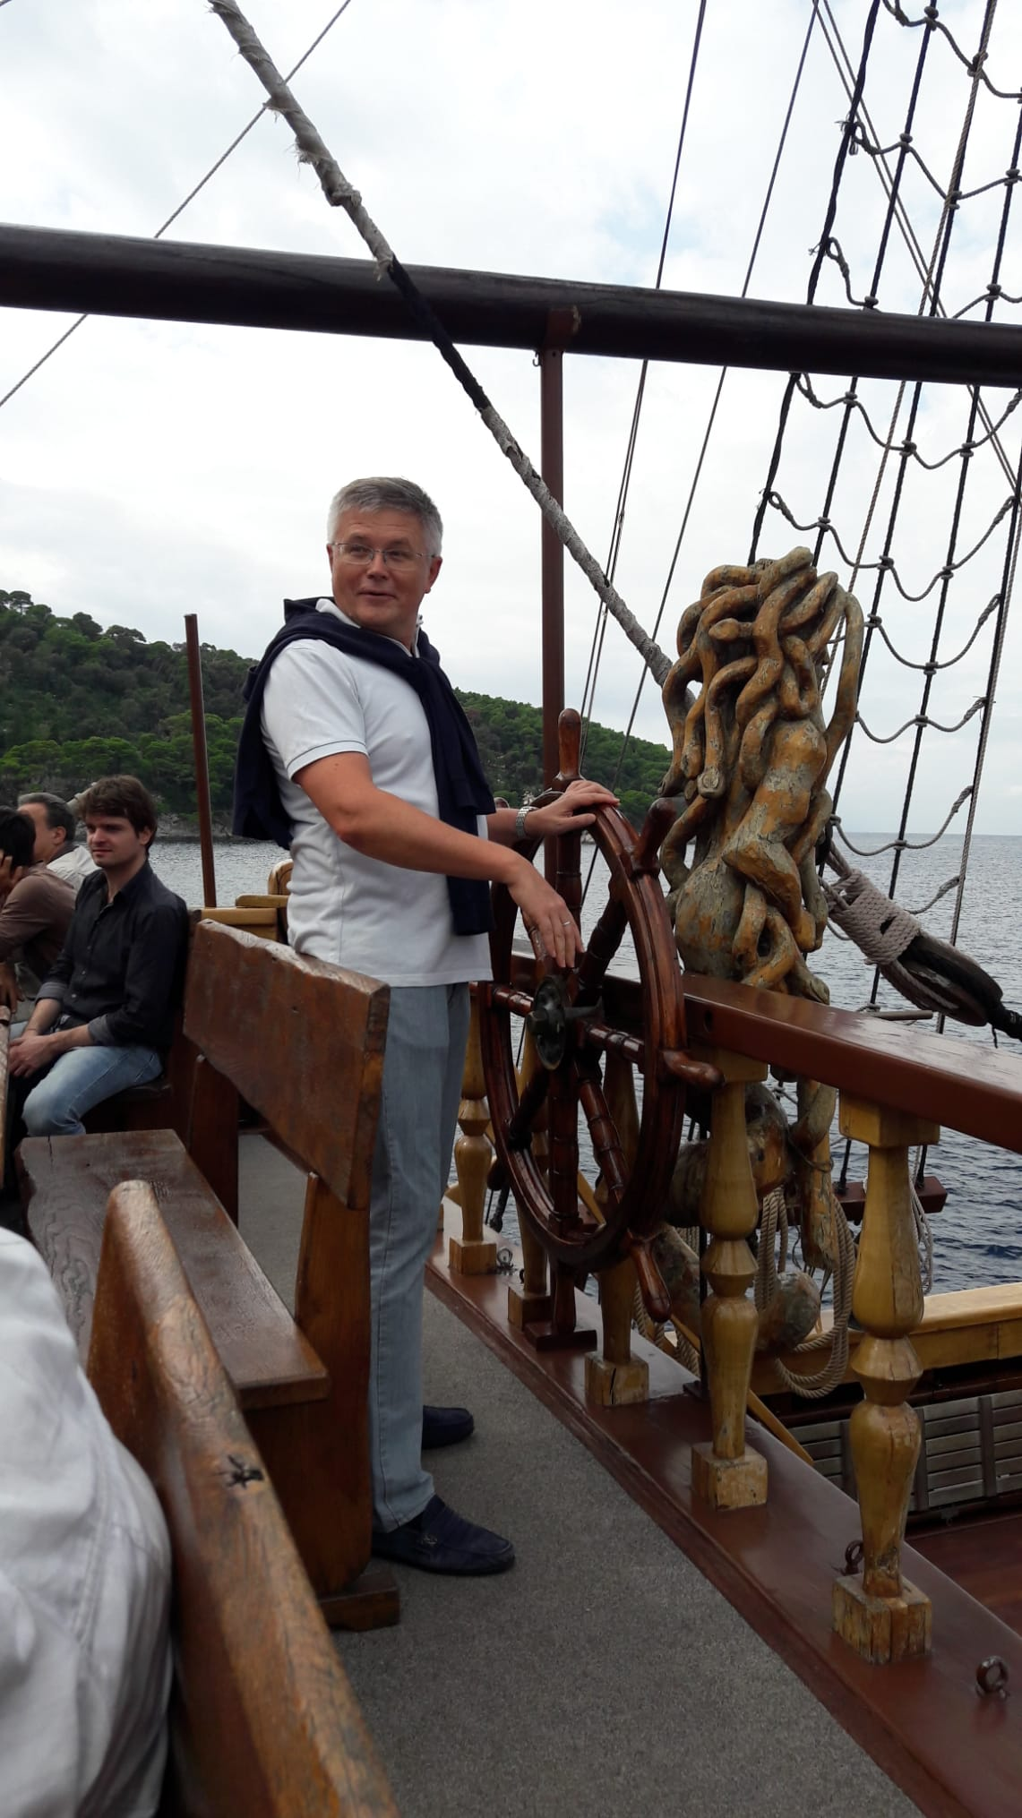
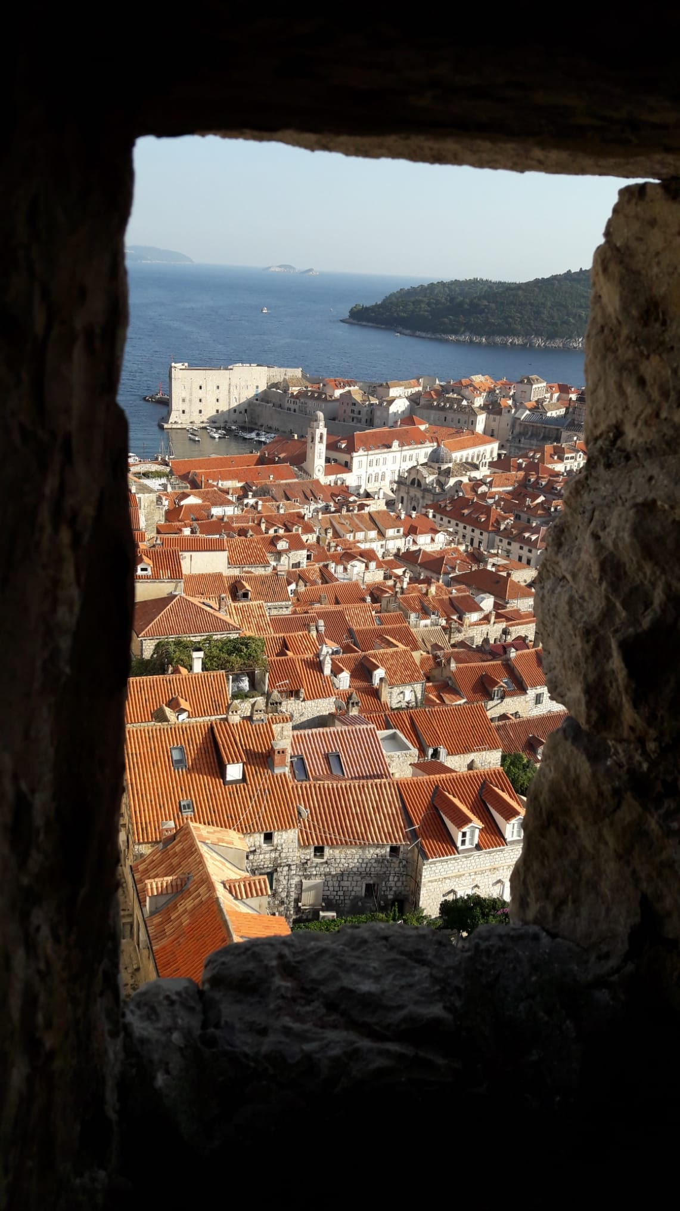
THANKS!

Slide 3
Captatio benevolentiae
Too many and too broad topics to be covered in a single talk.
Around 55 contributions !
Do not expect detailed nor comprehensive explanations.
So, please, do not look for your plot or your “key” message.
I will try to show you the forest without paying much attention to the trees

Slide 4
What was the
VERTEX 2019 about?

Slide 5
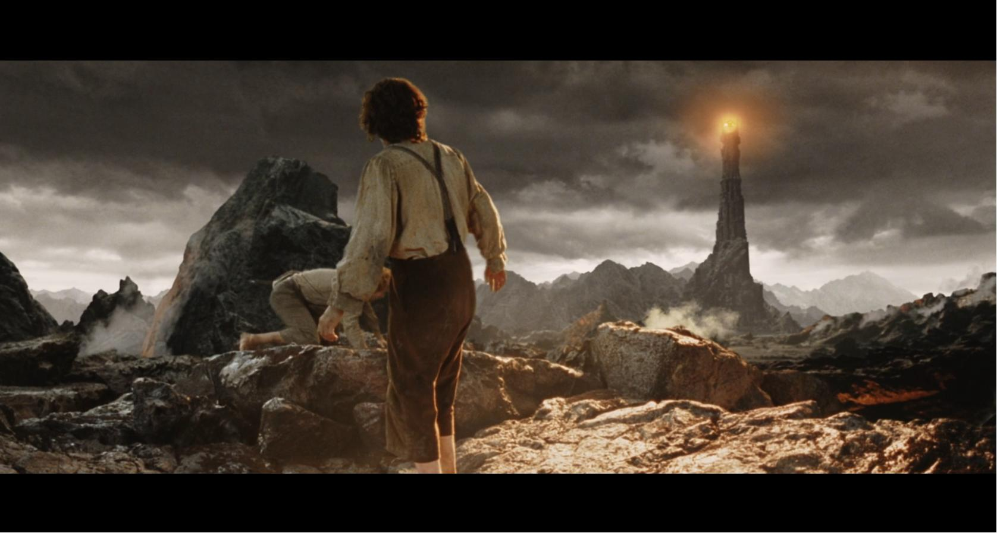
Vertex 2019 was about how to get to Mordor, the unchartered land where dark matter and dark energy reign…

Slide 6
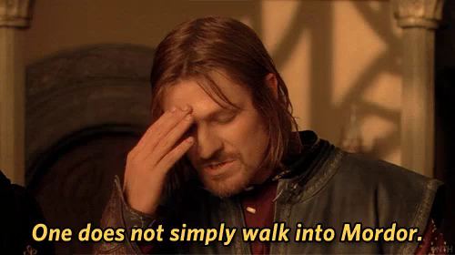
BUT…

Slide 7
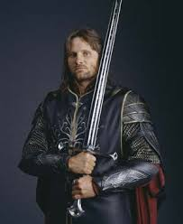

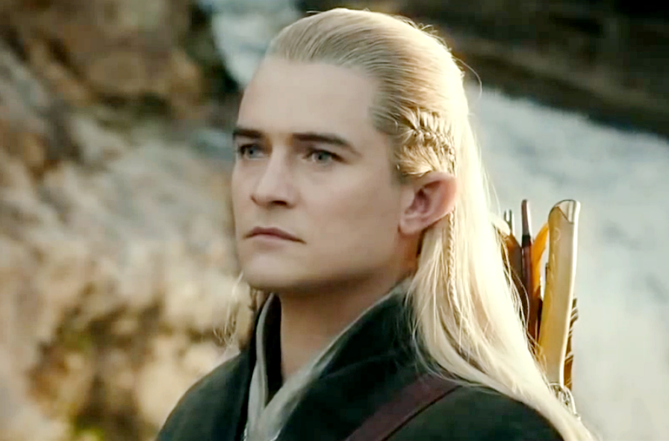

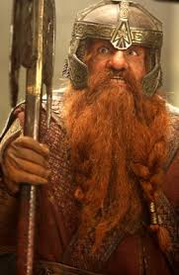
The fellowship of the (colliding) ring
Race: Professor
(“The Physicist”)
Untouchable being
For them World is a
nuisance
full of systematic errors
(Never found alone)
Race: Theorist
(“The one who knows””)
Ethereal being
They live in a
11-Dimesion
De Sitter Space
Race: Student
(“The one who does the work”)
They are a doom race
without a true independent live
to survive they
have to be around a Professor
Race: Phenomenolog
(“The Montecarlo guru”)
Mythical being able
Communicate both with
Theorist and Physicist
Motto: Always go to the
Next Leading
Order
Race: “Detector Builder”
Also know as experimental
Physicist, engineer or
“the hardware guy”
They love dark isolated places (“The Lab”)
Motto: Always check
the radiation-effect
YES, WE ALL ARE DWARF BLACKSMITHS OR (EVENT WORSE) APPRENTICES
Notes:
The theorist, the physicist, the phenomenologist and the hardware guy. (the enabling technology)

Slide 8

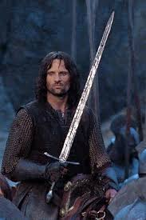
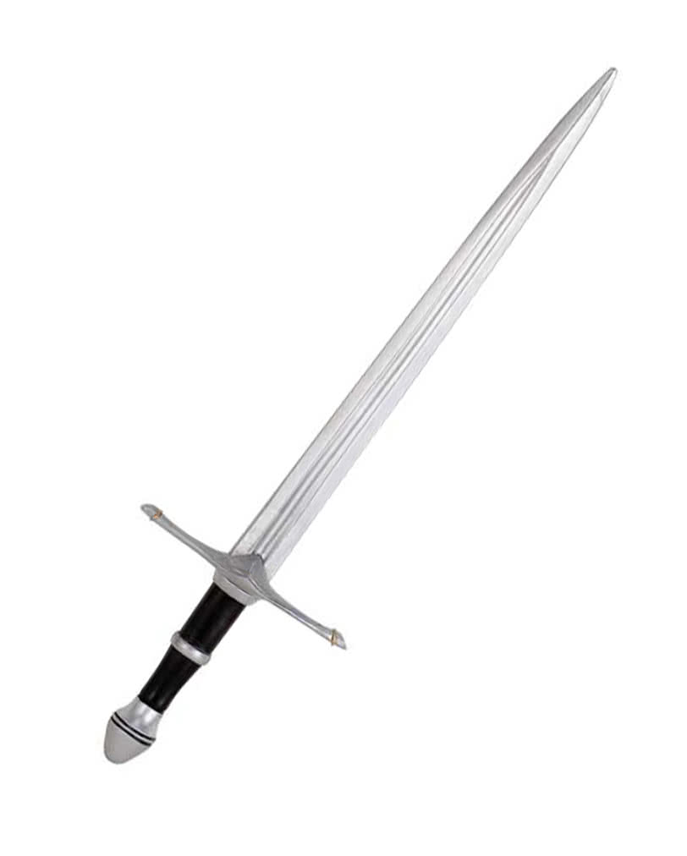
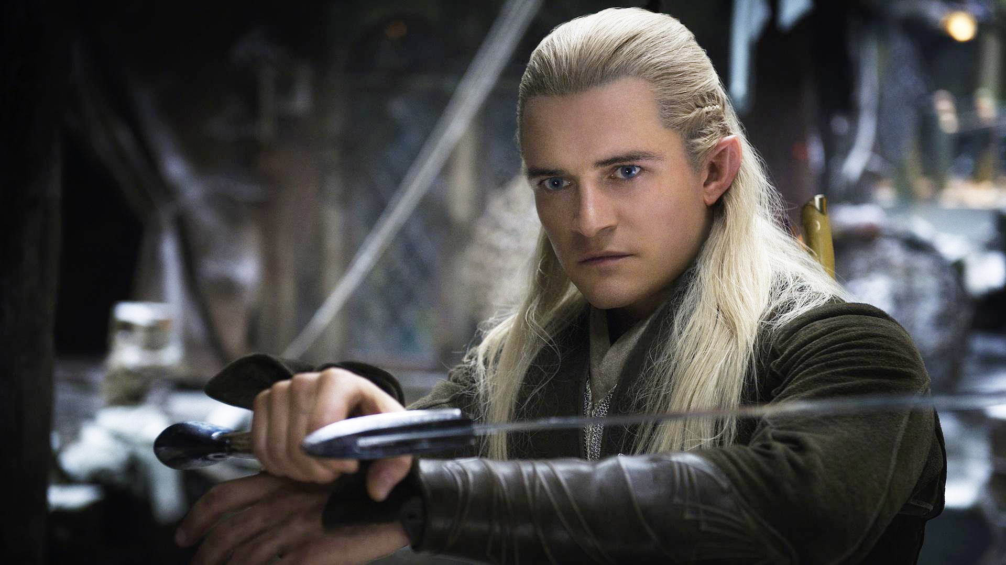
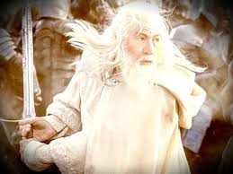
The enabling technology:
Why all the races rely on the Dwarf Blacksmith

Slide 9
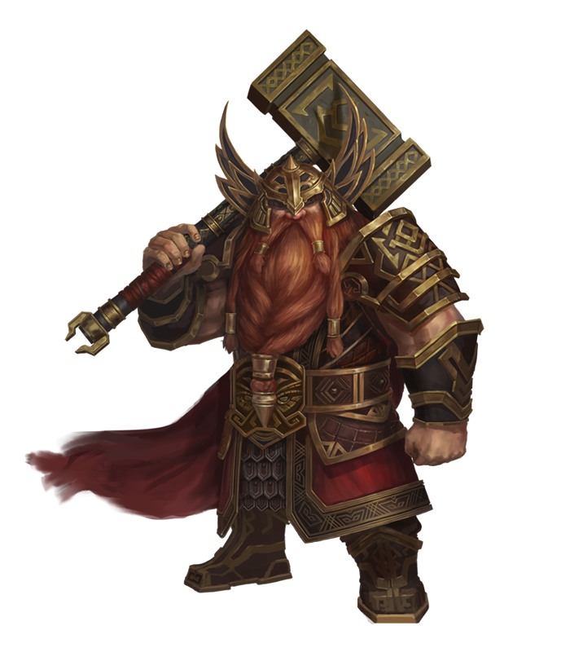
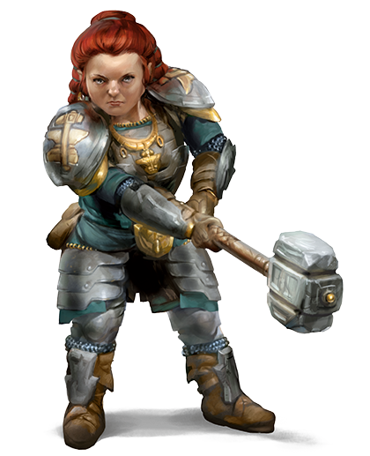
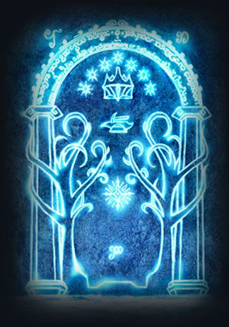
Vertex 2019 was about the handcraft of the dwarf forgers of the silicon technology that enables the exploration of the (yet) unknown universe
Let’s get in

Slide 10
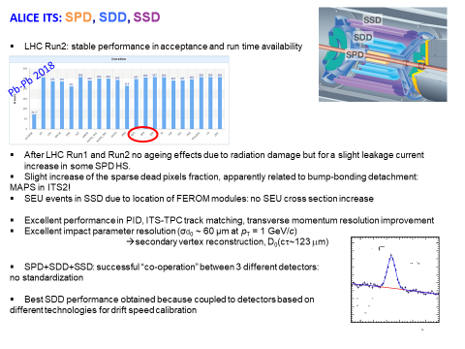
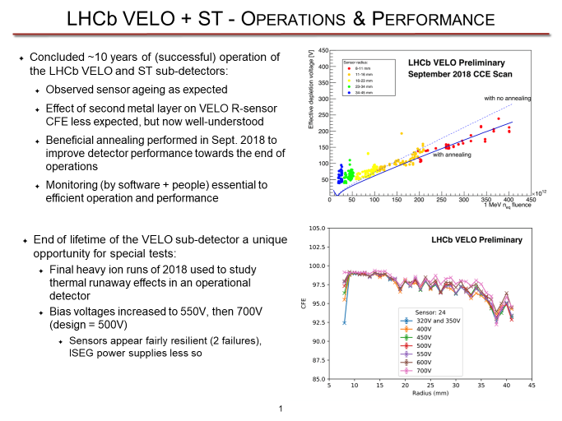
Operational experience
Shigeki Hirose/U. Freiburg
Tatjana Susa/RBI Zagreb
Elena Botta/ INFN Torino
Preema Rennee Pais/ EPFL Lausanne

Slide 11
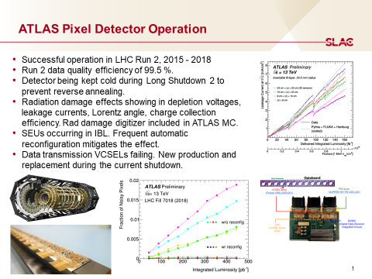
Operational experience
Christoph Schwanda/ HEPHY Vienna
Martin Kocian/ SLAC
Atanu Modak/U. Kansas
Danek Kotlinski/PSI

Slide 12
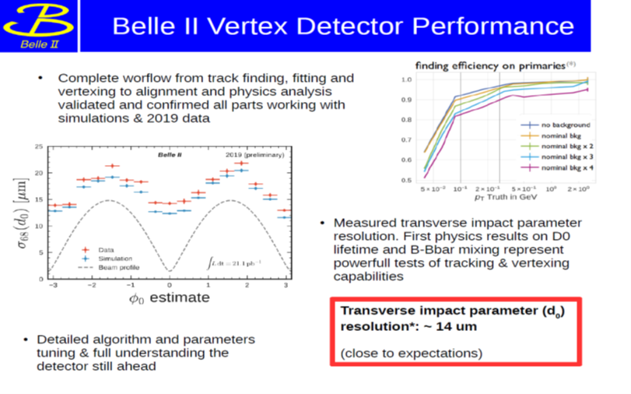
Operational experience
Björn Spruck U. Mainz
T. Bilka/ Charles University Prague
Belle-2 new silicon vertex (depfet) and tracking (strips) started to take physics data in 2019!
LHC detector still extremely high efficiency by HV bias adjustment and programmed annealing.
In all detectors the observed damage (depletion voltage and leakage current) can be described by (best to say fitted to) Hamburg model.
Lesson learned: As in a plane, thing can go bad when minor failures interfere positively, but a committed and talented crew will accomplish the mission.

Slide 13
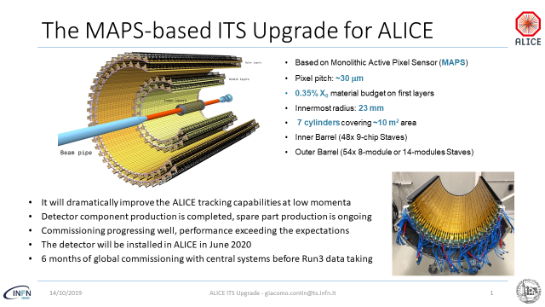
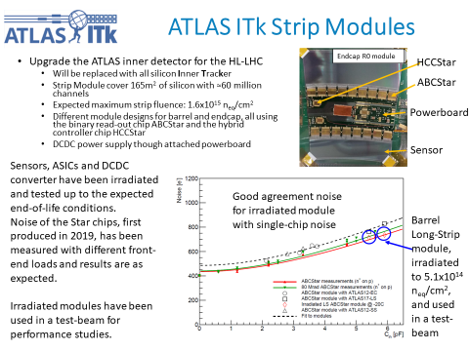
LS2 and LS3 upgrades at LHC
G. Contin/ INFN Trieste
S. Wonsak/ U. Liverpool
A. Rossi INFN/Perugia
K de Bruyn/CERN

Slide 14
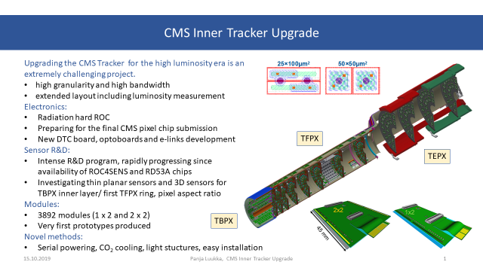
LS2 and LS3 upgrades at LHC
LS2 upgrades well on track
LS3 upgrades on progress, still several system aspects no resolved, essentially affecting the inner tracker systems (power distribution system, thermal management)
J. Pater/ U. Manchester
M.S. Rudolph/ U. Syracuse
P. Luukka/HIP Helsinki

Slide 15
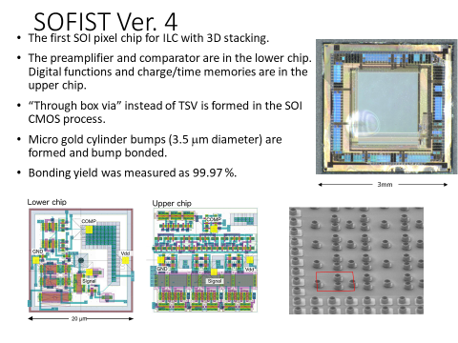
Hybridization
T. Tsuboyama/KEK
K. Nakamura/KEK

Slide 16
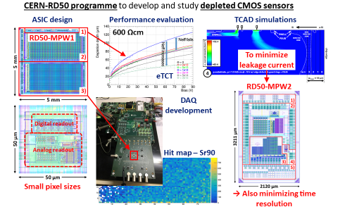
CMOS Sensors
E. Vilella Figueras/U. Liverpool
A. Schoening/U. Heiderberg
P. Moriishi Freeman/U. Birmingham
Z. Liang/IHEP Beijing

Slide 17
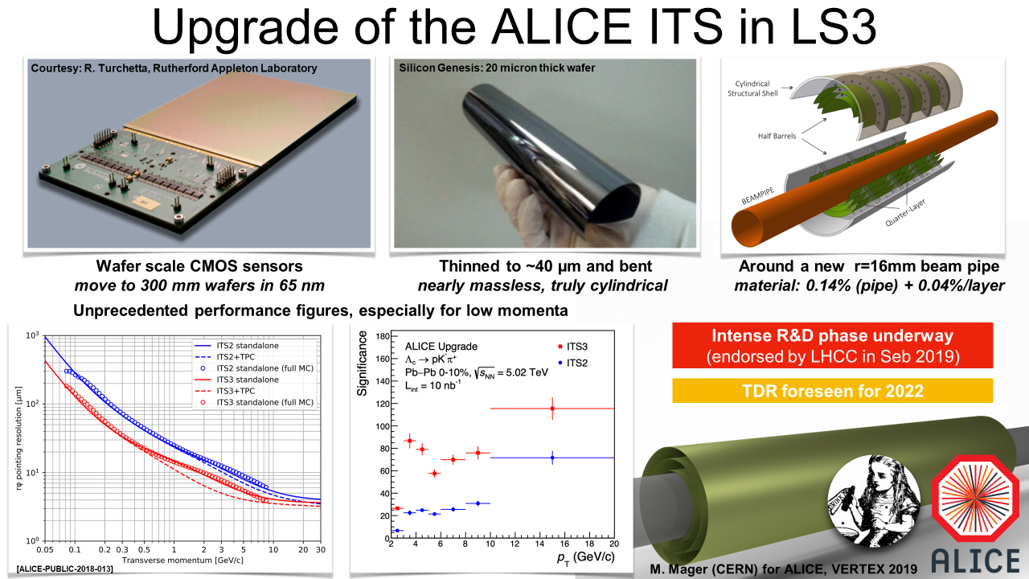
CMOS Sensors (2)
M. Dionisio Da Rocha Rolo/INFN Torino
M. Mager/CERN
Technological proof-of-concept from Tower Jazz and Lfoundry foundries.
The DMAPS sensing element (collecting diode + in-pixel front-end) reaching maturity.
Radiation tolerance for the outer tracker hadronic experiment, ion-ion and leptonic colliders demonstrated
Two approaches: Large collector electrode (high efficiency CCE, high capacitance, high power), Small collector electrode (limited, slow charge collection, low capacitance, low power)
Large sensor, stitching?, yield?, thermal dissipation optimization, ultrathin?

Slide 18
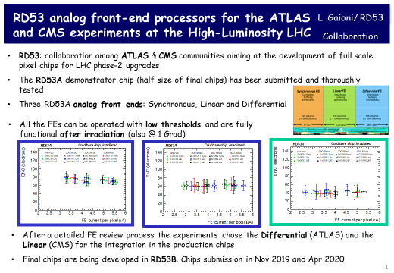
Read Out ASIC
RD53 has been the workhorse of the sensor’s RD for the LH-LHC
Excellent radiation tolerance, functional after 1GRad (fast rate, cold)
Linear FE for CMS, Differential for Atlas
Keep in mind: succeeded to perform correctly after the first submission.
CHIPS at CERN for supporting ASIC development and foundry access.
L. Gaion/ INFN Pavia
X. Llopart / CERN

Slide 19
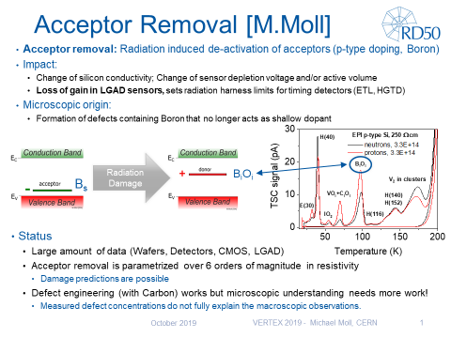
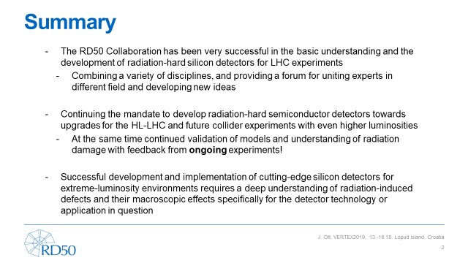
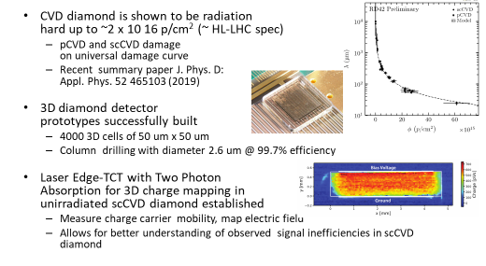
Radiation effects
RD50 and RD42 remain two very active communities.
The emergence of DMAPS open new field to explore.
TPA-TCT technology enabled brought new insight for understanding the diamond CCE.
Progressing on the modeling of radiation-induced boron de-activation.
M. Moll/CERN
J. Ott/HIP Helsinki
R. Wallny/ETH Zurich

Slide 20
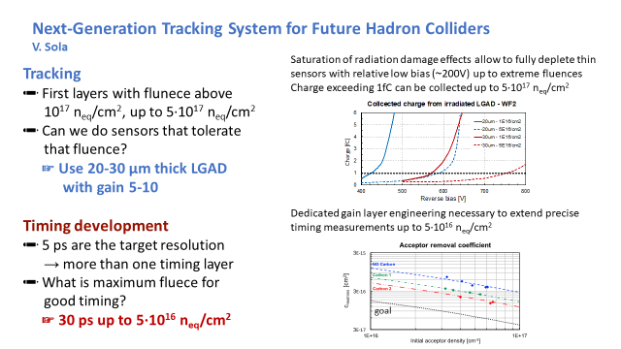
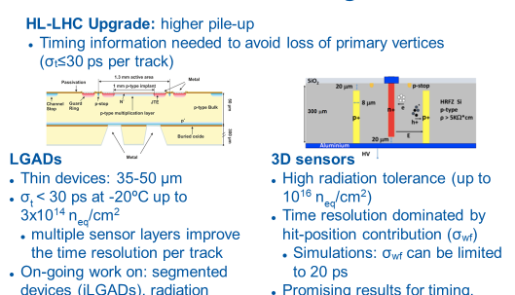
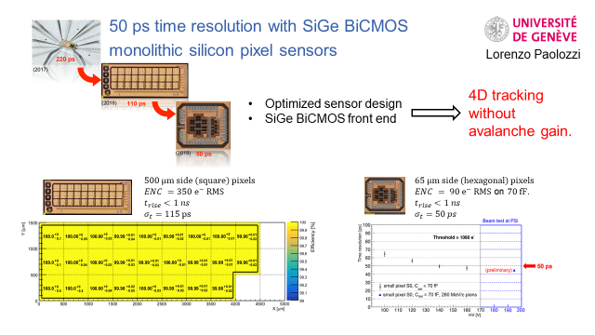
Detectors for 4D-tracking
V. Sola/Torino
S. Otero Ugobono/IMB-CNM
L.Paolozzi/U. Geneve
A. Lai/INFN Cagliari

Slide 21
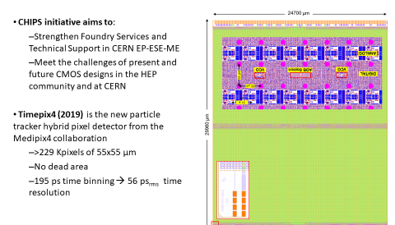
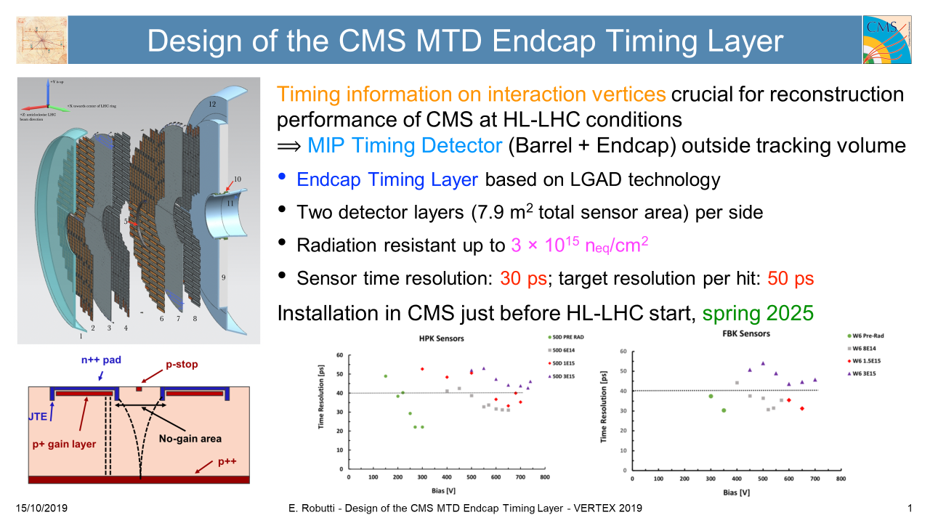
4D-tracking and MIP timing detector fro HL-LHC
Dedicated LGAD and 3D implementations for 4D tracking (fill factor, small pitch, radiation tolerance..) and Monolithic SiGe BiMOS
Timepix as hybrid electronics (Timespot electronics under design
Reliability?, Long term stability, yield ? Size scalability?
In terms of timing performance, LGAD sensors are quite there for the MIP timing detectors.
X. Llopart Cudie/CERN
E. Robutti/INFN Genova
A. Boveia/U. Ohio

Slide 22
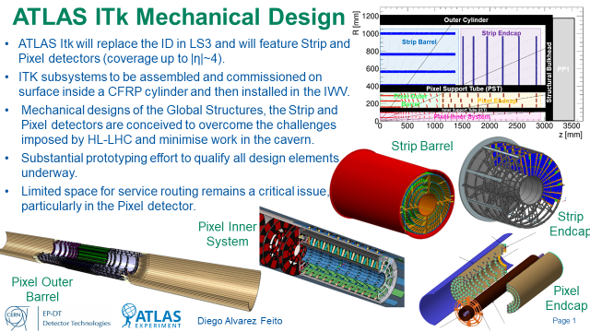
Cooling and mechanics
C. Bertella/CERN
F. Meier/PSI
Microchannel cooling becoming a mature technique to be implemented in a large scale experiment (after NA62) for large power dissipation scenarios.
Low dissipation, low mass experiments: Gas (Helium) based cooling enabling technique
Major effort in the design of the very large tracker systems to suppress the “weak” aligment modes
D. Alvarez Feito/CERN

Slide 23
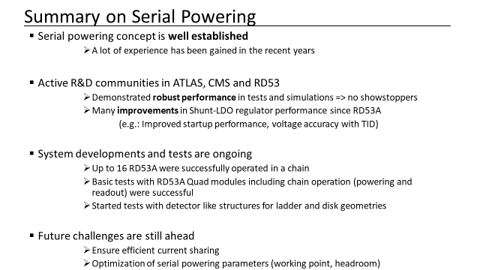
DAQ & Power systems
F. Vasey/CERN
D. Koukola/CERN
Serial powering: “the physicist dream the engineering nightmare (J.Christiansen)”
Still a long route to demonstrate the fisibility of serial powering in large systems ( huge progress in the understanding of systems aspects and testing of demonstrators).
Silicon photonics modulator possible solution for a radiation hard optical transceiver.
Piero Giubilato/INFN Padova

Slide 24
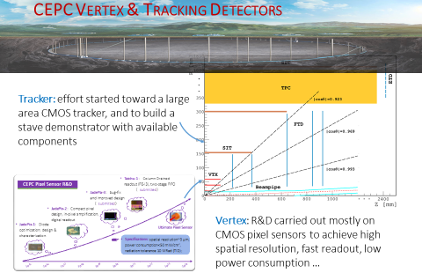
Future lepton collider experiments
S. Spannagel/CERN
M. Winter/IPHC/CNRS Strasbourg
Similar requirements in term of hit resolution, power disipation and material budget.
CLIC requires precise bunch time stamping O(ns)
Still several options under discussion (both monolithic and hybrid.
CEPC ambitious timeline (data taking 2030).
Hongbo Zhu/IHEP, Beijing

Slide 25
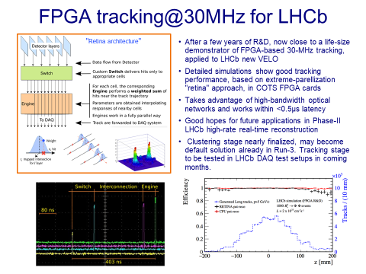
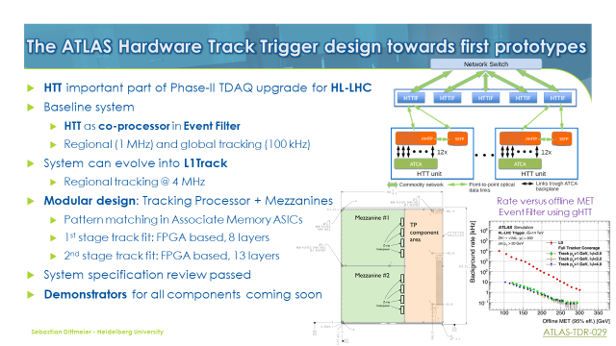
Track Trigger and real-time tracking
In a hadron collider environment the trigger system is the underdog.
For HL-LHC first level tracking system is mandatory (no other option)
Atlas (associative memory), CMS (to be decided…)
Real-time tracking for LHCb for run 3.
G. Punzi/INFN Pisa
S. Dittmeier/U. Heidelberg
F. Ravera/FERMILAB

Slide 26
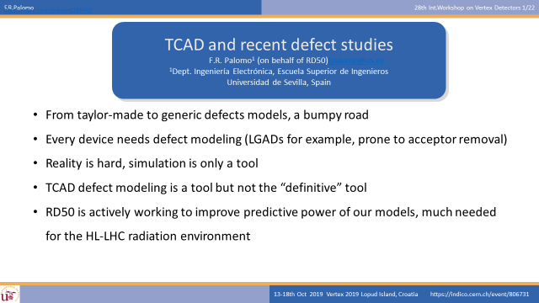
Radiation-induced defects modeling
R. Palomo Pinto/U. Sevilla
A. Morozzi/ INFN Perugia

Slide 27
Non Collider HEP
DAMIC: Lowest leakage current measured in Silicion achieved with a extremely pure Silicio pn-CCD. Sub-electron noise !!!
DAMIC: Nuclear recoil sensitivity interesting for studying the radiation damage.
Space missions with microstrip detectors.
Requirements like a HEP experiment and space mission (low power and EMI/EMC compatilibility)
Calocube (3D calorimetry)
Pixels to Space (Alpide family).
N. Castello Mor/IFCA Santander
G. Ambrosi/INFN Perugia

Slide 28
Outlook
Increasing understanding of the radiation damage on LHC detectors in terms of operational conditions driven by sensor’s bulk damage (bias and temperature) and recovery of electronic SEU driven by TID. There is a huge amount of data available to compare against models and technological simulations.
System wise, several key developments are maturing and becoming ready for LS2 and LS3: microchannel cooling, L1 track trigger architectures, serial power, high-bandwidth radiation tolerance data links. Tough still much work ahead us.
Sensor wise, the dedicated timing hybrid techniques and DCMOS are here to stay and become the workhorse of future experiments.
Ambitious and highly promising enabling technologies for ultralight detectors and fast monolithic technologies or extreme low noise were introduced for the firs time.

Slide 29
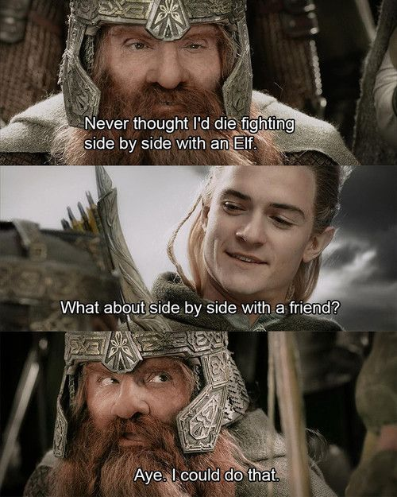
Final message
Don’t be pure, mix with other scientific races (even theorists!).
Scientific purity is as boring and useless as intrinsic Silicon.
Team play is the only path to new territories.
THANK YOU !

