Slide 1

SMB-SE
BIM Presentation
REVIT CATIA exchange
Angel Navascués

Slide 2

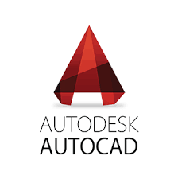

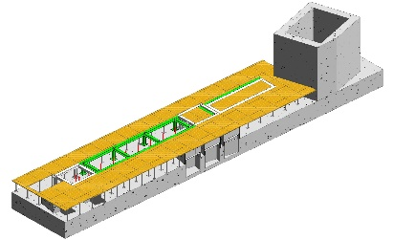
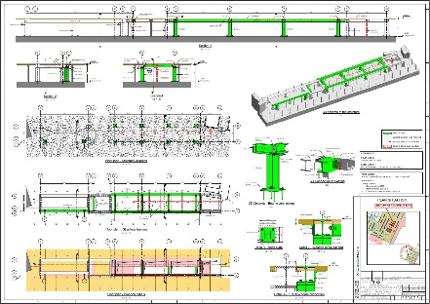
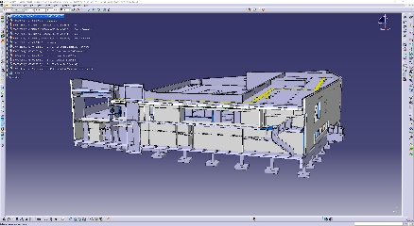
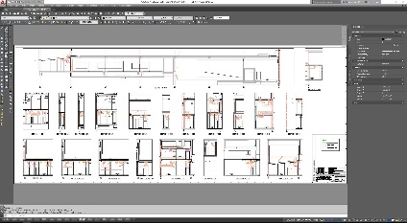


... - 2012 - 2013 - 2014 - 2015 - 2016 - 2017 - 2018 - 2019 - …
SMB-SE-TOD
SMB-SE-TOD
3D
2D
3D & 2D
How do we share our 3D models?

Slide 3
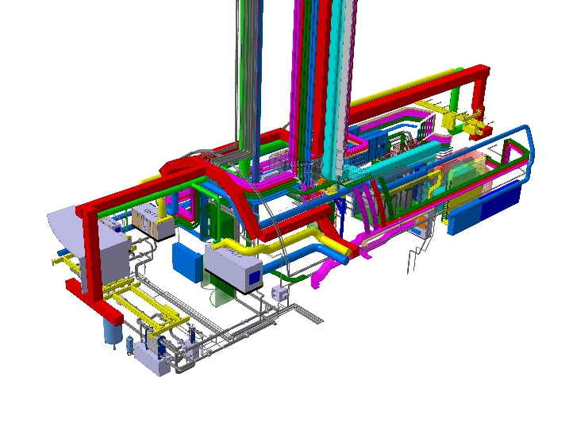




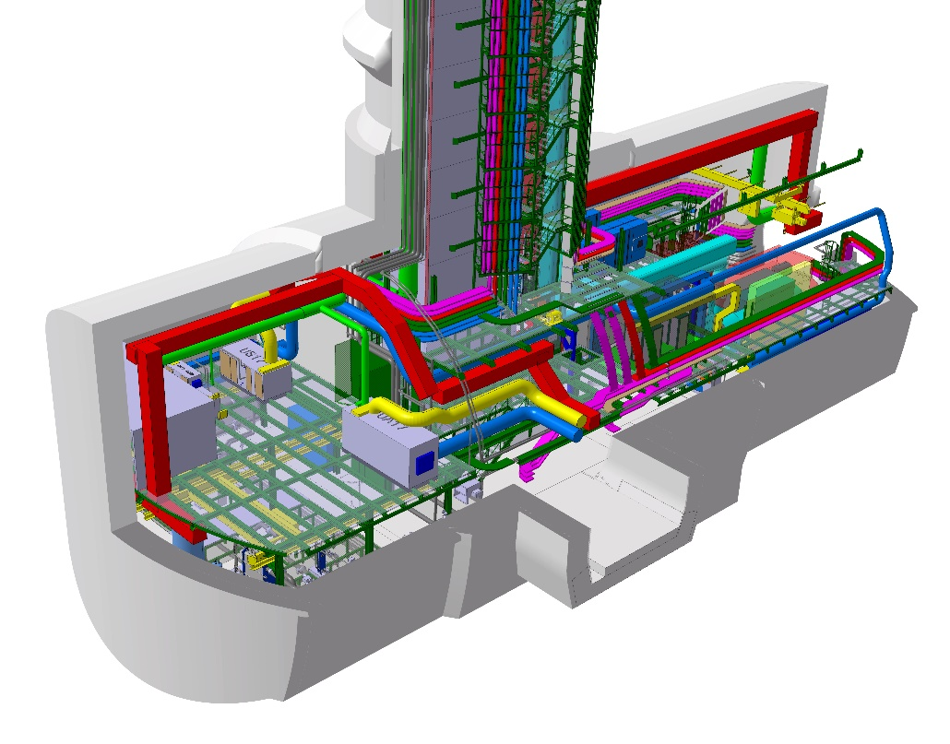



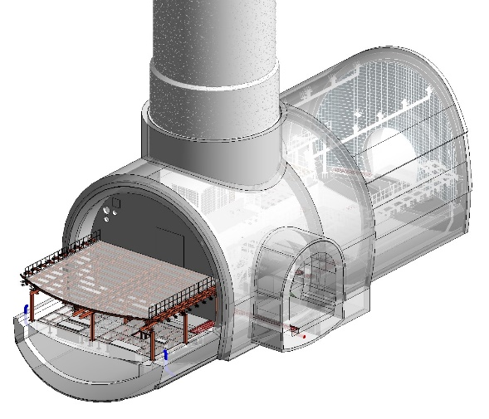





We are able to share our BIM models by storing them in a PLM software, in order to make them accessible to the rest of agents involved in the projects.
Engineering
Department
Technology
Department
Beams
Department
PLM:
…
PLM
Multicad
SMB
Department
DFS
Engineering
Department
Nowadays the exchange is still manual and with intermediate steps

Slide 4

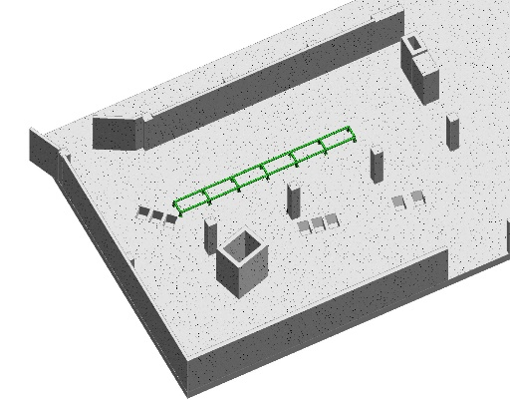
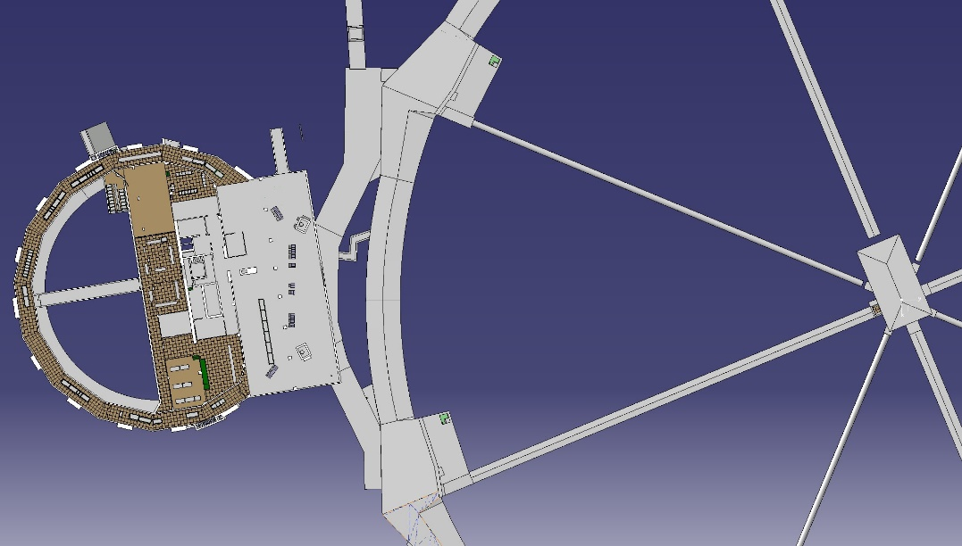
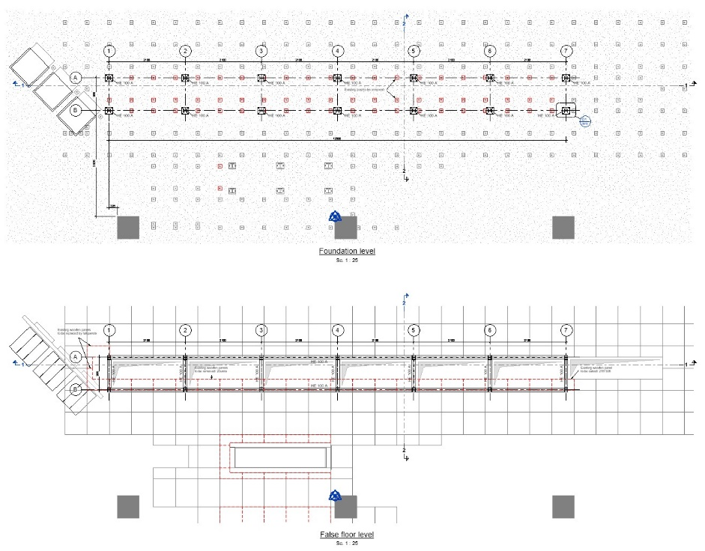

Differences between REVIT base point and CATIA local axis system.
New structure
CATIA local axis system
REVIT base point
Every time we do an exchange we must move the model, either in CATIA or in REVIT
CCS

Slide 5

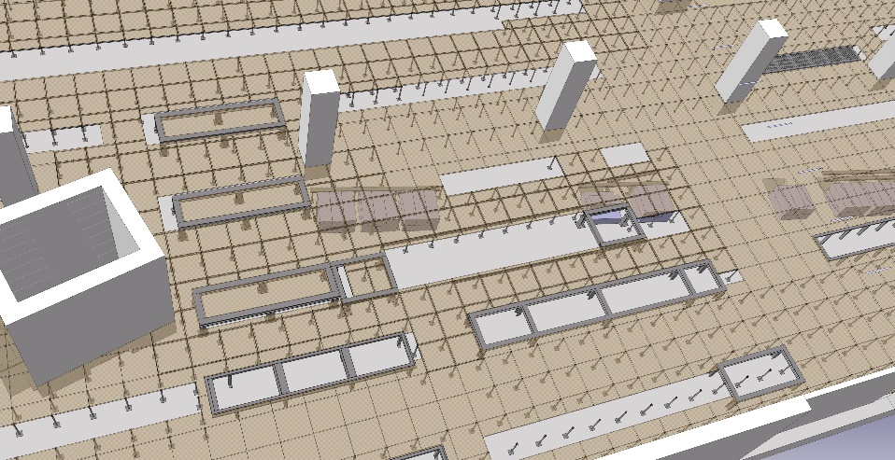
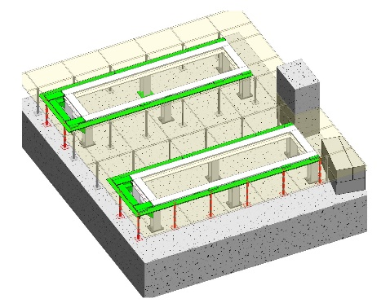
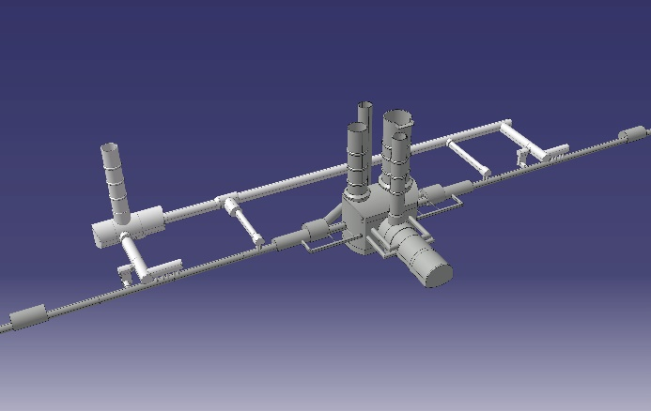
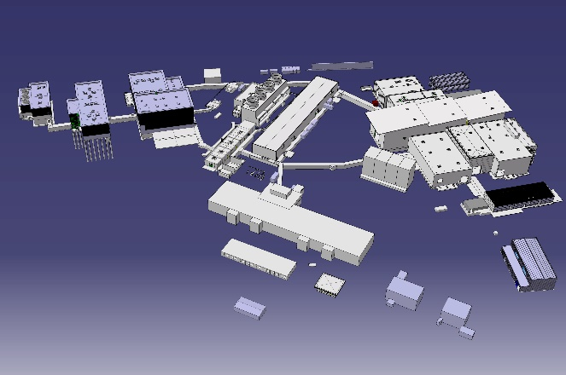
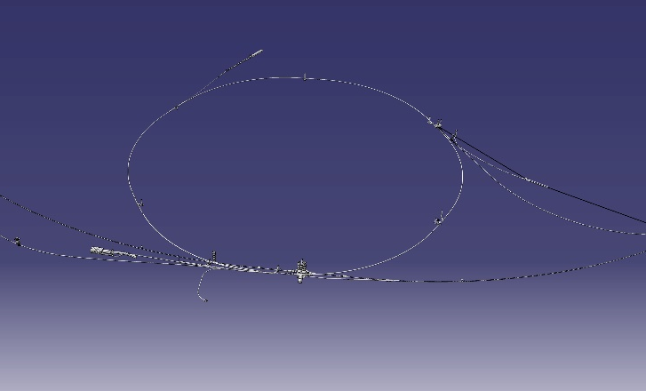
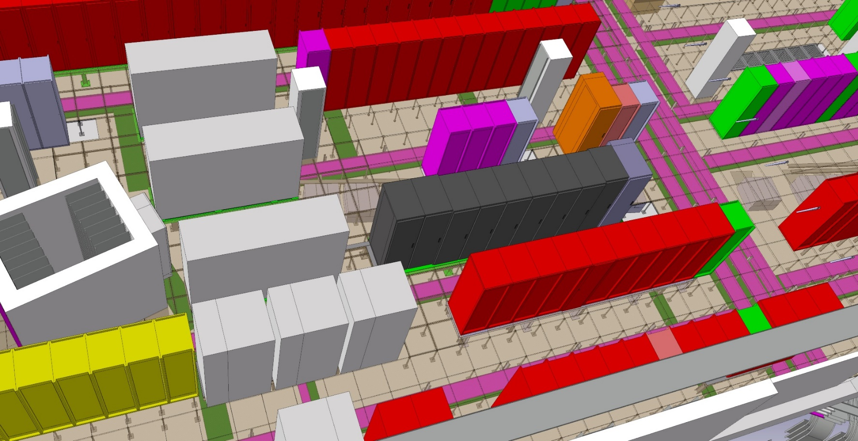


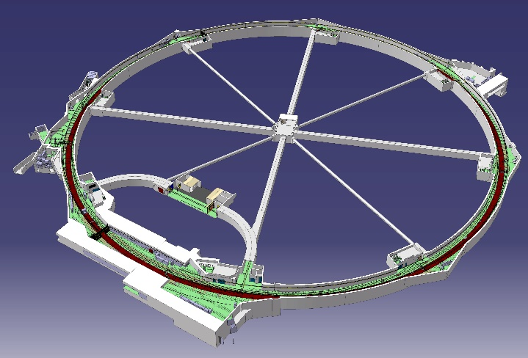
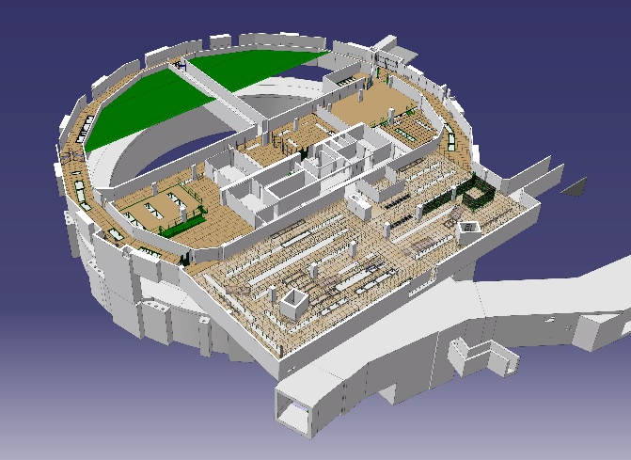
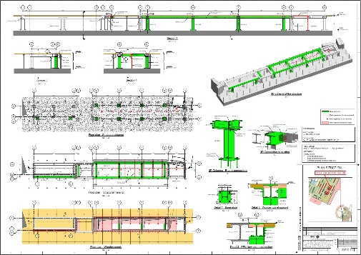
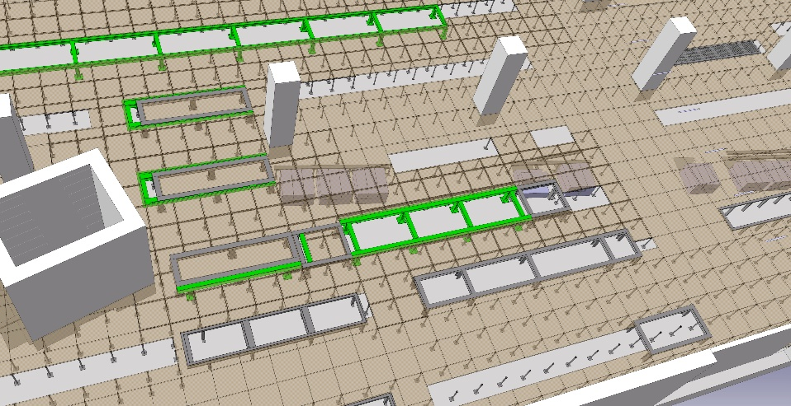

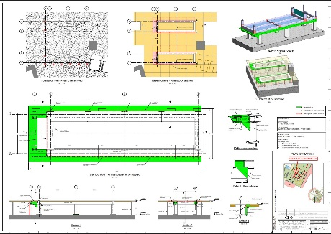
Existing CATIA models: geometry that sometimes we can use as reference for our BIM models and Drawings
LHC P1 Underground
LHC P1 Surface
SPS + Transfer lines + Awake + etc.
Sometimes this models need to be checked or redo before using in REVIT
PS
PS Booster

Slide 6

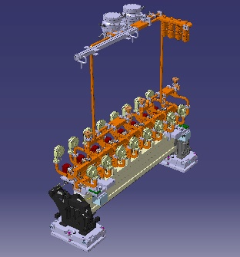
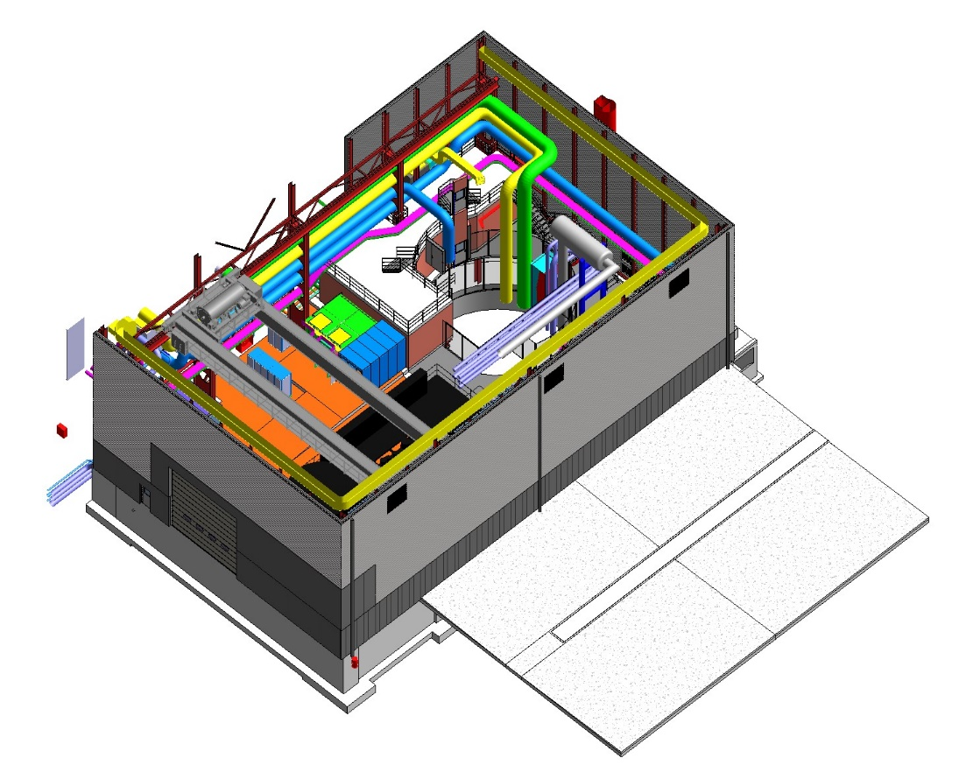
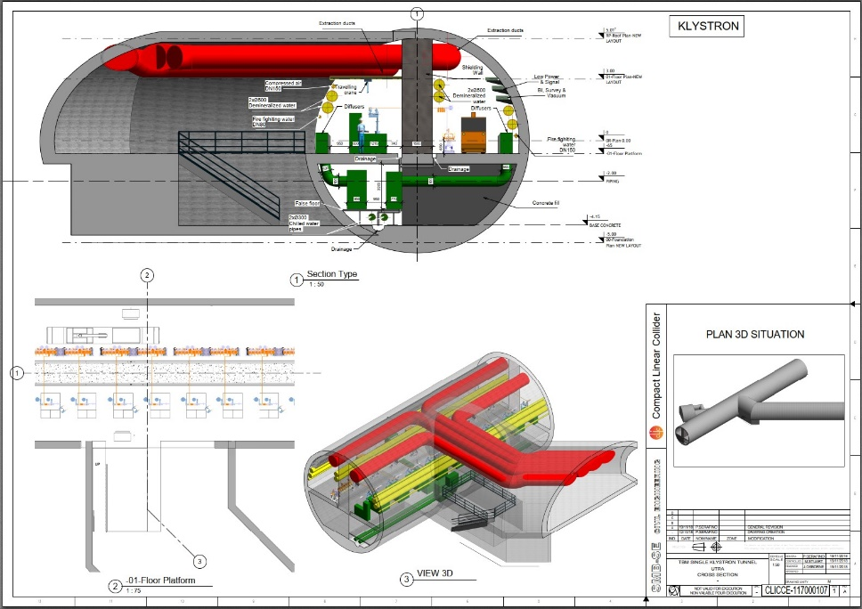
We can use models from others services in REVIT to optimize our designs, detect conflict between elements, etc.
Klystron module by BE department
EN-CV
EN-EL
EN-ACE-INT
EN-HE
SD17 Building
CLIC study drawing

Slide 7

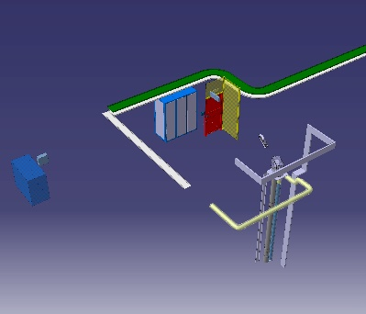
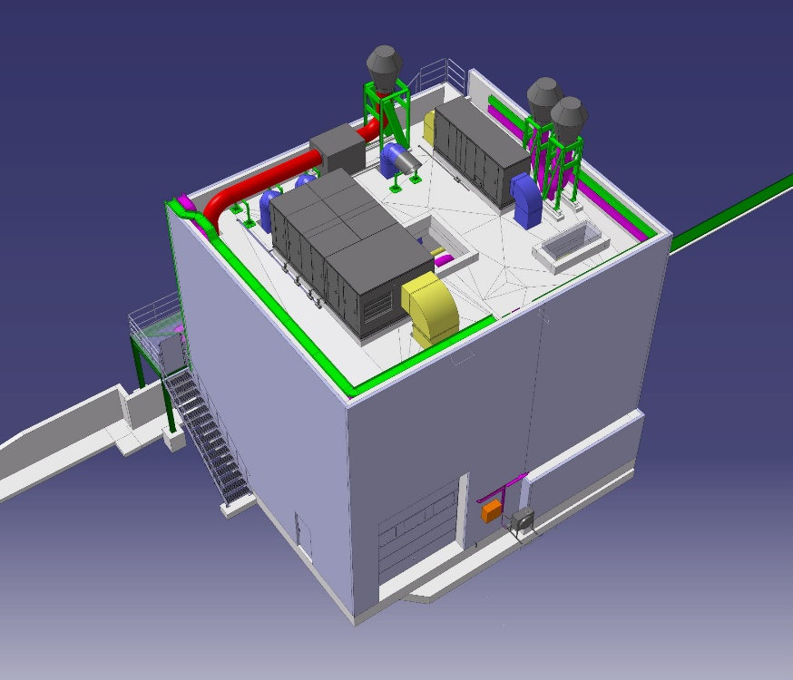
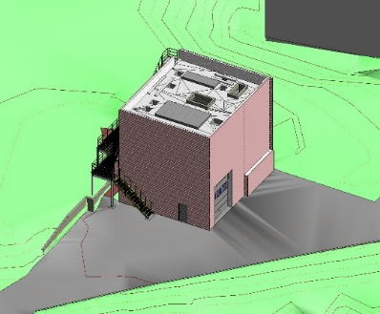

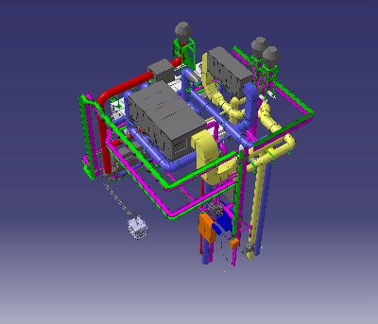

External consultants can work with BIM softwares and provide to SMB 3D models which will be shared through PLM
EN-EL model + Optics by EN
PLM
B.196 – Consultant BIM model
Coordination model by EN
Currently all is done through CATIA/Smarteam and the process is manual, but in the future:
Each discipline could use different CAD
All models will be combined in the same PLM
The coordination model could be done with a multicad software
EN-CV model

Slide 8
Thanks for your attention!

