Slide 1
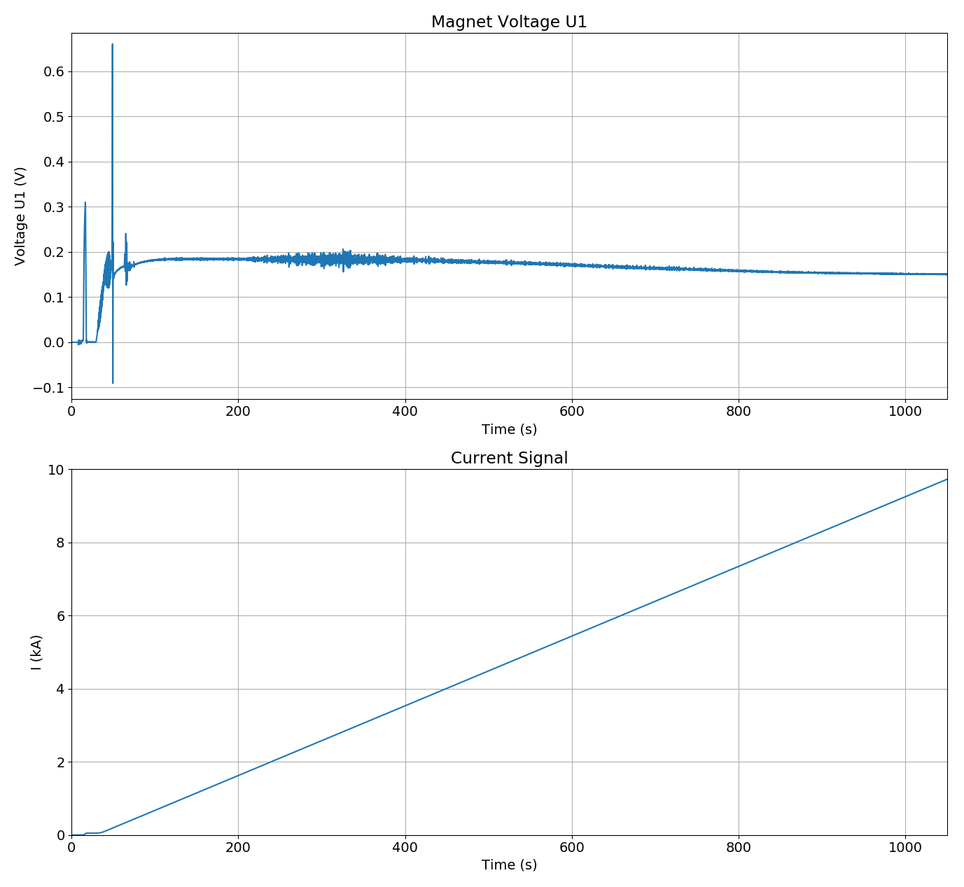
11T Quench Detection
Flux jump main region
Depending on their amplitude and width voltage perturbations created by flux jumps in the Nb₃Sn superconductor may cause false positives in quench detection system (QDS).
As magnet protection requires a rather short evaluation time of the QDS, it is not always possible to filter those type of perturbations efficiently.
Image: hybrid 11T prototype flux jumps

Slide 2
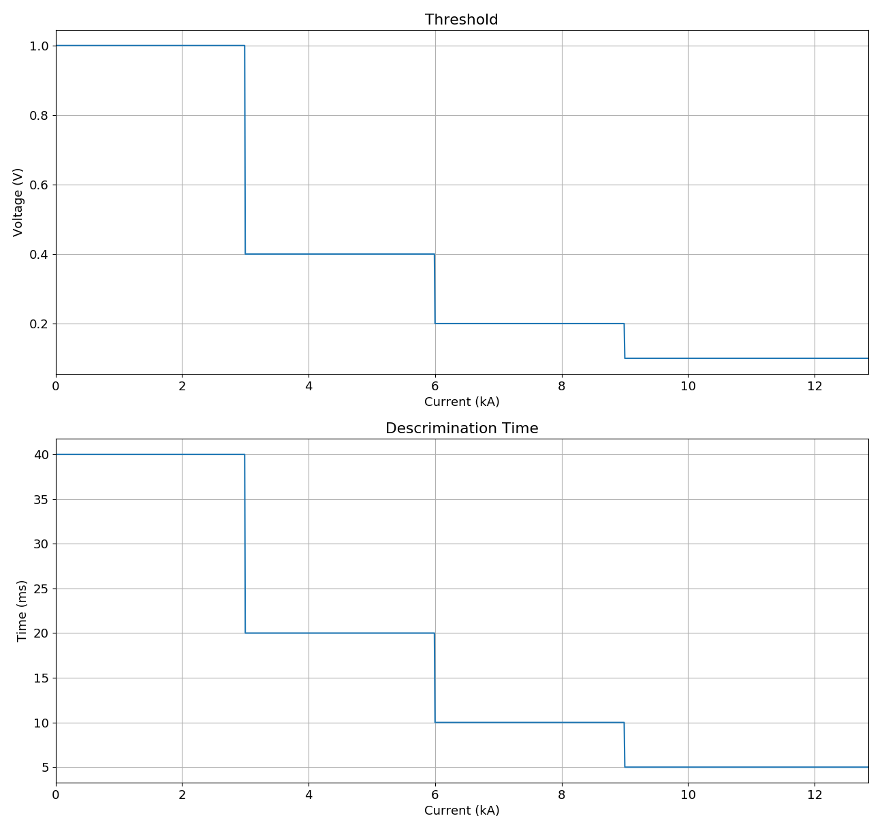
Quench Protection Enhancement
Detection settings can however relaxed at lower currents without without compromising the protection of the magnet.
Profiting from the fact that the maximum of voltage perturbations due to flux jumps occurs at low currents, the introduction of current dependent QDS settings allowed successfully to overcome the problem.
Image: example with 4 different current dependent threshold settings

