Slide 1



Update on Nb-Ti magnets power tests
E. Todesco, M. Sorbi, M. Statera, A. Musso, A. Foussat, P. Fabbricatore, S. Farinon, A. Bersani, J. Carlos Perez, M. Bajko, M. Guinchard, F. Toral, F. Mangiarotti, G. Willering
CERN 21th March 2019

Slide 2
TABLE OF CONTENTS
Test of MQSXFP1 at LASA
  (skew quadrupole corrector)
Test of MBRDS1 at CERN
  (short model recombination dipole)
Test of MCBXFBP1 at CERN
  (Prototype of short nested orbit corrector)

Slide 3

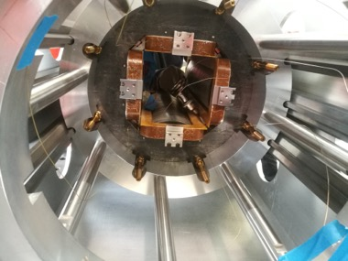
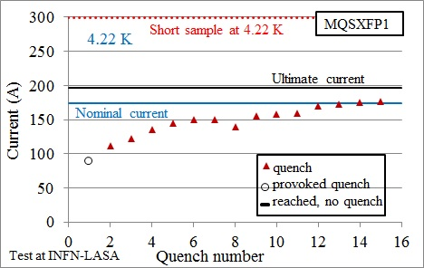
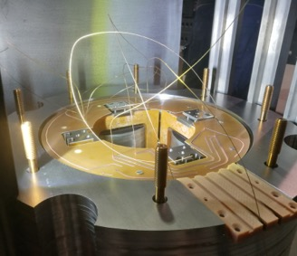
SKEW QUADRUPOLE
Test in February 2019
  Nominal reached after long training
  Short appeared after quench 17
MCQSXFP1 assembly
(M. Statera, M. Sorbi, A. Musso et al.)
Training of MQSXFP1 (M. Statera, M. Sorbi, A. Musso et al.)

Slide 4
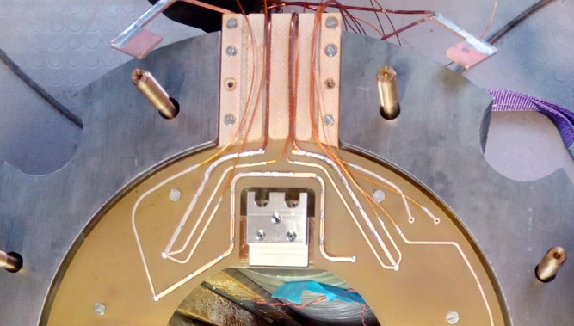
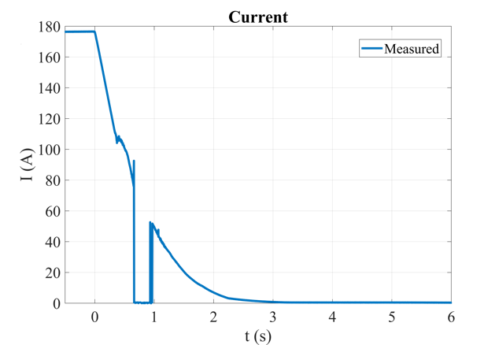
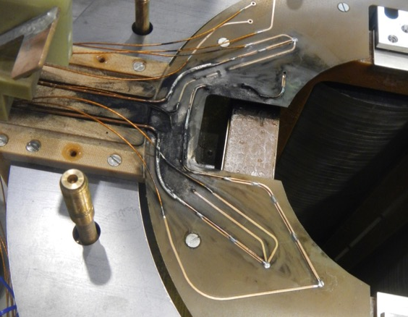
SKEW QUADRUPOLE
Damages on PCB after quench 17
  Broken paths and short circuits
Broken path
Short circuit
Current during quench 17 in MQSXFP1
(M. Statera, M. Sorbi, et al.)

Slide 5
SKEW QUADRUPOLE
Two issues possibly not correlated:
  Long training of the coils
    Quenches in different coils
  Weakness of the magnet/PCB insulation
    This lead to the short
  Analysis is ongoing – first report on March 6
  https://indico.cern.ch/event/801069/

Slide 6
TABLE OF CONTENTS
Test of MQSXFP1 at LASA
  (skew quadrupole corrector)
Test of MBRDS1 at CERN
  (short model recombination dipole)
Test of MCBXFBP1 at CERN
  (Prototype of short nested orbit corrector)

Slide 7

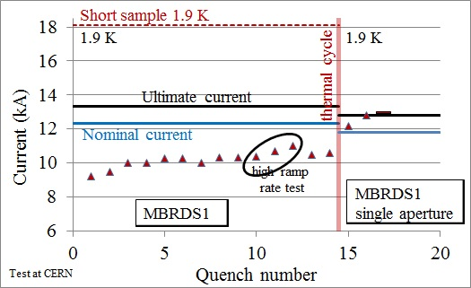
RECOMBINATION DIPOLE
Test in February 2019
  All quenches in Ap. 2, blocking the magnet performance below nominal
    Decision to deconnect the weak aperture and test again
    Incredible performance of 927/SM18 team: 7 days quench-to-quenc to disconnect one aperture
  Ultimate reached with 2 quenches
Training of MBRDS1 (F. Mangiarotti, et al.)

Slide 8
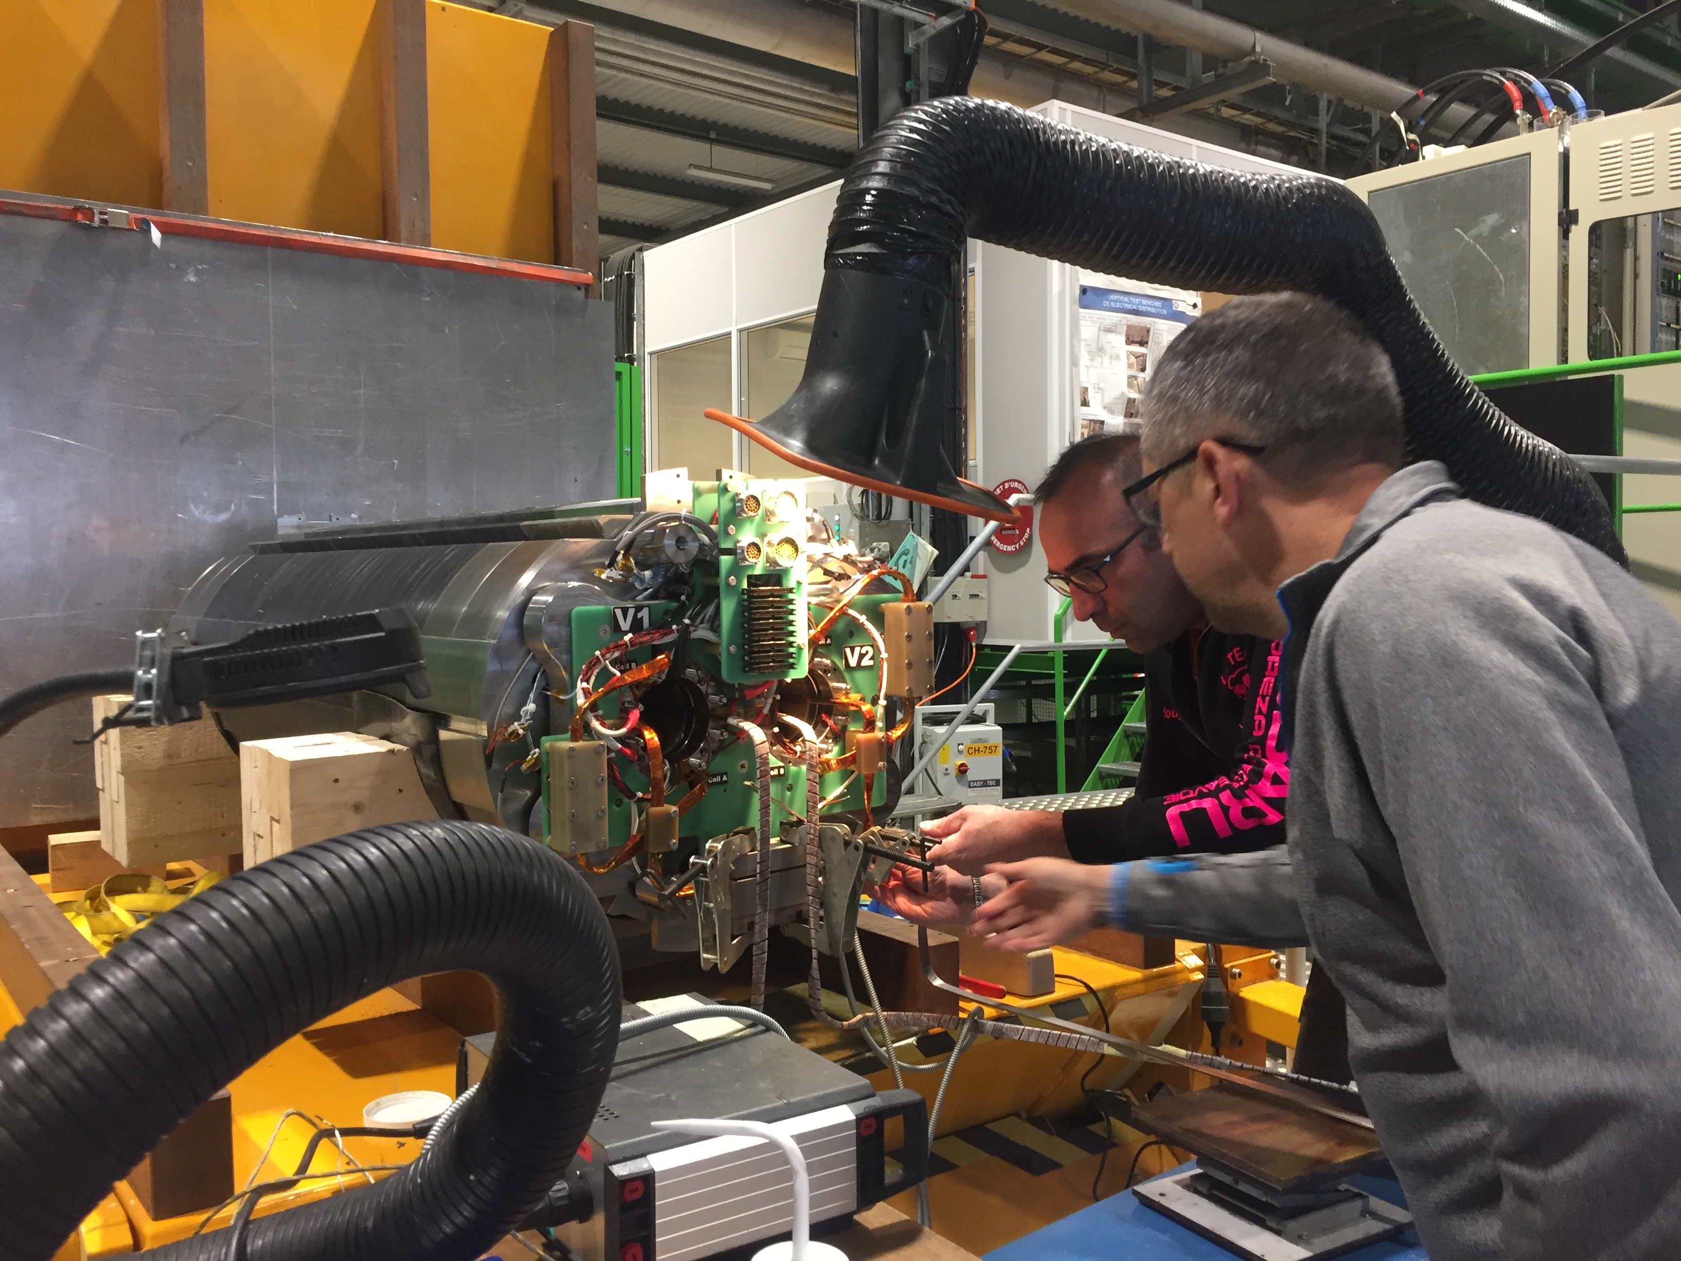
RECOMBINATION DIPOLE
Aperture disconnection in SM18 by MDT personnel
Plan: ASG is building the fifth coil
  Decollaring and coil replacement starting as soon as possible
  Tentative goal of test of repaired magnet before end of summer
  Still in time to feedback on prototype (first practice coil in November)
Disconnection of one aperture in SM18 by 927 team

Slide 9
TABLE OF CONTENTS
Test of MQSXFP1 at LASA
  (skew quadrupole corrector)
Test of MBRDS1 at CERN
  (short model recombination dipole)
Test of MCBXFBP1 at CERN
  (Prototype of short nested orbit corrector)

Slide 10
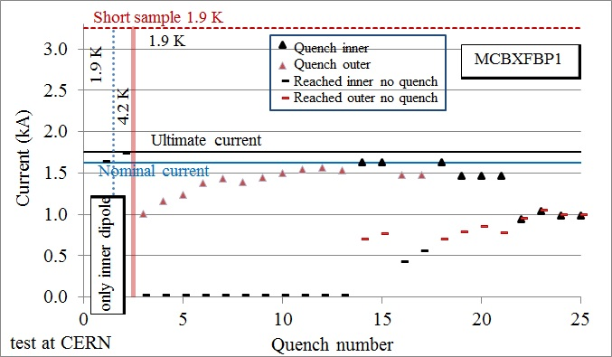
NESTED CORRECTOR
Succesful test of the inner dipole
  No quench to ultimate
Training of MCBXFBP1, inner dipole only (G. Willering, F. Toral, J. C. Perez, et al.)

Slide 11
NESTED CORRECTOR
Test of complete magnet in February
  Outer aperture long training, reached nominal with inner at zero current
Training of MCBXFBP1 (G. Willering, F. Toral, J. C. Perez, et al.)

Slide 12
NESTED CORRECTOR
Test of complete magnet in February
  Then we powered both, but we are blocked at about half of the torque B_{inner}×B_{outer} (see next slide)
Training of MCBXFBP1 (G. Willering, F Toral, J. C. Perez, et al.)

Slide 13
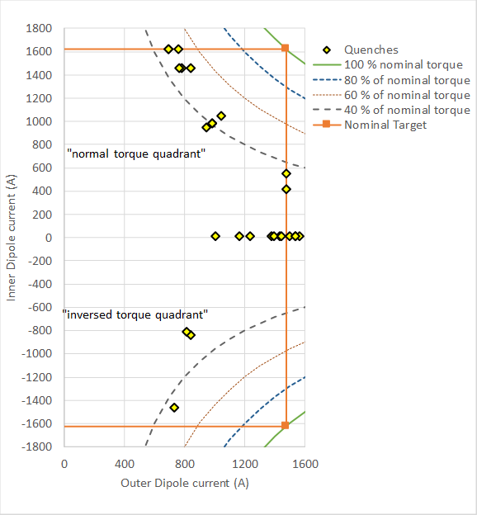
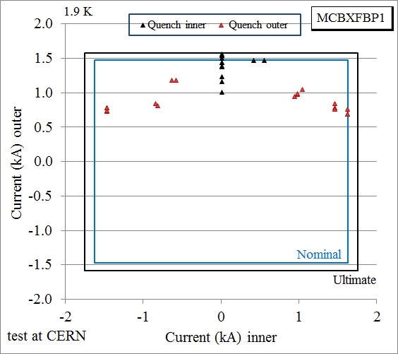
NESTED CORRECTOR
Test of complete magnet in February
  We explored positive and negative currents in the inner dipole
Asynchronous view of training of MCBXFBP1 (two views of the same data
(G. Willering, F. Toral, J. C. Perez, et al.)

Slide 14
NESTED CORRECTOR
Hypothesis: limit is the torque, limit is in the coil heads (not locked)
  Action: warm up, reducing axial stress and check behaviour
  Then iteration on the design to cure the problem

