Slide 1
Powering accuracy specification for all power converter types
D. Gamba, S. Kostoglou, M.Hofer, J. Coello De Portugal, R. De Maria,
M. Giovannozzi, R. Tomas Garcia, M. Cerqueira Bastos, M. Martino,
… and many other colleagues from different WPs
71st HL-LHC TCC Meeting – 21/03/2019

Slide 2
Outline and References
Available PC and their low frequency specifications (as of 2019)
Allocation in HL-LHC main circuits
Additional questions being addressed (2019 w.r.t. 2017):
  Can the HL-LHC 120A PCs be classified as class 4 (instead of 3), as the LHC ones?
  Can the HL-LHC RQSX circuits be powered by a 600A PC?
    instead of 200A -> i.e. 3 times more “noisy”
  Can the HL-LHC RTB8 circuit be powered by a 600A PC?
    instead of 300A -> i.e. 2 times more “noisy”
  Do we need to create a new class “1-2” for HL-LHC 2kA?
  Can we replace “remote” by “on request” PC calibrations?
  Can the HL-LHC RD(1/2) circuits be powered by a 14 kA PC?
    Instead of 13 kA previously specified, i.e. ~8% more noisy?
Still work in progress on “high frequency” part
Main references:
WP2 original document CERN-ACC-2017-0101
WP2 amendment CERN-ACC-2019-0030 (being finalised)
New PC specifications by EPC: EDMS #2048827

Slide 3
Available PC in HL-LHC era
Many PC types
  depending on PC internal components (mainly ADC, DCCT), FGC platform, PC assembly, rack configuration
Can be categorized in a few “classes” with similar performance
PC class | PC type | Configuration ADC | DCCT type
0 | (UR) – 18kA IT, 14kA D1 & D2 | FGC3.2 + EXT ADC + AIRCON RACK | D0
1 | (UA) – 13kA MDQ | FGC2.1 + EXT ADC + AIRCON RACK | D1
2 | (UR) – 2kA HL-LHC | FGC3.2 + EXT ADC | D2
2 | (UA) – 4-7kA Kempower | FGC2.1+ INTERNAL ADC + TC COMP | D2
2 | (RR) – 4-7kA R2E | FGCLITE + INTERNAL ADC + TC COMP | D2
3 | (UA) – 600A LHC | FGC2.1 + INTERNAL ADC + TC COMP | D3
3 | (UR) – 600A HL-LHC | FGC3.2 + INTERNAL ADC | D3
3 | (RR) – 600A R2E | FGCLITE + INTERNAL ADC + TC COMP | D3
4 | (ULs, RRs) – 120A HL-LHC, R2E | FGCLITE + INTERNAL ADC + TC COMP | D4
4 | (UA) – 120A LHC | FGC2.1 + INTERNAL ADC + TC COMP | D4
4 | (Tunnel) – 60A R2E | FGCLITE + INTERNAL ADC | D4
4 | (UR) – 60A HL-LHC (Q1a trim) | FGC3.2 + INTERNAL ADC | D4
From M. Bastos - Power converter specification – 137th WP2 Meeting (indico)

Slide 4
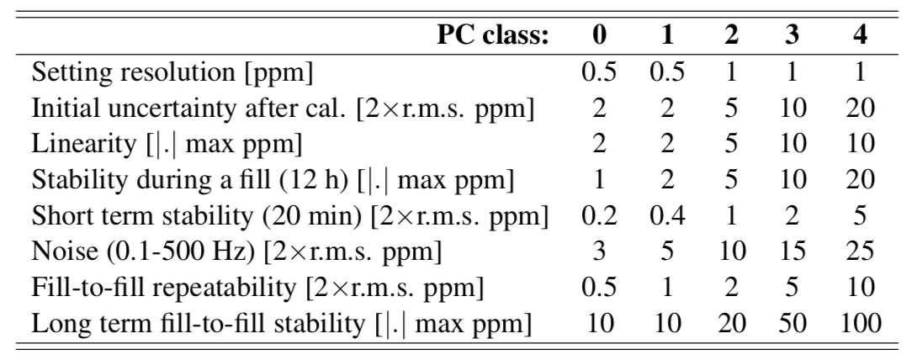
Definitions and PC classes (2017)
7 TeV
I_{ultimate} := 1.08 I_{nom}
|I_{actual} - I_{requested}| in steady condition between I_{min} and I_{max}
All values given in ppm w.r.t. I_{rated}
Quasi-monotonic, dominated by thermal effects and 1/f noise
Important for optics correction
Coefficients OUTDATED - see next slide
Figure of merit of PC only.
Impact on physics under study
2*r.m.s over 10 consecutive fills
- Yearly figure, dominated by ageing of control electronics.
- It can be reduced by means of dedicated calibrations during the year (eventually via a remote calibration system, if available)
New class only available in HL-LHC
Table 6 in the note CERN-ACC-2017-0101

Slide 5
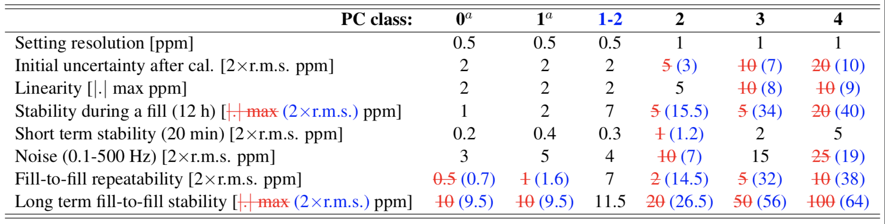
New (2019) specifications (w.r.t. old (2017) ones)
(Note: 2017 version already different than 2016 TDR – ECR will be issued)
New class
2019 takes into account better estimate of ambient temperature variation at the location where PC are typically installed
  Main differences are for higher class number and long term performance
Introduced a new possible PC class (1-2)
  Is a class 2 PC with a different ADC module.
  Significant additional cost (about 200 kCHF more in total) if we “buy” it!
Reminder: all values (but “Noise”) are for f < 0.1 Hz
  At higher frequency the PC works in voltage-regulation

Slide 6
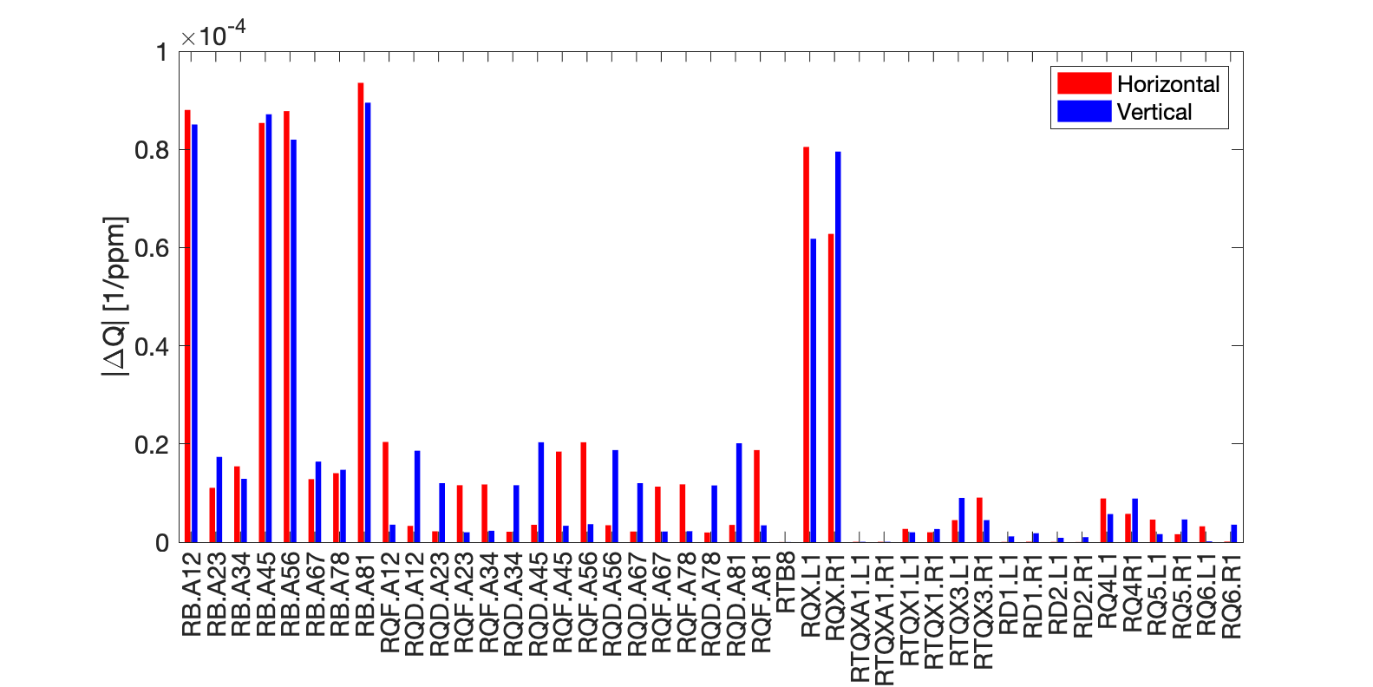
Optics sensitivity (β* = 15 cm)
Choice of PC classes is dominated by tune stability
  Main triplet circuits have dominant effect
  “ATS” arc dipoles are as important as triplet in IR1/5
Orbit stability also considered – not a dominant effect (see backup slides)
Proposed class 0
To be considered for class 0 upgrade!
Class 1-2 possible
Class 1 – no upgrade
Class 2
no upgrade

Slide 7
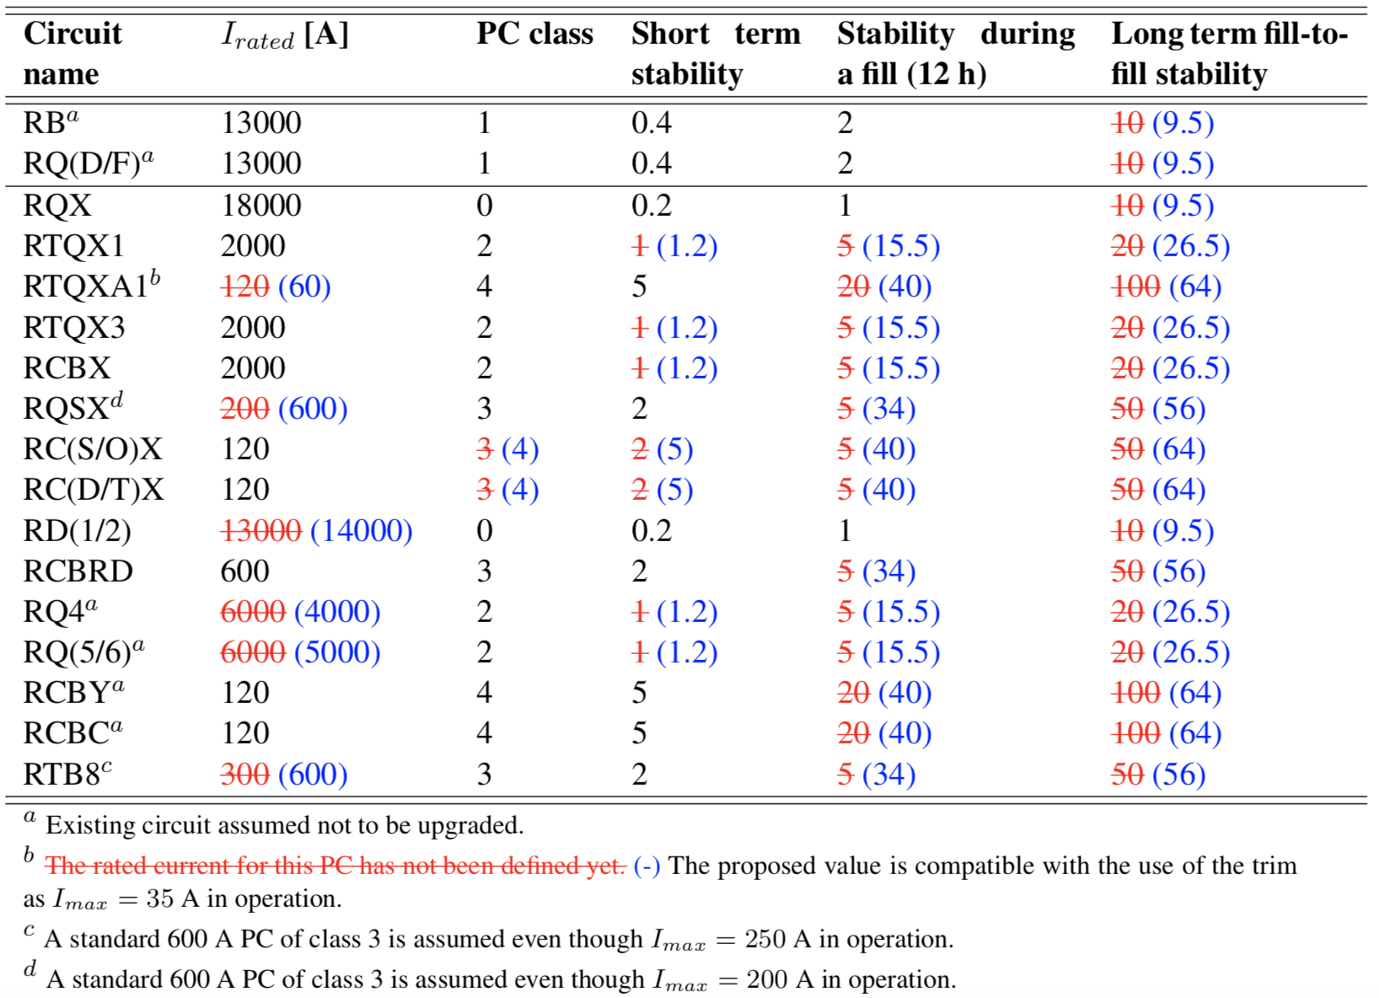
Main parameters for each (main) circuit (2017 vs 2019)
All values specified in 2 x ppm r.m.s. of I_{rated}
In 2017 given as
|.| max

Slide 8
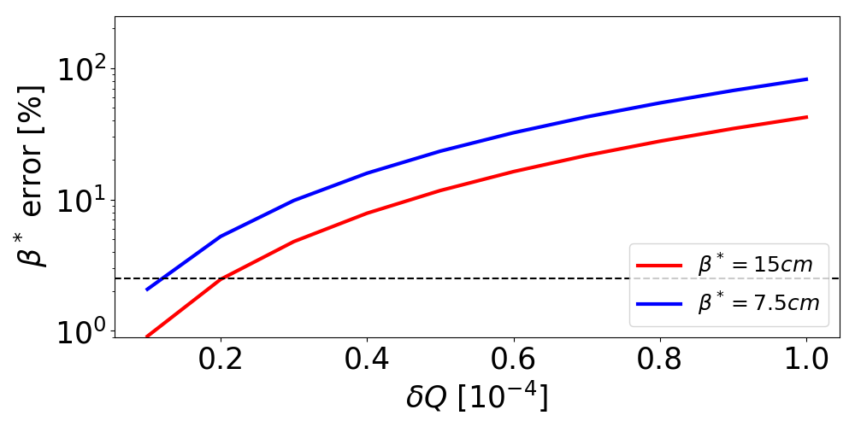
Expected tune stability and β* control
Round optics
(w or w/o class 1-2 PCs)
(2017 or 2019 specs)
Flat
optics
Round (ATS arc upgraded)
Target (round)
5% CMS/ATLAS luminosity imbalance
Presently not yet on target for β* control
  For flat optics (not baseline) things even more difficult
  No difference 2017-2019 specs and no need for class 1-2 PCs
  Update of ATS arc dipole PCs still our highest level arm
  Also working on optics correction strategy
  Also investigating if other dominant jitter sources are present
β* control study from M.Hofer et al. K-Modulation for […] - IPAC2019 – in preparation

Slide 9
Impact over long time scale
Over 1 year time scale (w/o mid-year calib. of any PC)
  ~1e-3 tune r.m.s. variation;
  <1% β* r.m.s. variation;
  <10%σ_{beam} IP orbit r.m.s. variation;
  All values in the shadow of other effects
No need of a remote calibration system for class 0 PCs
  Still want to maintain the possibility for dedicated manual verification/calibration during technical stop if found out necessary.

Slide 10
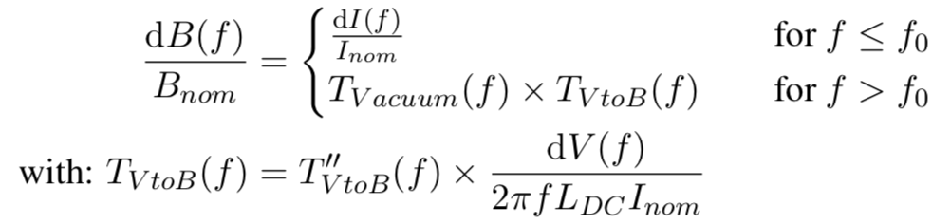
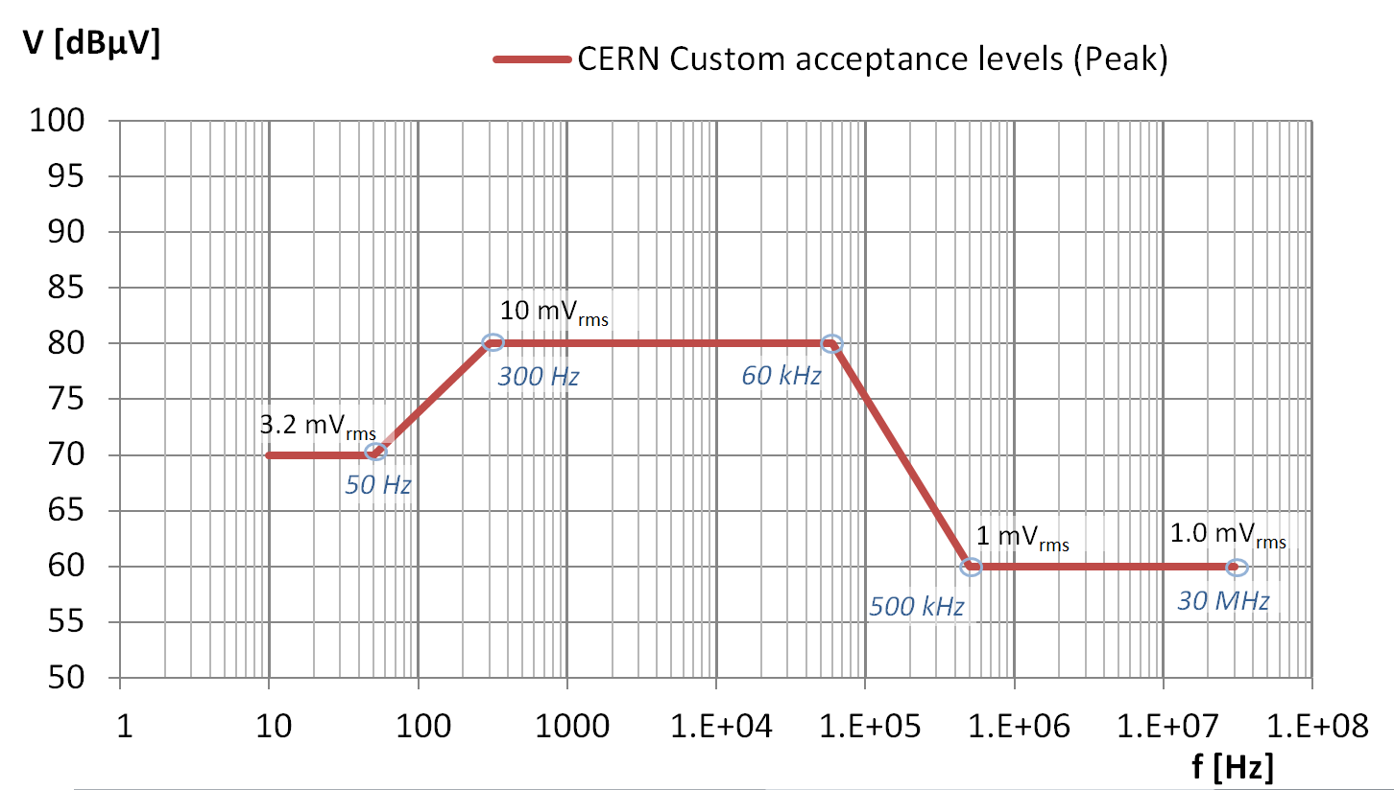
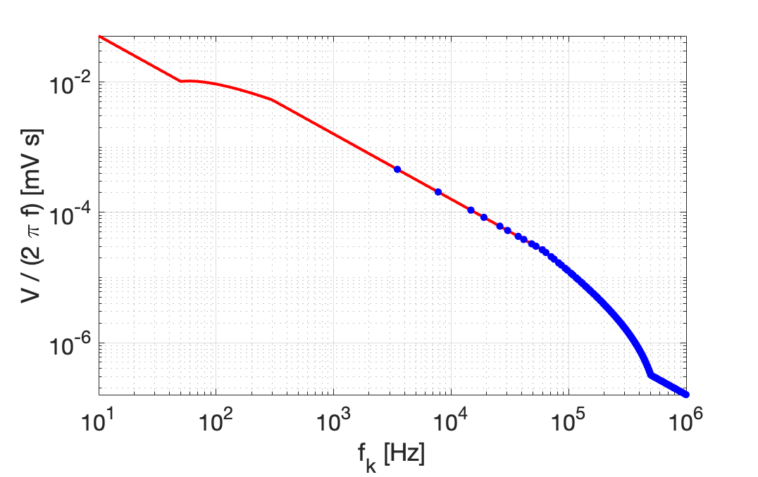
Still work in progress: Voltage ripple
It could decrease with frequency!
-> less damping
Vacuum/Beam Screen have damping effect
First “dangerous” betratron frequencies
~ covered by “Noise” spec.
+ sidebands depending on working point and actual ripple spectra
No accurate information between 0.1 and 10 Hz
  No tones expected in this region. Discussion with EPC to use “Noise” as a first guess.
At high f Gabarit only gives acceptance levels - only a few lines expected
  Actual PC Voltage spectrum and its damping due to Inductance and Beam Screen
  still under investigation/discussion
Notes:
Note: T’’ is NOT second time derivative of T_{VtoB}
f = (Q+n)f_{rev}

Slide 11
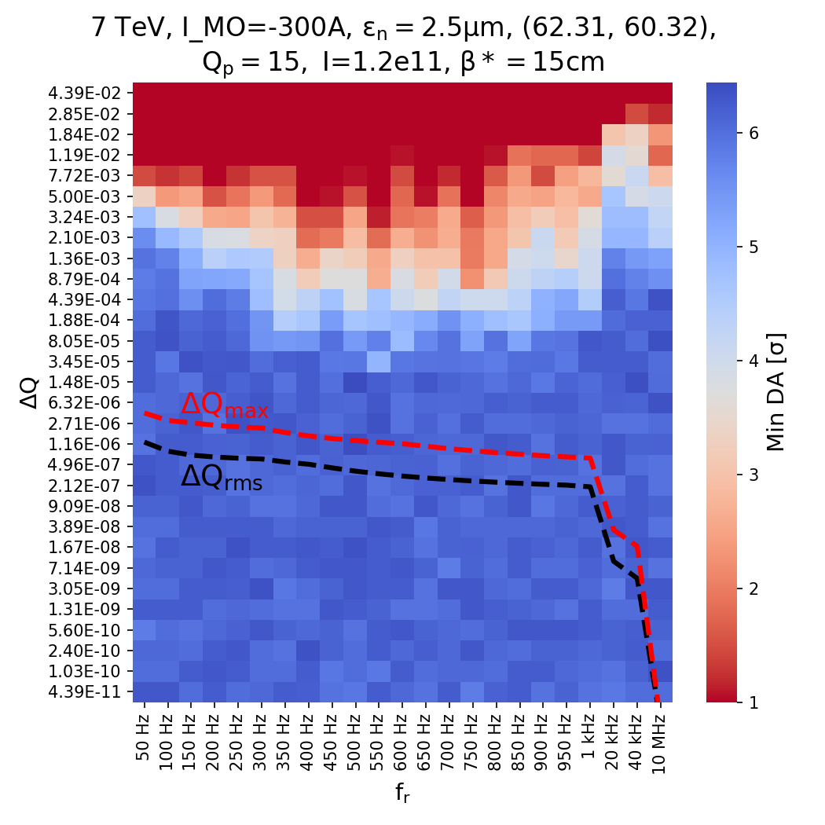
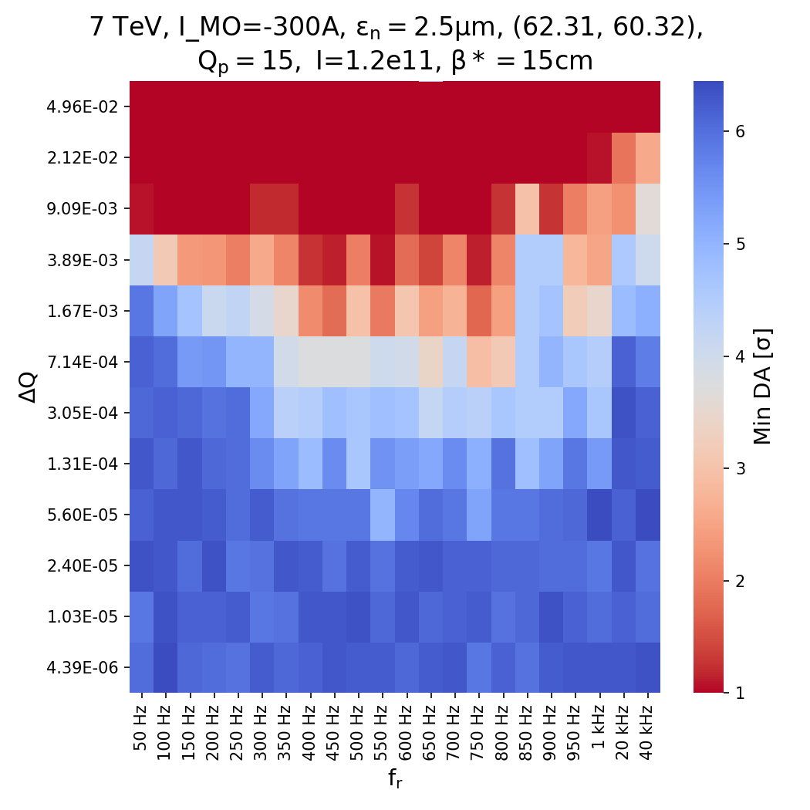
Work in progress: Dynamic Aperture studies at high frequencies
Impact of single frequency tune jitter on DA
Similar results as LHC where no impact observed
At this stage, not warring
  But more info needed!
Computed from Gabarit
w/o L(f) / BS considerations
With CC (no major difference)
Without CC
Similar study for dipolar kick from main dipoles ongoing
  More complex problem, observed in LHC – see S.Kostoglou – 63rd TCC
From S. Kostoglou et al. Effect of Tune modulation […] - IPAC2019 – in preparation

Slide 12
Conclusions
PC class specifications and choices for HL-LHC allow for:
Over 20 min time scale: 4e-5 tune jitter; <1% σ_{beam} IP orbit jitter
  Not yet at target for optics control (>5% ATLAS/CMS lumi imbalance)
    Working on optics correction strategy and tooling
    Option of upgrading ATS arc dipole PCs to class 0 still our (WP2) main handle
    Under investigation if there are other dominant sources of tune noise
    A possible flat optics is even more challenging
  No major impact on orbit stability
  2019 specs have minor impact on optics w.r.t. 2017 specs
  No sizable improvement from adopting class 1-2 -> we can drop this PC class
Over one year: minor impact on beam, even w/o calibration
  No need of a remote calibration system for class 0 PCs
Specs. in 0.1 – a few Hz range still to be clarified
  Present estimate using “Noise” information do not show issues
In kHz range DA studies so far do not show issues
    Single line analysis only
    Realistic actual B field spectra needed for a final verification
-- Thanks for your time and comments --

Slide 13
Backup

Slide 14
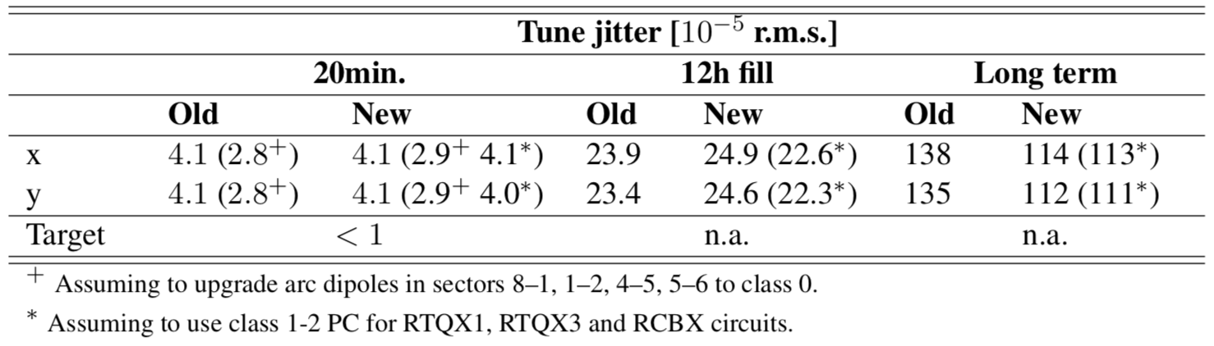
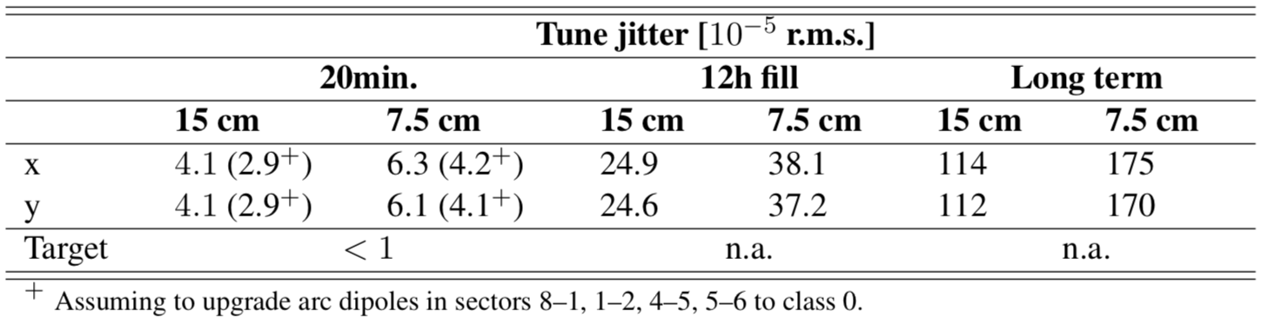
Expected tune stability
Class 1-2 on new 2kA PCs
Old specifications vs. new specifications (15cm beta*):
Class 0 on ATS arc dipoles
New specifications. Round (15 cm) vs Flat (7.5-18cm)
”Far” from target…
Order 10⁻³ over one year

Slide 15
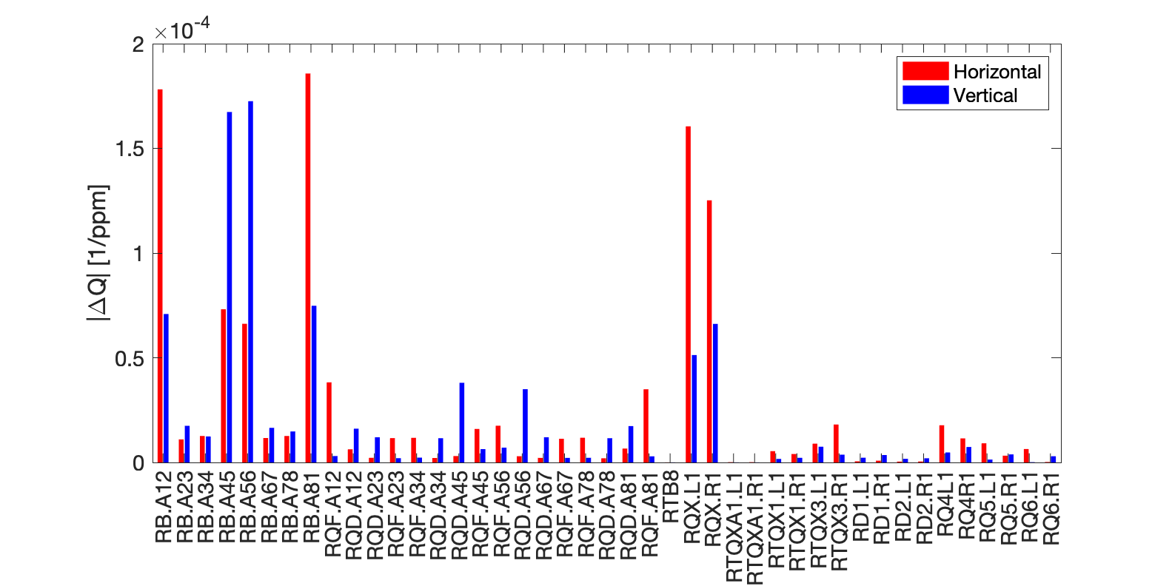
Round vs Flat
Proposed class 0
HL-LHC 1.3 baseline optics
Beta* = 15cm
“ATS” arcs as important as triplet in IR1/5
Class 1-2 possible
Class 1 – no upgrade
Class 2
no upgrade
HL-LHC 1.3 flat optics
Beta* = 7.5-18cm
Clearly asymmetric due to asymmetric betas
  (IR5 H = IR1 V and vice versa)

Slide 16
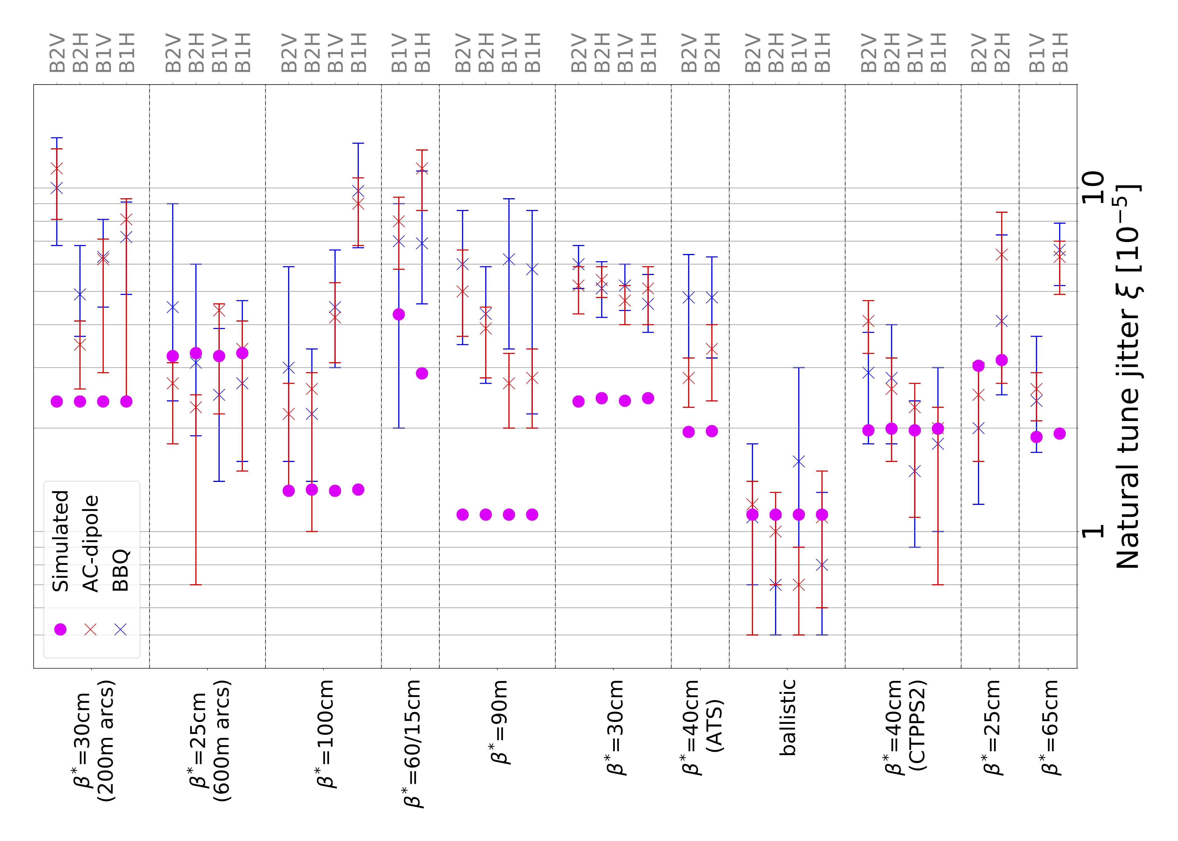
LHC experience: how far are we from PC noise limit?
Simulations seems to be consistent or even optimistic with respect to observed tune jitter in LHC for various optics.
  More studies ongoing to find additional sources of tune jitter.
From F. Carlier et al. - LHC Run 2 Optics […] - IPAC2019 – in preparation
and Wolf, Dominik Werner - Analysis of tune modulations in the LHC - link

Slide 17
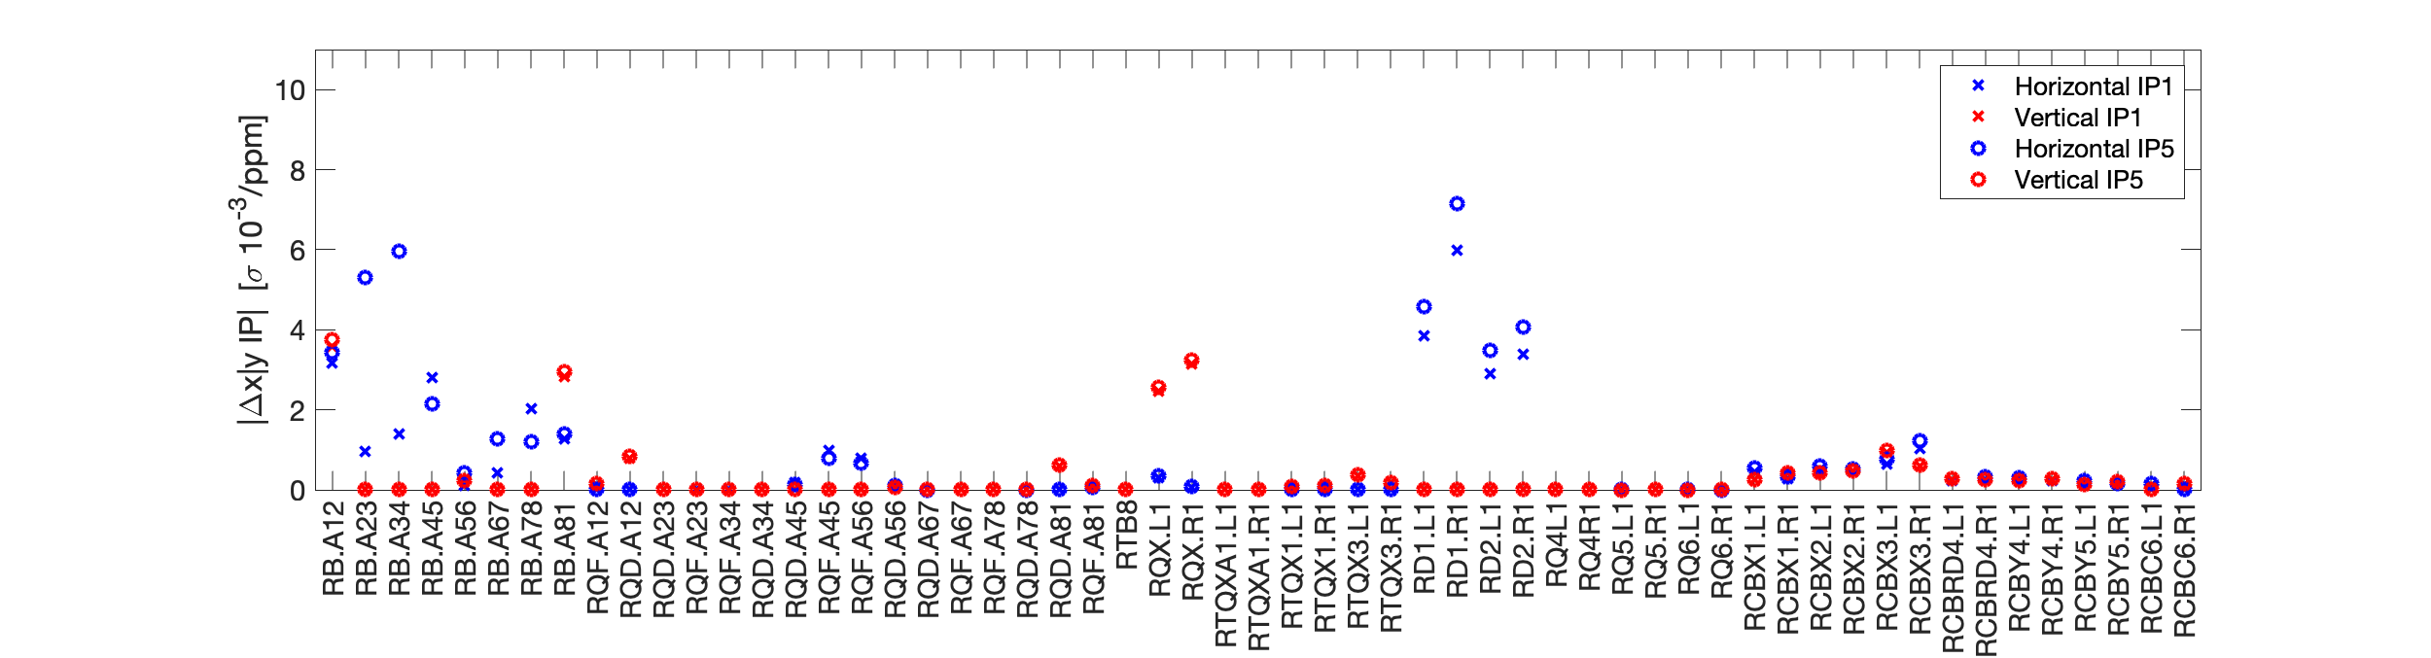
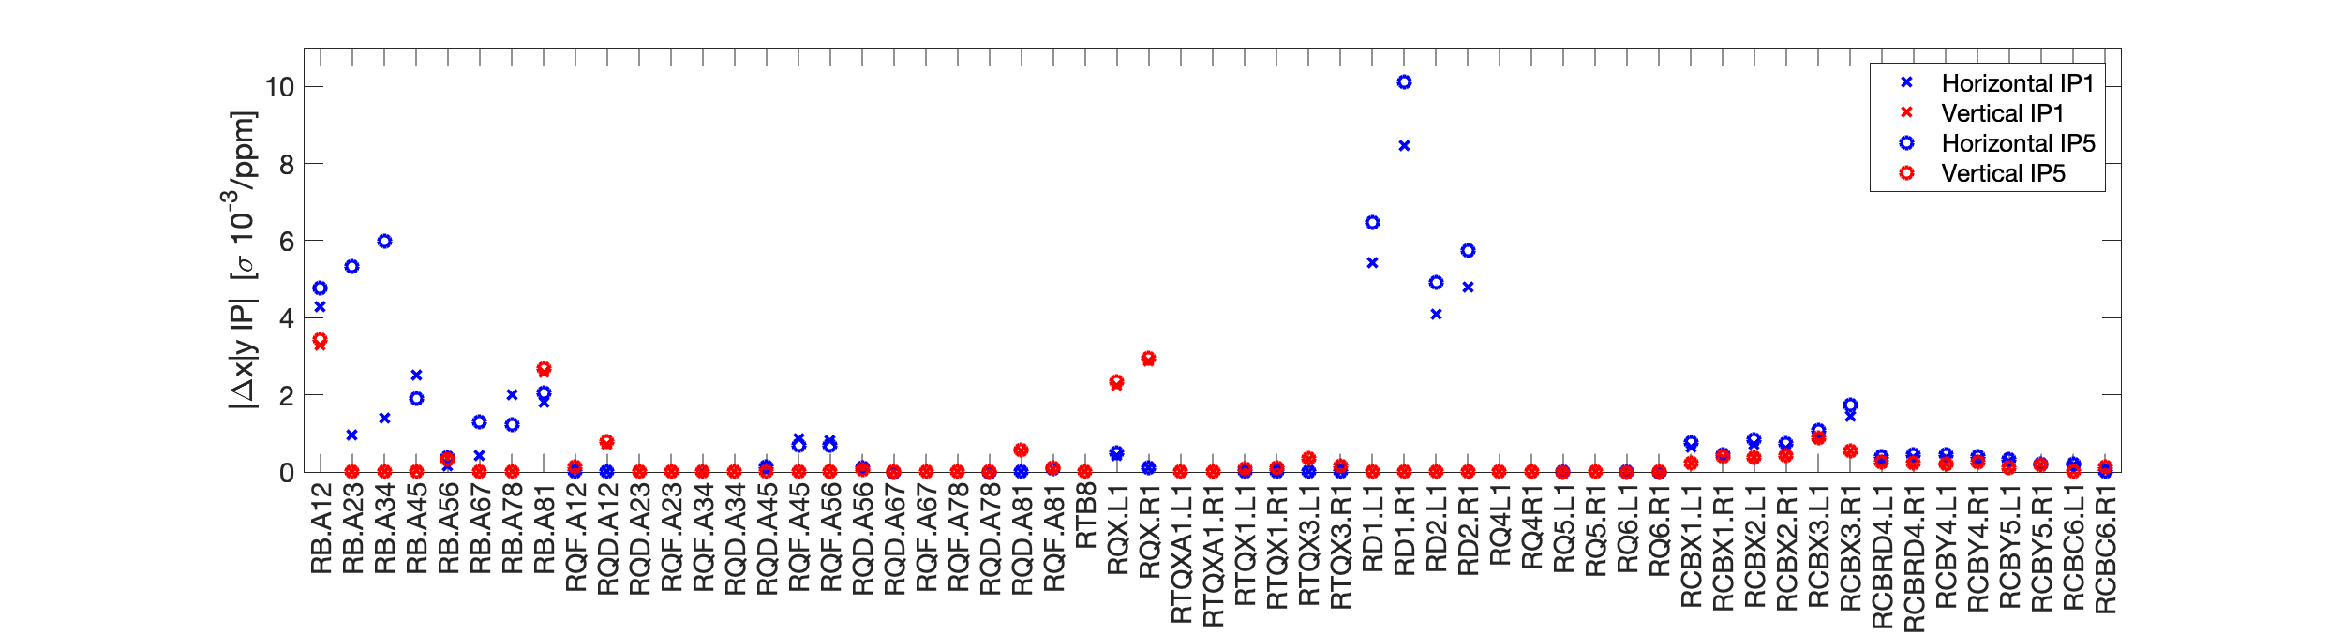
Optics sensitivity: impact on IP orbit
PC stability have small impact on IP orbit jitter (< 0.01 σ_{beam}/ppm)
  Normally in the shadow of slow ground motion (about 0.1 σ_{beam} rms (see for example here and here))
HL-LHC 1.3 baseline optics
Beta* = 15cm
Proposed class 0
Class 1 – no upgrade
class 0 (from tune)
About x5 less impact than D1/2
Propose class 2
HL-LHC 1.3 flat optics
Beta* = 7.5-18cm

Slide 18
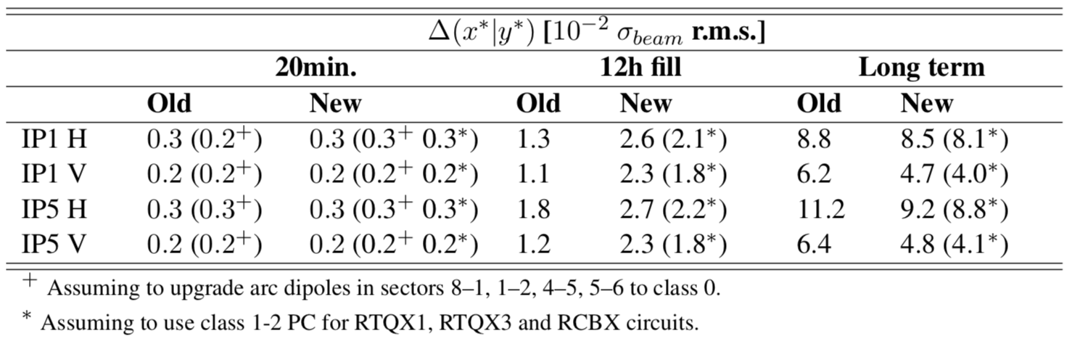
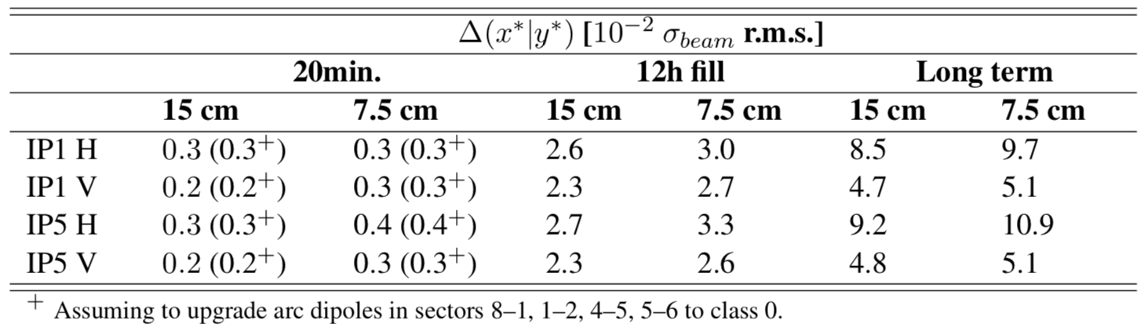
Expected Orbit Stability
Old specifications vs. new specifications (15cm beta*):
New specifications. Round (15 cm) vs Flat (7.5-18cm)
Negligible
<<1% lumi loss
Order 3%σ during fill
Order 10%σ over one year

Slide 19
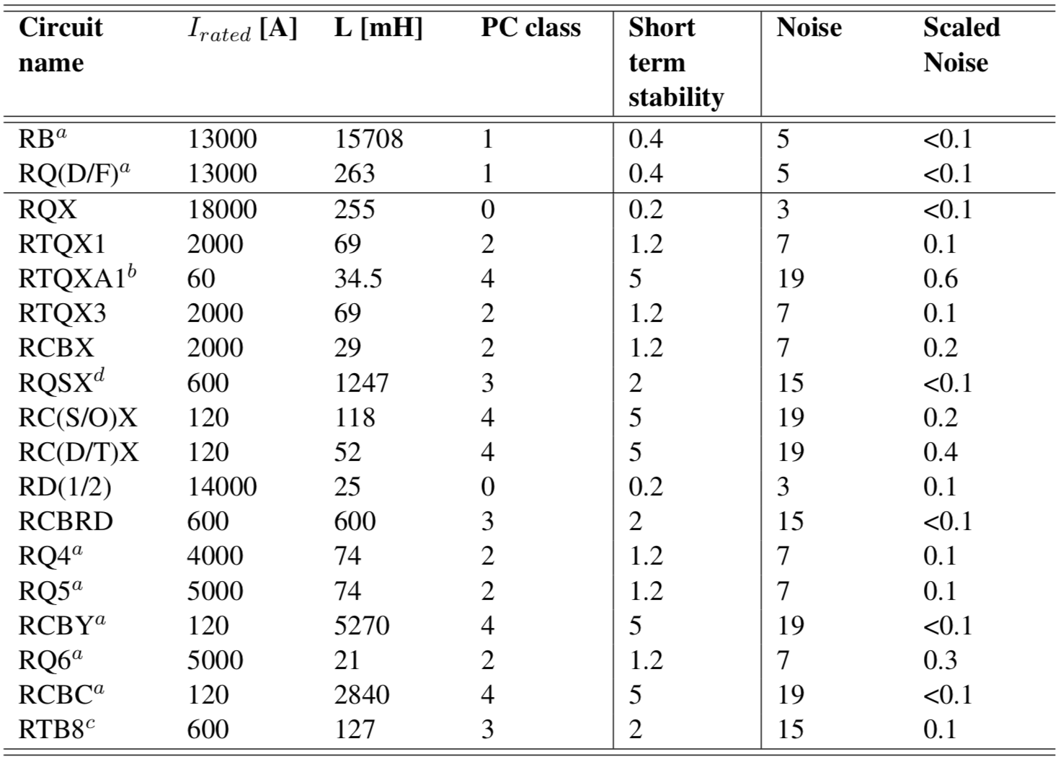
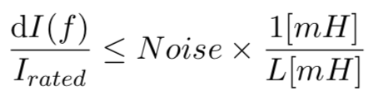
Work in progress: from low frequency voltage ripple (< 500 Hz) to current using PC “Noise” specification
Present PC specification lack of constraints in [0.1 – a few Hz] range
  Normally assumed to be in the shadow of “Short term stability”.
Preliminary estimate can be done using the “Noise” specification
  normally used for characterizing the PC only (without a circuit).
  Still under discussion with EPC – spec will probably come out quite different…
Assuming “Noise” value is measured with L = 1mH (or less)
+ Simplified model
In the shadow of “Short term stability”
Careful:
at high f L might actually decrease…
1mH is an arbitrary value! Still to be defined by EPC

Slide 20
Work in progress: dynamic Aperture studies at high frequencies - zoom in
Even close to first betatron frequencies it seems we are still safe.
Warning: single frequency analysis!
  In reality one should sum various components in function of actual voltage spectra.
  LHC experience that some lines on the circuit might be higher than gabarit….
From S. Kostoglou et al. Effect of Tune modulation […] - IPAC2019 – in preparation

