Slide 1
Vertical Cores to LHC
WP17.1
18/03/2018

Slide 2
Agenda
Cores geometry overview
Possible Construction methods
Site installations
  In LHC
  In HL-LHC
Access constraints
  In LHC
  In HL-LHC
LHC services to be removed for CE works
LHC services to be provided by CERN to Contractor
Schedule
Conclusions & Strategy

Slide 3
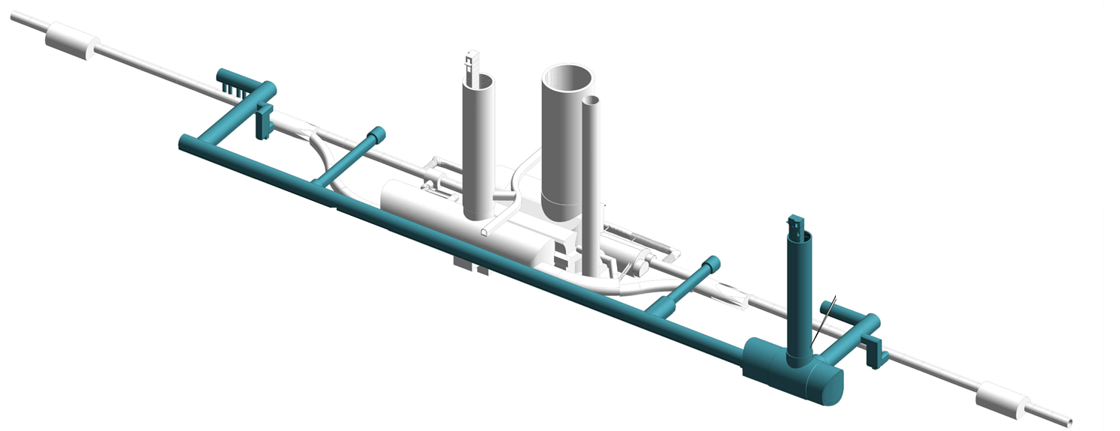
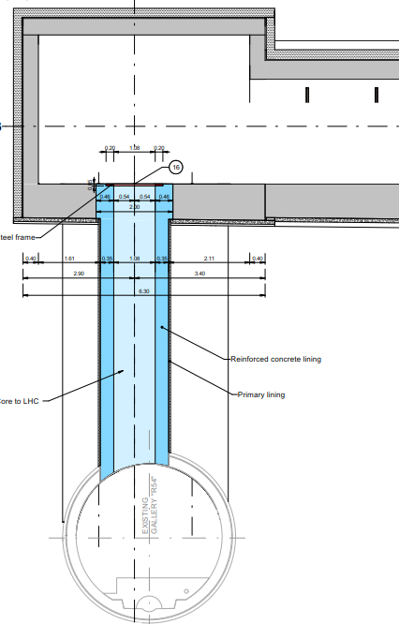
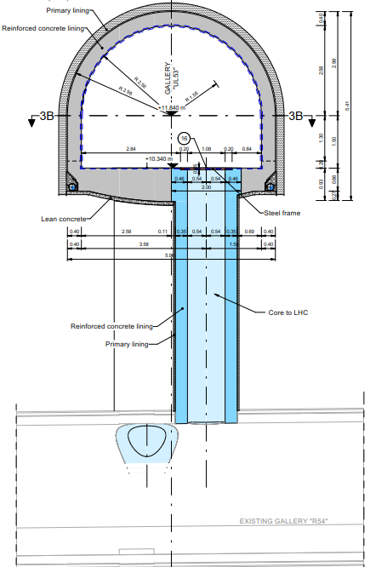
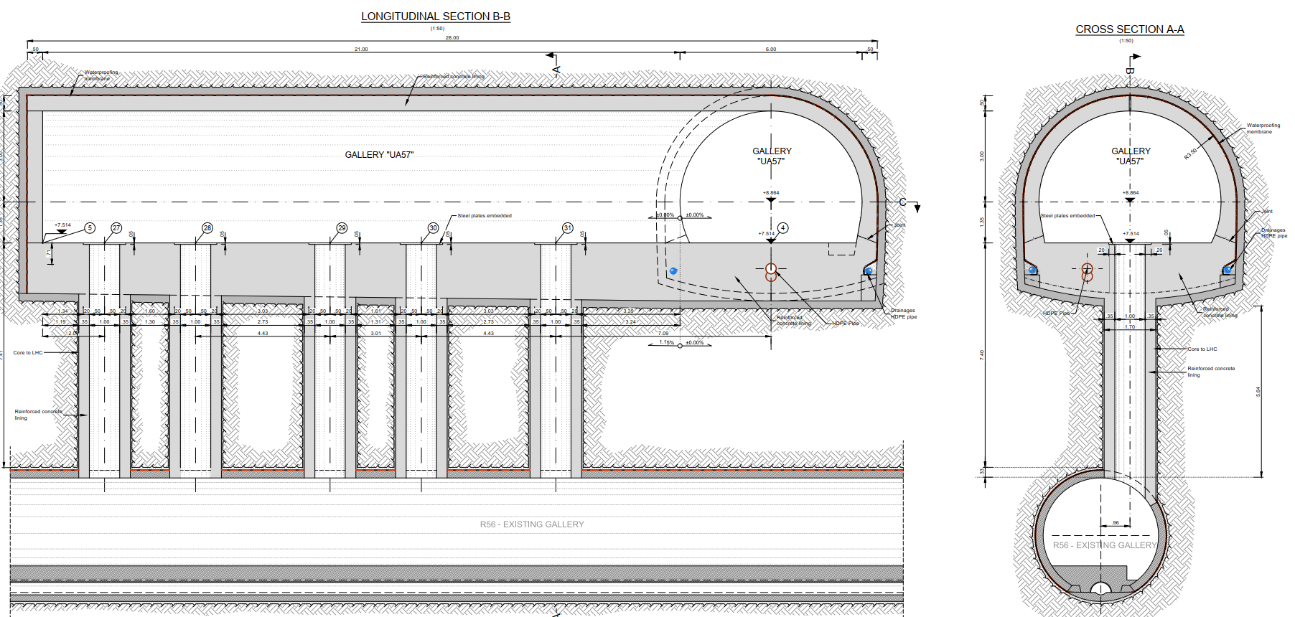
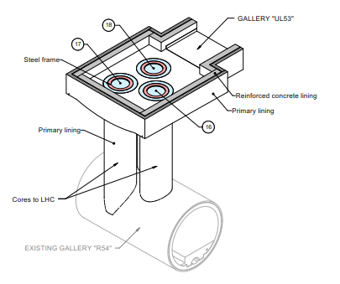
Geometry & Setting out
UAx3
(3 pcs)
12 cores per point
  6 left from IP
  6 right from IP
Internal Diameter: 1m
Excavation length: 5 to 7m
ULx3
(3 pcs)
ULx7
(3 pcs)
UAx7
(3 pcs)
ULs
UAs
*final core positions to be defined

Slide 4
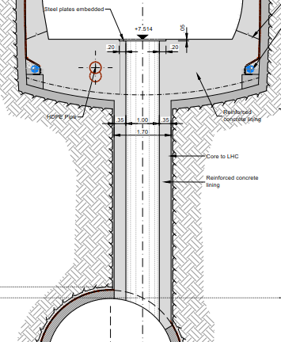
Geometry & Setting out
Inner Lining
CE consultants proposal:
Fully reinforced concrete lining
Alternative proposal:
Steel tube with injections
1.00
Steel tube
Injection/Grouting
It has been confirmed by WP15 that this solution is compatible with the future equipment hosted in these areas.

Slide 5
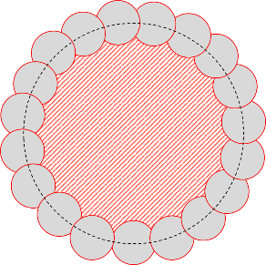
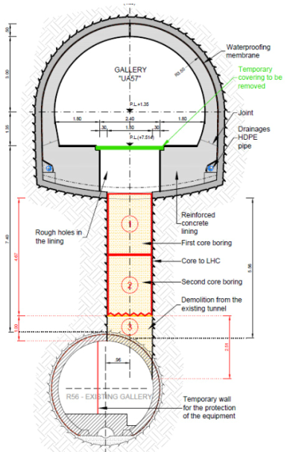
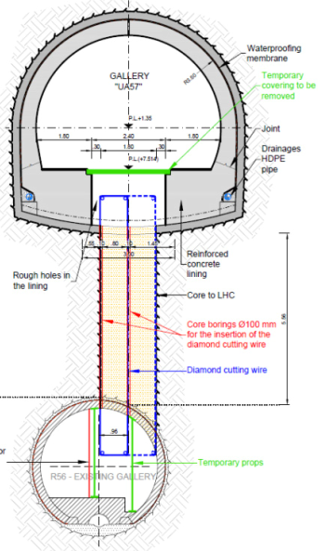
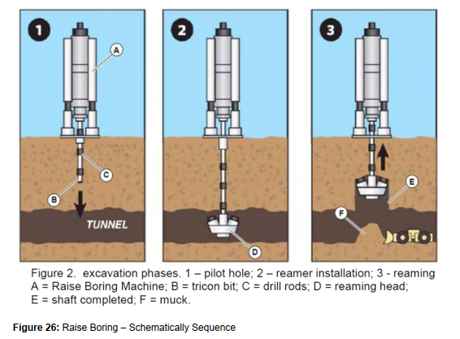
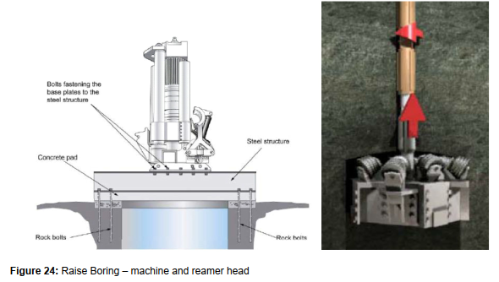
Possible Methods
(CE consultants preliminary study)
Large Diameter Core Drilling:
Top-Down Method
Excavating equipment via HiLumi
Spoil evacuated via HiLumi & LHC
Demolition works in LHC
Alternative:
Small diameter secant cores (along the circumference of the main core)
Diamond Cutting Wire:
Excavating equipment via HiLumi & LHC
Spoil evacuated via LHC
Demolition works in LHC
Description: Flexible tool for cutting reinforced concrete, masonry and steel. It allows almost any large concrete or masonry structure to be cut.
Raise Boring:
Bottom-Up Method
Excavating equipment via HiLumi & LHC
Spoil evacuated via LHC
Demolition works in LHC
Description: A small diameter sub-vertical pilot hole is drilled to reach a tunnel located in the lower part of the section. Once the pilot hole reaches the tunnel, a reamer head is installed at the end of the drill string and pulled up, creating a hole with the desired diameter.

Slide 6
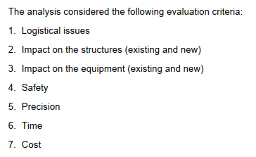
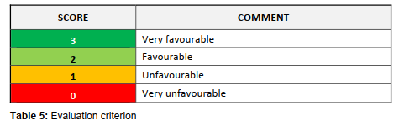
Multi-criteria Analysis
(CE consultants study)

Slide 7
Multi-criteria Analysis

Slide 8
Multi-criteria Analysis
Main points:
  Raise boring equipment might be larger than the transport corridor in HL and workspace necessary in UA/UL is larger as well:
  Height available in UA/UL is too low for raise boring
  Raise boring equipment is less common:
    uncertainty if 2 machines can be mobilized for a reasonable cost
  With Raise boring, all spoils shall be removed through LHC
  Large core drilling & Diamond cutting wire show equivalent scores except for excavation tolerances.

Slide 9
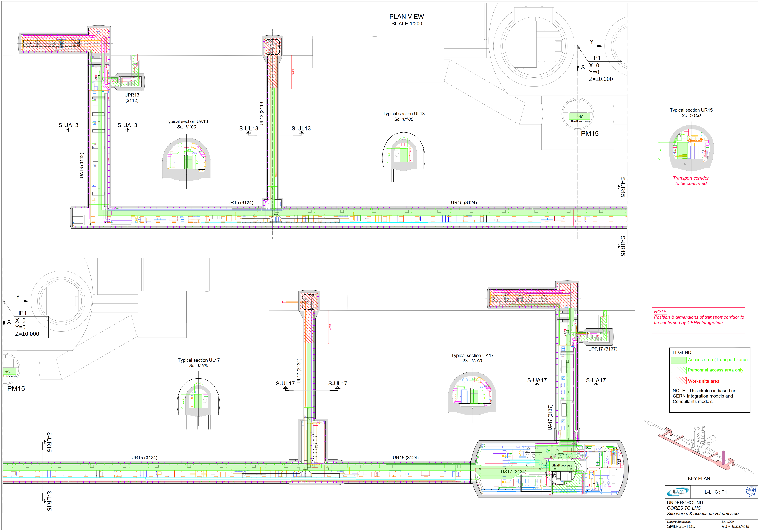
Site installations (HL / P1)
Shielding walls & sector doors
!
!
Sector doors
* Possibility to remove/enlarge partition/ventilation doors ? Delay shielding walls to LS3 ?
* HL equipment installed before the CE works to be defined more precisely.
!
Shielding walls & sector doors
!
Sector doors
Situation @ 2024: Status of equipment installation to be confirmed by Integration

Slide 10
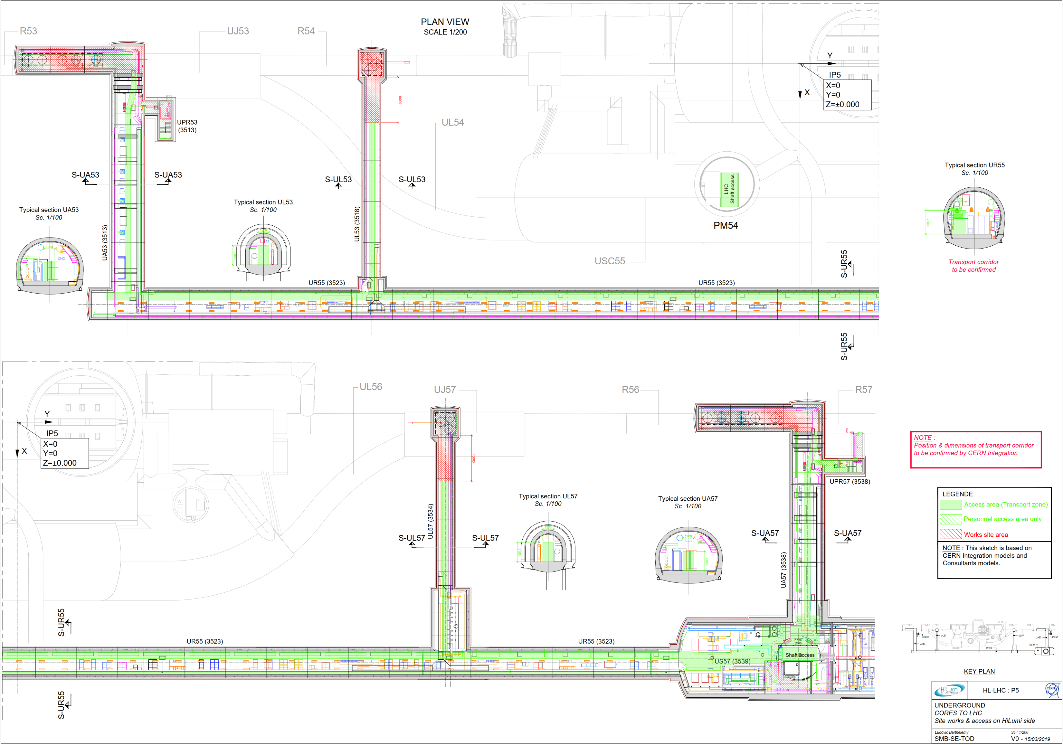
Site installations (HL / P5)
Shielding walls & sector doors
!
!
Sector doors
* Possibility to remove/enlarge partition/ventilation doors ? Delay shielding walls to LS3 ?
* HL equipment installed before the CE works to be defined more precisely.
!
Shielding walls & sector doors
!
Sector doors
Situation @ 2024: Status of equipment installation to be confirmed by Integration

Slide 11
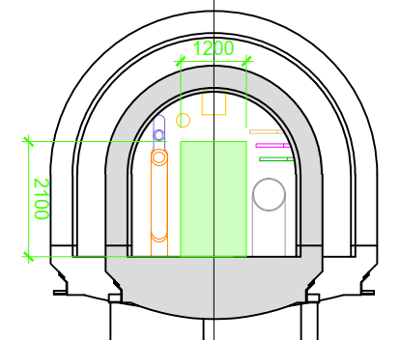
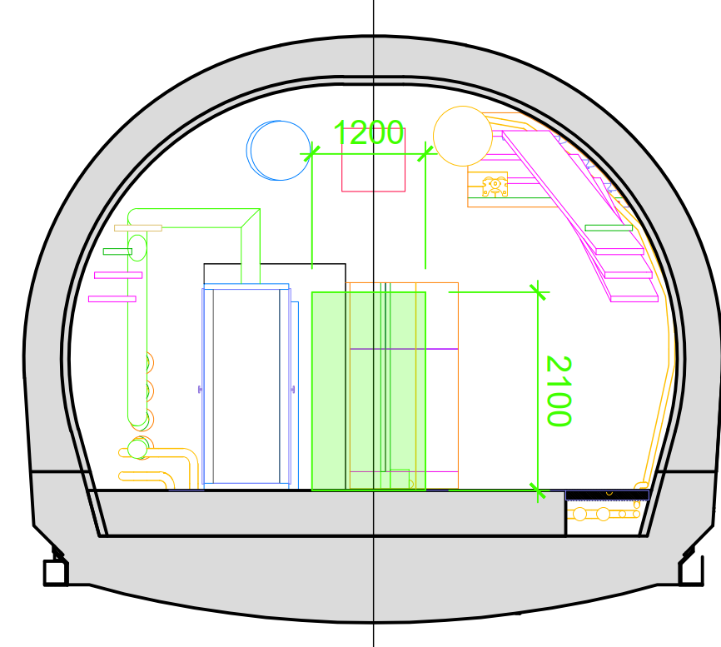
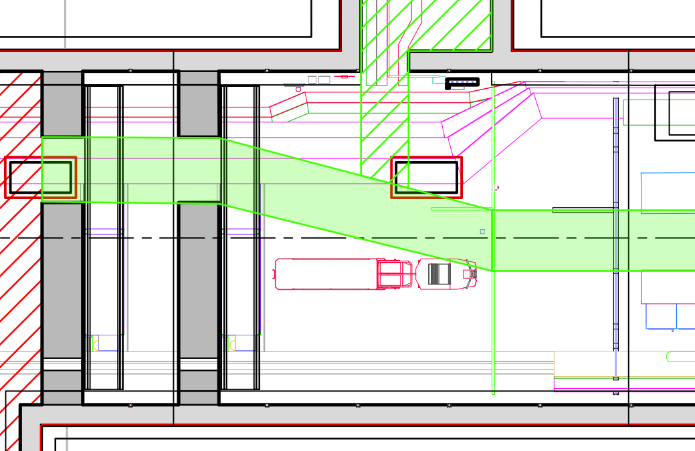
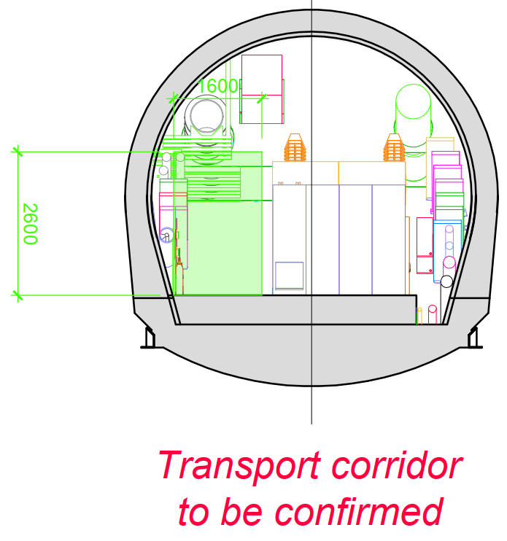
Access constraints
(HL side)
UL
Main constraints in UA/UL:
  Partition/Ventilation walls: Possible to remove them OR enlarge the access through these walls ?
  Shielding walls: Delay the construction to LS3 ?
UA
UR
Main constraint in UR:
  Width/Height of transport corridor to be confirmed
Situation @ 2024: Status of equipment installation to be confirmed by Integration

Slide 12
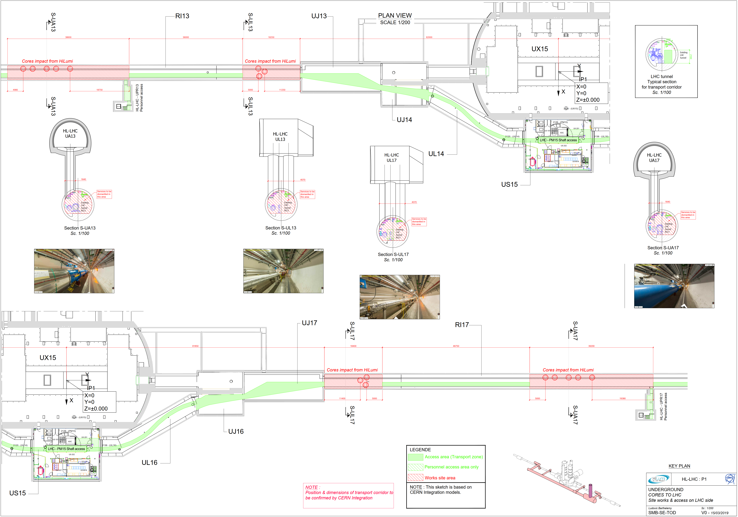
Site installations (LHC / P1)

Slide 13
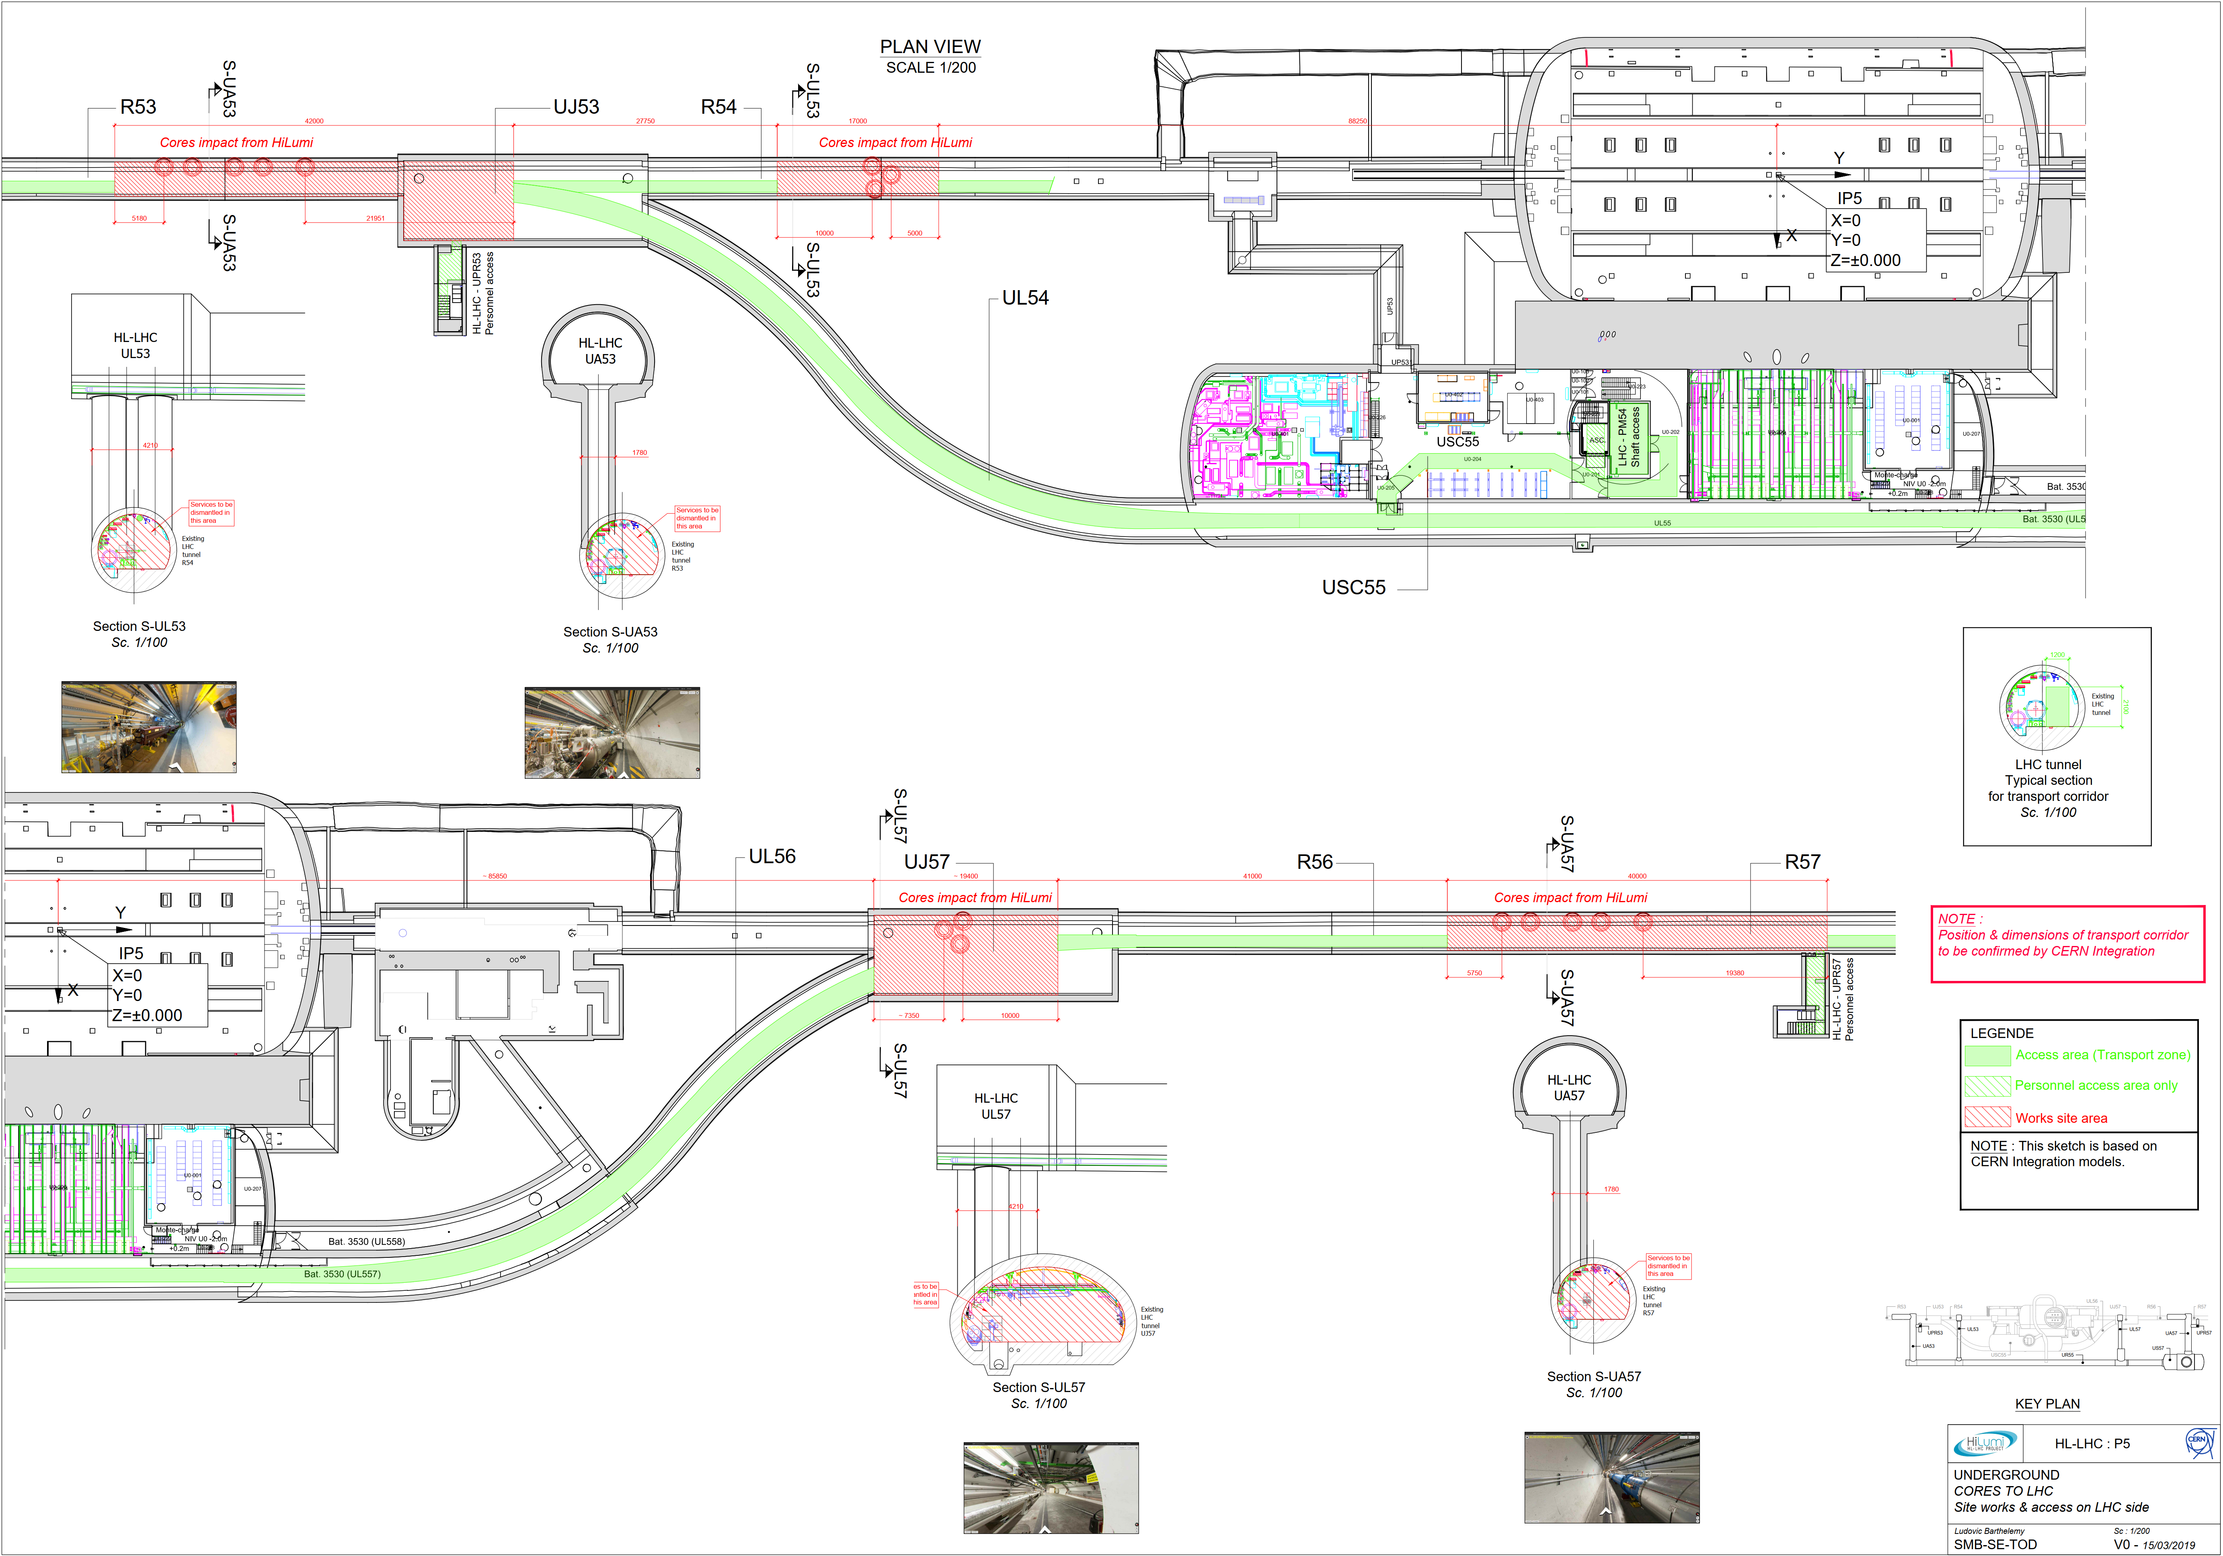
Site installations (LHC / P5)

Slide 14
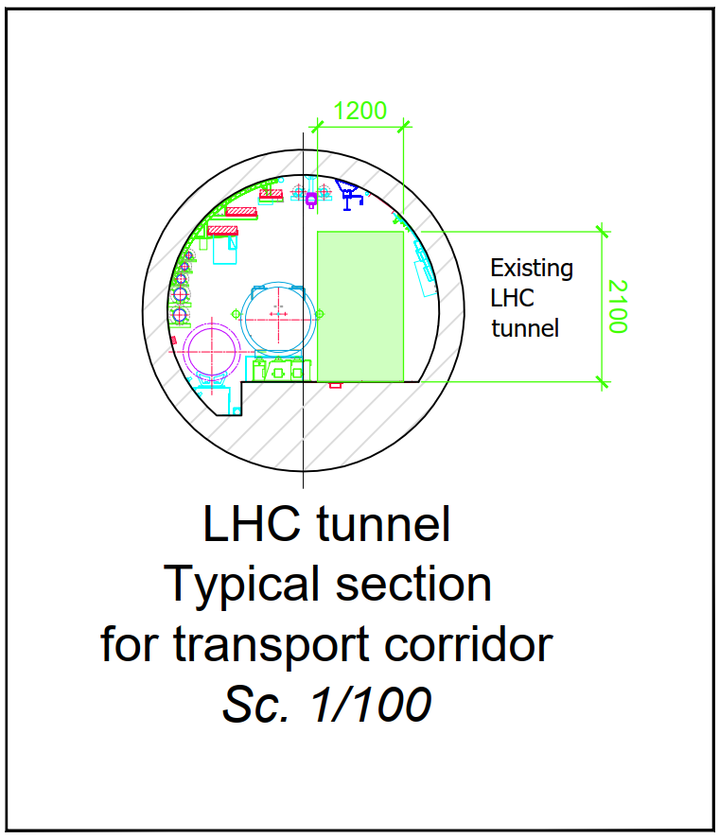
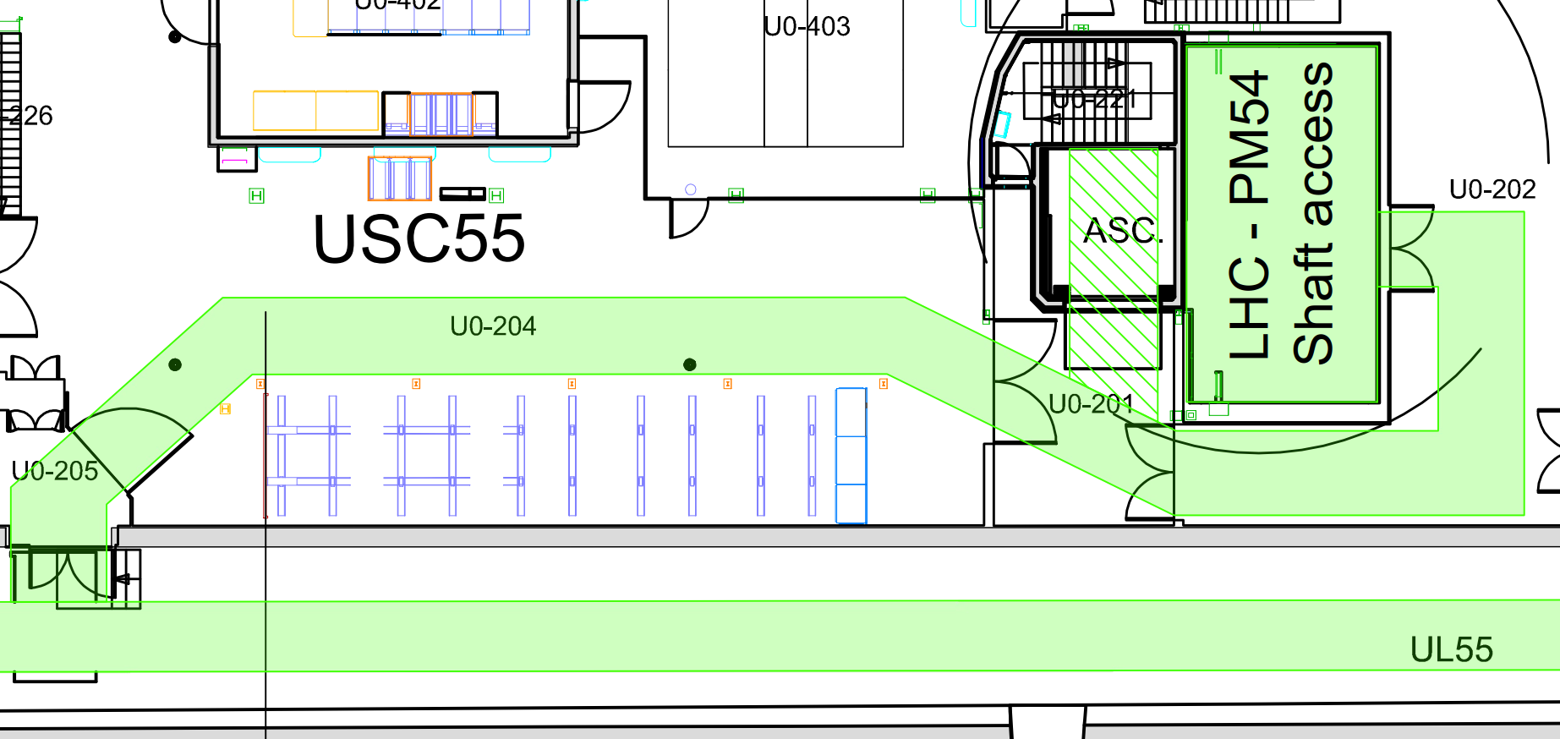
Access constraints
(LHC side)
Transport corridor to be confirmed
And other transport constraints ?
  Capacity of lifting platform near PAD at P5: 10 tons
  LHC tremies dimensions & capacities

Slide 15
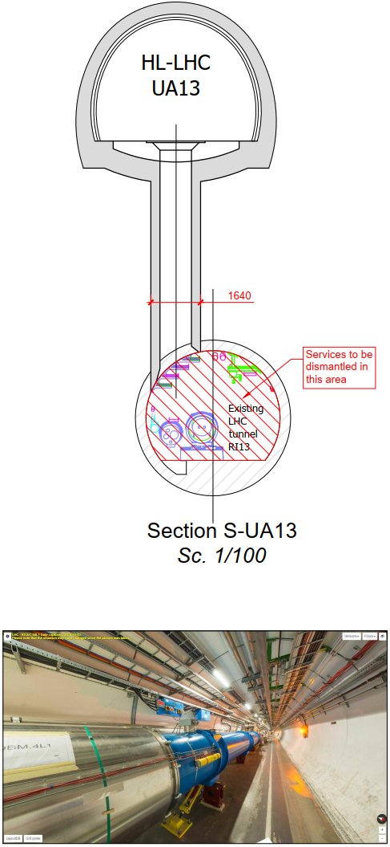
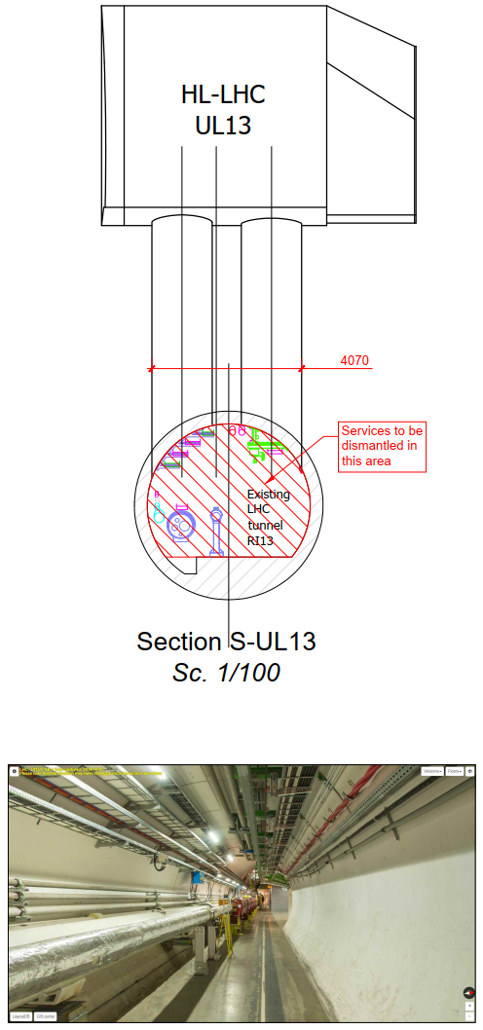
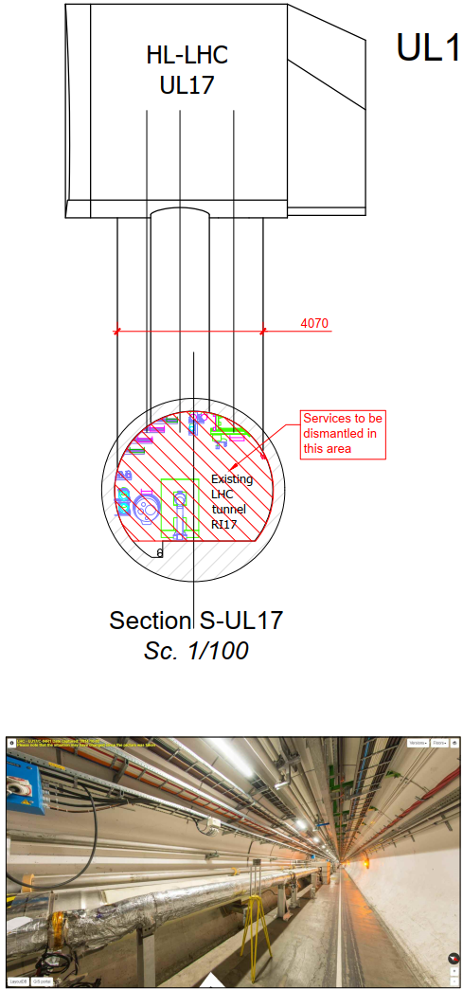
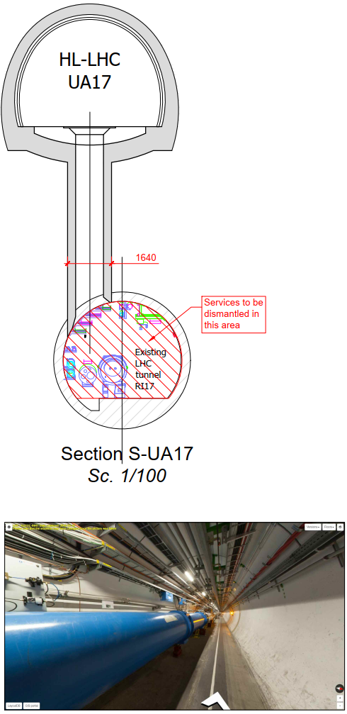
LHC services to be removed
Point 1

Slide 16
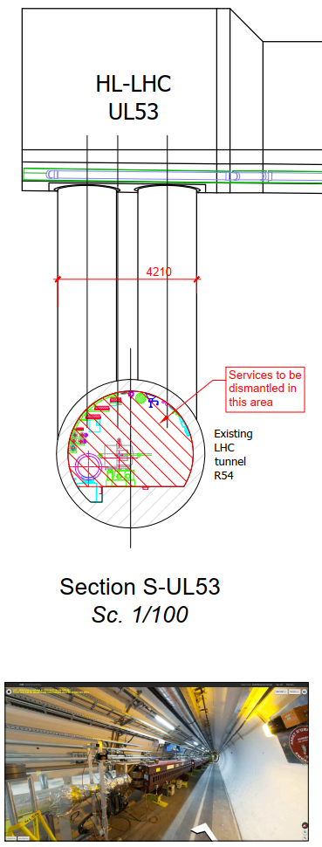
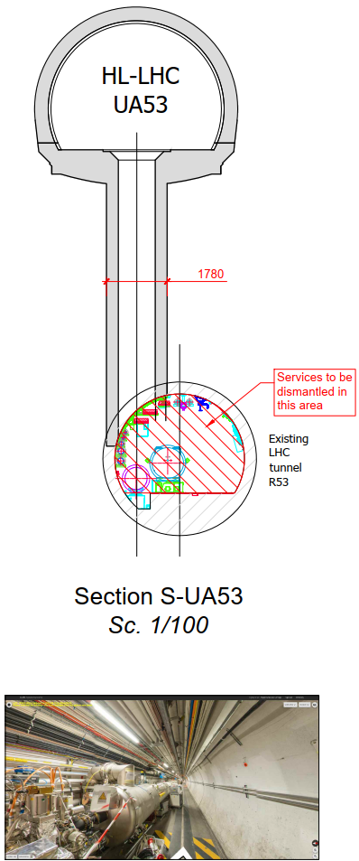
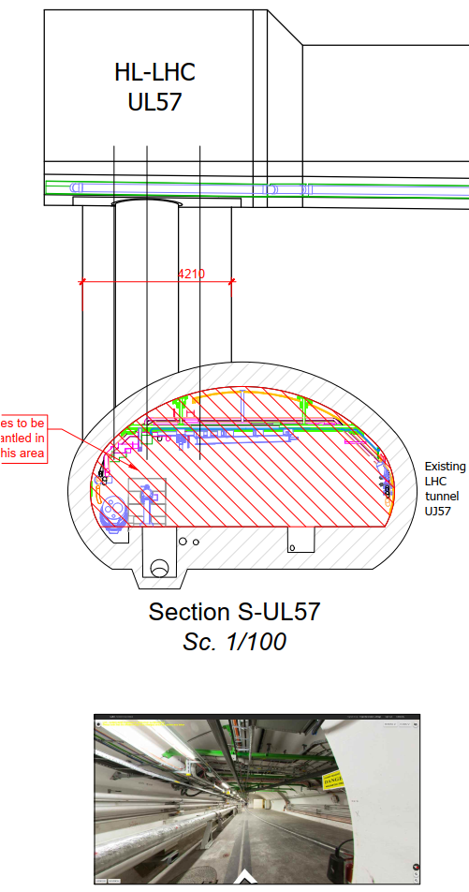
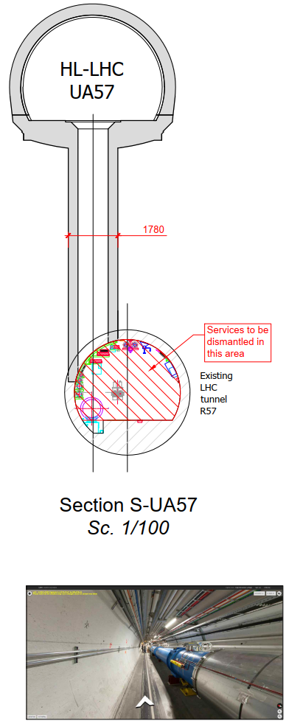
LHC services to be removed
Point 5

Slide 17
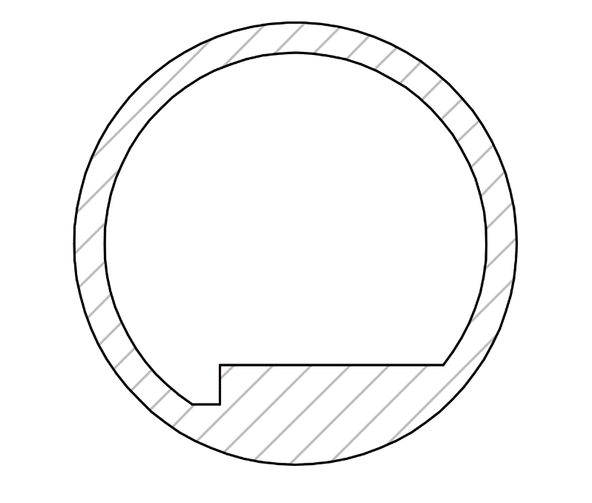
Services to be provided by CERN
To execute the works, CERN will have to provide the contractor with:
  Survey: Setting out of cores
  RadioProtection (activation of spoils, equipment, material)
  Electricity
  Water
  Transport activities:
    Overhead cranes in LHC & HL-LHC’s shafts
    Handling of the contractor’s equipment/excavated material between worksites and shafts in order to avoid risk of damages to the LHC/HL equipment + Spoils to be covered
  Ventilation concept & compatibility with LHC ventilation to be studied with CV:
    Continuity of LHC ventilation to be kept? Or can it be stopped?
CE dust/air proof worksite wall
LHC Ventilation duct

Slide 18
Conceptual schedule
(CE Consultants preliminary inputs)
CE works schedule will be tightly link to Machine & Access constraints such as:
  Machine warm up
  Machine de-installation
  Services removal
In order to limit the impact on LHC activities, it is considered to execute the works starting with left side and switching to the right side once it is finished.
Conceptual schedules applicable at each point are shown in the next slides

Slide 19
Conceptual schedule
(CE Consultants preliminary inputs)
Option A:
  Hypothesis: at P1 & P5, Left and Right sides can be done consecutively without down time of the CE works (optimal solution for equipment availability).

Slide 20
Conceptual schedule
(CE Consultants preliminary inputs)
Option B:
  Hypothesis: For LS3 schedule reasons, Left and Right sides cannot be done consecutively and some down time is necessary between the CE works in each area.

Slide 21
Conclusions & Strategy
Execution Methods: Core drilling methods (Large or Small cores) seem to be the most suitable but other methods should be left opened to contractor’s choice for further optimisation, respecting CERN constraints.
Site installations & transport area: a proposal compatible with the pre-selected execution method is made. Some critical sections are identified (i.e partition/ventilation doors and UA’s shielding walls).
Services removal to be studied in details and solutions to be defined for services which cannot be removed (i.e 18-kV cable).
Services to be provided by CERN to Contractor: a preliminary list is given in slide 17. Some input is necessary from WP17 (transport, ventilation, electricity, etc…).
Preliminary schedule: What are the possible slots for CE per point & side ?
Two options have been investigated.
Next steps:
  Finalise CERN requirements (site installations, access constraints, CERN services to be provided…) in collaboration with WP15 & WP17.
  Request tender in 2019 from current contractors (P1 and P5) and, if results are not satisfactory, open the tender to other specialist contractors.

