Slide 1
Directed flow in HIC at FAIR and NICA energies
Yurii Kvasiuk, TSNUK
Part of materials has been already published:
Bravina L.V.; Y.K., Sivoklokov S.Y.; Vitiuk O.V.; Zabrodin E.E. Directed flow in Microscopic Models in Relativistic A+A Collisions. MDPI Universe 2019, 5, 69.
21 March, Oslo, Norway

Slide 2
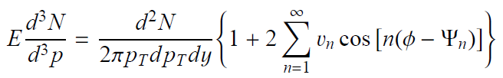

What is Flow?...
Coefficients of the expansion $v_{n}=<cos⁡(n(φ−Ψ))>$ are called directed, elliptic, triangular, etc.

Slide 3
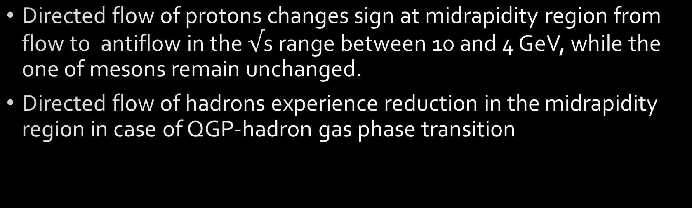
What do we know?
Directed flow of protons changes sign at midrapidity region from flow to antiflow in the $√$s range between 10 and 4 GeV, while the one of mesons remain unchanged.
Directed flow of hadrons experience reduction in the midrapidity region in case of QGP-hadron gas phase transition

Slide 4
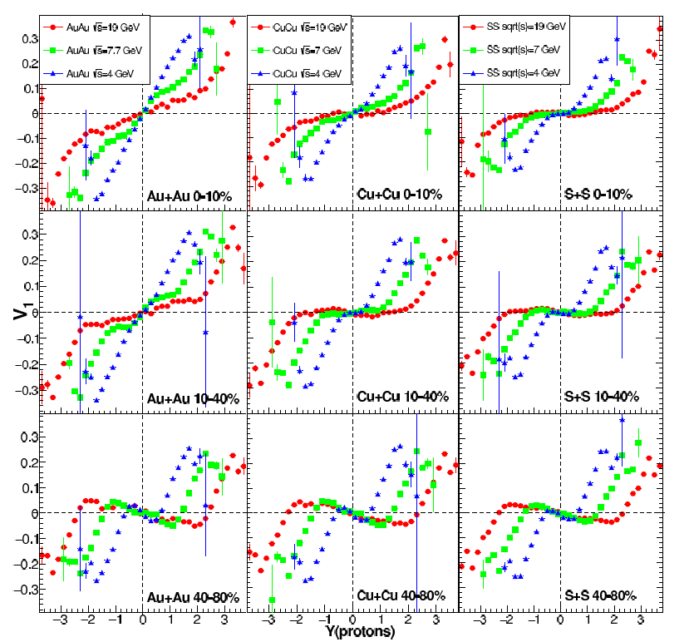
Directed flow in QGSM

Slide 5
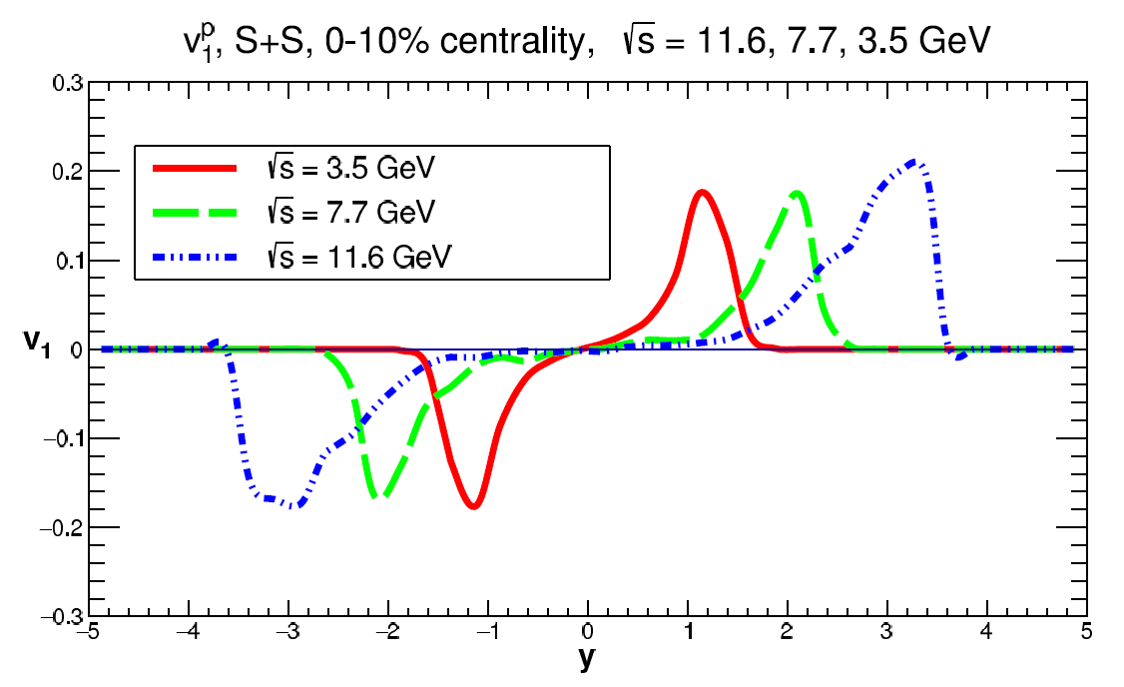
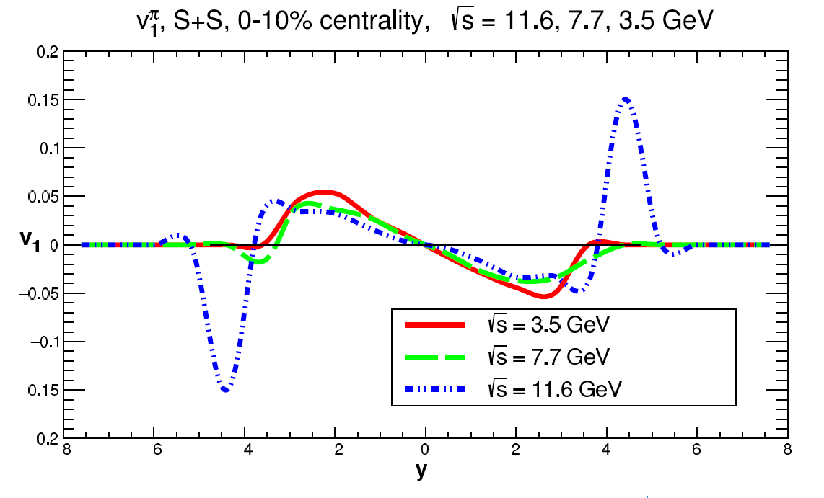
Directed flow in S+S collisions, UrQMD
pions
protons

Slide 6
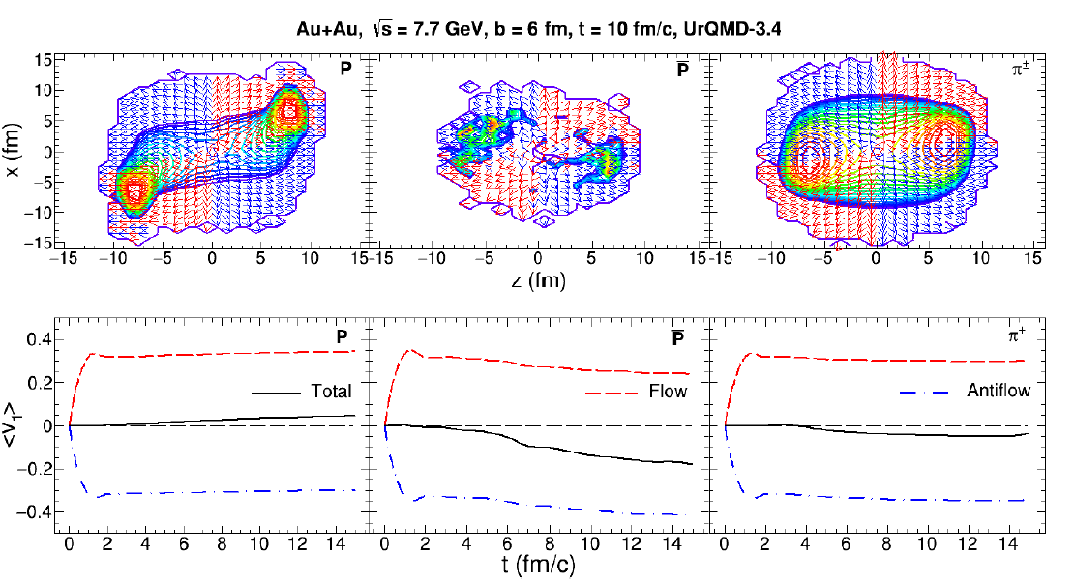
Flow and baryon density
Upper row: baryon dencity(contour plot) and collective velocity of each 3 fm^3 cell at 10 fm/c
Bottom row:
Time development of total flow as a sum of normal flow and antiflow.

Slide 7
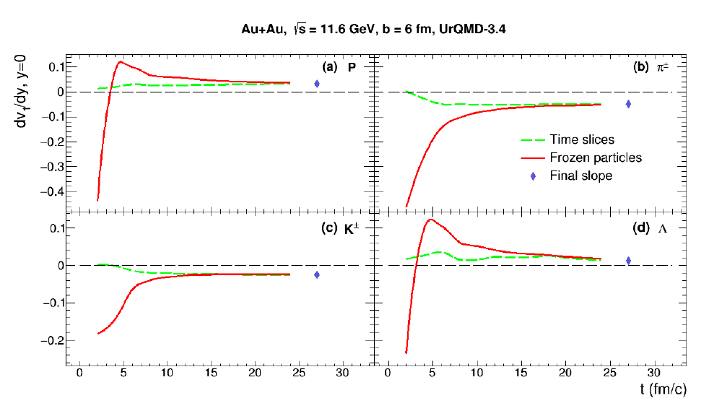
Flow formation

Slide 8
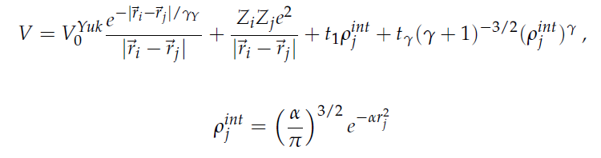
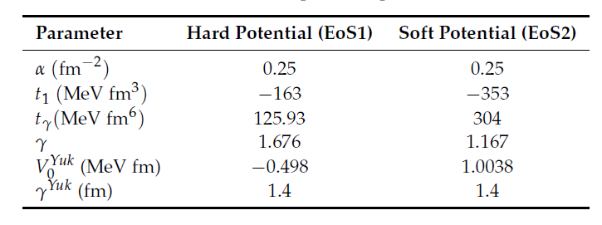
Influence of mean-field potentials

Slide 9
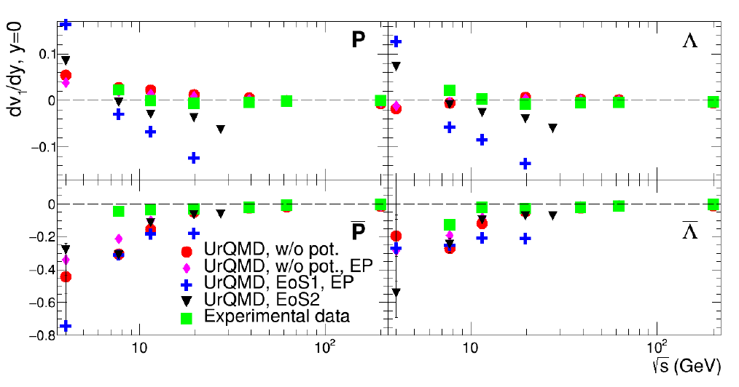
Baryons

Slide 10
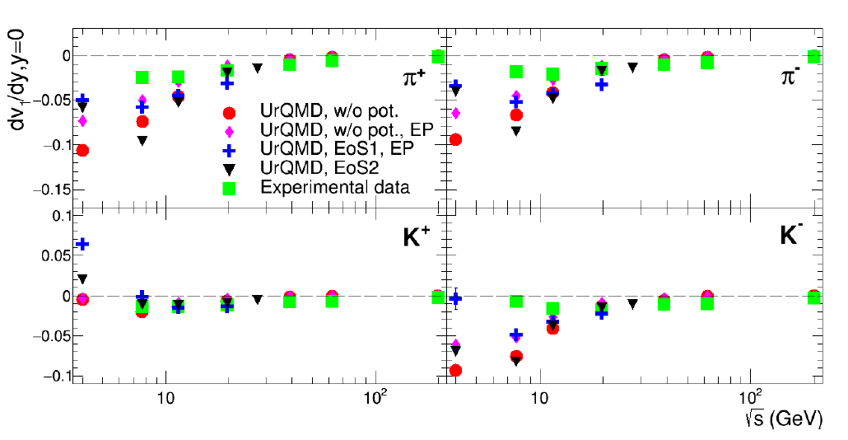
Mesons

Slide 11
Current work
3.5, 5.5, 7.7, 11.6 GeV
Xe+Xe and Au+Au
0-10%, 10-40%, 40-80%
directed and elliptic flows
y and pT dependence
time evolution

