Slide 1
Follow-up of
PS Landau system
H. Damerau
Landau cavity study working group
29 March 2019

Slide 2
Status of Landau RF system
  24/01/2019: ‘Check point’ meeting → Comments and suggestions
  https://indico.cern.ch/event/778836/

Slide 3
Findings
No obvious show-stoppers for cavity and amplifier design of dedicated Landau RF system for PS
LIU-PS baseline intensity of 2.6 ∙ 10¹¹ p/b reached in 2018
  New anode power converters and multi-harmonic feedbacks
  Improvement of 0.2 - 0.3 ∙ 10¹¹ p/b since 2017 not identified
Operation of existing 40 MHz cavities during final part of accel-eration improves stability, resulting in ~15% emittance margin
Existing 40 MHz cavities can only be operated as Landau
RF system above ~13 GeV leaving a gap of 180 after transition
Longitudinal emittance and halo crucial at PS-SPS transfer
  Requires longitudinal emittance below baseline?

Slide 4
Comments and suggestions
Keep dedicated RF system for Landau damping as back-up option, no strong argument for immediate implementation
Finish conceptual RF system design
  Complete evaluation of 4-core shroud for Finemet options and tests with improved material at KEK
  Characterize garnet material; build and measure radially scaled model
Document results of cavity and amplifier design study
Consolidate present 40 MHz RF system for operational use as Landau RF system above 13 GeV
  Evaluate limitations of power amplifier and feedback chain
  Study implementation of LLRF controls and impact on
  multi-harmonic feedback strategy
  Propose and implement improvements
Continue beam dynamics study effort in view of improved
PS-SPS transfer
  Smaller longitudinal emittance? How to reduce halo?

Slide 5
Status of Landau RF system
  24/01/2019: ‘Check point’ meeting → Comments and suggestions
  https://indico.cern.ch/event/778836/
  05/02/2019: LIU Technical Coordination meeting
  https://indico.cern.ch/event/793575/
  05/02/2019: Beam Dynamics Coordination meeting → Recommendation
  https://indico.cern.ch/event/794059/

Slide 6
Recommendation
LIU Beam Dynamics Coordination meeting (minutes):
LIU Executive Committee follows the recommendation (minutes)
‘In general, while it is clear that lots of work on the Landau cavity has been done and should be duly documented, there is no strong reason related to beam performance for which this item should become baseline within LIU.’

Slide 7
Status of Landau RF system
  24/01/2019: ‘Check point’ meeting → Comments and suggestions
  https://indico.cern.ch/event/778836/
  05/02/2019: LIU Technical Coordination meeting
  https://indico.cern.ch/event/793575/
  05/02/2019: Beam Dynamics Coordination meeting → Recommendation
  https://indico.cern.ch/event/794059/
  07/02/2019: LIU Executive Committee meeting → Decision for LIU
  https://indico.cern.ch/event/792027/
  14/02/2019: LIU Workshop, Montreux → Only option after LS2
  https://indico.cern.ch/event/774181/timetable/, direct link to presentation

Slide 8
How to proceed?

Slide 9
Comments and suggestions
Keep dedicated RF system for Landau damping as back-up option, no strong argument for immediate implementation
Finish conceptual RF system design
  Complete evaluation of 4-core shroud for Finemet options and tests with improved material at KEK
  Characterize garnet material; build and measure radially scaled model
Document results of cavity and amplifier design study
Consolidate present 40 MHz RF system for operational use as Landau RF system above 13 GeV
  Evaluate limitations of power amplifier and feedback chain
  Study implementation of LLRF controls and impact on
  multi-harmonic feedback strategy
  Propose and implement improvements
Continue beam dynamics study effort in view of improved
PS-SPS transfer
  Smaller longitudinal emittance? How to reduce halo?
→ LIU-PS beam dynamics WG

Slide 10

Comments and suggestions
Keep dedicated RF system for Landau damping as back-up option, no strong argument for immediate implementation
Finish conceptual RF system design
  Complete evaluation of 4-core shroud for Finemet options and tests with improved material at KEK
  Characterize garnet material; build and measure radially scaled model
Document results of cavity and amplifier design study
Consolidate present 40 MHz RF system for operational use as Landau RF system above 13 GeV
  Evaluate limitations of power amplifier and feedback chain
  Study implementation of LLRF controls and impact on
  multi-harmonic feedback strategy
  Propose and implement improvements
Continue beam dynamics study effort in view of improved
PS-SPS transfer
  Smaller longitudinal emittance? How to reduce halo?
$✓$Measurements at KEK/J-PARC soon
→ LIU-PS beam dynamics WG

Slide 11
Comments and suggestions
Keep dedicated RF system for Landau damping as back-up option, no strong argument for immediate implementation
Finish conceptual RF system design
  Complete evaluation of 4-core shroud for Finemet options and tests with improved material at KEK
  Characterize garnet material; build and measure radially scaled model
Document results of cavity and amplifier design study
Consolidate present 40 MHz RF system for operational use as Landau RF system above 13 GeV
  Evaluate limitations of power amplifier and feedback chain
  Study implementation of LLRF controls and impact on
  multi-harmonic feedback strategy
  Propose and implement improvements
Continue beam dynamics study effort in view of improved
PS-SPS transfer
  Smaller longitudinal emittance? How to reduce halo?
$✓$Measurements at KEK/J-PARC soon
→ To be followed outside working group
→ LIU-PS beam dynamics WG

Slide 12
Internal note summary

Slide 13
Document: draft table of contents (1/2)
Introduction and motivation, 1 p.
Requirements, 2 p.
  2.1 Frequency range, voltage
  2.2 Beam loading considerations
  2.3 Impedance and stability
RF system parameters, 1 p.
Cavity design
  4.1 Garnet cavity option, 3-4 p.
  4.2 Finemet option (incl. measurements), 3-4 p.
  4.3 Ferrite cavity benchmark (?), 2 p.
Heiko
Heiko
Giorgia
Alexandre
Heiko
Nasrin
Mauro
Giorgia + Nasrin

Slide 14
Document: draft table of contents (2/2)
Amplifier design
  5.1 Beam loading, 1 p.
  5.2 Power amplifier, 2-3 p.
  5.3 Direct feedback, 2-3 p.
LLRF, 1-2 p.
  6.1 Cavity controller
  6.2 Feedback
Summary, 0.5-1 p.
Total: aim at ~20-25 pages
LaTeX or MS-Word?
Giorgia
Florian/Heiko
Heiko

Slide 15
Garnet cavity model

Slide 16
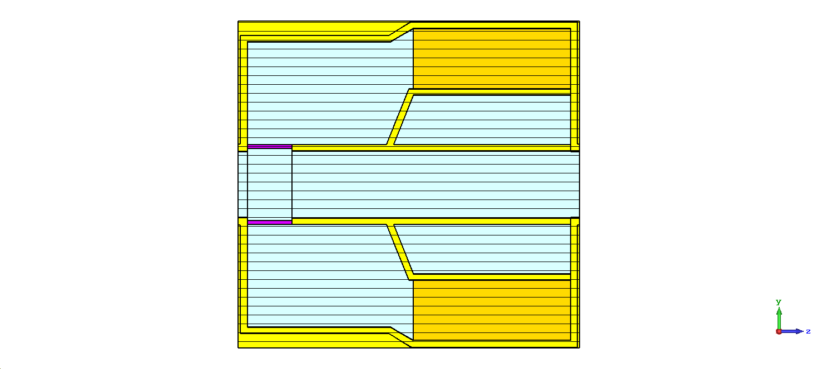
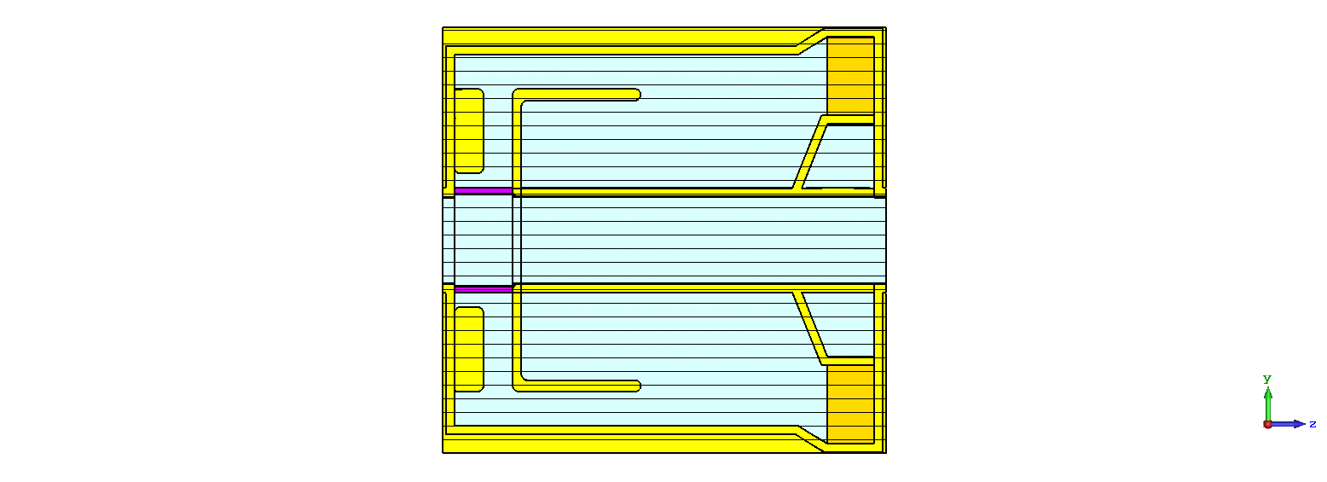
Radially scaled garnet cavity model
Motivation for model measurements
  Low-power measurements with garnet cavity option at 40 MHz
  Benchmarking of simulations
  Check perpendicular tuning, garnet material versus gap capacity
  Bring design one step beyond simulations
  Comparable test set-ups for garnet and Finemet options
Proposal: Radially scale coaxial resonator: f_{res} constant
Nasrin’s design
Radially squeezed

Slide 17
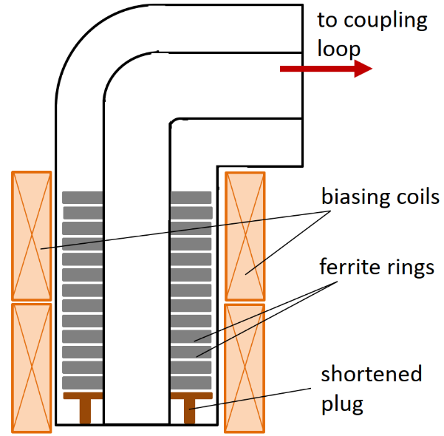
Radially scaled garnet cavity model
Guidelines for model resonator design
  Design to use standard components
    Standard size coaxial line
    Garnet rings size as for 80 MHz fast tuner
    Materials: G510, AL800
  Could part of the 80 MHz ferrite demonstrator tuner be abused as cavity at 40 MHz?
80 MHz tuner
40 MHz λ/4 cavity
?
C. Vollinger, IPAC15

Slide 18
Radially scaled garnet cavity model
Guidelines for model resonator design
  Design to use standard components
    Standard size coaxial line
    Garnet rings size as for 80 MHz fast tuner
    Materials: G510, AL800
  Could part of the 80 MHz ferrite demonstrator tuner be abused as cavity at 40 MHz? Or other existing test set-up?
80 MHz tuner
40 MHz λ/4 cavity
?
C. Vollinger, IPAC15

