Slide 1
Current HEP Computing Models
Ian Bird, WLCG, CERN
ESPPU Open Symposium
Granada, 15th May 2019

Slide 2
Acknowledgement
Input to this talk has been drawn from many discussions with colleagues from many HEP and closely related experiments over recent years, in particular
  Preparation of CWP and WLCG strategy documents
  Recent WLCG and HOW2019 workshops
  Contributions as input to the ESPPU

Slide 3
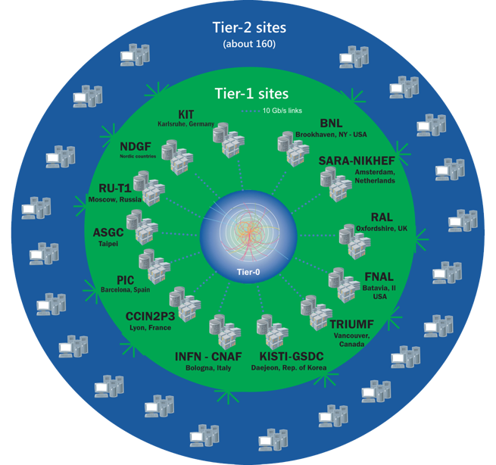
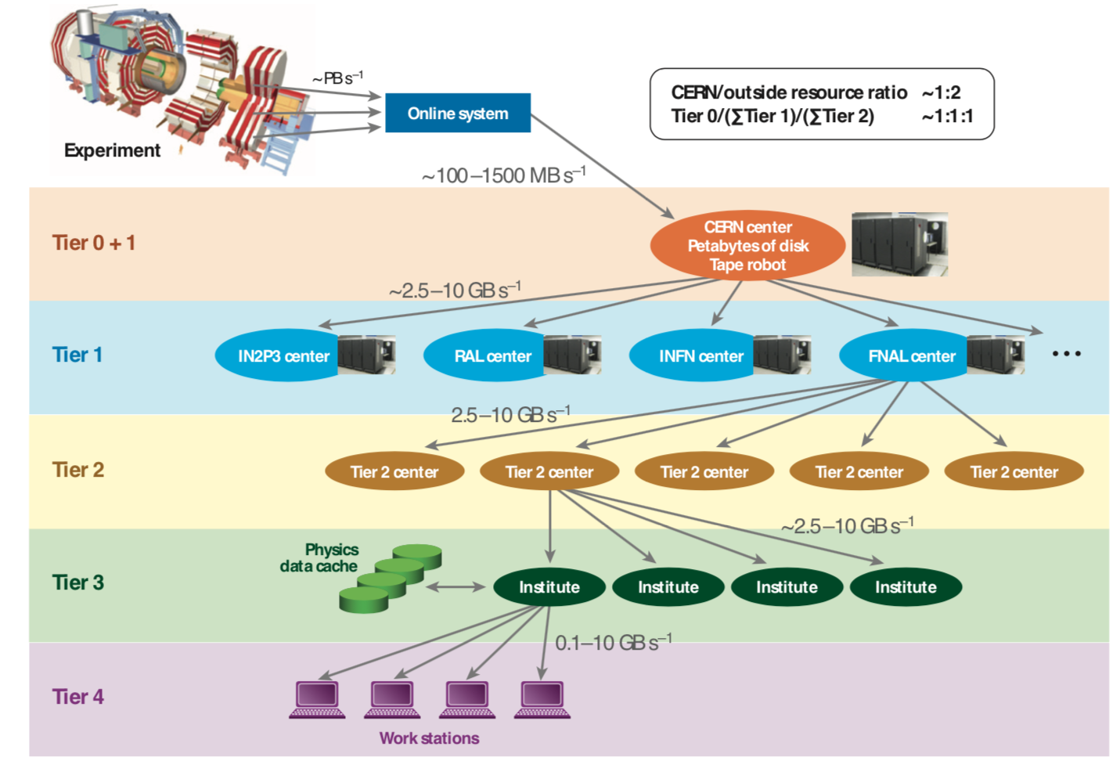
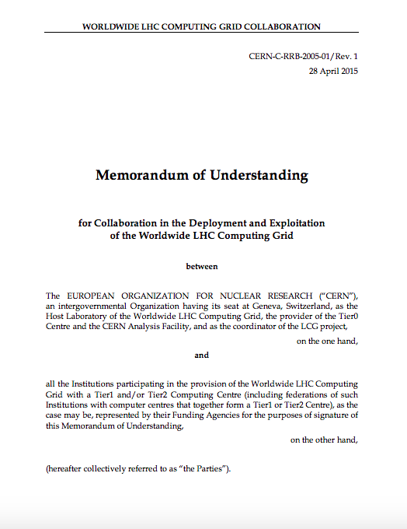
Today’s computing models
HEP has always done distributed computing
Scale of the challenge for LHC forced a more organized and formal structure
Built a federated system – grid – to integrate and make easily usable pledged resources
WLCG Collaboration

Slide 4
LHC and other HEP experiments
LHC computing (WLCG) was a significant step in organization and change of computing models
However, from the beginning of the grid projects
  Most other HEP experiments have made use of many of the tools and benefitted from the grid infrastructures (national, regional, global)
All experiments’ computing is distributed to some degree
Major features and capabilities of todays HEP computing infrastructures:
  Networks – international and national, private and public
  Data management – key to success, data transfers, storage systems, data management tools and data organization
  Compute – provisioning of resources and workload scheduling; evolution of types of resources
  AAI (Authentication, Authorization Infrastructure) - the mechanism of federation, single sign on, etc.
  Operations support – security, incident response, problem tracking, daily operations, upgrade campaigns
  Other common services – software delivery, databases and db replication/caching, etc.
  Diverse experiment-specific services and tools – applications

Slide 5
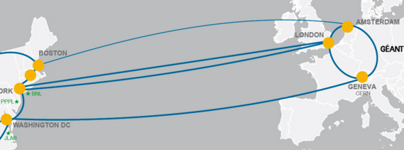
Networks
OPN – private connections – managed by WLCG
LHCOne – Virtual Overlay on national academic networks – managed by NRENs
  Also used by many other “HEP & related” experiments
Needs of LHC have helped the networking community deploy state of the art networking
Significant transatlantic capacity

Slide 6
Storage & data services
Storage tiers:
  Tape – archive and infrequently accessed data
  Disk – actively processed data
  SSD – caches for certain services, databases, etc
Storage is managed by a software components developed & proven over time
  Tape – Castor (CERN), Enstore (FNAL), HPSS or TSM (IBM)
    Tier 0 and Tier 1s have concentrated on these solutions
  Disk – EOS (CERN), dCache (DESY/FNAL), DPM (CERN); some others (filesystems like ceph with grid interface, StoRM)
    All highly reliable, scalable, and robust: needs operational effort to manage
    All compute sites today require some form of managed storage
Databases
  Conditions and other volatile data – Oracle as underlying db, with Oracle tools for replication (online→offline, Tier 0 → Tier 1s) and backup
  Metadata served via a cache infrastructure → Frontier (dev by CMS/FNAL) used by many
    Replaces original need to have full Oracle replication everywhere
Software distribution
  Was initially a clumsy problem to distribute complex software (often!) to ~100 sites
  Solved by cvmfs – publishing, content distribution, caching – now used by many communities
Cost

Slide 7
Data management tools
Experiment/common DM tools
Data placement planning – workflow driven
Tools have evolved over many years – experience and changing use patterns
Rucio – becoming a common tool
DIRAC – has broad user community – mainly as workflow
Dirac
Rucio
Alien
Phedex
Data transfers
Very robust and tested services
~100 PB/month for 10 years (~10¹¹ files!)
FTS service on gridftp, xroot, https
xroot
T1 Disk storage
T2 Disk storage
T1 Disk storage
Organised movement
These are tools used by and interesting for many HEP and other experiments

Slide 8
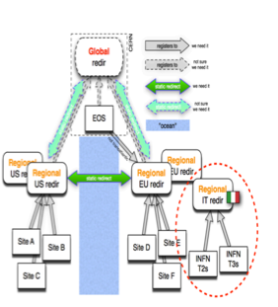
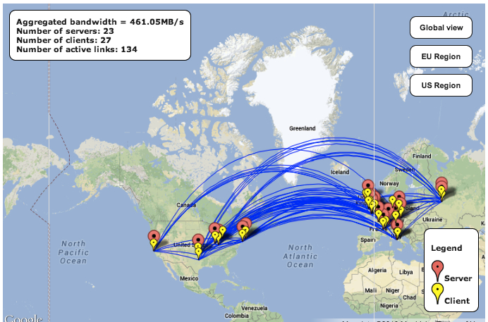
Data organization
Several different formats of data:
  RAW, ESD, AOD, derived-AOD, other new formats of reduced AOD, ntuple
    Parallel formats for simulated data
Different formats have different policies for replication, accessibility, lifetimes, distribution
Initially data was pre-placed according to a policy ready for processing
  More or less strong hierarchy between Tiers
  Today much more dynamic – peer-peer and remote access –
  data federations
  Each experiment has variations
  on this

Slide 9
Workload management
Different experiments have different workload management systems, but have converged towards a model of “pilot” jobs
  Late binding – a placeholder job is sent to any free resource, calls home for next (appropriate) priority work
  This has been very effective at filling available resources, and allows dynamic prioritization within an experiment queue of work
LHC Experiments have each developed their own workload management service
  Panda, DIRAC, GlideInWMS/WMAgent, Alien
  Each have broader communities in HEP, NP, astronomy, and other disciplines using these tools
  These tools organize the workflows, dispatch chains of jobs, interact with the DM services, collect output, manage errors and resubmissions
    They communicate with distributed compute resources
Physicists interact via the experiment frameworks
  Which in turn make use of the workload management and data management systems

Slide 10
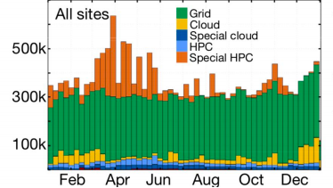

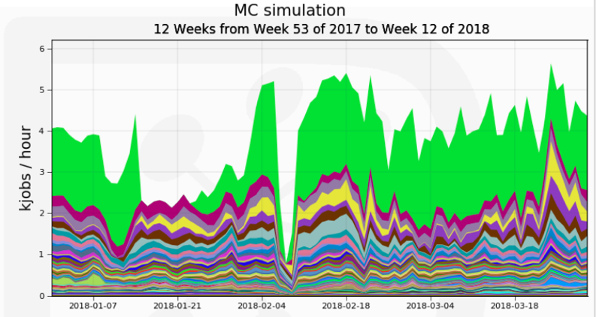

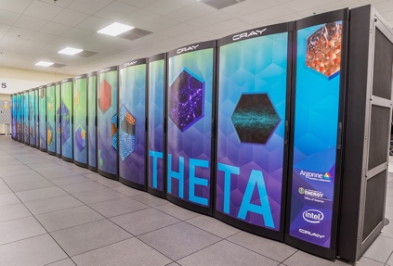
Heterogenous computing
The majority of today’s HEP processing is performed on dedicated clusters of commodity processors (“x86”)
Recently: opportunistic use of many types of compute, in particular HPC systems, and HLT
In future, this heterogeneity will expand; we must be able to make use of all types:
  Non-x86 (esp GPU), HPC, clouds, HLT farms (inc FPGA?)
HPC Use is challenging
HEP engagement with DOE & NSF in USA and
(together with SKA) with PRACE and EuroHPC in Europe
and participating in BDEC2 workshops
HLT

Slide 11
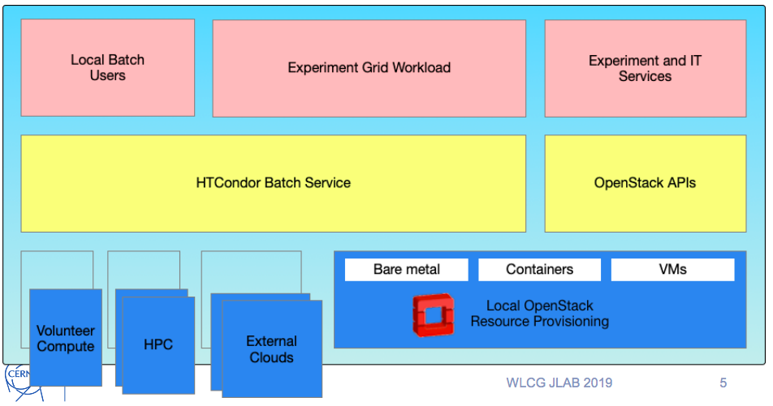
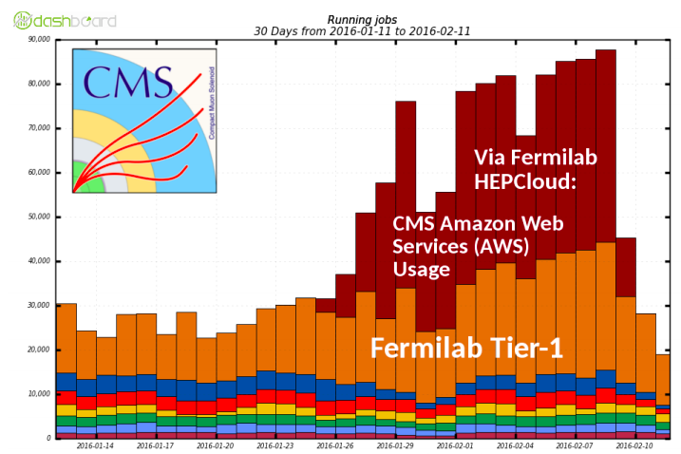
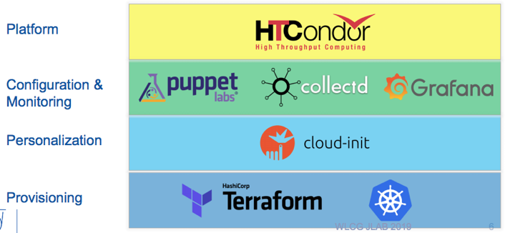

Heterogenous compute
Requires:
  Common provisioning mechanisms, transparent to users
  Facilities able to control access (cost), appropriate use, etc
HPC, Clouds, HLT will not have (affordable) local storage service (in the way we assume today)
  Must be able to deliver data to them when they are in active use
Deployed in a hybrid cloud mode:
Procurers’ data centres
commercial cloud service providers
GEANT network and EduGAIN Federated Identity Management

Slide 12
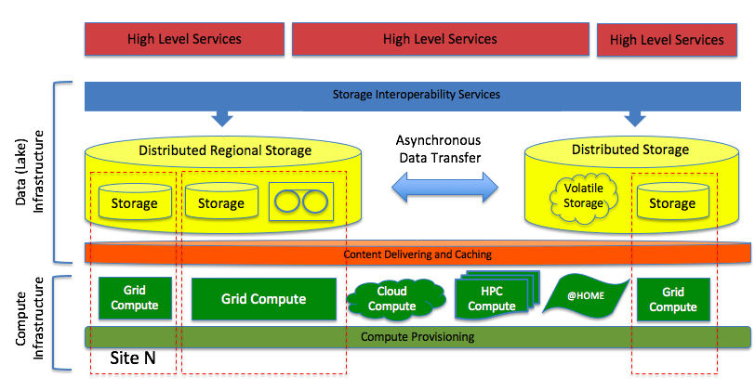
Data delivery “data lake (cloud)”
Idea is to localize bulk data in a cloud service (Tier 1’s ➔ data lake): minimize replication, assure availability
Serve data to remote (or local) compute – grid, cloud, HPC, ???
Simple caching is all that is needed at compute site (or none, if fast network)
Federate data at national, regional, global scales

Slide 13
Data management and storage
Set of R&D projects to prototype such a data management infrastructure – and associated tools
Aims:
  Reduce the global cost of storage (hw and operations)
  Enable a more effective use of existing storage
  Be able to efficiently and scalably deliver data to large, remote, heterogenous, compute resources (LHC Tier centres or HPC, clouds, other opportunistic)
  Build a common set of DM tools that can be used by a broad set of scientific experiments
    Today LHC, DUNE, SKA, Belle-II, GW-3G, and others are all looking at a common set of identified tools
Also collaboratively (LHC+SKA with GEANT) looking at underlying data transfer and network tools (replace gridftp, network protocols, etc.)

Slide 14
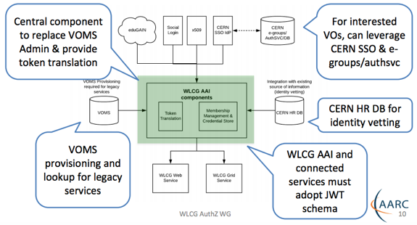
Authentication, Authorization - trust
The grid is based on the idea of identity federation
  “single sign on” in a distributed computing environment
  Credentials issued to a user by a trusted local authority
  Network of trust between all participating institutions and authorities
  Acceptance of the credentials by each resource (storage, compute, service)
  This has been implemented using X.509 certificates as the trusted credential
Authorization:
  Implemented by a service “VOMS”
  that enables access to resources
The success of this model and the
international trust framework has
been instrumental in the success
of the grid model
For the future this is moving to a
“token-based” system – more
common in the rest of the world

Slide 15

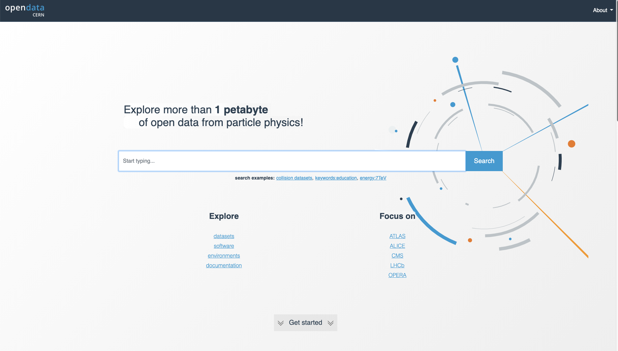
Data preservation, open access
Bit preservation is a solved problem (modulo cost)
Data preservation (reproducibility, accessibility) lacks consistent policies and costing
Open access also lacks consistent policies and is not explicitly funded
  Although required by many funding agencies
There are many use cases of data preservation (for physics) and open access
  Some are coincident – many are not
Long term DP for physics requires evolving the mechanisms and tools used to do analysis
  Cannot afford different solutions
Open access requires policy agreement and appropriate resources
HEP can learn from other sciences who do this well

Slide 16
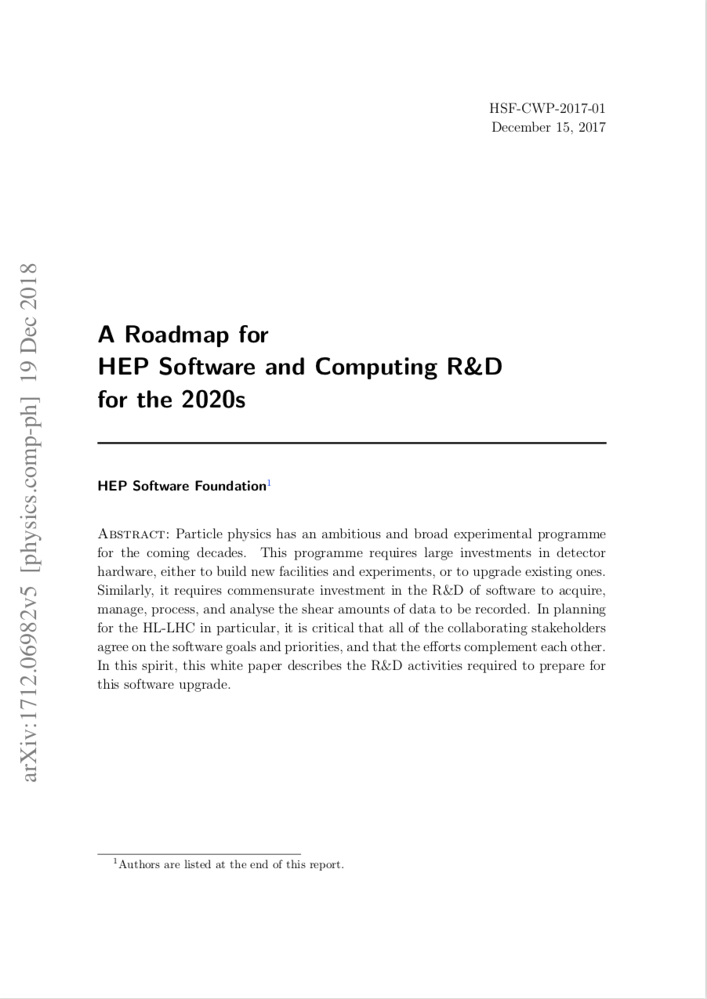
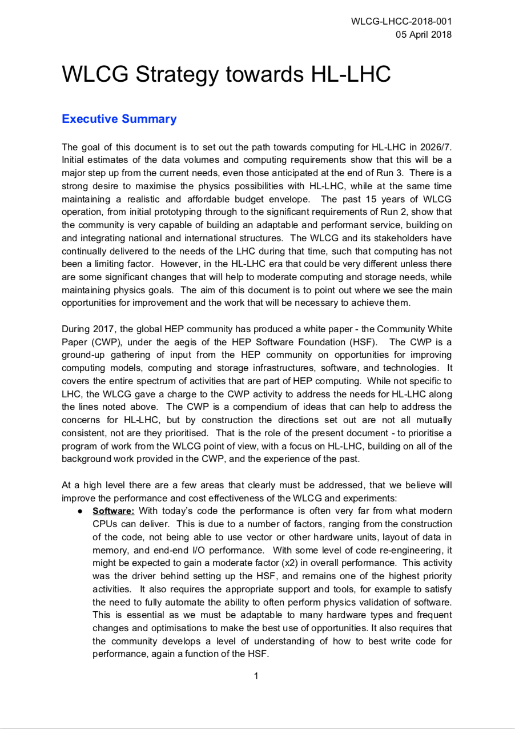
Evolution of HEP computing
https://doi.org/10.1007/s41781-018-0018-8
  https://cds.cern.ch/record/2621698

Slide 17
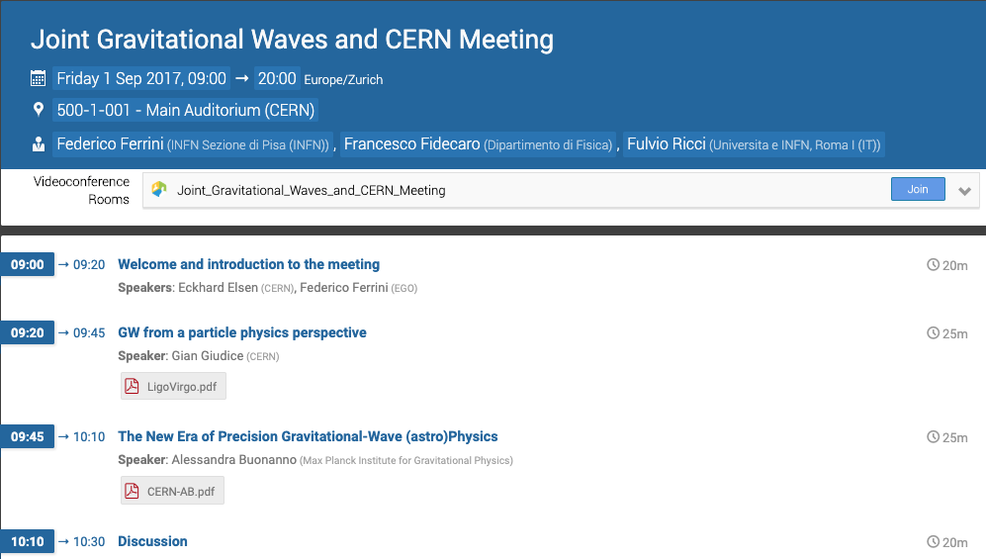
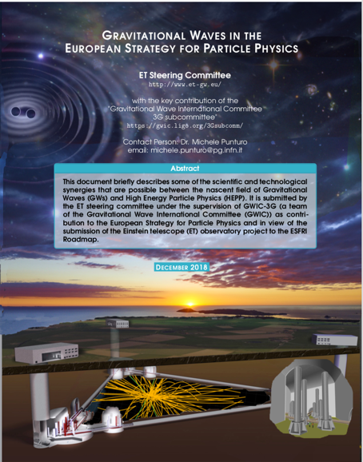
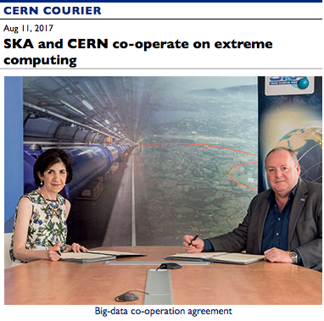
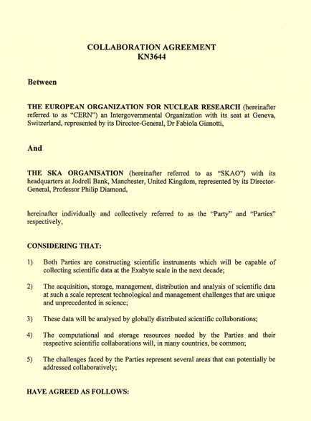

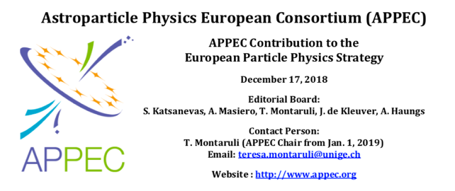
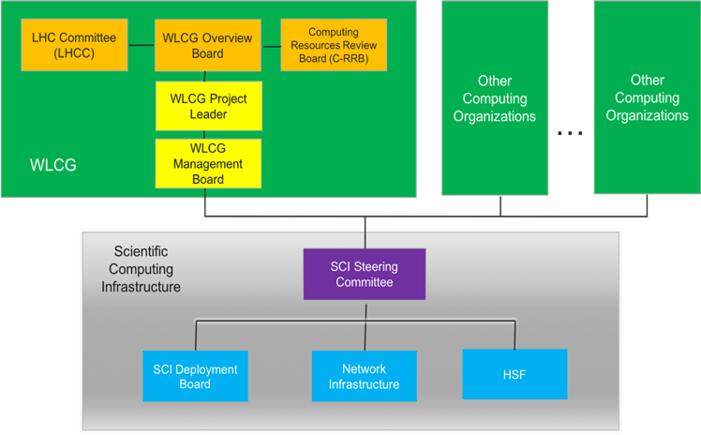
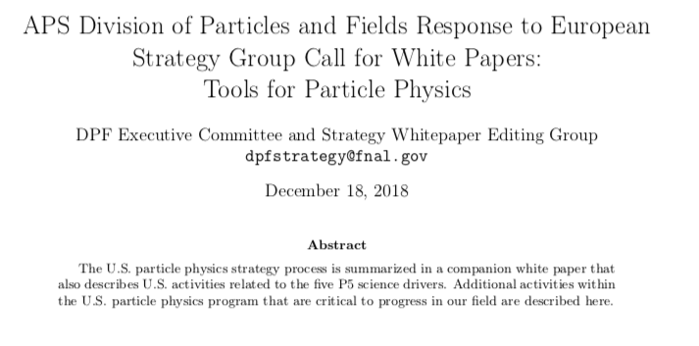

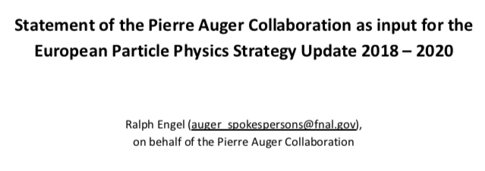
Synergies
#64
#126
DUNE will leverage the WLCG for its computing infrastructure
First formal non-LHC “associate” member of WLCG
Common theme in many contributions is the desire to collaborate with and benefit from LHC R&D work
➔ implies governance evolution
#84
#150
#77
#53
#117

Slide 18
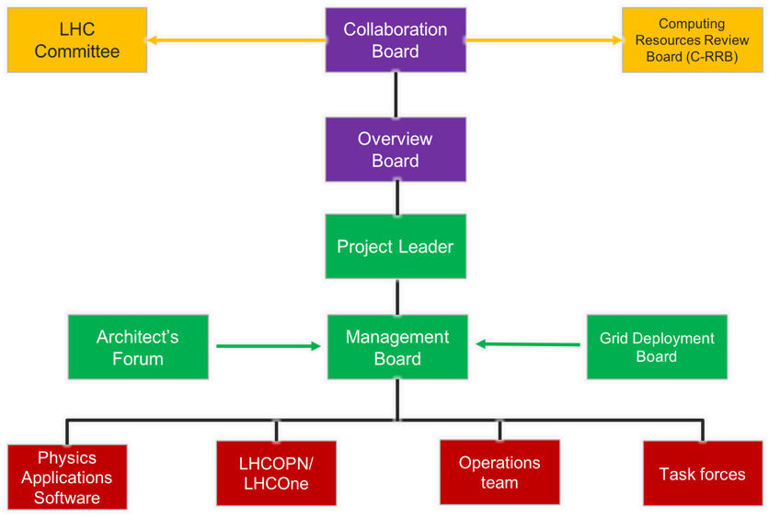
Governance / organization
Contribution #53

Slide 19
Conclusions
The LHC computing models and WLCG have been very successful, and have evolved significantly over 15 years
Many other HEP experiments have collaborated and used the infrastructures and tools (WLCG, EGI, OSG, others)
Strong desire to strengthen the synergies and collaborations for the future – infrastructure, tools, and software

Slide 20
Backup

Slide 21
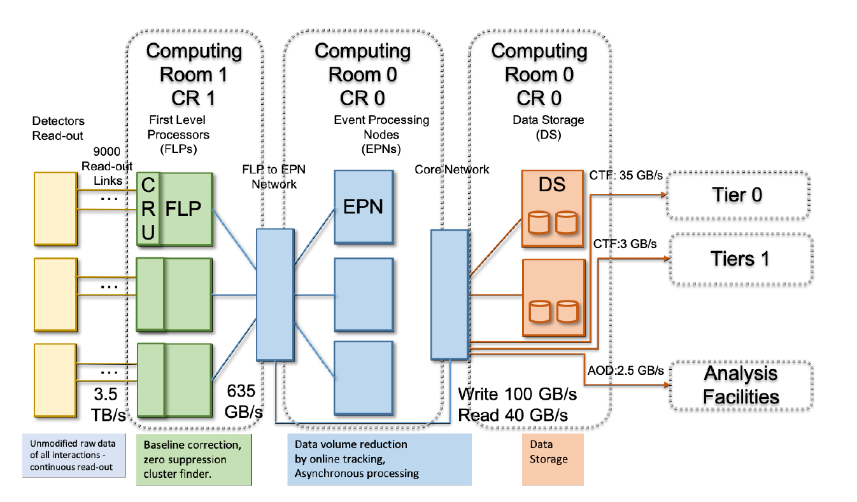
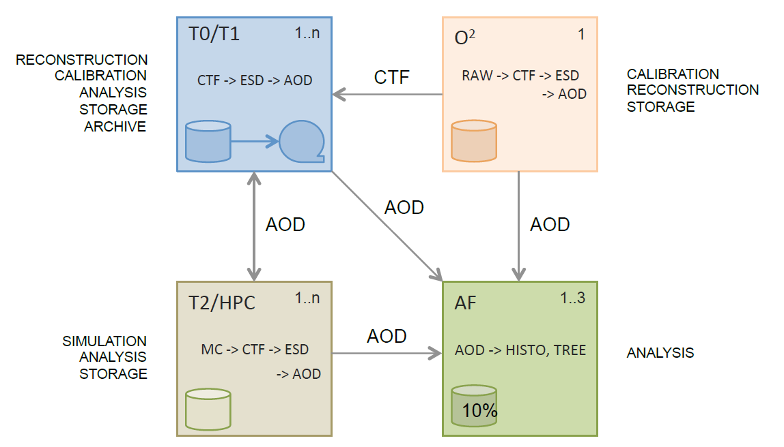
Recent Evolution - ALICE

Slide 22
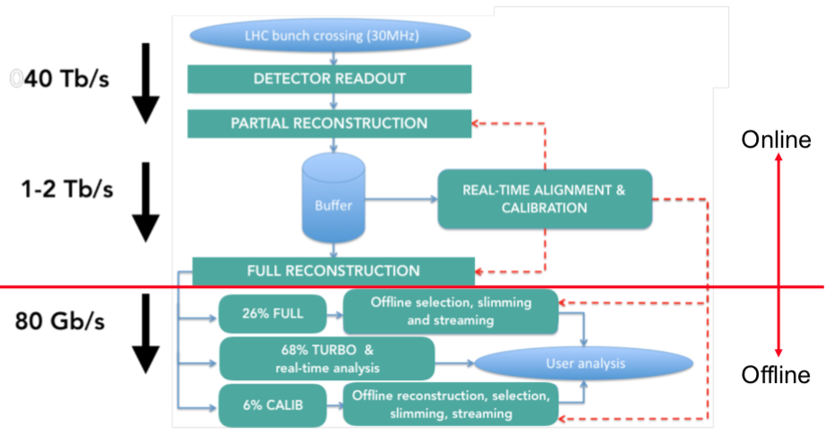
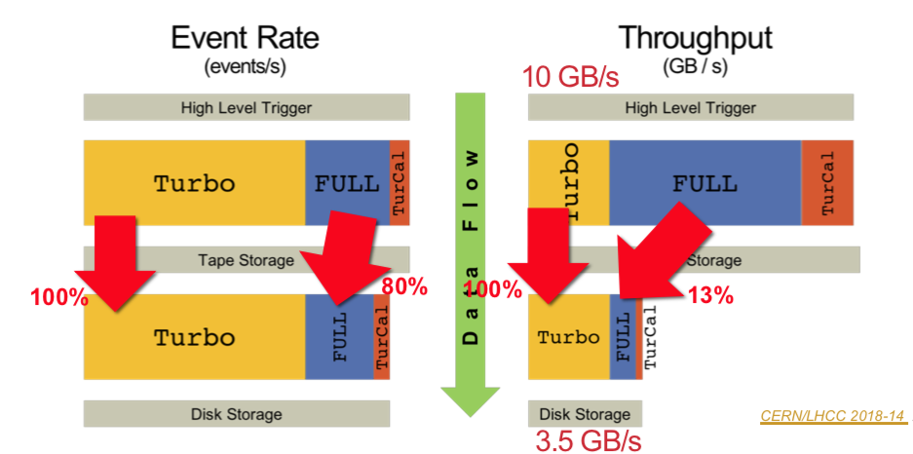
Recent Evolution - LHCb

