Slide 1
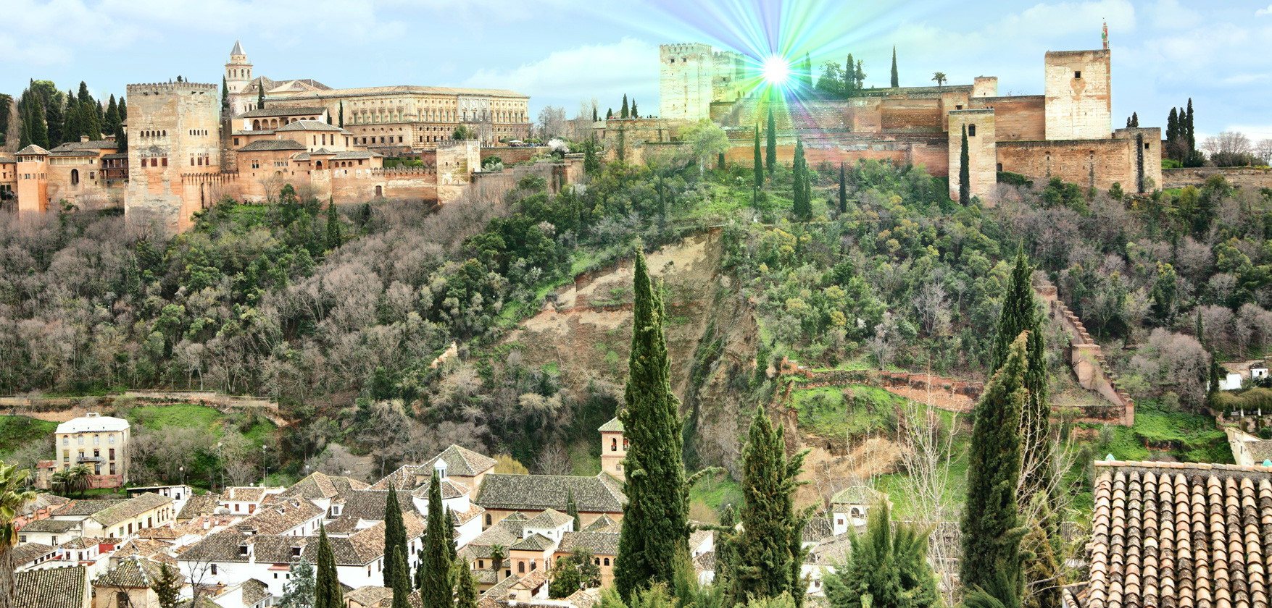



FLAVOUR AND CP VIOLATION IN K
M. Sozzi – University of Pisa
ESPP Symposium – May 13th 2019 - Granada

Slide 2
CP/flavour and Strategy
Shaping the SM
τ − θ puzzle and Parity 1956
The fall of CP 1964
CKM 1973
Charm 1974
Neutral currents 1973
The τ lepton 1975
Beauty 1977
W,Z bosons 1983
Top 1995
Direct CP violation 1999
CP violation in B 2001
The Higgs 2012
CP violation in D 2019
Cracking the SM
Neutrino oscillations 2014
“Tensions/anomalies” ?
Big SM issues
Generations
Neutrino masses
Dark stuff
Missing CPV
…
Flavour is rewarding
and promising
TeV-scale NP + flavour data → MFV
No TeV-scale NP → «anything goes»

Slide 3
Working with kaons
The Kaon legacy
Flavour itself ‘40s
τ − θ puzzle (parity) ‘50s
CP violation ‘60s
Predicting charm ‘70s
T violation (maybe) ‘80s
“Best” CPT limit ‘80s
Direct CP violation ‘90s
“Best” FV limits ‘90s
SM physics with kaons
“Minimal flavour laboratory”
Low mass (~ Λ_{QCD}) hadron
PQCD does not work
hard (have effective “theory”)
Same CPV as everywhere
(“small effects on large BRs”)
Long (really long) life
versatile (CPV realization and experimentally accessible states)
Small number of decay modes
(and backgrounds, and people)
Quite specific questions posed
(usually no “general purpose” experiment)
“But not quantitative enough…”
Kaons back with a revenge
as XXI century precision probes:
Semi-leptonic decays with ℓ⁺ℓ⁻
It’s usually hard

Slide 4
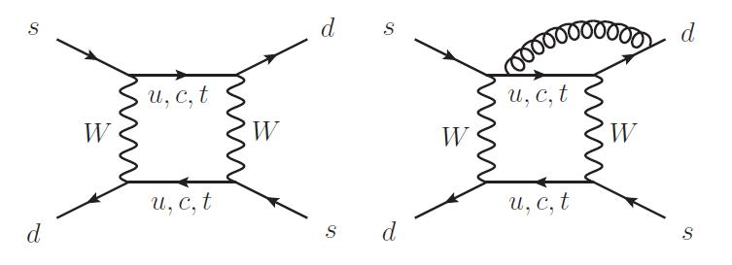
ε_{K}
2007
Strong dependence on |V_{cb}|
The ball is on the lattice side for quantitative checks (B_{K} now determined to ~2%)
No exp. improvements foreseen
(but possible in principle)
2003-2010: “Kaon BR revolution”
Proper treatment of radiative corrections and correlations
Several 10⁴ evts/experiment
ε_{K} = (2.228 ± 0.011)· 10⁻³
Trust theorists (sort of),
but not their schedules
measured to 0.5%
Notes:
CKM fitter new, theory

Slide 5
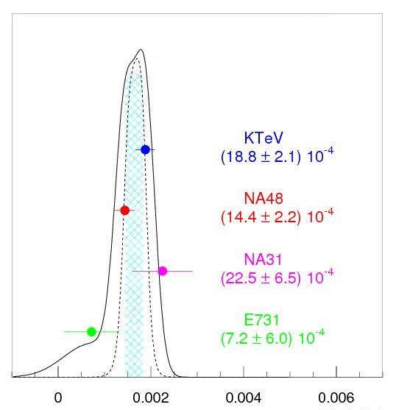
ε’
Re(ε’/ε) = (16.4 ± 1.9) · 10^{–4}
χ²=5.3/3
Including ΔI=3/2 correction
[PDG scaled error]
(BR=2.0∙10^{–3}) O(10⁷) events
Direct CP violation established at 9 σ
after a 36-year long experimental program
with 4 generations of experiments
14% consistency, no plans for new experiments
Again, the ball is on theory
SM prediction has been a 20-year challenge for lattice QCD
Accidental cancellation of EW and Z penguins
Short-distance part NLO → NNLO
Progress on matrix elements: B determined to 5-30%
Some trouble here:
e.g. SM: ε’/ε < (6.0 ± 2.4) ∙10^{–4} 3σ away
It can be pretty hard for both th and exp

Slide 6
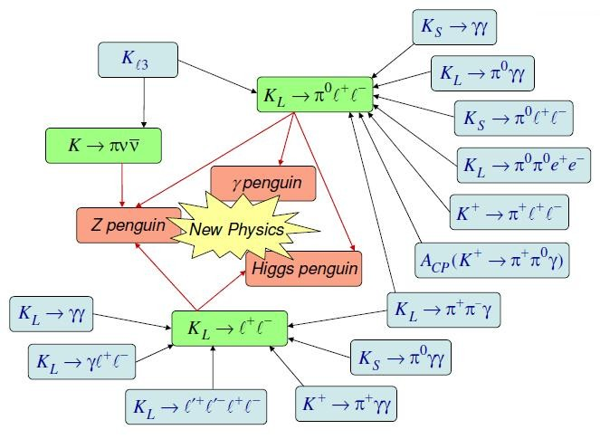
Precision
K probes
7%
0.8%
Im
−
−
(ρ, η)
---
3%
−
K → (π)ℓ⁺ℓ⁻
α
50%
70%
BR(K_{L} → π⁰νν)
BR_{SD}(K_{L} → π⁰ℓ⁺ℓ⁻)
BR(K⁺ → π⁺νν)
---
The full picture:
−
γ
β
3-7%
BR_{SD}(K_{L} → μ⁺μ⁻)
Re
---
charm
0.7%
2-70%
4%
Kaon measurements alone can fully constrain the unitarity triangle
Comparison with B physics can provide description of NP couplings
3-4%
35%
6-10%
6%
Decay | Γ_{SD}/Γ | Theory err. | SM BR ×10⁻¹¹ | Exp BR ×10⁻¹¹
K_{L} → µ⁺µ⁻ | 40% | 20% | 681 ± 32 | 684 ± 11
K_{L} → π⁰e⁺e⁻ | 40% | 10% | 35 ± 10 | < 28 @90%CL
K_{L} → π⁰µ⁺µ⁻ | 30% | 15% | 14 ± 3 | < 38 @90%CL
K⁺ → π⁺νν | 90% | 3.6% | 9.3 ± 0.8 | 17 ± 12
K_{L} → π⁰νν | >99% | 1.5% | 3.7 ± 0.7 | < 240 @90%CL

Slide 7
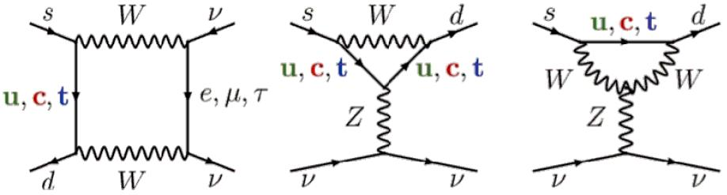
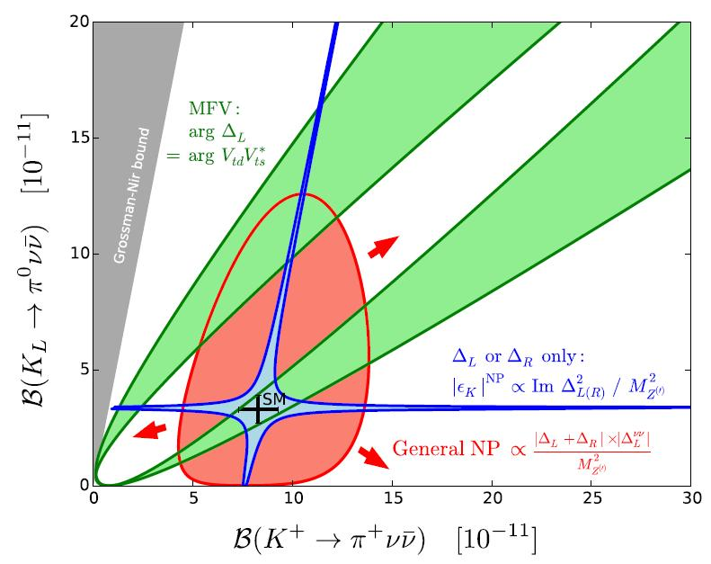
Why K → πνν ?
Only EW penguin/box, GIM, t-loop dominates,
c-contribution to CPC charged mode, hadronic ME
obtained from expt.
Uniquely clean and predictable BR, both in SM (NLO and NNLO corrections) and beyond
Probe NP mass scales ~ 100 TeV
Deviation pattern correlated to
NP model
MFV-class models
All the rest
LH or RH
models
Grossman-Nir bound
Γ(K_{L}→π⁰νν) < Γ(K⁺→π⁺νν)
w. isospin correction
BR(K_{L}→π⁰νν) < 1.45 · 10⁻⁹

Slide 8
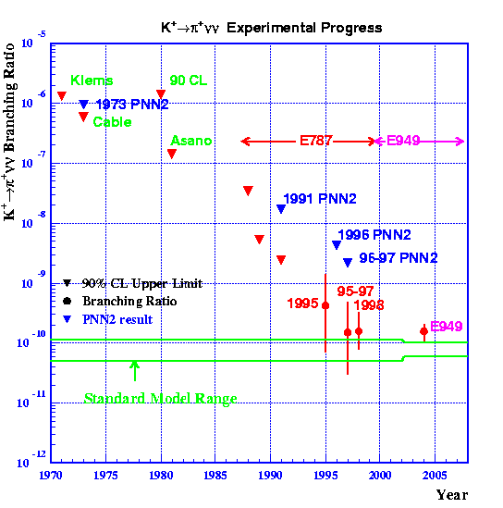
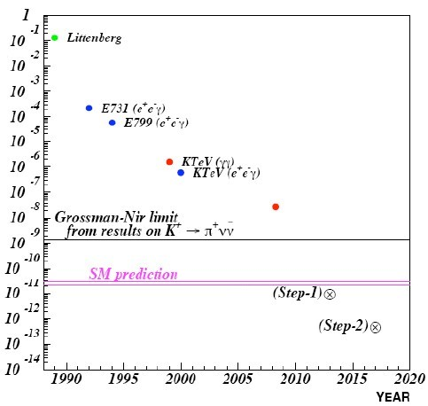
The long K→ πνν march
“The best it can be said is that so far nobody demonstrated conclusively that the measurement is impossible”.
First search: 1969 (10⁻⁴)
Observation: 1997 (10⁻¹⁰)
K⁺→ π⁺νν
K_{L}→ π⁰νν
© C. Smith
NA62 2018
E391a
KOTO 2019
KOTO
KOTO
NA62 goal
It takes time

Slide 9
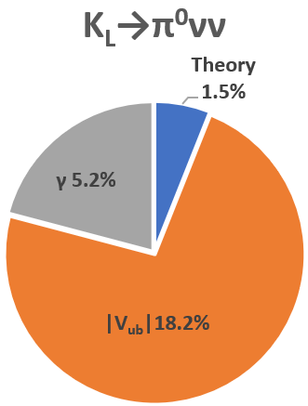
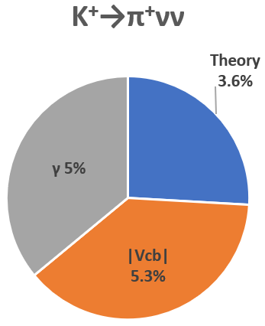
K → πνν landscape
K_{L}→π⁰νν
SM BR = (3.74 ± 0.72) × 10⁻¹¹
Exp BR < 3.0 × 10⁻⁹
Bound: BR < 1.45 × 10⁻⁹
World sample: 0 events (0.42 bkg)
K⁺→π⁺νν
SM BR = (9.31 ± 0.76) × 10⁻¹¹
Exp BR = 17.3^{+11.5}_{−10.5} × 10⁻¹¹
World sample: 8 events (2.26 bkg)
Errors dominated by CKM: 6% γ,
2% |V_{cb}|, 9% |V_{ub}| (incl/excl)
(Expect x1/2 LHCb and Belle II)
Correlations (among these and
B→µ+µ−, ε, ε’/ε, sin 2β) can be
found which are independent
of given CKM inputs
It’s quite tough

Slide 10
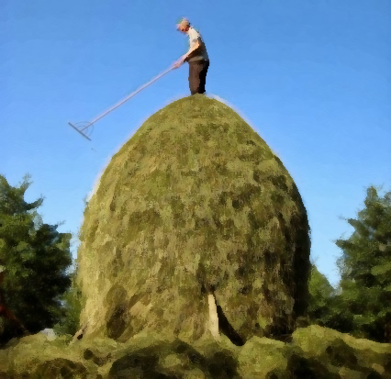

K → πνν now
KOTO
E787/E949
“Kaon physicist at work”
Oil on canvas, 2019

Slide 11

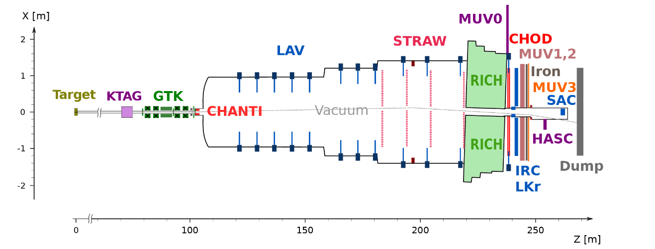
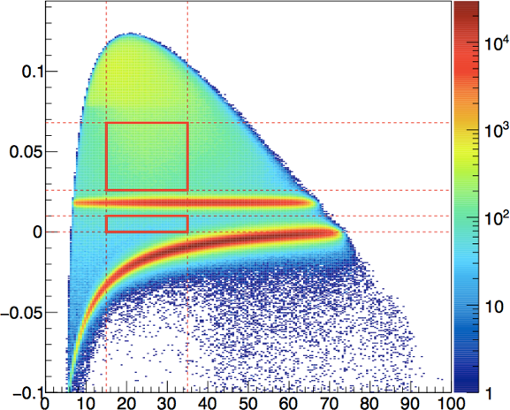
NA62 @ CERN
K⁺→π⁺νν
New high-energy decay-in-flight approach (larger acceptance, better vetoing)
75 GeV/c 750 MHz beam (6% K)
100m long detector
80m long fiducial region
K⁺ identification and tracking
Single track in final state
- kinematics
- π⁺ identification (ε_{μ} ~ 1· 10⁻⁸)
- γ rejection (ε_{π0} ~ 2.5 · 10⁻⁸)
Goal: 10% measurement of BR

Slide 12
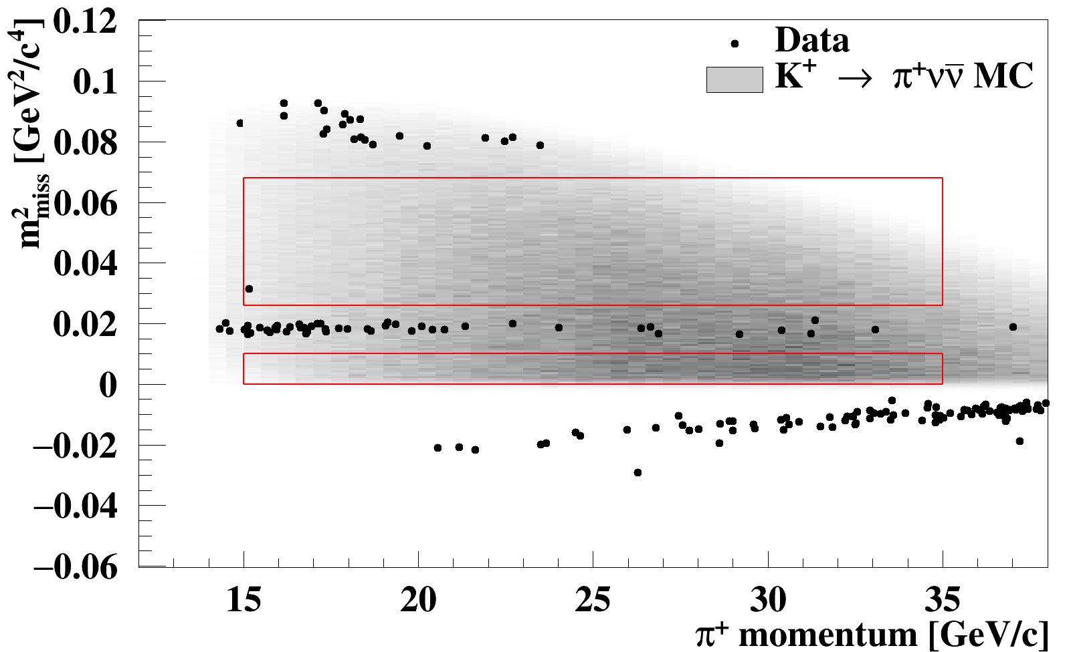
First NA62 limit (2019)
Analysis of first 2016 data (2%):
1-1.3· 10¹² ppp (30-40% nominal)
1.2· 10¹¹ K decays
3.5% acceptance & eff
24% random veto
SES = 3.15· 10⁻¹⁰
Expected signal (SM): 0.267
Expected bkg: 0.15
Background source | Expected events
K⁺ → π⁺π⁰ (γ_{IB}) | 0.064
K⁺ → μ⁺ν (γ_{IB}) | 0.020
K⁺ → π⁺π⁻e⁺ν | 0.018
K⁺ → π⁺π⁻π⁺ | 0.002
Upstream background | 0.050
Total | 0.15 ± 0.09
1 event observed (in Region 2)
BR < 14· 10⁻¹⁰
Proof of the technique
Another way
is possible

Slide 13
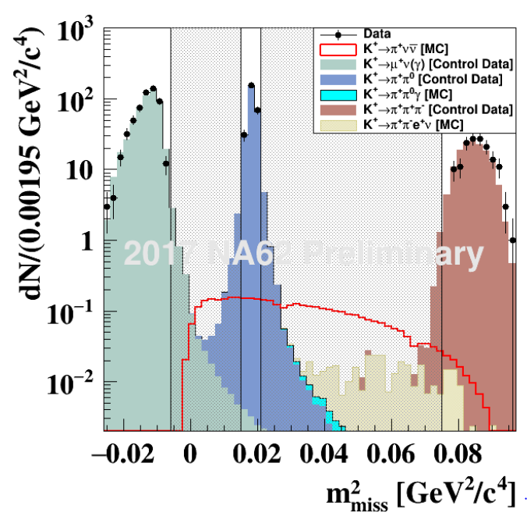
NA62 prospects
Analyzing 2017 data (x10):
1.7-2· 10¹² ppp (50-60% nominal)
Longer run, reduced inefficiencies,
37% random veto, comparable background
13· 10¹¹ K decays, SES = 0.34· 10⁻¹⁰
Expected signal (SM): 2.5
Aim at surpassing BNL result in 2019
Collected 2018 data:
2-2.3· 10¹² ppp (60-70% nominal)
+35% longer data-taking
~40· 10¹² recorded K decays
Tested at 100% nominal beam intensity
Deep into the learning curve
Complete data-taking in run 3 (2021+) to reach 10% measurement
Analysis improvements, test DAQ for higher intensities
Discussions on possibilities for ultimate measurement

Slide 14

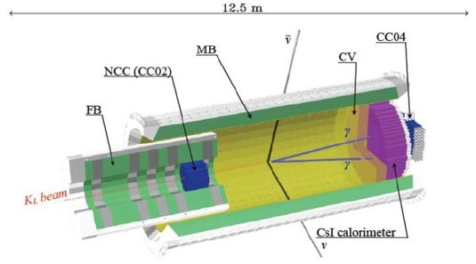
KOTO @ J-PARC
K_{L}→π⁰νν
Successor of E391a @ KEK
Higher beam intensity, acceptance
Lower DC, larger angle, better n/K
<p> = 1.4 GeV/c “pencil beam”
Yield: 2.1· 10⁻⁷ K_{L}/p
18m long detector, 1.7m long fiducial region
Upgraded E391a detector
Improved background control:
new EM calorimeter, new charged vetos, new beam-hole γ veto
Step 1 (present machine, present detector) goal: reach SM-level SES
First limit (2013 data)
(24 kW, 1.6· 10¹⁸ pot, 7.7· 10⁹ K_{L})
SES = 1.28· 10⁻⁸
Expected background: 0.34
0 events
BR < 5.1· 10⁻⁸ (~ E391a)
Notes:
KOTO proposal

Slide 15
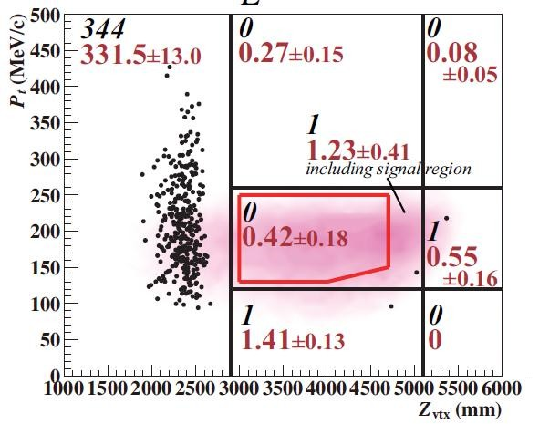
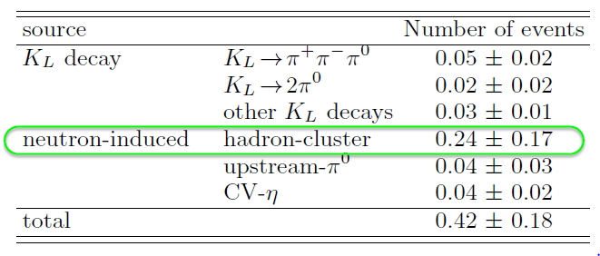
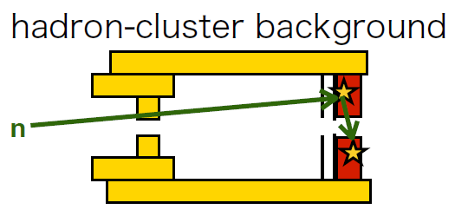
Second KOTO limit (2019)
Analyzed 2015 data:
42 kW beam power
2.2· 10¹⁹ pot (x14), 1.5· 10¹¹ K_{L}
0.7% acceptance & eff.
−17% random veto
SES = 1.3· 10⁻⁹
Expected SM signal: 0.023
Expected background: 0.42
0 events
BR < 3· 10⁻⁹
Be ready to cope with the unforeseen

Slide 16
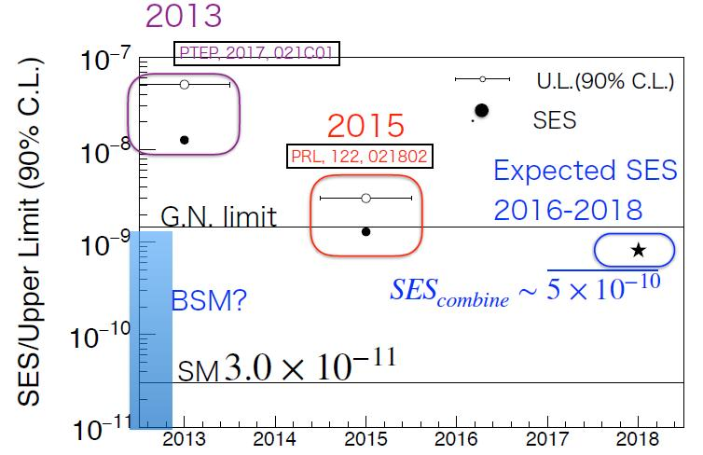
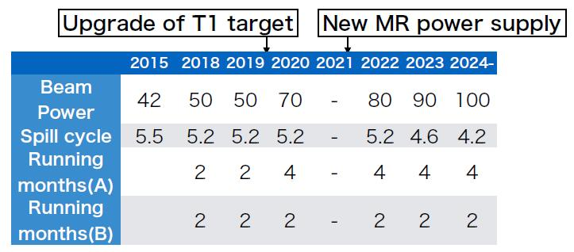
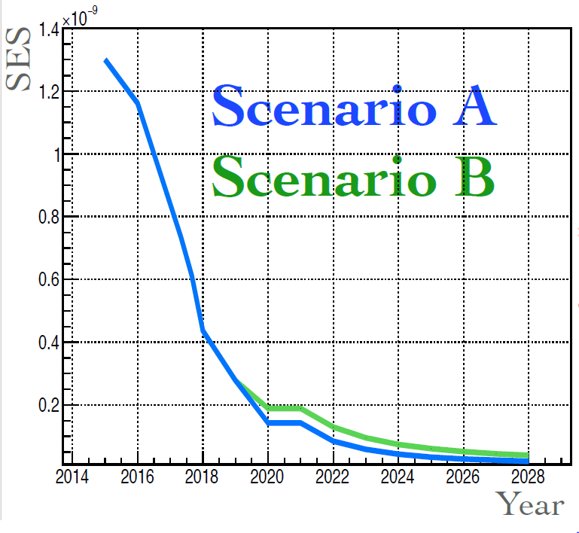
KOTO prospects
Analysis of new 2016-18 data (x1.4):
Further detector/readout upgrades
SES = 8.2· 10⁻¹⁰ (x 1.6)
Expected background: 0.20
New limit in 2019
(expect to cross Grossman-Nir limit)
Collecting more data
Collecting more data
→ 100 kW beam
It always takes longer

Slide 17
K → πνν future (mid 2020)
Educated guesses
NA62
KOTO

Slide 18
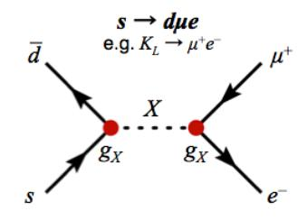
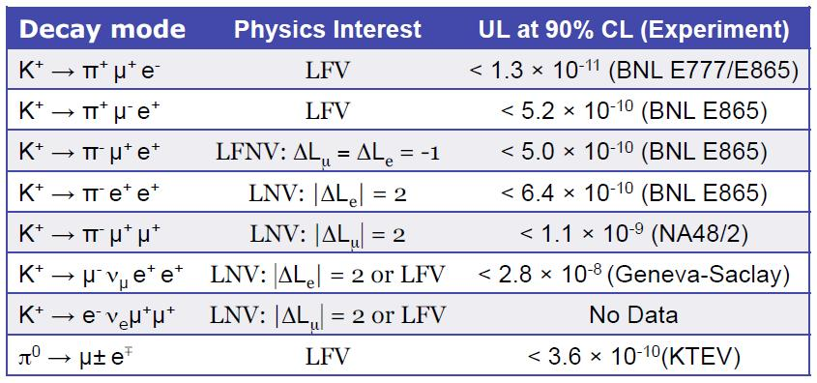
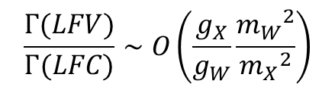
Intermezzo: LFV and more
«Single-measurement experiments?»
LFV decays: unmeasurable rates within SM → good probes for NP
K offer: high statistics, clean signatures, controllable backgrounds
sensitivity to 10⁻¹² level BRs
< 8.6 x 10⁻¹¹
< 2.1 x 10⁻⁸
For g_{X}~g_{W} a 10⁻¹² BR
probes m_{X}~100 TeV
Most of these expected to improve with current expts.

Slide 19

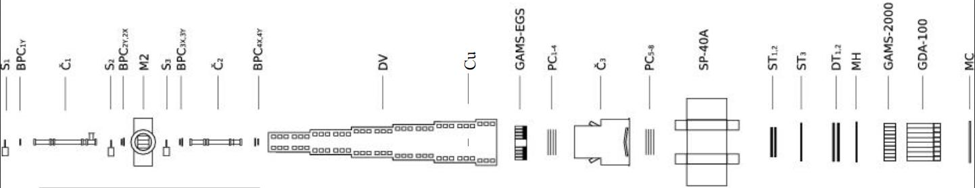
OKA @ IHEP
Panofsky (RF)-separated beam, 18 GeV/c with 5· 10⁵ K⁺/3s (12.5%)
Analyzing 2011-2013 data, O(300M) K⁺ decays in detector
Focusing on radiative and semileptonic decays:
K⁺ →μ⁺νγ (22K → 95K events, aim at 300K)
K⁺ → π⁺π⁺π‒γ (7 → 450 events, aim at 5K)
K⁺ → π⁰ℓ⁺νγ (T-odd correlations)
K⁺ → π⁰e⁺ν (1M → 5M, aim at 10M)
Ran in 2018. Detector upgrade and next run in 2020

Slide 20
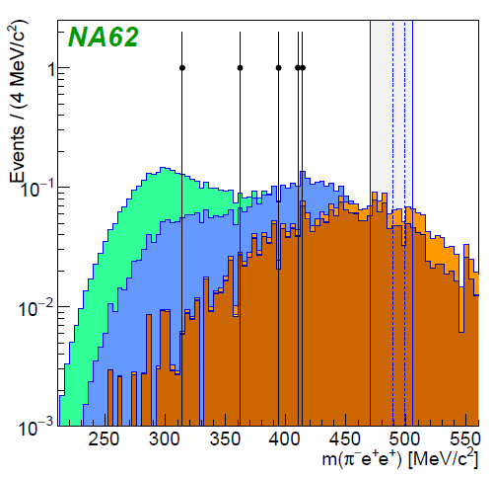
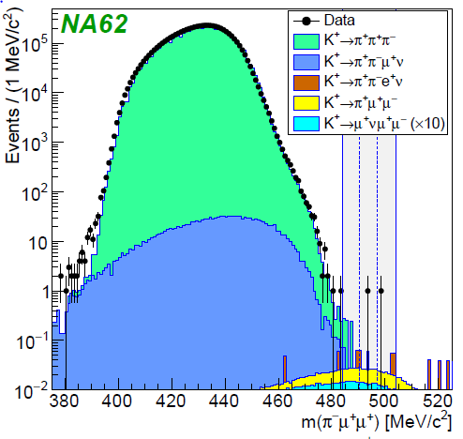
LFV K decays
Representative xample: byproduct results from NA62 (not a multi-purpose exp.):
K⁺ → π⁻e⁺e⁺
K⁺ → π ⁻µ⁺µ⁺
BR(K⁺→π⁻e⁺e⁺) < 2.2· 10⁻¹⁰
2· 10¹¹ K decays in fiducial region
BR(K⁺→π⁻µ⁺µ⁺) < 4.2· 10⁻¹¹
8· 10¹¹ K decays in fiducial region
Not background-limited, x3 more data
Reach into
You never know where NP lurks

Slide 21
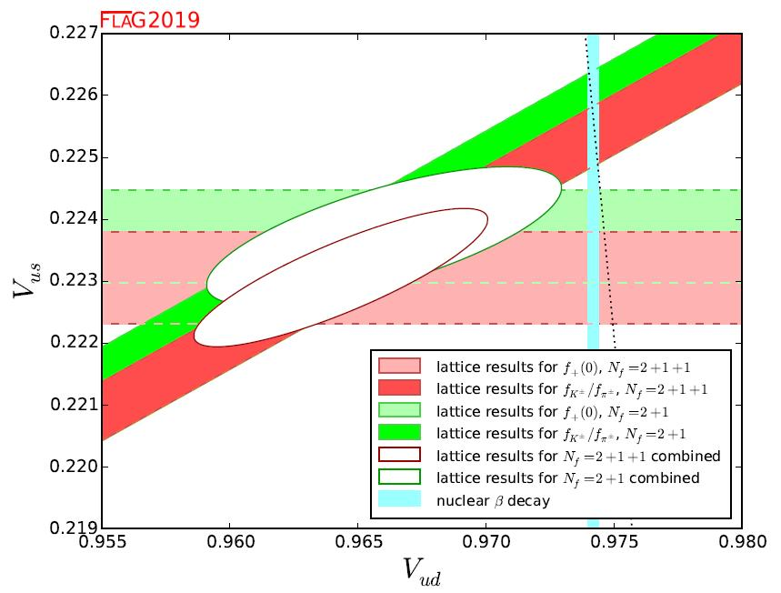
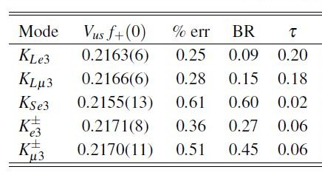
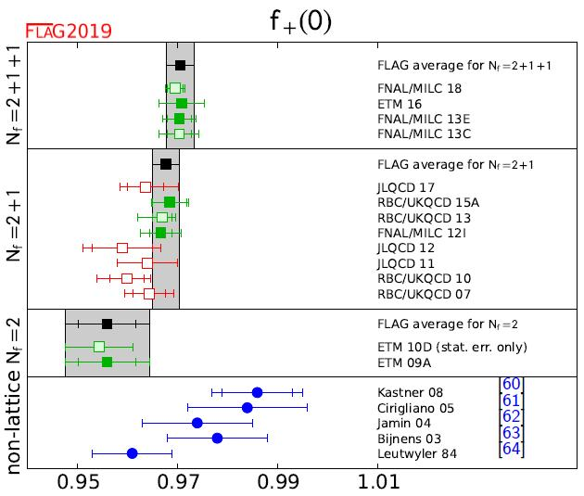
Vus, unitarity
(Semi)-leptonic decays + lattice
K_{ℓ2}/π_{ℓ2}
K_{ℓ3}
Unitarity
β
|V_{us}| = (0.2249±0.0007)
Known at 0.3%, Expt better than 0.2%
Unitarity OK at ≈ 2.2σ (error from |V_{ud}|)
Some stuff you get (almost) for free
Samples: several M
Might improve
Notes:
Moulson leggere, FLAG

Slide 22
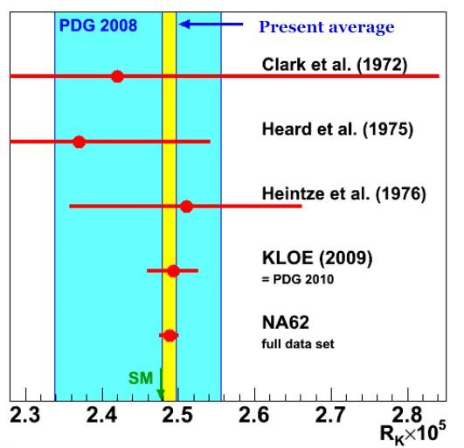
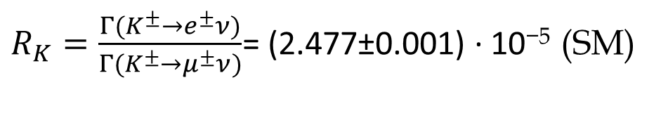
Lepton flavour universality
Helicity-suppressed K_{ℓ2} decays: K±→e±υ K±→ μ±υ
$R_{K}=\frac{Γ(K^{±}→e^{±}ν)}{Γ(K^{±}→μ^{±}ν)}$= (2.477±0.001) · 10⁻⁵ (SM)
KLOE (2009): 14K events, 16% bkg
NA62 (2013): 147K events, 11% bkg
x10 improvement , consistent with SM
0.4%, stat/syst dominated
NP potential still open (factor 10)
J-PARC TREK stopped K⁺:
(took data 2015) aim at 2.5 per mille
CERN NA62 (phase 2) in-flight K⁺:
better vetoing, resolutions, PID
Systematically challenging, different expt. issues
Notes:
Moulson leggere, FLAG

Slide 23

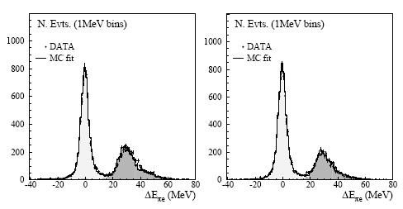
K_{S} decays
Semileptonic K_{S} decays
BR(K_{S}→πeν) = (7.05 ± 0.09) × 10^{–4}
(Indirect) CPV charge asymmetry:
π–e⁺ν
π⁺e–ν
CPT test by comparison to δ_{L}(e) (still far from being significant)
KLOE (2001-02 data, 410 pb⁻¹):
first observation, 13K events
Highly valuable for V_{us}
(precise K_{S} lifetime)
(Indirect) CPV K_{S} → 3π⁰ (SM expect.: 2 x 10⁻⁹ )
KLOE + KLOE2: 8 fb⁻¹
Excellent K_{S} factory but...
strong competitor
KLOE (2004-05 data): 1.7 fb⁻¹, 0 events
BR(K_{S}→3π⁰) < 2.6 × 10^{–8} (90% CL)
Notes:
Moulson leggere, FLAG

Slide 24

K_{S} decays at LHC
LHCb:
- large cross-section for K (~10¹³ K_{S} per fb⁻¹, 40% decay in VELO)
- good capabilities for µ channels
- very high boost (acceptance: 1% for K_{S} → μμ)
- ultimate reach on paper (upgrade-II): O(10^{‒15}) BR for K_{S} (that’s tough)
- K_{L} at most 1% of K_{L} (hardly competitive)
K_{S} → μμ (LD, not quite like B), SM (5.2±1.5)·10⁻¹²:
with 3 (2011-12) out of 8 fb⁻¹
Can approach SM with (300 fb, possible upgrade-II)
K_{S} → πμν (valuable for V_{us}): never observed, SM 4.7· 10^{‒4}
K_{S} → πμμ (useful for K_{L}): BR = (2.9 ± 1.4)· 10^{‒9} (NA48)
Expected error down to (at most) 0.25 (0.10)· 10^{‒9} in phase I (phase II)
K_{S} → ππee (CPV search): BR = (4.79 ± 0.15)· 10^{‒5} (NA48 23K events)
Expect 50K events/fb^{‒1}
BR(K_{S}→µ⁺µ⁻) < 8·10⁻¹⁰ (90% CL)
Notes:
Moulson leggere, FLAG

Slide 25
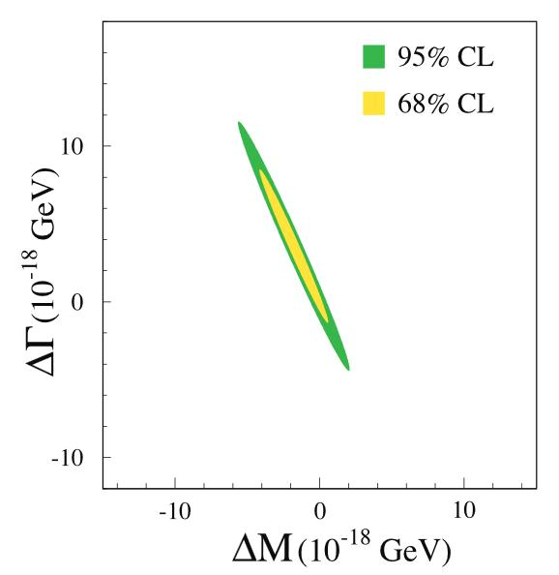
T/CPT tests
Kabir test for T-violation:
CERN CPLEAR (1998):
T
⟨A_{T}⟩ = (6.6 ± 1.3)· 10^{–3}
T
ISTRA+ (2007): 4K events
NA62: O(10⁵) events
T-asymmetries in K⁺→π⁰e⁺υγ decay
Transverse μ⁺ polarization in K⁺→π⁰μ⁺υ decay
Tiny SM contribution (≈ 10^{–7}), small FSI (≈ 10^{–5}):
good window for NP search
40 years of experimental history
J-PARC E06 (TREK): proposal for σ(P_{T}) ≈ 10⁻⁴
(requires 300 kW & new separated beam-line)
Now considering new concept at present machine
KEK E246 (2004):
P_{T} < 5· 10^{–3}
T
“Best” CPT limit: Δm_{K}/m_{K} < 6· 10⁻¹⁹
No new experiment
Old CP/T proposal: CPT experiment
with Λ~ M_{Pl} reach
CPT
Notes:
TREK proposal

Slide 26
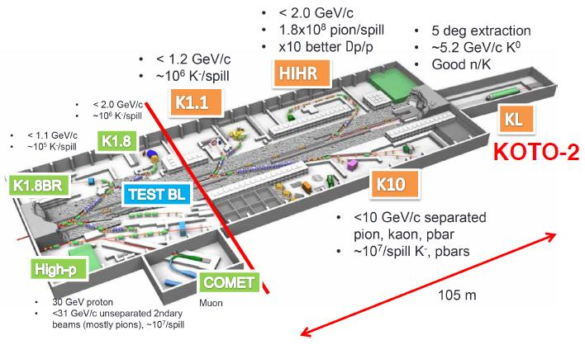
KOTO Step-2 @ J-PARC
K_{L}→π⁰νν
Now using 50% of protons
Increase to 100kW
Extension of Hadron Experimental Facility: O(140) M$: considered among JP priority projects (not yet approved nor funded)
2 new targets, 4 new lines
Higher beam power, better extraction
Smaller angle (16 °→ 5°) beam line
<p> = 5.2 GeV/c, 10⁸ K_{L}/5.2 s
New, larger detector (2m x 2m → 3m x 11m), larger acceptance
KOTO Step 2: ~30 SM events (S/B ~ 5) in 3 years
No official proposal nor time estimate yet (203x)

Slide 27

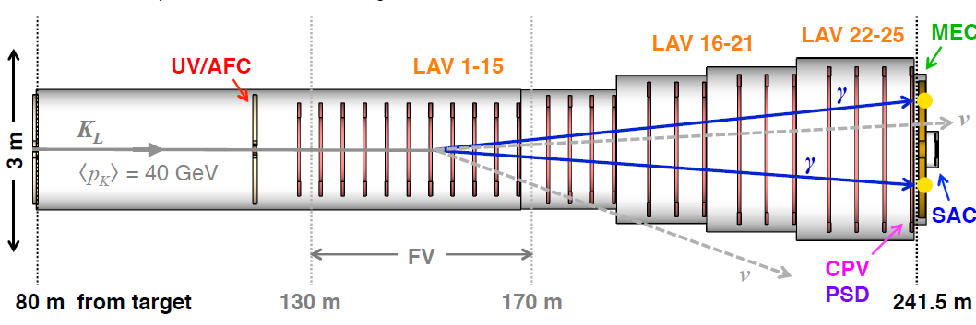
KLEVER @ CERN
K_{L}→π⁰νν
A 20% BR measurement exploiting existing infrastructure (SPS machine, NA62 hall)
after completion of NA62
400 GeV/c p targeting at 8 mrad, 2.1· 10⁻⁵ K_{L}/p (100x KOTO)
Need 5· 10¹⁹ p (~2· 10¹³ ppp, ~6x NA62)
High-energy approach (complementary to KOTO): <p> = 40 GeV/c
easier photon vetoing (coverage up to 100 mrad), longer (~ NA62) detector
40m fiducial region, 0.2% acceptance
Challenging veto detectors, overall cost estimate ~40 M
SPS can deliver 3x the required protons. Beam-line upgrade: 1-10 M
KLEVER: ~60 SM events (S/B ~ 1) in 5 years
Might take data in Run 4 (2026), preparing EoI

Slide 28
K → πνν next++ (203x)
MAYBE ?
KOTO Step 2
KLEVER

Slide 29
What about silver modes?
K_{L}→π⁰e⁺e⁻ , K_{L}→π⁰μ⁺μ⁻
Theoretically less clean but quite complementary (γ/H penguins)
BR prediction requires many experimental inputs (many roughly secured)
In principle they allow more insight through spectra
K_{L}→π⁰e⁺e⁻: (35±10)· 10⁻¹¹ (SM) < 28· 10⁻¹¹ (KTeV 2004)
Irreducible K_{L}→γγe⁺e⁻ QED background (BR = 6· 10⁻⁷)
Exploit K_{S}/K_{L} interference?
K_{L}→π⁰µ⁺µ⁻: (14±3)· 10⁻¹¹ (SM) < 38· 10⁻¹¹ (KTeV 2000)
Irreducible K_{L}→γγµ⁺µ⁻ QED background (BR = ~10⁻⁸)
Might turn out to be more tractable
A «do-it-all» K_{L} experiment is quite hard to realize in practice:
dedicated solutions required at these BR levels
Still: sinergies/advance planning/staging are conceivable

Slide 30
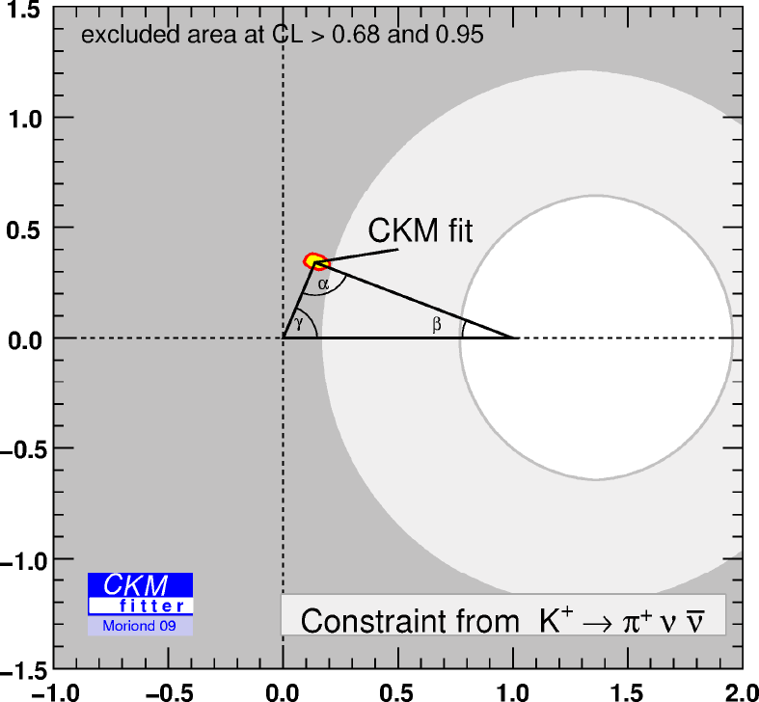
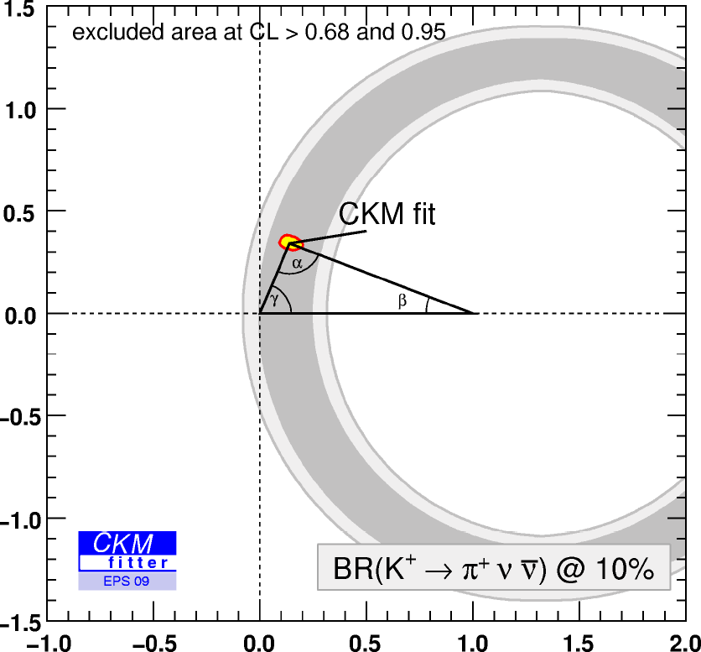
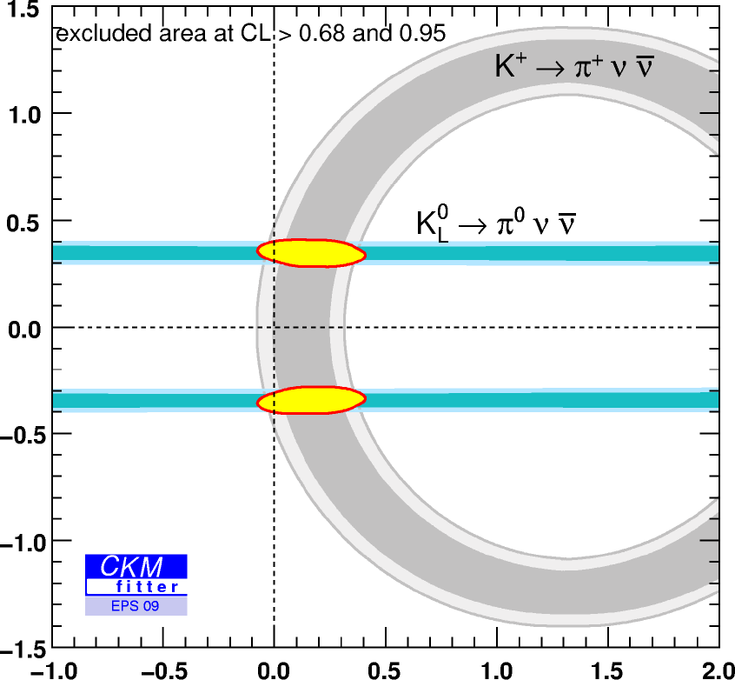
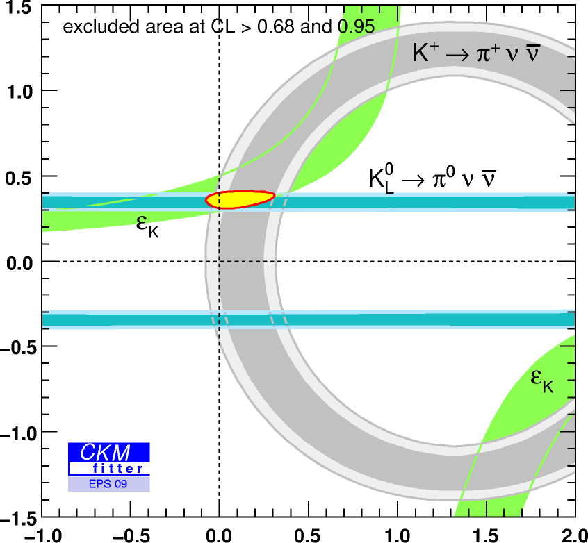
Impact on UT
Using only K measurements
From current K⁺→π⁺νν
to 10% K⁺→π⁺νν (202x)
to 15% K_{L}→π⁰νν (203x)
(with no quadrant ambiguity)
Improvements on
“tree-dominated”
CKM elements
γ, V_{ub} and V_{cb} coming
in parallel

Slide 31
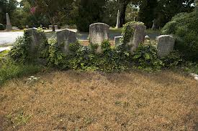
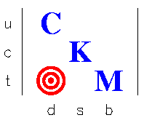



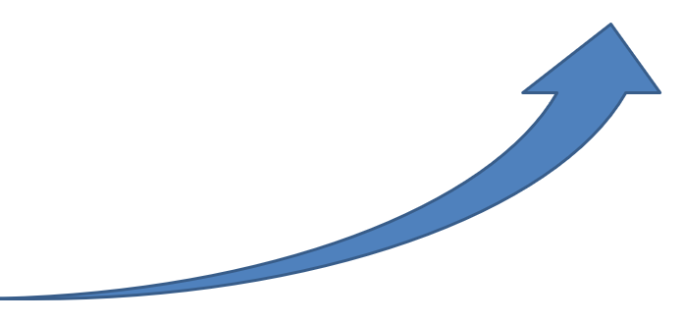



Im K
K → πνν landscape
KAMI
US: strong interest
and (too) many casualties
Step-by-step progress,
systematic pursuit
5% ?
15%
15%
K_{L}
K_{L}
CERN
J-PARC
5% ?
2
10%
100%
100%
K⁺
K_{L}
K⁺
K_{L}
CERN
J-PARC
BNL KEK
E949 E391a
Re K

Slide 32
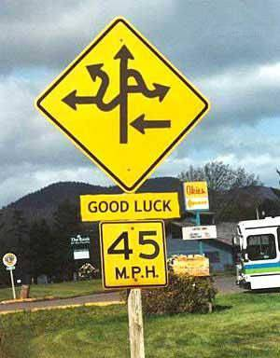


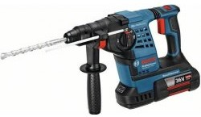

The road ahead
Fixed-target experiments have the potential:
K⁺: discovery experiment done, 10% experiment running
K_{L}: discovery experiment running, two experimental plans
for ~15% experiment in 203x
People: dedicated teams all over the world
- proficient and passioned US community wounded but not killed
- small but forceful and dedicated Japanese community
- dedicated community working at CERN aiming at complete exploitation of the entire potential of K
Power tools:
- CERN SPS at 160kW and 4· 10¹³ 450 GeV p still strong potential,
could accommodate multiple experiments (e.g. KLEVER = ¼ SHiP)
- J-PARC MR at 100kW and 1.2· 10¹⁴ 30 GeV p could eventually take over
in the long term
“Concept” experiments for several 100s events were put forward

Slide 33
Which future facility or experiment is scientifically better for challenging SM and identifying NP through K decays?
Kaon decays have great potential to contribute in unique, complementary, self-contained ways to the understanding of flavour
“Facility” is not a single general-purpose experiments
Forbidden/LFV decay searches can probe unreachable mass scales, will mostly come as byproducts
Ultra-rare K decays are the most-promising driving goal in the field: experiments are hard and different shots must be taken at them
After fully exploiting the existing p machines (CERN SPS, J-PARC)
with suitable sharing to fixed-target intensity frontier experiments
A very intense (MW) slowly-extracted proton machine (the driver for an energy-frontier machine?) would be a highly versatile, multi-purpose, discovery tool, allowing ultimate NP searches though K decays, suited to whatever NP turns out to be
BUT
THEREFORE
WHILE
HENCE

Slide 34

Thank-you

