Slide 1


LHC future
Lucio Rossi – CERN
HL-LHC Project Leader
Open symposium – UESPP – Granada, 13 May 2019

Slide 2
Highlights
LHC present and near future
HL-LHC
  Scope and challenges
  Status
  Energy exploitation
LEP/LHC/LHC upgrade(s) timeline
HE-LHC
  Evolution from 2010 to today
  New configuration LHC1.5
Synergy with other programs (LHeC)

Slide 3
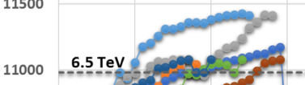
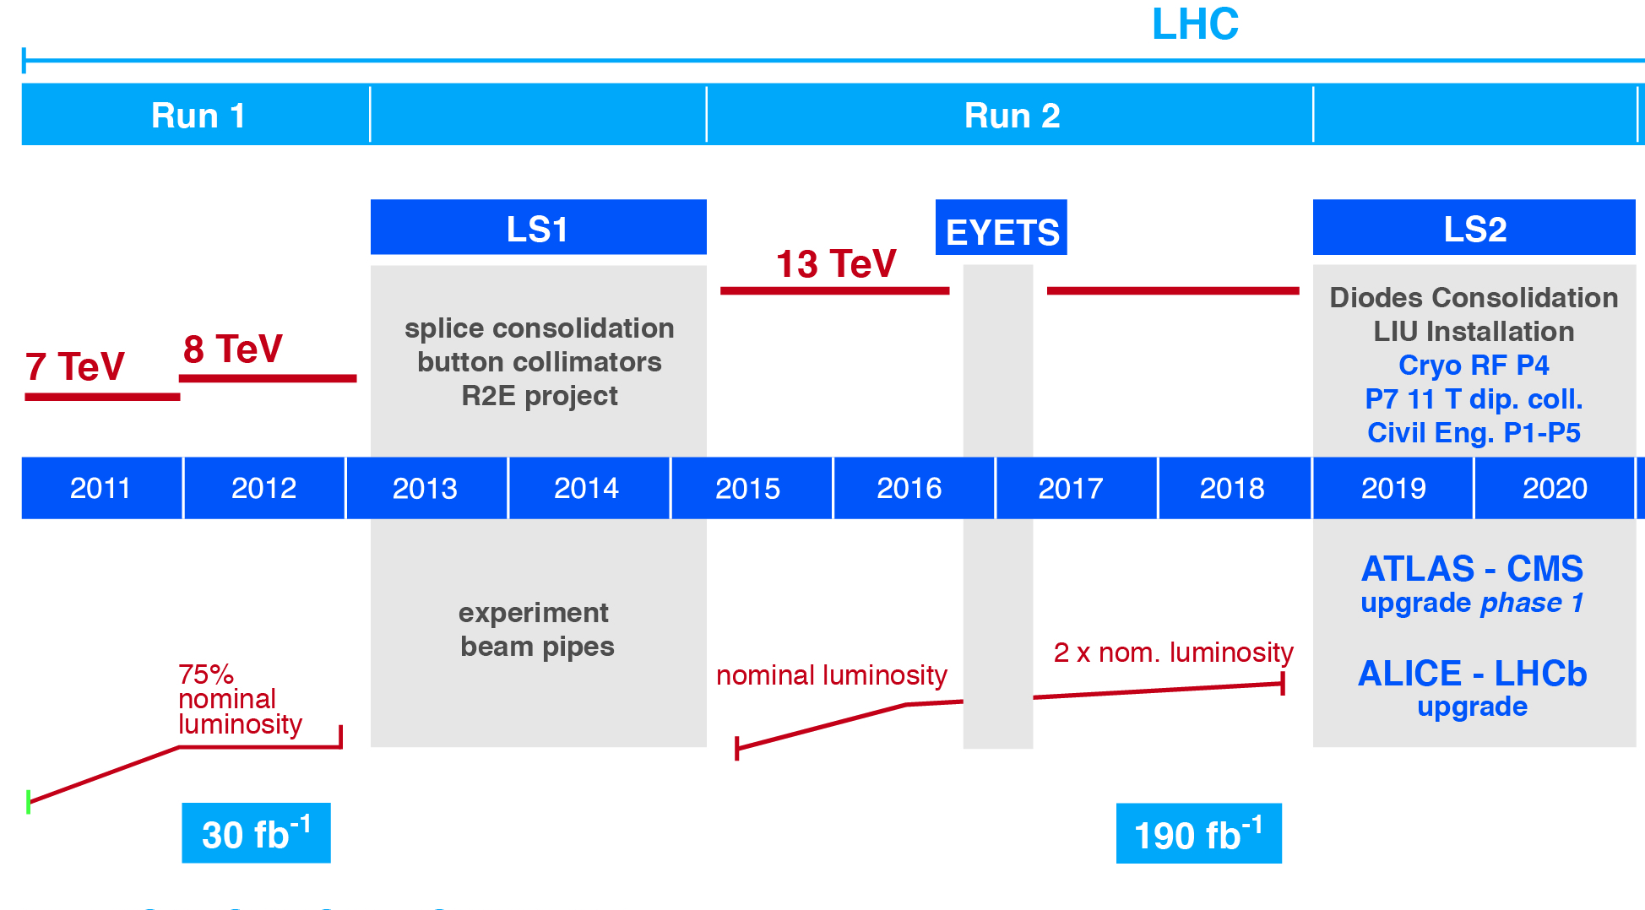
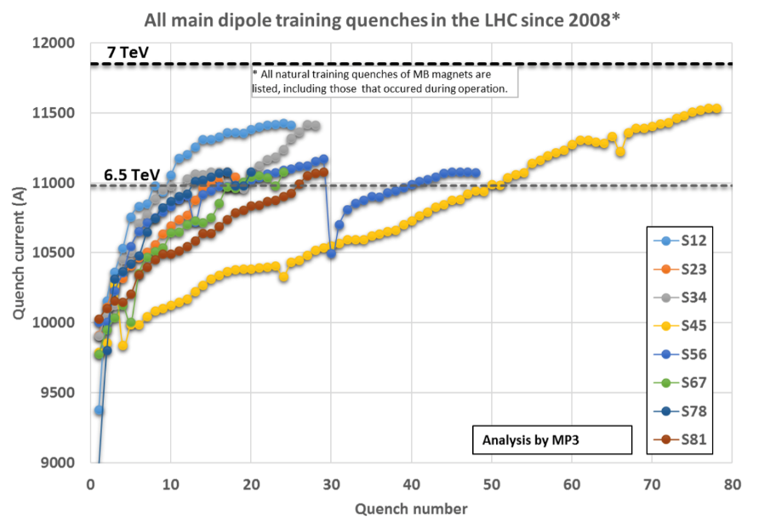
LHC performance at a glance
F. Bordry, CERN Director for A&T
7 TeV → 8.33 tesla, 86% of the max Ic
WG on quench performance.
E. Todesco, chair
Notes:
Trovare rampa cpllisioni 30 marzo 2010 2x3.5; in 2012 2x4 T ; in 2015 2x6.5 T

Slide 4
LHC full energy exploitation
(input from WG - O. Bruning, chair)
14 T=2x7 TeV operation (8.3 T dipole field)
  Tests before YETS 2016/2017 revealed problem with diode box that prevented termination of the proposed tests ➔ LS2 consolidation of diode boxes.
  The test in sector 1-2 for validating magnet performance at 7TeV prior to LS2 showed that we may need 1 quench/magnet: ≥ 1000 quenches, 2-3 months of intense quench campaign.
15 TeV=2x7.5 TeV (ultimate energy, dipoles at 9 T - 93% of intrinsic limit):
  Not impossible but very challenging due to large overhead and possible reduced availability in operation. Some magnets were never trained to ultimate and some may need replacement. Will be a trade off with lumi loss: 20% lost seems the maximum acceptable, difficult to assess today if we are below that level.
Beyond ultimate energy by replacing 1 LHC dipole out of 3 with an 11 T HiLumi dipole:
  15.5 TeV= 2x7.75 TeV at nominal current (2x 8.33 T + one 11.1 T)
  16.6TeV= 2x8.3 TeV at ultimate current (2x9 T + 12 T, since are powered in series)
  Very unlikely: big change, big overheads of de and re-installation (2-3 y?) and very difficult operation. The cost is in the 2-3 BCHF range. Luminosity will be reduced by less avialbiltiy.
  The HiLumi 11 T dipole is not optimized for cost since must be in series with LHC dipoles: big constraints.

Slide 5
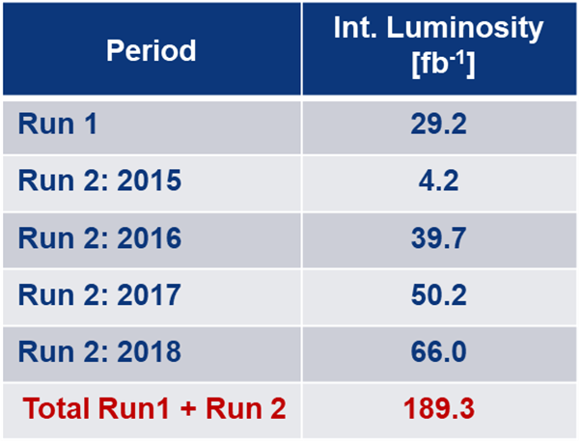
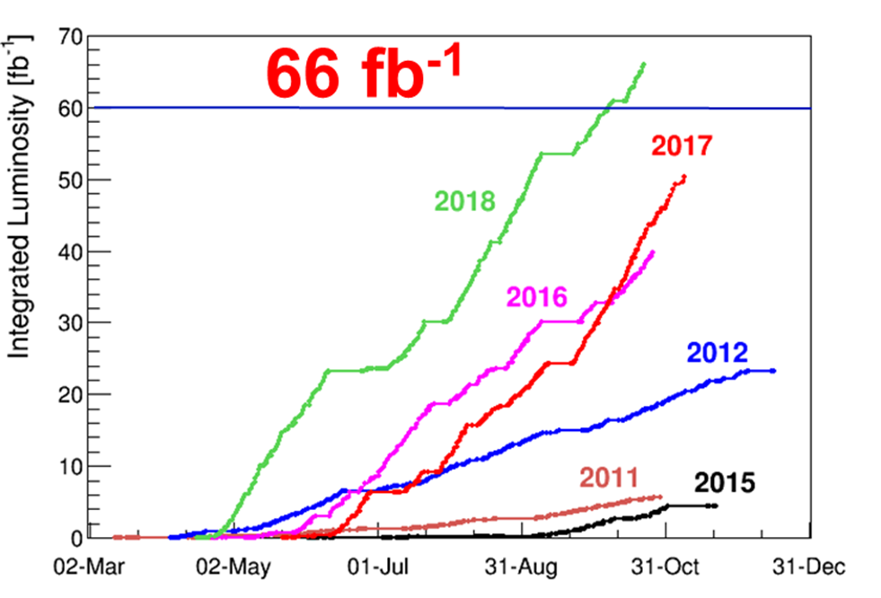
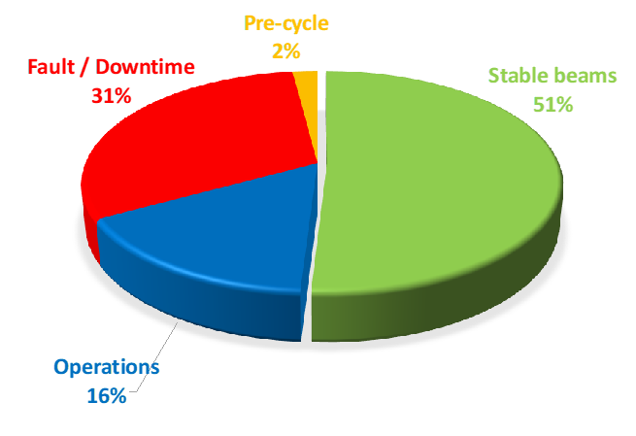
Performance: Integrated Luminosity
F. Bordry, CERN Director for A&T
Cryo availbility: 97-99 % !
Goal of Run1+Run2 was 150 fb⁻¹!

Slide 6

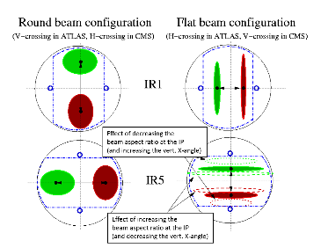
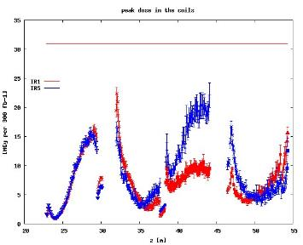
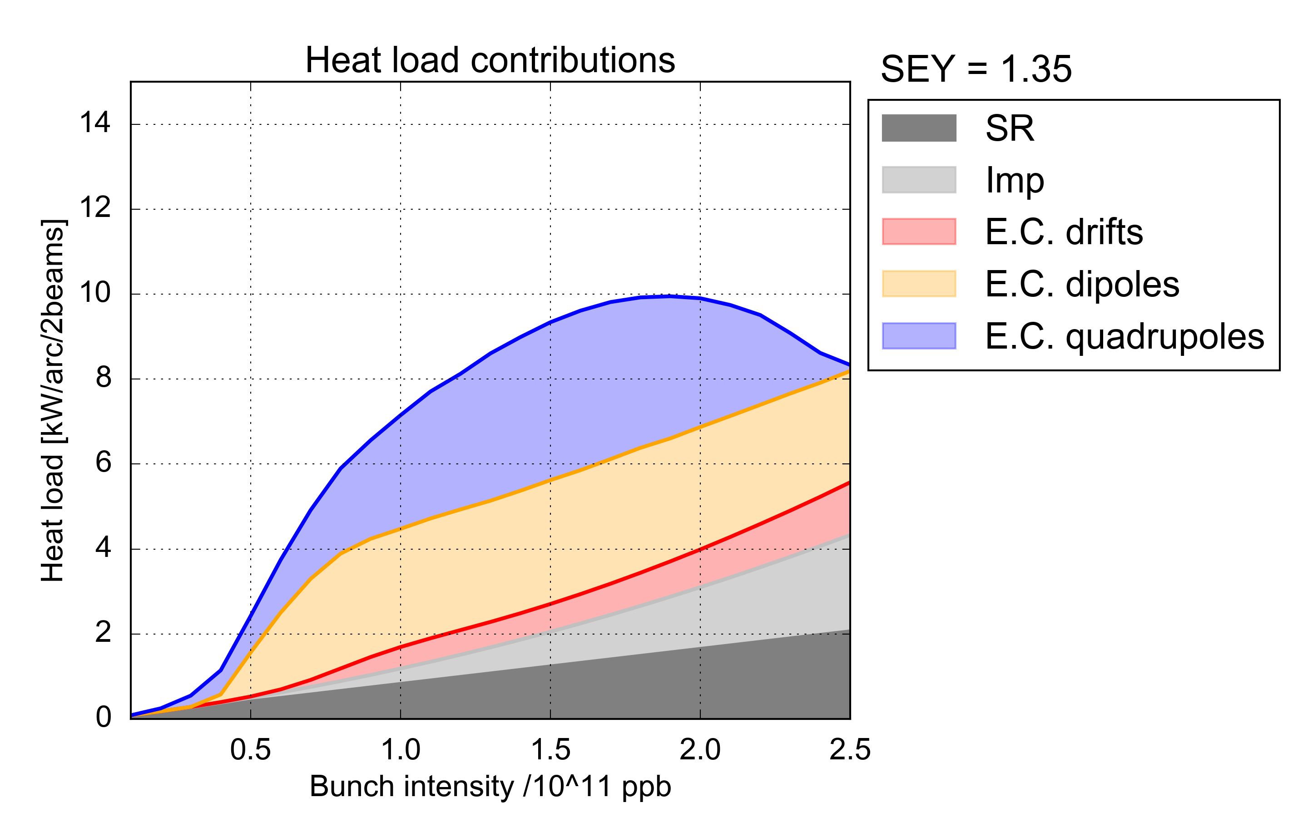
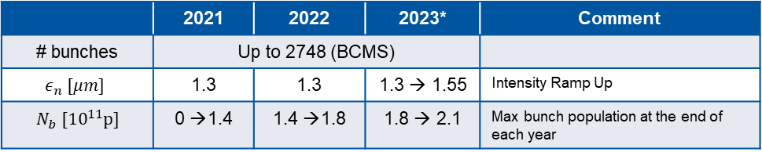
Outlook to LHC Run 3 (2021-2023)
Run3 WG ,
S. Fartoukh, chair
N. Karastathis
LIU forecast for beam intensity ramp up for HL: can be used in LHC Run3 ?
 | 2021 | 2022 | 2023* | Comment
# bunches | Up to 2748 (BCMS)
$$ε_{n} [μm]$$ | 1.3 | 1.3 | 1.3 → 1.55 | Intensity Ramp Up
$N_{b} [{10}^{11}p]$ | 0 →1.4 | 1.4 →1.8 | 1.8 → 2.1 | Max bunch population at the end of each year
Pushing present LHC at the limits (using HL-LHC studies and early installation of HiLumi equipment in LS2…: Levelling, collimator low-Z and DS, TDIS…
Approaching cryogenic limitations different heat load emerged in Run2 is to be understood
Swapping the vertical crossing polarity
Pure BCMS
9.7 kW/arc (195 W/hc)
L_{int} 160 fb⁻¹ at reach in Run3 with margins
➔
40% increase in integrated luminosity
r=30% decrease

Slide 7
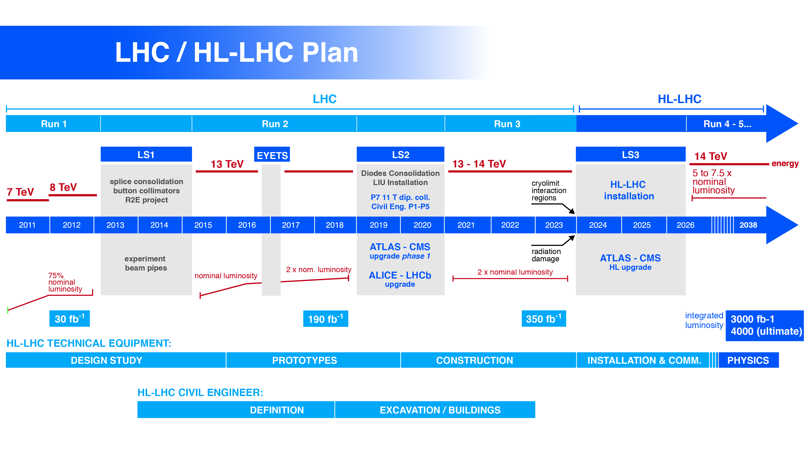
Technical limitation on the istantaneous lumi:
1. Collider (cryolimit in the triplet region) at 2×10³⁴ cm⁻²s⁻¹ twice the nominal design luminosity)
2. Experiments (pile up in the detectors). Designed for PU 40 they are actually dealing with 60!
Technical limitation on integrated lumi:
1. Collider (radiation damage to the IT magnets – correctors and quadrupoles)
2. Experiments (radiation damage in the Inner Tracker)
0.75 10³⁴ cm⁻²s⁻¹
50 ns bunch
high pile up ∼40
1.4 10³⁴ cm⁻²s⁻¹
25 ns bunch
pile up ∼40
2 10³⁴ cm⁻²s⁻¹
25 ns bunch
pile up ∼60
2 10³⁴ cm⁻²s⁻¹
with levelling, 25 ns b.
pile up ∼60 continuous
Notes:
Radiation damage and halveningtime

Slide 8
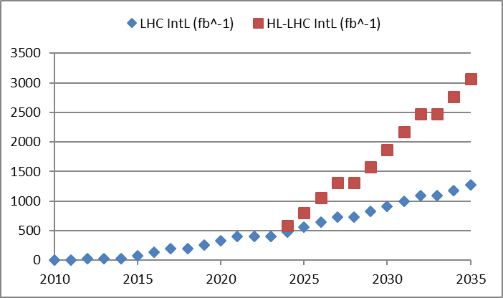
Why not just keep going with cons?
Upgrade!
Performance improving consolidation

Slide 9
Goal of HL-LHC
From EC-FP7 HiLumi LHC Design Study application of 2010
The main objective of HiLumi LHC Design Study is to determine a hardware configuration and a set of beam parameters that will allow the LHC to reach the following targets:
A peak luminosity of L_{peak} = 5×10³⁴ cm⁻²s⁻¹ with levelling, allowing:
An integrated luminosity of 250 fb⁻¹ per year, enabling the goal of L_{int} = 3000 fb⁻¹ twelve years after the upgrade.
This luminosity is more than ten times the luminosity reach of the first 10 years of the LHC lifetime.
Ultimate performance established 2015-2016: with same hardware
and same beam parameters: use of engineering margins:
L_{peak ult} ≅ 7.5 10³⁴ cm⁻²s⁻¹ and Ultimate Integrated L_{int ult} ∼ 4000 fb⁻¹
LHC should not be the limit, would Physics require more…
Experiment are designing for this goal. We need to be compatible with it!

Slide 10
Half way

Slide 11
HL-LHC parameters

Slide 12
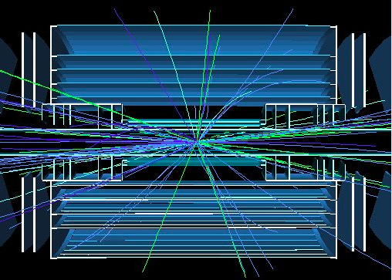
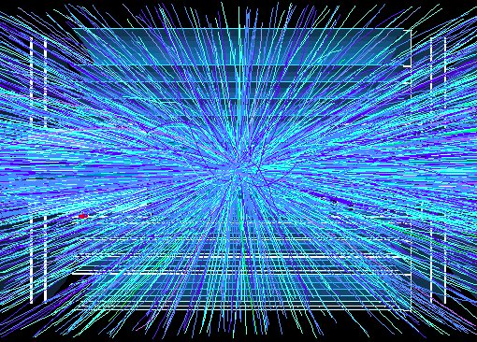
Pile up
400
events
5 events
Pushing at the maximum the parameters of HL-LHC we would start the fill at L = 15x10³⁴ with 400 events/crossing.
Notes:
Ask Rogelio how degrade sensitivity wit pile up and ple up density.

Slide 13
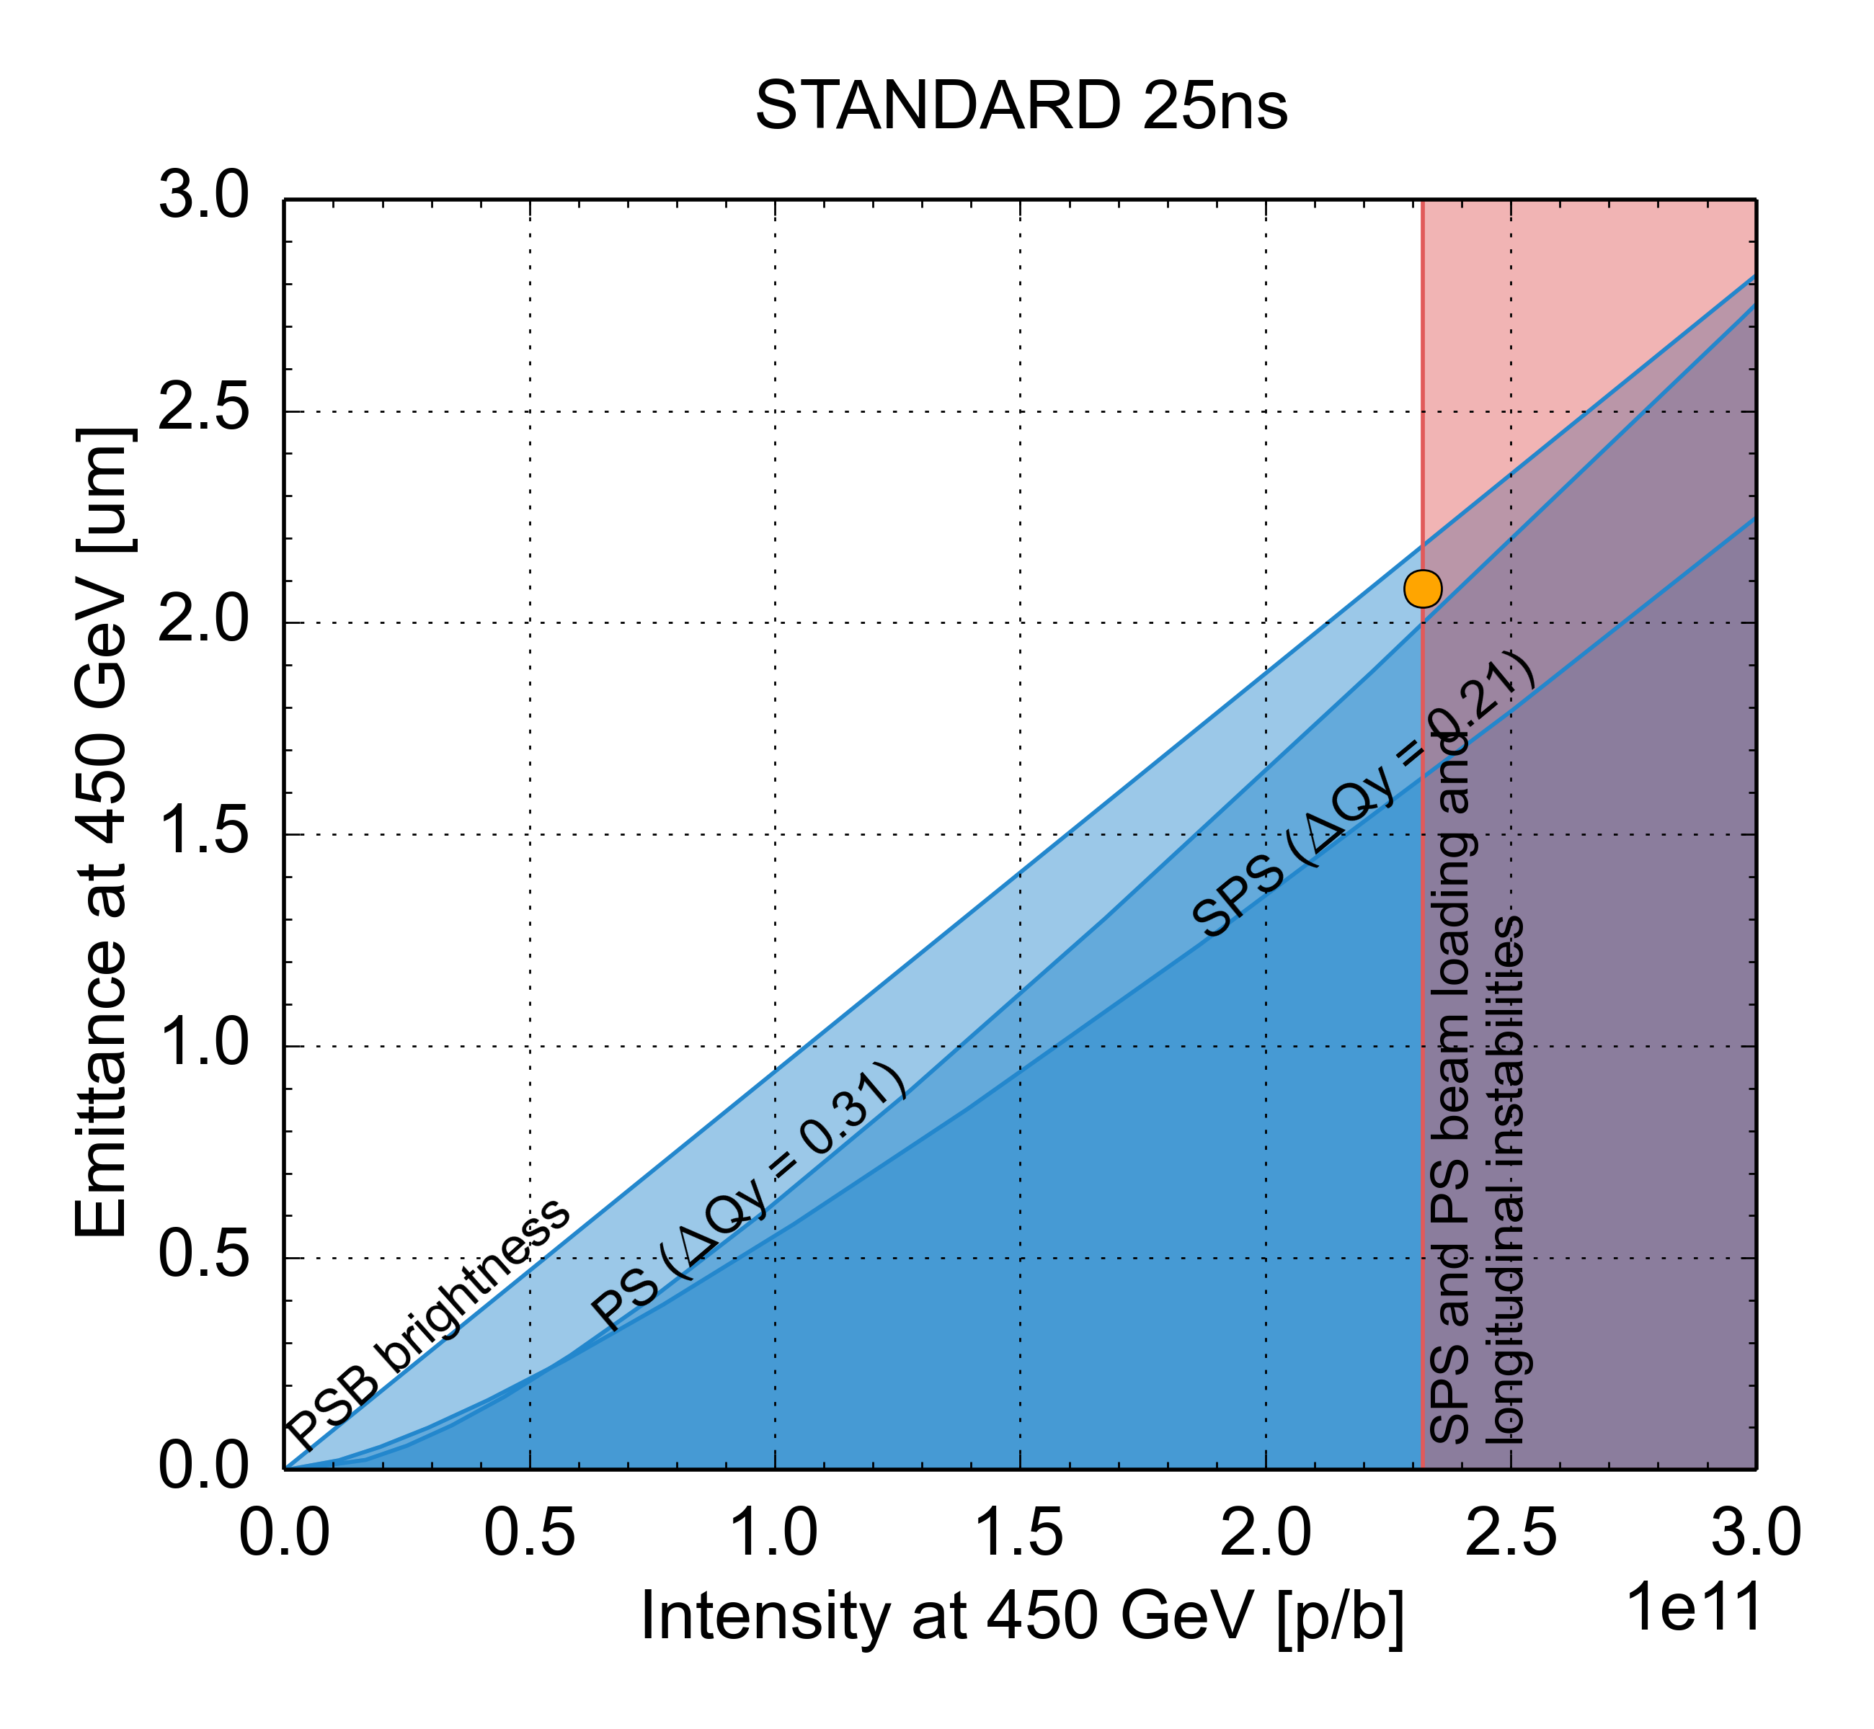
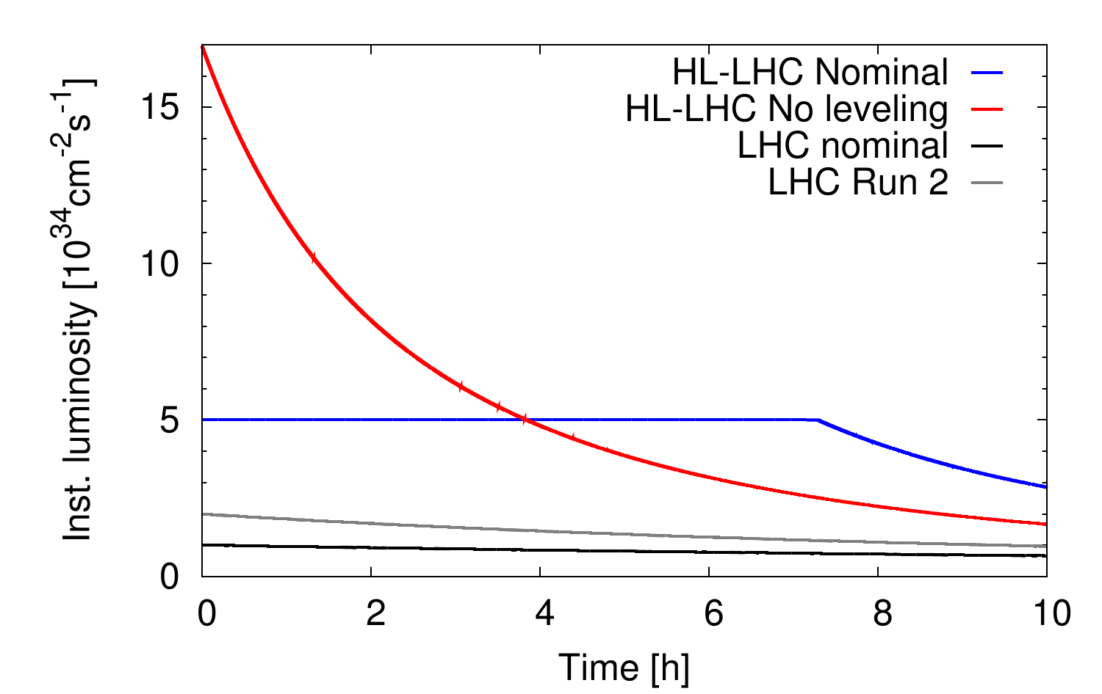
LIU (Intensity) and Levelling mode
LHC design
Reducing heat load on the IT triplet (quench and cooling limits)
Limiting pile up in the detectors
Present Injectors
HL-LHC needs

Slide 14
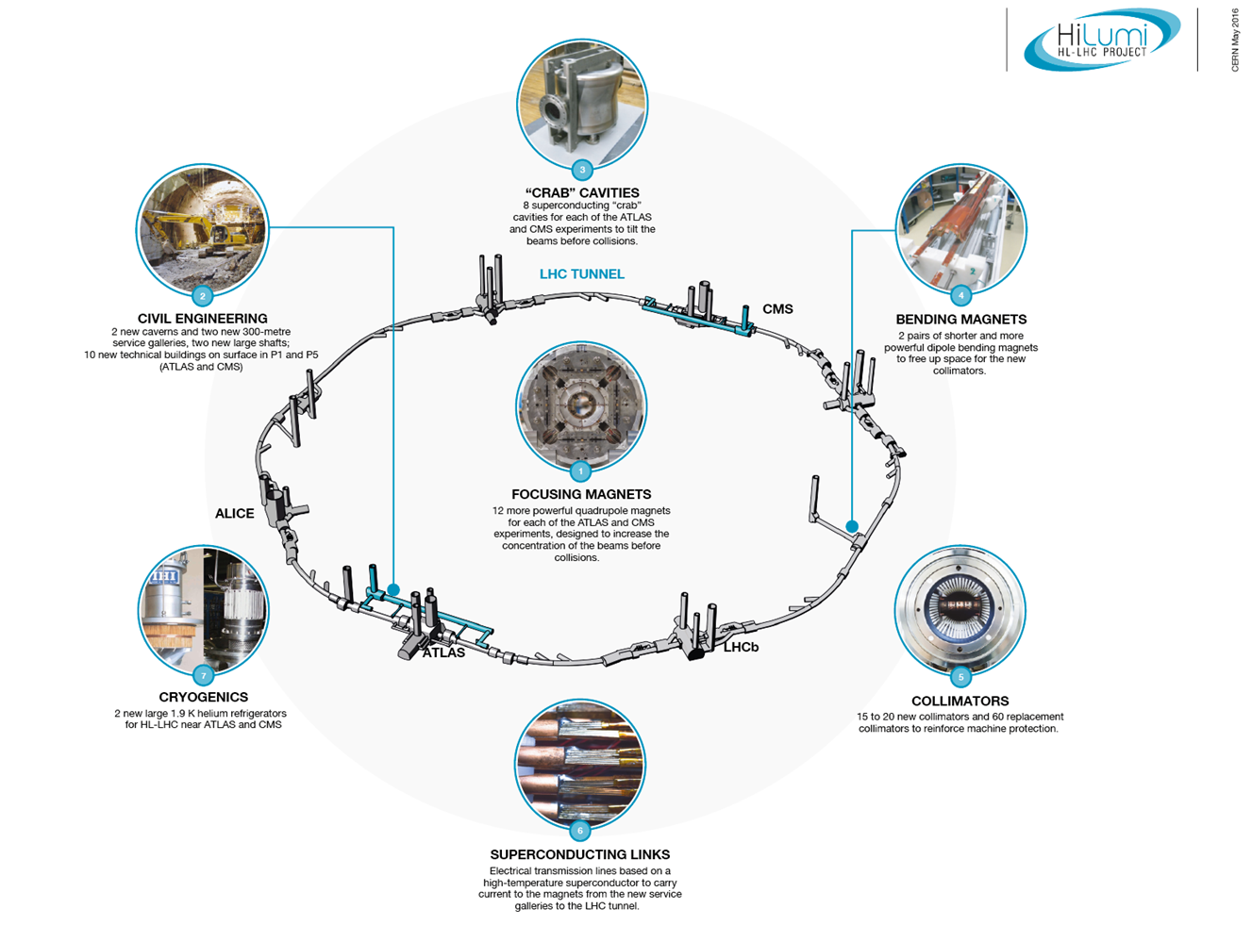
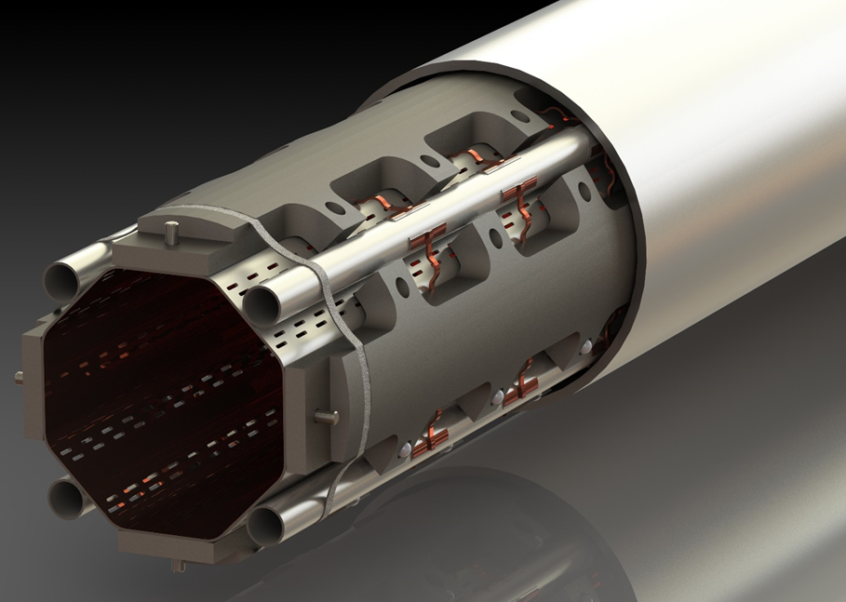
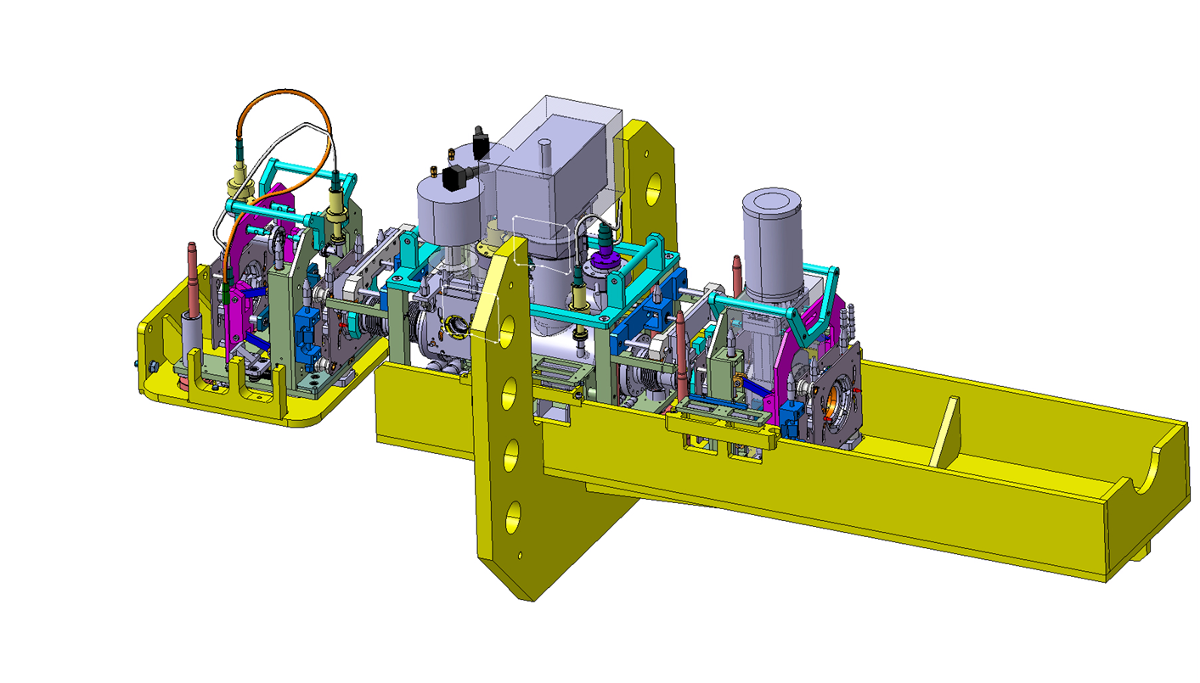
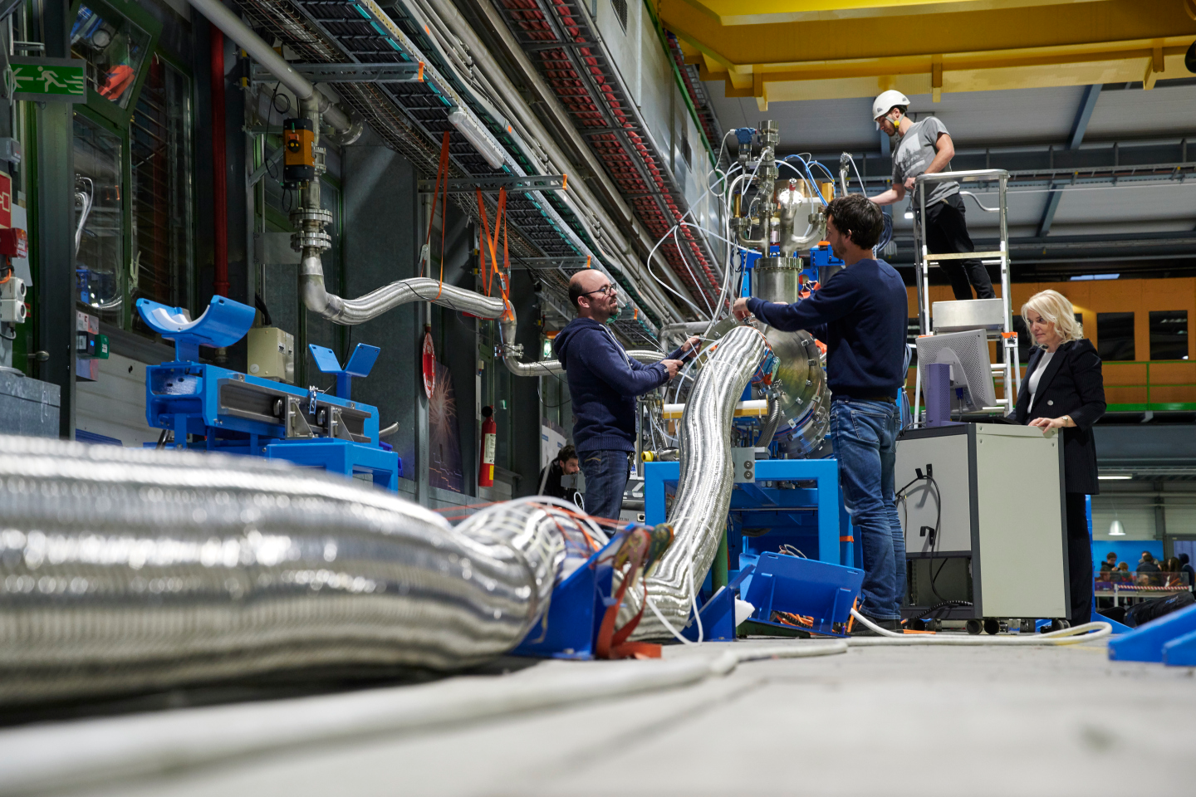
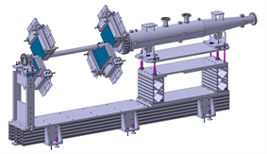
Technology landmarks

Slide 15
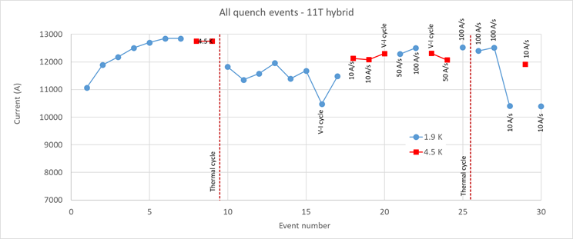
LBH_A (11T)
By-pass cryostat with collimator
LBH_B (11T)
Complete 11.2 T cryo-assembly replacing a 15 m long 8.3 LHC dipole
Operation 7 TeV
7 TeV
L. Bottura & A. Devred
HiLumi WP11- F. Savary et al.
Hybrid (long proto): Excellent!, But strong permanent degradation after thermal cycle. Absence of thermal gradient control in the procedure.

Slide 16
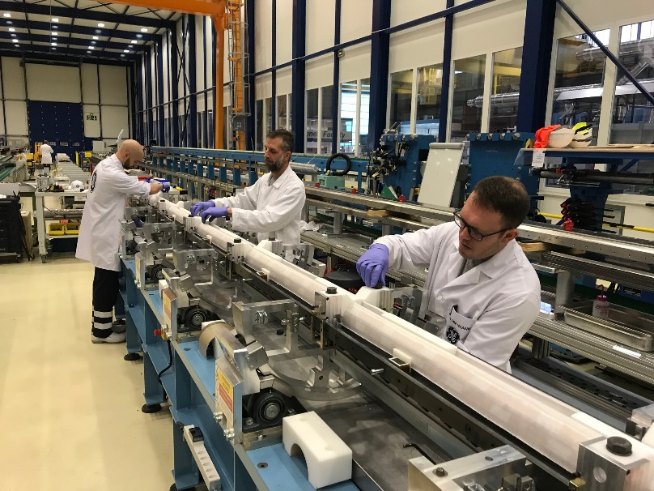
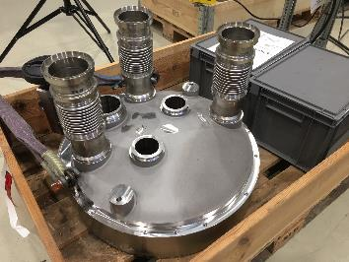
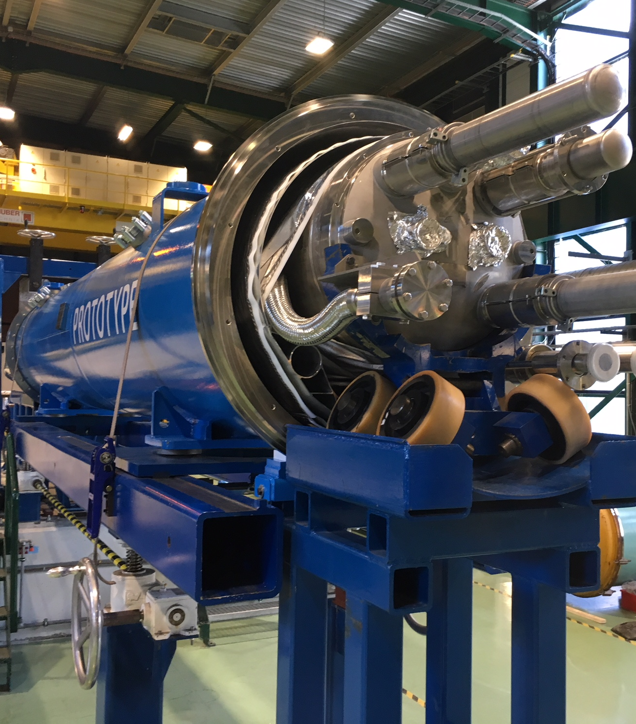
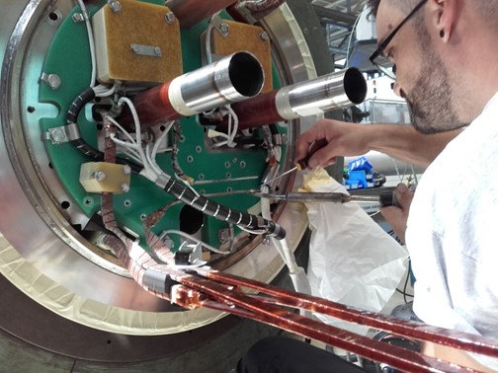
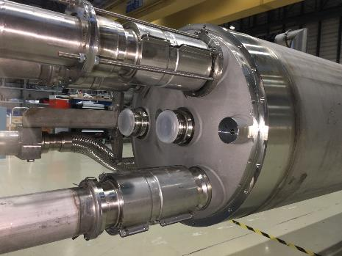
11 T in full swing production: LS2 installation in 2020! great care given the stress sensitivity of Nb₃Sn

Slide 17
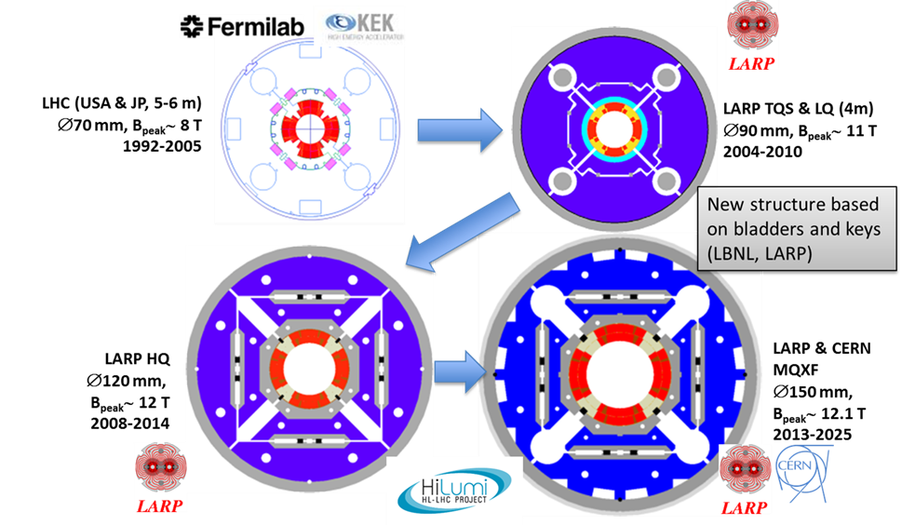

IT quadrupole. Increase in field btu also in size wrt LHC. Very relevant also for FCC magnets

Slide 18
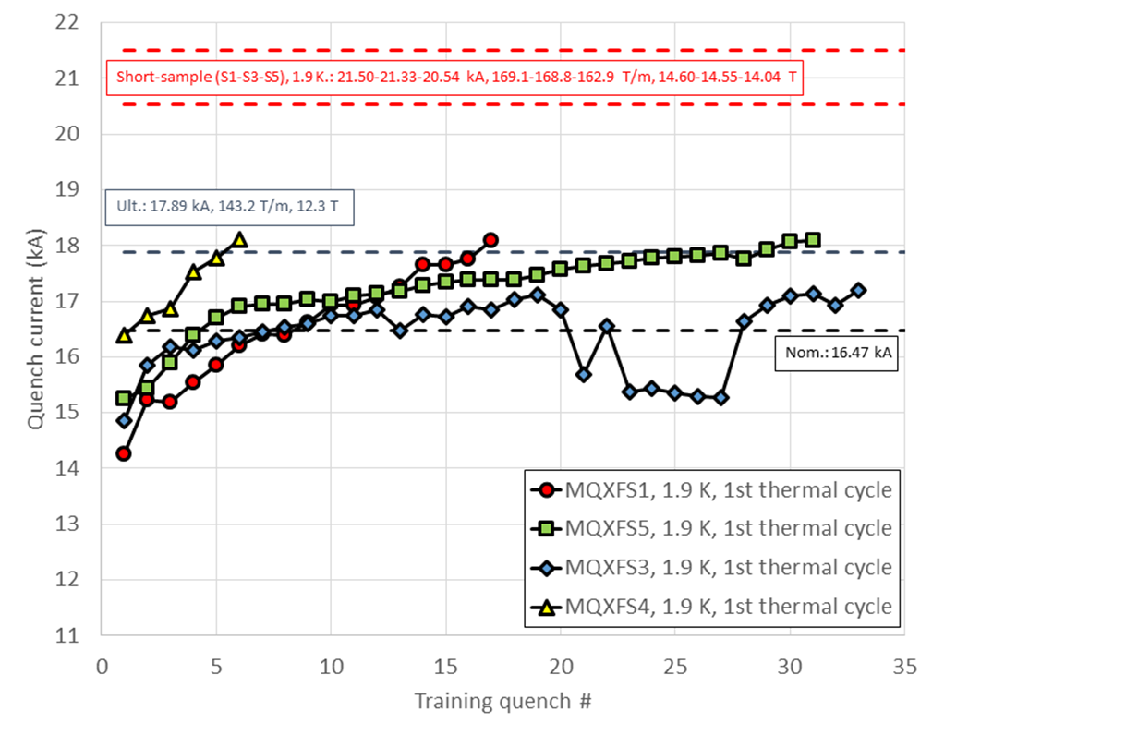
Excelent results IT quadrupoles short models
(thanks also to US-LARP)
All magnets have exceptional memory (no low current quench after thermal cycle)
Best HF magnet ever tested in terms of behaviour (not max field)
Final conductor, final prestress procedure
This magnet had a too high prestress The last higher quench have fast ramp rate
HiLumi WP3:
E. Todesco et al.
However we found recently electrical and structural problems on the first two long prototypes (partly seen also on 11 T).
Structural problems on IT Quads understood and being solved: traced to too small margin (in shells).
Electrical problem (QH insulation): 2 solutions identified.
Industrialization of long magnets is being more difficult than anticipated! Difference from LHC NbTi.

Slide 19
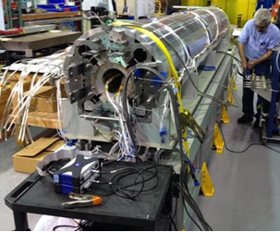
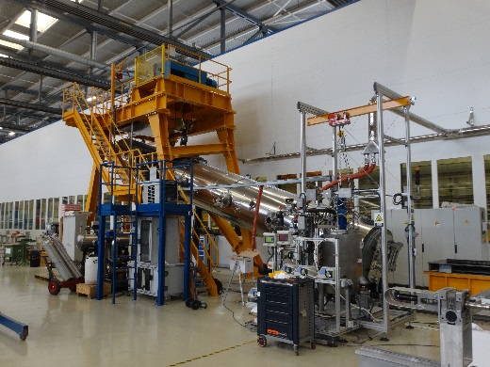
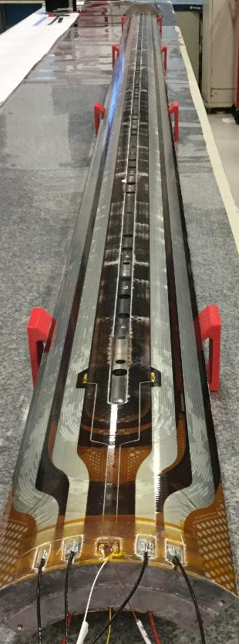
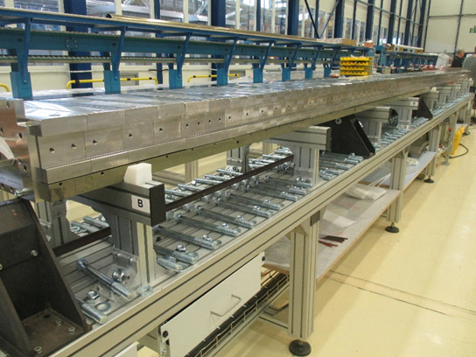
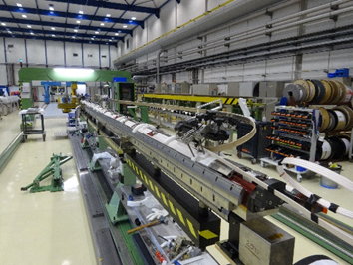
Construction of the 1st and 2nd long (7.5 m!) IT Quad in CERN; in USA winding 4th long magnet
Making long magnets in Nb₃Sn is challenging – especially in view of for mass production. We are confident for HiLumi: the project is big but not enormous (about 30 magnets of 4.2, 5.5 and 7.2 m length) by 2024

Slide 20
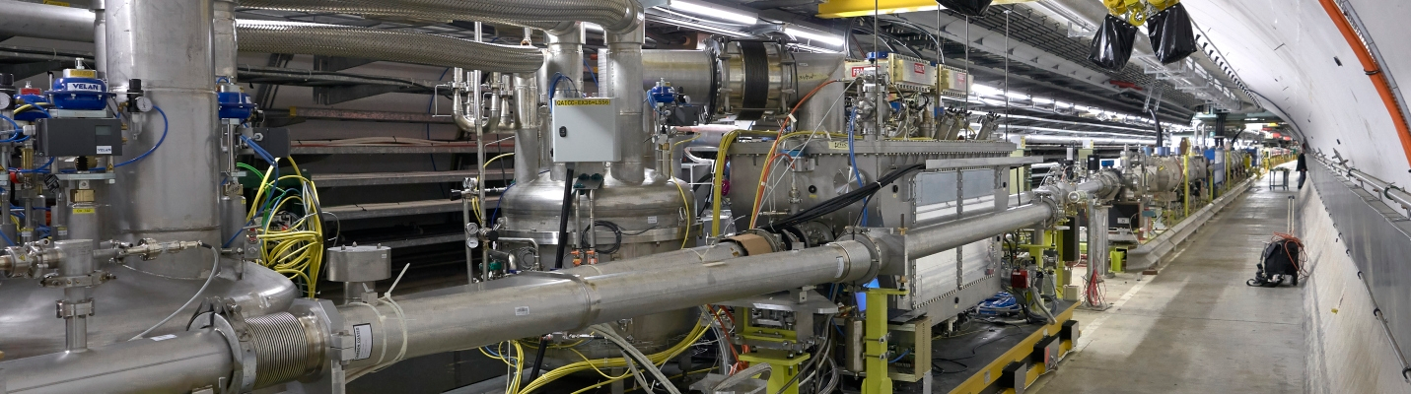
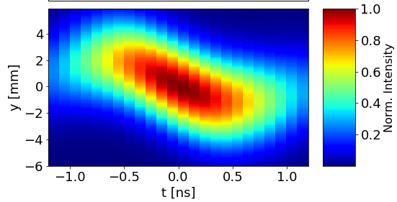
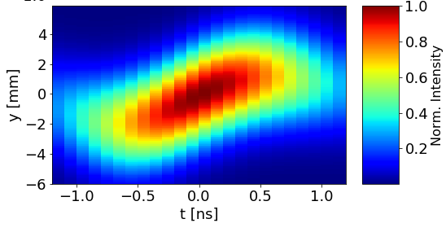
Crab Cavities: progress in design, construction and test infrastructure
New SRF test stand with beam in SPS for HiLumi LHC Crab Cavities
Industrial contracts : launched both from CERN and US-HL-AUP
RF phase scan w.r.t the beam phase with cavity 1: principle validated!
Transparency of CC to beam demonstrated! MDs very successful (with voltage limitation).

Slide 21
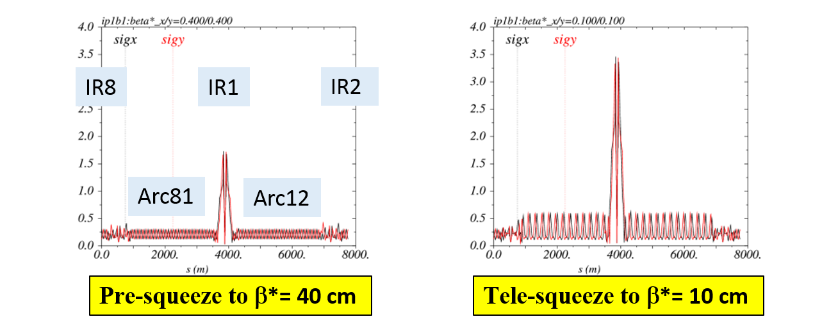
ATS: new operation mode for hadron colliders Making 13 km of matching section!
S. Fartoukh, CERN
Beam size (mm)
Overcoming LHC chromatic and matching limitations of β* = 25-30 cm.
Around each P1 and P5 6.5 km machine become a giant matching section and beam size can be made as small as 5 µm.

Slide 22
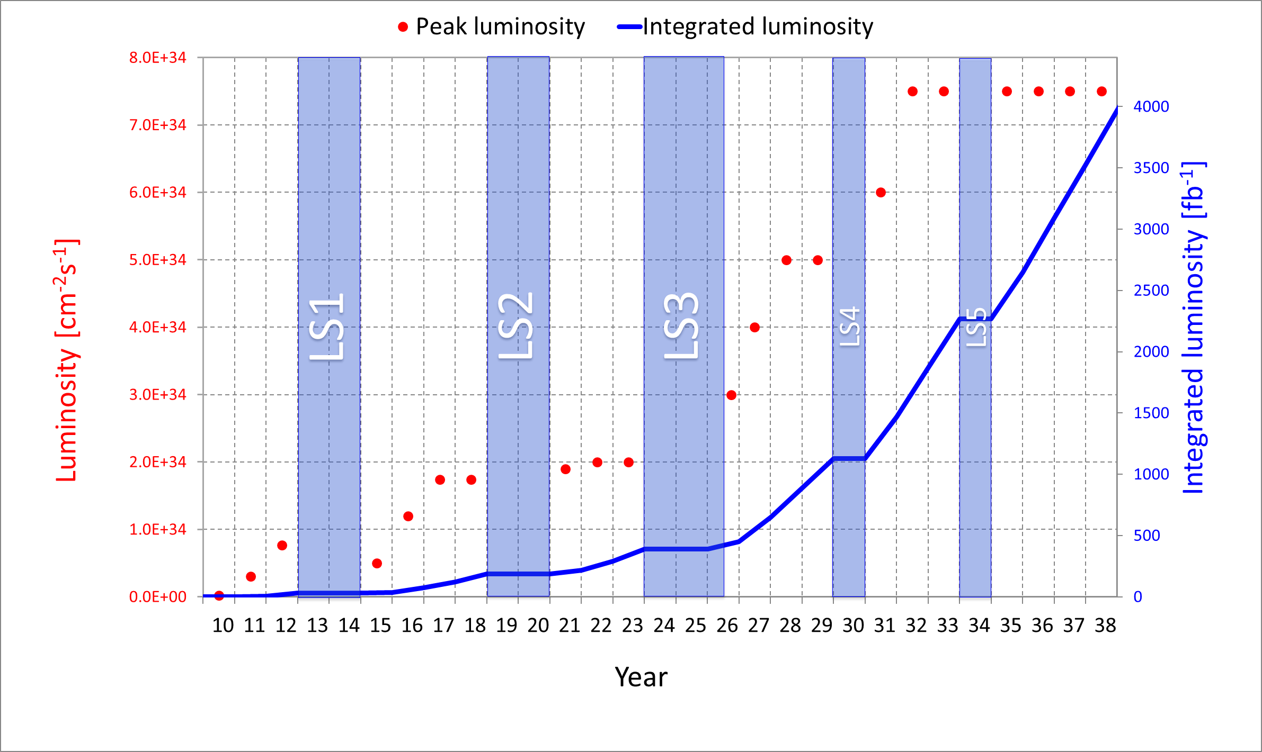
HL-LHC performance (ultimate from 2032)
Design goal
M. Lamont, O. Bruning, L. Rossi

Slide 23
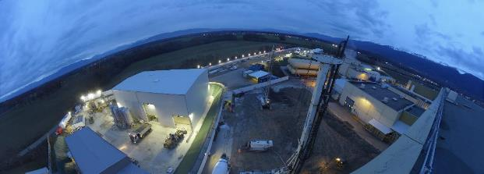
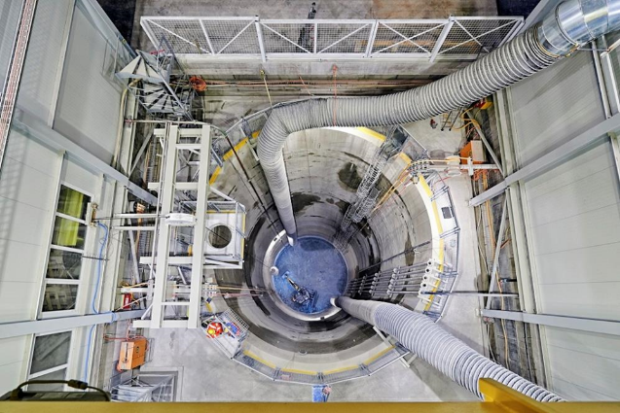
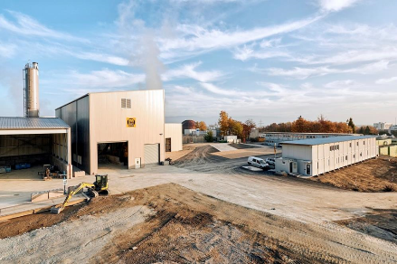
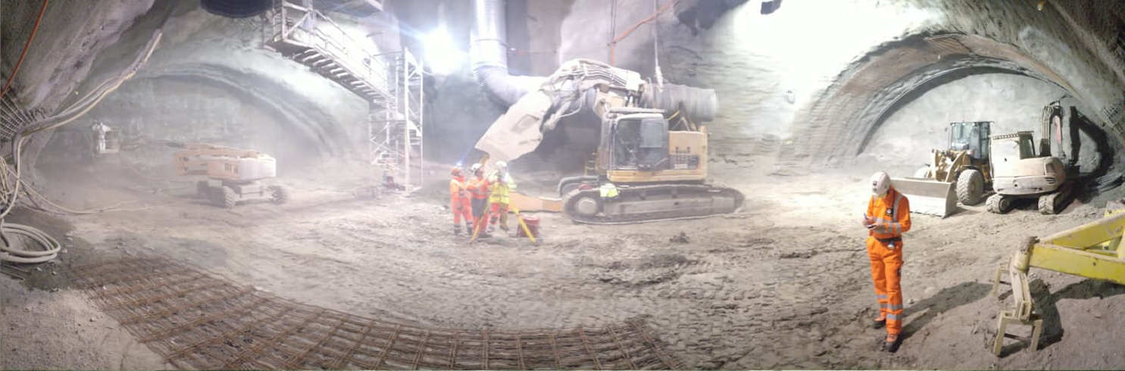
Hilumi Civil Engineer: 2 large shafts; 1 km of new underground; 20 new buildings;
Contract T117 – JVMM (LHC-P1)
Contract T118 – CIB (LHC-P5)

Slide 24
The LHC after HiLumi
LHC as FCC-hh (expensive) injector
  Foreseen to work at low maintenance 3 TeV beam
  Can provide also beam for fixed target at 1..3 TeV
High(er) Energy LHC (for HEP community to assess if interesting or not)
  33 TeV c.o.m. : 20 T magnets (2010 Malta Workshop)
  27 TeV c.o.m. : 16 T magnets (FCC baseline magnet)
  21 TeV c.o.m. : LHC1.5, based on 12 T magnets
LHeC compatible with
  Present LHC (with important modifications)
  New HE-LHC, whatever configuration (a bit easier than present LHC)

Slide 25
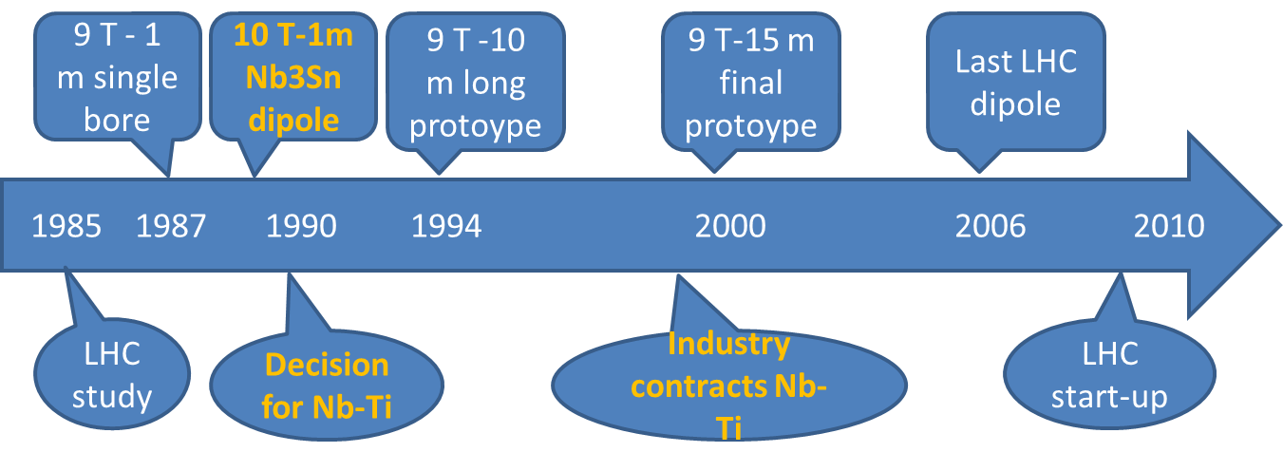
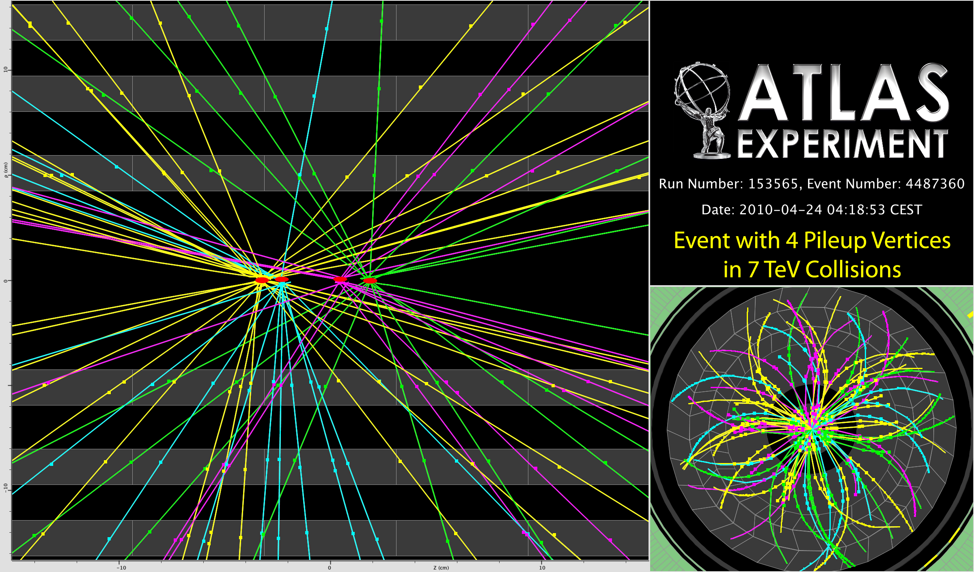
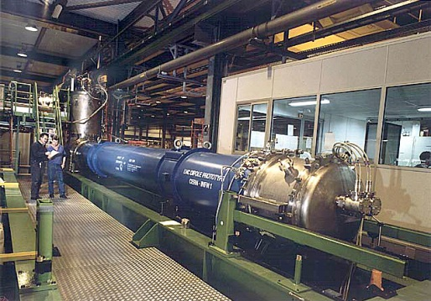
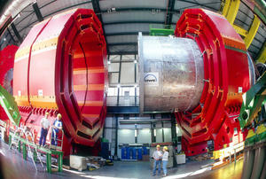
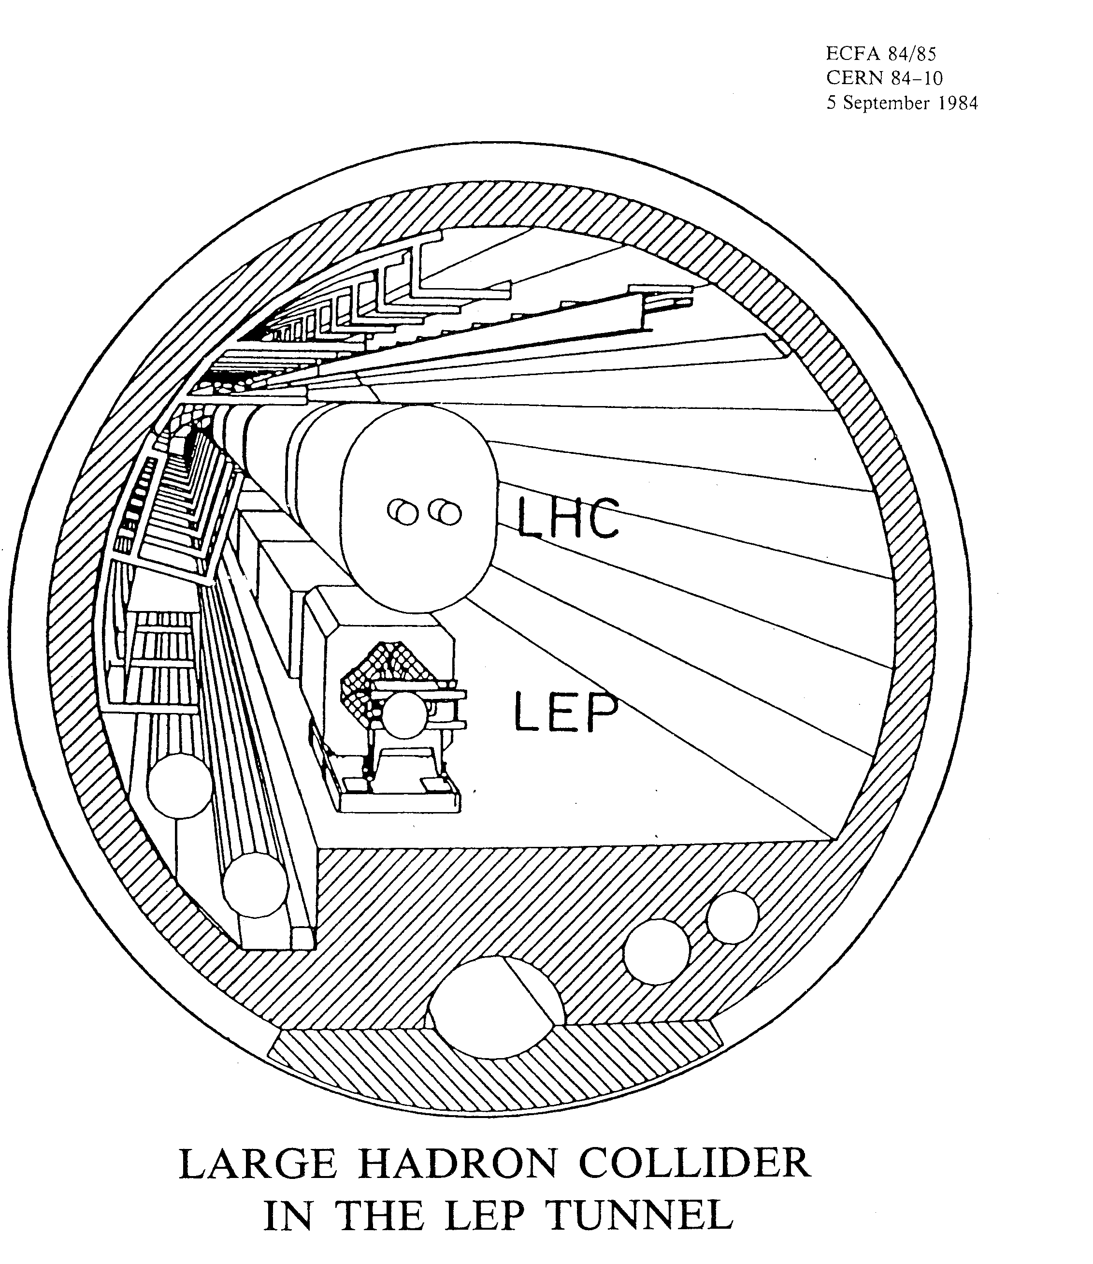
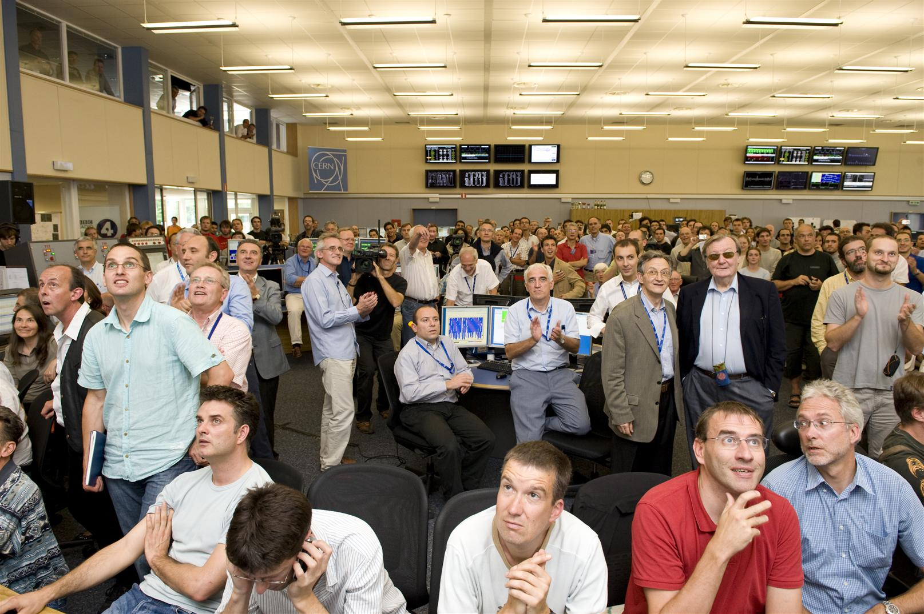
The 25 y LHC construction time line possible only because SSC developed the superconductor…
Only 2 y to make a short magnet «near to final». Conductor available(SSC)
7 years from start R&D to 1st Industry proto
12 y from first working prototype to last magnet

Slide 26
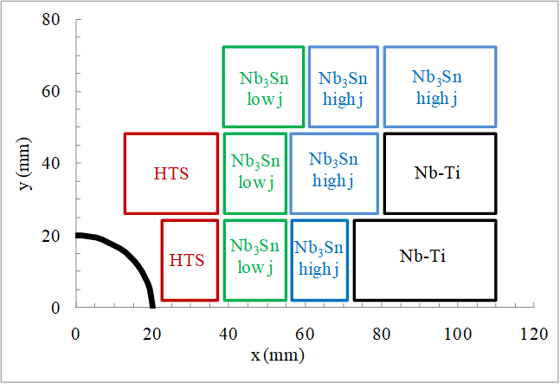

HE-LHC Malta FP7-Eucard workshop (2010)
Dipole at 20 T
Energy 33 TeV (c.om.)
Where are we?
Little work in that direction.
Magnet technology Hilumi (11-12 T) is taking longer than anticipated
Minimal resources for HTS
It took > 10 years to develop the SC for HiLiumi (2003-2015)
SC for B>12-14 T is not yet there. Effort for a more realistic HE-LHC done in the frame of FCC-hh (since 2013)
L. Rossi & E. Todesco, CERN

Slide 27

HE-LHC as designed inside FCC-hh project very complete and consistent design
Dipole Field 16 T → 27 TeV c.o.m.
M. Benedikt, F. Zimmermann et al.

Slide 28
p-p machine CERN
parameter | FCC-hh |  |  | HE-LHC | HL-LHC | LHC
collision energy cms [TeV] | 100 |  |  | 27 | 14 | 14
dipole field [T] | 16 |  |  | 16 | 8.33 | 8.33
circumference [km] | 97.75 |  |  | 26.7 | 26.7 | 26.7
beam current [A] | 0.5 |  |  | 1.1 | 1.1 | 0.58
bunch intensity [10¹¹] | 1 |  | 1 | 2.2 | 2.2 | 1.15
bunch spacing [ns] | 25 |  | 25 | 25 | 25 | 25
synchr. rad. power / ring [kW] | 2400 |  |  | 101 | 7.3 | 3.6
SR power / length [W/m/ap.] | 28.4 |  |  | 4.6 | 0.33 | 0.17
long. emit. damping time [h] | 0.54 |  |  | 1.8 | 12.9 | 12.9
beta* [m] | 1.1 | 0.3 |  | 0.25 | 0.15 (min.) | 0.55
normalized emittance [μm] | 2.2 |  |  | 2.5 | 2.5 | 3.75
peak luminosity [10³⁴ cm⁻²s⁻¹] | 5 |  | 30 | 28 | 5 (lev.) | 1
events/bunch crossing | 170 |  | 1000 | 800 | 132 | 27
stored energy/beam [GJ] | 8.4 |  |  | 1.4 | 0.7 | 0.36

Slide 29

The timeline of HE-LHC is determined by magnet technology wich depends on SC development
Main development goal is wire performance increase:
J_{c} (16T, 4.2K) > 1500 A/mm² →50% increase wrt HL-LHC wire
Reduction of coil & magnet cross-section
This is difficult
Present FCC targets
A. Ballarino & L. Bottura, CERN

Slide 30


HE-LHC time line and cost
2020?
2040?
2900 Magnets; 260 for LHC disposal
1 TeV beam from SPS

Slide 31
Consideration on HE-LHC
Assume we want to have for installing in 2035-2040, right after HiLumi
We need to have the magnet proof tomorrow (2023-25)
But for tomorrow we will have «only» the HiLumi Magnets: 30 magnets, 4- to 7.5 m long, B= 11.2-11.5 T operative, B=12.3 T ultimate. I do not think that 16 T dipole industrial construction for HE-LHC can be launched by 2030 (only way to have it by beginning of 2040).
For 16 T dipole project we need a «buy-time project» like LHeC , see later. Or…
With a moderate effort a 12 T operative dipoles can be engineerized with HiLumi SC wire shortly after HiLumi.
  Still SC needs to cost less and needs a small, key, improvements: D_{eff} is ∼ 45 µm for HiLumi; we need 20 µm. But we have plenty of I_{c}…
  Still the magnet technology at 11-12 T level is not yet fully gained, especialy in view of a mass production. We need to understand and improve long term degradation, stress control (mechanical & thermal) and electrical insulation robustness

Slide 32
Timeline and cost (very rough, no study)
Cost scaled from 2019 HE-LHC study. If it is of real interest the study could be done
Domain | Cost MCHF | Comments | Wrt HE-LHC
Collider | 4500 | 2400 for Magnets | -500
Injectors | 500 ÷ 1100 | New optimization TBD | 0 ÷ -600
Tech Infr.+C.E. | 900 ÷ 1100 | Probably is less (< P_{syn}) | ? (-200?)
TOT | 6100 ÷ 6700 | (LHC2008 was 3400) | Cost should be optimized as upgrade

Slide 33


Can LHC system & T.I. be re-used, lasting 15 years more?
YES if proper maintenance and consolidation is done. Already now Consolidation and serious maintenance are keys for the LHC availbilty and success.
Consolidation cost: 15-20 MCHF (10-15 MCHF for LHC and 5-8 for Injectors).
For system the maintenance (under Operation) is critical for duration: cryogenics
CONS Budget by system
40% Tech. Infrastr. & Transp.
33% Magn. & Powering
Courtesy M. Lamont, CERN

Slide 34

What will look like this new HE-LHC option?
A realistic LHC1.5 @ 21 TeV for 2040…
HTS
In LHC, 14 T dipoles give 23.5 TeV
But timeline is NOT the same
12 T Nb₃Sn dipoles HiLumi technology in LHC: 21 TeV c.o.m.
LHC1.5
Energy tripler 100km
7 T Nb-Ti dipole (low cost LHC, 4.2 K):
44 TeV c.o.m. (100 km)
2040

Slide 35


Long term development of SC is critical for HEP Hadron Collider: Open SC Lab Proposal
L. Bottura and F. Bordry
Phase I - Construction and commissioning (3 years)
• Equipment and labour: 10 MCHF
• Surface: 2000 m2
• Personnel: 10 FTEy (1 project engineer + 2 techn.)
Phase II - Facility ramp-up and initial operation (7 years, processed R&D material of the order of 25 kg/week, operation 40 weeks/year)
• Total cost: 20-30 MCHF

Slide 36


LHeC: RL with ERL Operation as Baseline
O. Bruning
and M. Klein
Super Conducting Recirculating Linac with Energy Recovery
Choose ⅓ of LHC circumference ➔
Two 1 km long, 10 GeV
SC LINACs with
3 accelerating and
3 decelerating passes in CW operation
SRF sees 6*current
at the IP (≈ 4ns spacing)
➔ Q₀ = 10¹⁰ requires
cryogenic system
comparable to LHC
system! Q₀ > 10¹⁰
10³³ cm⁻² s⁻¹ Luminosity reach | PROTONS | ELECTRONS
Beam Energy [GeV] | 7000 | 60
Luminosity [10³³cm⁻²s⁻¹] | 1 | 1
Normalized emittance γε_{x,y} [μm] | 3.75 | 50
Beta Funtion β∗_{x,y} [m] | 0.1 | 0.12
rms Beam size σ∗_{x,y} [μm] | 7 | 7
rms Beam divergence σ’∗_{x,y} [μrad] | 70 | 58
Beam Current @ IP [mA] | 430 (860) | 6.6
Bunch Spacing [ns] | 25 (50) | 25 (50)
Bunch Population | 1.7*10¹¹ | (1*10⁹) 2*10⁹
Bunch charge [nC] | 27 | (0.16) 0.32
10³⁴ cm⁻² s⁻¹ Luminosity reach | PROTONS | ELECTRONS
Beam Energy [GeV] | 7000 | 60
Luminosity [10³³cm⁻²s⁻¹] | 16 | 16
Normalized emittance γε_{x,y} [μm] | 2.5 | 20
Beta Funtion β∗_{x,y} [m] | 0.05 | 0.10
rms Beam size σ∗_{x,y} [μm] | 4 | 4
rms Beam divergence σ’∗_{x,y} [μrad] | 80 | 40
Beam Current @ IP[mA] | 1112 | 25
Bunch Spacing [ns] | 25 | 25
Bunch Population | 2.2*10¹¹ | 4*10⁹
Bunch charge [nC] | 35 | 0.64
Over 600MW Beam power in electron Beam!!!
Thanks to energy recovery the bill is only 100 MW!
ERL is a must for efficient operation!!!
ERL is new technology for energy efficiency and must be pursued: LHeC is the ideal first HE demonstrator
Cost: 1000-1500 MCHF (30÷60 GeV e⁻ beam)
944 cavities; 59 cryo modules per linac
ca. 9 km underground tunnel installation
more than 4500 magnets (same magnet design as for RR option)
36

Slide 37


O. Bruning
and M. Klein
S. Russenschuck
The insertion region in LHC must be studied in detail to asses properly the feasibility

Slide 38
LHeC and LHC1.5
In case of HE type LHC1.5 (realisitic for 2040)
  The option Ring-Ring should be again considered
  It consists of an electron ring in the LHC tunnel on the top of the HE new magnets.
  Certainly possible: was so at the design of LHC (LEP inside). Abandoned in 2001 to make simpler a few points.
  In a new ring design it should be accommodate
  The lepton magnets can be used alosd as LER (Low Energy Ring) for proton injector to avoid upgrade of SPS for post LHC1.5 use: LHC3 with HTS, if anything else is done). We have a (narrow!) tunnel and infrastructure to exploit at the maximum.

Slide 39
Conclusions
HiLumi will allow LHC to continue to produce top class HEP till 2035-2040; it is technology drivers and buys time for next project
A HE-LHC of 27 TeV (16 T dipoles) is probably for 2050…
A new HEP hadron collider to start in 2040 can be – with realism – a LHC1.5 @ 21 TeV, based on 12 T magnets of HiLumi technology and SC. If treated as un upgrade (and not as a full new project, may save time&money (cryogenics and T.I. …)
The LHeC machine may be a mid-size project to fill the gap to a very large project (like FCC-hh) or a very appealing complement in case of:
  LHC used as Injector for FCC-hh (today baseline of FCC study)
  LHC1.5 at 10.5 TeV/beam (from 2040)
  HE-LHC at 13.5 TeV/beam (from 2050)

Slide 40

Thanks you

Slide 41

Great performance of 30 km 1.9 K cryo-system
D. Delikaris
S. Claudet, CERN

Slide 42

(Peak) Luminosity evolution and limitation
2018
F. Bordry, CERN Director for A&T
Notes:
Ask picture of heat exchanger in triplet

Slide 43


Asymmetric IR Design: example LHeC
O. Bruning
and M. Klein
Beam pipe: in CDR 6m, Be, ANSYS calculations
Composite material R+D, prototype, support..
→ Essential for tracking, acceptance and Higgs
Have optics compatible with HL-LHC ATS optics and β*=0.1m
Head-on collisions mandatory →
High synchrotron radiation load, dipole in detector
Optimize LHeC to LHC ATS optics
Specification of Q1 – NbTi prototype
Revisit SR (direct and backscattered),
Masks+collimators
Beam-beam dynamics and 3 beam operation studies
S. Russenschuck
43

