Slide 1
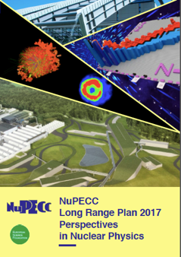
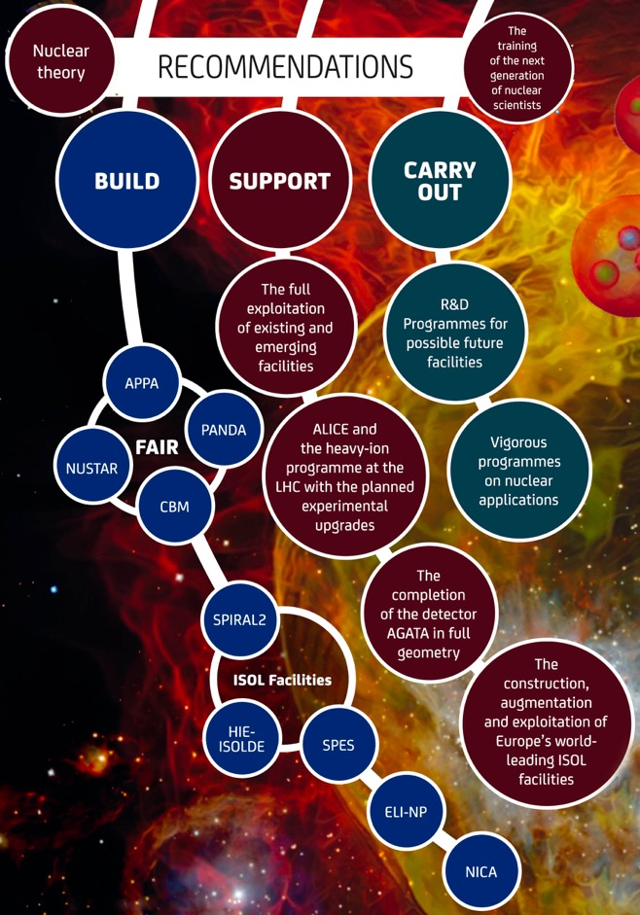
NuPECC
Long Range Plan
Open Symposium on the Update of
European Strategy for Particle Physics
Grenada, Spain, May 13-16, 2019
Marek Lewitowicz
Chair of NuPECC

Slide 2
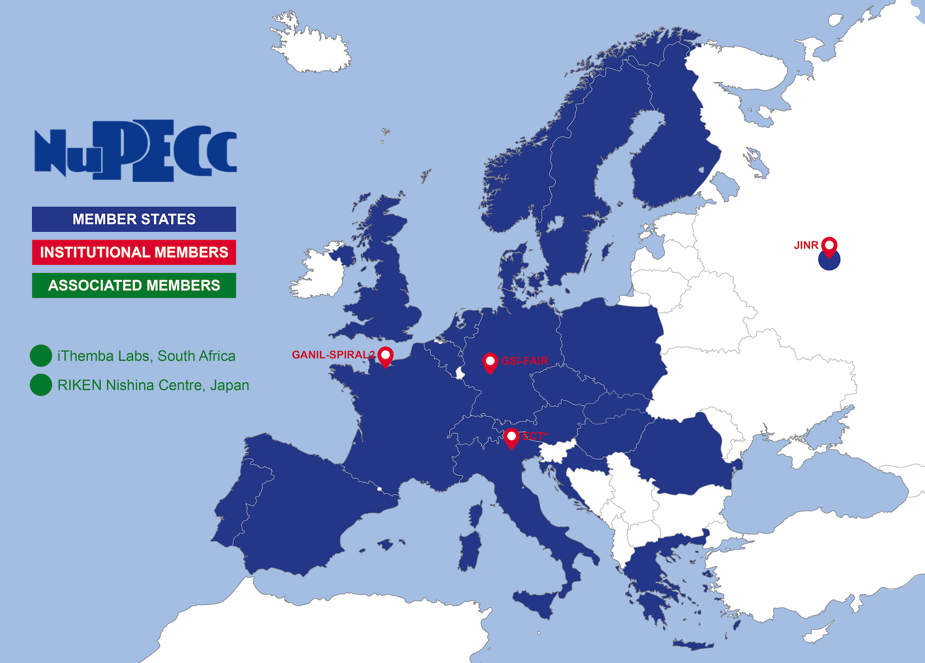
What is NuPECC ?
The European Expert Board for Nuclear Physics
hosted by European Science Foundation
Representing
about 6000 scientists
Composition:
32 representatives from 21 countries, ESFRI NP Infrastructures & JINR Dubna
2 associated members (iThemba Labs and Nishina Center)
6 observers (NPD/EPS, ECFA, NSAC, ANPhA, ALAFNA, CINP )
3 regular Committee meetings/y
30 Years of NuPECC activities
Marek Lewitowicz

Slide 3
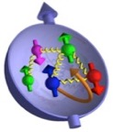

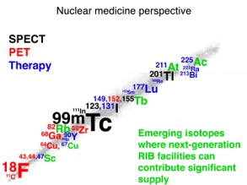

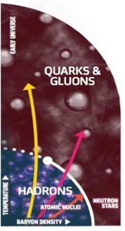

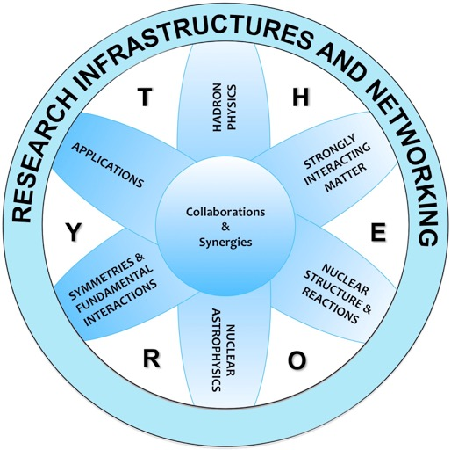
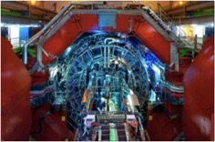
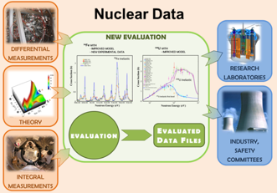
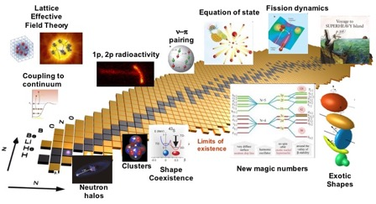
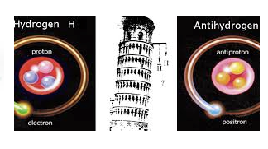
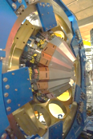
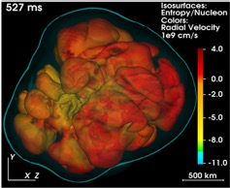
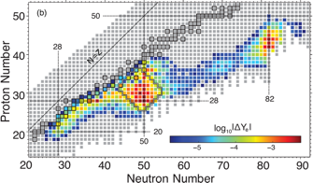

Nuclear Physics in Europe
http://www.nupecc.org
Marek Lewitowicz
Notes:
Wheel of Fortune of nuclear physics with 6 sub- fields

Slide 4
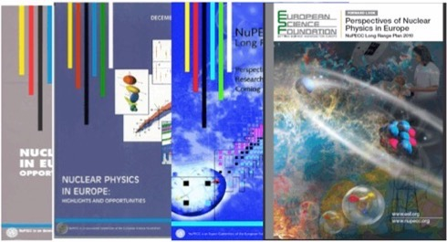
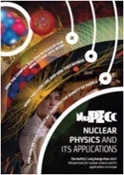

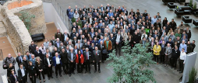
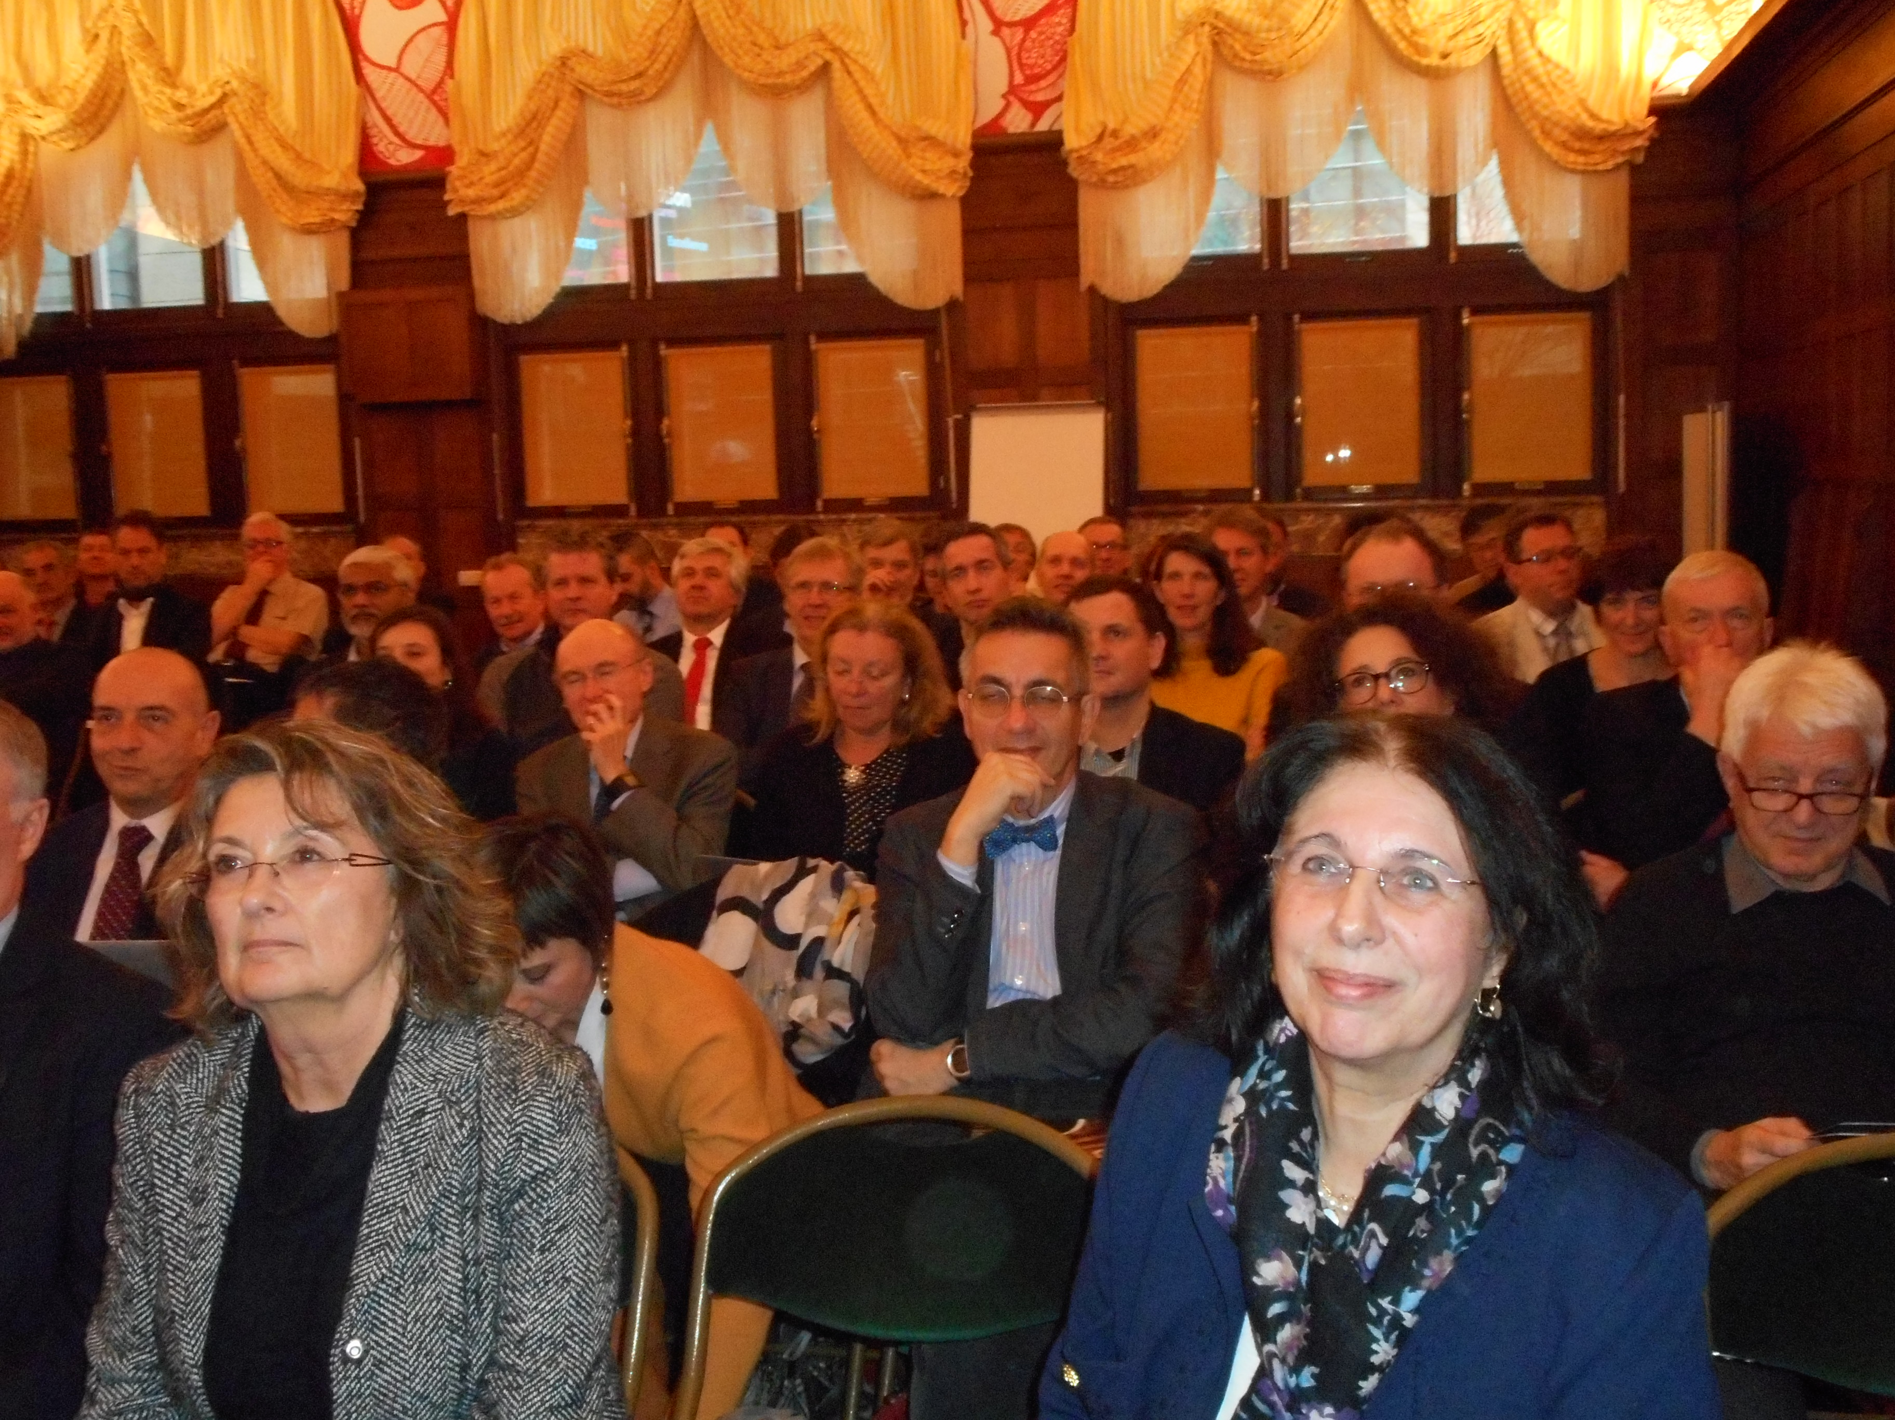
Long Range Plan organization
& schedule
1991
1997
2004
2010
The LPR identifies opportunities and priorities for the nuclear science in Europe
The LRP provides national funding agencies, ESFRI and European Commission with a framework for coordinated advances in nuclear science in Europe
Community
200 experts
7 working groups
Town meeting in Darmstadt January 2017
Report
June 2017
LRP presentation
in Brussels
Nov. 27, 2017
Beginning of
2016
End of 2017
http://www.nupecc.org/lrp2016/Documents/lrp2017.pdf
4

Slide 5
Central questions in
Nuclear Physics
How is mass generated in QCD and what are the static and dynamical properties of hadrons?
How does the strong force between nucleons emerge from the underlying quark-gluon structure?
What are the properties of nuclei and strong-interaction matter as encountered shortly after the Big Bang, in catastrophic cosmic events and in compact stellar objects?
How and where in the universe are the chemical elements produced?
How does the complexity of nuclear structure arise from the interaction between nucleons?
What are the limits of nuclear stability?
Marek Lewitowicz
5

Slide 6
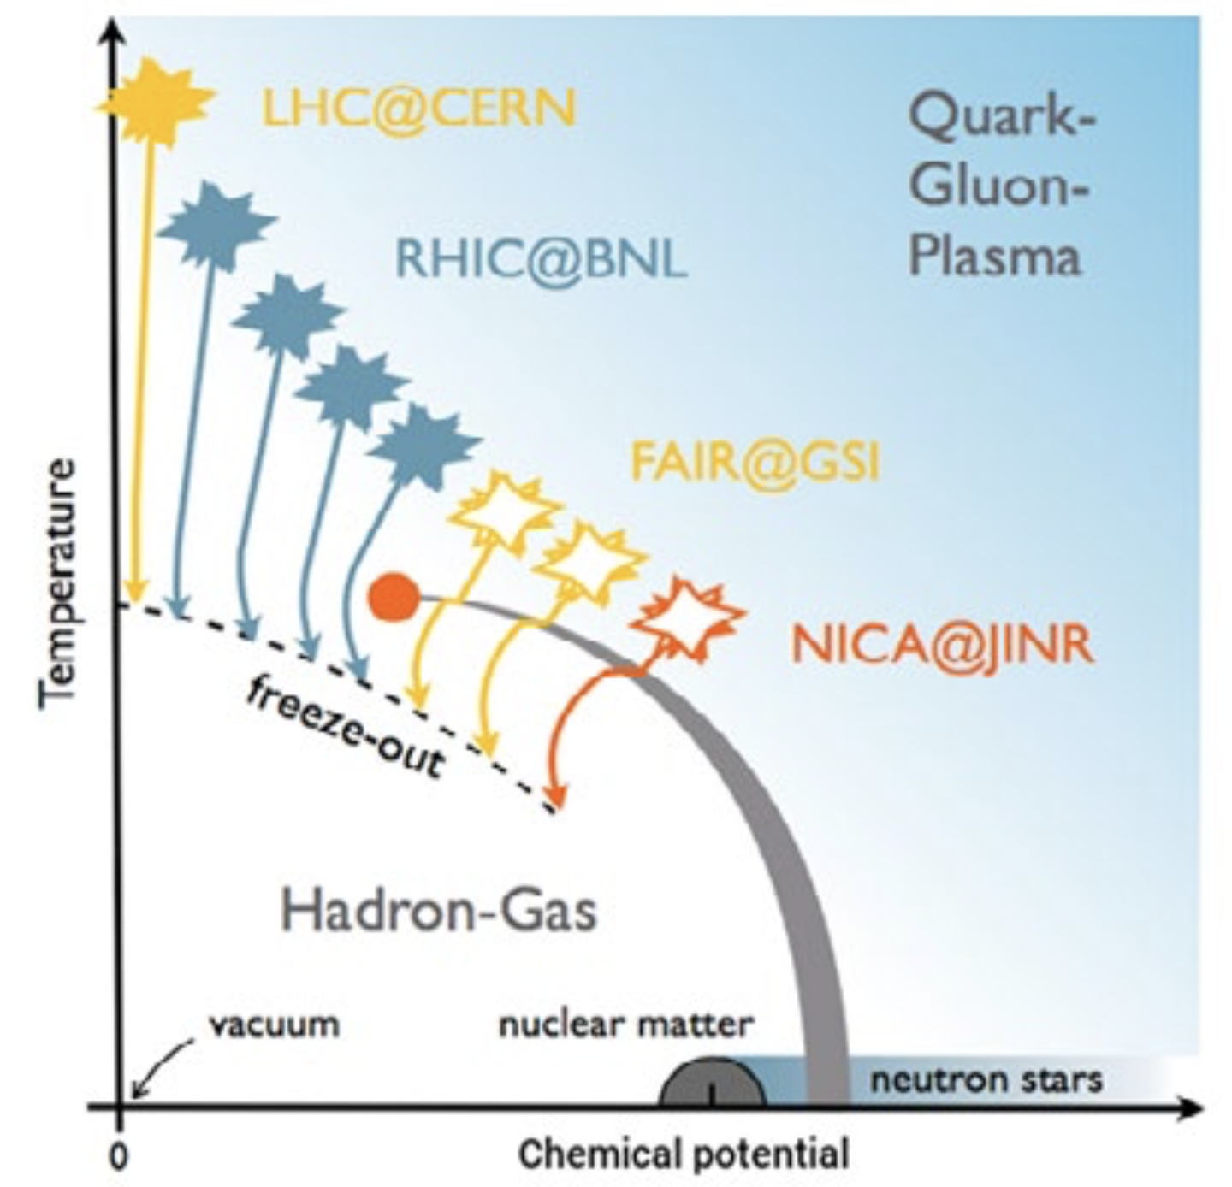
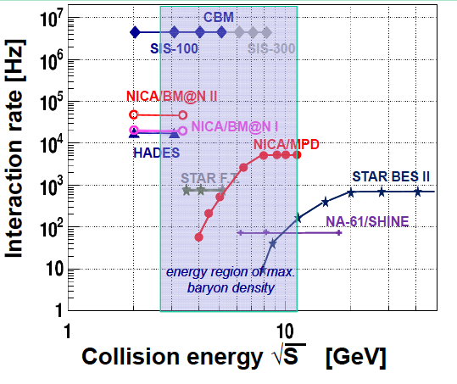
Hadronic Matter at
the very extremes
What are the properties of nuclei and strong-interaction matter as encountered shortly after the Big Bang, in catastrophic cosmic events, and in compact stellar objects?
NuPECC LRP recommendation:
Fully develop synergies between ALICE, NICA and FAIR
6

Slide 7
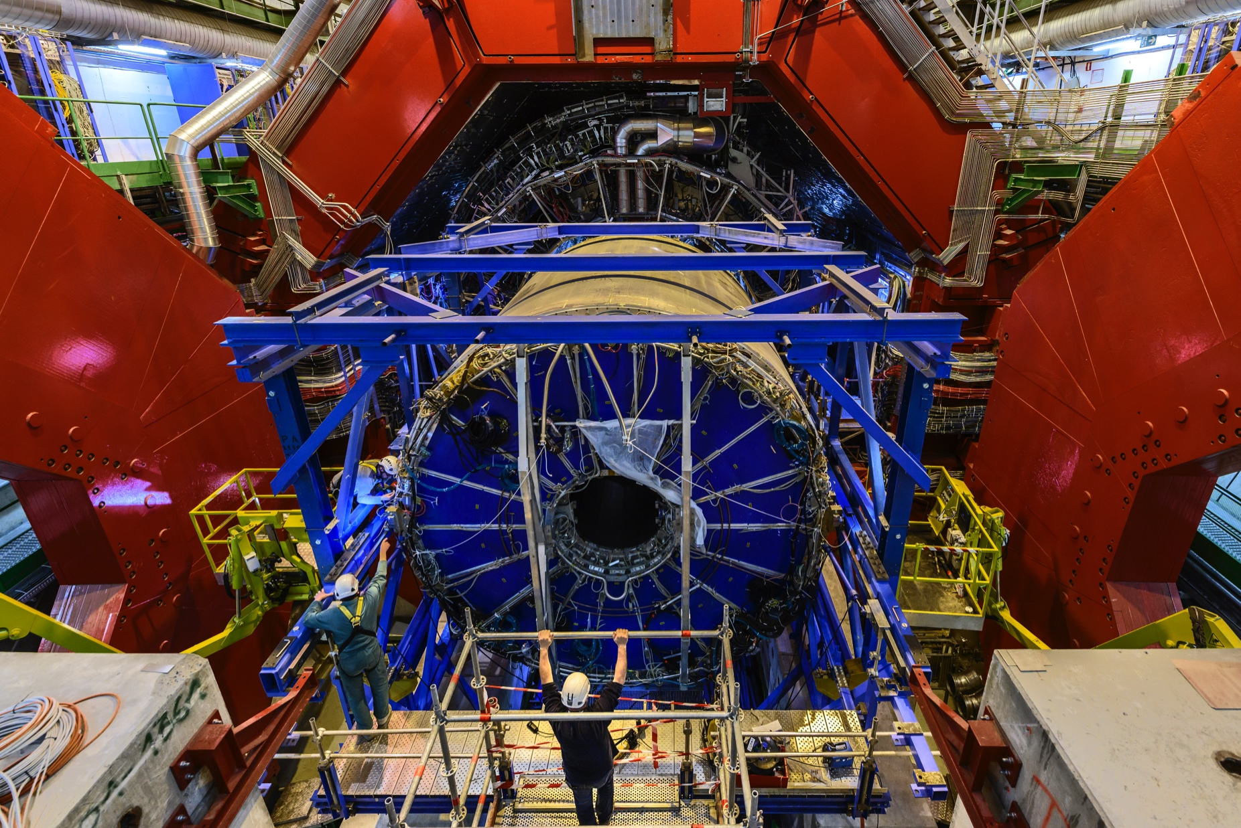
Hadronic Matter at
the very extremes
Ongoing: Heavy-ion program at the LHC
LHC Run 2 completed (Dec 2018) Target integrated luminosity 1nb⁻¹ reached! Large harvest of physics results
LHC Long Shutdown 2 (2019-2020)
  Improvements on LHC injection chain to reach 50 kHz Pb-Pb collision rates
  Major detector upgrades for ALICE → and LHCb
2021-2029: Run 3 and 4
  Goal: 13nb⁻¹ integrated luminosity
  Heavy-ion physics program arXiv:1812.06772
Ideas for a new heavy-ion experiment for Run 5 (from 2031)
ESPP-INP-110
Main NuPECC LRP recommendation:
All aspects of the LHC heavy-ion programme, including manpower support and completion of the detector upgrades, are strongly supported.
Marek Lewitowicz
7
Notes:
The ALICE solenoidal magnet (in red) was opened after the end of Run 2 (open doors visible on the left and on the right). The Time Projection Chamber (in blue) has been extracted, to be brought to the surface, to replace its readout chambers. (Add Input Number)

Slide 8

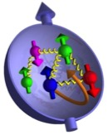
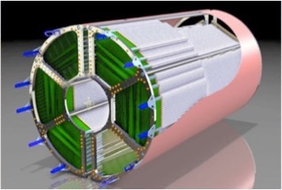
The Physics of Hadrons
How is mass generated in QCD and what are the static and dynamical properties of hadrons?
How does the strong force emerge from the underlying quark-gluon structure of nucleons?
The proton
discrepancies in measurements of the proton radius made with different techniques.
“proton spin puzzle”
High resolution experiments with antiprotons (PANDA) at FAIR to test in detail QCD
Main NuPECC LRP priority for this topic:
The antiproton programme at the FAIR/PANDA facility combined with programmes with polarised protons in Dubna (NICA) and those with lepton and hadron beams at existing facilities (MAMI, Bonn, INFN-Frascati, COMPASS).
A New QCD Facility at the M2 beam line of the CERN SPS
ESPP-INP-143
Marek Lewitowicz
8

Slide 9
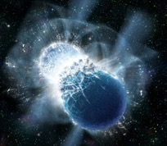
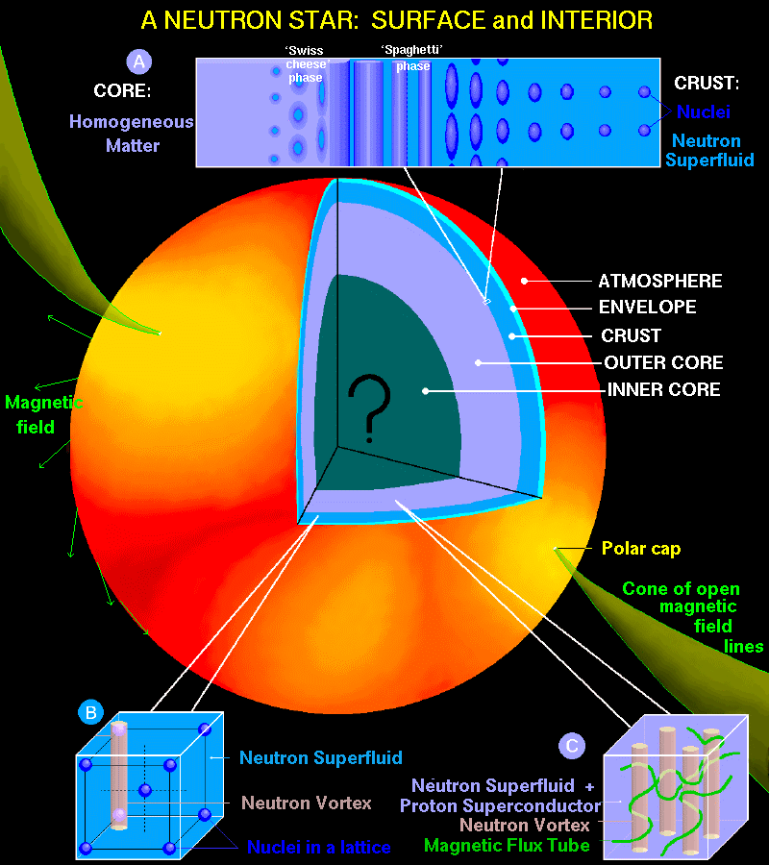
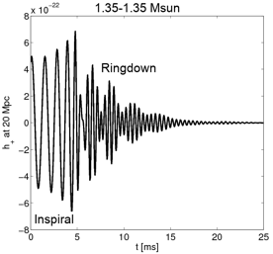
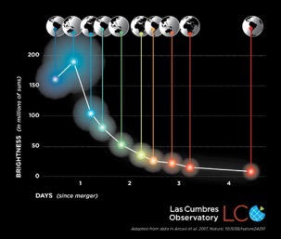
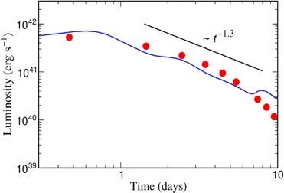
Neutron star mergers:
GW and production of heavy elements
Gravitational wave signal
Neutron star
mass
This depends on
the Nuclear
Equation of state
The messengers from
neutron star mergers :
Gravitational waves
Electromagnetic signals characterizing the nuclei in the ejecta
neutrinos
Gravitational wave emission
seen together with electromagnetic signals
Time evolution determined by the radioactive decay of r-process nuclei
(science drive of facilities with RIB)
Metzer, Martinez-Pinedo, Arcones et al. (2010)
Cowperthwaite, et al. (2017)
Kilonova observations
Marek Lewitowicz
9

Slide 10
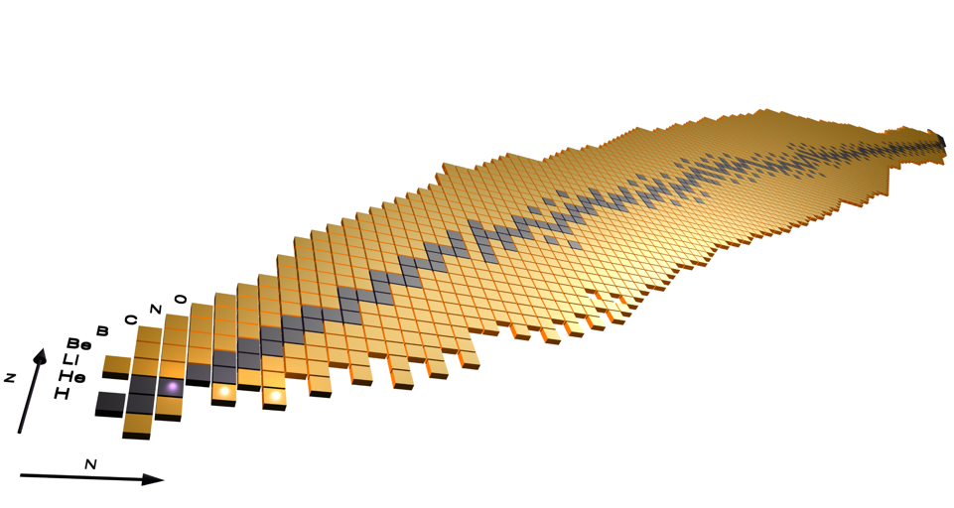
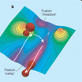

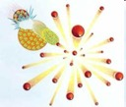




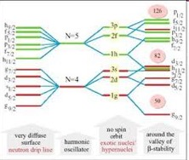
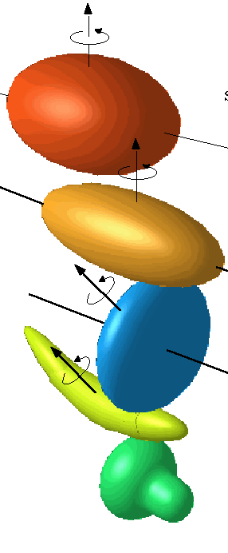




Structure of complex nuclei
How does the complexity of nuclear structure arise from the interaction between nucleons?
What are the limits of nuclear stability?
Fission dynamics
Lattice Effective
Field Theory
ν−π pairing
Equation of state
1p, 2p radioactivity
Coupling to continuum
Limits of
existence
Clusters
Shape
Coexistence
New magic numbers
Exotic Shapes
Neutron halos
Main NuPECC LRP recommendation:
Construction of FAIR/NUSTAR, ISOL Facilities, ELI-NP, full AGATA array
Marek Lewitowicz
10

Slide 11
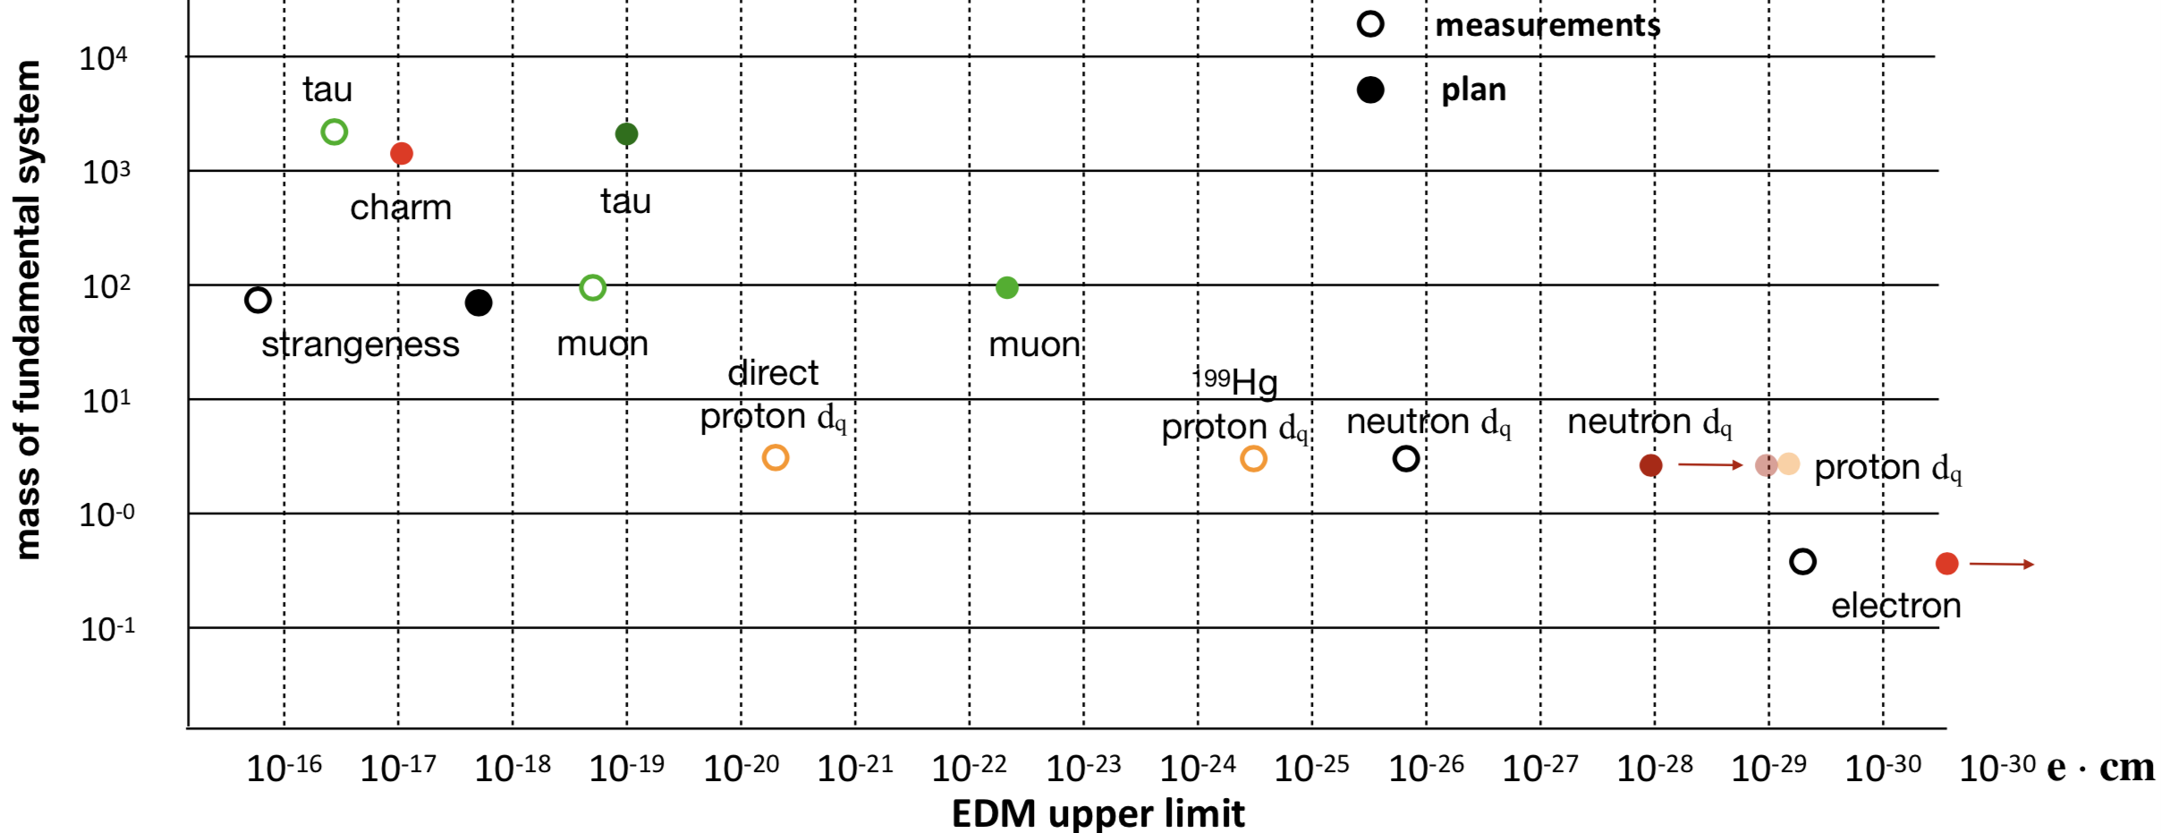
Fundamental interaction
and symmetries
Talks of Klaus Kirch, Stephan Paul, Gunar Schnell, …
EDMs
Symmetries in antimatter (antihydrogen)
Electron and neutrino correlations for the weak interaction
High precision measurements at low energies
Complementary to experiments at the highest energies and offering sensitivities to new effects beyond the Standard Model
EDMs Summary Different Fundamental Systems
MeV/c²
Nuclear Physics: exotic nuclei, input & techniques
Courtesy of Stephan Paul
Marek Lewitowicz
11

Slide 12
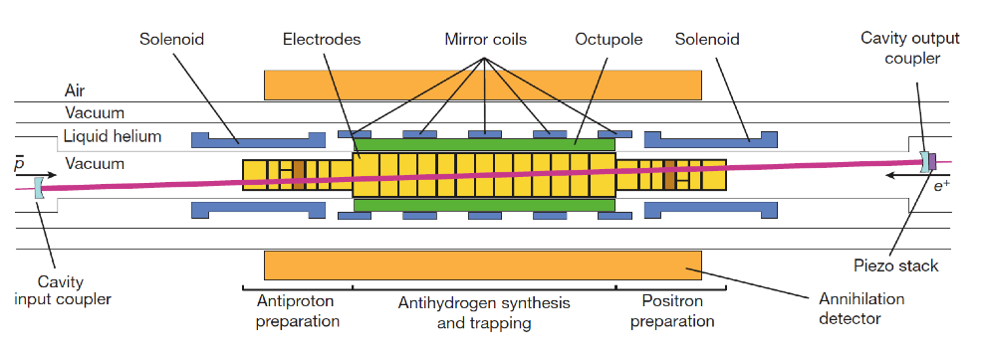
Fundamental interaction
and symmetries
EDMs
Symmetries in antimatter (antihydrogen)
Electron and neutrino correlations for the weak interaction
Experiments at AD
(antiproton and antihydrogen)
Spectroscopy
Gravity
ALPHA
ASACUSA
AEgIS
ATRAP
GBAR
BASE
Symmetries
ALPHA-2 apparatus at CERN
Ahmadi, M. et al. (ALPHA collaboration). Characterization of the 1S–2S transition in antihydrogen. Nature 557, 71–75 (2018)
Courtesy of Eberhard Widmann
Marek Lewitowicz
12
Notes:
Fig. 3 | Spectral line of antihydrogen. a, The complete dataset, scaled as described in the text. The simulated curve (not a fit, drawn for qualitative comparison only) is for a stored cavity power of 1 W and is scaled to the data at zero detuning. ‘Appearance’ refers to annihilations that are detected during laser irradiation; ‘disappearance’ refers to atoms that are apparently missing from the surviving sample. The error bars are 1-s.d. counting uncertainties.

Slide 13
EXAMPLE: new interactions –
future limits for beta-decay and LHC
Electron and neutrino correlations for the weak interaction
LHC8, 20 fb⁻¹
Courtesy of
M. Gonzalez-Alonso,
N. Severijns, B. Blank
Marek Lewitowicz
13

Slide 14
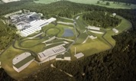



Recommendations for European
Nuclear Physics facilities
Complete urgently the construction of the ESFRI flagship FAIR and develop and bring into operation the experimental programme of its four scientific pillars APPA, CBM, NUSTAR and PANDA
Support for construction, augmentation and exploitation of world leading ISOL facilities in Europe towards EURISOL
GANIL/SPIRAL2
ISOLDE, SPES,
JYFL
Support for the full exploitation of existing and emerging facilities
ELI-NP
NICA, SHEF
MYRRHA
IFMIF-DONES
Support for ALICE and the heavy-ion programme at the LHC with the planned experimental upgrades
Support to the completion of AGATA array in full geometry
14
Notes:
European Strategy Forum on Research Infrastructures

Slide 15


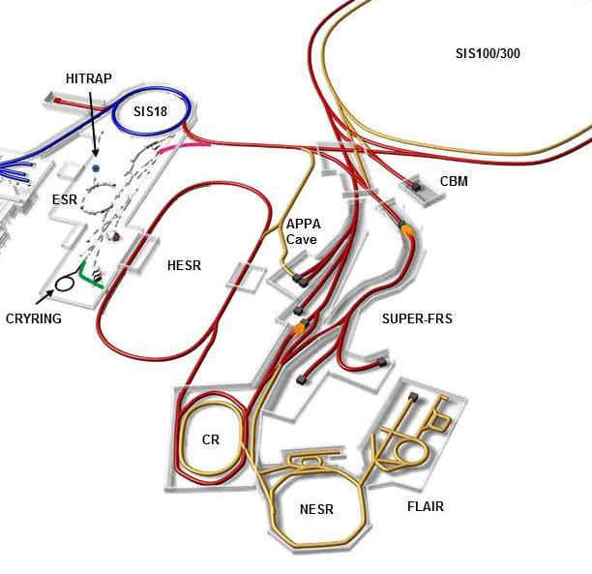
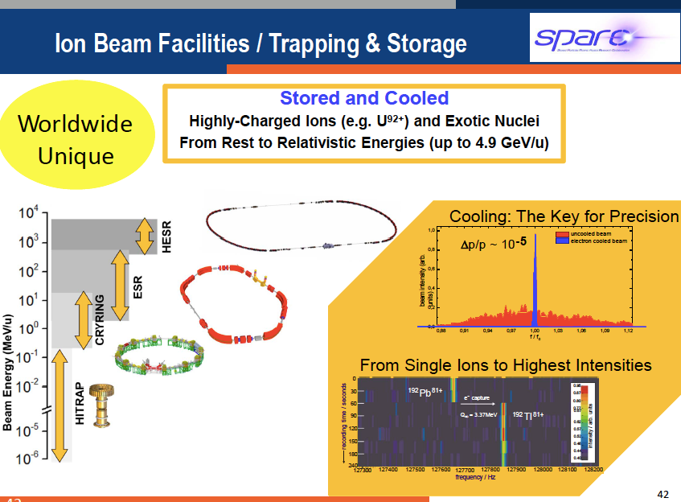
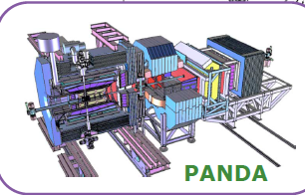
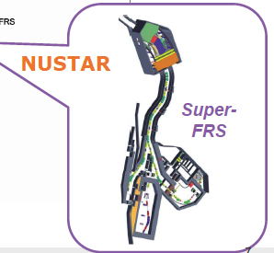
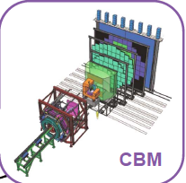
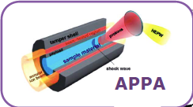
Roadmap NP facilities
Courtesy of
Paolo Giubellino
Large facility covering all nuclear physics domains !
Antiprotons, highly charged ions (e.g. U⁹²⁺ ) and exotic Nuclei) from rest to relativistic energies 4.9 GeV/A
4 pillars
Worldwide
Unique
Ongoing experiments FAIR Phase-0 (run 2019)
Marek Lewitowicz
15

Slide 16
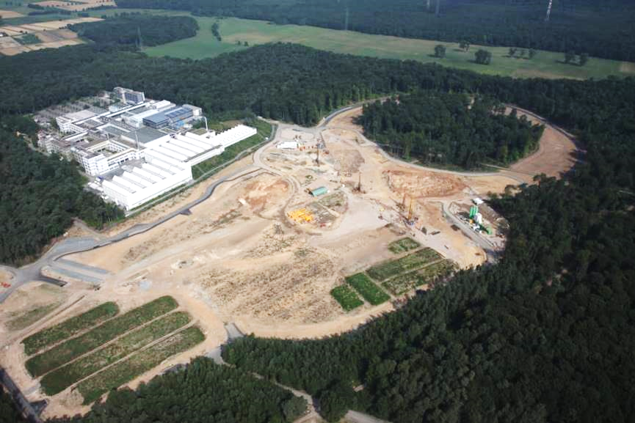
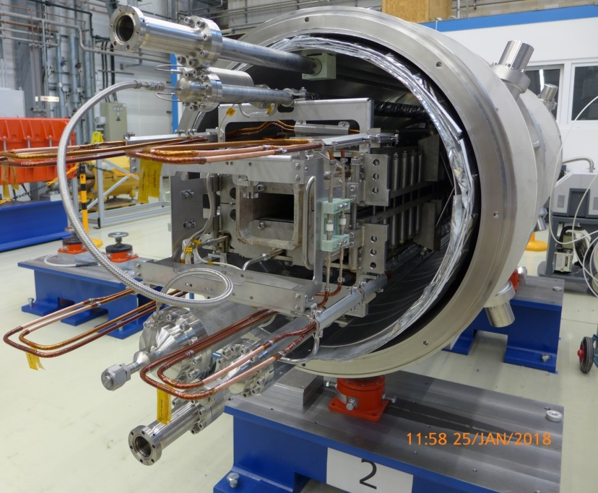

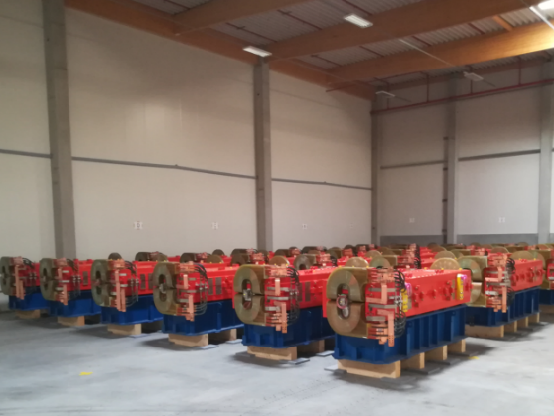
Roadmap NP facilities
before July 2017
24 SIS100 (of 120) dipole magnets
delivered and cold-tested
1km
Courtesy of Paolo Giubellino
January 2019
All HESR Dipoles are produced, in Jülich and 65% are delivered to FAIR
tunnel ceiling
Marek Lewitowicz
16

Slide 17

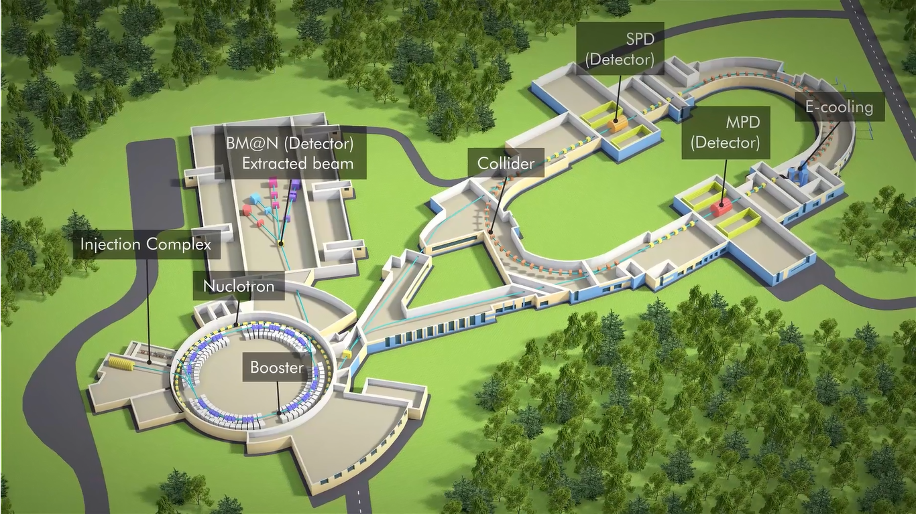
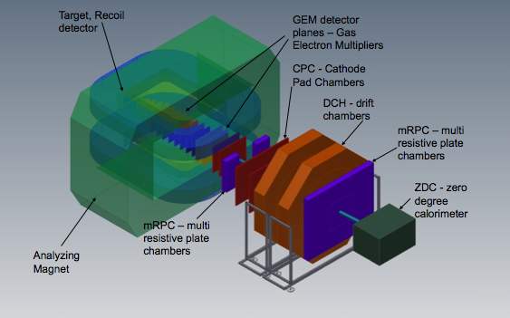
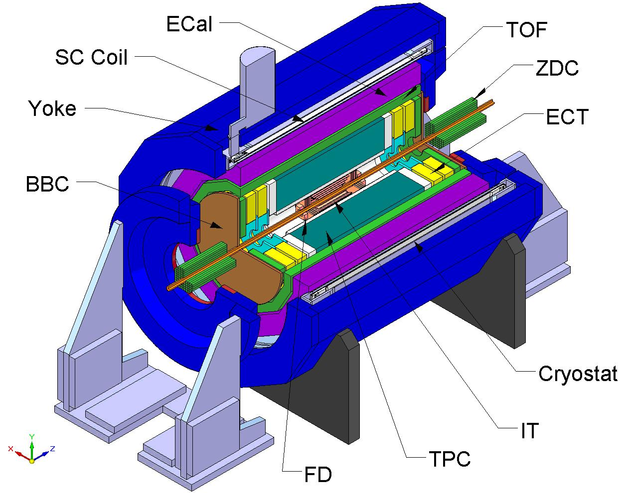
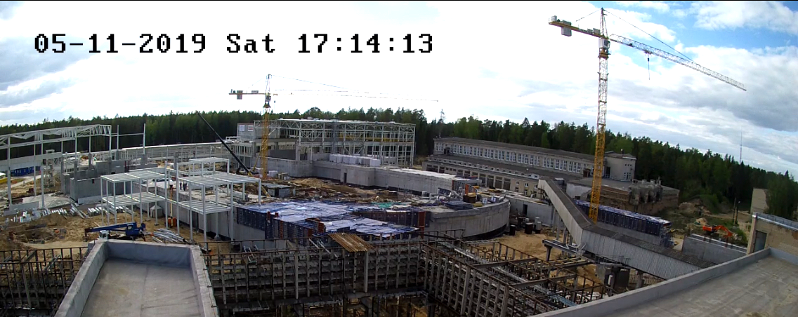
Roadmap NP facilities
at JINR
BM@N
Collider ring (c=503 m)
MPD
Nuclotron ring (c=251,5 m)
Courtesy of Boris Sharkov
Marek Lewitowicz
17

Slide 18

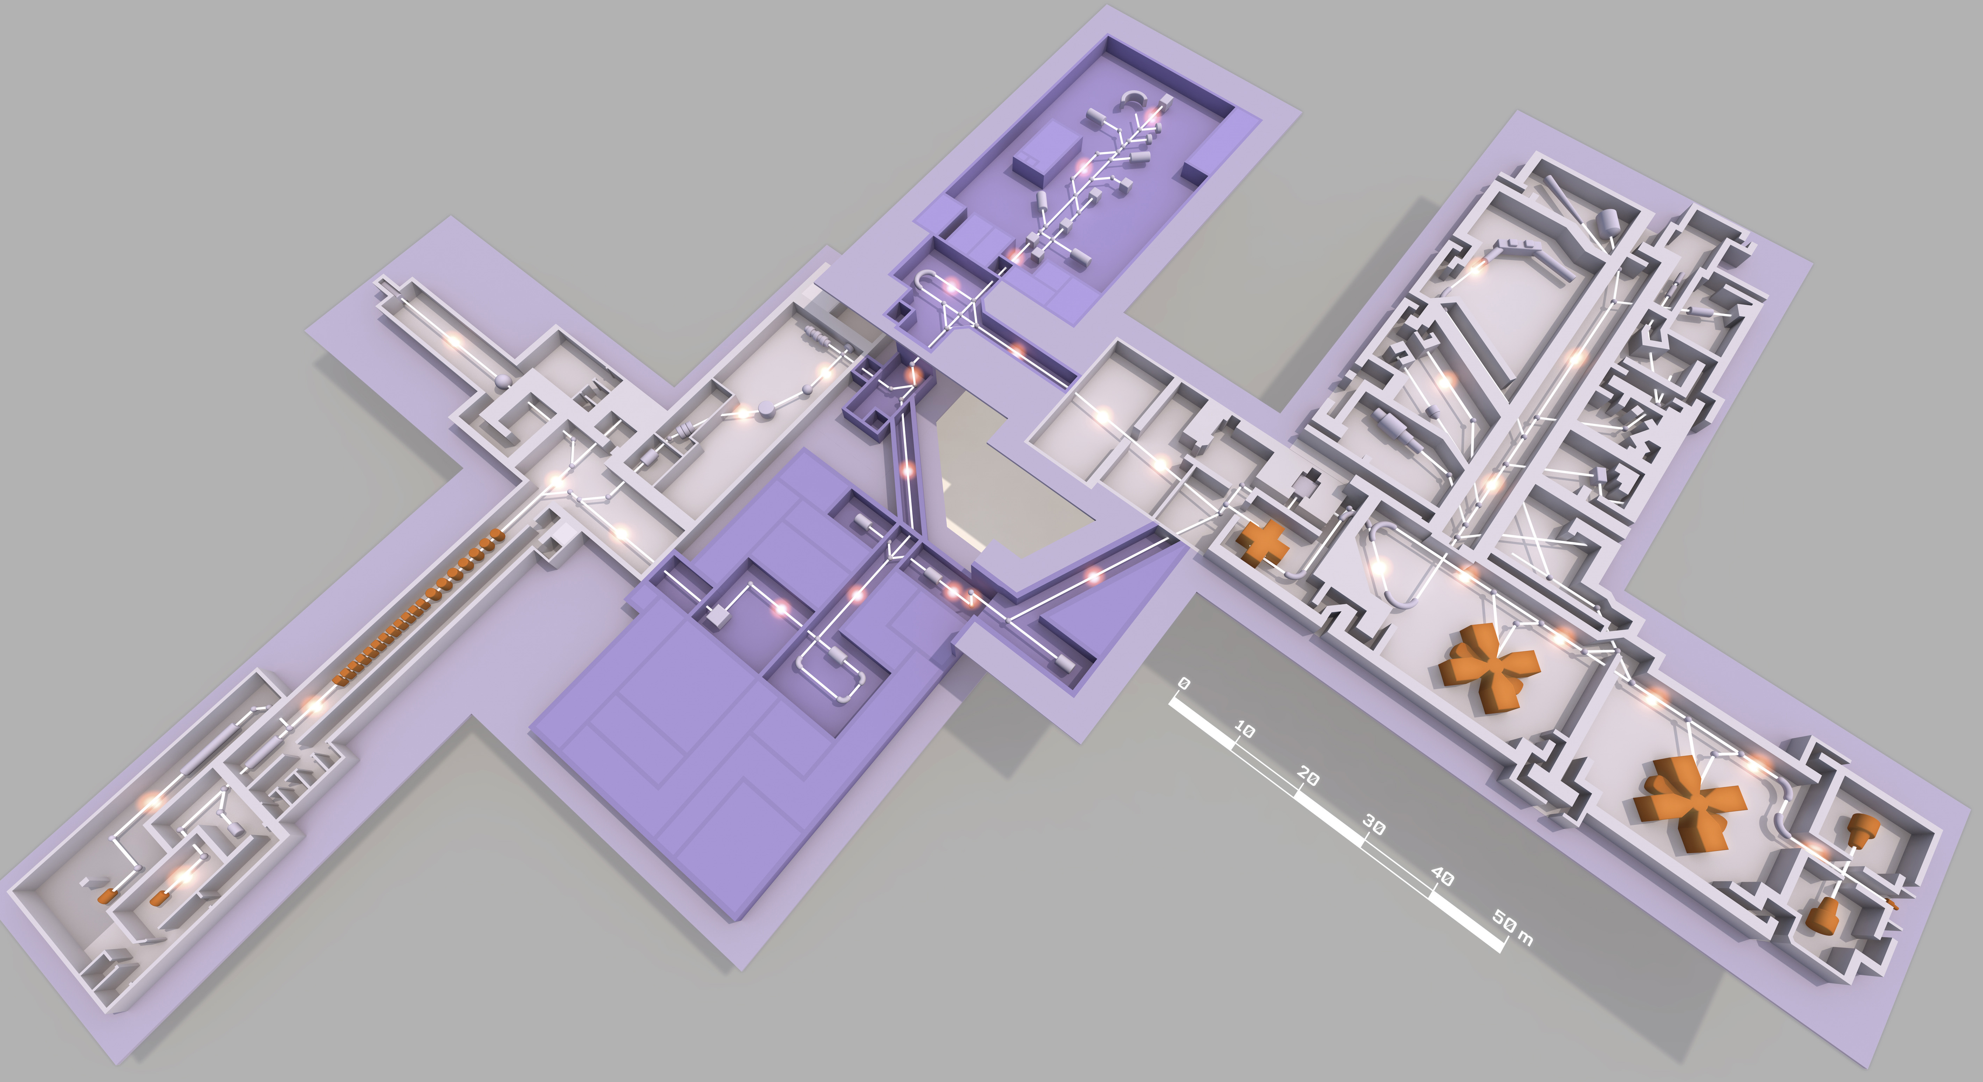






Roadmap NP facilities
S3
DESIR
AGATA
VAMOS
NFS
FAZIA
INDRA
HI SC LINAC
SPIRAL2 Phase 2
under discussion
SPIRAL1
SPIRAL2 Phase 1
5mA 14-20 MeV/n light and heavy ions
First SPIRAL2 beams beginning of 2020
Courtesy of Navin Alahari
Marek Lewitowicz
18

Slide 19



Roadmap NP facilities
The nominal power of 10 PW laser system was achieved in March 2019, making HPLS from ELI-NP the most powerful laser in Europe
Courtesy of Dan Gabriel Ghiță & Ionel Andrei
19

Slide 20



CERN / ISOLDE
World-leading ISOL facility
Nuclear and Atomic Physics
Nuclear Astrophysics
Materials sciences
Life sciences and biochemistry
AND Fundamental Interactions and Symmetry studies
See presentations of
Suzanne Mertens
Stephan Paul
Gunar Schnell
50-60% of CERN
protons
HRS
WISArD
ISCOOL
GPS
MINIBALL
TAS
VITO
ISS
collections
NICOLE
HIE ISOLDE
COLLAPS
Travelling
setups
IDS
CRIS
ISOLTRAP
Future: Exploiting the Potential of ISOLDE at CERN - EPIC
ESPP-INP-39
Curtesy of Karsten Riisager & Gerda Neyens
20
20

Slide 21
NuPECC LRP
The 2017 NuPECC Long Range Plan defined an ambitious strategy for European Nuclear Physics
NuPECC efforts to transform the LR Plan into reality
Development of a global international approach to nuclear science in collaboration with IUPAP, NPD/EPS, ECFA, NSAC (US), ANPhA (Asia), ALAFNA (S. America), CINP (Canada)
Joint activities of
ECFA, ApPEC & NuPECC
Joint “JENAS” seminar – Oct. 2019
Diversity Charter
…
21

Slide 22
Nuclear Physics inputs to
the ESPP Update
> 60/160 inputs related to nuclear physics and techniques
Physics & methods
  Symmetries & Fundamental Interactions
  Hadron physics
  Strongly Interacting matter at extreme conditions of temperature and baryon number density
  Nuclear Physics methods for neutrino physics and search for dark matter
Experiments and accelerators
  ALICE and future RHI exp. at CERN
  Physics beyond colliders (ELENA, COMPASS, …)
  FAIR at Darmstadt, NICA at Dubna
  ISOL-type Nuclear Physics facilities (ISOLDE,…)
  Applications (n-TOF, MEDICIS,…)
Importance of proton and HI beams for the nuclear physics experiments and applications at CERN – to be considered for the future projects
22

Slide 23

Warm thanks to all contributing colleagues
Thank you for your attention

Slide 24

Hadronic Matter at
the very extremes
Future: A next-generation LHC heavy-ion experiment
Ideas for a new heavy-ion experiment for Run 5 (from 2031), after LS4
capable to handle extremely high rates for rare probes (heavy flavors, heavy quarkonia, light (anti-)(hyper-)nuclei), and measure ultra low momentum particles
Ultra-light all-silicon apparatus:
Tracker: ~10 tracking barrel layers based on CMOS sensors (blue, yellow, green)
Spatial resolution: 1-5 μm
Hadron ID: TOF with outer silicon layers (orange)
Time resolution: ~30 ps
Electron ID: pre-shower (outer blue)
arXiv:1902.01211
Marek Lewitowicz
24

Slide 25





Hadronic Matter at
the very extremes
Ongoing: FAIR Phase-0 (run 2019)
HADES
Ag+Ag (1.58 AGeV), 4 weeks, 50 billion events
mCBM
A CBM full-system test-setup at SIS18
MAPMT based Cherenkov Photon Detector
Joint project of CBM and HADES
Forward Detection System (2020)
Based on PANDA Straw Technology
CBM prototype detector systems
free-streaming read-out and data transport to the mFLES inside the GreenITCube
up to 10 MHz collision rate
Marek Lewitowicz
25

Slide 26

EXAMPLE: Charged-particle (proton, deuteron)
EDM-searches in storage rings
Science case: high EDM sensitivity (10⁻²⁹ e.cm); essential to determine EDM sources (also: axion DM search)
Technique: observation of time-development of polarization vector in E-fields (out-of-plane precession)
Requirements: polarized proton/deuteron beams; dedicated precision storage rings; polarimetry
Timeline:
Ongoing now
5 yrs
10 yrs
Sensitivity:
10⁻⁽¹⁸⁻¹⁹⁾ e.cm
10⁻⁽²³⁻²⁴⁾ e.cm
10⁻⁽²⁸⁻²⁹⁾ e.cm
Curtesy of Hans Stroeher
Marek Lewitowicz
26

Slide 27
Fundamental interaction
and symmetries
Nuclear physics contributions
2. SM parameters
  2.1 Leptons
    2.1.1 Neutrinos
    2.1.2 Charged leptons and fundamental
    constants
  2.2 Baryons
    2.2.1 Semi-leptonic decays
    2.2.2 Quark mixing matrix
    2.2.3 Nucleon and nuclear properties from atomic-physics measurements
      Muonic hydrogen and the proton charge radius
      Nucleon and nuclear polarizabilities
      Combining muonic-atom spectroscopy with elastic electron scattering
      Heavy muonic atoms
      Kaonic atoms
      Precision nuclear spectroscopy of thorium-229
3. Searches beyond the SM
  3.1 Fundamental-symmetry tests
      Searches for CP and T violation
      P violation in atoms, ions and molecules
      Searches for CPT and Lorentz violation
      Spin-statistics tests
      Search for cLFV
  3.2 Dark Matter, Dark Energy and exotic forces
    3.2.1 Direct Search for Dark Matter Particles
    3.2.2 Test of Dark Energy models with precision experiments
    3.2.3 Exotic forces
  3.3 Temporal and spatial variation of fundamental constants
High precision measurements at low energies
Complementary to experiments at the highest energies and offering sensitivities to new effects beyond the Standard Model
See talks of Klaus Kirch, Stephan Paul, Gunar Schnell,…
27

Slide 28
EXAMPLE: best limit on the electron EDM
comes from molecules
atoms
molecules
GOAL for RaF molecules (radioactive only!)
100 TeV
Courtesy R.F. Garcia Ruiz

