Slide 1
Summer Student Induction
17 June 2019

Slide 2
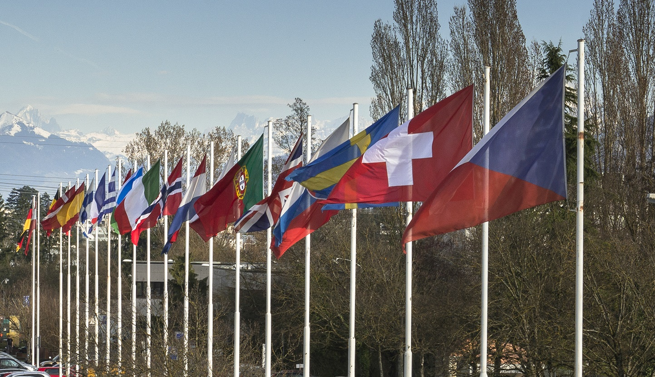
WHAT IS CERN?
European Organization for Nuclear Research
23 Member States:
Austria, Belgium, Bulgaria, Czech
Republic, Denmark, Finland, France, Germany,
Greece, Hungary, Israel, Italy, Netherlands, Norway,
Poland, Portugal, Romania, Serbia, Slovakia, Spain, Sweden,
Switzerland and United Kingdom
Associate Members in the Pre-Stage to Membership:
Cyprus, Slovenia
Associate Members:
India, Pakistan, Turkey, Ukraine, Lithuania
Observers to Council:
Japan, Russia, United States of
America, the European Commission, Joint Institute for
Nuclear Research and UNESCO
~ 3 000 members of personnel
~ 12 000 users
Budget ~ 1 100 MCHF per year
FOUNDED IN 1954

Slide 3
CERN OPENLAB’S MISSION
Our recipe for success
• Evaluate state-of-the-art technologies in a
challenging environment and improve them.
• Test in a research environment today
technologies that will be used in many business
sectors tomorrow.
• Train the next generation of
engineers/researchers.
• Promote education and cultural exchanges.
• Communicate results and reach new audiences.
• Collaborate and exchange ideas to create
knowledge and innovation.

Slide 4
A VIRTUOUS CYCLE
Driving ICT innovation in science

Slide 5
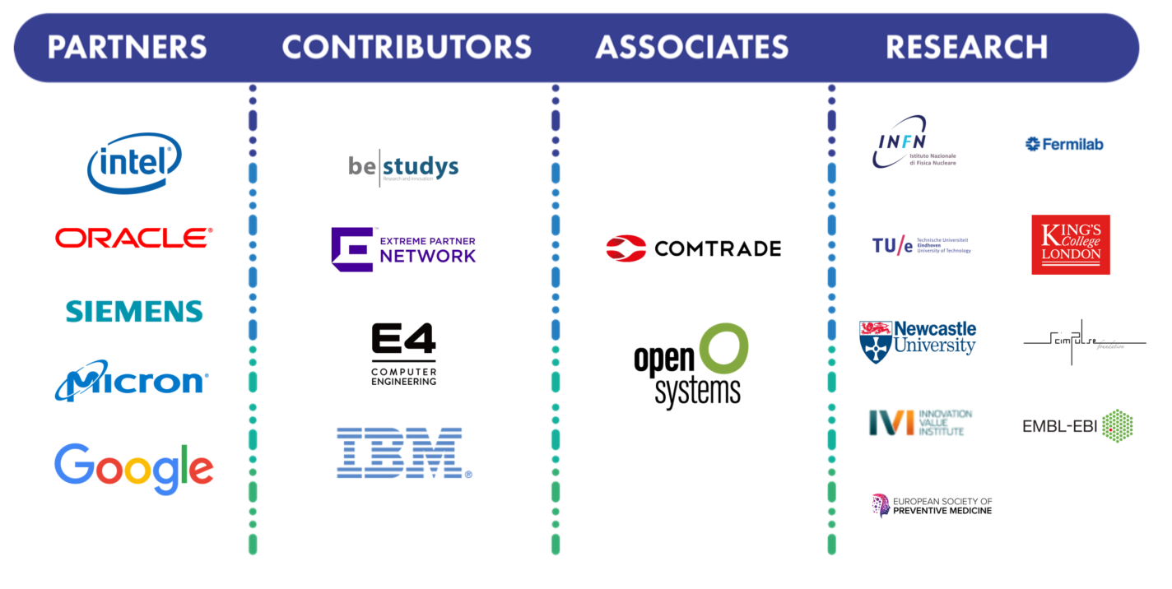
COLLABORATION MEMBERS
A public-private partnership between the research community and industry

Slide 6
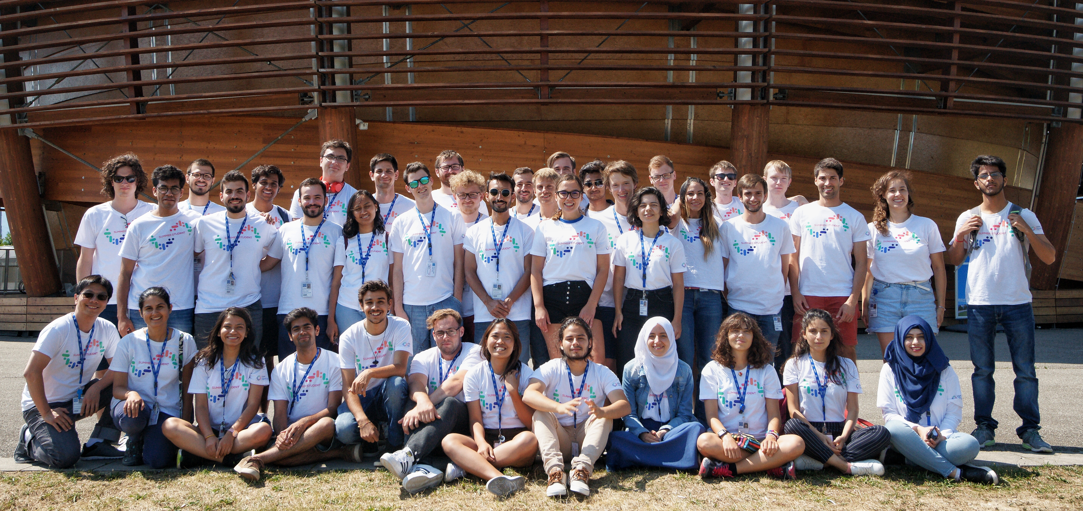
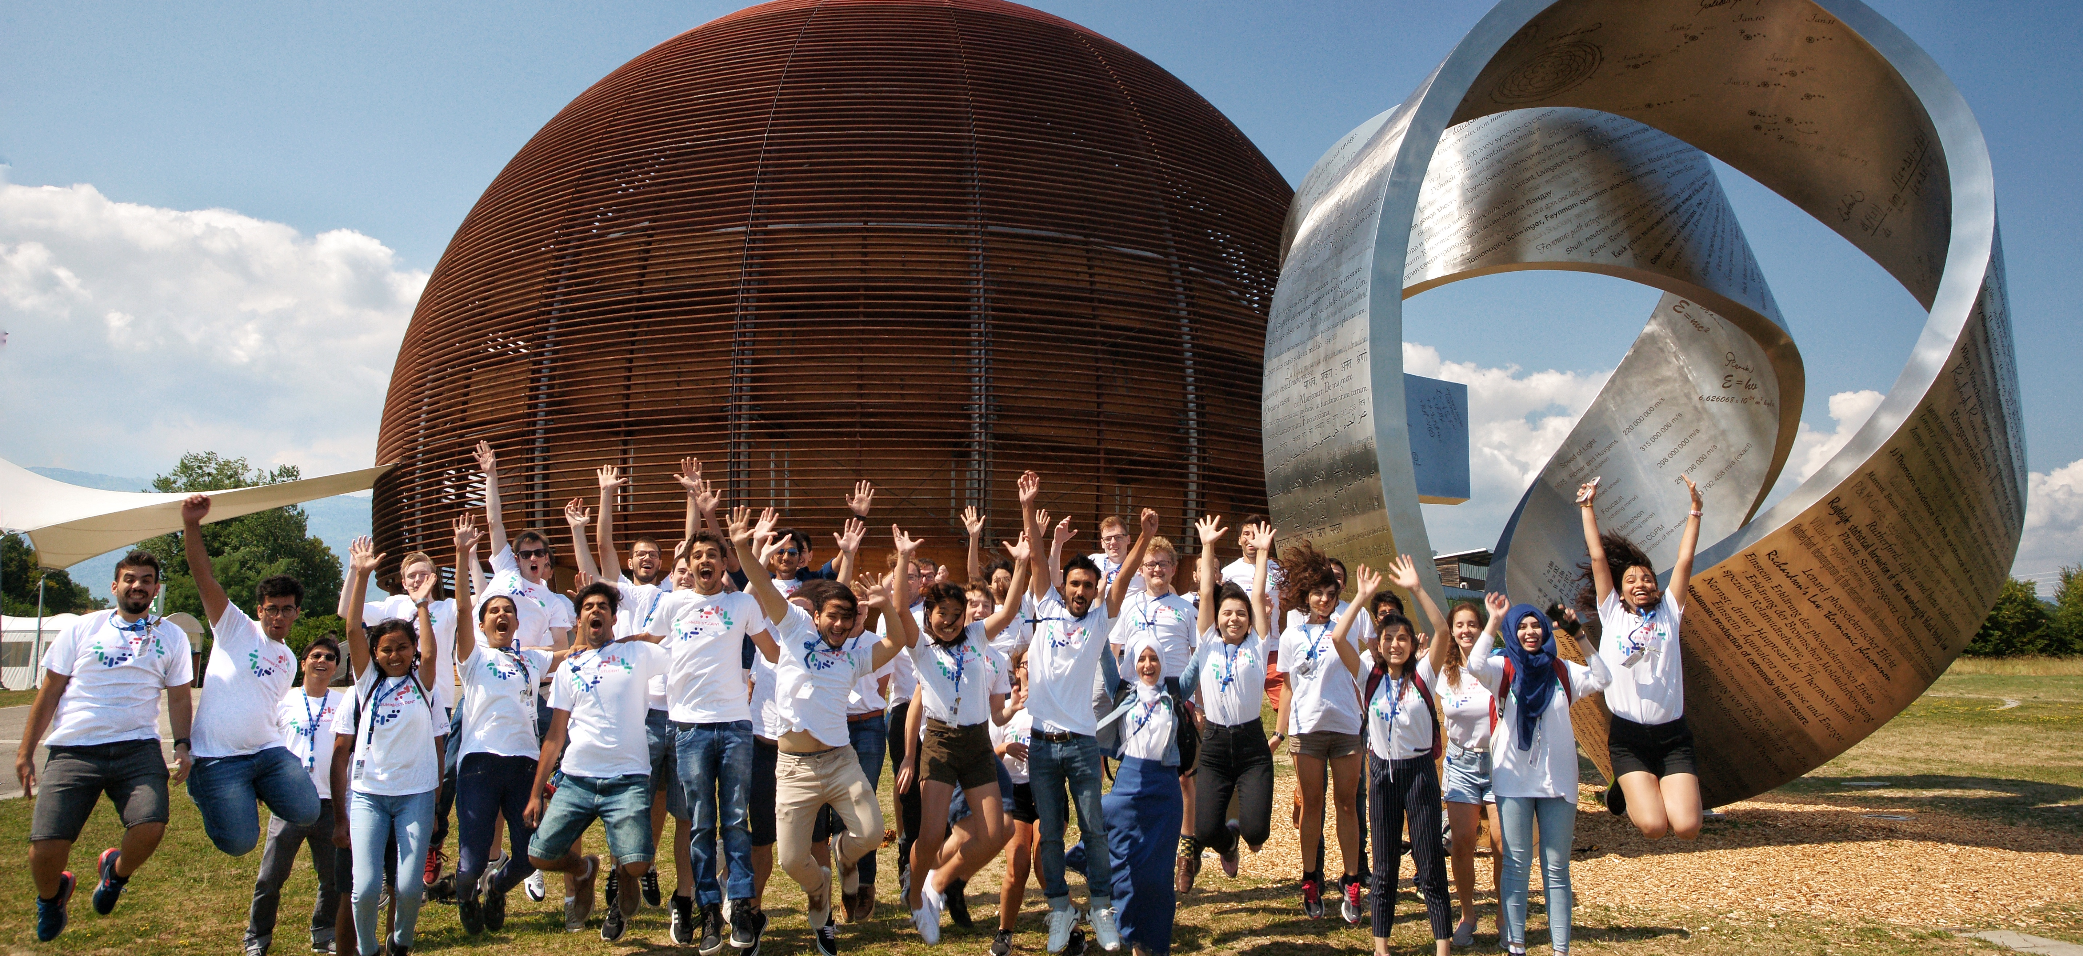
EDUCATION AND TRAINING
Training tomorrow’s leaders in ICT
CERN openlab runs a highly competitive summer-student programme
Most dedicated CERN openlab personnel are young, talented ‘fellows’.
Workshops, training courses, and other initiatives run with our collaborators.
Experts from industry and research give lectures.
40 students selected from 1660 applicants this year
Receive hands-on experience with cutting-edge technologies
Competitions, challenges, online training, hackathons.
Participate in events both inside and outside CERN.

Slide 7

Your CERN openlab Summer Student Experience
9 weeks
A project report to complete
    Initial draft after 4 weeks (table of content, main sections)
    Final draft to your supervisor a week before leaving
A 5-minute ‘lightning talk’ to describe your project and its outcome at the end of your stay
Visits to external companies and research institutes
A series of lectures about IT, computing and data management applied to HEP and other scientific domains

Slide 8
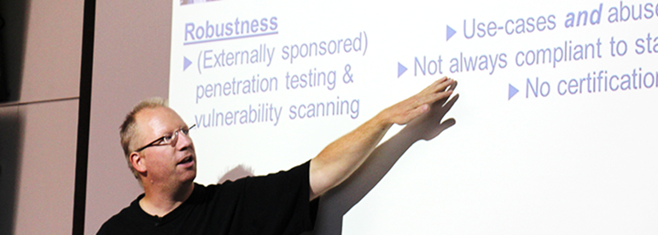
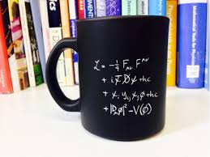
CERN openlab lecture programme
Bring your own coffee…
CERN openlab summer student lecture programme can be found here:
https://indico.cern.ch/category/11195/
Lectures usually start at 13.30 (except the first one that will start at 14.30!)
As CERN openlab summer students you are required to attend the lectures ☺
Start on July 2nd !

Slide 9
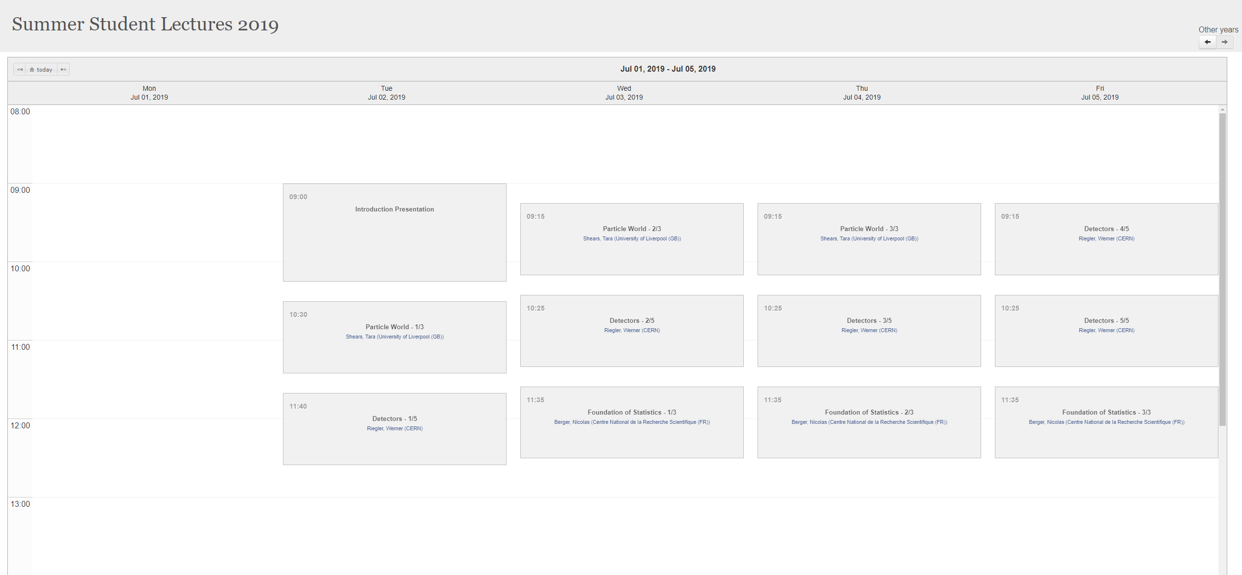
Physics Lecture Programme Schedule (Main auditorium): http://summer-timetable.web.cern.ch/summer-timetable/
Monday 8 July at 11.30: Presentation by the CERN Director for Research and Computing
July 15-17 at 10.25: From raw data to Physics results

Slide 10
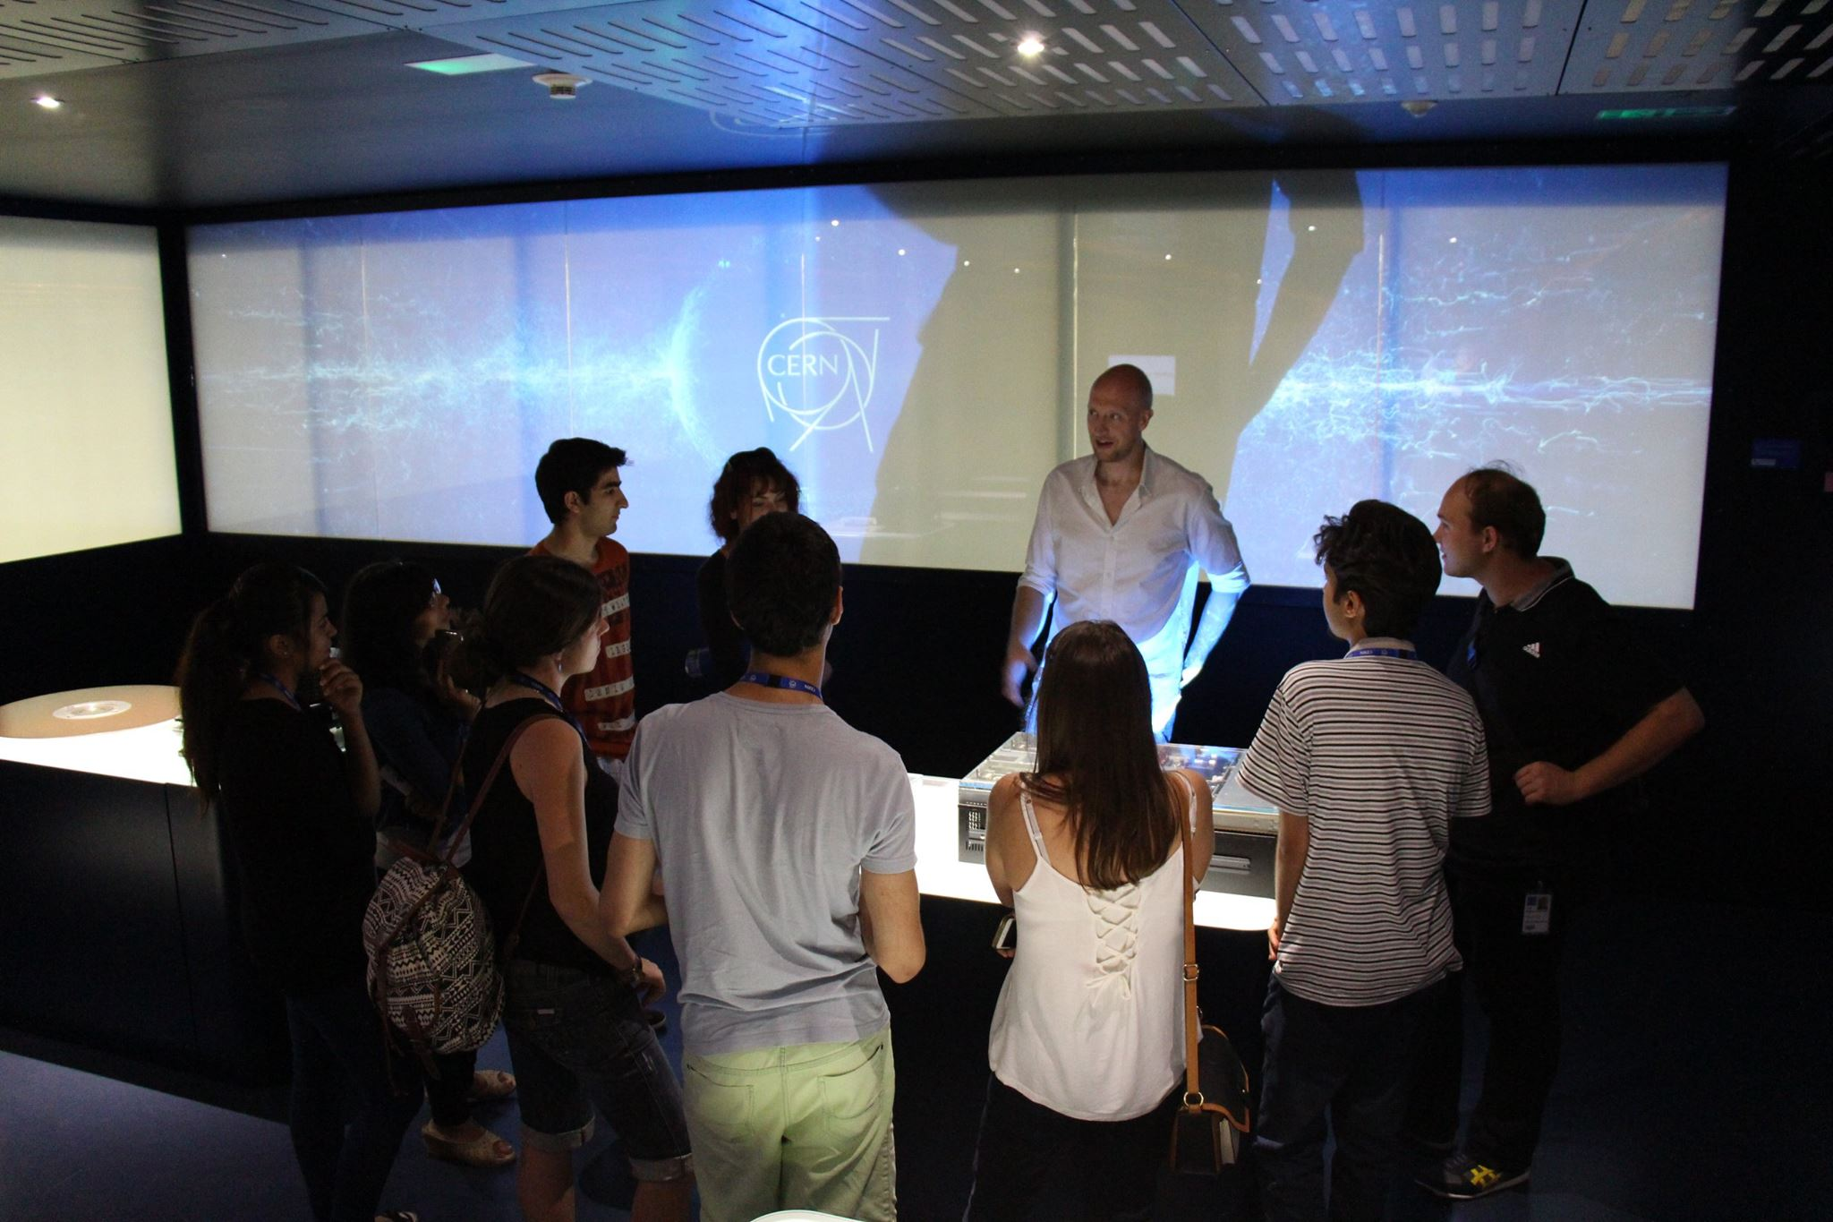

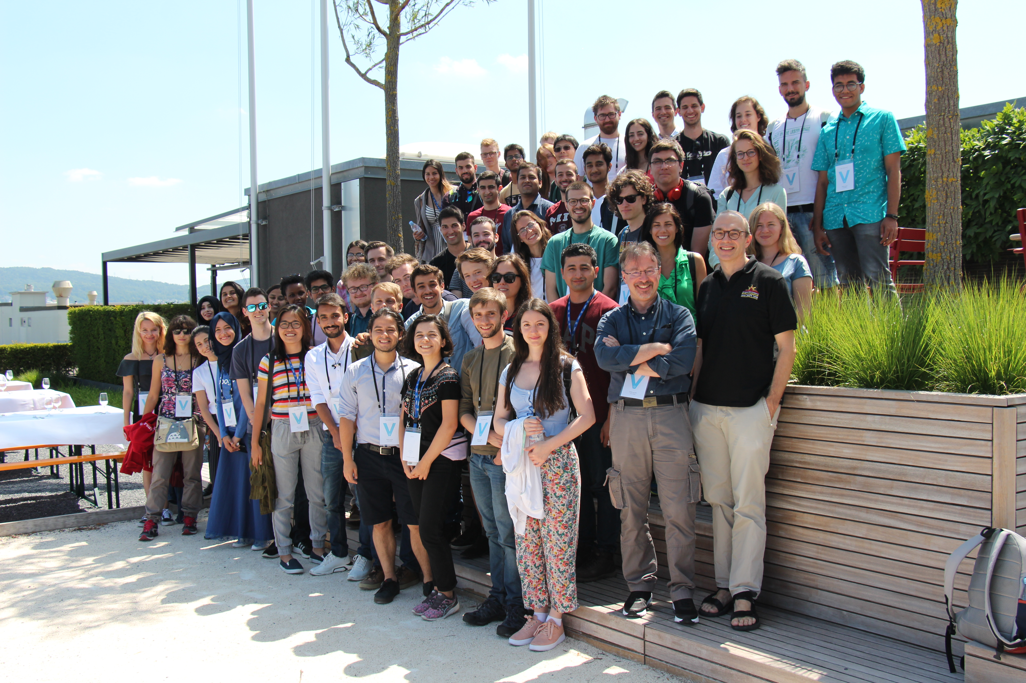
Events, excursions
Welcome drink for all summer students, Restaurant 2, Wednesday 3rd of July at 17h
Treasure hunt in Geneva, Monday 8th of July at 17h
Field trip to Zurich 11-12 July – Registration details will be circulated shortly
Webfest 26-28 July
Various CERN visits starting end of July – Registration details will be circulated shortly
Final Lightning talk session drink -16th August
…and anything else you can think of!

Slide 11
Your contract conditions
Associated member of personnel
Subject to all relevant legislation of CERN: Staff Rules and Regulations, Code of Conduct, Operational Circulars
Respecting the Organizations working hours (40h/week) 8.30-17.30
Behaving in a appropriate manner when being on the CERN site, handling property of CERN or when exposing in public your link to CERN (e.g. via social media)

Slide 12
Your contract conditions
Working
Hours
8 hours/day - ~08:30 – 17:30 -1 hour lunch break
Subsistence
90 CHF/day – tax free (every day from your 1st Monday – last Friday).
Health insurance
You are insured by UNIQA (already deducted from your subsistence)
Last salary+ travel lump sum will be paid on your last contractual day
40 hour week
No paid overtime or shift work
See CHIS website: http://hr-dep.web.cern.ch/fr/chis/defaut
No annual leave (holidays)
Pre paid cards for your subsistence
Pre-paid cards valid for around six months, exact date in letter provided with the card
In case you have to see a doctor, try one in France first.
Reimbursements are made once the bill has been paid and the reimbursement for filled out and sent tu UNIQA.
Emerencies: Hopital de La Tour in Meyrin.

Slide 13

Prepaid Card
By Swiss bankers – distribution here today!
First pay on the Wednesday in your first week.
Last pay the day of your departure
(including travel allowance)
The card is valid for six months, exact date is marked in letter
Fees:
Card fee: 0 CHF, paid by CERN
No fees charged for payments (shops & online)
No currency exchange fees, normal “exchange rate”
Cash withdrawal fee: CHF 5.- wherever you are
Online bank app:
  To see transactions & sold
  To transfer money to your home bank account (if you wish to)
Questions?
  a) marion.devouassoux@cern.ch
  b) Summer.Students.financialinfo@cern.ch
Did you know!?
  There is a 10 % reduction for meals at lunch time at the Novae restaurants, applicable to students under 25 years. Reduction cards available in your secretariat.

Slide 14
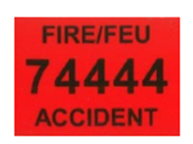

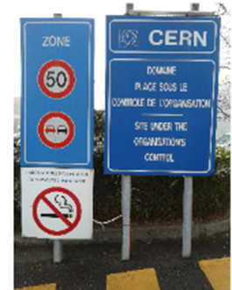



Safety at CERN
The CERN Safety Policy:
Each person … shall actively contribute to the implementation of the CERN Safety Policy through:
Exemplary conduct
Compliance with CERN Safety Rules
Actively seeking information to minimize risks
Avoiding dangerous situations for her/himself
Exercising the responsibilities given to her/him safely

Slide 15
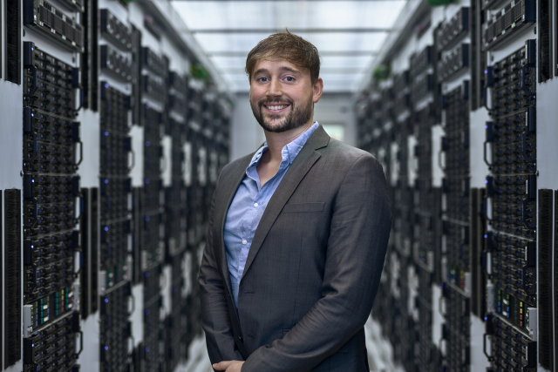
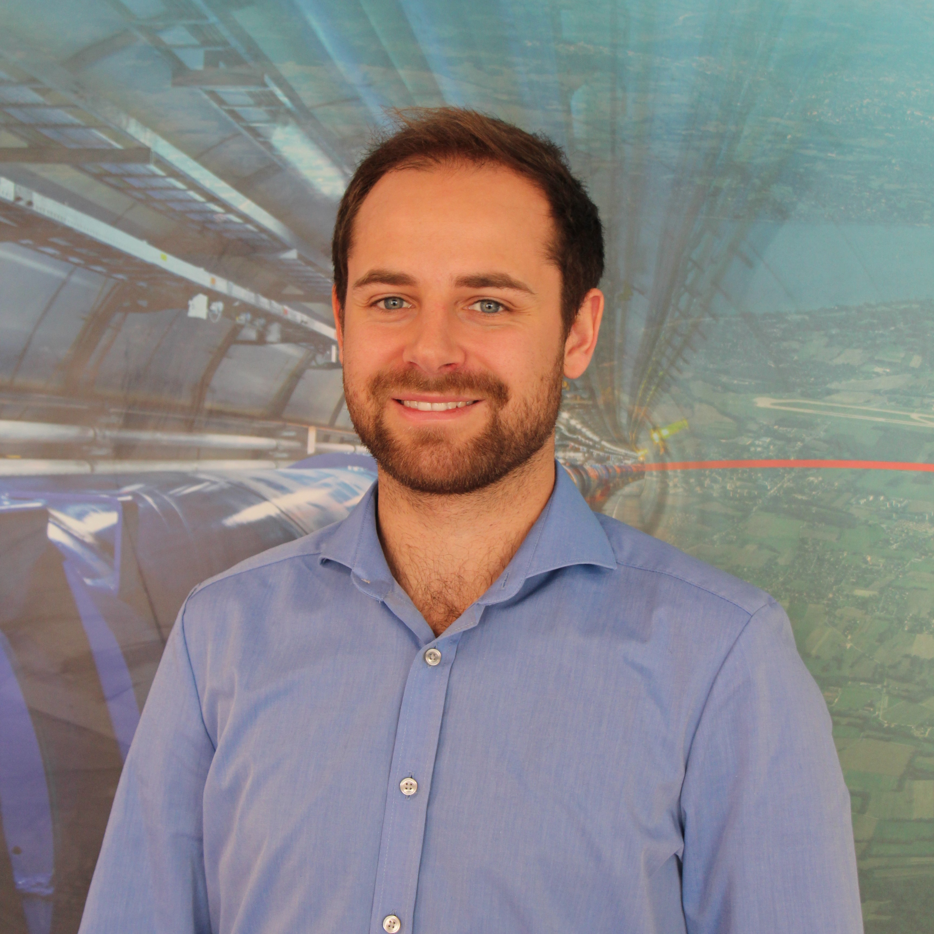
Communications
Contact the communications office
We encourage you to communicate about your work publically.
It is important, however, that you please contact us first!
Andrew Purcell
Communications officer
If you are contacted by the media, let us know.
We can provide you with guidance, facts/figures, and other info.
It is vital that you respect confidentiality agreements.
Be sure to remember the CERN Code of Conduct: http://cern.ch/go/CbD8.
Hans Baechle
Junior communications officer

Slide 16
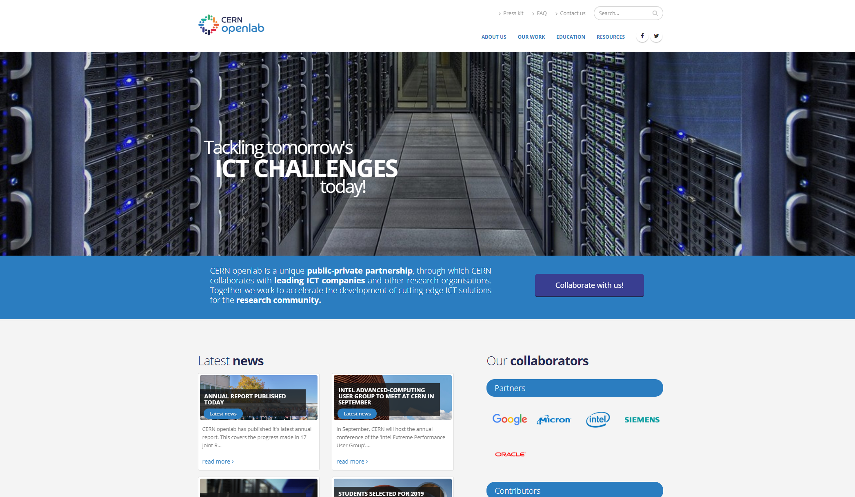

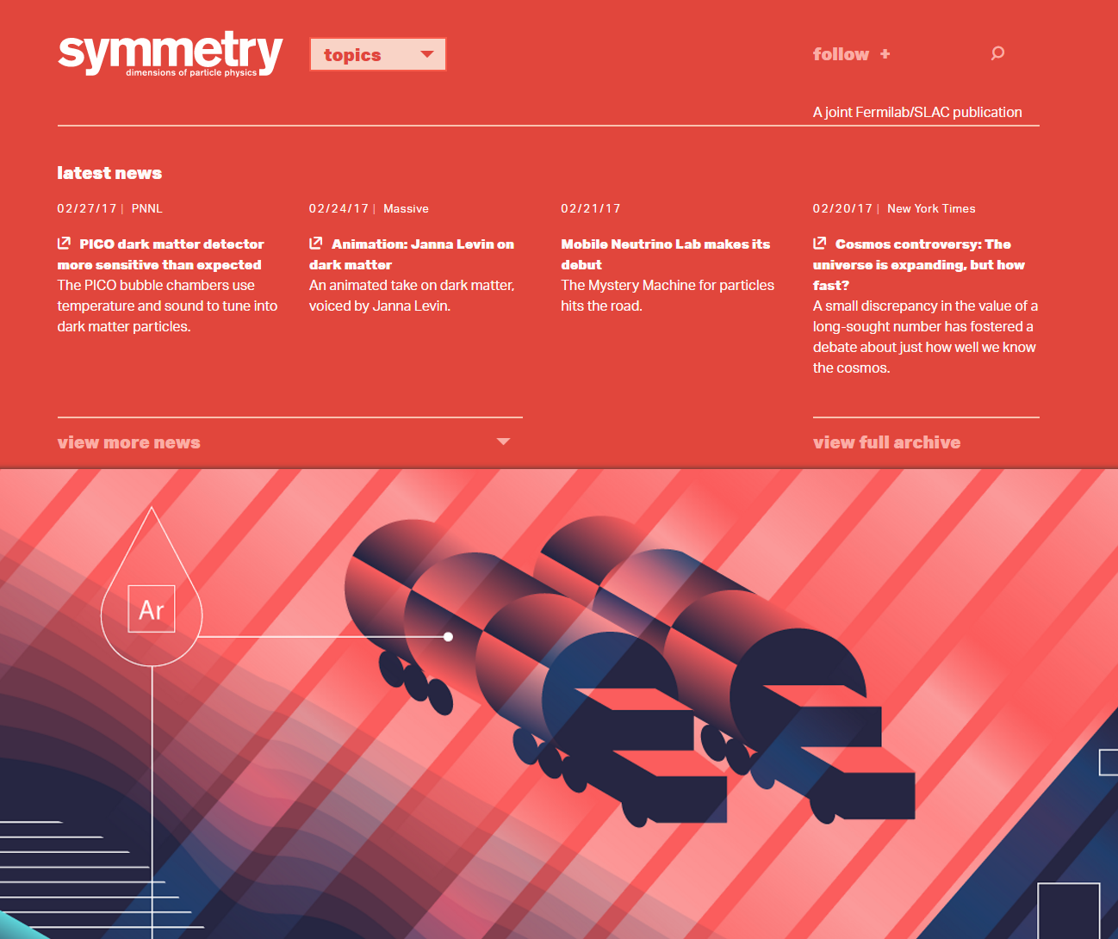
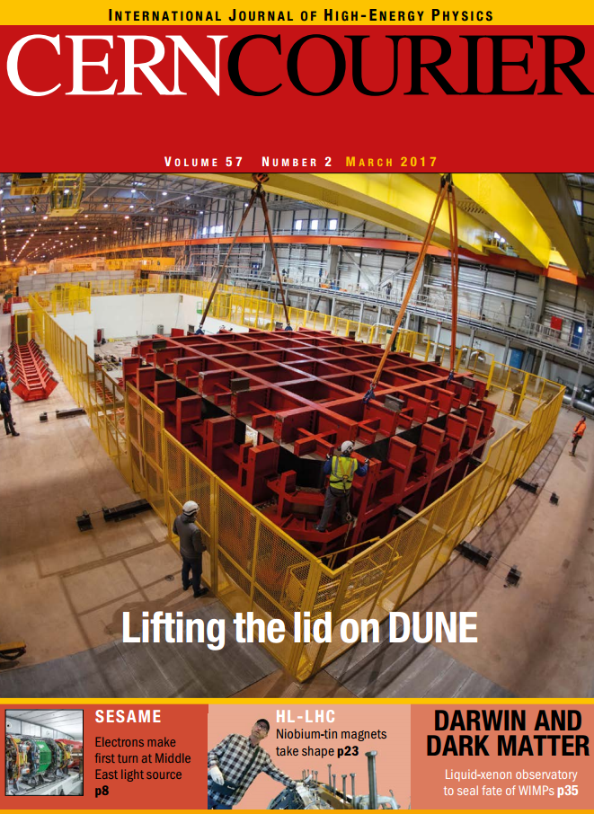
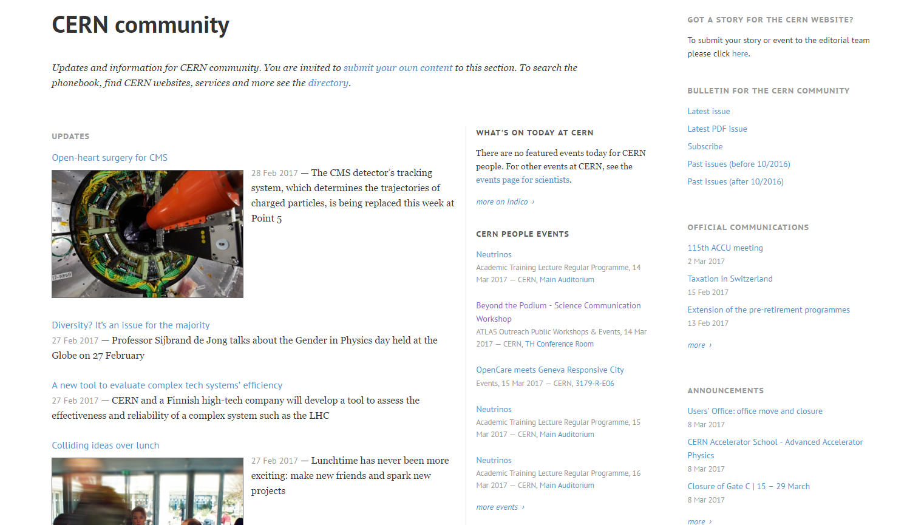
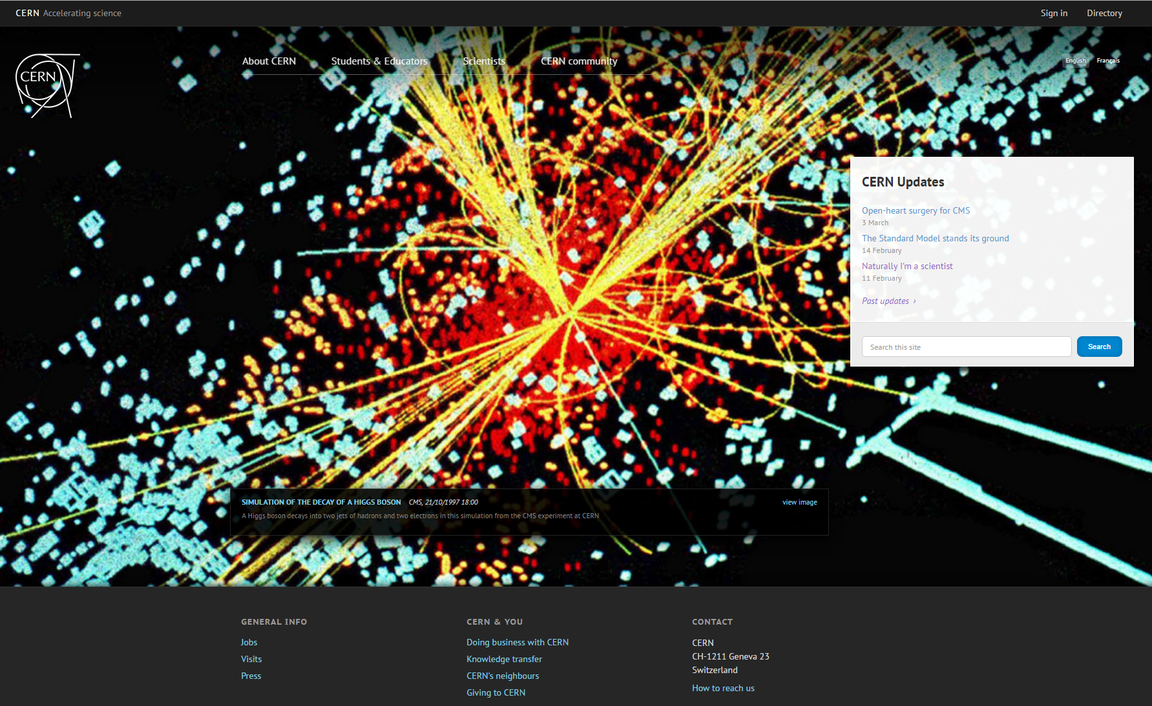
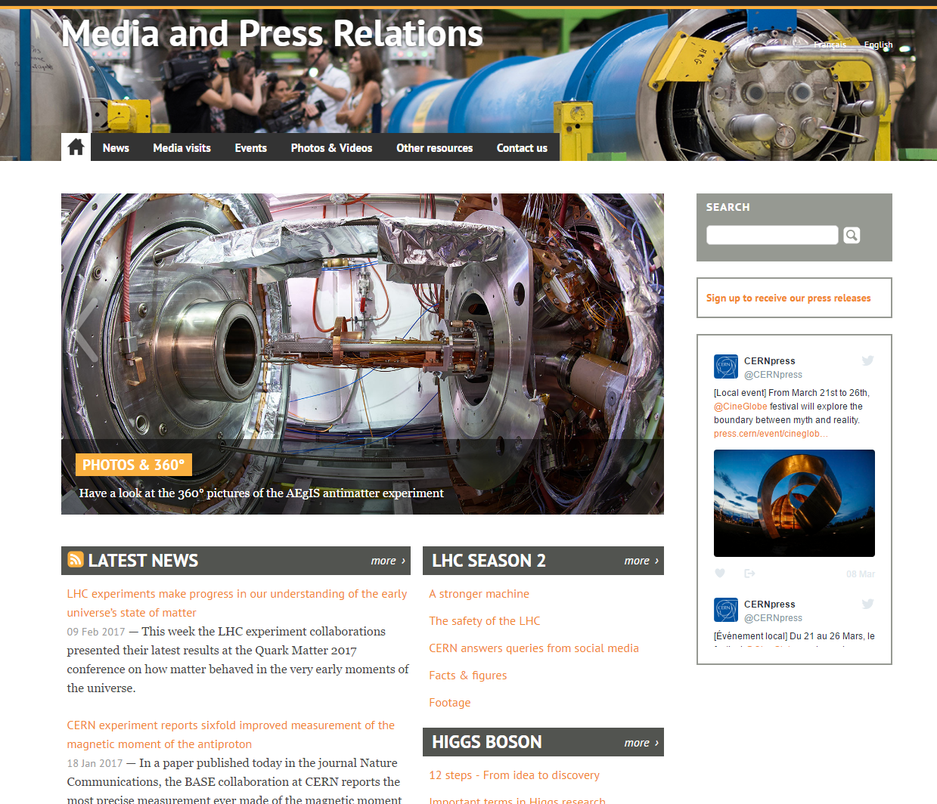
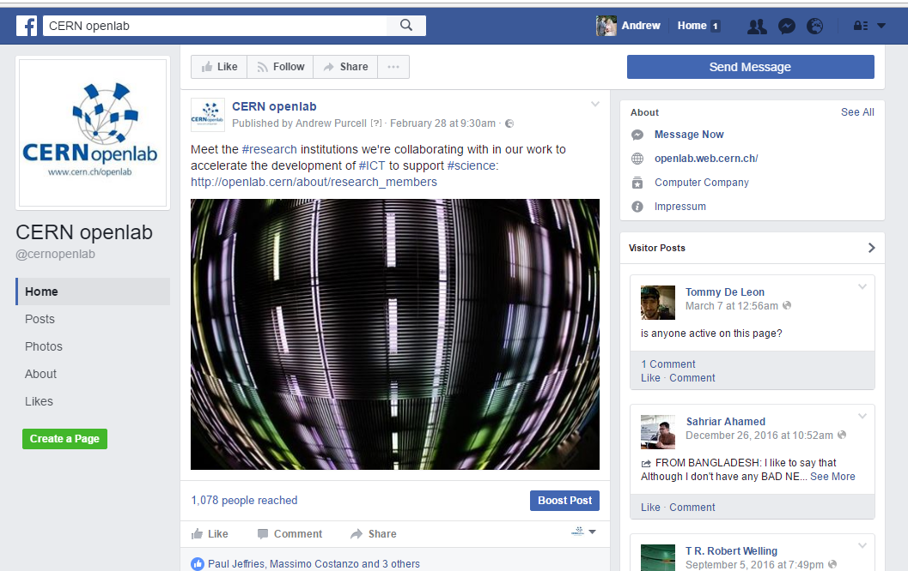

Communications
Our main channels
~ 150k visits to our website per year
Articles in other CERN channels
Facebook: http://cern.ch/go/p7pF
Facebook group
Twitter: http://cern.ch/go/7vvk
Workplace: http://cern.ch/go/6MTQ
LinkedIn: http://cern.ch/go/NK9k
Join the alumni: https://alumni.cern/

Slide 17


Communications
For you today
Group photo
A group photo will be taken on Monday 8th of July (16:00) before the Geneva treasure hunt.
Don’t forget: add this to your calendar.
Meet in front of the Globe
Remember to wear your T-shirts!
Don’t forget to pick up your t-shirt…
… and take a copy of the guide with you!

Slide 18
Bike to work
You can loan a bike at CERN for free!
How?
Map Meyrin-Hostel by Bike:
Online bike security training
Fill in the electronic bike form
Enjoy biking to work
Pick up your bike, locker, helmet and fluorescent vest
(building 6167)
Deposit 100CHF
(in cash)
Wait for the email
Careful:
Always wear your helmet and fluorescent vest
Pay attention: at the roundabout in Saint-Genis, you do not have priority!

Slide 19
CERN Shuttles

Slide 20
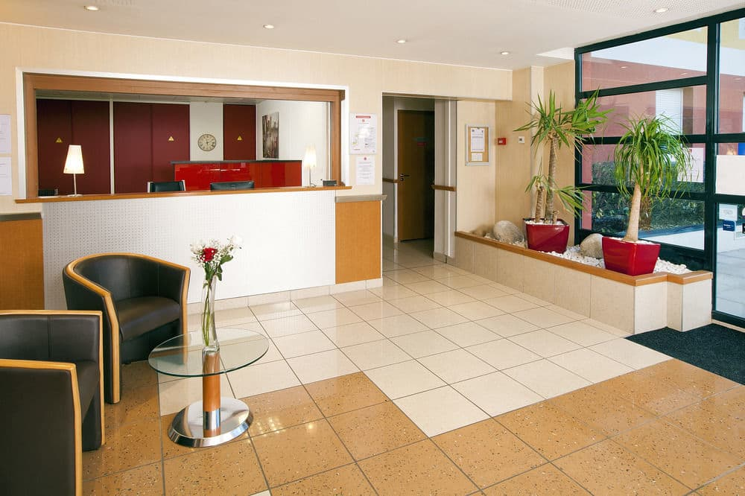
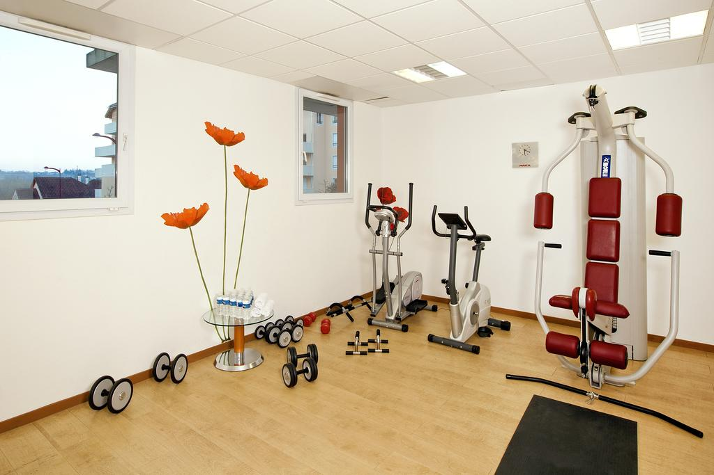
Hotel and cleaning
Séjours & Affaires Saint Genis
The facilities:
Green area
Fitness room
Balcony in each apartment
Parking (also for bikes)
Washing machine (5€/machine)…
Extra cleaning against a fee, ask the reception!
The location:
Shops, restaurants, bars, bakeries nearby
Picnic area in a few minutes on foot
Close to CERN
30 minutes away from Geneva
Noise:
Remember that you aren’t alone in the hostel
If you gather, avoid making too much noise
Cleaning:
For your own comfort and to avoid any conflict, keep your apartment clean during your stay
Vacuum cleaner available at the reception
Cleaning plan usually helps ☺
Also, you will pay a cleaning fee at the end of your stay, this will be added to your last hotel invoice. (around 10 Euros/person)
Notes:
Cleaning fee:
45 EUR / Apartment
36 EUR / Studio

Slide 21





Other useful information
Want to organize a BBQ? Book your space at: https://indico.cern.ch/rooms/book

Slide 22
QUESTIONS?

