Slide 1

BBQ
(BusBar Quench)
1st STEAM Workshop 13-14 June 2019
cern.ch/STEAM
Matthias Mentink
on behalf of the STEAM team

Slide 2
Overview
Motivation
Tool basics
Thermal aspects
Model states
Initial quench behavior of superconducting magnet
Simulation versus measurement of initial voltage development in HL-LHC Twin Orbit corrector
Demo: Hotspot temperature in superconducting busbar
Summary

Slide 3
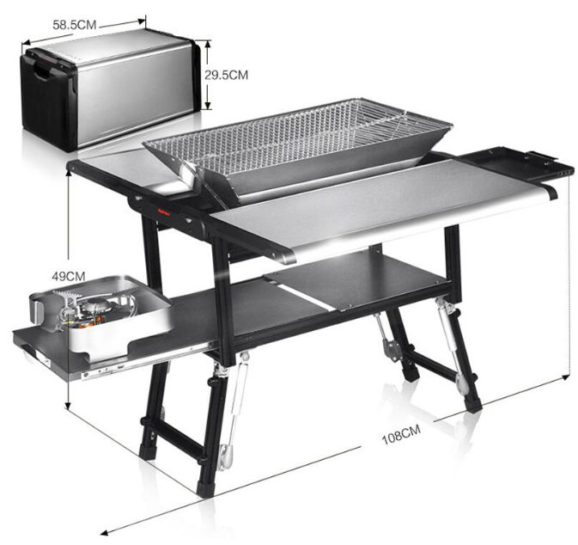
Motivation for STEAM-BusBarQuench (BBQ)
For a circuit with a known discharge quench integral:
What is the time required to detect and validate a quench?
What is the total quench integral that the superconducting conductors see?
What are implications of cooling to the helium bath?
How long does it take for a normal zone to traverse a given conductor length, also considering local field variations, joints, inhomogeneous cooling conditions etc.?
What is the hotspot temperature of a conductor quenching at a given circuit current?
→ STEAM-BBQ
Multi-functional barbecue grill

Slide 4
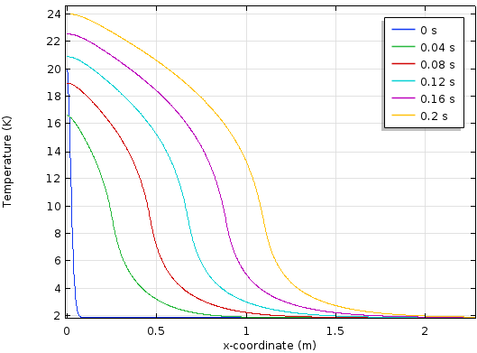
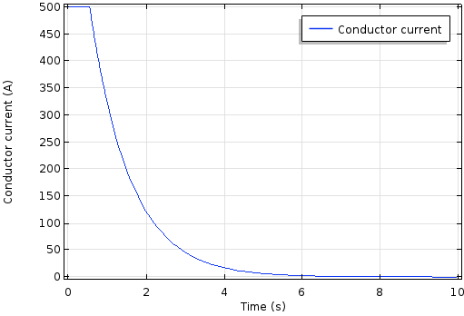
Some basics
STEAM-BBQ [1]: FEM-based Comsol simulation model (Inspiration: [2])
Calculation of quench-related conductor properties:
  Quench propagation velocity v_{Q}
  Development of voltage after quench origination for quench detection
  Hotspot temperature as a function of quench integral
For circuit with known discharge quench integral:
  Time-dependent current (Exponential decay after quench detected)
  Time-dependent hotspot temperature
Compatible with STEAM co-simulation framework
Temperature [K]
v_{Q}
x [m]
Temperature-development along length of conductor
Circuit current [A]
Time [s]
[1] M. Mentink and M. Maciejewski, “STEAM-BBQ User manual”, EDMS nr. 2159478, (2019)
[2] D. Paudel, CERN thesis 2015-090, June 30th (2015)
Circuit current discharge

Slide 5
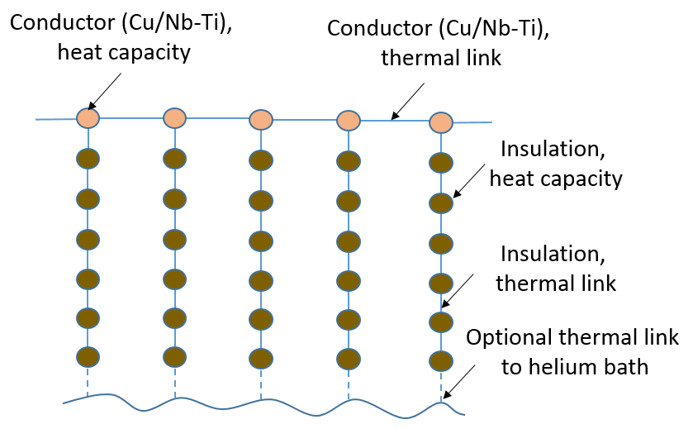
Thermal aspects
BBQ dimensionality: 1+1D
  Longitudinal heat transfer
  Transverse heat transfer (one node for core, six for insulation layers)
  Optional heat transfer to helium bath
BBQ simultaneously calculates the busbar hotspot temperature in two ways:
  ‘Adiabatic hotspot temperature’: No longitudinal heat propagation, perfect transverse heat propagation without cooling to bath
  Regular hotspot temperature, with longitudinal heat propagation and transverse heat propagation
Uses STEAM material library for user-selected material properties (with cross-checked temperature and magnetic-field dependence)
Thermal layout: 1+1D dimensionality

Slide 6
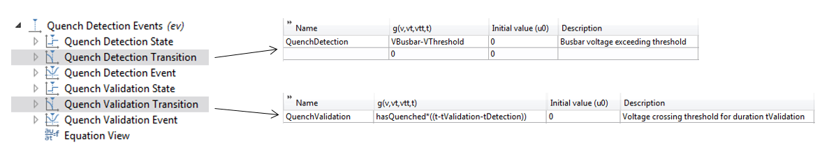
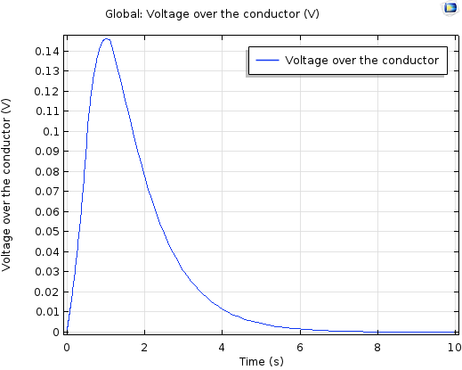
Model states
All model equations are visible to the user, to allow user to see underlying physics and give high degree of flexibility
Circuit state with Comsol ev module: Switch from constant current to exponential discharge upon meeting condition
Here: Circuit discharge once total voltage exceeds VThreshold for duration tValidation
Flexible feature for switching model states. Here: Circuit discharge once VThreshold is exceeded for duration tValidation
Voltage over conductor
Circuit discharge

Slide 7
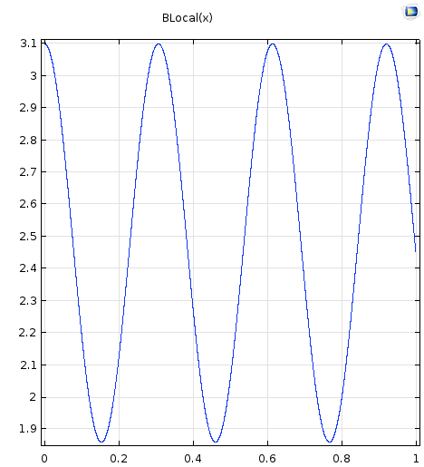
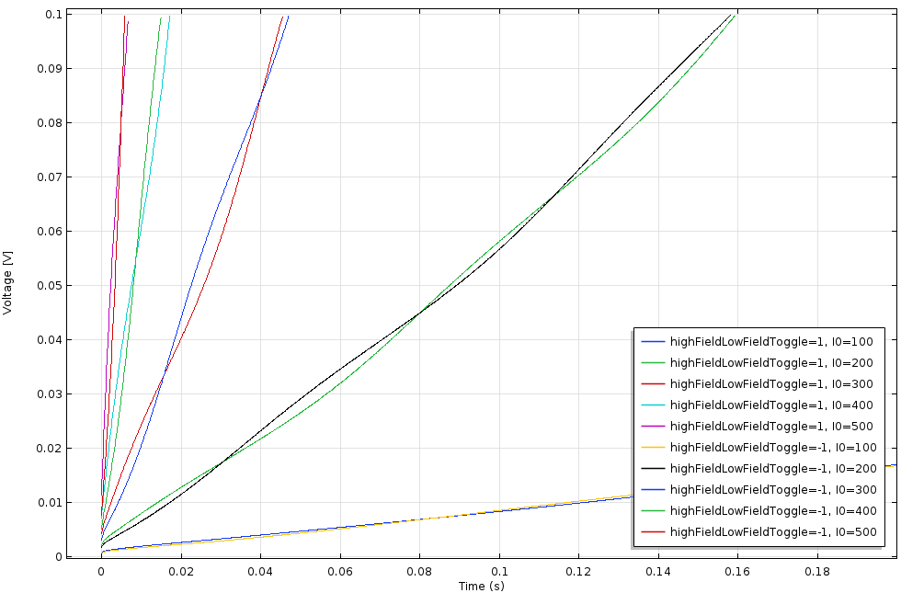
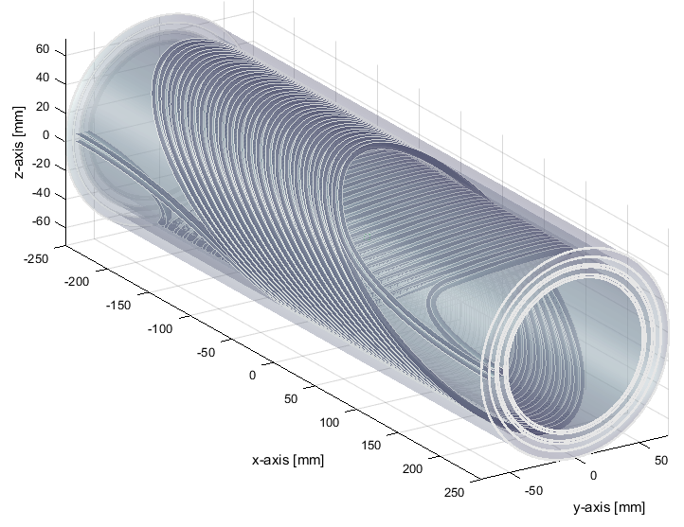
Calculation of initial voltage development in HL-LHC Twin Orbit corrector
500 A 400 A 300 A 200 A
Magnetic field B [T]
Voltage [V]
100 A
MCBRD Twin orbit corrector (here: short model version). Model rendered with Field
Position x [m]
Time [s]
Periodic field variation over conductor
Initial dV/dt calculated with BBQ for different currents
HL-LHC MCBRD Twin Orbit Corrector: Two concentric coils held in place by formers
Periodic field variation over conductor
BBQ calculation of initial dV/dt before quench detection

Slide 8
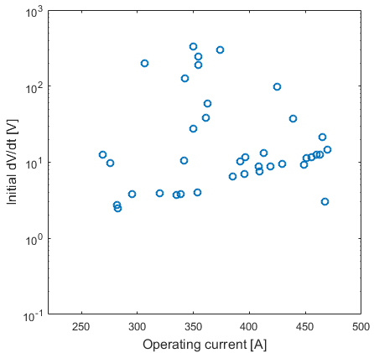
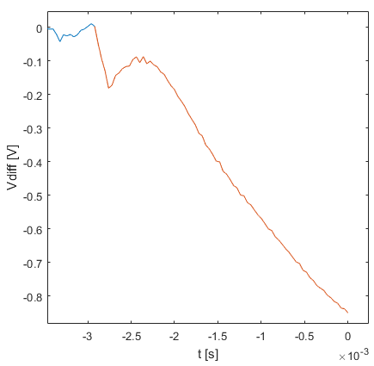
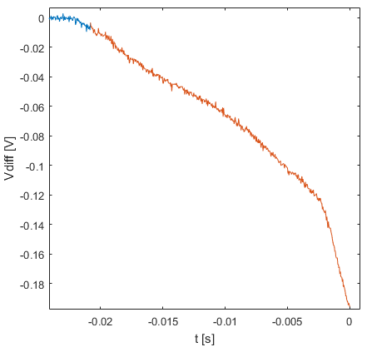
Experimental observations on Twin Orbit Corrector prototype
300 V/s
7 V/s
Symmetric quench
Fast voltage development
Slow voltage development
Experimentally observed initial dV/dt for training quenches on MCBRDp1
Experimental observations on MCBRDp1: For some training quenches, very fast voltage development (mechanical movement), for others, slower voltage rise (thermal propagation)

Slide 9
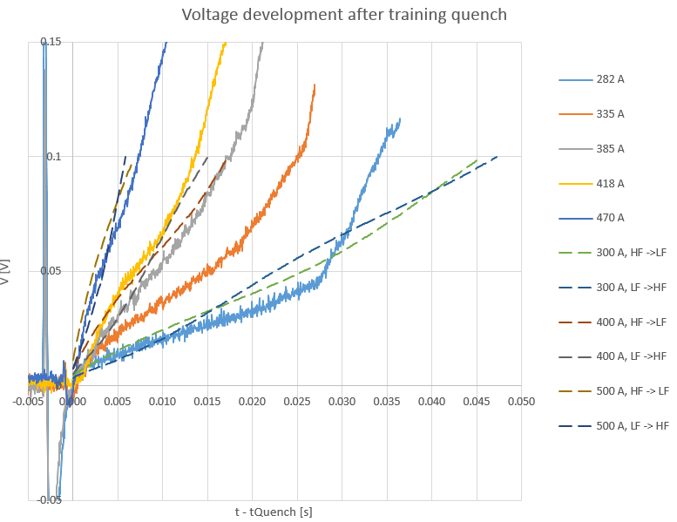
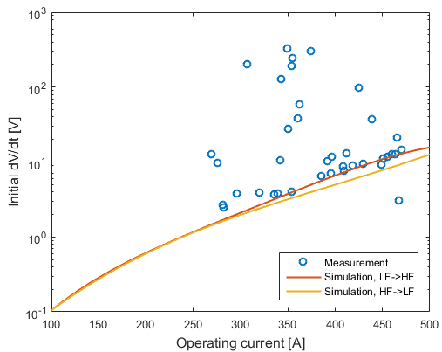
Comparison, simulations vs. experimental results
Simulation: Single strand propagation
470
418
385
500
400
335
Voltage [V]
300
282
Measurement: Normal zone propagation to neighboring strand
Symmetric quench
t – t_{Quench} [s]
Simulation vs. measurement
Derived initial dV/dt
Measurements: Normal zone eventually propagates to neighboring strand
Simulation versus measurement: In spite of missing propagation to neighboring strand, simulated and measured dV/dt are fairly consistent (simulation somewhat pessimistic)
Useful for calculating the time required to reach detection and validation

Slide 10
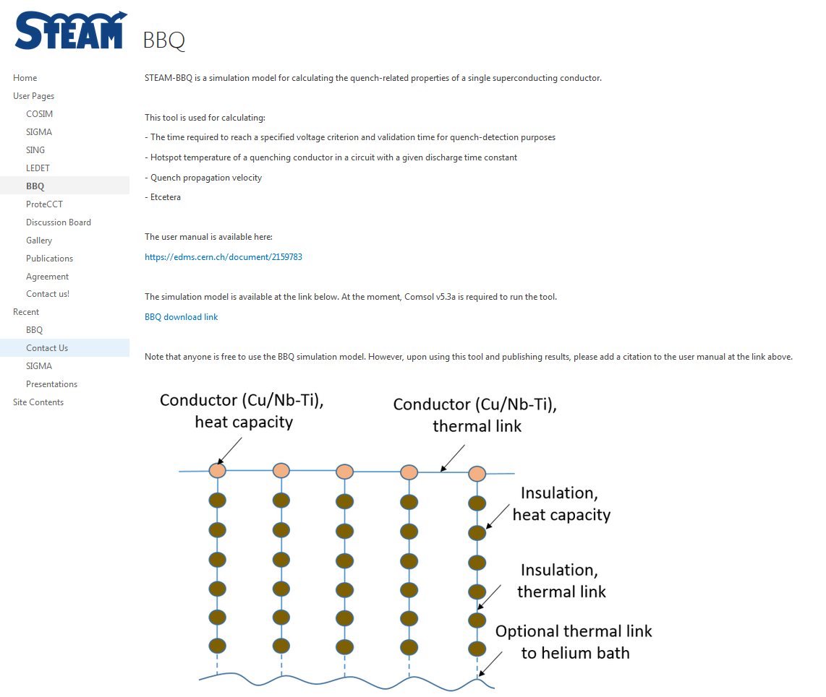
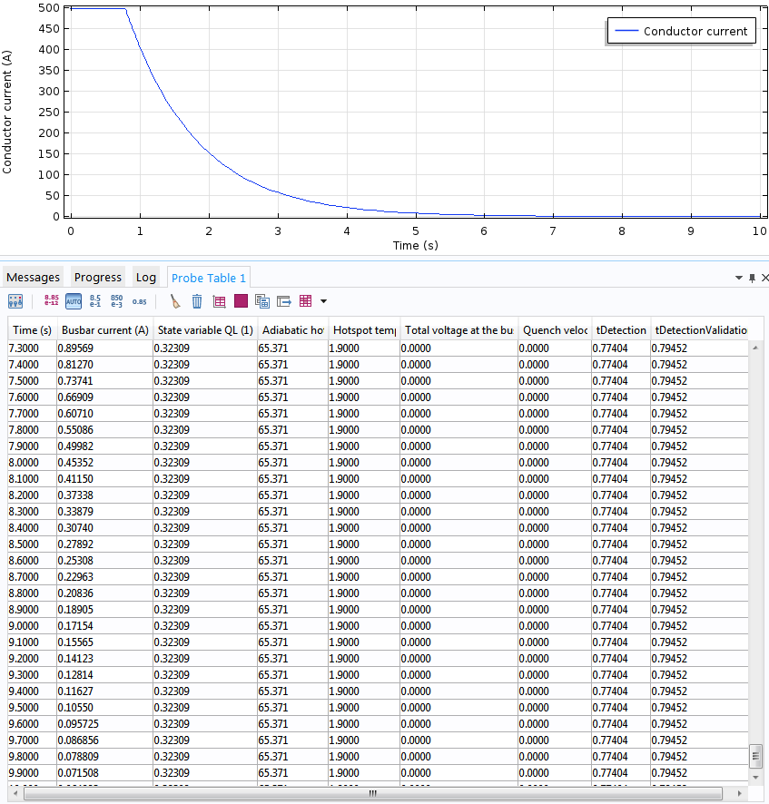
Demo: Calculating the hotspot temperature of a superconducting busbar after quench detection + circuit discharge
STEAM website: cern.ch/steam
Calculation of quench-related properties
(Comsol v5.3a)
BBQ model available at: cern.ch/steam
BBQ Manual: EDMS doc. 2159783, link on STEAM website

Slide 11
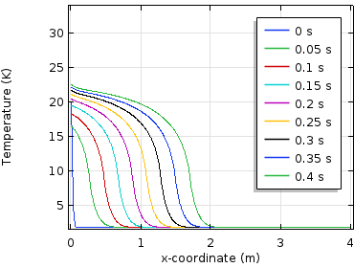
Summary
BBQ: A multi-purpose tool for calculating quench-related properties of individual conductors
Initial voltage rise after a quench, hotspot temperature, etc.
Compatible with STEAM co-simulation framework
Uses the STEAM material library for cross-checked properties → Material properties are available to user through BBQ for quick look-up
Future work:
Stand-alone app
Suggestions?
Temperature development

