Slide 1

cern.ch/STEAM
Modelling of Electrodynamics
in HTS Tapes and Coils
Workshop 13-14 June 2019
Lorenzo Bortot^{(1,2)} on behalf of the STEAM team
Acknowledgements: J. Van Nugteren, C. Petrone

Slide 2

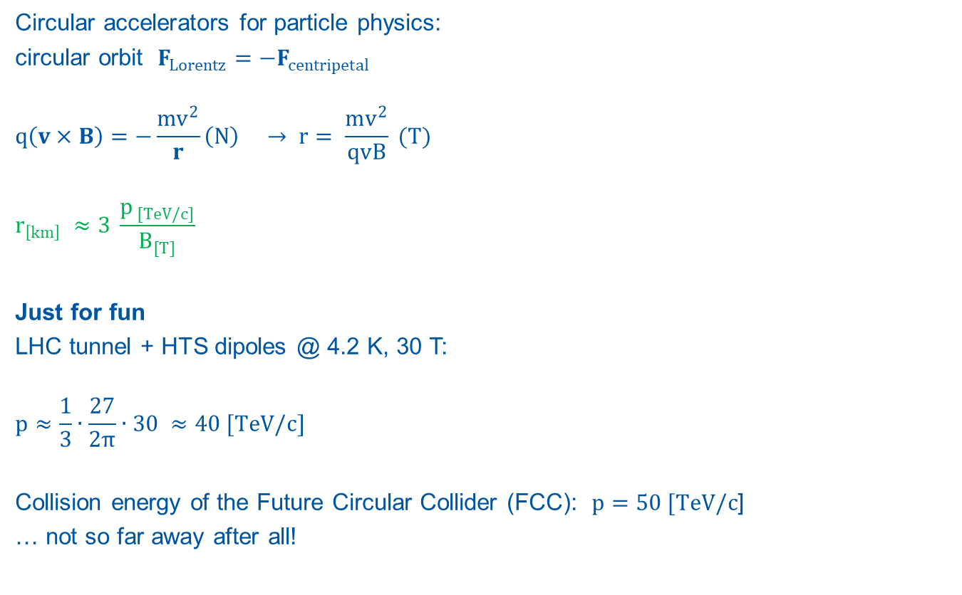



…Why HTS?
Circular accelerators for particle physics:
circular orbit $F_{Lorentz}=−F_{centripetal}$
$$q\left(v×B\right)=−\frac{mv^{2}}{r}\left(N\right) → r= \frac{mv^{2}}{qvB} (T)$$
$$r_{\left[km\right]} ≈3 \frac{p_{ [TeV/c]}}{B_{[T]}}$$
Just for fun
LHC tunnel + HTS dipoles @ 4.2 K, 30 T:
$$p≈\frac{1}{3}∙\frac{27}{2π}∙30 ≈40 [TeV/c]$$
Collision energy of the Future Circular Collider (FCC): $p=50 [TeV/c$]
… not so far away after all!
$$B_{y}$$
$$v_{z}$$
$$+q$$
$$F_{x}$$

Slide 3

High-Temperature Superconductors
Cuprate compounds (CuO₂) doped with rare earth elements (La, Bi-Sr-Ca, Y-Ga-Ba …)
Higher Tc and Bc0 respect to the traditional LTS competitors
Higher performance comes with higher prices! $\$_{HTS}≈{1e}^{2} \$_{LTS}$
.. But in the early 2000s it was $≈{1e}^{3}$

Slide 4
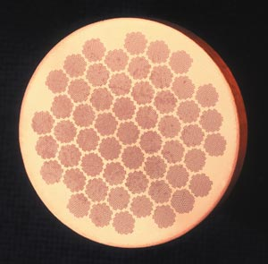
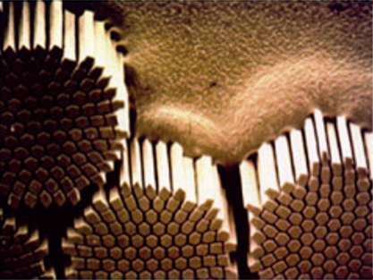
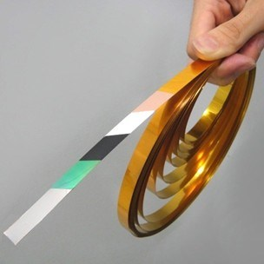





Main Differences
Cable architecture:
LTS – filamentary compound
HTS – multi-layer tape
Resistivity $ρ$: power law
$$ρ=\frac{E_{c}}{J_{c}}{\left(\frac{J}{J_{c}}\right)}^{n−1}$$
$n_{LTS}≈40,n_{HTS}≈20$
$J_{c, HTS}$ anisotropic
CERNcourier.com
www.fujikura.co.uk
$$\vec{n}$$
$$\vec{B}$$
$$θ$$
$$J_{c}(T,B,θ)$$
Tape cross section

Slide 5
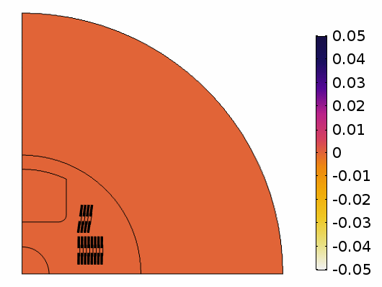


Outline
Introduction
Motivation
Formulation
Verification
Theoretical references
Validation
Measurements from Feather2
Summary and Outlook
$$i(A)$$
$$t(s)$$
B(T)
Feather2 magnet: net magnetic flux density contribution due to screening currents (first quadrant)
Notes:
From Oberkampf book:
[…].veriﬁcation can simply be described as “solving the equations right” and validation as “solving the right equations.”

Slide 6







Introduction: Screening (Eddy) Currents
ReBCO tape in an external magnetic density $\vec{B}$:
External magnetic field change $∂_{t}\vec{B}$:
→ Persistent screening currents ${\vec{j}}_{screen}$, due to $ρ→0$ → Persistent magnetization ${\vec{B}}_{screen}$
Large filament size (~5 mm), significant persistent magnetization:
→ Relevant for field quality, especially at low field
→ Relevant for tape thermal behavior, dominant AC loss contribution
■ Copper ■ ReBCO ■ Substrate
$$∂_{t}\vec{B}$$
$${\vec{B}}_{screen}$$
$$\sim mm$$
$$\sim μm$$
$${\vec{J}}_{screen}$$
$ρ→0$
Notes:
Brief description of tape and superconducting layer in external field.
Introduction of eddy currents as persisting screening phenomenon.
Large filament size → impact on field quality and AC loss

Slide 7
Motivation
The analysis of future HTS magnets for accelerators
needs to take into account the screening currents dynamics
At CERN, there is a need for a code:
Fast and numerically stable
Scalable to accelerator magnets
Capable of accounting for iron
Capable of field-circuit coupling
Validated, reliable (maintainable)
Our contributions
Investigation and extension of a suitable field formulation
Implementation in a proprietary software (*), using the Finite Element Method
Scaling of the implementation to an HTS magnet (Feather2)
(*) COMSOL Multiphysics® v. 5.3. www.comsol.com. Last access: 10/04/2018

Slide 8

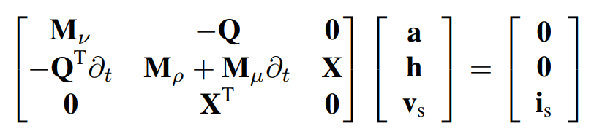












Formulation: Overview
Mixed potentials (*), starting from [1]
$\vec{A}$ solved in $Ω_{0}$ (air, iron), where $σ→0$
$\vec{H}$ solved in $Ω_{c}$ (conductors), where $ρ→0$:
  Finite condition number → Stability
Model order reduction (e.g., [2, 3])
  High aspect ratio
  Tapes as surfaces in $ℝ^{3}$ (lines in $ℝ^{2}$) → Speed-up
$$\vec{A}→Ω_{0},ℝ^{3}$$
$$−$$
$$\vec{H}→Ω_{c},ℝ^{3}$$
$$+$$
$$v_{s}$$
$$i_{s}$$
Domain decomposition
$$−$$
$$−$$
$$\vec{H}→Ω_{c},ℝ^{3}$$
$$\vec{H}→Γ_{c},ℝ^{2}$$
$$+$$
$$+$$
Model order reduction
(*) Paper accepted to COMPUMAG 2019
[1] Bíró, O. "Edge element formulations of eddy current problems." CMAM 169.3-4 (1999): 391-405.
[2] Carpenter, C. J. "Comparison of alternative formulations of 3-dimensional magnetic-field and eddy-current problems at power frequencies." Proceedings of the Institution of Electrical Engineers. Vol. 124. No. 11. IET Digital Library, 1977.
[3] Zhang, H., et al. "An efficient 3D finite element method model based on the T–A formulation for superconducting coated conductors.“ SuST, 30.2 (2016): 024005.
Notes:
Math analysis not yet over
Analysis of stability criteria is ongoing
We are aware about previous work in this direction:
We do not like it too much since is not clearly described (e.g., gauge, interface)
We like to do it more rigorously (with emphasis on field circuit coupling)
Before this work, there was no tools to carry out the field quality analysis

Slide 9

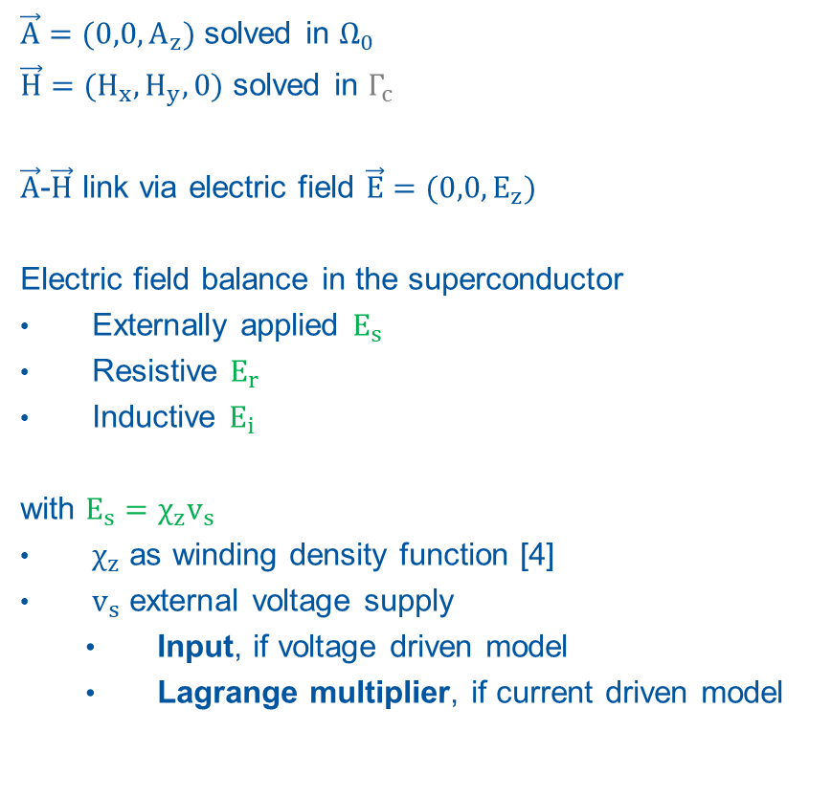
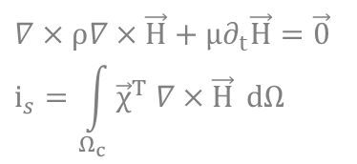





Formulation: 2D Implementation
$\vec{A}=(0,0,A_{z})$ solved in $Ω_{0}$
$\vec{H}=(H_{x},H_{y},0)$ solved in $Γ_{c}$
$\vec{A}$-$\vec{H}$ link via electric field $\vec{E}$ $=(0,0,E_{z})$
Electric field balance in the superconductor
Externally applied $E_{s}$
Resistive $E_{r}$
Inductive $E_{i}$
with $E_{s}=χ_{z}v_{s}$
$χ_{z}$ as winding density function [4]
$v_{s}$ external voltage supply
  Input, if voltage driven model
  Lagrange multiplier, if current driven model
$Ω_{0}$ : air
$$y$$
$Γ_{c}$ : coil
$$∇×μ^{−1}∇×\vec{A}=\vec{0}$$
$$z$$
$$x$$
$$∇×ρ∇×\vec{H}+μ∂_{t}\vec{H}=\vec{0}$$
$$i_{s}=\int_{Ω_{c}}{{\vec{χ}}^{T} ∇×\vec{H}} dΩ$$
[4] Schöps, S., et al. "Winding functions in transient magnetoquasistatic field-circuit coupled simulations." COMPEL: The International Journal for Computation and Mathematics in Electrical and Electronic Engineering 32.6 (2013): 2063-2083.
Notes:
Practical implementation in a 2D configuration.
Electric field balance.
Importance of the voltage supply in the power balance

Slide 10
Outline
Introduction
Motivation
Formulation
Verification
Theoretical references
    Critical State (Bean) Model
    Skin Effect
    Field Dependency
Validation
Summary and Outlook
Notes:
Some of the verifications.
Mention Current dependency, PEC behavior, comparison with other formulations..

Slide 11




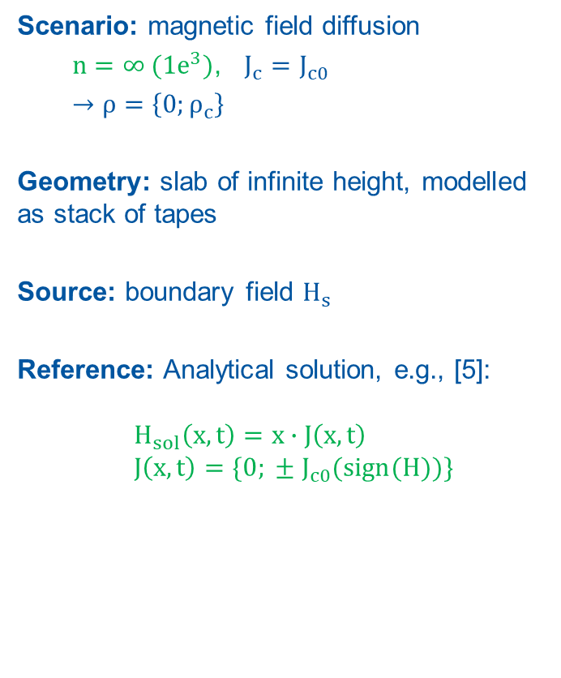


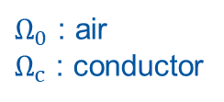





Verification – 1. Critical State (Bean) Model
Scenario: magnetic field diffusion
  $n=∞ ({1e}^{3})$, $J_{c}=J_{c0}$
  $→ρ=$ $\left\{0;ρ_{c}\right\}$
Geometry: slab of infinite height, modelled as stack of tapes
Source: boundary field $H_{s}$
Reference: Analytical solution, e.g., [5]:
$H_{sol}\left(x,t\right)=x∙J\left(x,t\right)$
$J\left(x,t\right)=\{0; ± J_{c0}(sign(H))\}$
$$Ω_{0}$$
$$Ω_{c}$$
$$Ω_{0}$$
$$H_{s}$$
$$H_{sol}$$
$$H_{s}$$
$$y$$
$$z$$
$$x$$
$Ω_{0}$ : air
$Ω_{c}$ : conductor
Computational domain
$$H_{s}$$
$$t$$
Source term
[5] Russenschuck, S. Field computation for accelerator magnets: analytical and numerical methods for electromagnetic design and optimization. John Wiley & Sons, 2011.

Slide 12
Verification – 1. Critical State (Bean) Model
Numerical Solution: magnetic field diffusion
B (T)
J/J_{c} (-)
x (mm)
x (mm)
x (mm)
x (mm)
Magnetic flux density and normalized current density distribution
→ Profiles consistent with theory [5]
[5] Russenschuck, S. Field computation for accelerator magnets: analytical and numerical methods for electromagnetic design and optimization. John Wiley & Sons, 2011.

Slide 13


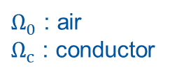

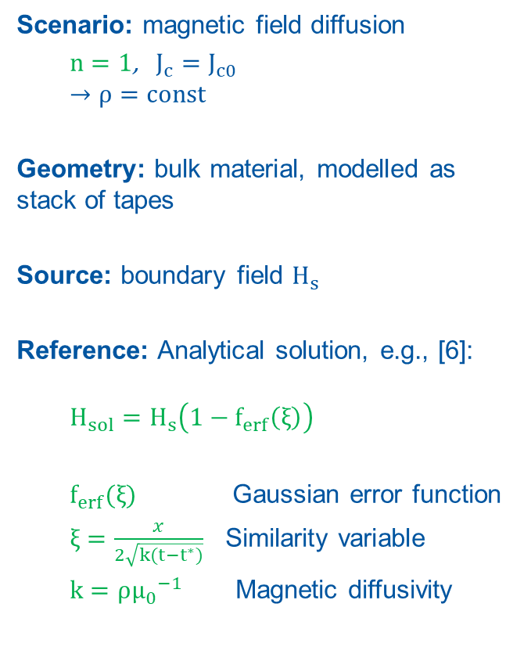







Verification – 2. Skin Effect
Scenario: magnetic field diffusion
  $n=1$, $J_{c}=J_{c0}$
  $$→ρ=const$$
Geometry: bulk material, modelled as stack of tapes
Source: boundary field $H_{s}$
Reference: Analytical solution, e.g., [6]:
  $$H_{sol}=H_{s}\left(1−f_{erf}\left(ξ\right)\right)$$
  $f_{erf}(ξ)$ Gaussian error function
  $ξ=\frac{x}{2\sqrt{k(t−t^{∗})}}$ Similarity variable
  $k=ρ{μ_{0}}^{−1}$ Magnetic diffusivity
$$Ω_{0}$$
$$Ω_{c}$$
$$H_{s}$$
$$H_{sol}$$
$$y$$
$Ω_{0}$ : air
$Ω_{c}$ : conductor
$$z$$
$$x$$
Computational domain
$$H_{s}$$
$$t^{∗}=0$$
$$t$$
Source term
[6] Knoepfel, H. E., Magnetic fields: a comprehensive theoretical treatise for practical use. John Wiley & Sons, 2008.

Slide 14
Verification – 2. Skin Effect
Numerical Solution: magnetic field diffusion
Magnetic flux density distribution
in the conductive slab
Magnetic flux density distribution
at x=1 mm, as function of time: numerical solution (sol) and analytical solution (ref)
→ Consistent with theory [6]
[6] Knoepfel, H. E., Magnetic fields: a comprehensive theoretical treatise for practical use. John Wiley & Sons, 2008.

Slide 15





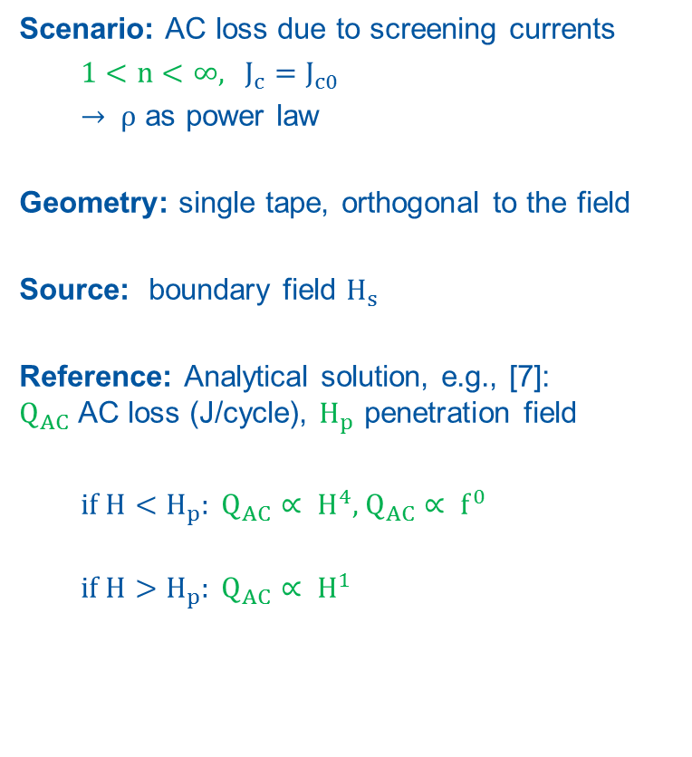



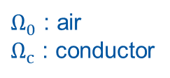

Verification – 3. Field Dependency
Scenario: AC loss due to screening currents
  $1<n<$ $∞$, $J_{c}=J_{c0}$
  $→ ρ$ as power law
Geometry: single tape, orthogonal to the field
Source: boundary field $H_{s}$
Reference: Analytical solution, e.g., [7]:
$Q_{AC}$ AC loss (J/cycle), $H_{p}$ penetration field
  if $H<H_{p}: Q_{AC}∝ H^{4}$, $Q_{AC}∝ f^{0}$
  if $H>H_{p}: Q_{AC}∝ H^{1}$
$$Ω_{0}$$
$$H_{s}$$
$$y$$
$$Ω_{c}$$
$$Q_{AC}$$
$Ω_{0}$ : air
$Ω_{c}$ : conductor
$$z$$
$$x$$
Computational domain
$$H_{s}$$
$$t$$
Source term
[7] Brandt, E.H., "Superconductors of finite thickness in a perpendicular magnetic field: Strips and slabs." Physical review B 54.6 (1996): 4246.

Slide 16

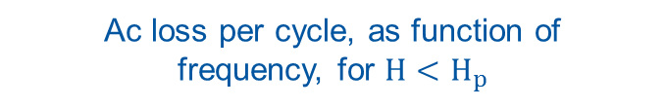


Verification – 3. Field Dependency
Numerical Solution: AC loss due to screening currents
$$∝H^{4}$$
$$∝H^{1}$$
$$∝f^{0}$$
Ac loss per cycle, as function
of the applied field
Ac loss per cycle, as function of
frequency, for $H<H_{p}$
→ Consistent with theory [7]
[7] Brandt, E H., "Superconductors of finite thickness in a perpendicular magnetic field: Strips and slabs." Physical review B 54.6 (1996): 4246.
Notes:
Meissner is reversible. Losses per cycle are always zero

Slide 17
Outline
Introduction
Motivation
Formulation
Verification
Validation
Measurements on Feather2: Field quality assessment
    Magnetic Field Quality
    Screening Current Effects
Summary and Outlook

Slide 18
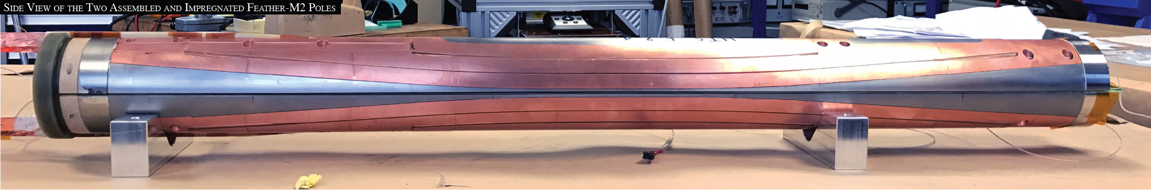

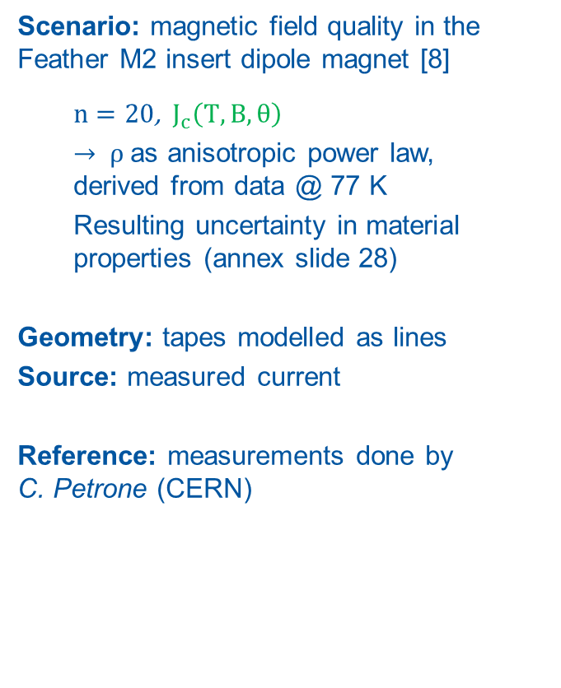






Measurements on Feather2
Scenario: magnetic field quality in the Feather M2 insert dipole magnet [8]
  $n=20$, $J_{c}\left(T,B,θ\right)$
  $→ ρ$ as anisotropic power law,
  derived from data @ 77 K
  Resulting uncertainty in material properties (annex slide 28)
Geometry: tapes modelled as lines
Source: measured current
Reference: measurements done by
C. Petrone (CERN)
$$Ω_{m}$$
$$Ω_{c}$$
$$Ω_{0}$$
$$y$$
$$Ω_{c}$$
$Ω_{0}$ : air
$Ω_{c}$ : coil
$Ω_{m}$ : iron
$$z$$
$$x$$
Computational domain
$$I_{s}$$
$$t$$
Source term
Feather2 magnet. Courtesy of J. Van Nugteren
[8] Van Nugteren, J., et al. "Powering of an HTS dipole insert-magnet operated standalone in helium gas between 5 and 85 K." SuST 31.6 (2018): 065002.

Slide 19
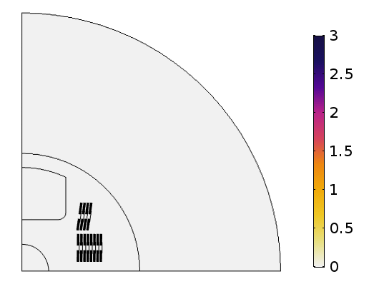



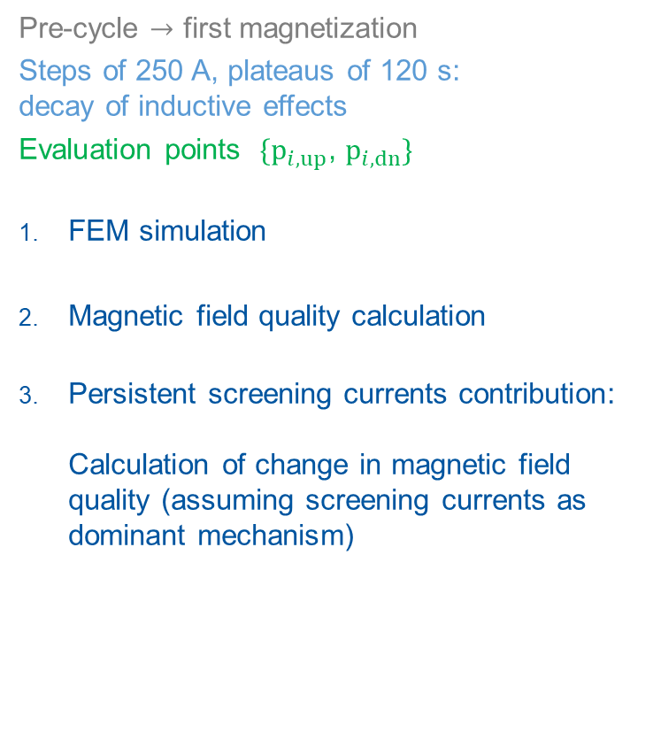
Field Quality Assessment
Pre-cycle $→$ first magnetization
Steps of 250 A, plateaus of 120 s:
decay of inductive effects
Evaluation points $\{p_{i, up}$, $p_{i, dn}\}$
FEM simulation
Magnetic field quality calculation
Persistent screening currents contribution:
Calculation of change in magnetic field quality (assuming screening currents as dominant mechanism)
$$p_{i, up}$$
$$p_{i, dn}$$
B(T)
Total magnetic flux density (T),
1 quadrant
Notes:
No iron hysteresis in the model
Uncertainties in Jc(T,B,theta)
Uncertainties of scaling from 3D to 2D (e.g. layer jump)

Slide 20
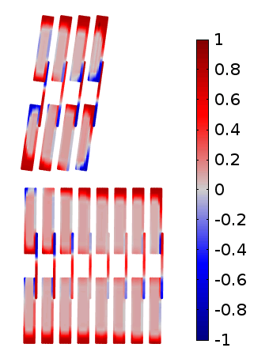
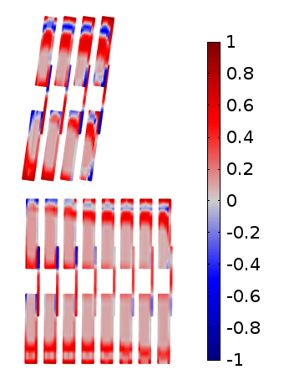
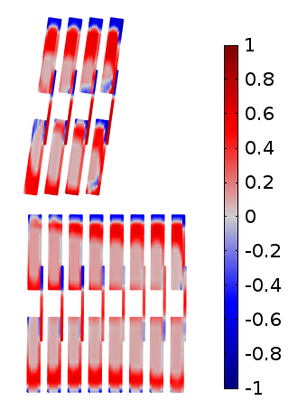



Results – FEM Simulation
Current density distribution (*) in the coil:
same external current
different time steps
$$i (A)$$
$$i^{∗}$$
a)
b)
c)
$$t (s)$$
J/J_{c} (-)
J/J_{c} (-)
J/J_{c} (-)
a)
b)
c)
Normalized current density in the coil, shown for the first quadrant
(*) Current sharing resolved using a binary search algorithm (bisection method). Internal call for each time step
Notes:
Influence of screening currents

Slide 21

Validation – 4. Magnetic Field Quality
Measurement
Simulation
$b_{i}$ field multipoles, as function of the normalized staircase time
B_{1 (T)}
4.5 K
25.0 K
68.0 K
b_{3 (units)}
b_{5 (units)}
t (s)
t (s)
t (s)
→ Very good agreement with measurements
Notes:
Multipoles dominated by geometry and iron contributions:
Screening currents only small contribution

Slide 22

Validation – 5. Screening Currents
Measurement
Simulation
$∆b_{i}$ field multipole variations, as function of current (in kA)
B_{1 (T)}
4.5 K
25.0 K
68.0 K
b_{3 (units)}
b_{5 (units)}
kA
kA
kA
→ Good agreement with measurements, considering uncertainty in $J_{c}\left(T,B,θ\right)$

Slide 23
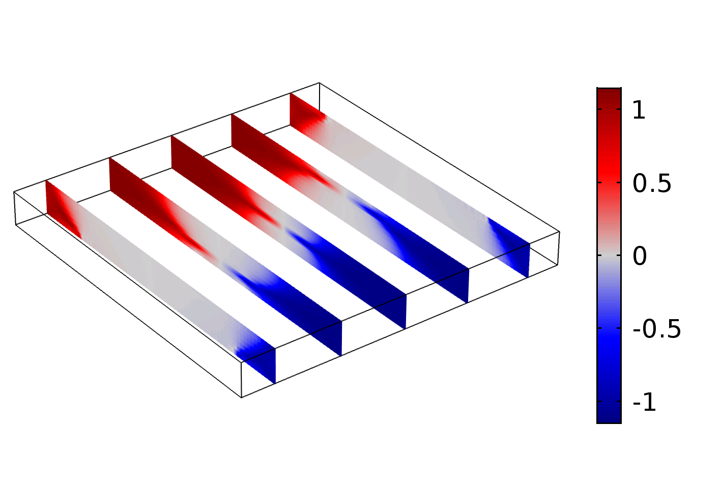
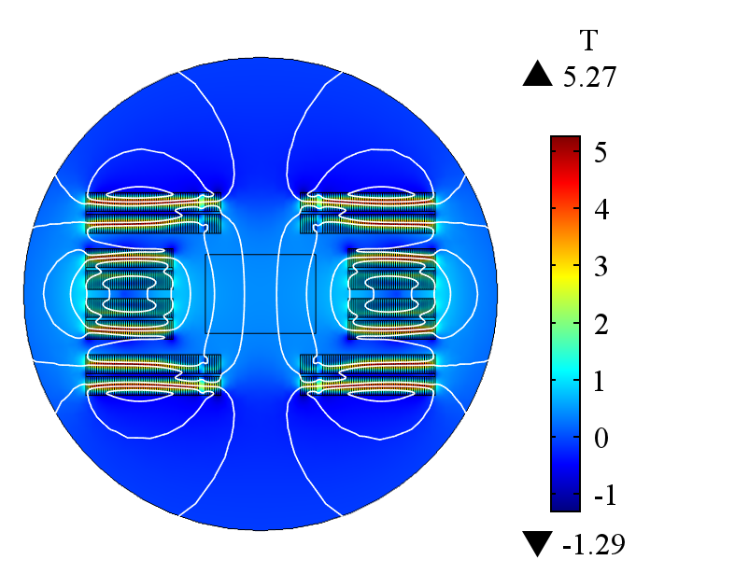
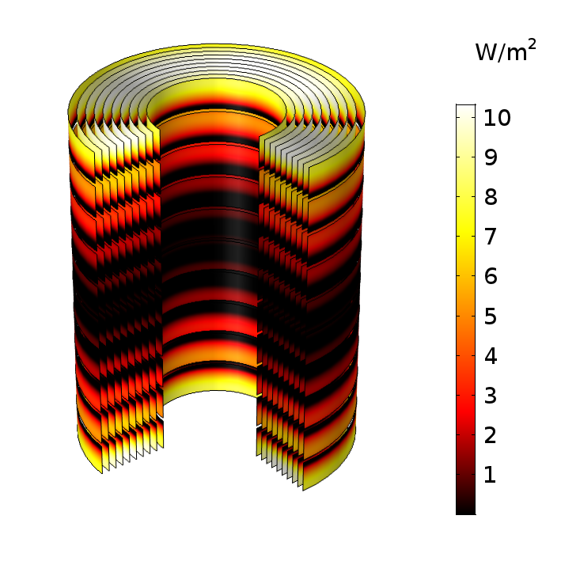

Summary and Outlook
Summary
$\vec{A}$-$\vec{H}$ weak formulation for FEM:
Excellent agreement with theory
Consistency with Feather2 measurements
Scalable and fast (few hours for ~${10}^{4}$ tapes in 2D models)
Outlook
Include heat balance equation
Develop field-circuit coupling interface
Include the models in the STEAM framework
Run field quality analysis and optimization
Run quench protection studies (e.g., Feather2 in FRESCA2)
Thank you for your attention!

Slide 25
Annex

Slide 26



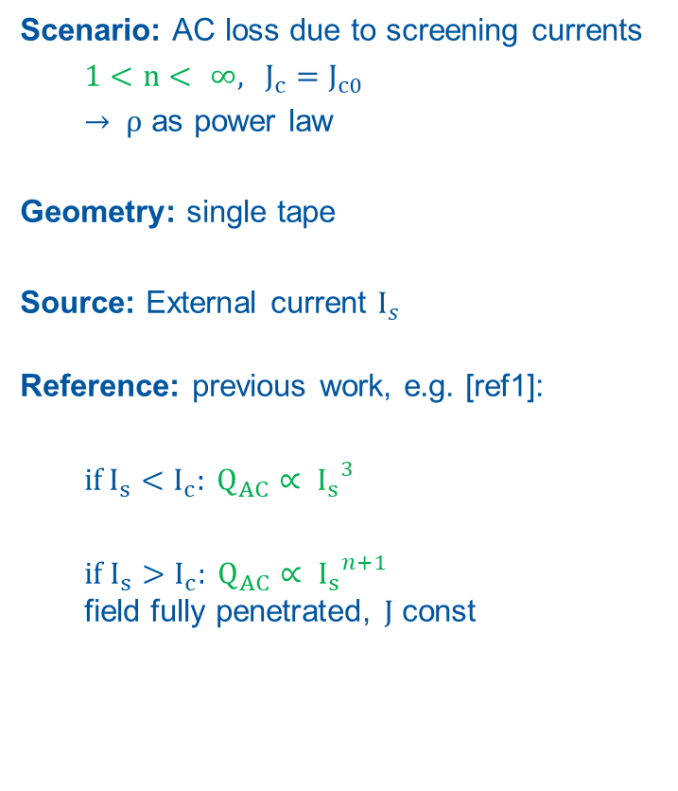



Validation – D. Current dependency
Scenario: AC loss due to screening currents
  $1<n< ∞$, $J_{c}=J_{c0}$
  $→ ρ$ as power law
Geometry: single tape
Source: External current $I_{s}$
Reference: previous work, e.g. [ref1]:
  if$I_{s}<I_{c}: Q_{AC}∝ {I_{s}}^{3}$
  if $I_{s}>I_{c}: Q_{AC}∝ {I_{s}}^{n+1}$
  field fully penetrated, $J$ const
$$Ω_{0}$$
$$Ω_{c}$$
$$Q_{AC}$$
$$I_{s}$$
$$y$$
$$z$$
$$x$$
$Ω_{0}$ : air
$Ω_{c}$ : conductor
Computational domain
$$I_{s}$$
$$t$$
Source term
[ref1] Grilli, F, et al. "Computation of Losses in HTS Under the Action of Varying Magnetic Fields and Currents." IEEE Transactions on Applied Superconductivity 24.1 (2014): 78-110.

Slide 27


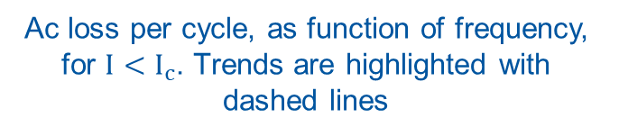


Validation – D. Current dependency
Solution of the transport + screening currents problem
$$∝I^{n+1}$$
$$I_{c}$$
$$∝I^{3}$$
$$∝f^{0}$$
$$I_{c}$$
Ac loss per cycle, as function of the applied current. Trends are highlighted with dashed lines
Ac loss per cycle, as function of frequency, for $I<I_{c}$. Trends are highlighted with dashed lines
→ Consistent with previous research

Slide 28





Project Overview
Protection of HTS-based high-field accelerator magnets
CERN
Technische Universität Darmstadt
Graduate School of Excellence Computational Engineering (GCE)
Dr. Matthias Mentink (TE-MPE-PE)
Prof. Dr. Sebastian Schöps (TU Darmstadt)
05.2018 – 05.2021
Gentner Programme at CERN (grant no. 05E12CHA)
‘Excellence Initiative’ of the German Government
GCE at TU Darmstadt

Slide 29
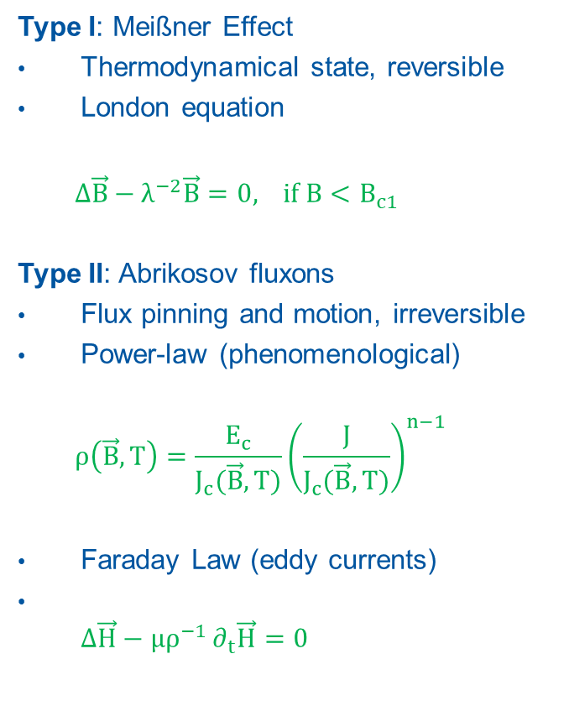
Magnetic field dynamics in superconductors
Type I: Meißner Effect
Thermodynamical state, reversible
London equation
  $∆\vec{B}−λ^{−2}\vec{B}=0$, if $B<B_{c1}$
Type II: Abrikosov fluxons
Flux pinning and motion, irreversible
Power-law (phenomenological)
  $$ρ\left(\vec{B},T\right)=\frac{E_{c}}{J_{c}(\vec{B},T)}{\left(\frac{J}{J_{c}(\vec{B},T)}\right)}^{n−1}$$
Faraday Law (eddy currents)
$∆\vec{H}−μρ^{−1}∂_{t}\vec{H}=0$
B
B-T Diagram
B_{c2}
Type II
B_{c1}
Type I
T_{c}
T

Slide 30
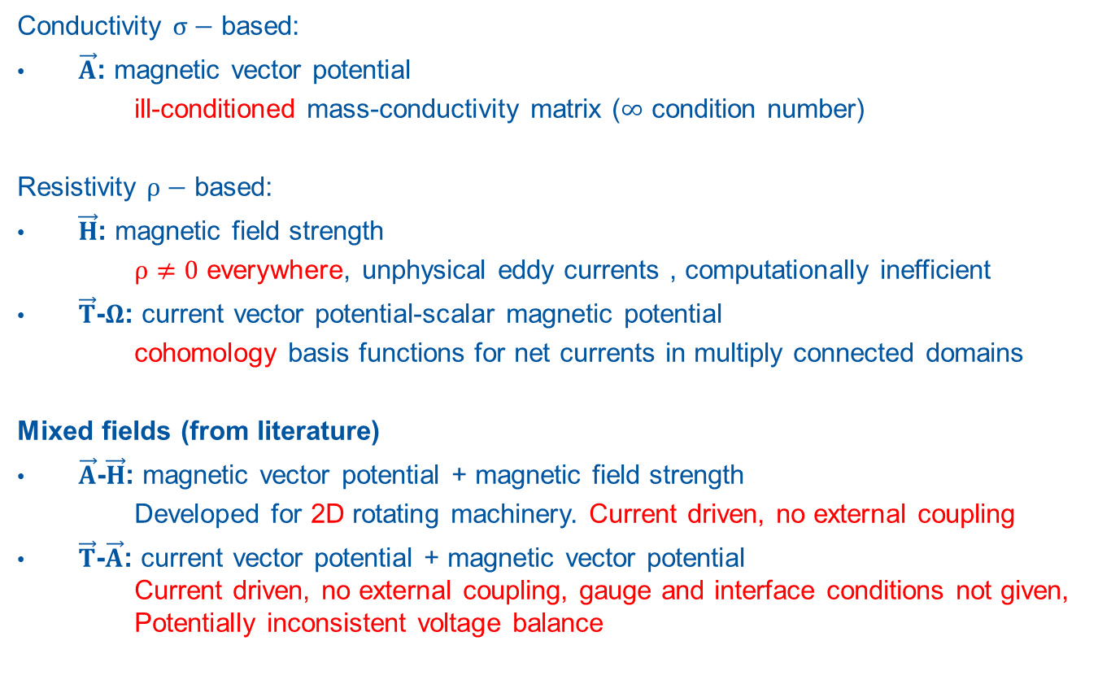
Formulations
Conductivity $σ−$ based:
$\vec{A}$: magnetic vector potential
  ill-conditioned mass-conductivity matrix ($∞$ condition number)
Resistivity $ρ−$ based:
$\vec{H}$: magnetic field strength
  $ρ≠0$ everywhere, unphysical eddy currents , computationally inefficient
$\vec{T}$-$Ω$: current vector potential-scalar magnetic potential
  cohomology basis functions for net currents in multiply connected domains
Mixed fields (from literature)
$\vec{A}$-$\vec{H}$: magnetic vector potential + magnetic field strength
Developed for 2D rotating machinery. Current driven, no external coupling
$\vec{T}$-$\vec{A}$: current vector potential + magnetic vector potential
Current driven, no external coupling, gauge and interface conditions not given,
Potentially inconsistent voltage balance

Slide 31
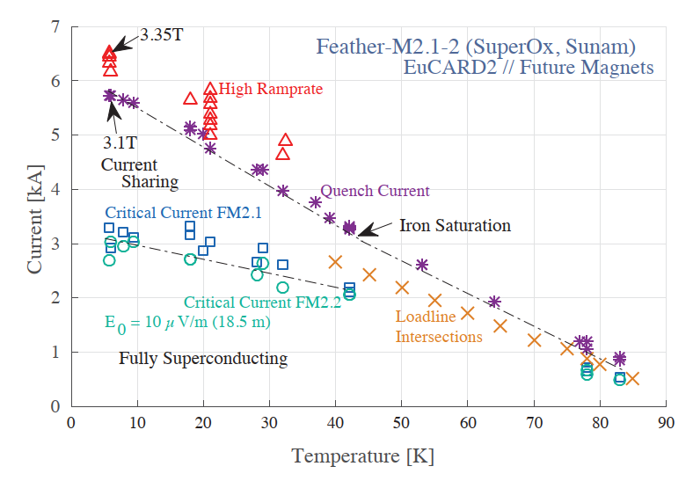




Modelling of Jc (T, B, $θ$)
Jc data from Fujikura [9]
Fit from [10]
$J_{c}$ available only for $T=77 K$ $→$ Lift factor, calibrated with the measured $I_{c}$
Lift factor assumed consistent with $θ=30\text{°}$
Pic. From [6]
$$\vec{n}$$
$$\vec{B}$$
$$θ$$
$J_{c}(T,B,θ)$ fit in the model
Measured $I_{c}(T,B)$
→ Anisotropy included in the model, but uncertainty on material properties
[9] Fujikura, Y-based high temperature superconductor. Company leaﬂet at ICEC (2014).
[10] Fleiter, J., and A. Ballarino. "Parameterization of the critical surface of REBCO conductors from Fujikura." CERN internal note, EDMS 1426239 (2014).`

Slide 32
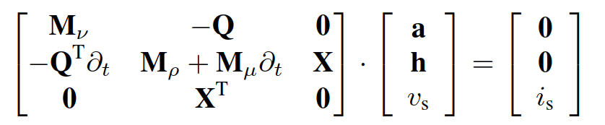
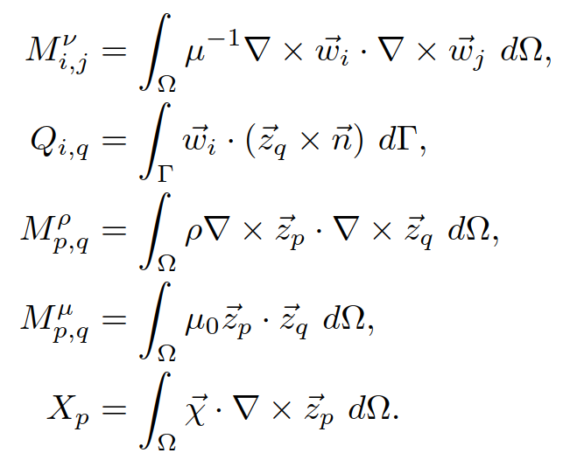




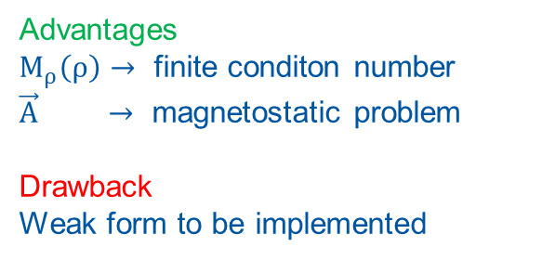

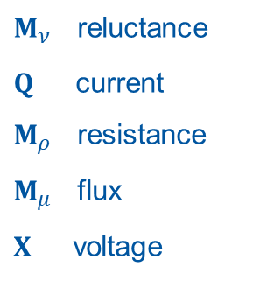


Formulation - Mixed potentials
$\vec{A}−\vec{H}$ formulation, weak form:
$Ω_{0}→$ Ampere-Maxwell Law
$Ω_{c}→$ Faraday Law
$Ω_{c}→$Constraint on transport current
$$\vec{A}→Ω_{0},ℝ^{3}$$
$$\vec{H}→Ω_{c},ℝ^{3}$$
$$−$$
$$v_{s}$$
$$+$$
$$i_{s}$$
$M_{ν}$ reluctance
$Q$ current
$M_{ρ}$ resistance
$M_{μ}$ flux
$X$ voltage
Advantages
$M_{ρ}\left(ρ\right)→$ finite conditon number
$\vec{A} →$ magnetostatic problem
Drawback
Weak form to be implemented

Slide 33
High-Temperature Superconductors
Cuprate compounds (CuO₂) doped with rare earth elements (La, Bi-Sr-Ca, Y-Ga-Ba …)
Higher Tc and Bc0 respect to the traditional LTS competitors
Higher performance comes with higher prices! $\$_{HTS}≈{1e}^{2} \$_{LTS}$
.. But in the early 2000s it was $≈{1e}^{3}$

Slide 34
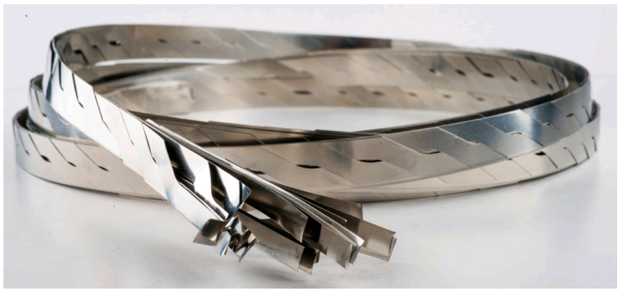



Tapes and Cables
Tapes
ReBCO - Rare Earth Barium Copper Oxide tape
Batches of $\sim {10}^{2} m$ and beyond
Cost driven by production process
Features
Multi-layer, multi material
Aspect ratio ~${10}^{2}$ (tape), ~${10}^{3}$ (HTS layer)
HTS as anisotropic, nonlinear mono-filament $J_{c}(\overset{⃑}{B},T)$
AC losses: eddy currents
Cables
Roebel geometry (1912)
“Coil-able”, bended on the long edge
Fully transposed: even current distribution
Aligned-coil concept against AC losses
$$mm$$
$$μm$$
■ Copper ■ ReBCO ■Substrate
Source: CDS. Coiled Roebel cable (Henry Barnard, CERN).

Slide 35

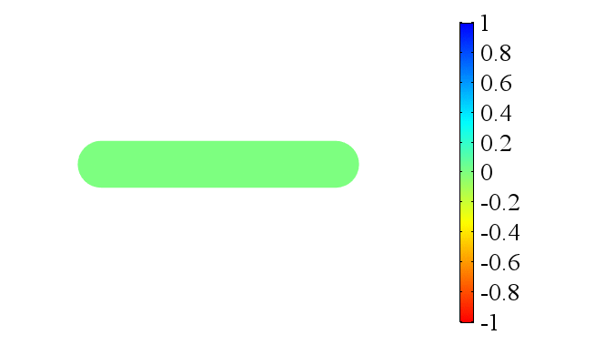

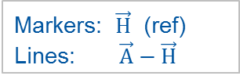

Formulation - Crosscheck
Reference model [*] based on the $\vec{H}$ formulation,
provided by http://www.htsmodelling.com
2D model of a Single HTS tape in self-field
Source: $I_{s}=I_{0}sin(2πft)$, $I_{0}=2I_{crit}$ $t∈[0;1]$
1 Hz
10 Hz
100 Hz
1000 Hz
Markers: $\vec{H}$ (ref)
Lines: $\vec{A}−\vec{H}$
$\frac{J}{J_{crit}}$
[*] V. M. Rodriguez-Zermeno et al., "Towards Faster FEM Simulation of Thin Film Superconductors: A Multiscale Approach," in IEEE Transactions on Applied Superconductivity, vol. 21, no. 3, pp. 3273-3276, June 2011.

Slide 36

Formulation - Benchmark
Forecasts on expected computational time:
Same physics…
1 tape
8 h
5 tapes
10 tapes
Increased computational cost
Optimization of:
Mesh, solver, numerical implementation

Slide 37


Formulation - PEC Limit Behavior
$$∝f^{1}$$
$$∝f^{−1}$$
[1] Knoepfel, Heinz E. Magnetic fields: a comprehensive theoretical treatise for practical use. John Wiley & Sons, 2008.

Slide 38
Field multipoles without eddy currents
Staircase Scenario at 4.5 K
“Eddy” considers the HTS tape dynamics
“No Eddy” assumes a homogeneous current density in the tapes

