Slide 1

Simulations of failure cases
1st STEAM Workshop 13-14 June 2019
cern.ch/STEAM
Emmanuele Ravaioli
on behalf of the STEAM team

Slide 2
Failures in magnet systems
Failures are part of life – better be prepared for them!
  → Parametric studies and worst-case analysis during the design phase
  → Keep a software “tool-box” ready to use in case unusual events occur during operation
The STEAM framework is our tool-box
Tools: Programs dedicated to simulation, when possible previously validated
Model generator APIs: Semi-automatic generation of models and simulation lists
Tool Adapters: Interface to communicate programmatically with models
Meta-Methods: Co-simulation to couple different tools
Frontends: Even easier ways to interact with the previous
In this presentation we show a few examples of how the STEAM team tackled different
failure case simulations – either during the design or during the operation phases

Slide 3
Strategy to simulate failures
Progressive strategy
Use one program
Semi-automatic input generation
Semi-automatic simulation management
Couple two or more programs
Develop new features of a program
Develop ad-hoc code
Develop a new program
Choice depends on required accuracy, desired output, simulation time, type of analysis,…

Slide 4
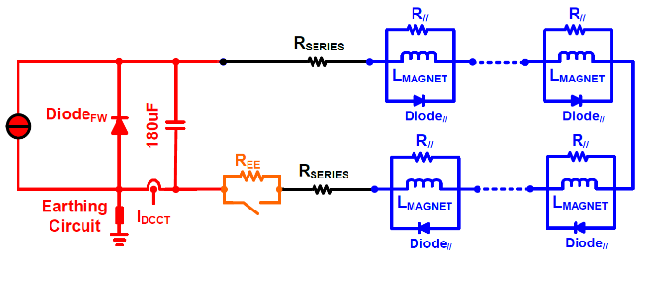
Example 1: LHC main quadrupole circuit earth fault
Voltage to ground distribution
Magnet 001 → Blue
Magnet 154 → Red
Simplified circuit
Current to ground at main grounding point
PSPICE netlist
Work of L. Bortot

Slide 5
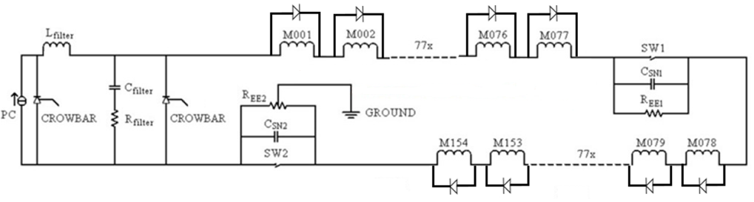
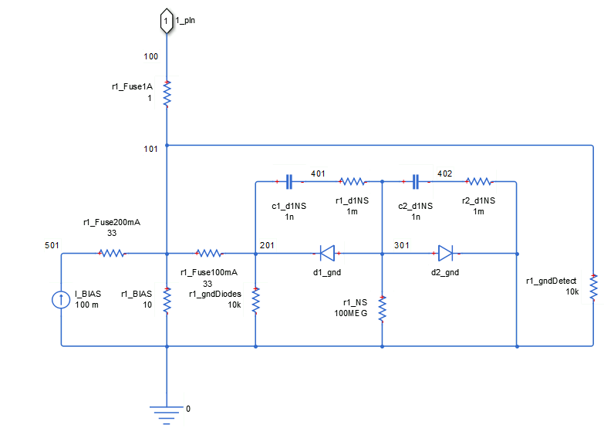
Example 2: LHC main dipole circuit fuse blow-up
Current to ground at power supply side
Current to ground at main grounding point
PSPICE netlist, SING
Work of L. Bortot, M. Maciejewski

Slide 6
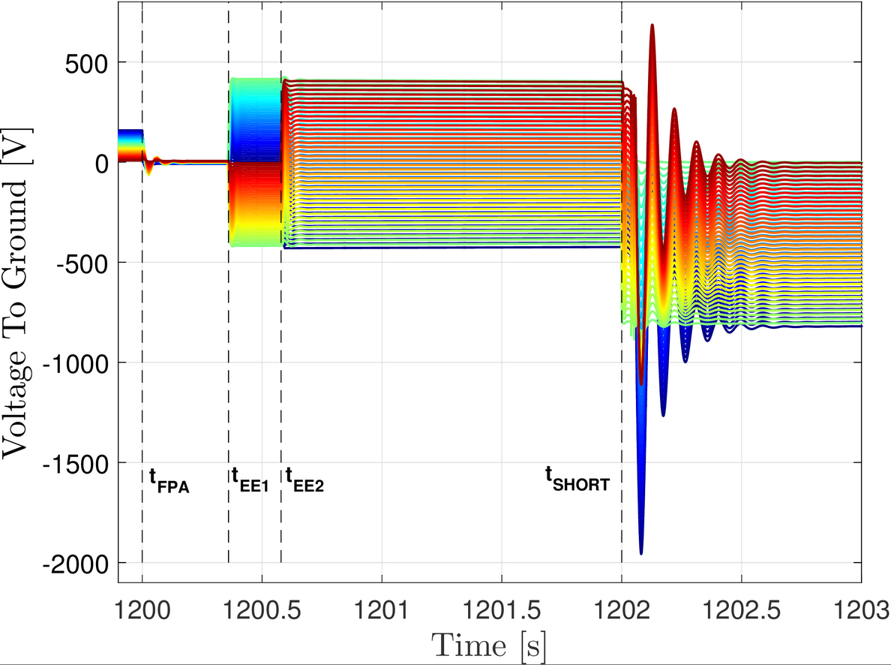
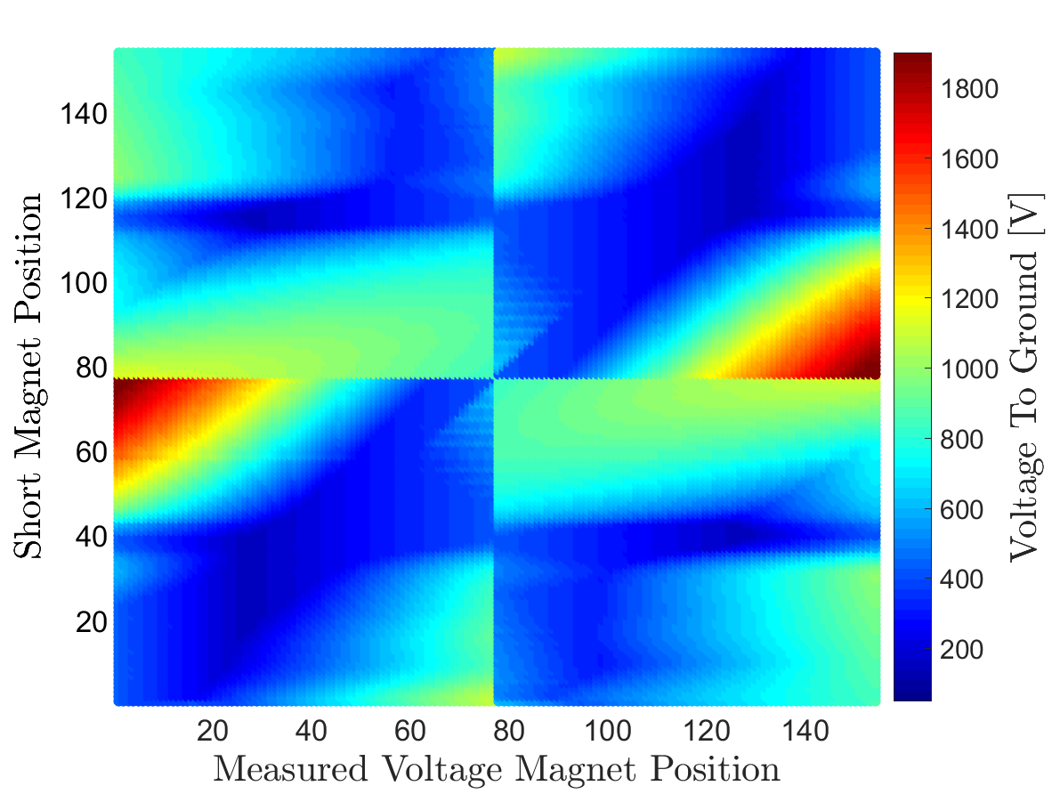
Example 3: LHC main dipole circuit short-circuit failure
Magnet 001 → Blue
Magnet 154 → Red
Intermittent short-circuit to ground
Parametric analysis → Worst-case identification
PSPICE netlist, SING, PSPICE Manager
Work of A. Liakopoulou

Slide 7
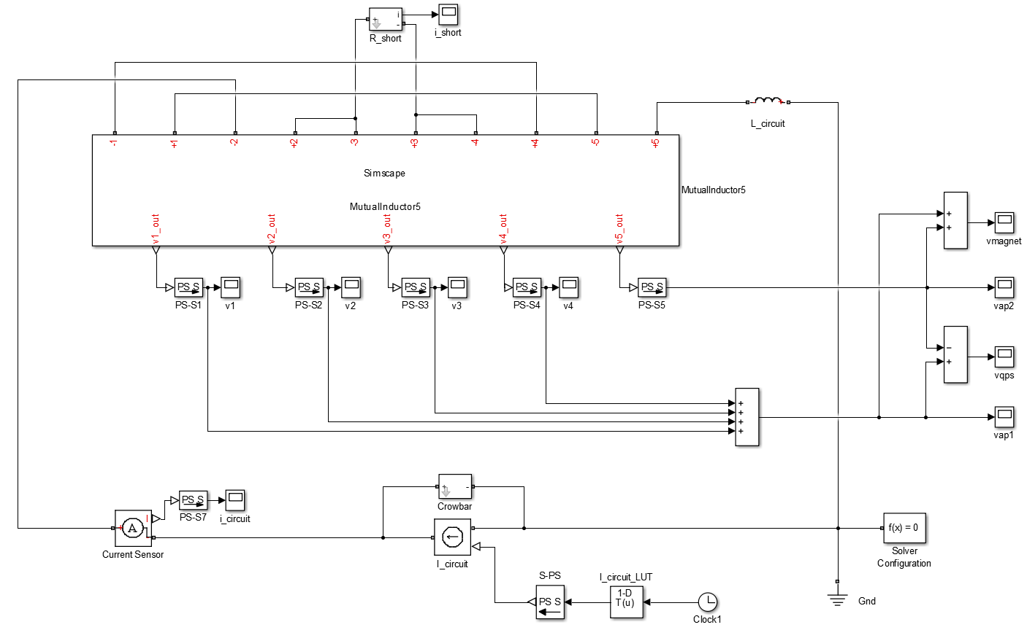
Example 4: Internal short-circuit in a LHC main dipole
Equivalent circuit
Simulated short-circuit current
Voltage difference between magnet halves
Simulink
Work of M. Maciejewski

Slide 8
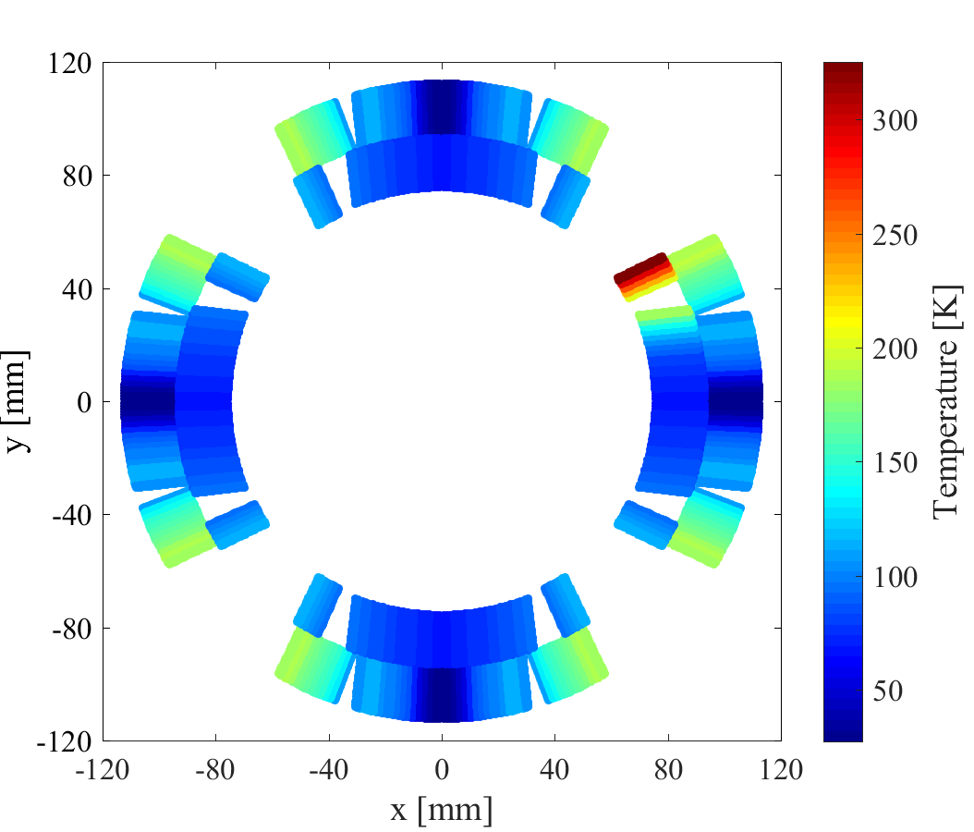
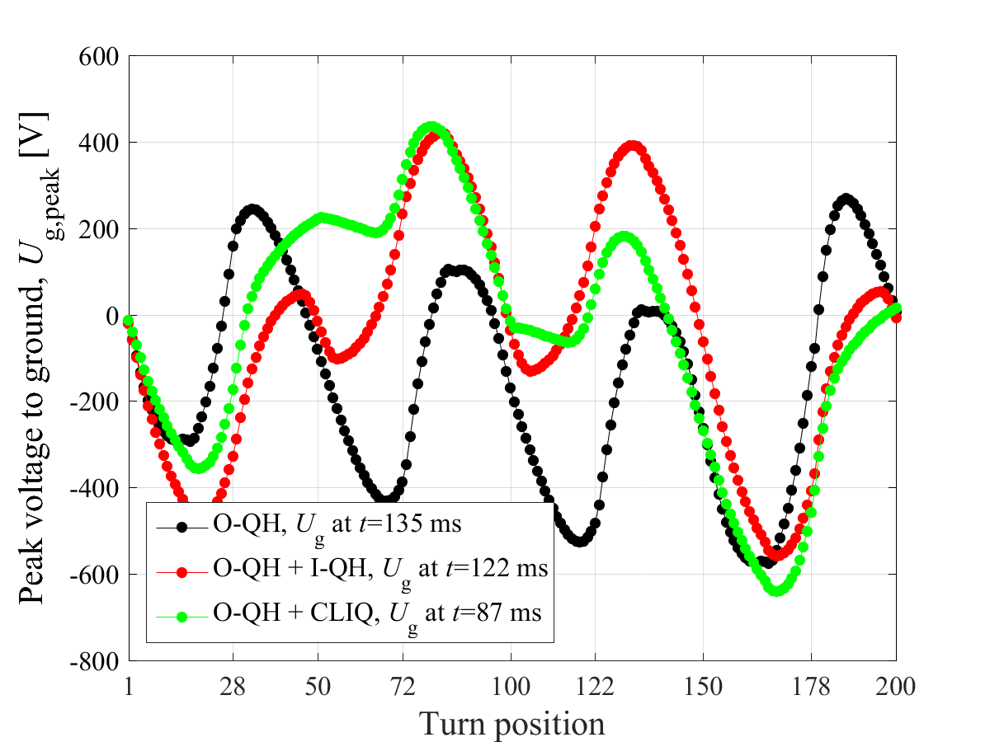
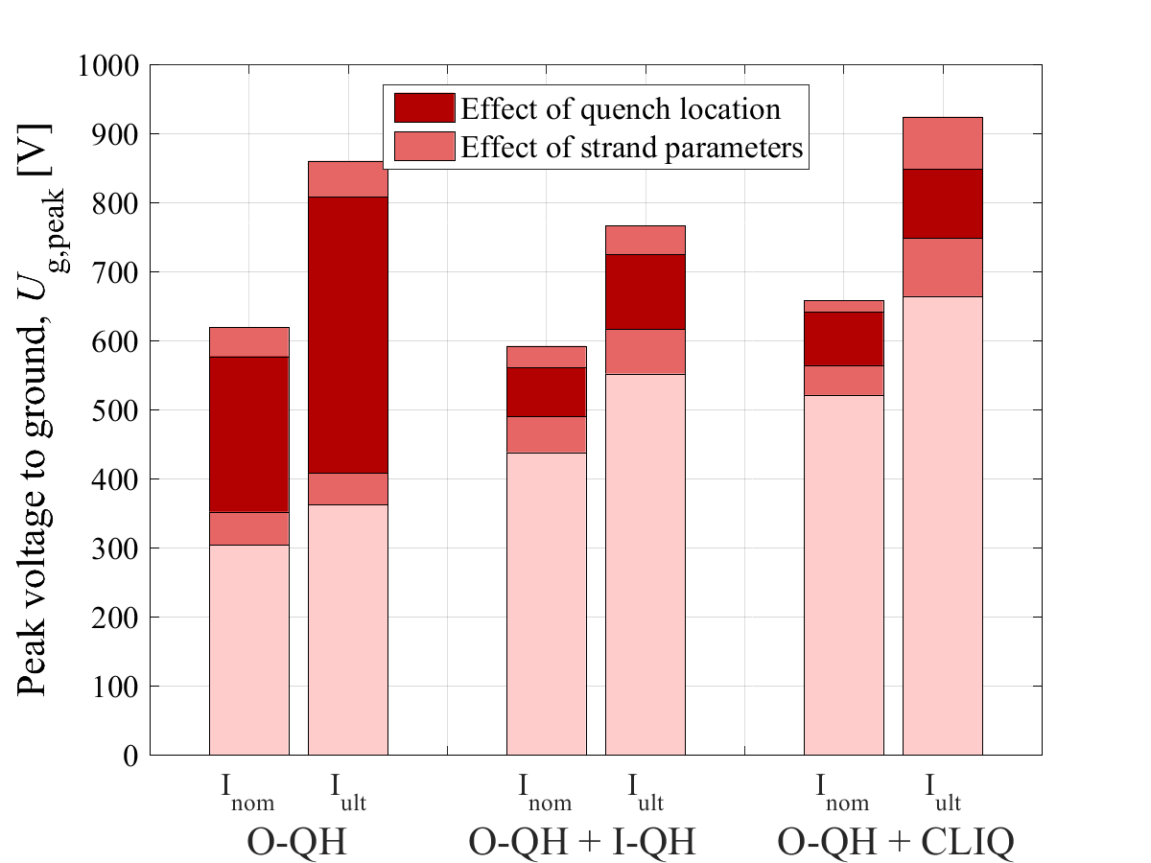
Example 5: Worst-cases in HL-LHC Nb₃Sn quadrupole magnet
Temperature distribution
Voltage to ground distribution
Parametric analysis
LEDET

Slide 9
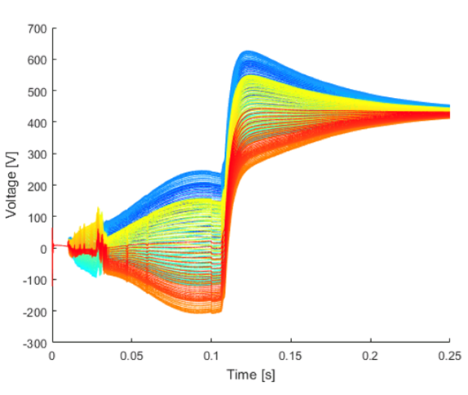
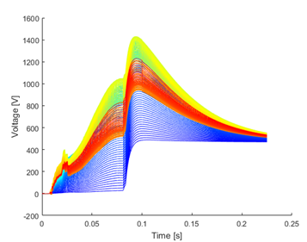
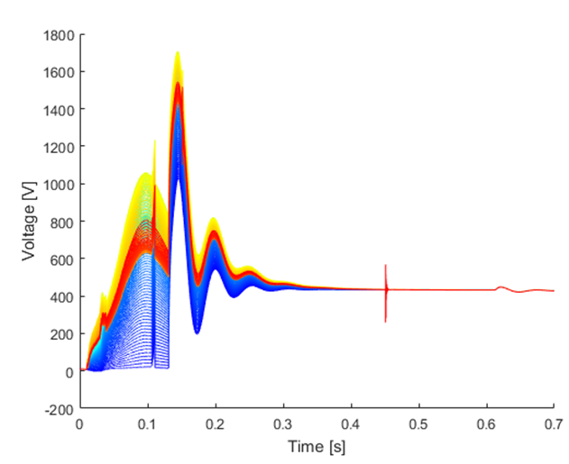
Example 6: HL-LHC main dipole circuit heater / short failures
Voltage to ground distribution in the turns of an 11 T dipole magnet in the HL-LHC main dipole circuit
First magnet turn → Blue
Last magnet turn → Red
Normal operation
Double heater failure
Intermittent short circuit to ground
COSIM of [PSPICE+LEDET]
Work of M. Maciejewski, M. Mentink

Slide 10
Example 7: Short-circuit in HL-LHC Nb₃Sn quadrupole magnet
Electro-thermal model
4 different short-circuit scenarios considered
Parametric analyses
COSIM of [PSPICE+LEDET]

Slide 11
Example 8: Frequency-domain analysis
Model validation
Effect of a short-circuit
SING, PSPICE netlist
Experimental data: J. Taylor (LBNL)

Slide 12
Example 9: Effect of spurious quench heater firing on the LHC beam
Impact on the LHC beam along its trajectory
SIGMA→COMSOL
MAD-X (particle tracking)
Magnetic field due to heater discharge
Work by L. Bortot, M. Valette

Slide 13
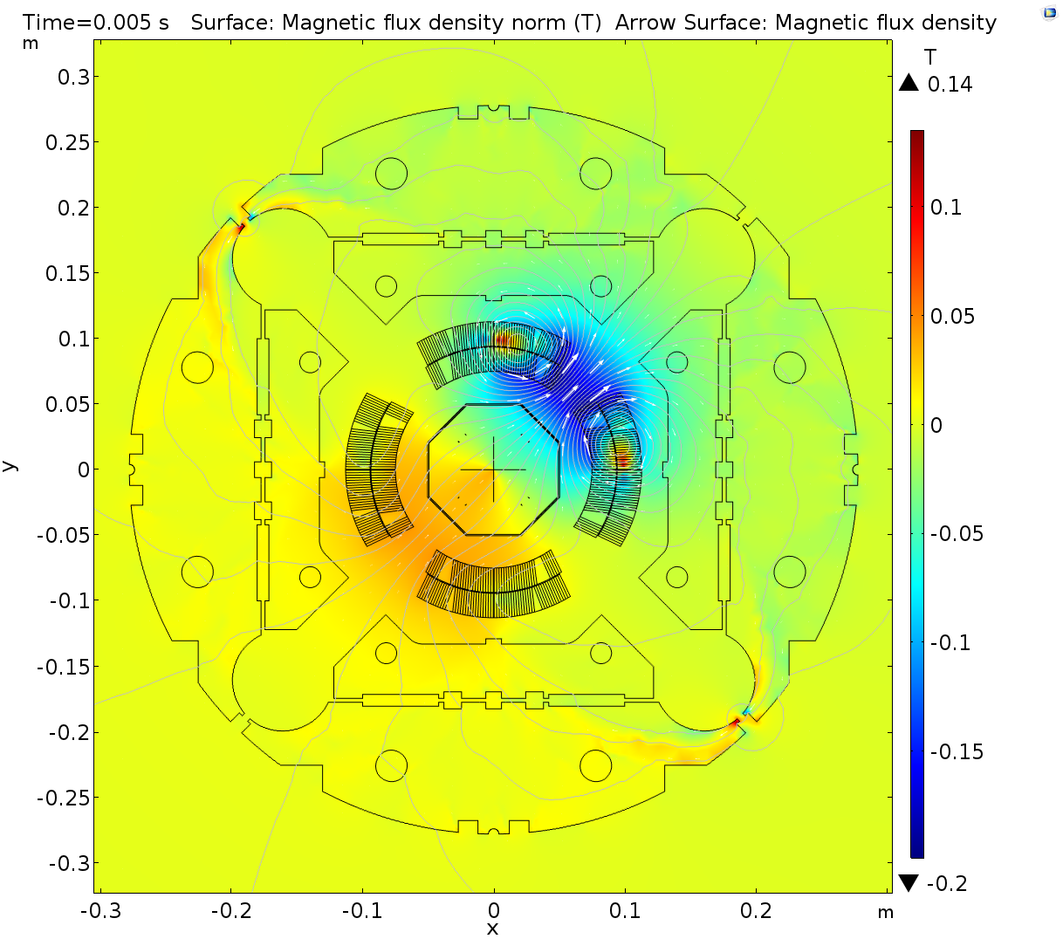
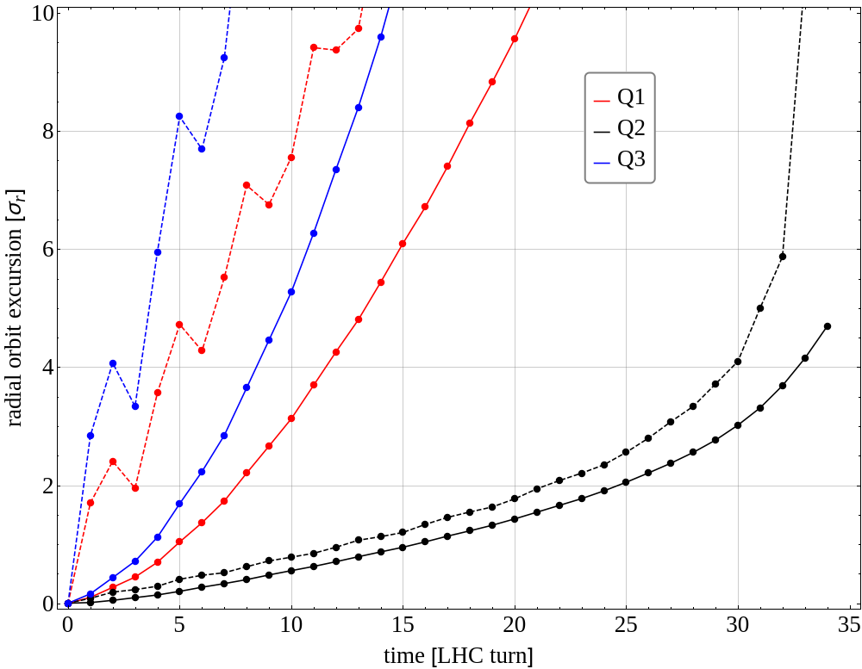
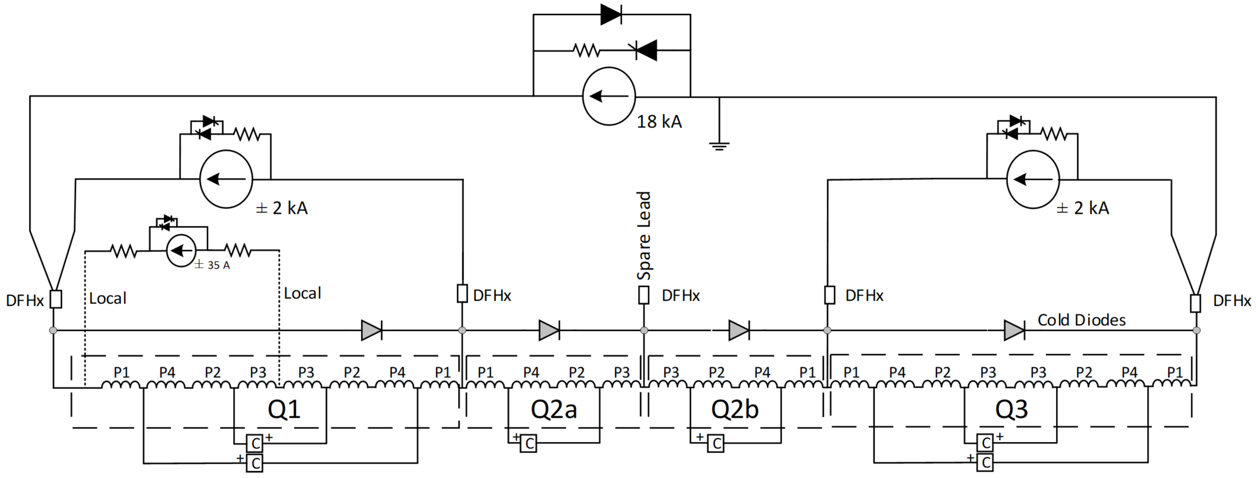
Example 10: HL-LHC inner triplet CLIQ spurious triggering
P2/P3/P4
P2
P1
P1
P3
P4
Electro-thermal simulation
Magnetic simulation
Beam dynamics simulation
COSIM of [PSPICE+LEDET]
SIGMA→COMSOL
Ad-hoc code (mag. field)
MAD-X (particle tracking)
Work with Lindström, M. Mentink

Slide 14
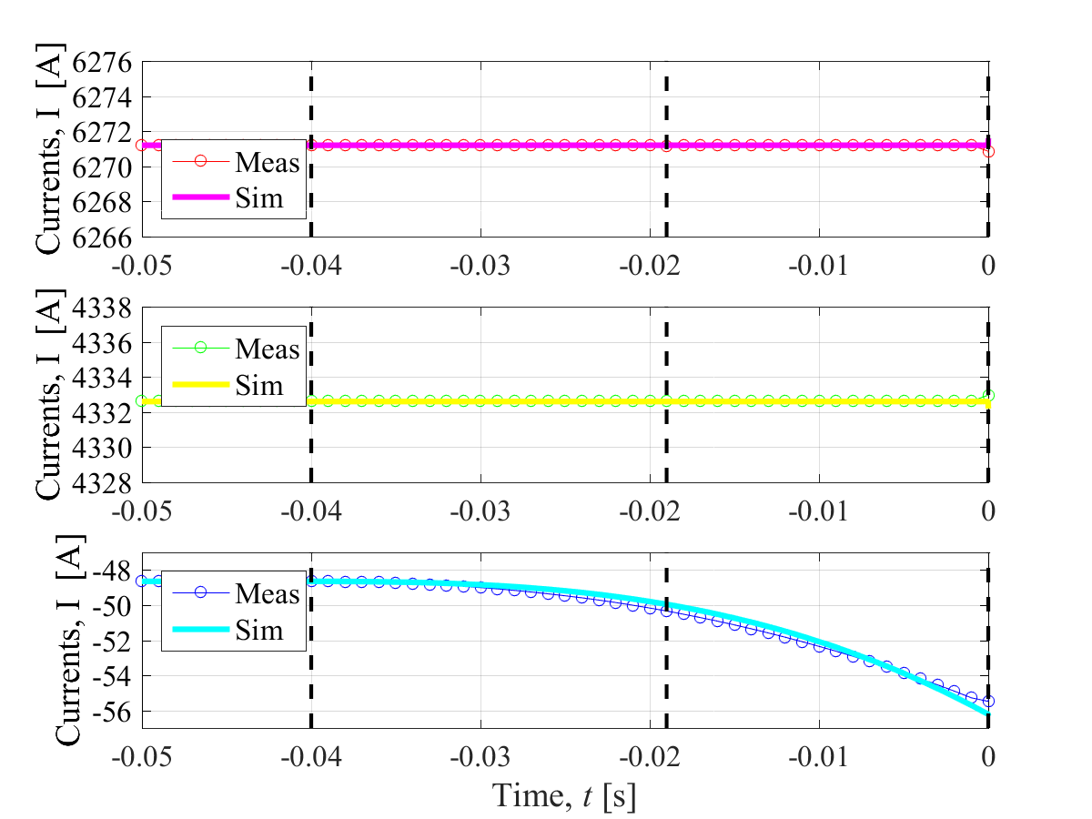
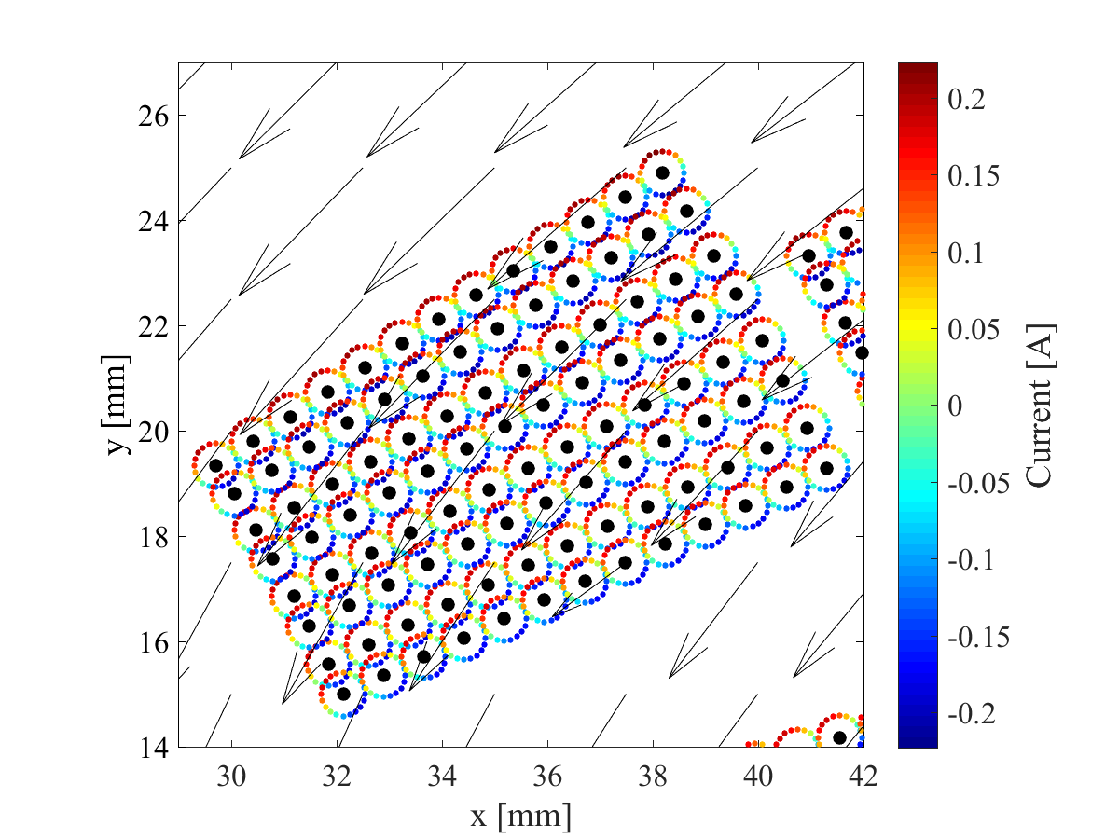
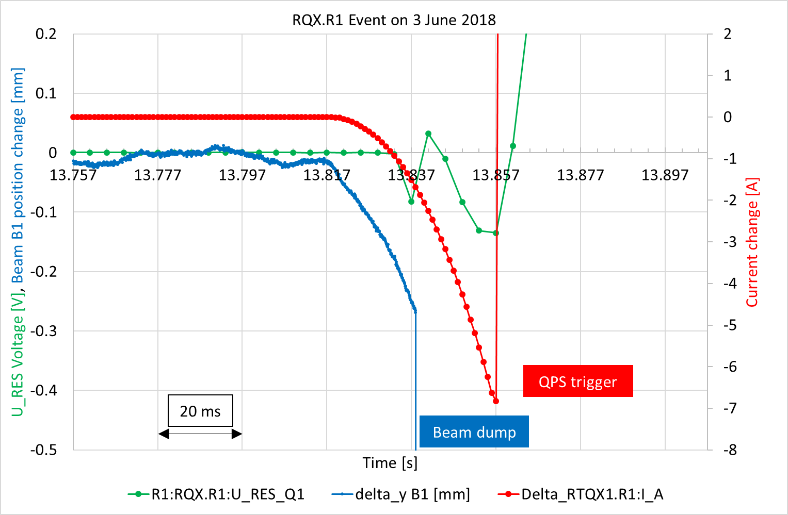
Example 11: Unusual event occurred in the LHC inner triplet circuit…
Experimental observation
COSIM of [PSPICE+LEDET]
Ad-hoc code 1 (mag. field)
MAD-X (particle tracking)
Ad-hoc code 2 (mag. field)
Work with Lindström
Electro-thermal simulation
Magnetic simulation

Slide 15
Summary
Failures are part of life – better be prepared for them!
  → Parametric studies and worst-case analysis during the design phase
  → Keep a software “tool-box” ready to use in case unusual events occur during operation
The STEAM framework is our tool-box
Tools: Programs dedicated to simulation, when possible previously validated
Model generator APIs: Semi-automatic generation of models and simulation lists
Tool Adapters: Interface to communicate programmatically with models
Meta-Methods: Co-simulation to couple different tools
Frontends: Even easier ways to interact with the previous
Questions?

Slide 16
Annex

Slide 17
LHC main dipole circuit (RB)
By-pass Diode
Power supply
Filter
77 Magnets
Energy Extraction 1
77 Magnets
Crowbars
Energy Extraction 2
Non-linear electrical model of a superconducting magnet (parasitic capacitances, eddy currents)
[ref1] https://ieeexplore.ieee.org/abstract/document/6126021
[ref2] https://ieeexplore.ieee.org/abstract/document/6082398

Slide 18
LHC inner triplet circuit

Slide 19
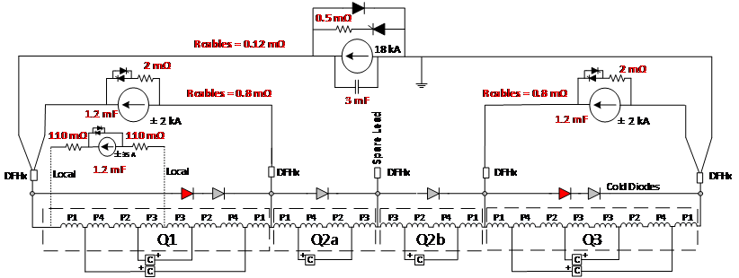
HL-LHC inner triplet circuit

