Slide 1

STEAM Apps
1st STEAM Workshop 13-14 June 2019
cern.ch/STEAM
Emmanuele Ravaioli
on behalf of the STEAM team

Slide 2
Why developing STEAM apps?
STEAM develops app
User runs app
Feedback to STEAM
User requests feature
Reduce learning curve for the users
Solve specific tasks more efficiently
Use in a test facility for quickly comparing measurements to simulations
Faster feedback exchange with users
Discussion Board

Slide 3
Two approaches tried so far
Executables
Notebooks
Offline based
No need to install payware software
Graphical User Interface available
Runs locally
New versions need to be downloaded
Shared via download link
Can’t be modified by the user
Online based
No need to install any software
Runs like an interactive script
Runs in the cloud (can’t run executables)
New versions uploaded online
Shared with a web link
Can be cloned and edited by the user

Slide 4
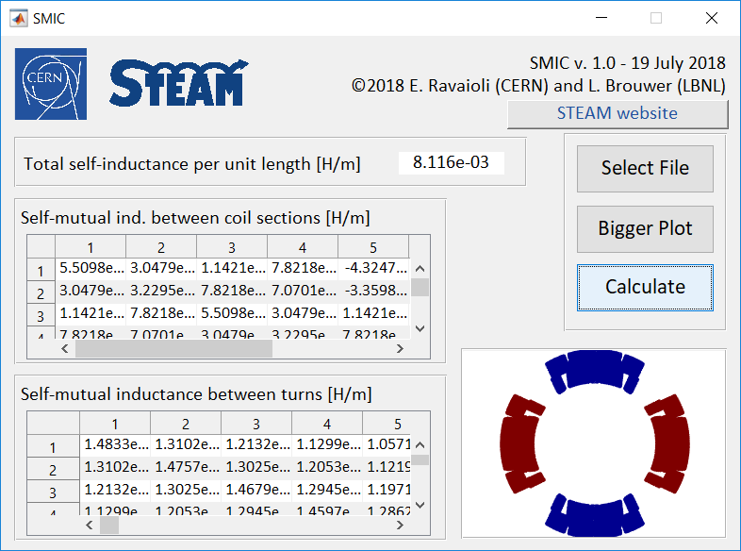
Example 1: SMIC (Self-Mutual Inductance Calculator)
Link for Emmanuele:
https://swan003.cern.ch/user/emm/notebooks/SWAN_projects/swanSMIC_forTesting/swanSMIC_forTesting.ipynb
Calculates self-mutual inductance per unit length between each magnet turn
Useful for voltage to ground simulations
Runs in ~1 minutes for a typical accelerator magnet (hundreds of turns)
Written in Matlab, and comes as a .exe
Doesn’t work for solenoids
Doesn’t include effect of iron-yoke
Executable:
\\cern.ch\dfs\Projects\STEAM\Other\SMIC\for_testing
Notebook:
https://cernbox.cern.ch/index.php/s/PbtKYBfGdj8kQMm
steam-frontend-smic
Developed with
L. Brouwer, LBNL, CA

Slide 5
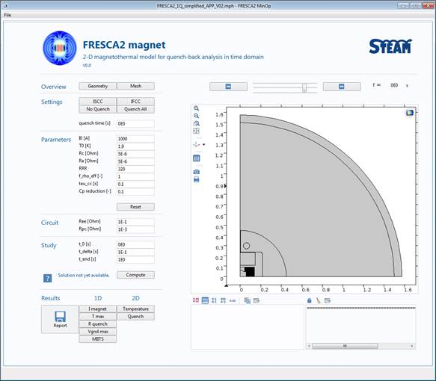
Example 2: Fresca2 COMSOL app
Calculates electro-magnetic and thermal transient in the magnet
Conductor parameters and operating conditions can be changed
Developed in COMSOL, comes as a .mph
\\cern.ch\dfs\Projects\STEAM\Other\FRESCA2
Developed by L. Bortot

Slide 6
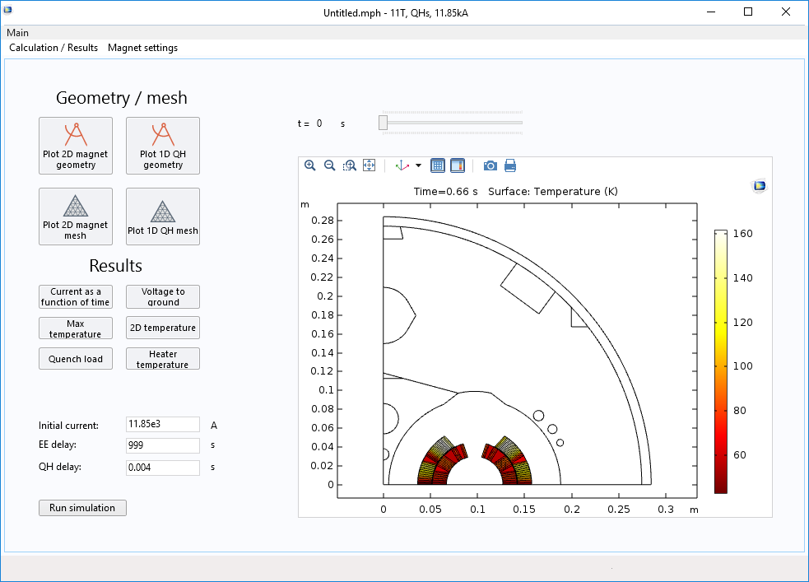
Example 3: 11T dipole COMSOL app
Calculates electro-magnetic and thermal transient in the magnet
Conductor parameters and operating conditions can be changed
Developed in COMSOL, comes as a .mph
Developed with
M. Mentink

Slide 7
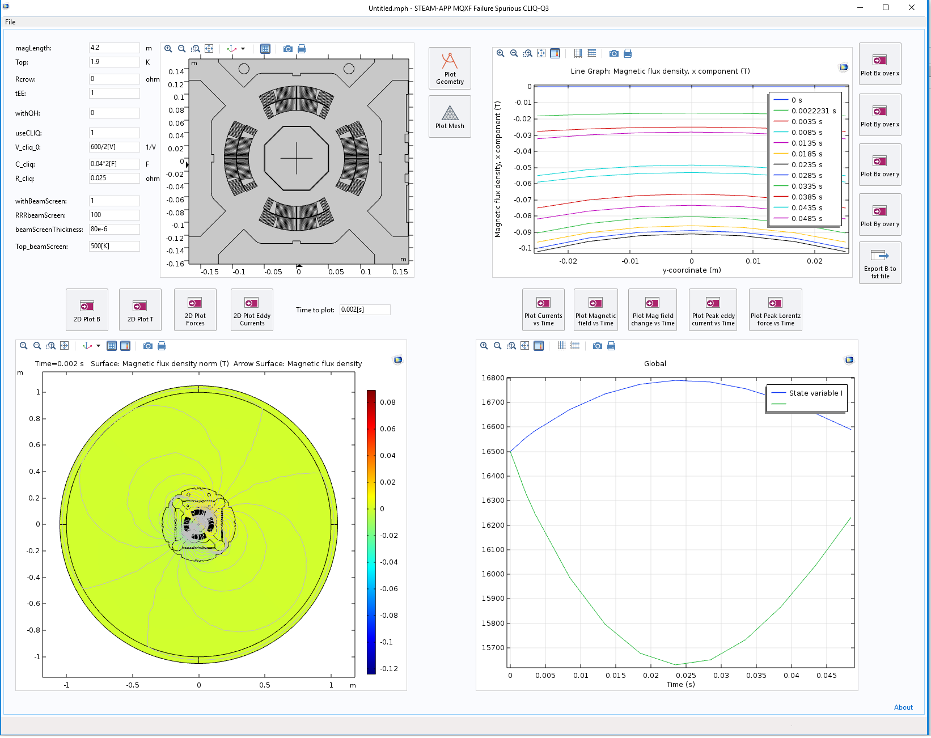
Example 4: MQXF COMSOL app
Calculates electro-magnetic and thermal transient in the magnet
Conductor parameters and operating conditions can be changed
Magnetic field in the bore and screening due to eddy currents in the beam screen
Developed in COMSOL, comes as a .mph
\\cern.ch\dfs\Projects\STEAM\HL-LHC\MQXF\ElMaThMe\Comsol
Developed with M. Mentink
First tester: C. Wiesner

Slide 8
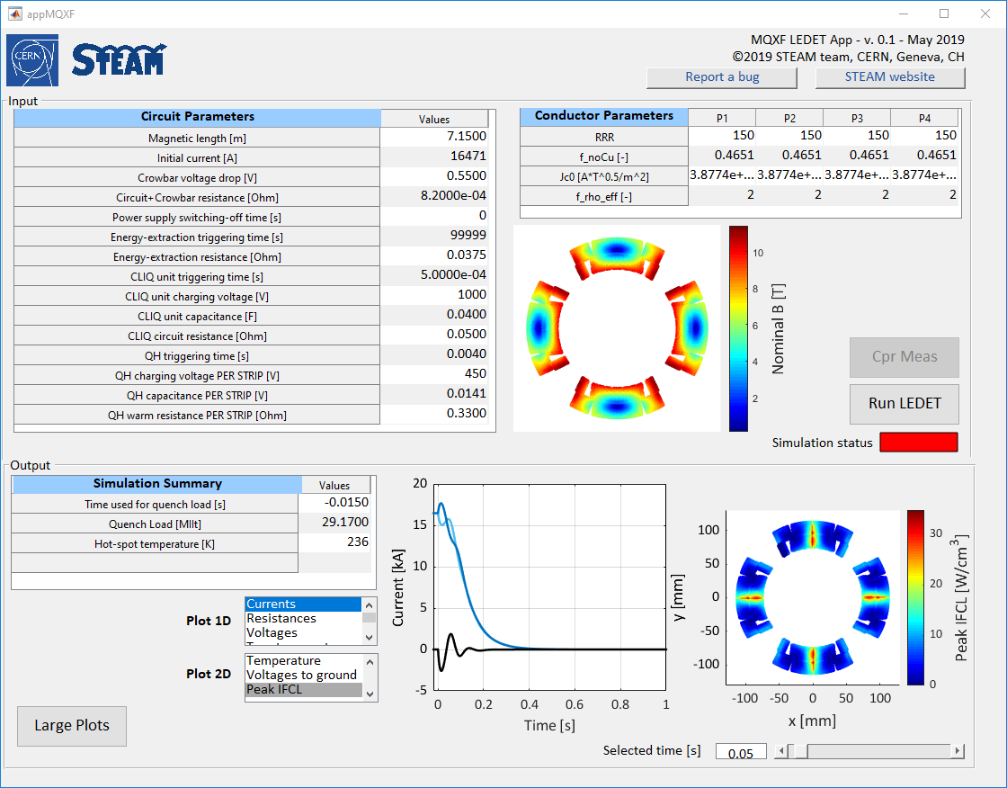
Example 5: MQXF LEDET app
Calculates electro-magnetic and thermal transient in the magnet
Conductor parameters and operating conditions can be changed
Runs in ~2 minutes
Written in Matlab, and comes as a .exe

Slide 9
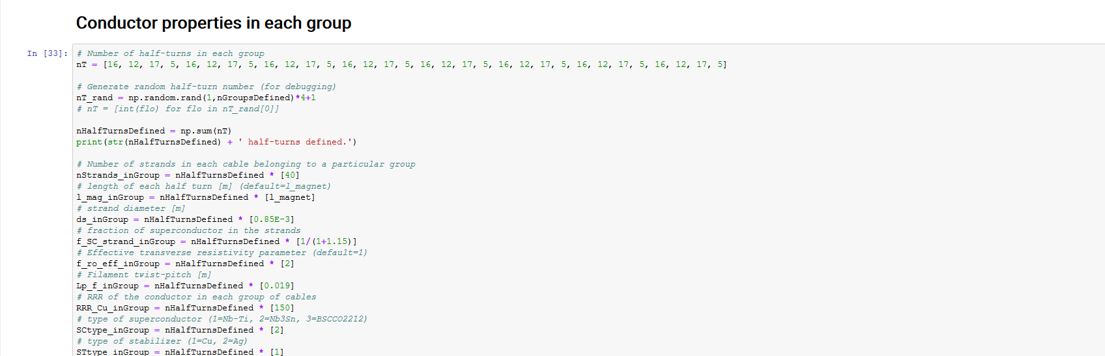
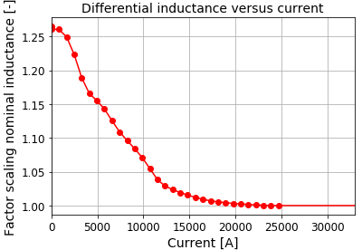
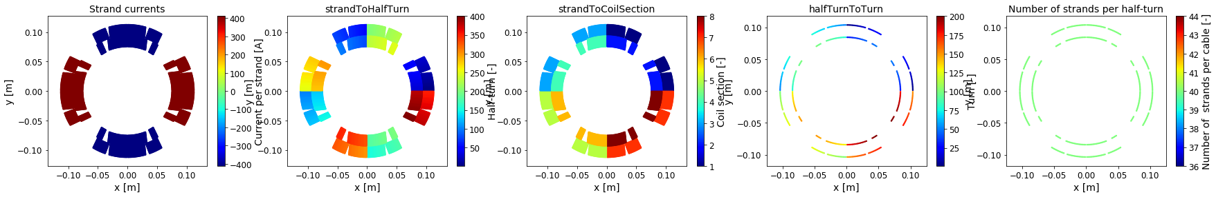
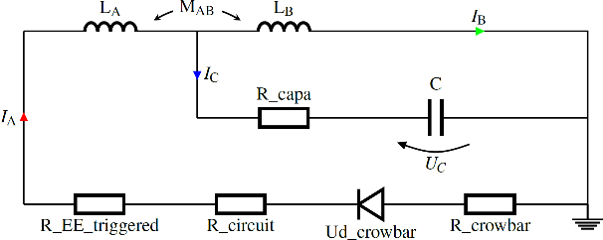
Example 6: Semi-automatic generation of LEDET input file
Link for Emmanuele:
https://swan003.cern.ch/user/emm/notebooks/SWAN_projects/sigma2ledet/sigma2ledet_main.ipynb
Manually define input parameters
Visualize inputs
Generate a LEDET input file
Runs in ~1 minutes
Written in Python
Can be cloned and edited
Notebook:
https://cernbox.cern.ch/index.php/s/PbtKYBfGdj8kQMm
sigma2ledet
Developed with
M. Maciejewski

Slide 10
New developments?
Send us your wishlist !
Discussion Board

