Slide 1
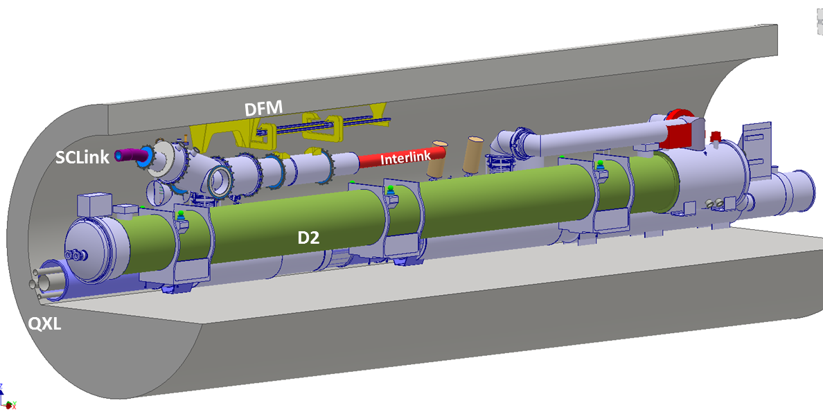
DFM Concept Proposal v0.2
Y. Leclercq, A. Kolehmainen, DFH-DFM meetings members
8th DFH-DFM meeting : 3 Apr. 2019

Slide 2
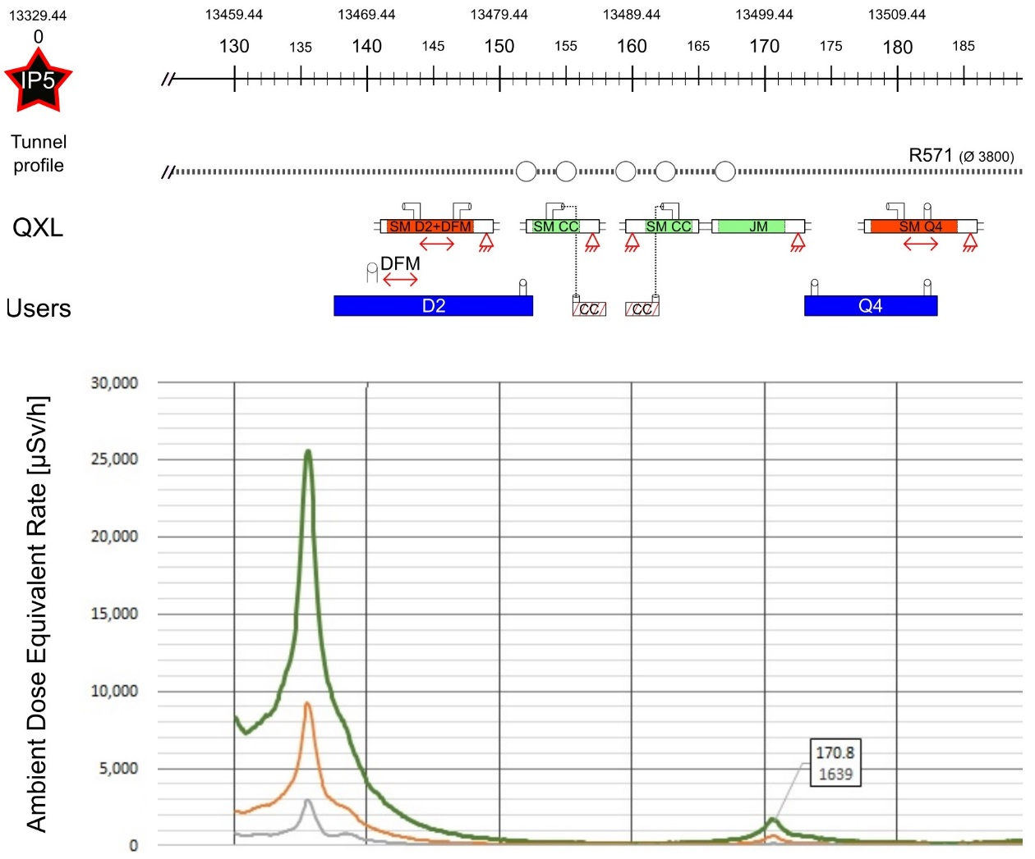
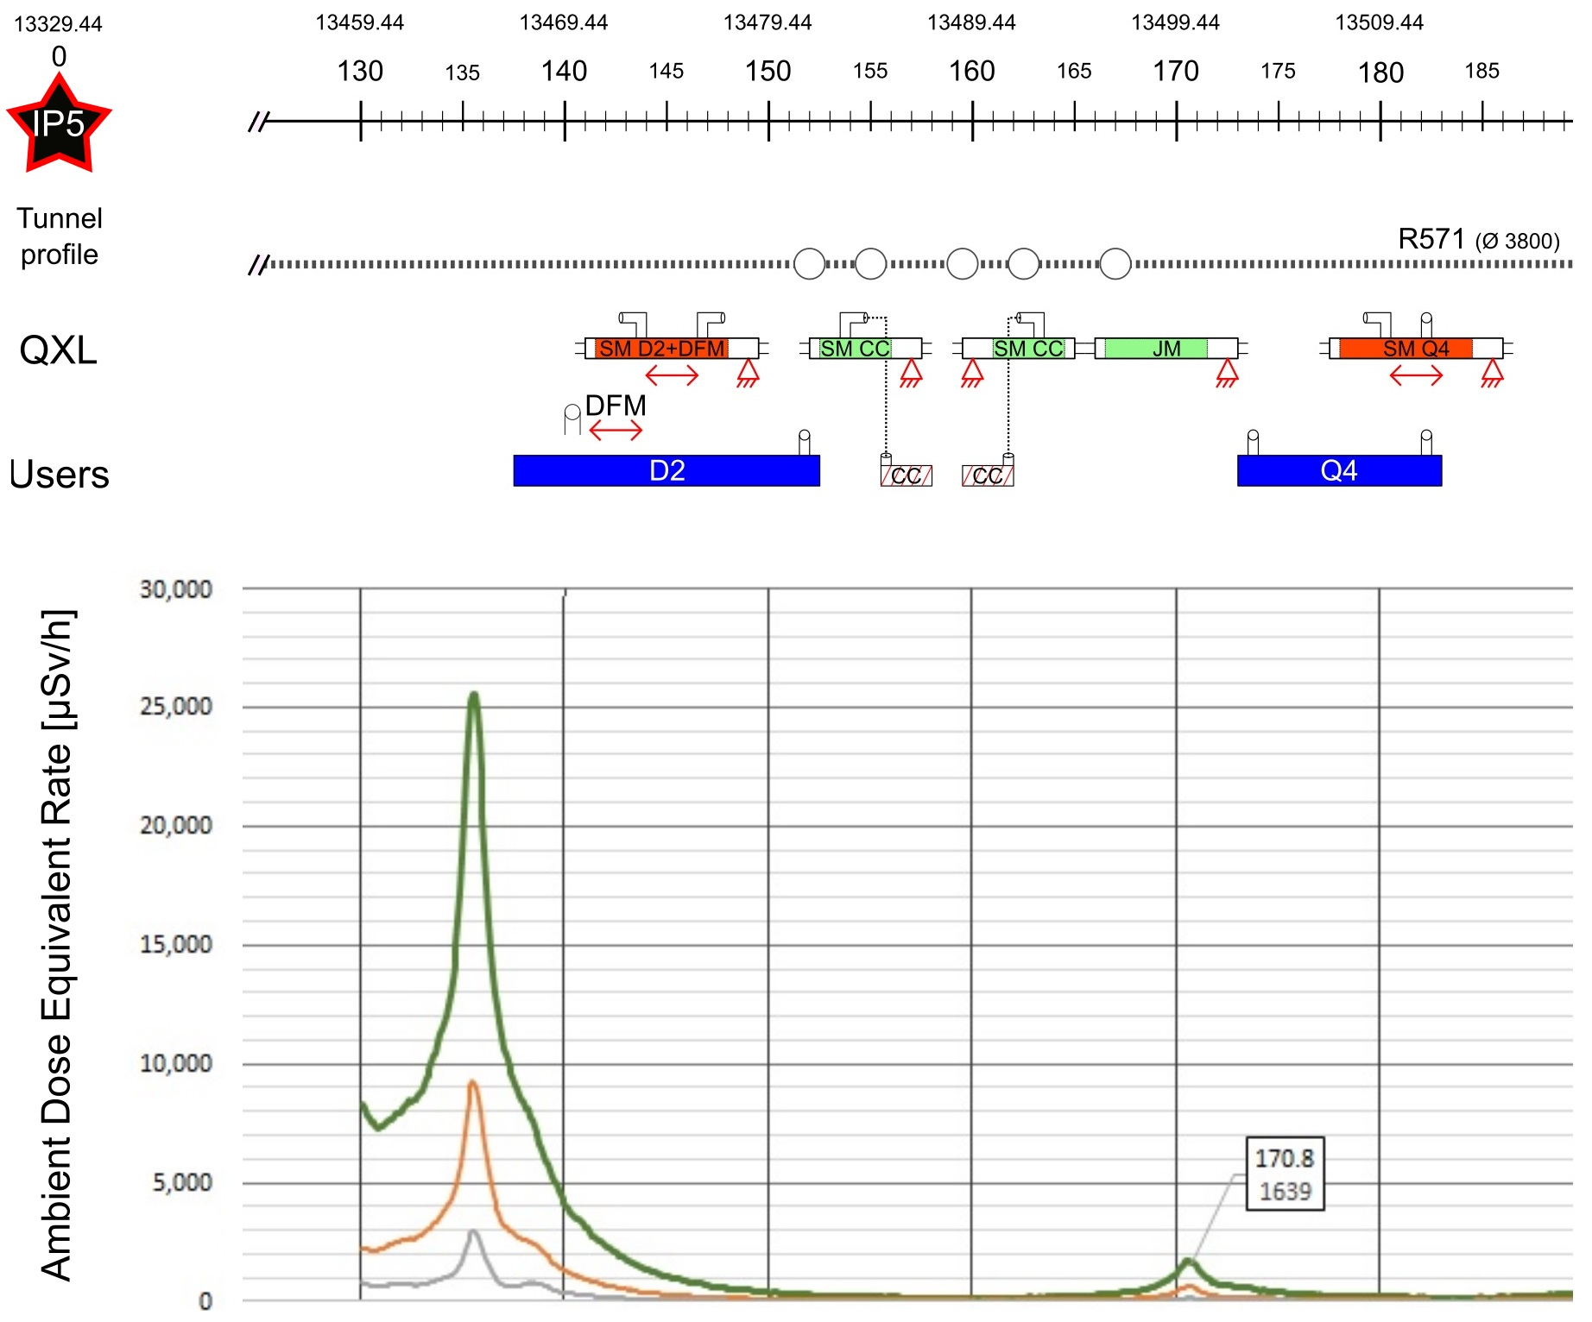


DFM environment
Courtesy M.Sisti
C. Adorisio
Location : 45m non IP side of SCLinks inlet shaft
Interface with :
  DSHm (cables & cryogenics volume)
  D2 (cables & cryo piping)
  QXL (cryo piping)
  Integration (tunnel, Collimators, Crab Cryomodules)
Radiation : Dose ≈ 1 MGy, Neutron f. ≈ > 1.10¹⁵ cm⁻², up to 25 mSv/h
2 x 13 kA
8 x 0.6 kA
DFHm
2 x 18 kA
2 x 13 kA
3 x 7 kA
3 x 7 kA
12 x 2 kA
HTS
PT
DFHx1
PT
DFHx2
Superfluid @ 1.9K
Liquid He @ 4.5 K
Gaseous He
Heater
Vacuum barrier
HTS
MgB2
NbTi
Warm cable
Splice
PT
⬅ $\dot{m}=2 g/s$
➔ $\dot{m}=5 g/s$
PT
Ghe <17K
Ghe <17K
MgB₂
DSHx
UR: Service tunnel
25 mSv/h
5 mSv/h
1 mSv/h
Ambient
Dose
Eq Rate
Non IP side
UL: Transverse tunnel
PT
IP side
DSHm
LHC tunnel
Ghe @4.5K
DFM
PT
Jumper DFM
PT
Jumper DFX
SFHe @1.9K
Ghe @4.5K
Splice
NbTi
Jumper D2
DFX
PT
Jumper D1
Lhe @4.5K
Lhe @4.5K
CC
D2
Collimators
SFHe @1.9K
MBCRD
MBRD
Beam
D1
MBXF

Slide 3
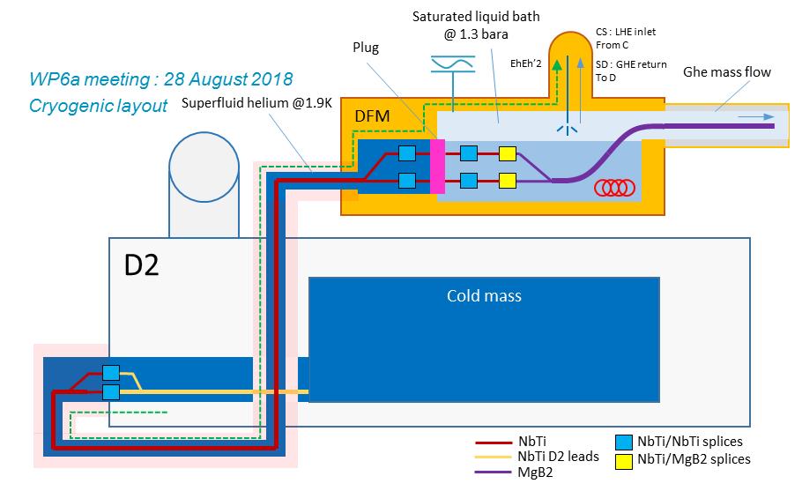
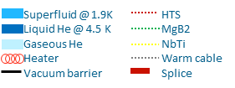
DFM concept
Concept v0.2 key features:
  Same Interlink & cryo concept
  Inclined concept
  DDFX principle : Ghe mass flow created in a separated reservoir
  “Fountain” design to gain vertical height
  SCLink interface as for DFX:
    MgB2-NbTi splices protected in perforated cylinder
    Only NbTi leads accessible
Basic concept
  Lhe injection in splice volume
  Level flows in side reservoir by gravity
  Heater vaporises liquid (based on DFHm needs)
  Level gauge control LHE inlet to ensure level
Plug
LHe Inlet

Slide 4
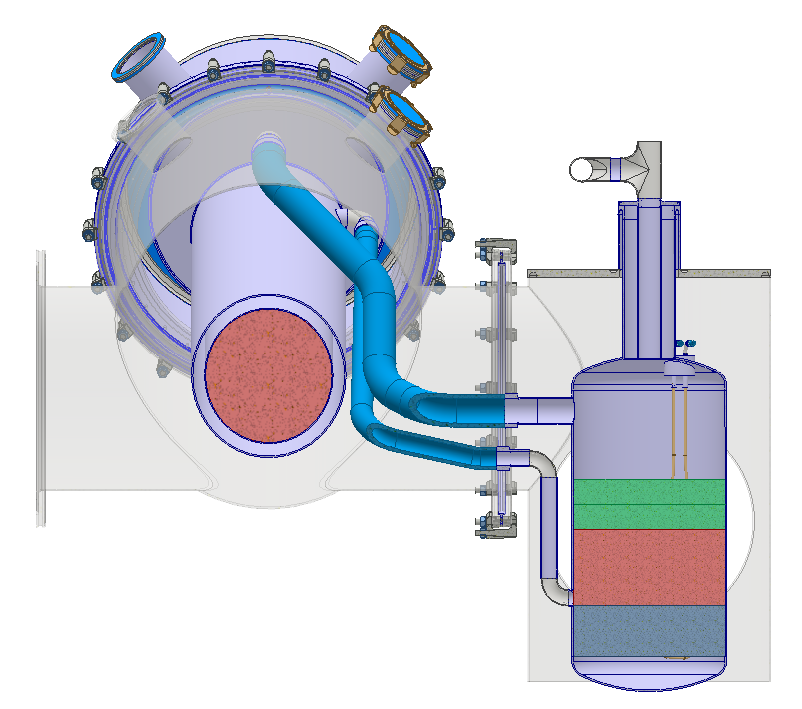
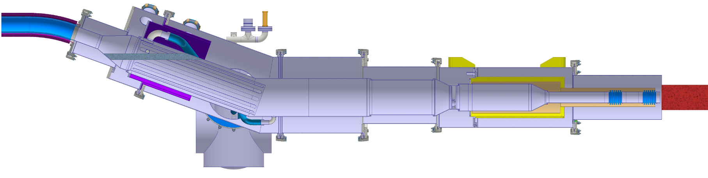
Nominal configuration
Electrical:
  MgB₂-NbTi Splices protected
  NbTi-NbTi splices on either side of plug
Cryogenics:
  Superfluid in interlink
  Splices immersed in LHE
  Fountain principle
  10 min buffer at nominal conditions
Insulation vacuum
  Vacuum barrier in DFM
  Vacuum barrier at plug level
Fill reservoir
MgB2-NbTi
Splices
14 litres
700
100
+50mm
Nominal level
-50mm
Inlet reservoir
10 litres
10 min @ 2g.s⁻¹
100
Heaters volume
← SCLink
to DFHm
100
IFS
Fill reservoir
16 min @ 20 W
8 litres
Top splices
Ø250 x 600
MgB₂-NbTi splices
Plug
Interlink
To D2 ➔
LHe inlet
20°

Slide 5
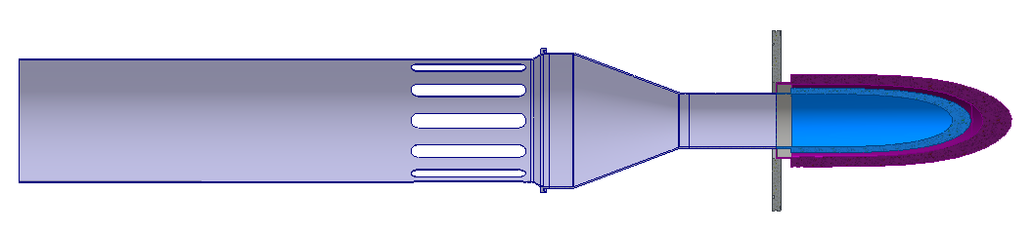
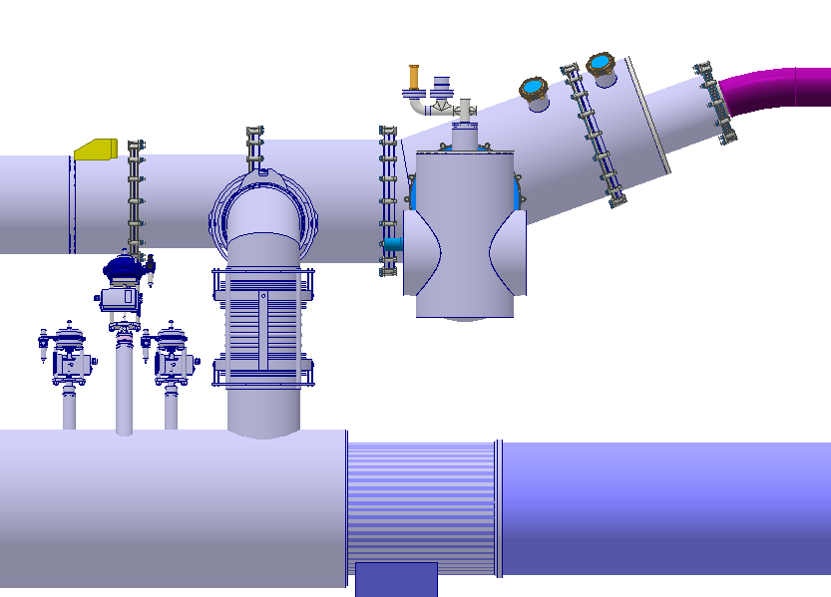
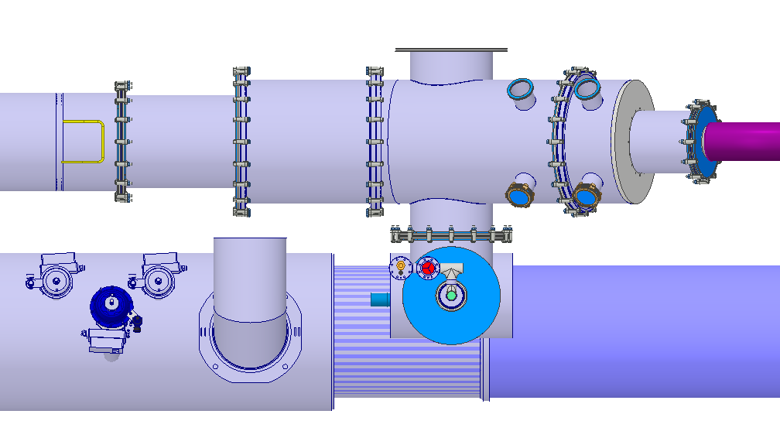
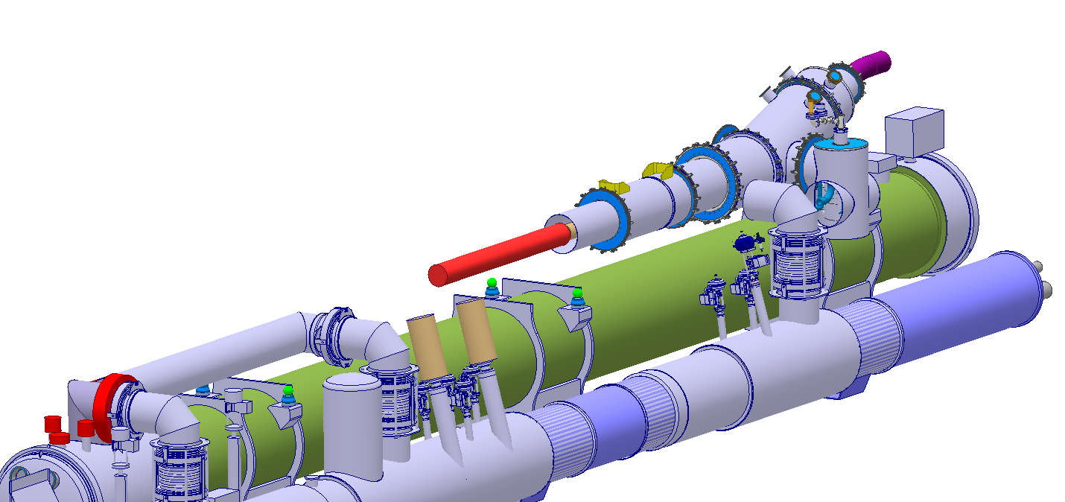
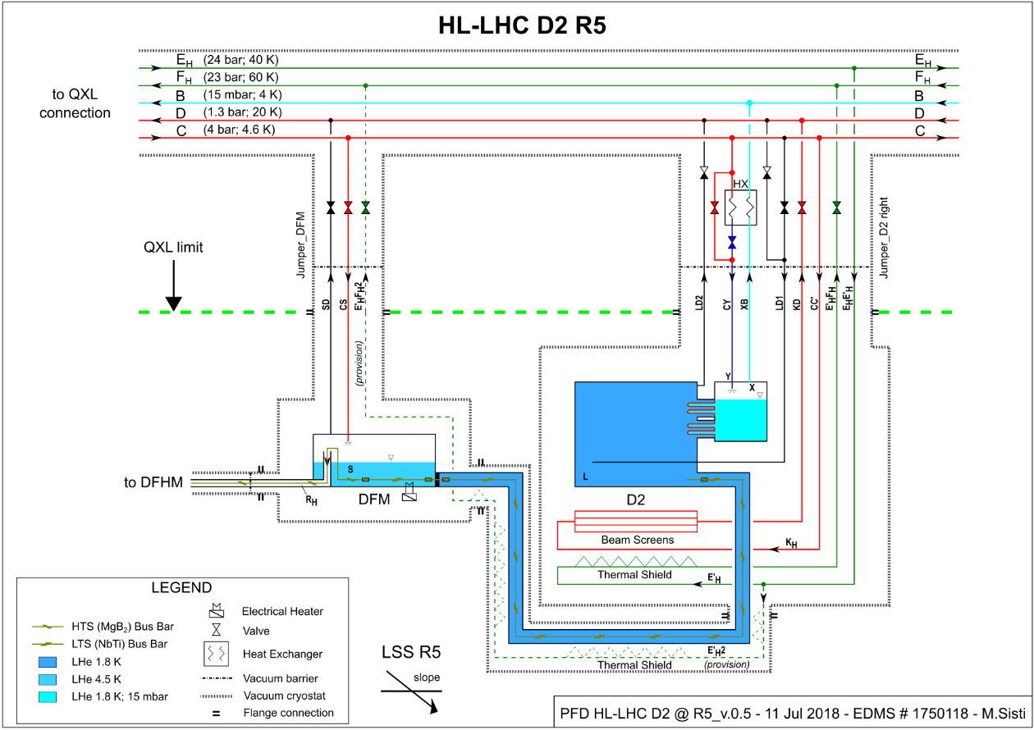
Interfaces
Vacuum flange
Weldable He flange
SCLink configuration for transport
NbTi leads
SCLink:
  As for DFX
  Independent inner and outer flexibles
  MgB2-NbTi protected
  Insulation vacuum on DFM side
Cryogenics:
  Jumper on reservoir side
    1 x LHE In + 1 x GHE out + 1 x TS_{Interlink} + 2 x 4-6 Heat Ex.
  Location : close to today’s jumper proposal (work on going)
Ø250 x 600
MgB₂-NbTi splices
Protected sleeve
EDMS1750118

Slide 6
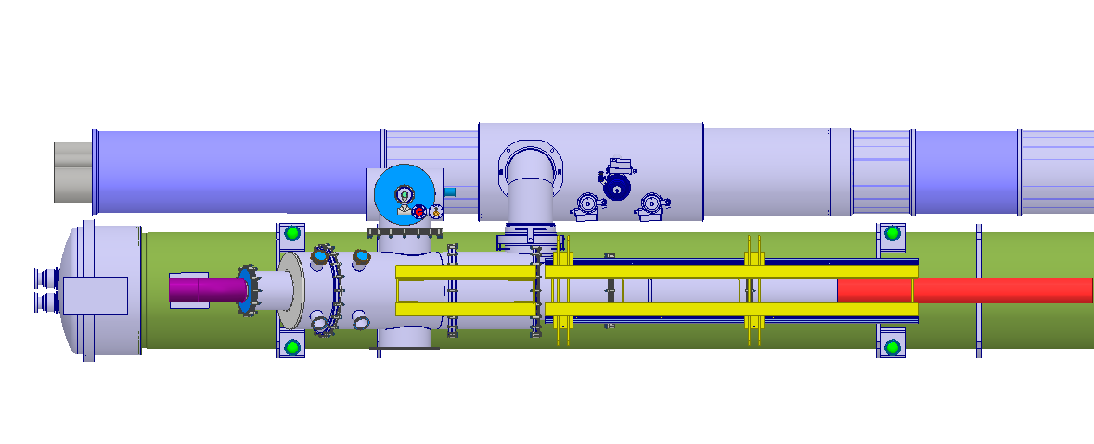
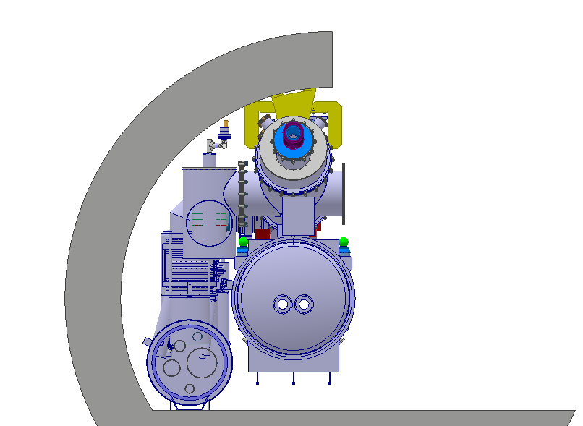
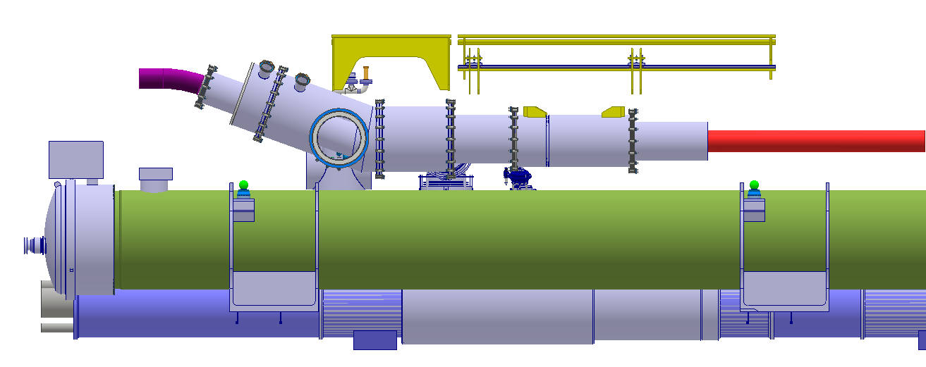
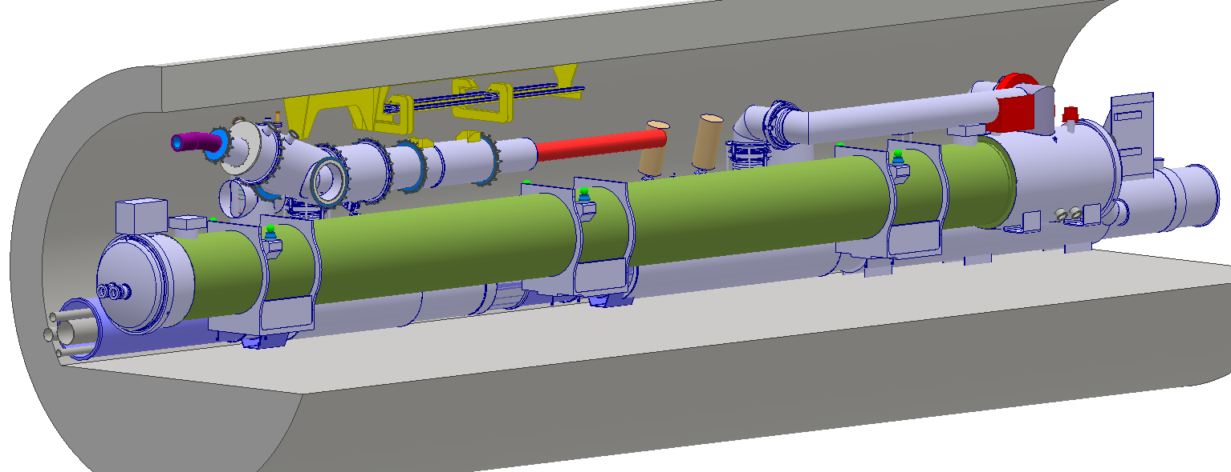
Integration on going work
QXL
DFM located above D2
  Distant enough to allow independent assemblies
Longitudinal position in discussion
  Not relevant for concept within ≈1-2m
Cryo interface:
  1 dedicated jumper (Details TBD)
SCLink interface:
  As for DFX concept
Interlink interface:
  Plug at DFM level (interlink work on going)
Maintenance:
  Pumps, safety devices, V-taps and instru accessible
  Cryo maintenance access TBD
Integration proposal: (TBD)
  Roof support
  Independent assembly D2-DFM
  Compatible with QXL maintenance ?
SCLink
DFM
Interlink
D2
QXL
DFM
SCLink
Interlink
D2
QXL

Slide 7
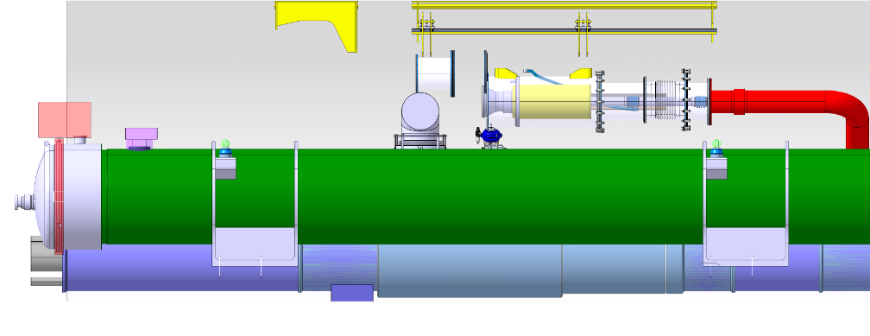
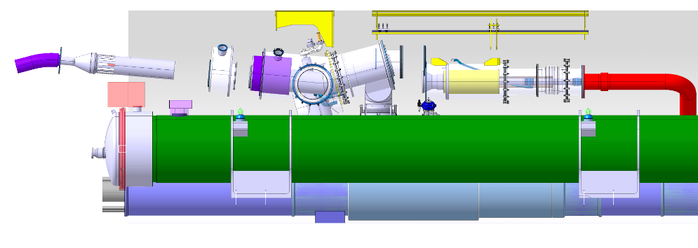
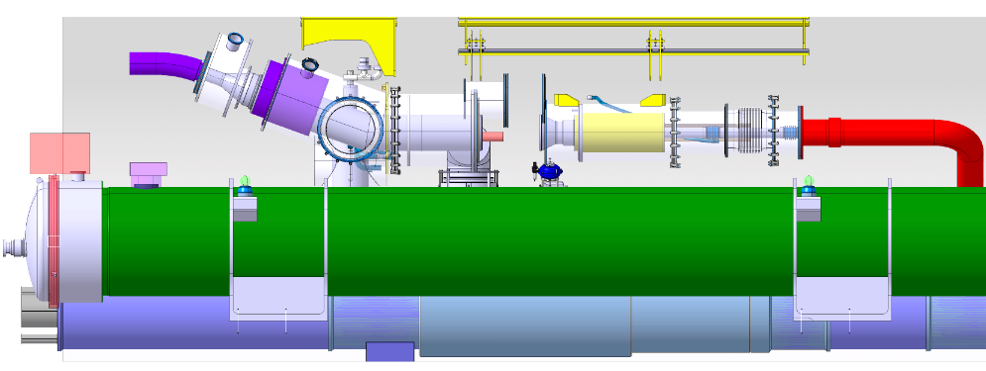
Assembly preliminary sequence
Plug
NbTi-NbTi
splices
Interlink
Initial conditions:
  D2 present
  Interlink installed until plug
DFM installed rotated of 10 deg
SCLink insertion with limited angle
DFM rotation to nominal
Weld jumper interfaces
NbTi-NbTi splices
He and Vacuum vessels closure
NbTi leads
Weld He volumes
NbTi-NbTi
splices

Slide 8
Next Steps
Interlink integration and access for maintenance to QXL
Interface with Cryolines
Interface with integration / tunnel / D2
Assembly sequence detailed
IFS design

Slide 9
Spare slides

Slide 10
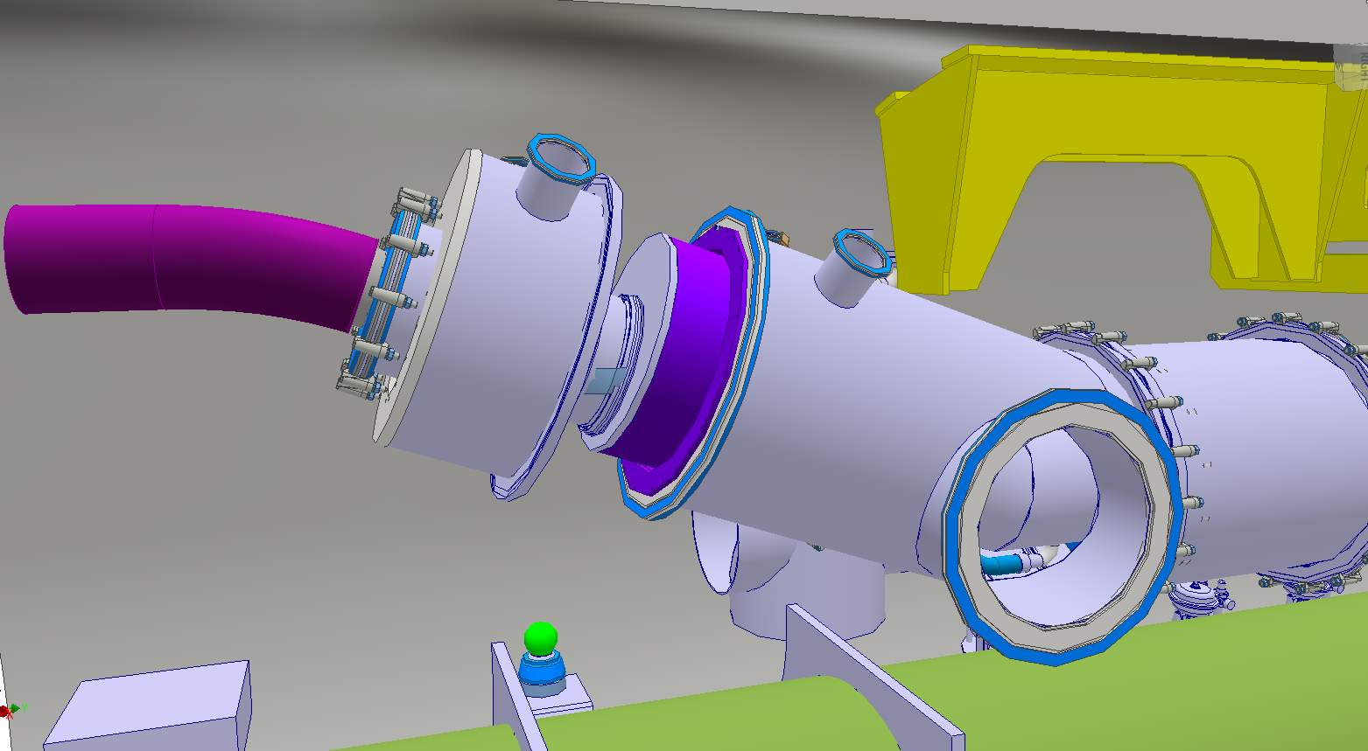
SCLink He jacket welding to DFM helium vessel

Slide 11
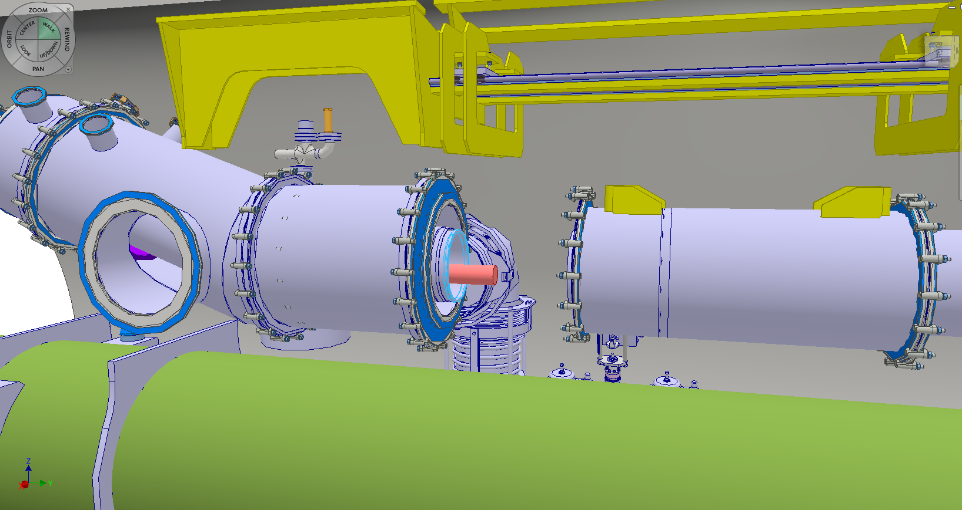
SCLink NbTi leads soldering to Plug NbTi leads

Slide 12
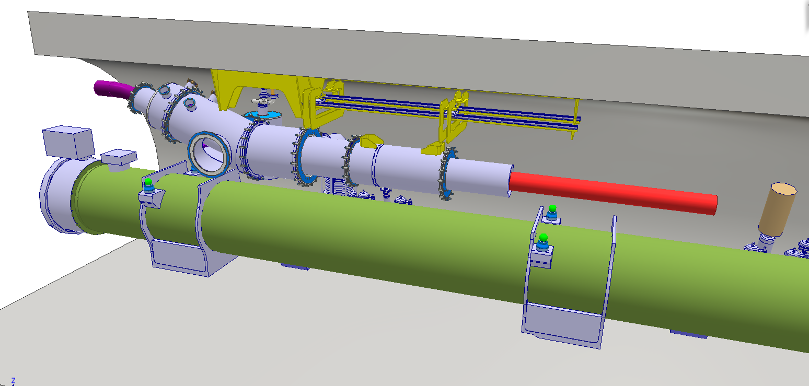
Nominal configuration

Slide 13
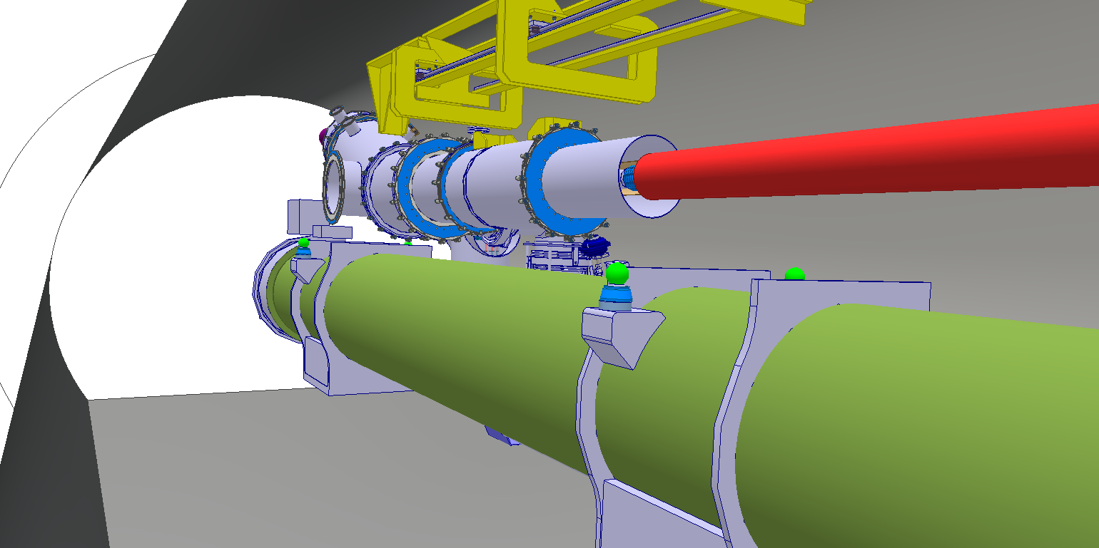
View from tunnel

Slide 14
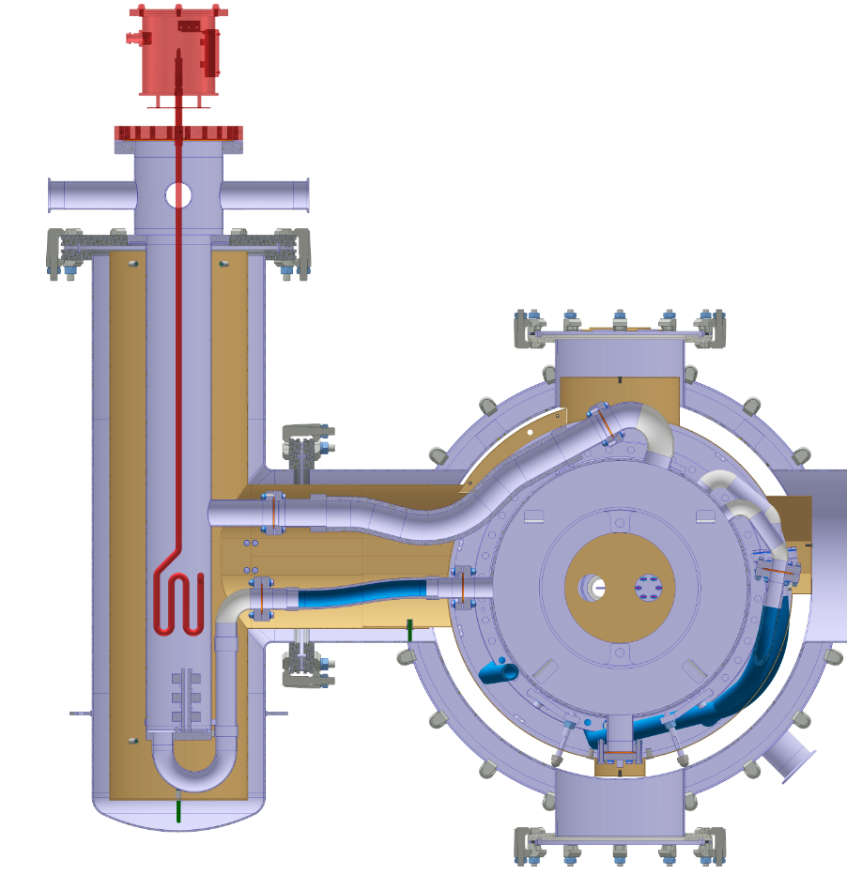
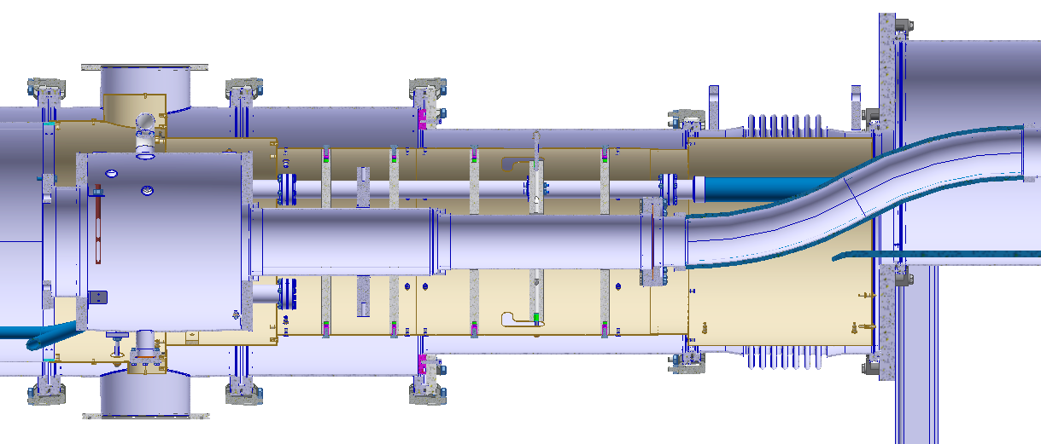
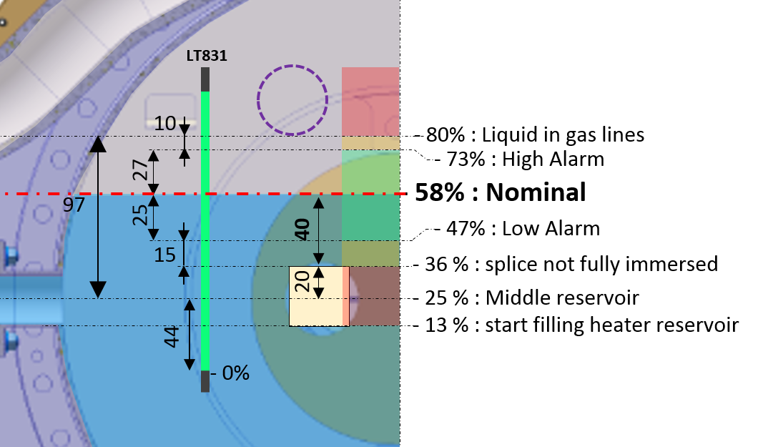
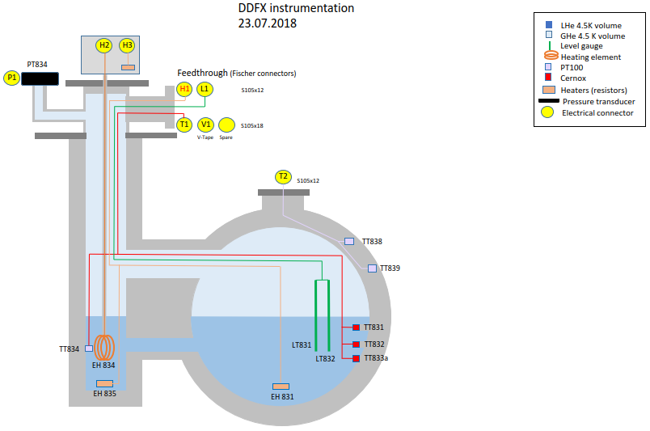
DDFX cryo layout
TT839
LT831
LT832
- 80%
- 80% : limit for gas lines
TT831
134
- 58%
40
97
- 58% : Nominal
30
- 42%
- 42% : TT831
- 25%
40
- 25% : Middle plane / max Ø
TT834
65
44
- 13%
- 13% : start filling heater volume
TT838
165
TT832
- 0%
- 0% : min level reading
EH834
TT833
EH831
EH831
EH835

Slide 15
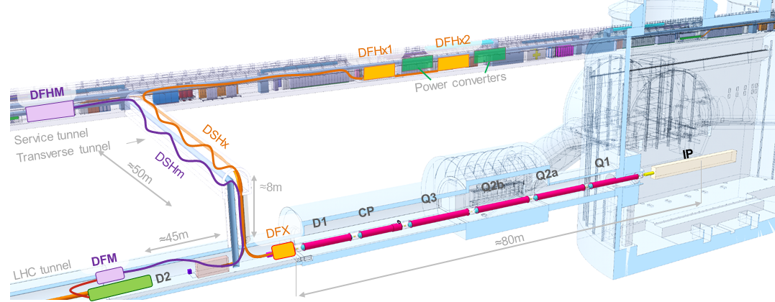
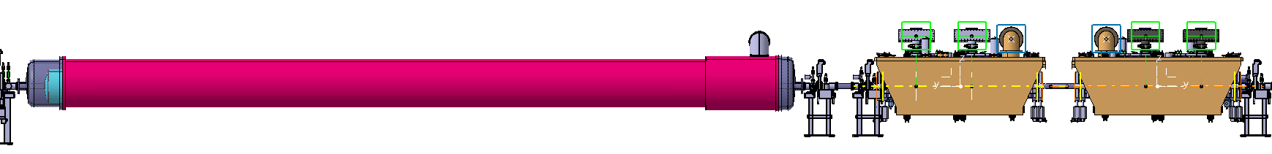
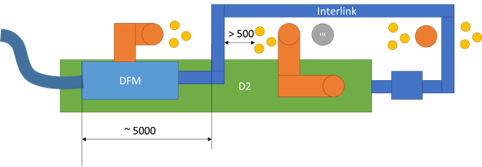
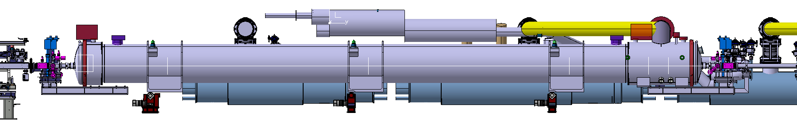
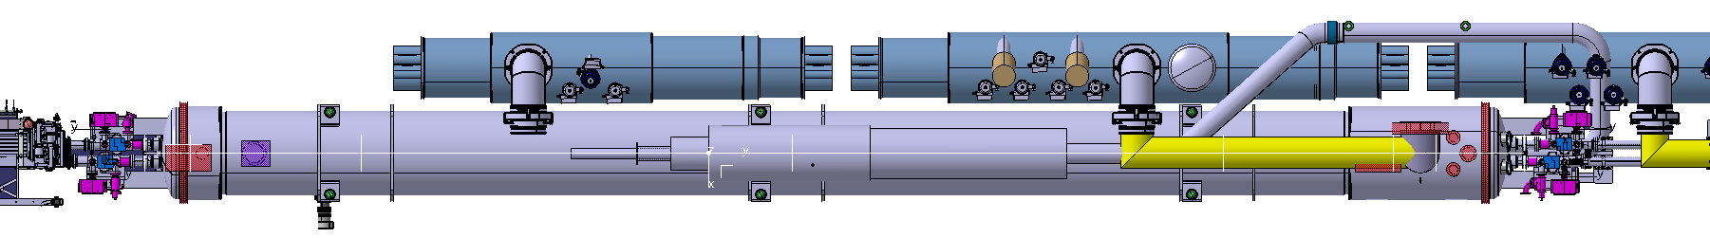
DFM environment (not today’s key topic)
Busy area (radiation, QXL, D2, SCLink)
On going discussions to study feasibility
Sequence:
DFM concept
DFM integration
Iterations WP15
D2
CC1
CC2
Updated
137340mm
D2 total length increased 300mm
152383mm
Avoid interferences
DFM Space reservation
D2
Motorised jacks added
Area under study
Valves between the 2 jumpers
Define connection to jumper
Define Interlink routing
SM fixed
SM fixed
DFM Space reservation
Courtesy M. Gonzalez de la Aleja
around 5 m
Provide access to the valves

Slide 16
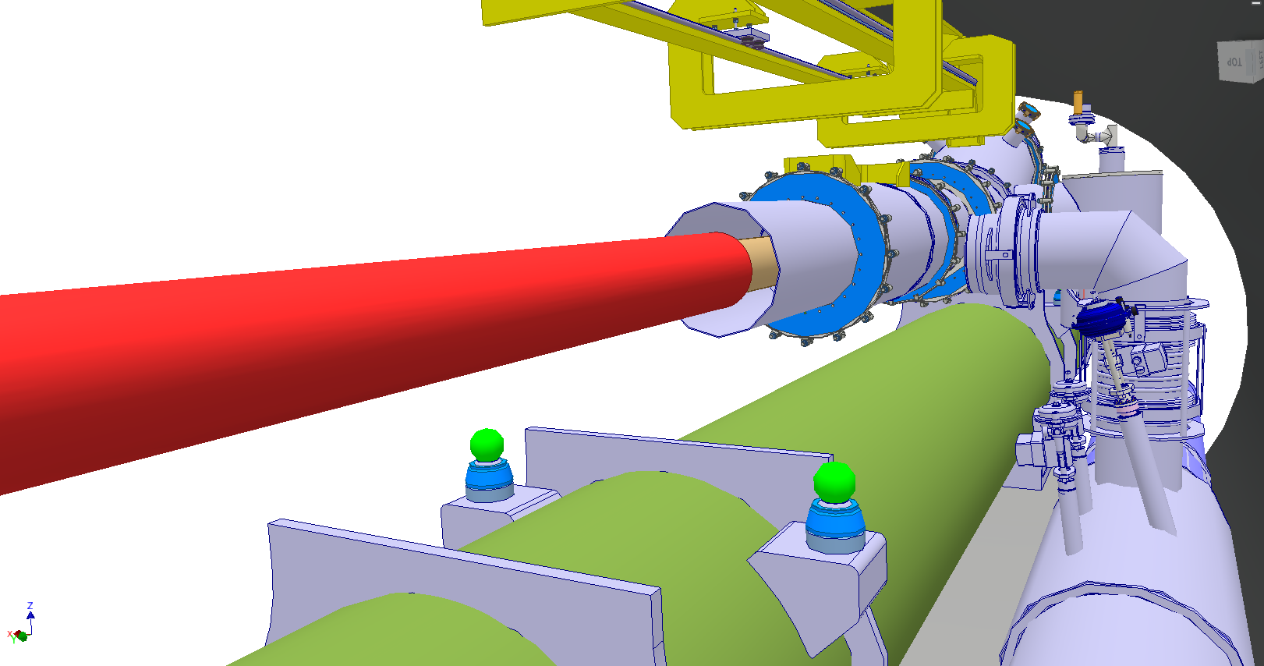

Slide 17
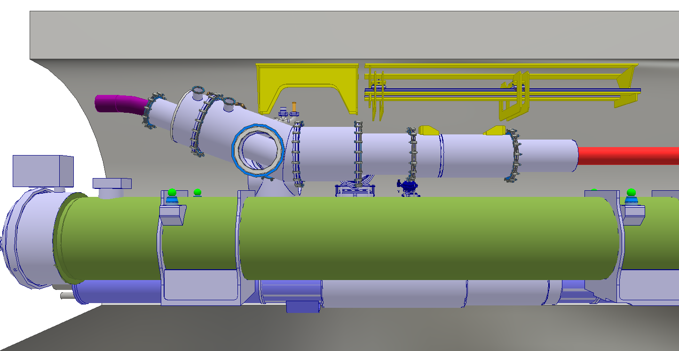
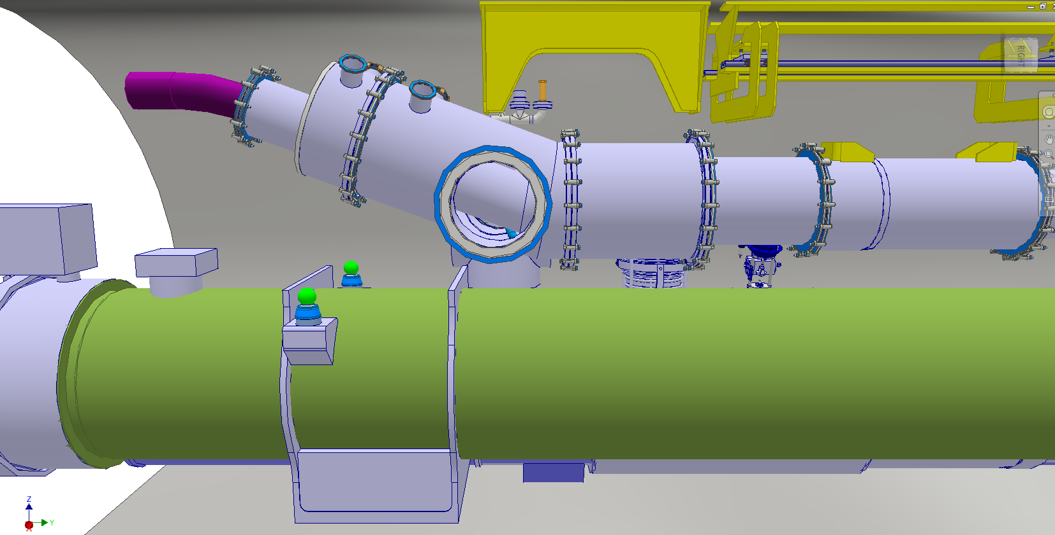
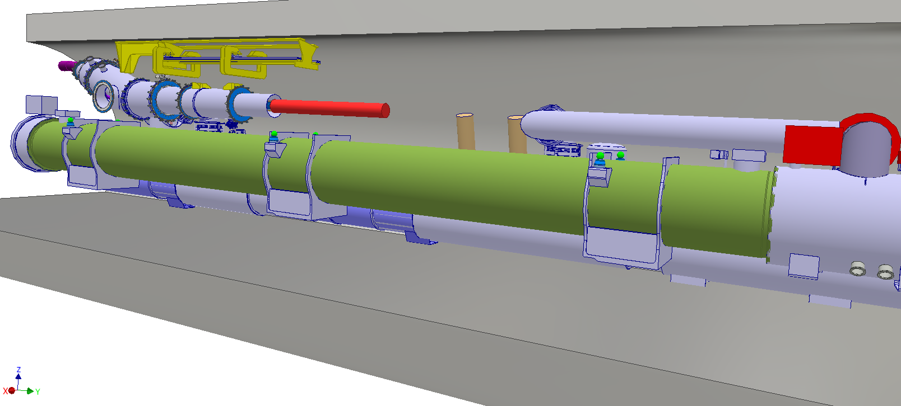

Slide 18
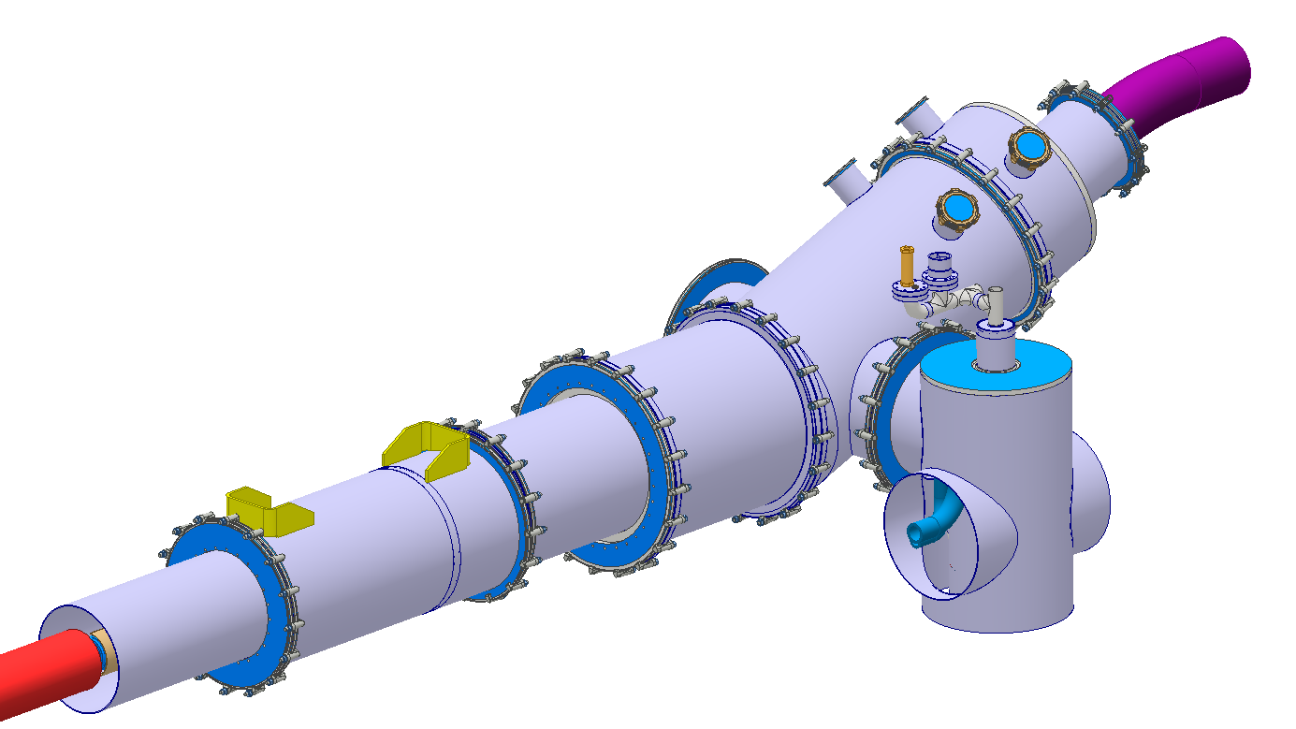

Slide 19
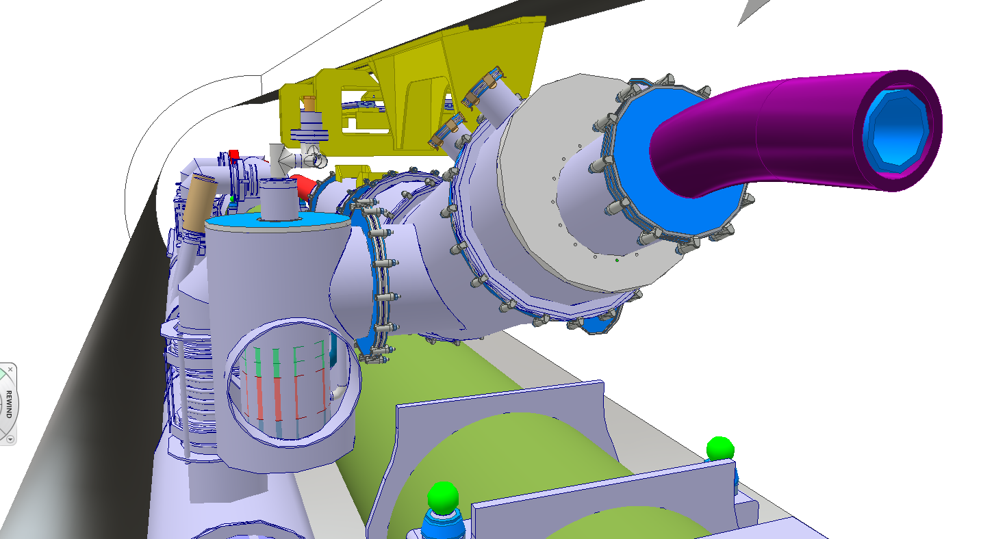

Slide 20
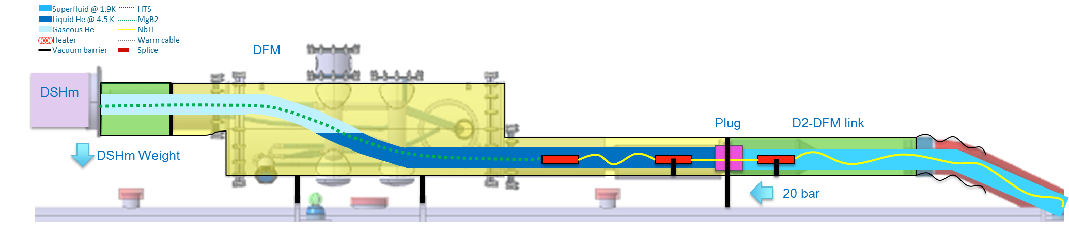
DFM concept
4th DFH-DFM meeting actions:
  Reduce distance between outer and inner SCLink flanges
  Study supporting options

