Slide 1
Technical meeting on MQXFBP1 aluminium shell: introduction and goals
Paolo Ferracin
on behalf of the MQXF collaboration
28/03/2019
HL-LHC Technical Coordination Committee
CERN

Slide 2
Acknowledgments
CERN
  A. Ballarino, H. Bajas, M. Bajko, B. Bordini, N. Bourcey, J.C. Perez, S. Izquierdo Bermudez, S. Ferradas Troitino, L. Fiscarelli, J. Fleiter, M. Guinchard, O. Housiaux, F. Lackner, F. Mangiarotti, A. Milanese, P. Moyret, H. Prin, R. Principe, E. Ravaioli, T. Sahner, S. Sequeira Tavares, E. Takala, E. Todesco
US Accelerator Upgrade Project (AUP)
  BNL: M. Anerella, P. Joshi, J. Muratore, J. Schmalzle, P. Wanderer
  FNAL: G. Ambrosio, M. Baldini, J. Blowers, R. Bossert, G. Chlachidze, L. Cooley, S. Krave, F. Nobrega, V. Marinozzi, I. Novitsky, C. Santini, S. Stoynev, T. Strauss, M. Yu
  LBNL: E. Anderssen, D. Cheng, M. Marchevsky, H. Pan, I. Pong, S. Prestemon, G. Sabbi, G. Vallone, X. Wang
  NHMFL: Lance Cooley

Slide 3
Acknowledgments
From CERN EN/MME
  Analysis and finite element computations:
    Alessandro Bertarelli and Federico Carra
  Measurement of mechanical properties:
    Stefano Sgobba, Ignacio Aviles Santillana, Gonzalo Arnau Izquierdo, Mickael Denis Crouvizier
  Update on shell design
    Thomas Sahner and Pierre Moyret
  Procurement of shells with updated design
    Alessandro Dallocchio and Pierre Moyret
  Measurements of corner radius
    Ahmed Cherif and Jean Philippe Rigaud
  General comments and feedbacks
    Diego Perini

Slide 4
Outline
Introduction
  MQXF design
  MQXFAP2 shell fracture
Technical meeting
Investigation and comparison
  Material propertie measurements
  Cut-out corners
  Stress levels
  Finite element analysis results
Proposal, panel’s comments, and decision on MQXFBP1

Slide 5
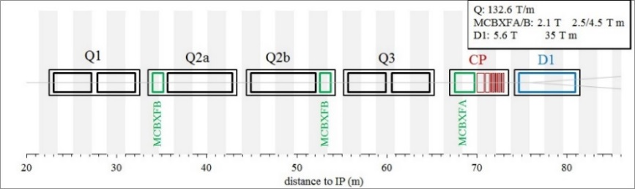
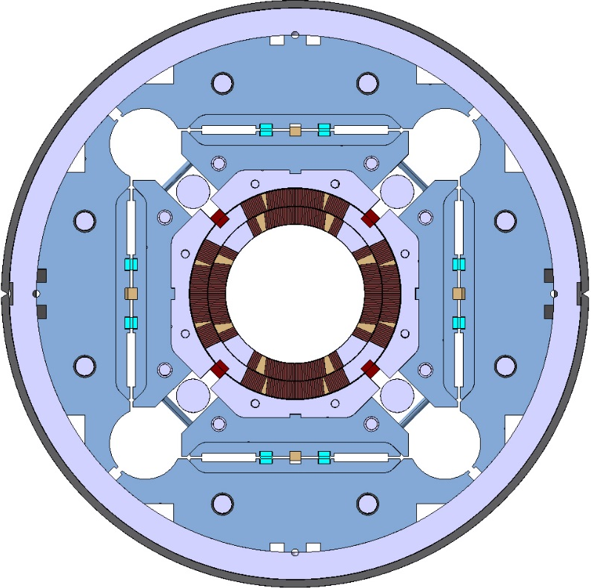
Introduction
HiLumi low-β quadrupole MQXF
Target
  G_{nom}=132.6 T/m, 11.4 T B_{peak_nom}
Q1/Q3 (by AUP)
  2 magnets MQXFA with 4.2 m
    Series: 20 magnets
Q2a/Q2b (by CERN)
  1 magnet MQXFB with 7.15 m
    Series: 10 magnets
Different lengths, same design
  Identical short models

Slide 6
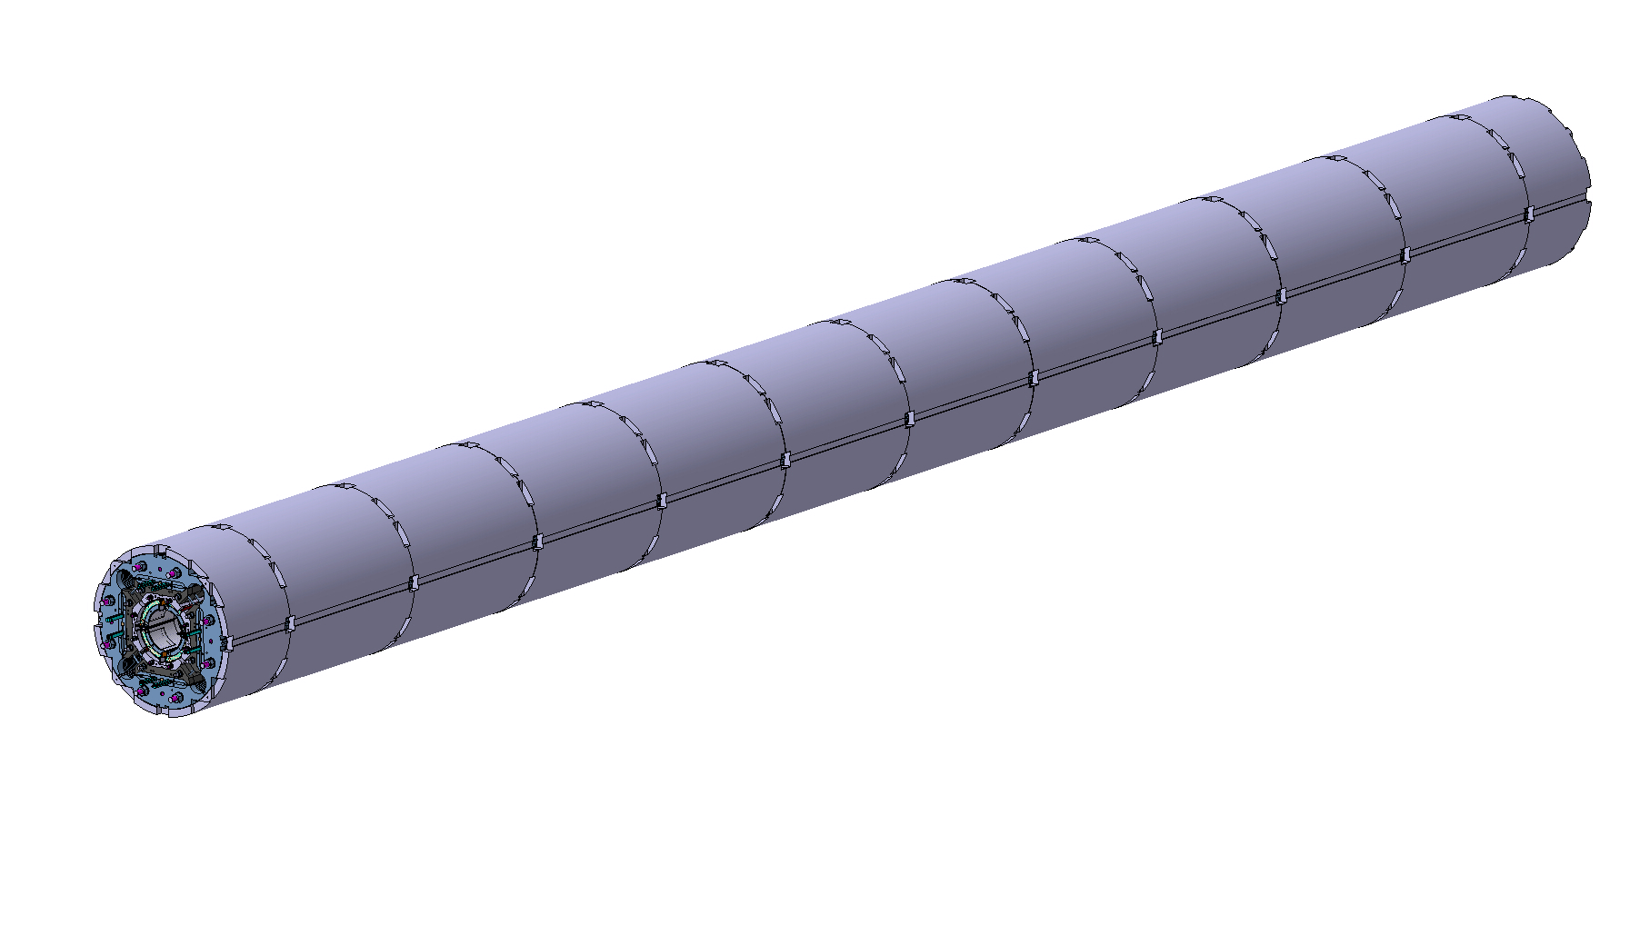
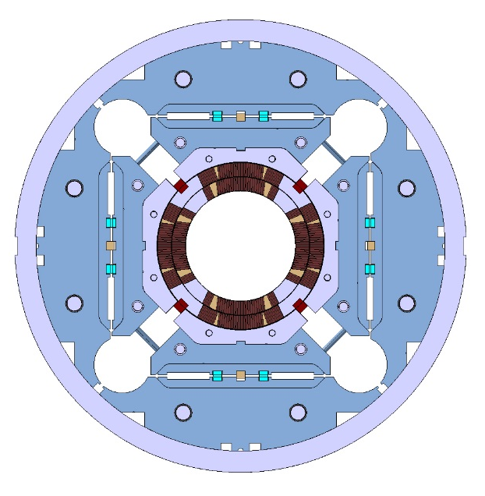
Magnet design
MQXFB
Segmented aluminium shell

Slide 7

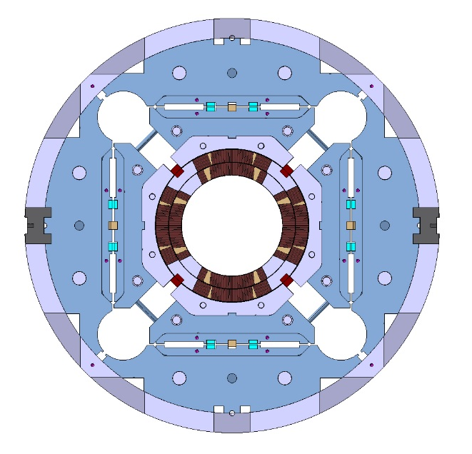
Magnet design
MQXFB
Tack-welding blocks
  Aligned to the yoke

Slide 8

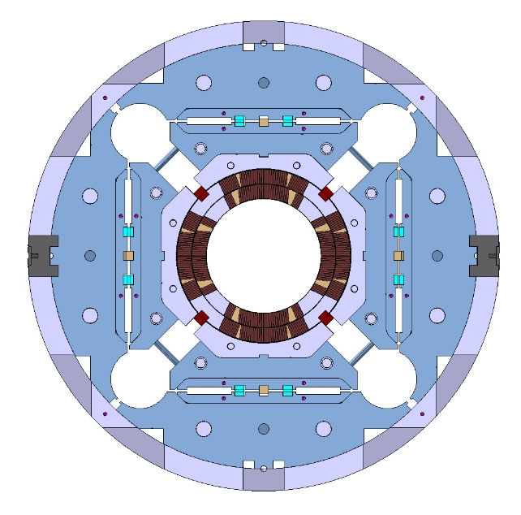
Magnet design
MQXFB
Backing strip
  For Lhe vessel welding

Slide 9
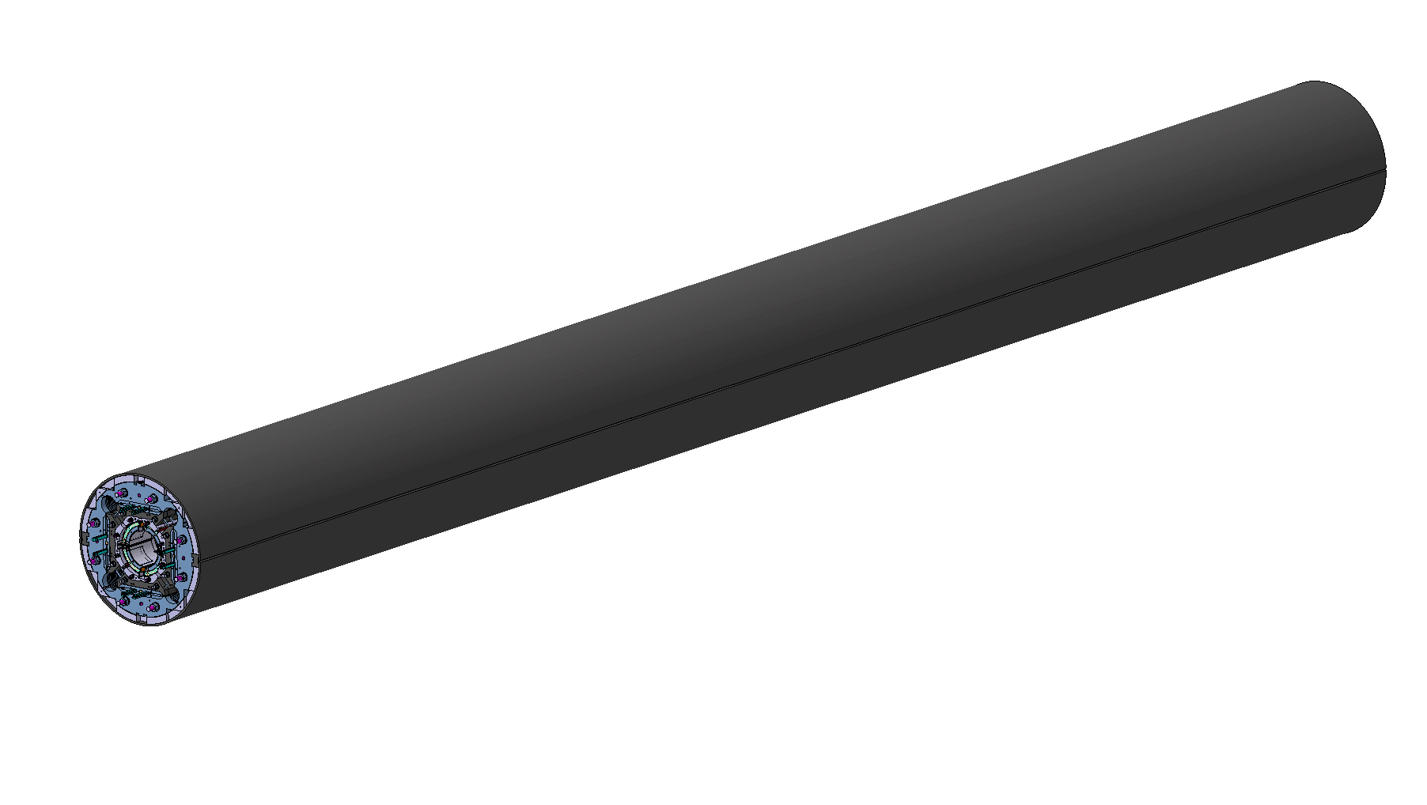
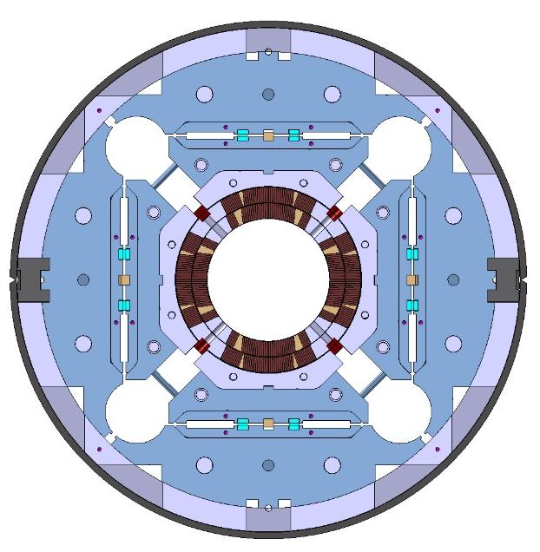
Magnet design
MQXFB
Welded LHe vessel
  Minimum welding tension

Slide 10
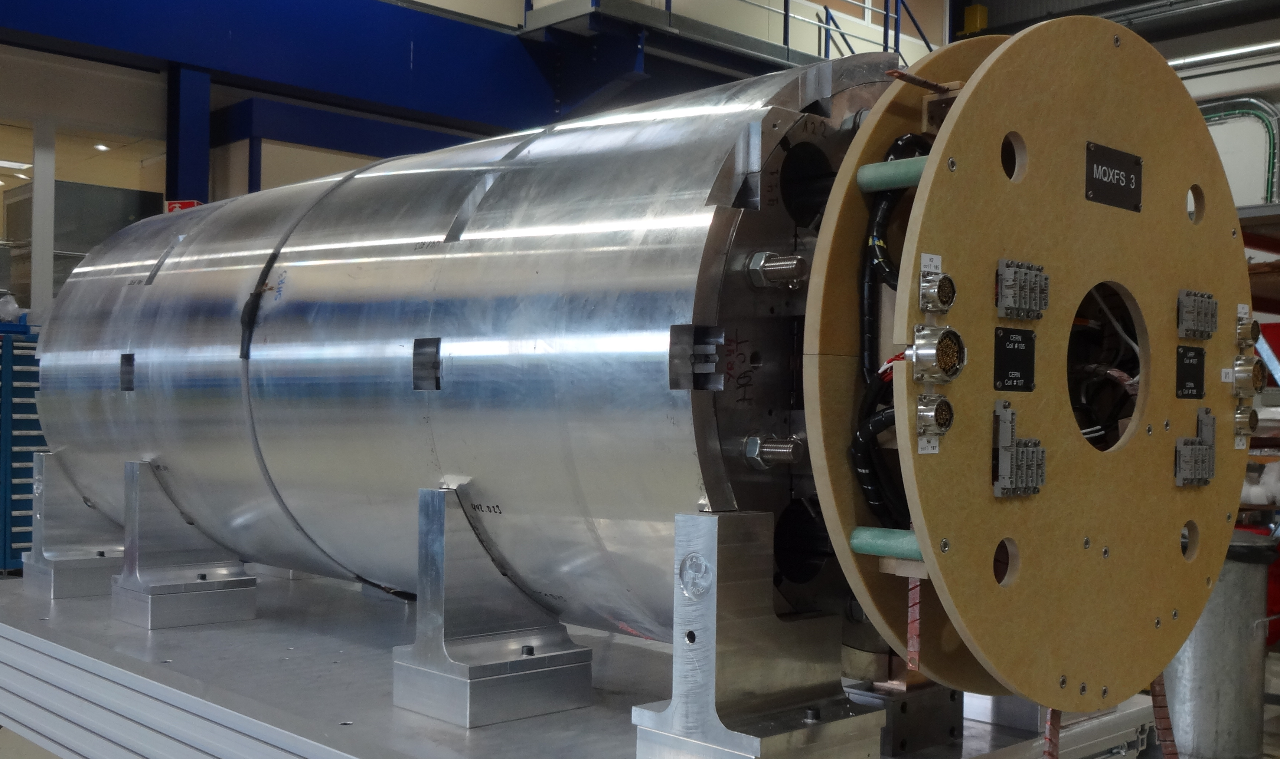
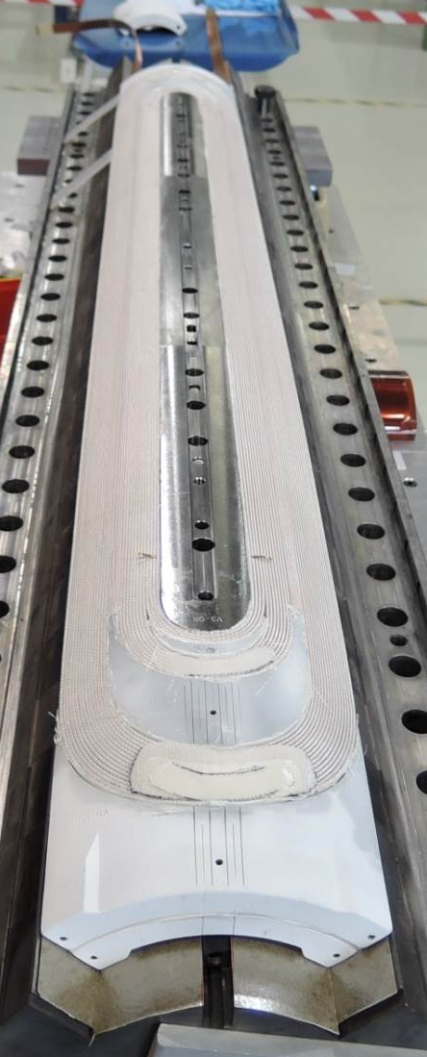
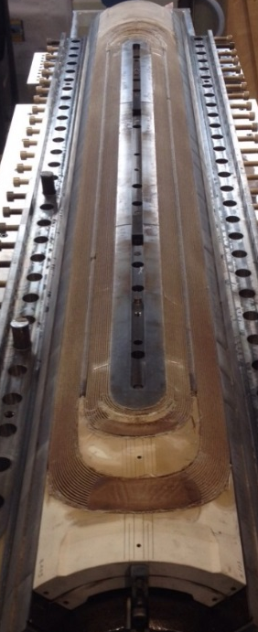
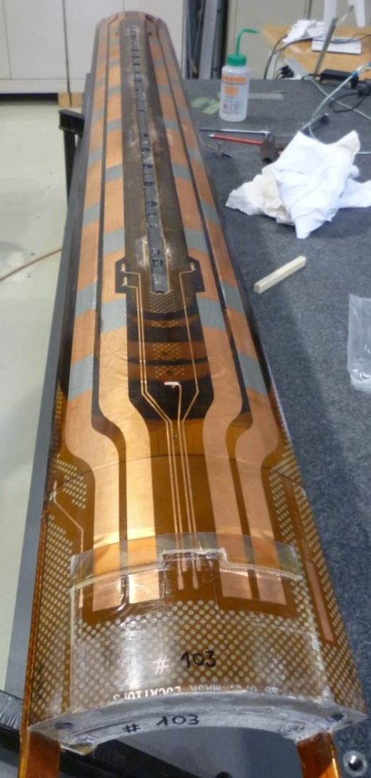
Test overview
MQXFS (1.20 m)
6 short models tested
  MQXFS1, MQXFS3, MQXFS5, MQXFS4, MQXFS6

Slide 11
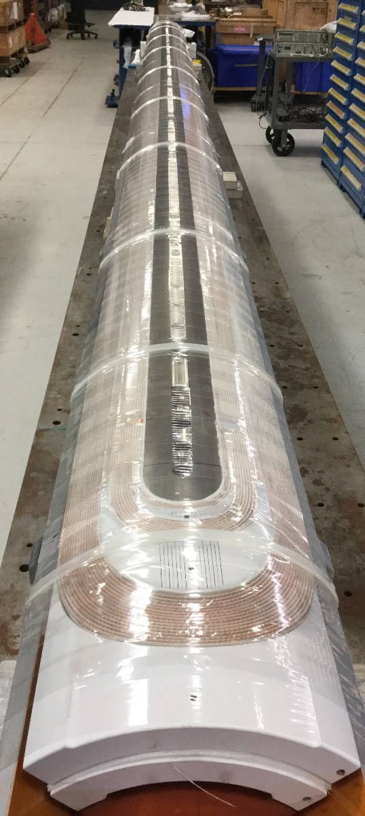
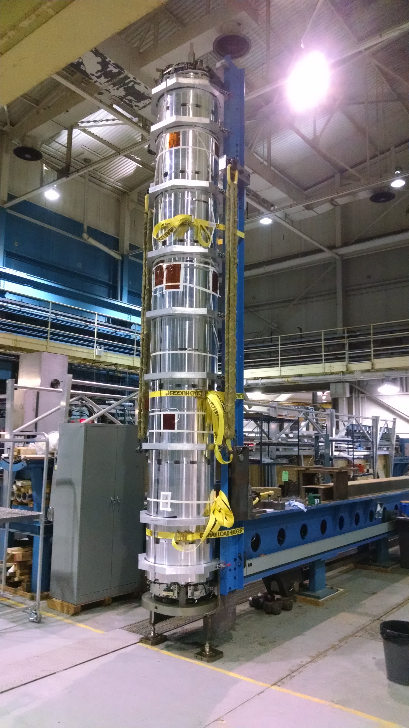
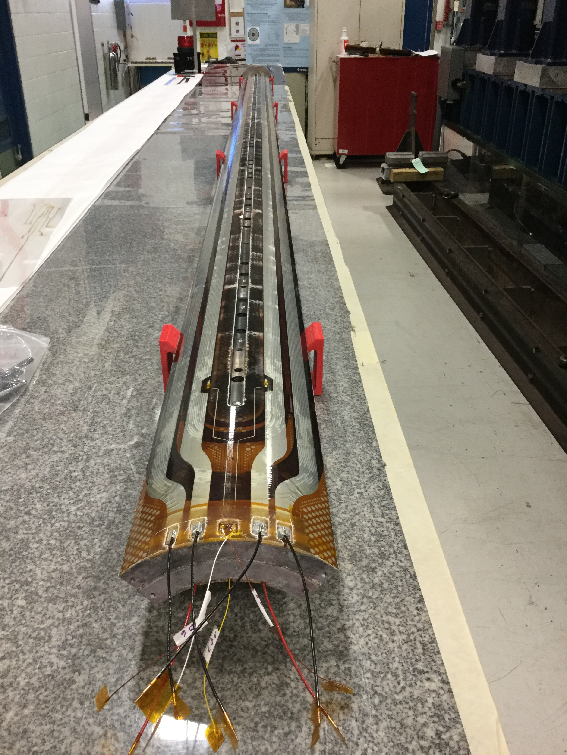
Test overview
MQXFA (4.2 m)
2 MQXFA prototypes
  MQXFAP1 (4.0 m)
  MQXFAP2

Slide 12
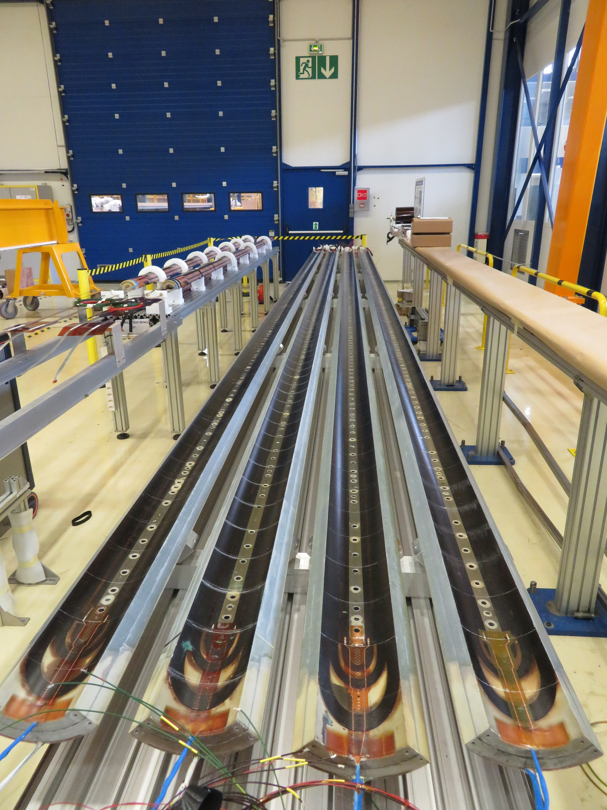
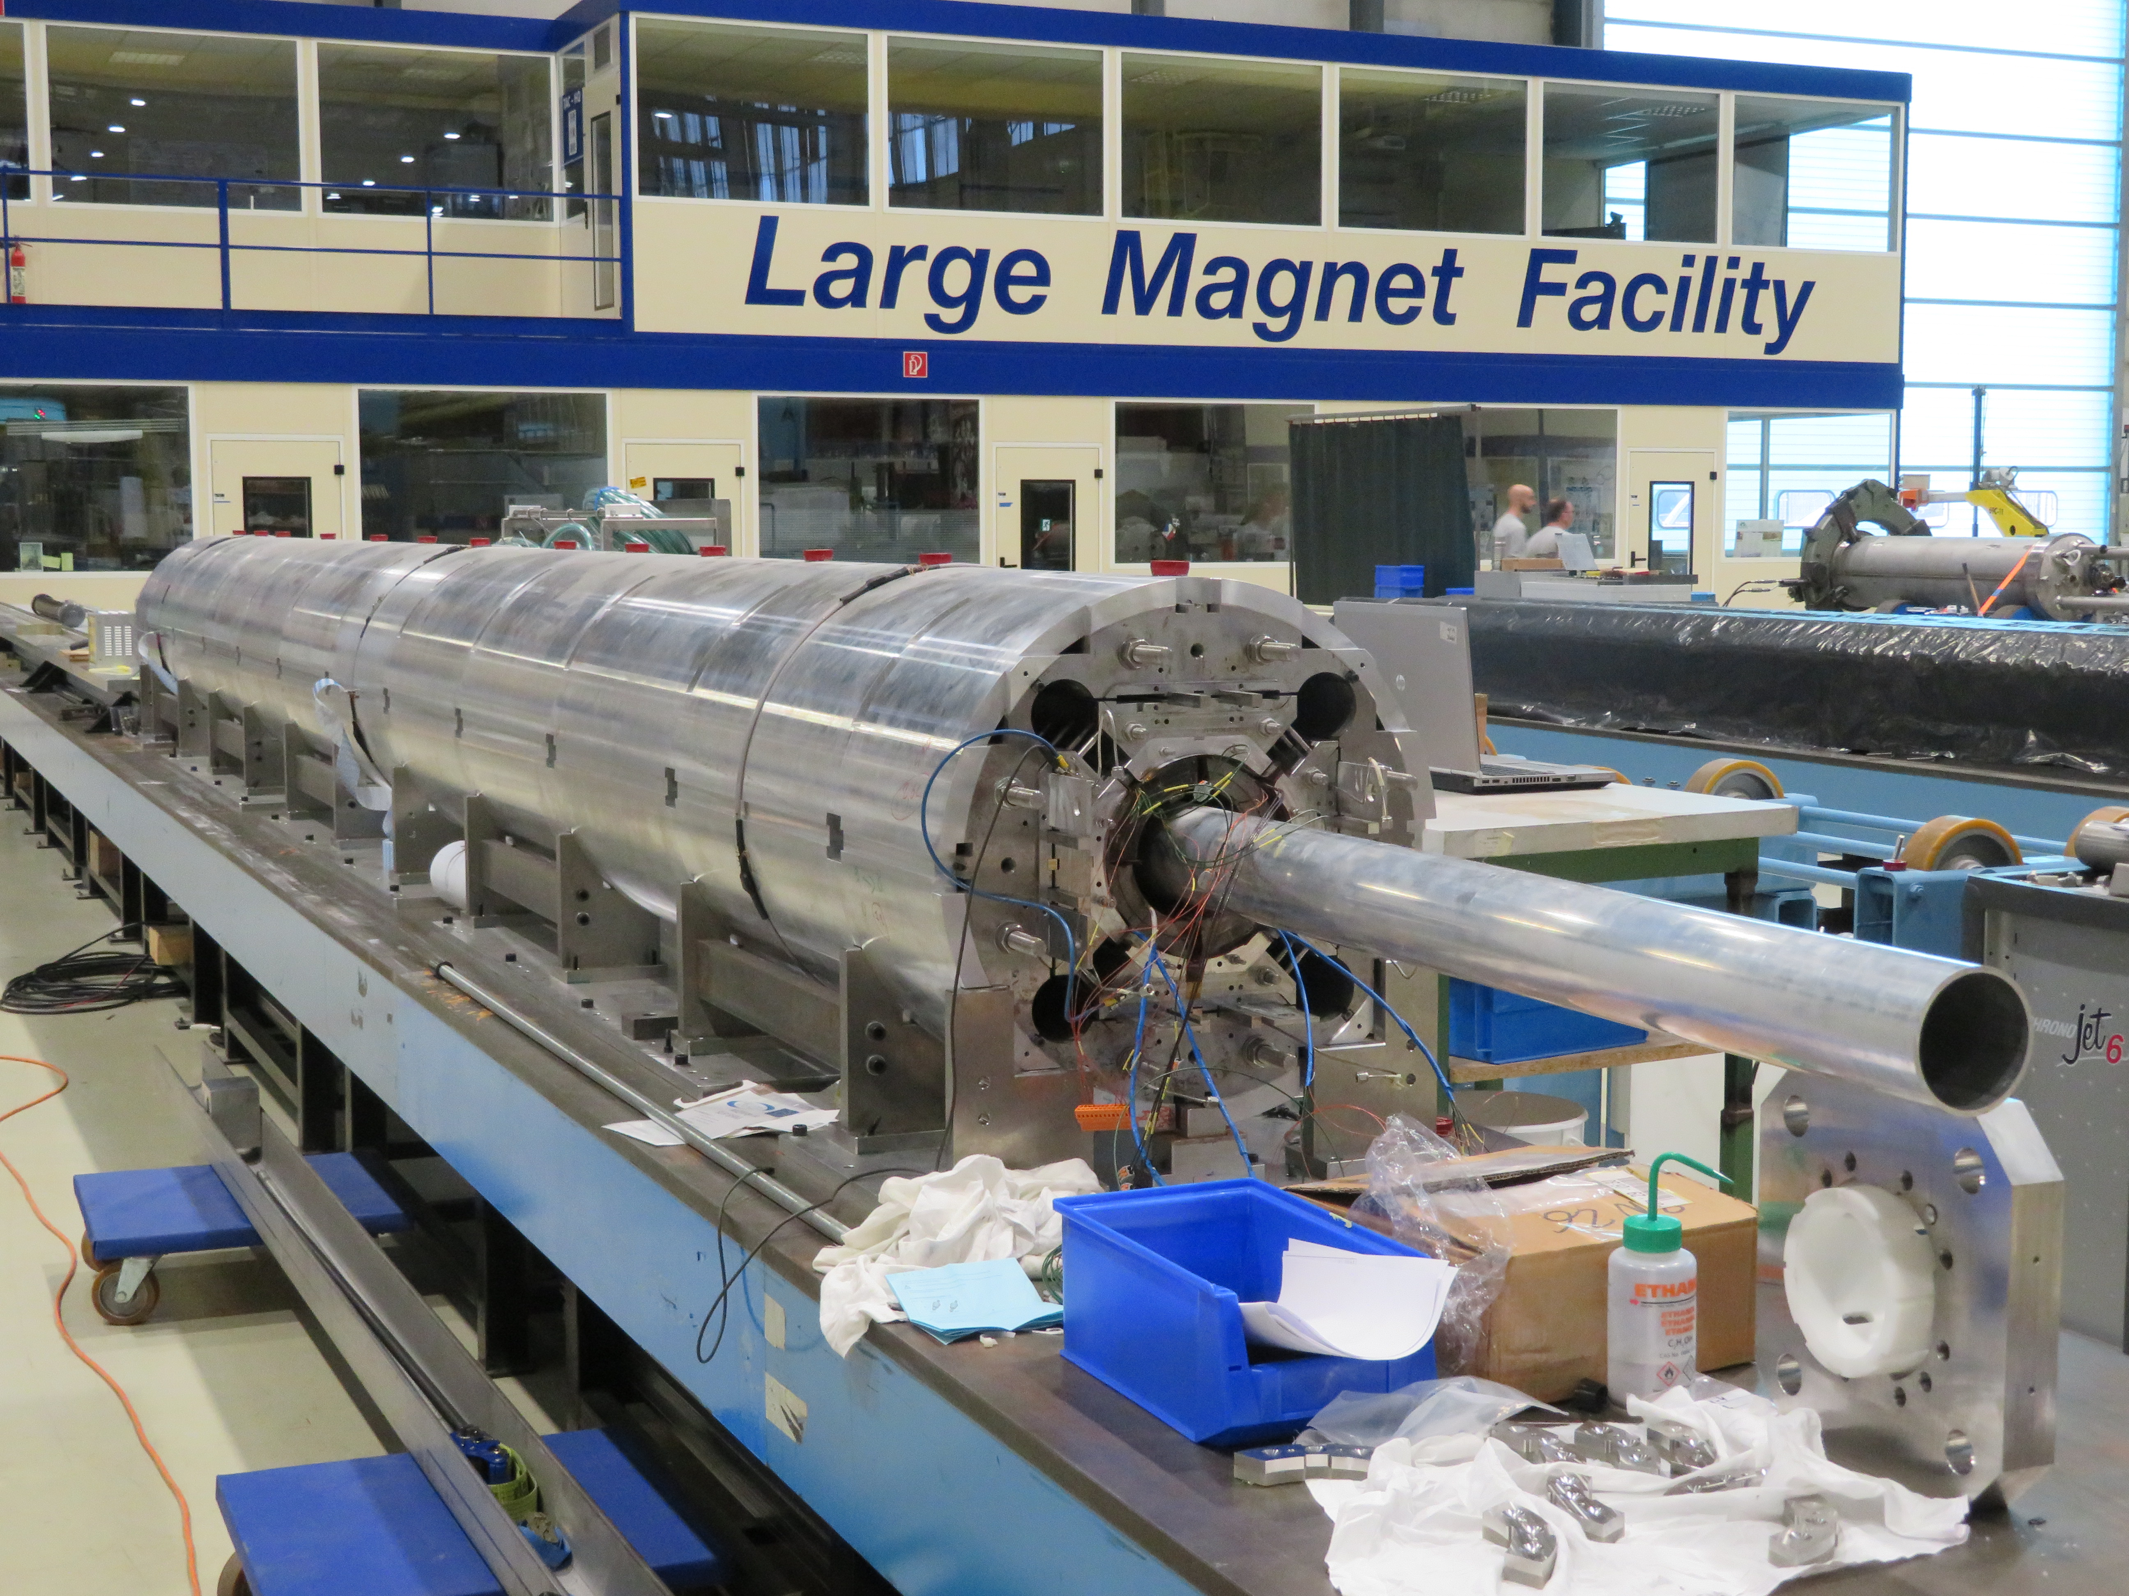
Test overview
MQXFB (7.15 m)
First prototype MQXFBP1 being loaded

Slide 13
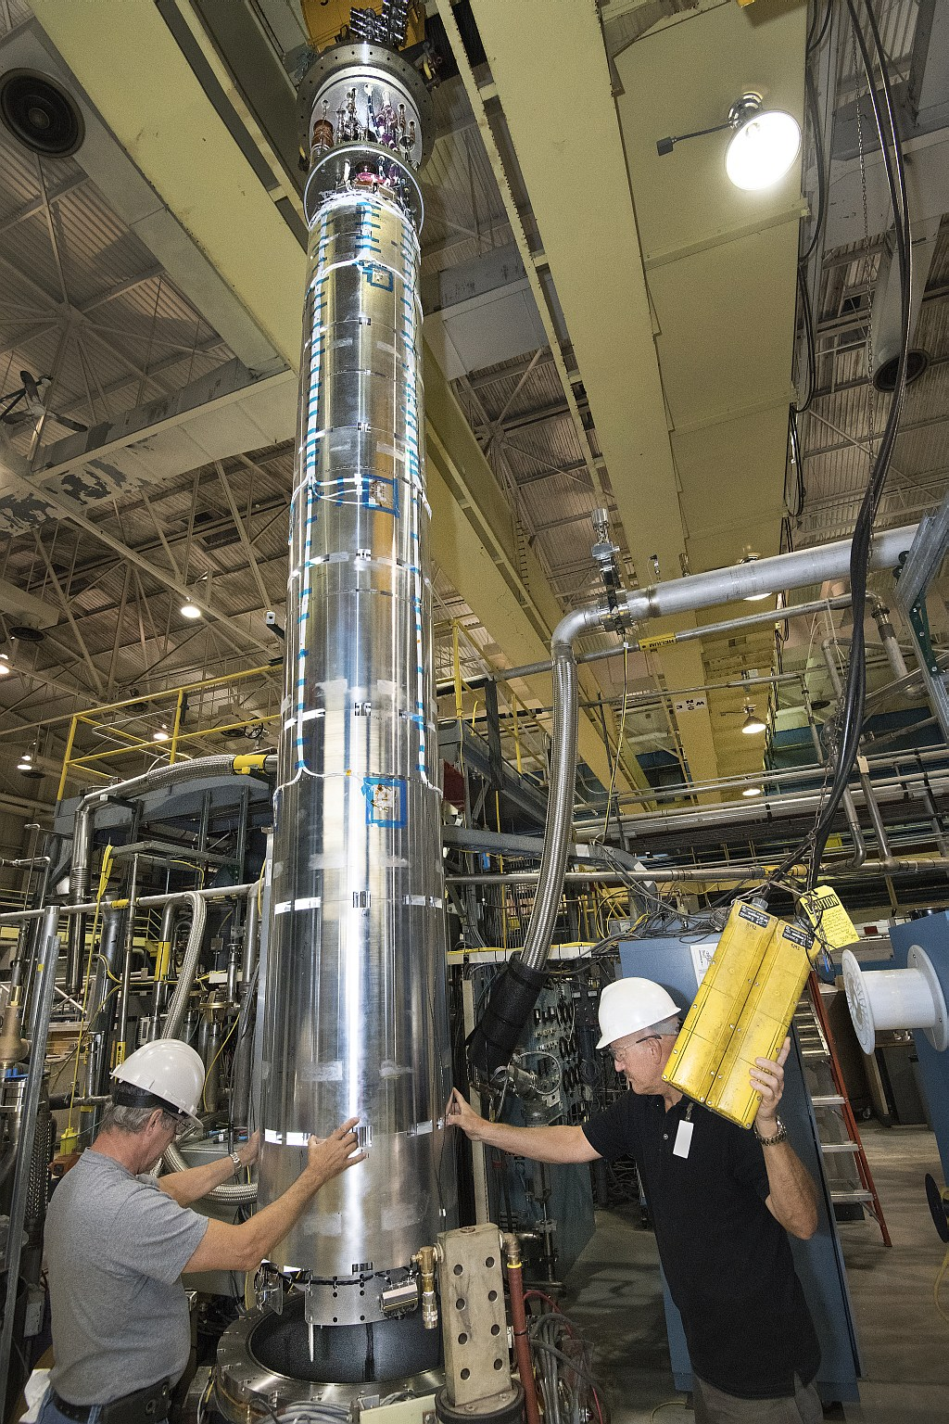
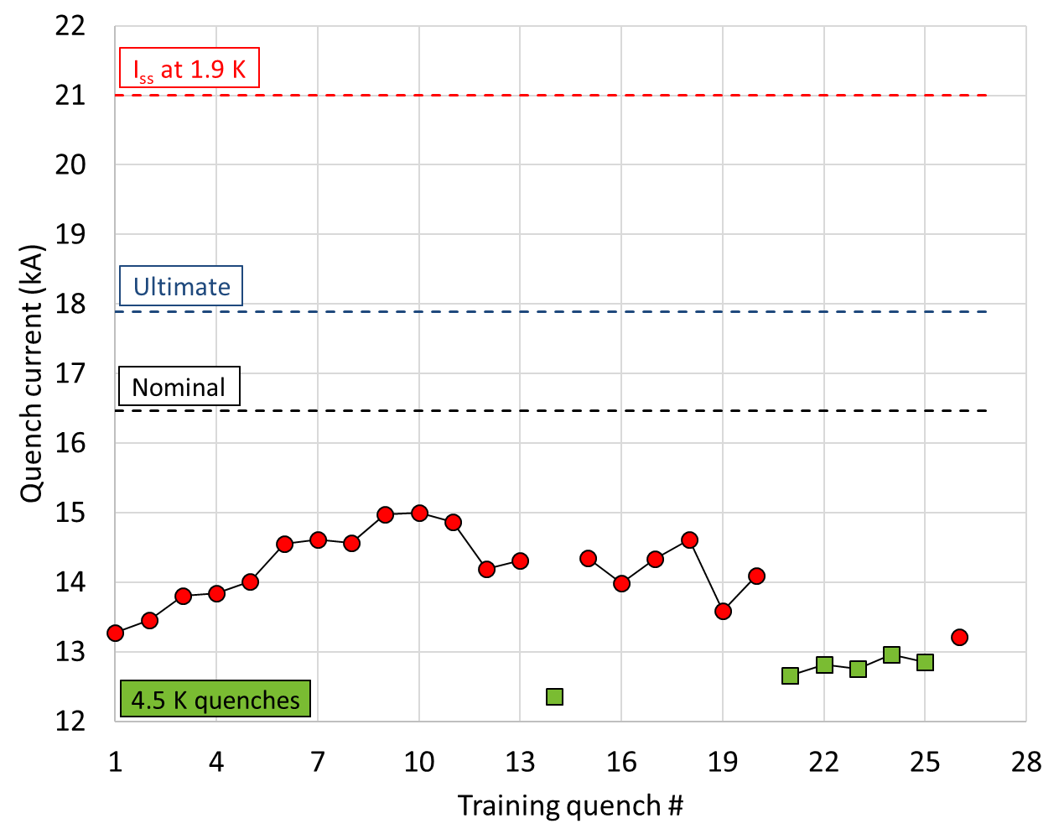
MQXFAP2
Training performance
RE

Slide 14
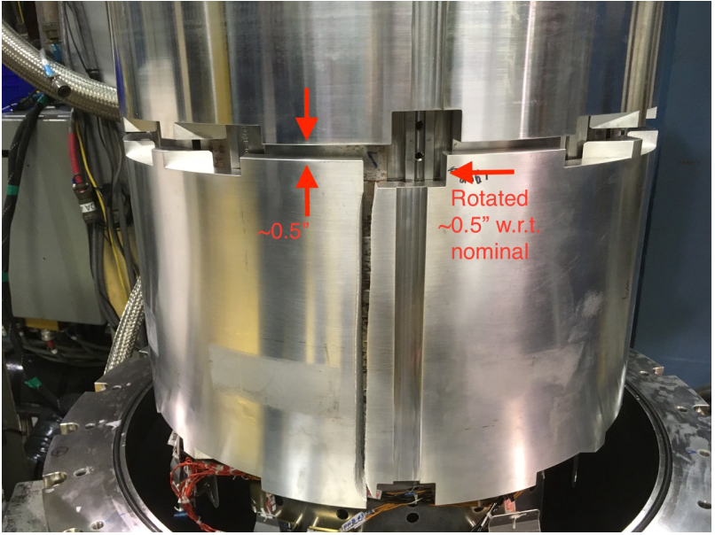
MQXFAP2 visual inspection

Slide 15
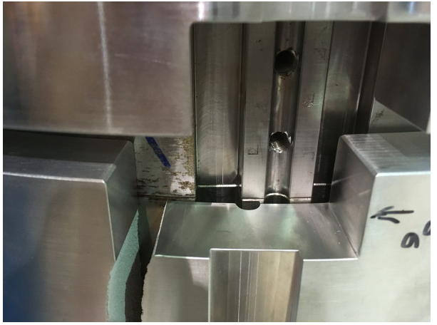
MQXFAP2 visual inspection

Slide 16
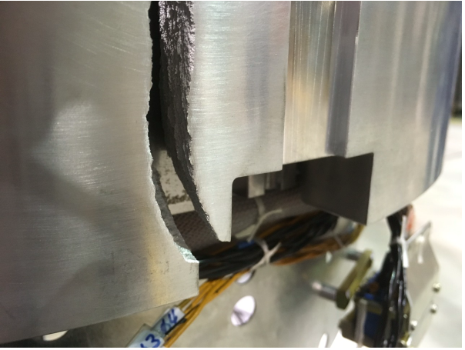
MQXFAP2 visual inspection

Slide 17
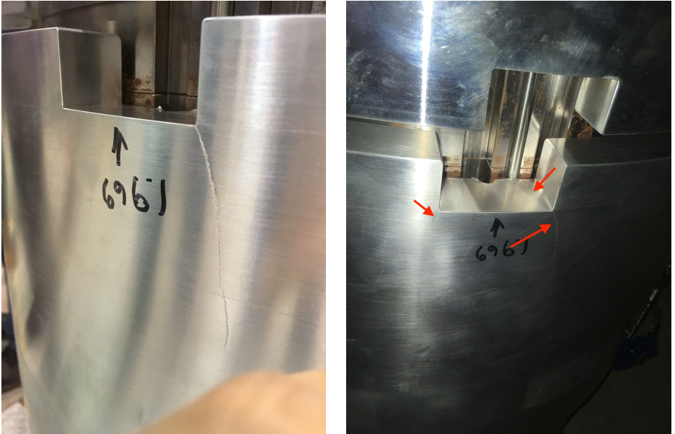
MQXFAP2 visual inspection

Slide 18
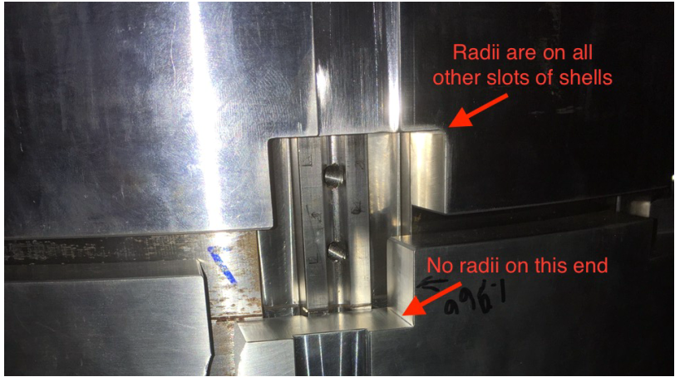
MQXFAP2 visual inspection

Slide 19
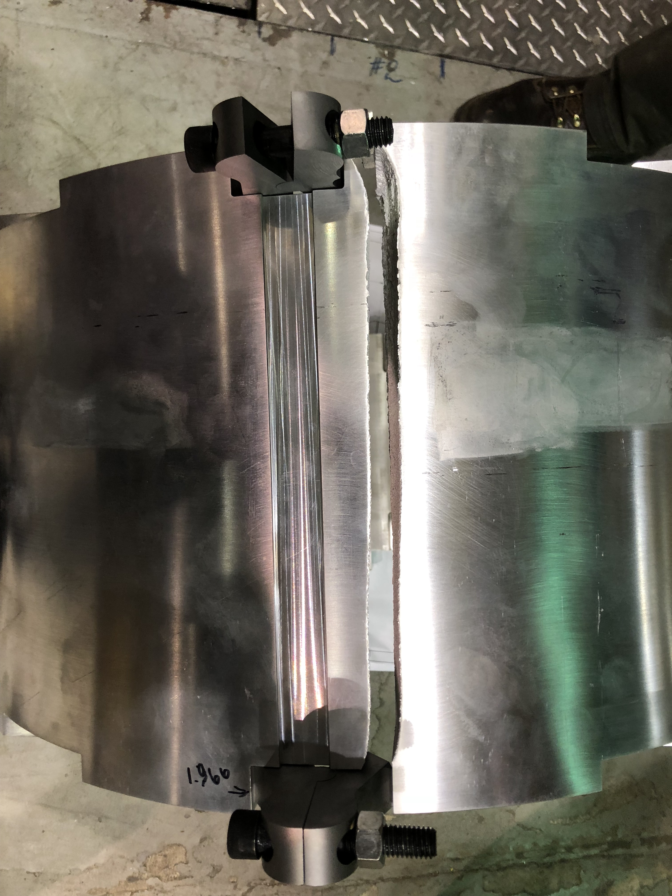
MQXFAP2 shell after removal

Slide 20
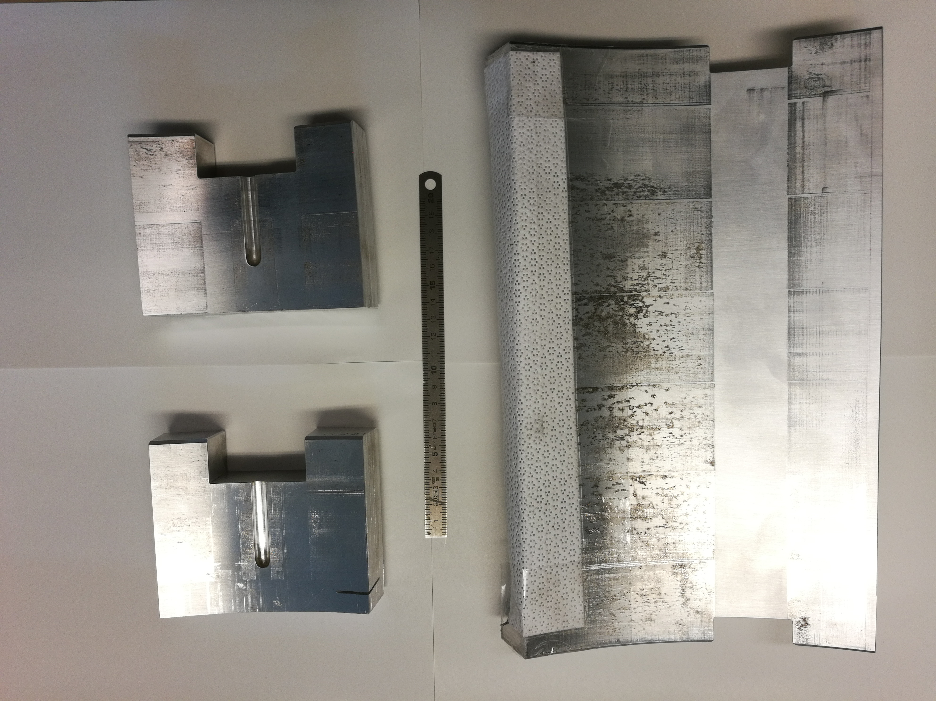
Samples of fractured shell delivered to CERN

Slide 21
Outline
Introduction
  MQXF design
  MQXFAP2 shell fracture
Technical meeting
Investigation and comparison
  Material properties measurements
  Cut-out corners
  Stress levels
  Finite element analysis results
Proposal, panel’s comments, and decision on MQXFBP1

Slide 22
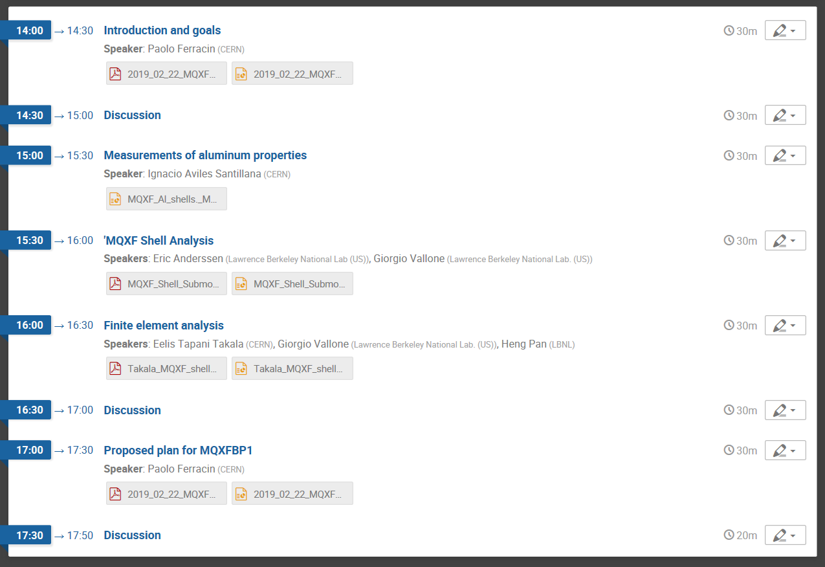
Technical meeting on MQXFBP1 shells
CERN, February 22nd 2019
https://indico.cern.ch/event/796422/

Slide 23
Goal of the technical meeting
Panel
  Diego Perini (CERN), Chair
  Helene Felice (CEA, Saclay)
  Soren Prestemon (LBNL)
…we expect the participants, and especially the panel, to provide comments on the following specific topics:
Understanding of the causes of the MQXFAP2 aluminium shell failure;
Completeness and adequacy of the finite element models and of the measurements of the aluminium mechanical properties to have a reliable assessment of the safety limits for the shell;
Proposed plan for MQXFBP1 and for future magnets.

Slide 24
Outline
Introduction
  MQXF design
  MQXFAP2 shell fracture
Technical meeting
Investigation and comparison
  Material properties measurements
  Cut-out corners
  Stress levels
  Finite element analysis results
Proposal, panel’s comments, and decision on MQXFBP1

Slide 25
Measurements of mechanical properties
Tensile tests
AUP MQXFAP2
  Long shell (Metalex)
    7075-T6
  Short shell:
    7075-T652
CERN short models and prototype
  Short and long shells (Forgital)
    7175-T74
 | Material | Direction | E [GPa] | Rp_{0.2} [MPa] | R_{m} [MPa] | A [%] | Z [%]
Forgital | AA 7175 T74 | Circumferential | 84.5 ± 2.6 | 551.4 ± 0.4 | 756.0 ± 2.3 | 10.9 ± 0.4 | 21.7 ± 2.0
 | AA 7175 T74 | Axial | 87.9 ± 1.2 | 486.6 ± 1.1 | 644.9 ± 1.4 | 4.5 ± 0.0 | 12.0 ± 0.2
Metalex | AA 7075 T652 | Circumferential | 84.0 ± 1.4 | 634.1 ± 11.5 | 750.6 ± 9.8 | 4.1 ± 0.2 | 12.2 ± 1.1
 | AA 7075 T652 | Axial | 85.2 ± 1.3 | 539.6 ± 5.2 | 659.7 ± 5.8 | 4.5 ± 0.1 | 12.0 ± 0.2

Slide 26
Measurements of mechanical properties
Fracture toughness
AUP MQXFAP2
  Long shell (Metalex)
    7075-T6
  Short shell:
    7075-T652
CERN short models and prototype
  Short and long shells (Forgital)
    7175-T74
Supplier | Material | Direction | K_{Q} [MPa√m]
Metalex | AA 7075 T652 | C-L | 24.8
Metalex | AA 7075 T652 | C-L | 27.6
Supplier | Material | Direction | K_{Q} [MPa√m]
Forgital | AA 7175 T74 | C-L | 29.4
Forgital | AA 7175 T74 | C-L | 29.8

Slide 27
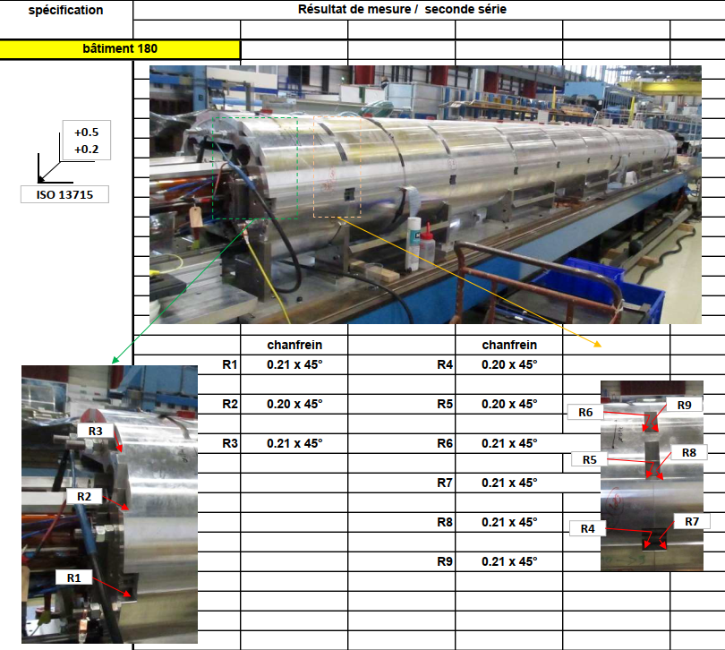
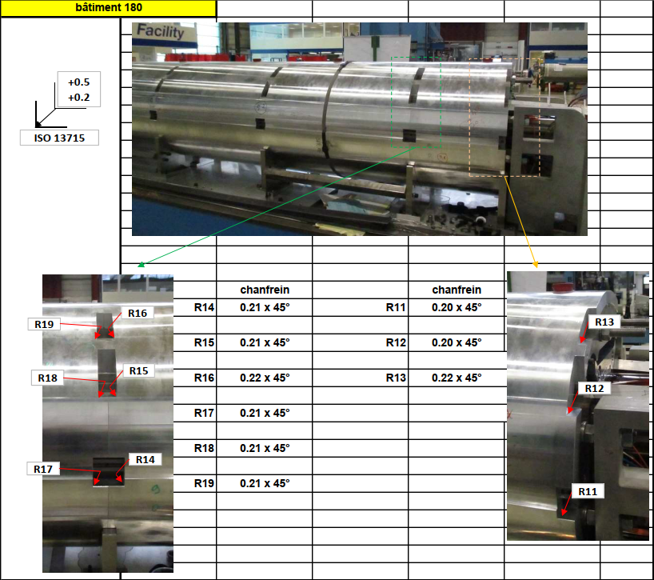
Measurements of cut-out measurements
Performed on short models, AUP prototypes and CERN prototypes

Slide 28
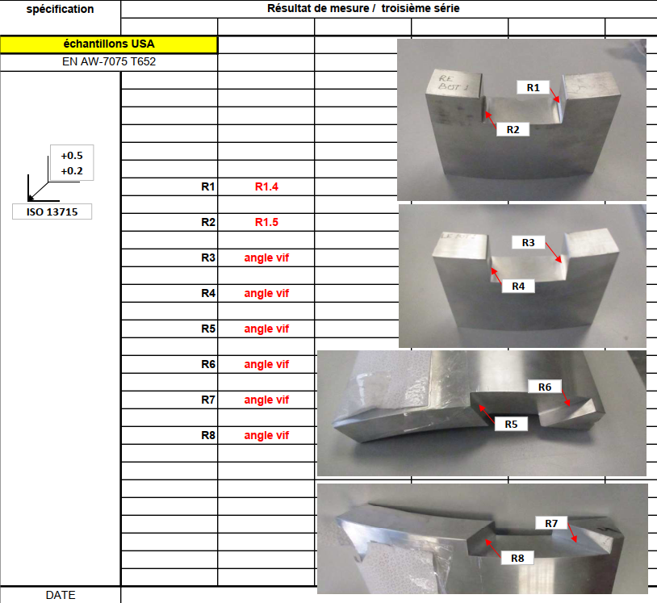
Measurements of cut-out measurements on short models and prototypes
Summary
  MQXFS: 0.100-0.200 mm
    Used in MQXFS3c, MQXFS6
  MQXFAP1: 0.030-0.140 mm
  MQXFAP2 (fractured, CERN): “angle vif”→ < 0.020 mm
  MQXFAP2 (fractured, LBNL): 0.036-0.079 mm
    Specified ~1.5 mm
      Non conformities: no radius in 1 side of 1 short shell (broken side)
  MQXFBP1: 0.200-0.220 mm

Slide 29
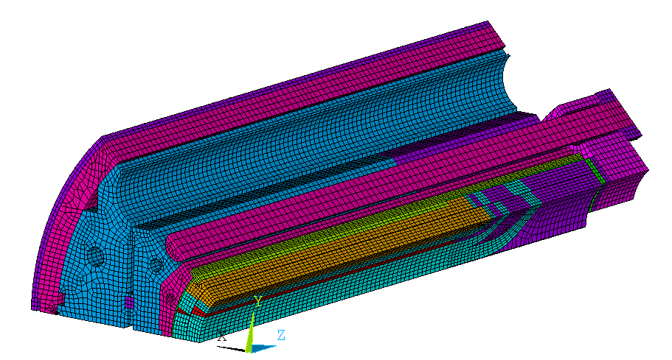
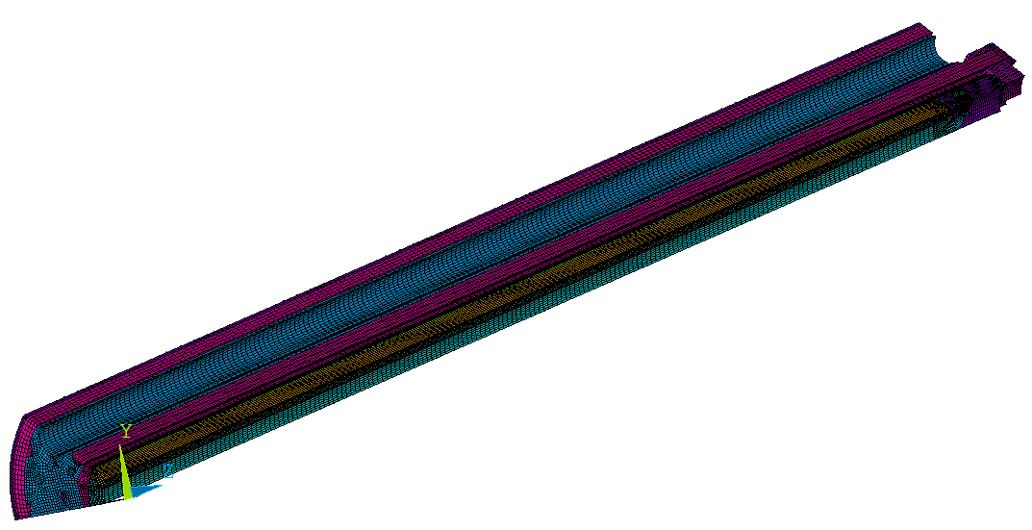
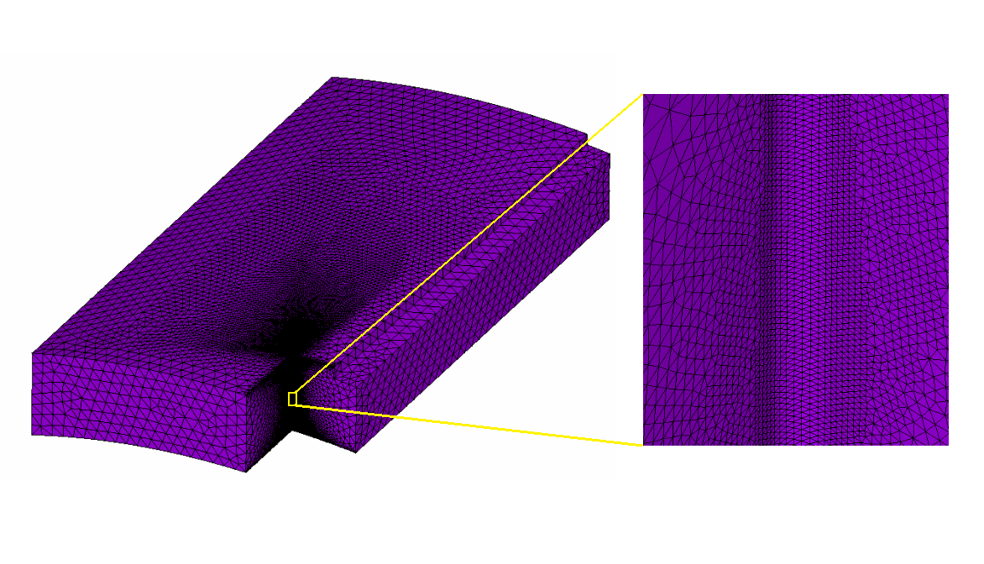
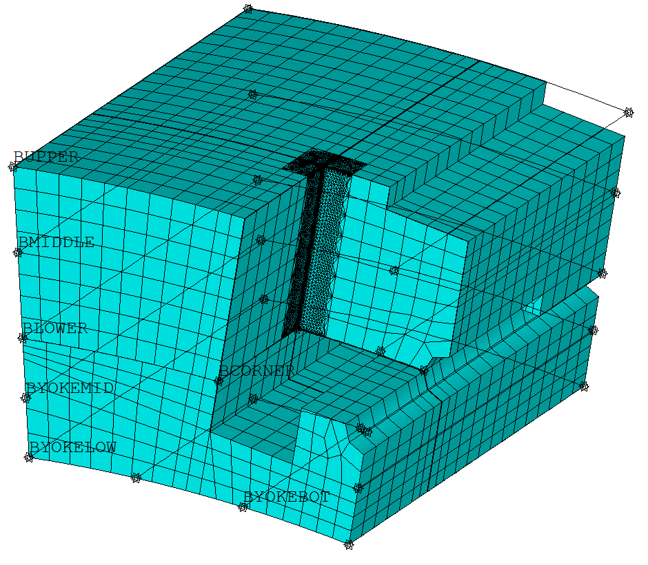

Finite element models
“Global” models
Sub-models

Slide 30
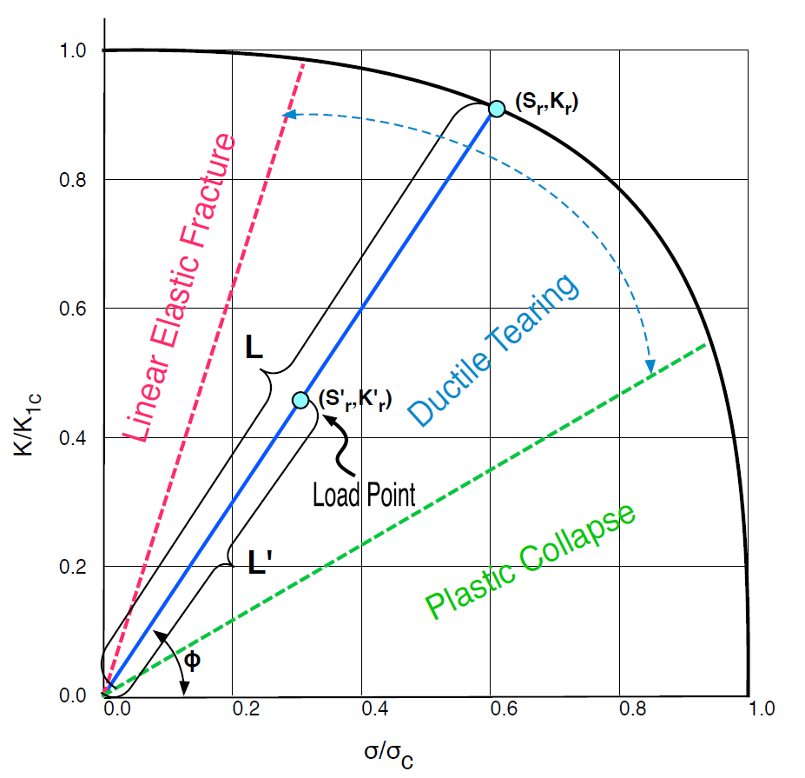
Finite element models
Elastic analysis
  Failure Assesment Diagram (FAD)
    If there is a crack (fabrication defect or plastic collapse)
      Does it propagate?
Plastic analysis
  Which is the extension of the plastic region?
  Do we have plastic collapse?

Slide 31
Finite element models
Conclusions
In BP1 → a total strain of ~5% and plastic zone of ~400 µm
  Significantly smaller than short models and AP2
The plastic analysis and the comparison with previous magnets suggests that the BP1 shell should not fail locally – no crack initiation due to plastic strain
The FAD was used for structural assessment
  For a shell pre-stress of 130 MPa cracks smaller than 2.5 mm will not propagate

Slide 32
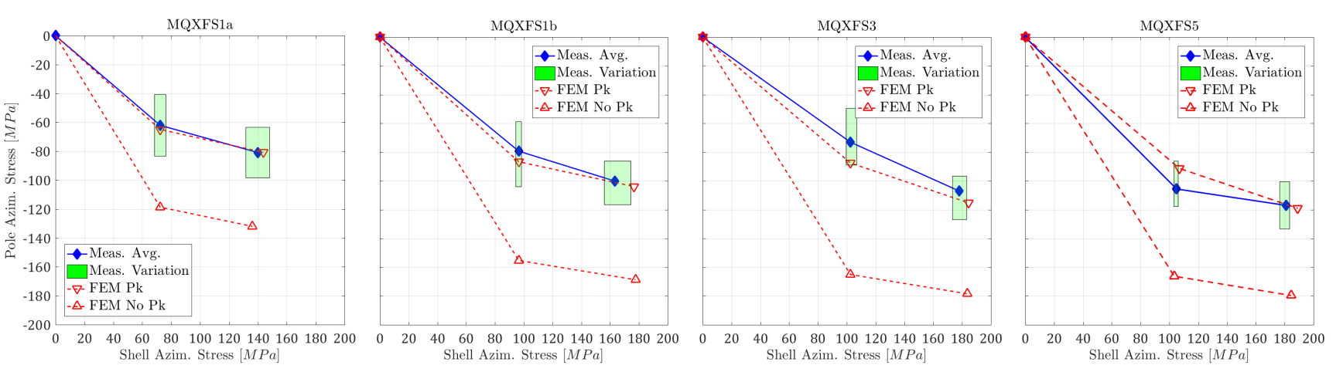
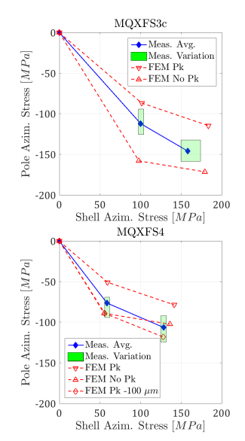
Comparison of shell stress levels
BP1 target average stress is the same as S4 (successfully tested) → 130 MPa
Short models with same material and smaller radiuses tested up to 180 MPa
Smaller stress than AP2 → 150 MPa

Slide 33
Outline
Introduction
  MQXF design
  MQXFAP2 shell fracture
Technical meeting
Investigation and comparison
  Material properties measurements
  Cut-out corners
  Stress levels
  Finite element analysis results
Proposal, panel’s comments, and decision on MQXFBP1

Slide 34
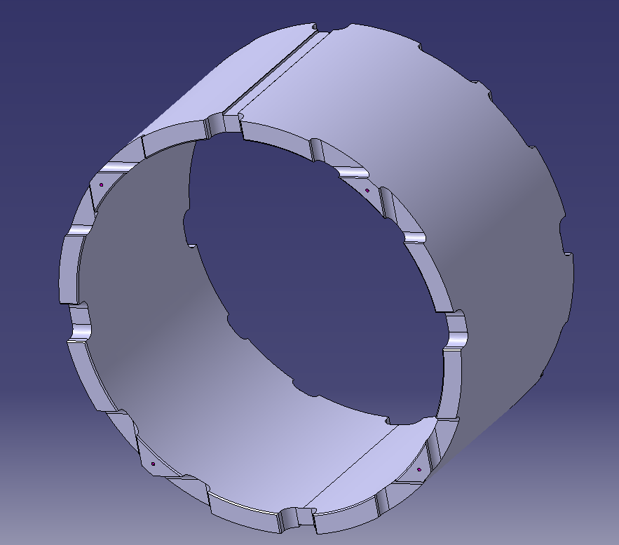
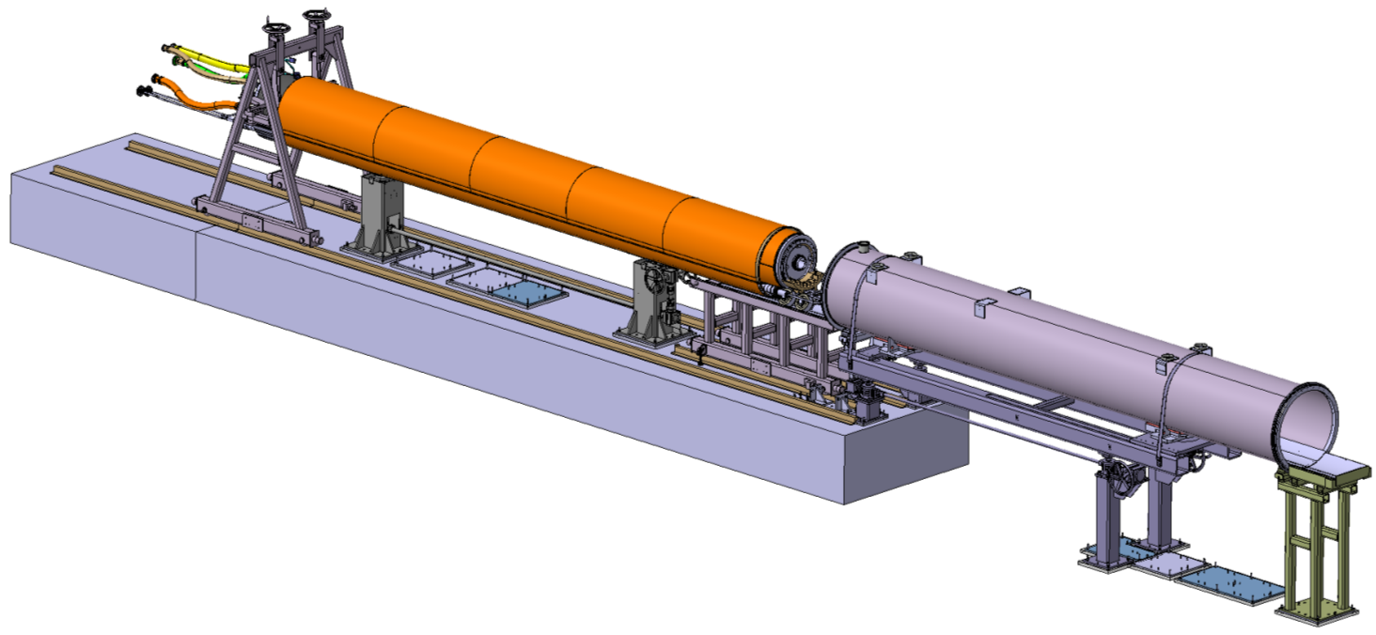
Plans
Proposed plan
  Use current shells for BP1 and continue the magnet assembly
    Cryo-assembly completed in 08/2019
Alternative plan
  Use 10 to 15 mm radius shells in BP1
    No plastic strain
    Cryo-assembly completed in 11/2019

Slide 35
Panel’s comments and final decision
“The shells with a radius of 10 mm and 15 mm are safe and represent the solution of the problem for the future quadrupoles.”
“The FEM analysis are very well done but as all the mechanical computations do not take into account everything that may happen.”
“In the case of the MQXFBP1 the aluminium state and the radius of the slots are better than those of the shell that broke.”

Slide 36
Panel’s comments and final decision
“Furthermore, the decision to pre-stress the shells at lower level (130 MPa) is adding another little margin.”
“The option of continuing the assembly has strong chances to work but it is associated to a certain risk of failure. This risk is small but not zero.”
“In this case, it is important to monitor the assembly in order not to overstress the shells (130 MPa nominal value).”
Final decision: continuation of the magnet assembly-loading with current shells

Slide 37
Appendix

Slide 38
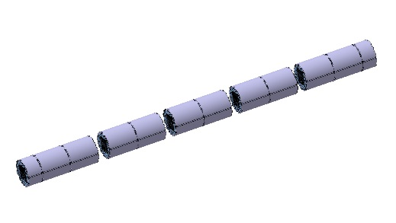
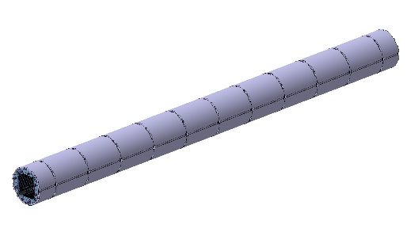
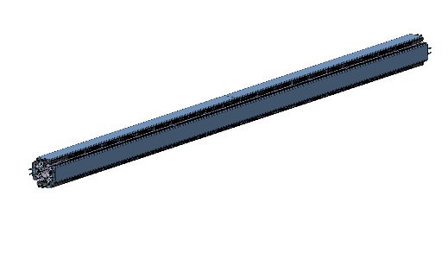

Magnet assembly and pre-loading
Shell-yoke modules combined
Insertion of coil-pack sub-assembly
Then bladder operation
Deformed shape and coil peak azimuth. stress from ANSYS
-105 MPa
-67 MPa
-156 MPa
-148 MPa

Slide 39
MQXFAP2
Long shells
  7071-T6
Short shells
  Both CS and NCS
  7071-T652
All 1.5 mm round corners except for
  all cut-outs of “top” side of “bottom” short shell
    Start of the fracture

Slide 40
Measurements of mechanical properties
Conclusions
AA 7175 shows to be a highly performing alloy down to 4 K. Its use at cryogenic temperature deserves a careful attention. Indeed, its properties strongly depend on product and temper state.
T652
  Limited ductility, lower fracture toughness and a very high sensitivity to the presence of sharp notches at 4 K.
T74
  Higher toughness and higher ductility, and it is a temper less sensitive to the presence of sharp notches at 4K. The cost is a moderate reduction of the strength.

Slide 41
Overview of shells
CERN MQXF short models (3 structures)
  Short and long shells (Forgital)
    7175-T74
    No rounded corners
AUP MQXFAP1:
  Short and long shells (Metalex)
    7075-T6
    No rounded corners
AUP MQXFAP2
  Long shell (Metalex)
    7075-T6
    Rounded corners (1.5 mm)
  Short shell:
    7075-T652 (mechanically stress relieved after forging)
    Rounded corners except 1 side of 1 shell (bottom one)
CERN MQXFB prototypes (assembly in progress)
  Short and long shells (Forgital)
    7175-T74
    No rounded corners
CERN MQXFB prototypes (assembly in progress)
  Short and long shells (Imbach)
    7175-T74
    Rounded corners (10-15 mm)

Slide 42
Overview of shells: short models
CERN MQXF short models (3 structures, by Forgital, EU)
  Short and long shells
    7175-T74
    No rounded corners
Structure 1
  MQXFS1a-b-c-d
    7 cool-downs (with re-loadings)
    ~100 quenches
    Average stress level: up to 163 ± 10 MPa
Structure 2
  MQXFS3c, MQXFS6
    2 cool-downs
    ~40 quenches
    Average stress level: up to 158 ± 10 MPa
Structure 3
  MQXFS3a-b, MQXFS4a-b, MQXFS5
    9 cool-downs (with re-loadings)
    ~120 quenches
    Average stress level: up to 181 ± 5 MPa

Slide 43
Overview of shells: AP
AUP MQXFAP1 (by Metalex, US)
  Short and long shells:
    7075-T6
    No rounded corners
  4 cool-downs
  ~20 quenches
  Average stress level: 137 MPa
AUP MQXFAP2 (by Metalex, US)
  Long shell
    7075-T6
    Rounded corners (1.5 mm)
  Short shell:
    7075-T652 (mechanically stress relieved after forging)
    Forged from “billet”, so pierced, not from “ring”, like all the others
    Rounded corners except 1 side (the broken one)
  1 cool-down
  ~30 quenches
  Average stress level: 153 MPa

Slide 44
Overview of shells: BP and B
CERN MQXFB prototypes (by Forgital, EU)
  Short and long shells:
    7175-T74
    No rounded corners (same as short models)
CERN MQXFB series (by Imbach, EU)
  Short and long shells:
    7175-T74
    Rounded corners: 10-15 mm

Slide 45
Radius measurements
MQXFAP2 (sample of fractured shell) at CERN

Slide 46
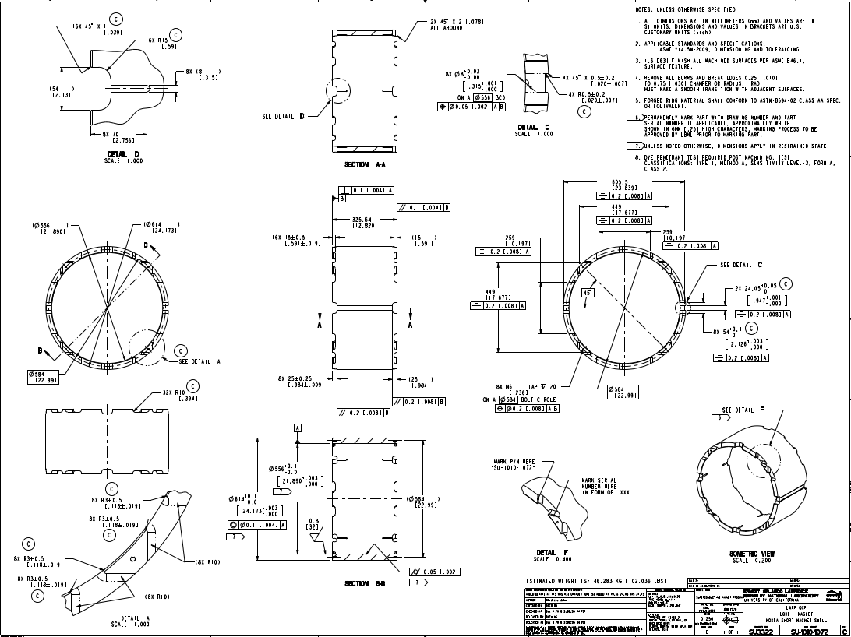
Overview of shells: AP
Drawings for short models (no corners)
AP1: in the drawings, 0.25-0.75 mm
AP2: specified ~1.5 mm
  Non conformities: no radius in 1 side of 1 short shell (broken side)

Slide 47
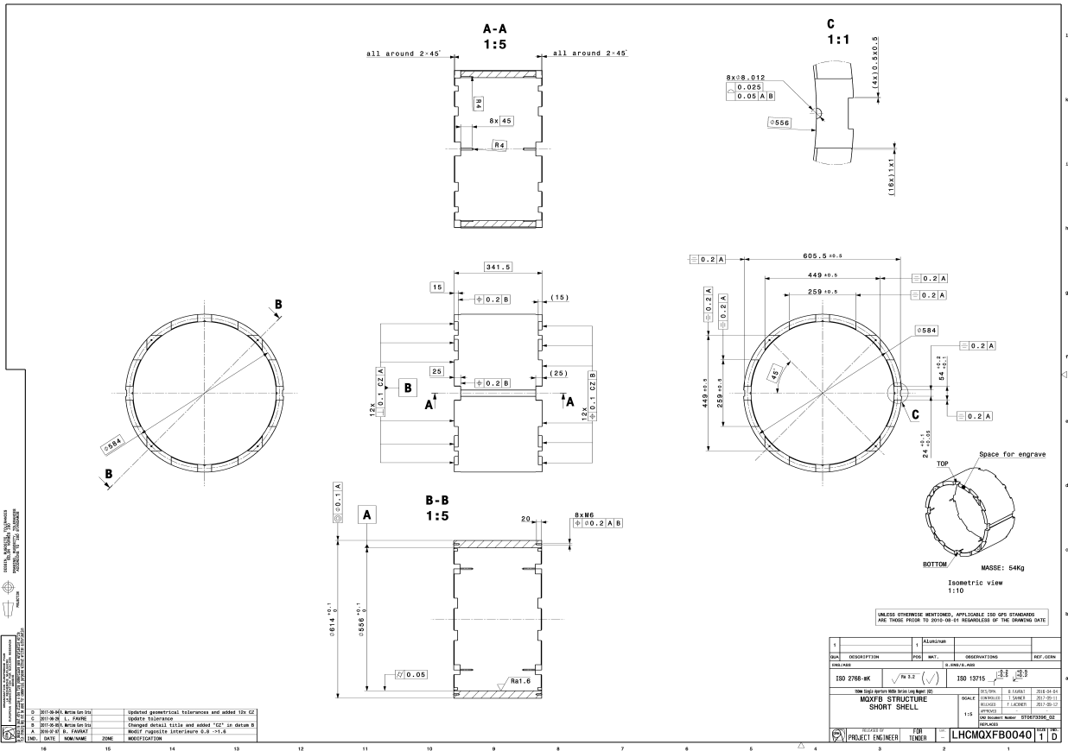
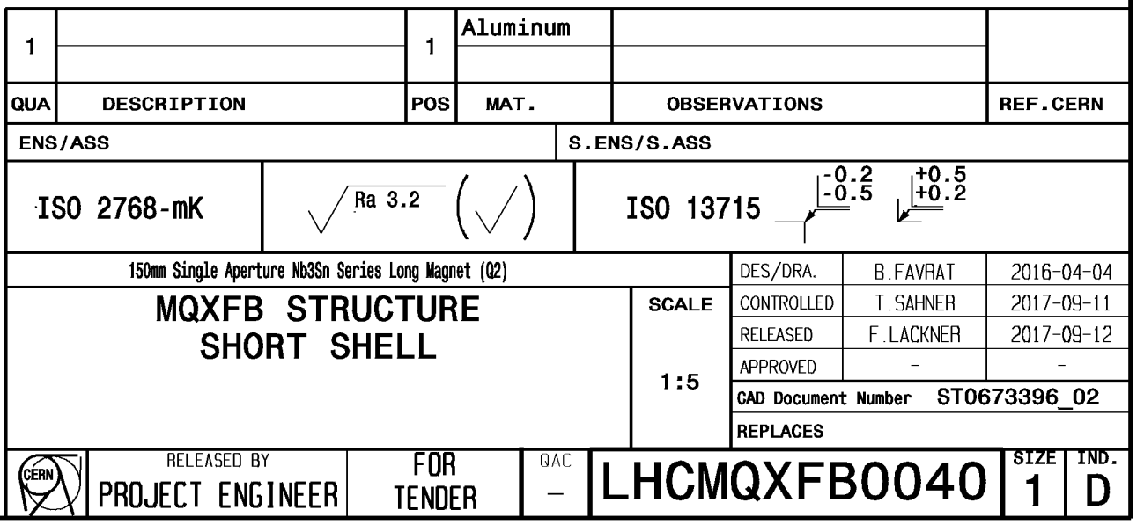
Overview of shells: short models
Drawings for short models (no corners)
In the drawings: 0.2-0.5 mm

Slide 48
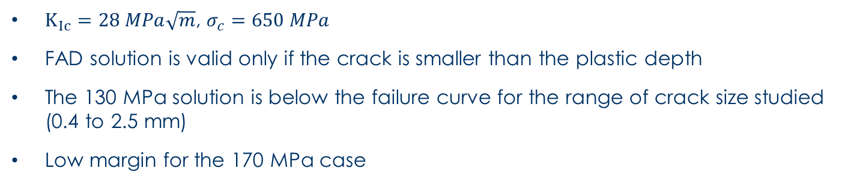
FAD – MQXFBP1 (2)
Plastic zone
$K_{Ic}=28 MPa\sqrt{m}$, $σ_{c}=650 MPa$
FAD solution is valid only if the crack is smaller than the plastic depth
The 130 MPa solution is below the failure curve for the range of crack size studied (0.4 to 2.5 mm)
Low margin for the 170 MPa case

Slide 49
Overview of shells: short models
Shell “average” stress after cool-down

Slide 50
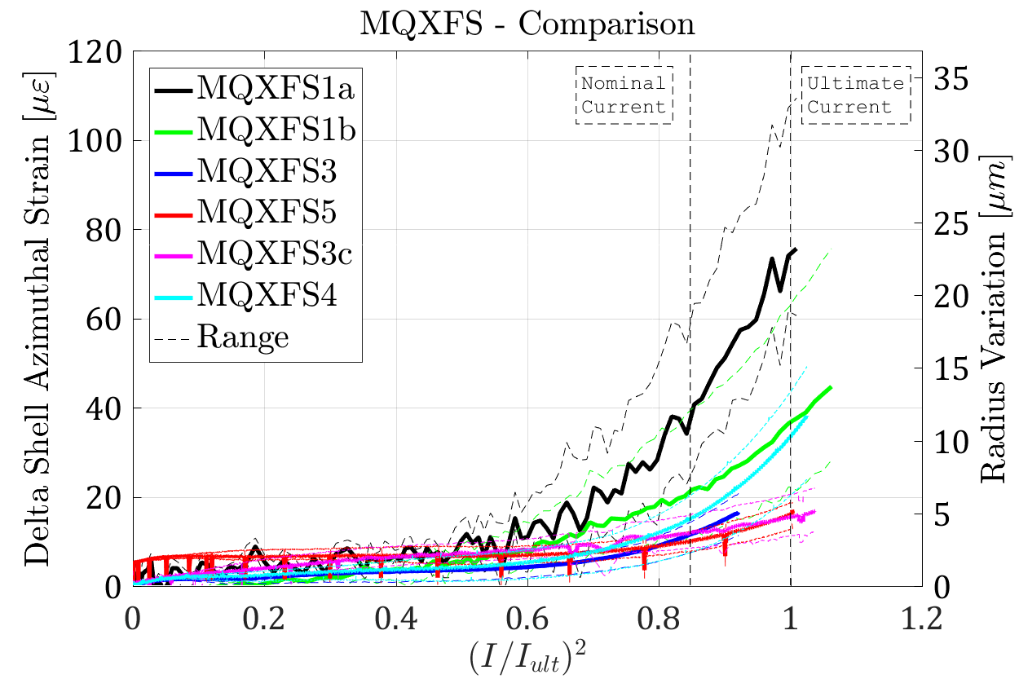
Overview of shells: short models
Delta stress → 40-50 µstrain → ~3 MPa

Slide 51
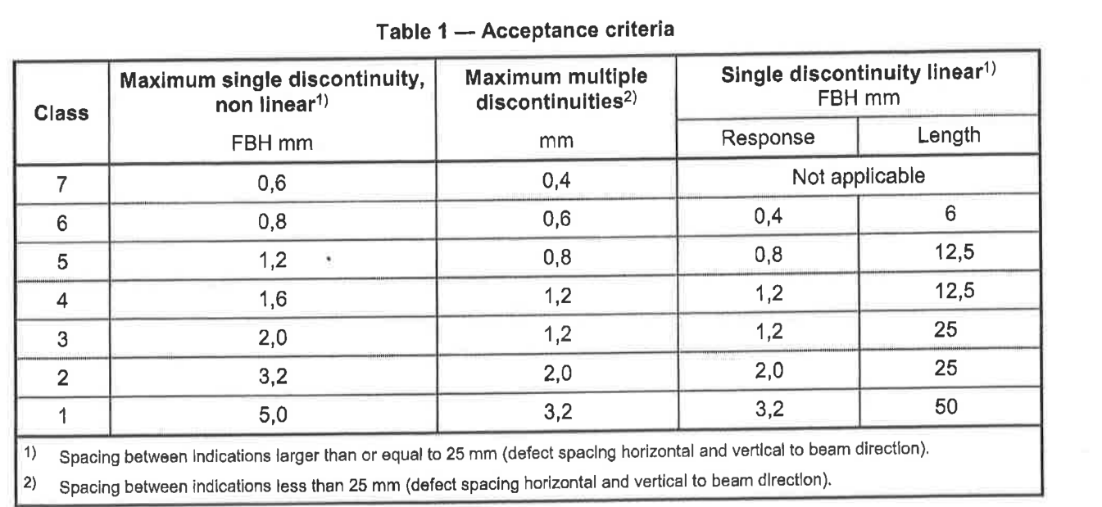
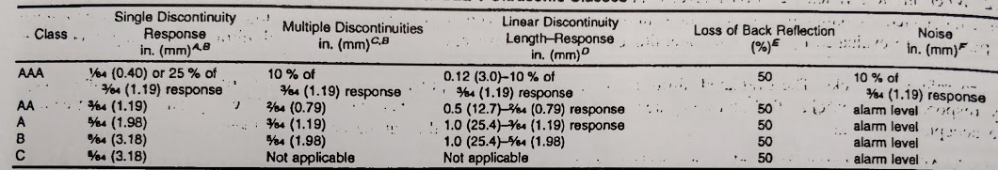
Control
CERN short models and prototypes and series
  Class A or 3
    2.0 mm
AP1 prototype
  Class B or 2
    3.18 mm
AP1 prototype
  Class A or 3
    2.0 mm

Slide 52
MQXF design
OD: 630 m
Stainless steel shell
  8 mm for LHe containment
Aluminum shell
  29 mm thick
Iron yoke
  Gaps open
  4-fold symmetry
Iron master plates
  Bladder and keys
Iron pad
SS axial rods
Aluminum collars
G10 pole key
Ti alloy poles

