Slide 1
ECR: TCLD installation in IR7
R. Bruce, A. Lechner, A. Mereghetti, S. Redaelli on behalf of WP5

Slide 2
ECR of TCLD in IR7
Installation of DS collimators (1 TCLD per side of IR7) foreseen for LS2.
To be installed together with the 11T magnets
ECR circulation started on 13/3, deadline yesterday
EDMS link: https://edms.cern.ch/document/1973028/0.2
These slides: summary of comments on EDMS
Not showing trivial comments here

Slide 3
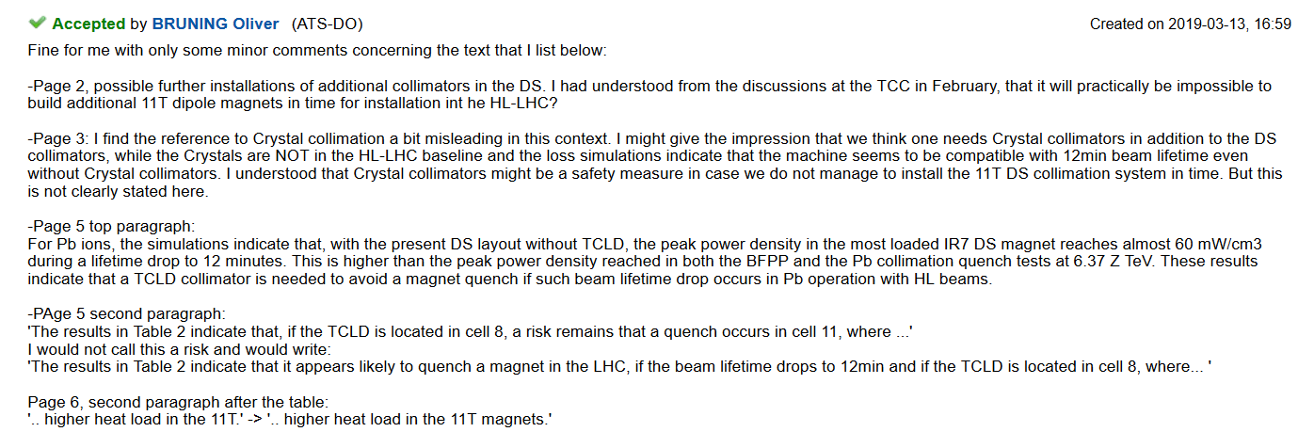
EDMS Comments (1)
We are implementing the changes and clarifications. We will add a statement to clarify that the crystal is not part of the baseline and that they are considered a backup solution

Slide 4
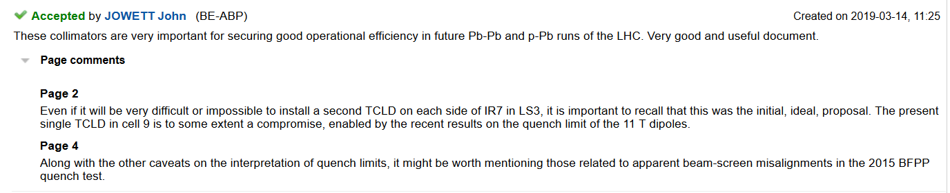
EDMS Comments (2)
We add statements on these points

Slide 5
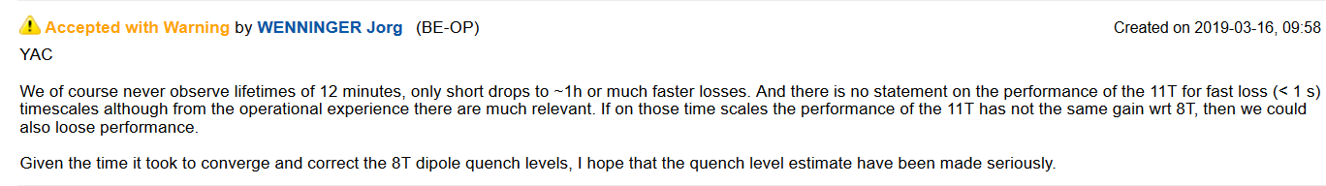
EDMS Comments (3)
Comments on 11T quench limit are maybe more relevant for the 11T ECR and the magnet group than for the TCLD?
Remark: Quench limit at different timescales presented by L. Bottura at the collimation review
  The quench limit seems lower for the 11T magnet than for the standard MB over intermediate timescales (1 ms – 1 s), however, these are shorter timescales than usual collimator losses
  The impact of this depends on the likelihood of large UFOs (estimated to be rather small) or other fast losses in this region
  For collimation losses, if the loss rate is constant and corresponding to 12 minutes beam lifetime, there is anyway more margin at shorter timescales (10 s is the most critical case)

Slide 6
Conclusions
Some comments received and implemented
We think comments on the 11T dipole quench limit are more suited for the 11T ECR
  Need to add anything in addition there?
Nothing blocking for the TCLD

Slide 7
Backup

Slide 8
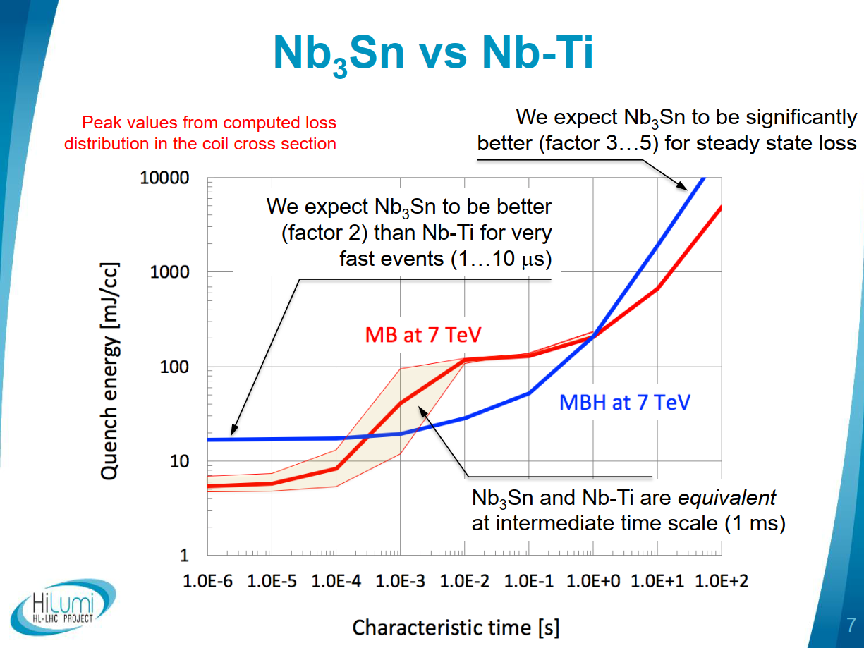
From L. Bottura, in 2019
collimation review

