Slide 1
CAS – Introduction to Accelerator Physics
Collective effects
Part II: Space charge cont.

Slide 2
In the last lecture, we have learned about the dynamics and the representation of multiparticle systems. We have seen how we differentiate between incoherent and coherent motion. Linked to this, we looked at the phenomenon of filamentation with decoherence and emittance blow-up.
We also discussed a first collective effect – direct space charge. We saw that direct space charge, for the case of a uniform coating beam, leads to an tune shift of all witness particles.
We will now look at the space charge induced tune footprint and into some of the mitigation methods for direct space charge and then discuss some of the effects of indirect space charge. We will then move to a phenomenon known as wake fields.
Part 2: Direct- and indirect space charge
  Direct space charge – impact on machine performance
  Direct space charge – mitigation techniques
  Indirect space charge
  From indirect space charge to (resistive) wall wakes

Slide 3
We have seen the impact of direct space charge for the case of a uniform coasting beam. We also got a first idea of the scaling laws for direct space charge in general.
Let’s have a look now at the more realistic case of non-uniformly charged, bunched beams and the impact of direct space charge on the beam and on the machine performance.
Part 2: Direct- and indirect space charge
  Direct space charge – impact on machine performance
  Direct space charge – mitigation techniques
  Indirect space charge
  From indirect space charge to (resistive) wall wakes

Slide 4
Coasting beam tune shifts
without space charge
with space charge
uniform distribution
with space charge
Gaussian distribution
+
+
particles in the tails
zero intensity working point
Q_{y}
Q_{y}
Q_{y}
tune shift
tune spread!
particles in the center
Q_{x}
Q_{x}
Q_{x}
All particles have the tunes Q_{x} and Q_{y} determined by the machine quadrupoles
All particles have the tunes Q_{x} and Q_{y} determined by the machine quadrupoles and the linear defocusing from space charge
Particles have a different tunes, since the space charge defocusing depends on the particles’ amplitude
The tune shift is largest for particles in the beam center

Slide 5
Coasting beam tune shifts
without space charge
with space charge
uniform distribution
with space charge
Gaussian distribution
+
+
Note: the maximum space charge tune shift in a Gaussian beam distribution is stronger compared to the detuning in a uniform beam distribution when considering similar beam sizes due to the higher particle density in the beam core!
particles in the tails
zero intensity working point
Q_{y}
Q_{y}
Q_{y}
tune shift
tune spread!
particles in the center
Q_{x}
Q_{x}
Q_{x}
All particles have the tunes Q_{x} and Q_{y} determined by the machine quadrupoles
All particles have the tunes Q_{x} and Q_{y} determined by the machine quadrupoles and the linear defocusing from space charge
Particles have a different tunes, since the space charge defocusing depends on the particles’ amplitude
The tune shift is largest for particles in the beam center

Slide 6
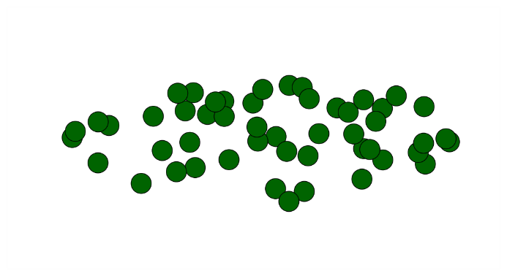



Coasting vs. bunched – Gaussian
In beams with Gaussian transverse distribution we observed already for coasting beams with constant line density a tune spread due to the nonlinear force and the resulting dependence on the transvers particle amplitude
In case a Gaussian beam is also bunched, an additional tune spread is induced by the variation of the line density
  The tune footprint is also called the space charge necktie due to its shape
Q_{y}
Particles close to the peak line density (often in the bunch center) will have the largest tune spread
Q_{x}

Slide 7
Coasting vs. bunched – Gaussian
In beams with Gaussian transverse distribution we observed already for coasting beams with constant line density a tune spread due to the nonlinear force and the resulting dependence on the transvers particle amplitude
In case a Gaussian beam is also bunched, an additional tune spread is induced by the variation of the line density
  The tune footprint is also called the space charge necktie due to its shape
Q_{y}
The tune spread is reduced for particles
further away from the peak line density
Q_{x}

Slide 8
Coasting vs. bunched – Gaussian
In beams with Gaussian transverse distribution we observed already for coasting beams with constant line density a tune spread due to the nonlinear force and the resulting dependence on the transvers particle amplitude
In case a Gaussian beam is also bunched, an additional tune spread is induced by the variation of the line density
  The tune footprint is also called the space charge necktie due to its shape
Q_{y}
The tune spread is reduced for particles
further away from the peak line density
Q_{x}

Slide 9
Coasting vs. bunched – Gaussian
In beams with Gaussian transverse distribution we observed already for coasting beams with constant line density a tune spread due to the nonlinear force and the resulting dependence on the transvers particle amplitude
In case a Gaussian beam is also bunched, an additional tune spread is induced by the variation of the line density
  The tune footprint is also called the space charge necktie due to its shape
Q_{y}
The tune spread is reduced for particles
further away from the peak line density
Q_{x}

Slide 10
Coasting vs. bunched – Gaussian
In beams with Gaussian transverse distribution we observed already for coasting beams with constant line density a tune spread due to the nonlinear force and the resulting dependence on the transvers particle amplitude
In case a Gaussian beam is also bunched, an additional tune spread is induced by the variation of the line density
  The tune footprint is also called the space charge necktie due to its shape
Q_{y}
The tune spread is reduced for particles
further away from the peak line density
Q_{x}

Slide 11
Coasting vs. bunched – Gaussian
In beams with Gaussian transverse distribution we observed already for coasting beams with constant line density a tune spread due to the nonlinear force and the resulting dependence on the transvers particle amplitude
In case a Gaussian beam is also bunched, an additional tune spread is induced by the variation of the line density
The longitudinal variation of the transverse space-charge force due to the line density fills the gap until the zero-intensity working point
The tune of individual particles is modulated by twice the synchrotron period
  The tune footprint is also called the space charge necktie due to its shape
Q_{y}
For bunched beams the tune spread
is as big as the maximum tune shift!
Q_{x}

Slide 12
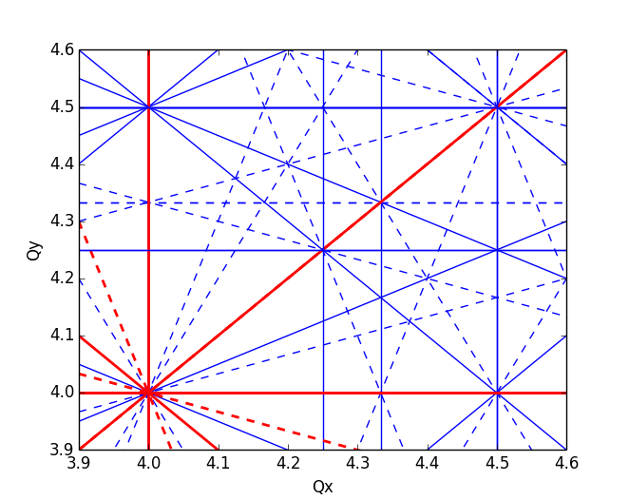
Brightness limitation due to space charge
A space charge tune spread beyond 0.5 can barely be tolerated without excessive emittance blow-up and/or particle loss due to resonances
  Dipole errors in the machine excite the integer resonances (Q=n)
  Quadrupole errors excite the half integer resonances (Q=n+1/2)
  Higher order resonances can be excited due to sextupoles and multipole errors
Imagine that a beam with a tune spread of beyond 0.5 is injected

Slide 13
Brightness limitation due to space charge
A space charge tune spread beyond 0.5 can barely be tolerated without excessive emittance blow-up and/or particle loss due to resonances
  Dipole errors in the machine excite the integer resonances (Q=n)
  Quadrupole errors excite the half integer resonances (Q=n+1/2)
  Higher order resonances can be excited due to sextupoles and multipole errors
Imagine that a beam with a tune spread of beyond 0.5 is injected
Particles in the beam core will cross the integer resonance resulting in emittance blow-up and a reduction of the tune spread

Slide 14
Brightness limitation due to space charge
A space charge tune spread beyond 0.5 can barely be tolerated without excessive emittance blow-up and/or particle loss due to resonances
  Dipole errors in the machine excite the integer resonances (Q=n)
  Quadrupole errors excite the half integer resonances (Q=n+1/2)
  Higher order resonances can be excited due to sextupoles and multipole errors
Imagine that a beam with a tune spread of beyond 0.5 is injected
Particles in the beam core will cross the integer resonance resulting in emittance blow-up and a reduction of the tune spread
Particles in the beam tails can be pushed onto the half integer resonance resulting in losses due to aperture restrictions

Slide 15
Direct space charge effects have the undesired property of generating incoherent tune spreads which can be a problem for dynamic aperture and emittance preservation.
We will look at a few of the different techniques used for the mitigation of direct space charge effects.
Part 2: Direct- and indirect space charge
  Direct space charge – impact on machine performance
  Direct space charge – mitigation techniques
  Indirect space charge
  From indirect space charge to (resistive) wall wakes

Slide 16
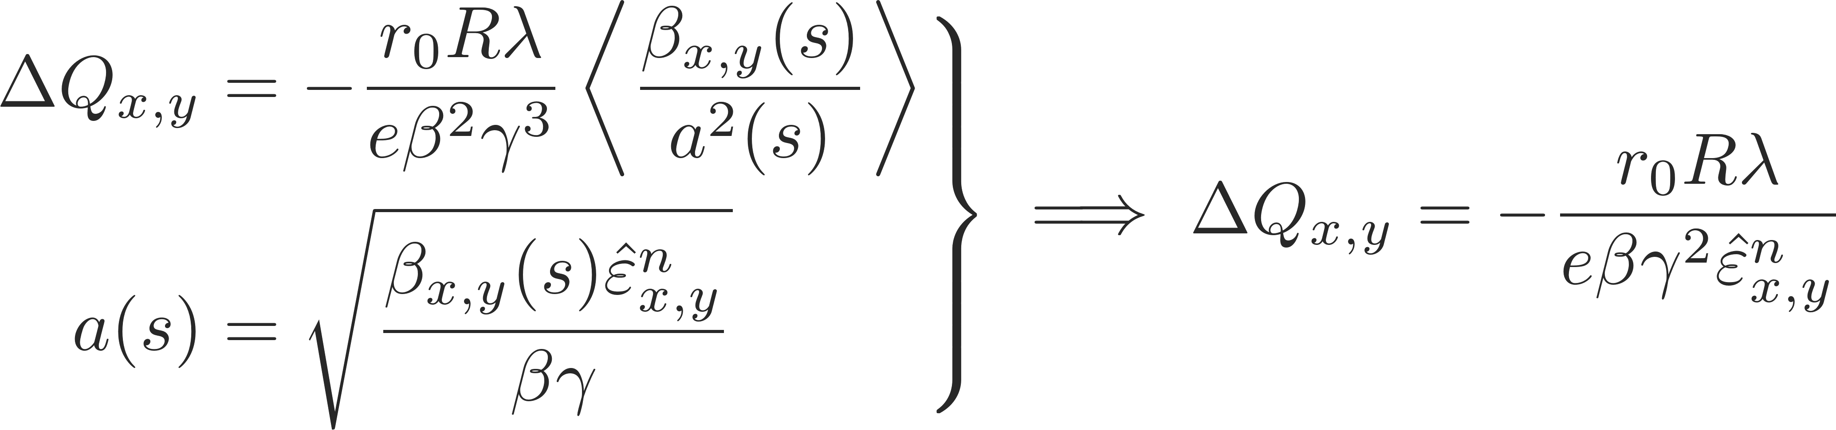
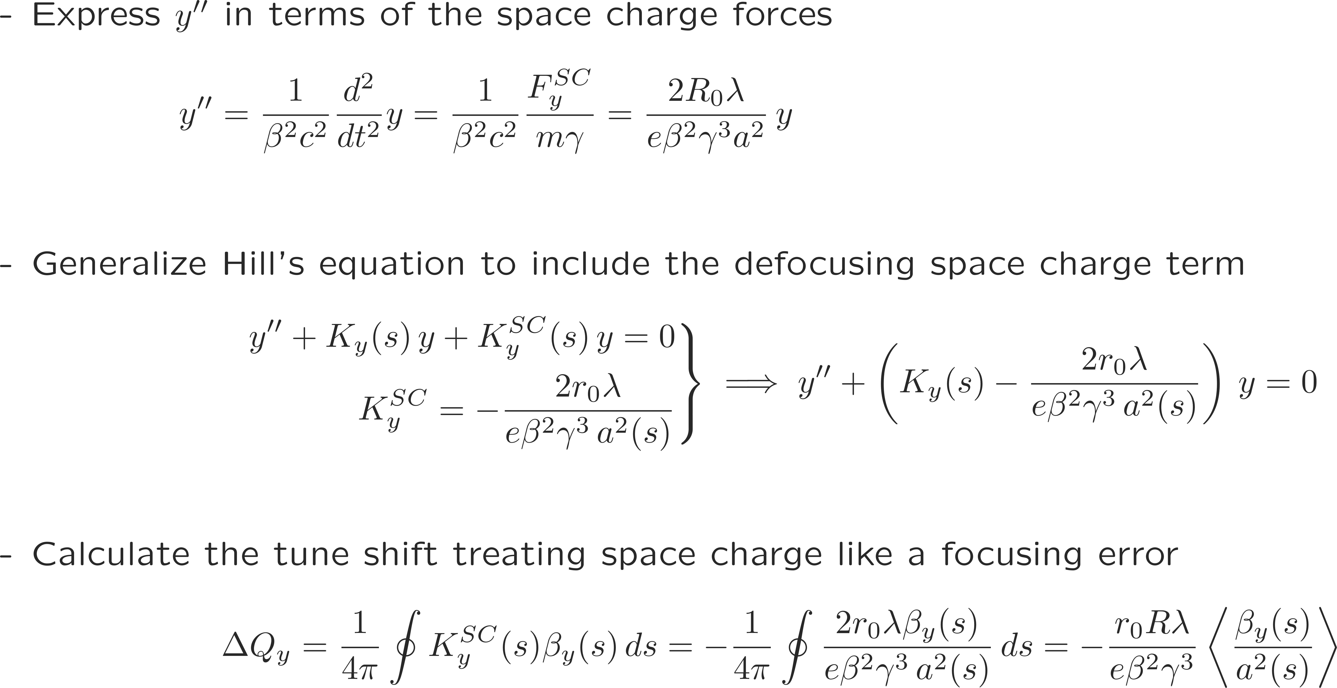
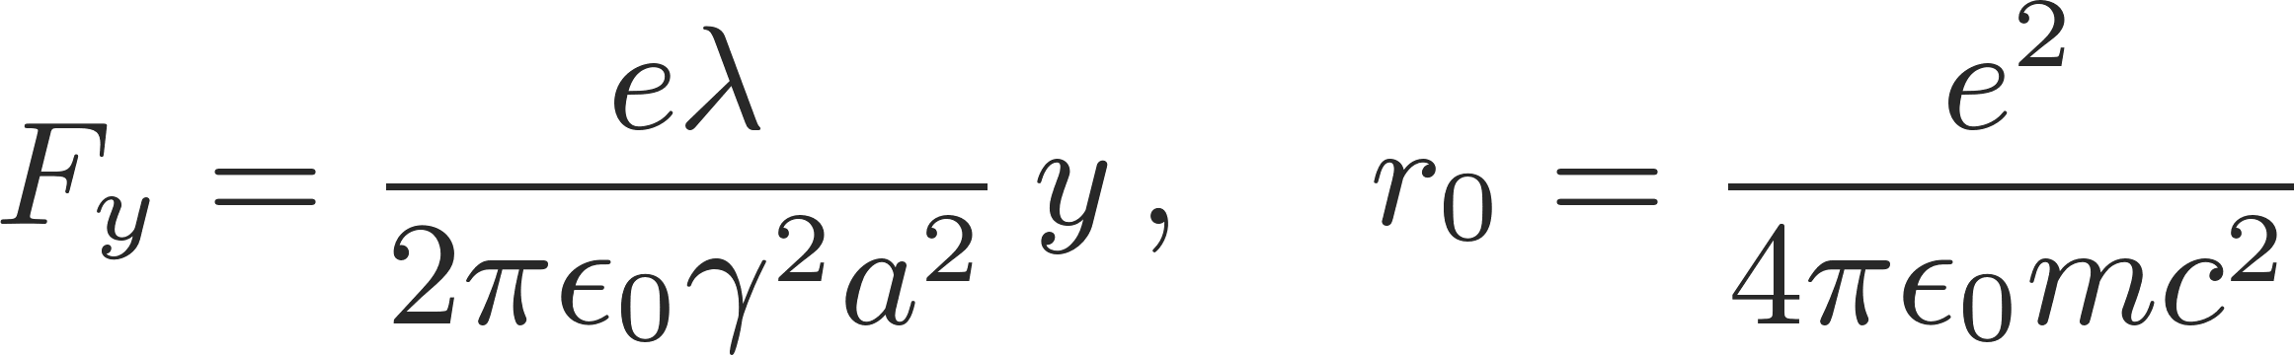
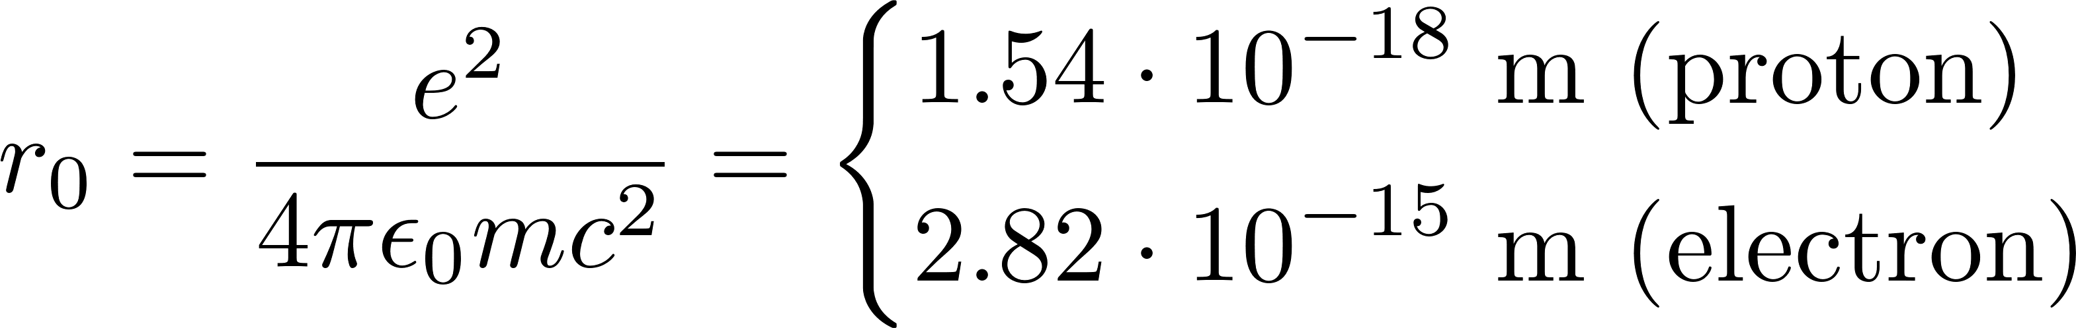

Direct space charge tune shift
After some reshuffling we notice some of the fundamental properties of the direct space charge tune shift:
is negative, because space charge transversely always defocuses
is proportional to the line density and thus to the number of particles in the beam
decreases with energy like $1/(βγ^{2})$ (when expressed in terms of normalized emittance) and therefore vanishes in the ultra-relativistic limit
does not depend on the local beta functions or beam sizes but is inversely proportional to the normalized emittance (here the emittance includes all particles!)
The direct space charge force for a beam with uniform charge distribution is linear in x and y
→ results in a direct space charge tune shift
We derive the general expression for the space charge induced tune shift in the vertical plane
Linear force Classical particle radius
Generalized Hill’s equation

Slide 17
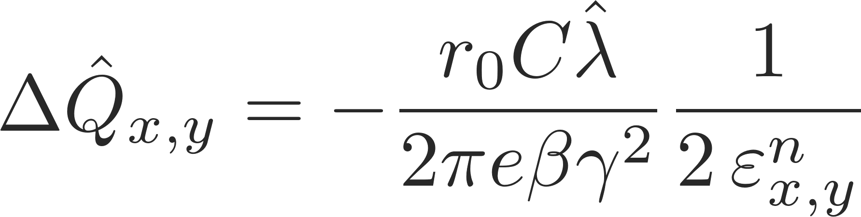
Mitigation techniques
Maximum tune shift (circular Gaussian)
Decrease the peak line density by
  maximizing the bunch length
  flattening the bunch profile with a specially configured (double harmonic) RF system

Slide 18
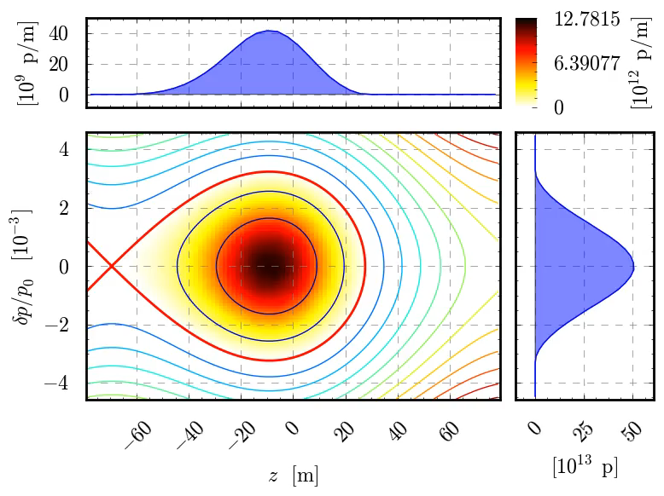
Mitigation techniques
Maximum tune shift (circular Gaussian)
Decrease the peak line density by
  maximizing the bunch length
  flattening the bunch profile with a specially configured (double harmonic) RF system
  using bunch distributions with small peak density (e.g. parabolic instead of Gaussian)
  reducing the central density of the particle distribution (e.g. “hollow bunches”)

Slide 19
Mitigation techniques
Maximum tune shift (circular Gaussian)
Decrease the peak line density by
  maximizing the bunch length
  flattening the bunch profile with a specially configured (double harmonic) RF system
  using bunch distributions with small peak density (e.g. parabolic instead of Gaussian)
  reducing the central density of the particle distribution (e.g. “hollow bunches”)
Increase the beam energy by
  accelerating the beam as quickly as possible
  increasing the injection energy (usually requires an upgrade of the pre-injector)

Slide 20
Mitigation techniques
Maximum tune shift (circular Gaussian)
Decrease the peak line density by
  maximizing the bunch length
  flattening the bunch profile with a double harmonic RF system
  using bunch distributions with small peak density (e.g. parabolic instead of Gaussian)
  reducing the central density of the particle distribution (e.g. “hollow bunches”)
Increase the beam energy by
  accelerating the beam as quickly as possible
  increasing the injection energy (usually requires an upgrade of the pre-injector)
Minimize the machine circumference
  when designing/building a new accelerator since the space charge detuning is an integrated effect

Slide 21
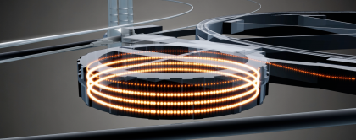
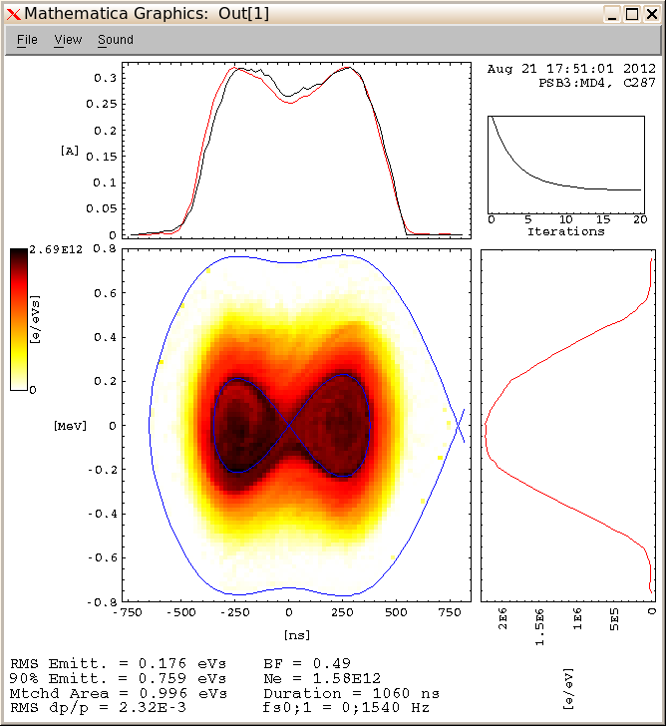
Direct space charge in the CERN PSB
An accelerator that is particularly subject to space charge effects and makes use of several mitigation schemes at the same time is the CERN PS Booster:
The PSB accelerates bright beams from 50 MeV to 1.4 GeV over 530 ms
Instead of one large ring is it made up of 4 smaller rings to reduce the integrated effect
Space charge is important, especially in first part of the cycle – bunch is flattened through a second harmonic RF system
A future upgrade (LIU) foresees to increase the injection energy from 50MeV to 160MeV
Injection@50MeV Extraction@1.4GeV
(275 ms) (850 ms)
β
21

Slide 22
Direct space charge leads to a purely incoherent tune shift and a tune spread leading to the characteristic tune footprint with its typical necktie shape for bunched beams. Direct space charge does not lead to any coherent tune shifts (on the centroid motion).
We will now look at the effect of indirect space charge. We will briefly look at the different sources of indirect space charge, that it can lead to both incoherent as well as coherent tuneshifts and how these tune shifts are usually parameterized using the Laslett coefficients.
Part 2: Direct- and indirect space charge
  Direct space charge – impact on machine performance
  Direct space charge – mitigation techniques
  Indirect space charge
  From indirect space charge to (resistive) wall wakes

Slide 23
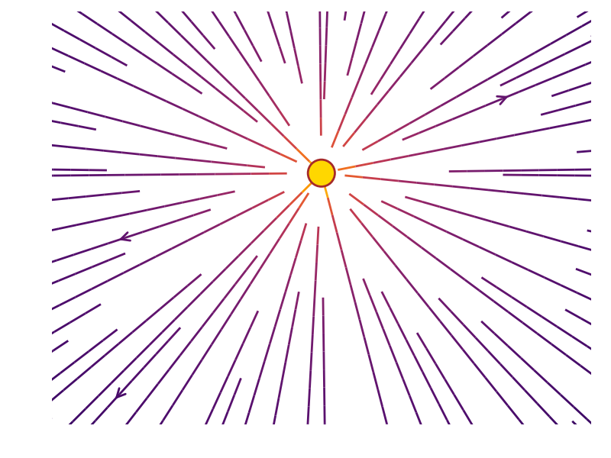
Direct vs. indirect space charge
Direct space charge – central force
The space symmetry endowed by free space eliminates any impact on the centroid motion
→ Exclusively incoherent tune shifts
Tune footprint - necktie
Q_{y}
Q_{x}

Slide 24
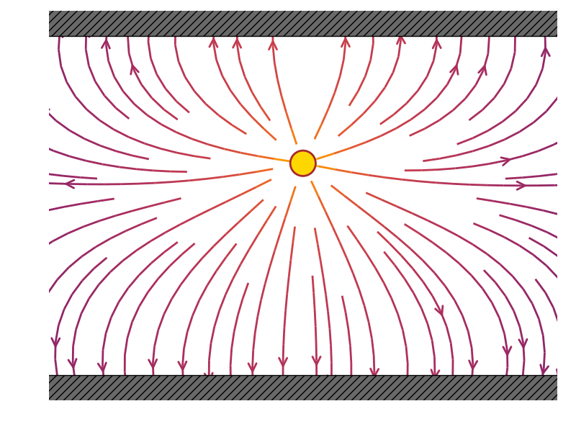
Direct vs. indirect space charge
Direct space charge – central force
The space symmetry endowed by free space eliminates any impact on the centroid motion
Indirect space charge – image charge forces
The free space symmetry is broken by the geometrical arrangement of the conducting parallel plates; this gives a net impact on the centroid motion
→ Exclusively incoherent tune shifts → Both incoherent and coherent tune shifts

Slide 25
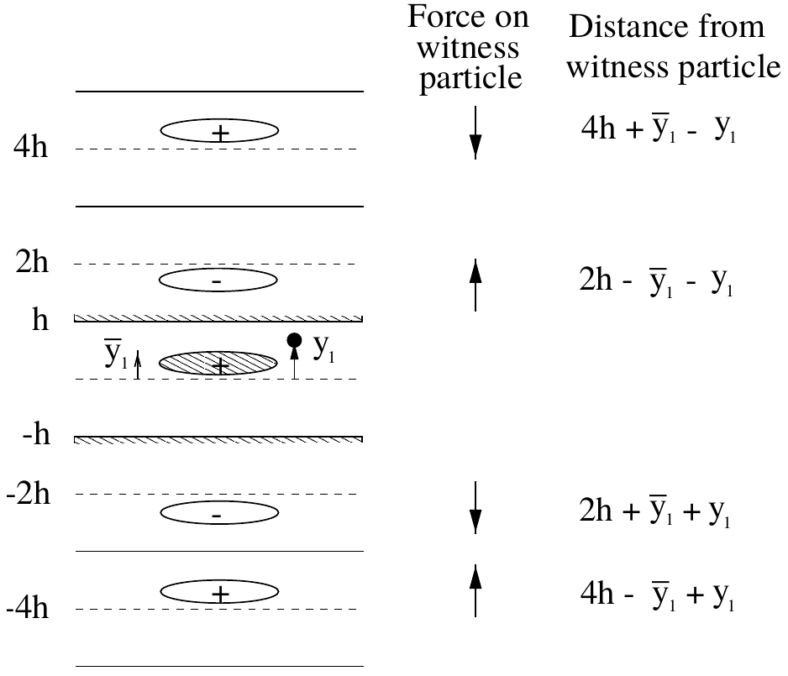
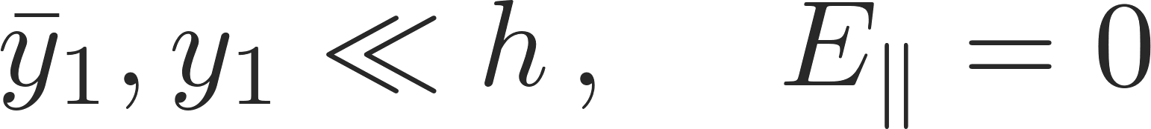
Direct vs. indirect space charge
Electro- and magneto-static forces can be computed with the method of image charges:
We consider the beam as line charge density λ with infinite length
Indirect space charge – image charge forces
The free space symmetry is broken by the geometrical arrangement of the conducting parallel plates; this gives a net impact on the centroid motion
→ Exclusively incoherent tune shifts → Both incoherent and coherent tune shifts

Slide 26
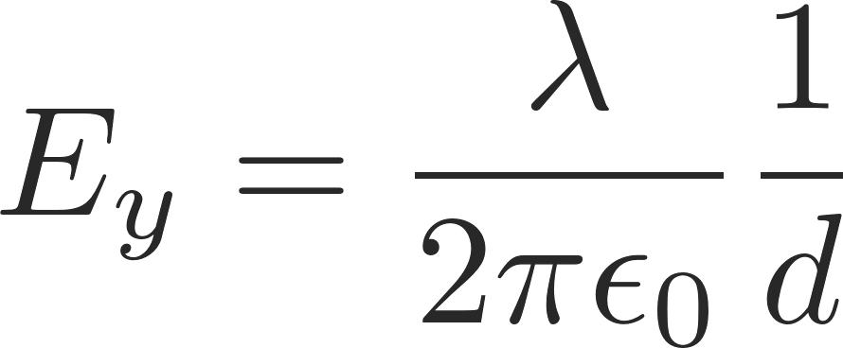
Direct vs. indirect space charge
Electro- and magneto-static forces can be computed with the method of image charges:
We consider the beam as line charge density λ with infinite length
We iteratively add charges to satisfy the boundary conditions. The resulting sum of fields converges to the final net field.
The electric field at distance d is given by Gauss’ law
Indirect space charge – image charge forces
The free space symmetry is broken by the geometrical arrangement of the conducting parallel plates; this gives a net impact on the centroid motion
→ Exclusively incoherent tune shifts → Both incoherent and coherent tune shifts

Slide 27
Direct vs. indirect space charge
Electro- and magneto-static forces can be computed with the method of image charges:
We consider the beam as line charge density λ with infinite length
We iteratively add charges to satisfy the boundary conditions. The resulting sum of fields converges to the final net field.
The electric field at distance d is given by Gauss’ law
A flat vacuum chamber can be approximated by two perfect conducting parallel plates placed at vertical positions +h and –h
Let the beam centroid be displaced vertically by y̅
The witness particle is at y
The boundary condition at the two perfect conducting plates is satisfied by superposing an infinite number of image line charges with alternating signs as shown in the sketch
The resulting electric field as a function of beam and witness particle offsets can be computed as

Slide 28
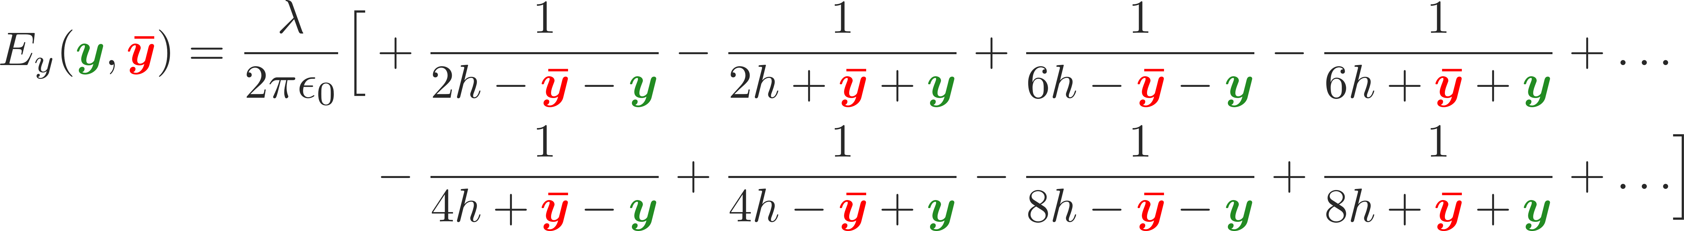
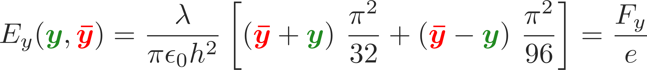
Direct vs. indirect space charge
Electro- and magneto-static forces can be computed with the method of image charges:
We consider the beam as line charge density λ with infinite length
The electric field at distance d is given by Gauss’ law
We iteratively add charges to satisfy the boundary conditions. The resulting sum of fields converges to the final net field.
A flat vacuum chamber can be approximated by two perfect conducting parallel plates placed at vertical positions +h and –h
Let the beam centroid be displaced vertically by y̅
The witness particle is at y
The boundary condition at the two perfect conducting plates is satisfied by superposing an infinite number of image line charges with alternating signs as shown in the sketch
The resulting electric field as a function of beam and witness particle offsets can be computed as
This is an infinite sum which, however, actually converges…

Slide 29
Image charge forces
Static electric fields vanish inside a conductor for any finite conductivity, while static magnetic fields pass through (unless in case of very high permeability)
This is no longer true for time varying fields, which can penetrate into the material in a region δ_{w} called skin depth
The skin depth depends on the material properties and on frequency. Fields pass through the conductor wall if the skin depth is larger than the wall thickness Δ_{w}. This happens at low frequencies. At higher frequencies, for a good conductor δ_{w} << Δ_{w} and both electric and magnetic fields vanish in the wall
We have seen how electric image charge force are induced by electrostatic fields in the presence of (perfectly) conducting boundaries
Similarly, there are also magnetics image current forces – here we need to differentiate between AC and DC forces

Slide 30
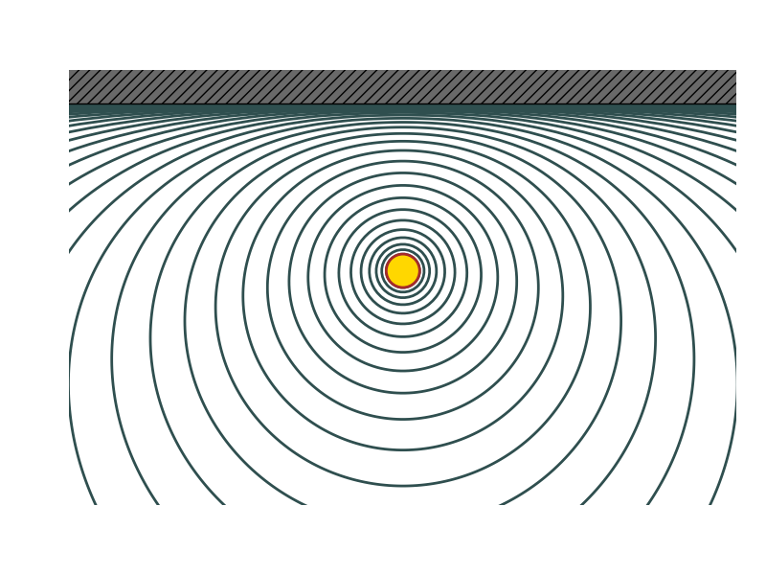
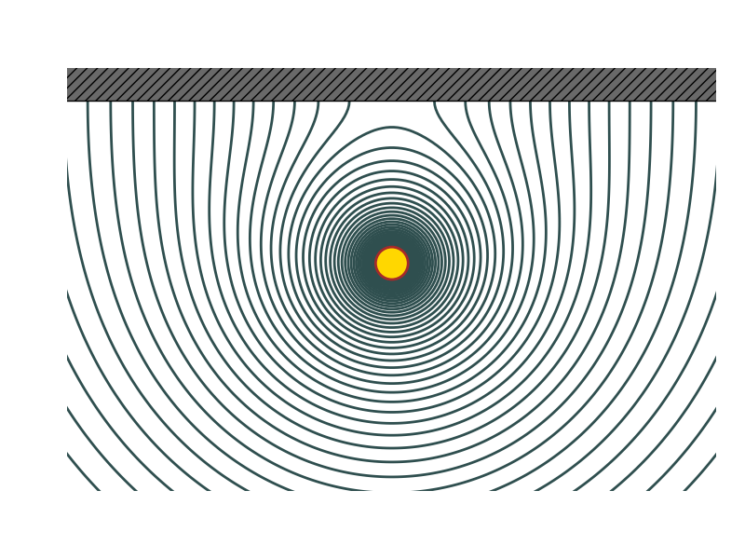
Image current forces
conductor
Static electric fields vanish inside a conductor for any finite conductivity, while static magnetic fields pass through (unless in case of very high permeability)
This is no longer true for time varying fields, which can penetrate into the material in a region δ_{w} called skin depth
The skin depth depends on the material properties and on frequency. Fields pass through the conductor wall if the skin depth is larger than the wall thickness Δ_{w}. This happens at low frequencies. At higher frequencies, for a good conductor δ_{w} << Δ_{w} and both electric and magnetic fields vanish in the wall
If the skin depth is very small (rapidly varying fields), magnetic fields do not penetrate and the field lines are tangent to the surface.
At low frequencies magnetic fields penetrate and pass through the vacuum chamber, they can interact with bodies behind the chamber
Ferromagnetic material
conductor

Slide 31
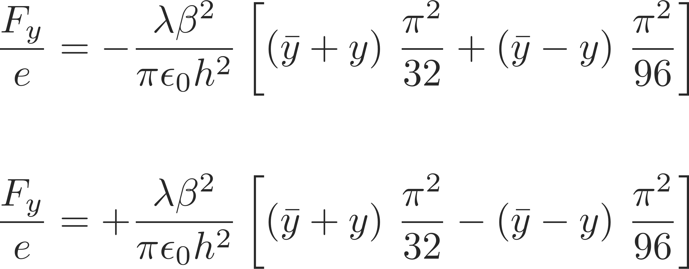
Image current forces
In a very similar fashion as done for the electrostatic case we can also here deploy the method of image currents to solve for the magnetostatic fields and forces
We obtain forces of the form
conductor
Static electric fields vanish inside a conductor for any finite conductivity, while static magnetic fields pass through (unless in case of very high permeability)
This is no longer true for time varying fields, which can penetrate into the material in a region δw called skin depth
The skin depth depends on the material properties and on frequency. Fields pass through the conductor wall if the skin depth is larger than the wall thickness Δw. This happens at low frequencies. At higher frequencies, for a good conductor δw<< Δw and both electric and magnetic fields vanish in the wall
If the skin depth is very small (rapidly varying fields), magnetic fields do not penetrate and the field lines are tangent to the surface.
At low frequencies magnetic fields penetrate and pass through the vacuum chamber, they can interact with bodies behind the chamber
Ferromagnetic material
conductor

Slide 32
Tune shifts and Laslett coefficients
These electric image charge and magnetic ac and dc image current forces have the general similar form
These forces can lead to both incoherent as well as coherent tune shifts – from the forces, the tune shifts can be computed. In fact, it turns out that the tune shifts can be parameterized via the Laslett coefficients. For example, for electric image charge forces between two perfectly conducting parallel plates, the incoherent and coherent tune shifts can be expressed as:
The Laslett coefficients can be evaluated for different geometries and are classified in incoherent and coherent tune shifts for electric, magnetic ac and magnetic dc image charges and currents.

Slide 33
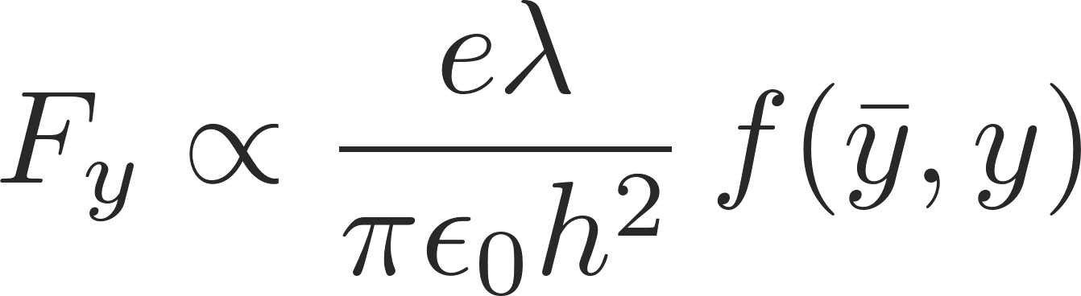
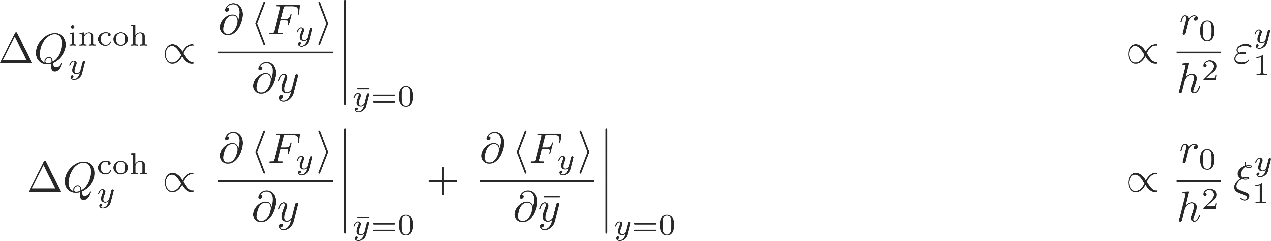
Tune shifts and Laslett coefficients
These electric image charge and magnetic ac and dc image current forces have the general similar form
These forces can lead to both incoherent as well as coherent tune shifts – from the forces, the tune shifts can be computed. In fact, it turns out that the tune shifts can be parameterized via the Laslett coefficients. For example, for electric image charge forces between two perfectly conducting parallel plates, the incoherent and coherent tune shifts can be expressed as:
Note: they are always defined with respect to the vertical half gap h or g
Assuming parallel plates for the ferro-magnetic boundary for all geometries …
* L. J. Laslett, LBL Document PUB-616, 1987, vol III
The Laslett coefficients can be evaluated for different geometries and are classified in incoherent and coherent tune shifts for electric, magnetic ac and magnetic dc image charges and currents.

Slide 34
Example: PS injection oscillations
The observed intra-bunch motion was reproduced with an amazing precision with multi-particle simulations (HEADTAIL code) including the indirect space charge effect taking
measurement
simulation
A. Huschauer et. al

Slide 35
Example: PS injection oscillations
The observed intra-bunch motion was reproduced with an amazing precision with multi-particle simulations (HEADTAIL code) including the indirect space charge effect taking
It was understood from simulations that the observed intra-bunch motion was induced by the beam injected off-center in combination with the indirect space charge effect, which causes a tune shift along the bunch proportional to the local charge density
measurement
simulation
A. Huschauer et. al

Slide 36
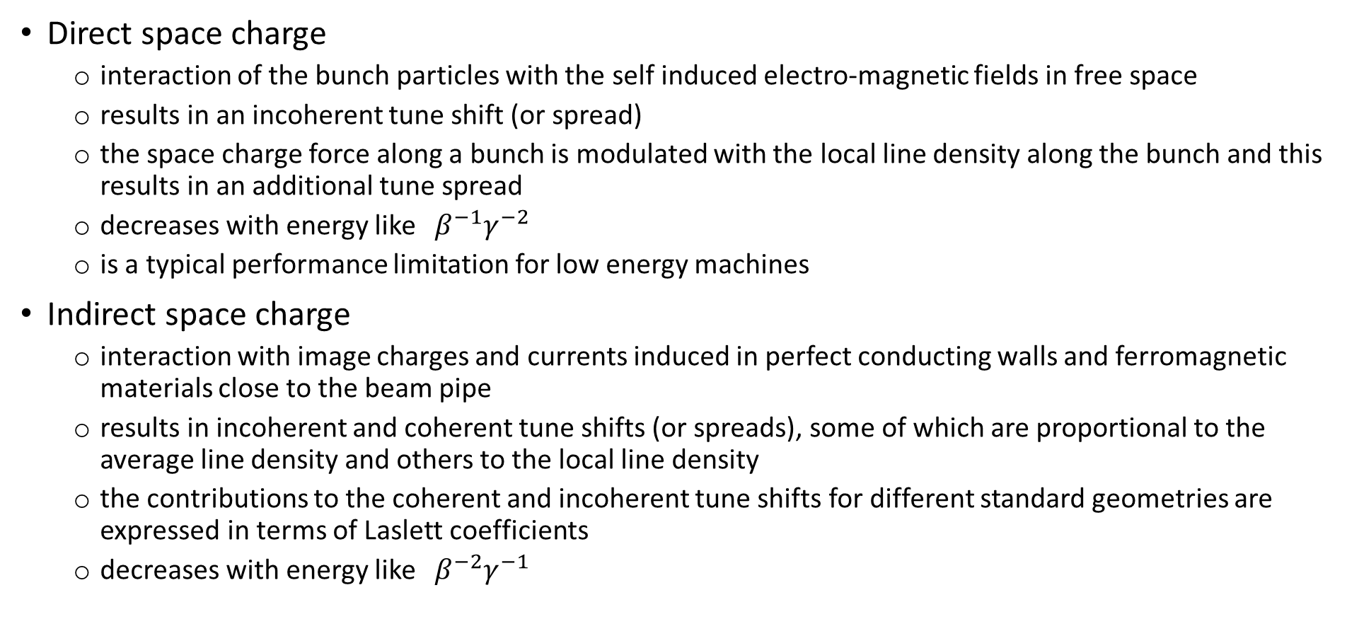
Remarks
Direct space charge
  interaction of the bunch particles with the self induced electro-magnetic fields in free space
  results in an incoherent tune shift (or spread)
  the space charge force along a bunch is modulated with the local line density along the bunch and this results in an additional tune spread
  decreases with energy like ${ β}^{−1}γ^{−2}$
  is a typical performance limitation for low energy machines
Indirect space charge
  interaction with image charges and currents induced in perfect conducting walls and ferromagnetic materials close to the beam pipe
  results in incoherent and coherent tune shifts (or spreads), some of which are proportional to the average line density and others to the local line density
  the contributions to the coherent and incoherent tune shifts for different standard geometries are expressed in terms of Laslett coefficients
  decreases with energy like ${ β}^{−2}γ^{−1}$

Slide 37
So far, we have introduced direct and indirect space charge as collective effects. The corresponding forces were not externally given but dependent on the actual particle distribution within the beam (remember, we looked at single particles as well as uniform and Gaussian distributions). The forces led to incoherent and coherent tune shifts.
We will now go a step further and investigate more complicated structures. We will try to find a smart way to deal with these structures. In the course of this, we will generalize and extend the direct and indirect space charge effects towards the concept of wake fields and impedances.
Part 2: Direct- and indirect space charge
  Direct space charge – impact on machine performance
  Direct space charge – mitigation techniques
  Indirect space charge
  From indirect space charge to (resistive) wall wakes

Slide 38
Electromagnetic fields of different sources
Direct space charge
  Free space: probe particles are effected directly by the source particles via the Lorentz force.
Indirect space charge/resistive wall wake
  Smooth boundaries: probe particles are effected by the source particles’ induced image charges and currents.
Resonator wake fields
  Discontinuities in boundaries: fields are excited by the source particles’ distribution and can keep ringing, thus effecting trailing probe particles
Probe
Source
From (in-)direct space charge to resistive walls…

Slide 39
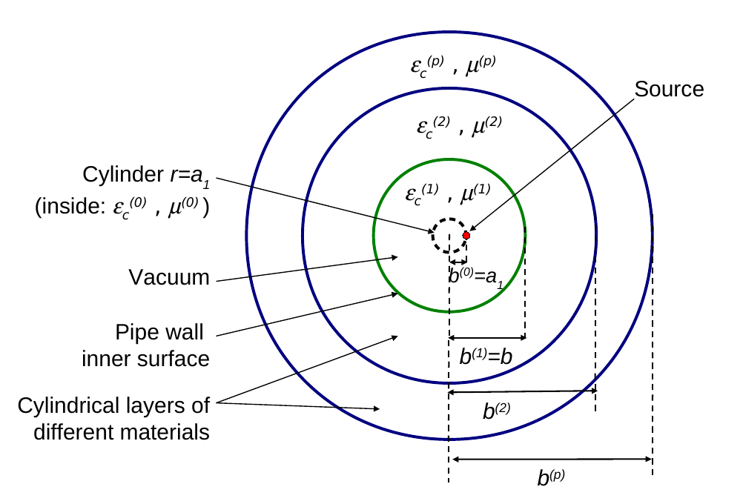
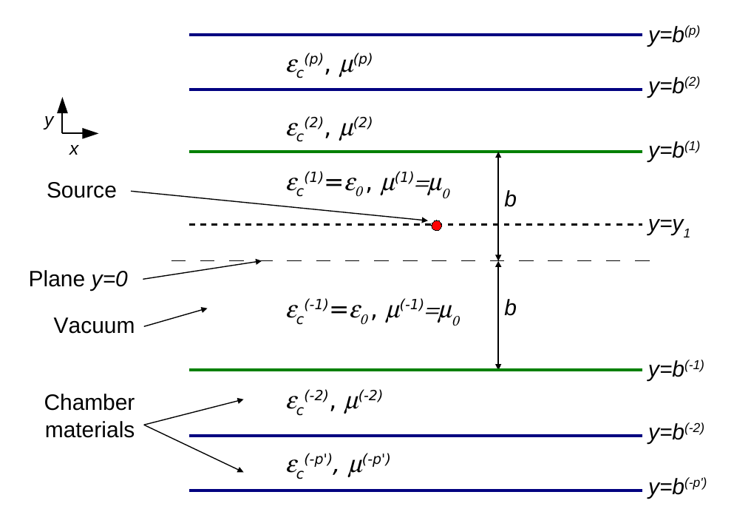
From (in-)direct space charge to resistive wall
We consider a smooth multilayer structure, longitudinally translation invariant and transversely bounded.
We consider a charged point particle traveling through the smooth multilayered structure.
The induced electromagnetic fields can be computed for certain geometries by means of Maxwell’s equations (longitudinal and transverse electromagnetic fields) with field matching at the boundaries. Two examples of such geometries are shown below.
Cylindrical Flat

Slide 40
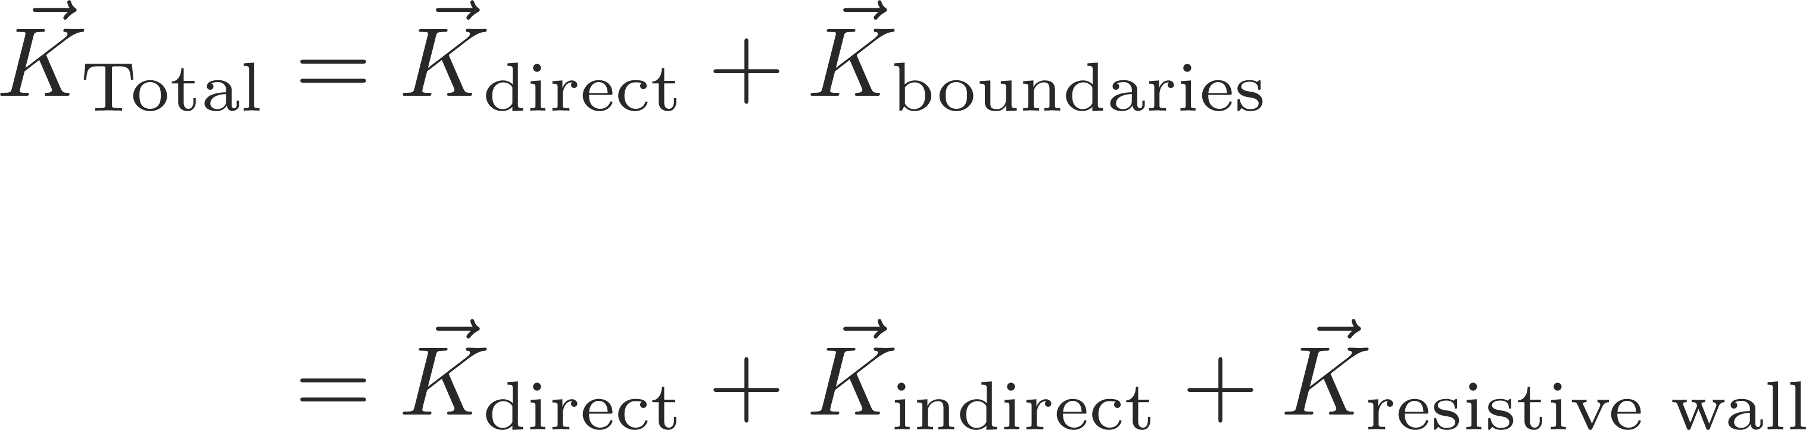


From (in-)direct space charge to resistive wall
We consider a smooth multilayer structure, longitudinally translation invariant and transversely bounded.
We consider a charged point particle traveling through the smooth multilayered structure.
The induced electromagnetic fields can be computed for certain geometries by means of Maxwell’s equations (longitudinal and transverse electromagnetic fields) with field matching at the boundaries. Two examples of such geometries are shown below.
It turns out, that the resulting electromagnetic fields can be decomposed into 3 components:

Slide 41
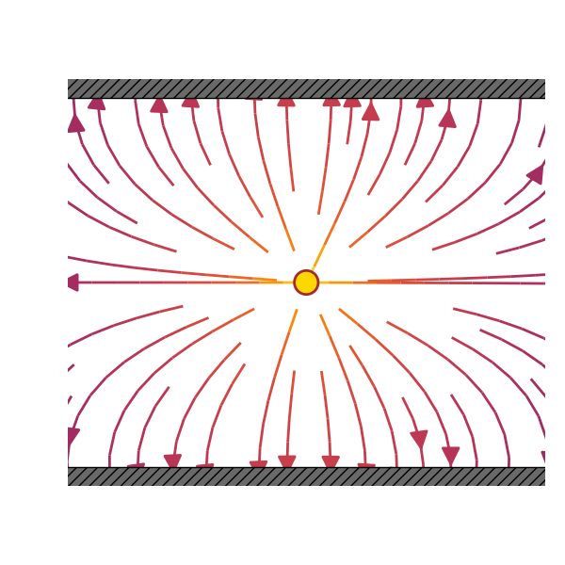
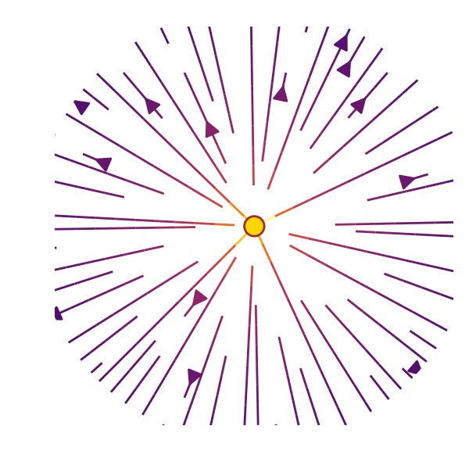
From (in-)direct space charge to resistive wall
We consider a smooth multilayer structure, longitudinally translation invariant and transversely bounded.
We consider a charged point particle traveling through the smooth multilayered structure.
The induced electromagnetic fields can be computed for certain geometries by means of Maxwell’s equations (longitudinal and transverse electromagnetic fields) with field matching at the boundaries. Two examples of such geometries are shown below.
It turns out, that the resulting electromagnetic fields can be decomposed into 3 components:
A component which is independent of the surrounding boundaries → direct space charge
A component which is independent of the surrounding material properties and purely depended on the surrounding geometry → indirect space charge
A component which is dependent on the surrounding material’s electromagnetic properties → resistive wall

Slide 42
Electromagnetic fields in different types of structures
Direct space charge
  Free space: probe particles are effected directly by the source particles via the Lorentz force.
Indirect space charge/resistive wall wake
  Smooth boundaries: probe particles are effected by the source particles’ induced image charges and currents.
Resonator wake fields
  Discontinuities in boundaries: fields are excited by the source particles’ distribution and can keep ringing, thus effecting trailing probe particles
Probe
Source

Slide 43
Electromagnetic fields in different types of structures
Direct space charge
  Free space: probe particles are effected directly by the source particles via the Lorentz force.
Indirect space charge/resistive wall wake
  Smooth boundaries: probe particles are effected by the source particles’ induced image charges and currents.
Resonator wake fields
  Discontinuities in boundaries: fields are excited by the source particles’ distribution and can keep ringing, thus effecting trailing probe particles
Probe
Source
For more complicated geometries the (semi-) analytic methods no longer work. One must rely on computational methods to evaluate the induced electromagnetic fields (FDTD, FEM etc.).
Some examples:
…

Slide 44
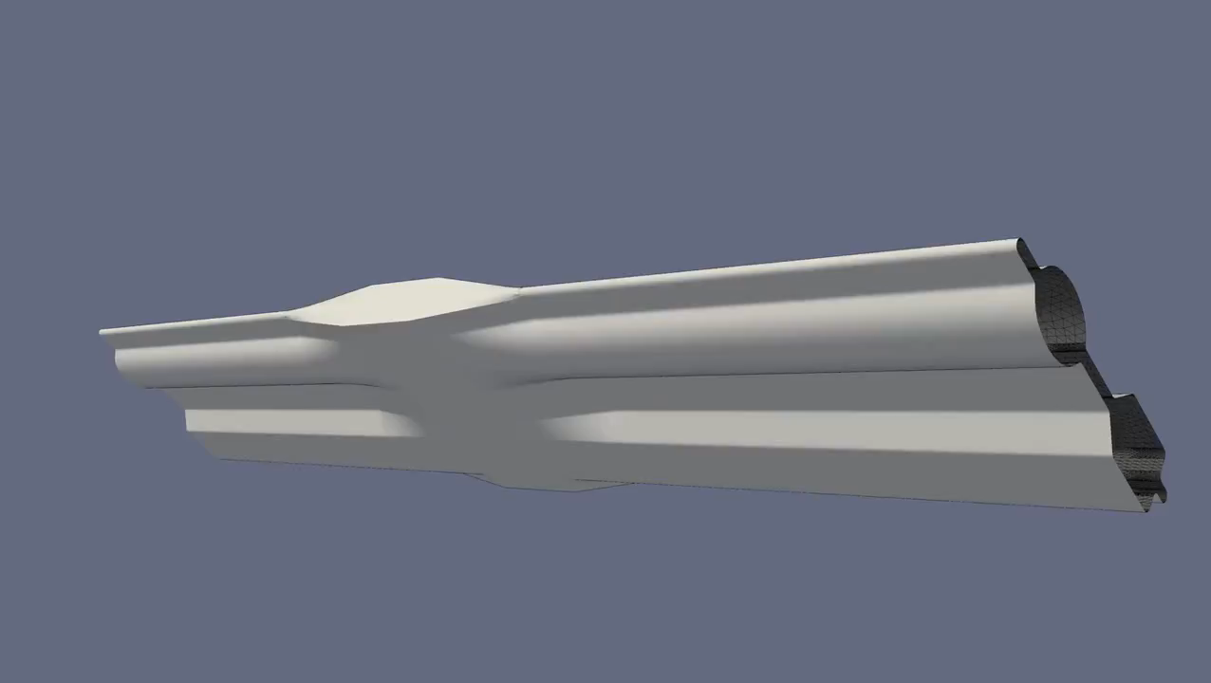
Electromagnetic fields in complex structures
For more complicated geometries the (semi-) analytic methods no longer work. One must rely on computational methods to evaluate the induced electromagnetic fields (FDTD, FEM etc.).
Some examples:
ERL vacuum chamber

Slide 45
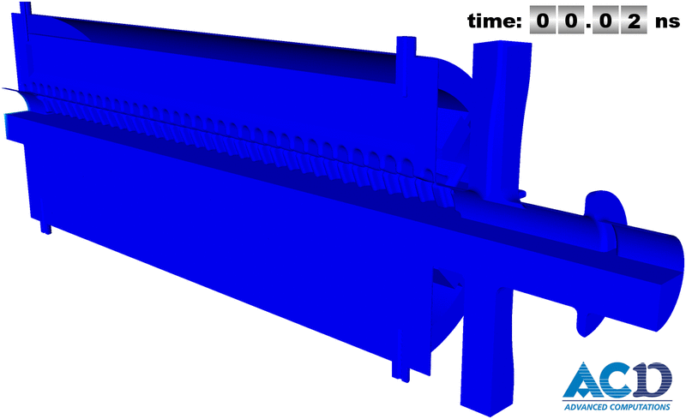
Electromagnetic fields in complex structures
For more complicated geometries the (semi-) analytic methods no longer work. One must rely on computational methods to evaluate the induced electromagnetic fields (FDTD, FEM etc.).
Some examples:
CLIC PETS

Slide 46
Electromagnetic fields in complex structures
For more complicated geometries the (semi-) analytic methods no longer work. One must rely on computational methods to evaluate the induced electromagnetic fields (FDTD, FEM etc.).
In principle, we need to solve the full set of Maxwell’s equations at every time step to obtain the electromagnetic fields at every location within the structure in order to evaluate to forces at the probe particle’s locations. This becomes very tedious and virtually impossible for a 27km ring such as the LHC.
How can we treat these phenomena more effectively in our models?
We normally use a set of assumptions to simplify the problem:
Rigid beam approximation: the beam traverses the discontinuity of the vacuum chamber rigidly
Impulse approximation: what the beam really cares about is the integrated impulse as it completes the traversal of the discontinuity

Slide 47
We have shown on the example of multilayer structures that one can in principle solve Maxwell’s equations to obtain the induced electromagnetic fields by a given charge distribution. We saw that it is possible to decompose these fields. We were able to identify the part that is dependent on the electromagnetic properties of the surrounding material as the wall wake which already led to the idea of wake fields.
We have seen examples of induced electromagnetic fields within complex structures. We will now look at how we can deal with these types of fields more practically by introducing the concept of wake fields.
Part 2: Direct- and indirect space charge, wake fields and impedances
  Direct space charge – impact on machine performance
  Direct space charge – mitigation techniques
  Indirect space charge
  From indirect space charge to (resistive) wall wakes
  Concept of wake fields

Slide 48
In this lecture we discussed indirect space charge and showed that this can lead to both incoherent as well as coherent tune shifts. We then moved on the a more general treatment of electromagnetic fields in simple structures where we were able to identify yet another type of induced fields originating from the electromagnetic properties of the surrounding material – the wall wake.
We also already looked at more general examples of induced fields in complex structures.
Next we will introduce the concept of wake fields and impedances and study the effect of these on the machine and on the beam.
Part 2: Direct- and indirect space charge
  Direct space charge – impact on machine performance
  Direct space charge – mitigation techniques
  Indirect space charge
  From indirect space charge to (resistive) wall wakes

Slide 49

End part 2

Slide 51
Backup

Slide 52
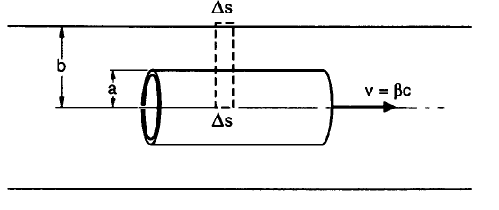
Longitudinal space charge
Longitudinal (direct) space charge can be also computed analytically (via Maxwell’s equations) for cylindrically symmetric bunches of a given transverse density profile n(r):
Note about this formula
  For r=b the longitudinal electrical field vanishes as it should (perfect conducting pipe)
  It diverges for b → ∞ because the analysis breaks down if the bunch length ≤ b/γ

Slide 53
Longitudinal space charge
It has the following interesting dependencies:
It decreases with energy like 1/γ2 and vanishes in the ultra-relativistic limit
It is proportional to the opposite of the derivative of the line density –λ’. This can be understood intuitively because it must be directed from a region with higher charge density to a region with lower charge density (i.e. it pushes with the opposite of the gradient of the line charge)
Longitudinal (direct) space charge can be also computed analytically (via Maxwell’s equations) for cylindrically symmetric bunches of a given transverse density profile n(r):
Note about this formula
  For r=b the longitudinal electrical field vanishes as it should (perfect conducting pipe)
  It diverges for b → ∞ because the analysis breaks down if the bunch length ≤ b/γ
Space charge would then spread out charge bumps. However, remember that only below transition energy, accelerated particles go faster and space charge has this smoothing action. Above transition, accelerated particles take a longer time to go around the accelerator and density peaks can be enhanced. This is the origin of the so-called negative mass instability. Momentum spread (unbunched beams) or synchrotron motion (bunched beams) can usually stabilize this effect.

Slide 54
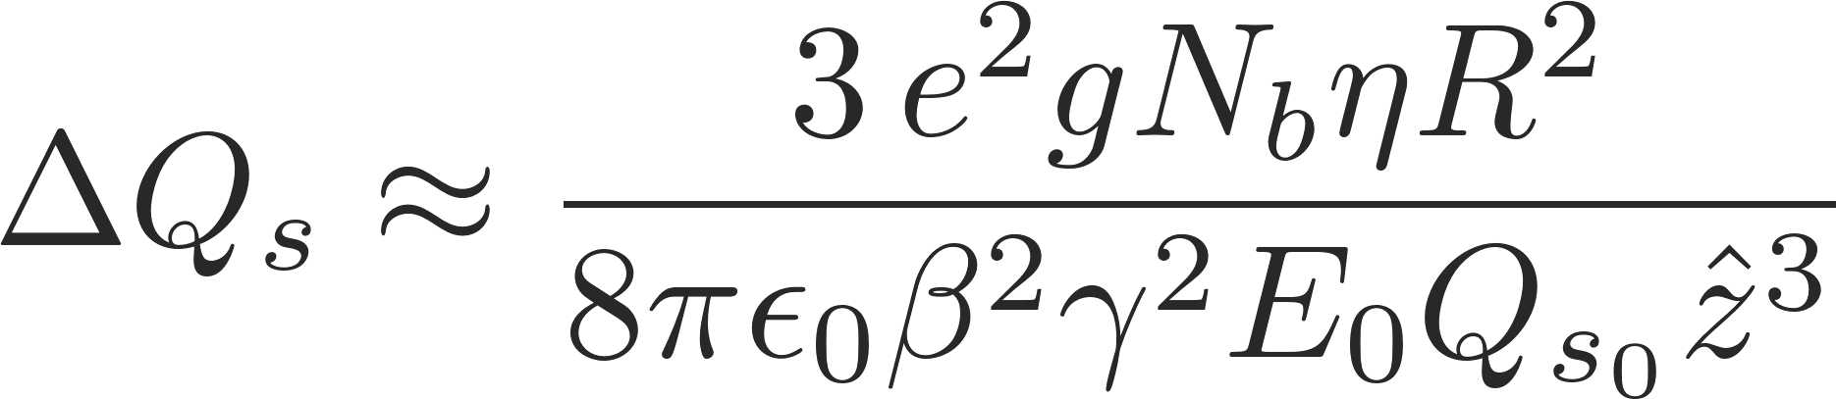
Longitudinal space charge: synchrotron tune shift
Similarly to the transverse plane, longitudinal space charge also leads to a synchrotron tune shift which is proportional to number of particles in the bunch N_{b} (linear)
… example of synchrotron tune shift due to space charge in the radial center of a transverse parabolic bunch
The longitudinal space charge force changes sign when crossing transition:
Quadrupolar oscillations are excited due to the sudden mismatch of the beam distribution at transition
This effect gets stronger with increasing space charge force
To avoid the mismatch, a jump of the RF voltage needs to be programmed similar to the phase jump

Slide 55
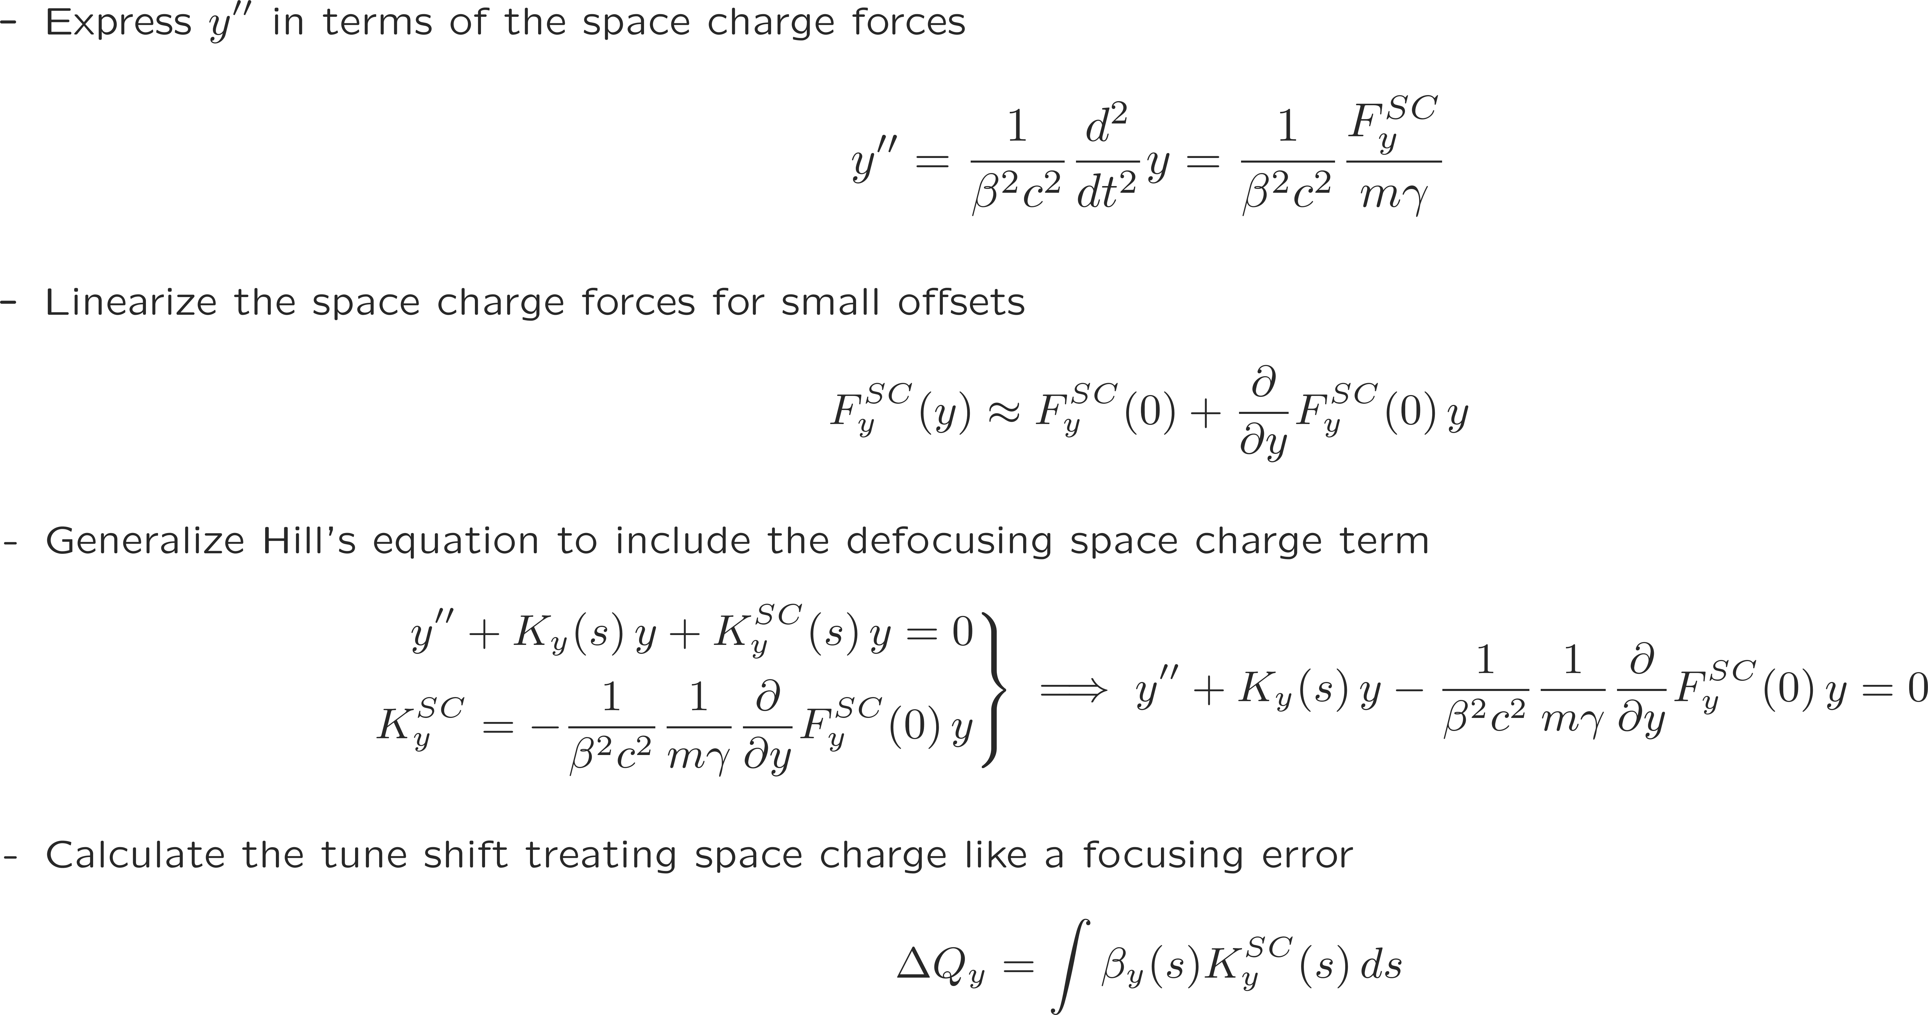
Direct space charge tune shift
The direct space charge force for a beam with uniform charge distribution is linear in x and y
→ results in a direct space charge tune shift
We derive the general expression for the space charge induced tune shift in the vertical plane

Slide 56
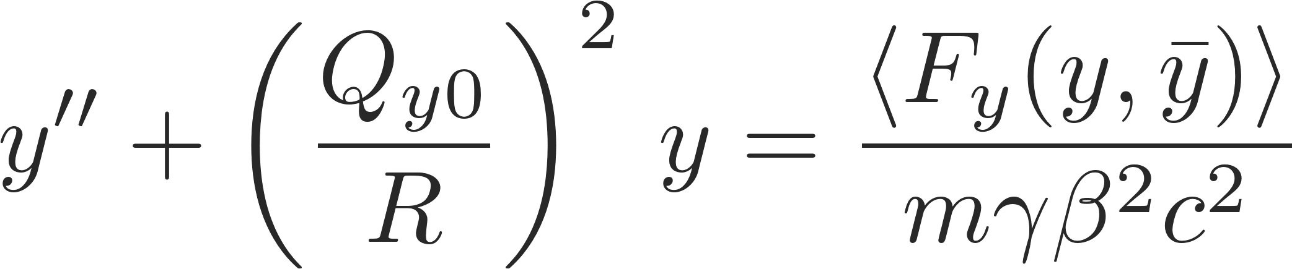
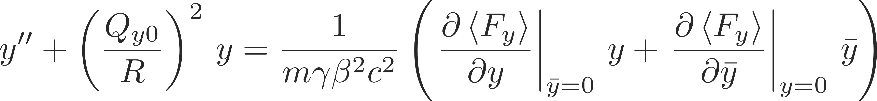
Incoherent vs. coherent tune shift
Indirect space charge generates forces via image charges – these forces are a function of the beam (centroid) offset and the witness particle offsets
We can write down the equation of motion for the (indirect space charge perturbed) betatron motion in smooth approximation as
We linearize the forces for small offsets in y and y̅
In case the induced tune shift is small, we can write
witness particle position
coherent beam position

Slide 57
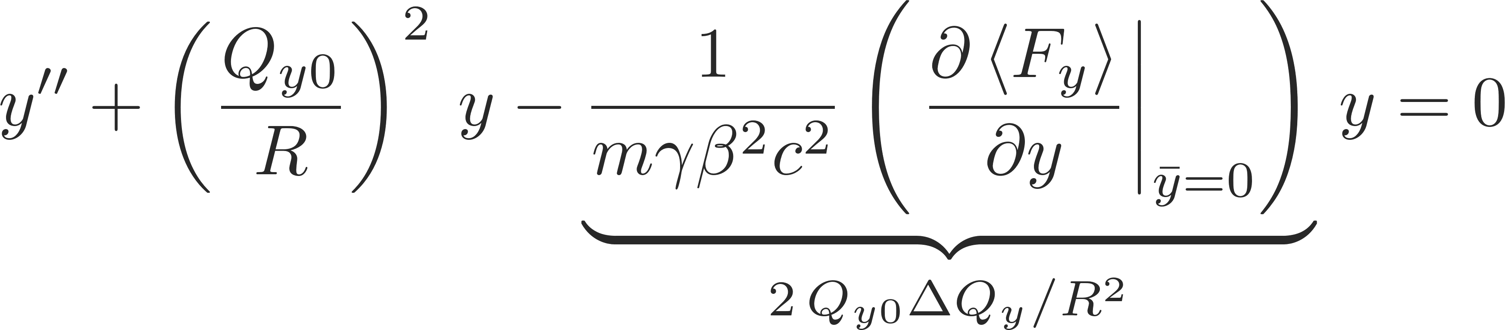
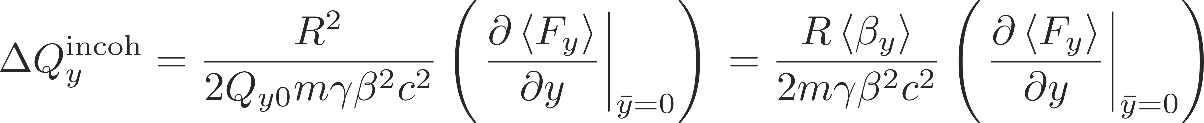
Incoherent vs. coherent tune shift
We linearize the forces for small offsets in y and y̅
The incoherent tune shift of an individual witness particle is obtained when considering the beam as a whole being centered; the second term in the general equation of motion becomes zero and we obtain:
Hence, the incoherent tune shift becomes
witness particle position
coherent beam position

Slide 58
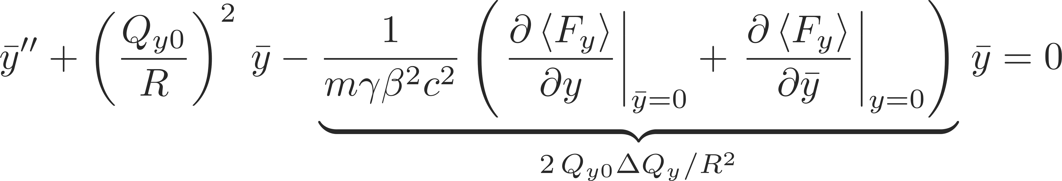
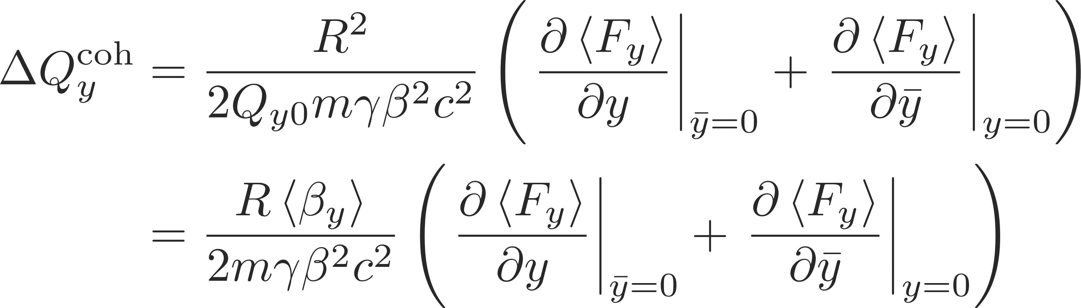
Incoherent vs. coherent tune shift
We linearize the forces for small offsets in y and y̅
The coherent equation of motion evaluates on the beam centroid motion as:
Hence, the coherent tune shift becomes
witness particle position
coherent beam position

Slide 59
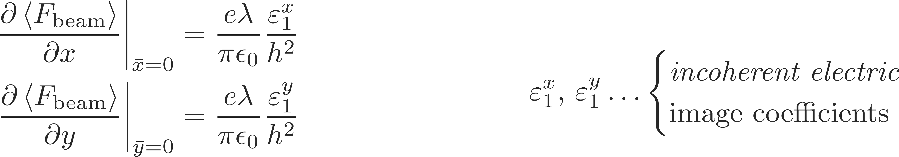
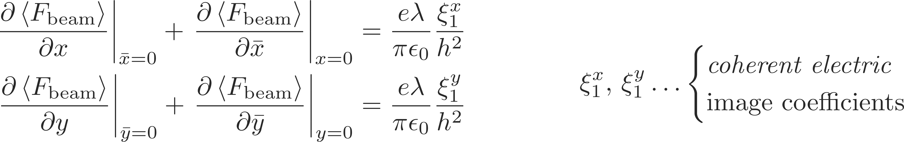
Laslett tune shift from indirect space charge
The coherent and incoherent tune shifts from indirect space charge are given by the derivatives of the image charge forces
In general the contribution from electric images to the inoherent beam force for a variety of geometries can be expressed in terms of Laslett coefficients
Similarly, contribution from electric images to the coherent beam force for a variety of geometries can be expressed in terms of Laslett coefficients

Slide 60
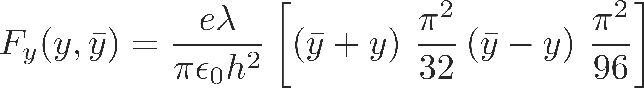
Laslett tune shift from indirect space charge
Incoherent electric Laslett tune shift - special case of two parallel perfect conducting plates
  In the vertical plane we get the Laslett coefficient from the force
  The horizontal force on the witness particle comes only from image charges and therefore it follows from the source free Gauss’ law
Coherent electric Laslett tune shift - Special case of two parallel perfect conducting plates
  In the vertical plane we get the Laslett coefficient from the force
  Due to the translational invariance in the horizontal plane in the case of the two parallel plates it follows that
valid for all geometries not valid in general

Slide 61
Overview of force contributions
The indirect space charge contributions from the different image charges and currents to the coherent and incoherent beam force are summarized below
  As mentioned before, the magnetic force due to image currents in the vacuum chamber (ac components) are described by the electric image coefficients
  The ac coherent component corresponds to betatron beam oscillations

Slide 62
Indirect space charge: incoherent tune shift
We found the expression for the coherent tune shift as function of the beam force as
  In the second step the tune shift is written in terms of the average beta function instead of the betatron tune (as given by the smooth approximation) – like this we can refine our model and account for different geometries around the machine
Collecting all contributions to the incoherent incoherent tune shift we find for the general case of bunched beams
  For coasting beams the peak line density is equal to the average line density
  The F factor corresponds to the ratio of the circumference surrounded by ferromagnetic material

Slide 63
Indirect space charge: coherent tune shift
The general expression of the coherent tune shift is obtained as
Here we need to consider two cases
  Betatron oscillations are of such low frequency that the induced magnetic field can penetrate through the vacuum chamber
  Magnetic fields from both betatron oscillations and longitudinal bunching cannot penetrate the vacuum chamber

