Slide 1


Introduction to Longitudinal
Hands-on Calculations
S. Albright, H. Damerau,
A. Lasheen, F. Tecker
CERN
Introduction to Accelerator Physics
16 September 2019

Slide 2
Outline
Introduction
Design of RF systems
  Design flow and constraints
  Examples of RF systems at CERN
Longitudinal particle tracking
  Basic tracking equations
  Single and multiple particle tracking
Summary

Slide 3
Introduction

Slide 4
Study interaction between beam and RF
Complementary approaches for the same problem
(Semi-)Analytical | Numerical: tracking
Describe particle motion by differential equations Continuous trajectories of particle motion Deduce useful parameters for stable acceleration: RF bucket Synchrotron frequency Stable phase ... | Track particle parameters from turn to turn Profit from discretization of motion: turn-by-turn No notion of RF bucket, synchrotron, stable phase, etc. Follow ensemble of particles to study evolution of bunch
Classical introduction of longitudinal beam dynamics | Flexible brute-force approach

Slide 5
Study interaction between beam and RF
Complementary approaches for the same problem
(Semi-)Analytical | Numerical: tracking
Describe particle motion by differential equations Continuous trajectories of particle motion Deduce useful parameters for stable acceleration: RF bucket Synchrotron frequency Stable phase ... | Track particle parameters from turn to turn Profit from discretization of motion: turn-by-turn, RF station-by-RF station No notion of RF bucket, synchrotron, stable phase, etc. Follow ensemble of particles to study evolution of bunch
Classical introduction of longitudinal beam dynamics | Flexible brute-force approach

Slide 6
Study interaction between beam and RF
Complementary approaches for the same problem
(Semi-)Analytical | Numerical: tracking
Describe particle motion by differential equations Continuous trajectories of particle motion Deduce useful parameters for stable acceleration: RF bucket Synchrotron frequency Stable phase ... | Track particle parameters from turn to turn Profit from discretization of motion: turn-by-turn, RF station-by-RF station No notion of RF bucket, synchrotron, stable phase, etc. Follow ensemble of particles to study evolution of bunch
Classical introduction of longitudinal beam dynamics | Flexible brute-force approach

Slide 7
Objectives of longitudinal hands-on
Design RF system (upgrade)
  LongitudinalHandsOnDraftRFSystemCalculations_empty.ipynb
  Study boundary constraints
  Derive requirements for RF system
  Choose main components
  Compare with existing facilities
Play with longitudinal beam dynamics
  LongitudinalHandsOnDraftTracking_empty.ipynb
  Build your own particle tracker
  Understand motion of particles in longitudinal phase space
  Transition from single particle motion to evolution of an entire bunch

Slide 8
RF system design
Tomorrow afternoon

Slide 9
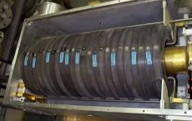
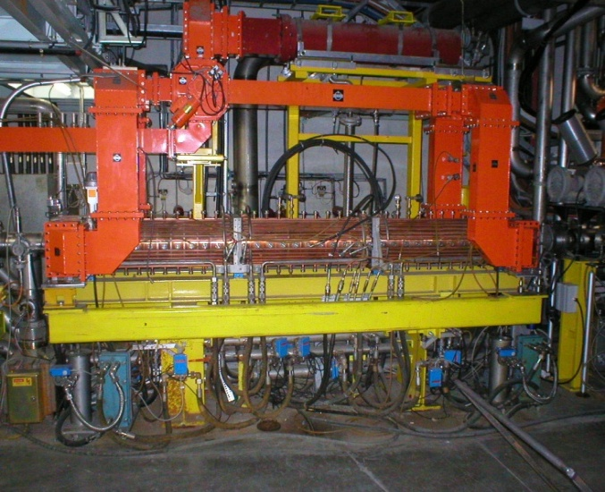
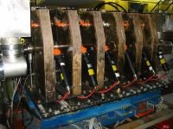
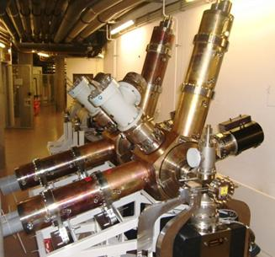
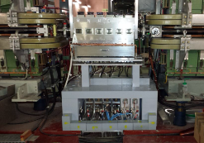
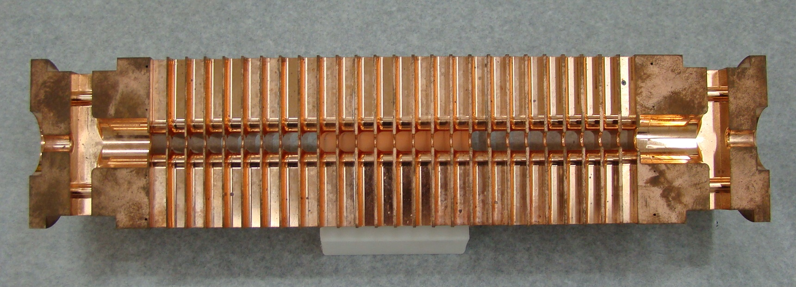
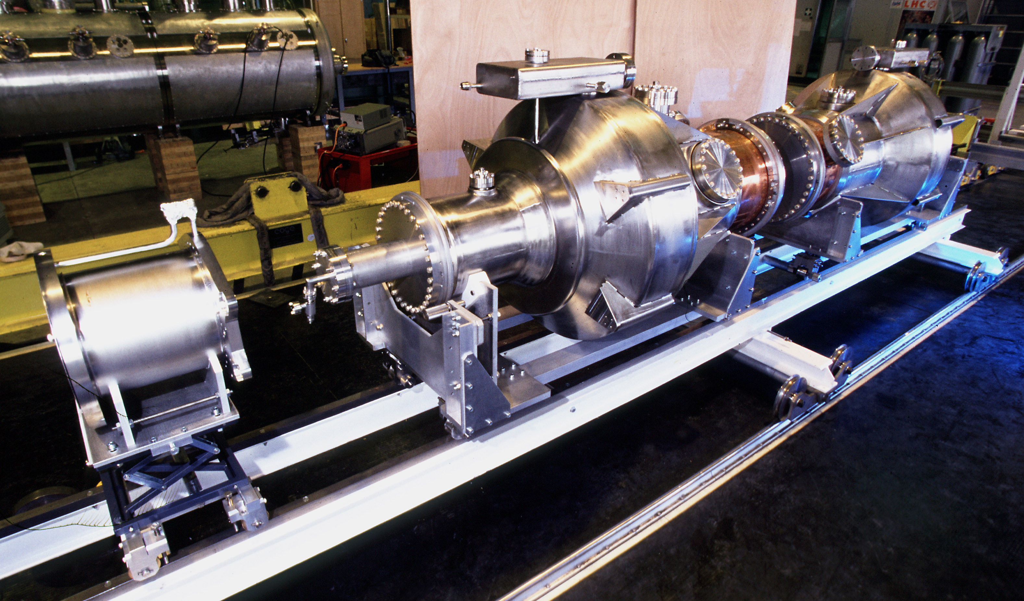

Introduction
What to do to design an RF system?
How to choose the right one?

Slide 10
Simplified design work flow
Accelerator and
beam parameters
Ramp rate limitations
Magnetic cycle, B(t)
  Revolution frequency swing
  Voltage gain per turn during cycle
  Harmonic number, RF frequency range
  Voltage program during the cycle
  Choice of RF system: number of cavities, type, …

Slide 11
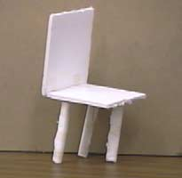
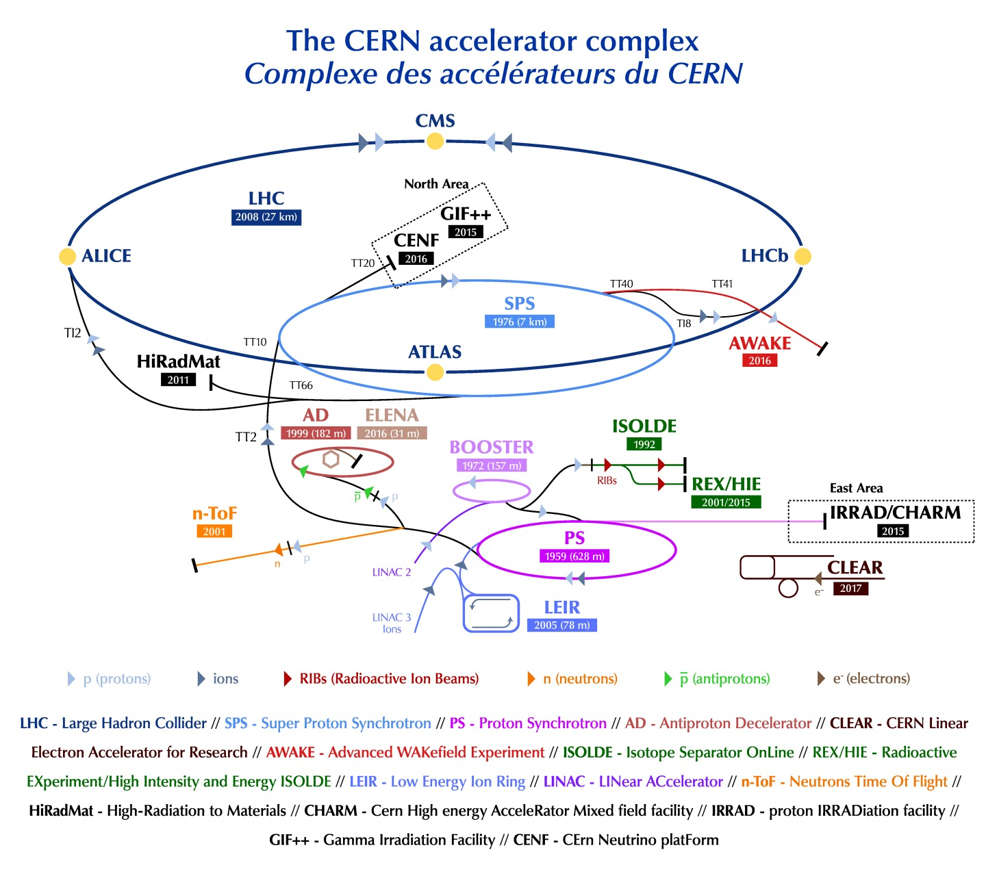
RF parameters of existing accelerators
Try to follow design choices of existing accelerator
  Can we understand the arguments?
  Are the choices reasonable?
Good design?
Accelerators at CERN
Linac2/4 | 50 MeV → 160 MeV
PS Booster | 1.4 GeV/2 GeV
PS | 26 GeV/c
SPS | 450 GeV/c
LHC | 7 TeV
Intensity with 25 ns | 1.3 · 10¹¹ ppb → >2 · 10¹¹ ppb

Slide 12
Proton Synchrotron

Slide 13
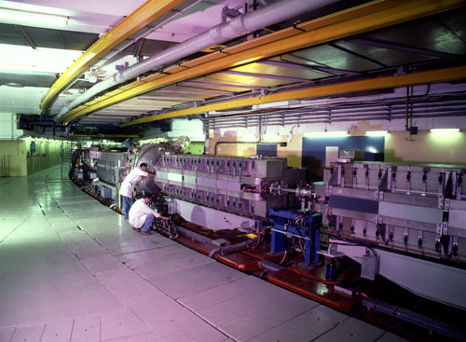
Example: RF System for CERN PS
Attention
  Present RF system designed in ~1969
  Not the same energy range as today
Parameter | Value
Circumference, 2πR | 2π ∙ 100 m = 628 m
Acceleration time, t_{cycle} | 1 s
Maximum ramp rate, dB/dt | 2.3 T/s
Injection energy, E_{kin} | 45 MeV
Flat-top energy, E_{tot} | initially 28 GeV
Revolution frequency at injection, f_{rev,inj} | 143 kHz
at flat-top, f_{rev,FT} | 477 kHz
Relative frequency swing | 3.33

Slide 14
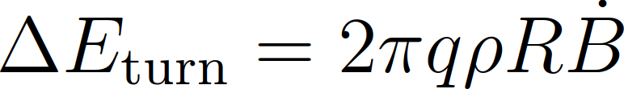
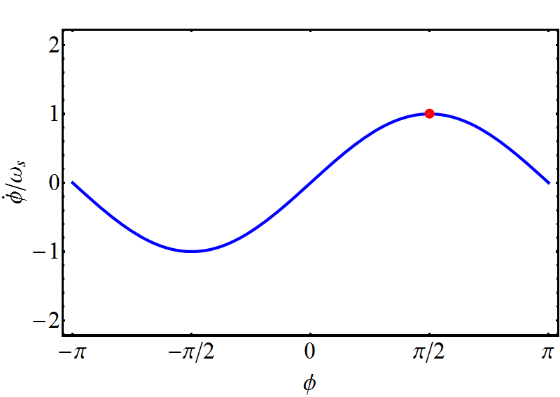
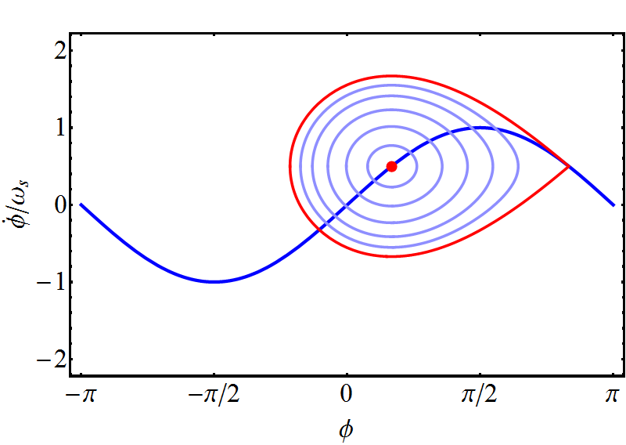
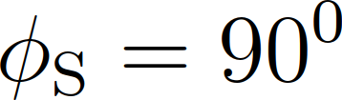
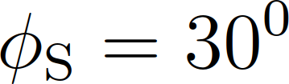
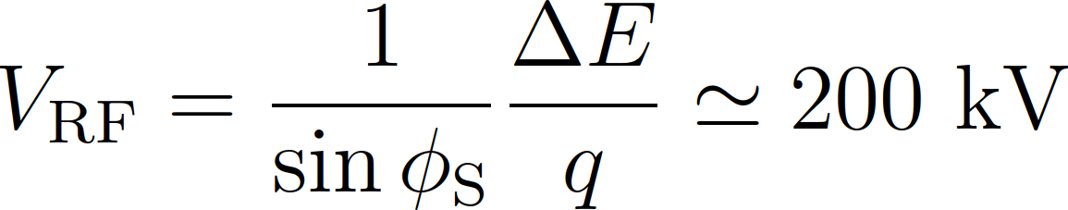
Example: CERN PS - choice of RF voltage
Energy gain per turn defined by size and ramp rate
At 2.3 T/s ramp rate: ~100 keV gain per turn
Just sufficient to accelerate synchronous particle
Over-voltage for bucket area:

Slide 15
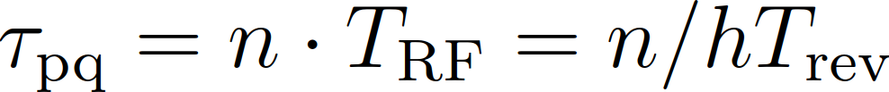
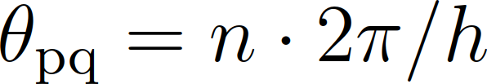
Example: CERN PS - choice of RF harmonic
Operate RF stations in phase with respect to beam
Use common RF signal
2
Time of flight, τ_{nm} between RF cavities:
Multiple of RF period
τ₁₂
1
τ₂₃
θ₁₂
θ₂₃
3
RF
RF stations must be located an multiples of 2π/h

Slide 16
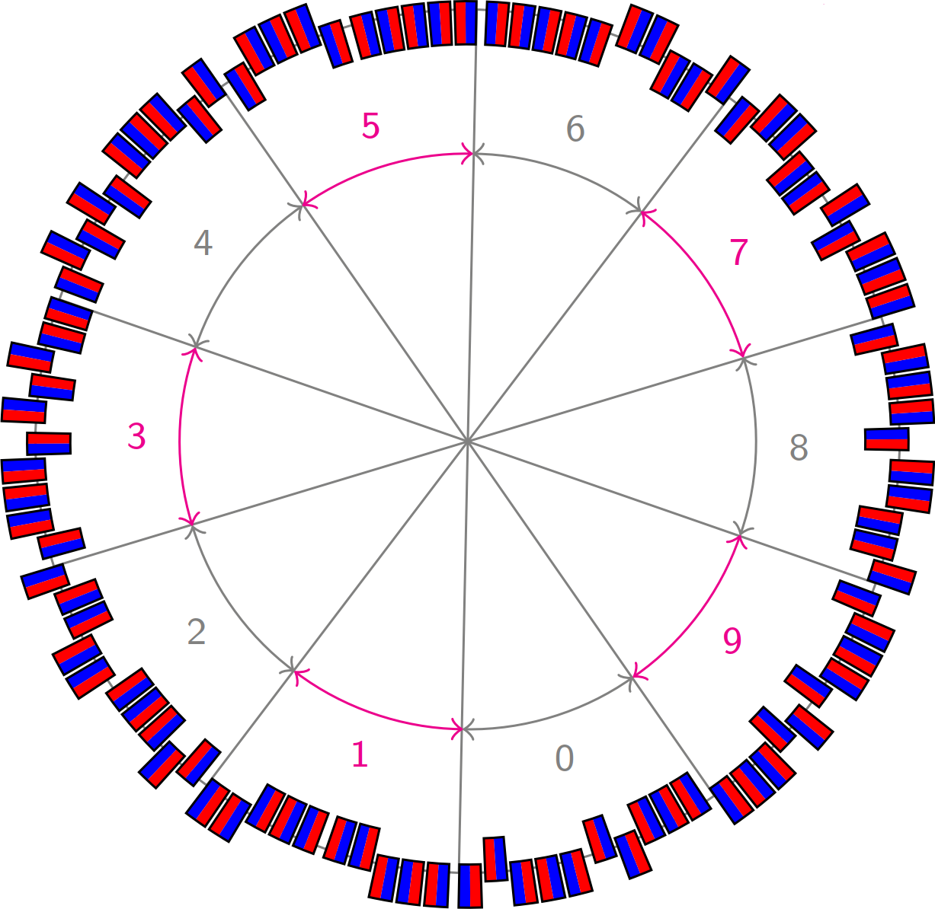
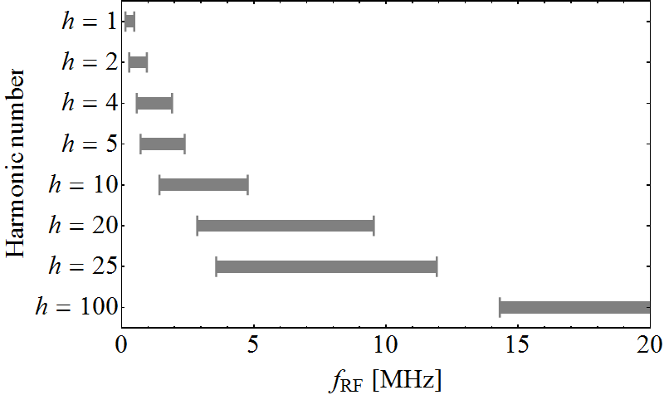
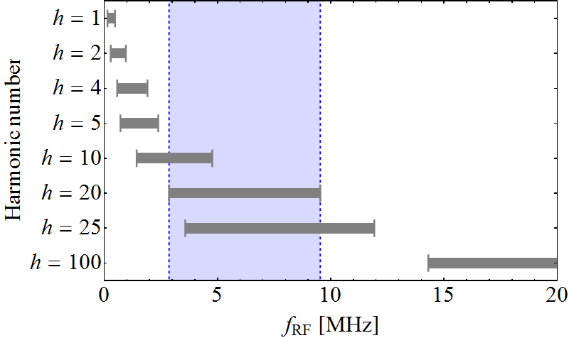
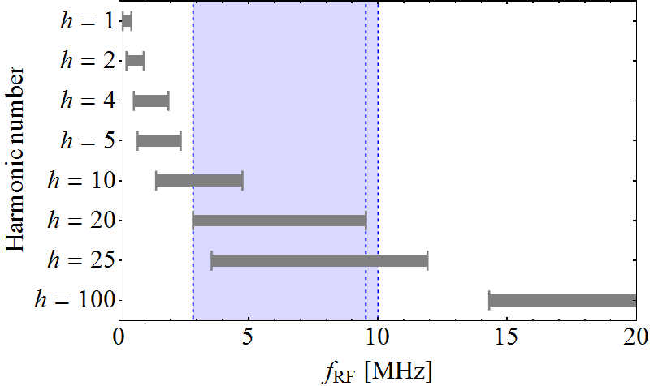
Example: CERN PS - choice of harmonic
Main elements: 100 bending magnets
100 possible location for RF stations in-between
100 = 2 ∙ 2 ∙ 5 ∙ 5, hence divisible by 2, 4, 5, 10, 20, 25, 50
Distribute total RF voltage over many cavities
Possible harmonic numbers 20 or 25
→ h = 20 retained

Slide 17
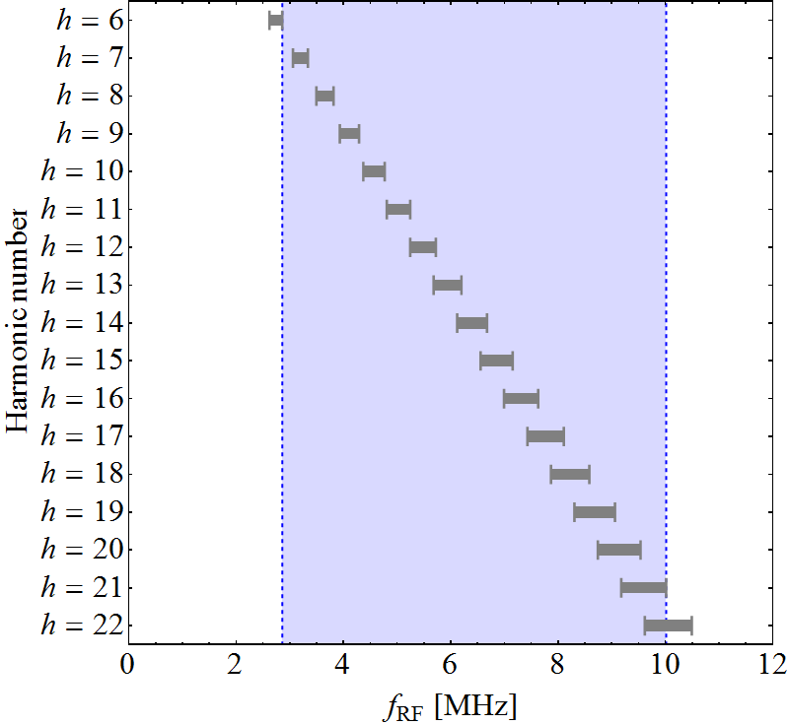
Example: CERN PS choice of harmonic
Distance between RF stations: multiples of 2π/20
No need to use common RF with todays technology
Injection energy at 1.4 GeV (2 GeV) → 10% (5%) swing
Early design choices based on h = 20
Today’s flexibility

Slide 18
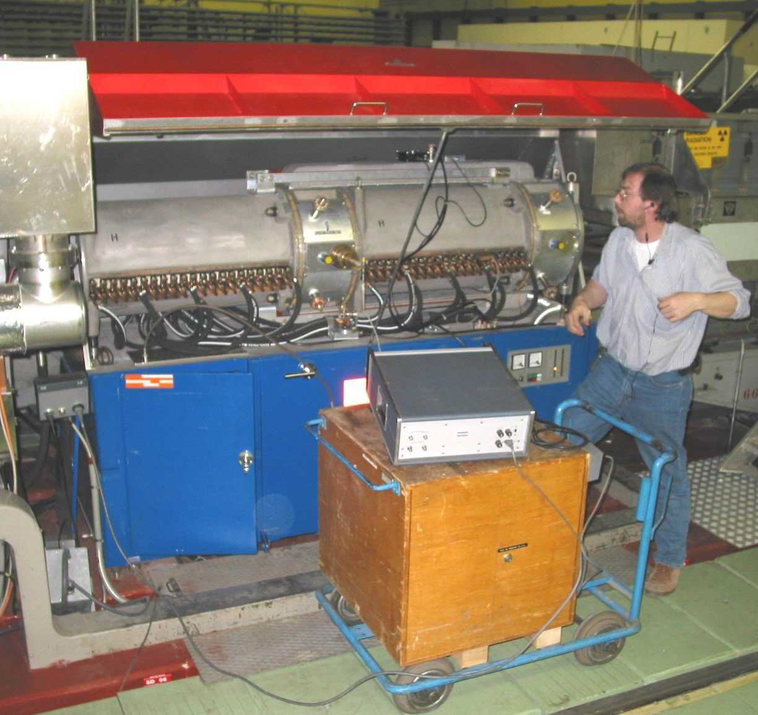
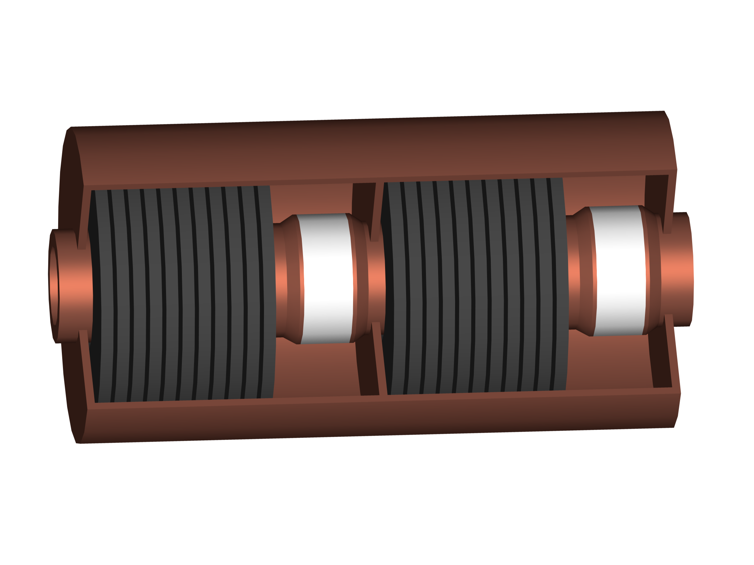
Example: CERN PS choice of cavity
RF system parameters:
Distribute voltage over 10 RF stations: 20 kV/cavity
Parameter
Harmonic, h | 7…, 20, 21
Frequency, f_{RF} | 2.8-10 MHz
Voltage, V_{RF} | 10 (+1) × 20 kV
Shortened λ/4 coaxial resonators with ferrite tuning
10 kV
10 kV
Beam
Beam
Ferrite stacks for shortening and tuning
Accelerating
gaps

Slide 19
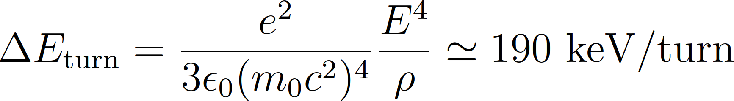
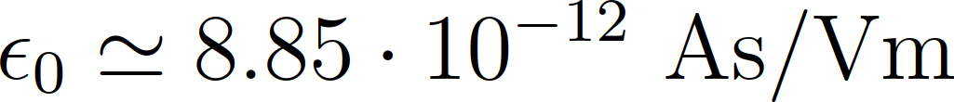
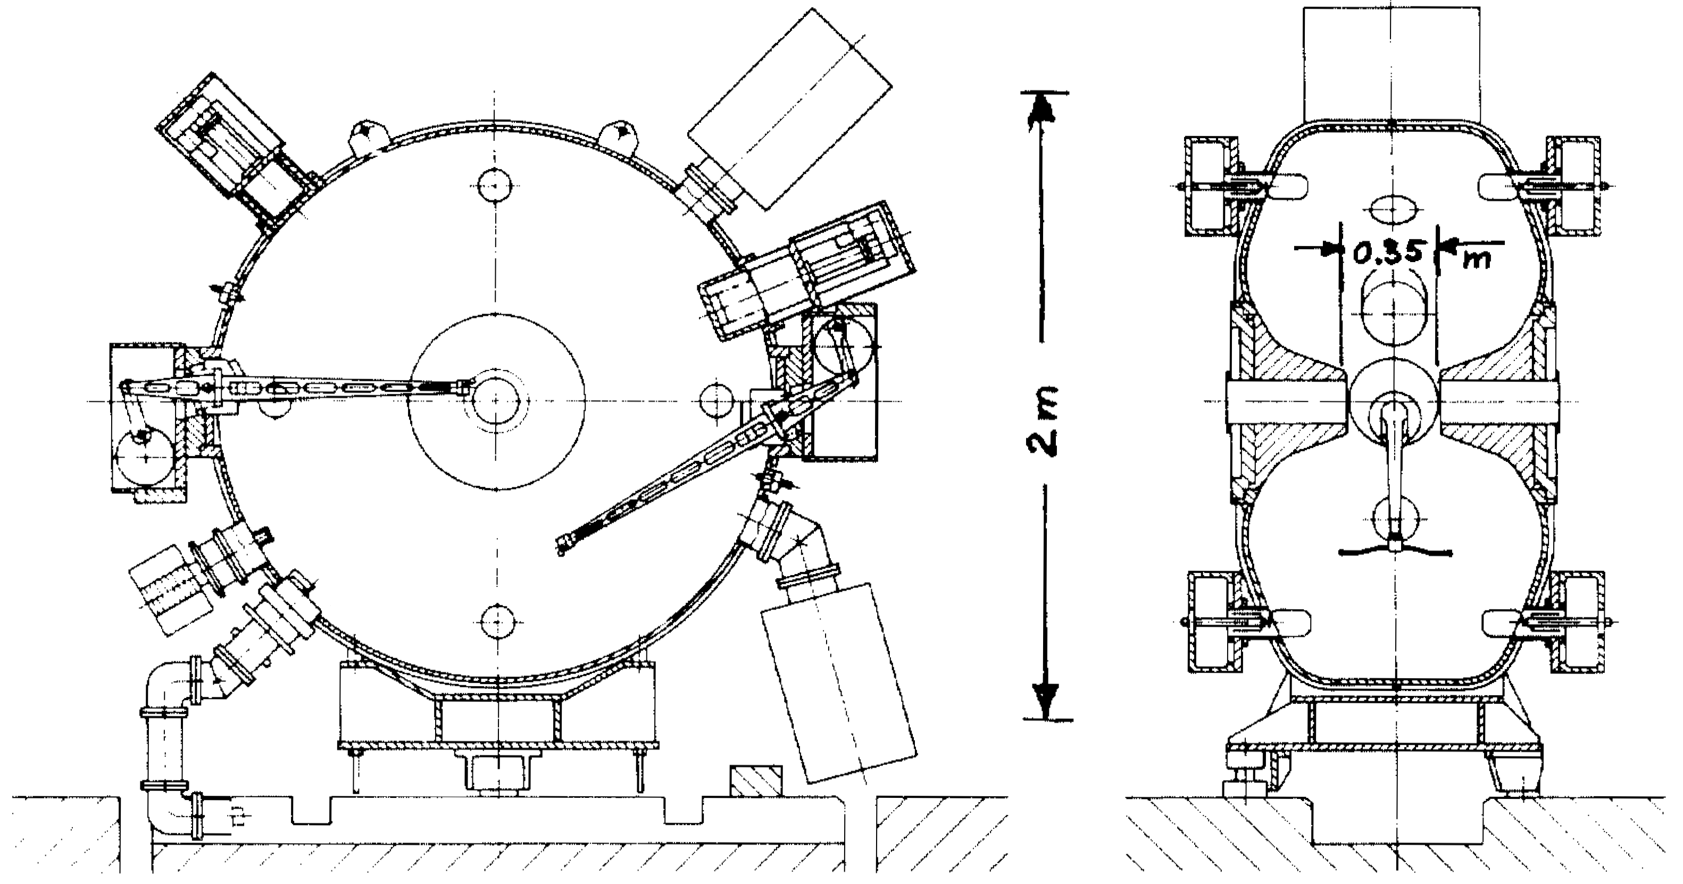
Electrons in the PS
As an injector of LEP electrons were accelerated
in the PS to E = 3.5 GeV
Is the RF system for acceleration of protons usable?
Bucket area too small and bunches too long at 3.5 GeV
Optimized RF system for electron acceleration
Parameter
Harmonic, h | 240
Frequency, f_{RF} | 114 MHz
Voltage, V_{RF} | 1 MV
(5 × more than 10 MHz cavities)

Slide 20
PS Booster

Slide 21
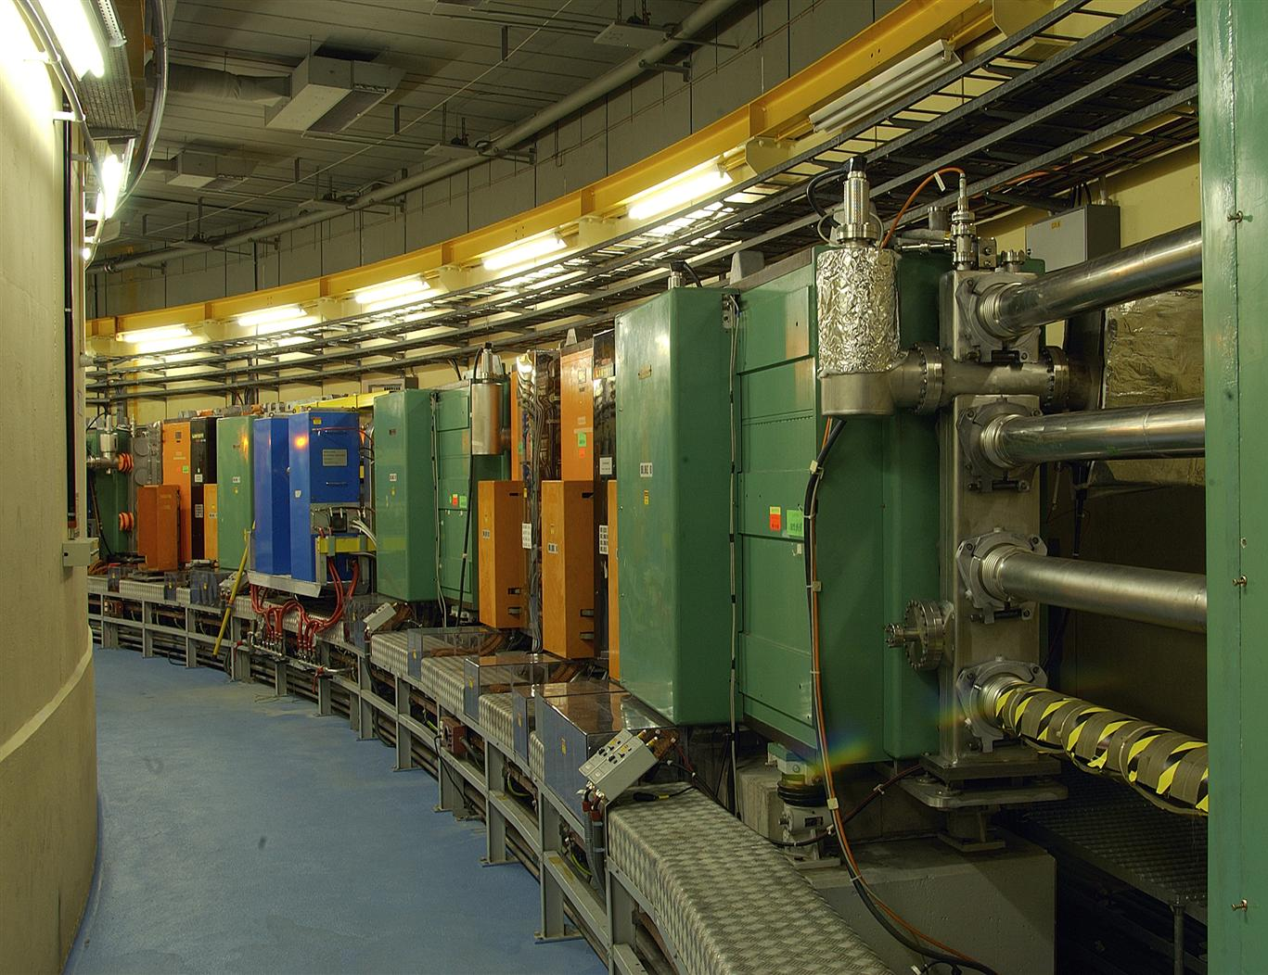
Example: RF System for CERN PS Booster
PS injector synchrotron
  2πR_{PSB} = 2πR_{PS}/4
  Sandwich of 4 rings
  Total length as PS circumference
Parameter | Value
Circumference, 2πR | 2π ∙ 25 m = 157 m
Acceleration time, t_{cycle} | 1 s
Maximum ramp rate, dB/dt | 2.3 T/s
Injection energy, E_{kin} | 50 MeV
Flat-top energy, E_{kin} | 0.8/1.0/1.4/2.0 GeV
Revolution frequency at injection, f_{rev,inj} | 600 kHz
at ejection, f_{rev,ej} | 1.81 MHz
Relative frequency swing | 3

Slide 22
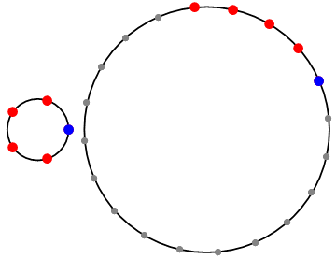
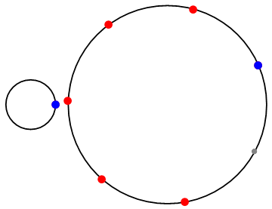
Example: CERN PS Booster (PSB)
Circumference 2πR_{PSB} = 2πR_{PS}/4 = 157 m
Initial design as PS injector
f_{RF,PSB} = f_{RF,PS}
h_{PSB} = h_{PS}/4 = 5
Modifications as pre-
injector to LHC:
Parameter
Harmonic, h | 1 or/and 2
Frequency, f_{RF} | 0.6…1.8 MHz
Voltage, V_{RF} | 8 kV

Slide 23
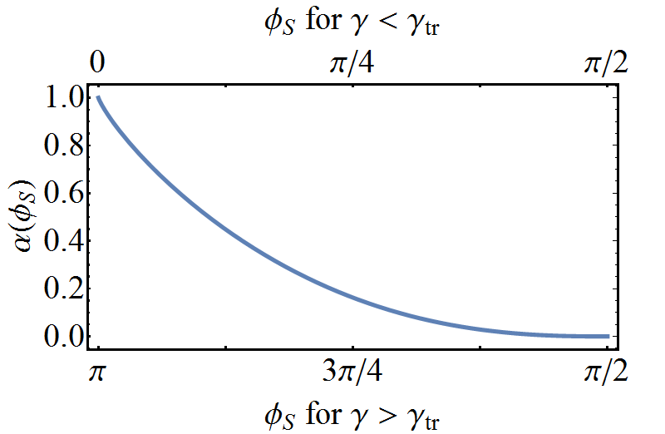
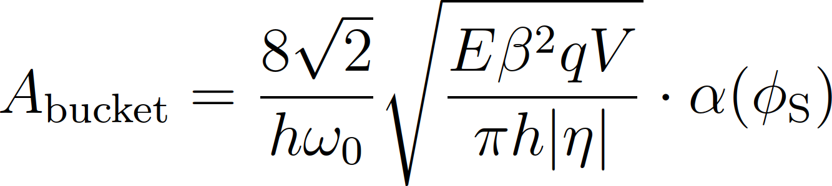
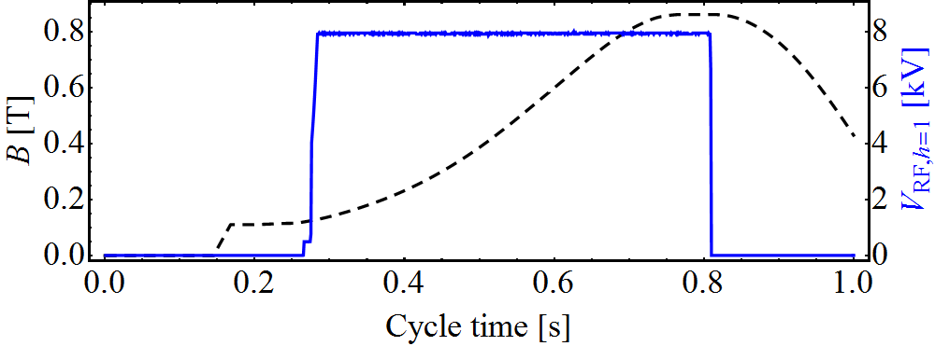
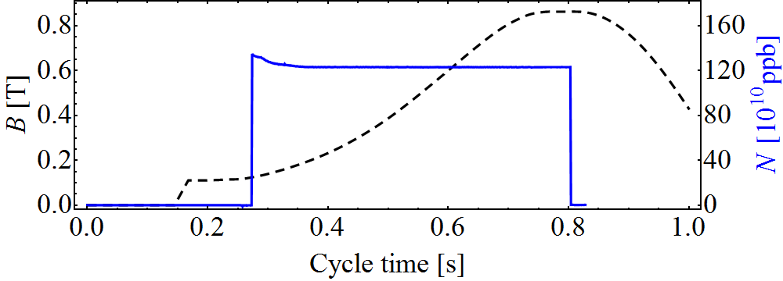
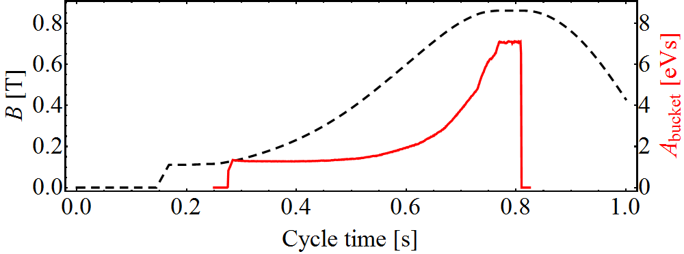
Example: CERN PSB (single harmonic, h = 1)
Bucket area:
Depends on:
Bending field, B and ramp rate dB/dt
RF voltage, V
Bending field and RF voltage
Beam intensity
Bucket area

Slide 24
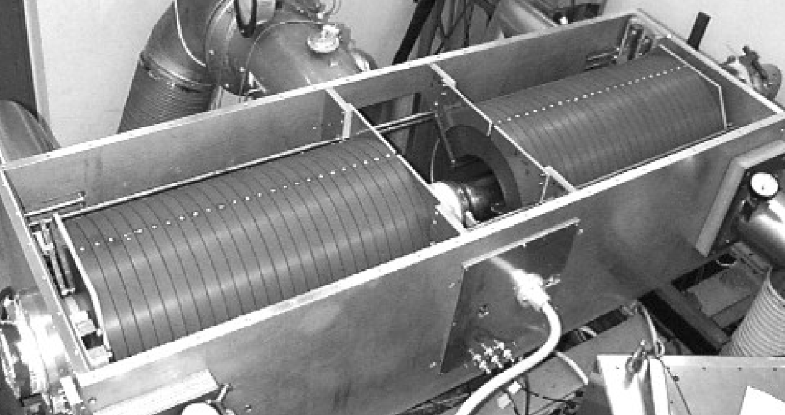
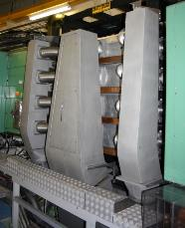
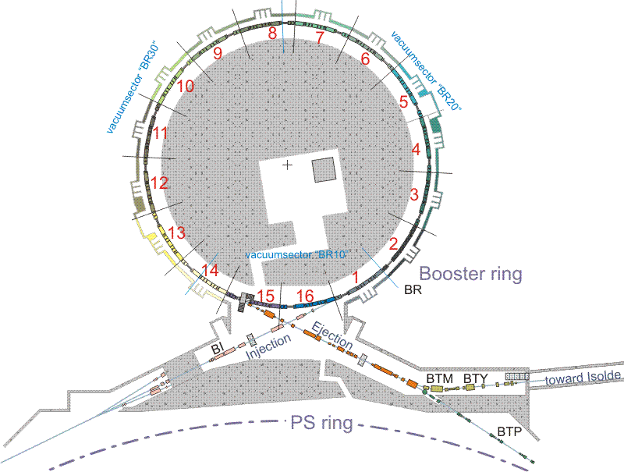
RF systems in the PS Booster
0.6 – 1.8 MHz, 8 kV
7
10
PSB
5
Acceleration and splitting
1.2 – 3.8 MHz, 8 kV
13
6 – 16 MHz
Controlled longitu-dinal blow-up
Acceleration and splitting
4 rings with 3 cavities
PS Booster RF systems based on tuned ferrite cavities

Slide 25
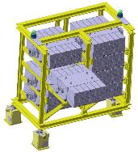
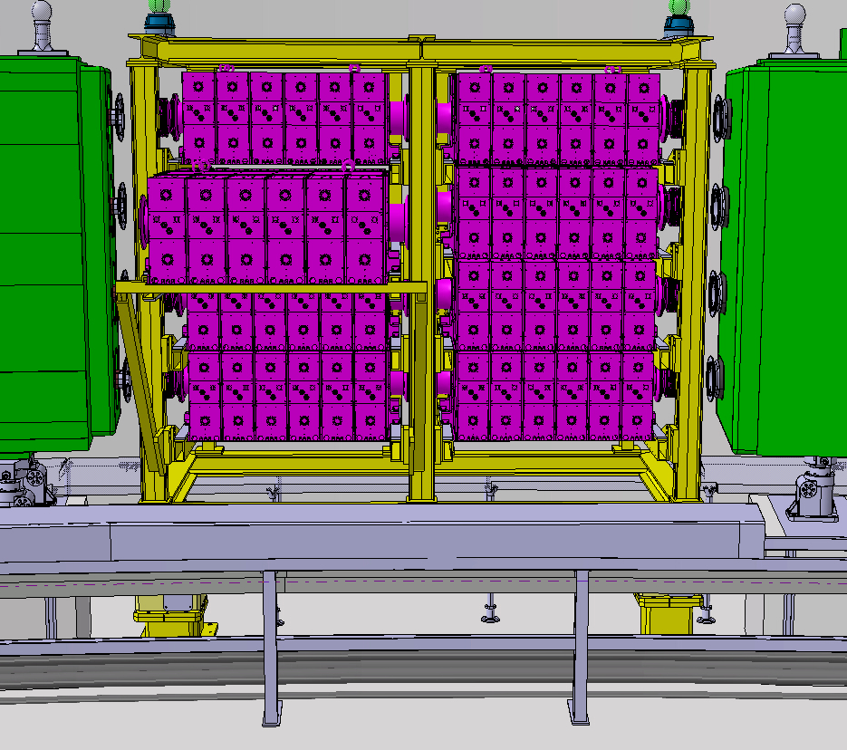
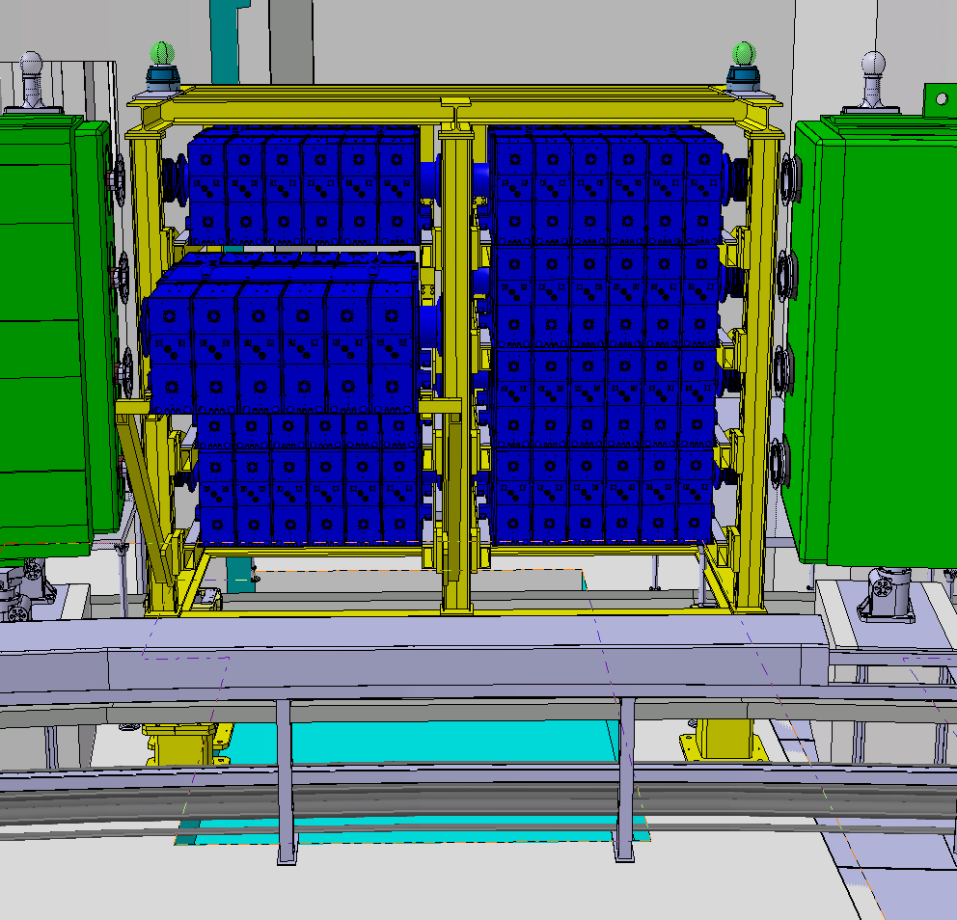
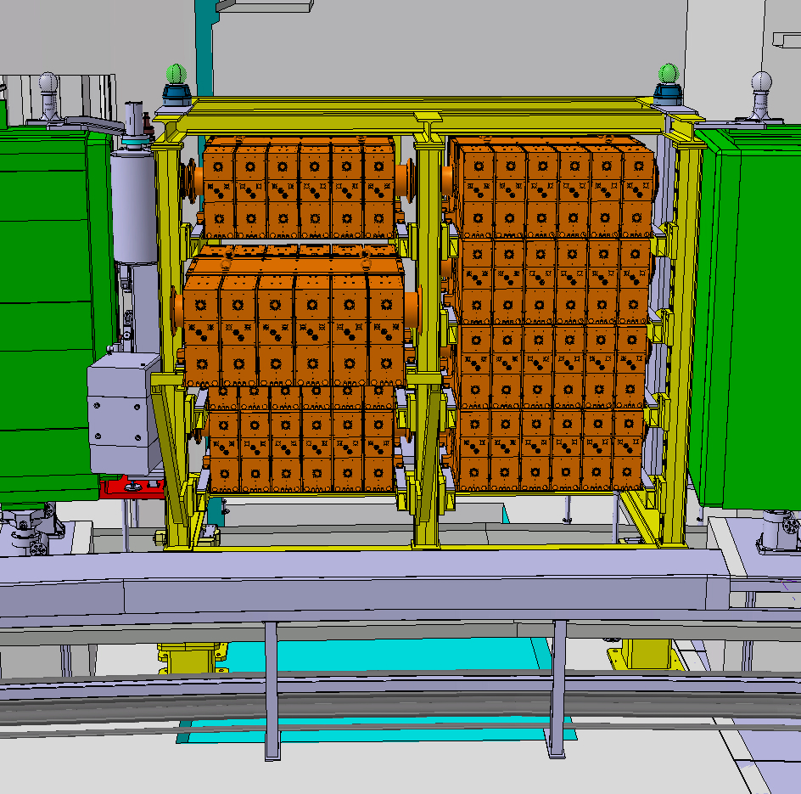
RF systems in the PS Booster after upgrade
7
10
Collaboration with KEK/JPARC
PSB
5
13
New wide-band cavities covering h = 1, 2, and higher
Based on innovative Finemet material
Much increased flexibility

Slide 26
Super Proton Synchrotron

Slide 27
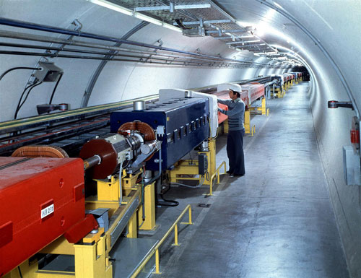
Example: RF System for CERN SPS
Needs significantly more
RF voltage: several MV
Parameter | Value
Circumference, 2πR | 2π ∙ 1.1 km = 6.91 km
Acceleration time, t_{cycle} | 1 s
Maximum ramp rate, dB/dt | ~0.74 T/s
Injection Energy, E_{tot} | initially 10 GeV
Flat-top energy, E_{tot} | 450 GeV
Relativistic beta, β = v/c at injection | 0.9955885
at flat-top | 0.9999978
Relative frequency swing | 0.44%

Slide 28

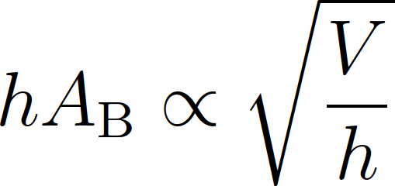
Example: SPS - choice of RF harmonic
Harmonic number should be multiple of
Revolution frequency ratio of PS and SPS | 11
Acceleration harmonic in the PS | 20
Super-periodicity of SPS | 6
Looking for multiples of 660
h | 660 | 1320 | 1980 | 2640 | 3300 | 3960 | 4620 | 5280 | 5940
f_{RF} [MHz] | 29 | 57 | 86 | 115 | 143 | 172 | 200 | 229 | 258
Lower RF frequency | Higher RF frequency
Total bucket area: Insufficient at inj. for h > 5500 | Mechanically smaller cavities
 | Higher shunt impedance easier to achieve → power efficiency
Magnetic tuning only possible at f_{RF} < 100 MHz) | Higher breakdown voltages
Y

Slide 29
Example: SPS choice of RF cavities
Requirements:
How to build such an RF system?
Cavity resonator would need tuning or low Q < 1/0.44% ≈ 230
Parameter
Harmonic, h | 4620
Frequency, f_{RF} | 200 MHz
Bandwidth, Δf_{RF} | 0.44%
Voltage, V_{RF} | Few MV
Mechanically
tuned cavity
Travelling wave
structure
Avoid cycling
mechanics in vacuum
High voltage in
moderate bandwidth

Slide 30
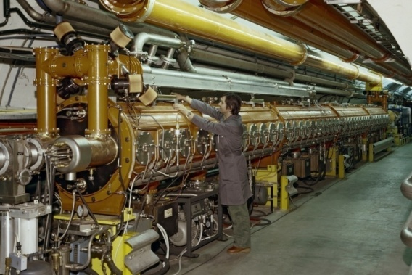
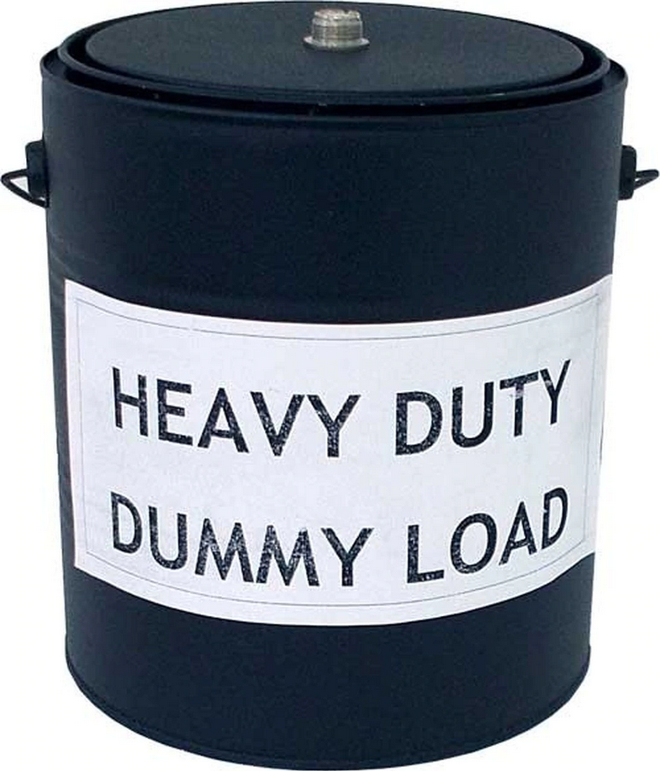
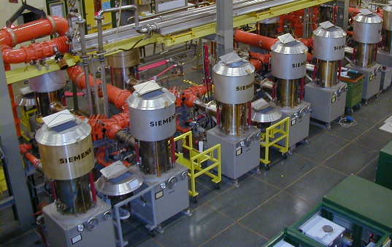
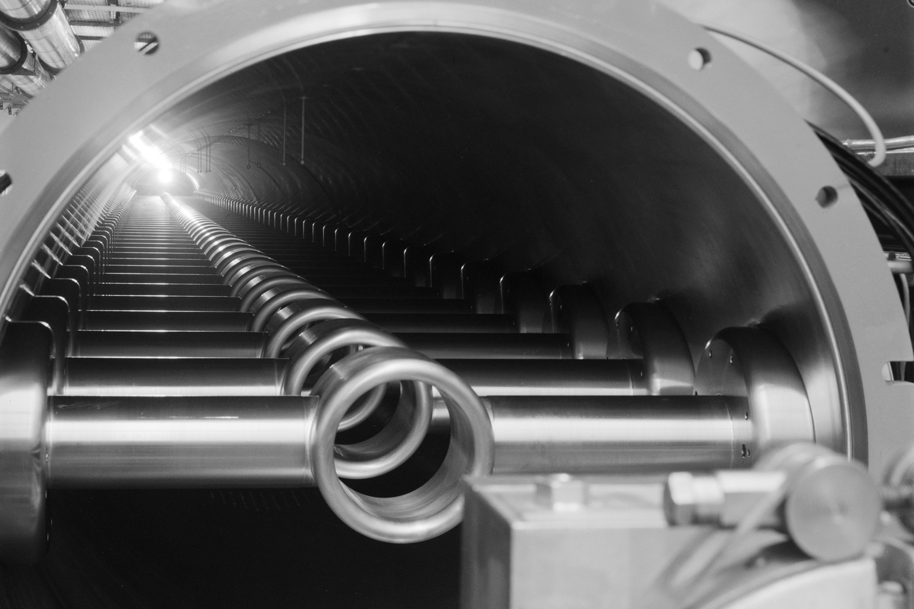
Example: SPS travelling wave cavities
Multi-cell structure operated as a waveguide
Sufficient bandwidth without mechanically moving parts
Travelling wave structure always matched to amplifier
Beam takes power it needs from the waveguide
P_{load} = P_{in} – P_{beam} – P_{loss}
Beam
RF power
RF power

Slide 31
Large Electron Positron
and Hadron Colliders

Slide 32
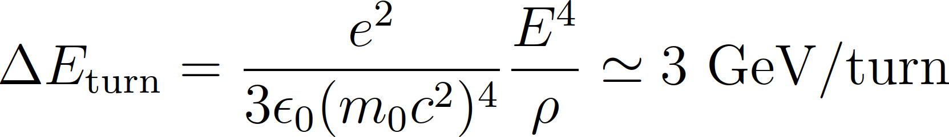



Ex.: RF against synchrotron radiation in LEP
LEP energy was entirely dominated by synchrotron radiation
At E = 100 GeV:
About 3 % of beam energy
lost each turn
RF voltage and beam energy

Slide 33

Example: LHC
LHC maximum energy and ramp rate limited by super-conducting bending magnets: 20 minutes ramp time
Average energy gain per turn only ΔE_{turn} ≈ 500 keV/turn
Revolution frequency stays almost constant
RF voltage required to keep
bunches short
Superconducting cavities chosen
to reduce beam induced voltage
(small R/Q)
8× per beam
Parameter (per beam)
Harmonic, h | 35640
Frequency, f_{RF} | 400.8 MHz
Voltage, V_{RF} | 16 MV
(cf. LEP: 3.5 GeV)

Slide 34

You will design an RF system (upgrade)
Protons accelerator: Special RF system for the CERN PS
Electron storage ring: Energy and current upgrade
… tomorrow

Slide 35
Longitudinal tracking
this afternoon

Slide 36
Tracking simulation flow
Accelerator parameters
RF system parameters
Generate initial distribution
Tracking
Plot and analyse results
Compare with measurements
Follow the coordinates of one or more particles determine its behaviour

Slide 37





Circular accelerator without RF system
ring
Particles with higher or lower momentum have a different orbit compared to a reference particle
Arrival time/phase depends on energy
, phase slip factor:

Slide 38






Arrival phase of a particle at next turn
Turn-by-turn drift equation
Azimuth, θ or phase, φ a particles arrives next turn

Slide 39

Circular accelerator with RF station
Particle energy changes at passage through cavity
For sinusoidal RF voltage:
With acceleration:
Reference particle:
General energy change:

Slide 40



Multiple RF stations
RF systems modelled point-like mostly valid approximation
Valid in most cases
Exceptions:
  Large synchrotron tune f_{S}/f_{rev}
  Strong intensity effects: interaction within one turn
  Beam energy changing during turn
LHC
SPS

Slide 41






Multiple RF stations
RF Manipulations
2.8 – 10 MHz
51
56
46
66
40 MHz
Acceleration
76
77
36
78
80
to SPS
81
86
88
89
91
96
92
80 MHz
11
8
6
2
200 MHz
Longitudinal blow-up
0.4 – 5 MHz
20 MHz
Small f_{S}/f_{rev}: Single kick per turn fully sufficient

Slide 42


Example: Electrons and positrons in LEP
Beam energy changed in LEP along turn due to strong synchrotron radiation
Positrons
4 × 2 RF sections
Energy loss in bending magnets
Track from RF section to RF section
Electrons

Slide 43


Combining both tracking equations
Observe phase and energy error at each turn with respect to reference particle
Test particles:
Δφ = φ – φ_{S} = 0 | ΔE = 0
Δφ ≠ 0 | ΔE = 0
Δφ = 0 | ΔE ≠ 0

Slide 44



Longitudinal phase space
Simple accelerator model:
Energy dependent phase advance, φ:
Phase dependent energy gain, ΔE:
Works for arbitrary shape of acceleration amplitude g(φ)

Slide 45


Continuous versus discrete
Analytical solution describes static condition
No notion of turn-by-turn evolution
Same result with both approaches for f_{S}/f_{rev} << 1

Slide 46


Example: simple tracking in Python
Follow the trajectory of a single particle
Turn n → n+1

Slide 47
Choice of particle coordinates
Time or phase? Momentum or energy?
Absolute or relative coordinates
 |  | Advantages | Disadvantages
t | E | Most universal Suitable for any tracking Canonically conjugated | Numerical precision: large absolute value Relative bunch motion more difficult to follow
Δt | ΔE | Relevant deviations only Canonically conjugated Most suited for multiple h | Required synchronous particle as reference Duration of turn may change
Φ | Ε, ΔE | Turn length always 2π Relevant deviations only | Requires synchronous particle as reference Not canonically conjugated
φ | Ε, ΔE | RF bucket length always 2π Relevant deviations only Most suited for single h | Requires synchronous particle as reference Not canonically conjugated

Slide 48
Tracking simulation flow
Accelerator parameters
RF system parameters
Generate initial distribution
Tracking
Plot and analyse results
Compare with measurements

Slide 49

Distributions and projections
From single particle tracking to distribution
10¹⁰…10¹² particles per bunch → too much computing power
Macro-particles to reduce → up to few 10⁶ per bunch
Normal distribution in x, y

Slide 50



Projections of distributions
Very common task:
  e.g. Python seaborn
  plotPhaseSpace
Time projection directly observable: bunch profile

Slide 51


Example: Tracking of a single bunch
Set-up bunch with parabolic distribution: generateBunch
Most simple case: single harmonic RF without acceleration
Correct voltage at correct phase
Wrong voltage at correct phase
Matched bunch
Breathing bunch (quadrupole)

Slide 52


Example: Tracking of a single bunch
Set-up bunch with parabolic distribution: generateBunch
Most simple case: single harmonic RF without acceleration
Correct voltage at wrong phase
All correct, but wrong energy
Dipole oscillations
Phase and energy offset for example at injection

Slide 53
Getting closer to reality
State-of-the-art tracking may include much more
Non-linear phase slip factor, e.g. transition
Beam induced
voltage
Energy loss: synchrotron radiation or impedances
Multiple RF systems with
changing parameters
Global regulation loops for beam phase and radial position
Acceleration
Feedbacks
around cavities

Slide 54

Longitudinal tracking codes
Dedicated to longitudinal dynamics: fast and focussed on RF aspects
Combined transverse and longitudinal tracking
Name | Remarks
BLonD | Widely used at CERN Complex RF manipulations and feedbacks Longitudinal intensity effects http://blond.web.cern.ch/
ESME | Longitudinal work horse code for many years RF manipulations with multiple RF systems Intensity effects esme.fnal.gov
PyHeadTail | Longitudinal and transverse combined simulation https://twiki.cern.ch/twiki/bin/view/ABPComputing/PyHEADTAIL
PyOrbit | Longitudinal and transverse combined simulation https://twiki.cern.ch/twiki/bin/view/ABPComputing/PyORBIT
elegant | Longitudinal and transverse combined simulation Mainly used for electron accelerators https://ops.aps.anl.gov/elegant.html
… | …
Longitudinal, 1D
Combined, 3D

Slide 55


Examples of particle tracking
Multiple RF systems with changing RF voltages: RF manipulations
Single bunch with intensity effects (example from SPS)
Voltage induced
by bunch
Induced voltage affects bunch

Slide 56
(small)
You will build a
longitudinal tracking code
… after the coffee break

Slide 57
Summary
Design of RF system for circular accelerator
    Start from accelerator parameters
    Define RF parameters based on beam requirements
    Chose RF system
  Mostly several design options are possible
Longitudinal simulations using particle tracking
  Complementary approach to longitudinal beam dynamics
  Flexibility to change parameters during tracking
  Powerful technique to study
    Multi-harmonic RF systems
    Complicated intensity effects
    Longitudinal dynamics with feedbacks and RF loops

Slide 58
A big Thank You
to all colleagues providing support, material and feedback
Simon Albright, Maria-Elena Angoletta, Philippe Baudrenghien, Thomas Bohl, Wolfgang Höfle, Erk Jensen, Alexander Lasheen, Elena Shaposhnikova, Frank Tecker, Daniel Valuch, Manfred Wendt, Jörg Wenninger
and many more…

Slide 59
Thank you very much for your attention!

Slide 60
References
D. Boussard, Design of a Ring RF System, CERN SL/91-2 (RFS, rev.), 1991, http://cds.cern.ch/record/1023436/files/CM-P00065157.pdf
E. Regenstreif, The CERN Proton Synchrotron, pt. 1, CERN-59-26, https://cds.cern.ch/record/214352/files/CERN-59-29.pdf
CERN, The 300 GeV Programme, CERN/1050, 1972, https://cds.cern.ch/record/104068/files/CM-P00077738-e.pdf
G. Arduini, E. Shaposhnikova, J. Wenniger, Acceleration Cycles for the LHC Proton Beams in the SPS, CERN AB-Note-2006-018, 2006, http://cds.cern.ch/record/951985/files/ab-note-2006-018.pdf
R. W. Assmann, M. Lamont, S. Myers, A Brief History of the LEP Collider, CERN-SL-2002-009-OP, 2002, https://cds.cern.ch/record/549223/files/sl-2002-009.pdf

