Slide 1
Electron dynamics with
Synchrotron Radiation
Lenny Rivkin
Paul Scherrer Institute (PSI)
and
Swiss Federal Institute of Technology Lausanne (EPFL)

Slide 2
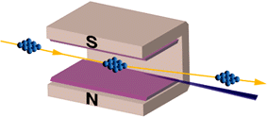
Curved orbit of electrons in magnet field
Accelerated charge
Electromagnetic radiation

Slide 3
Electromagnetic waves

Slide 4
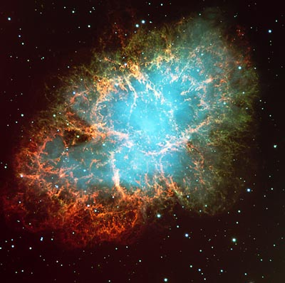
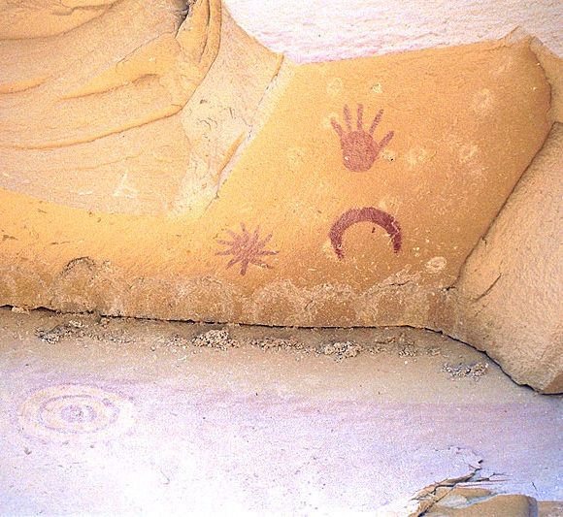
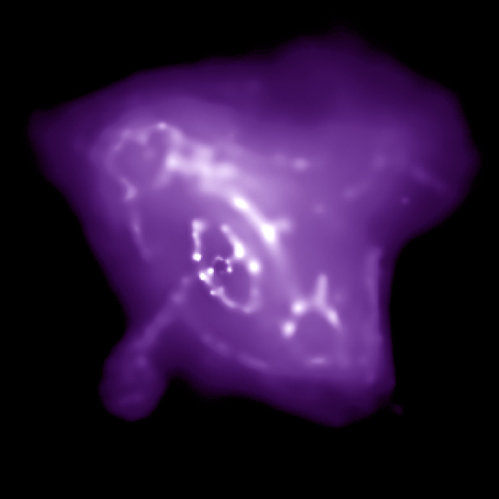
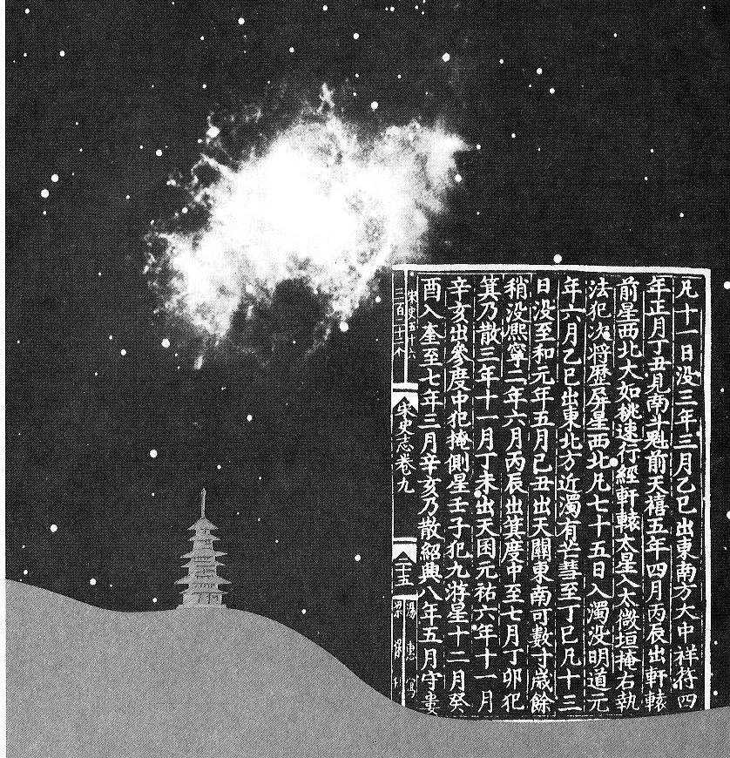
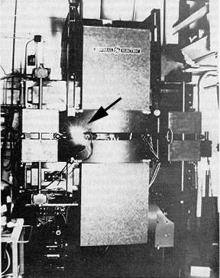
Crab Nebula
6000 light years away
GE Synchrotron
New York State
First light observed
1054 AD
First light observed
1947
Notes:
It took some time before the light reached us!

Slide 5
Synchrotron radiation: some dates
1873 Maxwell’s equations
1887 Hertz: electromagnetic waves
1898 Liénard: retarded potentials
1900 Wiechert: retarded potentials
1908 Schott: Adams Prize Essay
  ... waiting for accelerators …
  1940: 2.3 MeV betatron,Kerst, Serber

Slide 6
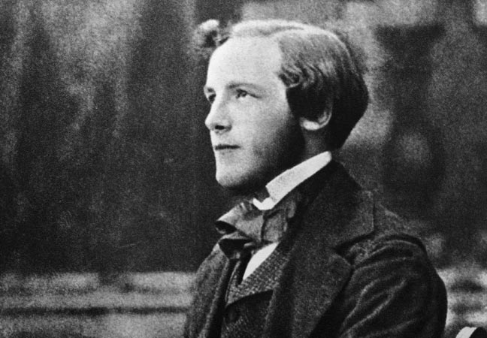
Maxwell equations (poetry)
War es ein Gott, der diese Zeichen schrieb
Die mit geheimnisvoll verborg’nem Trieb
Die Kräfte der Natur um mich enthüllen
Und mir das Herz mit stiller Freude füllen.
Ludwig Boltzman
Was it a God whose inspiration
Led him to write these fine equations
Nature’s fields to me he shows
And so my heart with pleasure glows.
translated by John P. Blewett

Slide 7
Synchrotron radiation: some dates
1873 Maxwell’s equations
1887 Hertz: electromagnetic waves
1898 Liénard: retarded potentials
1900 Wiechert: retarded potentials
1908 Schott: Adams Prize Essay
  ... waiting for accelerators …
  1940: 2.3 MeV betatron,Kerst, Serber

Slide 8
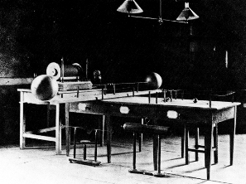
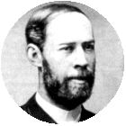
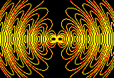
THEORETICAL UNDERSTANDING →
1873 Maxwell’s equations
→ made evident that changing charge densities would result in electric fields that would radiate outward
1887 Heinrich Hertz demonstrated such waves:
It's of no use whatsoever[...] this is just an experiment that proves
Maestro Maxwell was right—we just have these mysterious electromagnetic waves
that we cannot see with the naked eye. But they are there.

Slide 9
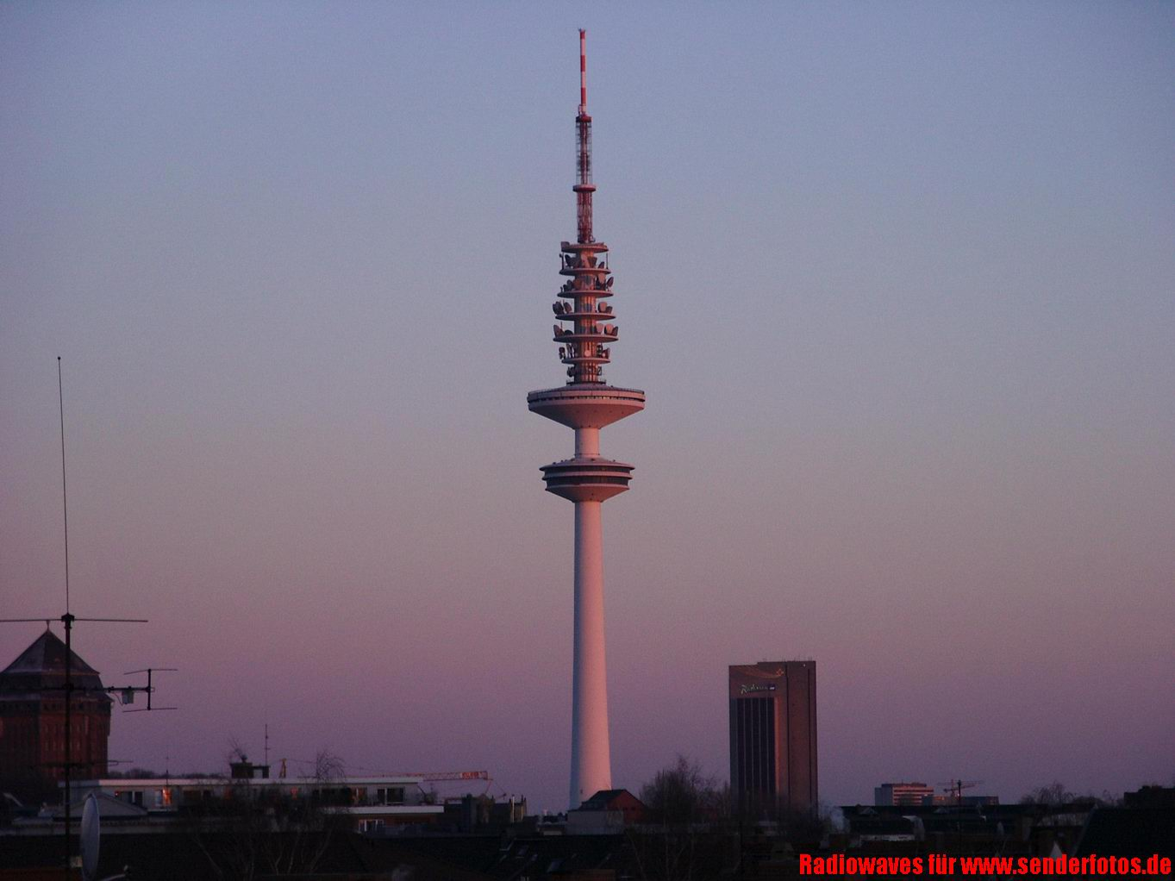
Electromagnetic waves

Slide 10
Synchrotron radiation: some dates
1873 Maxwell’s equations
1887 Hertz: electromagnetic waves
1898 Liénard: retarded potentials
1900 Wiechert: retarded potentials
1908 Schott: Adams Prize Essay
  ... waiting for accelerators …
  1940: 2.3 MeV betatron,Kerst, Serber

Slide 11
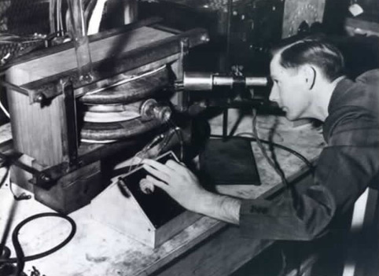
Donald Kerst: first betatron (1940)
"Ausserordentlichhochgeschwindigkeitelektronenentwickelndenschwerarbeitsbeigollitron"

Slide 12
Synchrotron radiation: some dates
1946 Blewett observes energy loss due to synchrotron radiation
100 MeV betatron
1947 First visual observation of SR
70 MeV synchrotron, GE Lab
1949 Schwinger PhysRev paper
…
1976 Madey: first demonstration of
Free Electron laser
NAME!

Slide 13
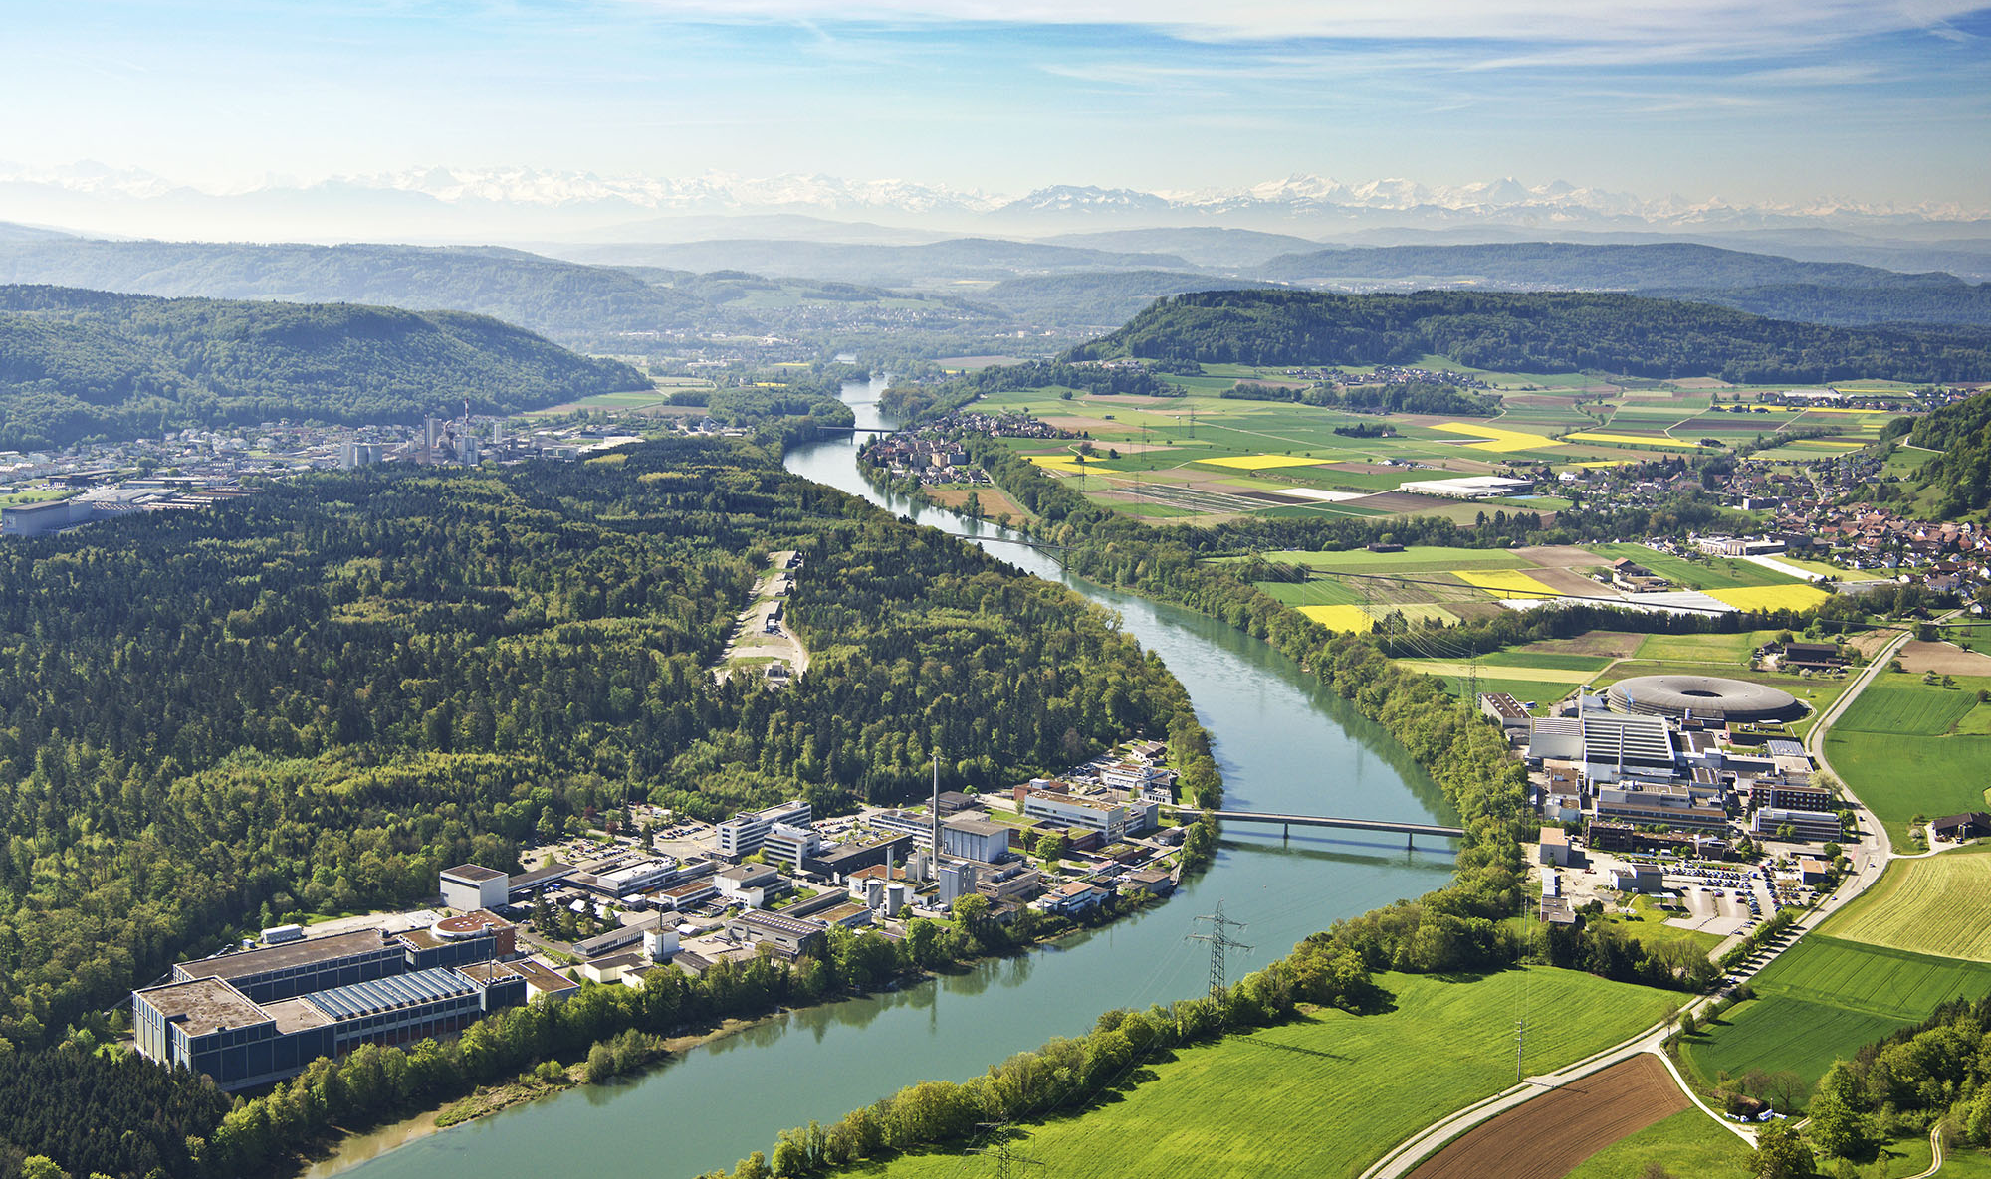
Paul Scherrer Institute, Switzerland
Swiss Light Source
SwissFEL

Slide 14
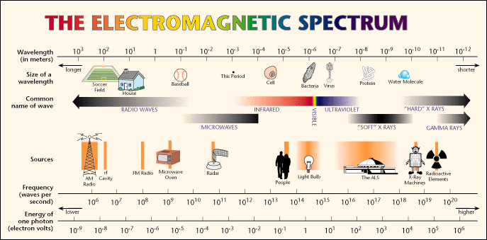
Wavelength continuously tunable !

Slide 15
60‘000 SR users world-wide

Slide 16
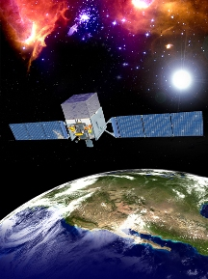
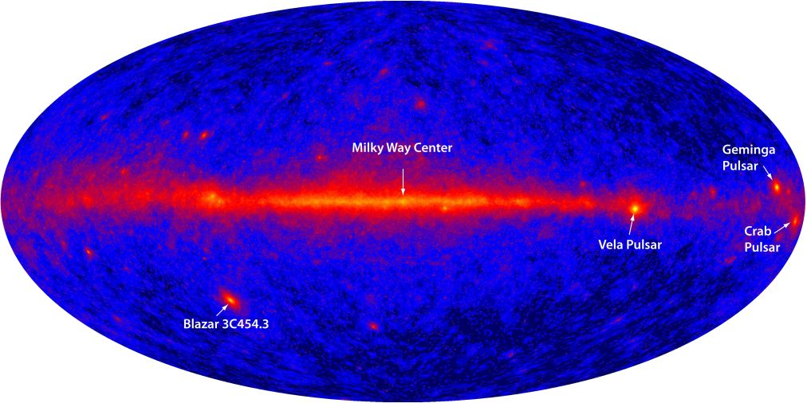
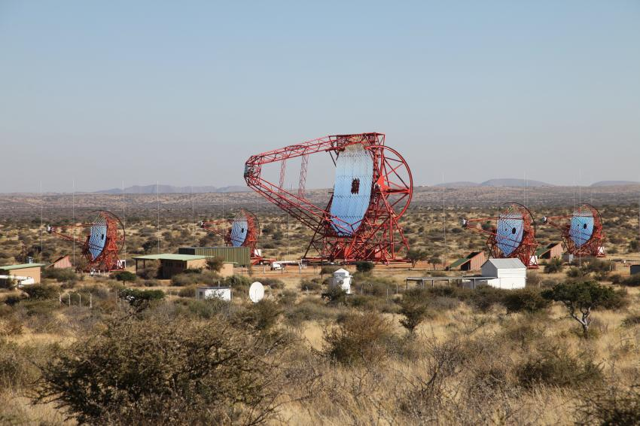
A larger view

Slide 17
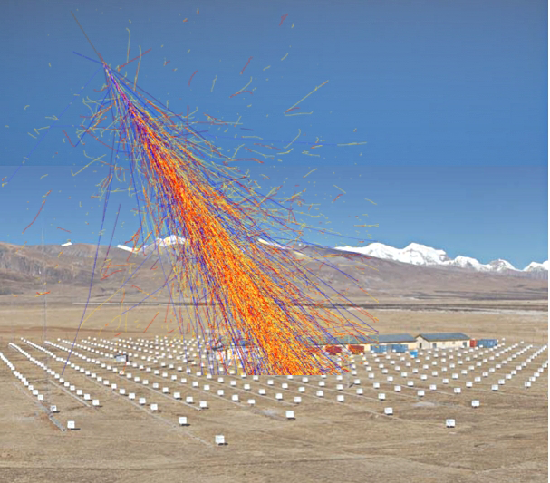
Crab Nebula sent a 450 TeV photon
Tibet
ASγ
Collaboration

Slide 18
Why do they radiate?

Slide 19
Synchrotron Radiation is not as simple as it seems
… I will try to show
that it is much simpler

Slide 20
Charge at rest
Coulomb field, no radiation

Slide 21
Uniformly moving charge does not radiate
v = constant
But! Cerenkov!

Slide 22



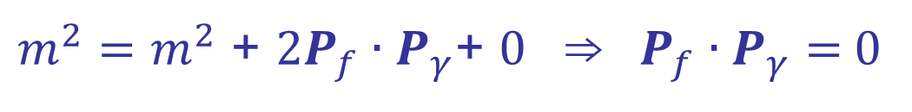
Free isolated electron cannot emit a photon
Easy proof using 4-vectors and relativity
  momentum conservation if a photon is emitted
  square both sides
  in the rest frame of the electron
  this means that the photon energy must be zero.
$$P_{i}=P_{f}+P_{γ}$$
γ
e_{i}⁻
e_{f}⁻
$m_{}^{2}=$ $m_{}^{2}$ + 2$P_{f}∙P_{γ}$+ 0 ⇒ $P_{f}∙P_{γ}=$0
$$P_{f}=(m,0)$$
$$P_{γ}=(E_{γ}, p_{γ})$$

Slide 23
We need to separate the field from charge

Slide 24

Bremsstrahlung or
“braking” radiation

Slide 25




Transition Radiation
$$ε_{1}$$
$$ε_{2}$$
$$c_{1}=\frac{1}{\sqrt{ε_{1}μ_{1}}}$$
$$c_{2}=\frac{1}{\sqrt{ε_{2}μ_{2}}}$$

Slide 26
Liénard-Wiechert potentials
and the electromagnetic fields:
(Lorentz gauge)

Slide 27
Fields of a moving charge
“near field”
“far field”

Slide 28
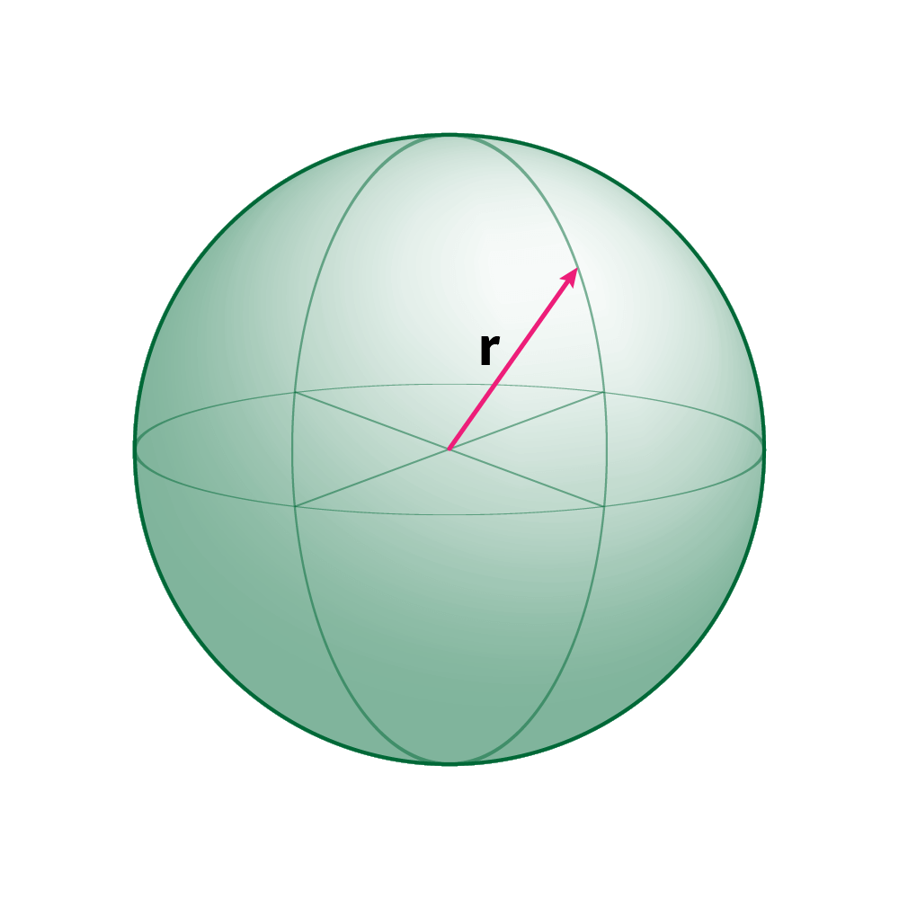

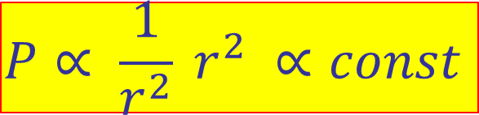
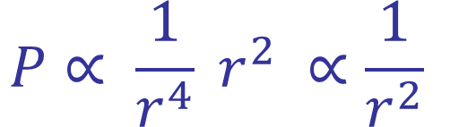

Energy flow integrated over a sphere
$$Power \sim E^{2}⋅Area$$
$$A=4πr^{2}$$
$$P∝ \frac{1}{r^{4}} r^{2} ∝\frac{1}{r^{2}}$$
Near field
$$P∝ \frac{1}{r^{2}} r^{2} ∝const$$
Far field
Radiation = constant flow of energy to infinity

Slide 29
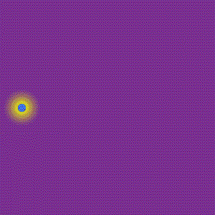
Transverse acceleration
v
a
Radiation field quickly separates itself from the Coulomb field

Slide 30
Longitudinal acceleration
a
v
Radiation field cannot separate itself from the Coulomb field

Slide 31
Synchrotron Radiation
Basic Properties

Slide 32
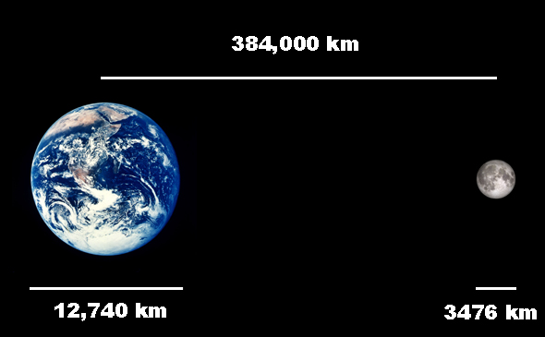
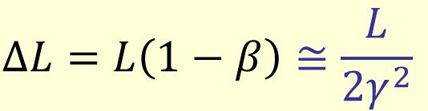

Beams of ultra-relativistic particles: e.g. a race to the Moon
An electron with energy of a few GeV
emits a photon… a race to the Moon!
Electron will lose
  by only 8 meters
  the race will last only 1.3 seconds
$∆t=\frac{L}{βc}−\frac{L}{c}=\frac{L}{βc}\left(1−β\right)\sim$ $\frac{L}{βc}∙\frac{1}{2γ^{2}}$
$$∆L=L\left(1−β\right)≅\frac{L}{2γ^{2}}$$

Slide 33
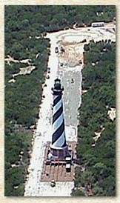

Moving Source of Waves: Doppler effect
“redshift”
“blueshift”
Cape Hatteras, 1999

Slide 34
Time compression
Electron with velocity β emits a wave with period T_{emit} while the observer sees a different period T_{obs} because the electron was moving towards the observer
The wavelength is shortened by the same factor
in ultra-relativistic case, looking along a tangent to the trajectory
since

Slide 35
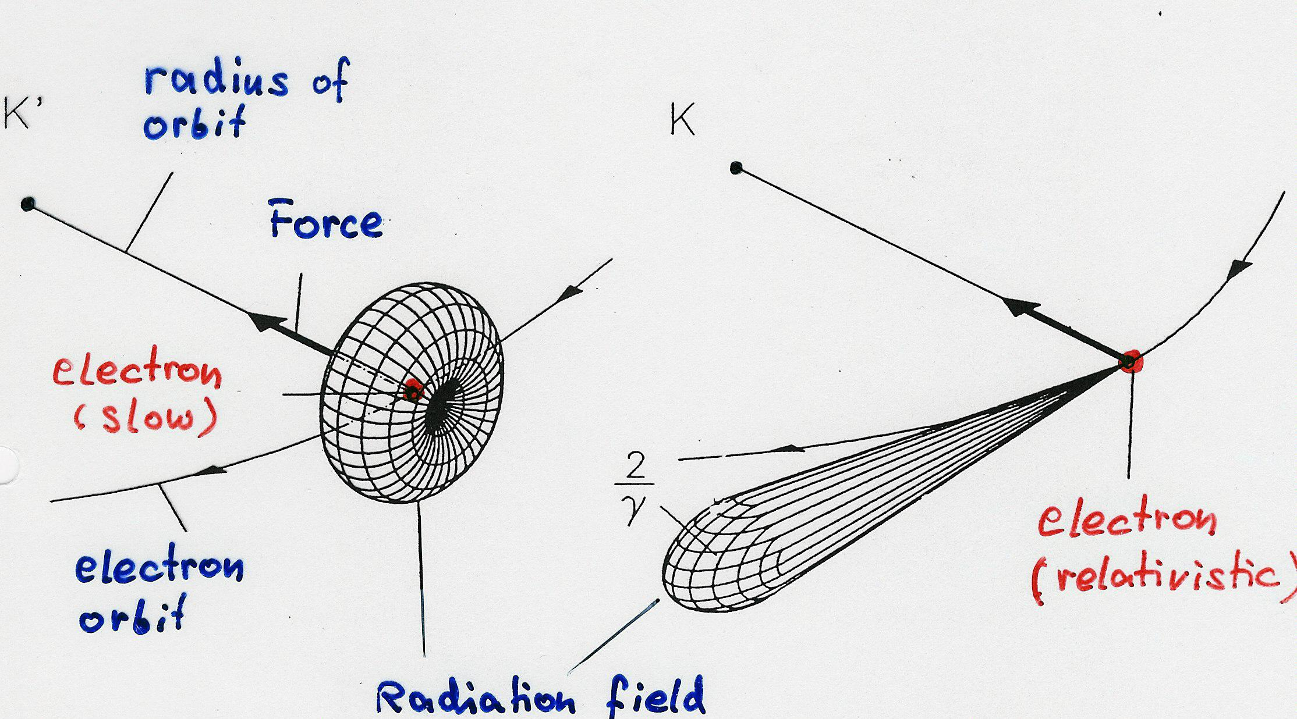
Radiation is emitted into a narrow cone
θ_{e}
θ
v ~ c
v << c
v ≈ c

Slide 36
Sound waves (non-relativistic)
Angular collimation
θ_{e}
θ
v
v
Doppler effect (moving source of sound)

Slide 37
Synchrotron radiation power
Power emitted is proportional to:
E = Energy!

Slide 38
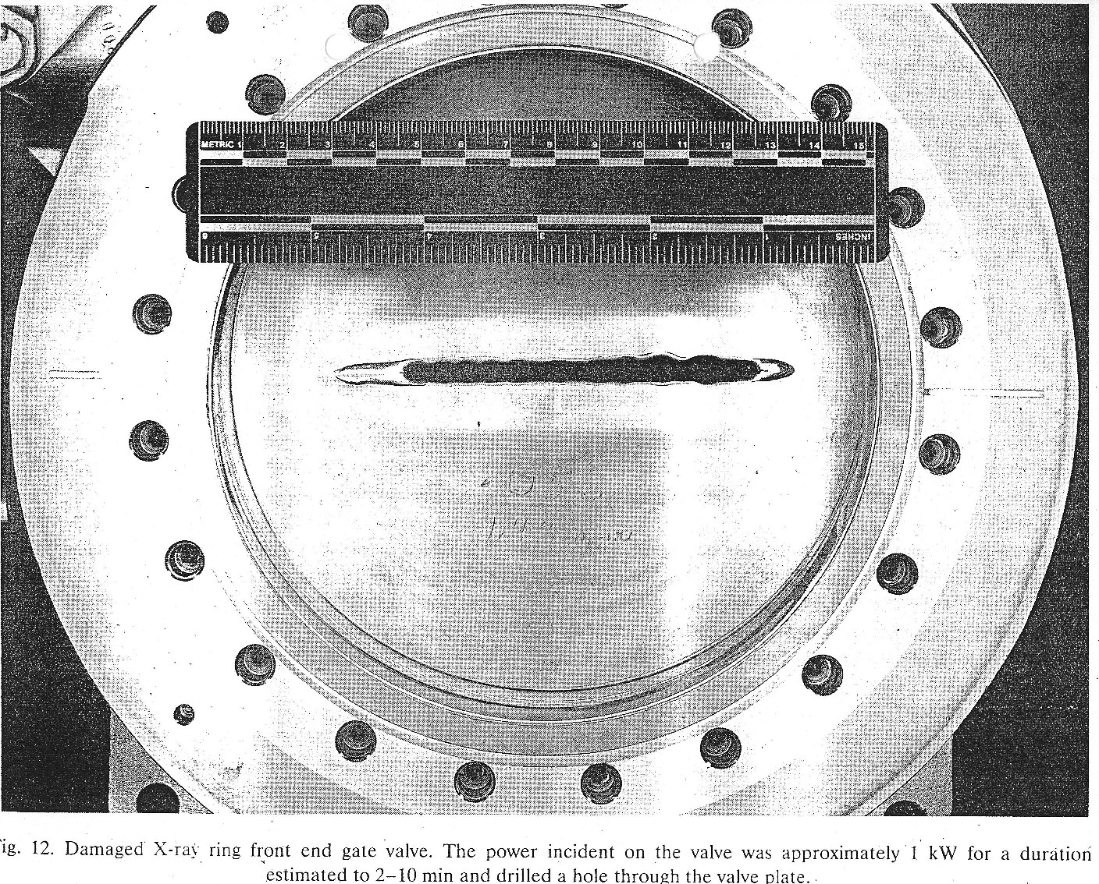
The power is all too real!

Slide 39
Synchrotron radiation power
Power emitted is proportional to:
Energy loss per turn:

Slide 40
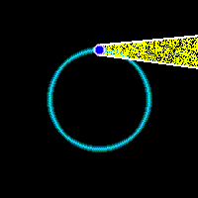
Typical frequency of synchrotron light
Due to extreme collimation of light observer sees only a small portion of electron trajectory (a few mm)
Pulse length: difference in times it takes an electron and a photon to cover this distance
Notes:
High end of the spectrum can be modified by
using a short magnet
changing the speed of light?

Slide 41
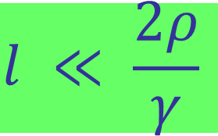

Short magnet: higher energy photons
When Lorentz factor is not very high (e.g. protons)…
$$l ≪ \frac{2ρ}{γ}$$
Pulse length: difference in times it takes an electron and a photon to cover this distance
$∆t \sim \frac{l}{c} \frac{1}{2γ^{2}}$
Notes:
High end of the spectrum can be modified by
using a short magnet
changing the speed of light?

Slide 42
Spectrum of synchrotron radiation
Synchrotron light comes in a series of flashes
every T₀ (revolution period)
the spectrum consists of
harmonics of
flashes are extremely short: harmonics reach up to very high frequencies
At high frequencies the
individual harmonics overlap
T₀
time
continuous spectrum !

Slide 43
Wavelength continuously tunable !

Slide 45
Synchrotron radiation flux for different electron energies

Slide 46
Angular divergence of radiation
The rms opening angle R’
at the critical frequency:
well below
well above
independent of γ !

Slide 47
Synchrotron light polarization

Slide 48
An electron in a storage ring
TOP VIEW
SIDE VIEW
Polarization:
Linear in the plane of the ring
the electric field vector
E
TILTED VIEW
elliptical out of the plane
E

Slide 49
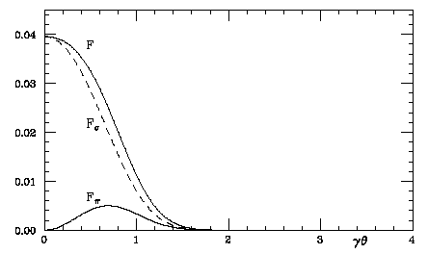
Angular distribution of SR
E
E

Slide 50
Synchrotron light based electron beam diagnostics

Slide 51
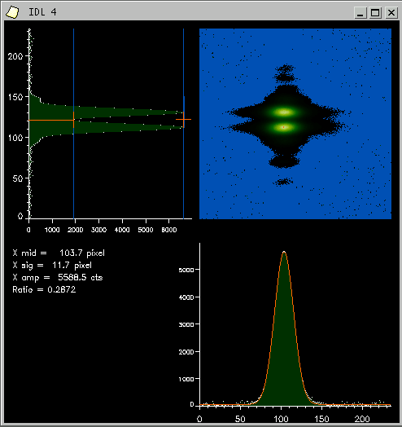
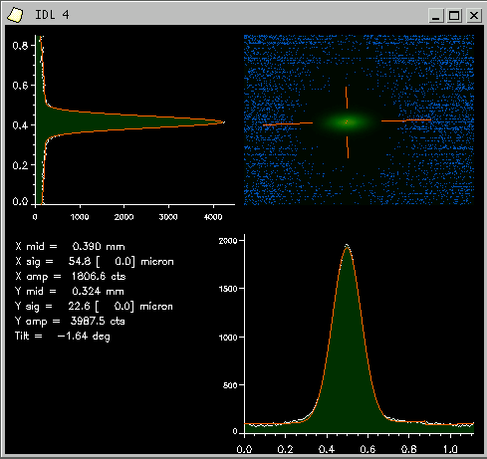
Seeing the electron beam (SLS)
X rays
visible light, vertically polarised

Slide 52
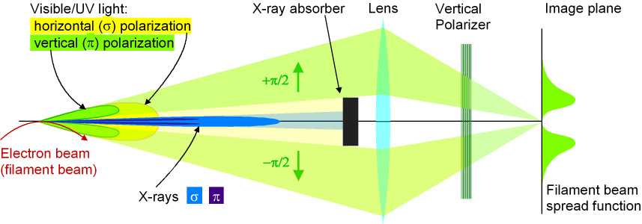
Seeing the electron beam (SLS)
Making an image of the electron beam using the vertically
polarised synchrotron light

Slide 53
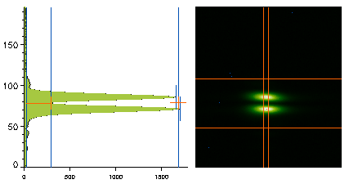
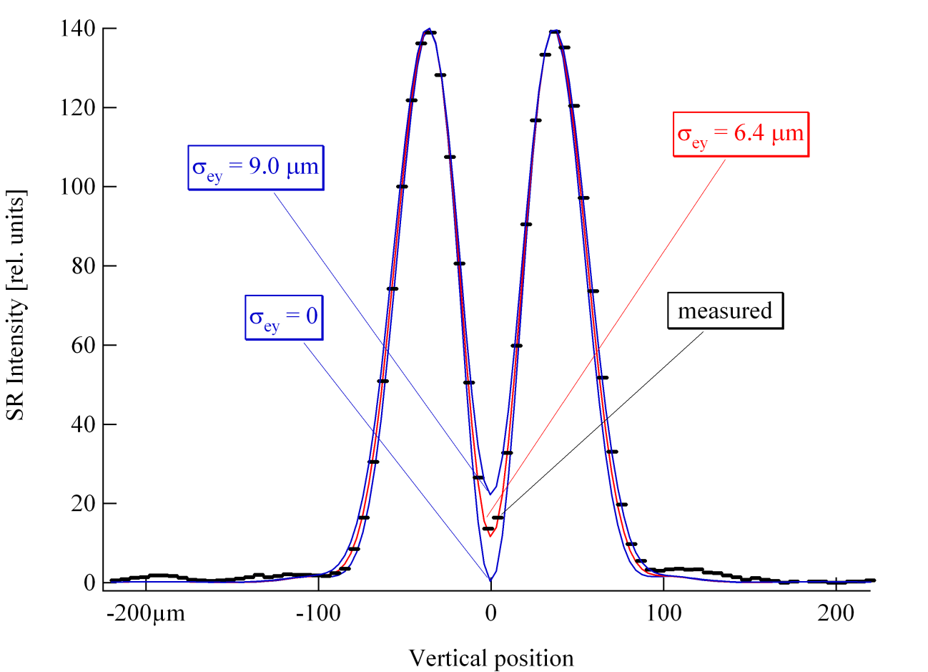
High resolution measurement
Wavelength used: 364 nm
For point-like source the
intensity on axis is zero
Peak-to-valley intensity ratio
is determined
by the beam height
Present resolution: 3.5 μm

Slide 54
Useful books and references
H. Wiedemann, Synchrotron Radiation
Springer-Verlag Berlin Heidelberg 2003
H. Wiedemann, Particle Accelerator Physics I and II
Springer Study Edition, 2003
Hofmann, The Physics of Synchrotron Radiation
Cambridge University Press 2004
A. W. Chao, M. Tigner, Handbook of Accelerator Physics and Engineering, World Scientific 1999

Slide 55
CERN Accelerator School Proceedings
Synchrotron Radiation and Free Electron Lasers
  Grenoble, France, 22 - 27 April 1996
  (A. Hofmann’s lectures on synchrotron radiation)
  CERN Yellow Report 98-04
  Brunnen, Switzerland, 2 – 9 July 2003
  CERN Yellow Report 2005-012
Previous CAS Schools Proceedings

