Slide 1
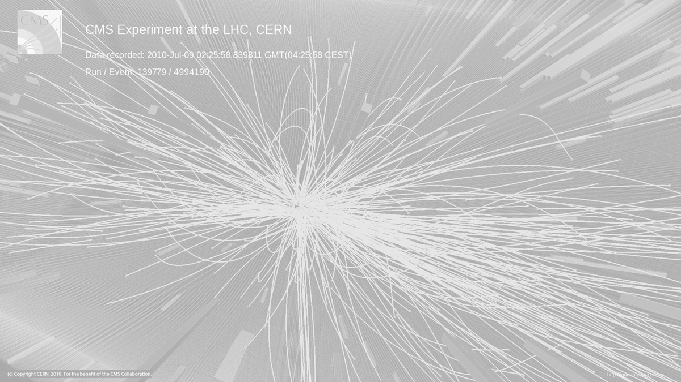
Luminosity and
(future) colliders
CERN Accelerator School
Vysoke-Tatry, Slovakia 2019
Hermann Schmickler (CERN, ATS-DO)
With many slides taken from:
G.Papotti (CERN): CAS 2016, Budapest
W.Herr (CERN): CAS 2018, Constanta
M.Benedikt(CERN): CAS@ESI 2018
(But also with a few slides by myself)

Slide 2
Outline
Why colliding beams?
What do physicists do with the data?
Lepton or Hadron Collider?
Figures of merits: Energy and luminosity
→Details on luminosity
Not too much:
→ Detector Occupancy in hadron collisions
The possible future at CERN:
HL-LHC
FCC
CLIC

Slide 3
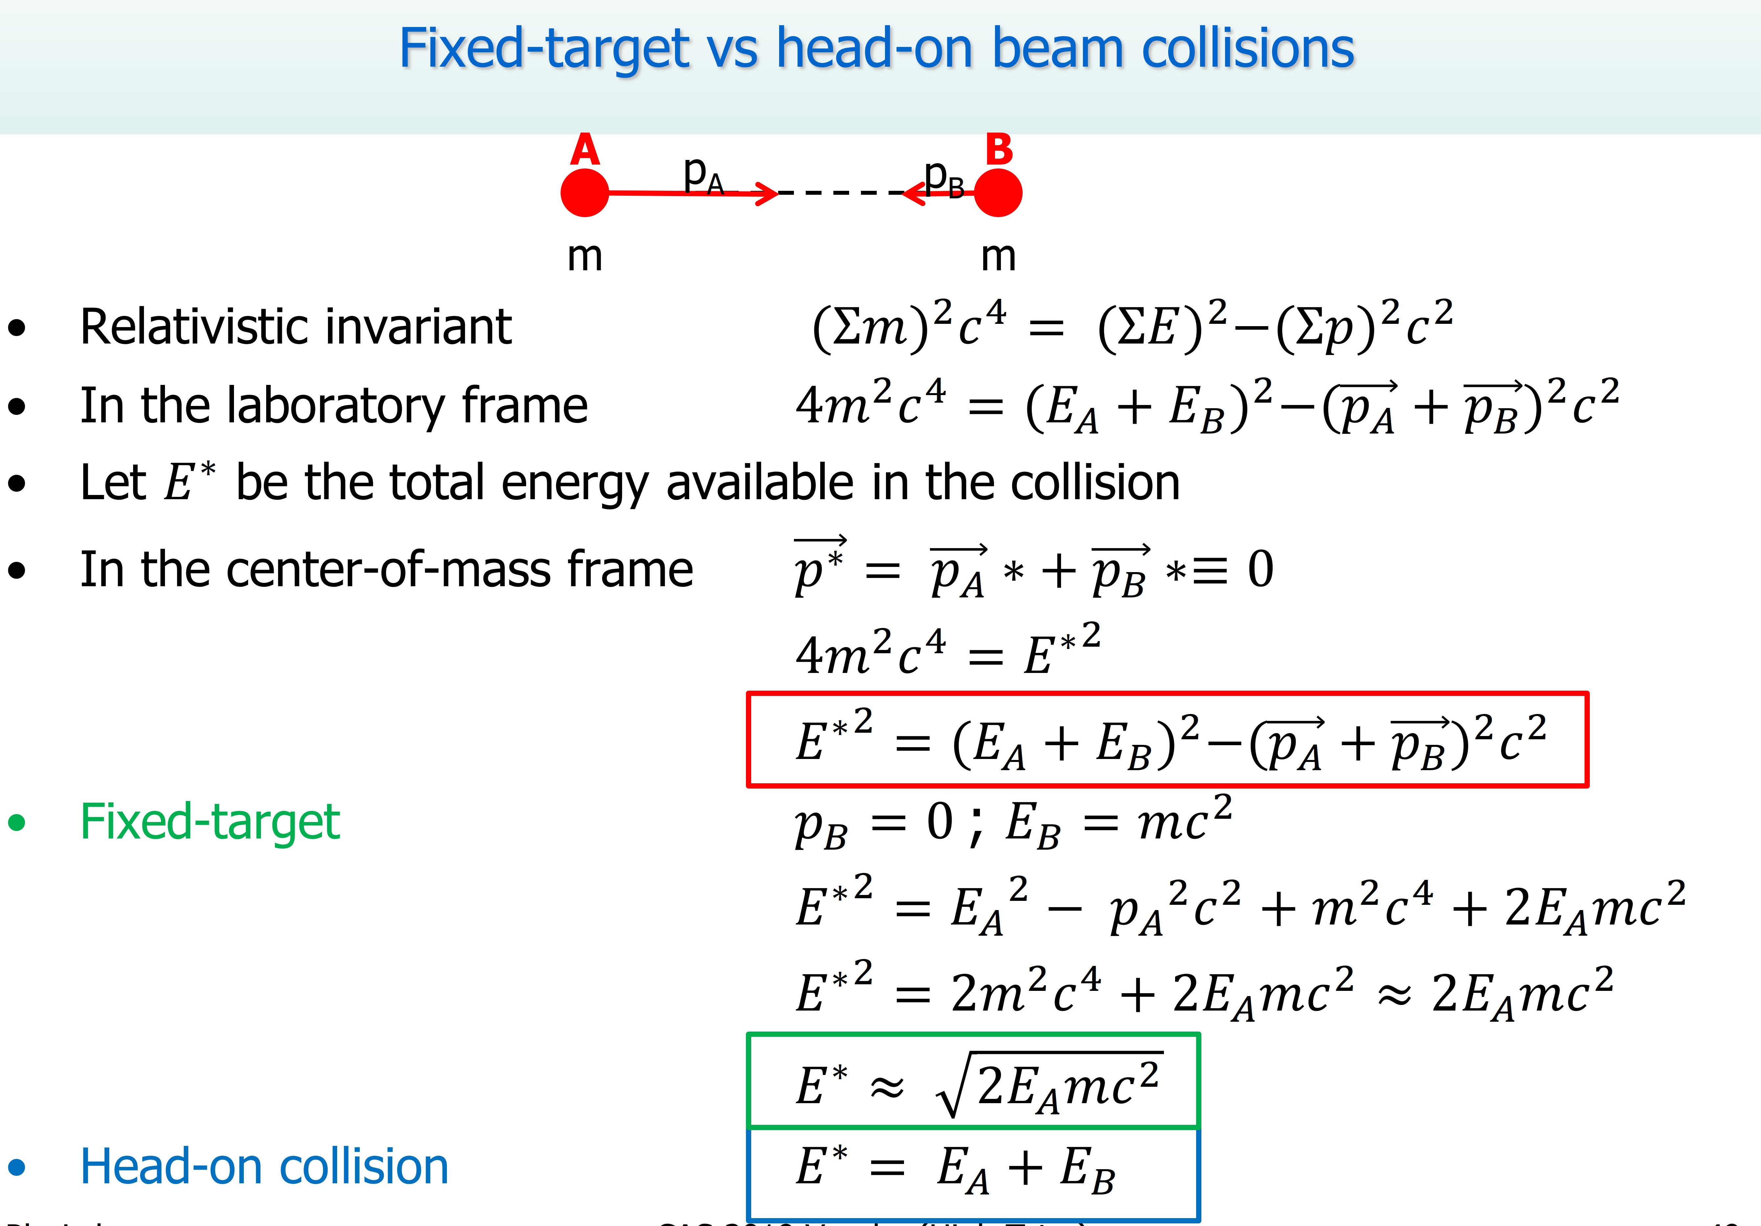

Slide 4
Past/Existing High Energy Frontier Colliders
Only referring to the highest energy
Lepton colliders:
LEP (Large Electron Positron Colliders)
  Z₀ factory at 90GeV electron-positron cms energy
  W⁺W⁻ factory at 160GeV
  Maximum 209 GeV cms energy for higgs search
  (bad luck: e+e- → Z⁰H needs about 250 GeV)
  Closed in the year 2000
SLC (Standford Linear Collider)
  Z₀ factory at 90GeV electron-positron cms energy
  Single linac for e+ and e-, two return arcs for collision
  Closed in summer 1998
Hadron colliders
LHC (Large Hadron Collider):
  Proton-proton with 13TeV
  Ion-ion operation

Slide 5
Considered Future High Energy Frontier Colliders
Circular colliders:
FCC (Future Circular Collider)
  FCC-hh: 100TeV proton-proton cms energy, ion operation possible
  FCC-ee: Potential intermediate step 90-350 GeV lepton collider
  FCC-he: Lepton-hadron option
CEPC / SppC (Circular Electron-positron Collider/Super Proton-proton Collider)
  CepC : e⁺e⁻ 240GeV cms
  SppC : pp 70TeV cms
Linear colliders
ILC (International Linear Collider): e⁺e⁻, 500 GeV cms energy, Japan considers hosting project
CLIC (Compact Linear Collider): e⁺e⁻, 380GeV-3TeV cms energy, CERN hosts collaboration
Others
Muon collider, has been supported mainly in the US but effort has stopped
Plasma wakefield acceleration in linear collider…not yet ready
Photon-photon collider
LHeC

Slide 6
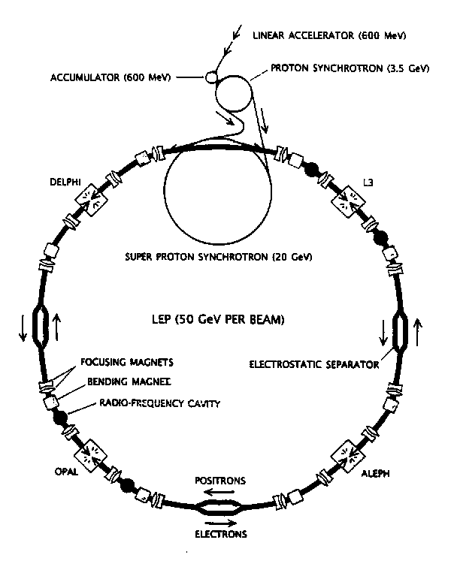
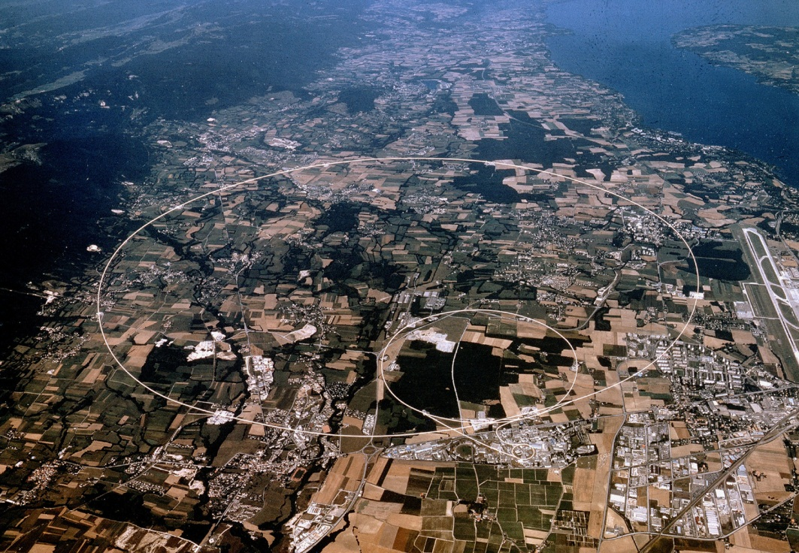
LEP (at CERN)
27km circumference
Electron-positron collider
4 experiments: ALEPH, DELPHI, L3, OPAL
CMS energy: 90GeV (LEP I) - 209GeV (LEP II)
Peak Luminosity: 10³²cm⁻²s⁻¹
Operation: 1989-2000
Highest particle speed in any accelerator

Slide 7
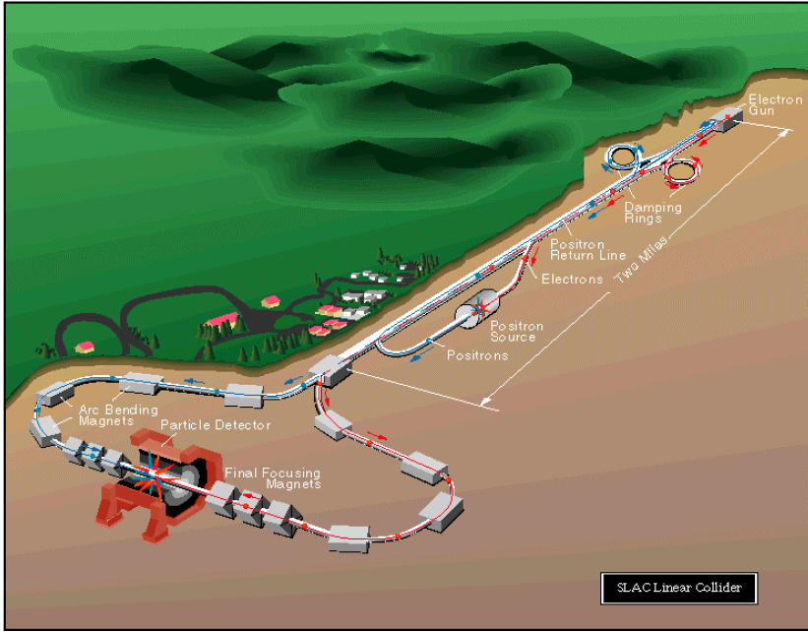
SLC (at SLAC)
Electron-positron linear collider
2 experiments: first MARK II, then SLD
CMS energy: 92GeV
Peak Luminosity: 2x10³⁰cm⁻²s⁻¹
Operation: 1989-1998
The only linear collider sofar

Slide 8
The LHC (at CERN)
27km circumference (well, the LEP tunnel)
4 main experiments
Nominal CMS energy: 14TeV
Peak Luminosity: 10³⁴cm⁻²s⁻¹
Operation: 2009-today
Highest particle energy in any accelerator

Slide 9
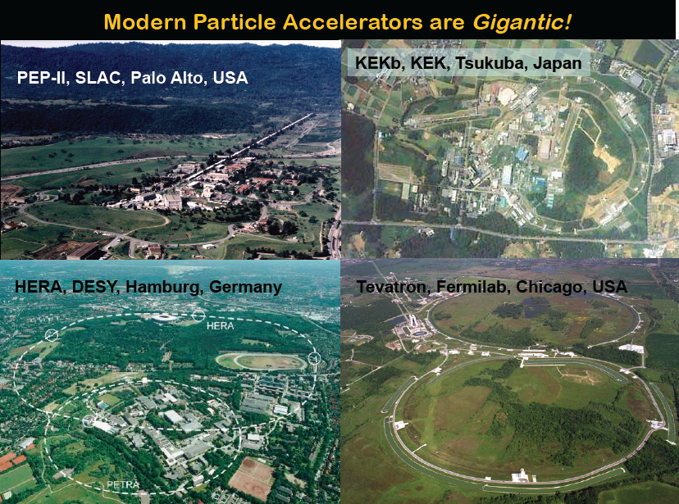
Other Colliders

Slide 10
What do physicists with the data?
…short outline in a nutshell
The primary interaction is not visible.
Physicists measure identity and energy/momentum of secondary particles, which emerge from the primary interaction
Physicists make model assumptions about the primary interaction and compare observables like the angular distribution of the secondaries with the model. If it fits in all aspects, they declare the model the “truth”.
(historic example: Rutherford scattering )
Quantitative measurements like the mass of a new particle are possible, if all secondary particles are measured and the invariant mass is computed.
It is very useful to know the total energy of the original collision, which is only the case for collisions of elementary particles (leptons)
Most of the processes have “background” signals with similar signature.
Very careful simulations of this background must accompany every measurement.

Slide 11
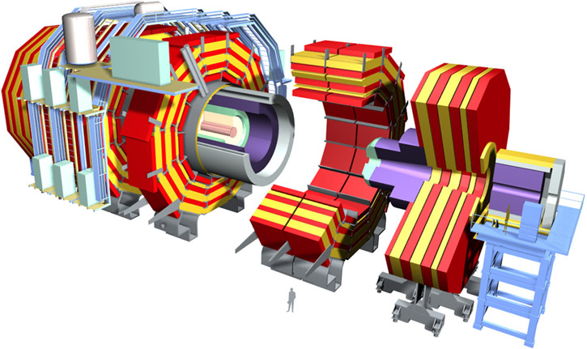
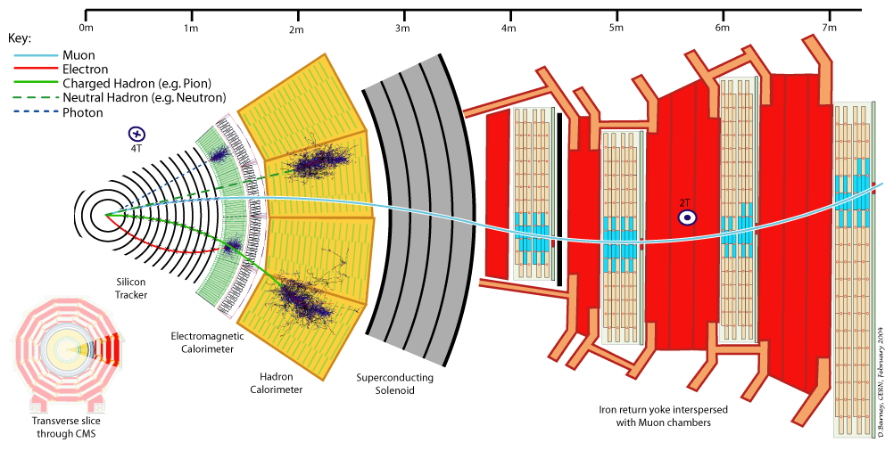
Particle identification: a CMS slice
or “what the experiments do with the collisions”

Slide 12
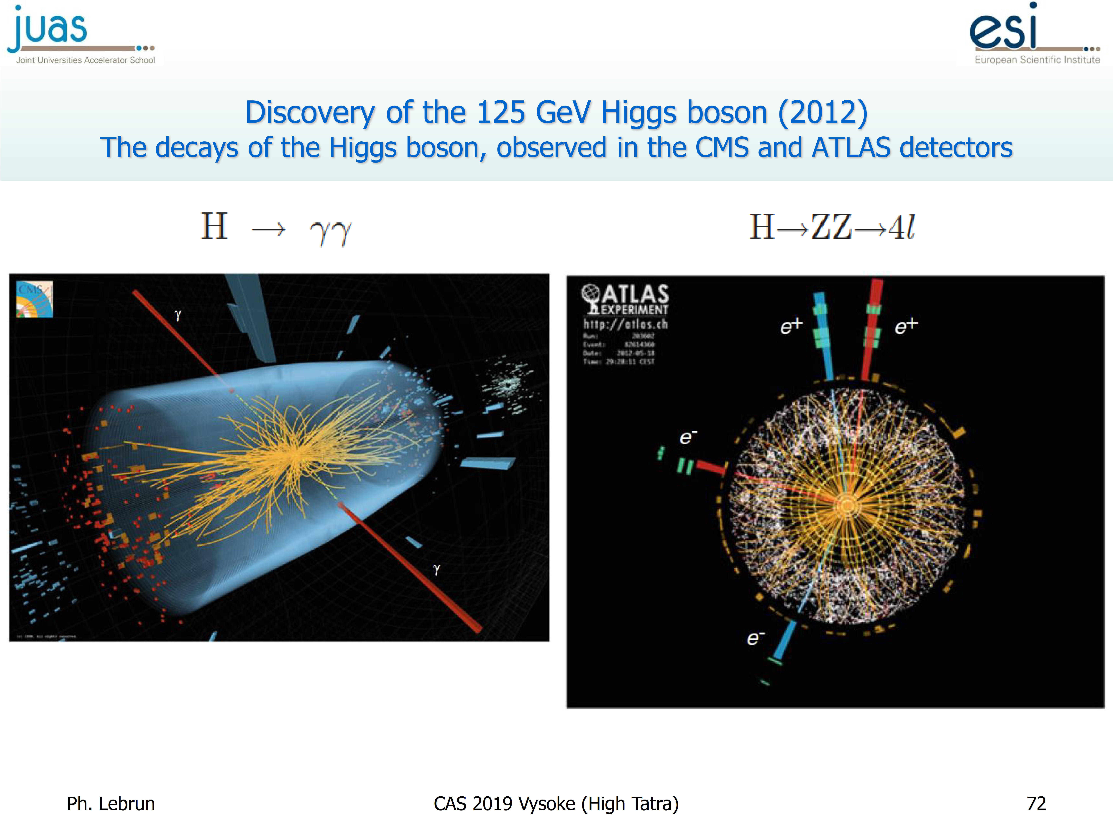

Slide 13
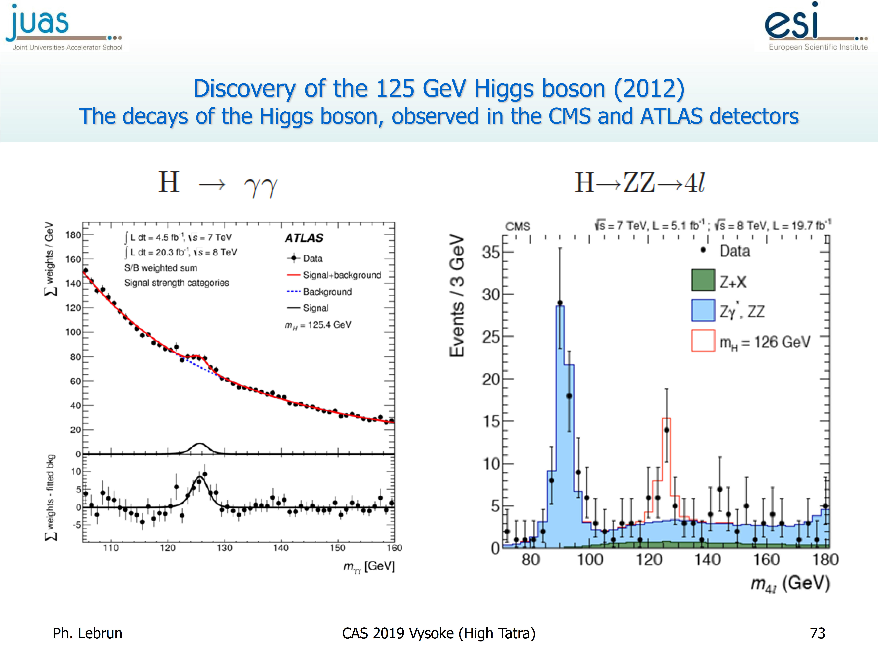

Slide 14
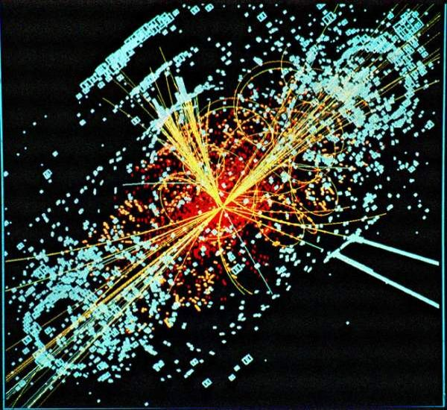
Collider figures of merit:
c.m.s. energy: higher energy means particles with higher masses can be produced
Luminosity: A number characterizing a collider to produce a certain number of events of a given process →
The cross section of a process:
cross-section σ_{ev} expresses the likelihood of the process
  σ_{ev} represents the “area” over which the process occurs
  units: [m²]
    in nuclear and high energy physics: 1 barn (1 b = 10⁻²⁴ cm²)

Slide 15
definition: Luminosity (L)
luminosity L relates cross-section σ and event rate R = dN_{ev}/dt at time t:
  quantifies performance of collider
  relativistic invariant and independent of physical reaction
accelerator operation aims at maximizing the total number of events N_{ev} for the experiments
  σ_{ev} is fixed by Nature
  aim at maximizing ∫L(t)dt
Luminosity unit : [m⁻² s⁻¹]
The integrated luminosity ∫Ldt is frequently expressed in
pb⁻¹ = 10³⁶ cm⁻² or fb⁻¹ = 10³⁹ cm⁻²

Slide 16
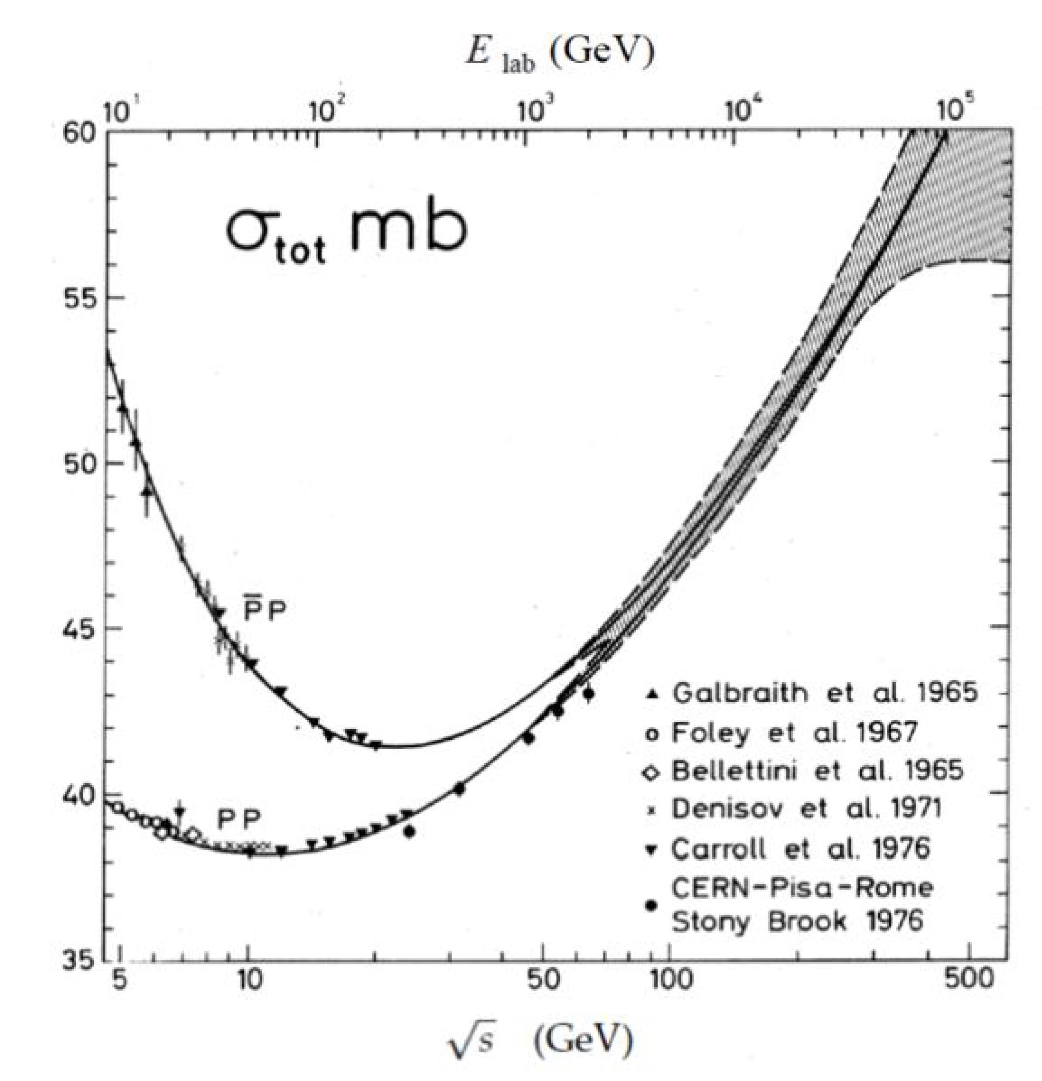
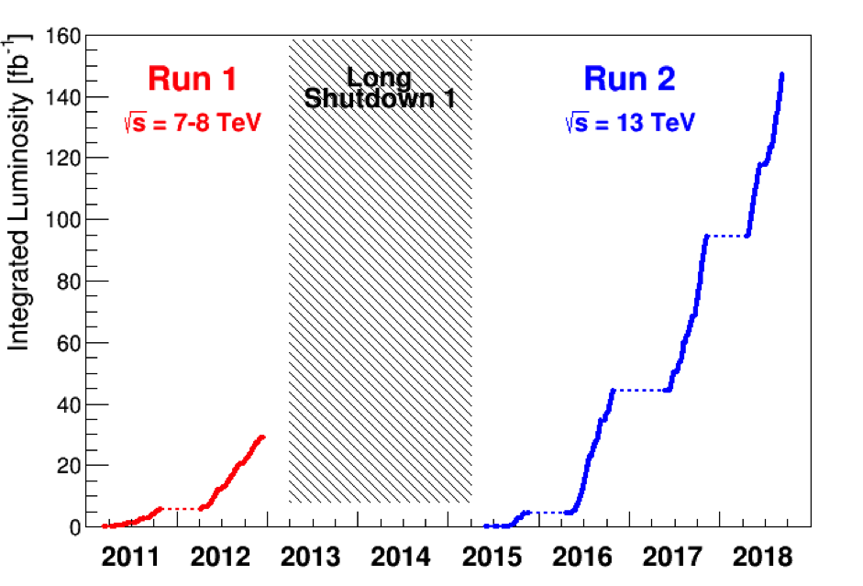
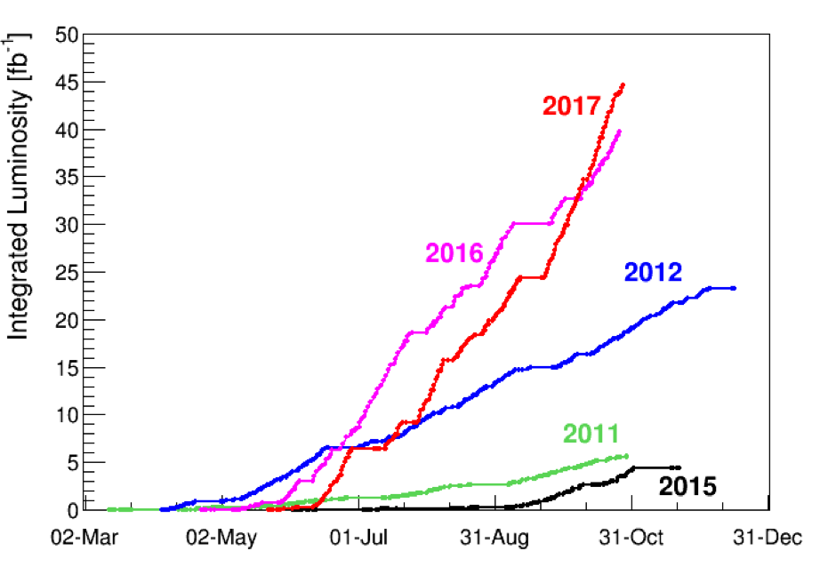
Example: LHC
Total integrated luminosity LHC Run 2: 150 fb⁻¹
Total cross section pp collisions: 100 mb
→ Ncollisions = 150 * 10¹² mb⁻¹ * 100 mb = 15 * 10¹⁵ events !!!
→ Only a small fraction gets recorded….still Pbytes of data

Slide 17
Details on luminosity
luminosity
  derivation from machine parameters
  head-on and offset collisions
  reduction factors
    crossing angles and crab cavities, hourglass
  luminosity lifetime, contributions
  luminosity scans and luminosity levelling
integrated luminosity and ideal run time

Slide 18
L from machine parameters -1-
intuitively: more L if there are more protons and more tightly packed
N_{b2}ρ₂(x,y,z,z₀)
N_{b1}ρ₁(x,y,z,-z₀)
z₀
K = 2 c: kinematic factor (see W. Herr, “Kinematics of Particle Beams I - Relativity”)
N_{b1}, N_{b2}: bunch population
ρ_{1,2}: density distribution of the particles (normalized to 1)
x,y: transverse coordinates
z: longitudinal coordinate
z₀: “time variable”, z₀ = c t
Ω_{x,y}: overlap integral

Slide 19
L from machine parameters -2-
for a circular machine can reuse the beams f times per second (storage ring)
for n_{b} colliding bunch pairs per beam
for uncorrelated densities in all planes:
for Gaussian bunches:
for equal beams in x or y: σ_{1x} = σ_{2x}, σ_{1y} = σ_{2y}
can derive a closed expression:
LHC
n_{b} = 2808
N_{b1},N_{b2} = 1.15 10¹¹ ppb
f = 11.25 kHz
σ_{x}, σ_{y} = 16.6 μm
L = 1.2 10³⁴ cm⁻²s⁻¹
f: revolution frequency
n_{b}: number of colliding bunch pairs at that Interaction Point (IP)
N_{b1}, N_{b2}: bunch population
σ_{x,y}: transverse beam size at the collision point
Notes:
remove the time dependence!

Slide 20
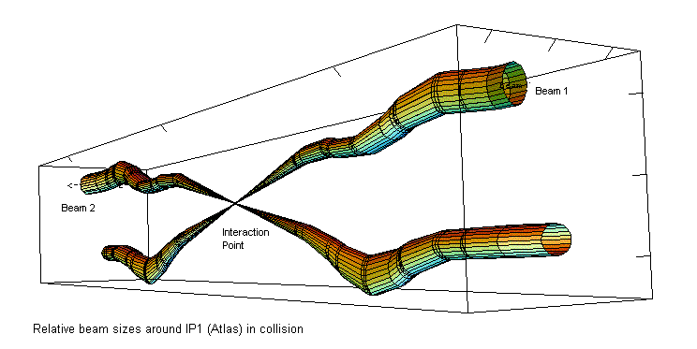
need for small β*
expand physical beam size σ_{x,y}:
  * means “at the IP”
try and conserve low ε from injectors
  explicit dependence on energy (γ_{r})
intensity N_{b} pays more than ε and β*
design low β* insertions
  limits by triplet aperture, protection by collimators
  in LHC nominal cycle: “squeeze”
➔
LHC
β* = 18 ➔ 0.55 m
ε = 3.75 μm
γ_{r} = 7463
σ_{x,y} = 16.6 μm
J. Jowett

Slide 21
Luminosity reduction factors (F_{i})
L = L_{max} * F₁ * F₂ * F₃….
transverse offsets
crossing angles and crab cavities
hourglass effect

Slide 22
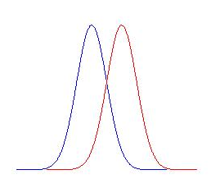
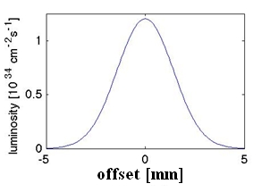
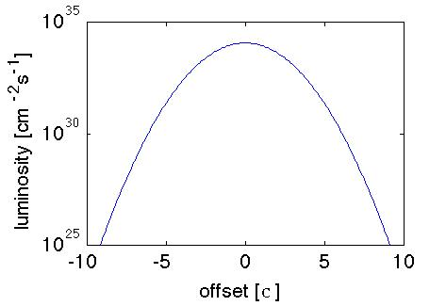
transverse offsets -1-
in case the beams do not overlap in the transverse plane (e.g. in x)
more generally
Δx
Δx=1σ_{x}
F
Δx | F
0 | 1
1 σ | 0.779
2 σ | 0.368
3 σ | 0.105
4 σ | 0.018
5 σ | 0.002
σ

Slide 23
For experts: transverse offsets -2-
more general expression including different beam sizes:
  σ_{1x} ≠ σ_{2x}, σ_{1y} ≠ σ_{2y}

Slide 24
crossing angles
to avoid parasitic collisions when there are many bunches
  otherwise collisions elsewhere than in interaction point only
    e.g.: CMS experiment is 21 m long, common vacuum pipe is 120 m long
luminosity is reduced as the particles no longer traverse the entire length of the counter-rotating bunch
φ
25 ns = 7.5 m
F
LHC
φ = 285 μrad
σ_{z} = 7.5 cm
F = 0.84
is called the Piwinski angle
valid for small φ and σ_{z}>>σ_{x},σ_{y}
Notes:
long bunches or big xing angle make the reduction bigger
eg sep = 1/sqrt (beta*) … beta 4 times smaller needs 2x the crossing angle

Slide 25

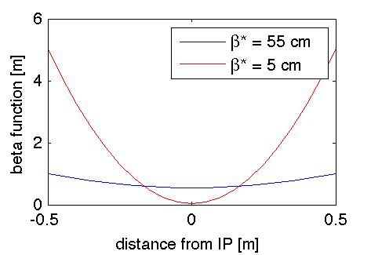
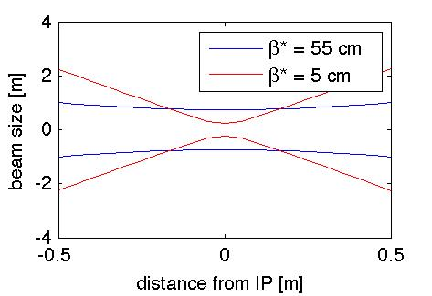
hourglass effect
β depends on longitudinal position z
  see W.Hillert,
  “Transverse Beam Dynamics”
then beam size σ_{x,y} depends on z
  if β* >> σ_{z}, effect is negligible
  if β* ~ σ_{z}, bunch samples bigger β than β*
1
L reduction is non-negligible for long bunches and small β
F
LHC | HL-LHC
β*/σ_{z} > 7 | β*/σ_{z} ~ 2
F ~ 1 | F ~ 0.90
0.1
W. Herr
0 β*/σ_{z} 3
Notes:
always makes you lose on luminosity

Slide 26
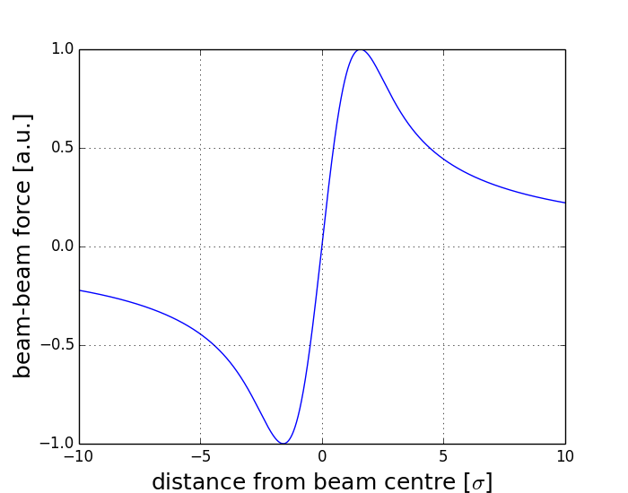
beam-beam force
important for high brilliance beams
  i.e. high luminosity …
gives an amplitude dependent tune shift
  for small amplitude, linear tune shift
the slope of the force at zero amplitude is called the beam-beam parameter
indicates the strength of the beam-beam force
  but does not describe changes to the optical functions, non-linear part…
with
LHC
σ_{x,y} = 16.6 μm
β* = 0.55 m
N = 1.15 × 10¹¹ ppb
ξ = 0.0037

Slide 27
linear colliders: additional reduction/enhancement factors
disruption, pinch effect
beamstrahlung

Slide 28
disruption effects -1-
strong field by one beam bends the opposing particle trajectories
quantified by disruption parameter
nominal beam size is reduced by the disruptive field (pinch effect)
  additional focusing for the opposing beam
D_{x,y} normally > 1
W. Herr
r_{e}: electron classical radius
N_{b}: bunch population
σ_{x,y,z}: beam size at the collision point
γ_{r}: relativistic factor

Slide 29
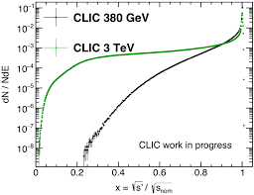
beamstrahlung
disruption at the interaction point is a strong bending:
results in synchrotron radiation (beamstrahlung)
  causes spread of centre-of-mass energy
  high energy photons increase detector background
quantified by beamstrahlung parameter Y
with

Slide 30
Not too much Luminosity please (in pp)…
experiments might need luminosity control
  if too high can cause high voltage trips then impact efficiency
  might have event size or bandwidth limitations in read-out
  too many simultaneous event cause loss of resolution
...experiments also care about:
  time structure of the interactions: pile up μ
    average number of inelastic interactions per bunch crossing
 | design | 2010 | 2011 | 2012 | 2015 | 2016 | HL-LHC
μ | 21 | 4 | 17 | 37 | 17 | 41 | 140
  f = bunch repetition frequency
  spatial distribution of the interactions: pile-up density
    e.g. HL-LHC: accept max pile up density of 1.3 events/mm
  quality of the interactions (e.g. background)
  size of luminous region
    e.g. need constant length (input to MonteCarlo simulations)

Slide 31
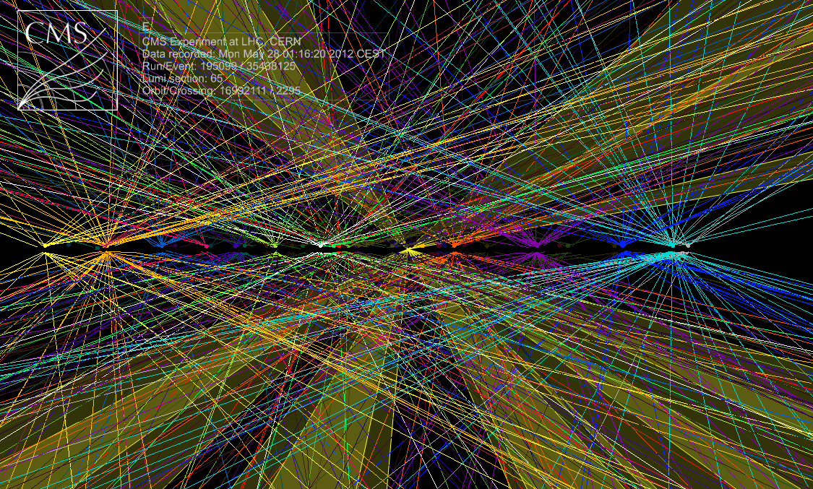
pile-up

Slide 32
Luminosity levelling
some experiments need to limit the pile-up
  thus luminosity per bunch pair
    e.g. μ < 2.1 at LHCb in 2012
stay as long as possible at the maximum value that experiment can manage
  which is lower than what the machine could provide
maintain the luminosity constant over a period of time (i.e. the fill)
possible techniques:
  by transversely offsetting the beams at the IP
  by changing β*
  by decreasing the crossing angle
  by bunch length variations

Slide 33
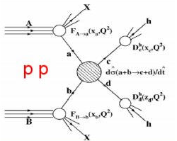
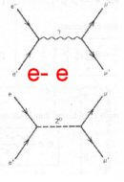
The possible future@CERN: Some physics arguments
Hadron collisions: collision of compound particles
  Mix of quarks, anti-quarks and gluons: variety of processes
  Parton energy spread
  QCD processes large background sources
  total cross section increases with log s;
  “interesting cross sections” decrease with s
  Hadron collisions ⇒ large discovery range
Lepton collisions: collision of elementary particles
  Collision process known
  Well defined energy
  Other physics background limited
  All cross sections decrease with s
Lepton-hadron is also possible

Slide 34
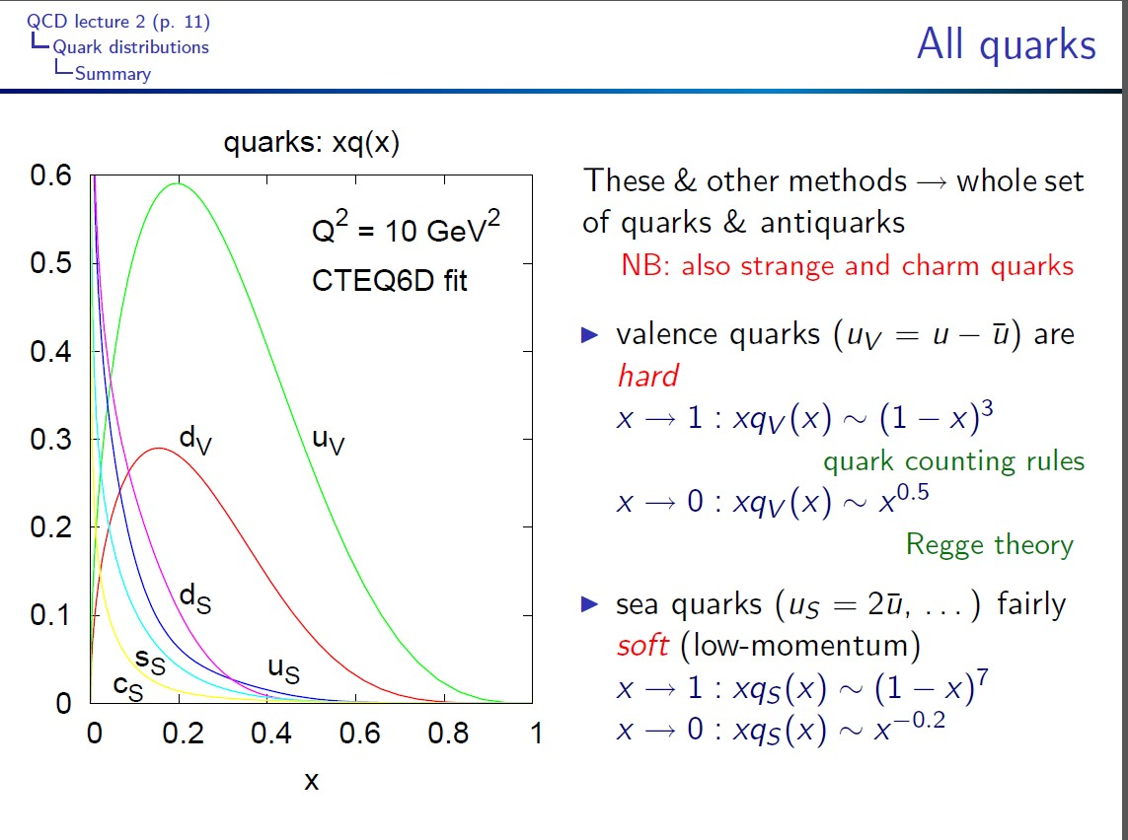

Slide 35
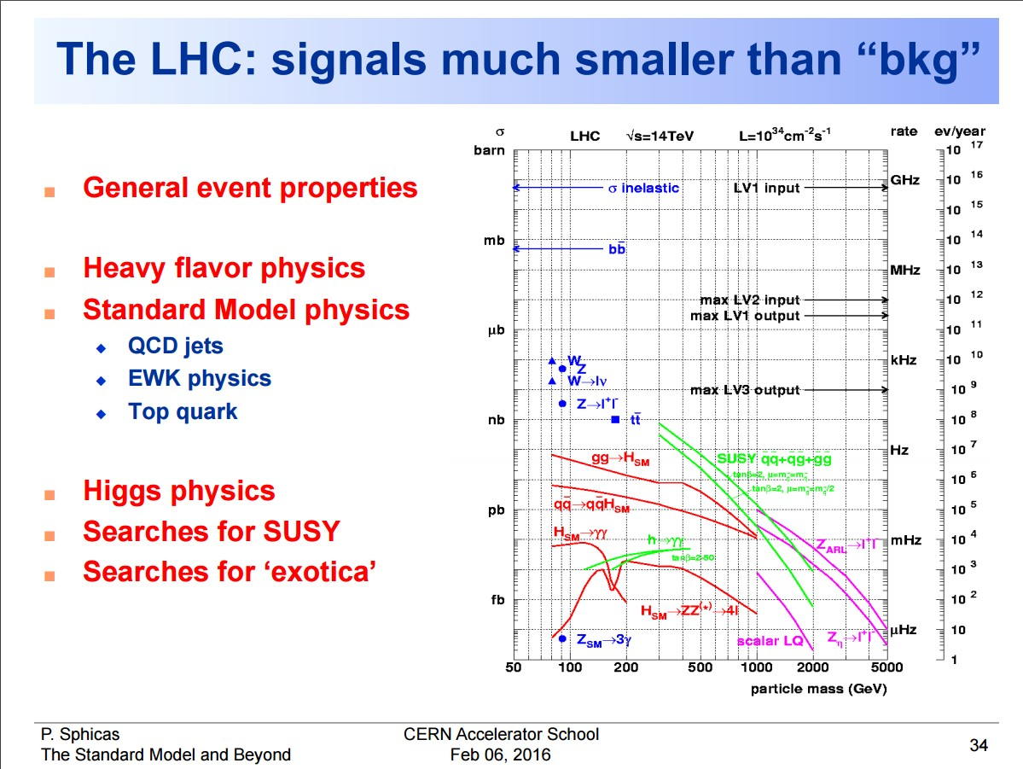

Slide 36
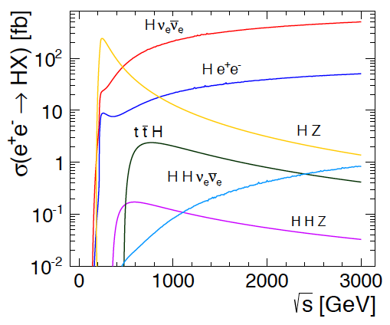
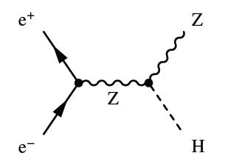
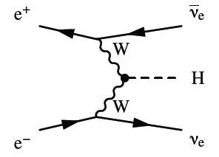
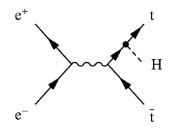
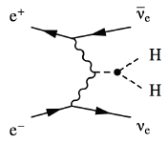

Higgs Physics in e+e- Collisions
Precision Higgs measurements
Model-independent
  Higgs couplings
  Higgs mass
Large energy span of linear colliders allows to collect a maximum of information:
  ILC: 500 GeV (1 TeV)
  CLIC: ~350 GeV – 3 TeV

Slide 37
Future seen from the accelerators: Lepton Collider Options
Three main approaches
Big LEP-type collider ring
  FCC-ee (or/and CepC in China)
  Later a proton collider in the same tunnel
Linear collider
  CLIC (or ILC in Japan)
Muon collider (presently all efforts stopped)

Slide 38
e+ e- Ring Collider Energy Limitation
Beam can be used many times
Lepton beam energy is below LHC
-> magnets are not a problem
accelerating cavities
N
N
But synchrotron radiation is:
At LEP2 lost 2.75GeV/turn for E=105GeV
Pay for installed voltage (ΔE) and size (R),
so scale as:
S
S
-> use heavier particles, e.g. muons
-> or linear collider
(-> or try to push a bit harder on cost)

Slide 39
Linear Collider Energy Limitation
source
main linac
Hardly any synchrotron radiation
Beam can only be used only once
-> strong beam-beam effects
Acceleration gradient is an important issue

Slide 40
Simplified Cost Scaling Comparison
Linac:
Ring:
Power consumption behaves similar to cost for constant luminosity
There will always be an energy where linear colliders are better

Slide 41
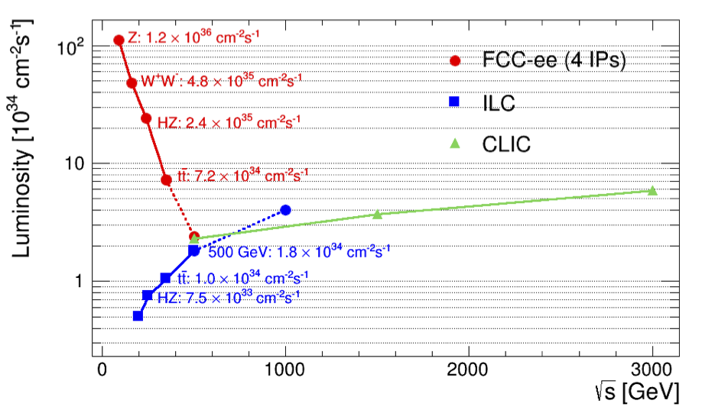
Circular vs. Linear Colliders
F. Gianotti
Circular,
adding four experiments
Modified from original version:
http://arxiv.org/pdf/1308.6176v3.pdf
CepC (2 IPs)
China prepares a project similar to FCC-ee
Linear

Slide 42
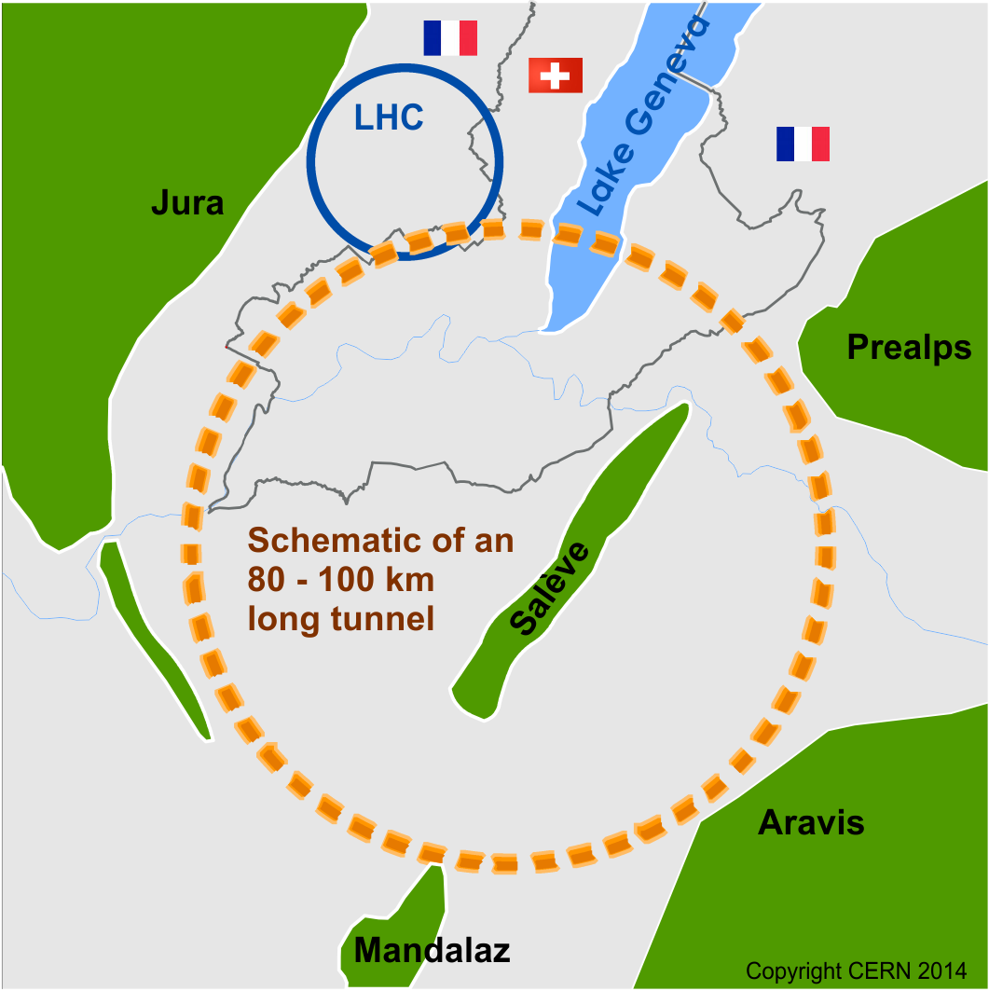
Future Circular Collider Study
Goal: CDR for European Strategy Update 2018/19
International FCC collaboration (CERN as host lab) to study:
pp-collider (FCC-hh) → main emphasis, defining infrastructure requirements
80-100 km tunnel infrastructure in Geneva area, site specific
e⁺e⁻ collider (FCC-ee), as potential first step
p-e (FCC-he) option, integration one IP, FCC-hh & ERL
HE-LHC with FCC-hh technology
~16 T ⇒ 100 TeV pp in 100 km

Slide 43
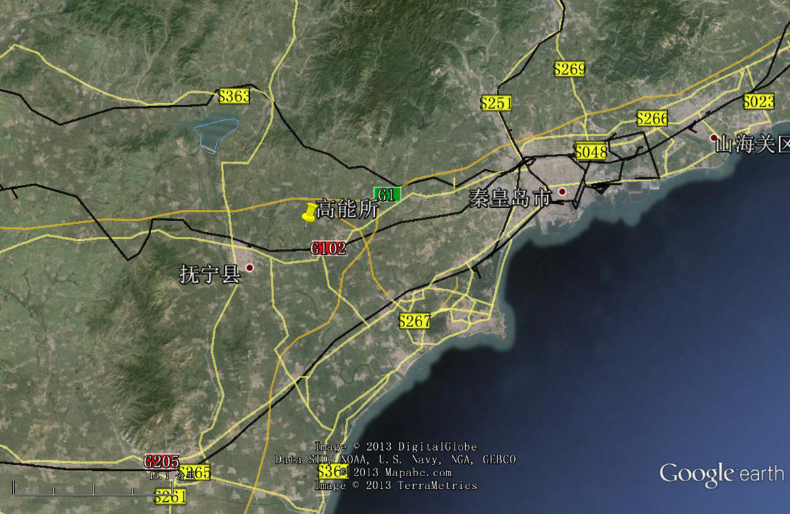
CepC/SppC study (CAS-IHEP) 100 km (new baseline!) , e⁺e⁻ collisions ~2028; pp collisions ~2042
Qinhuangdao (秦皇岛）
CepC, SppC
50 km
100 km
easy access
300 km east
from Beijing
3 h by car
1 h by train
“Chinese Toscana”
Yifang Wang

Slide 44
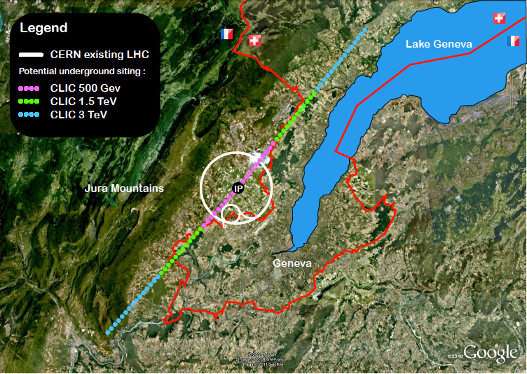
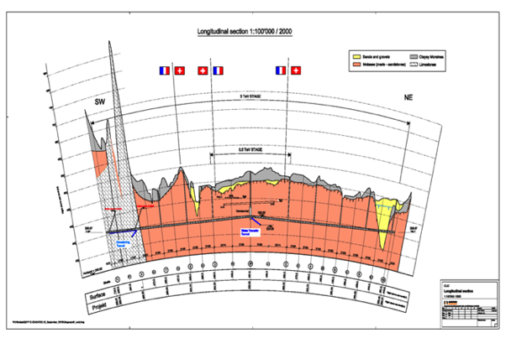
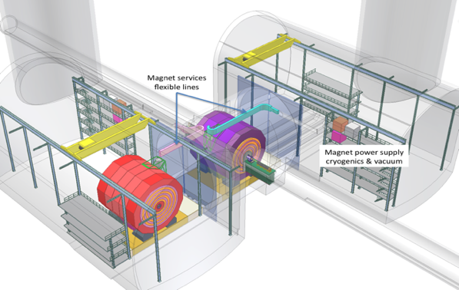
CLIC near CERN
Tunnel implementations (laser straight)
Central MDI & Interaction Region

Slide 45

hadron collider parameters (pp)
parameter | FCC-hh |  | HE-LHC | (HL) LHC
collision energy cms [TeV] | 100 |  | 27 | 14
dipole field [T] | 16 |  | 16 | 8.3
circumference [km] | 100 |  | 27 | 27
# IP | 2 main & 2 |  | 2 & 2 | 2 & 2
beam current [A] | 0.5 |  | 1.27 | (1.12) 0.58
bunch intensity [10¹¹] | 1 (0.2) | 1 (0.2) | 2.5 | (2.2) 1.15
bunch spacing [ns] | 25 (5) | 25 (5) | 25 (5) | 25
IP β*_{x,y} [m] | 1.1 | 0.3 | 0.45 | (0.15) 0.55
luminosity/IP [10³⁴ cm⁻²s⁻¹] | 5 | 30 | 16 | (5) 1
peak #events/bunch crossing | 170 | 1020 (204) | 460 (92) | (135) 27
stored energy/beam [GJ] | 8.4 |  | 1.4 | (0.7) 0.36
synchrotron rad. [W/m/beam] | 30 |  | 4.1 | (0.35) 0.18

Slide 46
The main technology challenges
FCC – hh
- SC dipole magnets with 16T or 20T field strength
- machine protection and beam collimation
FCC-e⁺e⁻
- 100 MW synchrotron radiation power
- @350 GeV cms energy > 10GV energy loss/turn
- huge RF plants based on SC-RF
CLIC
- 100 MV/m gradient for acceleration
- Uses drive-beam of 100 A! (electrons) to power main linac
- vertical beam size at IP = 1nm for high luminosity (10 ³⁴)
- very high demand on alignment of RF (wakefields) and on quadrupole mechanical stability (in order to maintain small emittance)

Slide 47

Drive beam time structure
2904 bunches
83 ps (12 GHz)
240 ns
5.8μs
140μs, 24 trains
Bunch charge: 8.4 nC, Current in train: 100 A

Slide 48
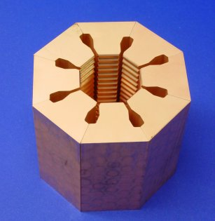
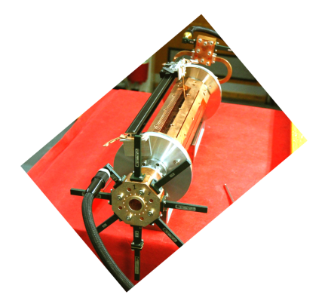
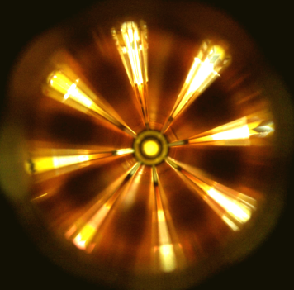
Power extraction structure PETS
must extract efficiently >100 MW power from high current drive beam
passive microwave device in which bunches of the drive beam interact with the impedance of the periodically loaded waveguide and generate RF power
periodically corrugated structure with low impedance (big a/λ)
ON/OFF
mechanism
The power produced by the bunched (ω₀) beam in a constant impedance structure:
Design input parameters
PETS design
Beam eye
view
P – RF power, determined by the accelerating structure needs and the module layout.
I – Drive beam current
L – Active length of the PETS
F_{b} – single bunch form factor (≈ 1)

Slide 49
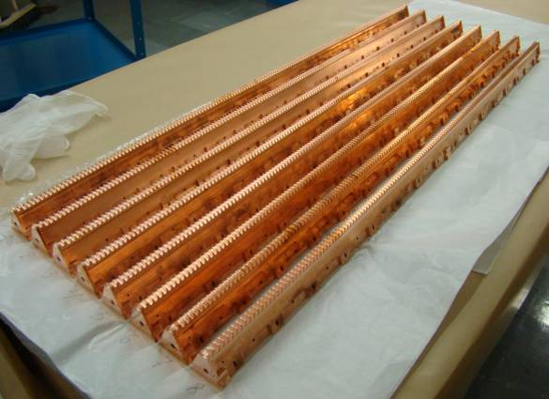
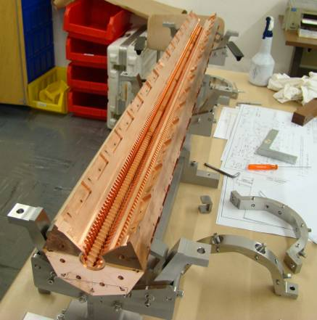
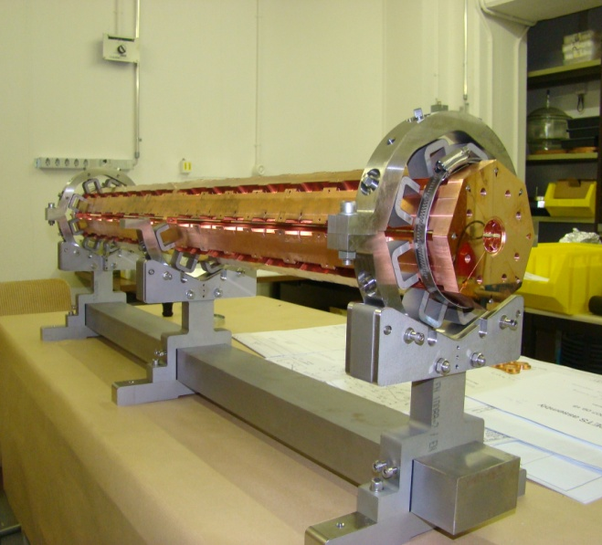
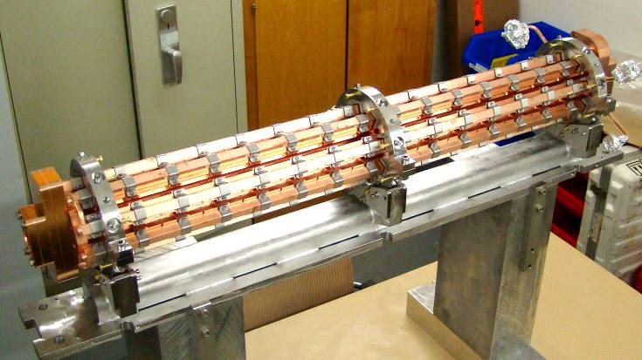
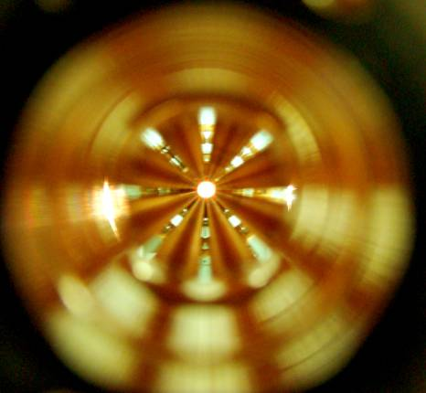
12 GHz PETS assembly
8 bars, as received from VDL
PETS octants assembly
I. Syratchev

Slide 50
Summary
Interesting time ahead of us in high energy physics
→ LHC still “usefull” until about the year 2035
→ LHC will get a luminosity upgrade around the year 2025
( 5-10 times integrated luminosity/year)
HE-LHC (LHC tunnel filled with FCC magnets) is also an actively discussed option
Expect publication of “European strategy update” within the next month: Guidance for all laboratories for the next 5 years
Presently active R&D on all three options:
- CLIC, FCC (leptons) and FCC (hadrons)
All options require a lot of resources and collaboration across the whole world

Slide 51
Backup Slides

Slide 52
Past/present circular colliders
Machine | Years in operation | Beam type | Beam energy [GeV] | Luminosity [cm⁻² s⁻¹]
ISR | 1971-’84 | p p | 31 | >2x10³¹
LEP I | 1989-’95 | e+ e- | 45 | 3x10³⁰
LEP II | 1995-2000 | e+ e- | 90-104 | 10³²
KEKB | 1999-2010 | e+ e- | 8 x 3.5 | 2x10³⁴
SppS | 1981-’84 | p anti-p | 315 (400) | 6x10³⁰
TEVATRON | 1983-2011 | p anti-p | 980 | 2x10³²
LHC | 2008-? | p p (Pb) | 7000 | 10³⁴
HL-LHC | ~2026-2037 | p p (Pb) | 7000 | 5x10³⁴
FCC-hh | 2040+ | p p (Pb) | 50000 | 2-3x10³⁵
FCC-ee | 2040+ | e+ e- | 45-175 | ~10³⁶

