Slide 1
A first taste of Non-Linear Beam Dynamics
Yannis PAPAPHILIPPOU
Accelerator and Beam Physics group
Beams Department
CERN
CERN Accelerator School
Introduction to Accelerator Physics 2019
Atrium Hotel, Vysoké Tatry, Slovakia
19-20 September 2019

Slide 2
Purpose of the lecture
Introducing aspects of non-linear dynamics
  Mathematical tools for modelling nonlinear dynamics
    Power series (Taylor) maps and symplectic maps.
  Eﬀects of nonlinear perturbations
    Resonances, tune shifts, dynamic aperture.
  Analysis methods:
    Normal forms, frequency map analysis.
Employ two types of accelerator systems for illustrating the methods and tools
  Bunch compressor (a single-pass system)
  A storage ring (a multi-turn system).

Slide 3
Aim of the 2nd Lecture
Describe some of the phenomena associated with nonlinearities in periodic beamlines (such as storage rings)
Explain signiﬁcance of symplectic maps, and describe some of the challenges in calculating and applying symplectic maps
Outline some of the analysis methods that can be used to characterise nonlinear beam dynamics in periodic beamlines.

Slide 4
Example of a periodic system: a simple storage ring
Notes:
Tabor 53-54

Slide 5
A simple storage ring
As example, consider the transverse dynamics in a simple storage ring, assuming:
  The storage ring is constructed from some number of identical cells consisting of dipoles, quadrupoles and sextupoles.
  The phase advance per cell can be tuned from close to zero, up to about 0.5×2π.
  There is one sextupole per cell, which is located at a point where the horizontal beta function is 1 m, and the alpha function is zero.
Usually, storage rings will contain (at least) two sextupoles per cell, to correct horizontal and vertical chromaticity. To keep things simple, we will use only one sextupole per cell.

Slide 6
Reminder: chromaticity correction
Sextupoles are needed in a storage ring to compensate for the fact that quadrupoles have lower focusing strength for particles of higher energy:
The change in focusing strength with particle energy has undesirable consequences, especially in storage rings: it can lead to particle motion becoming unstable because of resonances

Slide 7
Reminder: chromaticity correction
A sextupole can be regarded as a quadrupole with focusing strength that increases with horizontal oﬀset from the axis.
If sextupoles are located where there is non-zero dispersion, they can be used to control the chromaticity in a storage ring.

Slide 8
Linear dynamics in a storage ring
The chromaticity, and hence the sextupole strength, will normally be a function of the phase advance
However, just to investigate the nonlinear eﬀects of the sextupoles, we shall keep the sextupole strength ﬁxed, and change only the phase advance
We can assume that the map from one sextupole to the next is linear, and corresponds to a rotation in phase space through an angle equal to the phase advance:
Again to keep things simple, we shall consider only horizontal motion, and assume that the vertical co-ordinate

Slide 9
Nonlinear transfer map: sextupole
Recall that the vertical field component in a sextupole magnet is:
with the beam rigidity and the normalized sextupole gradient is
In the “thin lens” approximation, the deﬂection of a particle passing through the sextupole of length is

Slide 10
Nonlinear transfer map: sextupole
The map for a particle moving through a short sextupole can be represented by a “kick” in the horizontal momentum:
Let us choose a ﬁxed value , and look at the eﬀects of the maps for diﬀerent phase advances.
For each case, we construct a phase space portrait by plotting the values of the dynamical variables after repeated application of the map (rotation + sextupole) for a range of initial conditions.
First, let us look at the phase space portraits for a range of phase advances from 0.2 × 2π to 0.5 × 2π

Slide 11
Phase space: single sextupole
For small amplitudes, particles trace out closed loops around the origin: this is what we expect for a purely linear map
As the amplitude is increased, there appear “islands” in phase space. The phase advance (for the linear map) is often close to , where is an integer and is the number of islands
Larger number of islands appears at larger amplitude

Slide 12
Phase space: single sextupole
Usually, there is a closed curve that divides a region of stable from a region of chaotic motion.
Outside that curve, the amplitude of particles increases without limit
The area of the stable region depends strongly on the phase advance

Slide 13
Phase space: single sextupole
Usually, there is a closed curve that divides a region of stable from a region of chaotic motion.
Outside that curve, the amplitude of particles increases without limit
The area of the stable region depends strongly on the phase advance
For phase advance close to 2π/3, it appears that the stable region almost vanishes altogether

Slide 14
Phase space: single sextupole
Usually, there is a closed curve that divides a region of stable from a region of chaotic motion.
Outside that curve, the amplitude of particles increases without limit
The area of the stable region depends strongly on the phase advance
When phase advance approaches π, the stable area becomes large, and distortions from the linear ellipse become less evident

Slide 15
Phase space: single sextupole
Usually, there is a closed curve that divides a region of stable from a region of chaotic motion.
Outside that curve, the amplitude of particles increases without limit
The area of the stable region depends strongly on the phase advance
When phase advance approaches π, the stable area becomes large, and distortions from the linear ellipse become less evident

Slide 16
Eﬀect of phase advance on nonlinear dynamics
Notes:
Tabor 53-54

Slide 17
Effect of phase advance
An important observation is that the eﬀect of the sextupole in the periodic cell depends strongly on the phase advance across the cell
We can start to understand the signiﬁcance of the phase advance by considering two special cases:
  Phase advance equal to an integer times 2π
  Phase advance equal to a half integer times 2π

Slide 18
Integer phase advance
Let us consider ﬁrst a phase advance equal to an integer. In that case, the linear part of the map is just the identity
So the combined eﬀect of the linear map and the sextupole kick is:
Clearly, the horizontal momentum will increase without limit
There are no stable regions of phase space, apart from the line

Slide 19
Half- Integer phase advance
Now consider what happens if the phase advance of a cell is a half integer times 2π, so the linear part of the map is just a rotation through π.
If a particle starts at the entrance of a sextupole with and , then at the exit of that sextupole:
Then, after passing to the entrance of the next sextupole, the co-ordinates will be:

Slide 20
Half- Integer phase advance
Finally, on passing through the second sextupole:
In other words, the momentum kicks from the two sextupoles cancel each other exactly
The resulting map is a purely linear phase space rotation by π.
In this situation, we expect the motion to be stable (and periodic), no matter what the amplitude

Slide 21
Impact of phase advance: dipoles
The eﬀect of the phase advance on the sextupole “kicks” is similar to the eﬀect on perturbations arising from dipole and quadrupole errors in a storage ring
In the case of dipole errors, the kicks add up if the phase advance is an integer, and cancel if the phase advance is a half integer

Slide 22
Impact of phase advance: quadrupoles
In the case of quadrupole errors, the kicks add up if the phase advance is a half integer.
Higher-order multipoles drive higher-order resonances but the eﬀects are less easily illustrated on a phase space diagram.

Slide 23
Resonances
Notes:
Tabor 53-54

Slide 24
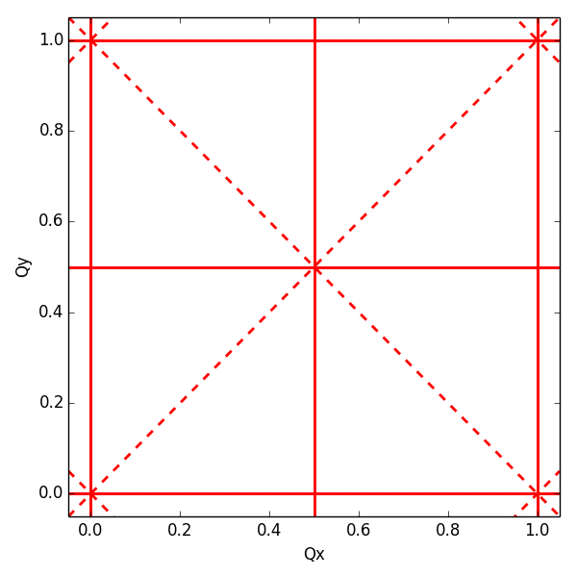
Resonances
If we include vertical as well as horizontal motion, then we find that resonances occur when the tunes satisfy
where n_{x}, n_{y} and r are integers and resonance is of order |n_{x}| + |n_{y}|
Resonances up to order 2
normal resonances
(= even n_{y})
skew resonances
(= odd n_{y})

Slide 25
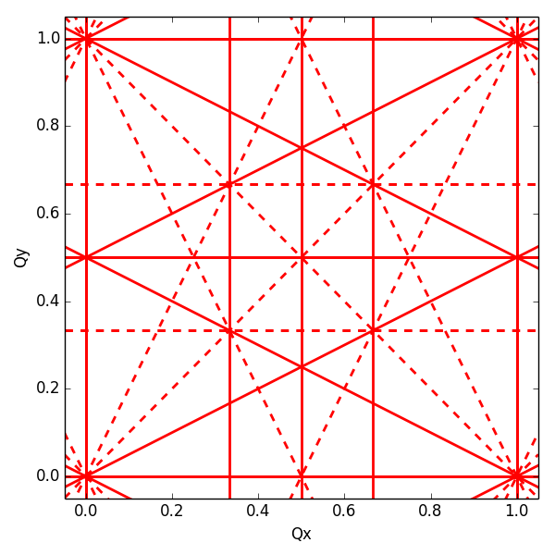
Resonances
If we include vertical as well as horizontal motion, then we find that resonances occur when the tunes satisfy
where n_{x}, n_{y} and r are integers and resonance is of order |n_{x}| + |n_{y}|
Resonances up to order 3
normal resonances
(= even n_{y})
skew resonances
(= odd n_{y})

Slide 26
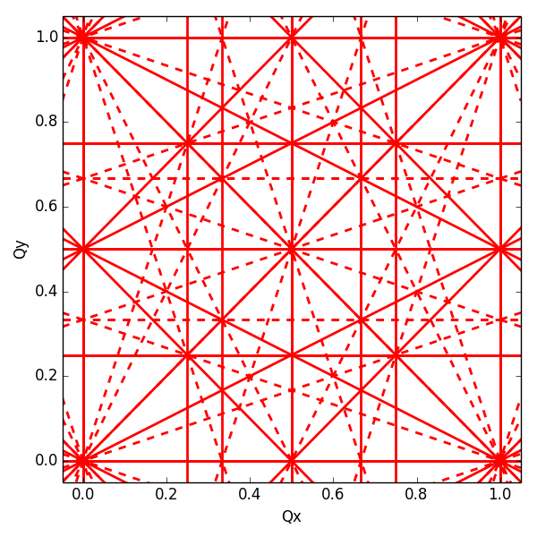
Resonances
If we include vertical as well as horizontal motion, then we find that resonances occur when the tunes satisfy
where n_{x}, n_{y} and r are integers and resonance is of order |n_{x}| + |n_{y}|
Resonances up to order 4
normal resonances
(= even n_{y})
skew resonances
(= odd n_{y})

Slide 27
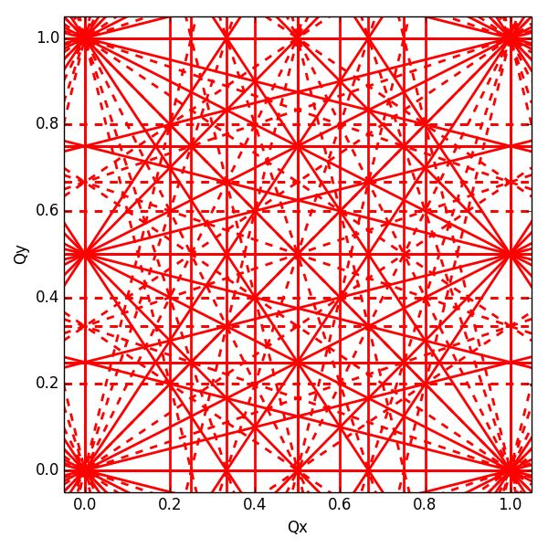
Resonances
If we include vertical as well as horizontal motion, then we find that resonances occur when the tunes satisfy
where n_{x}, n_{y} and r are integers and resonance is of order |n_{x}| + |n_{y}|
Resonances up to order 5
normal resonances
(= even n_{y})
skew resonances
(= odd n_{y})

Slide 28
Resonances in storage ring
Resonances are associated with chaotic motion for particles in storage rings.
However, the number of resonance lines in tune space is inﬁnite: any point in tune space will be close to a resonance of some order.
This observation raises two questions:
  How do we know what the real eﬀect of any given resonance line will be?
  How can we design a storage ring to minimise the adverse eﬀects of resonances?
These are not easy questions to answer and usually necessitate numerical integration of the equations of motion
We shall discuss some of the issues in the remaining parts of this lecture.

Slide 29
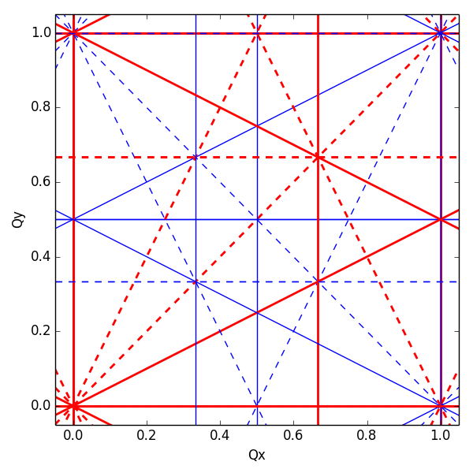
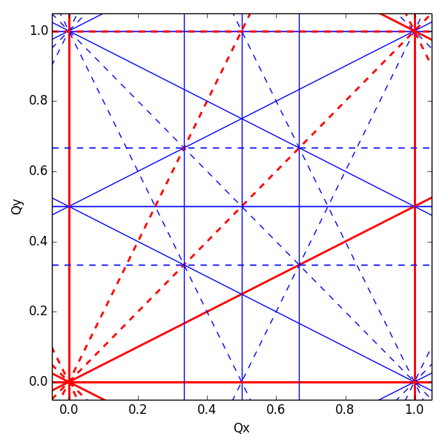
Resonance cancellation by periodicity
By imposing a periodicity P in the lattice (i.e. building a machine from P identical cells) the resonance condition becomes
Resonances for which r×P is integer → systematic
If r×P is NOT integer the resonance cancels → non-systematic
periodicity P=1
periodicity P=2
periodicity P=3
solid lines: normal resonances
dashed lines: skew resonances

Slide 30
Real life example for periodicity: ALS
Advanced Light Source design lattice periodicity: 12
Measurement of beam loss as function of tune
Synchrotron light beam spot
Uncorrected optics
Corrected optics
Beta beating
Before optics correction: ~30%
After optics correction: <1%
Simulated phase space
  D. Robin, C. Steier, J. Safranek, W. Decking, “Enhanced performance of the ALS through periodicity restoration of the lattice,” proc. EPAC 2000.

Slide 31
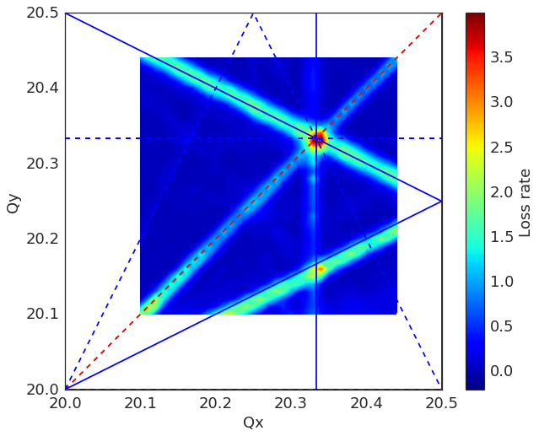
Real life example for periodicity: SPS
SPS (hadron machine) has design lattice periodicity of 6
Some indication for the strength of individual resonance lines can be inferred from the beam loss rate during dynamic tune scans, i.e. the derivative of the beam intensity at the moment of resonance crossing
Sextupole resonances can be clearly identified although they should be suppressed by lattice periodicity … but SPS has no individual quadrupoles to restore optics functions distortions
Measured losses during tune scan
Measured loss rate in 2D scan
time
time

Slide 32
Analytical methods for nonlinear dynamics
Notes:
Tabor 53-54

Slide 33
Analytical methods for NLD
There are two approaches widely used in accelerator physics: perturbation theory and normal form analysis.
In both these techniques, the goal is to construct a quantity that is invariant under application of the single-turn transfer map. Unfortunately, in both cases the mathematics is complicated and fairly cumbersome
In the case of a single sextupole in a storage ring, we ﬁnd from normal form analysis the following expression for the betatron action as a function of the betatron phase (angle variable):
where is a constant (an invariant of the motion), is the angle variable, and is the phase advance per cell.
The second term becomes very large when is close to third integer

Slide 34
Normal form for sextupole

Slide 35
Normal form for sextupole

Slide 36
Normal form for sextupole

Slide 37
Tune-shift with amplitude
Close inspection of the plots on the previous slides reveals another eﬀect, in addition to the obvious distortion of the phase space ellipses: the phase advance per turn (i.e. the tune) varies with increasing betatron amplitude
Normal form analysis (and perturbation theory) can be used to obtain estimates for the tune shift with amplitude
In the case of a sextupole, the tune shift is higher-order in the sextupole strength
An octupole, however, does have a ﬁrst-order in the octupole strength tune shift with amplitude, given by:

Slide 38
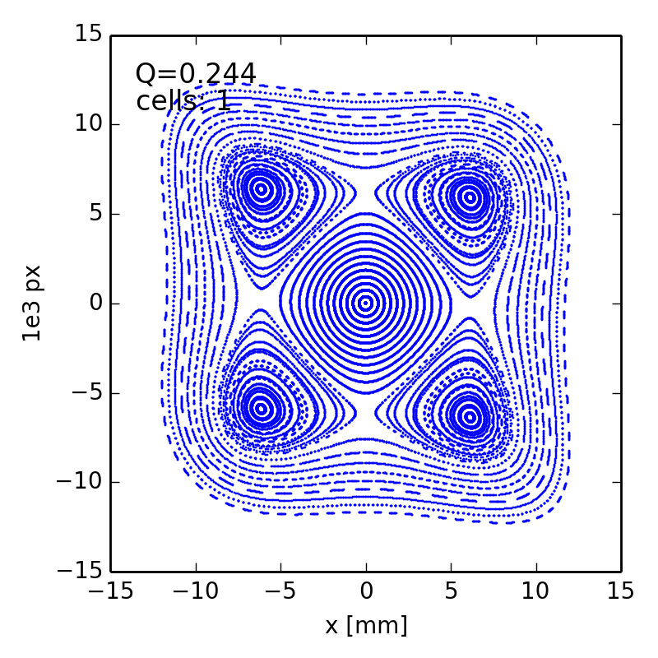
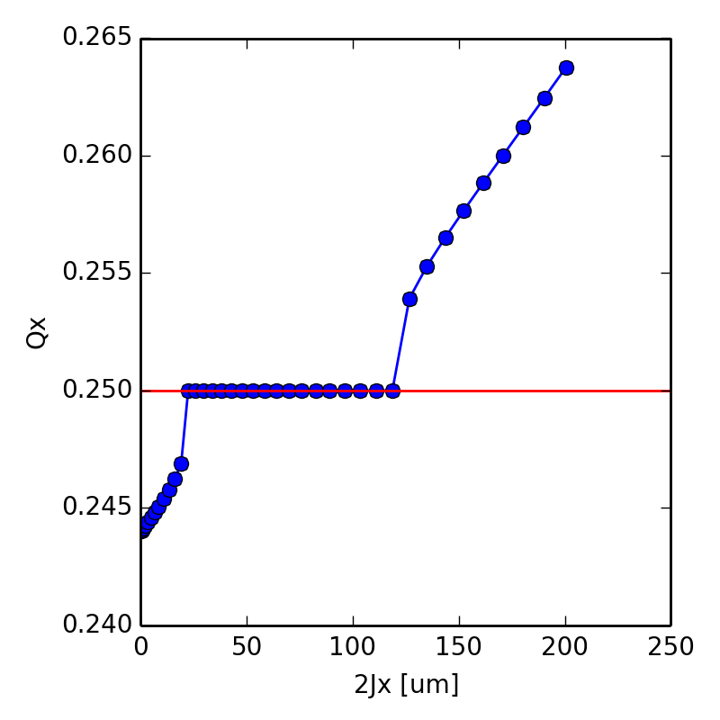
Particle trapped in 4th order resonance
Simulation of simple storage ring with a single octupole close to 4th order resonance
Detuning with amplitude (linear in action)
Particles in the stable islands have tune locked to resonance

Slide 39
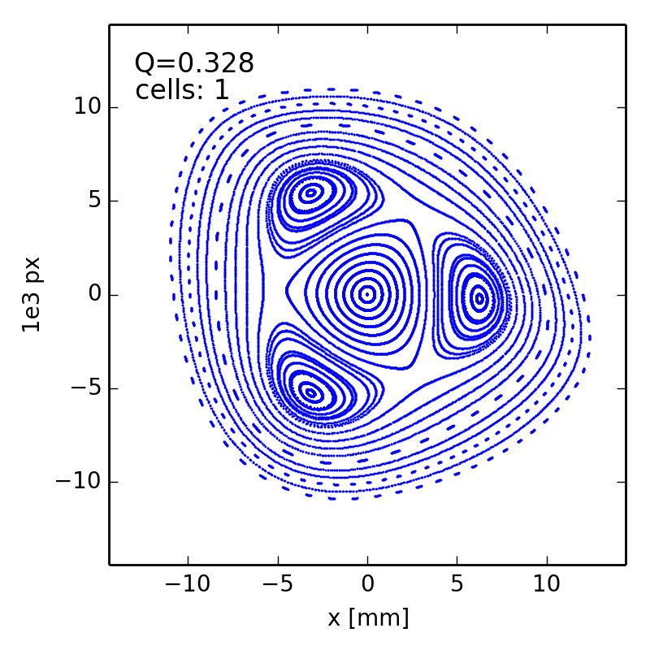
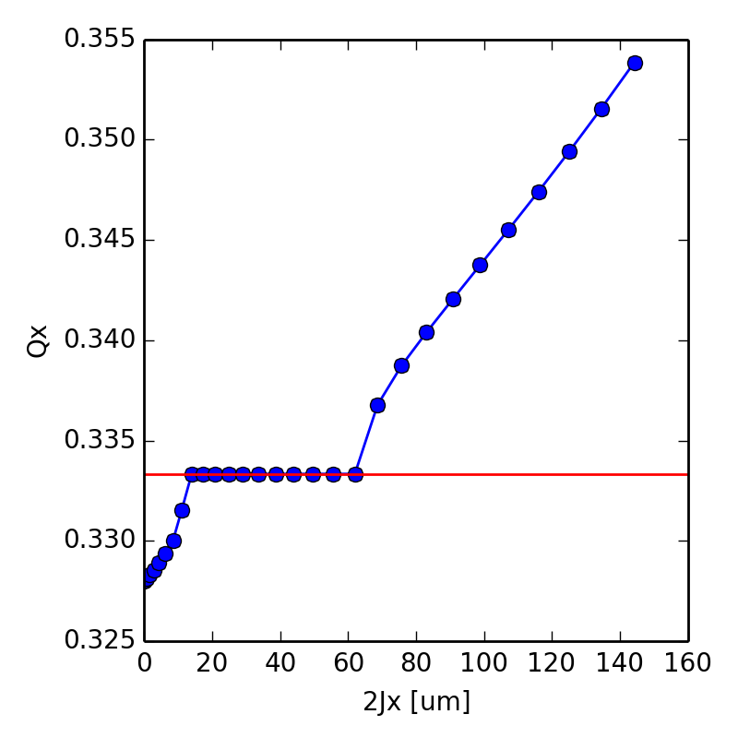
Particle trapped in 3rd order resonance
Simulation of simple storage ring with a sextupole and an octupole close to 3rd order resonance
The amplitude detuning induced by the octupole can create stable islands even for the 3rd order resonance
The tune of particles in islands is locked to the resonance

Slide 40
Non-linear map representation
Notes:
Tabor 53-54

Slide 41
Taylor maps
For any dynamical variable the Taylor map up to 3rd order can be written as
Taylor series provide a convenient way of systematically representing transfer maps for beamline components, or sections of beamline
The main drawback of Taylor series is that in general, transfer maps can only be represented exactly by series with an inﬁnite number of terms
In practice, we have to truncate a Taylor map at some order, and we then lose certain desirable properties of the map
In particular, a truncated map will be usually be non-symplectic.

Slide 42
Symplectic maps
Consider two sets of canonical variables which may be even considered as the evolution of the system between two points in phase space
A transformation from the one to the other set can be constructed through a map
The Jacobian matrix of the map is composed by the elements
The map is symplectic if , with
It can be shown that
Physically, a symplectic transfer map conserves phase space volumes when the map is applied
This is Liouville’s theorem, and is a property of charged particles moving in electromagnetic ﬁelds, in the absence of radiation.

Slide 43
Symplectic maps
The eﬀect of losing symplecticity becomes apparent if we compare phase space portraits constructed using symplectic (below, left) and non-symplectic (below, right) transfer maps.

Slide 44
Symplectic integration
Consider a sextupole with equations of motion:
Exact solutions using some elementary functions do not exist
By splitting integration into three steps, it is possible to write an explicit and symplectic approximate solution
This an example of a symplectic integrator known as a “drift–kick–drift” approximation.

Slide 45
Numerical methods: Dynamic aperture
Notes:
Tabor 53-54

Slide 46
Dynamic aperture
The most direct way to evaluate the non-linear dynamics performance of a ring is the computation of Dynamic Aperture (short: DA)
Particle motion due to multi-pole errors is generally non-bounded, so chaotic particles can escape to infinity. This is not true for all non-linearities (e.g. the beam-beam force)
Need a symplectic tracking code to follow particle trajectories (a lot of initial conditions) for a number of turns (depending on the given problem) until the particles start getting lost. This boundary defines the Dynamic aperture
As multi-pole errors may not be completely known, one has to track through several machine models built by random distribution of these errors
One could start with 4D (only transverse) tracking but certainly needs to simulate 5D (constant energy deviation) and finally 6D (synchrotron motion included)

Slide 47
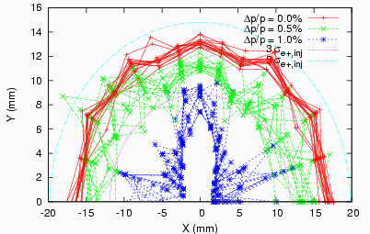
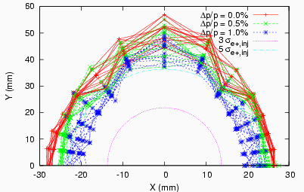
Dynamic Aperture plots
Dynamic aperture plots show the maximum initial values of stable trajectories in x-y coordinate space at a particular point in the lattice, for a range of energy errors
The beam size can be shown on the same plot
Generally, the goal is to allow some significant margin in the design – the measured dynamic aperture is often smaller than the predicted dynamic aperture

Slide 48
Numerical methods: Frequency map analysis
Notes:
Tabor 53-54

Slide 49
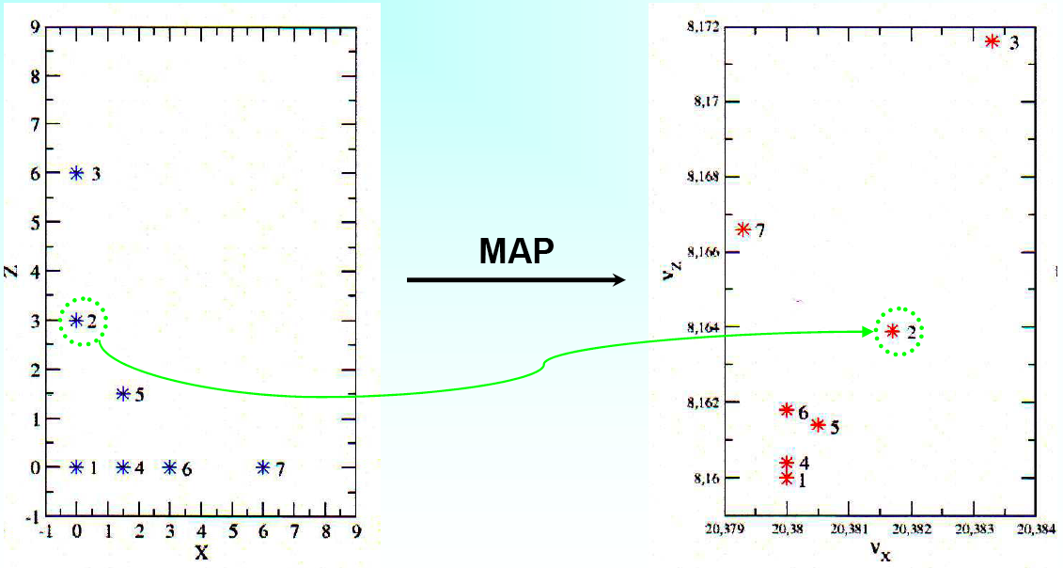
Building the frequency map
  Choose coordinates (x_{i}, y_{i}) with p_{x}=p_{y}=0
  Numerically integrate the phase trajectories through the lattice for sufficient number of turns
  Compute through advanced Fourier methods (NAFF algorithm) Q_{x} and Q_{y} after sufficient number of turns
  Plot them in the tune diagram
y
ν_{y}

Slide 50
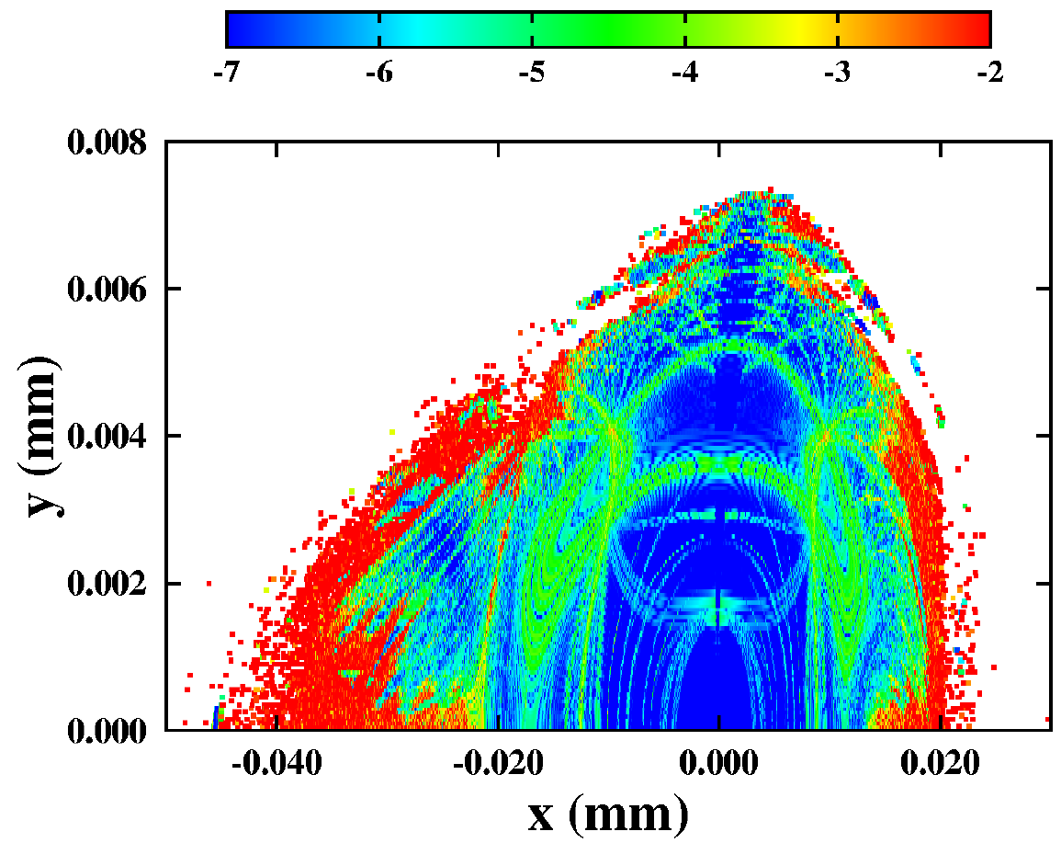
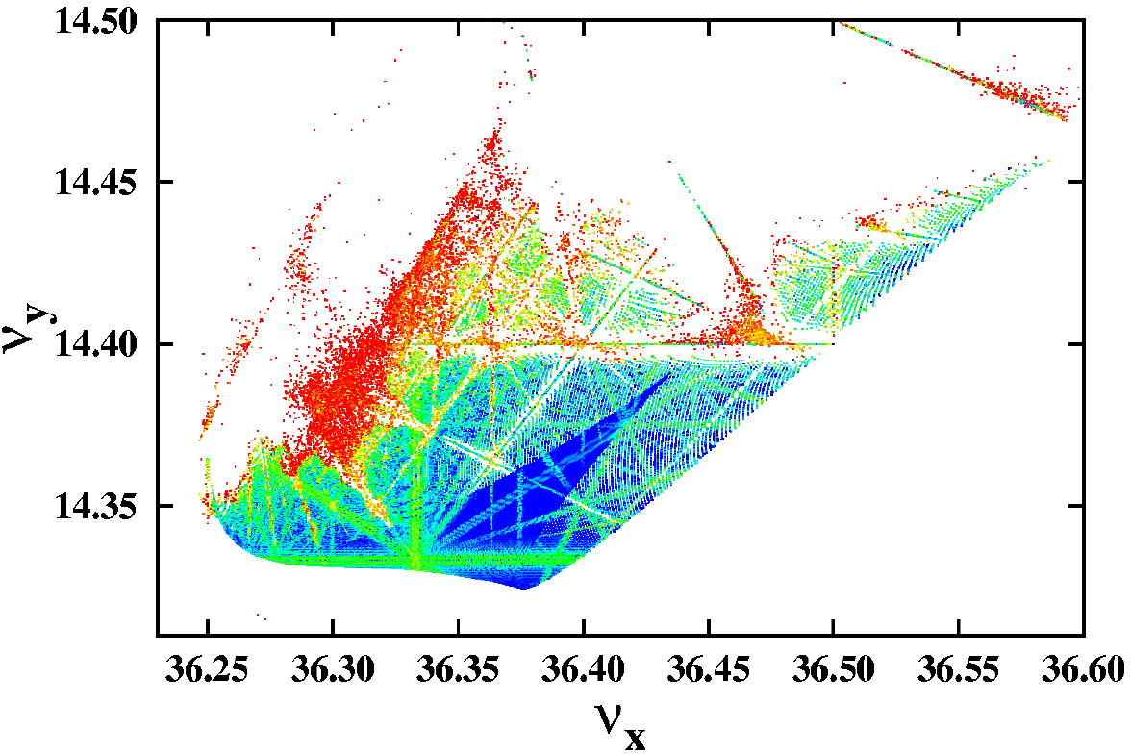
Frequency Map for the ESRF
All dynamics represented in two plots (Frequency Map / Diffusion Map)
Regular motion represented by blue colors
Resonances appear as distorted lines in frequency space (or curves in initial condition space)
Chaotic motion is represented by red scattered particles and defines dynamic aperture of the machine
FMA shows also nicely the detuning with amplitude
Frequency Map
Diffusion Map

Slide 51
Frequency Map for LHC in collision
Frequency map analysis for HL-LHC in collision
Large tune footprint and DA reduction due to “long range beam-beam” forces (electromagnetic field of other beam in interaction region)
DA clearly improved when compensating long range beam-beam with a wire
S. Fartoukh et al., PRSTAB, 2015

Slide 52
Experimental frequency maps
Frequency analysis of turn-by-turn data of beam oscillations produced by a fast kicker magnet and recorded on a Beam Position Monitor
Reproduction of the non-linear model of the Advanced Light Source storage ring and working point optimization for increasing beam lifetime
D. Robin, C. Steier, J. Laskar, and L. Nadolski, PRL 2000
experiment
simulation

Slide 53
Conclusions and Summary
Notes:
Tabor 53-54

Slide 54
Summary
Nonlinear dynamics appear in a wide variety of accelerator systems, including single-pass systems (such as bunch compressors) and multi-turn systems (such as storage rings)
It is possible to model nonlinear dynamics in a given component or section of beamline by representing the transfer map as a power series
Conservation of phase space volumes is an important feature of the beam dynamics in many systems. To conserve phase space volumes, transfer maps must be symplectic
In general, (truncated) power series maps are not symplectic.
To construct a symplectic transfer map, the equations of motion in a given accelerator component must be solved using a symplectic integrator (e.g. the “drift–kick–drift” approximation for a multipole magnet).

Slide 55
Summary
Common features of nonlinear dynamics in accelerators include phase space distortion, tune shifts with amplitude, resonances, and chaotic particle trajectories at large amplitudes (dynamic aperture limits)
Analytical methods such as perturbation theory and normal form analysis can be used to estimate the impact of nonlinear perturbations in terms of quantities such as resonance strengths and tune shifts with amplitude
Frequency map analysis provides a useful numerical tool for characterising tune shifts and resonance strengths from tracking data.
This can give some insight into limitations on the dynamic aperture

