Slide 1

We are living in exponential times…
…but what does it really mean?
Pablo Garcia Tello
CERN IdeaSquare

Slide 2

Why a physicist at CERN would want talk about this topic?
Exponential ~ hugely accelerated
At our LHC we accelerate “stuff” pretty fast and study what happens
when this “stuff” collides.

Slide 3

Why would you be interested in “exponential”?
Because you maybe interested in “sustainability”
Let’s briefly explore together.

Slide 4
I will not use equations…because
Editors always warn that for every equation in a book, the readership is halved. So I don’t want to end up this presentation talking to myself.
I am not the kind of physicist that likes equations too much except when they really tell something (..I say it here at CERN only to very good friends).

Slide 5
Let’s understand “exponential”…
two stories and a quiz for you

Slide 6
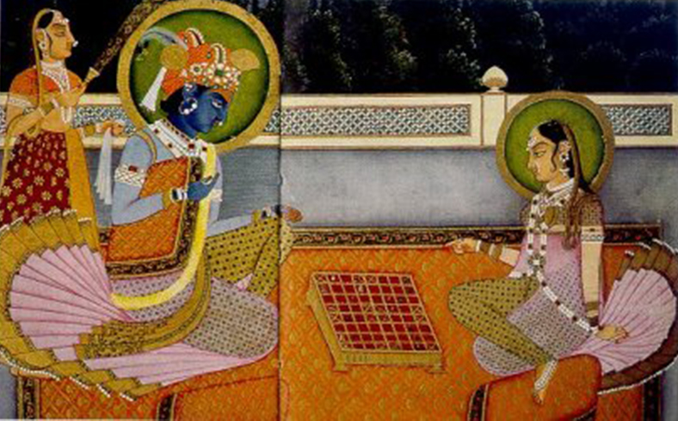
First story: The legend of the invention of Chess.

Slide 7

The legend of the invention of Chess.
Please, 2⁶³ rice grains here!!
460 billion metric tons (rice grain weight ~ 25 mg);
630 years of worldwide rice production;
10 light years of rice laid end to end (rice grain size ~ 5 mm long);
A tower of rice 40 x 40 m² base rising all the way to the Moon.

Slide 8
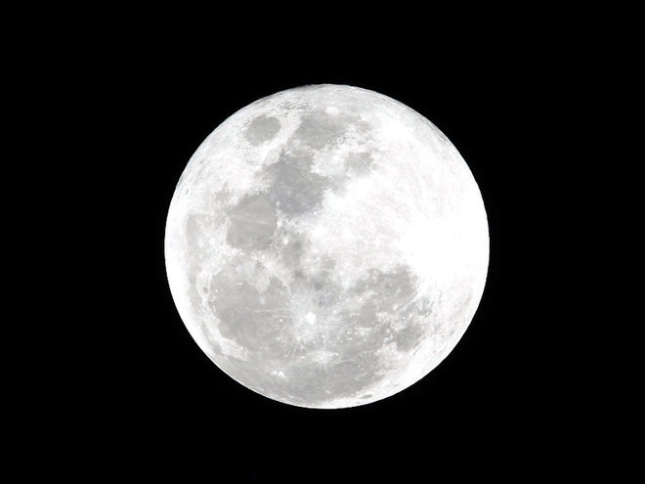
Second story: What is the cheapest way to get to the Moon?

Slide 9
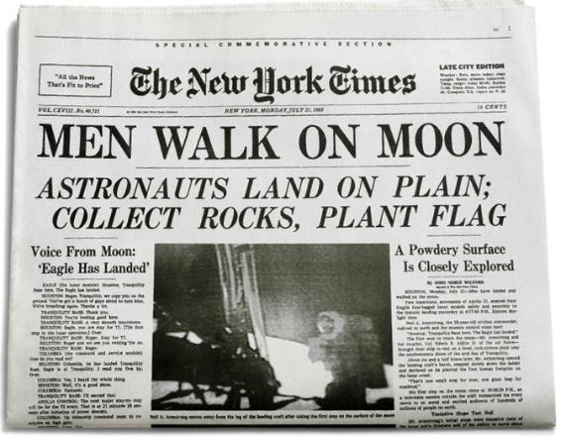
What is the cheapest way to get to the Moon?
1. Take a piece of paper.
2. Start folding it in half each time.

Slide 10
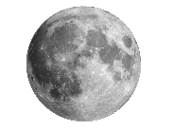
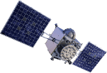


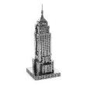

What is the cheapest way to get to the Moon?
45 folds ~ Congratulations, you have reached the Moon!
40 folds
~ GPS satellite orbit
30 folds
~ Altitude of planes
25 folds
~ Empire State Building
Folding increases thickness exponentially

Slide 11
And now the quiz…

Slide 12


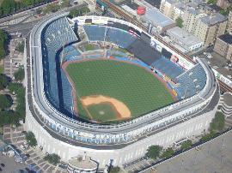

I am an evil physicist.
Disguised in a business suit I kidnap you.
You are here
I tie you to the highest seat in the Yankee stadium (NY).
At 15:00 h I set up a device that releases a first drop.
I set up my device so water accumulates doubling in size every minute…
… How much time do you have for escaping before you drown?
(assume the stadium is water tight)
Any guesses????

Slide 13

You are here
My device is here

Slide 14
You have until
15:50 h.
…ok that’s bad news…
Can things get worse?

Slide 15

When will the stadium be 93%
filled up so it gets you really nervous?
Again, any guesses?
You are here

Slide 16
At 15:45 h…
…yes, things can get worse…

Slide 17
Two lessons…
If something grows exponentially it means really, really fast.
Whatever happens as a consequence it hits up really, really hard in the last moment.

Slide 18
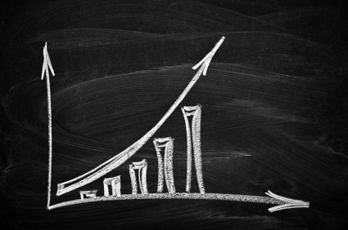
How does exponential growth looks like?
Amount of stuff
Time

Slide 19
Let me show you some examples of “stuff” that seems to grow exponentially in this planet.

Slide 20
Source:
“Global Change and the Earth System: A Planet Under Pressure” (2004), W. Steffen, et al., Springer-Verlag Berlin Heidelberg New York.

Slide 21
Source:
“Global Change and the Earth System: A Planet Under Pressure” (2004), W. Steffen, et al., Springer-Verlag Berlin Heidelberg New York.

Slide 22
Source:
“Global Change and the Earth System: A Planet Under Pressure” (2004), W. Steffen, et al., Springer-Verlag Berlin Heidelberg New York.

Slide 23
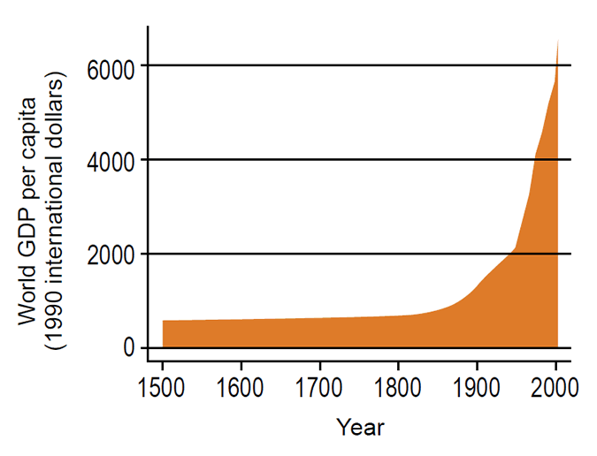
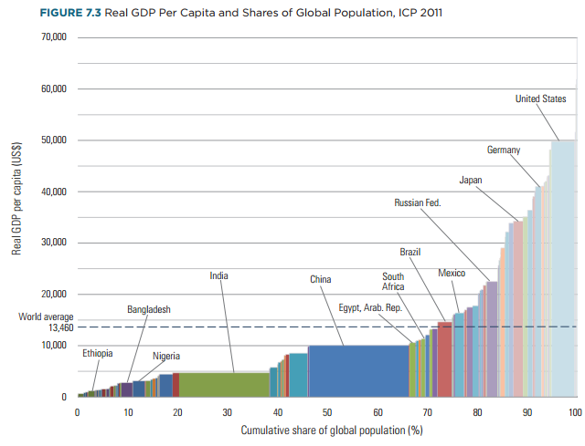
BE AWARE!!
Sometimes (global) exponentials hide inequality in wealth distribution.
Source: Purchasing Power Parities and Real Expenditures of World Economies, 2014 International Bank for Reconstruction and Development / The World Bank.

Slide 24
Now that we have a feeling about “exponential” allow me to offer you some
food for thought (3 cases).

Slide 25
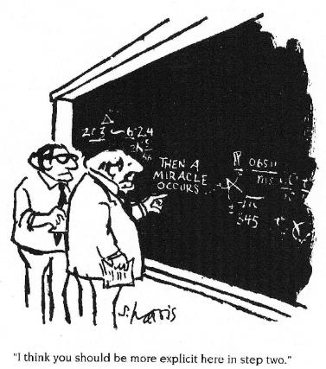
Case 1
Will science and technology alone save the day?
My answer: I don’t know…
I am just a physicist.

Slide 26
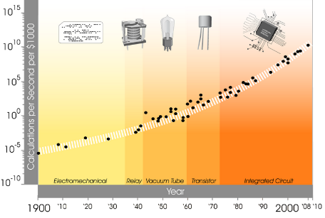
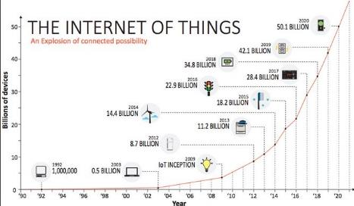
Technology seems to grow exponentially…
Internet of Things: online guide to the Internet of Things, http://www.i-scoop.eu/internet-of-things/ and https://exponential.singularityu.org/

Slide 27
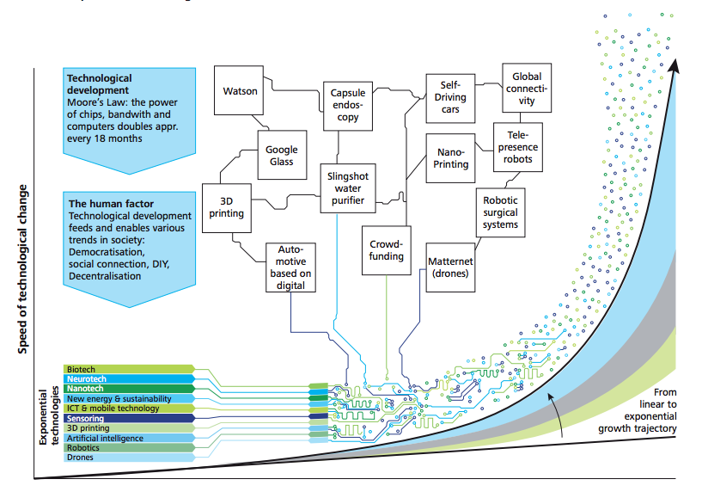
As well as the way several technologies are converging, adopted and the possibilities they may bring…
Source: Deloitte 4.0 report 2015 https://www2.deloitte.com/content/dam/Deloitte/ch/Documents/manufacturing/ch-en-manufacturing-industry-4-0-24102014.pdf

Slide 28
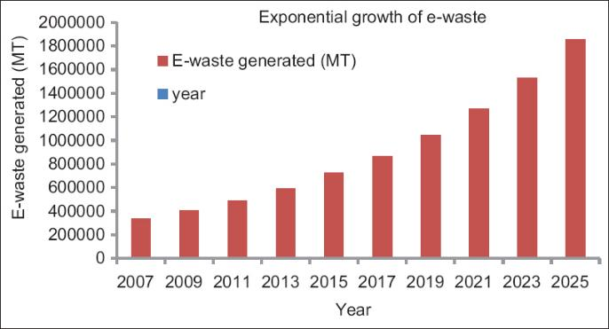
…but this doesn’t come for free…
(India figures)
J. Annamalai, Occupational health hazards related to informal recycling of E-waste in India: An overview, Indian Journal of Occupational and Environmental Medicine, Vol. 19, No. 1, January-April, 2015, pp. 61-65.

Slide 29
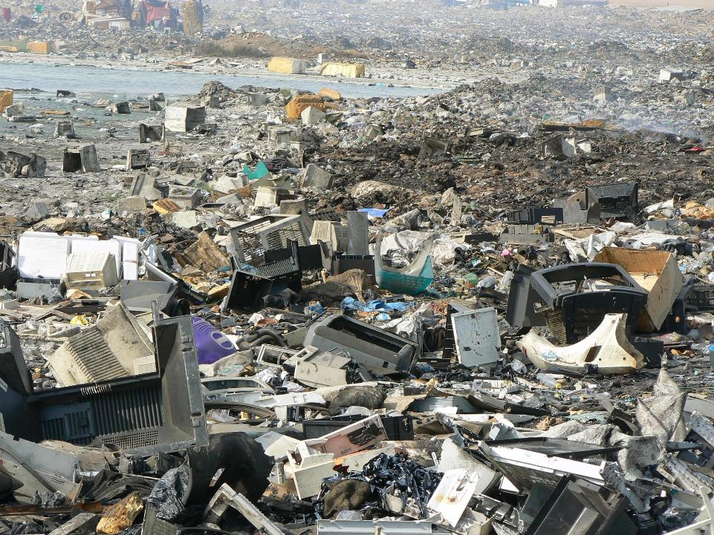

Slide 30
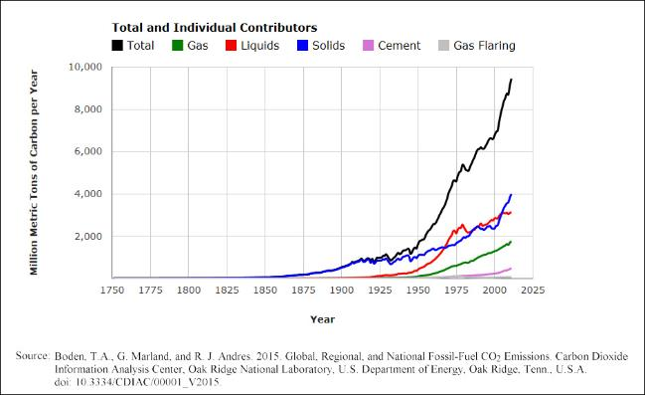
Case 2: A provocative question….
The graph above shows that our environmental problems are growing exponentially…should we advance exponentially towards a “green economy”?
Any answers?

Slide 31
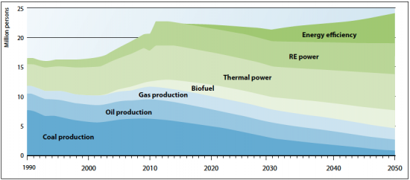
Source: Green Economy, UNEP Report 2011 http://web.unep.org/greeneconomy/resources/green-economy-report
What do we do with the people that will loose their jobs in nowadays polluting energy generation sectors?
My answer: Hell I know!

Slide 32
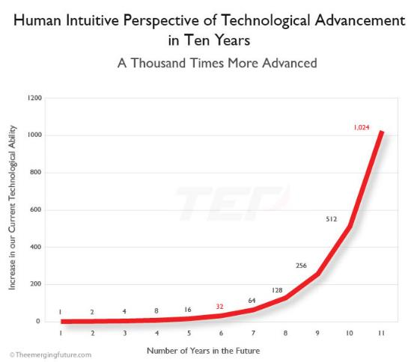
Case 3: Another provocative question….
Source: Estimating the Speed of exponential technological advancement, http://www.theemergingfuture.com/
An exponential growth of the capability of our technology will be good or bad?
Any answers?

Slide 33
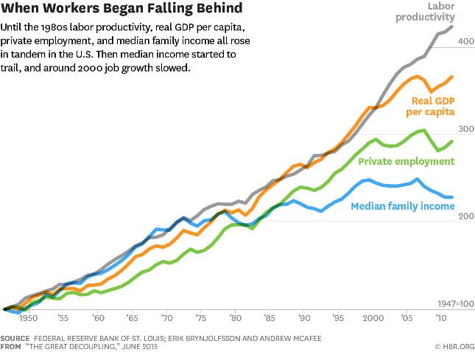
Quite some wise voices are starting to talk about “The Great Decoupling”:
productivity is rising, but employment may not.

Slide 34
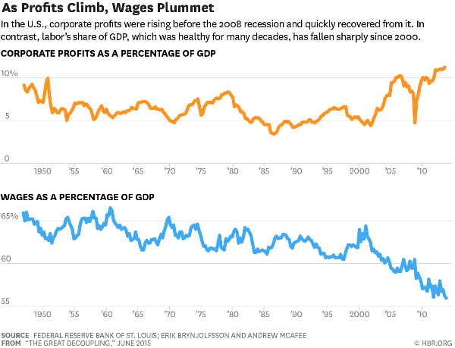
“The Great Decoupling”: Breaking most sacred economic dogmas
Rise in productivity = rise in employment = rise in wealth.

Slide 35
For ending my talk let me show you some quick math useful for getting a fast feeling for “exponential”.
I know I promised no formulas …but you remained with me… so now I take my chances.

Slide 36
The rule of 70
If something grows exponentially at a constant rate it is interesting to get a feeling about how much time it takes for this something to double (= doubling time).
Doubling time is the amount of time it takes for a given quantity to double in size.

Slide 37

The rule of 70
Quick math trick
Doubling time $=\frac{70}{\% growth rate}$
For example, if somebody tells you
that unemployment in your region
has 2% annual growth it will double in just 35 years.

Slide 38
Transformation wanted!
Unknown
Paradigms
(Transformative Innovation)
Potentials
(Breakthrough Innovation)
Known
Facts
(No Innovation)
Possibles
(Incremental Innovation)
Knowns
Unknowns

Slide 39
If we meet again my talk will be about
Super-exponential…
…when things get really scary

Slide 40
Conclusion: I hope humankind will follow the right law…
Solutions
Problems
Solutions
Problems
Law of increasing ignorance
Law of increasing wisdom
But it is just hope…after all, I am a physicist working at CERN…

Slide 41
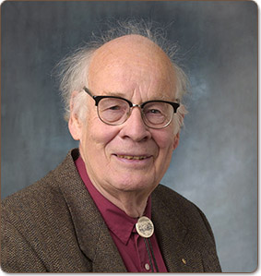
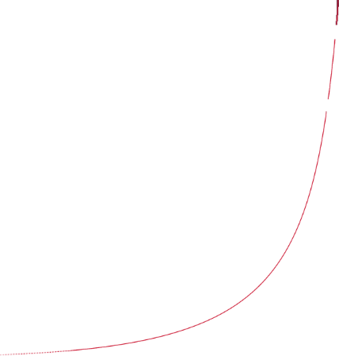
Thanks for your attention questions…
The greatest shortcoming of the human race is our inability to understand the exponential function.
Albert A. Bartlett (1923-2013), Physicist

