Slide 1


WP15 – Task 4 – Status QPR
Olive Kugeler, Helmholtz Zentrum Berlin
Notes:
Why do we need ARIES

Slide 2
QPR status
QPR ready to go, cryogenic schedule will be more relaxed in the near future
Cu/Nb samples at Legnaro
Metal transport frames built, to be shipped to Legnaro
Nb samples manufactured. Encountered problems, to be finalized at RI

Slide 3
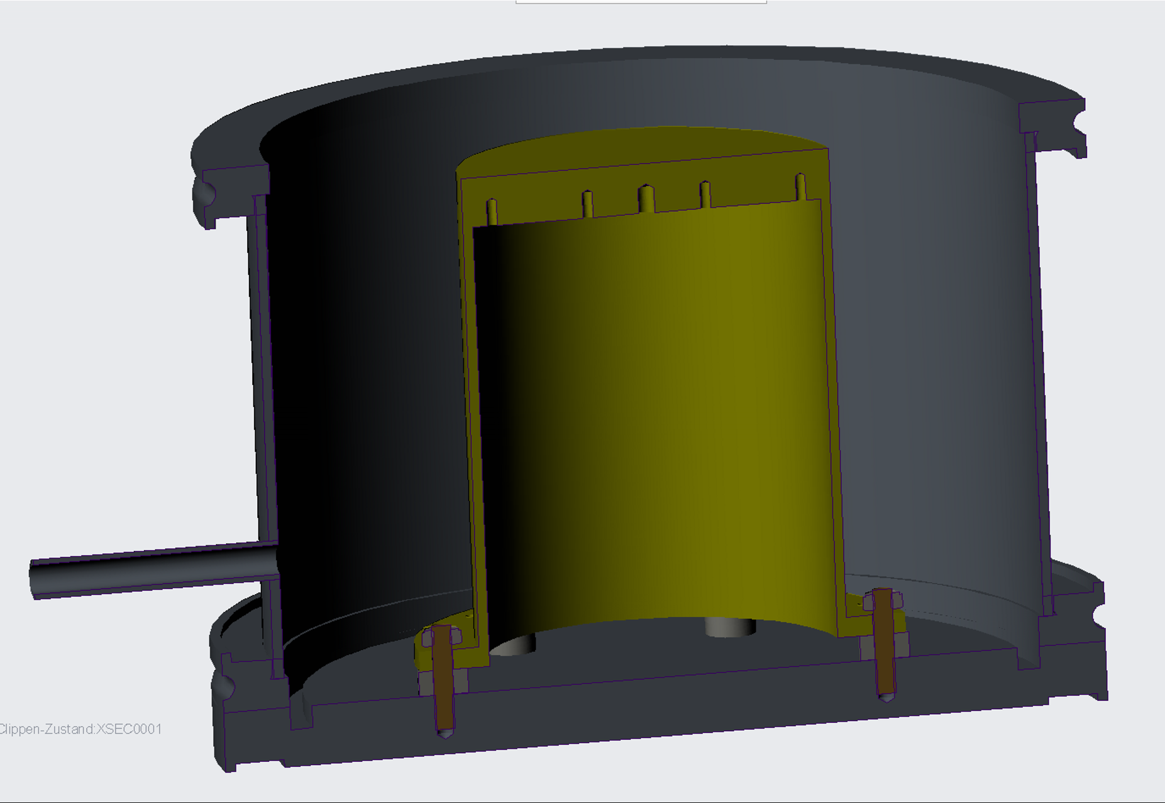
Sample transport box
Window flange on top for optical inspection
and LASER irradiation (?)
2 items produced
QPR sample
to 6mm Swagelok valve
and KF16 pump adapter
ISO-K160 flanges
chamber

Slide 4
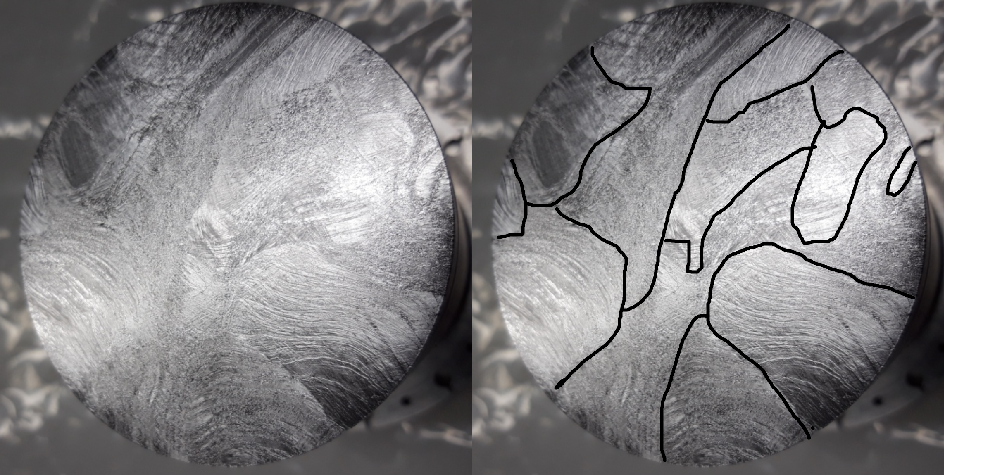
Top of Nb sample
after 150µ BCP and 2h@800°C and flash BCP
milling marks still visible
grain boundaries

Slide 5
Nb sample
Negotiated additional treament steps:
  100µm BCP
  Modification of BCP setup at RI
  Temperature monitoring of acid <12°C
  Optional 800°C bakeout

Slide 6
QPR cross-check CERN - HZB
CERN QPR v2.0 currently being commissioned
  Preliminary evaluation indicates an elevated measured surface resistance of same sample compared to QPR v1.0
  It was decided to build the sample adapter flange and test the RI samples at CERN and HZB
  Dmitry will take part in CERN measurements

Slide 7
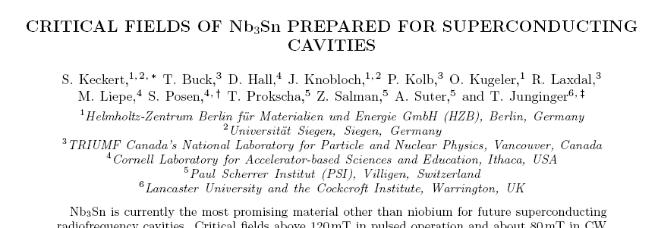
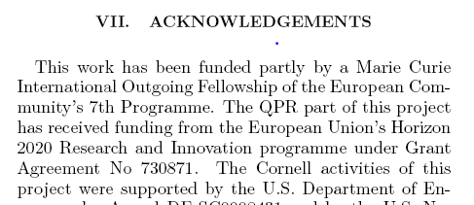
Publication (Sebastian Keckert‘s thesis)
accepted in Superconductor Science and Technology

