Slide 1
Linac4 Summary
(including schedule and performance)
M. Vretenar, CERN
Description, motivations
Main technical issues
Status
Expected performance
Schedule
CERN Machine Advisory Committee, 26.04.2010

Slide 2
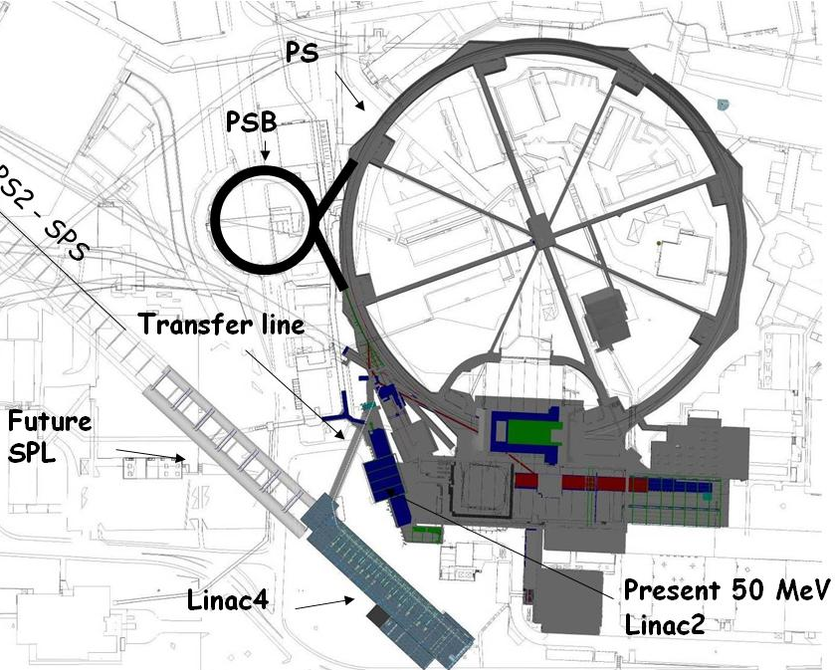
Linac4 - Description
Linac4 is a new
160 MeV H¯ linear accelerator,
which will inject into the PS Booster (PSB).
Project started in 2008, civil engineering well advanced, completion foreseen for 2015.
Linac4 because 4th linac built at CERN.

Slide 3
Linac4 - Motivations
Linac 4 is the 1st step of a programme aiming at increasing LHC Luminosity. First limitation for increased intensity from the LHC injector chain comes from space charge induced tune shift at 50 MeV injection in the PSB → need to increase injection energy!
Linac2 giving serious reliability/sustainability worries: persistent vacuum problems, obsolete RF tube design → instead of an intensive consolidation program, replace with a new linac.
Increase intensity for other PSB (and PS) users: ISOLDE,...
Implement at CERN modern technologies for better injection and reduced losses (chopping, H- charge exchange injection).
Prepare for a possible evolution towards higher intensities → Linac4 is compatible with 50 Hz operation and as injector to a high- duty cycle SPL (Superconducting Proton Linac).

Slide 4
Linac4 – Project History and Content
2001: proposal to build the 120 MeV warm part of the proposed Superconducting Proton Linac (SPL) in the PS South Hall, injecting H⁻ into the PSB.
2003: energy up to 160 MeV, called “Linac4”.
2004-08: Linac4 R&D (EU program + CERN).
2007: Linac4 part of “White Paper”, approved in June Council meeting. New location under the “Mont-Citron” (no interference with running machines, extension to SPL).
2008: Official Project start.
The “Linac4 Project” is composed of 3 parts:
Construction and commissioning of Linac4.
Construction of the transfer line, connection to Linac2 line, upgrade of the measurement lines (up to PSB wall, LBE dump).
Modification of PSB injection region for H¯, 160 MeV (+ commissioning of PSB with Linac4).

Slide 5
Linac4 – Main Parameters
Energy of 160 MeV giving a factor 2 in βγ² with respect to Linac2 (50 MeV) → space charge tune shift (limiting accumulated intensity in PSB) ΔQ~ N/βγ² → with twice the energy, double N keeping the same tune shift.
RF frequency 352 MHz, as old LEP RF system → can recuperate some klystrons and RF components from the LEP surplus.
Repetition frequency 2 Hz: 1.1 Hz present PSB limit, margin for some upgrade.
Beam current 40 mA in 400 μs: provide >2 present PSB maximum number of particles.

Slide 6
Linac4 Parameters
H⁻ particles + higher injection energy (160/50 MeV, factor 2 in βγ²) → same tune shift in PSB with twice the intensity.
Ion species H⁻
Output Energy 160 MeV
Bunch Frequency 352.2 MHz
Max. Rep. Rate 2 Hz
Max. Beam Pulse Length 1.2 ms
Max. Beam Duty Cycle 0.24 %
Chopper Beam-on Factor 65 %
Chopping scheme:
222 transmitted /133 empty buckets
Source current 80 mA
RFQ output current 70 mA
Linac pulse current 40 mA
N. particles per pulse 1.0 × 10¹⁴
Transverse emittance 0.4 π mm mrad
Max. rep. rate for accelerating structures 50 Hz
Re-use 352 MHz LEP RF components: klystrons, waveguides, circulators.
Chopping at low energy to reduce beam loss at PSB.
Structures and klystrons dimensioned for 50 Hz.
Power supplies and electronics dimensioned for 2 Hz.
Infrastructure (cooling, electricity) dimensioned for 2 Hz.

Slide 7
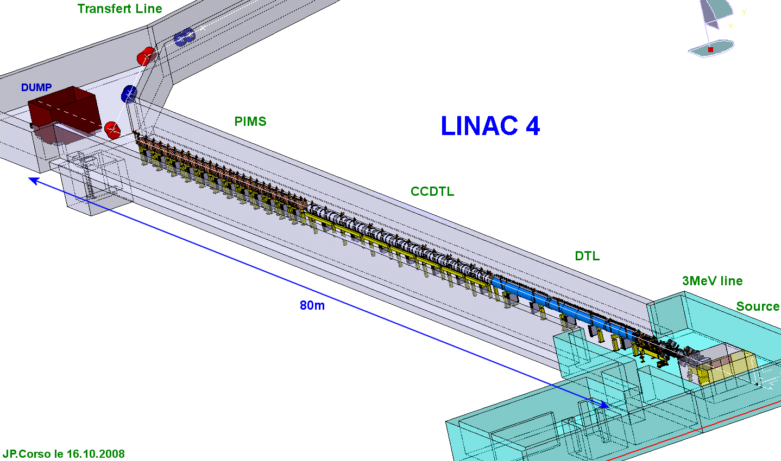
Linac4 layout
Standard (normal-conducting) linac layout, based on:
pre-injector (source, magnetic LEBT, 3 MeV RFQ, chopper line)
Three different types of accelerating structures, matched to the specific energy range (max. shunt impedance, easy access and maintenance, minimum construction cost).
Beam dump at linac end, switching magnet towards transfer line – PSB.
Beam measurements at linac end and at PSB entrance.
Transfer line to PSB
160 MeV
100 MeV
50 MeV
Linac length ~ 80 m

Slide 8
Linac4 civil engineering
Main features of the “Mount Citron” site:
Length ~100m .
Simple connection with the PSB, no interference with operating machines.
Available earth shielding (place of an old spoil dump and shielding for PS)
Possible extension to the future SPL

Slide 9
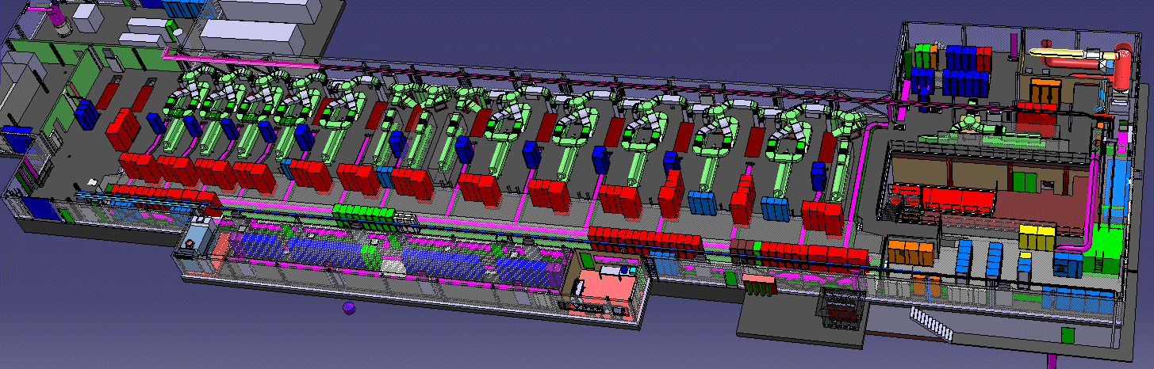
Linac4 – RF and equipment
RF:
13 LEP klystrons (1.25 MW) + 6 new klystrons (2.8 MW, pulsed) feeding 23 cavities.
In the long term, pairs of LEP klystrons will be replaced by new klystrons (at end of life).
Some (and eventually most) of the klystrons will feed 2 cavities.

Slide 10
Linac4 – Main technical challenges
Low-energy section: ion source, RFQ, chopping
Accelerating structures
PSB injection and beam optics
Linac beam dynamics
Reliability
Notes:
…and how we are going to face them

Slide 11
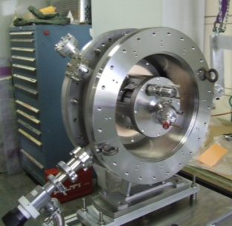
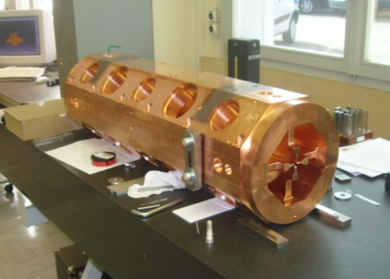
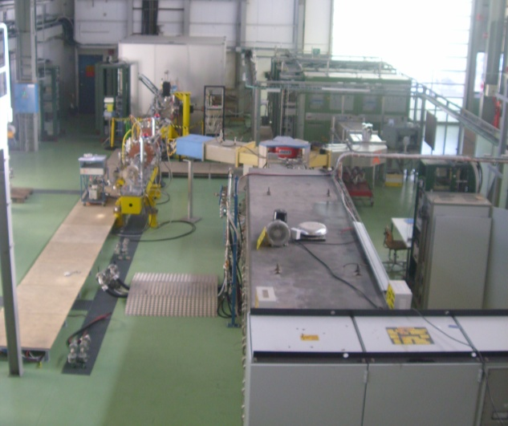
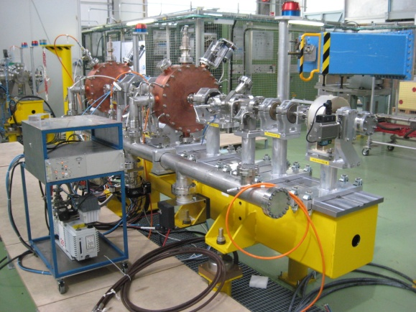
Linac4 – Low energy
3 MeV TEST STAND in the PS Hall:
Ion source completed, first beam in July 2009, presently improving current.
Magnetic Low Energy Beam Transport
Radio Frequency Quadrupole being built at CERN, to be delivered in early 2011.
Chopping line built and tested (w/o beam).
LEP klystron (+ modulator) installed and tested in pulsed mode.
Early characterization of the low energy beam is essential for a linac project!

Slide 12
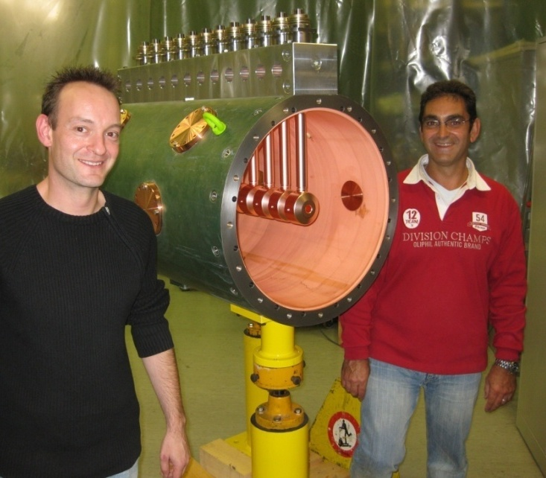
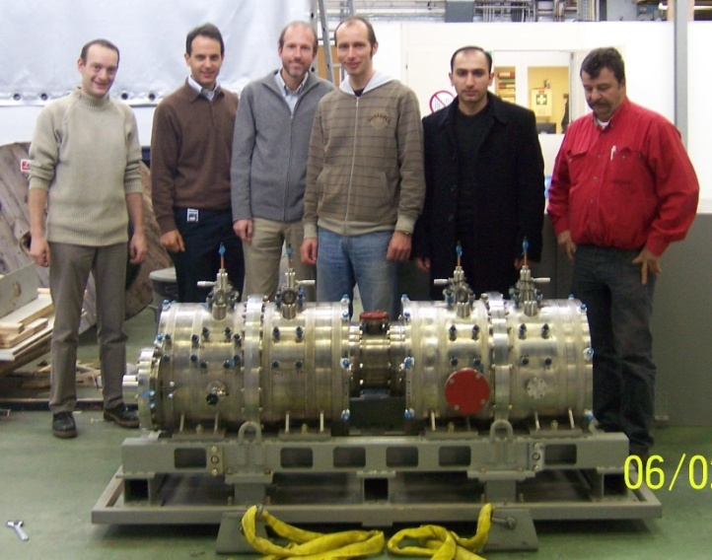
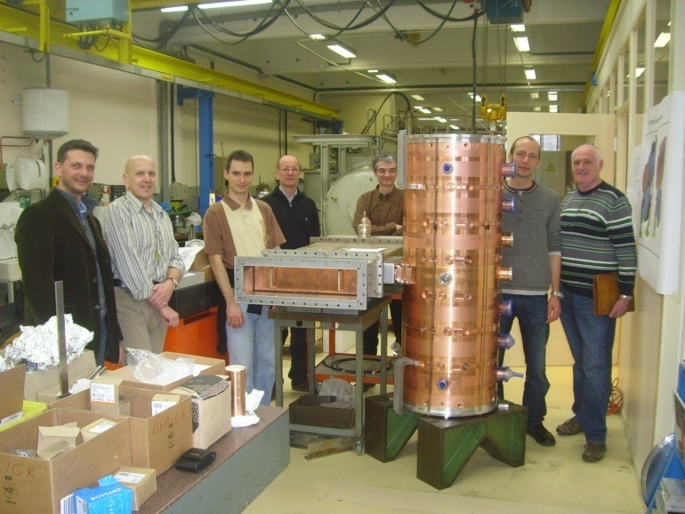
Linac4 – Accelerating structures
Three structures of new design:
DTL (Drift Tube Linac): complete revision of mechanical design w.r.t. other projects.
CCDTL (Cell-Coupled DTL): new structure, first time built for a linac.
PIMS (Pi-Mode Structure): new structure, first time built for a linac.
DTL prototype, 2009
R&D since 2003.
Prototypes built (and tested at high RF power) for the three structures.
Construction starting in 2010.
CCDTL prototype, 2008
PIMS prototype, 2010

Slide 13
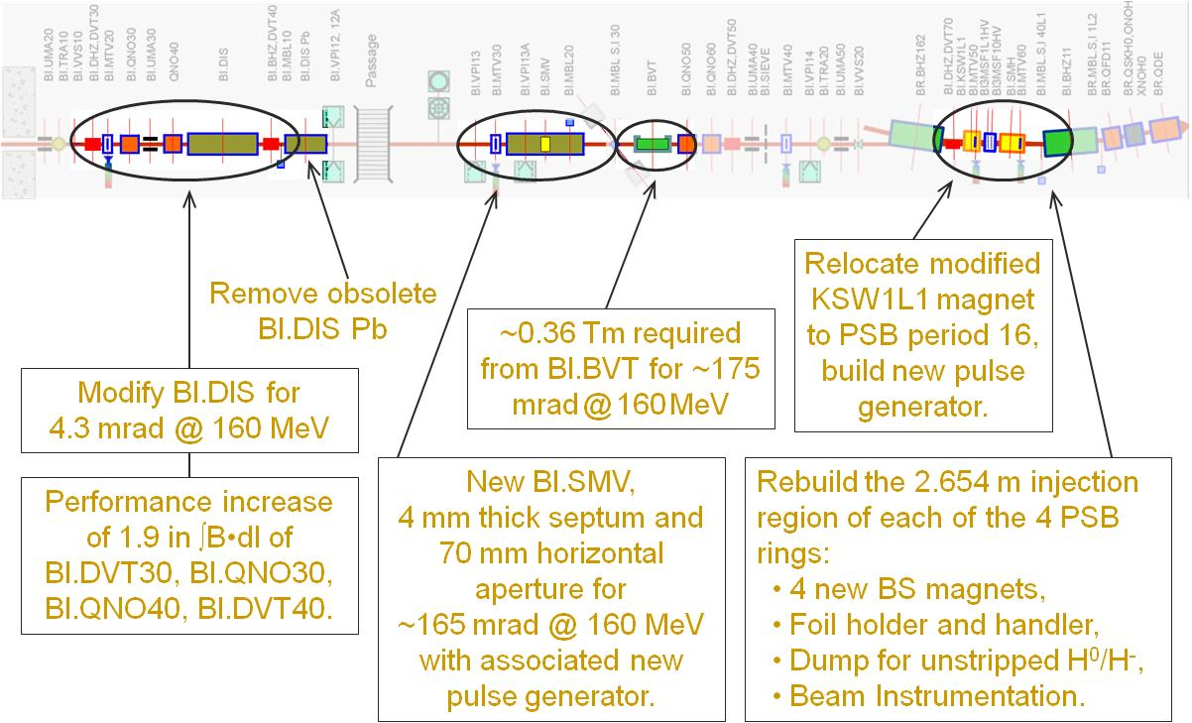
PSB injection and beam optics
Important modifications to the PSB injection region. The PSB is 4 superimposed rings!
- Higher injection energy (new distributor).
- H- charge exchange (4 rotating foil mechanisms, dumps for unstripped beam).
- Some new magnets, improved instrumentation, etc.
All to be installed and tested in 3 months!
New working point to be determined in PSB with the Linac4 beam.
Preparation of all the operational beams with the new injection
Study of the high intensity beams.
…all in 3 months!

Slide 14
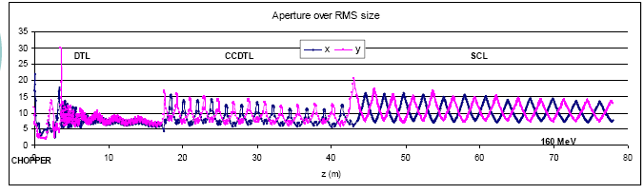
Linac4 – linac beam dynamics
    Beam optics design to minimize beam loss and emittance growth for:
    Low activation (in particular for high duty cycle operation).
    Minimum emittance growth for painting into the PSB acceptance.
    Losses on concentrated spots (collimation).
LINAC4 BEAM DYNAMICS DESIGN for beam loss < 1W/m at high beam power:
  Smooth phase advance transitions.
  Operating point far from resonances.
  Longitudinal to transverse phase advance ratio 0.5-08 (no emittance exchange).
  Smooth variation of transverse and longitudinal phase advance.
  Large apertures (> 7 rms beam size)
14

Slide 15
Linac4 - reliability
Reliability (specially in the first years!) will be a challenge for a machine that has to provide beam to all CERN.
Linac2: ~6000 hours/year with fault rate ~1.5%.
Main approach:
Prefer simple systems, with minimum number of components.
Standardized equipment (as much as possible).
Provide safety margins in the design.
Prepare failure scenarii (to be applied in case of problems).
Foresee a test period before connection to the PS Booster.
Provide a sufficient number of spares.

Slide 16
Linac 4 – Status April 2010
Ion source built, improving intensity.
RFQ in construction at the CERN owrkshop.
Chopper line completed, tested without beam.
DTL prototype tested, launching orders for construction (start in June 2010).
CCDTL construction started in Russia (VNIIEF Snezinsk + BINP Novossibirsk).
PIMS prototype being completed. High power tests in June, construction will start in January 2011.
Design of dump, measurement lines and transfer line completed.
PSB equipment in construction.
RF layout defined, klystron contract placed, major orders in preparation.
RF modulator prototype1 tested, prototype2 in construction, order in preparation.
Orders for major components placed or in preparation.
Building almost completed (foreseen delivery in September 2010).

Slide 17
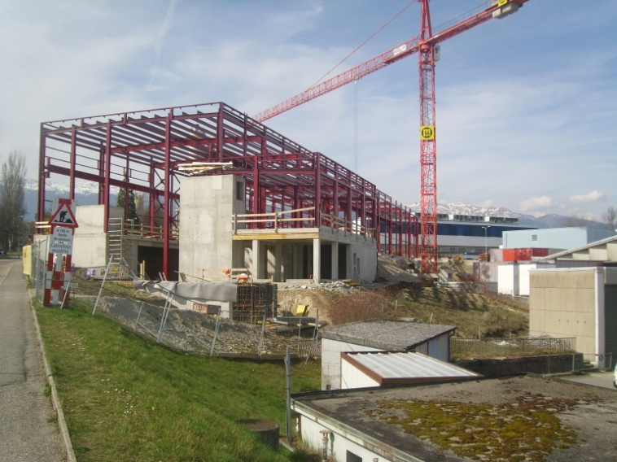
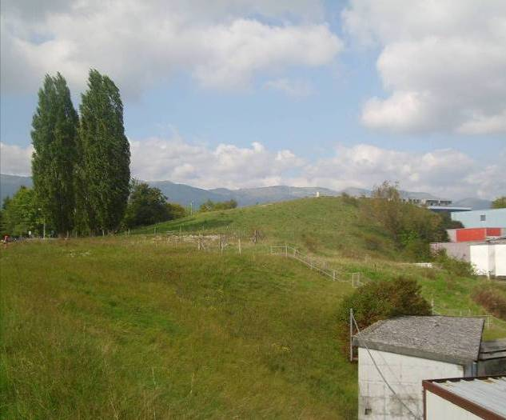
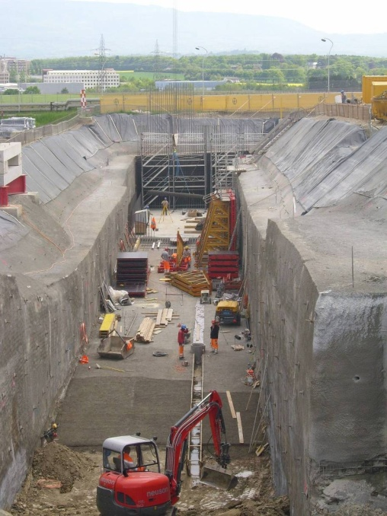
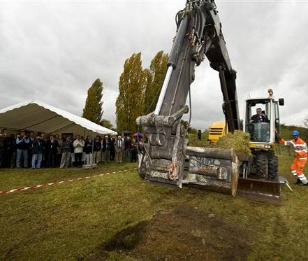
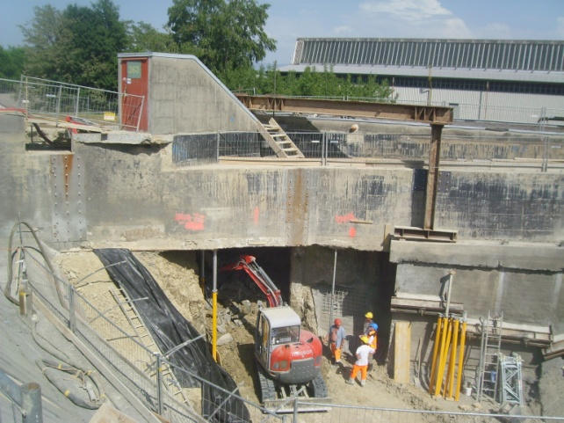
Progress in civil engineering
March 2010
Oct. 2008
Start of work: 10/2008
Delivery foreseen: 09/2010

Slide 18







Linac4 – External Contributions
Network of agreements to support Linac4 construction
RFQ RF design, RF amplifiers, modulator construction from French Special Contribution. agreed and started.
Prototype modulator, RF tuners, couplers, waveguides from India, in progress
Agreement with DESY to access drawings of H- source
completed
45 keV 3 MeV 50 MeV 90 MeV 160 MeV
Transfer line vacuum chambers and supports from Pakistan, agreed
H
-
LEBT
RFQ
chopper line
DTL
CCDTL
PIMS
transfer line to PSB
source
352 MHz
704 MHz
80 m
Chopper line built in a EU Joint Research Activity
completed
Construction of CCDTL in Russia, via an ISTC Project
agreed and started
Participation of ESS-Bilbao in DTL construction,
in preparation
Collaboration agreement with Soltan Institute (Poland) and FZ Julich (D) for PIMS construction, in preparation.

Slide 19
LHC Performance with Linac4
BOTTOM LINE:
Linac4 current 40 mA during 400 μs (in ε=0.45 π mm mrad) = 10¹⁴ ppp → plenty of margin in intensity.
160 MeV energy chosen in order to double βγ² and therefore intensity in PSB for same ΔQ (I/ΔQ ~ βγ²) → same performance as now with single batch injection from PSB into PS, increased performance in double batch.

Slide 20
Performance Tables – comparison Linac2/Linac4
LHC INJECTORS WITH LINAC2 |  | Nominal LHC Double Batch | Expected Maximum Double Batch
PSB out (ε* ≤ 2.5 μm) | ppr | 1.62 x10¹² (1bunch/ring) ↓ (6 bunches, h=7) | 1.8 x10¹² (1bunch/ring) ↓ (6 bunches, h=7)
PS out, per pulse | ppp | 9.72 x10¹² | 10.8 x10¹²
PS out, per bunch (ε* ≤ 3 μm) | ppb | 1.35 x10¹¹ (72 bunches) ↓ 15% loss | 1.5 x10¹¹ (72 bunches) ↓ 15% loss
SPS out | ppb | 1.15 x10¹¹ | 1.27 x10¹¹
Limitations are highlighted in yellow; values to be demonstrated are in italic.
Case of 25 ns bunch spacing.
LHC INJECTORS WITH LINAC4 |  | Nominal LHC Single batch | Maximum Single batch | Maximum Double batch | PSB @ 2 GeV Double batch
PSB out (ε* ≤ 2.5 μm) | ppr | 3.25 x10¹² (2bunch/ring) ↓ (6 bunches, h=7) | 3.6 x10¹² (2bunch/ring) ↓ (6 bunches, h=7) | 2.05 x10¹² (1bunch/ring) ↓ (6 bunches, h=7) | 3.2 x10¹² (1bunch/ring) ↓ (6 bunches, h=7)
PS out, per pulse | ppp | 9.72 x10¹² | 10.8 x10¹² | 12.3 x10¹² (scaled 1998 limit, 206ns bunches) | 19.2 x10¹² (PS limit scaled to 2 GeV)
PS out, per bunch (ε* ≤ 3 μm) | ppb | 1.35 x10¹¹ (72 bunches) ↓ 15% loss | 1.5 x10¹¹ (72 bunches) ↓ <15% loss | 1.7 x10¹¹ (72 bunches) ↓ 20% loss | 2.7 x10¹¹ (72 bunches) ↓ ??% loss
SPS out | ppb | 1.15 x10¹¹ | >1.3 x10¹¹ | 1.37 x10¹¹
Goal: |  | Nominal intensity in single batch: shorter filling time, lower losses and emittance growth. |  | Potential for ultimate intensity out of PS in double batch. | Potential for > ultimate with hardware modifications, as PSB @ 2 GeV.

Slide 21
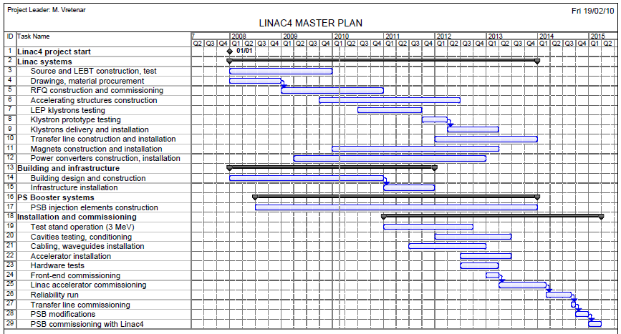
New Linac4 schedule
1. Construction
2. Linac installation, commissioning
3.
Reliability run (6 months)
4. Connection and PSB commissioning (7 months)
GOAL: all usual beams available in the PSB at start-up 2015

Slide 22
Tentative time line
Peak performance out of PS with Linac4

Slide 23
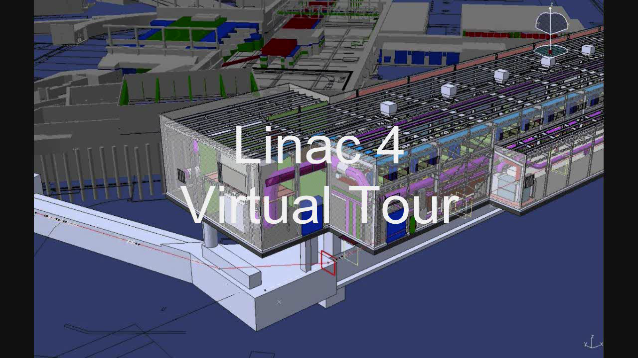
Linac4 Virtual Tour

