Slide 1
ATLAS and CERN Tape
Input from IT/ST

Slide 2
Overview
ATLAS 2018 recall analysis
Discussion – fallout from last week
  More efficient / fairer queueing
  Recall priorities / policies
  Storage class selection
CTA deployment plans for ATLAS

Slide 3
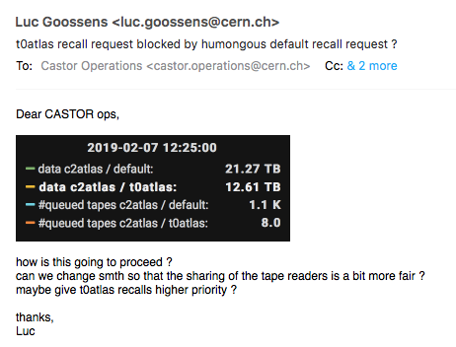
ATLAS recall analysis at CERN, 2018
Comparable volumes…
but 100x more mounts on “grid”/default ☹

Slide 4
ATLAS recall analysis at CERN, 2018
~4.2M file retrieves (7.9PB, 81K mounts) across two service classes (“default”, “t0atlas”)
ATLAS recall efficiency greatly differs between default and t0atlas
  Comparable data volume and files recalled (~55% t0atlas, 45% default)
  “default” access required ~10x more library access via read mounts (7.7K vs 73K mounts)
  Average per-mount volume and files per mount are an order of magnitude higher on t0atlas
  Contiguous file reads: 30% on t0atlas, 18% for default
    faster service speeds on t0atlas
  “default” handles recall requests for files that have a significant dispersion in terms of creation date
    service class handling very heterogeneous requests that are not organised by dataset
  t0atlas tape retrieval is active on less days (1/3rd year) while default is continuously active

Slide 5
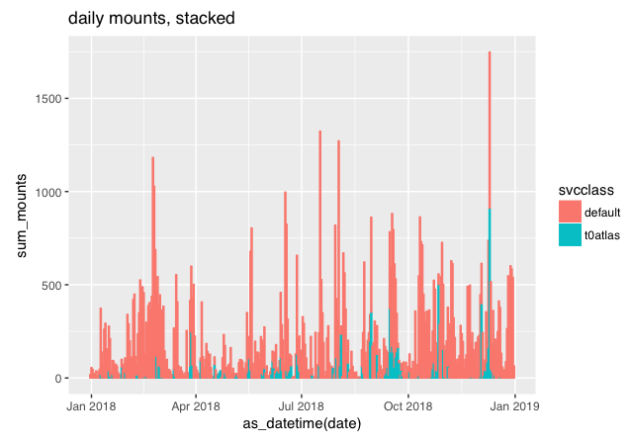
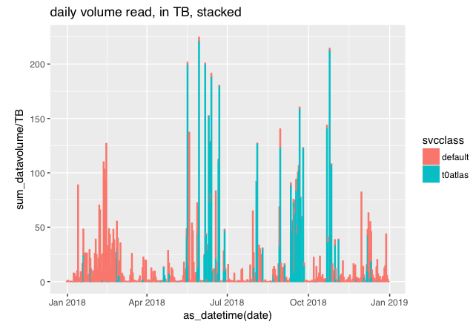
Daily mounts and volume read

Slide 6
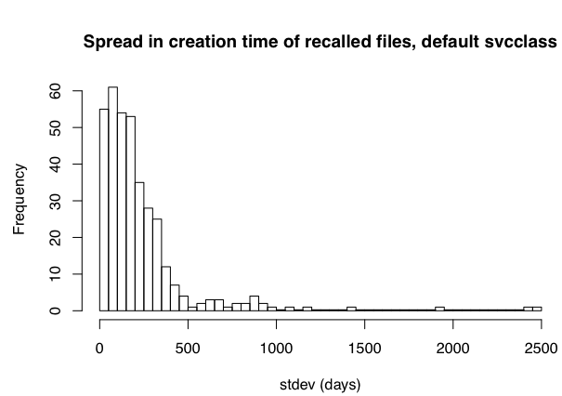
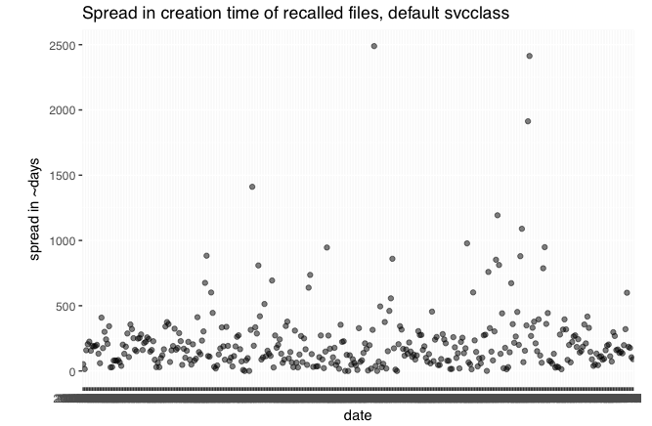
Daily creation time dispersion of recalled files (stdev, mean): default
Mean number of different file creation dates on a given day: 49.6

Slide 7
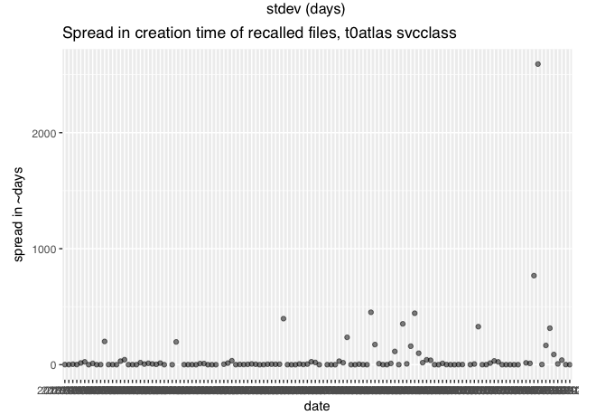
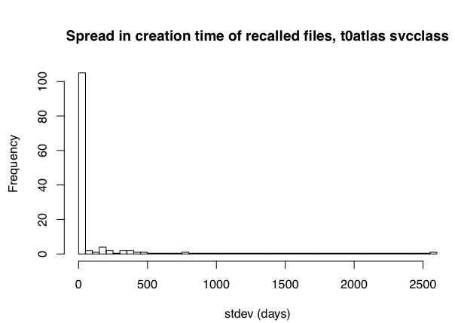
Daily creation time dispersion of recalled files (stdev, mean): t0atlas
Mean number of different file creation dates on a given day: 12.2

Slide 8
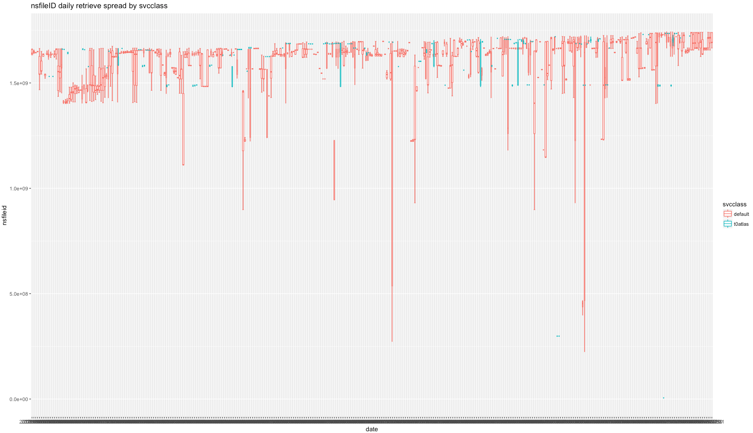
Box plot with file creation spread over time
date

Slide 9
distinct creation time days processed within a day
how grouped are the files, in addition to the
overall creation time spread?
default: average of 50 different creation days
t0atlas: average of 12 different creation days

Slide 10
Files/mount and creation time dispersion

Slide 11
ATLAS datasets
Total number of datasets in CASTOR: 12461 (99.6 % RUCIO)
Total number of files across all datasets: 14.3 million
Total volume across all datasets: 30 PB
Average number of files per dataset: 1145; median: 55
  The mean and median differ substantially: There are many datasets with just 1-2 files (27.6%) and there is a tail of a few, long datasets
  Average volume per dataset: 2.5 TB; median: 0.03 TB.
Average spread in time (first to last creation time): 2.5 days, median: ~2 hours
  If a file has been re-created (e.g. re-import from T1 following a file loss), the spread will become artificially large

Slide 12
Dataset access patterns (2018)
default: 9482 datasets accessed in 73.8K mounts, fraction of volume read per dataset: 13% (3.7PB)
t0atlas: 3214 datasets accessed in 7.6K mounts, fraction of volume read per dataset: 102% (4.1PB)
Average mounts per dataset:
default: 7.8 mounts / dataset
t0atlas: 2.4 mounts / dataset

Slide 13
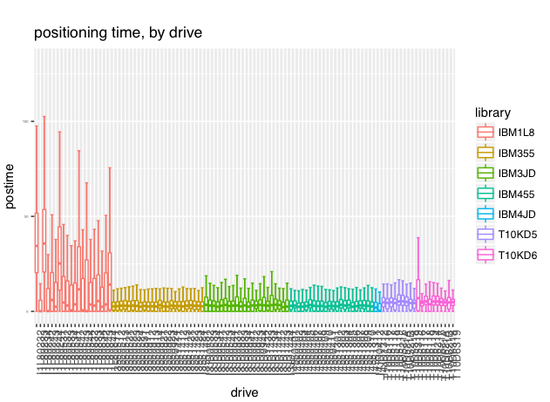
LTO positioning times
LTO positioning is significantly worse than on enterprise tape
Will be addressed at CERN with CTA (“CERN RAO”), but will affect retrieval from other ATLAS sites

Slide 14
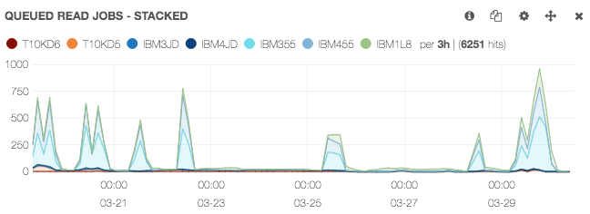
Discussion - Tape Queueing (1)
Today, in CASTOR, a two-level queueing is used: Tape read requests queue up a) first within the stager and b) then on VDQM.
a) the stager sorts requests, and holds back submitting tape mounts to VDQM to not exceed a given number of parallel mounts
But it doesn’t distinguish whether submitted jobs are running or just queued (e.g. due to busy library) – tarpit effect
Workaround: Jobs are (manually) released to VDQM, sometimes creating “avalanches”
b) VDQM tape queues processed (per library) in FIFO order across all stagers.
First come, first serve, VO’s have all same priority.
If stager of VO A submits 10K tape mounts for a given library before VO B submits a single one, VO B will have to wait.
Consequence of “split-brain” queueing mechanism between CASTOR stagers and VDQM

Slide 15
Discussion - Tape Queueing (2)
In CTA, queueing is handled uniformly
Tape mount requests are inserted in a queue, picked up by tape servers
Decision on what tape to be mounted next is done by each tape server, which knows exactly the availability of its library/drive
Configurable policies
  write: max concurrent drives (as function of data throughput), by storage class
  read: priority, max concurrent drives, policy (volume_first|FIFO)
Drive allocation across VO’s is fairshare-based
  VO B will get its mount through without having to wait for 10K mounts of VO A to complete!

Slide 16
Discussion - Recall priorities / policies via FTS
CASTOR mount policy does reorder tape requests taking into account volume
  A tape with few files to be recalled may fall behind others in the queue with more files
ATLAS requests:
  Allow to retrieve tapes in FIFO - ensure that datasets can be retrieved completely before reprocessing
  Allow to set priorities for different workloads (eg. T0 jobs >> grid jobs)
CTA/FTS team proposal:
  Mount policy to be (optionally) provided via FTS
  FTS.prepare(“/atlas/mydataset/myfile.RAW?eos.CTAMountPolicy=“FIFO”) (or job metadata attribute)
  Defaults can be set
  Priority to be honoured (already provided by ATLAS to FTS via bringOnline job API)
  Open questions: How to protect from abuse / priority inflation? Will there be any non-FTS access?

Slide 17
Discussion - Storage class selection via FTS
CASTOR allows for setting a “file class” per directory, which is inherited further down
  this requires using a CASTOR specific command (nschclass) with specific privileges
ATLAS requests:
  allow setting “storage class” via FTS
  allow setting “storage class” on a per-file level
CTA/FTS team proposal:
  Storage class to be (optionally) provided via FTS using URL (and/or job) parameters
  FTS.destURL(“/atlas/mydataset/myotherfile.AOD?eos.CTAStorageClass=“ATLAS18_AOD”)
  Per-directory defaults can be set
  Storage classes (and their mapping to tape pools) are pre-defined
  Changing storage class of a file is possible, but takes only effect after repack

Slide 18
CTA plans for ATLAS
Step 1. Production-quality endpoint for T0 archiving
  In parallel to CASTOR
  Revamped eosctaatlaspps.cern.ch instance (Julien)
    SSD-based disk servers, total capacity: ~20 TB, throughput: 40Gb/s (to grow to ~80 TB and 60 Gb/s by EOY 2019, then to ~250 TB and nominal rates (7.5GB/s?) by start of Run-3
  Initially, 20 tape drives (IBM Enterprise, LTO) shared across EOSCTA instances (grow to ~200 by start of Run-3)
  Target: ASAP
Step 2. CASTOR->CTA switchover for ATLAS
  Working on migration tools and workflow (Michael)
    Will involve switching CASTORATLAS to R/O beforehand and pre-import of metadata from CASTOR
    Switch off CASTORATLAS after CTA fully commissioned
  Setting up operational environment, monitoring (Julien)
  Data Challenges?
  FTS enhancements (file on tape check)
  Target: Q3/Q4 2019

