Slide 1

What’s new in HTCondor?
What’s coming?
HEPiX Autumn 2019
Oct 15, 2019 – Amsterdam
Todd Tannenbaum
Center for High Throughput Computing
Department of Computer Sciences
University of Wisconsin-Madison

Slide 2



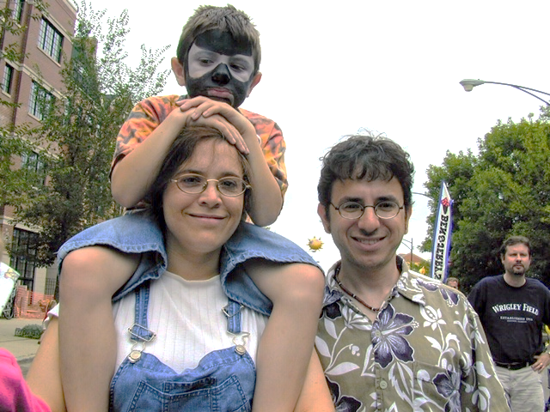

Slide 4
So what year was the first
Condor Week meeting?
There are 2 hard problems in computer science: caching, naming, and off-by-1 bugs!

Slide 5
Release Series
Stable Series (bug fixes only)
  HTCondor v8.8.x - introduced Jan 2019
  (Currently at v8.8.5)
Development Series (should be 'new features' series)
  HTCondor v8.9.x (Currently at v8.9.3)
In the past year…
  Public Releases: 10
  Documented enhancements: ~81
  Documented bug fixes: ~78
Detailed Version History in the Manual
  https://htcondor.readthedocs.io/en/v8_9_3/version-history

Slide 6
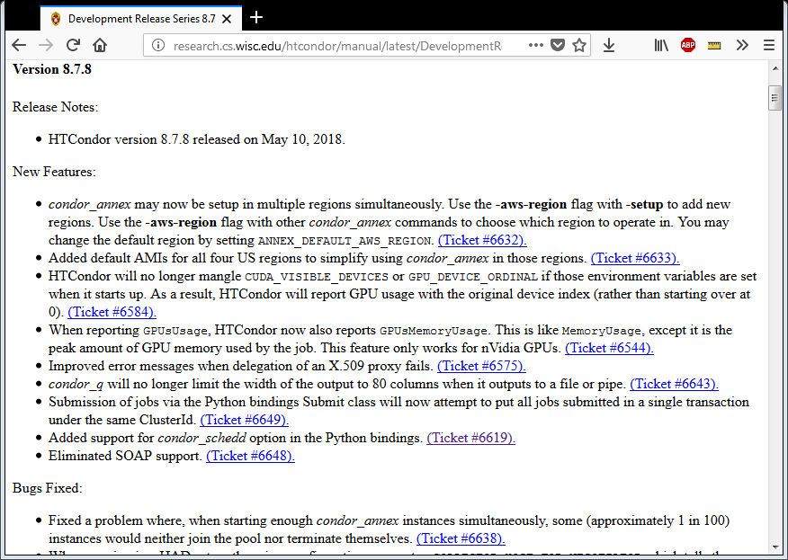

Slide 7
Enhancements in HTCondor v8.4
Scalability and stability
  Goal: 200k slots in one pool, 10 schedds managing 400k jobs
Introduced Docker Job Universe
IPv6 support
Tool improvements, esp condor_submit
Encrypted Job Execute Directory
Periodic application-layer checkpoint support in Vanilla Universe
Submit requirements
New RPM / DEB packaging
Systemd / SELinux compatibility

Slide 8
Enhancements in HTCondor v8.6
Enabled and configured by default: use single TCP port, cgroups, mixed IPv6 + IPv4, kernel tuning
Made some common tasks easier
Schedd Job Transforms
Docker Universe enhancements: usage updates, volume mounts, conditionally drop capabilities
Singularity Support

Slide 9

What's new in v8.8 and/or cooking for v8.9 and beyond?

Slide 10


"You know nothing, Job Snow!"

Slide 11

Winter is coming for…
SOAP API
  Long live House Python!
RHEL/Centos 6 Support
Quill
"Standard" Universe
  Instead self-checkpoint vanilla job support [1]
Non-standard packaging
  UW packages and Centos/Debian packages can now be the same
HTCondor Manual
[1] https://htcondor-wiki.cs.wisc.edu/index.cgi/wiki?p=HowToRunSelfCheckpointingJobs

Slide 12
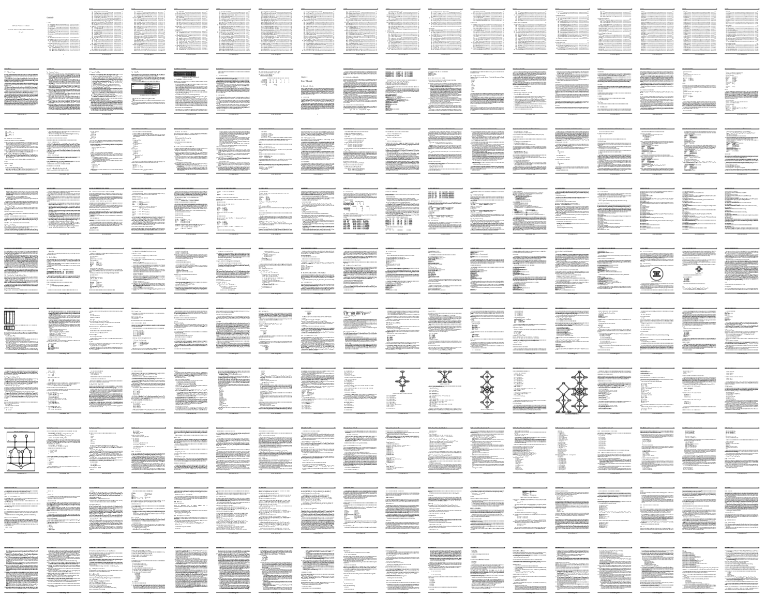
Manual is now a cheat-sheet "Page790.pdf"

Slide 13
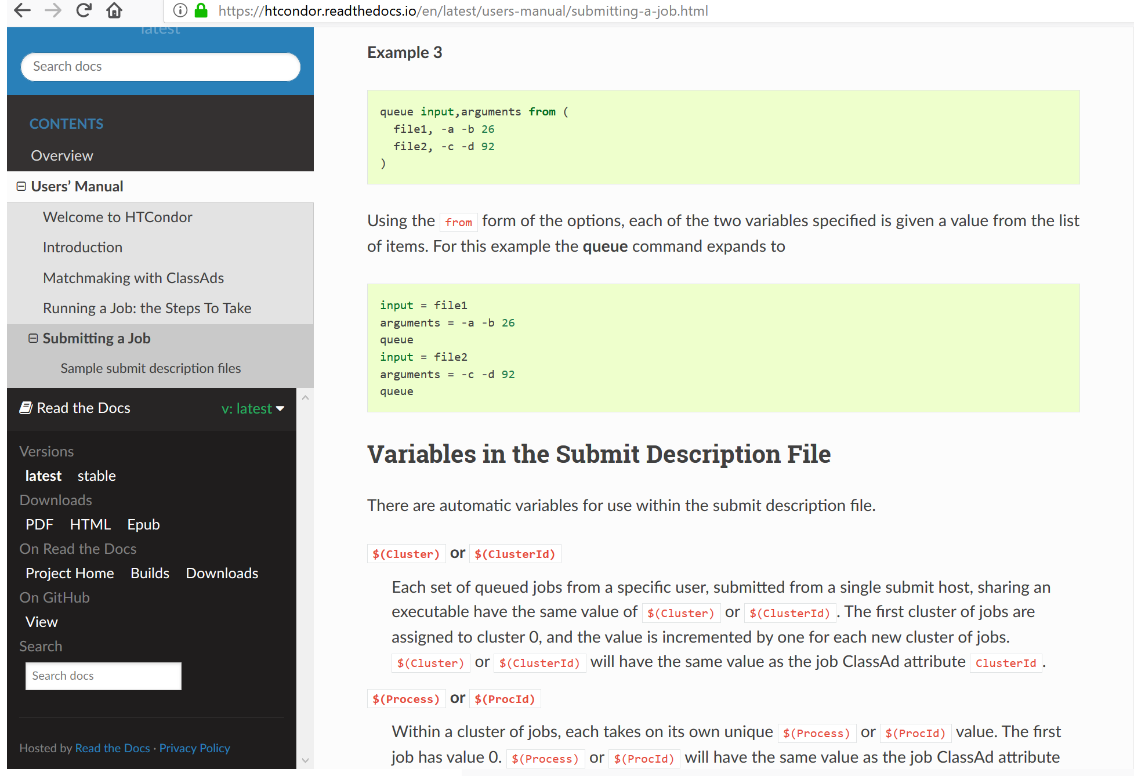
http://htcondor.readthedocs.io
Notes:
Search box! Latest, stable, and PDF/Epub in lower left! Single source of truth for Python API!

Slide 14
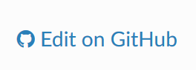
http://htcondor.readthedocs.io
Notes:
Search box! Latest, stable, and PDF/Epub in lower left! Single source of truth for Python API! Easily fork on GitHub and contribute via Edit Button

Slide 15

HTCondor Singularity Integration
What is Singularity?
Like Docker but…
  No root owned daemon process, just a setuid
  No setuid required (as of very latest RHEL7)
  Easy access to host resources incl GPU, network, file systems
HTCondor allows admin to define a policy (with access to job and machine attributes) to control
  Singularity image to use
  Volume (bind) mounts
  Location where HTCondor transfers files

Slide 16
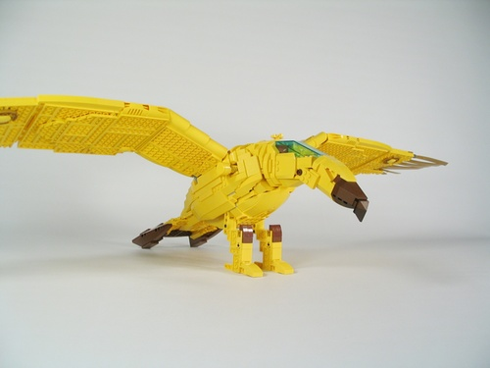
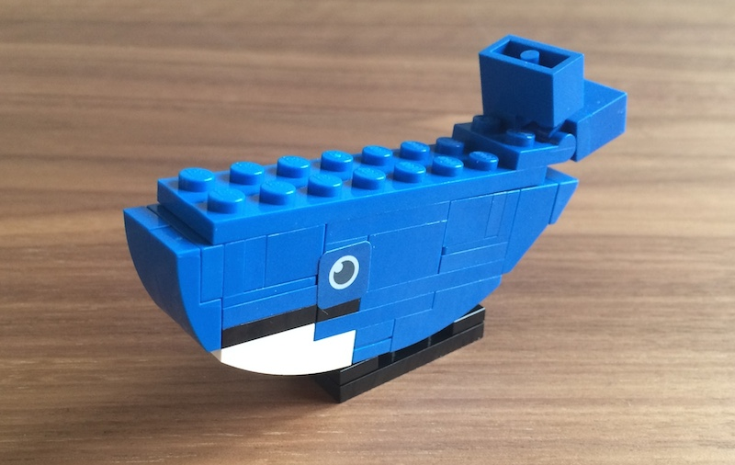
Docker Job Enhancements
Docker jobs get usage updates (i.e. network usage) reported in job classad
Admin can add additional volumes
Conditionally drop capabilities
Condor Chirp support
Support for condor_ssh_to_job
  For both Docker and Singularity
Soft-kill (SIGTERM) of Docker jobs upon removal, preemption

Slide 17

Not just Batch -
Interactive Sessions
Two scenarios for interactive sessions
  Interactive session alongside a batch job
    condor_ssh_to_job: Debugging job, monitoring job
  Interactive session alone (no batch job)
    condor_submit –i : Juptyer notebooks, schedule shell access
    p.s. Jupyter Hub batchspawner supports HTCondor
Can tell the schedd to run a specified job immediately! Interactive sessions, test jobs
  condor_now <job_id_to_run> <job_ids_to_kill>
  No waiting for negotiation, scheduling

Slide 18
Python
Bring HTC into Python environments incl Jupyter
HTCondor Bindings (import htcondor) are steeped in the HTCondor ecosystem
  Exposed to concepts like Schedds, Collectors, ClassAds, jobs, transactions to the Schedd, etc
Released our HTMap package
  No HTCondor concepts to learn, just extensions of familiar Python functionality. Inspired by BNL!

Slide 19
htcondor package
import htcondor
# Describe jobs
sub = htcondor.Submit('''
executable = my_program.exe
output = 'run$(ProcId).out'
''')
# Submit jobs
schedd = htcondor.Schedd()
with schedd.transaction() as txn:
clusterid = sub.queue(txn,count = 10)
# Wait for jobs
import time
while len(schedd.query(
constraint='ClusterId=='+str(clusterid),
attr_list=['ProcId'])):
time.sleep(1)

Slide 20


Job!

Slide 21
import htmap
# Describe work
def double(x):
return 2 * x
# Do work
doubled = htmap.map(double,range(10))
# Use results!
print(list(doubled))
# [0, 2, 4, 6, 8, 10, 12, 14, 16, 18]
htmap
package
See https://github.com/htcondor/htmap

Slide 22
HTCondor "Annex"
Instantiate an HTCondor Annex to dynamically add additional execute slots for jobs submitted at your site
  Get status on an Annex
  Control which jobs (or users, or groups) can use an Annex
Want to launch an Annex on
  Clouds
    Via cloud APIs
  HPC Centers / Supercomputers
    Via edge services (i.e. HTCondor-CE)

Slide 23








Grid Universe
Reliable, durable submission of a job to a remote scheduler
Popular way to send pilot jobs (used by glideinWMS), key component of HTCondor-CE
Supports many “back end” types:
  HTCondor
  PBS
  LSF
  Grid Engine
  Google Compute Engine
  Amazon AWS
  OpenStack
  Cream
  NorduGrid ARC
  BOINC
  Globus: GT2, GT5
  UNICORE
Notes:
23

Slide 24


V8.8 Added Grid Universe support for Azure, SLURM, Cobalt, soon k8s
Speak to Microsoft Azure
Speak native SLURM protocol
Speak to Cobalt Scheduler
Actively working on Kubernetes!
Jaime:
Grid
Jedi
Also HTCondor-CE "native" package
HTCondor-CE started as an OSG package
European Grid Infrastructure (EGI) wants to adopt HTCondor-CE without all the OSG dependencies….
Moving HTCondor-CE upstream from OSG to HTCondor Project (plus adding EGI/WLCG accounting support)

Slide 25

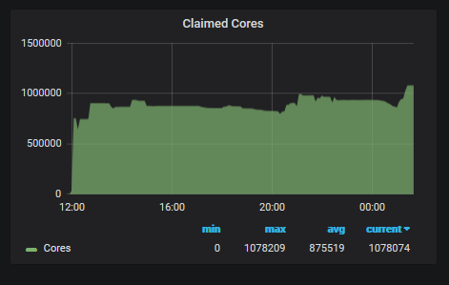
http://news.fnal.gov/2018/07/fermilab-computing-experts-bolster-nova-evidence-1-million-cores-consumed/
CPU cores!
FNAL HEPCloud
NOvA Run
(via Annex at NERSC)

Slide 26


No internet access to HPC edge service?
File-based communication between execute nodes
JobXXX
condor_starter
condor_starter'
request
status.1
status.2
status.3
input
input
output
input
output
output

Slide 27
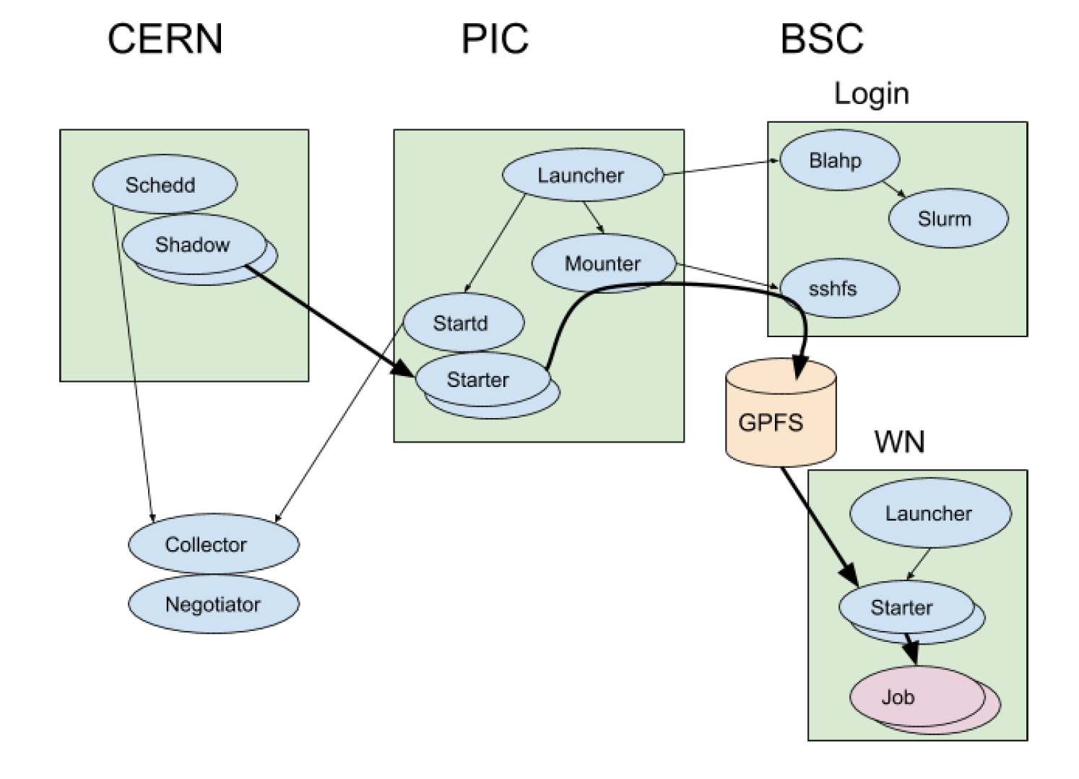
Using MareNostrum at BSC
Read more about our current approach at http://tiny.cc/f158cz
Notes:
The following figure shows all of the components of this system and how they interact. The
heavy arrows show the movement of the payload job. This example shows a single submit
machine and single MareNostrum execute node (Worker Node). A typical MareNostrum Slurm
job would allocate many execute nodes, which having its own startd representing it at PIC.

Slide 28
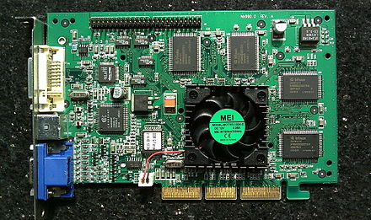
GPUs
HTCondor has long been able to detect GPU devices and schedule GPU jobs (CUDA/OpenCL)
New in v8.8:
  Monitor/report job GPU processor utilization
  Monitor/report job GPU memory utilization
Working on for v8.9.x: simultaneously run multiple jobs on one GPU device
  Specify GPU memory?
  Volta hardware-assisted Mutli-Process Service (MPS)?
  Working with LIGO on requirements
Nvidia's GeForce 256 was marketed in Oct 1999
as "the world's first GPU"

Slide 29
Security
Version of HTCondor available that has Federal Processing Standard (FIPS) Compliance
  Currently as a separate download
  AES has hardware support in most Intel CPUs, so investigating at just doing TLS 1.3 all the time by default
TLS all the time may motivate us to drop UDP communications in HTCondor
  Anyone care if UDP support disappears?

Slide 30
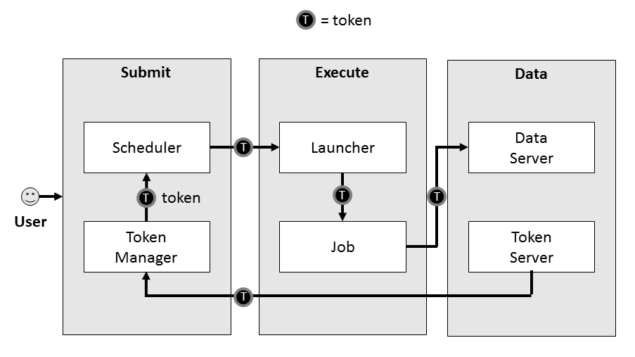

Security: From identity certs to authorization tokens
HTCondor has long supported GSI certs
Then added Kerberos/AFS tokens for CERN, DESY
Now adding standardized token support
  SciTokens (http://scitokens.org)
  OAuth 2.0 Workflow → Box, Google Drive, AWS S3, …

Slide 31
Token Authentication Method
Several Authentication Methods
  File system (FS), SSL, pool password….
Adding a new "tokens" method
  Administrator can run a command-line tool to create a token to authenticate a new submit node or execute node
  Users can run a command-line tool to create a token to authenticate as themselves
"Promiscuous mode" support

Slide 32
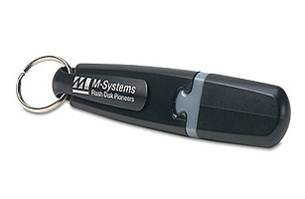
USB "Thumb Drive" first introduced in Yr 2000
(8MB for $50)
File Transfer Improvements

Slide 33
File Transfer Improvements
Error messages greatly improved: URL-based transfers can now provide sane, human-readable error messages when they fail (instead of just an exit code). Available in 8.8 series.
URLs for output: Individual output files can be URLs, allowing stdout to be sent to the submit host and large output data sent elsewhere. Available in 8.9.1.
Smarter retries. Including retries triggered by low throughput. Available in 8.9.2.
Via both job attributes and entries in the job's event log, HTCondor tells you the time when file transfers are queued, when transfers started, and when transfers completed.
If you use HTCondor to manage credentials, we include file transfer plugins for Box.com, Google Drive, and MS One Drive cloud storage for both input files and output files, and credentials can also be used with HTTP URL-based transfers. Available in 8.9.4.
File transfers are now sorted by the submit host and URLs are transferred last. This means you can ensure some inputs (such as your S3 credentials!) are at the worker node before URL transfers are invoked. And all transfers to/from the same endpoint happen over the same TCP connection. Available in 8.9.1.
Performance improvements? Edgar? ☺ No network turn-around between files. Available v8.9.2
Have an interesting use case? Jobs can now supply their own file transfer plugins — great for development! Available in 8.9.2.

Slide 34
executable = myprogram.exe
transfer_input_files = box://htcondor/myinput.dat
use_oauth_services = box
queue

Slide 35
Scalability Enhancements
Central manager now manages queries
  Queries (ie condor_status calls) are queued; priority is given to operational queries
More performance metrics (e.g. in collector, DAGMan)
In v8.8 late materialization of jobs in the schedd to enable submission of very large sets of jobs
  Submit / remove millions of jobs in < 1 sec
  More jobs materialized once number of idle jobs drops below a threshold (like DAGMan throttling)

Slide 36
Late materialization
This submit file will stop adding jobs into the queue once 50 jobs are idle:
executable = foo.exe
arguments = -run $(ProcessId)
materialize_max_idle = 50
queue 1000000

Slide 37
From Job Clusters to Job Sets
Job "clusters" (even with late materialization) mostly behave as expected
  Can remove all jobs in a cluster
  Can edit all jobs in a cluster
But some operations are missing
  Append jobs to a set (in a subsequent submission)
  Move an entire set of jobs from one schedd to another
  Job set aggregates (for use in polices?)

Slide 38
From Job Clusters to Job Sets, cont
Users want to think about a set of jobs as it relates to their mental model, e.g.
  Set of jobs analyzing genome 52
  Set of jobs doing analysis on image captures from date xxx
Initial support for sets in v8.9:
  User supplies a set name upon submission
  All jobs with the same name are in the same set
  Aggregate statistics on set written to History file when last job in a set completes
  More set operations to come…

Slide 39


REST API
Python (Flask) webapp for querying HTCondor jobs, machines, and config
Runs alongside HTCondor daemons
Listens to HTTP queries, responds with JSON

Slide 40



REST API, cont
$ curl "http://localhost:9680/v1/status\
?query=startd\
&projection=cpus,memory\
&constraint=memory>1024"
Client
HTTP GET
JSON
[
{
"name": "slot4@siren.cs.wisc.edu",
"type": "Machine",
"classad": {
"cpus": 1,
"memory": 1813
}
},
…
]
condor_restd
Collector.query()
condor_collector

Slide 41

REST API, cont
Swagger/OpenAPI spec to generate bindings for Java, Go, etc.
Evolving, but see what we've got so far at
  https://github.com/htcondor/htcondor-restd
Potential Future improvements
  Allow changes (job submission/removal, config editing)
  Add auth
  Improve scalability
  Run under shared port

Slide 42
DAGMan: Optimizations
DAGMan memory diet! Dedup node string data, edges are vectors instead of lists, etc:
  In one DAG, these reduced the memory footprint from 50 GB to 4 GB
Can now submit jobs directly (and faster!) without forking condor_submit
Introduced join nodes, which dramatically reduce the number of edges in dense DAGs. In one particularly dense DAG with ~300,000 edges, join nodes resulted in the following improvements:
  ~660M edges reduced to ~1.5M edges.
  condor_dagman memory footprint dropped from 90 GB to 1 GB
  Parsing time reduced from 1 hour to 20 seconds

Slide 43
Workflows: Provisioner Nodes
Working to implement provisioner nodes
  Special node that runs for the duration of a workflow
Responsible for provisioning compute resources on remote clusters (Amazon EC2, Microsoft Azure, etc.)
Important: also responsible for deprovisioning resources after they are no longer needed.
  These resources cost money.
  If we fail to deprovision them, this can incur large costs.
  Recovery from failures is a first class citizen.

Slide 44
Workflows: What's Coming Next
Sets, Sets, Sets!
  New syntax in the DAGMan language to describe sets of jobs
Defining ranges in DAG declarations
  New syntax to declare ranges of objects
  No more 10,000 JOB statements to declare 10,000 jobs whose only difference is a numeric suffic.
condor_dagedit
  Ability to edit certain properties of in-progress DAGs (MaxJobs, MaxIdle, etc.)
Dataflow mode
  Ability to skip jobs that have already been run (like /usr/bin/make!)

Slide 45
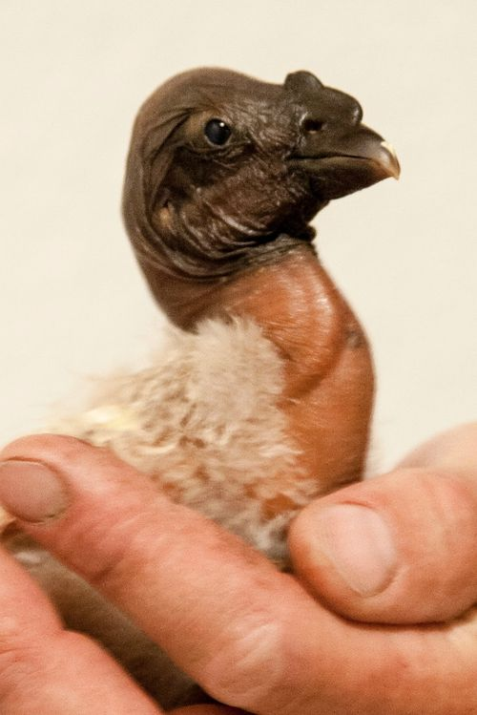
"Minicondor" Package
Minicondor package
  yum install minicondor
  apt-get install minihtcondor
"Personal Condor" = single machine, single user (daemons run as a regular user)
"Minicondor" = single machine, multi-user (daemons run as root)

Slide 46

The "iSmell"

Slide 47
Thank you!

