Slide 1

Introduction to SciTokens
HEPiX Fall 2019
Amsterdam
Todd Tannenbaum tannenba@cs.wisc.edu
On behalf of the SciTokens Team
https://www.scitokens.org
This material is based upon work supported by the National Science Foundation under Grant No. 1738962. Any opinions, findings, and conclusions or recommendations expressed in this material are those of the author(s) and do not necessarily reflect the views of the National Science Foundation.

Slide 2
SciTokens: Federated Authorization
Ecosystem for Distributed Scientific
Computing
The SciTokens project aims to:
  Introduce a capabilities-based authorization infrastructure for distributed scientific computing,
  provide a reference platform, combining a token library with CILogon, HTCondor, CVMFS, and Xrootd, AND
  Deploy this service to help our science stakeholders (LIGO and LSST) better achieve their scientific aims.
In this presentation, I’d like to unpack what this means

Slide 3
A common grid computing scenario
Scientist submits a compute job
This compute job is scheduled and ultimately starts running on some server out in the grid (or cloud, or HPC center)
The job requests to read (and/or write) data from some remote data storage service
How should the storage service validate the job's request to access the data?

Slide 4

Compute Server
Job
Data Server
?
Submit Server
Job

Slide 5
Identity & Impersonation-based Authorization Infrastructure w/ Certs
Common grid solution used today: identity and impersonation via X.509 certificates.
  Each user is assigned a grid certificate providing you with a globally-recognized identification.
  The grid proxy, shipped with the job, allows a third party to impersonate you, (ideally) on your behalf.
  The remote service maps your identity to some set of locally defined authorizations.
Not ideal for a few reasons: Not least privilege (what if identity is stolen?), global identity complicates life…

Slide 6
Compute Server
Job
ID: I'm Todd!
Data Server
ID: I'm Todd!
Submit Server
Job
ID: I'm Todd!

Slide 7
Capabilities-based
Authorization Infrastructure w/ tokens
We want to change the infrastructure to focus on capabilities!
  The tokens passed to the remote service describe what authorizations the bearer has.
  For traceability purposes, there may be an identifier that allows tracing of the token bearer back to an identity.
  Identifier != identity. It may be privacy-preserving, requiring the issuer (VO) to provide help in mapping.
Example: “The bearer of this piece of paper is entitled to read image files from /LSST/datasets/DecemberImages".

Slide 8
Compute Server
Job
Token: Allow read from /Images
Data Server
Token: Allow read from /Images
Submit Server
Job
Token: Allow read from /Images

Slide 9
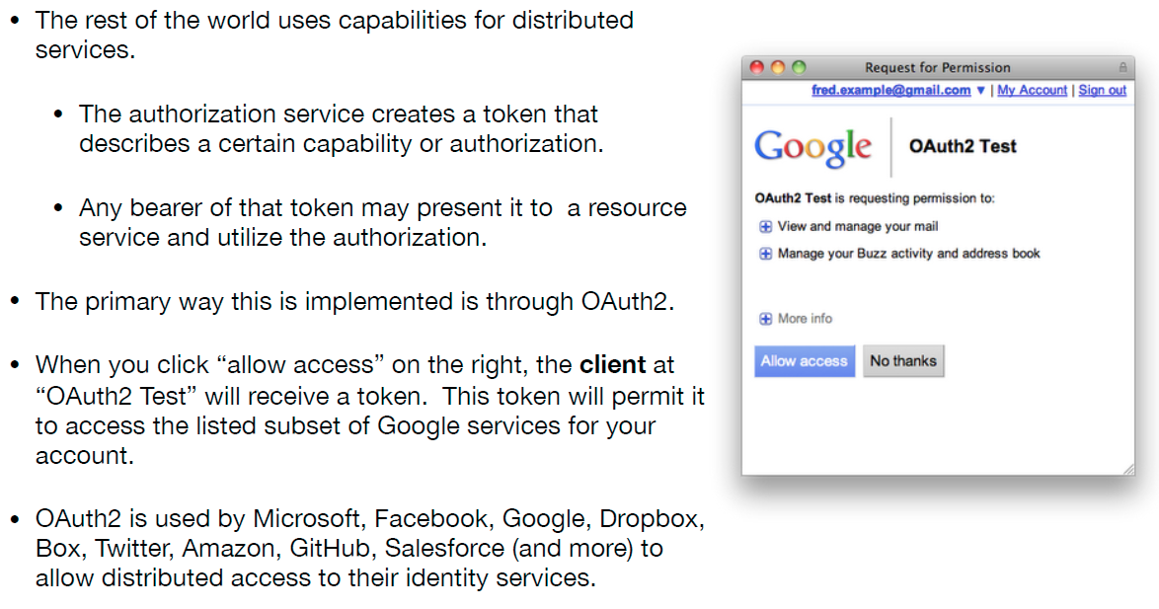
The rest of the world uses capabilities!

Slide 10
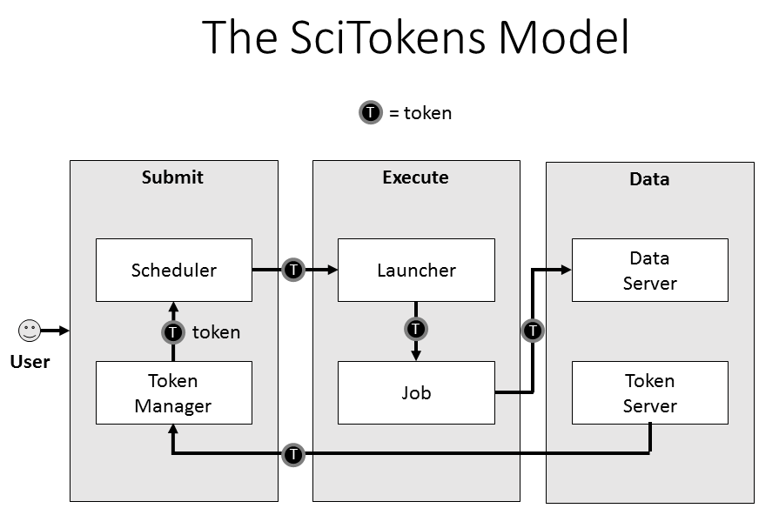
SciTokens Project Reference Platform
SciTokens team working to integrate an OAuth2 client into HTCondor submit host, and enhance OAuth2 at CILogon.
HTCondor being enhanced to manage the token lifetime (refreshing as needed), possibly attenuating it, and delivering to the job.
Data services (CVMFS, Xrootd) are being enhanced to allow read/writes utilizing tokens instead of grid proxy certificates.

Slide 11
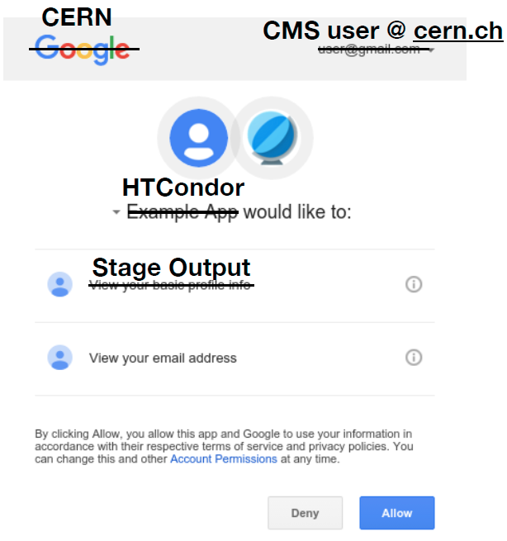
End-Goal will look like this
The first time you use HTCondor, you navigate to a web interface and setup your desired permissions.
  On every subsequent job submission, HTCondor will transparently create the access token for you. User sees nothing.
Replace LIGO, usernames, permissions as desired.
Bonus: Use OAuth to also send job output to cloud Box.com, Google Drive, etc.
LIGO Collaboration
AlbertE@ligo.org

Slide 12
PASSWORD IN TERMINAL
USER MANAGEMENT OF FILES
SCITOKENS-PROXY-INIT
COPY/PASTE

Slide 13
Leverage Relevant RFC Standards
We don’t exist in a vacuum, we'd rather adopt existing industry standards than create new ones.
Workflows for acquiring/using tokens: OAuth 2.0.
  Think of OAuth2 as describing how the various parties should interact
Access Tokens: JWT bearer tokens.
  The contents (claims) of JWT tokens are not standardized, so we will provide a SciTokens Claims specification and reference library implementation so tokens issued by an organization are understood by a wide variety of resources. SciTokens Library also supports
    Distributed verification
    Privacy preservation

Slide 14
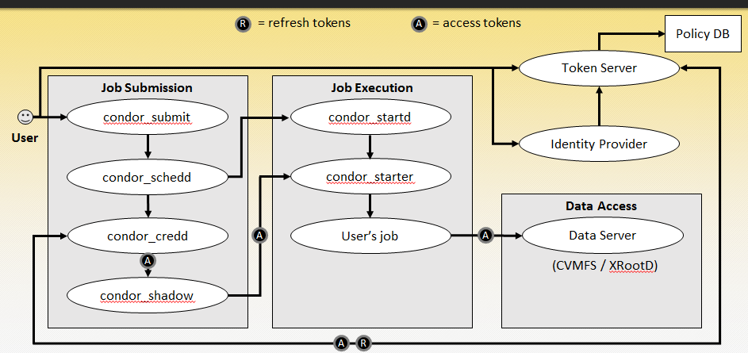
Architecture

Slide 15
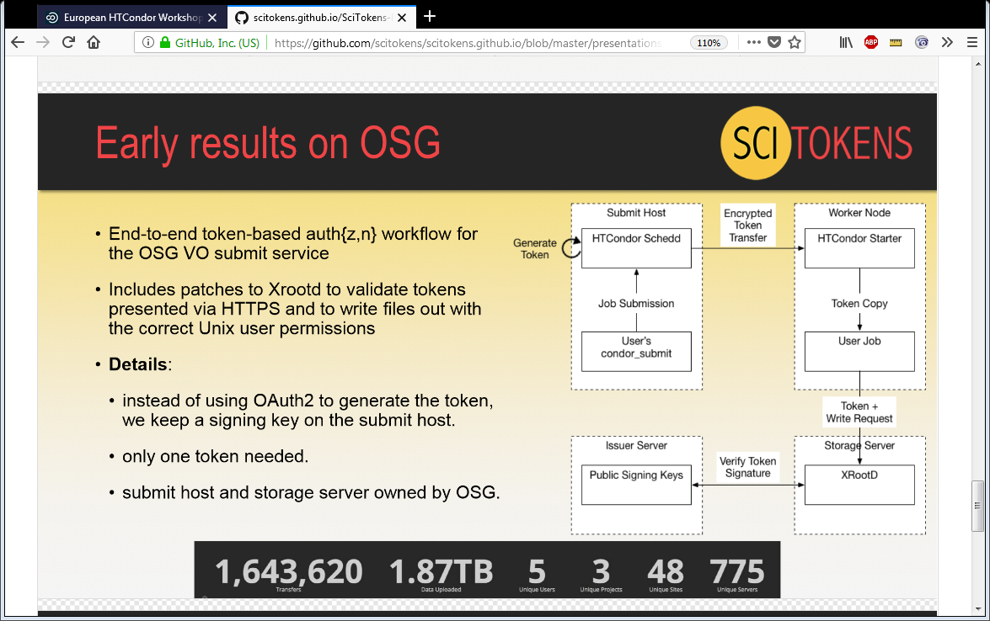
Early results on OSG

Slide 16
Status
Some accomplishments so far:
  Python, Java, and C++ libraries
  XRootD token validation plugins
  Token-based CVMFS access
  Token-based NGINX plugin for https get/put
  X509-to-SciToken translation service
  3rd-party HTTPS FTS transfers authorized with SciTokens
  SciTokens authentication method in HTCondor (for HTCondor-CE)
  OSG aims to have all current software using GSI provide a “demo-quality” GSI-free configuration by January 2021
  Enhanced HTCondor token support with OAuth flows… demo!

Slide 17
TL;DR
The SciTokens project aims to:
  Introduce a capabilities-based authorization infrastructure for distributed scientific computing,
  provide a reference platform, combining a token library with CILogon, HTCondor, CVMFS, NGINX, and Xrootd, AND
  Deploy this technology to help our science stakeholders (LIGO and LSST) better achieve their scientific aims.
Note: SciTokens does not do everything… e.g. SciTokens does not manage your identity (still need an identity management solution), nor does SciTokens provide an authorization service. But it will enable taking existing solutions and scale them out of distributed grid infrastructure.

Slide 18
We are working with a lot of people
Stakeholders: LIGO, LSST
Technologies: HTCondor, CILogin, CVMFS, XRootD, FTS
Discussions and Interest from Open Science Grid (OSG), LHC WLCG (Worldwide LHC Computing Grid), CMS, CERN IT
You?

Slide 19

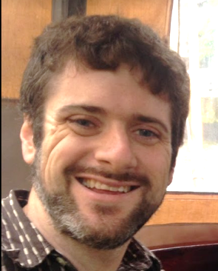
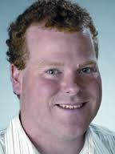
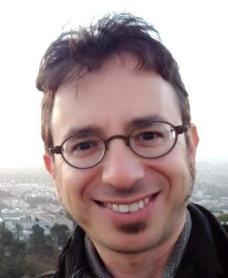
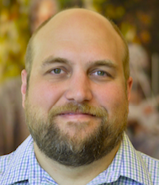
Feel free to contact us
Web Site (includes email lists):
https://scitokens.org
PI/co-PI contact info appears below
Questions and Thank You!
Jim Basney
Senior Research Scientist
NCSA / UIUC
jbasney@illinois.edu
Brian Bockelman
Asst. Research Professor, OSG Coord.
U of Nebraska-Lincoln
bbockelm@cse.unl.edu
Duncan Brown
Charles Brightman Professor of Physics
Syracuse University
dabrown@syr.edu
Todd Tannenbaum
Researcher, HTCondor Technical Lead
UW-Madison
tannenba@cs.wisc.edu
Alexander Withers
Senior Security Engineer
NCSA / UIUC
alexw1@illinois.edu

