Slide 2

Agenda
LHCb Containers Network overview
  LHCb Containers: why?
  Physical infrastructure overview
  Network topology
DWDM setup using PAM4 optics
  Feasibility test for shared HLT
  DWDM and PAM4 optics
  DWDM setup for experiments
Q&A

Slide 3
LHCb Containers
Network overview
Daniele Pomponi
Communication Systems Group
Information Technology Department

Slide 4

LHCb containers: why?
End of Wigner contract
WIGNER CAPACITY
Computer Center Meyrin site
2nd Network HUB Prevessin site
LHCb Containers
5 and 6

Slide 5
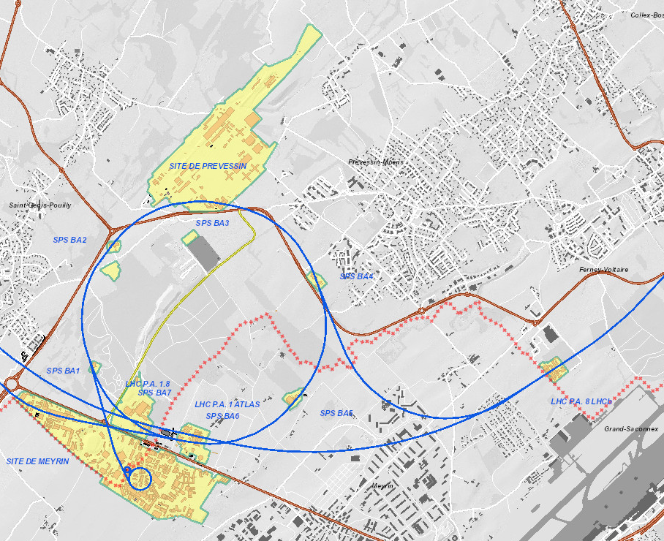
2nd Network HUB
Containers
Computer
Center

Slide 6
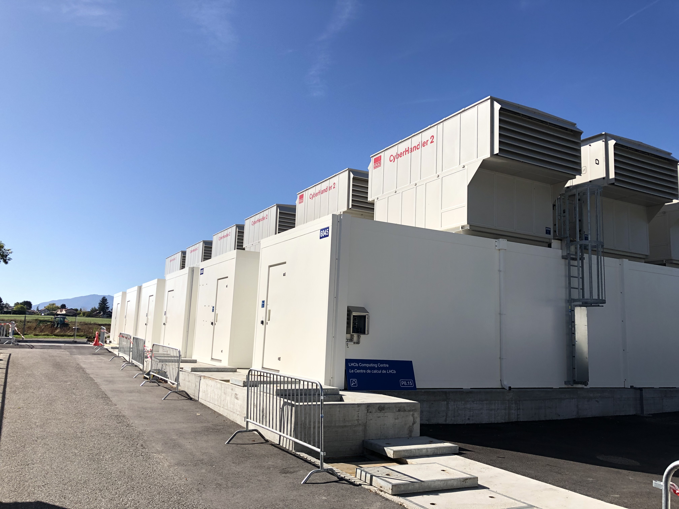

Slide 7
What do we have at Wigner?
4 Routers providing
  161 broadcast domains for LCG domain
  24 broadcast domains for management
  19 broadcast domains for intelligent PDUs
364 Switches attached to the routers
  185 data switches (LCG)
  179 management switches

Slide 8
What do we migrate to CERN?
 |  | Quad servers (CPU) |  | JBODs (Disk)
 |  | Units | Pallets | Units | Pallets | Total pallets
#1 | February | 150 | 12 | 0 | 0 | 15
#2 | April | 54 | 5 | 72 | 12 | 19
#3 | May | 129 | 11 | 144 | 18 | ~33
#4 | June | 150 | 13 | 104 | 13 | ~29
#5 | October | 174 | 14 | 120 | 15 | ~33
#6 | December | ~183 | 16 | 0 | 0 | ~20
TOTAL |  | 840 quads (3360 nodes) |  | 440 JBODs

Slide 9
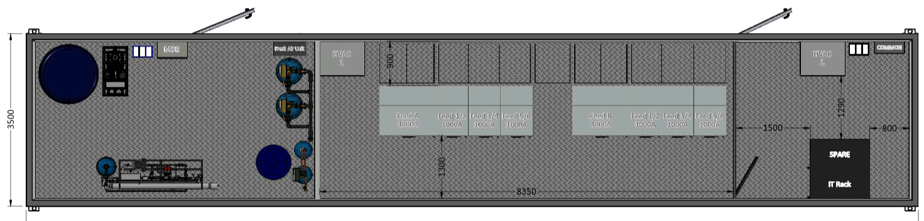
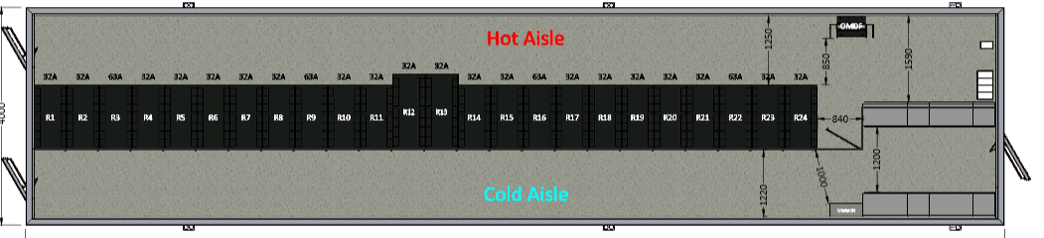
Physical infrastructure overview

Slide 10
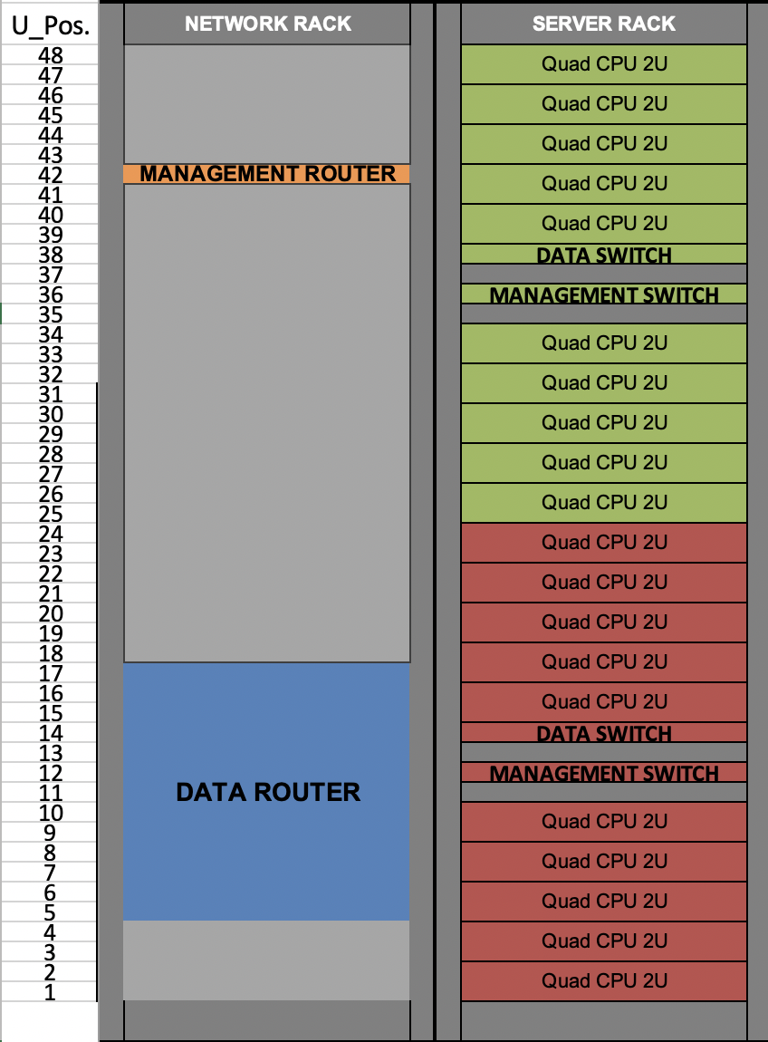
Rack layout
Server rack (23 per container):
2x Management switches – HP 2920
2x Data switches – Ruckus ICX
7750-48C
20x Quad CPU 2U
Network rack (1 per container):
1x Management router - Ruckus ICX 7750-48C
1X Data router – Juniper QFX10008
4 line-cards 30x100G

Slide 11
Cabling and Optics
Data switches to LCG/ITS distribution router:
  Multimode Fiber OM4 LC-LC
  40GBidi Optics
MGMT switches to MGMT distribution router:
  UTP Cat. 5E
Data Router to CORE LCG/ITS routers:
  Single-mode fibers LC-PC
  100G-LR4 Optics
MGMT Router to MGMT core routers:
  Single-mode fibers LC-PC
  10G-LR Optics

Slide 12
Network topology
The setup is exactly the same as the one currently used at Wigner
  The only difference is on the switch uplink (2x40Gbps, instead of 2x10Gbps)
8 new broadcast domain, each of them having:
  6 switches (except the last one with 4 switches only)
  240 physical servers - 40 per switch (except the last one with 160 servers)
  960 Virtual Machines - 4 per node (except the last one with 640 VMs)
Each switch connect 40 servers (40x10Gbps) and 2x40Gbps uplink
  Switch Blocking factor = 1:5 (compare to 1:20 on Wigner current setup).
  Initial uplink of the router (to go out of the container) is 4X100G

Slide 13
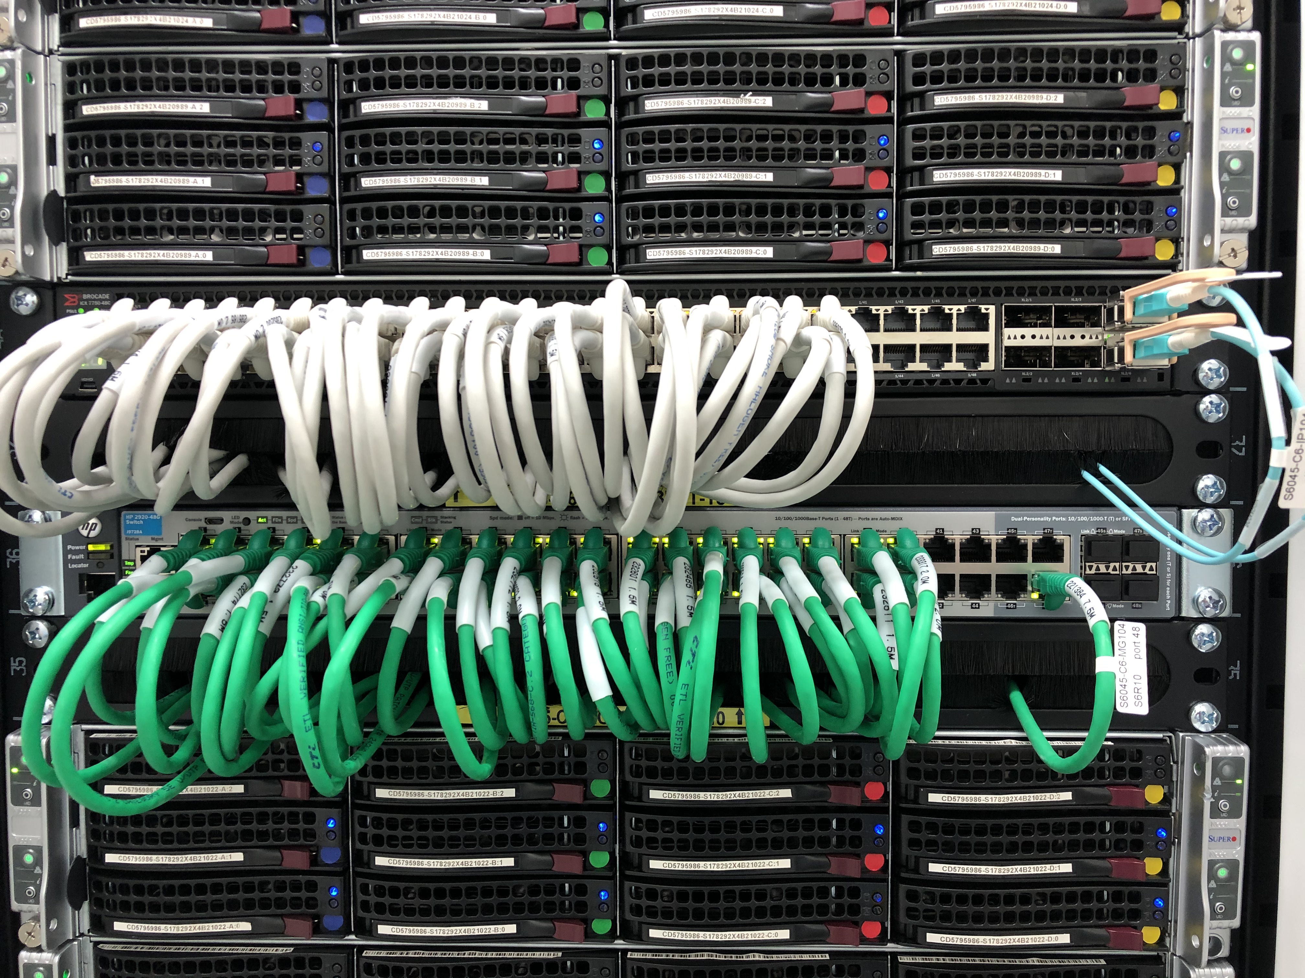

Slide 14
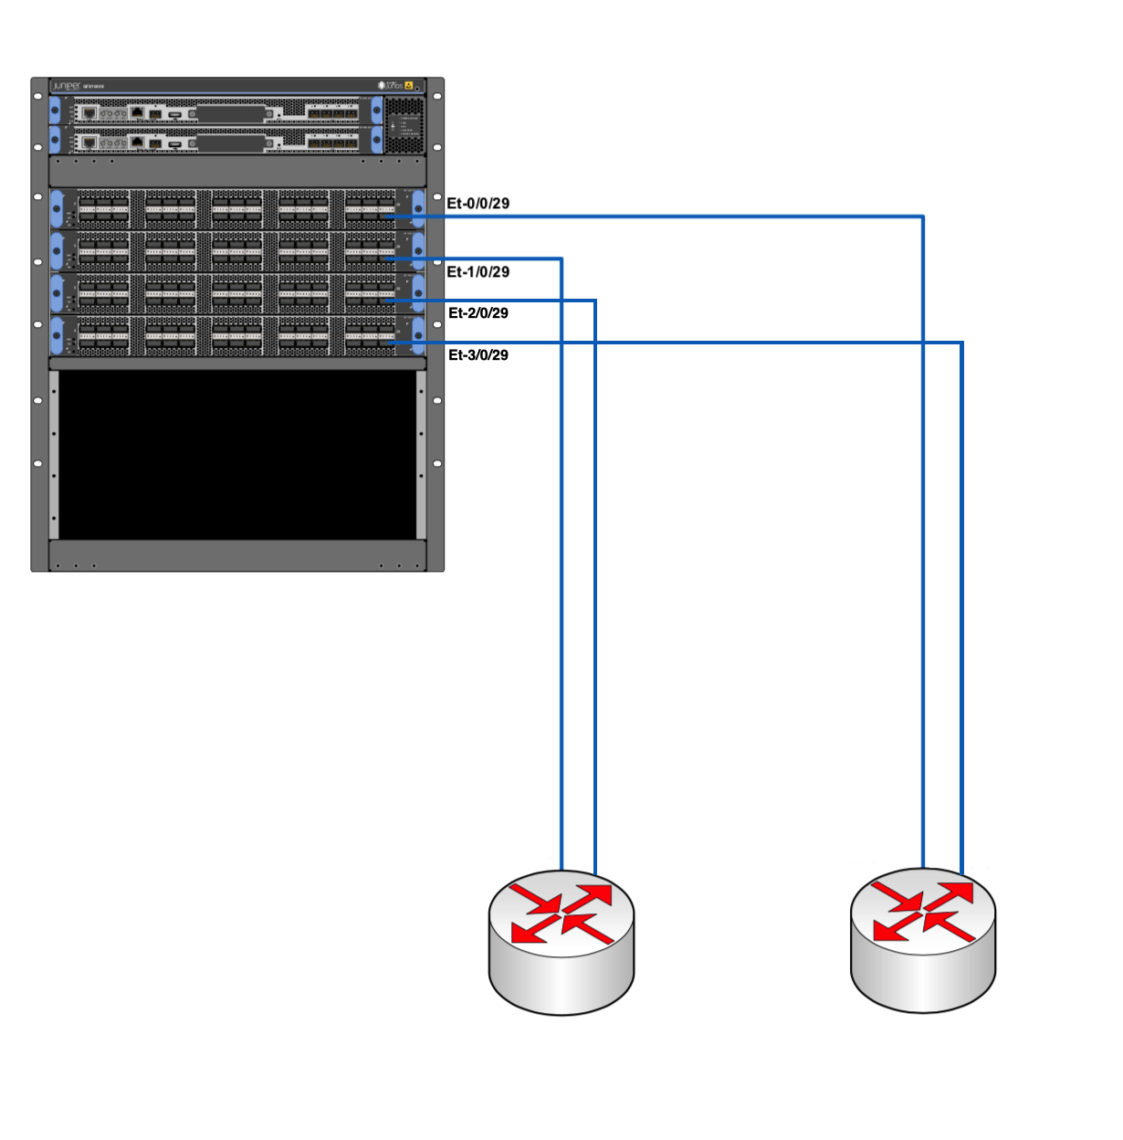
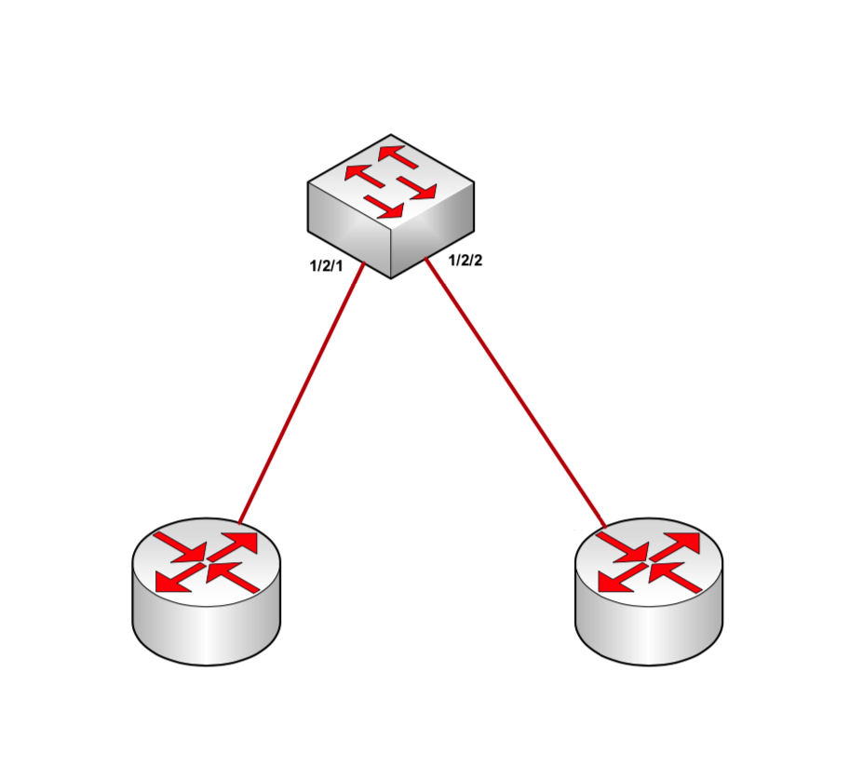
Data and Management routers
DATA ROUTER
MGMT ROUTER
1X100G
1X100G
1X10G
1X10G
1X100G
1X100G
CORE
NETWORK
MGMT
NETWORK

Slide 15
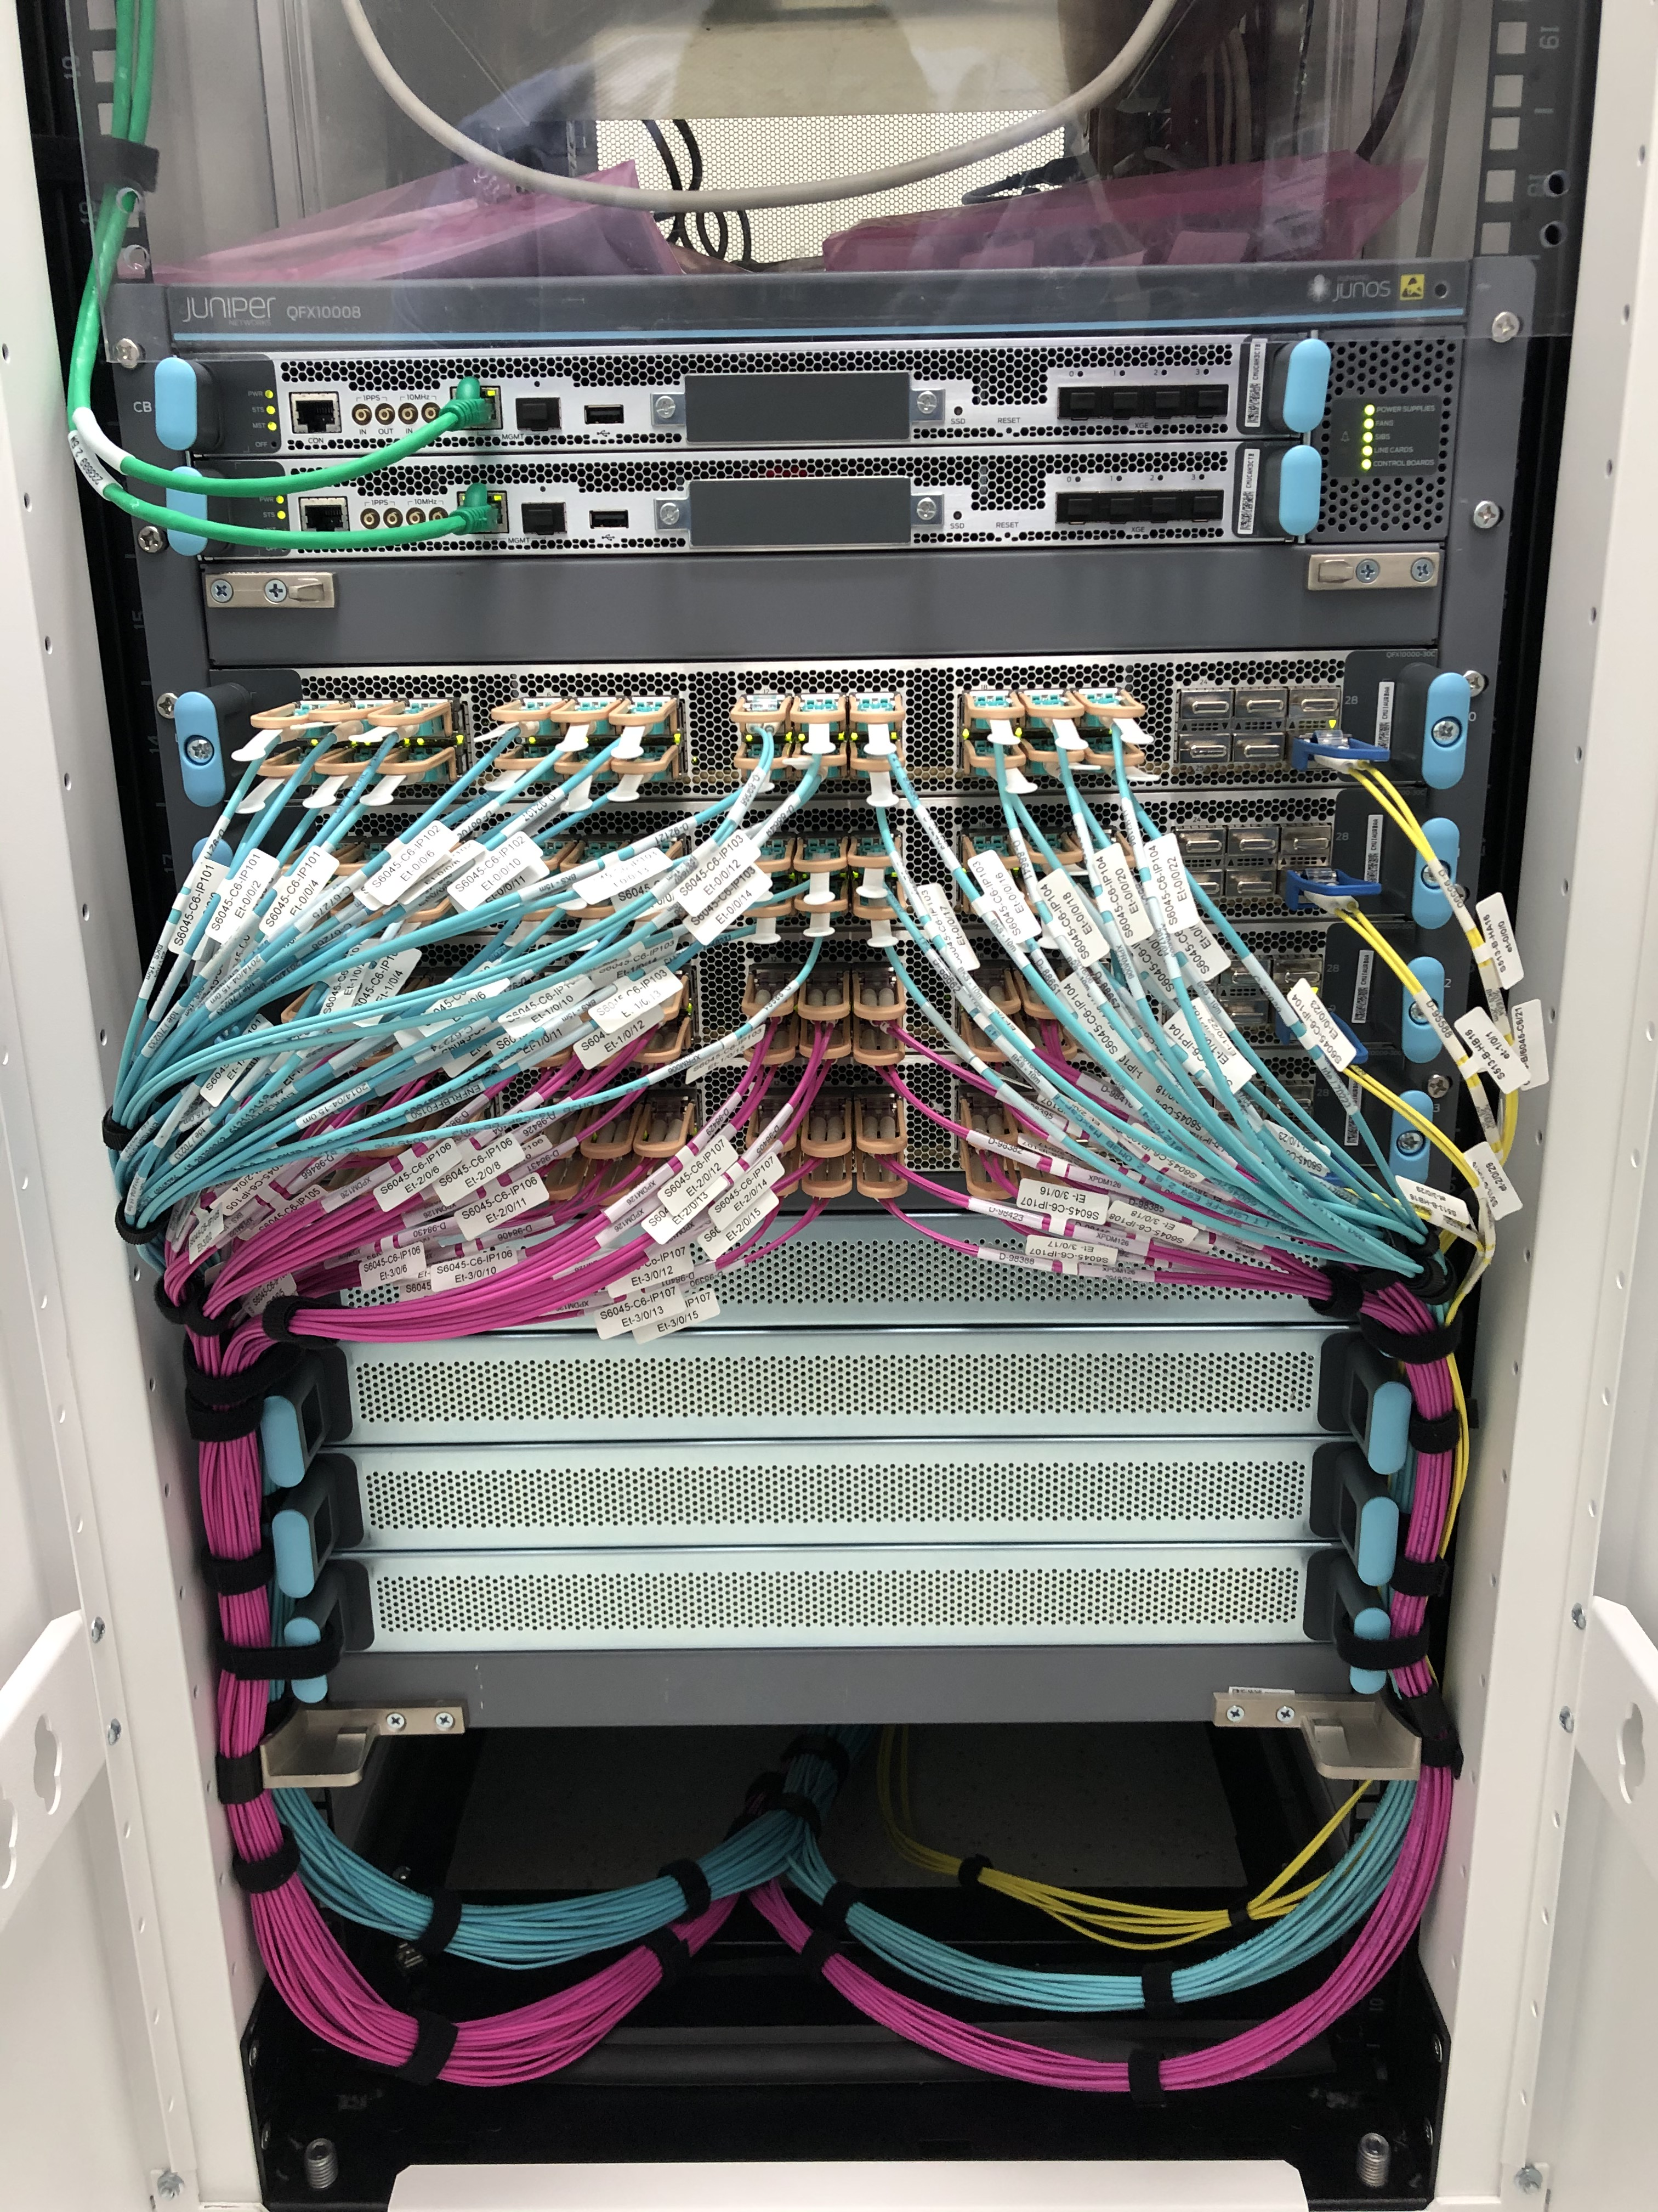

Slide 16
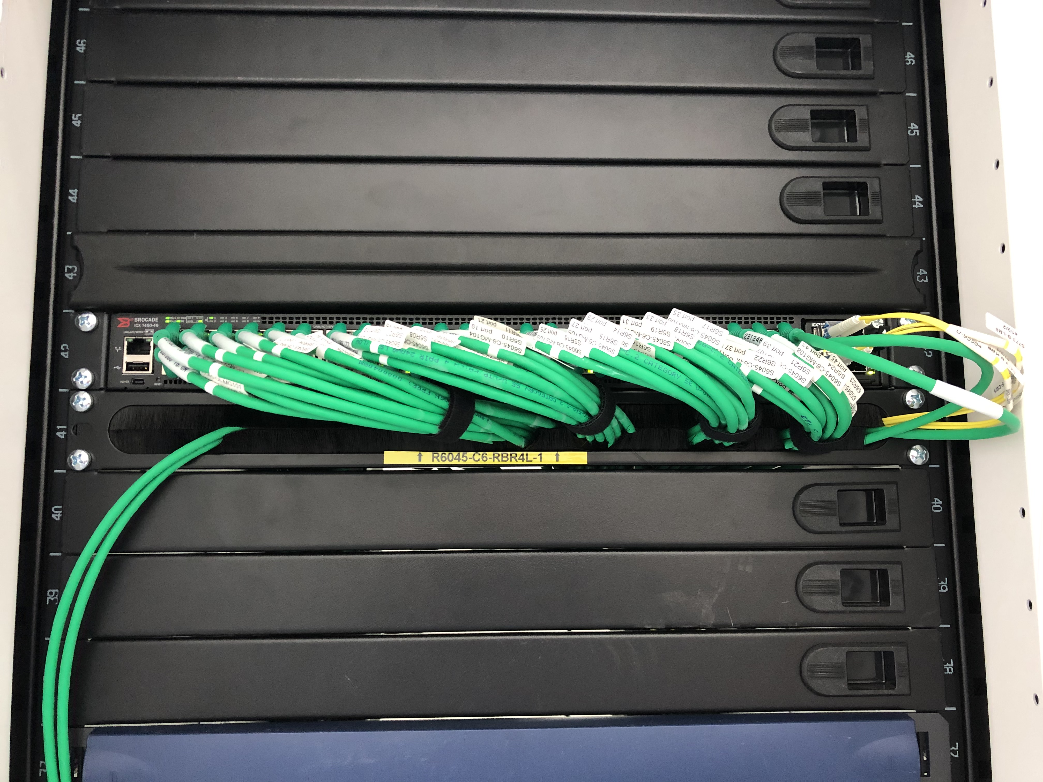

Slide 17

Prevessin 2nd Network hub
GPNCORE
3
2
LCG/ITS CORE
1X10G
~ 5.3KM
LHCb Containers
~ 3.7KM
DATA
MGMT
Meyrin Computer Center
2X100G
2X100G
1x10G
1
2
1
~ 8.4KM
LCG/ITS CORE
GPN CORE

Slide 18
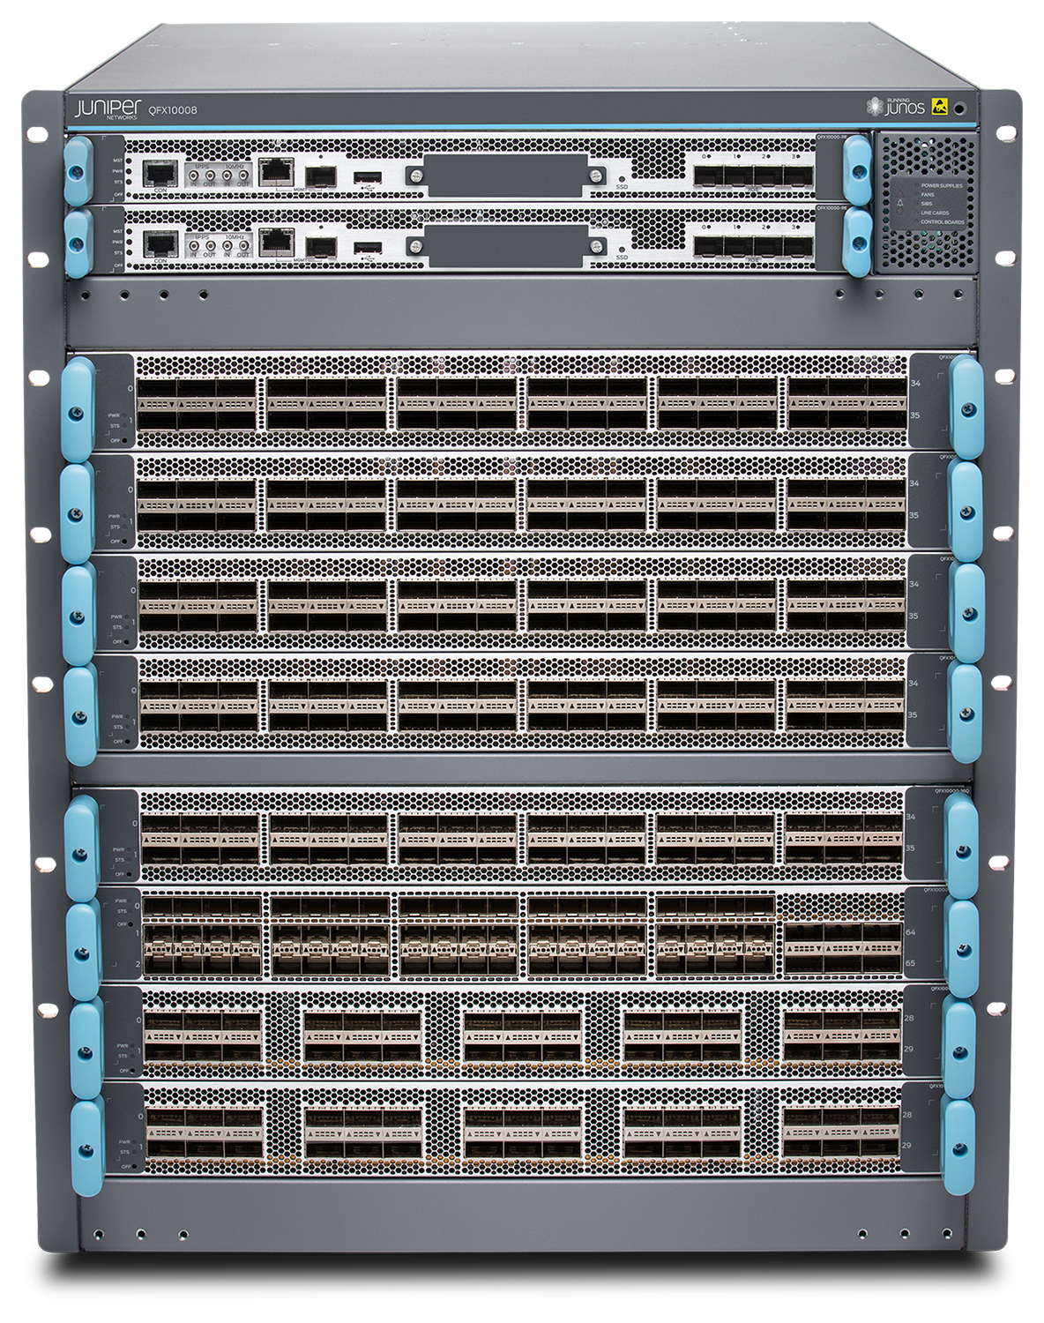
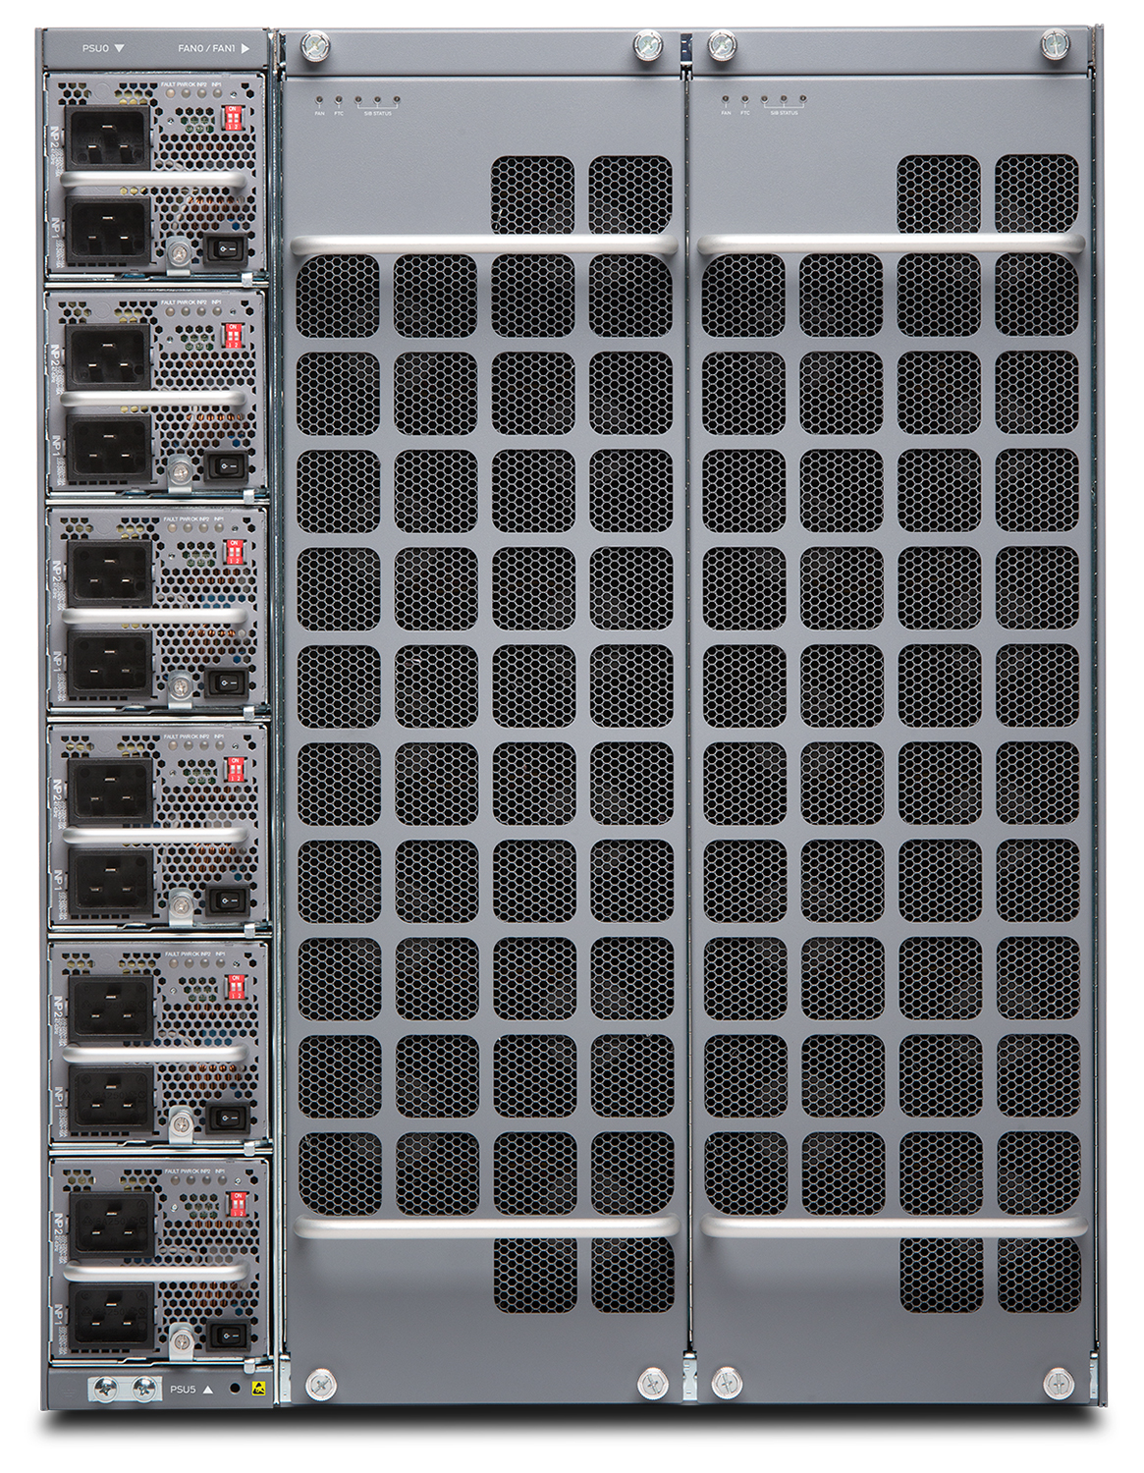
Rack units: 13
PSUs: 6 16200 W AC
Cooling: Front-to-back airflow
Weight: 146Kg
System throughput: Up to 48 TBs

Slide 19
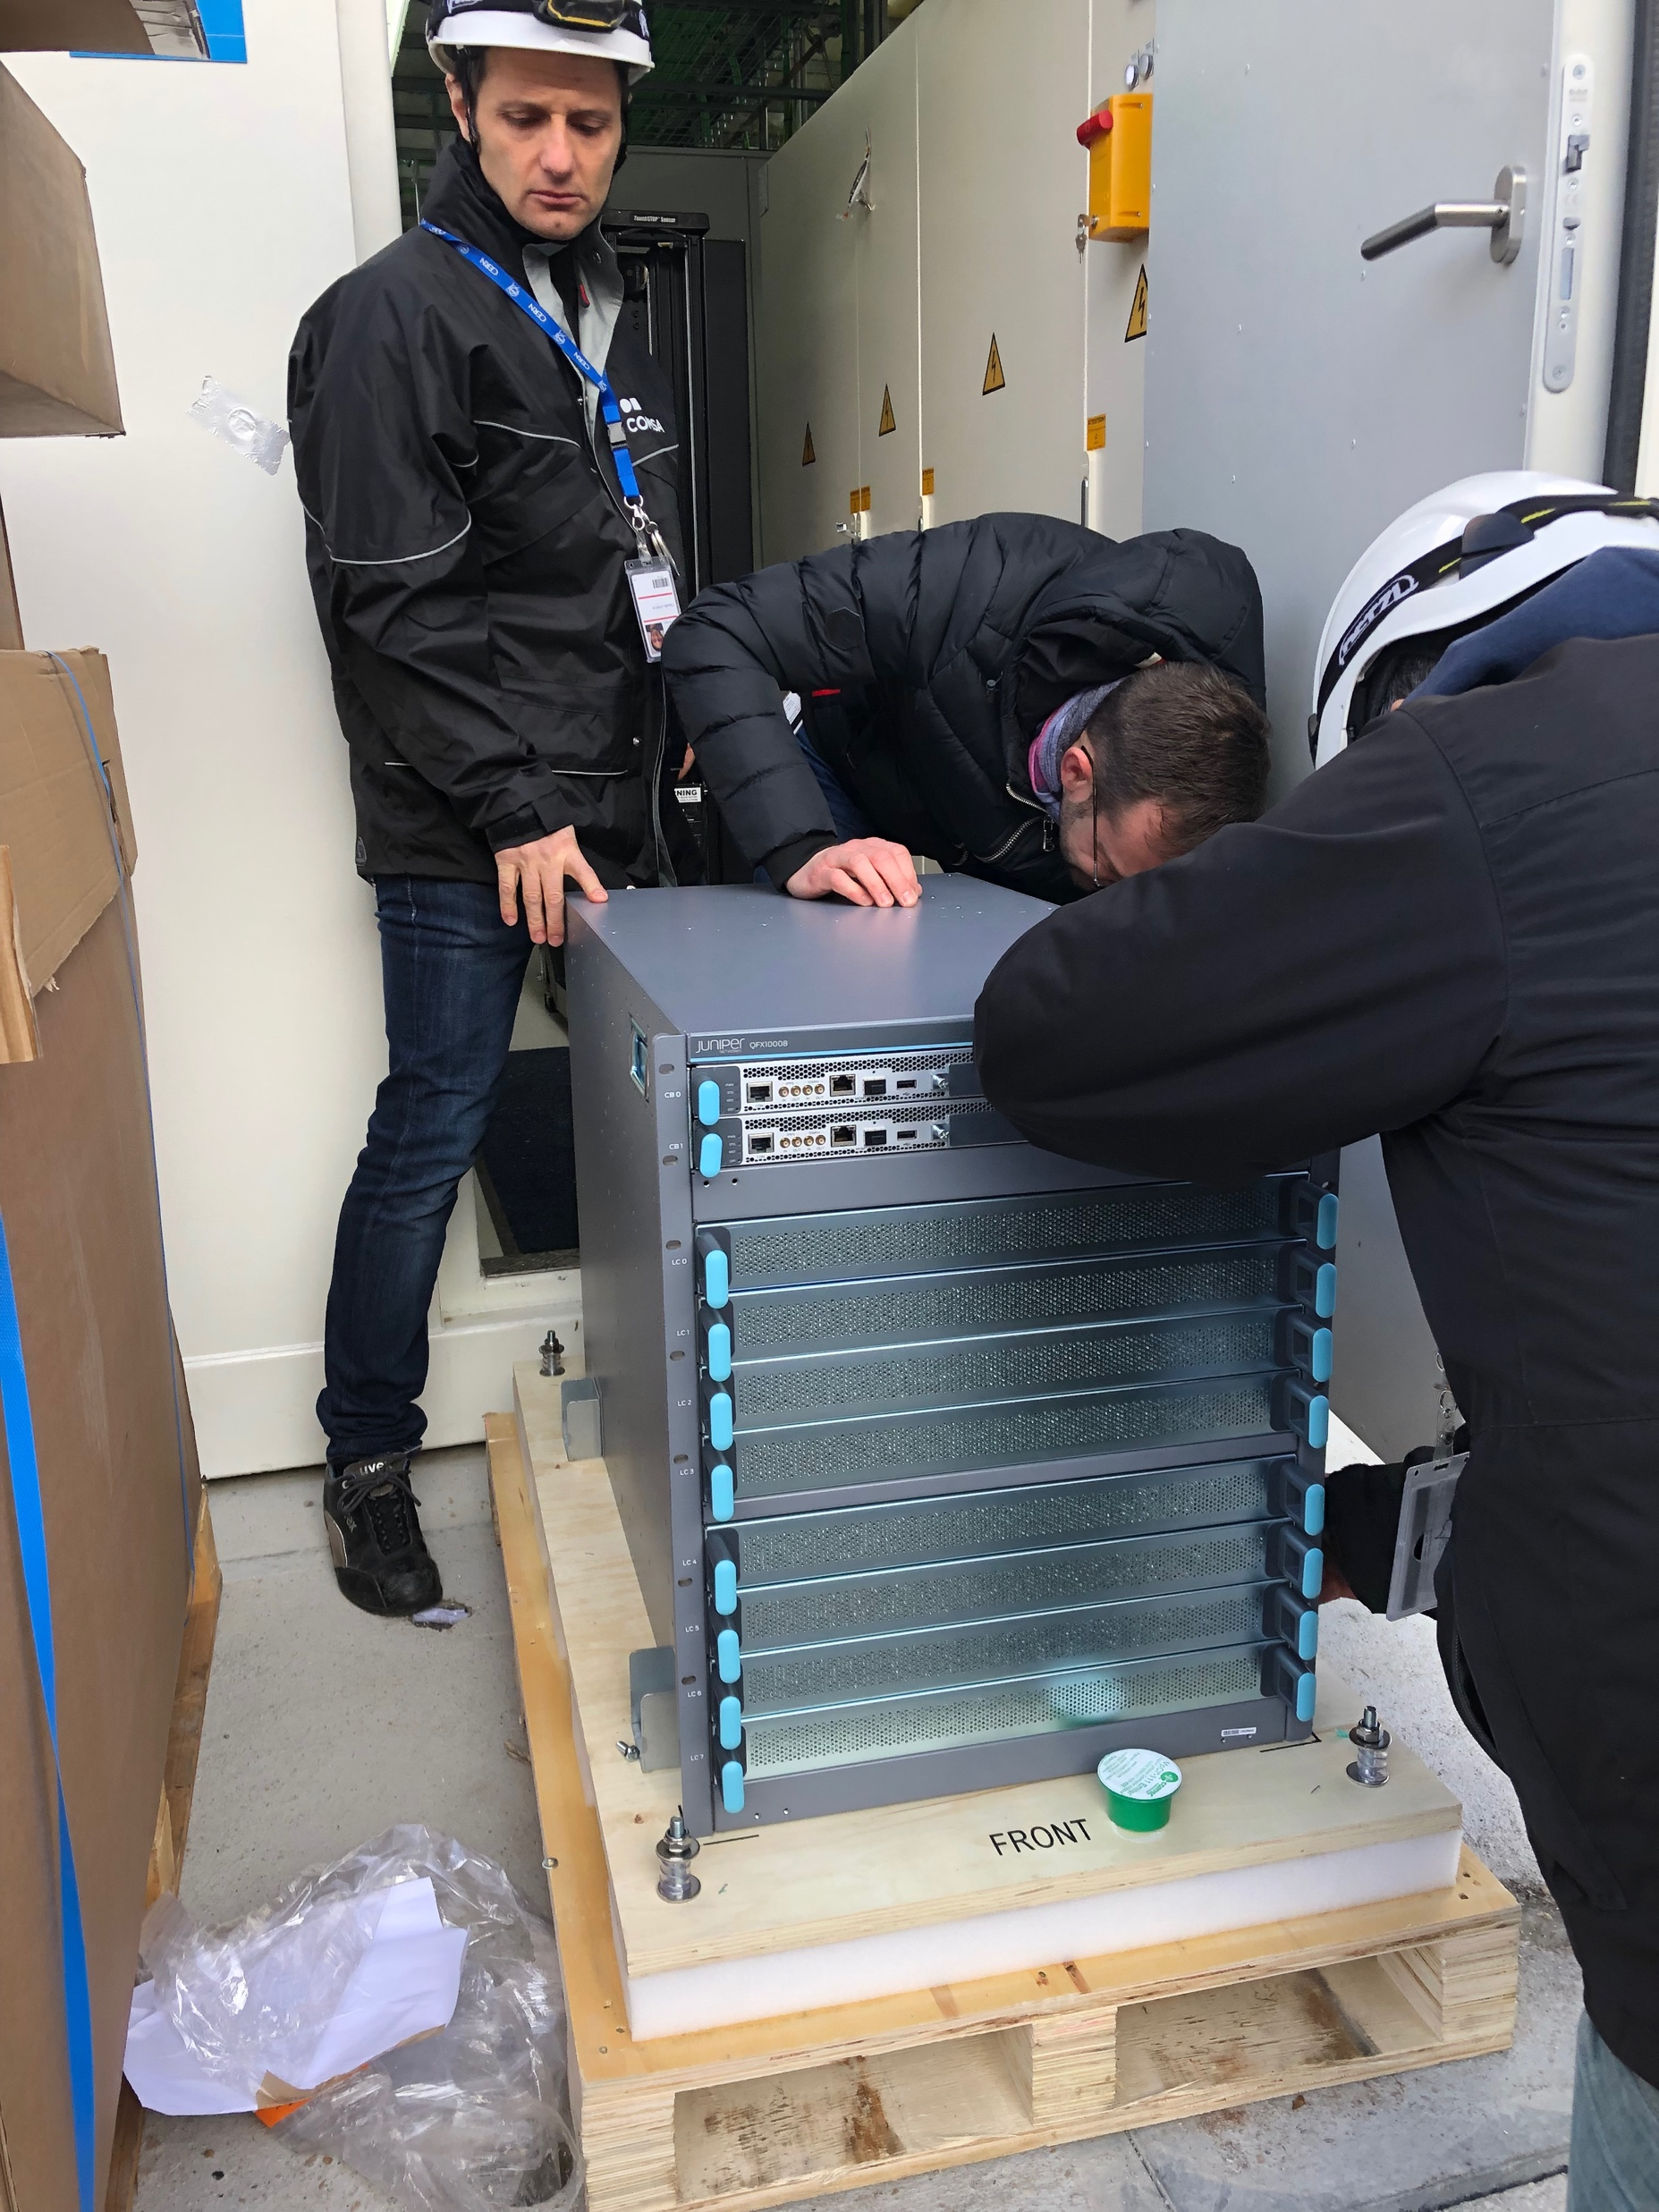
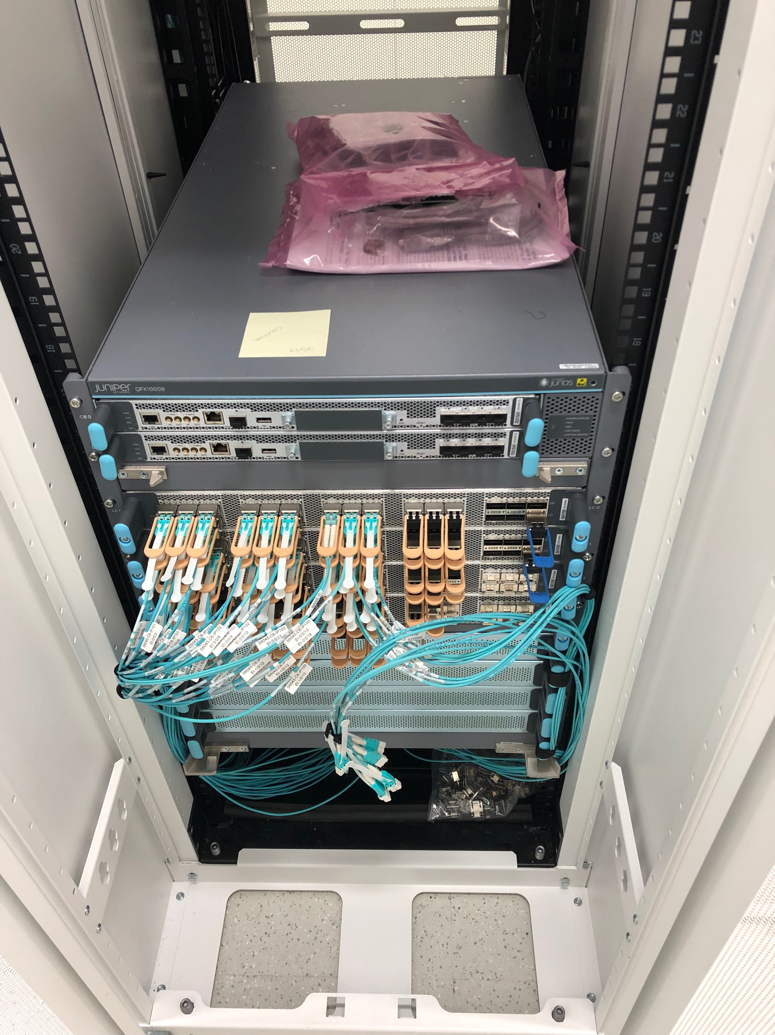

Slide 20
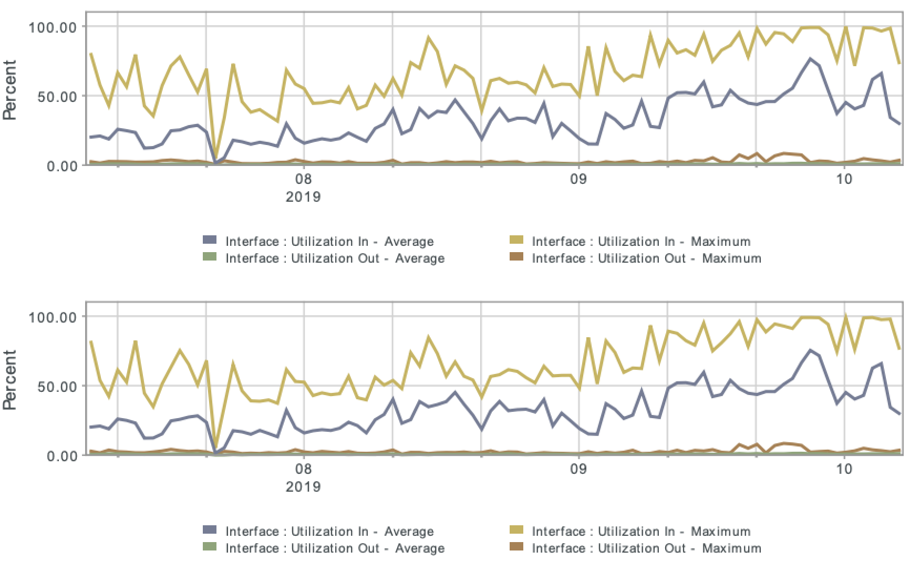
Looking at the stats …
LHCb Container data router to datacenter core router #1 [LCG-ITS vlans]
200G
LHCb Container data router to datacenter core router #2 [LCG-ITS vlans]
200G

Slide 21
DWDM Setup
PAM4 technology for Tbps transmission lines

Slide 22
Feasibility test for shared HLT
Feasibility of a shared facility for the High Level Trigger farms of the four LHC experiments was reviewed in 2017
Advantages:
re-purpose of servers when no data taking
shared cost of infrastructure and operations
Challenges:
Very high data rates from detectors to HLTs:
  RUN 3
  ALICE: 4Tbps
  LHCb: 40Tbps
  RUN 4
  ATLAS: 40Tbps
  CMS: 40Tbps

Slide 23
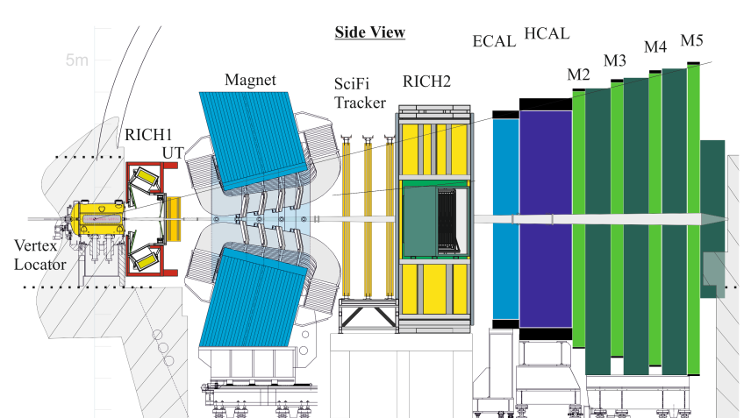

Logical test-setup
LHCb detector - Prevessin
IT datacentre - Meyrin
MGMT
1x 40G
Rack N040
MGMT
12x 10G
Ruckus ICX 7750
nb-n040-01
nb-n040-02
DATA
12x 40G
=
=
=
=
=
=
nb-n040-12
Rack N044
20x 10G-SR
20x 10G-SR
VMGMT
1x 40G
DATA-VLANs
Ruckus ICX 7750
MGMT
12x 10G
Juniper
QFX5110-48S
4x 100G-LR4
Juniper
QFX5200-32C
nb-n044-01
DATA + MGMT VLANs
DATA
12x 40G
nb-n044-02
=
MGMT VLANs
=
=
LHCb online
system
=
=
=
Credit: Edoardo Martelli - CERN
nb-n044-12

Slide 24
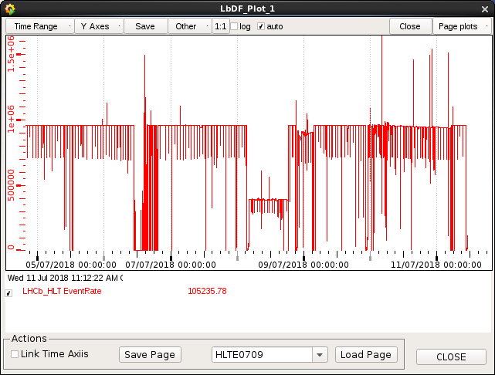
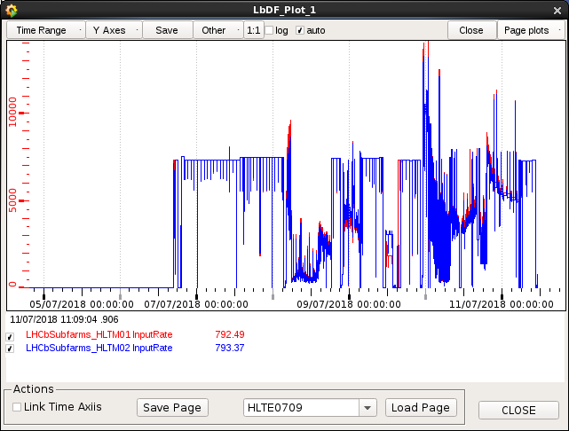
Transmission results
LHCb online commented: “Operationally and performance-wise, it seems to be the same as running a sub-farm at Point 8” [LHCb pit]
Local HLT
Local and Remote HLT

Slide 25
DWDM using PAM4 optics
The PAM4 optics are not tunable
1 wavelength = 1 optic
Support for high power consumption optics is mandatory
(similar case to ER4)
PAM4 lines were loaded with sustained 150Gbps traffic for several hours with no transmission errors

Slide 26
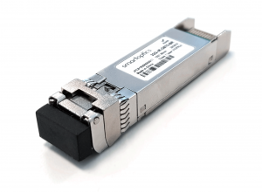
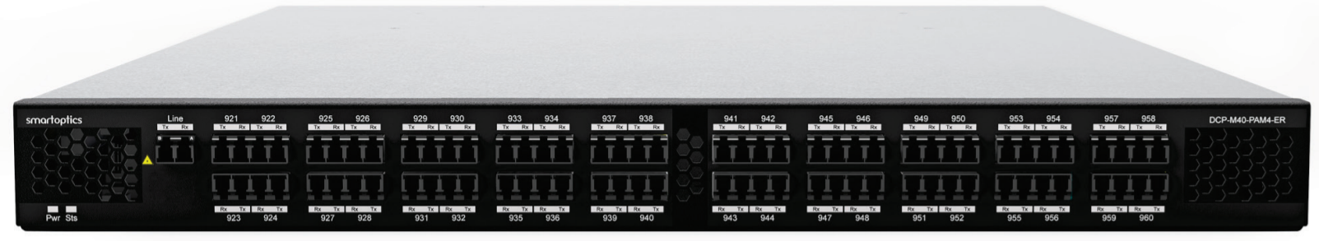
DWDM setup for experiments
High throughput link using WDM (PAM 4 system)
Up to 40 channels (40x100G) transported over a single pair of fiber (up to 40Km)
QSFP28 PAM4 (Pulse Amplitude Modulation) 100G optics used directly on Juniper devices (small specific configuration required)
4x100G installed between ALICE and Cern Computer Centre (will evolve to 1Tbps)
On-going installation between LHCb and Cern Computer Centre
Experiment
network
Datacentre Network

Slide 27
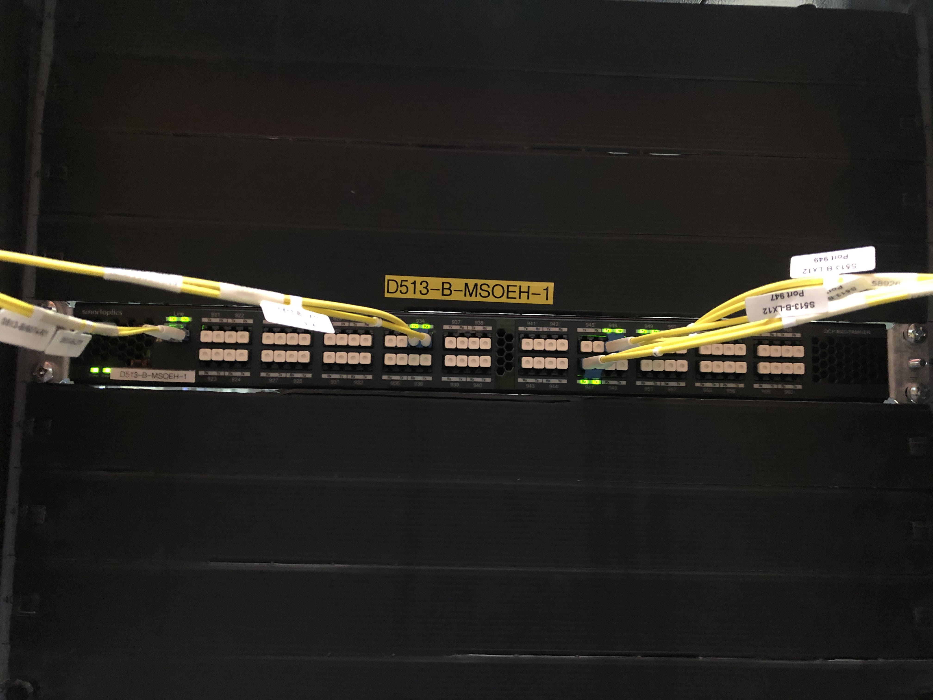
DWDM Physical setup
DCP-M-PAM4
Fiber to ALICE
DWDM PAM4 channels to QFX5200

Slide 28
DWDM Conclusion
WDM PAM4 is an affordable and ready to use technology for Tbps transmission lines
Taking into account that during RUN 3/4 we expect a substantial increase in the data sent by the experiments up to 40Tbps we believe that this technology can be a very valid solution to increase the bandwidth between the CERN data centers and the experiments sub-farm.
According with the vendor this technology will be ready to support 400G channels using the same equipment (PAM4 optics have to be developed in the coming years). This would allow transmission of up to 16 Tbps using a single pair of fibers.

Slide 29
Questions?
Daniele Pomponi – d.pomponi@cern.ch
Communication Systems Group
Information Technology Department

