Slide 1
Temperature Stabilized Measurements of Laser Spectra
T. Flick, Wuppertal University
Mini Opto Workshop
4.-5. March 2010
CERN

Slide 2
Overview
Introduction
  Measurement purpose
  Measurement principle
Setup
Performed measurements
  Temperature behavior
  Spectra
Status and future plans

Slide 3
Introduction
In the innermost of the existing HEP detectors VCSEL need to stand severe radiation environments
This will get worse with future experiments
Main damaging effects for lasers:
  Radiation Damages
  Temperature effects inside the semiconductor material (at the junction)
Mostly both effects come along together, but heat can be cooled away.
This study is investigating the possibility to quantify a measure and prepare an improvement possibility for the cooling.
Similar work has been investigated by Markus Axer (Jan, Francois) for the CMS experiment and we inherit a lot from this work.
  I will use several slides from him to explain the principle

Slide 4
Wavelength Spectrum
The wavelength spectrum emitted by a laser diode is a perfect indicator of the device’s internal temperature – the junction temperature T_{j}
The wavelength spectrum is red-shifted when the device is heated by increasing the ambient temperature or the input power
If a given cavity mode remains at the same wavelength, the junction temperature T_{j} must be constant
The change in junction temperature due to varying the input power P_{in} to the laser can be cancelled by a change in the heat sink temperature, so as to keep the selected mode fixed in wavelength (nulling method → Paoli method)
The thermal resistance is found from the ratio of the change in heat sink temperature to the change in input power.
Typical wavelength spectrum of a Fabry-Perot type laser measured with an Optical Spectrum Analyzer

Slide 5
L-I Characteristic
Light-Current (L-I) characteristic of a non-irradiated laser at T_{amb}=20°C
Thermal
rollover
I_{th}
ΔL
ΔI
Eff=ΔL/ΔI
  Threshold current I_{th}
  laser starts to emit coherent light
  Efficiency Eff
  slope of L-I curve in linear part
  Thermal rollover
  non-linear part of L-I curve where non-radiative
  recombination mechanisms (Auger) become
  dominant due to internal temperature

Slide 6
Spectral Behavior during Irradiation
55mA
The behavior of certain mode peaks is unique for all LDs:
  “Slight” λ red-shift with
  increasing fluence at the
  same input current level
  “Large” λ red-shift when
  increasing the input current
45mA
25mA
10mA
R_{s} is constant during irradiation
→ term is mainly affected by I
I_{th} increases during irradiation
→ term is mainly affected by irradiation
→ P_{opt} is affected by I and
by irradiation

Slide 7
Paoli Method

Slide 8
The Paoli Method

Slide 9
The Paoli Method Step by Step
Extraction of spectrum properties
Cavity Mode
Gain

Slide 10
Thermal Effects during Irradiation
A parameter that describes the device’s efficiency to release heat generated inside the laser is called Thermal Resistance R_{th}
Δλ/ΔT_{amb} measured in an oven:
Δλ/ΔP_{in} monitored during irradiation:

Slide 11
Measurement Setup
In Wuppertal a similar setup as used by Markus has been realized:
  DUT is kept in a thermally isolated box
  Cooling and heating capabilities are realized using a Peltier element and a temperature control / regulation circuit
  Optical fibres connected to an OSA
  (Yokogawa A6319)
  Laser driving using external pulser / waveform generator and current source.

Slide 12
Setup Schematic
PC
LabView Control Program
Data Stream
Spectra Mesaurement
Cooling
Waveform Generator
Thermal Enclosure
Temperature Regulation
Peltier
Current Source
DUT
OSA

Slide 13
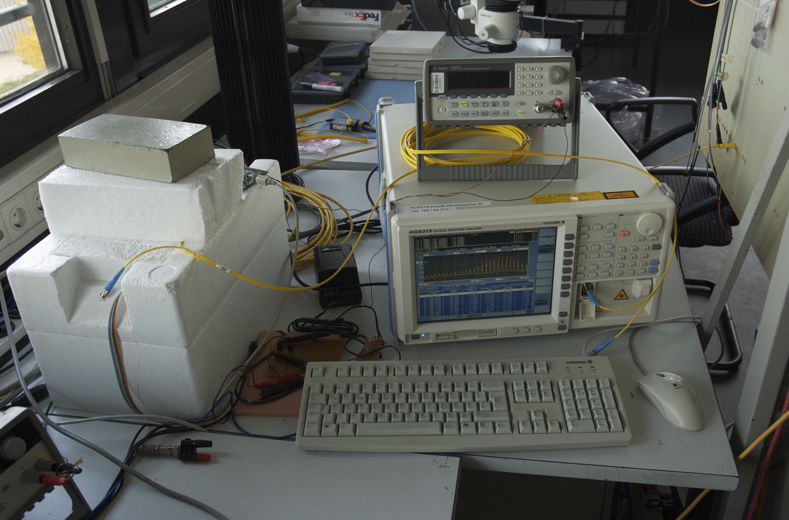
Setup Pictures
Waveform Generator
Thermal
Enclosure
Current Source for Laser
Spectrum Analyser

Slide 14
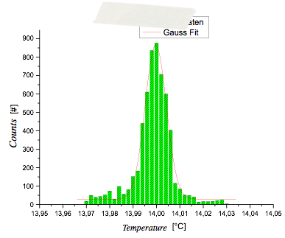
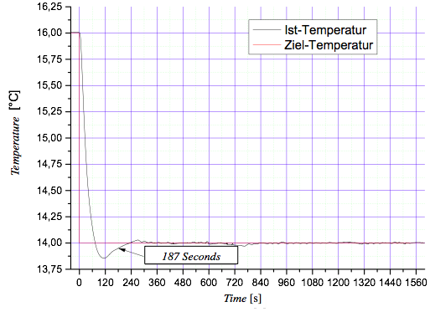
Temperature Studies
Different regulation algorithms have been studied
PID algorithm has been chosen to control the Peltier element
Temperature regulation is very fast
  O(few mins)
Temperature remains very stable
  < ±0.05 °C
22 min

Slide 15
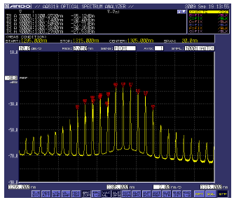
Optical Measurements
OSA measurement time is depending on the resulotion and span:
  1.5 - 25 s per measurement (10 pm resolution)
Different analysis possible, directly in the OSA or offline on the raw data
Scan of temperature dependent spectra shows the wished behavior
Red shift of the spectrum while warming the laser

Slide 16
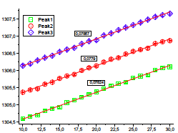
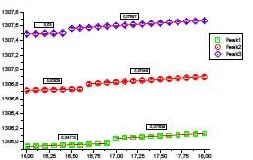
Red Shift vs Temperature
Monitoring 3 peaks from the spectrum under temperature change
Temperature range 10-30°C in 1°C steps
Spectrum peaks change by
  0.0780 nm/K
  0.0779 nm/K
  0.0786 nm/K
Zooming into the range of 16-18°C measured in 0.1°C steps shows a jump
It is not yet fully understood and needs further investigation
Wavelength [nm]
Temperature [°C]
Wavelength [nm]
Temperature [°C]

Slide 17
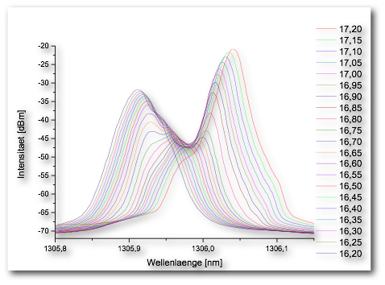
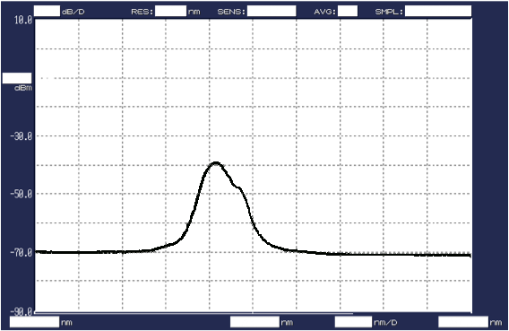
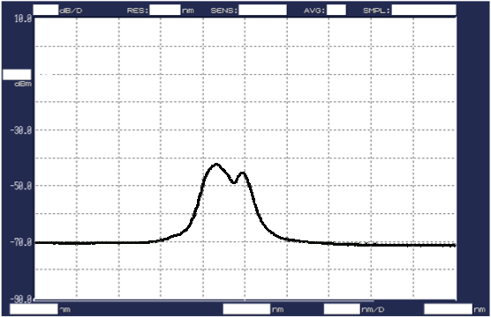
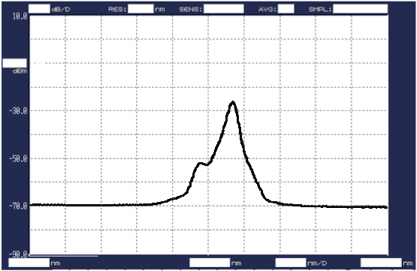
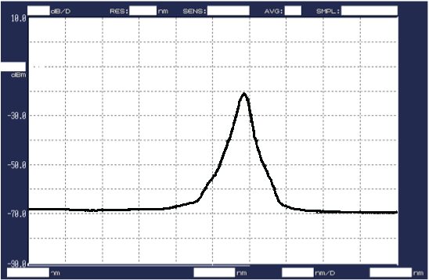
Interesting Topic to Look at
Peak does not shift, but more transforms into another
Polarization effect?
Intensity [dBm]
Wavelength [nm]

Slide 18
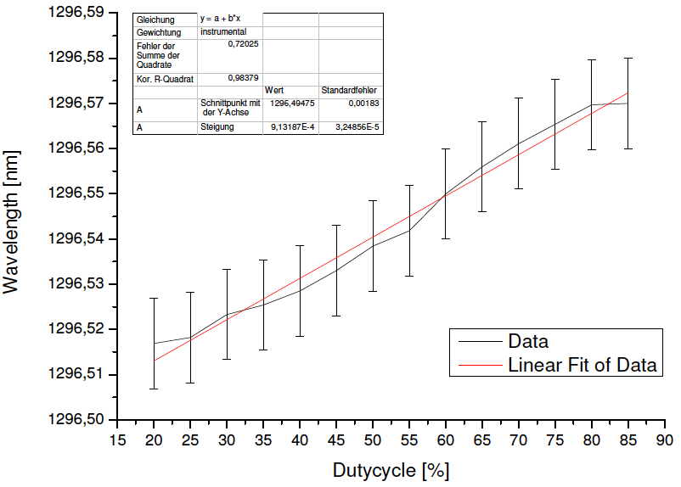
Duty Cycle Dependency
First DC measurements performed
Increase of wavelength with introduced power
Error is RMS of the peak
Careful handling of the peak error needed
Inclusion of this measurement into the Paoli Method to be done
This measurement shows the working principle only

Slide 19
Status of the Setup and Further Plans
The measurement itself (Paoli Method) is automized
Temperature depending spectra and duty cycle (power) depending spectra are taken automatically
Analysis tools are under investigation:
  Evaluate peaks
  Fit the Gaussian
  Extract the l shift and the gain curve
  Conclude for thermal resistance
  …
Different types of optical components (simple diode, transmitter board, …) need to be implemented, but this is prepared already.
Planned:
  Laser package optimization studies
  Test several different laser diodes (different materials, speed, wavelength … compare properties)
  Package optimization studies (heat coupling)
  Irradiation

Slide 20
Summary and Outlook
The setup used at CERN for CMS studies has been reproduced in Wuppertal
First measurements have been taken
Spectra measured in dependence on temperature and power have been performed
Measurement can be run automatically
Analysis software is under way
More devices will be tested and the setup will be qualified further
Will be used to qualify lasers afterwards

