Slide 1
CMS strip-Tracker
Recent optolinks experience
Karl Gill, Francesco Palmonari
Thanks also to strip-TK commissioning team
(and specifically Erik Butz, Steven Lowette, Stefano Mersi)

Slide 2
Outline
Very brief recap of system in CMS Tracker
  4/2008 o-links workshop describes integration, connection and test experience
    http://indico.cern.ch/conferenceDisplay.py?confId=29674
Cover here more recent (2009) Experience
  Digital control links
  Analogue readout links
Examples of recent calibration (‘monitoring’) measurements
  More a flavour of ‘work in progress’ than concrete results
Conclusion/outlook

Slide 3
CMS TK link system(s)
Si-strips
Readout links
  36234 lit fibres
  40MSamples/s
  8 bit range
Control links
  I2C configuration, trigger, clock, reset
  80Mbit/s
  2848 lit fibres

Slide 4
Timeline/activities
Operations
Cosmic + LHC
TIB/TID
only
TIB/TID
only
(Re)commissioning
for operation
10°C
4°C
Debug
+ Retest
Low gain
DAQ analysis +
Low gain
Lengths
X-check
Connection
+ Test
2008
2009
2010

Slide 5
Timeline/activities/effort
For info: Approx. FTE
~10
Operations
Cosmic + LHC
TIB/TID
only
TIB/TID
only
(Re)commissioning
for operation
10°C
4°C
Debug
+ Retest
Low gain
DAQ analysis +
Low gain
Lengths
X-check
~2
Connection
+ Test
~0.1
2008
2009
2010

Slide 6
Digital links
Little to report for digital control/trigger/timing links in token rings
5/356 rings failed to work properly in 2008
  2 recovered changing TRx parts at FEC
  1 using redundant optohybrid at front-end
  2 unrecoverable so far
    (power supply cabling problems suspected in patch panel within CMS magnet)
      Take a look at next shutdown
Did not yet measure power margins
  Would be useful thing to do to have a reference for future behaviour
    To be discussed with other subdetectors with same links

Slide 7
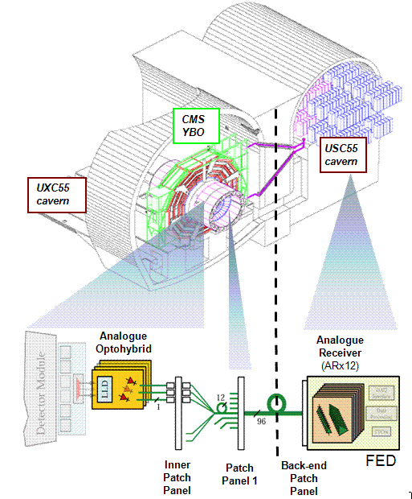
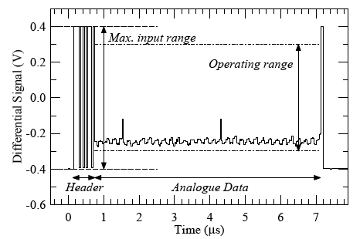
Analogue readout
Data transfer:
  2 APV chip outputs multiplexed to 40Msamples/s
  digital header/trailer plus 256 strips input to optolink

Slide 8
Readout links monitoring - 1
Optolinks not (yet) monitored directly at regular or fixed intervals
  Instead, checks made when calibrations (re)done
    Typically during long breaks in operation, or done after serious problems/change of temperature inside Tracker
Bias, gain, noise contribution measured.
  (related to laser threshold and efficiency (but laser driver, MUX and readout chip performance also partly entangled in the results…)
  Main parameters are T-dependent (and will be affected later by irradiation, wearout)

Slide 9
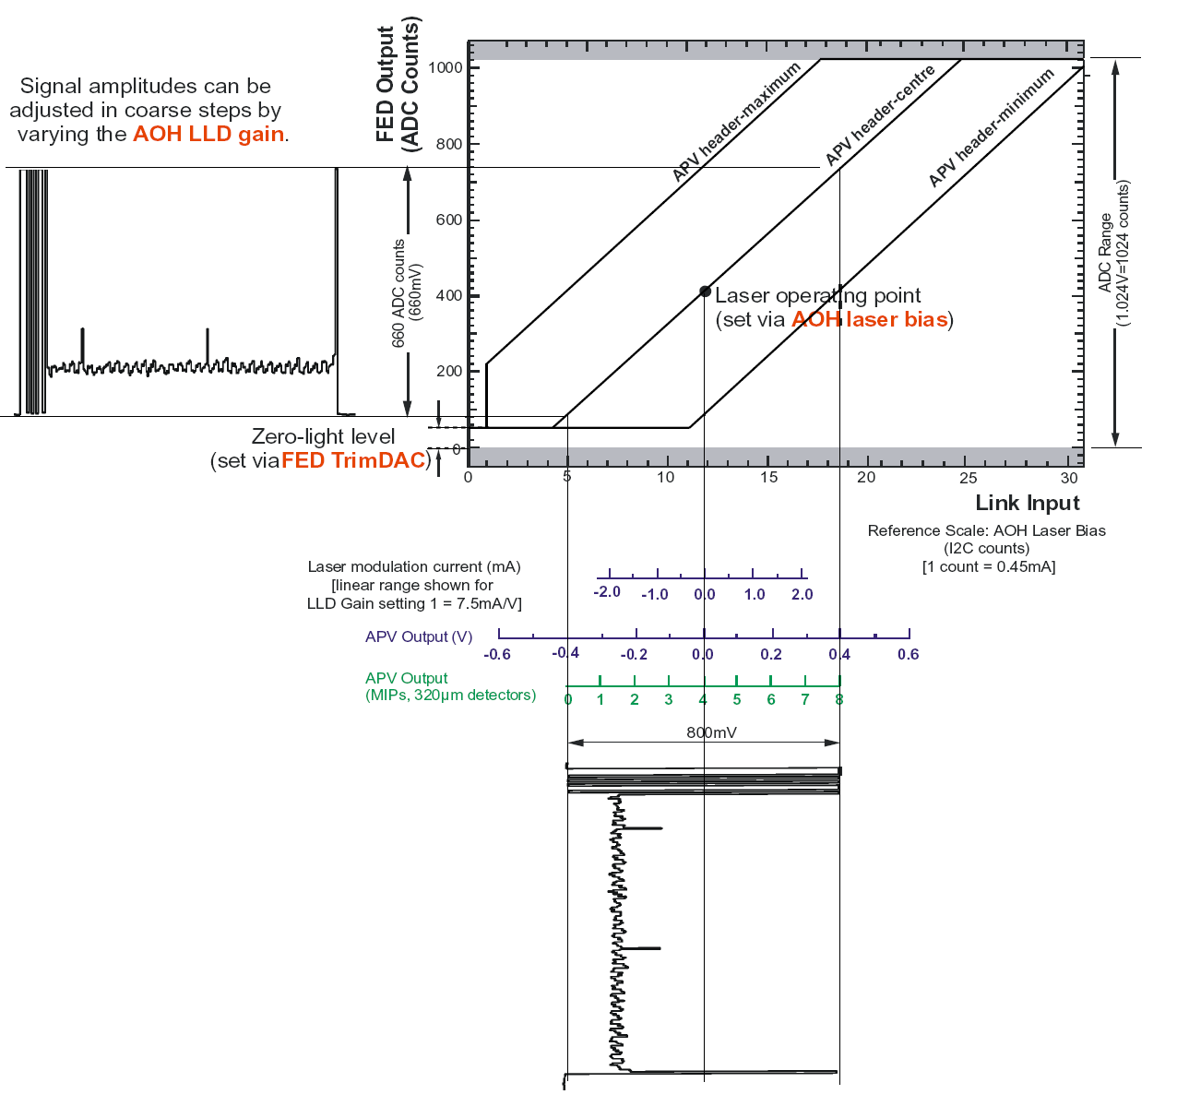
Analogue Link Characteristics
OUTPUT
I2C Programmable on analogue optohybrid:
  Bias-point (0-127)
    0.45 I2C counts/mA
  Gain settings (0, 1, 2, 3)
    (‘0’) 5, (‘1’) 7.5,
    (‘2’) 10, (‘3’) 12.5 mA/V
Calibration procedure
  Loop over gains 0 to 3, ramping Bias-point 0-50 for each laser.
  Check output and select optimal bias point (+2 I2C counts above zero light) and gain setting (nearest 0.88).
  Noise is rms of signal at given bias point
    Store noise at analogue pedestal level
INPUT

Slide 10
Readout links ‘monitoring’ - 2008
After first commissioning of detector (7/2008) very good situation.
  Almost all links functioning with good signal size.
  2-3 attempts to recover the ~1% low output (gain setting=3) channels
  Cleaning only MPO connections at back-end
    10% of 340 connections significantly improved
12/08: First comparison made of DAQ output and earlier OTDR tests
  3.7% of channels flagged with anomalous peaks/losses with OTDR
    Small but clear correlation between OTDR comments and gain measured with DAQ (see next slide)
Additional targeted microscope inspection and OTDR measurements in 08/09 shutdown
  Besides 11 known bad, additionally 40 bad connections identified inside detector plus 18 at PP1, not all fatal but unrecoverable for time being
Main issue was difficulty to have good access to system for intervention and rapid reiteration of opto-scan measurement
  Low priority during operations as these are considered refinements on 1% of complex system with other bigger concerns (particularly cooling in 2008).
  No DAQ feedback during 08/09 shutdown due to cooling plant refurbishment

Slide 11
First comparison OTDR and DAQ
OTDR comment classes (refers to size of reflection and losses observed):
MFS Small no loss – 98 instances
MFS Medium no loss – 30 instances
MFS Big no loss – 15 instances
MFS very Big no loss – 3 instances
MFS small loss – no instances
MFS medium loss – no instances ²
MFS Big loss – no instances ²
MFS Very Big loss – no instances ²
MU Small no loss – 9 instances
MU Medium no loss – 13 instances
MU Big no loss – 319 instances
MU Very Big no loss - 185 instances
MU Small with loss – 1 instances
MU Medium with loss – 3 instances
MU Big with loss – 168 instances
MU Very Big with loss – 549 instances
2) This kind of problem with MFS peak >18dB was object of a repairing campaign (connector cleaning) during fiber connection activity.

Slide 12
Readout links monitoring - 2009
In 2009, during operation 7/09 onwards, full readout and control system always under close surveillance
  Degradation/anomalies are reported/followed up
System was very stable from point of view of optical links
  (see later slides)
Some S/N losses seen where wrong fibre lengths provided/used, affecting tracker synchronization
  Length/connection DB problems in 2008. Fixed.
  All good in 2009 besides TEC -.
    ~50 modules with wrong fibre length. Now fixed.
    (new issue in full TEC - partition with ~20% effect still under investigation)

Slide 13
Readout links monitoring - 2010
Recent recommissioning of TIB/TID
  See next slides
Efforts being made to have ~continuous monitoring of readout through DAQ “spy channel”
Considering more regular (~2-3 per year) periodic calibration

Slide 14
Example results from TIB/TID recommissioning 2010 and comparison with full Tracker in 2009
TIB/TID recommissioned in last month after re-inclusion of some parts suffering leaks in cooling lines
  Now run ‘uncooled’ (2/56 cooling loops, ~3% of TIB/TID)
Will cover here only link gain spectrum, laser thresholds, link noise
Note: calibration measurement not a lightweight activity
  several days of expert effort per partition (TIB/TID, TOB, TEC+, TEC-) to go into good detail
  (… with thanks to people who do this work…)
  Warning: What follows is fresh and quite preliminary…
  …. but it gives a flavour of monitoring capabilities

Slide 15
Gain measurement
Measure size of tick at output in order to estimate gain of the link for each gain setting

Slide 16
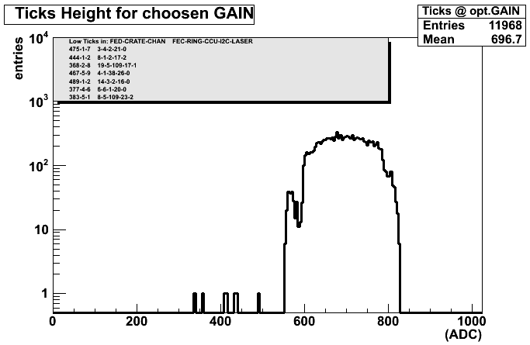
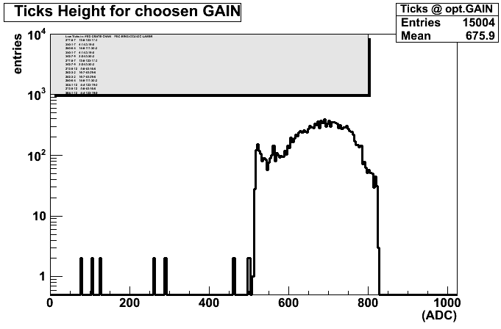
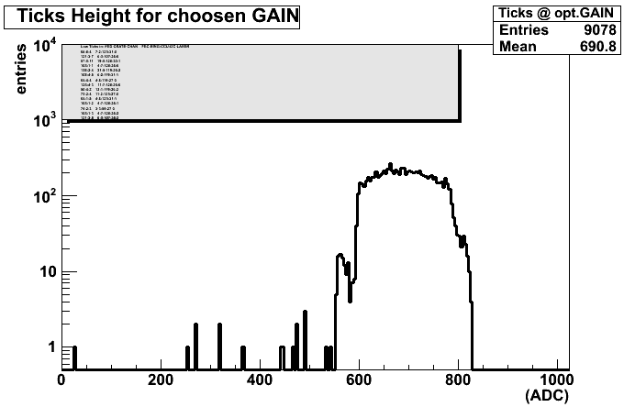
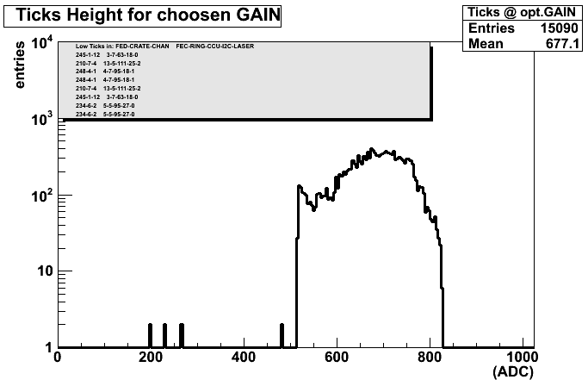
Measured tick height
(gain spectrum after gain setting optimization)
TOB 6/09
TECP 6/09
TIB/TID 6/09
TECM 6/09

Slide 17
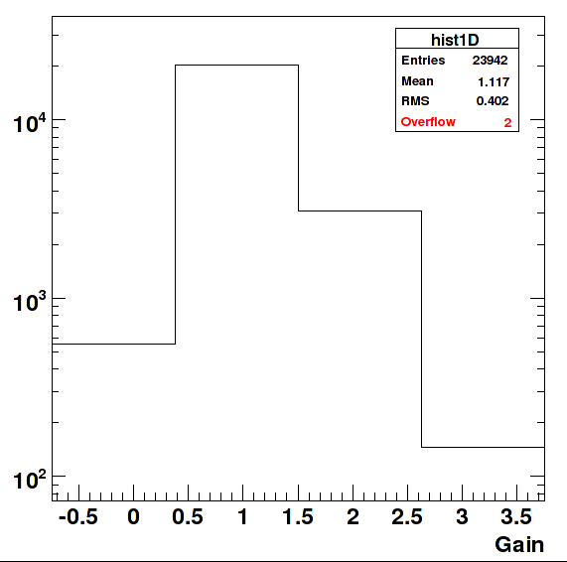
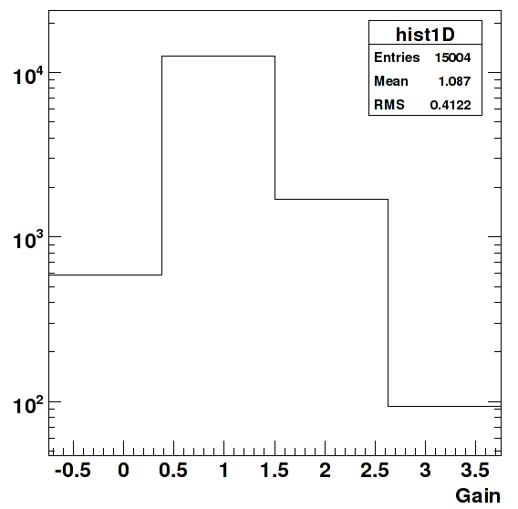
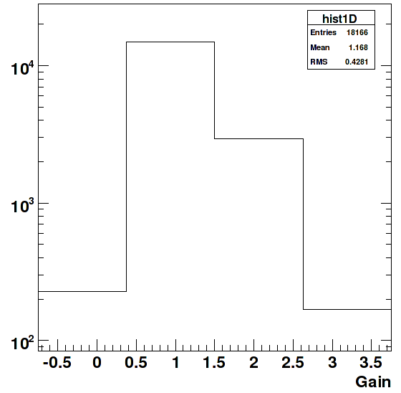
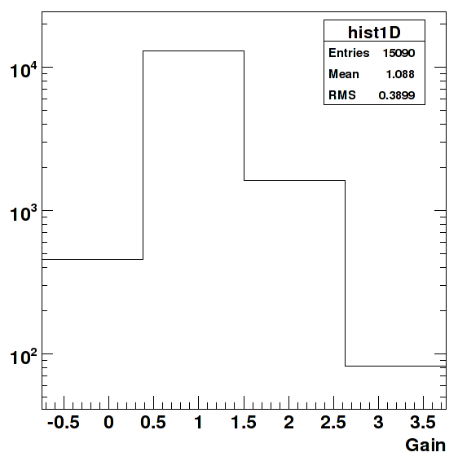
Link gain setting spectrum (+ missing channels)
TOB 6/09 11969/12066 fibres
TECP 6/09 7502/7552 fibres
History
8/08:12066
(20 missing fibres)
History
8/08: 7524
(4 missing fibres)
TIB/TID6/09 9083/9192 fibres
TECM 6/09 7545/7552 fibres
History
8/08: 9053
(17 missing fibres)
History
8/08: 7543
(9 missing fibres)
“missing fibres” means problems not attributed to electrical/other causes

Slide 18
Link gain setting spectrum (+ missing channels)
TOB 6/09 11969/12066 fibres
TECP 6/09 7502/7552 fibres
History
8/08:12066
(20 missing fibres)
History
8/08: 7524
(4 missing fibres)
Main fraction of bad channels are not due to failed optical links
e.g. control ring problem in TOB, electrical connection problems elsewhere
Effort ongoing to correctly record long-standing problems in a database
allowing identification and focus on new problems
TIB/TID6/09 9083/9192 fibres
TECM 6/09 7545/7552 fibres
History
8/08: 9053
(17 missing fibres)
History
8/08: 7543
(9 missing fibres)
“missing fibres” means problems not attributable to electrical/other causes

Slide 19
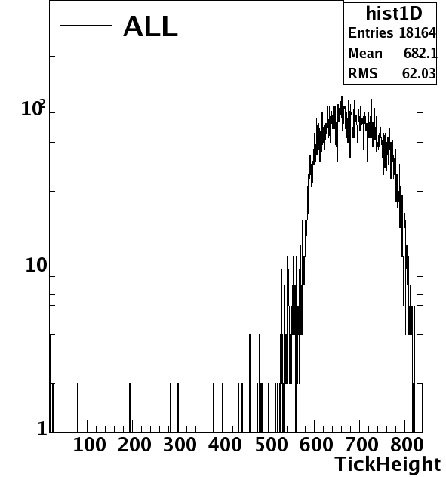
New TIB/TID 10/09
Recovery of 2 leaking cooling loops
  Run now uncooled
Now 9082 links back in measurement
earlier TIB/TID # fibres in plot
Out of 9192:
8/08: 9053
6/09: 9063
10/09: 8693

Slide 20
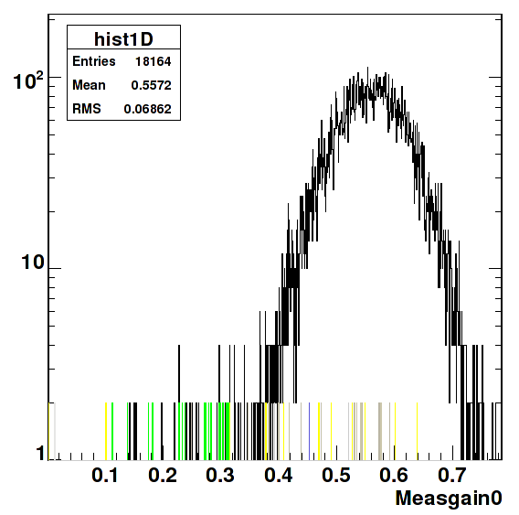
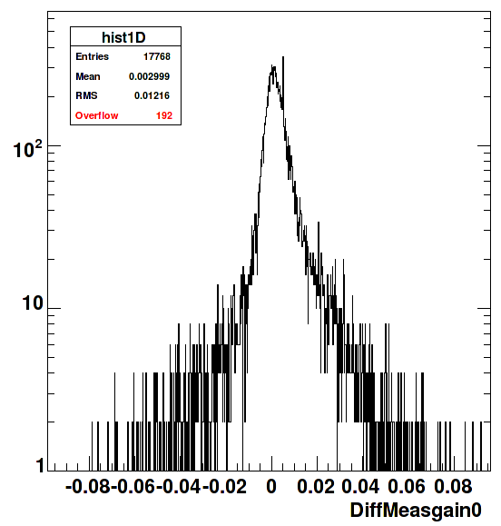
Going deeper – look at recent stability
TIB/TID Feb/10
TIB/TID difference Feb/10 and Oct/09
Over 5 months very little difference observed
Looking at gain measured for gain setting ‘0’

Slide 21
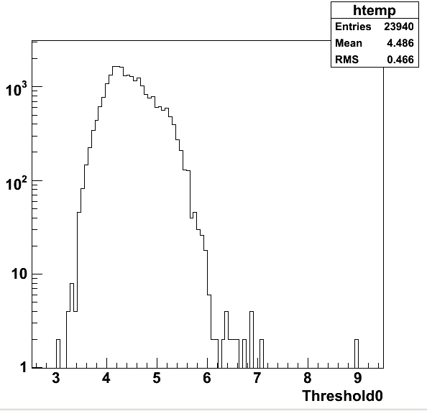
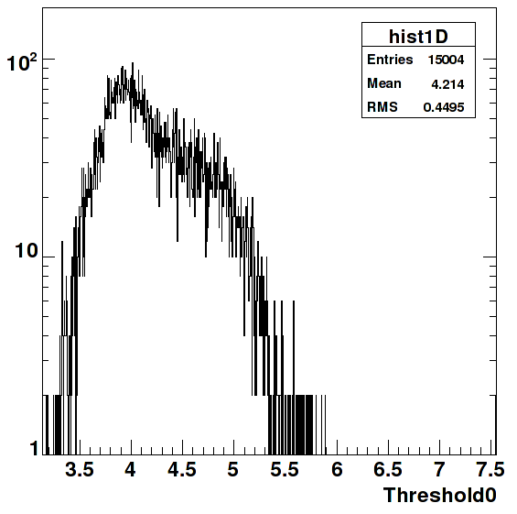
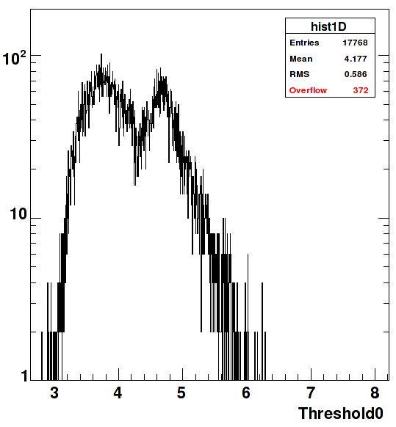
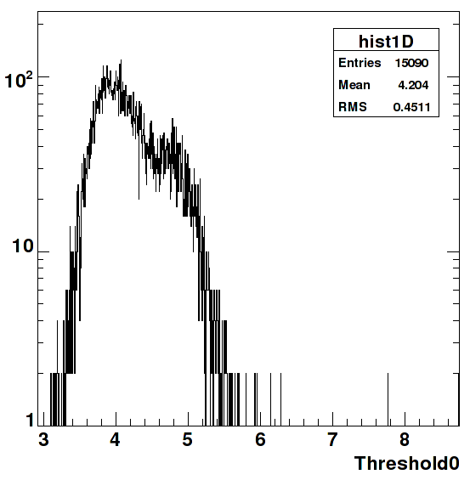
Another deeper point: Laser thresholds
TOB 6/09
TECP 6/09
Looking for any increases since like efficiency loss,
threshold increase is a main symptom of laser wearout
TIB/TID 10/09
TECM 6/09

Slide 22
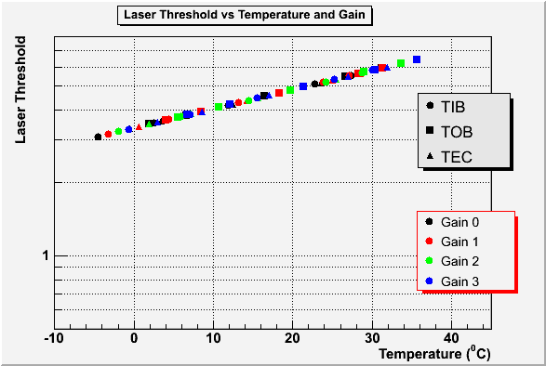
Temperature dependence
Complicated by temperature dependence
(laser is a good thermometer!)
And production lot which is largely responsible mainly for the double peak

Slide 23
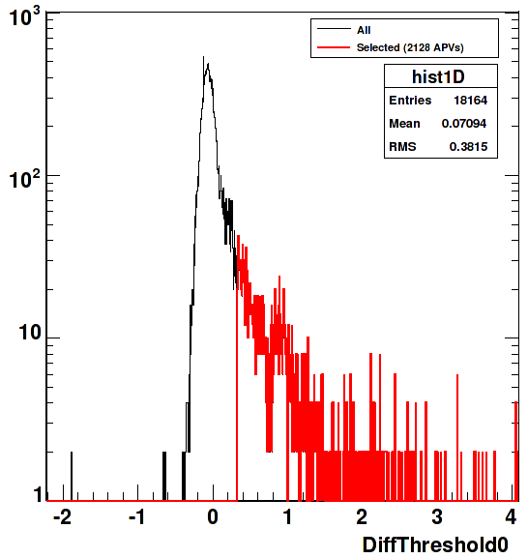
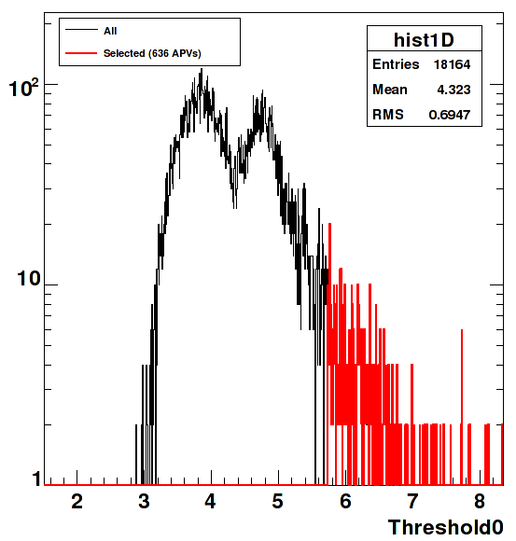
TIB threshold increases
Difference
2/10 – 6/09
Thresholds 2/10
Recall we are looking for
Differences, particularly increase in thresholds

Slide 24
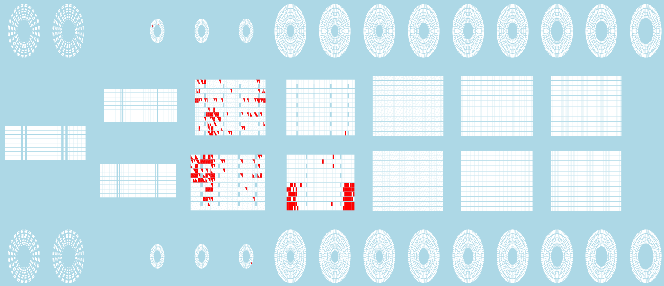
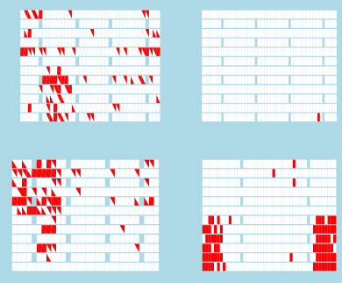
TIB outliers 2/10
TID+
TEC+
TIB
TOB
Difference
2/10 – 6/09
TEC-
TID-
Can dig into outliers with
‘TK commissioner’ tool

Slide 25

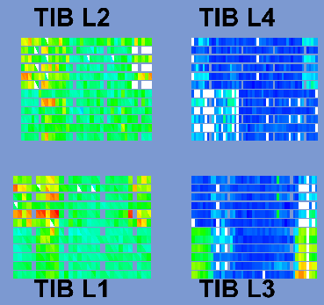
TIB outliers 2/10
TID+
TEC+
TIB
TOB
Difference
2/10 – 6/09
TEC-
TID-
hybrid (DCU)
temperatures

Slide 26
TIB outliers 2/10 – cooling related
TID+
TEC+
TIB
TOB
Difference
2/10 – 6/09
TEC-
TID-
hybrid (DCU)
temperatures

Slide 27
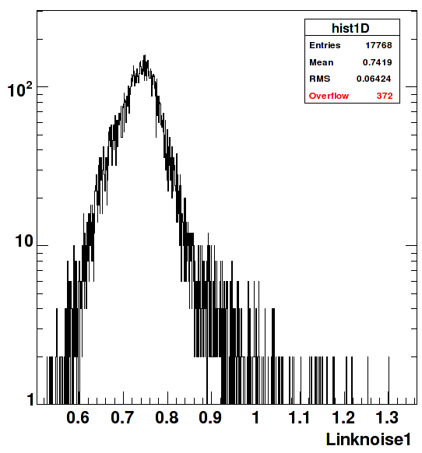
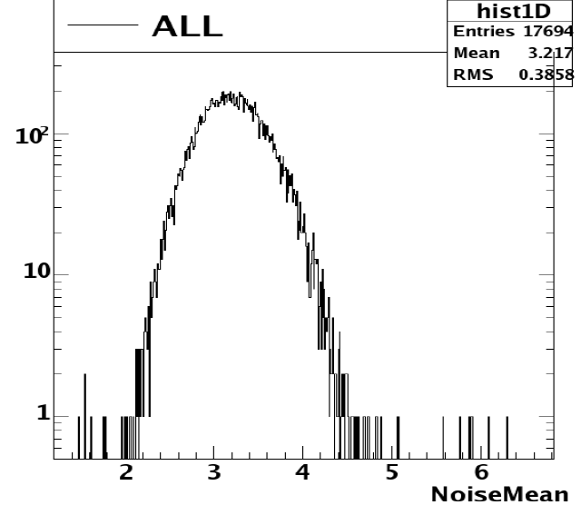
Link noise contribution
Preliminary point (TIB/TID again as example)
Link Noise
  (measured at readout chip pedestal level, not over full working range)
  ~20% of amplitude of front-end noise (ADC counts
  Compare with MIP most-probable signal size of 100ADC counts in 320um thick silicon
Links only
Full front-end noise measurement

Slide 28
Other points (for 2010)
Complete and include all partitions (TOB, TECs) and re-run 2008, 2009 analyses with new calibration code
Dig for any changes in threshold where dT small
Check link gain dependence on RX temperatures
Standardize analyses for link monitoring and establish periodic testing
Include spy channel measurements
Measure digital link margins
Usual question of resources/priorities

Slide 29
Summary
Readout optical link system still in great shape.
  Very few bad channels. System well optimised with respect to link margins/set points
    Most links have gain ‘1’ i.e. some range to compensate decreases/increases in light output
    Small noise contribution
No obvious degradation specific to the links in terms of light yield
  though we cannot easily isolate the changes of efficiency from temperature changes
Digital link system seems also in great shape.
  No recent issues with digital control links, though margin remains to be quantified
Monitoring can be improved with some more effort
  Regularize monitoring frequency and standardize procedure
  Try to move away from intense calibration/commissioning periods.
Very powerful monitoring tools and software available in CMS (TK Commissioner, TK-WBM, Spy channel and DQM)
Expect some difficulties will continue
  Access to system for intervention and retest/calibration
  Continuity not guaranteed in operation conditions
    Temperature should go down in future years
    Events leading to parts included/excluded

