Slide 1

Open Days 2019
DT activities

Slide 2
13 Sept family Day
14–15 Sept General public
Opening hours 8:30-19:00
Activities start-end 9:00-18:00
Visitor registration begins in June

Slide 3
Approximately 50 surface visit points and 6 LHC visit points

Slide 4
BEFORE END March we must complete the “Point Information Sheet”
BEFORE END March any budget requests must be made

Slide 5
BEFORE END May
We need to compile a list of volunteers.
Should we need extra help, this must be flagged with the organisation.

Slide 6
Feeding volunteers.
No food provided by the organisation however a 33 CHF subsidy for the volunteers.
( I have no idea how this works for half days !)

Slide 7
END MAY safety document OD2019-safety@cern.ch

Slide 8
POSTER(s) we need to make a draft of what we want.
I would suggest possibly a plan of the floor layout, that would be completed with the activities on show.
Open to suggestions

Slide 9
Closer to the event
Last tents will be installed on
Wednesday 11 September
THIS LEAVE ONE DAY TO INSTALL LIGHTS; COMPUTERS AND OUR EXHIBITION STANDS
A little too tight in my opinion.

Slide 10
BAT 154
Preparation for Open Days an opportunity for a clean start.

Slide 11
Activities / Suggestions
Scintillators / Fibres Sune/Thomas
NA62 Straw tracker Hans/Neil
GTK exploded Alessandro
Silicon Detector Isidre/Nicola
Microfabrication/cooling Alessandro
Carbon composites François/Francisco
Engineering Office François
3D Printed detectors Florian
X-ray station Florian
USB microscopes (to be allocated to stands)
Compass/magnet coils Nicola
Cooling Paolo (if we have space)

Slide 12
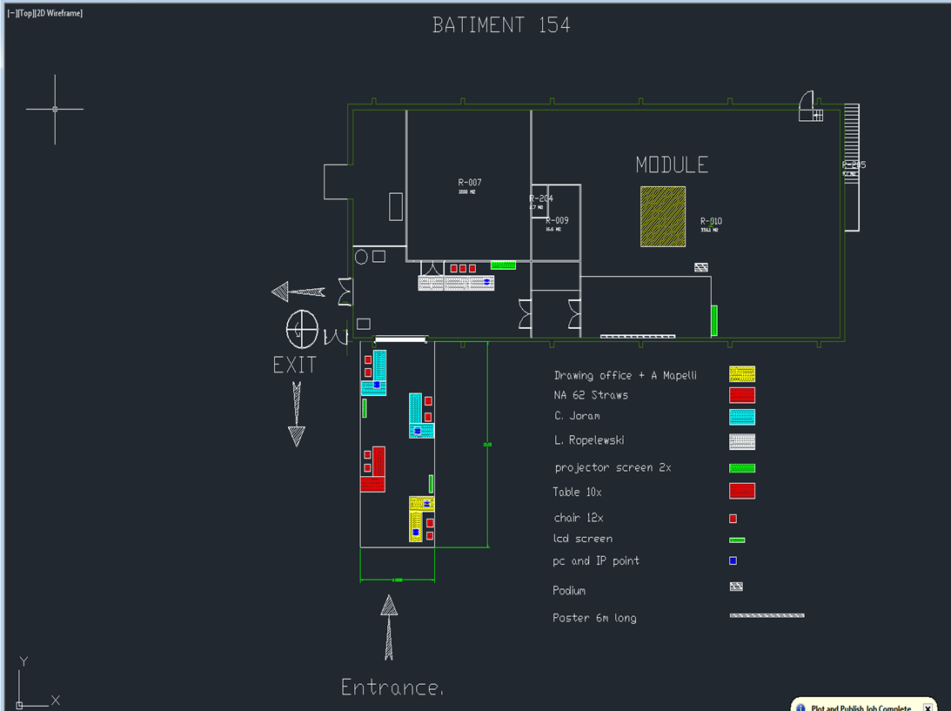

Slide 13
 |  |  |  |  | OPEN DAYS
 |  |  |  |  | PUBLIC DAYS 09:00 - 20:00 |  | PUBLIC DAYS 09:00 - 20:00
index | Name | First Name | CERN Id | GSM Number | 28 september 08:00 - 14:00 | 28 september 14:00 - 21:00 | 29 september 08:00 - 14:00 | 28 september 14:00 -21:00
A | Barinjaka | Rakotomiaramanana |  |  | 1 | 1
A | Casella | Chiara |  | N/A | 1 | 1 | 1 | 1
A | Dupertuis | Frederic Gullaume | epfl |  |  |  | 1 | 1
A | GIANI | Sebastiana |  | N/A | 1
A | HAEFELI | Guido | epfl |  |  |  | 1 | 1
A | HELLER | Matthieu | 103753 | 169019 | 1 | 1 | 1 | 1
A | Jakobsen | Sune |  | 168853 |  | 1 |  | 1
A | JORAM | Christian | 39507 | 160414 | 1 | 1 | 1 | 1
A | Medvedeva | Tatiana |  | N/A |  | 1 |  | 1
A | Rouvinet | Julien |  | N/A |  |  |  | 1
A | SCHNEIDER | Thomas Hans | 48183 | 164532 | 1 | 1
TOTAL |  |  |  |  | 5 | 6 | 5 | 8
 | Bianco | Michele |  |  | 1 |  |  | 1
B | GUIDA | Roberto | 50387 | 162146 | 1 | 1 | 1 | 1
 | Iengo | Paolo |  |  |  | 1
 | KUGER | Fabian |  |  |  | 1
B | MANDELLI | Beatrice | 117447 | 161831 | 1 | 1 | 1 | 1
B | MERLIN | Jeremie Alexandre |  | 166322 | 1
B | OLIVERI | Eraldo | 99820 | 166126 | 1 | 1 | 1 | 1
B | ROPELEWSKI | Leszek | 26720 | 163289 | 1 |  | 1
B | THUINER | Patrik | 126769 | 165918 | 1 | 1 | 1 | 1
TOTAL |  |  |  |  | 6 | 6 | 5 | 4
C | BERRUTI | Gaia Maria | 117567 | 161456 | 1
C | MAODDI | Pietro | 121125 | N/A |  |  |  | 1
C | MAPELLI | Alessandro | 52614 | 169605 |  | 1 | 1 | 1
C | Noy | Matthew |  | N/A |  |  |  | 1
C | ROMAGNOLI | Giulia | 120834 | N/A | 1
C | WEDLAKE | Veronique |  | N/A | 1 | 1
TOTAL |  |  |  |  | 3 | 2 | 1 | 3
D | BAULT | Christophe | 58177 | 162536 | 0 | 0 | 1
D | CATINACCIO | Andrea | 39335 | 163625 | 1
D | DEGRANGE | Jordan | 124019 | N/A | 0 | 1
D | LENOIR | Philippe | 45975 | N/A |  |  |  | 1
D | NUIRY | Francois-Xavier | 116344 | 169640 | 1
D | ZWALINSKI | Lukasz Krzysztof | 97940 | 162008 |  |  |  | 1
TOTAL |  |  |  |  | 2 | 2 | 2 | 2
E | BLANC | Pascal Herve | 88038 | 165330 | 1
E | BRUNEL | Bernard | 22923 | 163283 |  |  | 1 | 1
E | BENDOTTI | Jerome |  | 160748 |  |  | 1 | 1
E | CAPEANS GARRIDO | Maria Del Mar | 36682 | 164590 | 1 |  | 1
E | DANIELSSON | Hans Olof | 31924 | 163654 |  | 1 |  | 1
E | DIXON | Neil David | 36025 | 163451 | 1 | 1 | 1 | 1
E | HAHN | Ferdinand | 29072 | 163838 |  | 1
E | KRISTIC | Robert | 50113 | 160905 | 1
E | MOLL | Michael | 53176 | 164756 | 1
E | MORANT | Johan |  | 164878 | 1
E | PALLADINO | Vito |  | 161450 | 1 | 1
E | PEREZ GOMEZ | Francisco | 39044 | 163716 | 1 | 1 | 1 | 1
E | PONS | Xavier | 58703 | 164723 |  |  | 1 | 1
E | RAVAT | Sylvain | 53832 | 163402 |  |  | 1 | 1
E | VERGAIN | Maurice Marcel | 30185 | 165555 | 1 | 1
TOTAL |  |  |  |  | 8 | 5 | 6 | 6
GRAND TOTAL |  |  |  |  | 24 | 21 | 19 | 23

Slide 14
No. | Short Name | Site | Coordinator | Deputy | TSO | People/hour | Int. volunteers | Ext. volunteers | Cabled Network | TETRAS 2 way radio | Video Proj. | PCs | Laptops | Audio | Proj. Screen | LCD Screen
 | Responsible |  |  |  |  |  | Virginie | Virginie | Gyorgy Balazs | Gyorgy Balazs | Thomas Baron | Mick Draper | Mick Draper | Thomas Baron | Thomas Baron | Thomas Baron
10 | DETECTOR TECHNOLOGIES | 154 | Neil Dixon | Hans Danielsson | Neil Dixon | 100 | 10 | 3 | 1 | 2 | 2 | 5 | 0 | 0 | 2 | 2 (46")
 | Tents |  |  | Decking | Cold Lights/tents | Fire extinguishers/tents | Floor covering | Barriers |  |  | Closed barriers | Elect. Instal. | Elect. Exts. | Multi-plugs | Panels for posters | No. Posters
 | Number of Tents | Size of Tents (m) | M2 |  |  |  |  | Vauban | Heras | Airport type
 | Mick Draper | Mick Draper | Mick Draper | Gilles Collin | Maureen | Marie &Juliette | Dominique Bertola | Alan Favre | Alan Favre | Alan Favre | Dominique Bertola | Maureen | Marie &Juliette | Marie&Juliette | Marie&Juliette | Martine
 | 7 x 13 x 3.5 m (min 10x5m) |  |  | 1 | 1 | 1 | 20 x 4 m | 6 | 0 | equivalent of 20 metres | 15 | min. 24 outlets | 12 | 12 | 16 | 5 per language, but several prints of each
 | Podiums | Umbrella box | Chairs | Tables | Benches | Bins | Existing toilets | Extra toilets | Access Invalids | EXIT signs | Emergency exit sign | Age limit | Posts with chain | Plastic chain | Safety ribbon rolls | Painting
 |  |  |  | dim
 | GS | I. Pascu |  | Kathy&Ale | Kathy&Ale |  | Maureen | Maureen | Maureen | Richard Morton | Alain Bertrand | Hermann
 | 1 | 4 | 12 | 10 | 10 | 4 | NO | NO | YES | 1 | 0 | 0 | 1 | 0 | 2 | NO
 | Extra cleaning | Other specific needs | Other comments | OVERSHOES
 |  |  | URGENT
 | YES before and after the event | 15 special anti-dust barriers | Special poster 12x1.5 m + 2 x 1.5x1.5m on canvas with photo? | Several boxes of overshoes 1000 pieces

