Slide 1

^{Dominique Bertola 04-03-2019} 1

Slide 2
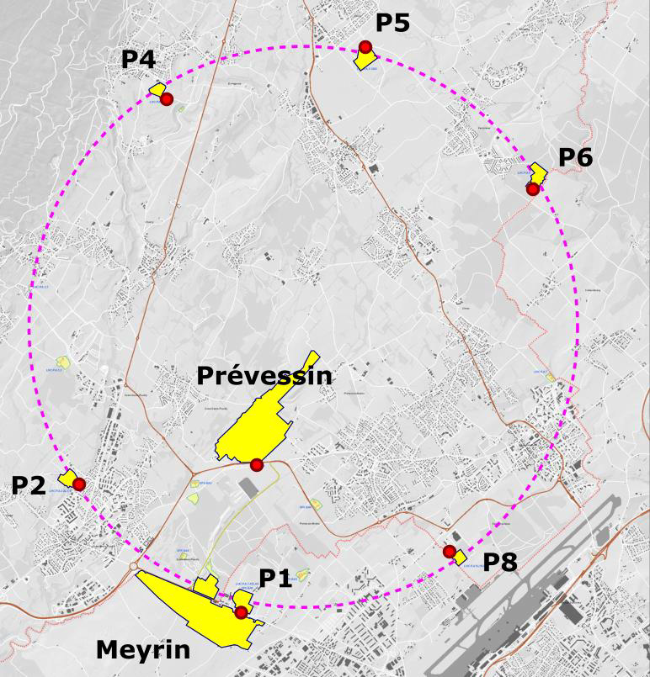
Locations
•9 sites
•7 check-in’s
Work package 3 ¹⁴

Slide 3
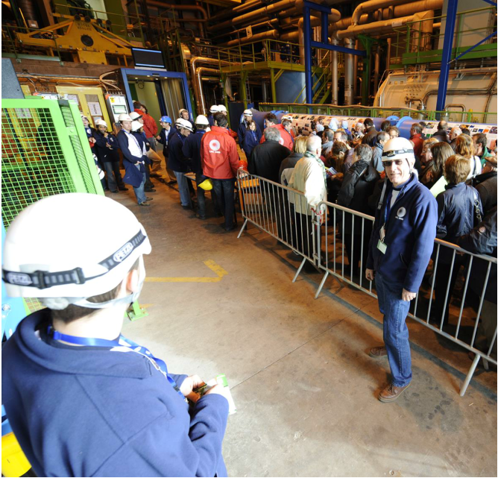
Key messages for our visitors
The Open Days are a unique opportunity to visit
CERN’slesser knownfacilities: workshops, control
rooms, labs.
Don’t miss it!
Entry is free and for all ages (12-year-old age limit for
underground visits).
All are welcome!
Encourage the use of public transport and means of
transport other than cars.
Travel green!
Pre-register to guarantee your access to our sites.
Plan your visit!
More than 3 000 physicists, engineers and staff will share
how and why we work.
Meet the people behind the science and the
technology!
04/03/2019 ²

Slide 4
Surface visits –Meyrinsite
Assistant: Maureen Prola-TessaurIR-ECO
AD-ELENA decelerators (bdg193) Vacuum (technique & science focussed, bdg113)
Data Centre (bdg513) Manutention, heavy equipment (bdg 130)
Robotics workshop for kids (bdg504) International Village (Restaurant 1, lawn)
Cryolab(bdg165) _{Superconductivity (bdg163)}
CLIC (bdg 2008-2010) _{Careers @CERN (bdg500)}
CLIC Detector (bdg162) _{LINAC 2 (bdg 363)}
MEDICIS (bdg179) _{Drôlede physique (1}^{st}_{Floor GLOBE + LHC 2,4,5,6,8)}
Central workshops (bdg72-100) _{MEDIPIX (bdg 14)}
3D Machining (bdg156) Electronic design, printed circuits, SMD (bdg107)
LEIR (bdg150) Interactive demonstrations, magnets powering (bdg355-251-250)
LINAC4 (bdg400) Field measurement and NC magnets (bdg311)
SC (bdg300) PSB acceleration system, new RF booster, (bdg364)
SM18 (Cold testing, bdg2173) CERN technical apprentice centre(bdg304)
Vacuum setup around 15 exhibitions (SMA18) Electricity EN-EL, Power distribution (bdg6060)
Detector technologies (bdg154) _{Photo booth (bdgs TBD)}
Applications that change our life (KT, building TBD) CERN & Society (bdg TBD)
CMS crystals (bdg27) GLOBE exhibition (bdg 80)
ISOLDE controlroom(bdg508) Microcosm exhibition (bdg143)
ATLAS Muonchambers(bdg191)
SESAME (bdgTBD)
CERN clubs, Fitness, SolarRenewableenergy, Frisbee
Infographics, computergames(bdg500)
Dominique Bertola 04-03-2019 ₄

Slide 5
Surface visits –Prévessinsite
Assistant: Maureen Prola-TessaurIR-ECO
AMS (bdg⁹⁴⁶⁾
Beam Instrumentation (parking near resto 3, bdg886)
COMPASS (bdg888)
Safety training centre(bdg969)
Superconducting magnets, Past Present, Future (bdg927)
Métrologiedes grandesdimensions (bdg927) + LHC P6
AWAKE (bdgTBD)
Neutrino platform (bdg887)
Robotics & tele-operations (bdg 927)
CERN Control Centre (bdg 874)
RF amplifiers-couplers (bdg770)
Polymer lab (bdg771)
Interactive demonstrations, electricity (bdg 866)
Future CERN Collider (bdgTBD)
NA62 (underground bdg911)
Dominique Bertola 04-03-2019 ₅

Slide 6
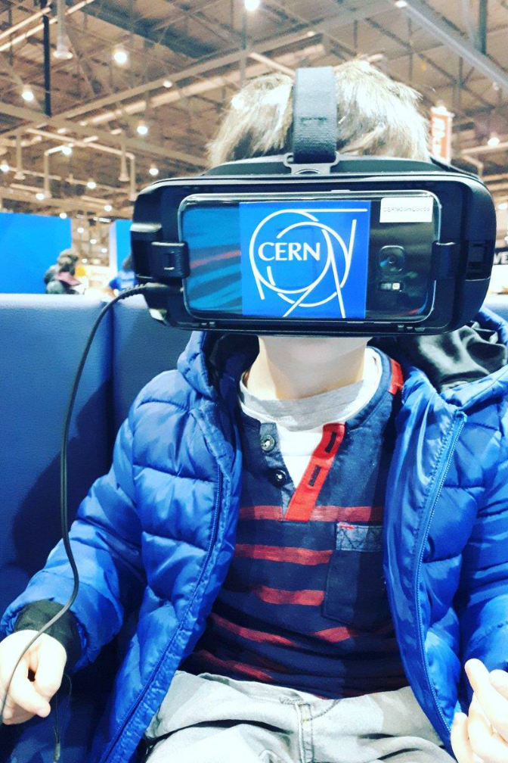
Thematic zones and Events
Alejandra Lorenzo Gomez (IR-ECO-VI)
Claudia Marcelloni(IR-ECO-EN)
•VR headsets
•Proton football, Proton for health
•Photo Booth
•Cloud chamber, Particle Identity, Science show Meyrin-
Prevessin, LHC points (antimatter…)
• “Drôlede physique”
•Fire Brigade
Dominique Bertola 04-03-2019 ₇

Slide 7
Whocanvolunteer?
✓MPEs
✓MPAs
✓Official CERN guides
✓ENTCs(on a personalbasis, not relatedto contract, volunteeragreement to besigned)
Why ? -ClearlinkwithCERN (code of conduct, etc.)
-Access to documents and IT systems(CERN account)
-Insurancecoverage
-Training
-Access to CERN sites
-Paymentof indemnityvia the guides’ system
_{Work package 3} 3

Slide 8
At whichconditions do I volunteer?
•Tools
-Ad hoc databasefor registration and assignments
-Sharepointto shareinformation/documents
-Widget OD2019 on LMS for training sessions
-Access withCERN account
•Training
-Online training
-Specific sessions and training for specific activities (Activity demonstrator, 1st Aid,
General info, Flow control, etc)
-General information sessions (+ webcast) in September
•Reward
-Volunteer kit: tee-shirt, hat, raincoat, bag
-Indemnity (proposal TBC) CHF 33/day paid
(volunteers are expected to make their own arrangements for food & drinks)
-Volunteerswillnot receiveanyothercompensation or additionalleaveor time in lieu
of theirwork
_{Work package 3} 5

Slide 9






CERN shop
•Only 1 sale point on Meyrinsite
•Should be considered as a service to visitors
more than a source of income
•Location to be defined
•Standard articles (No special items for Open
Days)
•Brand new items by Summer 2019 : T-shirts,
umbrellas, key rings, badges, caps, puzzles,
magnets, …
_{Work package 3} 8

Slide 10
Calendar
March April May June July August September
Applications (for ALL volunteers)
Applications (for newcomers)
Open Days
Training
Assignments
Communication via
CERN Community,
Final nameslists
frompoint managers
Final requirements
frompoint managers
Briefing
sessions
Workplaceetc.
_{Work package 3} 6

Slide 11
Calendar
March April May June July August September
Registration
Development
Tests
Registrations
Check-In
Open Days
Development
Tests
Final approvalof the
registration procedure
Communication of
final procedureand
date to visitors
Openingof
registrations
Training of
volunteers
and announcementto visitors
_{Work package 3} 12

Slide 12
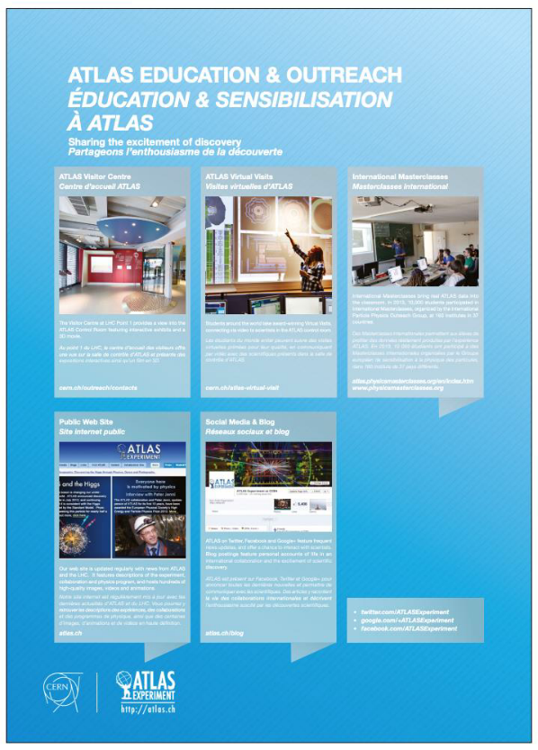
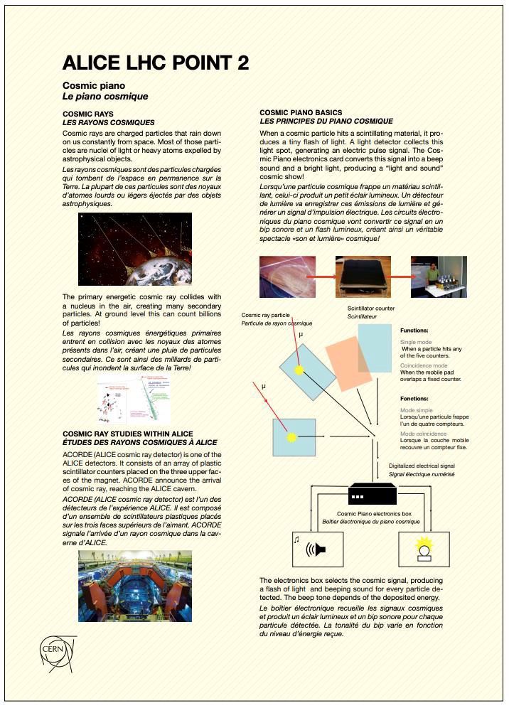
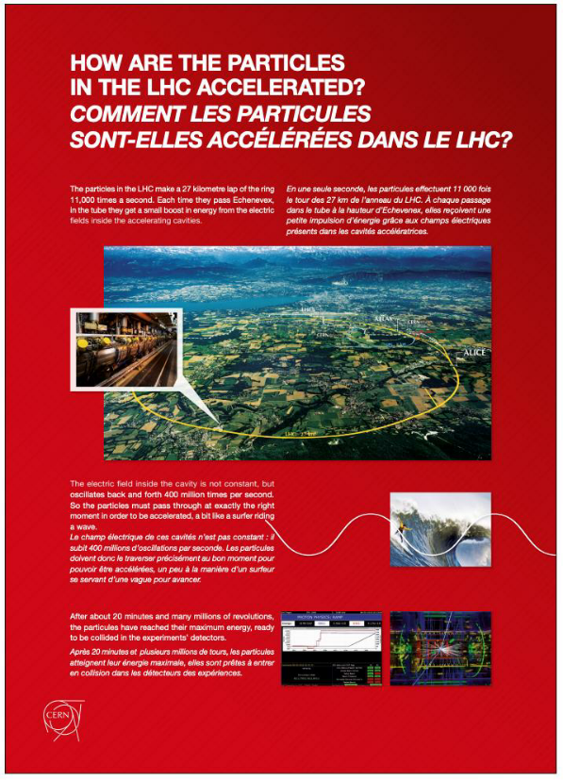
Poster principles
Freedom of style | Re-use from OD2013 | Update as needed
Dominique Bertola 04-03-2019 ₆

Slide 13

Pre
Registration
Check-In Enter Site On site
Exit site
•E-Mail address
•Nr visitors
•Minimum age
•Maximum age
•Point of arrival
•Time of arrival
•Origin
•Transport
•Scan barcode
•Confirm
•Distributewithe
wristbands
•Bag visual
inspection
•Wristband
•Surface visit
•Wristband
scanning
Nr visitors
Underground
SA visit
scanning
Underground
SA visit
•Queue
•Guide scan
•Scan wristband
•Enter visit
•Exit visit
•Guide scan
•Dose register
•Confirm
Nr visitors
Underground
SA visit
•Scan barcode
•Confirm
•For eachvisitor
•Scan ID
Nr visitors
•Associate
wristband
•Distribute
•Nr of visitors
red
wristbands
•Queue
•Scan 1 ID
•Confirm
Guaranteed
Nr visitors ^{•Distributewithe}
wristbands
Dependson availability
15

Slide 14
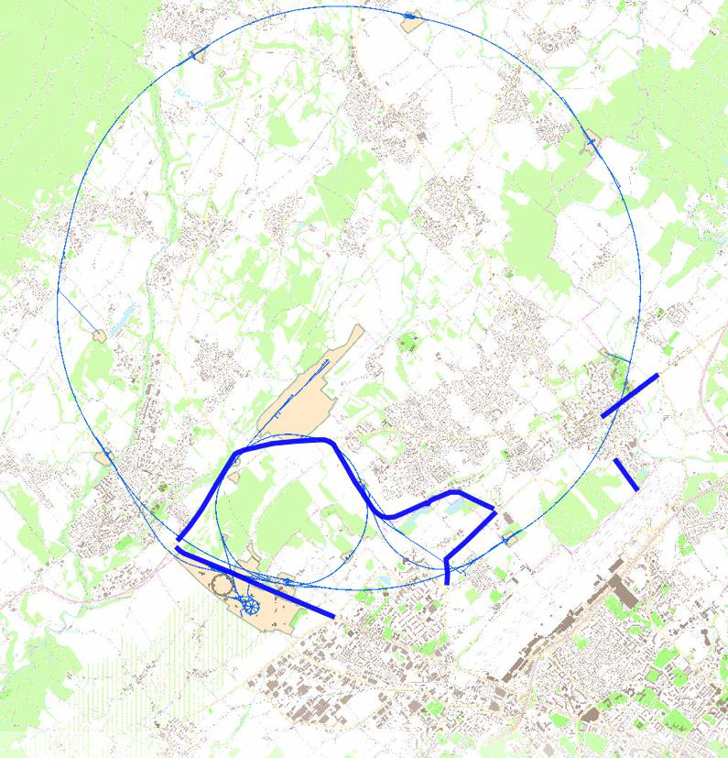


Le traffic routier
40K
8K
35K
25K
35K
17K
1K
20K
SMB-DI -JPO 2019 -04-03-2019 3

Slide 15
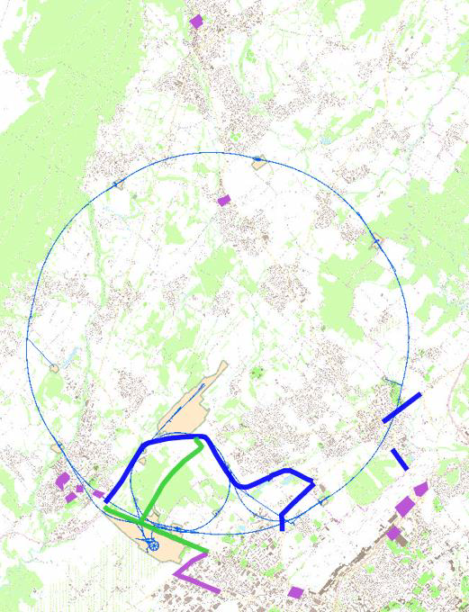

Les parkings à notre disposition
500
200
700
4000
2000
300
SMB-DI -JPO 2019 -04-03-2019 4

Slide 16
Comment cela fonctionne ?
•Salle d’opération et de contrôle pour tout ce qui est relié à
la sûreté (opération et crise),
•1erniveau : Equipe statique sur chacun des points pour les
aspects contrôle d’accès et sûreté,
•2èmeniveau : réserve mobile de Meyrin ou Prévessin
•3èmeniveau : accord de Paris (CH en FR ou FR en CH)
SMB-DI -JPO 2019 -04-03-2019 8

Slide 17
Les mesures préconisées
•Demander à tous les visiteurs de se munir d’une CNI
•Pré –enregistrement pour anticiper les pics
•Contrôle visuel des sacs (bombes de peintures, pinces,
banderoles, armes….)
•Comptage des personnes sur les sites
•Mise en place d’un exercice de crise (02/05/19)
SMB-DI -JPO 2019 -04-03-2019 ¹⁰

Slide 18
Safety aspects
•Safety general approach
•Safety documentation
•Radioprotection
•Volunteer training
•Tents and safety add-on
•Special plans
•During the event
04/03/2019 Safety aspects ²

Slide 19












Safety general approach
Site Manager •Propose site and pathway, concept of visit
From January to end of March
Preliminary site
visit by OD team
•Assess situation in general, feasibility, safety issues or
special requirements
Exchanges between the
OD team the site
manager
From February to end of May
•First draft of documentation, clarification, estimation of needs
(balance with existing),
From end of May
Sharing of the Safety
proposal (document)
•Between Site manager, TSO, DOS,
LEXGLIMOS, HSE correspondent, …
From September
Implementation /
control
•By the Site manger, with the support of
the OD2019 team.
•Inspection by HSE if needed
04/03/2019 Safety aspects ³

Slide 20
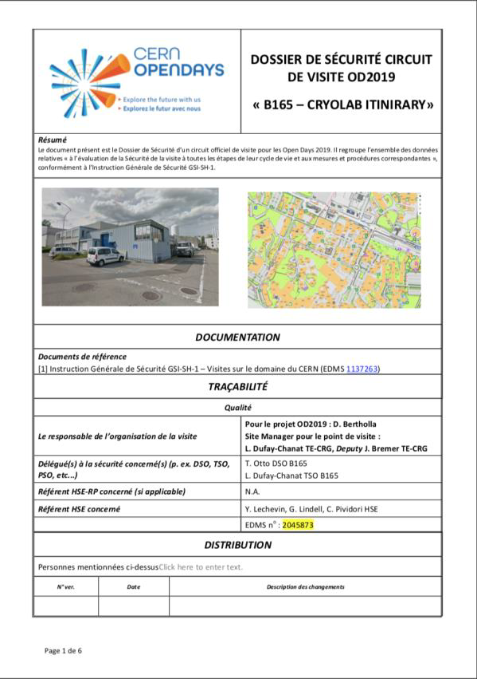
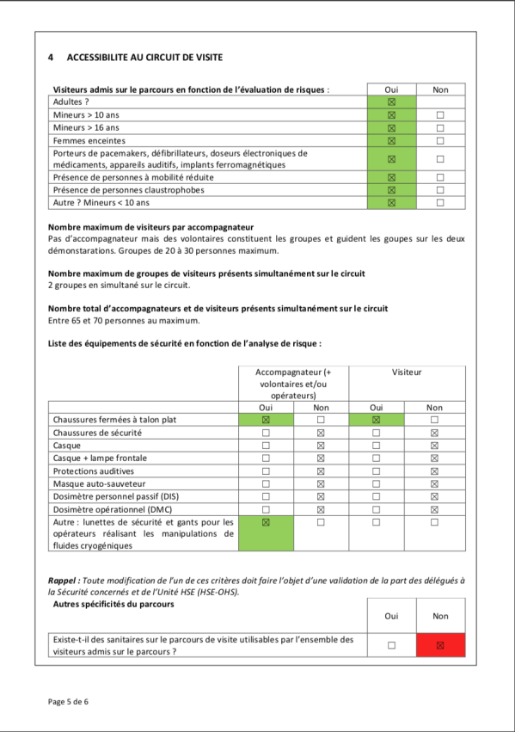
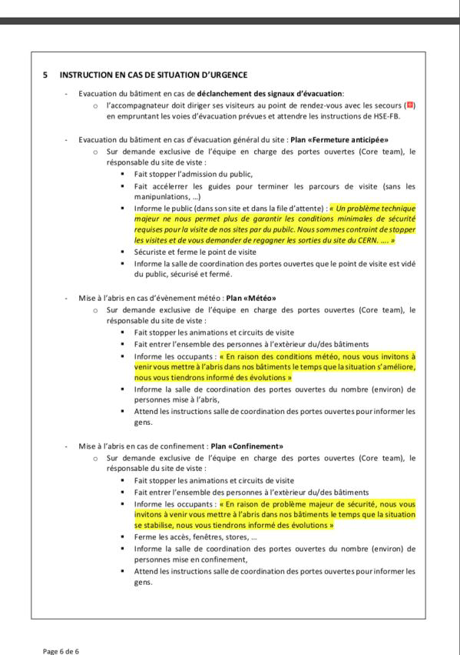
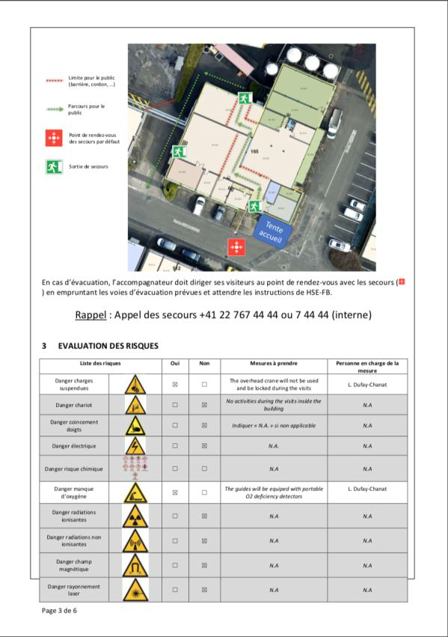
Safety documentation
04/03/2019 Safety aspects ⁴

Slide 21
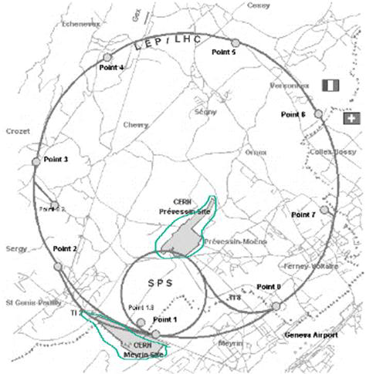
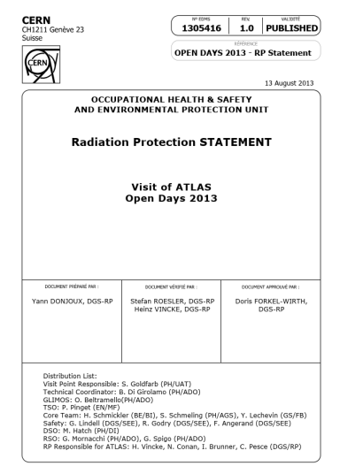
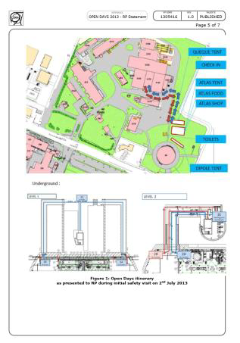
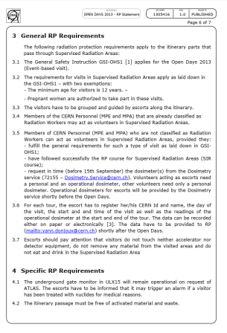
Radioprotection
•More than 60 visit points
•Surface + Underground
•Around 14 Supervised Areas
•RP Visits
•RP Checks
•RP Validation
•RP Statements
•Last Checks the week
beforetheevent
04/03/2019 Safety aspects ⁵
04/03/2019 ⁵

Slide 22
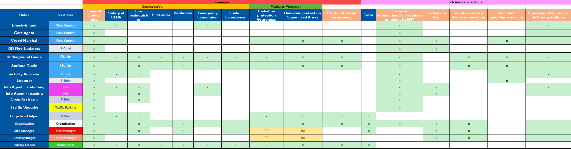


Volunteer training ^{--Different Themes}
Different speakers
→Awareness adapted to
the role
-Logistics : Safety Training
-Tracked on LMS
04/03/2019 ⁷

Slide 23
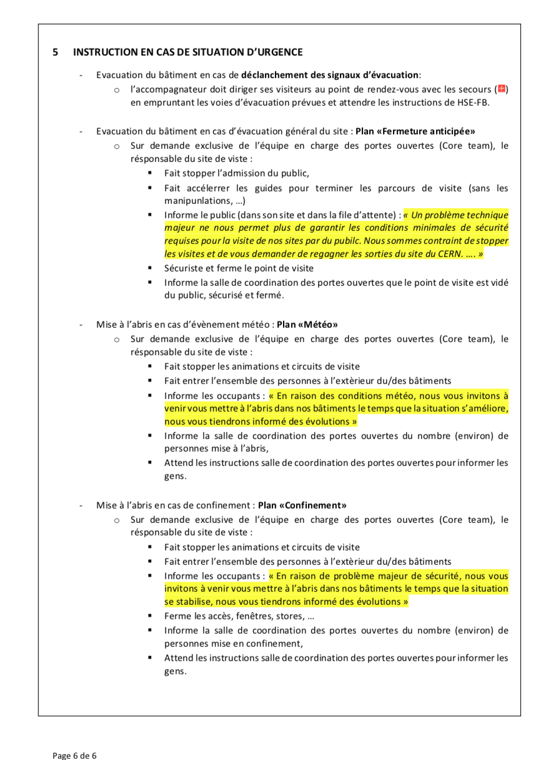
Special plans
•Soft site closure: in case of need to close the site earlier
than expected
•Meteorological event: in case of storm, hail, strong wind, …
•Containment: In case of adverse event involving to protect
people and put them safe
•Who launch the plan,
•How it is launch,
•What Site managers should do (and say)
•What will be connected action
•How we stop it
04/03/2019 Safety aspects ⁹

Slide 24






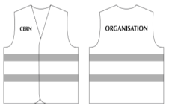






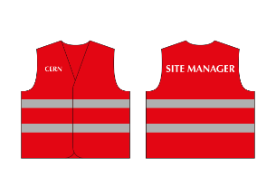


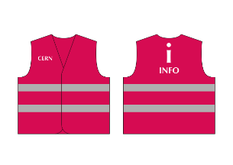



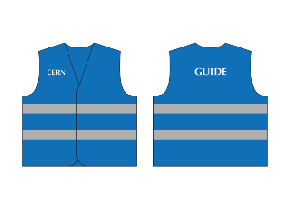

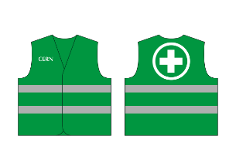

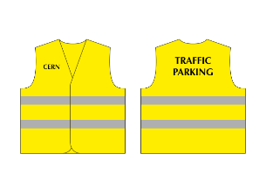
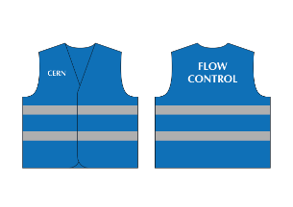
During the event
Building 160
04/03/2019 Safety aspects ¹⁰

Slide 25
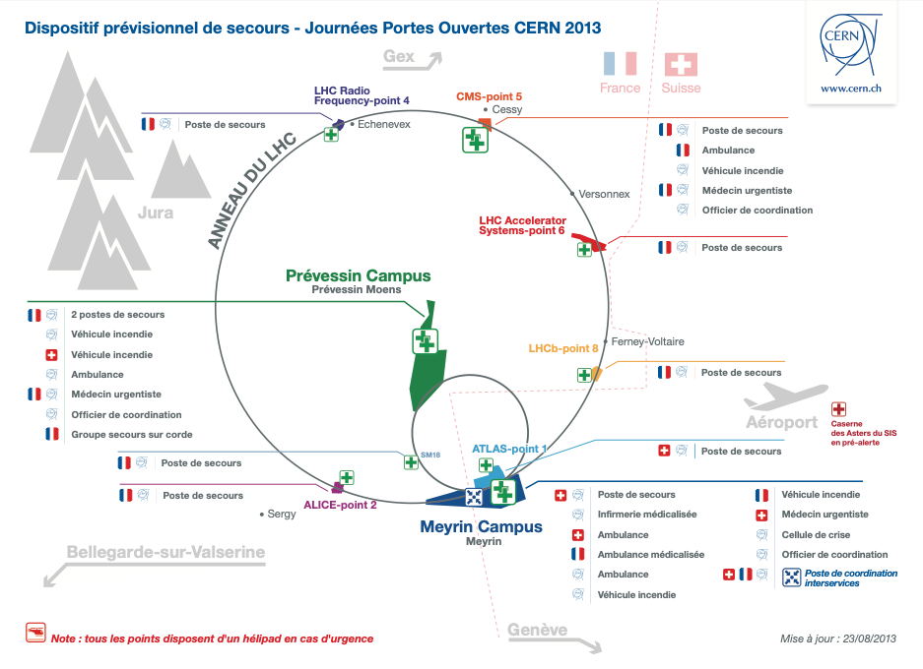

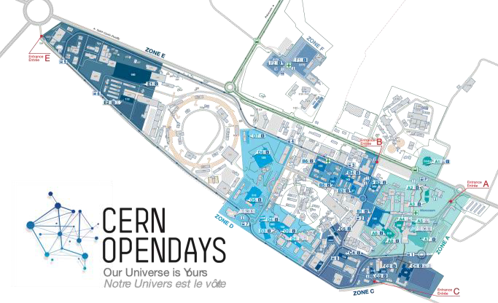
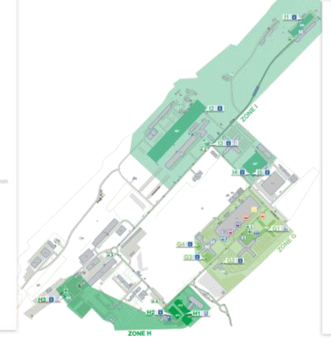

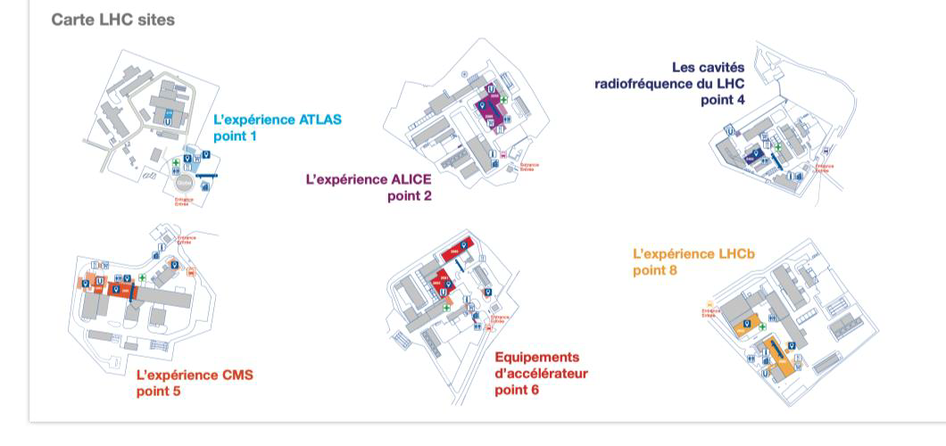




Under design by the Fire Brigade and
the working group from Host-states
04/03/2019 Safety aspects ¹¹

Slide 26
Organisation and Governance
CERN Directorate
Ana Godinho (Project Leader)
(Host-State Relations, Communication, Budget,
Evaluation, Sponsorship)
Didier Constant
Yann Lechevin
(Safety)
Dominique Bertola
François Briard
Marika Flygar
(Documentation, Purchasing)
(Security, Mobility, Logistics)
(Visit Points, Events, Activities)
(Visitor registration and
access, Volunteers, Shop)
https://espace.cern.ch/OD2019/_layouts/15/start.aspx#/SitePages/Home.aspx
04/03/2019 ³

Slide 27
Timeline
Mar 2019 –Sept 2019
Price
enquiries
, Call for
Tenders
and
Contract
s (Mar -
May
2019)
Mobility
plan
agreed
w/ HS
Call for
volunteer
s (Apr.
2019)
Safety files
and RP
Press
briefing
(Jul.
2019)
authoritie
s (Mar.
2019)
"CERNois"
afternoon
Statements
(Jun. 2019)
(13/09/2019)
2nd Meeting
with HS
Logistics
and
Local
communicatio
n: TPG,
outdoors, HS
channels
3rd
Progress
Report
meeting
(Jun.
2019)
Volunteer
training and
Open
Days
authorities
(09.04.2019)
Distribution
plan
assignment of
responsibilities
(Jun -Aug
2019)
(Apr/May
2019)
(May –Sept
2019)
04/03/2019 ⁶

