Slide 1
Overall strategy for the rf structure development program
W. Wuensch
CLIC ACE
2-2-2010

Slide 2
Organization of the rf structure presentations
PETS and accelerating structures will be presented together.
Snapshots of the PETS and accelerating structures and recent results to introduce the work and refresh everyone's memory.
Critical issues for structures and how we address them.
Three subjects in greater detail:
  Wakefield damping – me
  Production – Germana
  High-power rf testing - Steffen

Slide 3
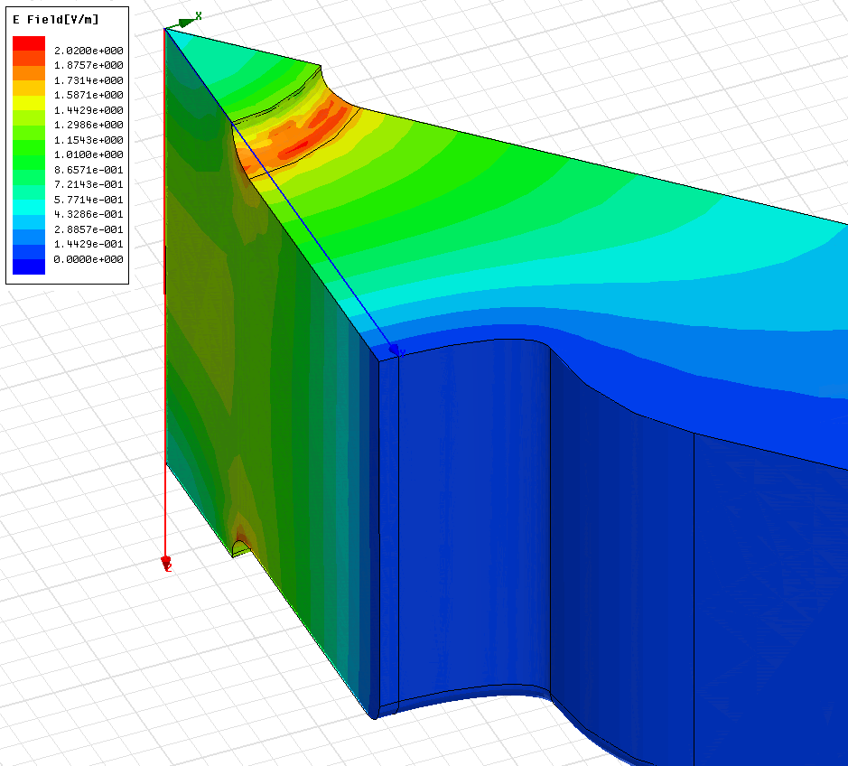
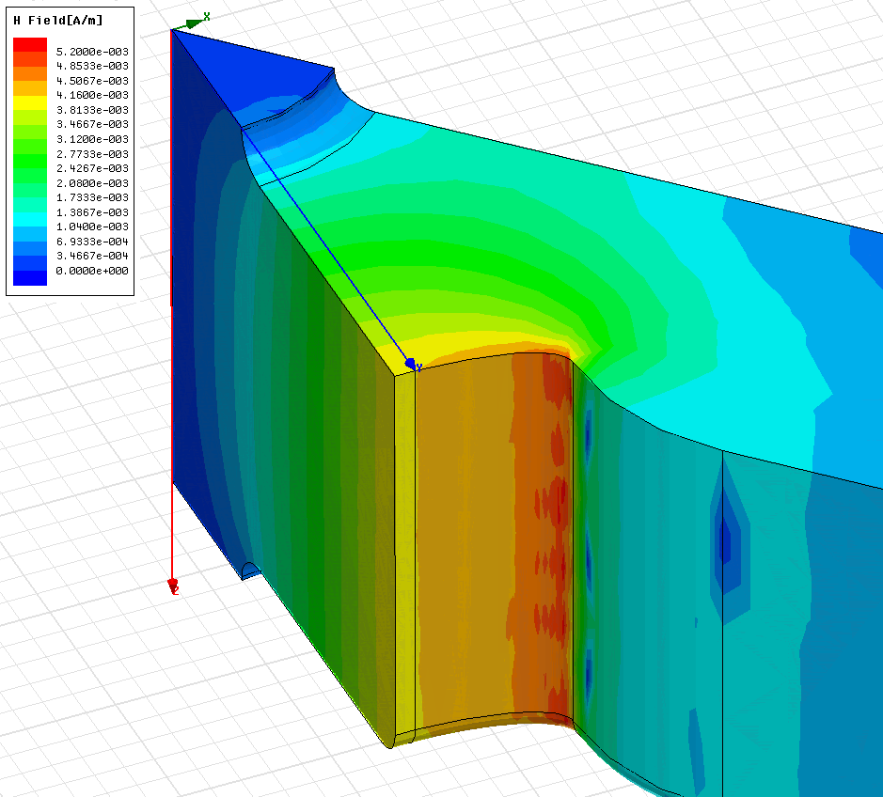
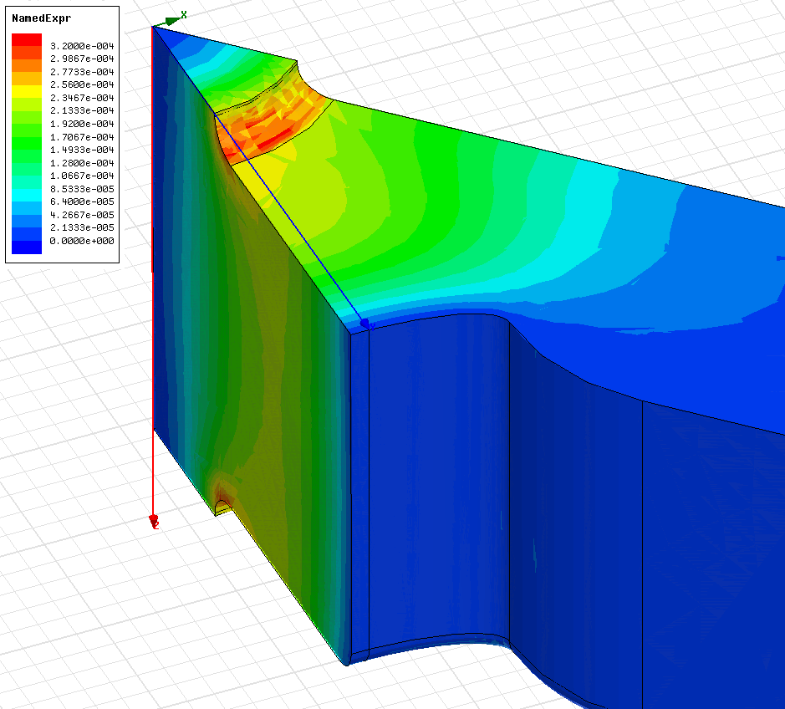
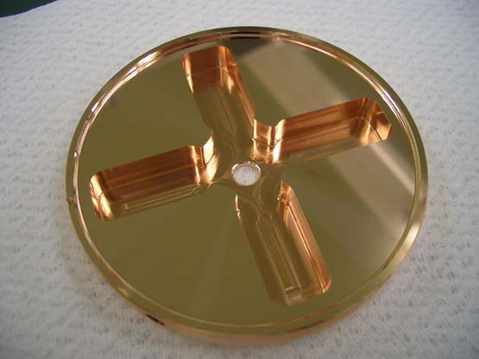
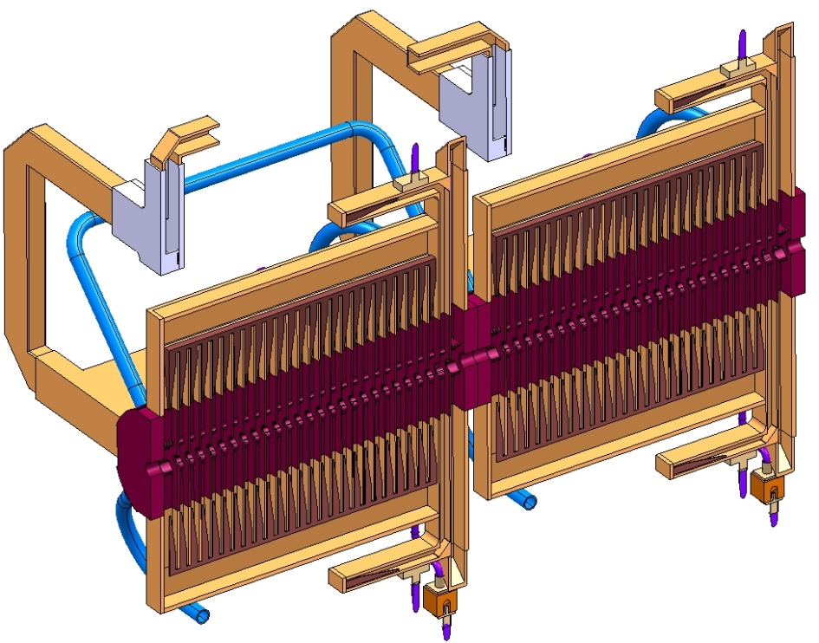
The CLIC accelerating structure
E_{s}/E_{a}
H_{s}/E_{a}
S_{c}/E_{a}²

Slide 4
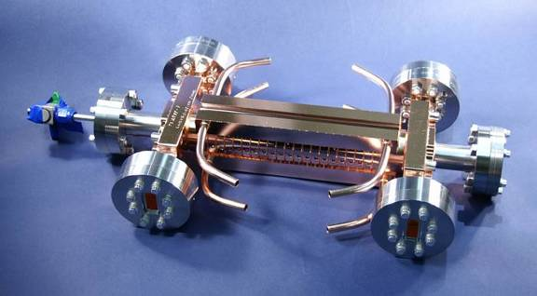
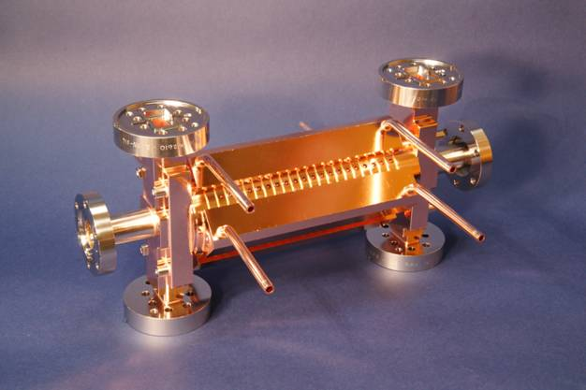
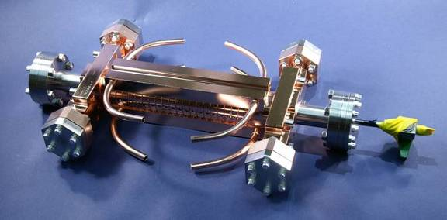
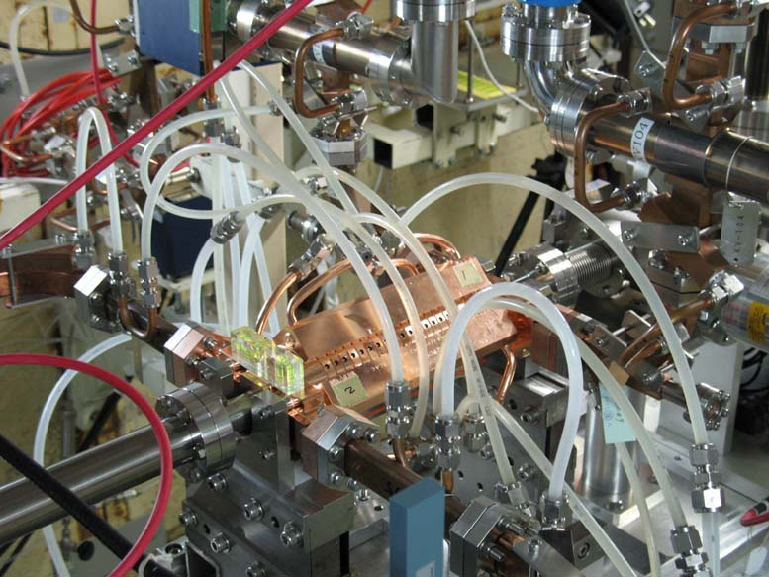
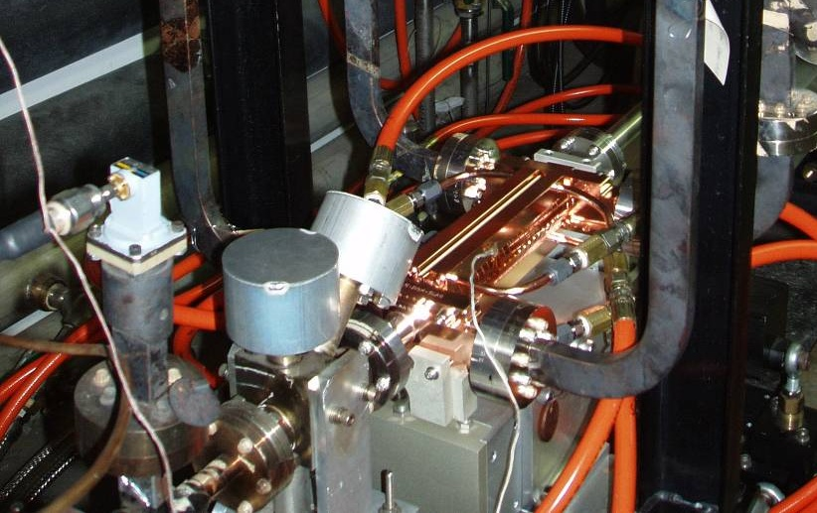
CERN/KEK/SLAC high-power test structures
T18 - undamped
TD18 - damped
Done
Under test

Slide 5
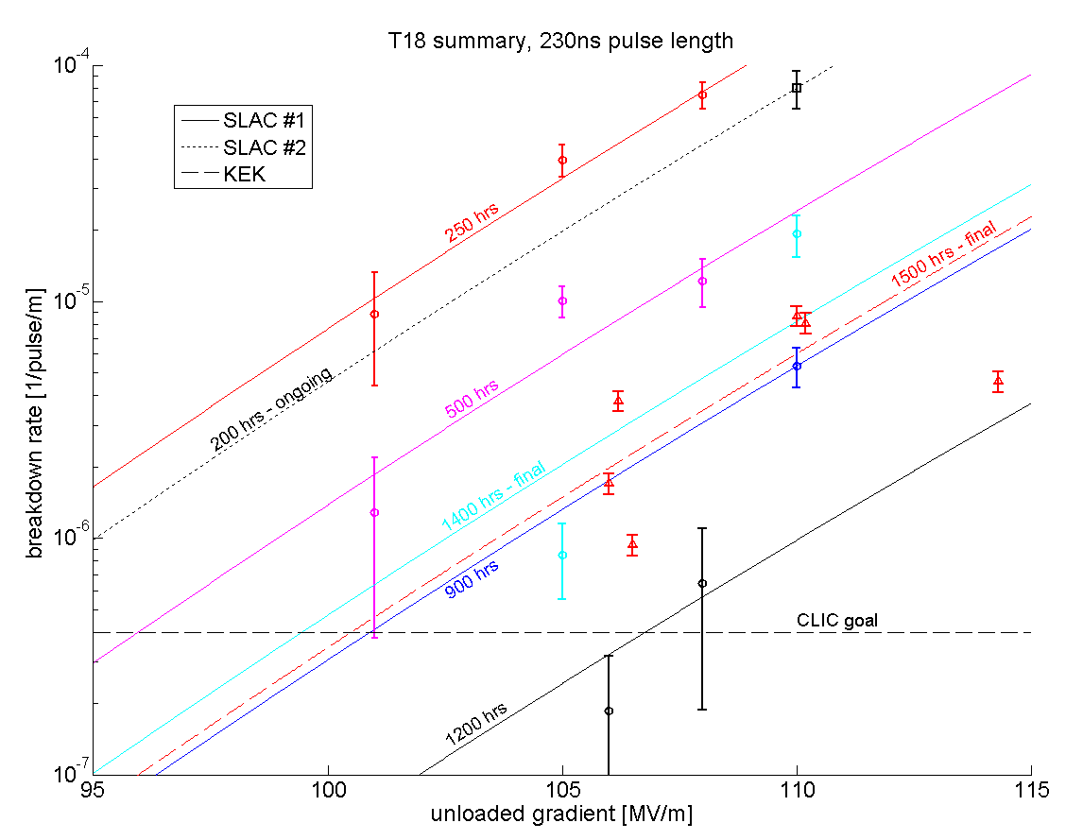
CERN/KEK/SLAC T18 structure tests
SLAC 2
SLAC 1
KEK
Lines are E³⁰/BDR=const

Slide 6
High Power Test begin at 12/03/2009 15:00
ΔT
73°C
68°C
TD18 test at SLAC
Faya Wang

Slide 7
BDR evolution with rf process
At least as fast as T18!
(but still a long time)
TD18 test at SLAC
Faya Wang

Slide 8
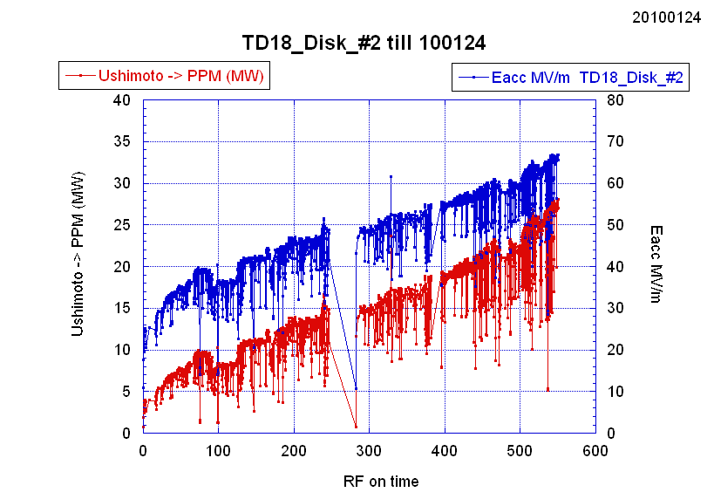
Power and Eacc of TD18_Disk_#2
50 ns pulse length
Slower than T18 and other TD18. Why?
TD18 test at KEK
T. Higo

Slide 9
Accelerating structure development core program
Adopt NLC/JLC technology
Two successful tests, third underway, have shown that 100 MV/m, 240 ns, 10⁻⁶ to 10⁻⁷ range is feasible.
Structure for 100 MV/m using high-power scaling laws – T18
Successful start of one test already shows damping features do not significantly affect performance. Damped structures at 100 MV/m are feasible.
Add damping features – TD18
CLIC nominal structure with better rf design for higher efficiency – TD24 (and T24 to be systematic)
Predicted equivalent performance from high-power limits but more efficient. Needs verification, tests in spring.
Verification of features such as SiC loads, compact coupler, wakefield monitor
Mechanical design underway (tricky).
Fine tuning of design, optimization of process, medium series production and testing

Slide 10
Accelerating structure critical issues and programs
100 MV/m with high beam loading (efficiency) in large aperture (luminosity) long structures (efficiency and cost) with long pulse length (efficiency) operating at 10⁻⁷/m breakdown rate (luminosity) and with long-range damping (efficiency). We are limited mainly by breakdown and pulsed surface heating.
Developing high-power scaling laws supported by fundamental theoretical and simulation studies and experiments.
Developed an integrated rf and linac design and optimization procedure
Developing preparation and manufacturing procedures for high gradient (KEK/SLAC is current baseline). Germana’s presentation.
High-power rf prototype testing program which is approaching the full CLIC structure in a progression of steps. Steffen’s presentation.
We currently have no alternative-material rf structures in the pipeline. This is only addressed in specialized experiments like dc spark.

Slide 11
Accelerating structure critical issues and programs 2
Long range wakefield damping of the order of two orders of magnitude in six fundamental cycles.
Simulations using a number of different techniques and programs
Experimental program including a test in ASSET and indirect wakefield monitor tests.
Baseline heavy damping. Alternatives are slotted quadrants, DDS (Manchester) and Choke mode (Tsinghua)
Micron precision manufacture, assembly and integration
Dedicated manufacturing study
Subsystem (cooling, vacuum, support) design
Wakefield monitor development
Dedicated cost studies are underway
Other X-band and high gradient applications like TERA, X-FEL to gain experience and spread expertise.
Dynamic Vacuum
Work program is now being established. Goal is direct measurement, we will likely need a combination of measurement and simulation.

Slide 12
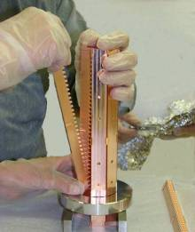
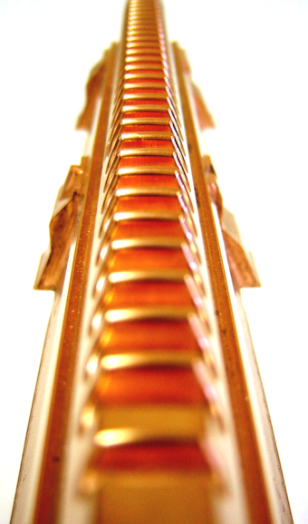
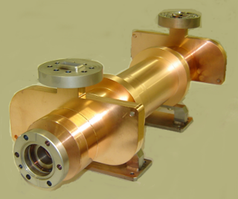
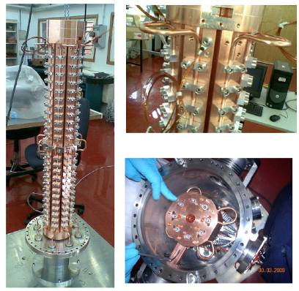
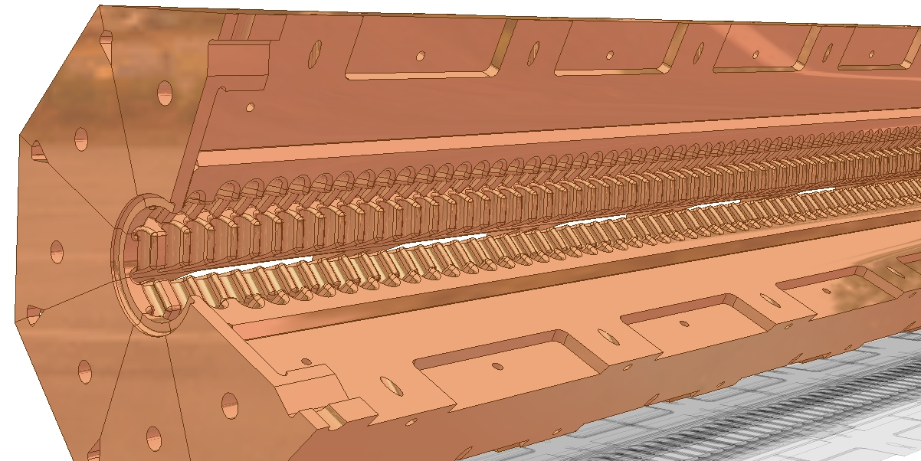
PETS

Slide 13
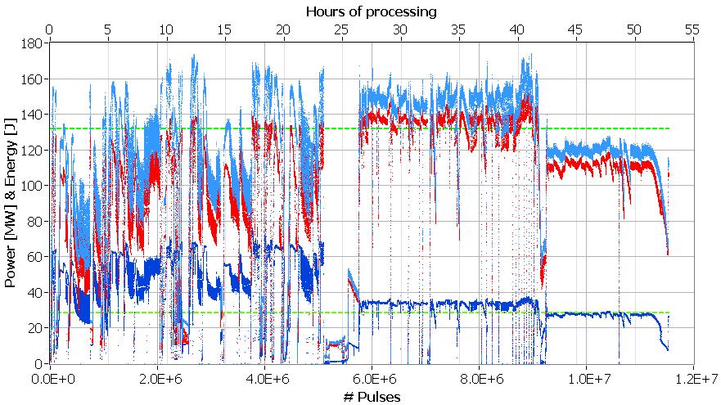
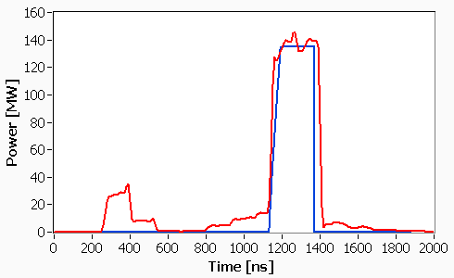
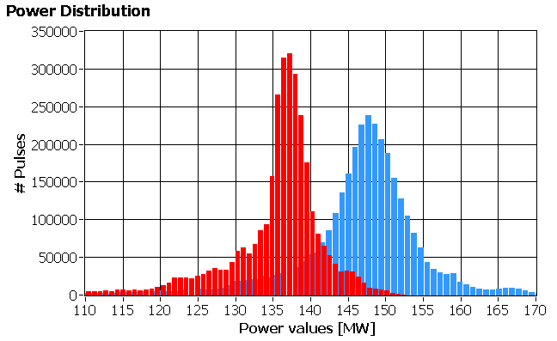
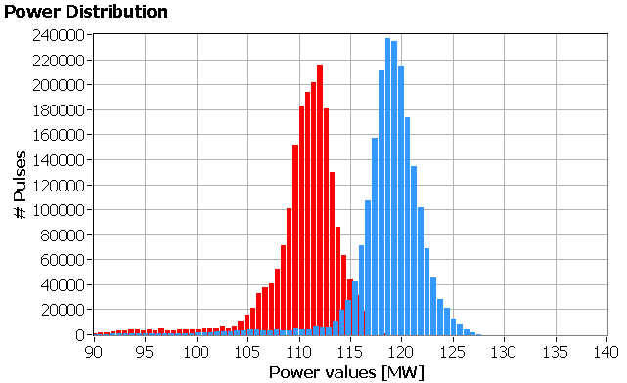
November 2009
2-5 11.09 (ASTA setting period)
19-24 11.09 (flat pulse)
Peak power
CLIC target
Average power
Energy
CLIC target
Typical ‘rectangular’ Pulse shape
Mean av. =137
Mean peak = 147.6
Mean av. =112
Mean peak = 118.6
CLIC target
CLIC target
2x10⁶
Total 3.4x10⁶

Slide 14
PETS critical issues and programs
Unique object
Dedicated computational and experimental program.
High-power capability – 140 MW and breakdown rate/m as low as accelerating structure
Klystron driven “waveguide-mode” tests
Beam-driven tests in the Two Beam Test Stand. First independent and driving accelerating structure for two-beam acceleration demonstration.
In principle less demanding than accelerating structures – program benefits from techniques developed for accelerating structures.
PETS on/off/ramp – Capability to regulate power produced by PETS to respond to breakdown including in PETS itself with a ramped-power recovery (may not be necessary but we can’t be sure yet).
Dedicated computational and experimental program in TBTS PETS (requires beam).
Higher-order mode damping
Computation with different codes
TBL beam-stability tests

Slide 15
PETS high-power testing program – three complementary pieces
Klystron-driven waveguide-mode tests.
Correct geometry.
Full repetition rate so breakdown rate can be determined.
Significant pulse length and power overhead available.
Harder because input coupler must take full power.
No beam.
Two Beam Test Stand
Beam driven.
Long structure and recirculation to compensate for lower current.
Harder because input coupler must take full power with recirculation.
Will feed accelerating structure.
Limited current pulse length combinations possible.
Low, 1 to 5 Hz, repetition rate so limited breakdown rate probe.
Test Beam line
Beam driven.
Mainly to study beam stability, validates wakefield model
Long structure to compensate for lower current.
Limited current pulse length combinations possible.
Low, 1 to 5 Hz, repetition rate.
The Ultimate test (not scheduled yet)
100 A drive beam
full pulse length
full repetition rate
etc.

Slide 16
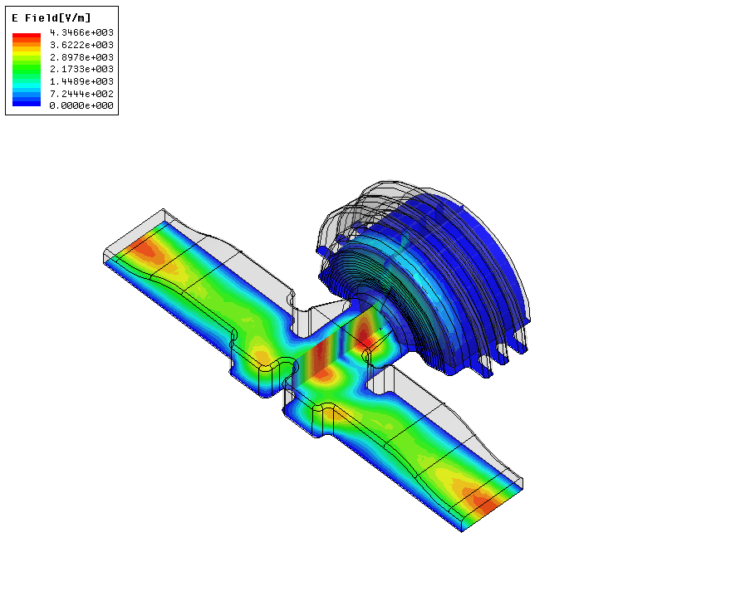
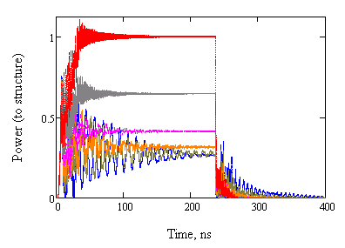

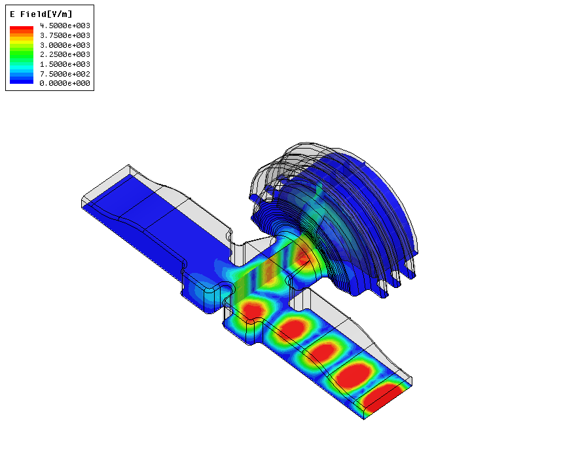
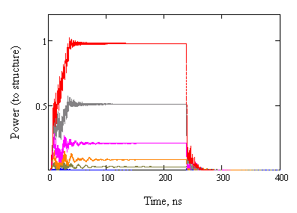
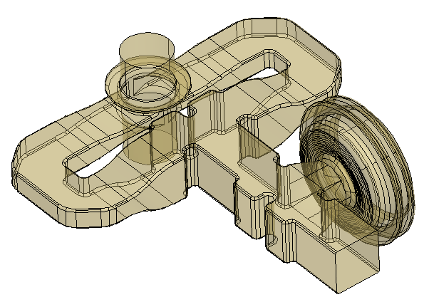
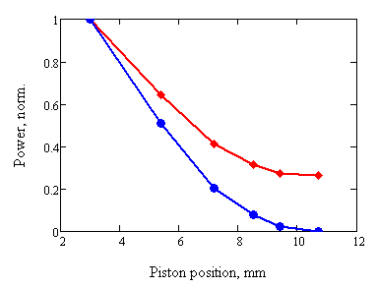
PETS ON/OFF/RAMP
Power attenuation vs. piston position (full reflection in OFF position)
ON
ON
OFF
Transmitted
RF power, dB
Reflected
Stroke 7.7 mm
OFF
Reflection=0 dB
ON
Piston position (gap width), mm
PETS coupler design with integrated RF reflector – mechanical movement
-1 dB
Stroke 7.7 mm
-3 dB
-6dB
OFF, full
Stroke 7.7 mm
ON
PETS output (steady state)
0.26
Structure input
OFF, full

Slide 17
Now some more detailed information about wakefield damping to reply to questions raised during the last ACE.

Slide 18
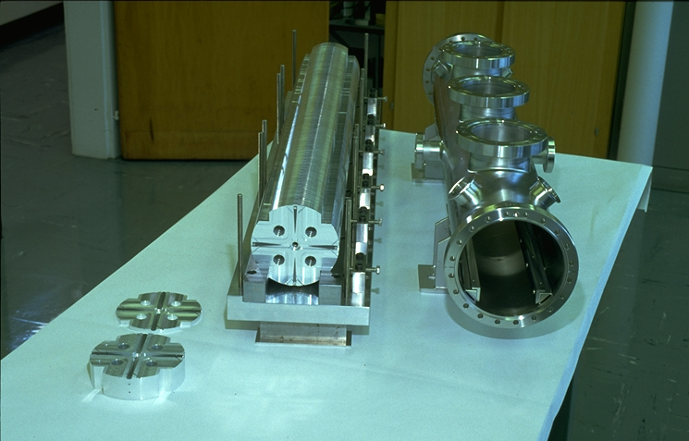
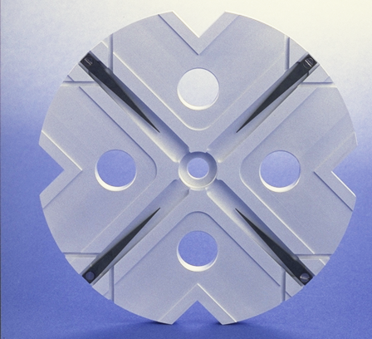
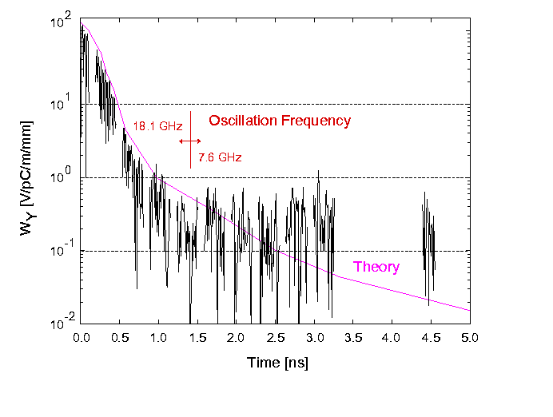
150 cells/structure, 15 GHz
Higher-order mode damping demonstration in ASSET
Then
Now
Double band circuit model
24 cells/structure, 12 GHz
(loads not implemented yet)
An Asset Test of the CLIC Accelerating Structure, PAC2000

Slide 19
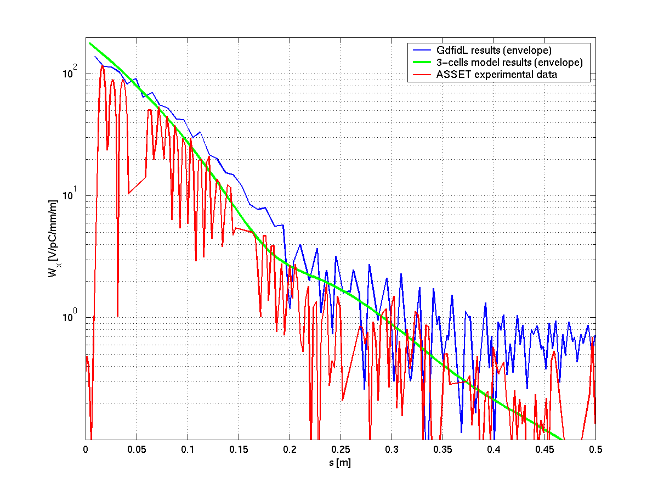
Full length TDS results comparison

Slide 20
Reflection: comparison
There is very small (~1MHz) or no difference in frequency between simulations and the air corrected measurements
Our computational capability is constantly being refined and benchmarked.

Slide 21
Transverse wakefield
2nd bunch
Transverse wakefield for nominal CLIC structure computed by GDFIDL. Details of wake behavior determined by the copper geometry. CLIC beam-stability requirement is 6.6 V/pC/mm/m which includes factor two safety margin.

Slide 22
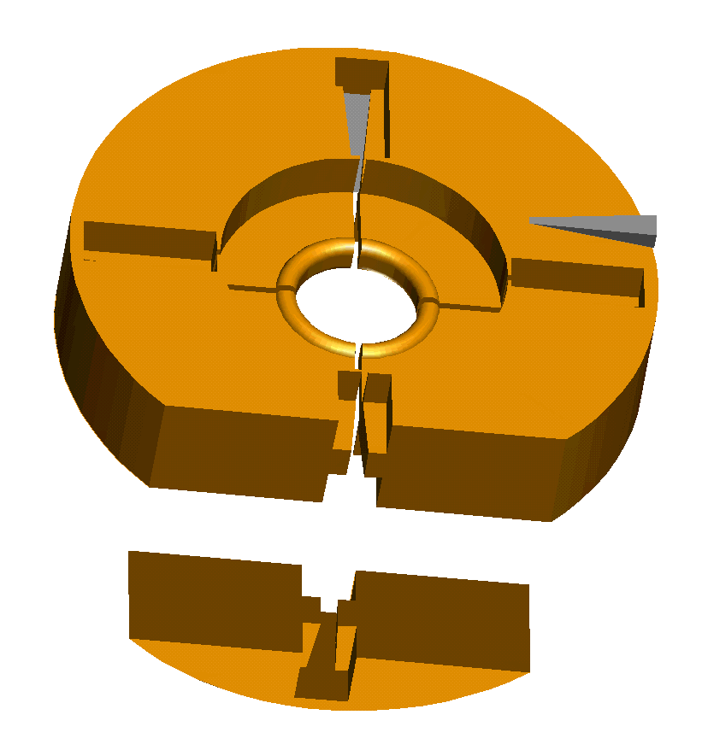
Cut-away view of slotted iris disc
4 iris slots
SiC (silicon carbide) wedge
tapered double ridged waveguide
A waveguide of width 33.32 mm would have a cutoff of 4.5 GHz.
Ridges bring the cutoff down below 3 GHz!
the next disc is azimuthally offset by 45 °

Slide 23
iris variation vs. nosecone variation
iris radius 17 mm
iris radius 17 mm
higher short-range wake
iris radius 13.3 mm
iris radius 17 mm

Slide 24
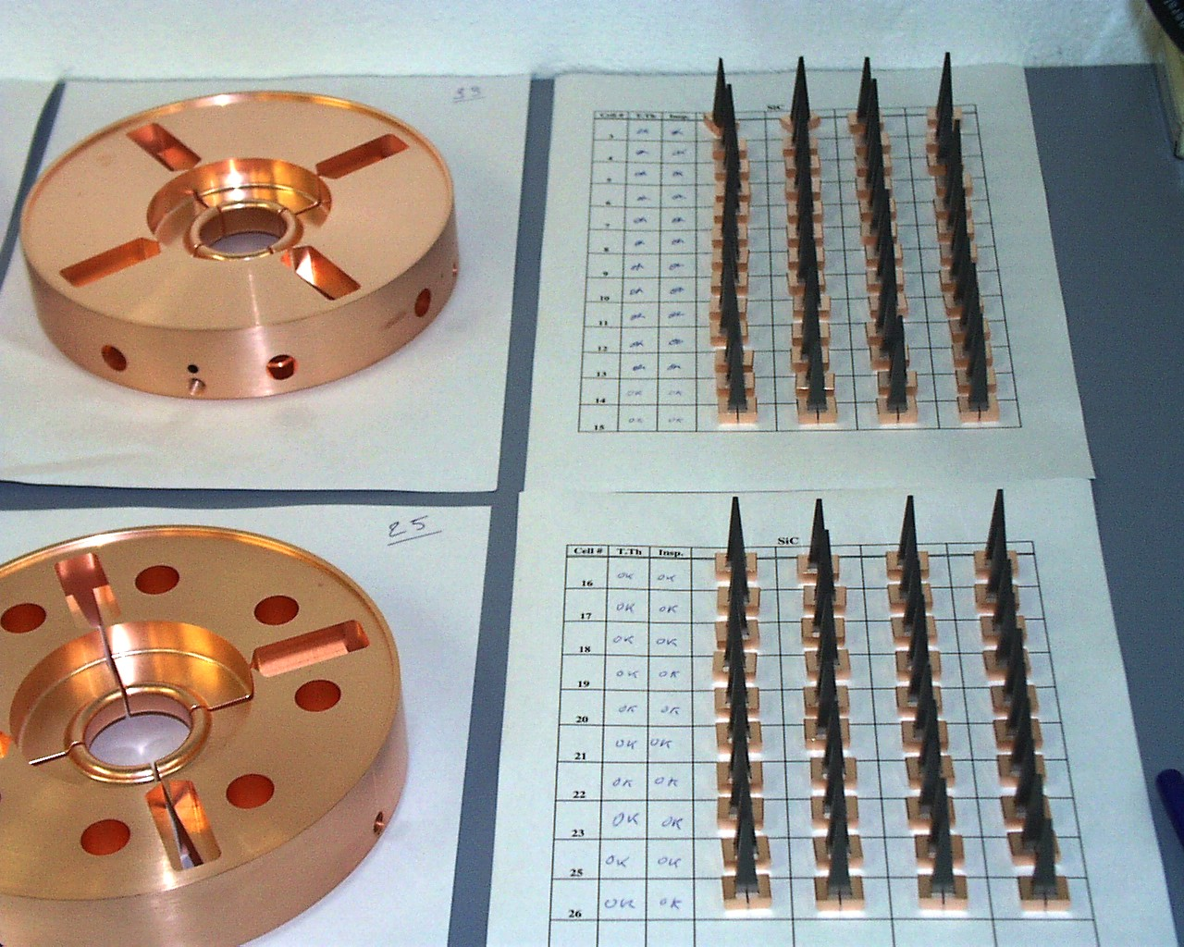
Putting it together

Slide 25
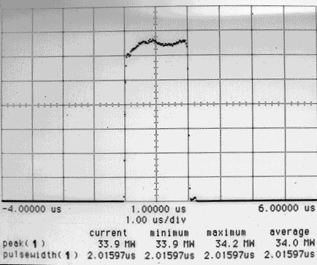
High power tests
Nominal: 30 MW · 1.55 μs
Obtained in high power tests:
34 MW · 2 μs (no breakdown): (corresponding to surface field of 110 MV/m)
98 MW with LIPS output pulse w/o phase modulation, corresponding to the surface field shown on the right (no breakdown).
31/5/02: Obtained 77 MW (!) peak with an almost flat pulse of 1.5 μs.
peak power meter reading

Slide 26
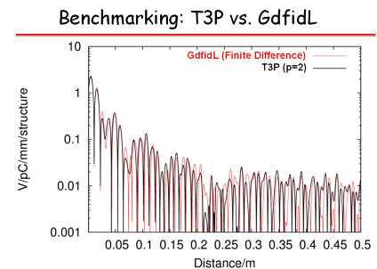
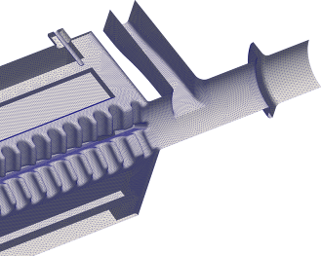
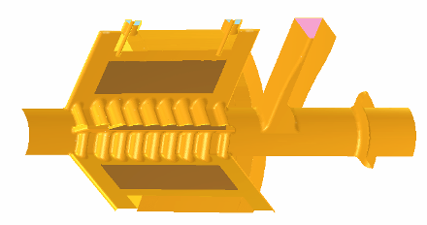
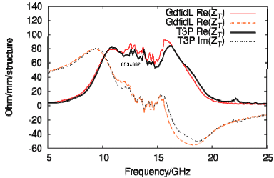
We believe that we can accurately calculate the PETS transverse impedance in the presence of heavy damping under condition, that properties of the damping material are correctly identified. The two sophisticated computer codes have been benchmarked and showed very close results.
T3P
Gdfidl

Slide 27
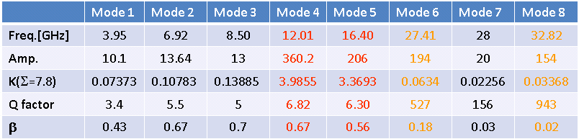
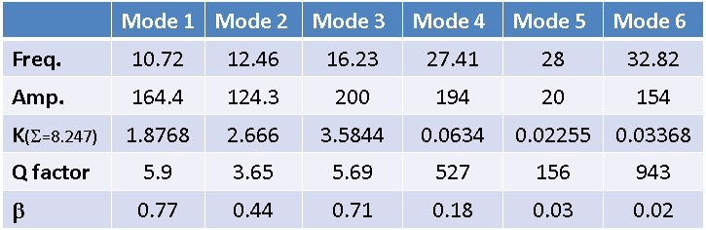
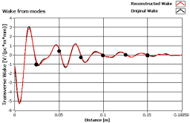
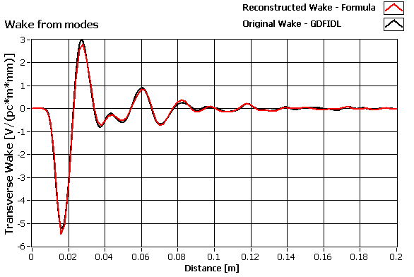
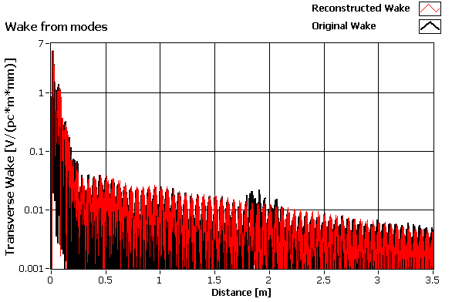
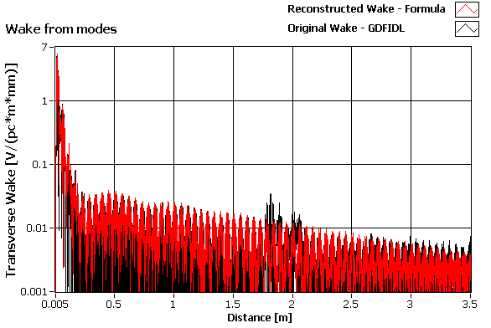
Examples of the simulated PETS transverse wakes (black) and model reconstruction (red) for the fixed damping loads layout and the two different types of the RF absorbing ceramic.
ε = 13, tgδ =0.2 (Boostec SiC- P)
ε = 24, tgδ =0.3 (CERADYNE 137)
With changing the RF absorbing material properties (ε’ and ε’’) by factor ~2, the amplitude of the wake (as one can expect) is not affected. The 15% relative change of the loaded Q-factor is observed together with certain modification of the modes frequencies.

Slide 28
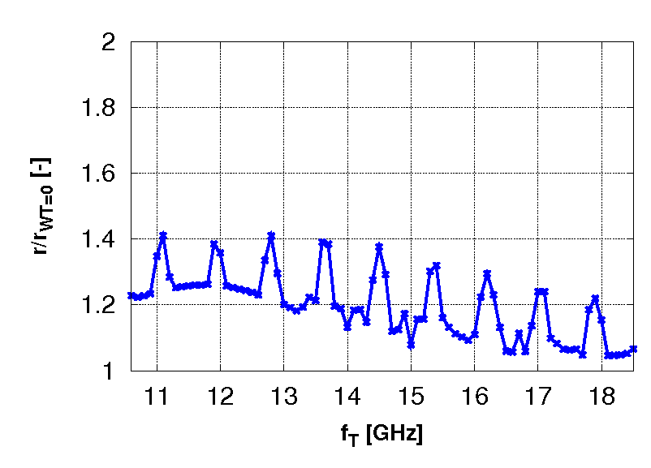
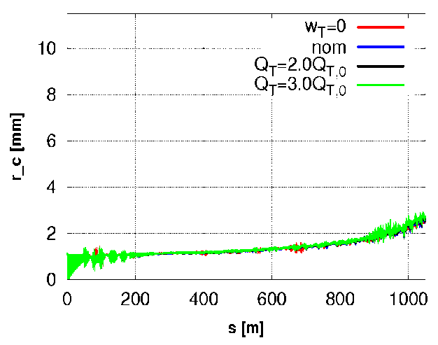
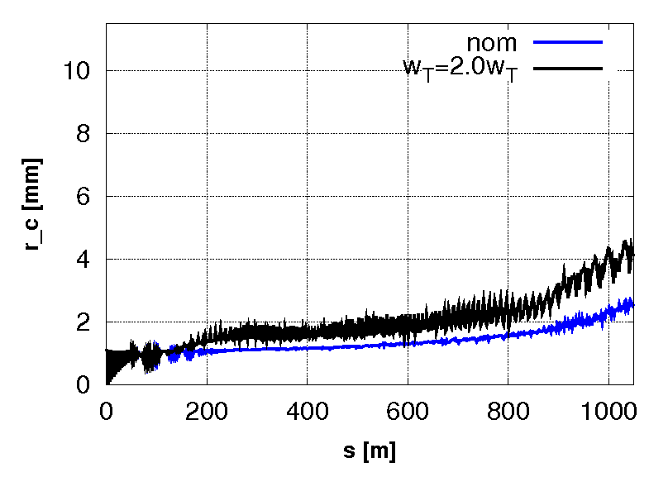
Beam envelope along CLIC decelerator sector simulated in PLACET. Sensitivity analysis.
Q-factor scan
Wake amplitude scan
Wake frequency scan (Q_{T}=2Q_{T,0} )
3σ beam envelope, mm
3σ beam envelope, mm
Jitter amplification
Summary
Damping material. Drastic changes of the material properties have a small influence on the modes loaded Q-factor, at a level of ~20%. The beam dynamic analysis showed that much severe changes, up to 300%, still can be accepted.
Fabrication tolerances. Due to the heavy damping and high group velocity of the modes, the fabrication errors will have negligible effect on the HOM damping performance.
Future work. Upon final selection of the damping material, the loads configuration will be re-optimized accordingly, aiming towards the best distribution of the modes frequencies.

Slide 29
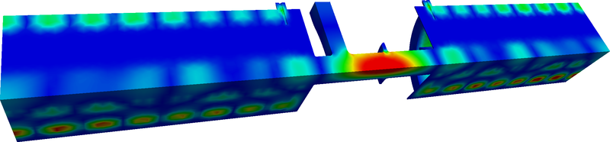
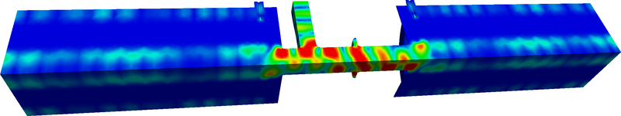
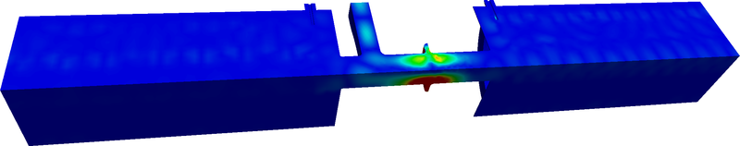



Investigation of trapped modes between PETS
Frequency-domain Finite Element eigensolver Omega3P - Example of potentially trapped modes:
Preliminary scan of thousands of modes – more studies planned

Slide 30
Damping - summary
CLIC Accelerating structure
ASSET experiment - Demonstrates waveguide damping directly and provides benchmark for simulation.
Simulation – Agreement among benchmark, multiple techniques and codes. Ongoing and constantly improving activity
Tolerances – Insensitive to mechanical errors and to variation in absorber material properties (SiC for now)
Further experiments – Wakefield will be measured indirectly in wakefield monitors. FACET?
We have a baseline concept and three alternatives under development: slotted iris, DDS (Manchester) and Choke mode (Tsinghua University).
CTF3 drive beam linac accelerating structure
Drive beam accelerator stability demonstrates that predicted wakefield behavior can’t be too wrong.
Thousands of SiC loads are working just fine in a high-power rf and high-power beam environment for many years now.

Slide 31
Damping – summary 2
PETS
Simulation – Agreement among multiple techniques and codes. Ongoing and constantly improving activity
Tolerances – Beam stability imposes loose tolerances on Q’s of HOMs, which in turn are highly insensitive to mechanical errors and in variation in absorber material properties (SiC for now)
Further experiments – Wakefield is very difficult to measure directly in an ASSET-like experiment due to the low impedance and low Q’s. TBL will uncover if something is missing from our analysis.
High-power behavior is an important question since the loads see the fundamental fields more directly than in the accelerating structure. A PETS with load material will be tested at ASTA and future TBL PETS will have loads.

Slide 32
Overview and outlook
Feasibility issues are more or less in hand.
It would be nice to get safely above specification but it is now a question of performance not feasibility.
Some details still need to be validated; testing with load material in, compact coupler, etc.
Need to consolidate results, get statistics, show yield, optimize.
Broader high-gradient program – including fundamental understanding of breakdown, development of scaling laws, new configurations (like slotted-iris damping and quadrants) – is progressing extremely well and will continue to contribute to improved performance in the coming years, but with the successful tests we can now have a clear baseline/alternative approach.
Technical issues, subsystems advance well. No time allocated for this at this ACE.
Some concerns
  We seem to get away with high ΔT’s for now but the lifetime issue is still lurking.
  We are just starting to address dynamic vacuum
  The availability of high-power testing infrastructure. Should get better one day but hasn’t yet.

