Slide 1
CTF3 experimental program, Plans for 2010
Outline
The CLIC feasibility issues in CTF3 – 2010 Objectives
Present status & outlook
  Drive Beam Generation
  RF power production & structure tests
  Two Beam Issues
  Other issues
Operating scenario for 2010, conclusions

Slide 2
CTF3 2010 main goals (feasibility demonstration)
Drive Beam Generation
  Bunch train recombination 2 x 4 in DL and CR (from 3.5 to 28 A)
  Transverse rms emittance < 150 π mm mrad (combined beam)
  Bunch length control to < 1 mm rms (combined beam)
  Beam current stability ~ 0.1 % for combined beam
RF Power Production
  20.8 A beam-powered test of a single PETS (without re-circulation) in the TBTS
    135 MW (with 28 A potentially available in CLEX, the peak power can reach 240 MW)
    140 ns total pulse length
    A measured breakdown rate in the range of 10⁻⁴ or lower
    Operation of a few hundred hours at 1 Hz
  7.4(10) A beam-powered test of a single PETS with external recirculation in TBTS
    135 (81) MW circulating power or 65 (65) MW available for accelerating testing
    250 ns total pulse length, 100 (170) ns flattish-top
    A measured breakdown rate in the range of 10⁻⁴ or lower
    Operation of a few hundred hours at 5 Hz
    On/off/adjust will be demonstrated using the external reflection/recirculation system mounted on one of the PETS in TBL.
Two Beam Acceleration issues
  TBTS
    Improved measurements of power and energy loss.
    Breakdown transverse kick measurements.
    Probe Beam energy gain and beam loading tests.
  TBL
    The current schedule is to have 8 PETS installed as well as a spectrometer dump for energy spectrum studies, toward the summer 2010. This will allow to verify transport of a beam with up to 30% of the energy extracted.

Slide 3
2009 CTF3 experimental program
Goals
30 GHz: One structure test (TM02) + breakdown studies
PHIN Beam characterization, reach ½ of nominal bunch charge ?
CALIFES Beam characterization, beam to TBTS (most likely still reduced current)
Delay Loop Back in operation, retrieve combination x 2 (~ 7 A)
Combiner Ring Final optics checks, isochronicity, put together with DL (> 24 A)
TL2 Complete commissioning (tail clipper), bunch length control, > 20 A to users
TBTS PETS to nominal power/pulse length (15 A, recirculation)
Beam commissioning of probe beam line
First accelerating structure tests (one structure ? – CLIC G)
Two-beam studies (deceleration/acceleration), initial breakdown kicks studies
TBL PETS validation (100 MW, need > 20 A), beam line studies (2-3 PETS ?)
Others CDR studies in CRM, beam dynamics benchmarking, stability studies, control of beam losses…
Nominal reached
~ 28 A
Max ~12 A
170 MW, 200 ns
No structure available
~20 MW with 10 A
Only one PETS installed

Slide 4
Drive Beam Generation
  Bunch train recombination 2 x 4 in DL and CR (from 3.5 to 28 A)
  Transverse rms emittance < 150 π mm mrad (combined beam)
  Bunch length control to < 1 mm rms (combined beam)
  Beam current stability ~ 0.1 % for combined beam
  Quite close to all requirements already at the end of 2009
Parameter | Unit | CLIC nominal | Present state | Objective 2010 | Objective 2012
I initial | A | 7 | 5 | 5 | 5
I final | A | 100 | 28 | 30 | 30
Q_{b} | nC | 8.4 | 4 | 2.5 | 2.5
Emittance, norm rms | p mm mrad | ≤ 150 | 100 (end of linac) ≤ 150 (vert., comb. beam) | ≤ 150 (comb. beam) | ≤ 150 (comb. beam)
Bunch length | mm | ≤ 1 | ≤ 1 (end of linac) | ≤ 1 (comb. beam) | ≤ 1 (comb. beam)
E | MeV | 2400 | 120 | 120 | 150
T_{pulse} initial | ms | 140 | 1.4 | 1.4 | 1.4
T_{pulse} final | ns | 240 | 140 (240) | 140 (240) | 140 (240)
Beam Load. Eff. | % | 97 | 95 | 95 | 95
Deceleration | % | 90 | - | 30 | 50
Phase stability @ 12 GHz | degrees | 0.2 | - | ?
Intensity stability |  | 7.510⁻⁴ to few 10⁻⁵ | a few 10⁻³ | 10⁻³ | < 10⁻³

Slide 5
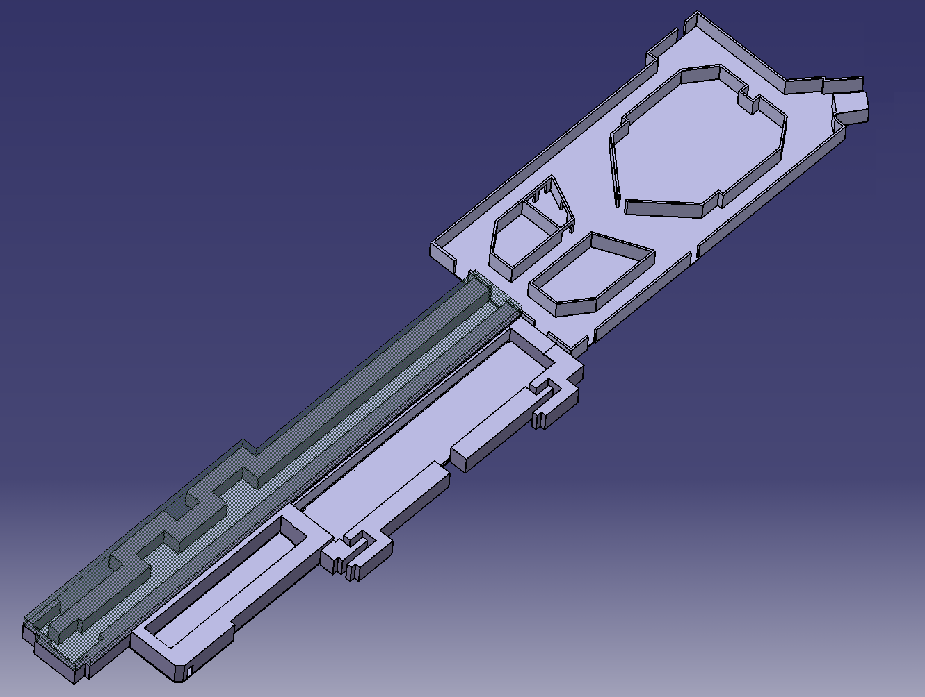
CTF3 – Layout
DELAY
LOOP
COMBINER
RING
DRIVE BEAM
LINAC
CLEX
CLIC Experimental Area

Slide 6
CTF3 – Current
Up to 7 A
Up to 5 A – 1.2 μs
120 Mev
28 A – 140 ns
120 Mev
Up to 7 A

Slide 7
CTF3 – Emittance & bunch length
< 100 π mm mrad
~ 70 π mm mrad
~ 1 mm rms
< 50 π mm mrad
~ 1 mm rms
< 150 π mm mrad,
combined, vertical
< 1-2 mm rms from
12 GHz power measurements

Slide 8
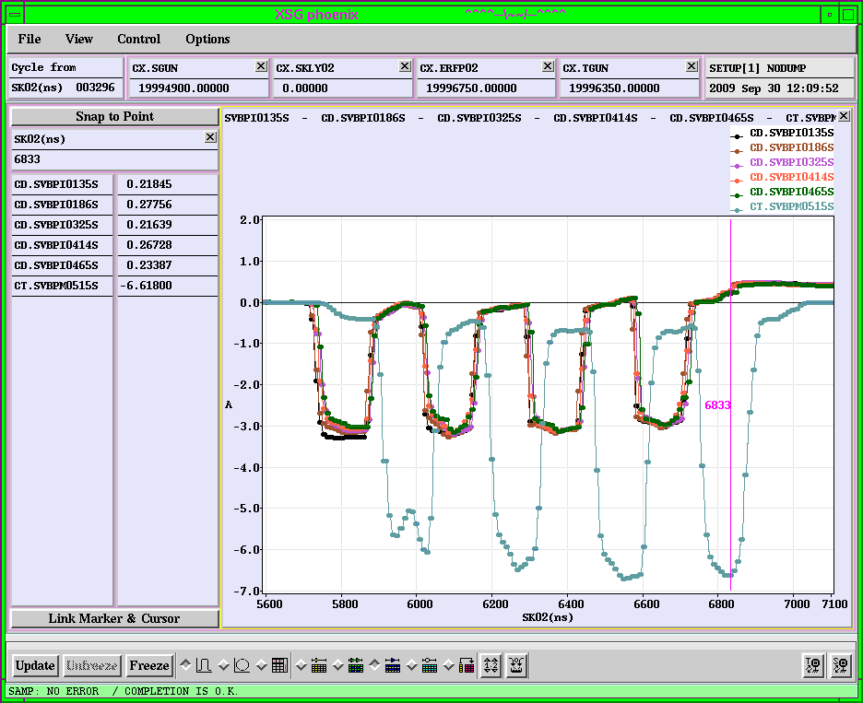
2007

Slide 9
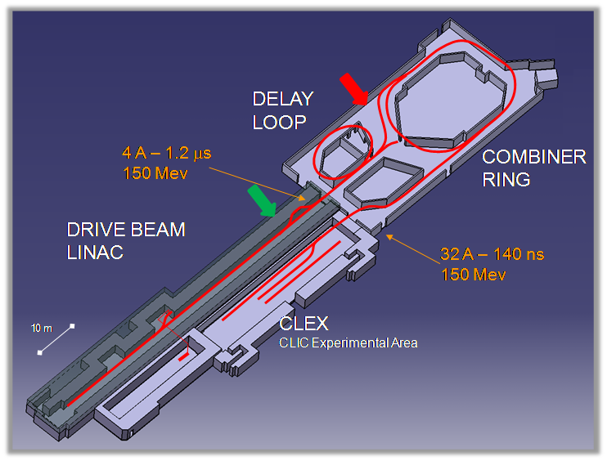
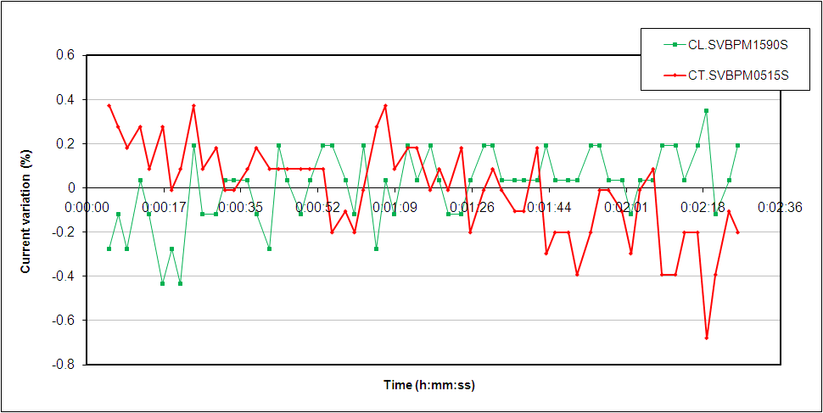
Delay loop: current stability
 | CL.SVBPM1590S | CT.SVBPM0515S
Min. (A) | -3.858 | -6.300
Max. (A) | -3.828 | -6.234
Mean (A) | -3.845 | -6.277
Std (A) | 0.007 | 0.014
Variation (%) | 0.17 | 0.22

Slide 10
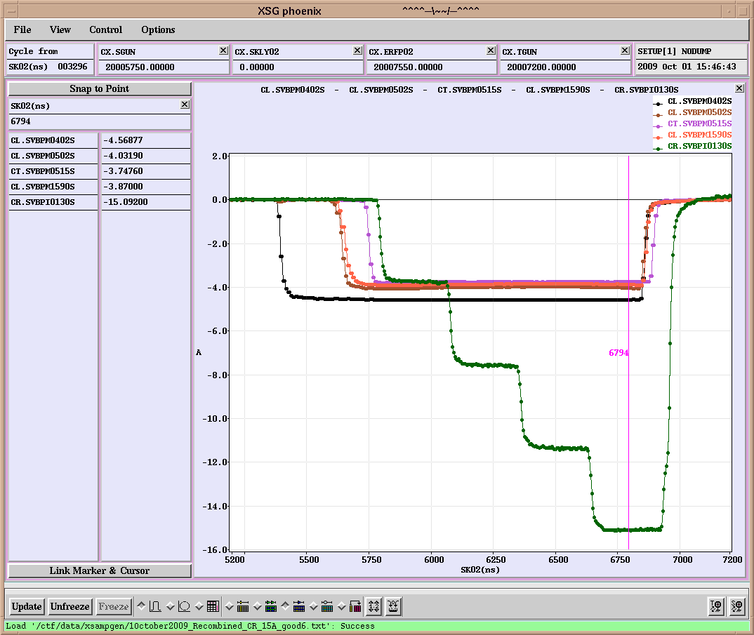
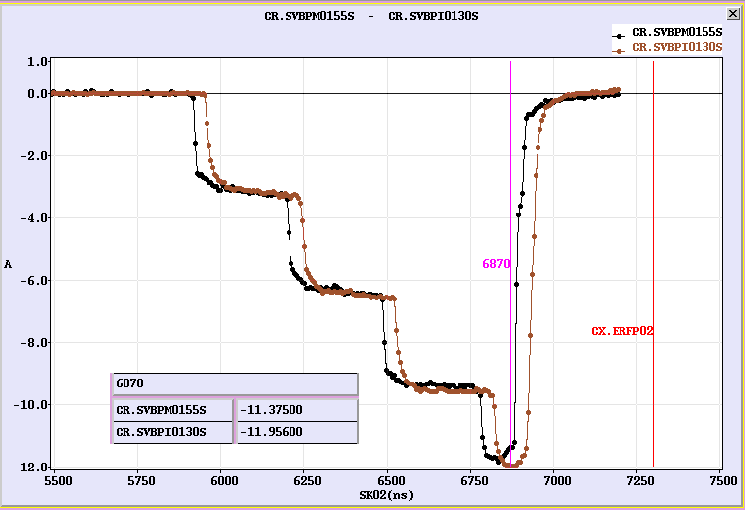
Combiner ring: the recombination
2008

Slide 11
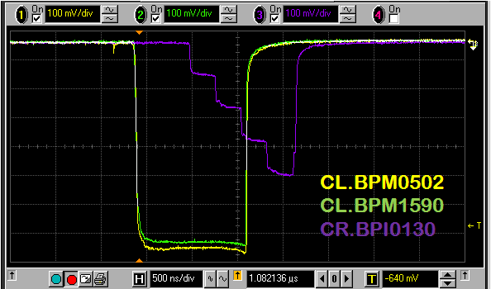
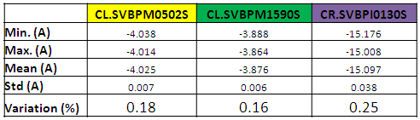
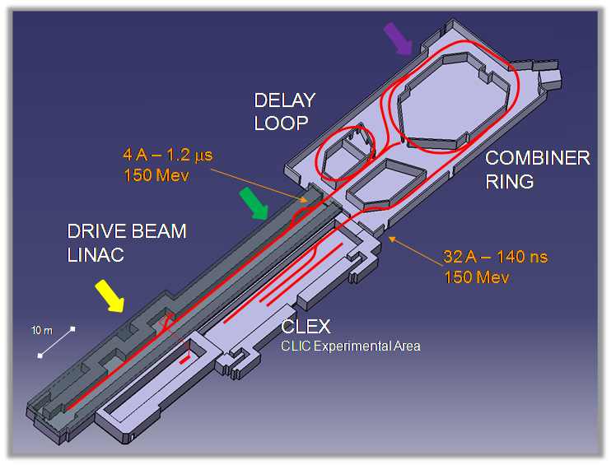
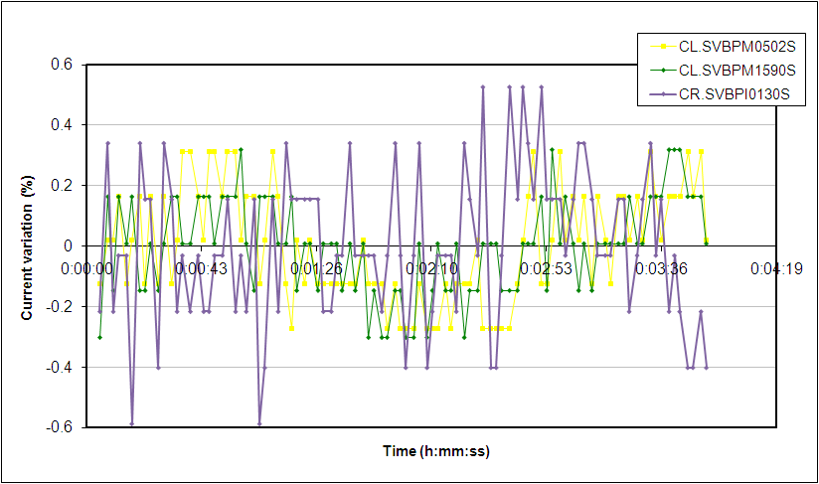

Slide 12
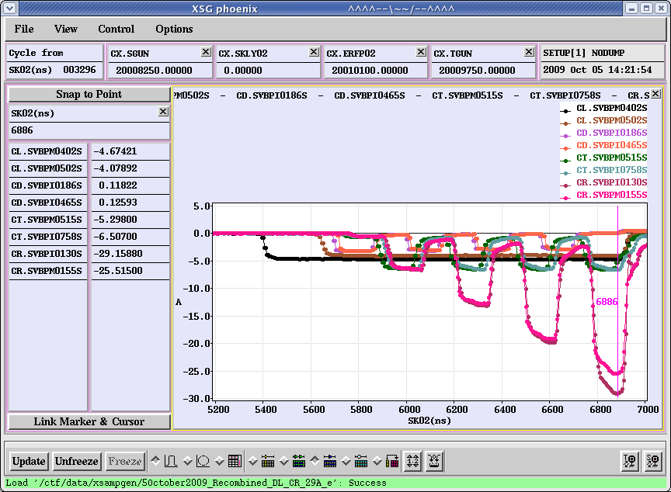
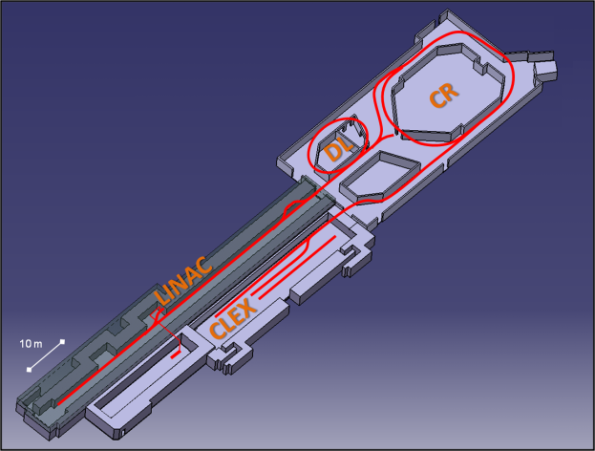
Delay loop & combiner ring: THE recombination
ONLY DL
DL & CR
ONLY CR

Slide 13
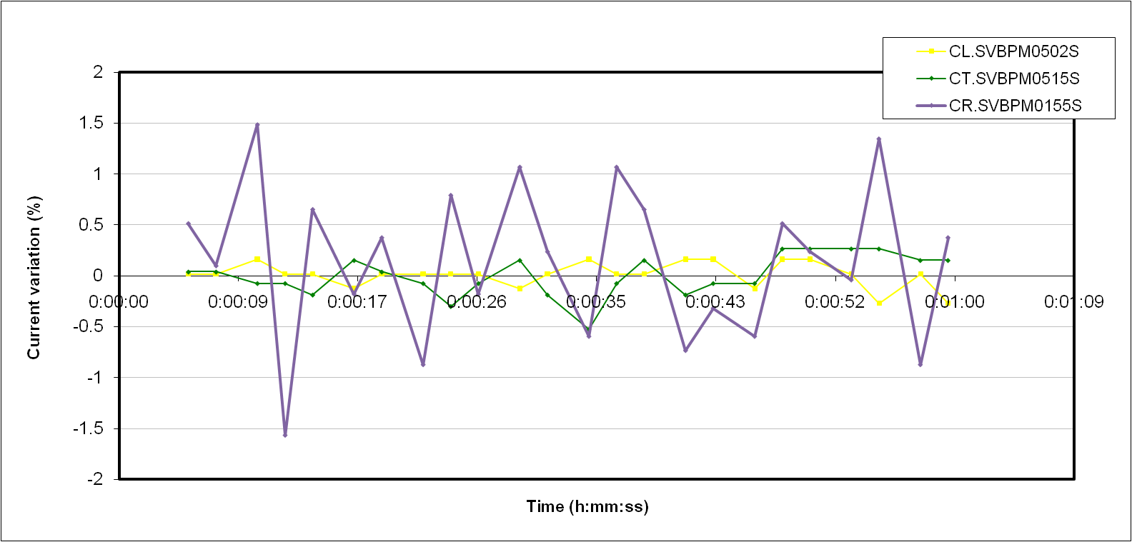
THE recombination: current stability
 | CL.SVBPM0502S | CT.SVBPM0515S | CR.SVBPM0155S
Min. (A) | -4.085 | -5.322 | -25.585
Max. (A) | -4.067 | -5.280 | -24.255
Mean (A) | -4.078 | -5.308 | -25.210
Std (A) | 0.005 | 0.011 | 0.254
Variation (%) | 0.13 | 0.20 | 1.01

Slide 14
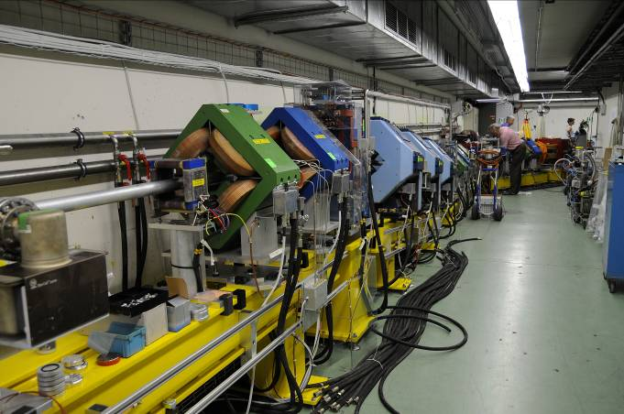
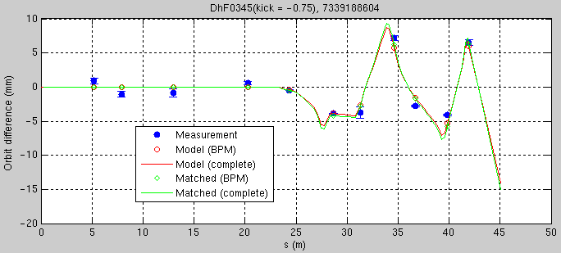
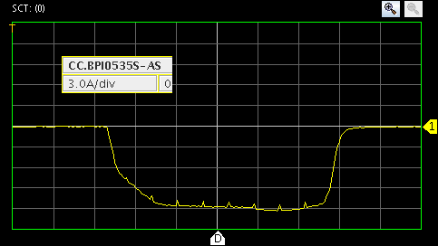
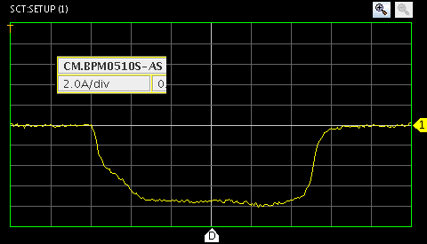
TL2, TL2’, TBTS beamlines
Line optics looks about OK (kick measurements), but difficult matching
Non-combined beam transported to TBTS and through PETS with small losses (about 10%)
Combined beam (factor 4) transported to TBTS with losses, from 15 A from ring to about 12 A - no local losses in PETS
21 Aug
21 Aug

Slide 15
Drive Beam Generation – 2010 outlook
  Bunch train recombination
    Consolidate results, routine operation, stability of fully combined beam
  Transverse rms emittance
    Complete TL2, TL2’, TBTS commissioning – full transport to CLEX
    < 100 π mm mrad after ring, combined beam
    < 150 π mm mrad in CLEX, combined beam
  Bunch length control to < 1 mm rms (combined beam)
    Measurement campaign with different meas. systems (RF defl.& screen, fast streak-camera, RF monitors)
    R₅₆ tuning experiments in Frascati chicane and TL2
  Beam current stability : improve slow variations, obtain ~ 0.1 % for combined beam
    Full measurement campaign (find correlations, jitter sources)
    Gun pulse flatness, “slow” feedback
    Improve overall klystron stability (at least up to best performing klystrons)
    Slow RF feedback (temp. in pulse compressors)

Slide 16





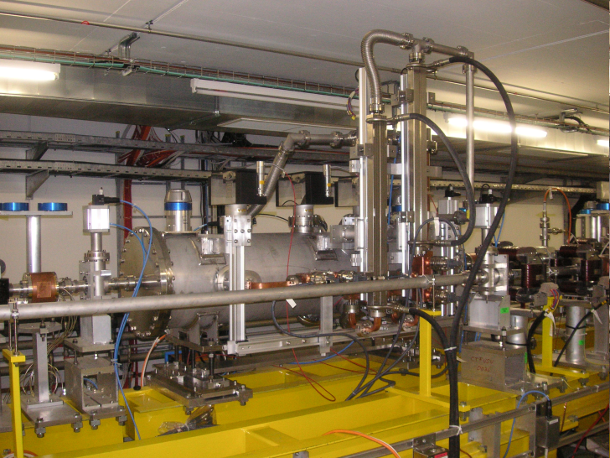
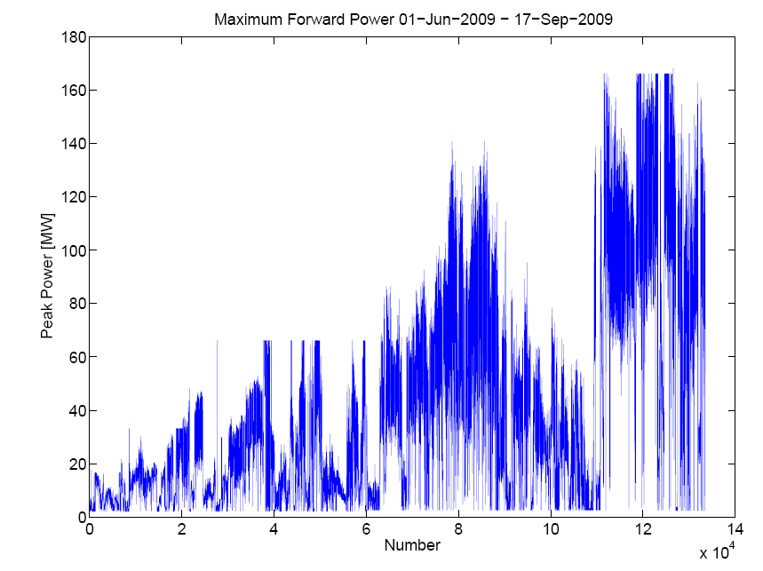
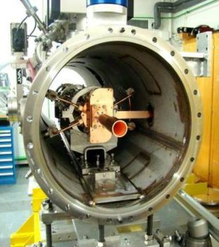
TBTS, PETS conditioning
Max beam current through PETS ~ 12 A
Aggressive, fast conditioning - well beyond CLIC nominal power
Pulse shortening in splitter and phase shifter
κ
φ
variable
splitter
variable
phase shifter
PETS
Prediction
Measurement

Slide 17
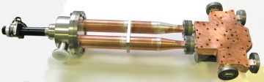
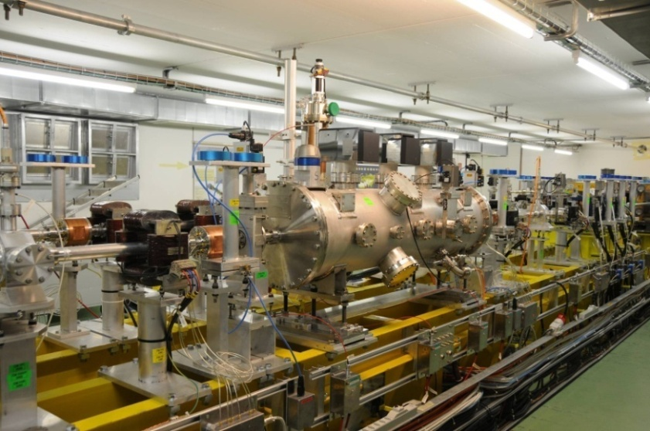
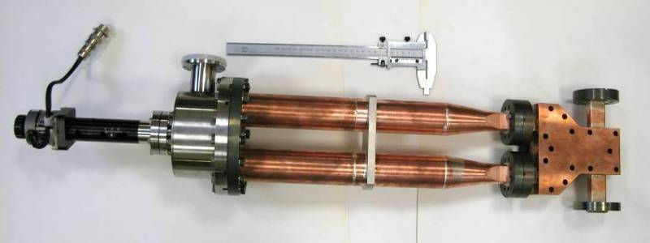
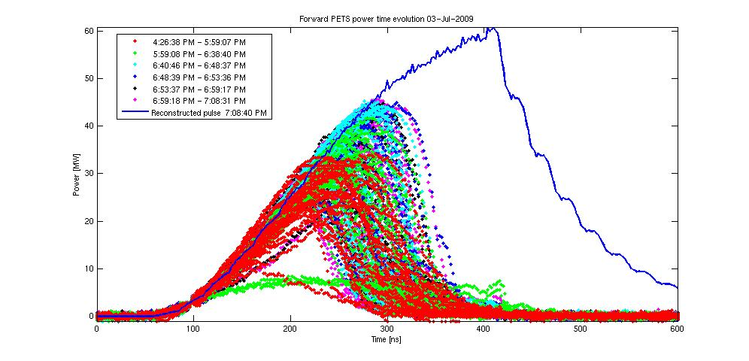
TBTS, PETS conditioning
Variable RF power splitter
Variable RF phase shifter
Max power reached 170 MW (peak)
Total pulse length about 200 ns – no flat top
3 July
135MW for CLIC

Slide 18
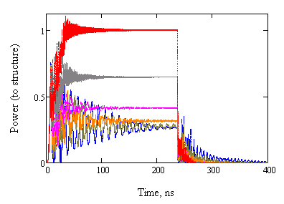
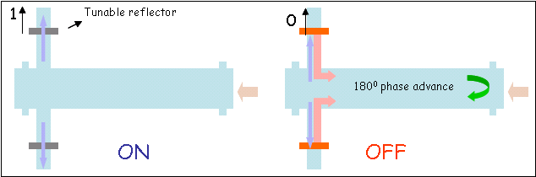
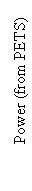
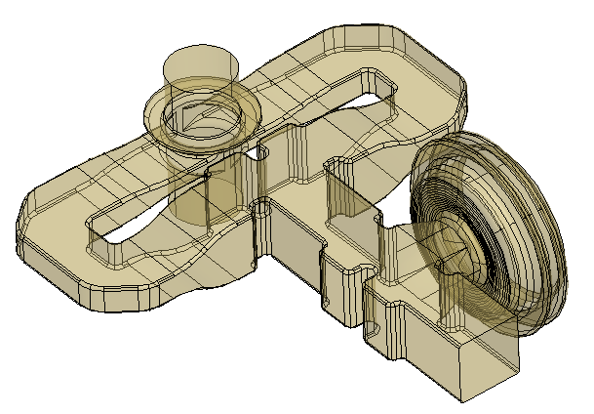
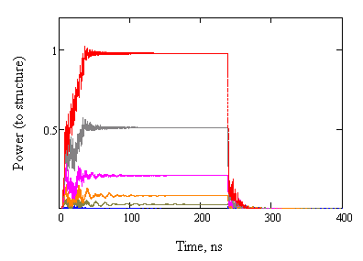
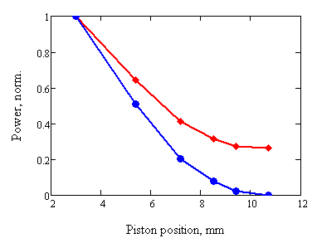
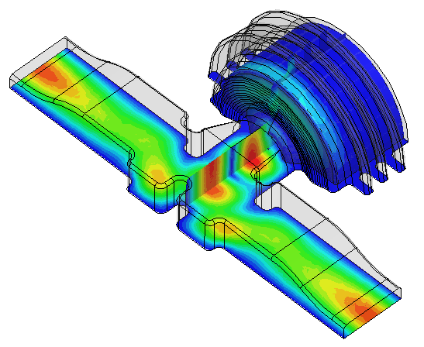
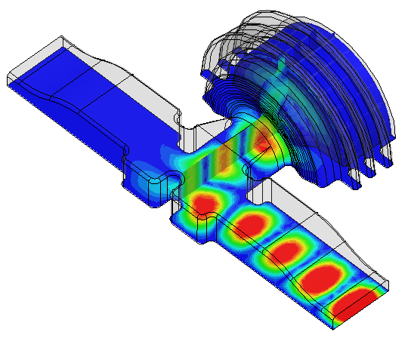
PETS on/off
Reflection=0 dB
ON
Power attenuation vs. piston position
(full reflection in OFF position)
-1 dB
Stroke 7.7 mm
-3 dB
-6dB
OFF, full
PETS coupler design with integrated RF reflector
Stroke 7.7 mm
ON
PETS output (steady state)
ON
0.26
OFF
Structure input
OFF, full

Slide 19
PETS on/off
Remarks:
High power tests of components and concept validation (slow movement, external reflector) will be done in 2010 in the TBTS PETS.
Meanwhile, the 25% power reduction can be tested this spring at SLAC with the new PETS (under construction).
The fast (~ 10-15 ms), vacuum compatible linear actuator prototype should be ready for testing in TBTS by mid 2010.

Slide 20
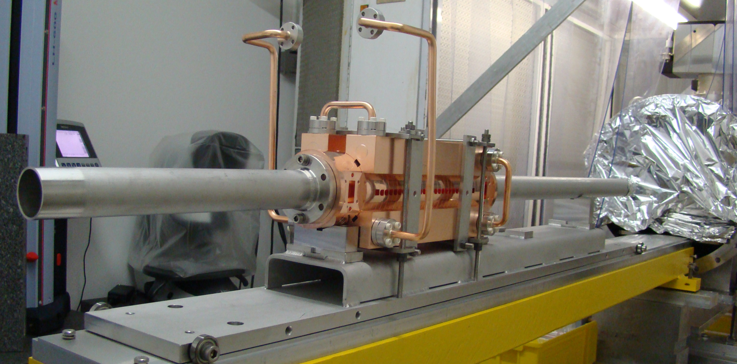
RF Power Generation – 2010 outlook
  PETS TBTS
    Initial configuration with variable power splitter & phase shifter
    Fast fall-back solution: recirculation with no active elements (maximum power to accelerating structure)
    Goal: nominal power /pulse length inside PETS - with recirculation (135 MW, 250 ns total pulse length, 170 ns flat-top)
    Breakdown rate measurements (at high BD rate - extrapolation to lower rates)
    Operation w/out recirculation (end of the year?) – may have different breakdown rate…
    Test of new PETS on-off scheme (components and concept)
  Acc. structure in TBTS
    TD24, initial conditioning in the shadow of PETS operation
    Goal: nominal power / pulse length delivered to structure (65 MW, 250 ns total pulse length, 170 ns flat-top)
12 GHz TD24. structure
under assembly before installation in TBTS

Slide 21
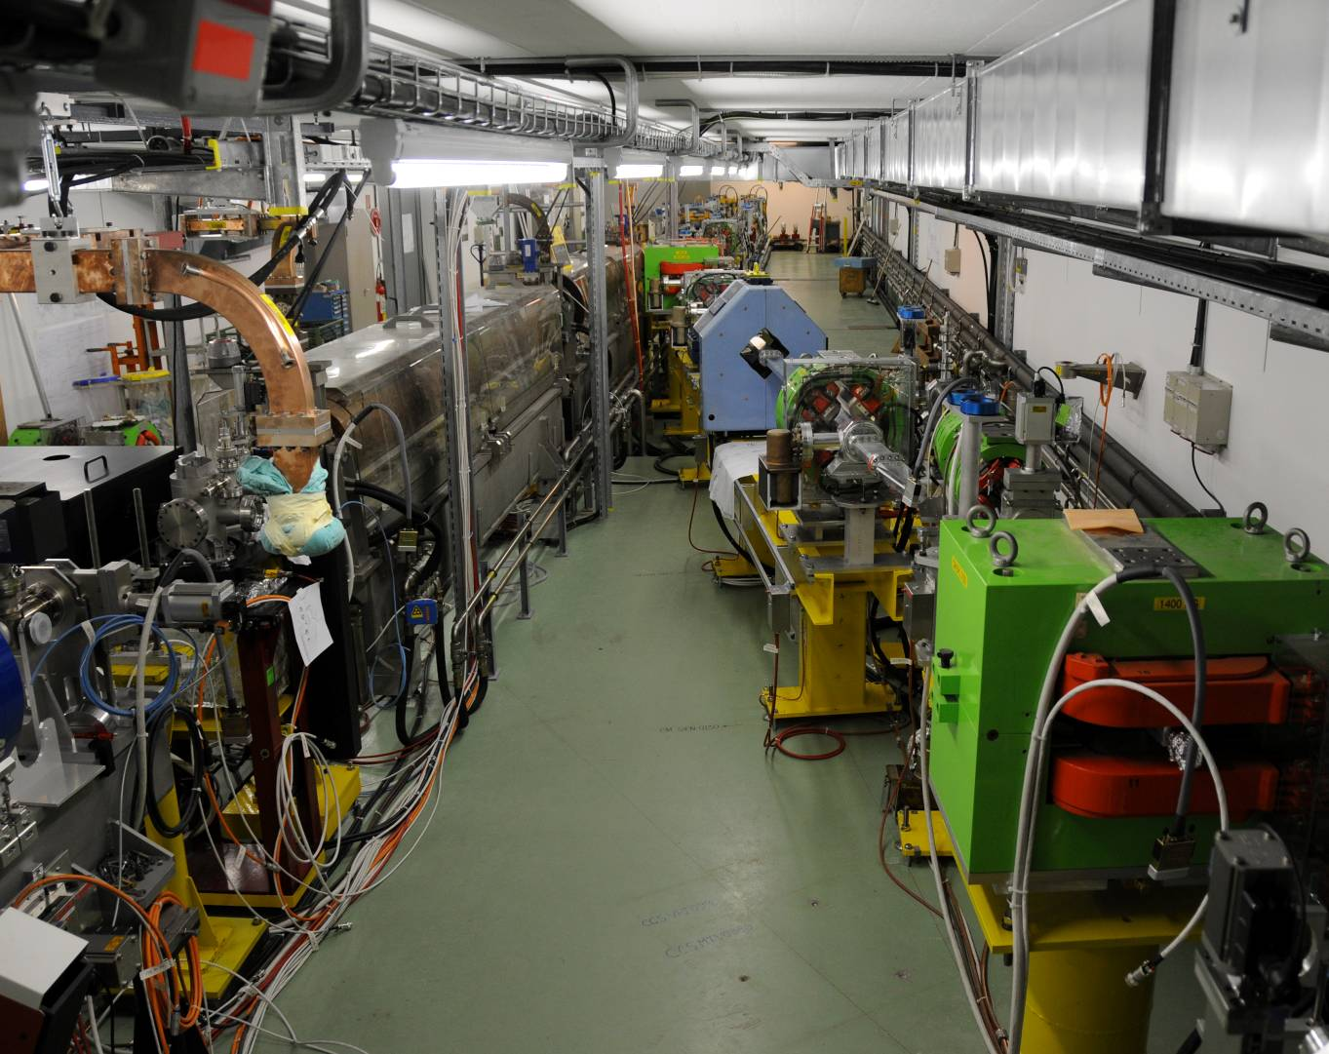
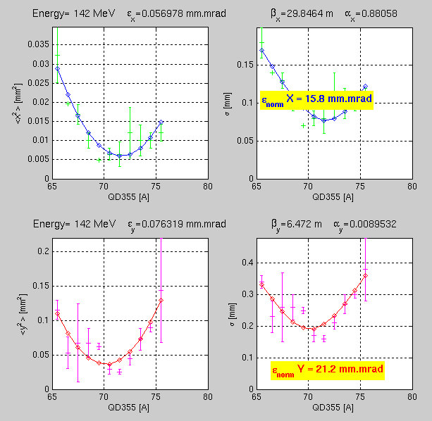
CALIFES
CALIFES beam in the final spectrometer
Full transport through TBTS (no aperture restriction yet)
Reached 140 MeV, 0.6 nC/bunch, total > 7 nC for 20 ns
Beam emittance optimization under way
(last measurements ~ 20 π mm mrad)
Specifications
Energy ~ 200 MeV
Emittance < 20 π.mm.mrad
Charge per bunch : 0.6 nC
Energy spread <2%
Number of bunches : 1 to 226
Bunch length (rms) : 0.75ps
Bunch spacing : 667ps

Slide 22
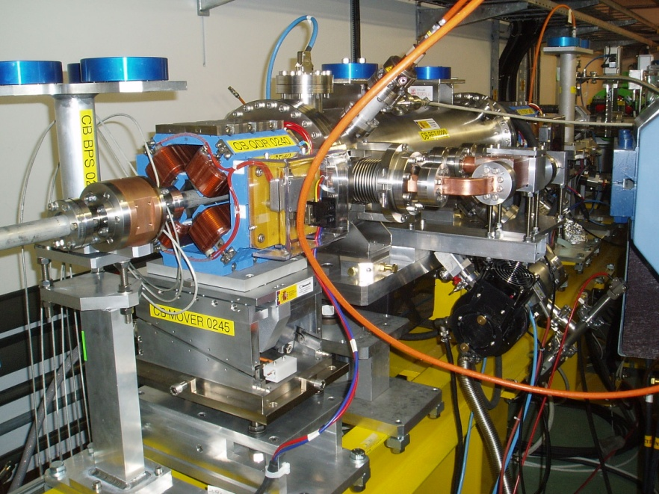
TBL
A few tests done in the (short) TBL
Up to 10 A, about 20 MW power produced (240 ns)
Good agreement with expectations
Sensitive to bunch length – in best conditions form factor equal to one, within measurement precision

Slide 23
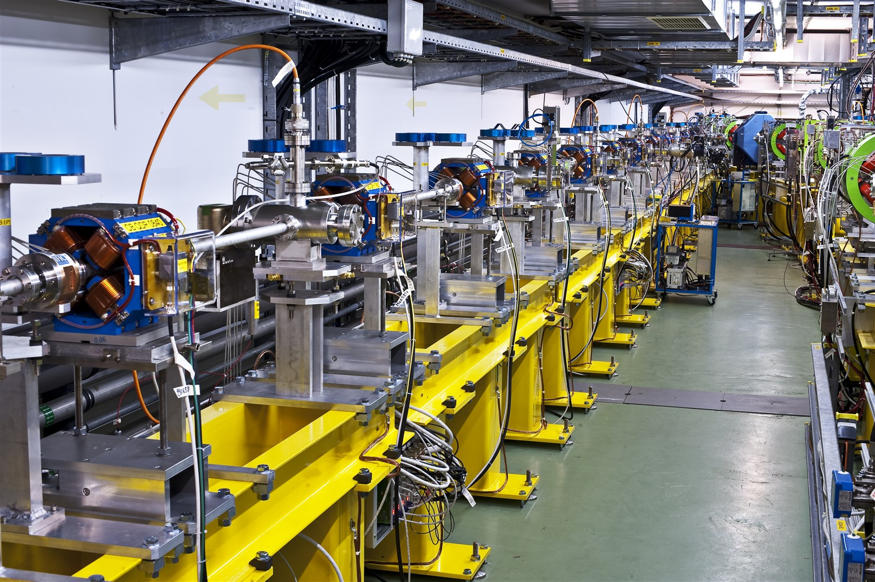
TBL
Full line installed
Up to 8 PETS should be installed before the end of the year

Slide 24
Two Beam Issues – 2010 outlook
  TBTS
    Two-Beam test – consistency between power & beam energy gain, 100MV/m
      Drive beam, deceleration, power produced
      Probe beam, power delivered to accelerating structure, energy gain
    Beam Loading compensation experiment - by variable fast phase switch – check control of RF pulse shape with probe beam acceleration
    Measurement of breakdown kicks
    Measurement of effect of beam loading on breakdown rate
  TBL
    Complementary measurement of deceleration / produced power.
    Goal: deceleration by 30% (need 8 PETS installed). Measurement of energy spectrum.
    Optics, steering algorithm studies.

Slide 25
Other Issues – 2010 outlook
  CALIFES
    Fully reach nominal parameters (total charge)
    Bunch length measurements (RF defl. & screen)
  PHIN
    Two runs planned
    Run 1: complete measurement program
    Run 2: test of phase coding
  Other
    First measurements of phase stability (PETS output, RF pickups…)
    Operation at 5 Hz (or more)
    Control of beam losses
    Coherent Diffraction Radiation (RHUL collaboration)
    …

Slide 26
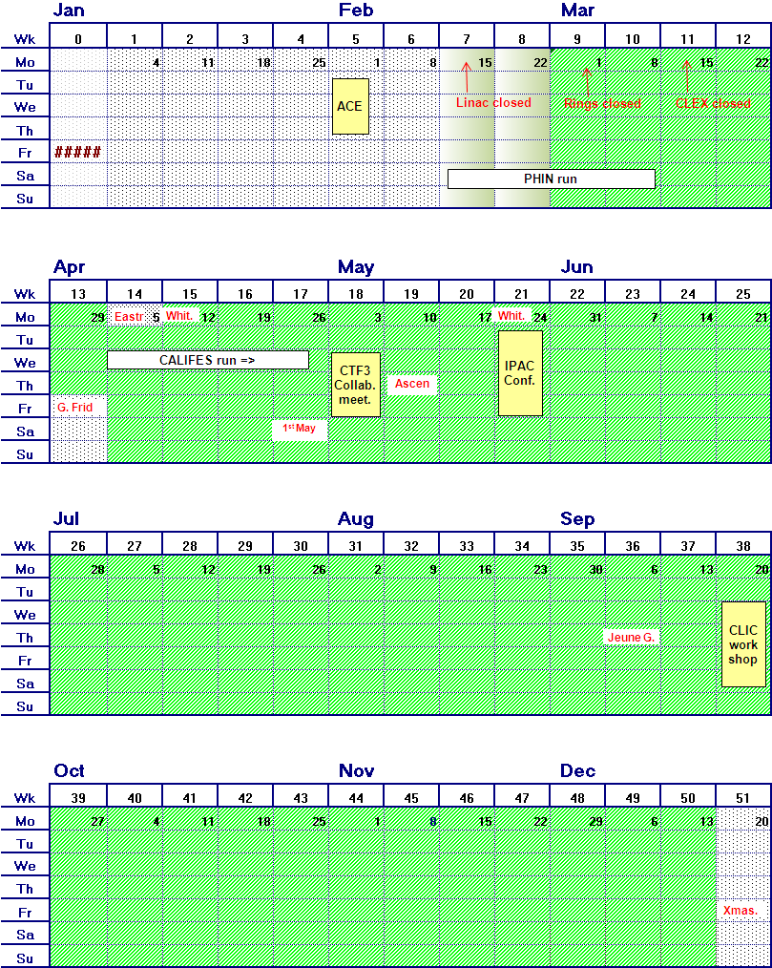
Operating scenario for 2010
(an exercise)
Optics improvements (DL dispersion)
Full transport to CLEX
Bunch length control (first tests)
PETS conditioned to nominal power/pulse length
Accelerating structure conditioned to nominal power/pulse length
  Two-Beam test
  power & energy gain,
  100MV/m
  1st TBL PETS installation
  TBL studies
PETS breakdown rate measurements?
  Measurement of breakdown kicks
  Beam Loading compensation experiment
  2nd run PHIN
    Measurement of effect of beam loading on breakdown rate
Test of new PETS on-off scheme
  TBL studies 30% deceleration
    Stability studies & improvements
    PETS no recirculation
    Phase stability
    Operation at 5 Hz (or more)
    Control of beam losses
    Coherent Diffraction Radiation …
  2nd TBL PETS installation

Slide 27
CTF3 2010 outlook
Drive Beam Generation
  Bunch train recombination 2 x 4 in DL and CR (from 3.5 to 28 A)
  Transverse rms emittance < 150 π mm mrad (combined beam)
  Bunch length control to < 1 mm rms (combined beam)
  Beam current stability ~ 0.1 % for combined beam
Drive Beam Power Production & Two Beam Acceleration
  20.8 A beam-powered test of a single PETS (without recirculation) in the TBTS
    135 MW (with 28 A potentially available in CLEX, the peak power can reach 240 MW)
    140 ns total pulse length
    A measured breakdown rate in the range of 10-4 or lower
    Operation of a few hundred hours at 1 Hz
  7.4(10) A beam-powered test of a single PETS with ext. recirculation in TBTS
    135 (81) MW circulating power or 65 (65) MW available for accelerating testing
    250 ns total pulse length, 100 (170) ns flattish-top
    A measured breakdown rate in the range of 10-4 or lower
    Operation of a few hundred hours at 5 Hz
    On/off/adjust will be demonstrated using the external reflection/recirculation system mounted on one of the PETS in TBL.
  TBTS
    Improved measurements of power and energy loss.
    Breakdown transverse kick measurements.
    Probe Beam energy gain and beam loading tests.
  TBL
    The current schedule is to have 8 PETS installed as well as a spectrometer dump for energy spectrum studies, toward the summer 2010. This will allow to verify transport of a beam with up to 30% of the energy extracted.
Will be OK, possibly somewhat reduced performance…
Overall reasonable goals, but difficult to have a few hundred hours, and 5 Hz
TBTS studies and especially TBL results can happen only quite late in 2010…

Slide 28
Reserve

Slide 29
TDR phase preliminary schedule
 | 2010 |  |  |  | 2011 |  |  |  | 2012 |  |  |  | 2013 |  |  |  | 2014 |  |  |  | 2015 |  |  |  | 2016
 | 1 | 2 | 3 | 4 | 1 | 2 | 3 | 4 | 1 | 2 | 3 | 4 | 1 | 2 | 3 | 4 | 1 | 2 | 3 | 4 | 1 | 2 | 3 | 4 | 1 | 2 | 3 | 4
CTF3 TBTS operation | inst. | 1-2 structures, beam loading, breakdown kick
CTF3 TBL operation | inst. |  | Deceleration 8 PETS |  | final decelerator test (16 PETS, 50%)
Modules lab | initial tests, installation 2 modules |  |  |  | further tests, installation 4 modules |  |  |  | testing |  |  |  |  |  |  |  | pre-series production, industrialization
Modules CTF3 |  |  |  |  |  |  |  | 1 module inst. |  | testing 1 module |  | 3 modules inst. |  | testing 3 modules |  |  |  |  |  |  | > upgrades?
CTF3 phase feedback | design, hardware tests |  |  |  |  |  |  | installation |  | testing
CTF3 TBL+ |  |  |  |  |  |  |  | installation |  | commissio-ning |  | RF testing, potential upgrades
CLIC DB injector & linac | design & hardware construction |  |  |  |  |  |  |  | installation |  |  |  | commissioning |  |  |  | staged upgrade & testing
RF structures construction | precision metrology, fabr. procedures |  |  |  | up to 40 structures built, establish precision machining at CERN or elsewhere, 5 μm tolerances achieved |  |  |  |  |  |  |  |  |  |  |  | more than 200 structures built, final cost optimization, pre-series with industry
RF test infrastructure | CERN test stand inst. |  | CERN test stand testing and upgrades (at least two slots) |  |  |  |  |  | continue testing with increased capabilities, CERN or elsewhere, up to 10 slots |  |  |  |  |  |  |  | testing, up to 200 accelerating structures plus PETS and RF components
Prototypes of critical components | technical choices, design |  |  |  | construction, hardware tests |  |  |  |  |  |  |  |  |  |  |  | finalization, performance & cost optimization, industrialization for large scale components

Slide 30
TBTS, PETS conditioning

Slide 32
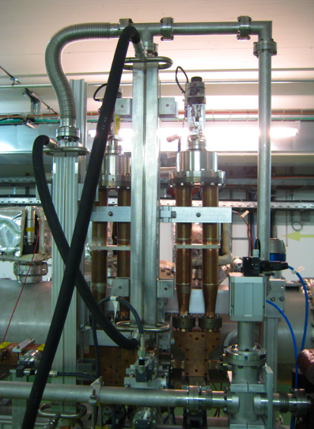
Variable phase shifter
Variable power splitter
Prediction
Measurement

Slide 33
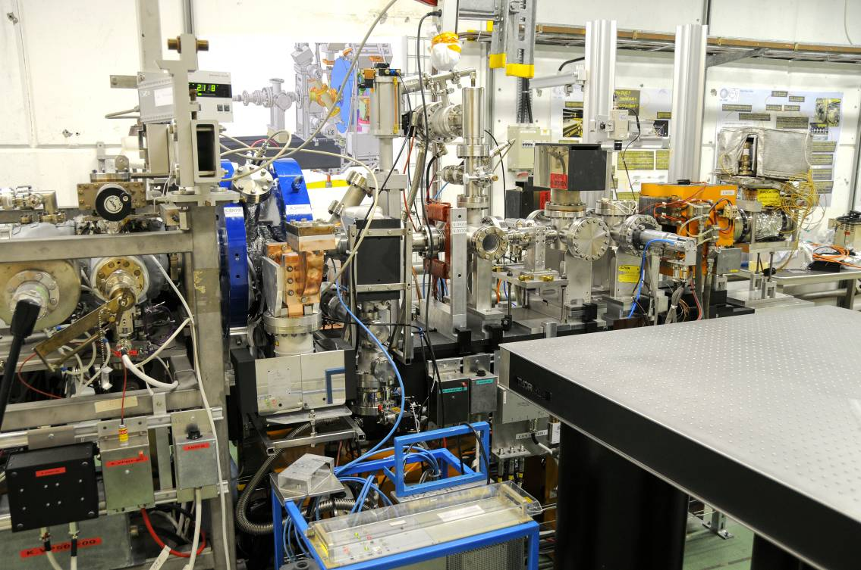
PHIN status
First run in 2009 very successfull
Bunch charge up to 2.5 nC, above nominal
Beam energy ~ 5-6 MeV
Emittance measured ~ 7 π mm mrad
Very good agreement with simulations
Several potential improvements identified, will be implemented for next run
Aims for next run: stability (short and long term)

